Slide 2
Advanced Power-Quality Technologies for Future Circular Collider (FCC)
Thomas Hoehn
PhD-Student
Electrical Power Converters Group / Graz University of Technology

Slide 3
Advanced Power-Quality Technologies for Future Circular Collider (FCC)
Introduction to Power Quality
Transient Voltage Dips
Dynamic Voltage Restorer
Back-to-Back HVDC Link
DC Distribution Grid
Comparison and Conclusions

Slide 4
Advanced Power-Quality Technologies for Future Circular Collider (FCC)
Introduction to Power Quality
Transient Voltage Dips
Dynamic Voltage Restorer
Back-to-Back HVDC Link
DC Distribution Grid
Comparison and Conclusions

Slide 5
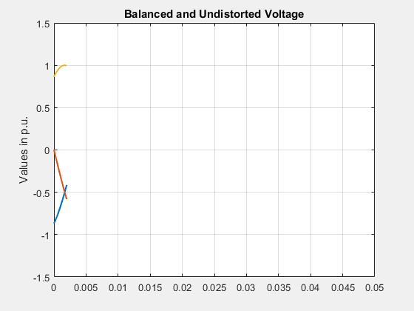
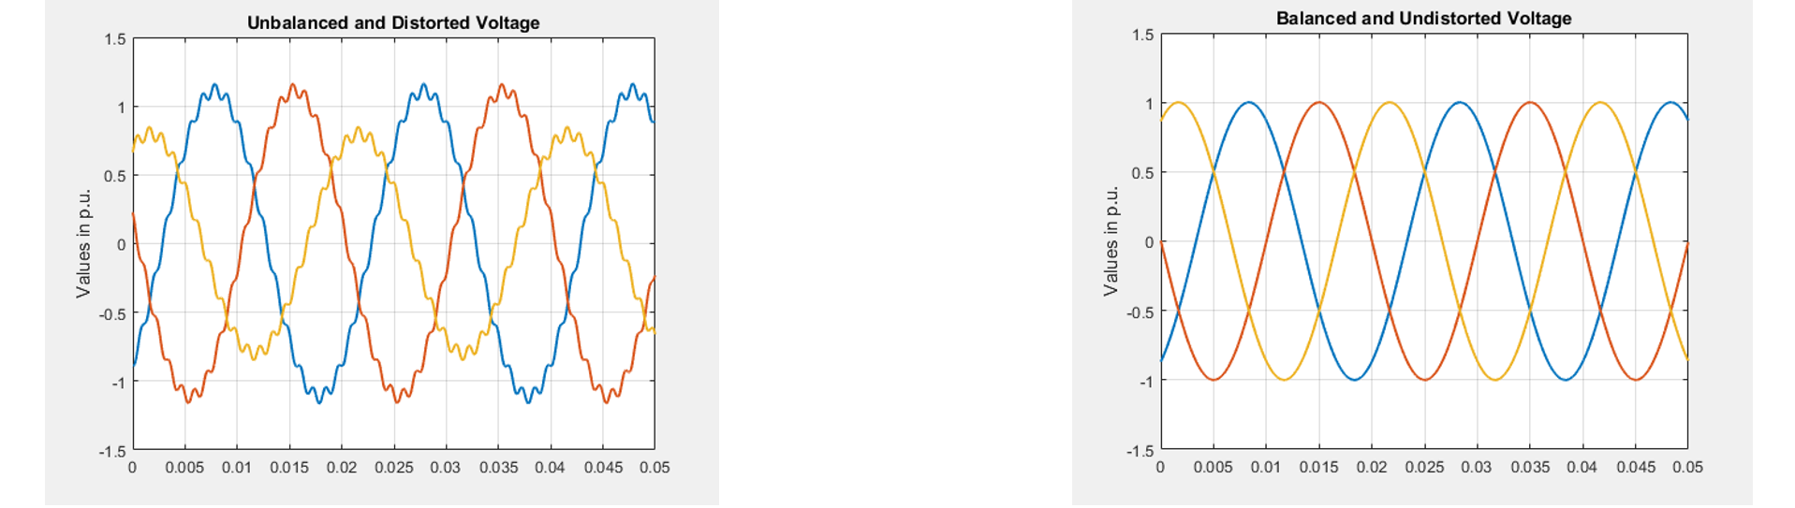
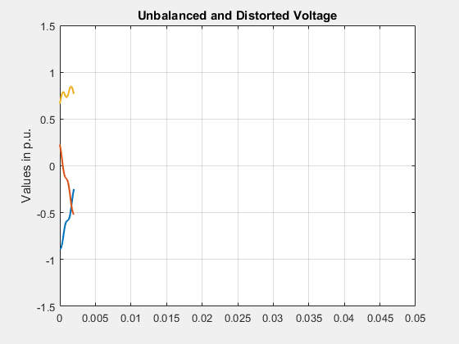
Power Quality for FCC
Introduction to Power Quality
FCC demands for an excellent power grid
Harmonic filtering
Voltage support/reactive power compensation
Transient voltage dip mitigation

Slide 6
Advanced Power-Quality Technologies for Future Circular Collider (FCC)
Introduction to Power Quality
Transient Voltage Dips
Dynamic Voltage Restorer
Back-to-Back HVDC Link
DC Distribution Grid
Comparison and Conclusions

Slide 7
Main Cause and Numbers
Transient Voltage Dips
Lightning strike in the 400kV overhead lines
At CERN now: 20-40 events per year
For FCC expected number of: 100-200 events per year

Slide 8
Statistics
Transient Voltage Dips

Slide 9
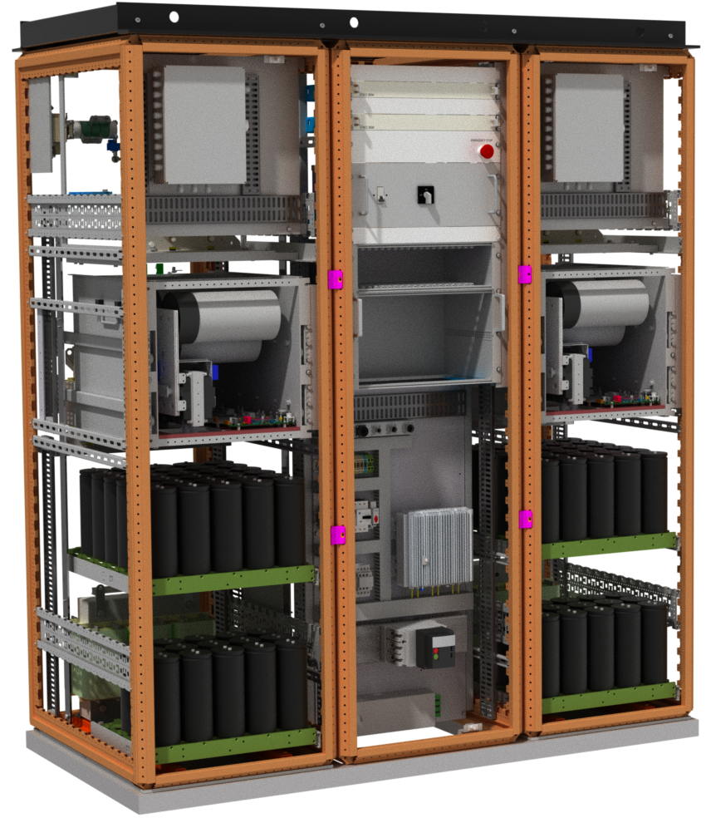
Mitigation at Equipment-Level
Transient Voltage Dips
Example: SIRIUS Power Converter
Higher cost and complexity per unit
Each equipment unit has to be upgraded
Synergy for cycling operations: energy recovery

Slide 10
Mitigation at System-Level
Transient Voltage Dips
  Provides the immunity of transient voltage dips for the complete FCC distribution grid
  Release pressure when designing equipment
  Three solutions are under study

Slide 11
Advanced Power-Quality Technologies for Future Circular Collider (FCC)
Introduction to Power Quality
Transient Voltage Dips
Dynamic Voltage Restorer
Back-to-Back HVDC Link
DC Distribution Grid
Comparison and Conclusions

Slide 12
Main Features
Dynamic Voltage Restorer
Economical: series injection of the Δu
Reaction time < 1ms
Already used for critical production processes

Slide 13
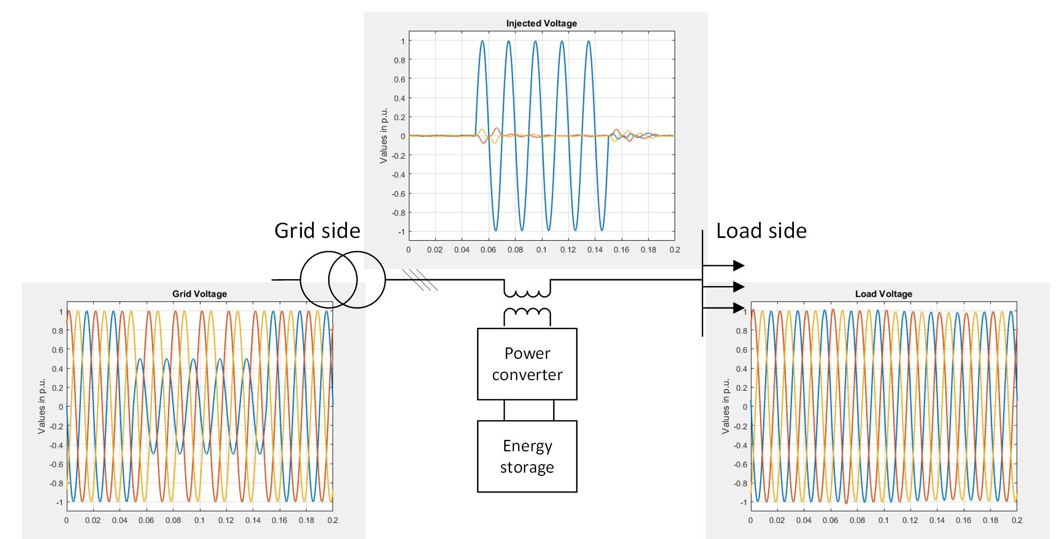
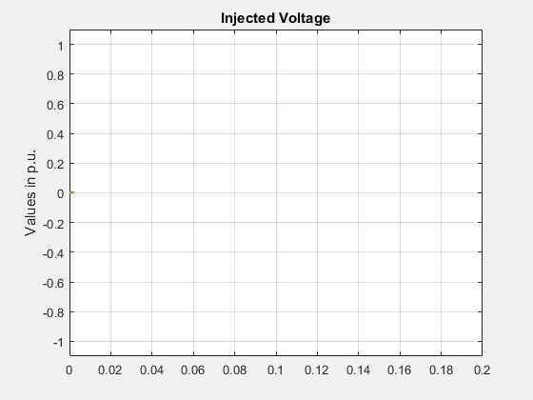
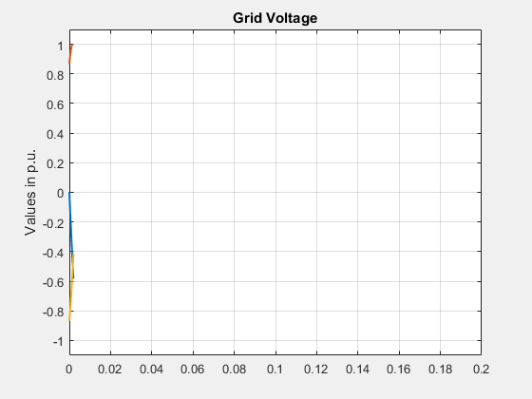
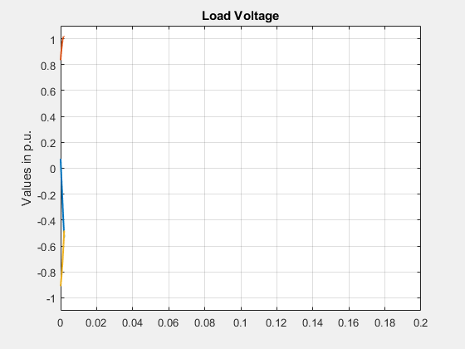
Operational Principle
Dynamic Voltage Restorer

Slide 14
Applied for FCC
Dynamic Voltage Restorer
Is integrated in classical AC distribution grid
  By-pass switch for downstream selectivity of the protection system
Several voltage levels are possible
Size to supply a 50MVA load:
6 m
6m

Slide 15
Advanced Power-Quality Technologies for Future Circular Collider (FCC)
Introduction to Power Quality
Transient Voltage Dips
Dynamic Voltage Restorer
Back-to-Back HVDC Link
DC Distribution Grid
Comparison and Conclusions

Slide 16
Main Features
Back-to-Back HVDC Link
Used for DC power transmission
Decoupling from the supplying grid
Protected from external disturbances
Provide reactive power at the load side

Slide 17
System Design Considerations
Back-to-Back HVDC Link
Rectifier design
DC link design
Inverter design
For example: hybrid solution

Slide 18
Applied for FCC
Back-to-Back HVDC Link
Is integrated in classical AC distribution grid
  By-pass switch for downstream selectivity of the protection system
Several voltage levels are possible
Size to supply a 50MVA load:
20m
20m

Slide 19
Advanced Power-Quality Technologies for Future Circular Collider (FCC)
Introduction to Power Quality
Transient Voltage Dips
Dynamic Voltage Restorer
Back-to-Back HVDC Link
DC Distribution Grid
Comparison and Conclusions

Slide 20
Main Features
DC Distribution Grid
No electro magnetic interference
Higher power transmission capability
Efficient large scale energy recovery
One powering point of FCC
Main bending dipoles
Compressor motor

Slide 21
Energy Recovery
DC Distribution Grid

Slide 22
Energy Recovery
DC Distribution Grid

Slide 23
Energy Recovery
DC Distribution Grid

Slide 24
Energy Recovery
DC Distribution Grid

Slide 25
Energy Recovery
DC Distribution Grid
See dedicated talk from Francisco R. Blanquez
in session:
Special Technologies: Machine protection, circuit and powering Thursday 16:30-16:50

Slide 26
R&D Aspects
DC Distribution Grid
Isolation
Optimal DC voltage level
Protection system
  Selectivity
  Short circuit detection and current breaking
Redundancy

Slide 27
Advanced Power-Quality Technologies for Future Circular Collider (FCC)
Introduction to Power Quality
Transient Voltage Dips
Dynamic Voltage Restorer
Back-to-Back HVDC Link
DC Distribution Grid
Comparison and Conclusions

Slide 28
Comparison and Conclusions
 | Dynamic Voltage Restorer | Back-to-Back HVDC Link | DC Distribution Grid
Transient Voltage Dips | covered | covered | covered
Compensation of Pulsating Reactive Power (load side) | Not covered | covered | covered
Compensation of Pulsating Active Power (load side) | Not covered | covered | covered
Stand-by losses | Very Low | High | Medium
Technology Readiness Level | Available in industry | Available in industry | Design and standardisation phase
Protection Aspects | Bypass is needed | Bypass is needed | In development

Slide 29
Comparison and Conclusions
Power quality is a key aspect
High number of transient voltage dips expected for FCC
Three potential solutions
  Different features
  Different impacts on the whole FCC distribution network
For the technical design phase
  More studies in detail
  One option has to be chosen

