Slide 2


Performance Based Safety Design and results on Cryogenic hazards
André Henriques, Saverio La Mendola
FCC Week 2018
Amsterdam, NL
Thanks to the FCC I&O WG members

Slide 3
1
Introduction
2
Performance Based Design
Outline
3
Cryogenic Safety studies (FCC-hh)
4
Conclusions

Slide 4


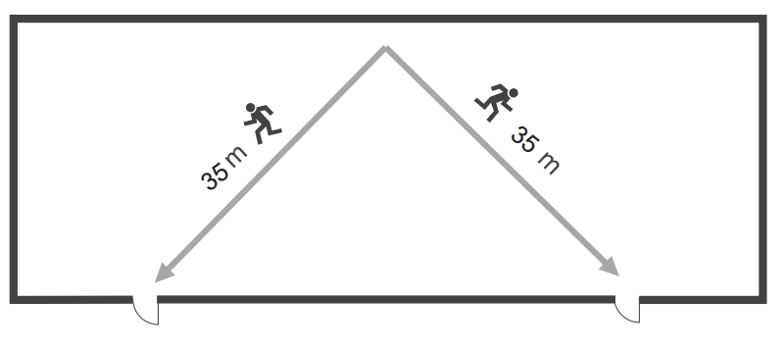
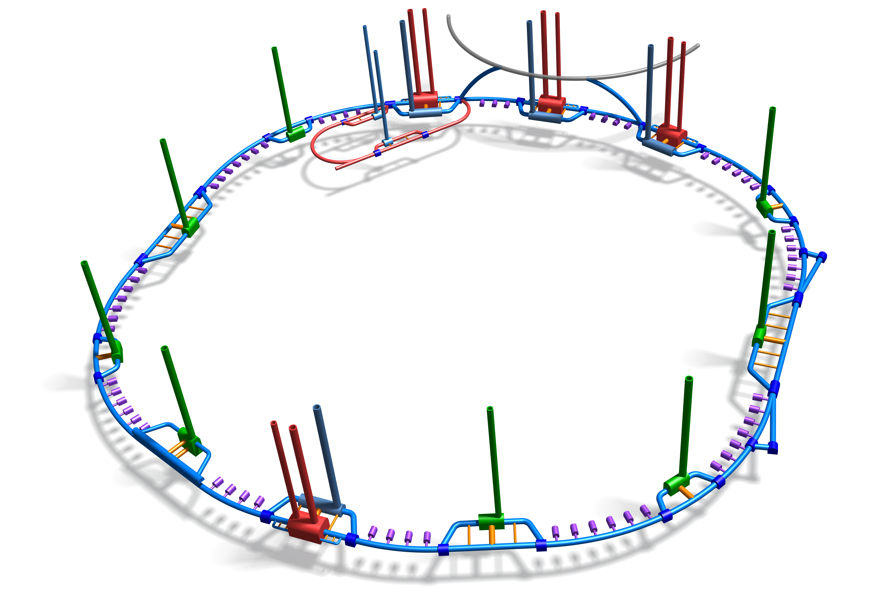
Introduction
Legislative references are applicable
Legislative references are NOT applicable
*see spare slide
Project Safety
Requirements
‘Standard Best Practices’
SBP
‘Performance Based Design’
PBD
Ex:
Egress
routes
35 m
500 m*
6.5-9.5 km
Automatically conform, without additional measures
Adaptation & additional measures needed
Notes:
35 to 10000 m is a factor ~300 (3 orders of magnitude)
Road tunnels is 500m

Slide 5


Introduction
Hazard Register
FCC Hazard Register:
Systematic collection of Hazards in the FCC facilities during different phases of its lifetime
No assessment of probability or severity
T. Otto
Database
…
H1
H2
H3
H4
H5
H6
H7
H8
H9
H10
H11
H12
H13
H14
H15
H16
Hn
e.g.
Cryogenic; Fire
PBD
Impact for FCC CDR
SBP
Thursday 08:55: Fire safety assessment for FCC (O. Rios)

Slide 6
Performance Based Design
Safety Objectives
Accidental Scenarios
New trial design
Safety Goals
Performance criteria
Trial Design
Additional measures
Evaluation
Meets Objectives
Notes:
Requirements of the project
(domain independent)

Slide 7
Performance Based Design
Defined by Organizations' Safety Policy
Safety Goals
Notes:
Requirements of the project
(domain independent)

Slide 8
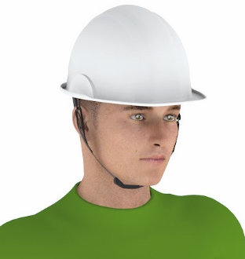
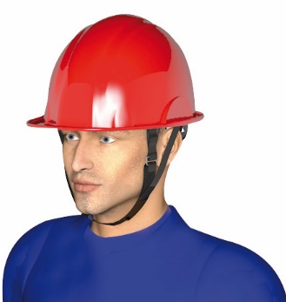




Safety Goals
Occupational Health and Safety
VISITOR
Workers
Visitors
Neighbours
…
Safety Goals:
Occupational Health & Safety
Environmental Protection
Property Protection
Continuity of Operation
Independent of the Safety domain / project
Priority
Protection of the envronment
CERN’s Safety Policy
Air
Water
Soil
…
Equipment and Operation
Unsafe operation
Property protection
Downtime
…

Slide 9

Performance Based Design
Safety Objectives
Defined by Organizations' Safety Policy
Requirements of the project
i.e. Applicable Rules
Safety Goals
Notes:
Requirements of the project
(domain independent)

Slide 10
Safety Objectives – FCC Study
 | Occupational Health and Safety | Environmental protection | Property protection | Continuity of operation
 | A | B | C | D
1 | Occupants shall be able to evacuate through protected areas, free from smoke/gas and other hazards at any time | Limit the release of polluting (incl. activated) agents to the environment in case of incident | The continuity of essential services and structural stability is assured in case of fire or gas release and other incidents | Limiting the downtime in case of incident
2 | Victims and other occupants, not able to self-evacuate, shall reach protected areas, and wait there to be rescued by the intervention teams | Limit the volume of polluted (incl. activated) water released to the environment in case of incidents | An incident shall not cause other potentially dangerous accidental events | -
3 | Rescue teams shall be able to intervene safely and according to current CERN SOPs | - | Limiting the property loss in case of incident | -
Notes:
(e.g. in case of major release, replacing damaged equipment)

Slide 11
Safety Objectives – FCC Study
 | Occupational Health and Safety | Environmental protection | Property protection | Continuity of operation
 | A | B | C | D
1 | Occupants shall be able to evacuate through protected areas, free from smoke/gas and other hazards at any time | Limit the release of polluting (incl. activated) agents to the environment in case of incident | The continuity of essential services and structural stability is assured in case of fire or gas release and other incidents | Limiting the downtime in case of incident
2 | Victims and other occupants, not able to self-evacuate, shall reach protected areas, and wait there to be rescued by the intervention teams | Limit the volume of polluted (incl. activated) water released to the environment in case of incidents | An incident shall not cause other potentially dangerous accidental events | -
3 | Rescue teams shall be able to intervene safely and according to current CERN SOPs | - | Limiting the property loss in case of incident | -
Occupants
Downtime
Env. impact
Victims
Property loss
Rescue teams
Notes:
(e.g. in case of major release, replacing damaged equipment)

Slide 12
Safety Objectives – FCC Study
 | Occupational Health and Safety | Environmental protection | Property protection | Continuity of operation
 | A | B | C | D
1 | Occupants shall be able to evacuate through protected areas, free from smoke/gas and other hazards at any time | Limit the release of polluting (incl. activated) agents to the environment in case of incident | The continuity of essential services and structural stability is assured in case of fire or gas release and other incidents | Limiting the downtime in case of incident
2 | Victims and other occupants, not able to self-evacuate, shall reach protected areas, and wait there to be rescued by the intervention teams | Limit the volume of polluted (incl. activated) water released to the environment in case of incidents | An incident shall not cause other potentially dangerous accidental events | -
3 | Rescue teams shall be able to intervene safely and according to current CERN SOPs | - | Limiting the property loss in case of incident | -
Occupants
Downtime
Independent on the Safety Domain !
Env. impact
Victims
Property loss
Rescue teams
Notes:
(e.g. in case of major release, replacing damaged equipment)

Slide 13
Performance Based Design
Safety Objectives
Defined by Organizations' Safety Policy
Requirements of the project
i.e. Applicable Rules
Safety Goals
Performance criteria
Measurable requirements
i.e. Harmonized Standard
Notes:
Requirements of the project
(domain independent)

Slide 14


Performance criteria
Qualitative
Performance
goals
Quantitative
Threshold
values
- Presence of toxic smoke shall not influence the evacuation of occupants
Exposure to :
FED < 0.1 (e.g.)
Exposure temperature < 60ºC (e.g.)
Visibility > 10 m (e.g.)
- Helium cloud shall not reach the compartment door before the occupant evacuating
Exposed to:
O₂ level > 18 %
V_{ventilation} < V_{walking} = 1.2 m/s
CDR
TDR
Technical specification can also become performance criteria
Notes:
Technical design spec: e.g. pressure SRF limited to a low PS

Slide 15
Performance Based Design
Safety Objectives
Accidental Scenarios
Defined by Organizations' Safety Policy
Requirements of the project
i.e. Applicable Rules
Safety Goals
Performance criteria
Measurable requirements
i.e. Harmonized Standard
List of scenarios based on Risk Assessment
Notes:
Requirements of the project
(domain independent)

Slide 16
Performance Based Design
Safety Objectives
Accidental Scenarios
Defined by Organizations' Safety Policy
Requirements of the project
i.e. Applicable Rules
Safety Goals
Performance criteria
Trial Design
Measurable requirements
i.e. Harmonized Standard
List of scenarios based on Risk Assessment
First iteration with initial specification
Notes:
Requirements of the project
(domain independent)

Slide 17
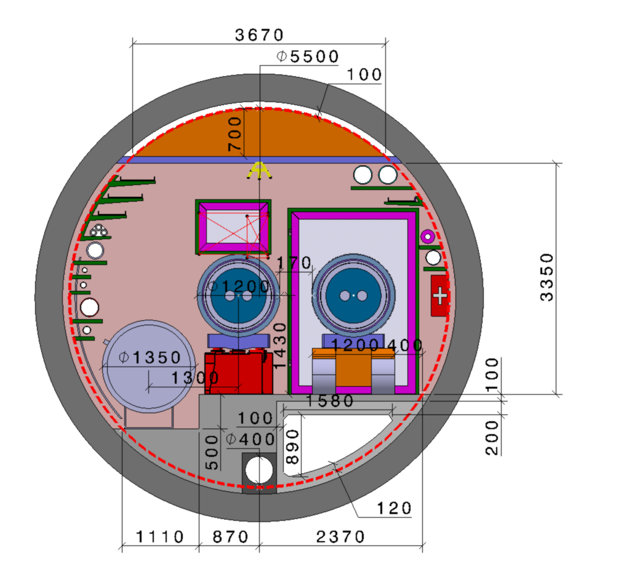
Trial Design
F. Valchkova-Georgieva
Baseline includes Safety features
FCC-hh

Slide 18

Performance Based Design
Safety Objectives
Accidental Scenarios
Defined by Organizations' Safety Policy
New trial design
Requirements of the project
i.e. Applicable Rules
Safety Goals
Performance criteria
Trial Design
Additional measures
Measurable requirements
i.e. Harmonized Standard
Evaluation
List of scenarios based on Risk Assessment
Meets Objectives
First iteration with initial specification
Measured against the safety objectives (iterative process)
Notes:
Requirements of the project
(domain independent)
Binary evaluation

Slide 19
Evaluation
Consequences are described on a qualitative basis
(e.g. egress possible, compartments doors open/close)
Qualitative
Deterministic
CDR
Quantitative
Same as above but consequences are quantified
(e.g. smoke/He propagation, damage to equipment, etc.)
Probabilistic
Consequences and probabilities of scenarios are quantified and their combination evaluated in a risk matrix
Probabilistic
TDR
Full Probabilistic
Every scenario is evaluated through risk profiles and other risk indicators.

Slide 20

Performance Based Design
Defined by Organizations' Safety Policy
Requirements of the project
i.e. Applicable Rules
Measurable requirements
i.e. Harmonized Standard
List of scenarios based on Risk Assessment
Measured against the safety objectives (iterative process)
First iteration with initial specification
Safety Objectives
Accidental Scenarios
New trial design
Safety Goals
Performance criteria
Trial Design
Additional measures
Evaluation
Meets Objectives
Trial Design is valid
Notes:
Requirements of the project
(domain independent)

Slide 21
Cryogenic Safety studies – FCC-hh
Based on contributions from the FCC PBD Working Group

Slide 22
Input Data
+ LHC
studies
M.Nonis, G. Peon, L. Tavian
Air/He velocity in the tunnel
  Nominal: 0.3 m/s
  For the first 100s seconds after a helium release, downstream: 0.7 m/s
Helium inventory:
  Superconducting magnets: 33 l LHe / m
  Cryogenic ring line (QRL): 49 l supercritical He / m*
Helium sectorisation:
  Superconducting magnets: 220 m (corresponding to 1 cell)
  Cryogenic ring line (QRL): 8400 m (corresponding to sub-sector)
Gaseous helium inventory
  Superconducting magnets: 1 t
  Cryogenic ring line (QRL): 22 t
* header E

Slide 23
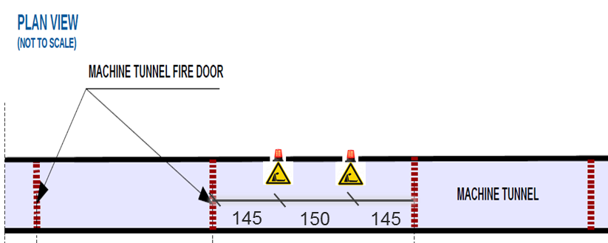
Input Data
Distance from a helium release in the tunnel that can be detected by human senses (sight or hearing): ~150 m
2 ODH detectors per compartment
Notes:
150 m Note: important assumption – further studies needed
LHC have ODH detector every 300m

Slide 24
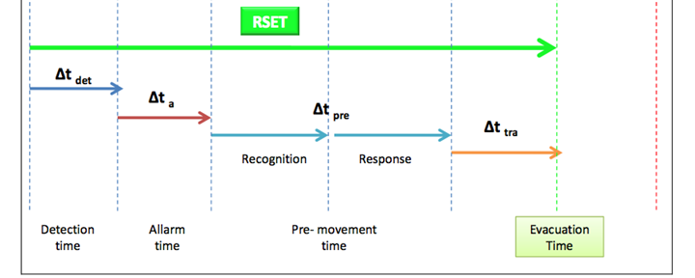
Input Data
Evacuation time (according to British Standard PD 7974-6 ):
Δt_{det} = distance to ODH detector / He cloud prop. velocity
Δt_{a} = 5s
Δt_{pre} = 30 s *
Δt_{tra} = walking speed x evac. distance
walking speed = 1.2 m/s
* Occupants are properly familiar with the underground layout and trained to a high level of safety management
Release point is next to one door
Evacuation is made downstream
Occupant doesn’t stop to put on SRM

Slide 25

Release scenarios
Based on LHC data
MCI* (design) → ~ 30 kg/s
Relief plate release → ~ 1 kg/s
Small leak → ~ 300 g/s
Minor leak → ~ 100 g/s
Note: No detailed studies yet made for FCC cryostats
*Maximum Credible Incident

Slide 26
Accidental scenarios
Scenario | Description
Cryo1 | 1 kg/s ; 5 m from release point
Cryo2 | 1 kg/s ; 5 m from release point; emergency extraction ON
Cryo3 | 1 kg/s ; 200 m from release point
Cryo4 | 0.3 kg/s; 150 m from release point
Cryo5 | 0.1 kg/s; 5 m from release point
Cryo6 | 32 kg/s during operation
Varying the relief mass flow & distance to the release

Slide 27
Evaluation of the Trial Design
Summary
Based on simplified model

Slide 28




Cryo1: 1 kg/s ; 5 m from release point
Time lapse after release (d=5m)
Fire door open
t=40s
d = 0
20
30
440
[m]
Critical distance in the ‘Turbulent zone’
‘Turbulent Zone’ – non-stay areas
Fire door open
t=390s
d = 0
160
440
[m]
‘Stratified Zone’
Illustrations are not to scale
Notes:
Overtake the cloud after 2min

Slide 29
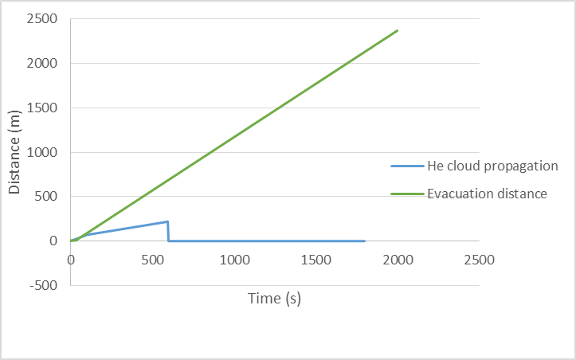
Cryo2: 1 kg/s ; 5 m from release point; extraction ON
t = [5, 10] min → The extraction is ON @ full capacity
Cloud propagation stops after 220 m
He ext. ON
After passing 2 fire doors (880m) is considered ‘safe’ to wait for transportation
Wednesday 13:30: Development for cooling and ventilation systems (M. Nonis; G. Peon)
Notes:
10 min is based on the time to “suck” all the air in a 5 km duct (8min) and to start up the ventilator
Flow rate of 20 000 m³/h

Slide 30
Cryo4: 0.3 kg/s ; 150 m from release point
Time lapse after release (d=150m)
t=400s
Door open
d = 0
150
160
440
[m]
Less mass flow = smaller GHe layer → t.b.c via CFD
Illustrations are not to scale

Slide 31
Cryo4: 0.3 kg/s ; 150 m from release point
Time lapse after release (d=150m)
t=400s
Door open
d = 0
130
150
440
[m]
He extraction ON after 5 min
Critical distance for this exercise is the ‘acknowledgment limit’ of the warning signs
He extraction critical
Innovative emergency evacuation signs
Illustrations are not to scale
Thursday 09:20: Virtual reality experiments for evacuation in the FCC (S. Arias)

Slide 32
Evaluation of Trial design - FCC
 | Trial design #1
Accidental Scenarios | Health & Safety of personnel |  |  | Environmental protection |  | Property protection |  |  | Continuity of operations
 | A1 | A2 | A3 | B1 | B2 | C1 | C2 | C3 | D1
Cryo1 | X | X | X(?) |  |  |  |  |  | 
Cryo2 | X (?) | X |  (?) |  |  |  |  |  | 
Cryo3 |  | X | X(?) |  |  |  |  |  | 
Cryo4 |  | X (?) |  |  |  |  |  |  | 
Cryo5 |  |  |  |  |  |  |  |  | 
Cryo6 | X | X | X |  |  |  | X | X | X

Slide 33
Evaluation of Trial design - FCC
 | Trial design #1
Accidental Scenarios | Health & Safety of personnel |  |  | Environmental protection |  | Property protection |  |  | Continuity of operations
 | A1 | A2 | A3 | B1 | B2 | C1 | C2 | C3 | D1
Cryo1 | X | X | X(?) |  |  |  |  |  | 
Cryo2 | X (?) | X |  (?) |  |  |  |  |  | 
Cryo3 |  | X | X(?) |  |  |  |  |  | 
Cryo4 |  | X (?) |  |  |  |  |  |  | 
Cryo5 |  |  |  |  |  |  |  |  | 
Cryo6 | X | X | X |  |  |  | X | X | X
(?) → Cannot be determined with 100% certainty, due to the lack of data (simulations/studies are needed)

Slide 34
Evaluation of Trial design - FCC
Full Report EDMS N. 1818330
 | Trial design #1
Accidental Scenarios | Health & Safety of personnel |  |  | Environmental protection |  | Property protection |  |  | Continuity of operations
 | A1 | A2 | A3 | B1 | B2 | C1 | C2 | C3 | D1
Cryo1 | X | X | X(?) |  |  |  |  |  | 
Cryo2 | X (?) | X |  (?) |  |  |  |  |  | 
Cryo3 |  | X | X(?) |  |  |  |  |  | 
Cryo4 |  | X (?) |  |  |  |  |  |  | 
Cryo5 |  |  |  |  |  |  |  |  | 
Cryo6 | X | X | X |  |  |  | X | X | X
(?) → Cannot be determined with 100% certainty, due to the lack of data (simulations/studies are needed)
X → To be mitigated by organisational measures (e.g. access restrictions, non-stay areas, accept property loss)

Slide 35



Conclusions
PBD is very useful as Risk Assessment method for non-standard installations → used for FCC CDR
Trial Design (with safety features) fulfils the majority of the Safety Objectives
Unfulfilled objectives can be mitigated by organisational measures
  No affect on the infrastructure of the FCC tunnel
  Baseline FCC cross-section is acceptable
A more qualitative evaluation shall be carried out at a TDR level
  Transportation system in case of evacuation
  Studies on the height of the helium gas layer (CFD simulations)
FCC-ee & HE-LHC studies are ongoing and will be ready for the CDR
Notes:
Cryo 4 against objective A1; A2 need to be further studied.

Slide 36
Thank you very much
for your attention
Acknowledgements:
S. La Mendola, V. Mertens, T. Otto, S. Marsh, M. Nonis, O. Rios, J. Osborne, L. Tavian, S. Grau, G. Lindell, G. Peon, M. Widorski, FCC I&O WG memebrs

Slide 38
Spare slides

Slide 39
Evacuation distance in road tunnels
L’Association mondiale de la Route (AIPCR), Manuel des tunnels routiers
“L’inter distance optimale entre deux issues de secours résulte de l’Analyse des Risques.”
Manuel AIPCR des tunnels routiers
EU Directive 2004/54/EC on minimum safety requirements for tunnels in the Trans-European Road Network
“Where emergency exits are provided, the distance between two emergency exits shall not exceed 500 m.”

Slide 40
Case study: Quantitative deterministic evaluation
Main assumptions (e.g.):
ventilation velocity;
length of detection zone;
When ventilation on, He propagates with the ventilation velocity;
When ventilation off, He propagates due to buoyancy
Based on these assumptions we can calculate:
He propagation downstream;
He propagation upstream;
Total tunnel length interested by He
estimated downtime cost;
Other quantities can be calculated: gas temperature, O2 levels, visibility, etc.
Courtesy of S. La Mendola

Slide 41
Case study: Probabilistic evaluation
Estimated total cost of an accidental scenario.
It was chosen because considered likely.
We can now try to estimate quantitatively its likelihood through a probability calculation.
Assumptions (e.g.):
20% of lifetime the facility is expected to be in shutdown;
10% of shutdown there will be works in arcs;
The probability of having a He release caused by works [10^{-x} /d];
ODH detection and actions (alarm and ventilation off) work as foreseen;
Calculate probability (Poisson process) for this scenario;
The expected cost (risk) is Estimate_cost * Poisson_prob [kCHF/y]
Consequences and probabilities can be used to locate this scenario in a risk matrix.
Courtesy of S. La Mendola

Slide 42
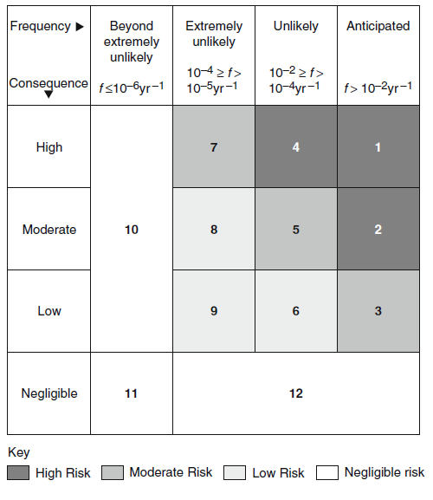
Case study: Probabilistic evaluation. Risk matrix (adapted from SFPE guide)
Description of Consequence
Negligible: Minimum damage to building, minimal operational downtime;
Low: Damage < CHFyy value, reparable damage to building, significant operational downtime, no impact on surroundings;
Moderate: CHFyy < damage < CHFxx, major equipment destroyed, minor impact on surroundings
High: Damage > CHFxx, building destroyed, surrounding property damaged.
Description of Frequency – SFPE approach
Anticipated, expected: incidents that might occur several times during the lifetime of the facility (f > 10⁻²/y);
Unlikely: events that are not anticipated to occur during the lifetime of the facility (10⁻⁴/y < f ≤ 10⁻²/y);
Extremely unlikely: events that will probably not occur during the life cycle of the facility (10⁻⁶/y < f ≤ 10⁻⁴/y);
Beyond extremely unlikely: all other incidents (f > 10⁻⁶/y).
The star indicates the position of the scenario (example)
Courtesy of S. La Mendola

Slide 43
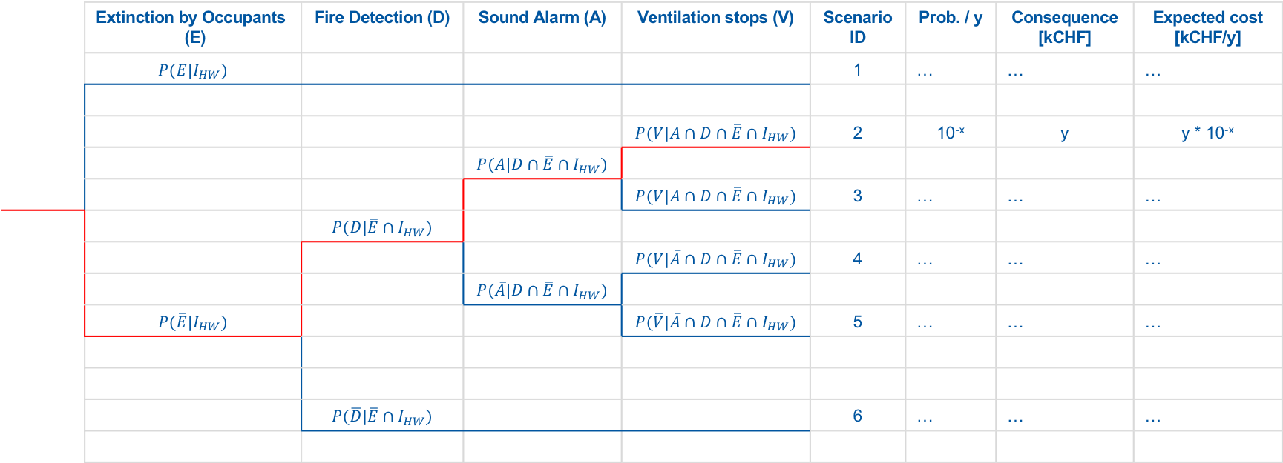
Case study: Probabilistic evaluation.
Scenarios can be seen as a particular path in an event tree:
Event tree: tunnel arc - long shutdown phase – ignition due to hot work
 | Extinction by Occupants (E) | Fire Detection (D) | Sound Alarm (A) | Ventilation stops (V) | Scenario ID | Prob. / y | Consequence [kCHF] | Expected cost [kCHF/y]
 | $$P(E|I_{HW})$$ |  |  |  | 1 | … | … | …
 |  |  |  | $$P(V|A∩D∩\overline{E}{∩I}_{HW})$$ | 2 | 10^{-x} | y | y * 10^{-x}
 |  |  | $$P(A|D∩\overline{E}{∩I}_{HW})$$
 |  |  |  | $$P(V|A∩D∩\overline{E}{∩I}_{HW})$$ | 3 | … | … | …
 |  | $$P(D|\overline{E}{∩I}_{HW})$$
 |  |  |  | $$P(V|\overline{A}∩D∩\overline{E}{∩I}_{HW})$$ | 4 | … | … | …
 |  |  | $$P(\overline{A}|D∩\overline{E}{∩I}_{HW})$$
 | $$P(\overline{E}|I_{HW})$$ |  |  | $$P(\overline{V}|\overline{A}∩D∩\overline{E}{∩I}_{HW})$$ | 5 | … | … | …
 |  | $$P(\overline{D}|\overline{E}{∩I}_{HW})$$ |  |  | 6 | … | … | …
Ignition due to hot work P(I_{HW})
Courtesy of S. La Mendola

Slide 44
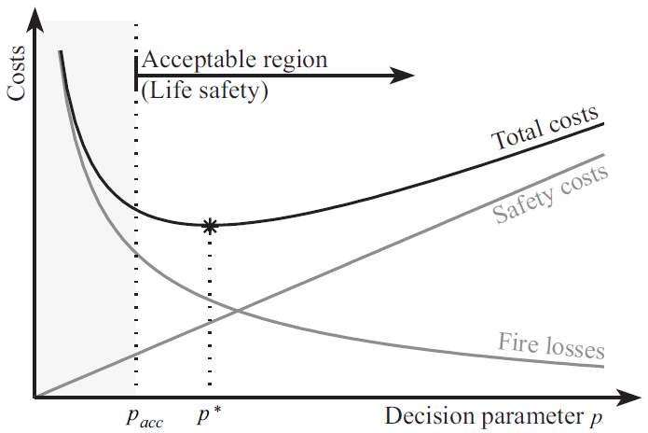
Case study: fire in the arc of a generic accelerator tunnel during a long shutdown.
Full probabilistic evaluation.
If the risk profile of a project:
is above the upper ALARP curve, the design solution is unacceptable;
is below the lower ALARP curve, the design solution is acceptable;
If the risk profile of a project lies between the upper and the lower ALARP curves, a cost – benefit analysis should be made.
10⁻¹
10⁻²
Unacceptable
10⁻³
10⁻⁴
Probability /y
10⁻⁵
10⁻⁶
Cost – Benefit analysis
If C is the total cost of fire protection measures and C_{F} is the expected fire loss, the optimum design minimizes:
C_{T} = C + C_{F}
C_{T} = C + C_{F}
10⁻⁷
C
10⁻⁸
C_{F}
Acceptable
10⁻⁹
C
1
10
10²
10³
10⁴
10⁵
Consequence kCHF
Courtesy of S. La Mendola

Slide 45
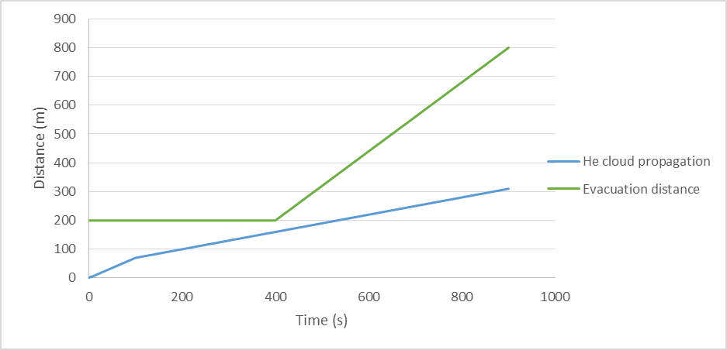
Cryo3: 1 kg/s ; 200 m from release point
Propagation of He cloud and evacuation distance
Occupant is always ‘ahead’ the He cloud
Δt_{pre}

Slide 46

Cryo6: : 32 kg/s during operation
L. Tavian
Sectorise the He inventory each 2 half-cells ~ 220m
33 l LHe / m → 7260 l LHe
@ 300 K → ~ 1 ton GHe
Fire compartment: 440 m
Property protection
Loss of one compartment & 1 cell
Downtime
1 year of operation
5.5 m Ø : 15 m2
5.5 m Ø → 7000 m³ of air + 5 600 m³ GHe
→ 1300 mbar pressure increase
With doors closed
CFD calculation needed…
With doors open

