Slide 1





Collimation Efficiency with Imperfections
M. Serluca¹, R. Bruce², G. Lamanna¹, J. Molson², S. Redaelli²
1: LAPP-IN2P3-CNRS, Université Savoie Mont Blanc, Annecy, France
2: CERN, Geneva, Switzerland
10/04/2018 FCC week Conference 2018, Amsterdam, Netherlands

Slide 2
Outline
FCC-hh layout and main parameters
Collimator and optics imperfections
Collimator gaps and simulation setup
Loss map with and without imperfections
Influence of imperfections on losses
Influence of imperfections on cold losses locations
Conclusions and outlook for future studies

Slide 3
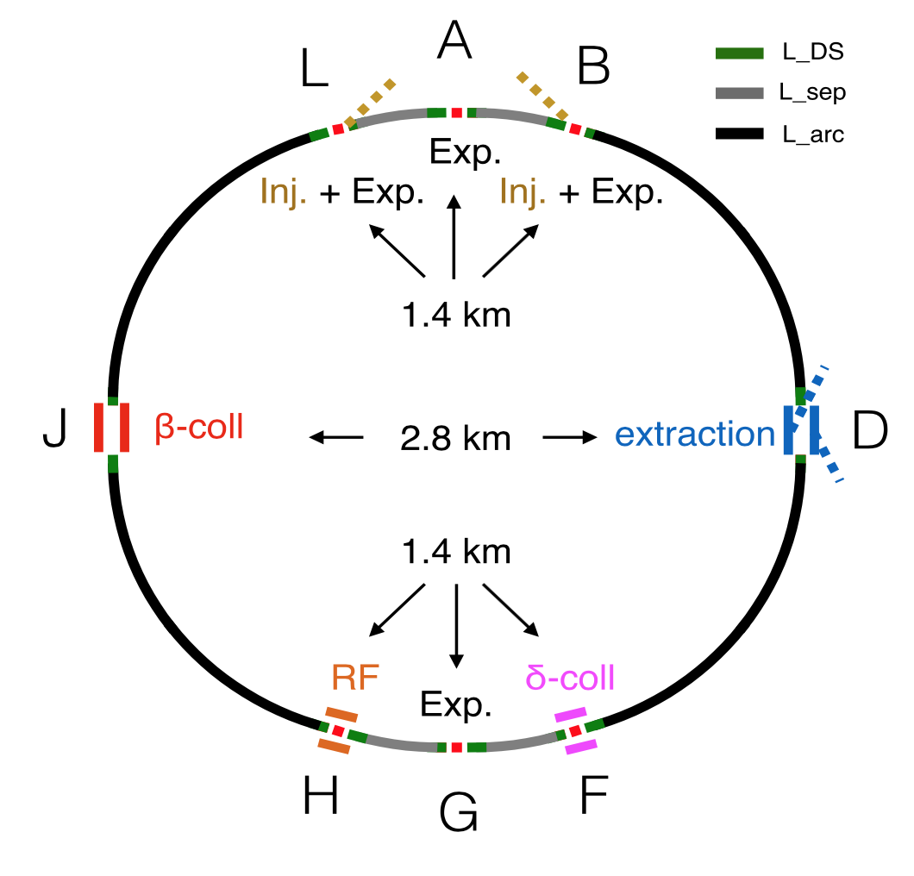
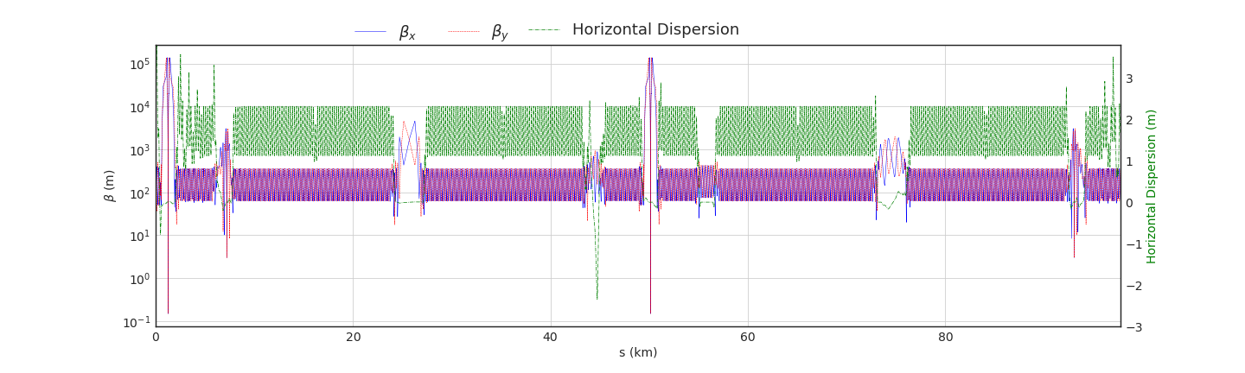
FCC layout and main parameters
FCC layout V9
Length = 97749 m
Top Energy = 50 TeV
Protons per bunch = 10¹¹
# of bunches (25 ns) = 10400
Stored Energy = 8.4 GJ
FCC optics
ε_{n} (H and V) = 2 mm mrad
β* (A and G) = 15 cm
β* (L and B) = 3 m
Q_{x}/Q_{y} = 111.31/ 109.32
A B D F G H J L

Slide 4
Collimator and optics imperfections
The error model is introduced in SixTrack following the procedure and experimental data used for LHC [*]:
positive tilt
* C.Bracco, PhD Thesis: EPFL_TH4271
ideal
θ
OFFSET: rms error offsets of the collimator centers
TILT: tilt angle of the collimator with respect to the beam axis
FLATNESS: imperfections of jaw flatness are modelled with a parabolic fit of the collimator jaw
GAP: RMS errors on the size of the collimator gap with respect to its ideal value
MAGNETIC AND MISALIGNEMENT: Phase advance and dispersion errors can only be simulated by adding magnetic errors and misalignments in the MAD-X lattice
APERTURE: Aperture of magnets could be misaligned. Design tolerances can be used to set random errors.
Half Gap
Ideal beam orbit = geometric center
Offset of
gap centre
ideal
negative tilt
L = 1 m
2nd degree
polynomial
(not to scale)
In SixTrack outward flatness deformation modelled with 4 slices
Max deformation
100 μm
Imperfection 5 and 6 are not currently considered.
Half Gap
Ideal beam orbit = geometric centre

Slide 5
Collimator gaps and simulation setup
Annular beam halo
Horizontal beam halo generated at primary collimator with 0.0015 σ impact parameter
Gaussian vertical distribution cut at 3 σ
NAME | N-SIGMA | LENGTH (M) | MATERIAL
TCP | 7.6 | 0.6 | C
TCSG | 8.8 | 1 | C
TCLA | 12.6 | 1 | INER
TCT | 10.5 | 1 | INER
TCLD | 35.1 | 1 | INER
Simulation parameters
Horizontal loss map at top energy
Mode: collision cross
N(protons) = 100M
Turns = 200-500
Bin width = 10 cm
Imperfections
Offset error: 100 μm rms
Tilt error: 200 μrad rms
Gap error: 0.17 σ (Assuming a beta beating of 4%)
Flatness error: inward fixed max deformation of 60/100 μm (0.6/1 m coll. length) applied to betatron collimators
Studied cases: ideal (no imperfection), offset, offset+tilt, offset+tilt+gap and offset+tilt+gap+flatness
N(IMPERFECTION SEEDS) = 20
Betatron collimator settings
Taking into account all seeds and imperfections a total of 8 10⁹ protons tracked for 200-500 turns

Slide 6
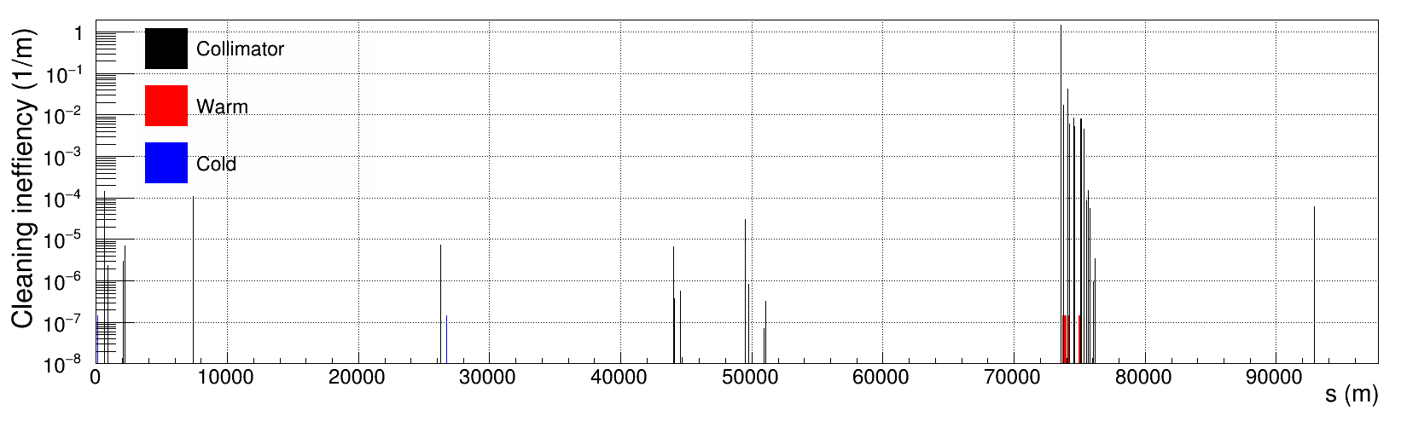
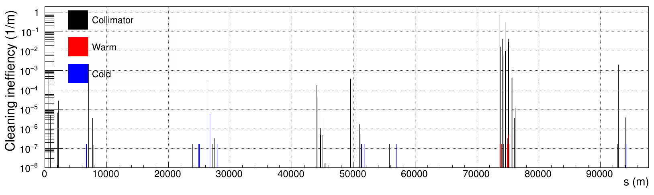
Loss Map with and without imperfections
A B D F G H J L
Ideal case
Worst case

Slide 7
Influence of imperfections on collimator losses
Losses ratio of betatron cleaning insertion with respect to TCP
Each point is an average over the 20 seeds
Hierarchy preserved
Slight losses increase in TCLA, TCSG and DS collimators
Losses ratio of tertiaries around detectors with respect to TCP
Similar scaling for all collimators
Highest losses around A and B insertions
Factor 4 increase with all imperfections with respect to the ideal case

Slide 8
Influence of imperfections on cold-warm losses
Global inefficiency
Warm losses with imperfections are within the error bars
Cold losses with tilts increase by a factor 4
Cold losses with all imperfection increase by a factor 6
Highest cold inefficiency along the ring
Tilt and offset do not affect the highest cold peak
Mean value of the highest cold loss with all imperfections increases by a factor 2 with respect to the ideal case

Slide 9
Influence of imperfections on cold losses locations
Stacked histograms of cold losses with 1 km bin width
Cold losses longitudinal locations are similar for all imperfections
Main locations are around the A and B detectors, and in the dump area (D)
seed number

Slide 10
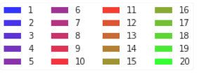
Influence of imperfections on cold losses locations
Stacked histogram of cold losses with all imperfections: zoom of the peak areas with 0.1 m bin width
seed number
60 m
s (m)
60 m
1 m
50 m
70 m
s (m)
s (m)
s (m)
s (m)
26701.1 m (MQI.4RD)

Slide 11
Conclusions
Presented horizontal collimation performance of FCC-hh with imperfections
Collimator hierarchy is preserved for all imperfections
Imperfections increase by a factor 6 the global cold losses
Cold Losses are mostly located in A, B and dump areas
Most affected element of cold losses is MQI.4RD
Complete the loss map studies with all possible imperfections (optics and aperture errors)
Vertical loss map with imperfections
Collimation performance with imperfections and new jaw-coating materials
Impact of new collimator geometries on loss map with imperfections (e.g. 30 cm collimator)
Study the asymmetry of impacts for left-right jaw with all imperfections as input for energy deposition studies
Future works

