Slide 1
Future Circular Collider Logistics Study
Dr. Ulrike Beißert, Konstantin Horstmann, Gerd Kuhlmann,
Andreas Nettsträter, Christian Prasse, Andreas Wohlfahrt

Slide 2
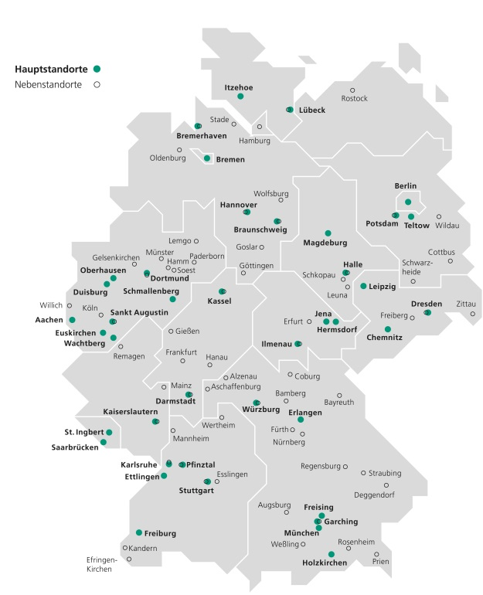
Fraunhofer-Gesellschaft and Fraunhofer IML
  24.500 Employees
  Fraunhofer IML, Dortmund
  280
  Employees
  69 Institutes and research facilities
  250
  scientific assistants and PhD students
  2,1 bn EUR
  Research budget
  28,4 Mio EUR
  Revenue, 50% from industry (contract research)
Structural invest and defence research
Basic financing
federal and state
Contract research and
public funded research projects
Revenue and number of employees 2016

Slide 3

FCC Logistics Study covers fives areas
Supply strategies for FCC cryo-units;
Locations for the storage, assembly and testing facilities;
Transport scenarios for cryo-units, including analysis of stresses and possibility of intercontinental transport;
Design concept for a special purpose vehicles for the underground transportation and handling of cryo-units;
Supply scenarios considering the overall FCC construction schedule.

Slide 4
The following assumptions about FCC have been taken into consideration
Related to installation schedule:
Cryo-unit installation phase Nov. 2035 – Nov. 2039
Related to cryo-units:
Maximum shock: 0.1 g
Maximum tilt angle: 5%
Weight of the cryo-unit: 60 t (Dipole Magnets)
Dimension (L/W/H) 13,4m x 1,5m x 1,64m
Amount of cryo-units to be transported: 5400

Slide 5

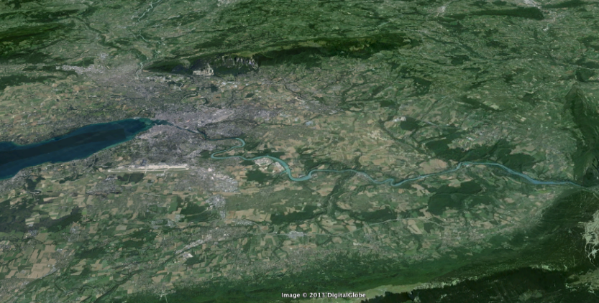
Supply strategies for FCC cryo-units:
Questions to be answered from logistics side
The construction of FCC entails high demands for materials that need to be installed.
As the construction timeframe for FCC is very tight and available space for material storage on site is limited, it is very important to have effective on-site logistics and a suitable supply chain strategy.
Questions to be answered from logistics side are
  Insourcing ←→ Outsourcing
  Single ←→ Multiple Souring
  Global ←→ Local Souring
  Central ←→ Decentral Facilites and Storages
  Overground ←→ Undergound Transports
Geneva
PS
SPS
LHC

Slide 6
Supply strategies for FCC cryo-units
Completely Built Up At CERN
Efficiency of this alternative strongly depends on the availability of proper and sufficient production capacities and process know-how.
If both aspects are not fulfilled, high costs will arise for building up a suitable infrastructure and/or for modernizing or expanding the existing one as well as for training and recruiting capable employees.
Outsourcing of Processes to Suppliers
Outsourcing the entire value-added process or only parts of it is often proposed when suppliers offer the same services or products but at lower cost. Usually the cost reduction is a result of economies of scale or lean production processes.
As the final product has neither been designed nor engineered yet, there are currently no suitable suppliers on the market to offer the requested product. As CERN owns process knowledge from LHC a collaboration between CERN and the future supplier will be essential.
Experiences gained from LHC production shows that it is possible to outsource the production of cryo-units. For test reasons a small charge of cryo-units was produced and delivered by a supplier. The quality was satisfying.
Notes:
With regard to the available resources and considering the fact that the dimensions of the FCC are 4 times higher than those of the LHC (regarding length of tunnel and number of cryo-units), outsourcing processes to suppliers seems to be the favourable solution.
Experiences gained from LHC production shows that it is possible to outsource the production of cryo-units. For test reasons a small charge of cryo-units was produced and delivered by a supplier. The quality was satisfactory.

Slide 7
Possible locations for the storage, assembly and testing facilities of FCC cryo-units
Applied criteria:
  Suitable size: approx. 10 ha
  (100.000 sqm)
  Convenient access to major roads
  Not in: city centres, mountain area,
  nature reserve, e.g. Lake Geneva
  Near to sufficient power supply
Result for two shafts:
  Use one Main Shaft (Shaft A) near CERN premises and one Secondary Shaft (Shaft E)
Shaft A
(Main Shaft)
Shaft E
(Secondary Shaft)

Slide 8
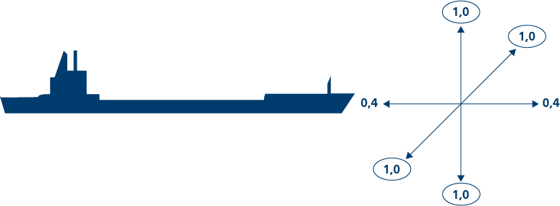
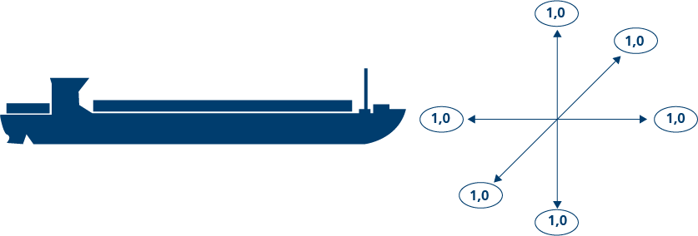
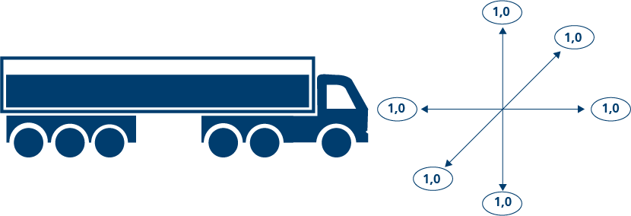
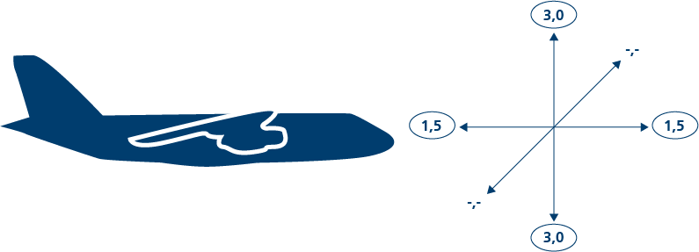
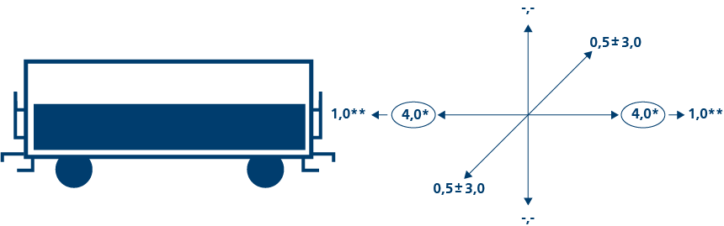
Transport stresses and modes of transport
International Transport / Overseas Regional Transport Local Transport / Last Mile

Slide 9
Transport stresses and modes of transport for international transport / overseas
Overseas transport of assembled cryo-units is only possible if they can handle 1g of shocks

Slide 10
Transport stresses and modes of transport for continental transport
due to coupling process

Slide 11
Transport stresses and modes of transport for continental and last mile transport
Can be reduced with special transports at low speed

Slide 12
Possible routes to CERN (not complete)
Alternative A: Marseilles -> Mâcon -> CERN
Oversea transport to Marseilles
Barge transport to Mâcon
Last mile via road transport to CERN
Alternative: direct road transport from Marseilles to CERN
Alternative B: Rotterdam -> Basel -> CERN
Oversea transport to Rotterdam
Barge transport to Basel
Last mile via road transport to CERN
Alternative: direct road transport from Rotterdam to CERN

Slide 13
Design concept for a special purpose vehicles for the underground transportation and handling of cryo-units
Main facts about vehicle concept:
Maximum speed: 10km/h – loaded, 20km/h unloaded
Maximum possible slope: ~3 Degree (ca. 5%)
Battery technology based on lithium-ion batteries
Autonomous driving technology based on contour navigation based on safety laser scanners and navigation scanners

Slide 14
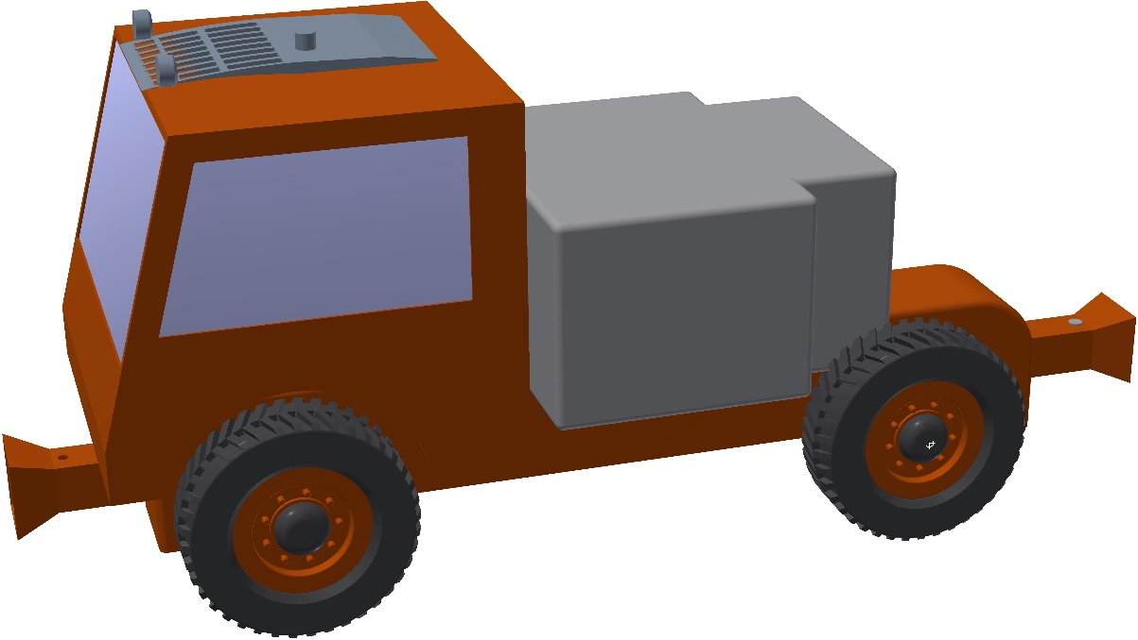
Design concept for a special purpose vehicles for the underground transportation and handling of cryo-units
Pulling tractor
The tractor is equipped with electric and emission-free drive
  E.g. based on lithium-ion batteries
An intelligent navigation and control system allows autonomous driving in tunnels
  E.g. using contour navigation based on safety laser scanners and navigation scanners
Friction weight and battery
trailer hitch
trailer hitch

Slide 15
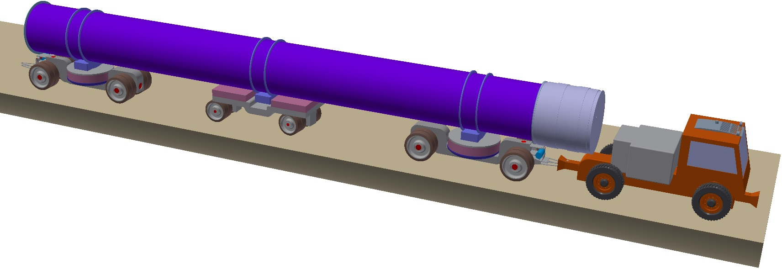
Design concept for a special purpose vehicles for the underground transportation and handling of cryo-units
Transport trailers (rear-trailer and front-trailer) equipped with electronic steering system, drawbar and vibration-dampening support for the loading
Ground contact of the special wheels is secured by using pendulum/swing axles
Support for centre of cryo-unit via supporting third trailer
Rear-trailer
Support-trailer
Front-trailer

Slide 16
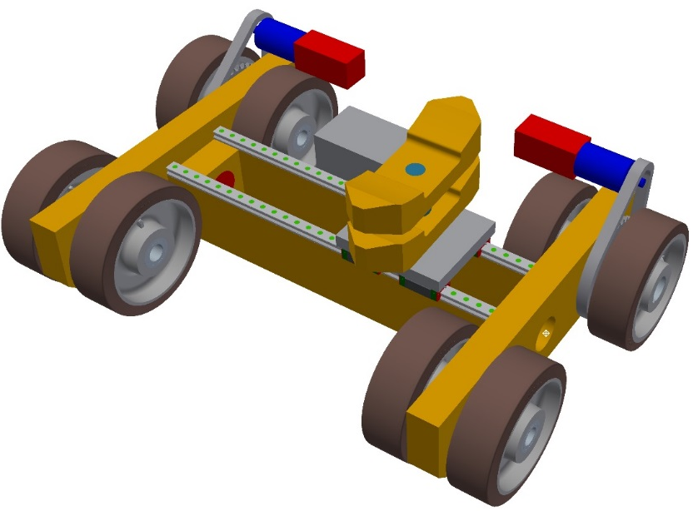
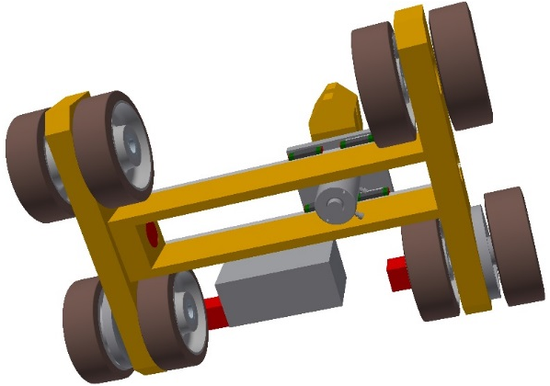
Design concept for a special purpose vehicles for the underground transportation and handling of cryo-units
Two transfer tables equipped with hoists are used for unloading the cryo-units of the transport vehicle
When the tractor with cryo-unit arrives at its designated position (mounting position) in the tunnel, the two transfer tables drive below the cryo-unit
The two transfer tables lift the cryo-unit and move it laterally into the assembling position of the cryo-unit
Swivel axle chassis
axis of rotation
Traction drive (motor, chain, pinion)
drive-direction: lateral
Lifting cylinder

Slide 17
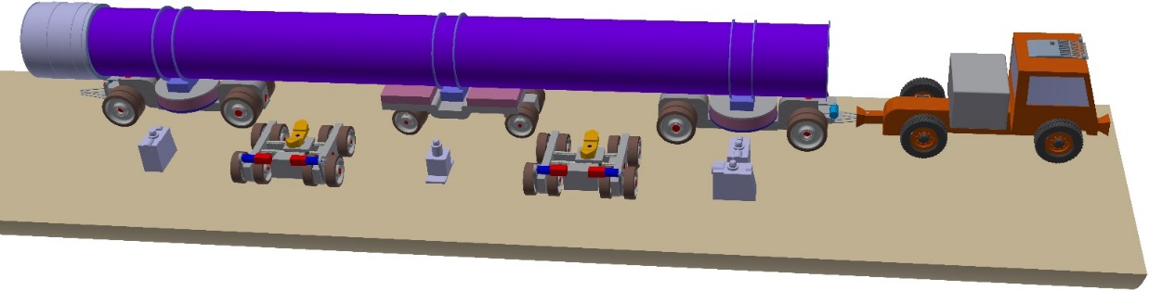
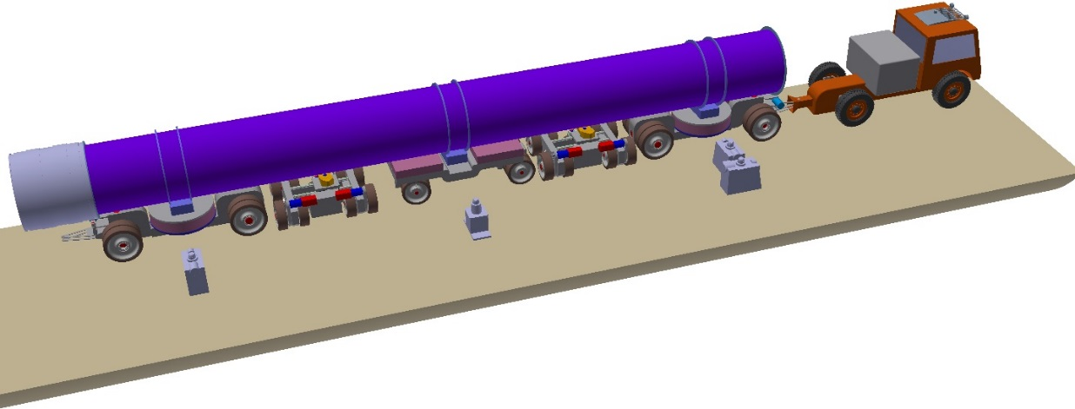
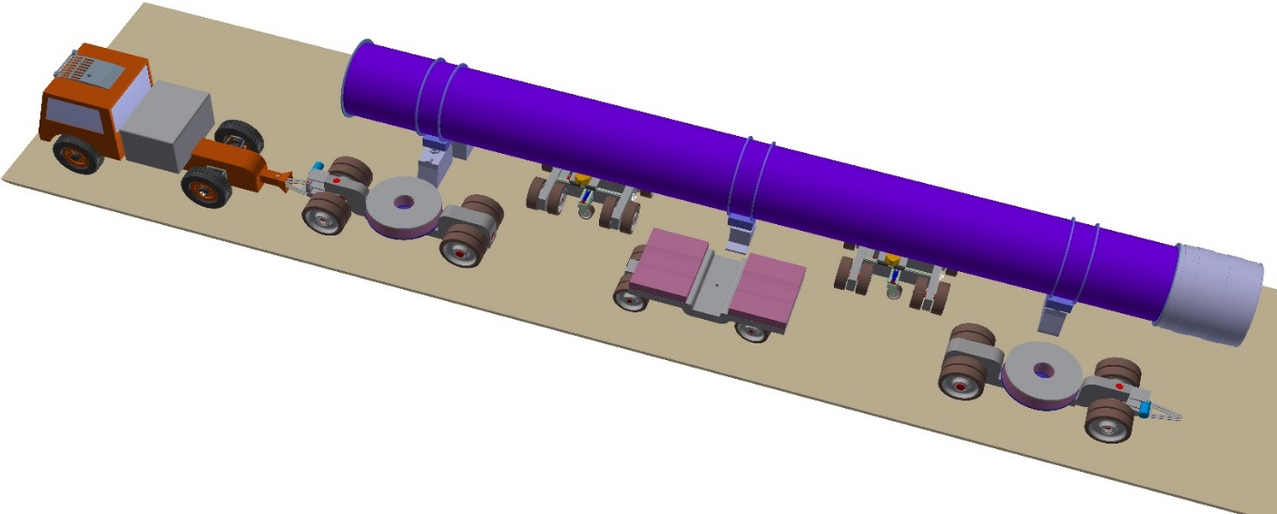
Design concept for a special purpose vehicles for the underground transportation and handling of cryo-units

Slide 18
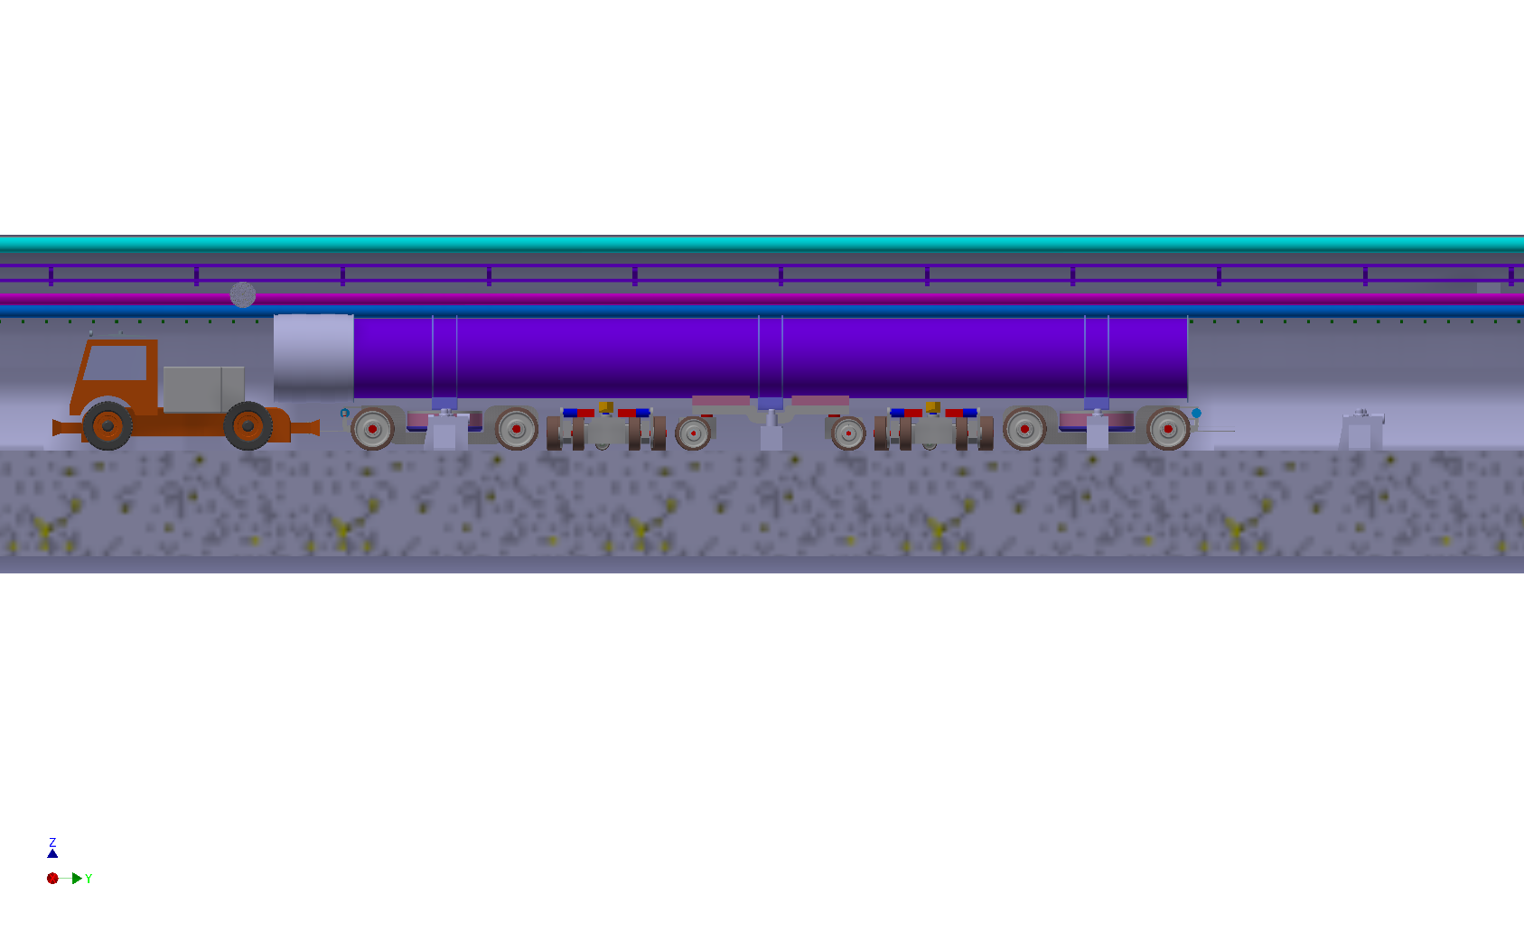
Design concept for a special purpose vehicles for the underground transportation and handling of cryo-units
Speed of vehicles is limited by their capability to do emergency breaks fully loaded within the range of safety sensors
Higher velocities could be realised by the development of a “watchdog” principle, where an additional vehicle or even drone is moving in front of the transport convoy in the tunnel
This watchdog is scanning the environment to identify possible blockings (e.g. assembly tools, cleaning tools, building materials, etc. remaining in the tunnel) and humans on the track
If something is detected the watchdog will trigger an emergency break at the convoy to prevent a collision -> The distance from the watchdog to the transport convoy needs to be at least the distance between the braking distance (length of the braking distance of the transport convoy from full speed to standstill).
length of the braking distance of the transport convoy from full speed to standstill

Slide 19
Analysis Tunnel Transport and Delivery Scenario
The focused processes can be executed by a supplier or by CERN, either organized central or decentral.
The aim of the following investigation is to analyse different scenarios for a central or decentral organized logistics by CERN. Therefore, a two-step approach was executed:
  Identification of a valid tunnel transport scenario
  Identification of a proper delivery strategy
Focus of Analysis

Slide 20
Three different alternatives are investigated
Ulrike
Central Supply Via Shaft A
Decentral Supply Via Two Shafts
Short Overground Transport from CERN: C – K
Opposite Location: E – K
Equal underground Transport Distances: J – D
Combination CERN and additional shaft: A – E
Current Planning
Decentral Supply Via Four Shafts
C – K – E – I

Slide 21
Analysis Tunnel Transport and Delivery Scenario
Assumptions
Parameter | Value
Underground transport (speed loaded) | 10 km/h
Underground transport (speed unloaded) | 20 km/h
Transport time interval | 10 PM – 6 AM (Duration: 8 hours)
Loading time (crane transport included) | 1h
Unloading time | 1h
Duration assembly (LHC x1 / x2 / x3) in days | 5,33 / 10,66 / 15,99
Duration coldmass test (LHC x1 / x2 / x3) in days | 5 / 10 / 15
Duration final test (LHC x1 / x2 / x3) in days | 0,5 / 1 / 1,5

Slide 22
Supply scenarios considering the overall FCC construction schedule
Ulrike
Central supply via shaft A
  existing capacities at CERN can be used (cryo-plant, storage capacities,..)
  disturbances in the tunnel or at the shaft like delay in installing, crane failures will have a major impact on compliance of construction schedule
# vehicles
5
4
# coldmass test benches
Decentral supply via two shafts A and E
  existing capacities at CERN can be used (cryo-plant, storage capacities,..)
  alternative far more robust
  Costs for construction higher than central supply alternative,
  additional area outside CERN needed for facilities at second shaft
  long transport ways for tested magnets on public roads if test/assembly facilities remain at CERN area
25
24
# assembly facilities *
35
34
# final test facilities
3
4
* Reduction if assembly and coldmass test shift times are adapted (coldmass test - 7 d/w, Assembly - 5 d/w)

Slide 23
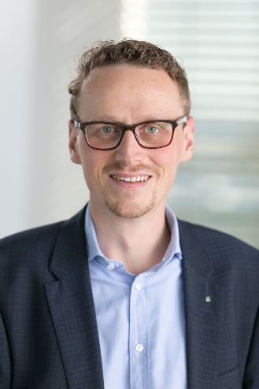
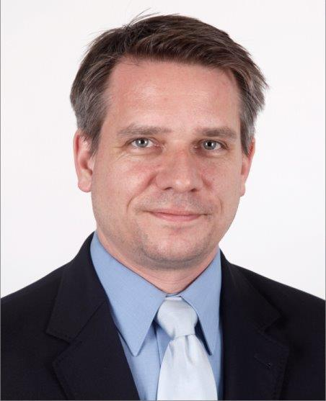
Follow-up and Discussions
Andreas Nettsträter
Fraunhofer IML
andreas.nettstraeter@iml.fraunhofer.de
+49 231 9743 286
Christian Prasse
Fraunhofer IML
christian.Prasse@iml.fraunhofer.de
+49 231 9743 269
Future Circular Collider Logistics Study:
Dr. Ulrike Beißert, Konstantin Horstmann, Gerd Kuhlmann, Andreas Nettsträter, Christian Prasse, Andreas Wohlfahrt
Acknowledgements:
Ingo Rühl, Volker Mertens and Matti Tiirakari

