Slide 1
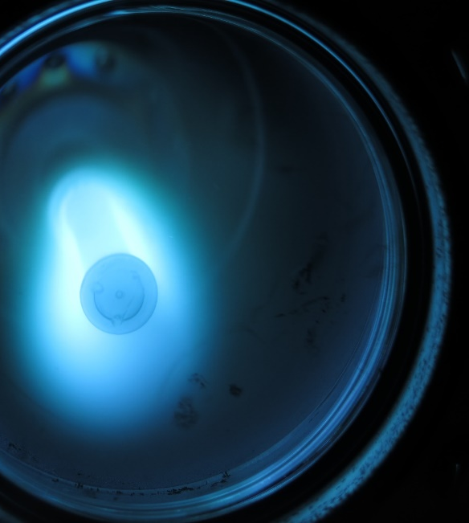


Coating studies on 6 GHz seamless cavities
Cristian Pira Giovanni Caldarola, Eduard Chyhyrynets,
Vincenzo Palmieri, Fabrizio Stivanello, Ruggero Vaglio
In the framework of CERN-INFN-STFC Agreement N. KE2722/BE/FCC
FCC Week 2018, Amsterdam, 12th April 2018

Slide 2
Outline
Q-slope problem and LNL approach
Deposition Set Up
Process Parameters
Results

Slide 3
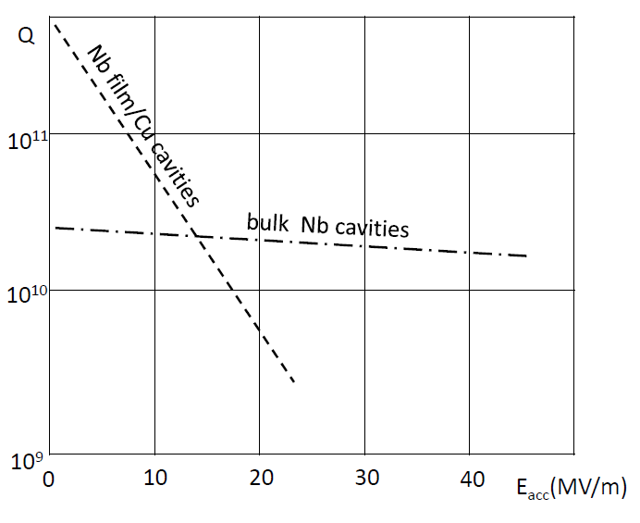
Q-slope problem

Slide 4
LNL Approach
High temperature
Thick films

Slide 5
Thick film motivation
Nb thin film
Copper cavity
Q-slope is related to local enhancement of the thermal boundary resistance at the Nb/Cu interface, due to poor thermal contact between film and substrate
Theoretical model from Vaglio and Palmieri
V. Palmieri and R. Vaglio, Supercond. Sci. Technol., vol. 29, no. 1, p. 015004, Jan. 2016

Slide 6
Thick film motivation
Nb thick film
Nb thin film
Copper cavity
Copper cavity
Q-slope is related to local enhancement of the thermal boundary resistance at the Nb/Cu interface, due to poor thermal contact between film and substrate
Theoretical model from Vaglio and Palmieri
V. Palmieri and R. Vaglio, Supercond. Sci. Technol., vol. 29, no. 1, p. 015004, Jan. 2016

Slide 7
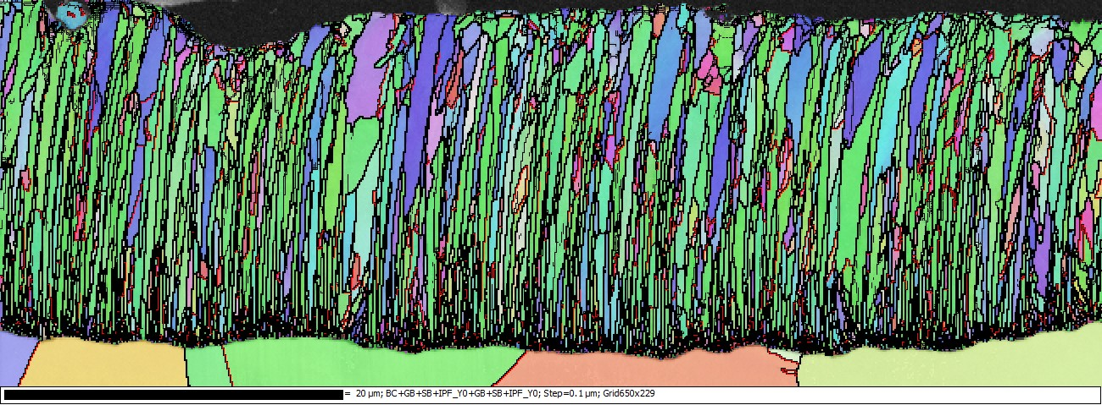
Thick films increase grain dimensions and RRR
Nb
20μm
Cu
Grain dimension ≈1μm
RRR > 60
EBSD Micrograph of cavity #4,
courtesy of Reza Valizadeh (STFC)

Slide 8
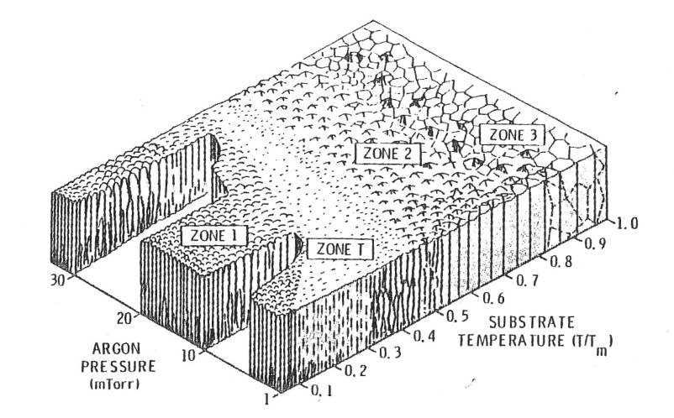
High Temperature Deposition Motivation
Thorton SZ Diagram
J.A. Thornton and D.W. Hoffman, Thin Solid Films, vol. 171, no. 1, pp. 5–31, 1989
CERN (550 °C)
C. Benvenuti et al., Physica B 197 (1994) 72-83
LNL Alpi Linac (300-500 °C)
Stark et al., Proceedings of SRF1997
Hie-Isolde (650 °C)
Sublet et al., Proceedings of SRF2013

Slide 9
6 GHz cavity coating protocol
(2 weeks per cavity)
Spinning
7 h PVD process
HP Rinsing
Mechanical Grinding
48 h Baking 600 °C
Cleanroom RF Assembly
Degreasing
Cleanroom Vacuum Assembling
4,2 K RF Test
EP + SUBU
HP Rinsing
1,8 K RF Test

Slide 10
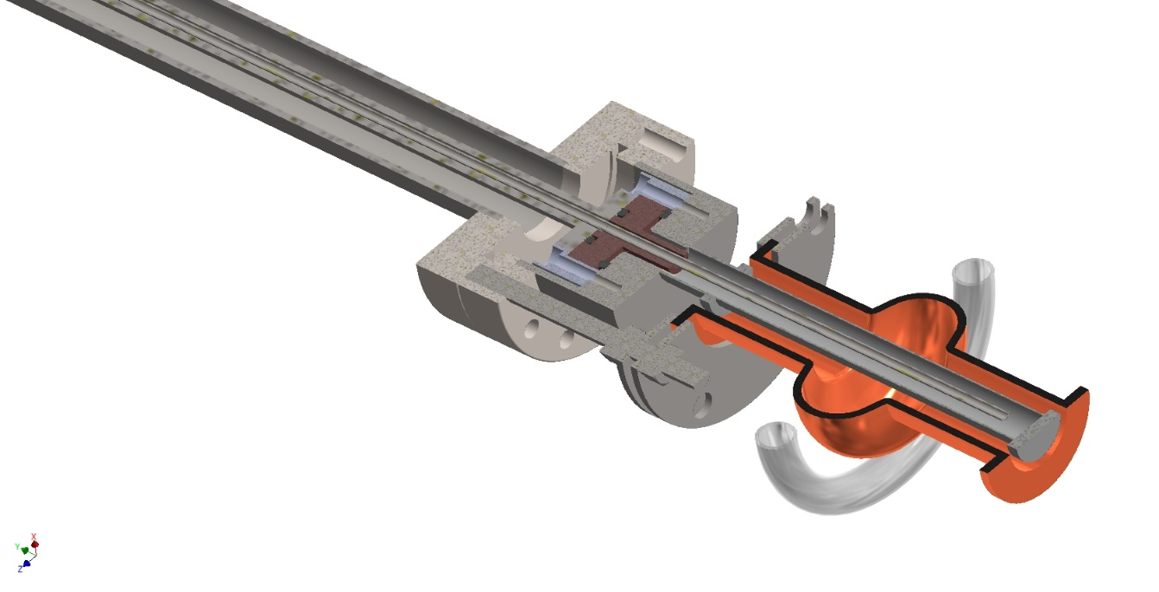
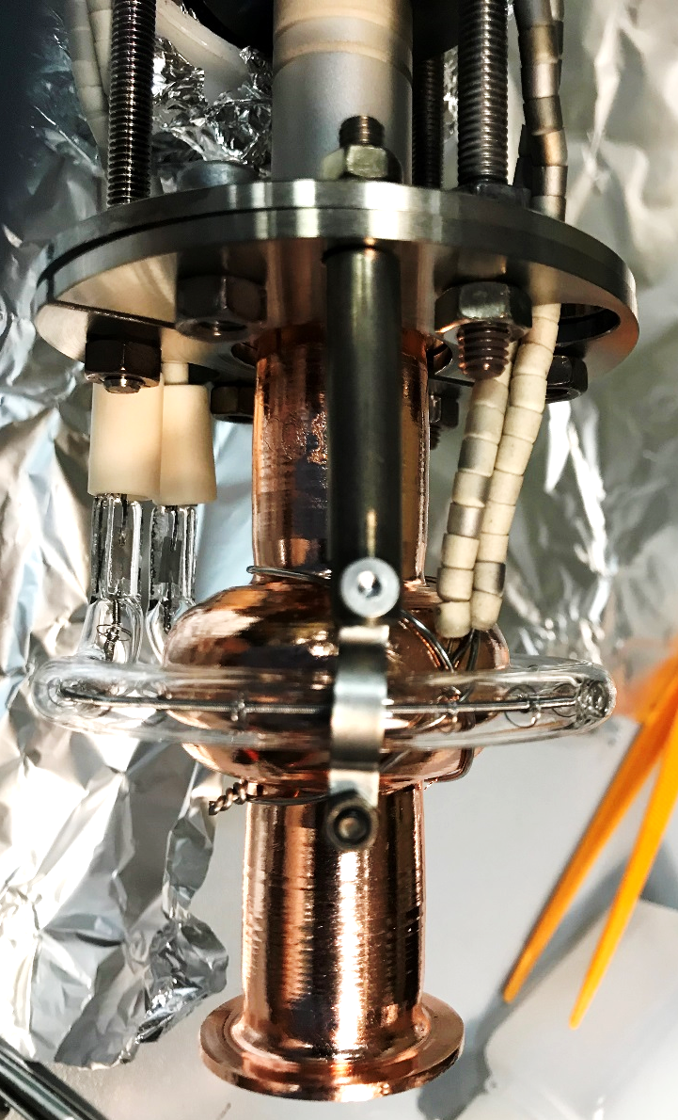
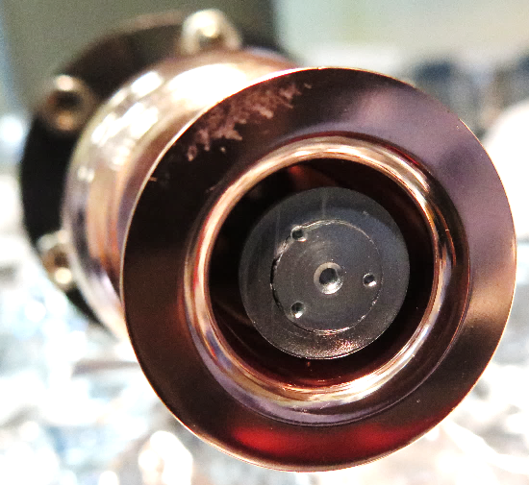
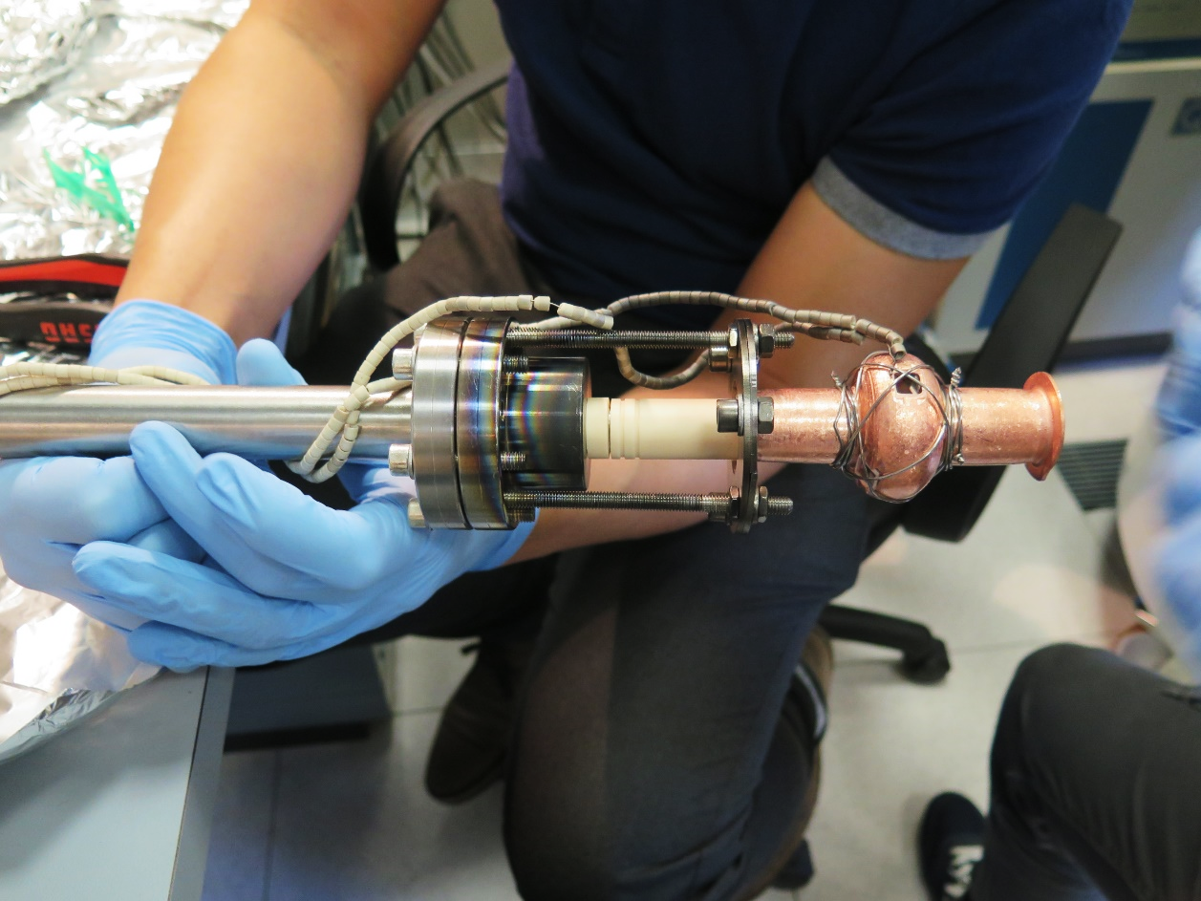
Deposition Set Up
6 GHz cavity
Nb Post Magnetron Target
Quartz sample
IR Lamp
Thermocouple

Slide 11
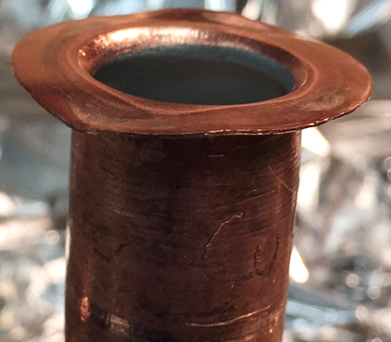
Process parameters
Temperature = 550 °C (baking 600 °C)
Base pressure < 2 • 10⁻⁹ mbar (room T)
Ar Pressure = from 7 • 10⁻³ to 5 • 10⁻² mbar
Current = 1 A (0,017 A/cm²)
Magnetic Field = 830 Gauss
Deposition Rate = 2,5 - 3 nm/s
Bending of the flange at 650 °C

Slide 12
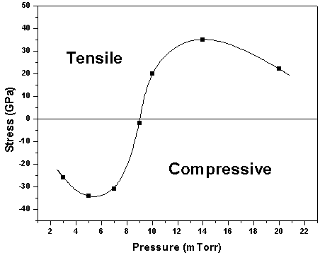
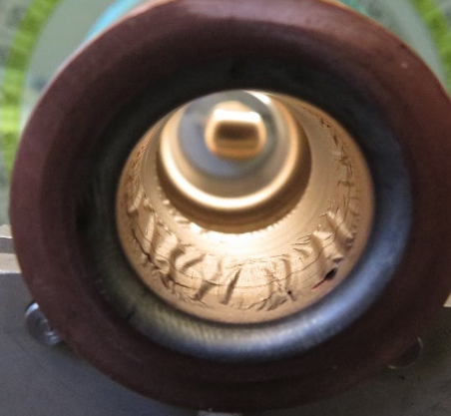
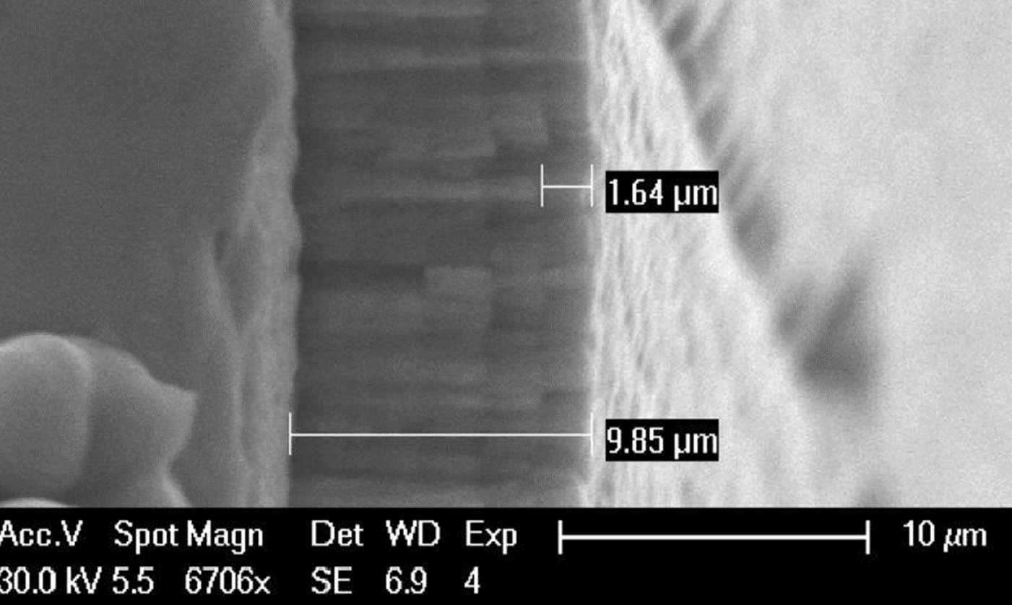
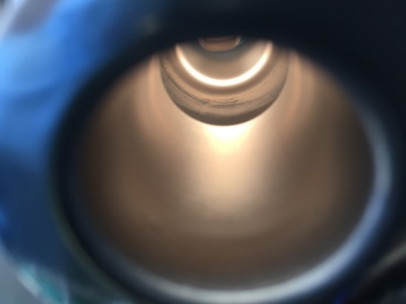
Deposition parameters optimization
Pressure
Multilayer

Slide 13
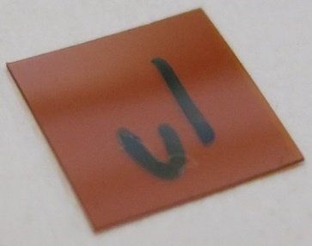
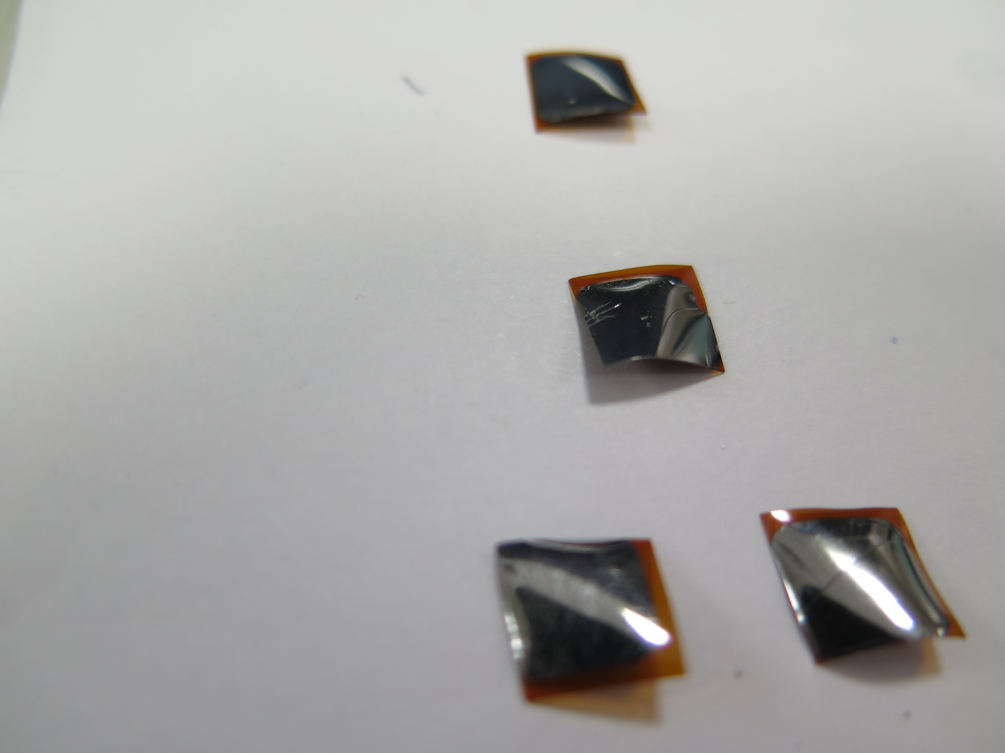
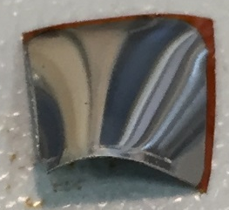
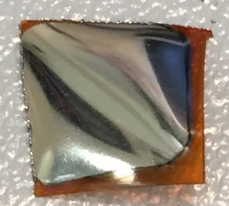
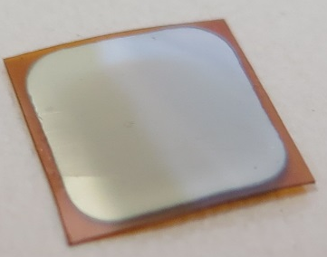
Pressure
Test on kapton foil
Bending as a function of a pressure
300 °C
7 · 10⁻³ mbar
9 · 10⁻³ mbar
2 · 10⁻² mbar
5 · 10⁻² mbar

Slide 14
Pressure
Test on kapton foil
Bending as a function of a pressure
300 °C
7 · 10⁻³ mbar
9 · 10⁻³ mbar
2 · 10⁻² mbar
5 · 10⁻² mbar

Slide 15
Multilayer
DC ON
70 %
30 %
DC OFF
Time = 9 - 10 h
Single Layer Thickness = 100, 300, 400, 500 nm
Total Thickness (on the cell) = 70 µm
Deposition Rate = 3 nm/s

Slide 16
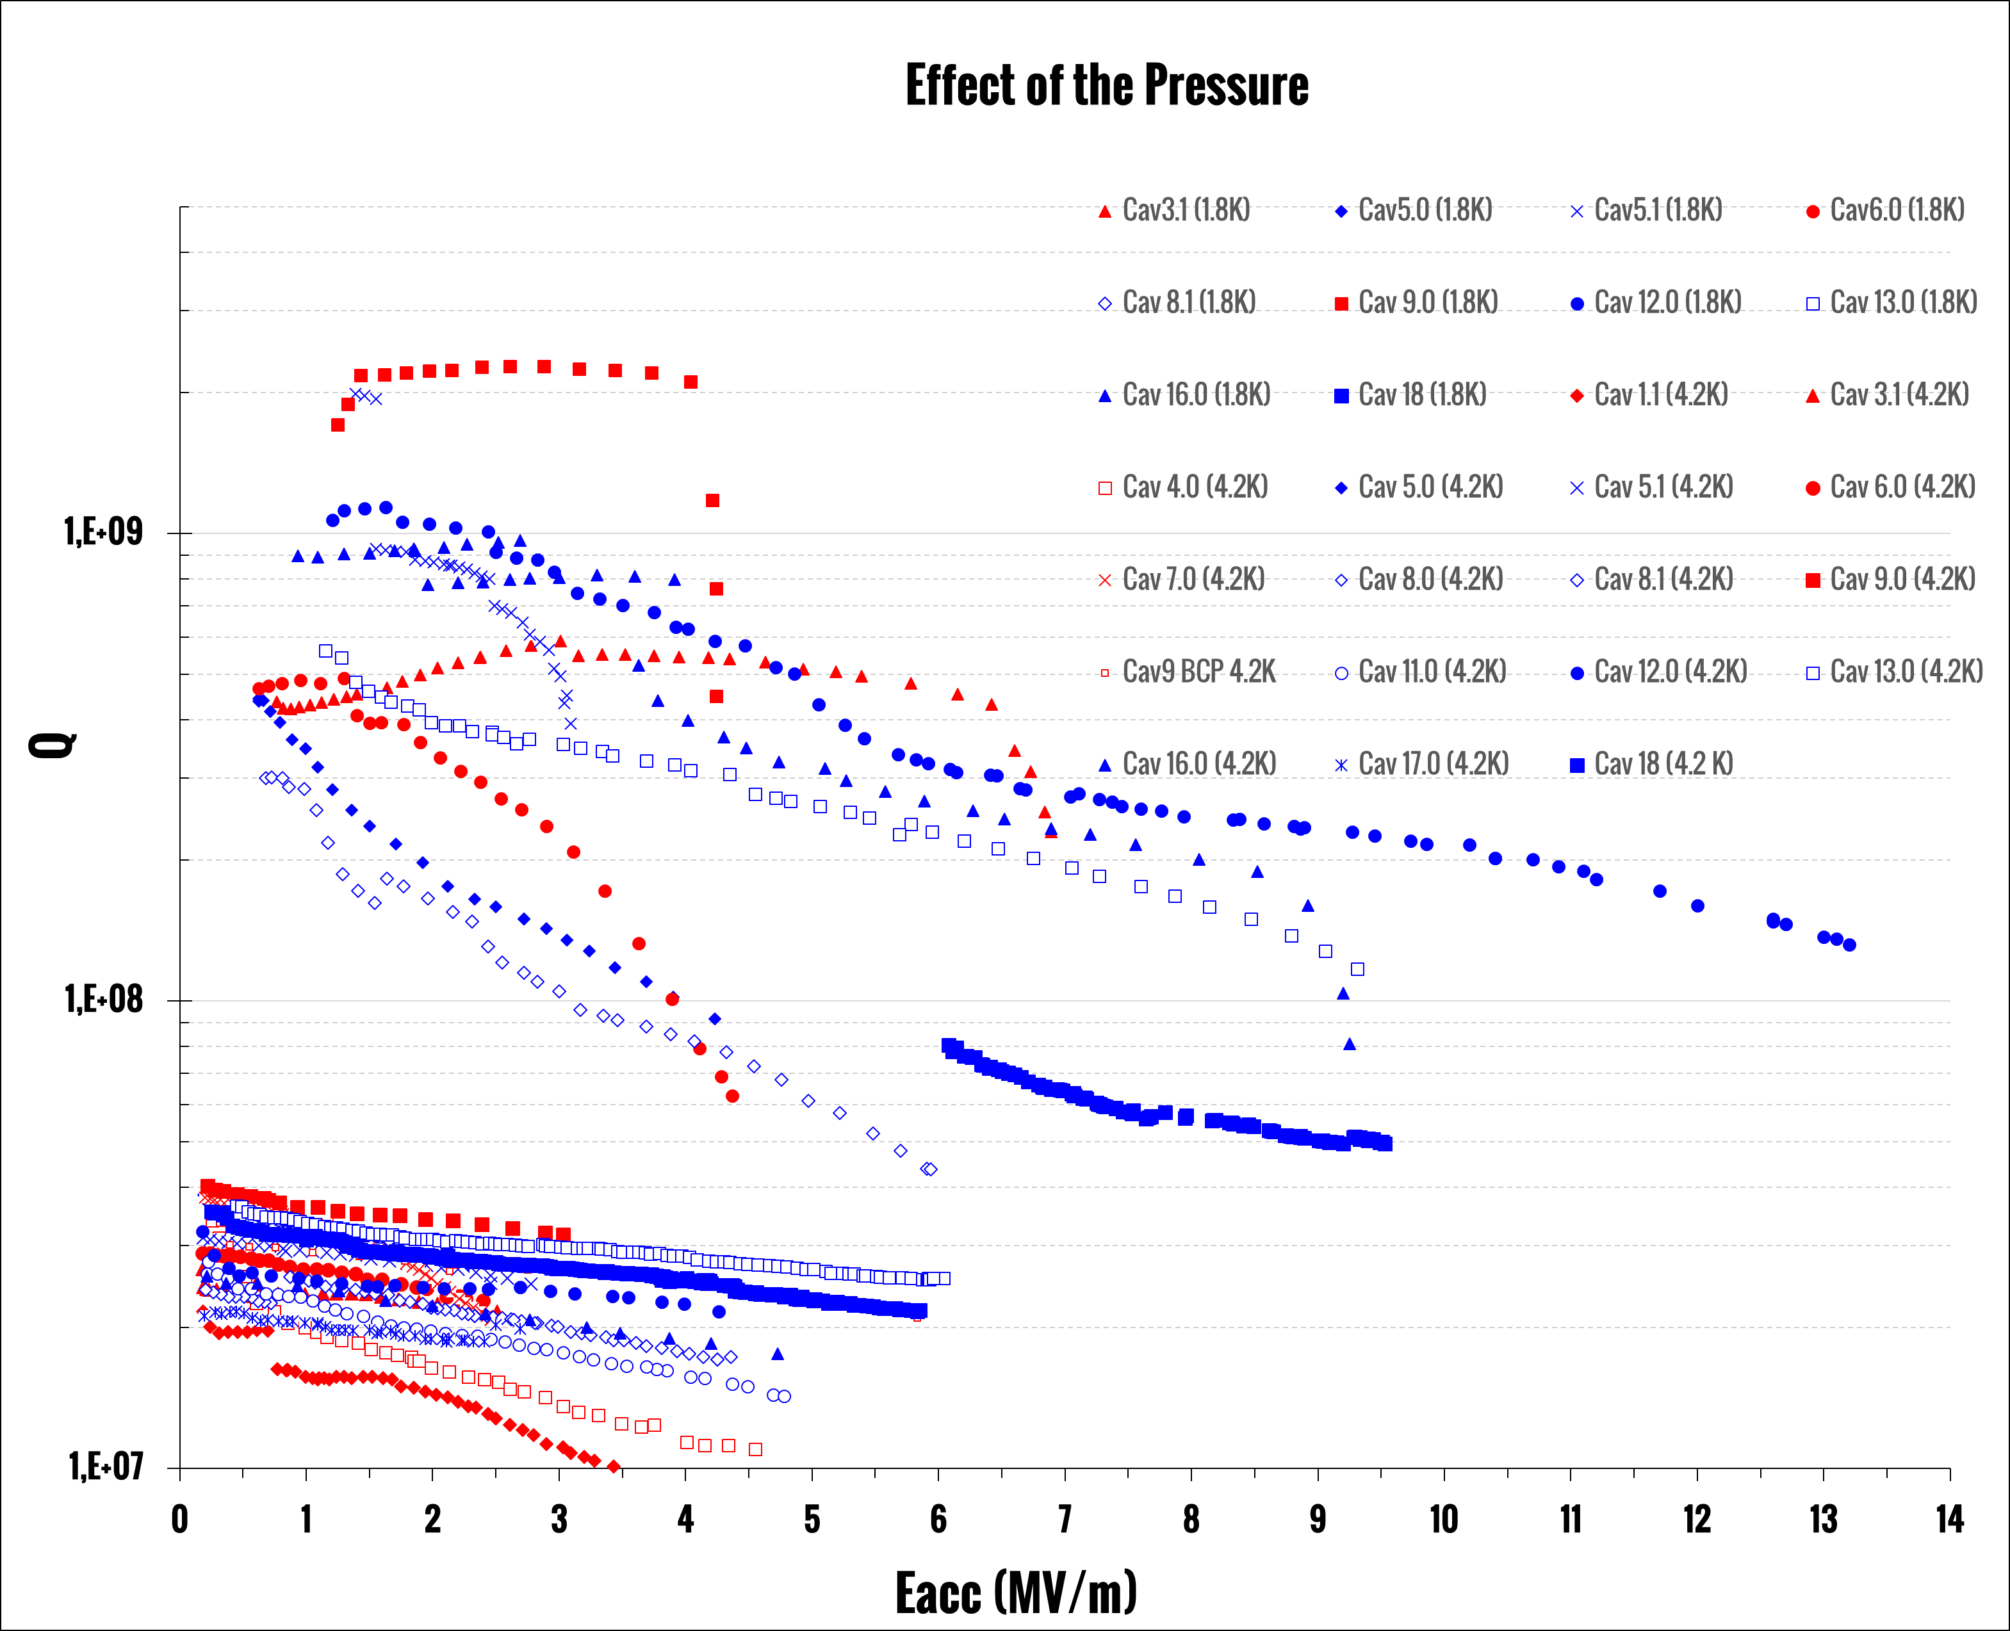
Pressure
5 • 10⁻² mbar
7 • 10⁻³ mbar
Zero stress pressure
helps to increase
accelerating gradient
6 GHz @ 1,8 K
6 GHz @ 4,2 K

Slide 17
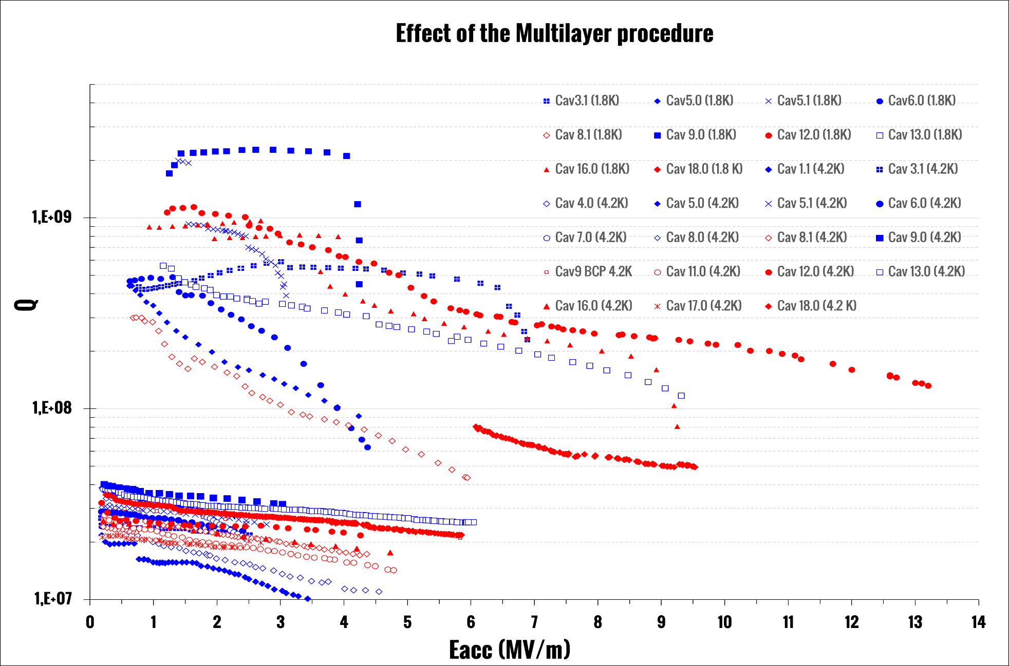
Multilayer
One shot deposition
Multilayer
Deposition
Multilayer process
helps to increase
accelerating gradient
6 GHz @ 1,8 K
6 GHz @ 4,2 K

Slide 18
Results interpretation
Sputtering pressure and multilayer deposition reduce film stress
Film stress reduction reduces film peeling and voids dimension at the interface
How to explain low reproducibility?

Slide 19
Cavity surface after spinning

Slide 20
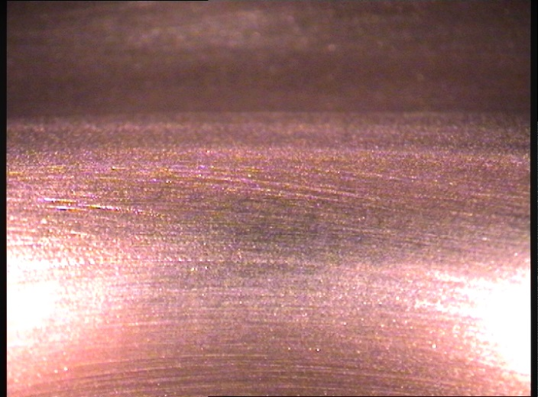
After Mechanical Finishing (grinding)
With mechanical grinding some areas of the cell are difficult to access

Slide 21
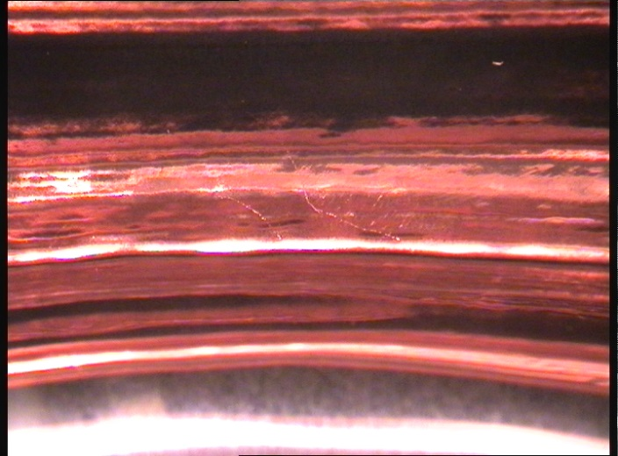
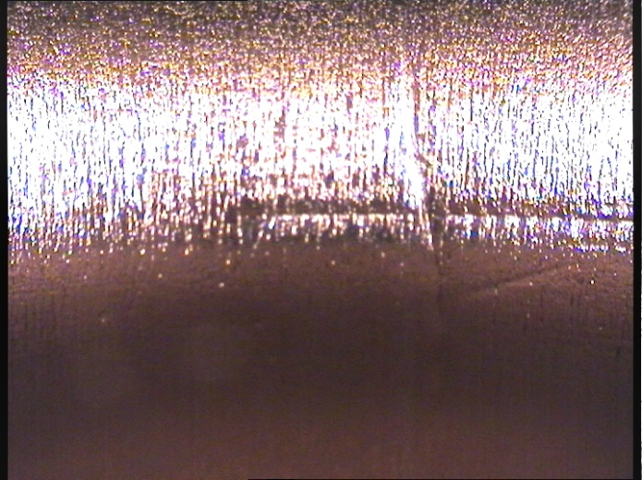
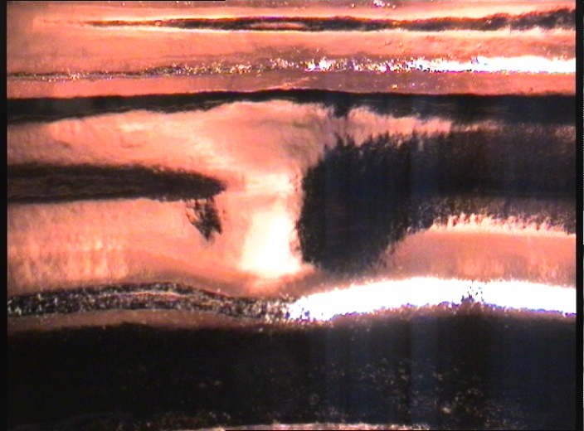
Surface defects after chemistry

Slide 22
Thick films help on Q-slope problem?

Slide 23
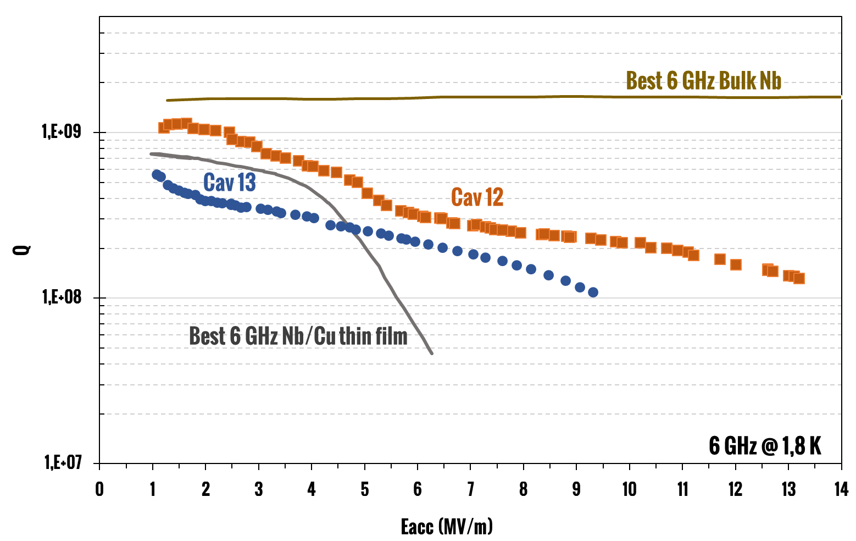
Q-slope remains in many cavities…

Slide 24
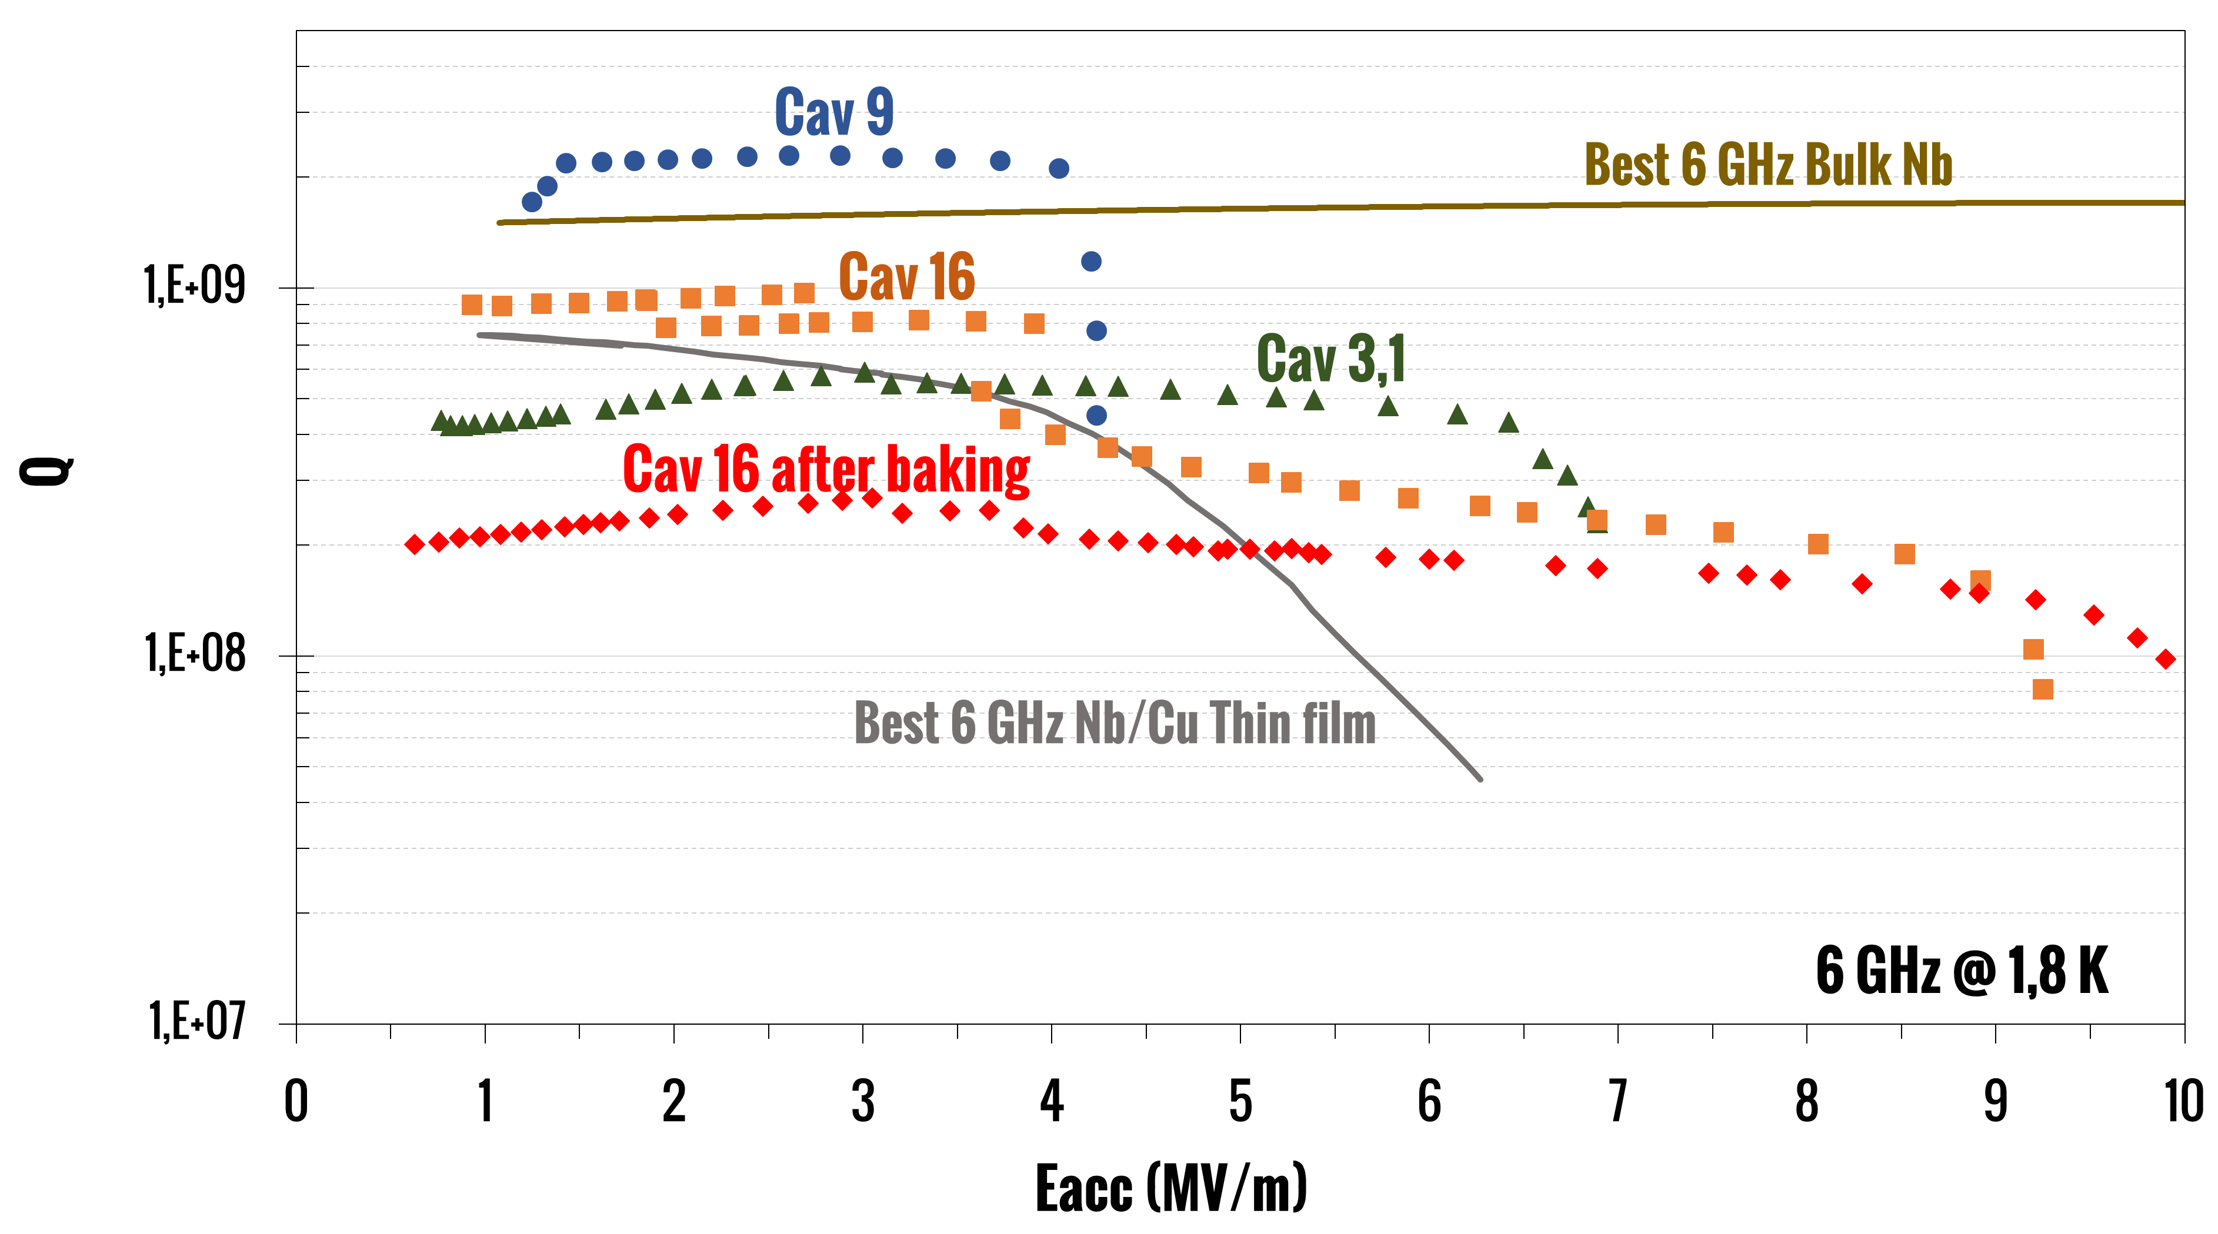
…but not in all ones!

Slide 25
Conclusions and future actions
We explored the thick films deposition on Nb/Cu cavities
Strong Q-slope mitigation on 3 cavities
The technique is very promising but not mature
Improvements on cavity preparation process is mandatory
Film characterization from STFC

Slide 26
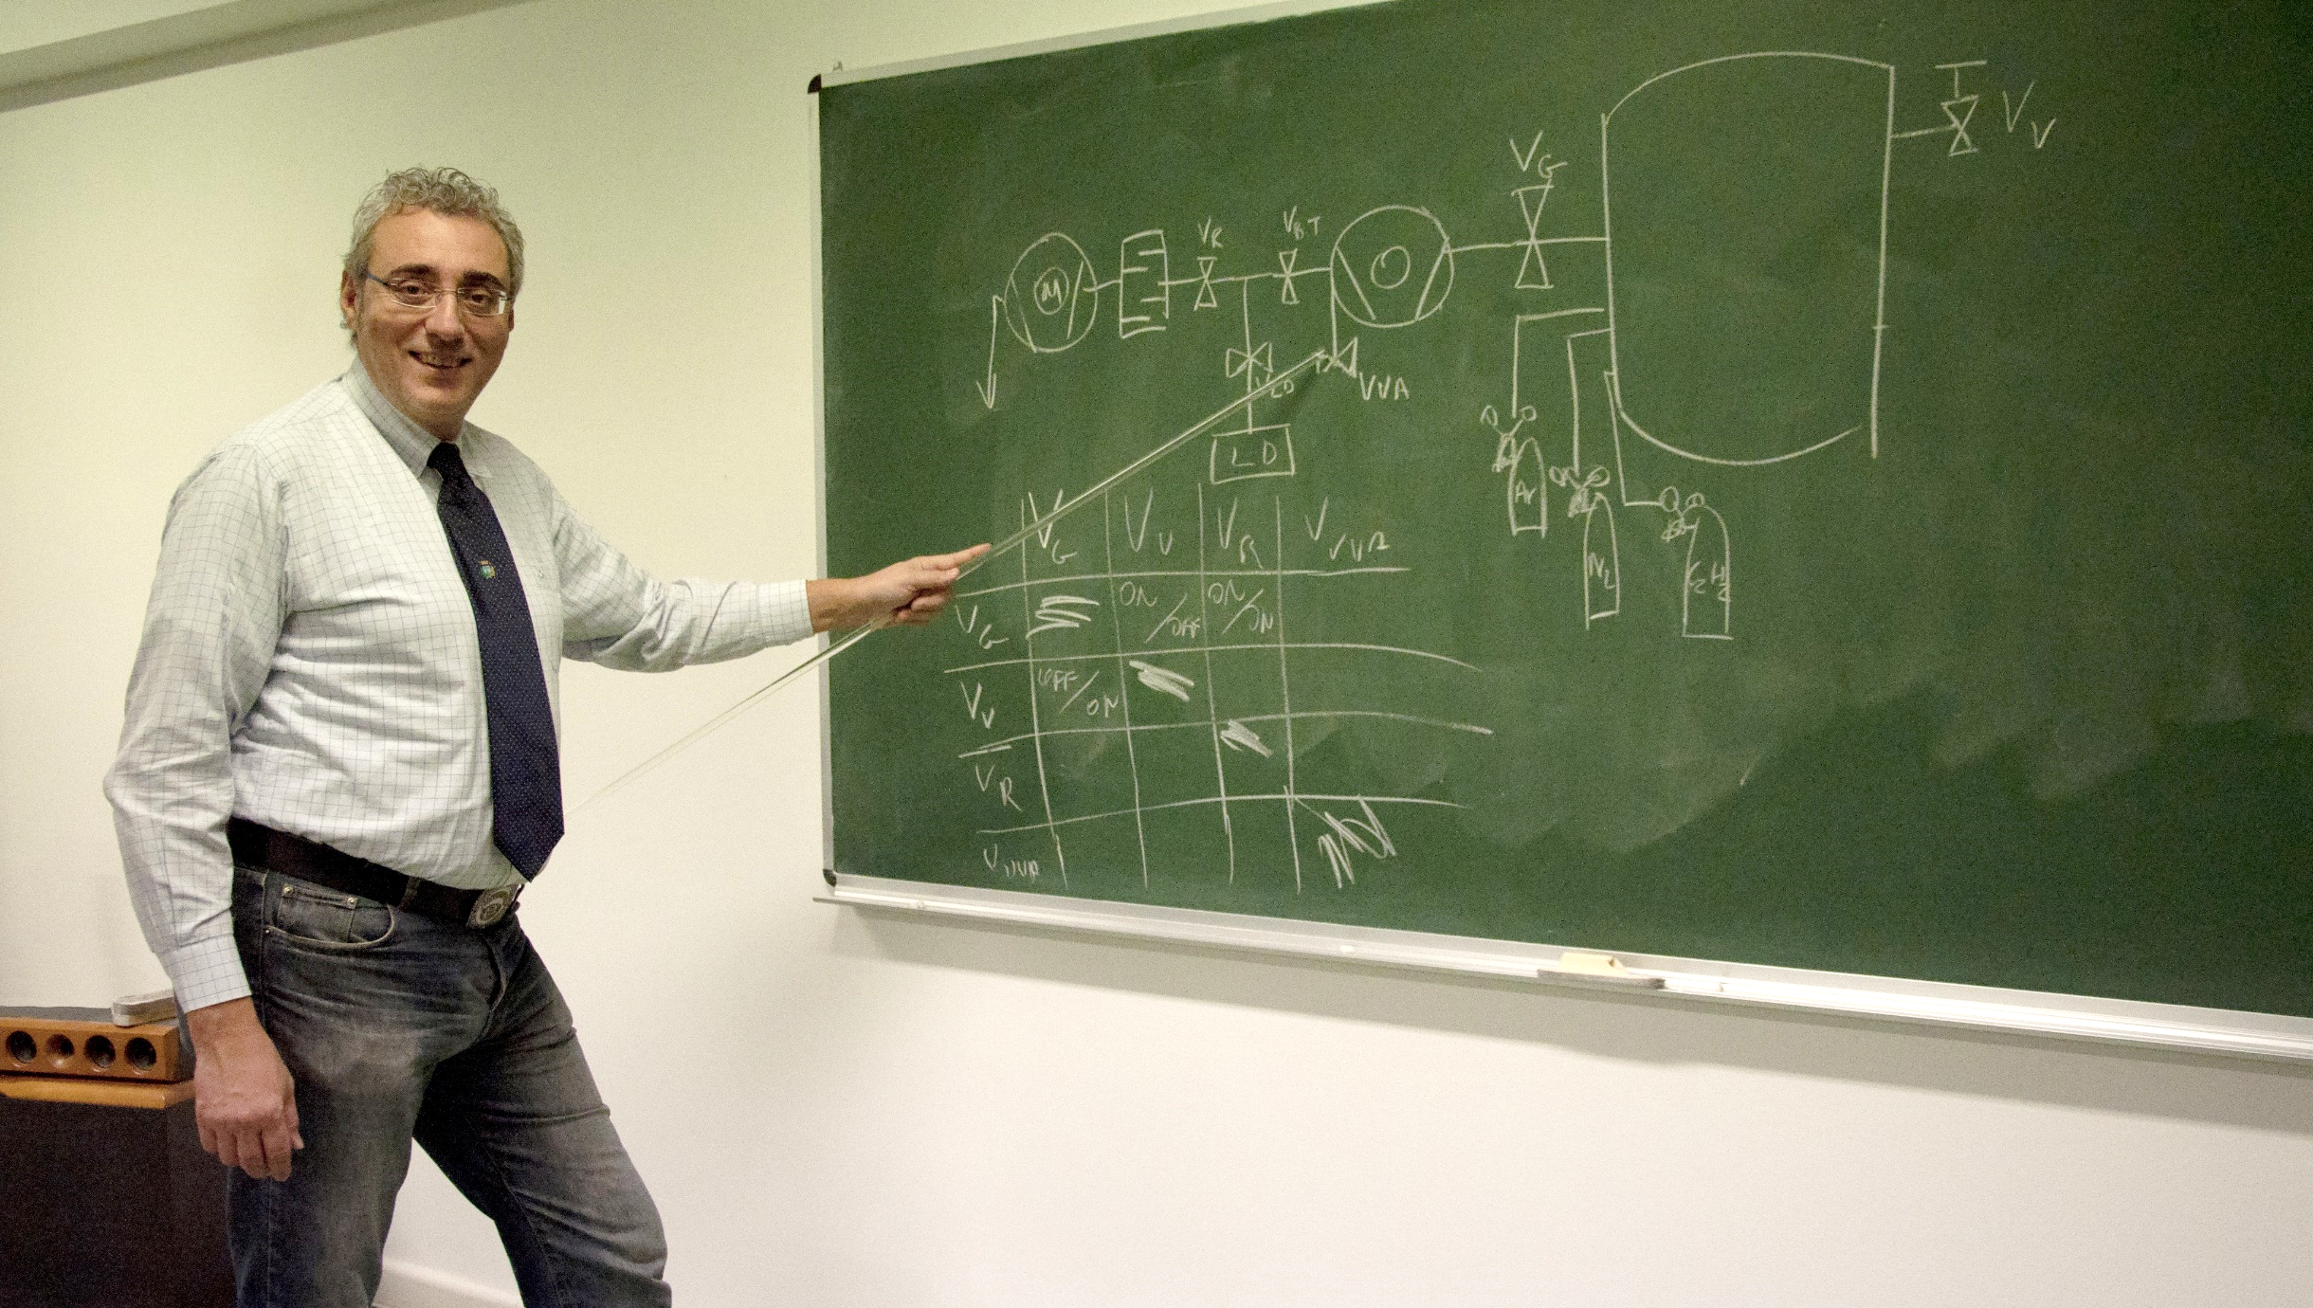
Enzo Palmieri

Slide 27
8th International Workshop on
Thin Films and New Ideas for Pushing the Limits of RF Superconductivity
October 8–10, 2018
Legnaro National Laboratories INFN
Legnaro (Padua) - Italy

