Slide 1

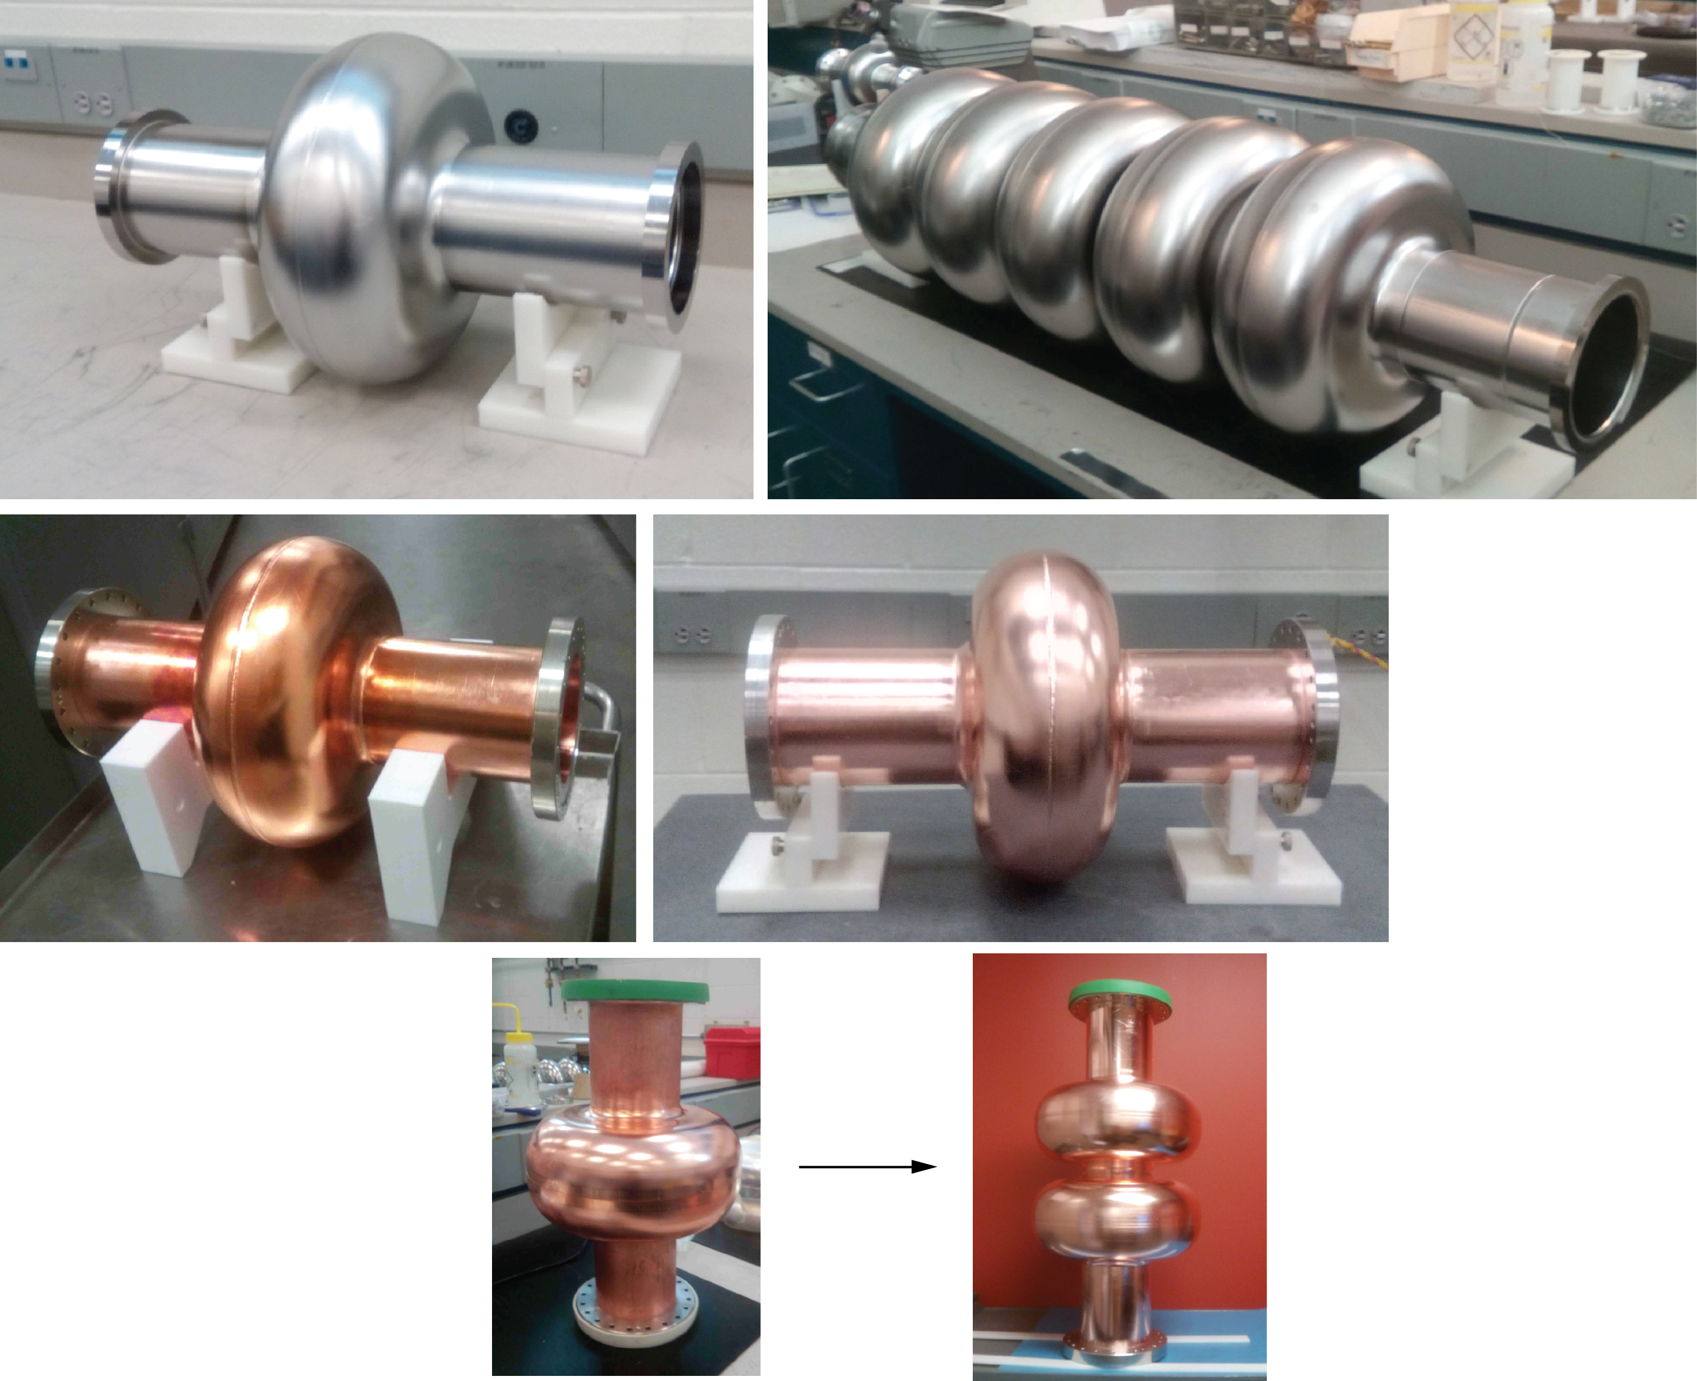

Recent Results on a Multi-Cell
802 MHz bulk Nb Cavity
FCC Week 2018
9-13 April 2018
Beurs van Berlage
Amsterdam
Frank Marhauser

Slide 2
Outline
JLab’s role in SRF cavity development for CERN’s FCC and LHeC
Cavity design principle
Relevant key performance parameters
Cavity fabrication stages
Vertical test results in dewar
Summary

Slide 3
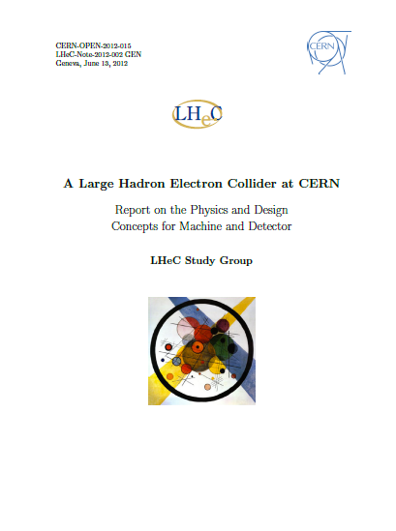
JLab’s Role in SRF Cavity Studies for CERN
CERN and JLab had signed a general Memorandum of Understanding to cooperate in the development of SRF accelerator technologies specifically related to CERN’s FCC studies
FCC includes a hadron-electron collider program envisioning a 60 GeV 3-pass race-track ERL
ERL is similar to that conceived for the LHeC linac-ring collider proposal (CDR 2012) utilizing the LHC protons or ions for collision
  LHeC provides strong, complementary physics case to LHC/HE-LHC physics program and would run concurrently
  Would bridge gap until FCC would be on horizon
arXiv:1206.2913, 2012

Slide 4
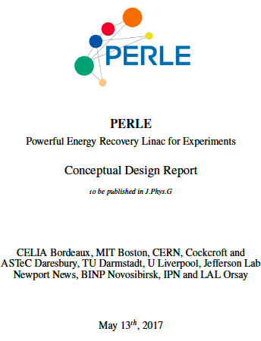
JLab’s Role in SRF Cavity Studies for CERN
In any case, substantial R&D for the ERL including SRF cavity
technology is required
  Triggered CERN to prepare studies for a multi-pass ERL test
  facility with up to 1 GeV electron beam energy
  However, this was not endorsed at CERN
But: To showcase the ERL concept, this eventually led to the proposal for PERLE (Powerful ERL Linac Experiments) facility to be hosted by INP+LAL in Orsay/France
  PERLE (~500 MeV) serves as a key demonstration machine for LHeC and FCC-he (CDR submitted May 2017)
arXiv:1705.08783, 2017

Slide 5
JLab’s Role in SRF Cavity Studies for CERN
Note: CERN requires SRF technology at 801.58 MHz for several other programs
  20th integer ref. to 25 ns bunch spacing, e.g. FCC-ee (ttbar) needs 802 MHz 5-cell cavities
  Frequency is good choice concerning cost optimization rationales
To initiate SRF cavity R&D, CERN and JLab had agreed on a Joint Work Statement to:
  Develop a conceptual design of a five-cell 802 MHz ERL-type cavity
  Fabricate and test the cavity vertically at 2 K to validate the RF design
Concerning task 1); one cannot optimize all cavity key parameters simultaneously
→ always a trade-off
→ geometry should relate to needs of the specific machine
→ aim was to obtain a geometry that well balances all key parameters

Slide 6
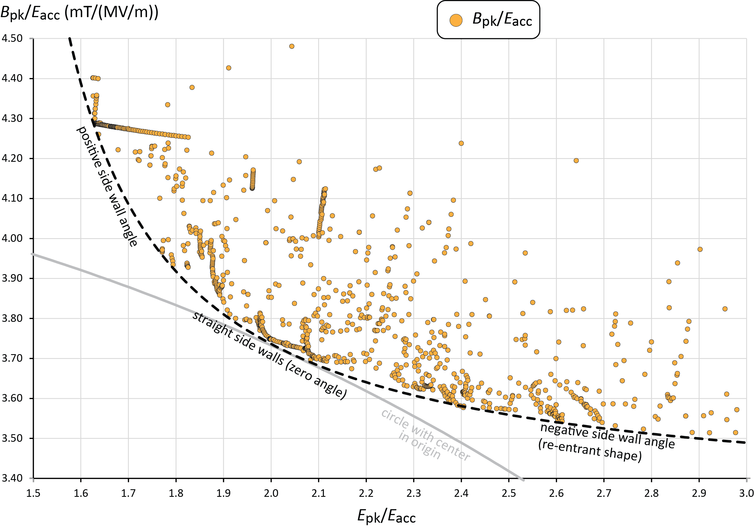
Cavity Design Rationale - When is a Cavity Shape Optimized ?
B_{pk}/E_{acc} versus E_{pk}/E_{acc}
> 1000 half-cells at 802 MHz,
iris ID fix for fair comparison
(example ID= 115 mm)

Slide 7
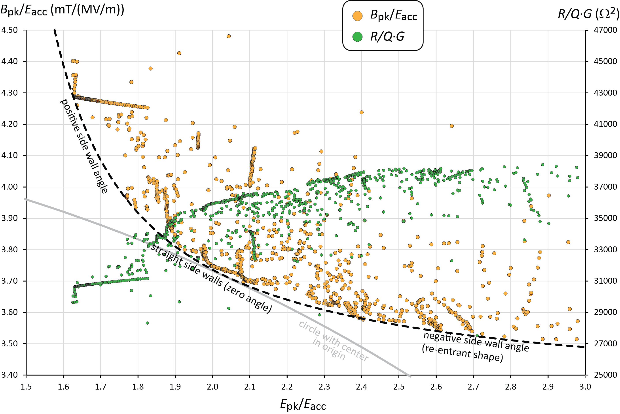
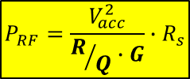
Cavity Design Rationale - When is a Cavity Shape Optimized ?
> 1000 half-cells at 802 MHz,
iris ID fix for fair comparison
(example ID= 115 mm)
Dynamic RF losses dissipated in Helium bath
$$P_{RF}=\frac{V_{acc}^{2}}{R/Q∙G}∙R_{s}$$

Slide 8
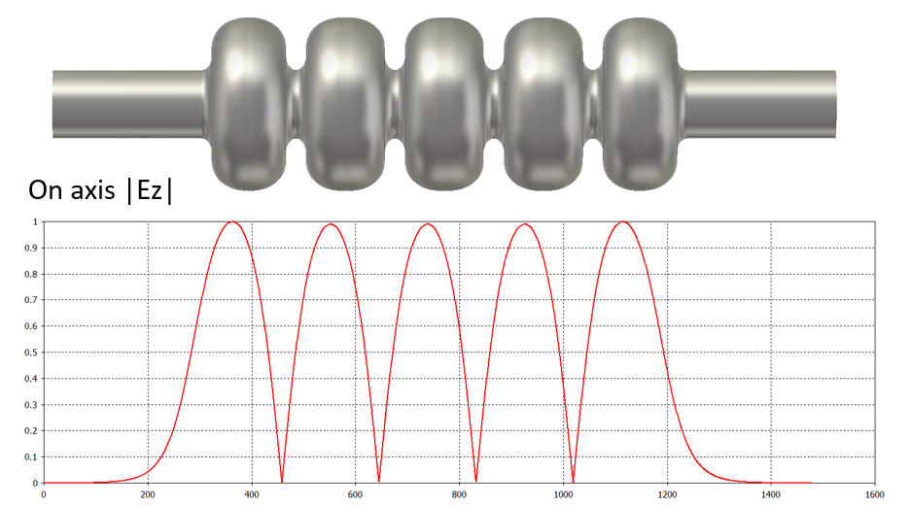
Cavity Design Studies
JLab version
Tube ID = 130 mm
Iris ID = 130 mm
Final design selected with:
iris ID = 130 mm = beam tube ID
  Same design principle applied
  This ID yields better mechanical stability
  Considers HOM-damping need (strong cell-to-cell coupling factor of 3.2%)

Slide 9
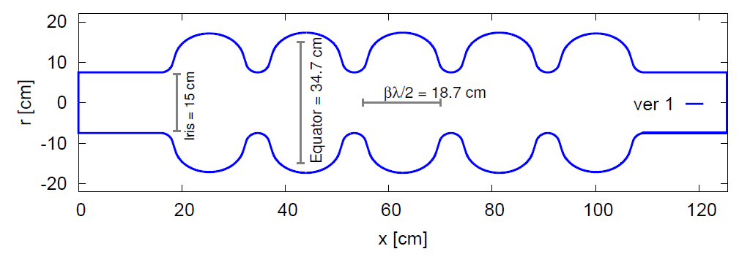
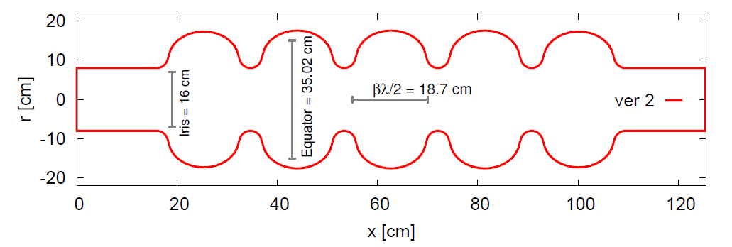
Cavity Design Studies
JLab version
CERN version 1
scaled from 704 MHz design
(E. Jensen et al. LINAC 2014)
Tube ID = 130 mm
Iris ID = 130 mm
Tube ID = 150 mm
Iris ID = 150 mm
Final design selected with:
iris ID = 130 mm = beam tube ID
  Same design principle applied
  This ID yields better mechanical stability
  Considers HOM damping need (strong cell-to-cell coupling factor of 3.2%)
CERN version 2
(R. Calaga, CERN-ACC-NOTE-2015)
Tube ID = 160 mm
Iris ID = 160 mm

Slide 10
Parameter Table for ERL Cavity Candidates
Parameter | Unit | Value | Value | Value
Cavity type |  | JLab | CERN Ver. 1* | CERN Ver. 2*
Frequency | MHz | 801.58
Number of cells |  | 5
L_{active} | mm | 917.9 | 935 | 935
Long. loss factor (2 mm rms bunch length) | V/pC | 2.742 | 2.894 | 2.626
R/Q = V_{eff}²/(ω*W) | Ω | 523.9 | 430 | 393
G | Ω | 274.6 | 276 | 283
R/Q∙G/cell |  | 28788 | 23736 | 22244
Eq. Diameter | mm | 328.0 | 350.2 | 350.2
Iris Diameter | mm | 130 | 150 | 160
Tube Diameter | mm | 130 | 150 | 160
Eq./Iris ratio |  | 2.52 | 2.19 | 2.19
Wall angle (mid-cell) | degree | 0 | 14.0 | 12.5
E_{pk}/E_{acc} (mid-cell) |  | 2.26 | 2.26 | 2.40
B_{pk}/E_{acc} (mid-cell) | mT/(MV/m) | 4.20 | 4.77 | 4.92
k_{cc} | % | 3.21 | 4.47 | 5.75
cutoff TE₁₁ | GHz | 1.35 | 1.17 | 1.10
cutoff TM₀₁ | GHz | 1.77 | 1.53 | 1.43
-18%
-23 %
+6 %
+14%
+17 %
* R. Calaga, CERN-ACC-NOTE-2015, 5/28/15
Notes:
Red Interior Page Design 1

Slide 11
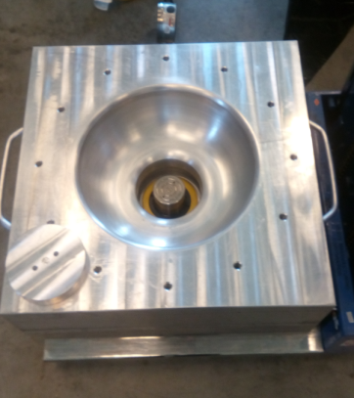
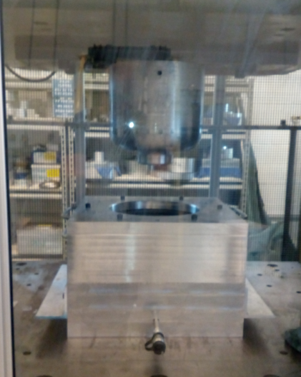
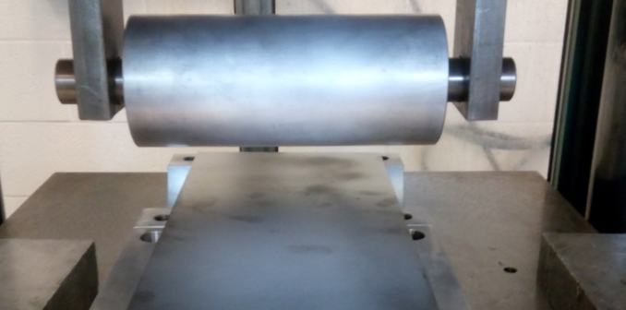
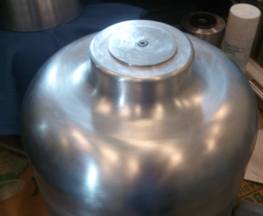
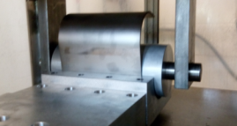
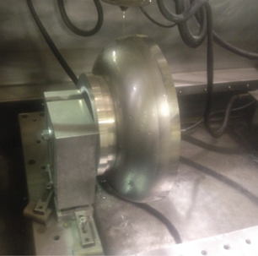
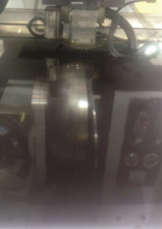
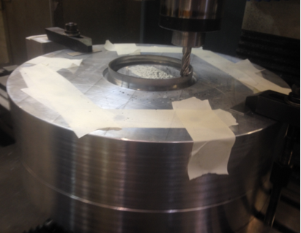
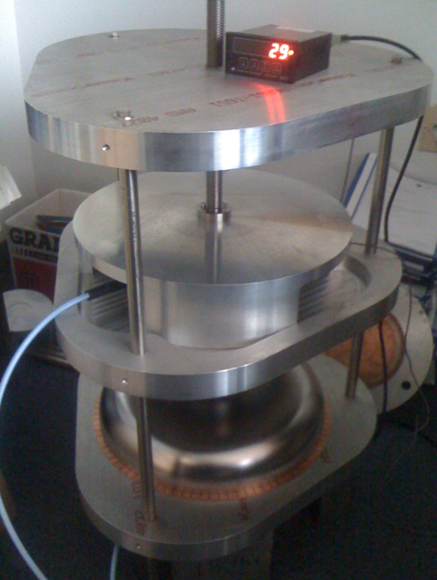
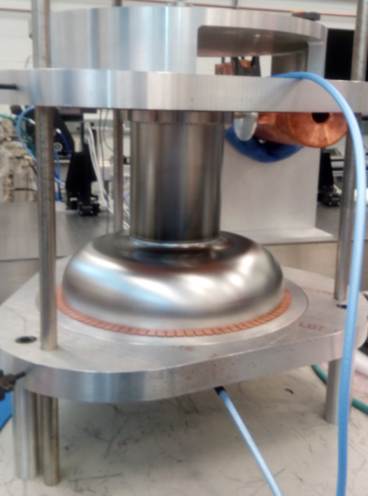
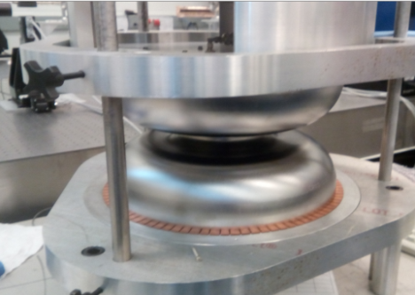
Cavity Fabrication Tools
802 MHz half-cell deep-drawing and beam tube rolling dies
Half-cell during pre-trimming by wire electro-discharge machining and final milling for iris weld joint preparation
802 MHz RF measurement fixture for dumbbells and end-groups

Slide 12
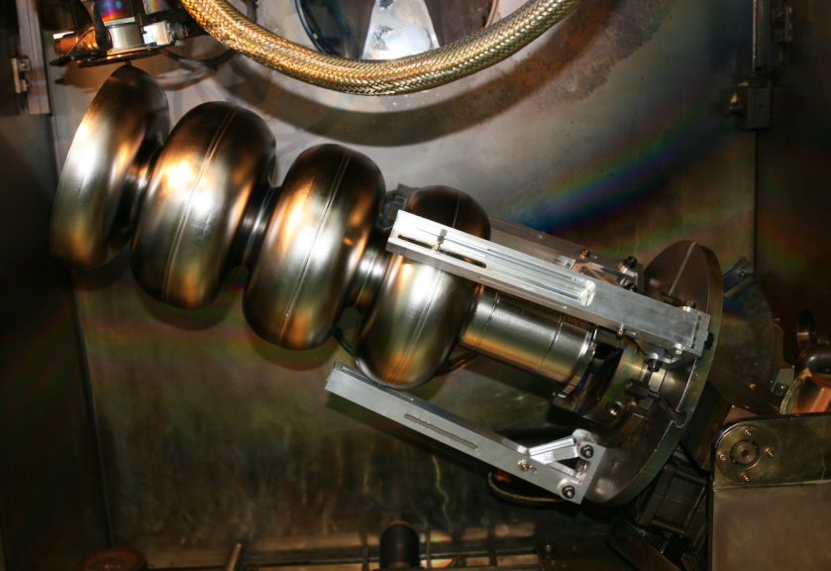
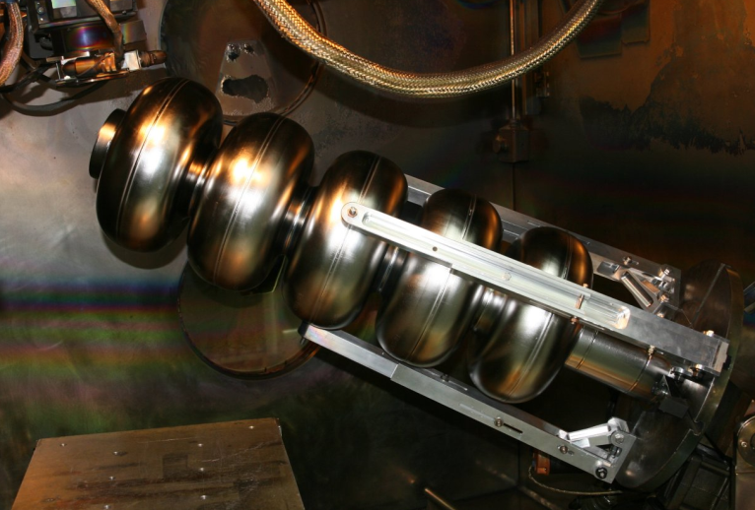
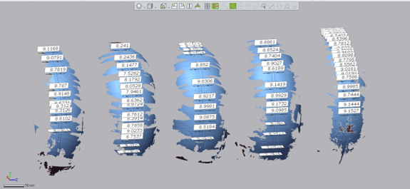
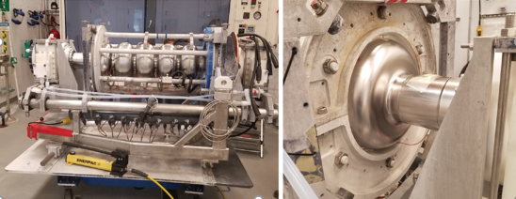
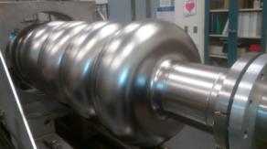
Cavity Fabrication Tools
Five-cell cavity at various equator weld stages of sub-assemblies
Assessment of weld-shrinkage with 3D laser scanner
Cavity on the tuning bench
Five-cell in preparation for electropolishing (EP)

Slide 13
Final Vertical Test Result at 2K (Five-cell CRN5)

Slide 14
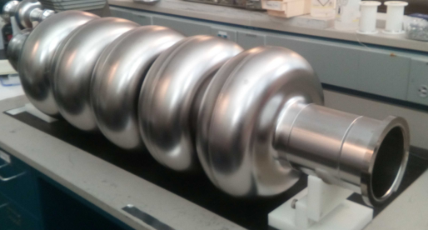
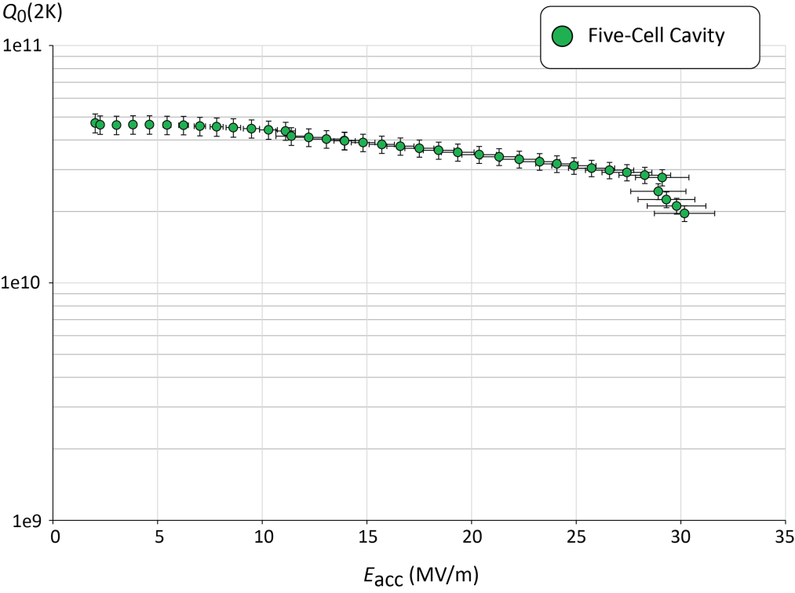
Final Vertical Test Result at 2K (Five-cell CRN5)
Subtracting 0.5 nΩ due to NC
RF losses in SS blank flanges
quench limit ~30 MV/m

Slide 15
Final Vertical Test Result at 2K (Five-cell CRN5)
Subtracting 0.5 nΩ due to NC
RF losses in SS blank flanges
quench limit
Record Q₀-values at 2K in this frequency regime
Q₀(2K) = 3e10 @ ~27 MV/m

Slide 16
Final Vertical Test Result at 2K (Five-cell CRN5)
Subtracting 0.5 nΩ due to NC
RF losses in SS blank flanges
Cavity design has been adapted as baseline for PERLE
Prototype well exceeds
conceived E_{acc} requirement
with Q₀-values > 3e10 at 2K
quench limit
Regime of E_{acc}
requirements
in LHeC, PERLE,
FCC-ee

Slide 17
Last Vertical Test Result at 2K (Five-cell CRN5)
Subtracting 0.5 nΩ due to NC
RF losses in SS blank flanges
Main post-processing steps
quench limit
 | Unit | CRN5
Bulk BCP | µm | 216
High-T heat treatment | °C, hrs. | 800, 3
Final EP | µm | 30
HPR cycles |  | 4
Low-T bake-out | °C, hrs. | 120, 12

Slide 18
Final Vertical Test Result at 2K (Five-cell CRN5)
Subtracting 0.5 nΩ due to NC
RF losses in SS blank flanges
Tabulated Results
Parameter | Unit | CRN5
E_{acc} at quench | MV/m | 30.1
E_{pk} at quench | MV/m | 68.1
B_{pk} at quench | mT | 126.3
FE onset field | MV/m | ~25
FE-induced radiation (max.) | mR/hr. | 0.06
Max. Q₀-value | /1e10 | 4.72
Q₀-value at 25 MV/m | /1e10 | 3.12
Lorentz Force Detuning | Hz/(MV/m)² | -1.5
quench limit

Slide 19
Summary
JLab completed the design, fabrication and vertical test of a 5-cell ERL prototype cavity suitable for LHeC PERLE, FCC-he, and FCC-ee (ttbar)
  Validation of RF design successful
  Record Q₀-values achieved, ~30 MV/m quench field
The fabrication efforts covered:
  Bulk Nb 5-cell cavity
  Bulk Nb 1-cell cavity
  Two OFHC Cu 1-cell cavities – for thin film coating R&D at CERN
  OFHC Cu cavity for R&D bench measurements at CERN allowing to add cells
JLab looks forward to collaborate with CERN and also with PERLE member institutions beyond the completion of this project
  Towards a production cavity incl. HOM couplers, input couplers, helium tank etc.

Slide 20


Many Thanks…
…particularly to the CERN colleagues
for the fruitful collaboration
and to all PERLE members!
Questions ?

Slide 21
Supplemental Slides

Slide 22
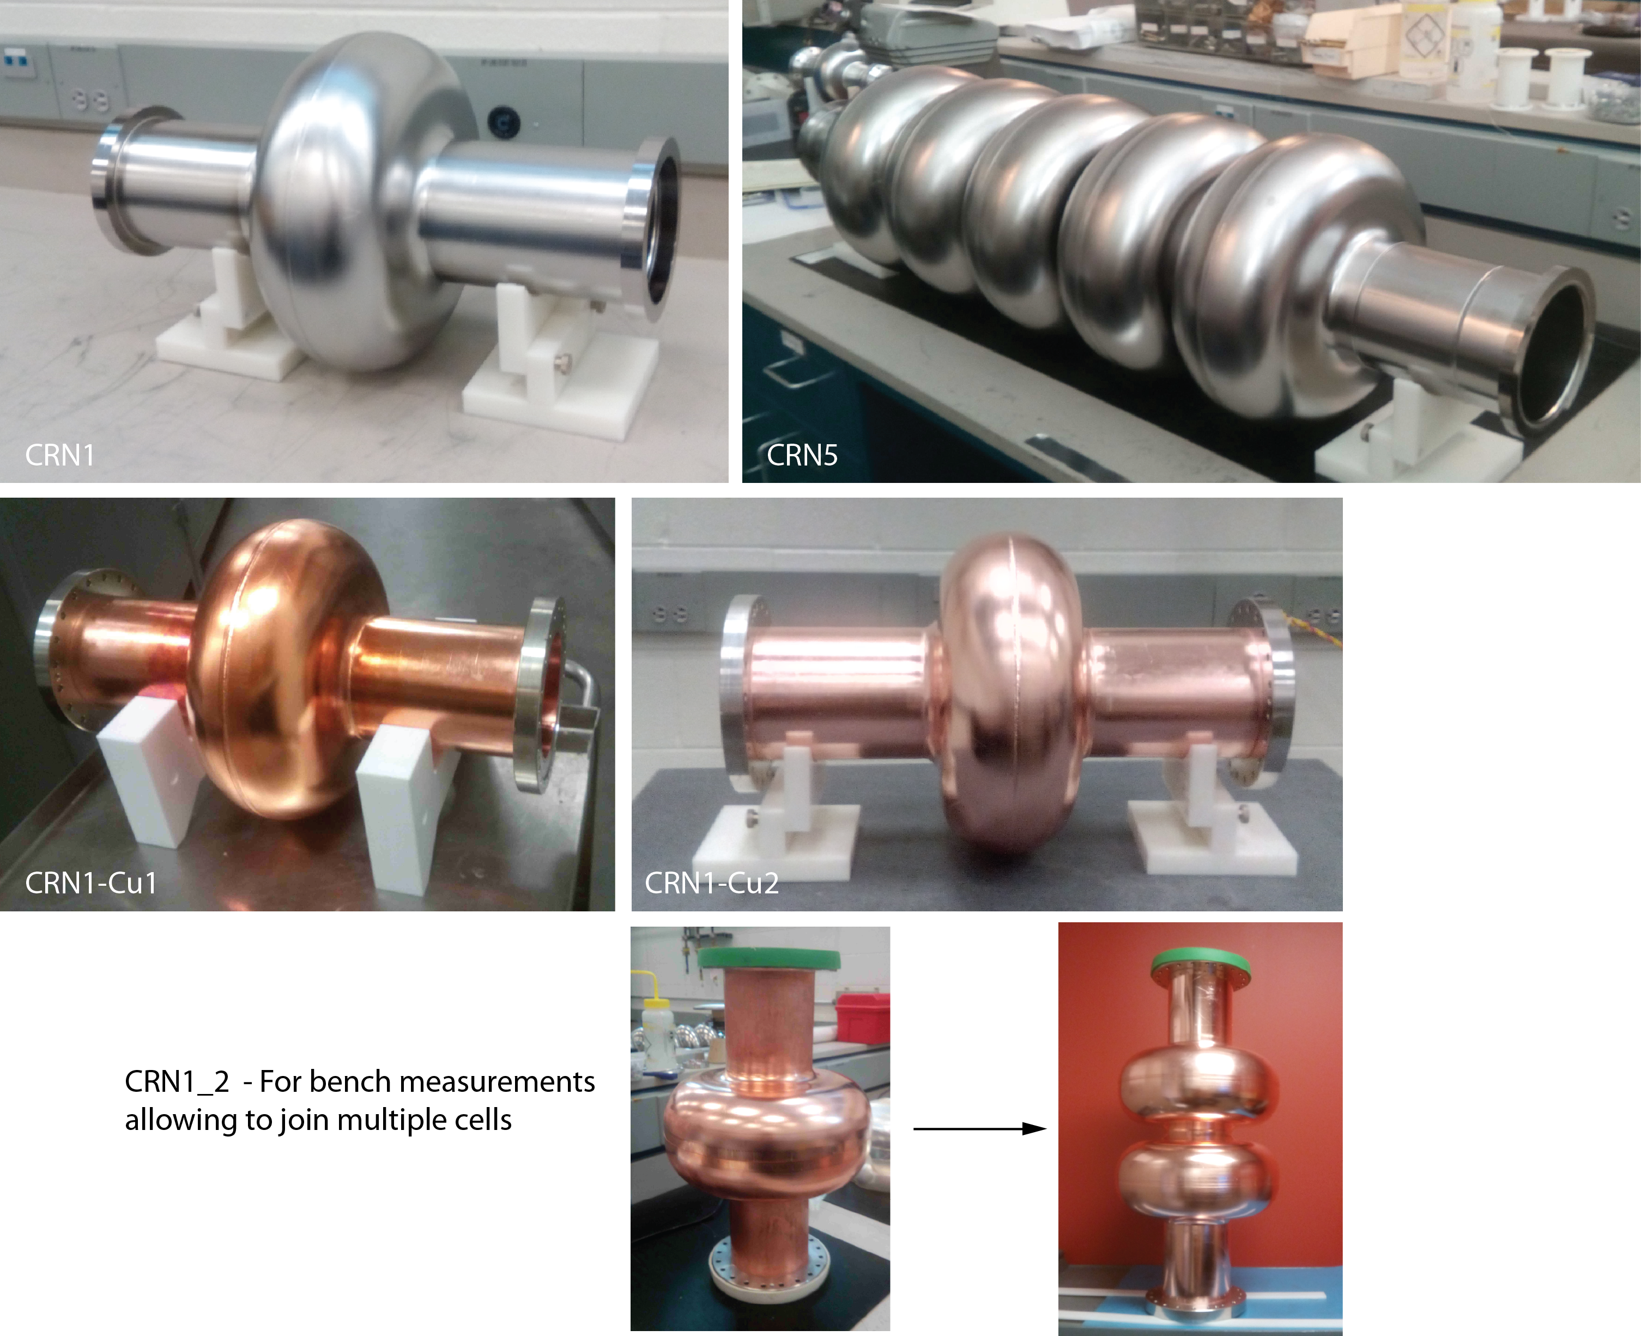
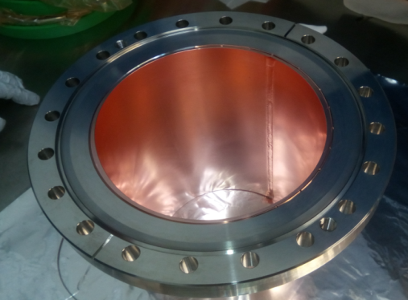
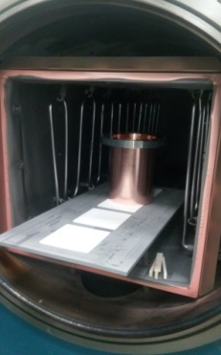
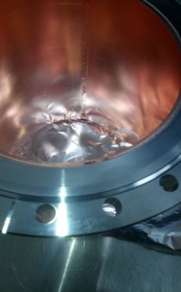
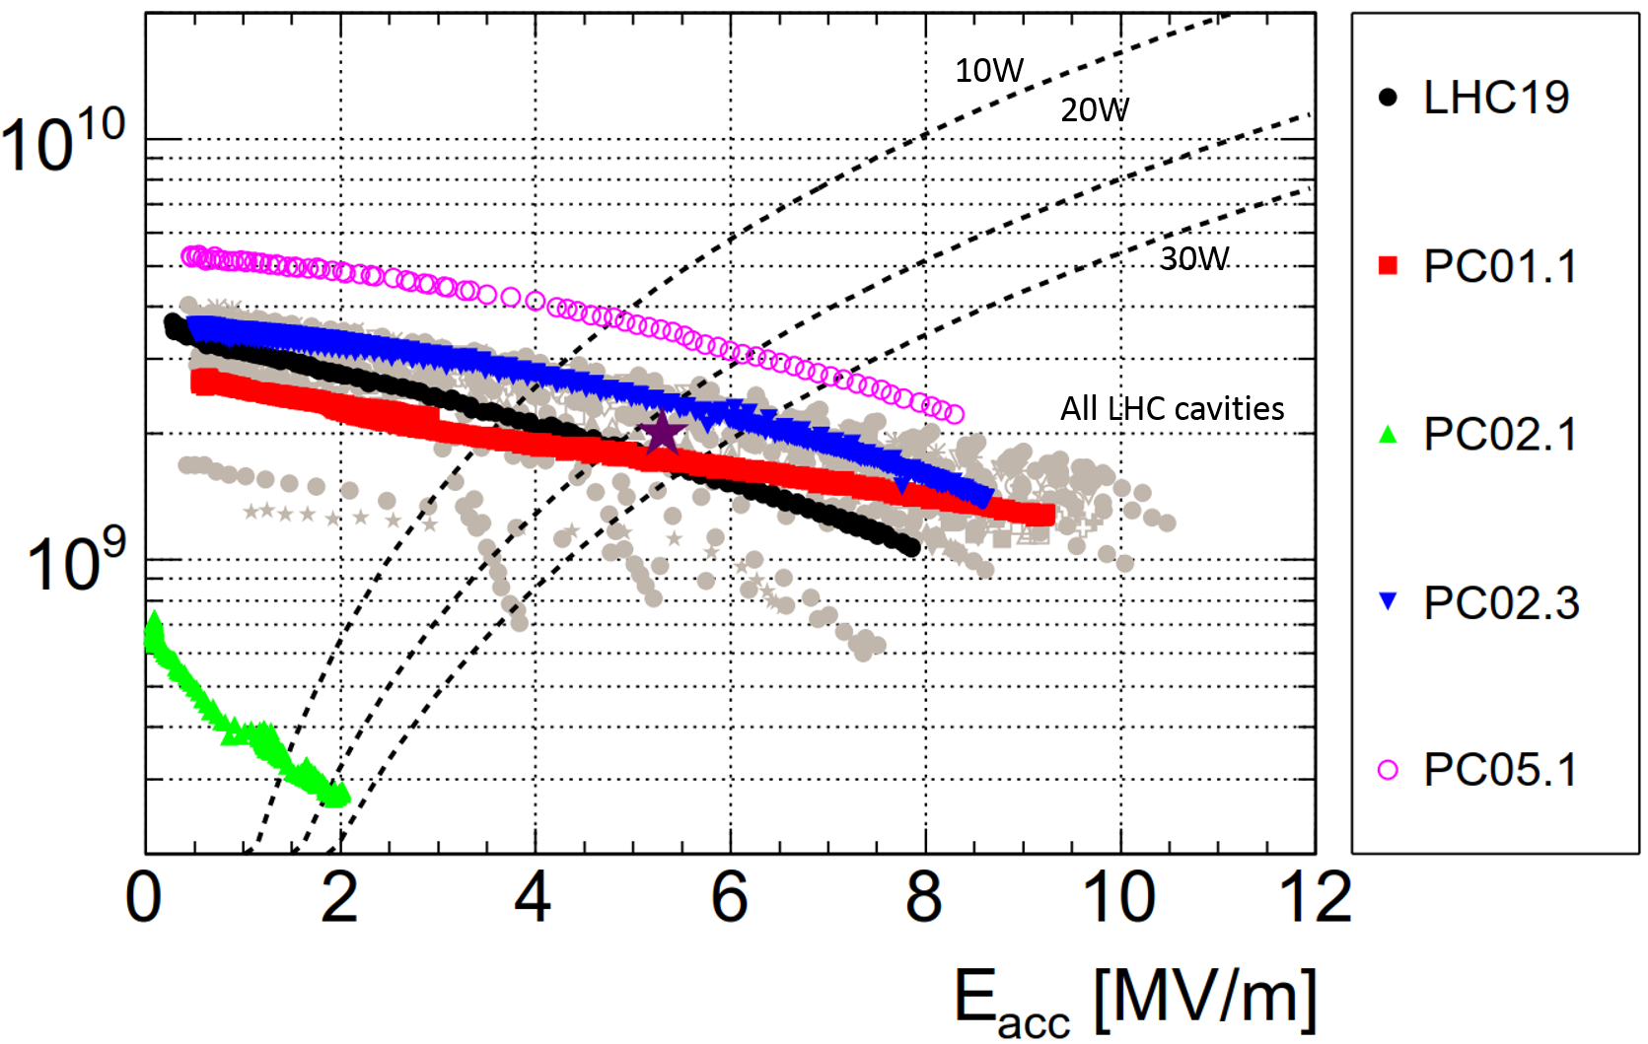
Ensemble of Cavities Fabricated
All 802 MHz prototype cavities built
Copper cavities required brazing of tubes to SS flanges
N-infusion R&D
Nb/Cu Technology - 400 MHz LHC Nb/Cu
SRF R&D Overview
Monday R&D summary talk
by A.-M. Valente-Feliciano
T= 4.5 K
G. Rosaz et al.
Progress: Spare cavities coated
Best RF performance achieved

Slide 23
CERN requires SRF Technology for Several Program
Cavities at 801.58 MHz needed
International (SRF)
CERN
Program | Frequency (MHz)
LHC, spare and more | 401
LHC upgrade | 200, 802
HIE-ISOLDE | 101
HL-LHC crab cavities | 401
SPL (ESS) | 704
LHeC, FCC-he, PERLE | 802
FCC-ee, FCC-hh | 401 & 802
Program | Frequency (MHz)
JLab CEBAF & LERF | 1497
ILC, X-FEL, LCLS-2, … | 1300
JLab EIC | 952.6
SNS | 805
JLab HC | 750
ESS | 704
PIP-II | 650
JAERI | 500
eRHIC | 394
CERN Linac4, ESS | 352
From Erk Jenson, LHeC workshop, 2015

Slide 24
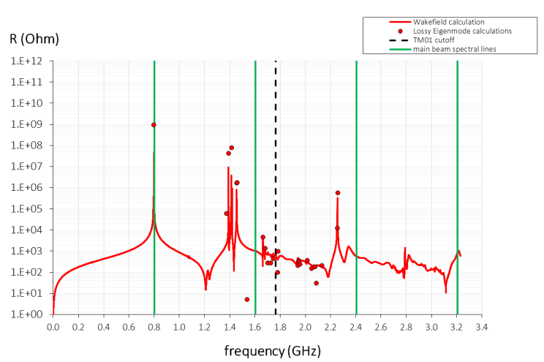
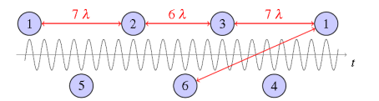
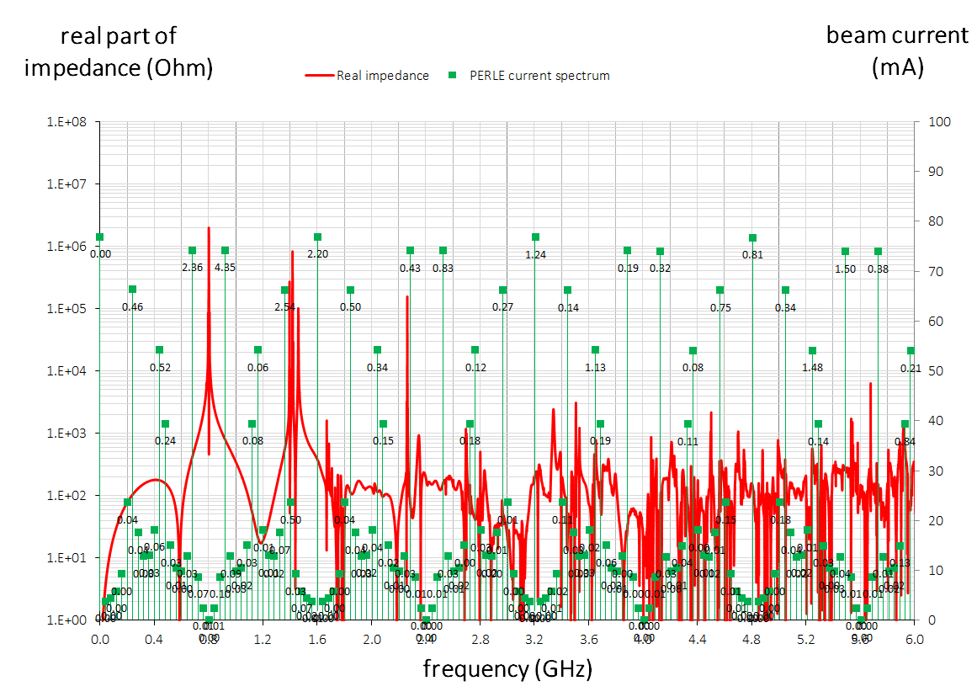
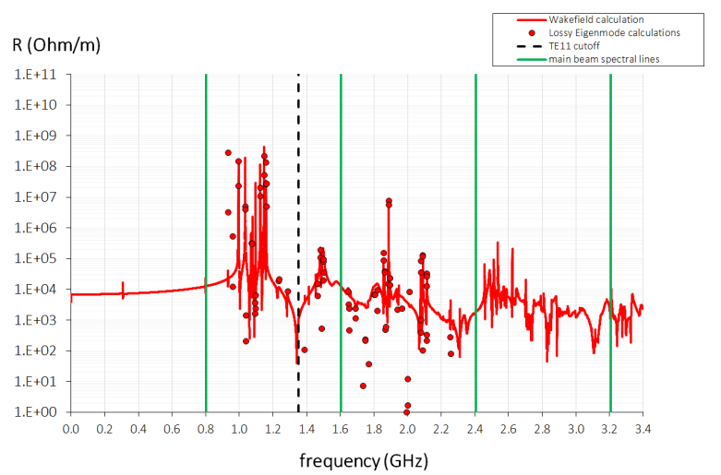
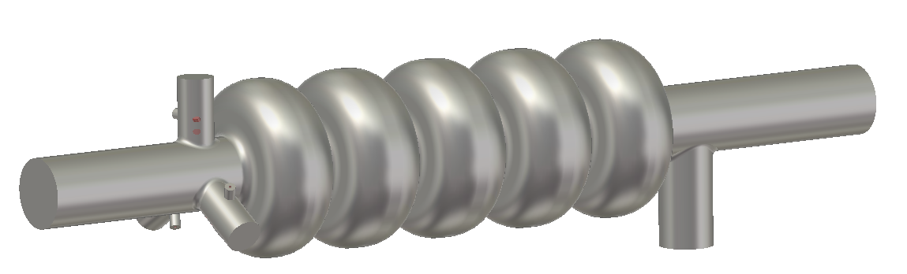
Beam Spectra vs. HOM Frequencies
Cavity design took into account avoiding main 802 MHz beam spectral lines
Case 1: Every RF bucket would be filled (no gap)
Case 2: PERLE baseline bunch spectrum for 801.58 cavities:
Bunch spacing 801.58MHz/20 = 40.079 MHz
Monopole mode spectrum
Bunch recombination pattern for PERLE. Bunches at different energies (the turn number is indicated) are separated by nearly constant bunch spacing.
Q_{b} = 320 pC
Dipole mode spectrum
Monopole mode spectrum

Slide 25
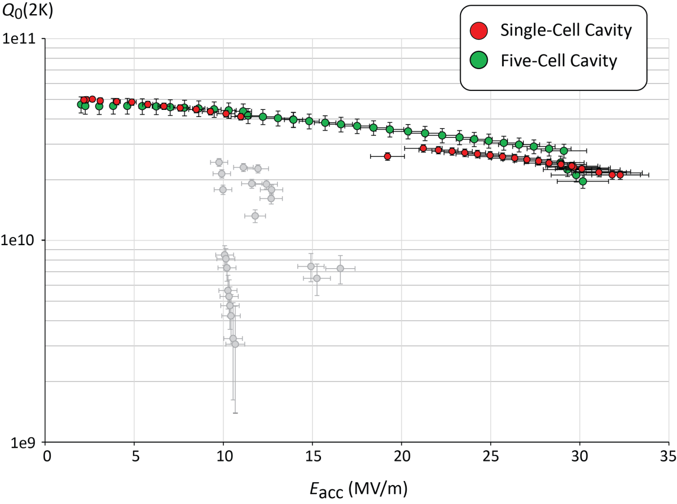
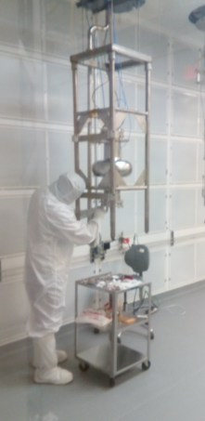
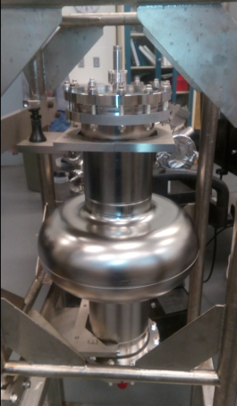
Latest Vertical Test Results at 2K
A single-cell Nb cavity (CRN1) was built and tested
MP activities observed at ~10 MV/m, but quickly processed, re-rinse & re-test planned
Main post-processing steps
Post-Processing steps | Unit | CRN1 | CRN5
Bulk BCP | µm | 160 | 216
High-Temperature heat treatment | °C, hrs. | 800, 3 | 800, 3
Final EP | µm | 30 | 30
High Pressure Rinse (HPR) cycles |  | 2 | 4
Low temperature bake-out | °C, hrs. | 120, 12 | 120, 12
quench limits
Summary of main results
RF results | Unit | CRN1 | CRN5
E_{acc} at quench | MV/m | 32.3 | 30.1
E_{pk} at quench | MV/m | 61.3 | 68.1
B_{pk} at quench | mT | 129.0 | 126.3
FE onset field | MV/m | ~20 | ~25
FE-induced radiation (max.) | mR/hr. | 2.3 | 0.06
Residual resistance | nΩ | 3.19 | n.m.
Max. Q₀-value | /1e10 | 4.97 | 4.72
Q₀-value at 25 MV/m | /1e10 | 2.62 | 3.12
Lorentz Force Detuning | (MV/m)²/Hz | -7.1 | -1.5
soft MP barrier

Slide 26
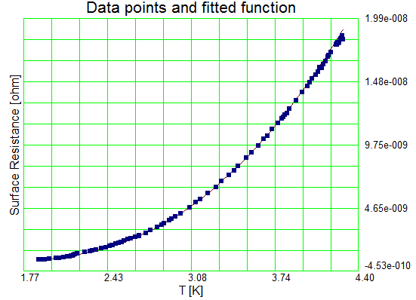
Residual Resistance
Material used is OTIC Ningxia high-RRR (250) fine grain Nb
Residual resistance has been assessed during tests for CRN1
Fit with BCS theory
R_{res} = 3.19 ± 0.79 nΩ
Note: This takes into account 2.49 nΩ due to NC RF losses
in SS blank flanges for the single-cell cavity

Slide 27
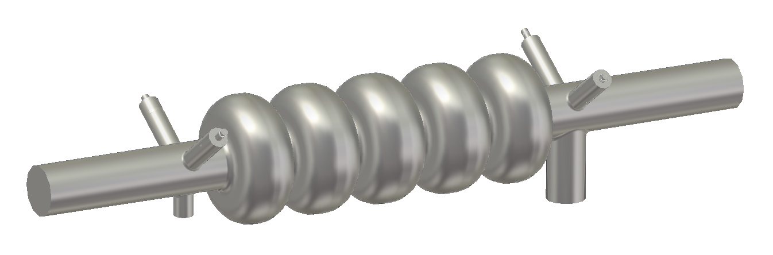
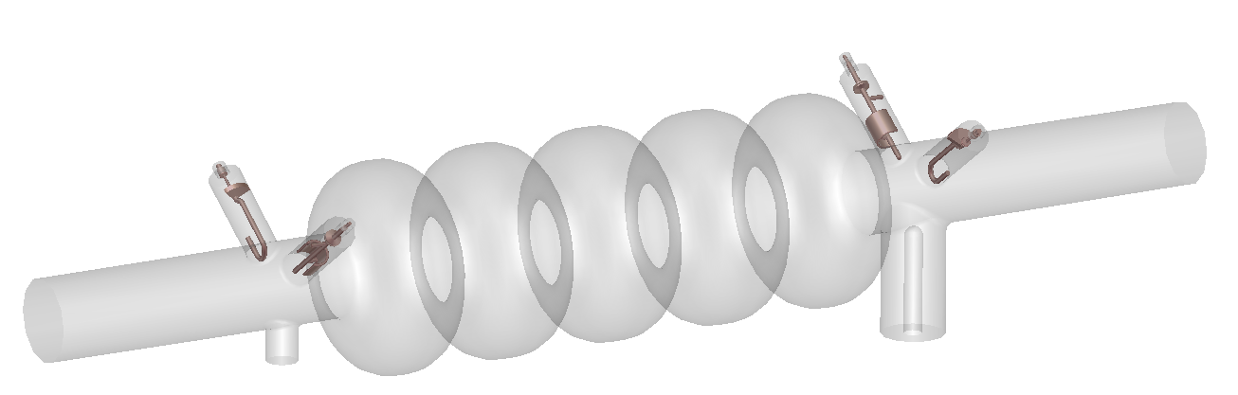
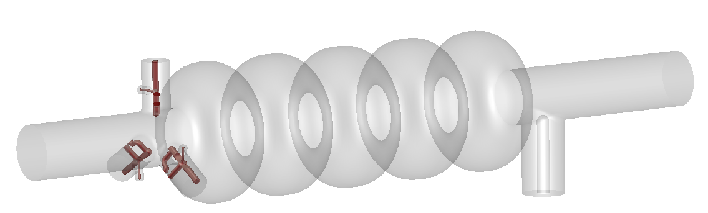
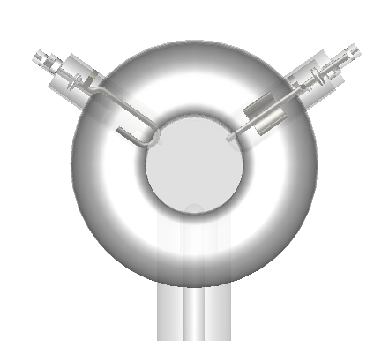
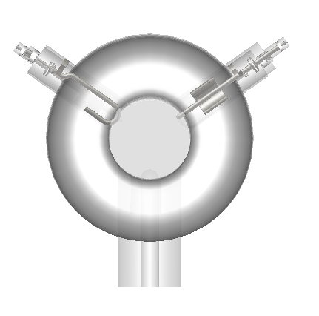
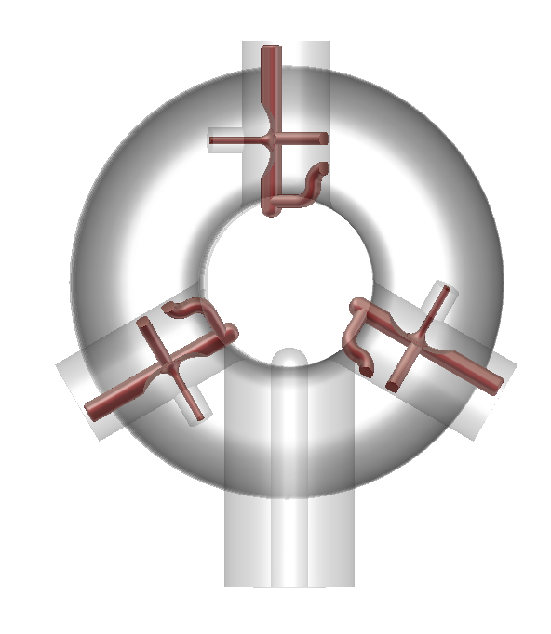
HOM Damping Studies
Preliminary HOM studies carried out incorporating LHC-type HOM couplers (and coaxial input coupler) scaled to adapt to new cavity shape at 802 MHz
  Broadband damping efficiency was found to be not optimal since also narrowband loop couplers are employed as required for LHC cavities
We considered using new coaxial HOM-couplers or scaled versions of existing designs (TESLA/JLab-type couplers) with up to 3 couplers combined in a single ‘Y’ end-group
  Benefit of ‘Y’ end-group: Minimizes/eliminates dependency on transverse mode polarization
scaled LHC cavity
coax FPC coupler
scaled LHC cavity loop
coupler (narrowband)
scaled LHC cavity
antenna coupler (broadband)
HOM ‘Y’ end-group with 3 coaxial couplers (here with scaled TESLA-type couplers)

Slide 28
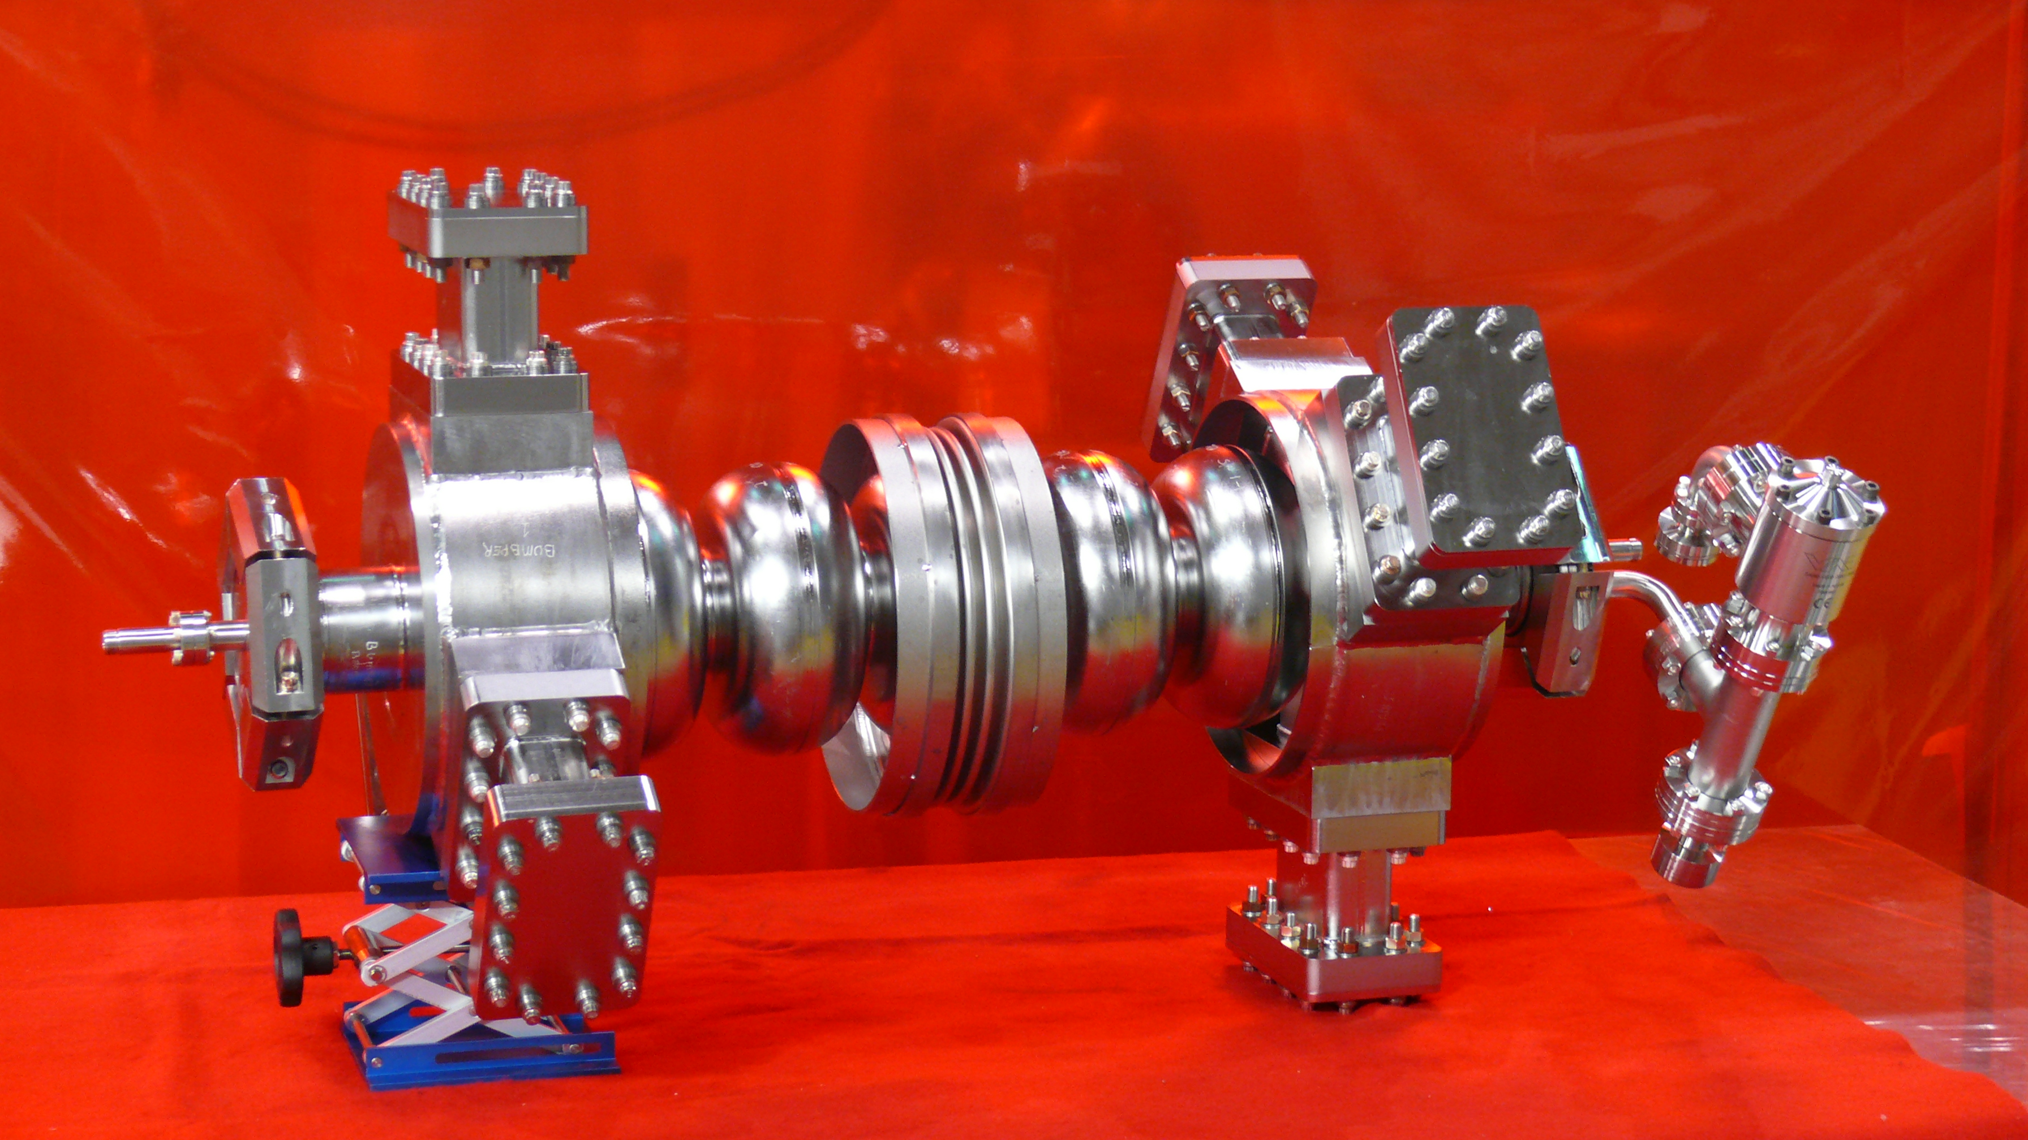
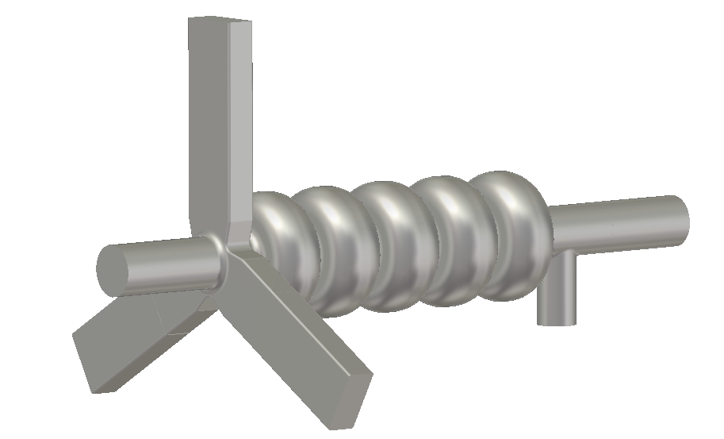
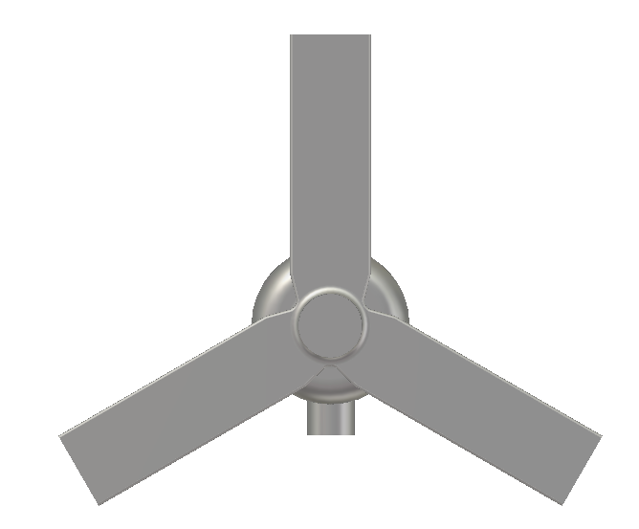
HOM Damping Studies
Alternative: Broadband waveguide HOM couplers such as developed at JLab in the past for Ampere-class ERLs
  Waveguide couplers could be ‘overkill’ for PERLE since 3-pass peak beam current is comparably small (< 100 mA)
  Benefit: Waveguides do not require fundamental mode notch filter and are broadband by nature
  Yet, trapped TE₁₁₁ and TM₁₁₀ dipole modes with high impedances might be better captured with coaxial couplers (cf. Supercond. Sci. Technol. 30 (2017) 063002)
scaled LHC cavity
coax FPC coupler
scaled LHC cavity loop
coupler (narrowband)
scaled LHC cavity
antenna coupler (broadband)
HOM ‘Y’ ‘High Current’
waveguide coupler end-group
HOM ‘Y’ end-group with 3 coaxial couplers (here with scaled TESLA-type couplers)

