Slide 2
Beam impact and machine protection challenges
Yuancun NIE
CERN, TE-MPE
Acknowledgments:
R. Schmidt, D. Wollmann, J. Uythoven, E. Renner, V. Raginel, A. Verweij, R. Denz, M. Zerlauth,
A. Siemko, C. Zamantzas, R. Bruce, C. Fichera, F. Carra, A. Bertarelli, N.A. Tahir, et al.
Another talk: Overall machine protection
(11th April, in session FCC-hh INJ: Collider beam transfer and injector II)
Poster: FCC machine protection requirements and architecture

Slide 3
Outline
Beam impact up to 50 TeV
Machine protection architecture
Specific requirements and strategies
Summary and conclusions

Slide 4
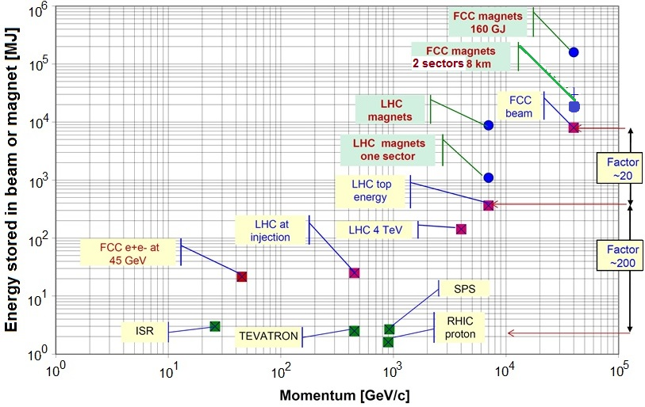
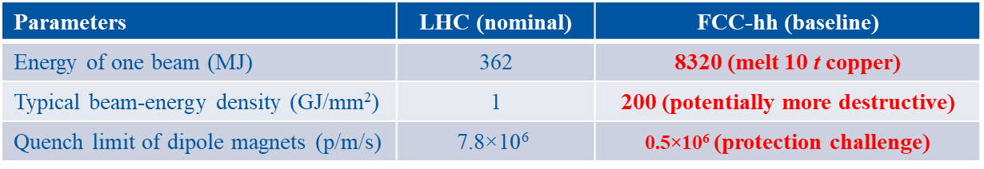
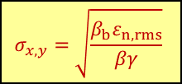
I. Beam impact up to 50 TeV: unprecedented energies
Energy stored in beams and magnets
[R. Schmidt, FCC Week 2015]
$$σ_{x,y}=\sqrt{\frac{β_{b}ε_{n,rms}}{βγ}}$$
Parameters | LHC (nominal) | FCC-hh (baseline)
Energy of one beam (MJ) | 362 | 8320 (melt 10 t copper)
Typical beam-energy density (GJ/mm²) | 1 | 200 (potentially more destructive)
Quench limit of dipole magnets (p/m/s) | $$\text{7.8×10}\text{6}$$ | $\text{0.5}\text{×10}\text{6}$ (protection challenge)

Slide 5
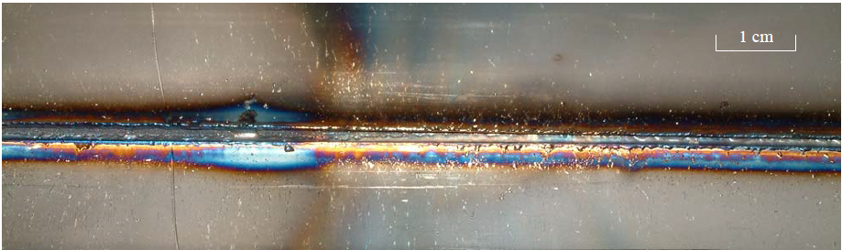
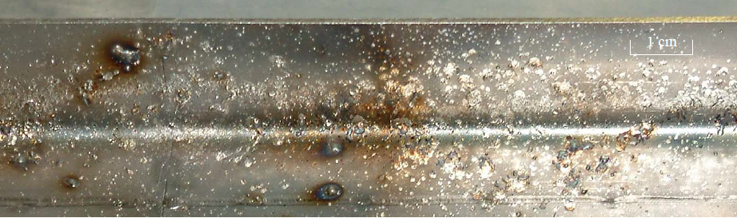
I. Beam impact up to 50 TeV: beam accidents
Beam induced damages at particle accelerators worldwide:
Damage of SPS-LHC transfer line
Damage of collimators at Tevatron
Damage at RHIC (MPC detector)
Damage of superconducting cavities at SNS
Damage of radioactive target at J-PARC
Damage of vacuum chamber at CERN LINAC 4 (few W beam power)
Damage at XFEL (electron beam)
And many more accidents (not published)
[R. Schmidt, CERN TE-MPE-PE meeting 2017]
  Outside of the vacuum chamber
  Inside, beam impact side
  Inside, opposite to the beam impact
In 2004, the full SPS beam (288 bunches, 3.4×10¹³ protons, 450 GeV) was once extracted with wrong angle due to the switching-off septum. Vacuum chamber (stainless steel) of one magnet was severely damaged. Both the vacuum chamber and the magnet had to be replaced. [B. Goddard, et al, AB-Note-2005-014 BT]

Slide 6
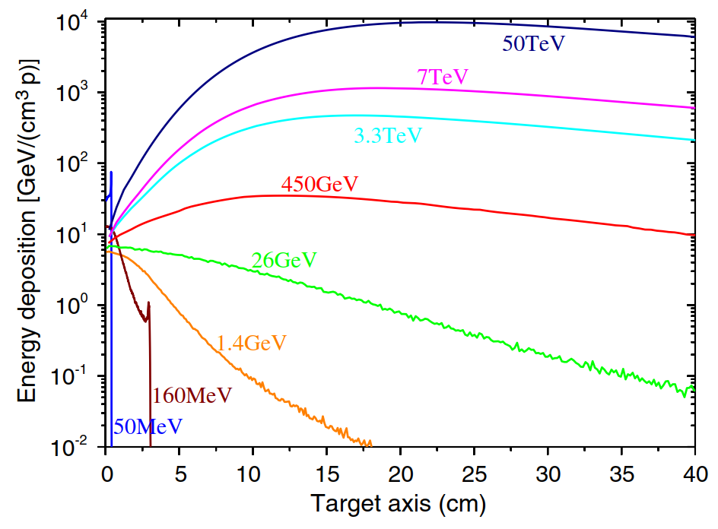
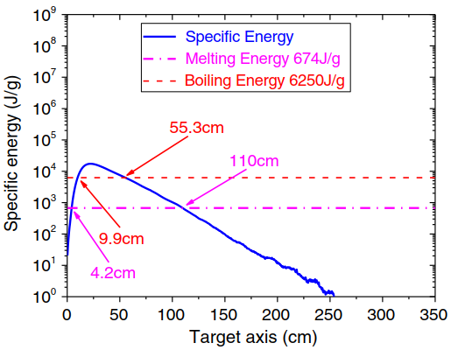
I. Beam impact up to 50 TeV: energy deposition
Energy deposition along cylinder axis of copper target (σ_{x,y} = 0.2 mm)
Specific energy of one nominal bunch (50 TeV, 1.0×10¹¹ p, σ_{x,y} = 0.2 mm)
Peak specific energy:
17390 J/g > > 6250 J/g (boiling energy)
@ 50 TeV, scaling linearly from energy deposition per proton, one nominal bunch has the potential to evaporate copper at the location of the maximum energy deposition!
[Y. Nie, et al., Physical Review Accelerators and Beams 2017]

Slide 7
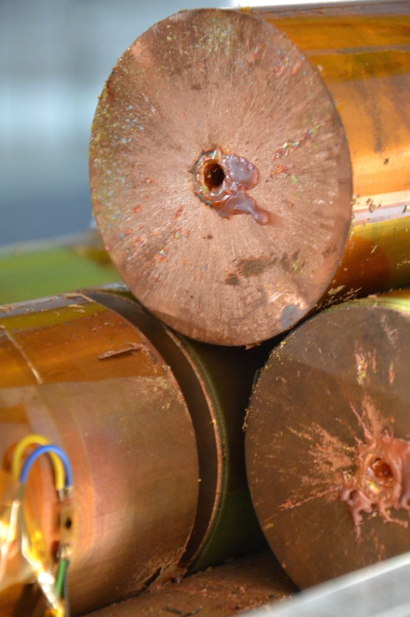
I. Beam impact up to 50 TeV: different regimes
HiRadMat-12 experiment at SPS
[F. Burkart, et al,
J. Appl. Phys. 2015]
Monte Carlo
& hydrocodes
Accelerator | RMS beam size | Target material | Tunneling range
FCC | 0.2 mm | copper | 350 m
FCC | 0.4 mm | water | 1300 m
[N.A. Tahir, et al, PRAB 2016; FCC Week 2017]
Maximum deposited power (W/cm³)
Accelerator components are usually designed to work in the elastic regime. → Linear scaling from energy deposition per proton is practical.
Hydrodynamic tunneling is the extreme situation which would be likely if a large number of bunches was lost at the same place. (“Risk” = Probability * Consequences)
Monte Carlo
& FEM codes
Monte Carlo & Linear scaling
Deposition time (s)
Mechanical responses in different regimes [A. Bertarelli, Joint Accelerator School 2014]

Slide 8
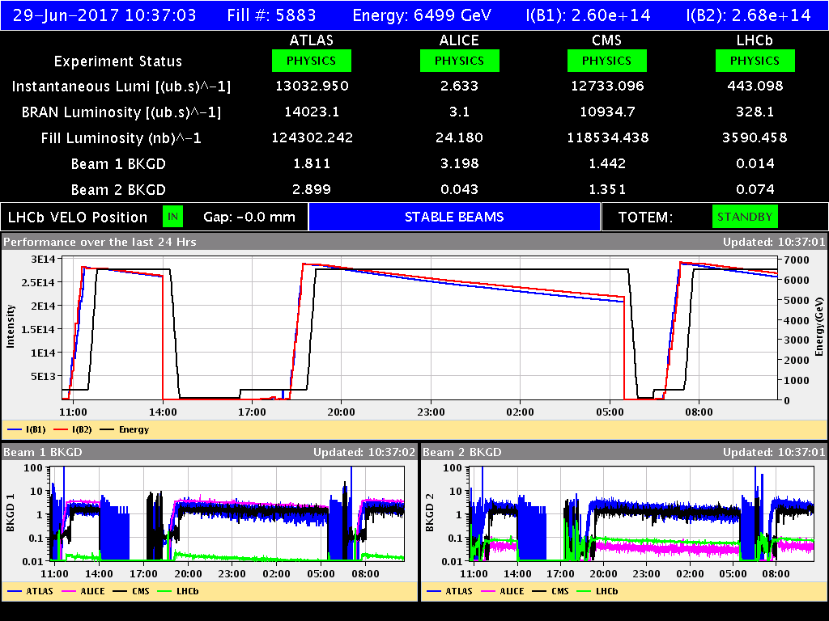
II. Machine protection architecture: protection through operational cycle
LHC fill #5882
#5883
Injection of trains of 144b, each set = 1.2 MJ: (FCC: 80b, 4.2MJ)
Transfer line collimators
Injection absorbers (90° downstream of the injection kicker)
Injection inhibit if necessary
Ramp 2556b from 450 GeV to 6.5 TeV and then circulate, energy of one beam from 20 MJ to 300 MJ: (FCC: 10400b, 3.3TeV to 50TeV, 550MJ to 8320MJ)
Continuous cleaning (multi-stage collimators)
Beam dump in case of any failure in the machine
End of fill: what to do with the two beams of 300 MJ each? (FCC: 8320MJ)
Extraction and dump
  Synchronous (Graphite block)
  Asynchronous (additional absorbers)
Interlock systems, hardware detections (FMCM…), beam monitors (BLMs, BPMs…), etc

Slide 9
II. Machine protection architecture: Beam Interlock System
Powering of magnet circuits
Magnet protection system
Beam loss monitors
Injection protection
Beam presence
Collimation
system
Software
interlocks
Beam
dumping system
Beam Interlock System (simplified extension of LHC architecture)
Injection
system
Beam lifetime
Cryogenic
system
Vacuum
system
RF
System
Screens, mirrors, etc
Operator buttons
Experiments
Personnel safety system
Scaling from LHC, the number of elements that should be capable of triggering a beam dump for the FCC-hh is estimated to exceed 100 000!
    [B. Todd, PhD Thesis 2006; A. Alonso, PhD Thesis 2009; R. Schmidt, FCC Week 2015]

Slide 10
II. Machine protection architecture: reaction time of the system
Fault / dangerous situation occurs
Beam interlock system informed of failures
Beam dumping system informed of dump request
Beam dump begins after waiting for beam-free abort gap
Beam dump completed
DETECT
COMMUNICATE
SYNCHRONISE
DUMP
> 80 µs for BLMs < 300 µs < 326 µs 326 µs For FCC
< 100 µs < 89 µs 89 µs For LHC
User system process Beam interlock system process Beam dumping system process
With a machine protection system similar to the LHC, the FCC would require up to three turns’ to dump the beam synchronously after the detection of a failure, i.e. ~1 ms.

Slide 11
II. Machine protection architecture: strategies for different scenarios
Beam lifetime | Beam power lost |  | Operation or failure scenario | Remark and basic strategy
 | LHC | FCC
100 h | 1 kW | 23 kW | Optimum operating conditions | (Possible) upgrade of the collimation system after some years of operating experience
10 h | 10 kW | 230 kW | Steady beam loss, acceptable operating conditions (expected during early operation) | Operation acceptable, collimators must absorb large fraction of beam energy
12 min | 500 kW | 116 MW | Particular operating conditions (during change of optics, tuning, collimator aperture setting, etc) | Operation only possible for short time (~10 seconds), collimators must be very efficient
1 s | 362 MW | 8320 MW | Slow failures (powering failures, magnet quenches, RF failures, …) | Detection of failure, beam must be dumped rapidly
A few ms (tens of turns) | ~100 GW | ~ TW | Fast failures (UFOs, fast equipment failures, e.g., magnet failures at the highest beta function or with short time constant) | Fast detection of hardware failures or beam losses, beam dump as fast as possible
1 turn or a few turns | up to 4 TW | up to 26 TW | Ultrafast failures (Single-passage beam losses during injection and extraction; ultrafast equipment failures, e.g., phase jump of crab cavity, leading to dramatic beam losses in 3 turns) | Passive protection with collimators and absorbers (made of novel or sacrificial materials) is required, sometimes asynchronous dump must be executed

Slide 12

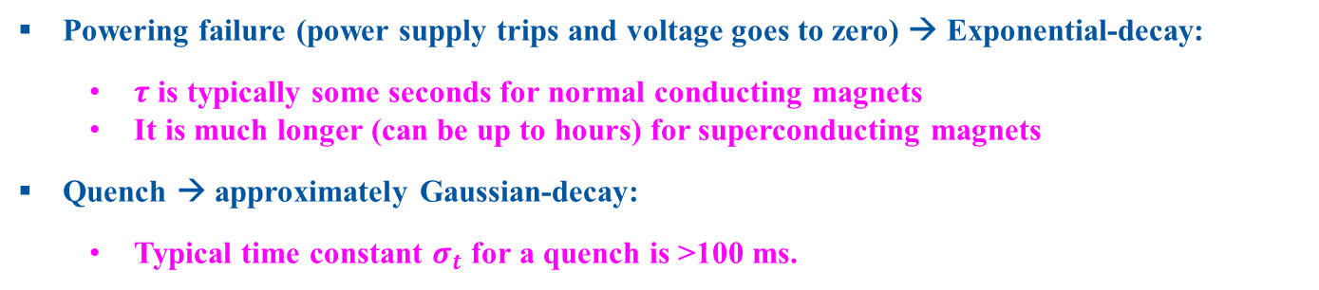
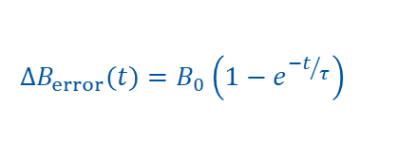

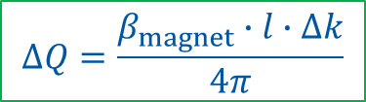
III. Specific requirements and strategies: magnet failures
Powering failure (power supply trips and voltage goes to zero) → Exponential-decay:
  $τ$ is typically some seconds for normal conducting magnets
  It is much longer (can be up to hours) for superconducting magnets
Quench → approximately Gaussian-decay:
  Typical time constant $σ_{t}$ for a quench is >100 ms.
$$∆B_{error}(t)=B_{0}\left(1−e^{{−t}/τ}\right)$$
$$∆B_{error}\left(t\right)=B_{0}\left(1−e^{−\frac{t^{2}}{2σ_{t}^{2}}}\right)$$
$∆x=\frac{\sqrt{β_{magnet}∙β_{test}}}{2\sin\left(πQ_{x}\right)}∙\left(α_{0}∙\frac{∆B_{error}}{B_{0}}\right)∙\cos\left(∆ψ+πQ_{x}\right)$, where $\cos\left(∆ψ+πQ_{x}\right)\sim 0.83$if $∆ψ=90°$
$α_{0}$ is nominal deflecting angle
$$∆Q=\frac{β_{magnet}∙l∙∆k}{4π}$$
    Details in: [Y. Nie, et al., IPAC 2017]
Beam is influenced faster if the failed magnet is located where the beta function is high, or the magnet has fast field decay!
The minimum time constant of field decay can be determined such that beam position is displaced up to 1.5 σ or tune change is up to 0.01, within 2 ms after magnet failure.

Slide 13
III. Specific requirements and strategies: failure modes
Magnet Name | Failure Scenario | Time Constant
Separation dipole ‘D1’ in IRA / IRG | Powering failure of all the magnets | > 20 s
Low-β triplet quadrupoles | Quench of 1 magnet (MQXC.3RA) | > 140 ms
Main dipole | Quench of 1 magnet | > 55 ms
Main quadrupole | Quench of 1 magnet | > 9 ms
Normal conducting dipole in collimation insertion | Powering failure of MBW.A6R3.B1 | > 270 ms
Normal conducting quadrupole in collimation insertion | Powering failure of MQWA.D4R3.B1 | > 23 ms
Powering failure or quench of magnets
  A beam displacement of up to 1.5 σ during 2 ms is just acceptable. If it is faster, the damage limit of collimators might be exceeded before the beam is dumped.
Phase/voltage jump of crab cavities
Unidentified falling objects (UFOs) causing beam instability (e.g. in the LHC 16L2 events)
…
    [Y. Nie, et al., IPAC 2017;
    Y. Nie, et al., Concept of beam-related machine protection for the FCC-hh, to be published]

Slide 14
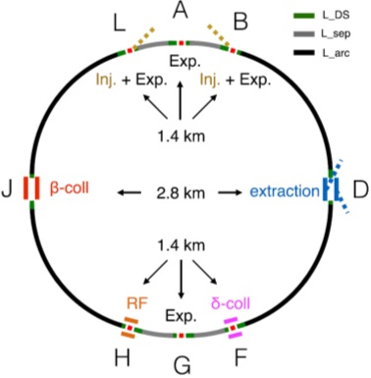
III. Specific requirements and strategies: make reaction time shorter
Requirements for the machine protection system:
Reaction time (around 1 ms if extending the LHC design)
  Shorten detection time of the failure from 80 µs to 1 µs by using faster detectors (e.g. diamond BLMs)
  Ensure minimum time for signal transmission from BLMs at collimators to beam dump
  Shorten synchronization time by using multiple beam-free abort gaps
Save ~140 µs
Reliability
  The likelihood of a missed dump should not exceed one occurrence in a 1000 year → redundant design!
Availability
  Possibly introduce a voting logic on redundant interlock channels to balance availability and reliability

Slide 15
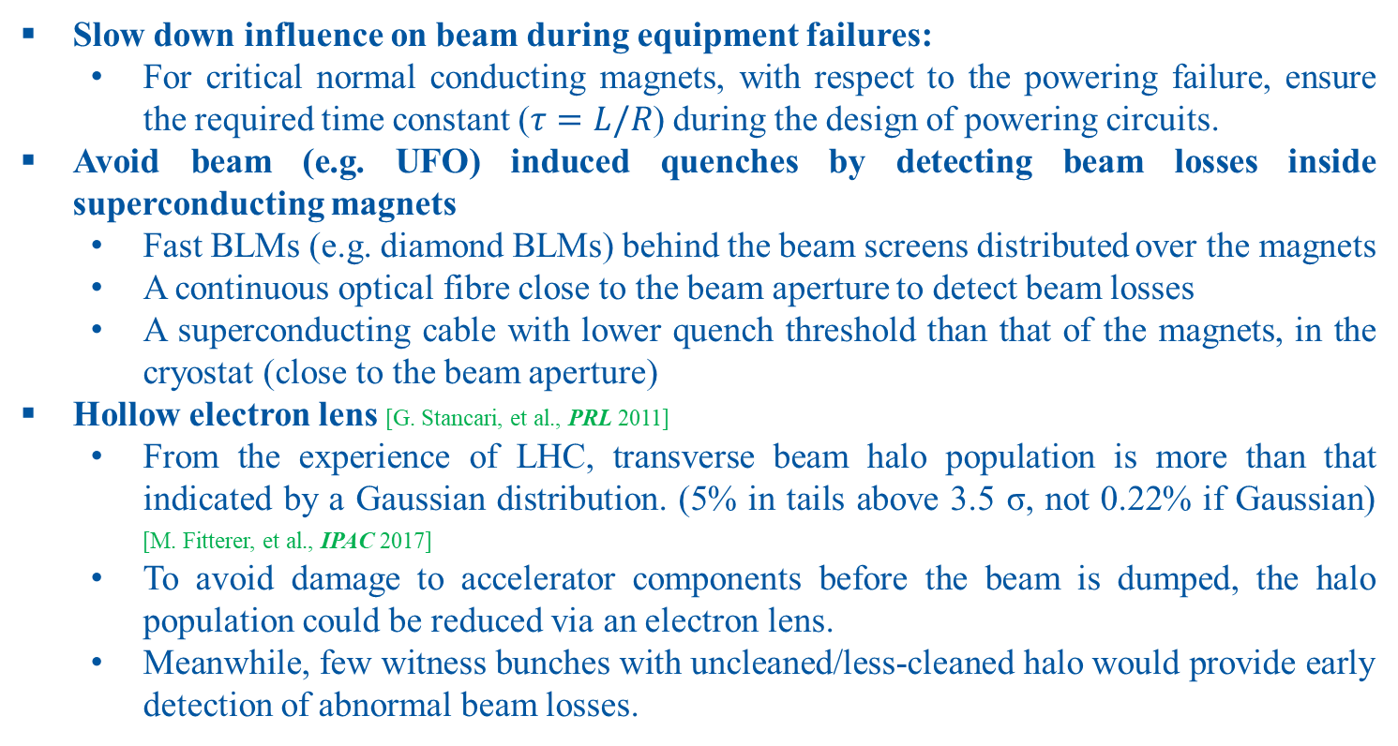
III. Specific requirements and strategies: other potential strategies
Slow down influence on beam during equipment failures:
  For critical normal conducting magnets, with respect to the powering failure, ensure the required time constant ($τ=L/R$) during the design of powering circuits.
Avoid beam (e.g. UFO) induced quenches by detecting beam losses inside superconducting magnets
  Fast BLMs (e.g. diamond BLMs) behind the beam screens distributed over the magnets
  A continuous optical fibre close to the beam aperture to detect beam losses
  A superconducting cable with lower quench threshold than that of the magnets, in the cryostat (close to the beam aperture)
Hollow electron lens [G. Stancari, et al., PRL 2011]
  From the experience of LHC, transverse beam halo population is more than that indicated by a Gaussian distribution. (5% in tails above 3.5 σ, not 0.22% if Gaussian) [M. Fitterer, et al., IPAC 2017]
  To avoid damage to accelerator components before the beam is dumped, the halo population could be reduced via an electron lens.
  Meanwhile, few witness bunches with uncleaned/less-cleaned halo would provide early detection of abnormal beam losses.

Slide 16
IV. Summary and Conclusions
Challenges of machine protection for FCC (especially for FCC-hh) arise from its unprecedented energies stored in the magnets and the beams.
FCC will profit from successful LHC experience in machine protection. LHC has been operating since nearly 10 years without beam accidents.
However, novel strategies have been being proposed for specific challenges:
  reducing the reaction time by using fast diamond BLMs, a shorter traveling path of the dump request and multiple abort gaps
  controlling the time constant of field decay in critical magnet failures
  avoiding beam/UFO induced quenches by detecting beam losses inside the cryostat
  cleaning the beam halos by using the e-lens

Slide 17
IV. Summary and Conclusions
Challenges of machine protection for FCC (especially for FCC-hh) arise from its unprecedented energies stored in the magnets and the beams.
FCC will profit from successful LHC experience in machine protection. LHC has been operating since nearly 10 years without beam accidents.
However, novel strategies have been being proposed for specific challenges:
  reducing the reaction time by using fast diamond BLMs, a shorter traveling path of the dump request and multiple abort gaps
  controlling the time constant of field decay in critical magnet failures
  avoiding beam/UFO induced quenches by detecting beam losses inside the cryostat
  cleaning the beam halos by using the e-lens
Thank you very much!

Slide 18
Backup

Slide 19
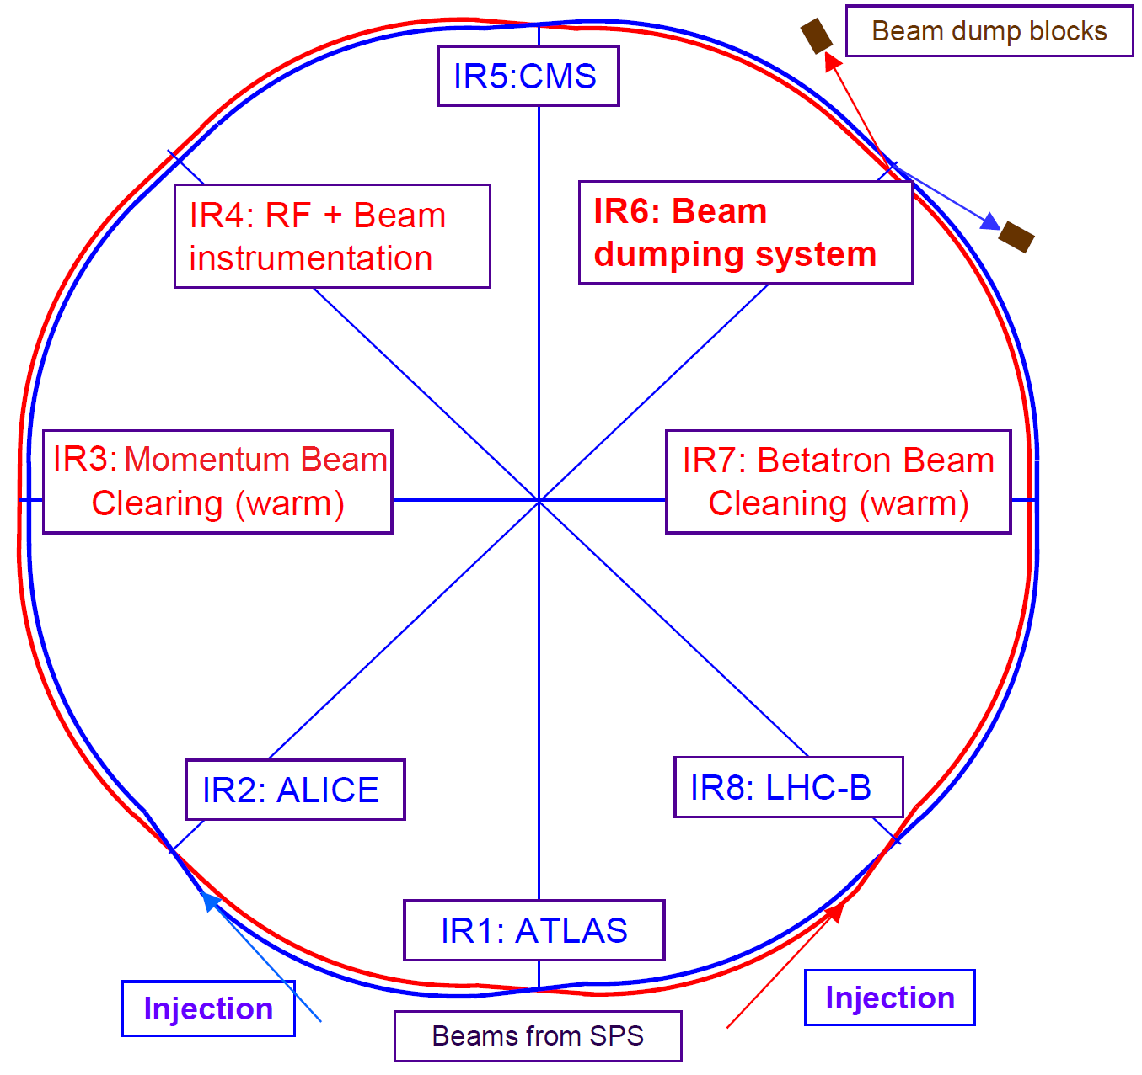
General protection strategy for LHC and possibly for FCC-hh
LHC dump
450 GeV → 7 TeV in 20 min (10 million turns) at LHC!
FCC dump
>3600 BLMs
    [R. Schmidt, JAS 2014; A. Lechner, FCC Week 2017; M. Benedikt, FCC Week 2017]

Slide 20
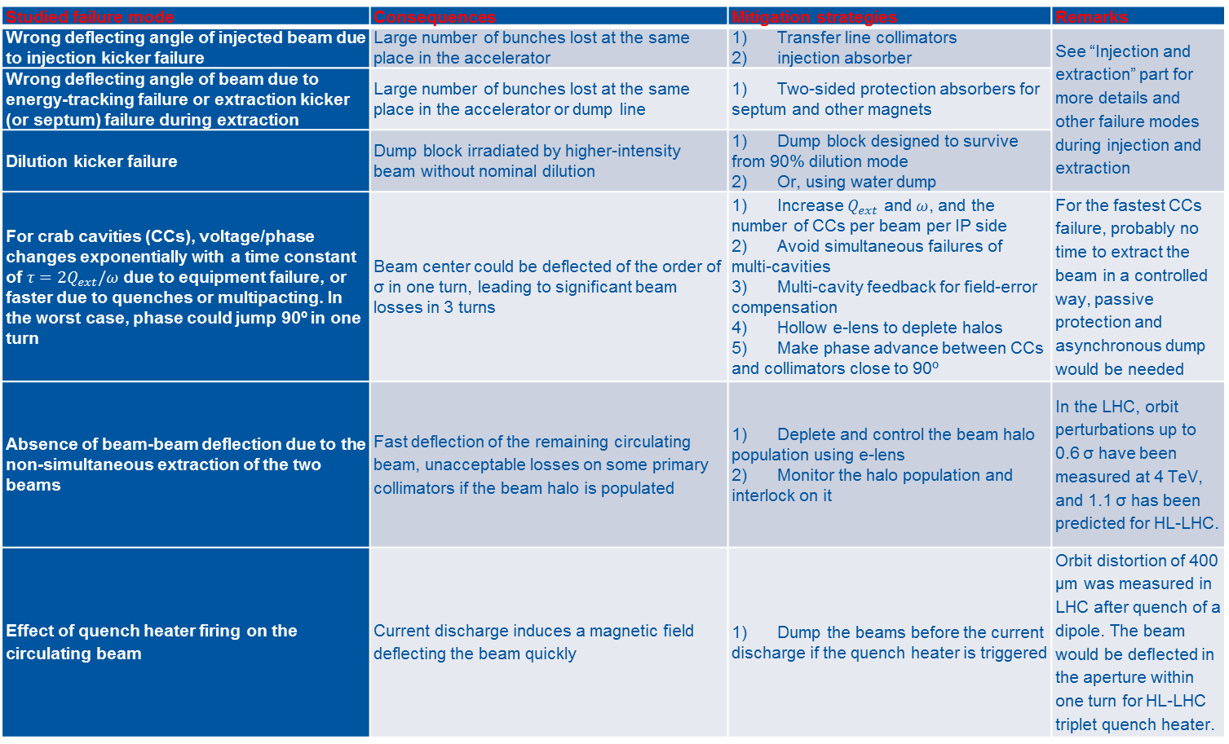
Ultrafast failures of FCC-hh
Studied failure mode | Consequences | Mitigation strategies | Remarks
Wrong deflecting angle of injected beam due to injection kicker failure | Large number of bunches lost at the same place in the accelerator | Transfer line collimators injection absorber | See “Injection and extraction” part for more details and other failure modes during injection and extraction
Wrong deflecting angle of beam due to energy-tracking failure or extraction kicker (or septum) failure during extraction | Large number of bunches lost at the same place in the accelerator or dump line | Two-sided protection absorbers for septum and other magnets
Dilution kicker failure | Dump block irradiated by higher-intensity beam without nominal dilution | Dump block designed to survive from 90% dilution mode Or, using water dump
For crab cavities (CCs), voltage/phase changes exponentially with a time constant of $τ=2Q_{ext}/ω$ due to equipment failure, or faster due to quenches or multipacting. In the worst case, phase could jump 90º in one turn | Beam center could be deflected of the order of σ in one turn, leading to significant beam losses in 3 turns | Increase $Q_{ext}$ and $ω$, and the number of CCs per beam per IP side Avoid simultaneous failures of multi-cavities Multi-cavity feedback for field-error compensation Hollow e-lens to deplete halos Make phase advance between CCs and collimators close to 90º | For the fastest CCs failure, probably no time to extract the beam in a controlled way, passive protection and asynchronous dump would be needed
Absence of beam-beam deflection due to the non-simultaneous extraction of the two beams | Fast deflection of the remaining circulating beam, unacceptable losses on some primary collimators if the beam halo is populated | Deplete and control the beam halo population using e-lens Monitor the halo population and interlock on it | In the LHC, orbit perturbations up to 0.6 σ have been measured at 4 TeV, and 1.1 σ has been predicted for HL-LHC.
Effect of quench heater firing on the circulating beam | Current discharge induces a magnetic field deflecting the beam quickly | Dump the beams before the current discharge if the quench heater is triggered | Orbit distortion of 400 µm was measured in LHC after quench of a dipole. The beam would be deﬂected in the aperture within one turn for HL-LHC triplet quench heater.

Slide 21
Fast failures of FCC-hh
Studied failure mode | Consequences | Mitigation strategies | Remarks
Powering failure of separation dipole “D1” in IRA/IRG (if NC) | The beam can be displaced quickly from nominal orbit, leading to fast beam losses | Time constant of the field decay must >20 s Connect a SC solenoid in series to increase the time constant Detect failure at hardware level (e.g., FMCM) Detect initial influences of the failure on the beam (fast BPM, BLM, etc) Dump beam as fast as possible | One of the fastest failure modes, but can be mitigated by using the SC solenoid to slow down the field decay
Quench of 1 magnet of D1 (if SC) |  | Fast detection of the quench Time constant of the field decay must >100 ms | Need to be careful about the time constant
Quench of 1 magnet of the low-β triplet | Tune change and β-beating, leading to resonances and beam instabilities | Fast detection of the quench Time constant of the field decay must >140 ms | Need to be careful about the time constant
UFOs | Beam instabilities and fast beam losses | Fast detection of initial effects on the beam and trigger dump Make use of the conditioning effect along the machine run | Lead to significant beam losses in ms at LHC
ADT/orbit corrector misfires | Fast beam deflections | Avoid coherent excitation of transverse dampers
Vacuum valve/screen reduces aperture or obstructs beam pipe | Aperture reduction and fast beam losses | Accurate control of these movable devices
Vacuum leak/wire scanner error scatters the beam | Beam scattering and fast beam losses | Fast detection of initial effects on the beam and trigger dump
Beam instability due to too high beam current/e-clouds | Fast beam losses | Fast detection of initial effects on the beam and trigger dump

Slide 22
Slow failures of FCC-hh
Studied failure mode | Consequences | Mitigation strategies | Remarks
Powering failure of other warm magnets | Change of the closed orbit | After detection of failure or abnormal beam parameters, dump the beam rapidly if necessary | Radiation levels should be paid attention to. Normally have enough time for synchronous dump
Quench of 1 main dipole or quadrupole | Change of the closed orbit or optics | After detection of failure or abnormal beam parameters, dump the beam rapidly if necessary
RF accelerating cavity failures | More particle population on the tail due to dephasing | After detection of failure or abnormal beam parameters, dump the beam rapidly if necessary

