Slide 1

A Muon detector based on the μ-RWELL technology
G. Bencivenni, L. Borgonovi, M. Gatta, G. Felici, P. Giacomelli,
M. Poli Lener, G. Morello, A. Ochi and R. de Oliveira

Slide 2
Overview
Requirements of Muon detectors
Muon detectors for future accelerators (FCC-ee, FCC-hh, CepC, SppC, CLIC, ILC)
Micro Pattern Gas Detectors (MPGD)
An example of a new MPGD: the μ-RWELL and its application for future muon systems
Conclusions

Slide 3
Muon detectors in large HEP experiments
These are the main requirements of a typical large muon detection system:
  Momentum resolution, σpT/pT² ≅ 1-2 x 10⁻⁵ GeV⁻¹
        With a B field of 2-4 Tesla and a few muon stations at a radius r > 5m, this translates to
          space resolution, σx, of a few hundred microns
      Detection efficiency ~ 98-99% over a large solid angle
        Three space points along a muon track
          At least 3 muon stations
          Redundancy is an asset
  BX identification (for hadron colliders)
              time resolution, σt, of 5-10 ns
      Standalone muon trigger (for hadron colliders)
    Fast level-1 trigger response from the muon system
Mass producible by industry

Slide 4
Muon detectors in large HEP experiments
Most current large detector experiments have a cylindrical structure closed at the two ends by 2 endcaps.
Detectors designed for future colliders (FCC-ee, FCC-hh, CLIC, ILC, CepC, SppC) adopt a similar design.
All these detectors have a length exceeding 20m and a radius of at least 7-8m.
Muon detection systems need to identify muons and measure their momentum with accurate precision. In hadronic collisions they also have to provide a standalone muon trigger and BX identification.
Muon systems are typically composed of several stations (ranging from 2 to 6) of detectors interleaved in the iron yoke (or in air) at several meters from the IP.
The barrel part of a muon detection system has dimensions of a few thousands of m², while the endcaps are typically about half of this size.
For evident reasons of price, gas detectors are the obvious choice for equipping these extremely large surfaces.

Slide 5
Muon detectors in large HEP experiments
Gas detectors used for muon detection systems can be separated into three main groups:
  Wire detectors (DTs, CSCs, MDT, etc.)
            Relatively simple construction, good space and time resolution
  RPCs
              Simple and cheap construction, very good time resolution, poor space resolution
      Micro Pattern Gas Detectors (GEM, MicroMegas, μRWell, etc.)
    Newer technology, provides both good space and time resolution.
    Uses PCB methods and can be mass produced by industry.

Slide 6
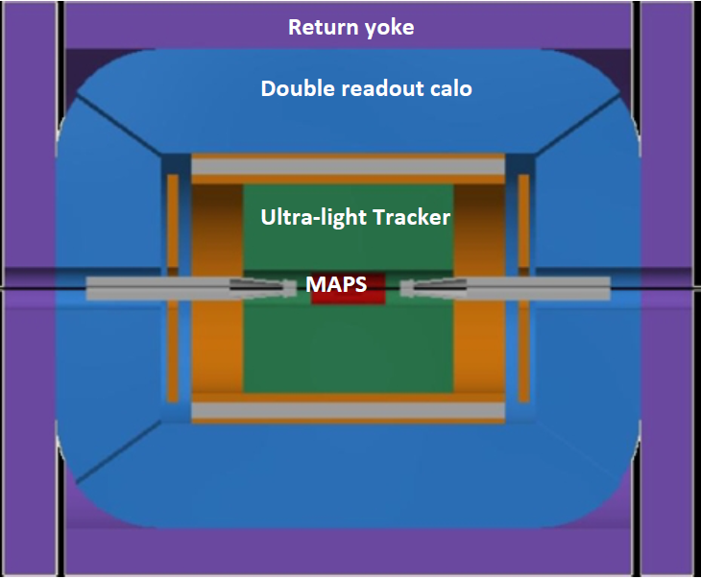
Muon detectors for FCC-ee
There are two detector concepts for FCC-ee: the CLD (CLIC-inspired detector) detector model and the IDEA concept.
In the CLD detector the muon system is made of 6 muon stations interleaved in the iron return yoke, and every muon station is made of RPCs.
In the IDEA detector, the muon detection system is made of three MPGD stations interleaved in the iron return yoke.
CLD
IDEA
Muon stations

Slide 7
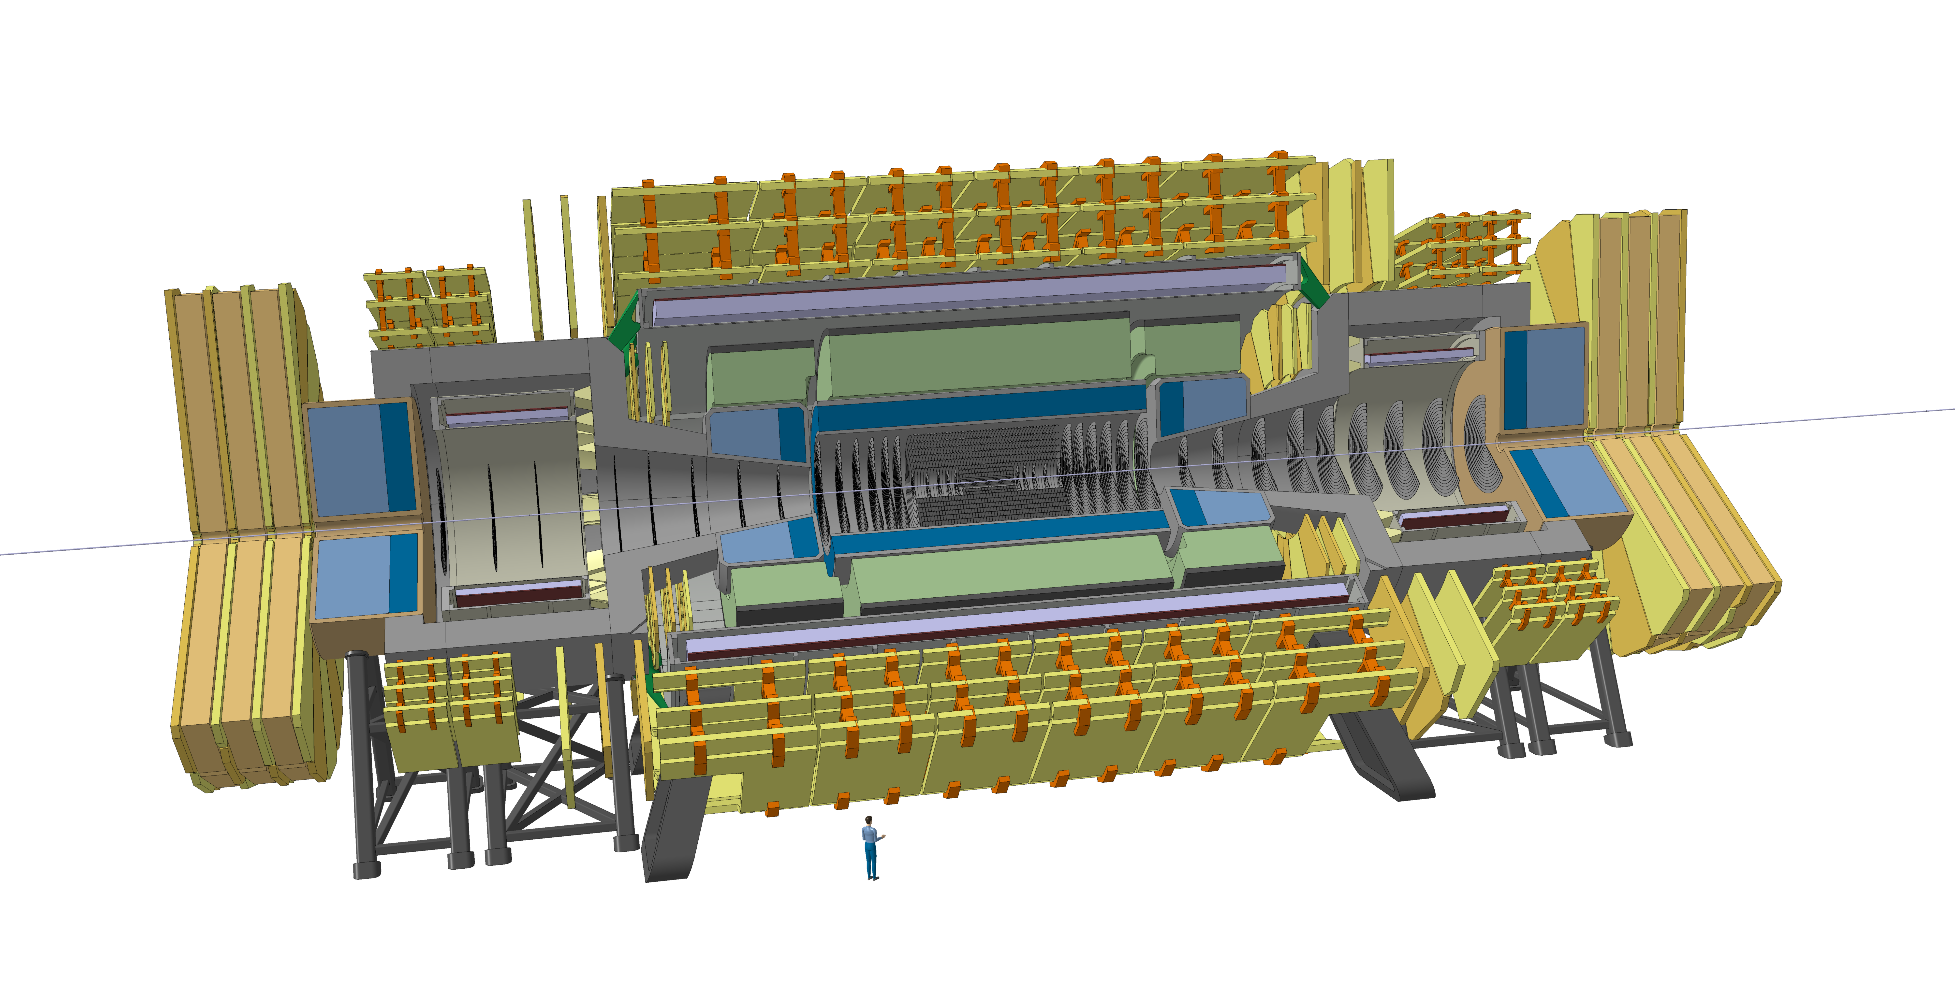
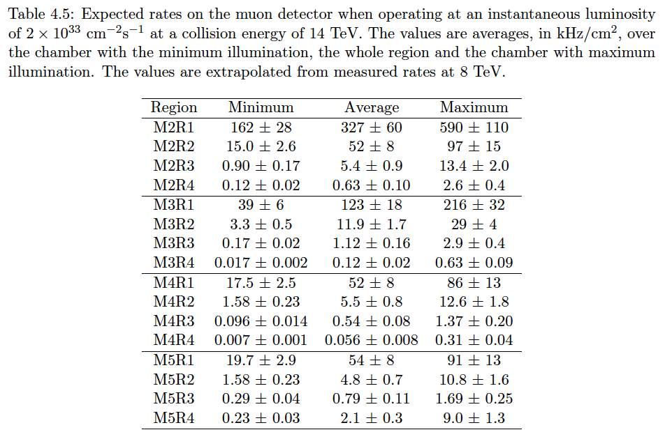
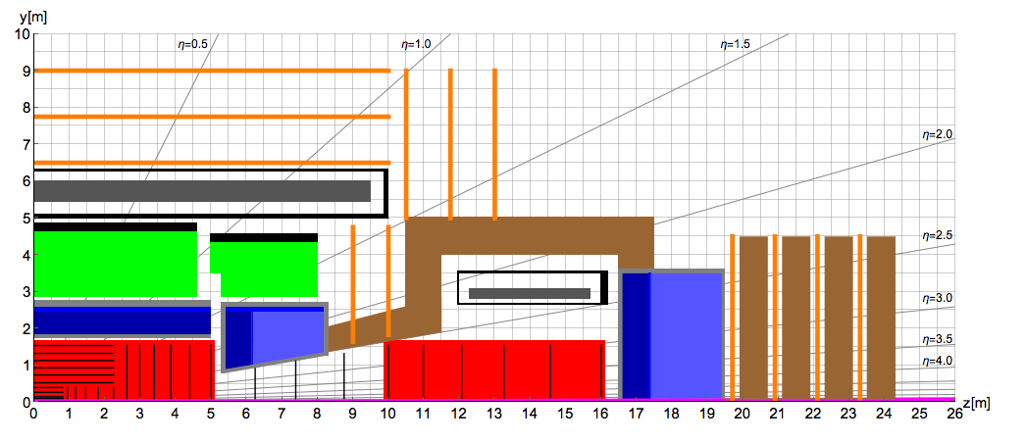
Muon detector for FCC-hh
FCC-hh detector
ATLAS muon system HL-LHC rates (kHz/cm²):
MDTs barrel: 0.28
MDTs endcap: 0.42
RPCs: 0.35
TGCs: 2
Micromegas and sTGCs: 9-10
LHCb
<0.5 kHz/cm²
<10 kHz/cm²
r>1m rate<500 kHz/cm²
HL-LHC muon system gas detector technologies, and especially MPGDs, would work for most of the FCC-hh detector area.

Slide 8
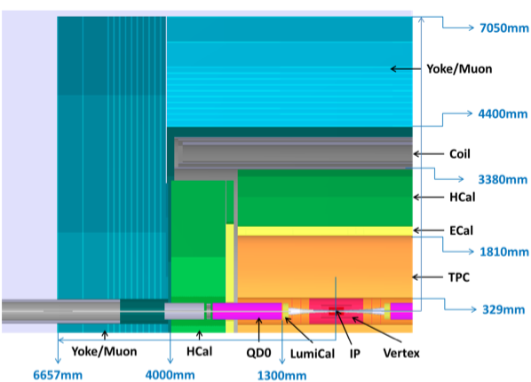
Muon detectors for CepC
In the baseline option, inspired from ILD, the muon detection system is composed of two layers of RPC stations.
An upgrade of the muon detector by using MPGDs could provide a much finer space resolution with a similar time resolution at a relatively modest increase in price.
The fine space resolution of the detectors could allow to obtain a standalone muon momentum measurement and to trace back the muon stabs to the tracker tracks.
/Muon chambers
In the IDEA detector concept, a muon detection system, made of three MPGD stations interleaved in the iron return yoke, is already foreseen.

Slide 9
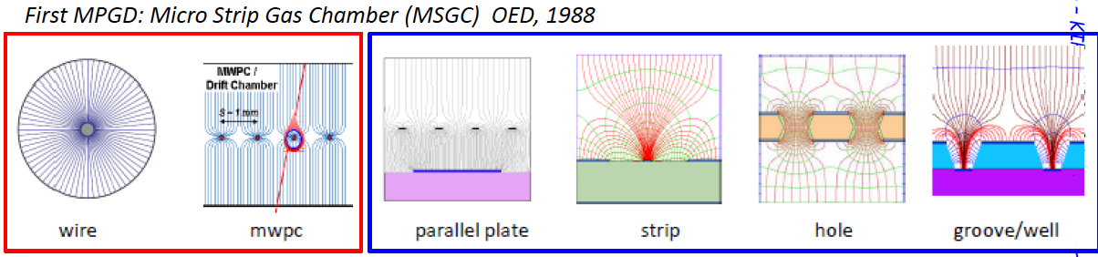
Principle of operation of MPGDs
Improve gas detectors
Reduce multiplication region size
Faster ion evacuation
Higher spatial resolution
Slow ion motion
Limited multi-track separation
S. Franchino, 2016
Reduce the size of the detecting cell (~100 μm) using chemical etching techniques
  Use PCB technology to obtain very fine electrodes O(10 μm)
Same working principle as proportional wire chambers
  Conversion region (low E field)
  High E field in well localised regions where multiplication happens

Slide 10
Evolution of MPGDs
S. Franchino, 2016

Slide 11
More recent MPGDs
F. Sauli, NIM. A386(1997)531
I. Giomataris et al., NIM A 376 (1996) 29
GEM (std, Thick, glass, …)
Micromegas
(bulk, micro bulk, resistive, ..)
Ageing: OK (no thin wires)
Spark protection: multiple amplification stages, resistive electrodes
S. Franchino, 2016

Slide 12
Properties of MPGDs
Gas multiplication and/or readout are performed by “micro patterns” instead of conventional wire chambers
Fine patterning realized with PCB photolithography techniques
  Fine position resolution ( < 100 microns )
  Good timing resolution ( < 10 nsec )
  High rate capability ( > 10⁷ counts/mm )
  Excellent radiation hardness
  Use components that can be mass produced by industry

Slide 13
The μ-RWELL technology
The µ-RWELL detector is composed of two elements:
the cathode and the ∝-RWELL_PCB .
Drift/cathode PCB
The ∝-RWELL_PCB is realized by coupling:
a “suitable WELL patterned kapton foil as “amplification stage”
a “resistive stage” for the discharge suppression & current evacuation
  “Low particle rate” (LR) ~ 100 kHz/cm²: single resistive layer → surface resistivity ~100 MΩ/☐ (CMS-phase2 upgrade - SHIP)
  “High particle rate” (HR) > 1 MHz/cm²: more sophisticated resistive scheme must be implemented (MPDG_NEXT- LNF & LHCb-muon upgrade)
a standard readout PCB
gas gap 4-7 mm
Copper top layer (5µm)
Well pitch: 140 µm
Well diameter: 70-50 µm
Kapton thickness: 50 µm
DLC layer (0.1-0.2 µm)
R ̴10 -200 MΩ/□
1
2
3
Rigid PCB readout electrode
∝-RWELL PCB
G. Bencivenni et al., 2015_JINST_10_P02008
Major advantages wrt. GEM
1 kapton foil instead of 3
No stretching
Spark safe
Collaboration of INFN, CERN, Eltos

Slide 14
μ-RWELL References
Low rate version:
G. Bencivenni et al., “The micro-Resistive WELL detector: a compact spark-protected single amplification-stage MPGD”, 2015_JINST_10_P02008
G.Bencivenni et al., “The Resistive-WELL detector: a compact spark-protected single”, PoS (BORMIO2015) 024
G. Bencivenni et al., "The μ-RWELL: a compact, spark protected, single amplification-stage MPGD”, NIM A 824 (2016) 565
G.Bencivenni et al., “Advances on micro-RWELL gaseous detector”, PoS (BORMIO2017) 002
G.Bencivenni et al., “The μ-RWELL detector”, 2017_JINST_114P_0517
G.Bencivenni et al., “Performance of μ-RWELL detector vs resistivity of the resistive stage”, NIMA 886 (2018) 36
High rate version:
G.Bencivenni et al., “Recent results of μ-RWELL detector”, PoS(MPGD2017)019
G.Bencivenni et al., “The μ-RWELL technology: status and perspective”, to be submitted to Pos
For more informations on the μ-RWELL technology please follow M. Poli Lener’s poster “The Micro-Resistive-WELL (μ-RWELL) detector for large area Muon systems at future circular colliders”

Slide 15
μ-RWELL features
μ-RWELL guiding principles
  Retain the same excellent performances of GEM and MM
  Improve the resistance to sparks
  Simplify the components construction and final assembly
Simpler construction
  Only 1 kapton foil instead of 3
  Single amplification layer
  Simpler etching of the kapton foil
More robust
  Resistive DLC layer makes the detector very spark safe
Simpler final assembly
  Kapton foil glued to PCB: no stretching needed
Less components, simpler construction → significant cost reduction

Slide 16
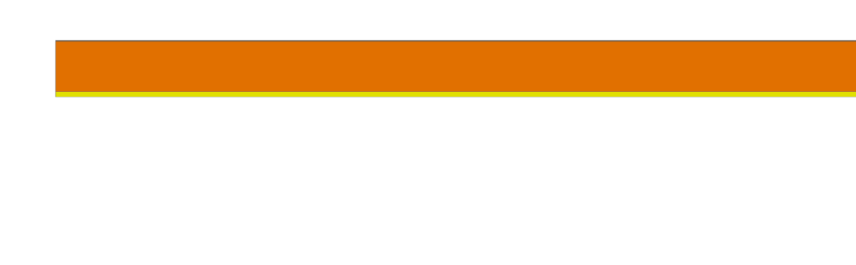
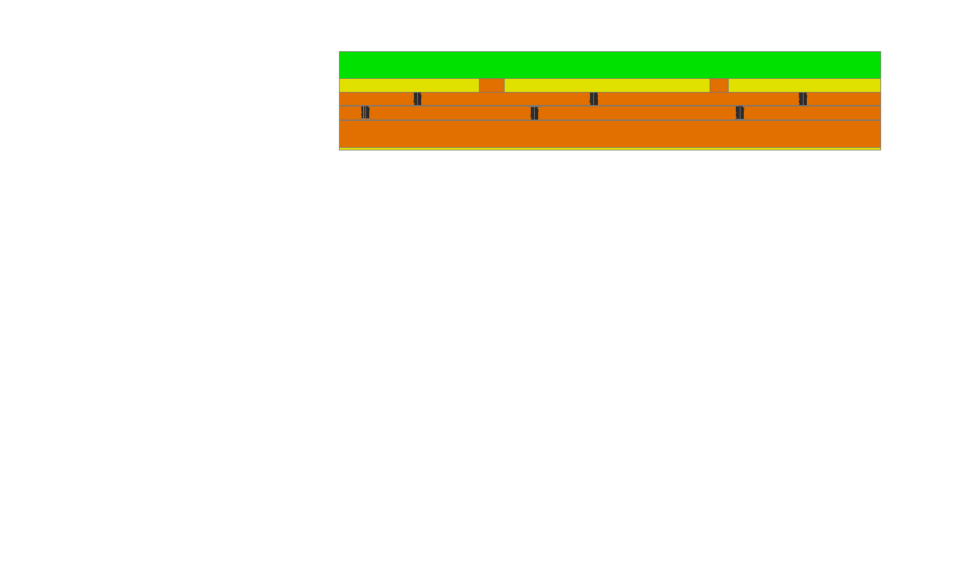
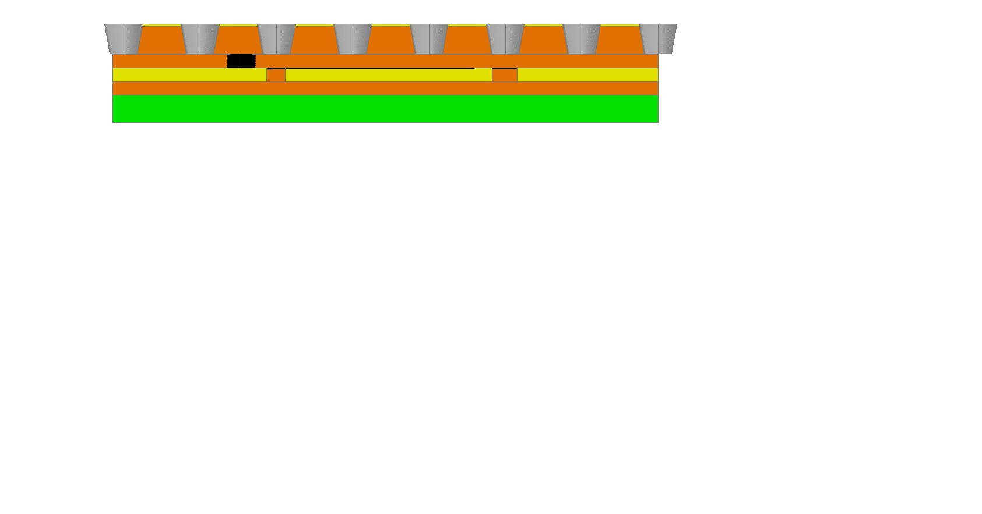
μ-RWELL High Rate version
The High Rate scheme (LHCb)
Copper layer 5 µm
G.Bencivenni et al., PoS(MPGD2017)019
G.Bencivenni et al., to be submitted to Pos
1
Kapton layer 50 µm
DLC layer: 0.1 – 0.2 µm
(10-200 MΩ/☐)
2
2nd resistive kapton layer with ∼ 1/cm² “through vias” density
DLC-coated kapton base material
3
2nd resistive kapton layer
pad/strips readout on standard PCB
This resistive scheme allows to reach a detector rate capability > 1 MHz/cm² with a negligible gain drop (see M. Poli Lener’s poster: «The micro-Resistive-WELL (μ-RWELL) detector for large area Muon system at Future Circular Colliders»
DLC-coated base material after copper and kapton chemical etching ( WELL amplification stage)
4

Slide 17
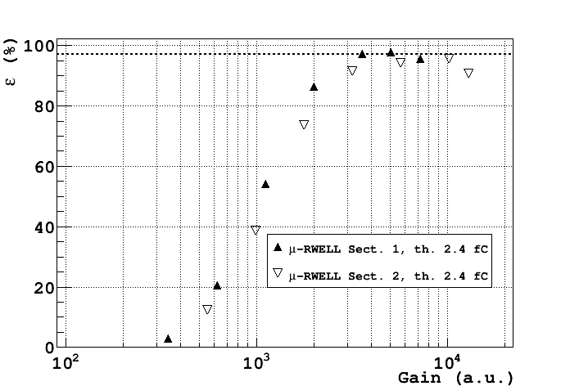
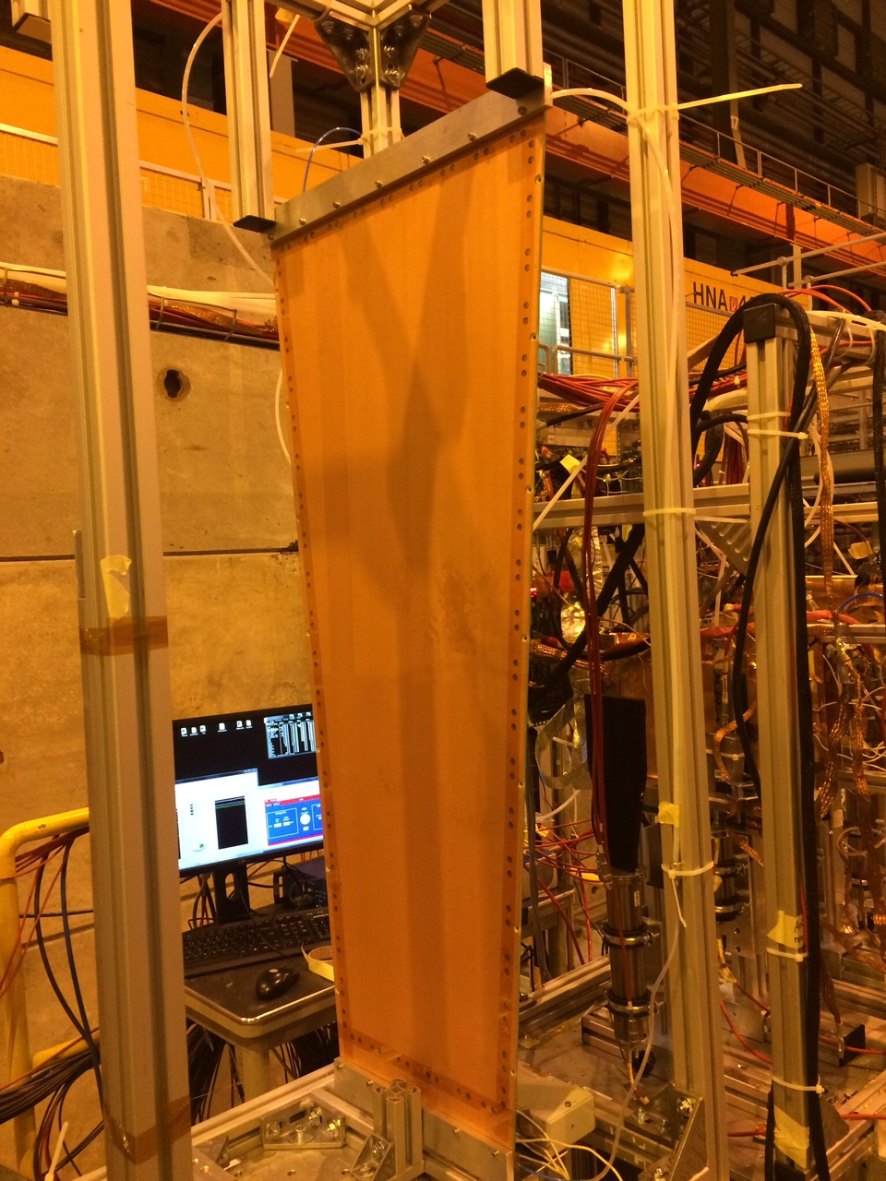
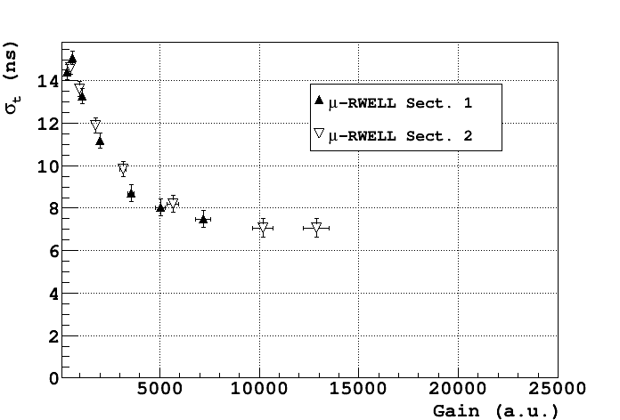
CMS GE1/1 μ-RWELL prototype at H8 test beam
Efficiency
Ar/CO2/CF4 45/15/40
VFAT FEE
97%
Time resolution
~ 6 ns
limited by VFAT saturation effects

Slide 18
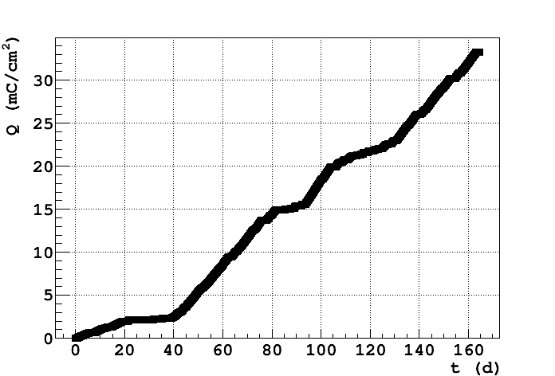
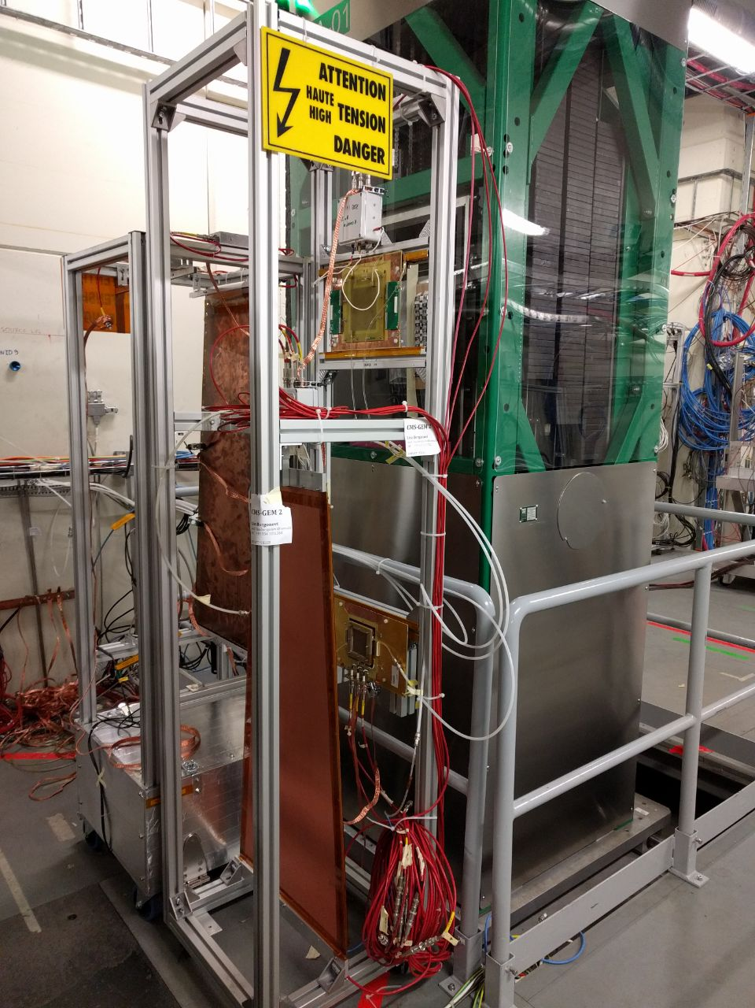
CMS GE1/1 μ-RWELL: GIF++ ageing test
1) GE1/1 μ-RWELL (ArCO2)
2) “high rate” μ-RWELL (ArCO2CF4) 10cmx10cm
3) reference μ-RWELL (ArCO2)
    10cmx10cm
GE1/1 has accumulated a dose of ~32 mC/cm² (more than 10 times the dose after 10 years of HL-LHC)
μRWELL prototypes exposed inside the GIF++

Slide 19
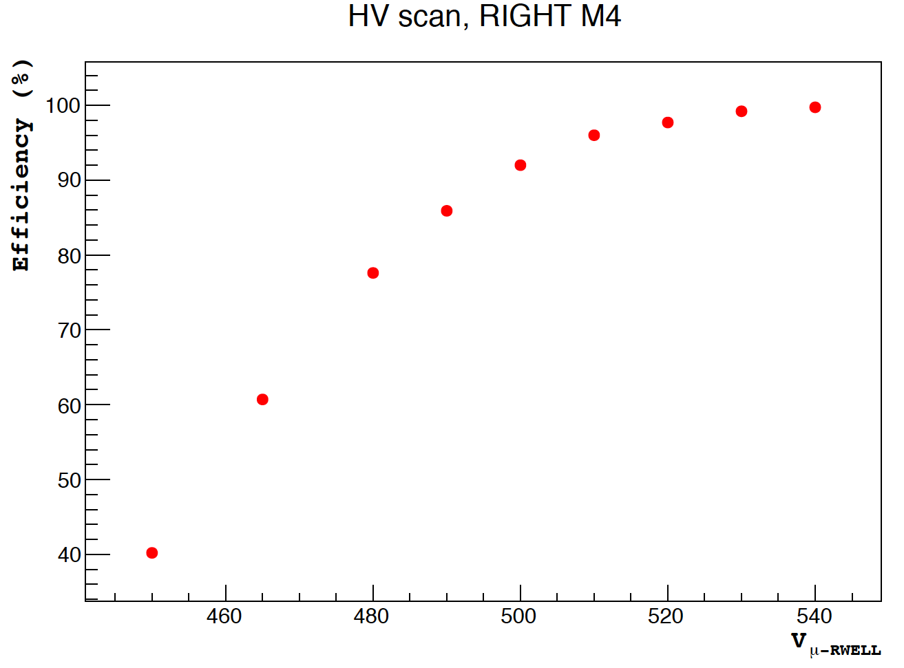
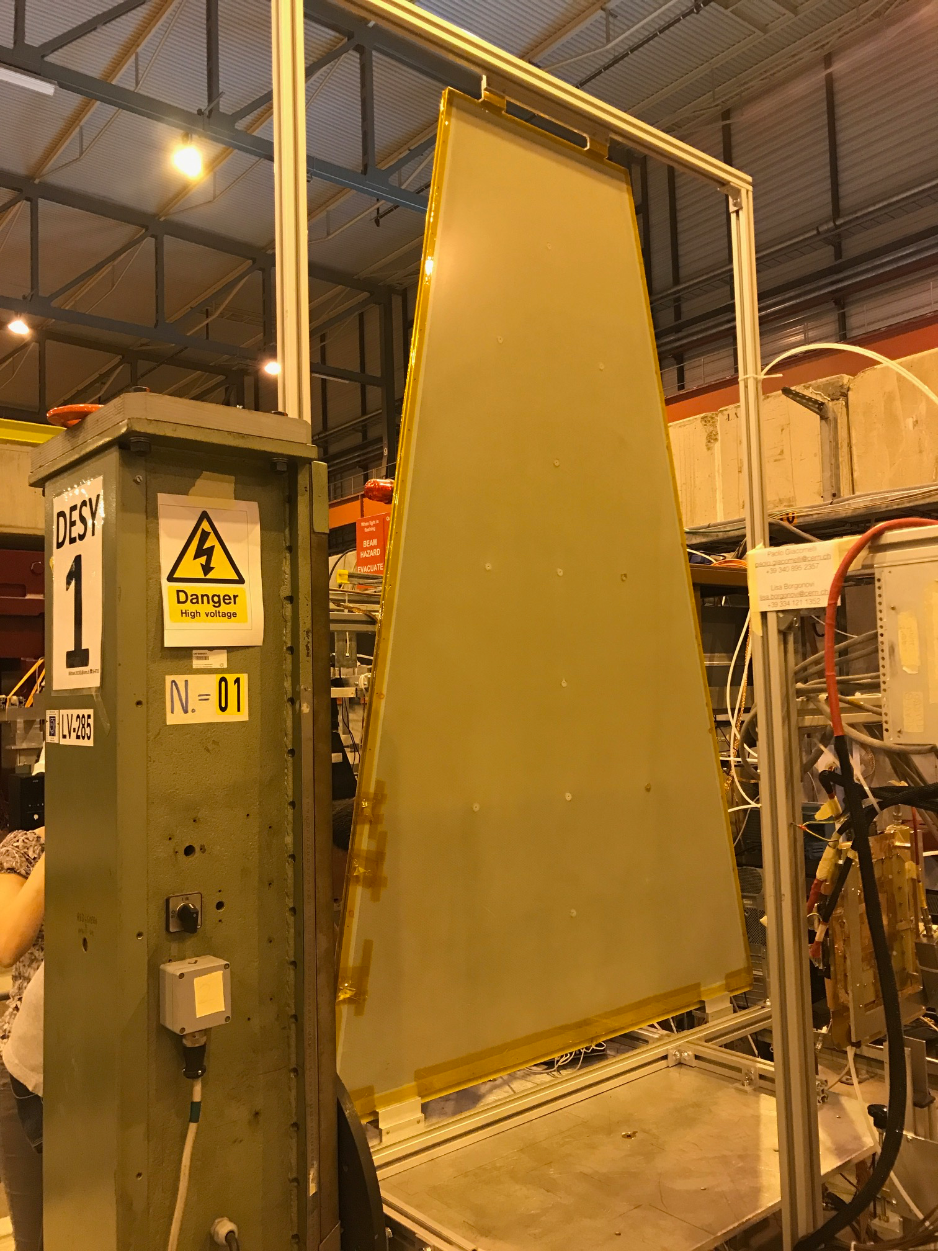
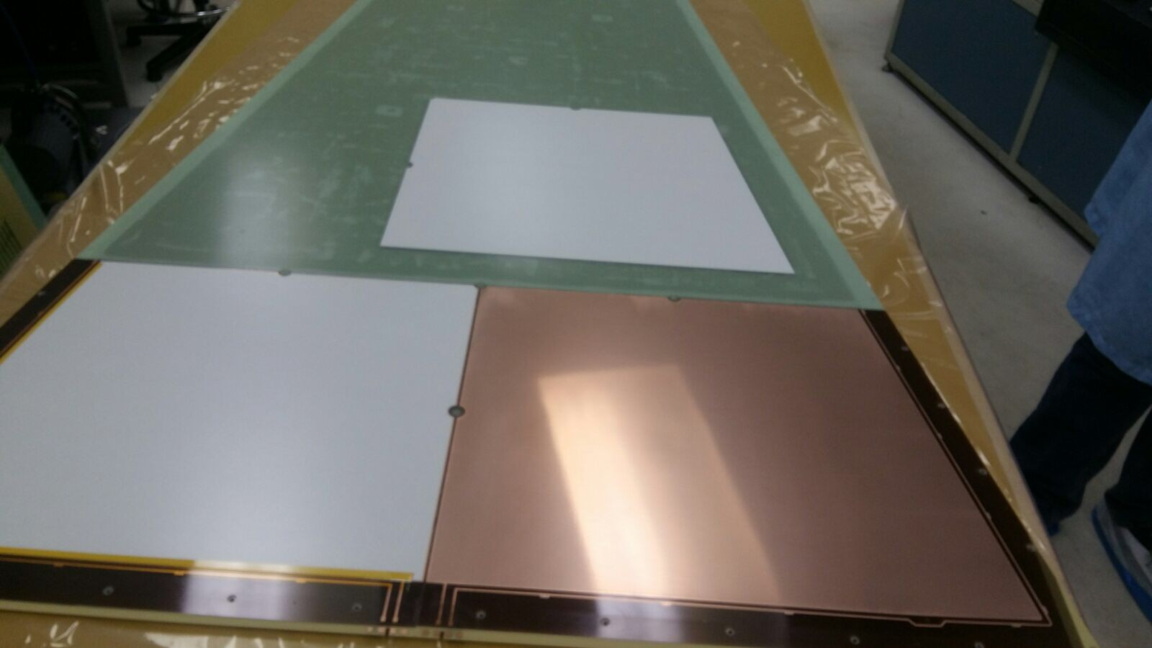
CMS GE2/1 sector μ-RWELL prototype
H4 test beam with 150 GeV muons:
Voltage scan (amplification scan)
Uniformity scan across the surface of the detector at 530 V (~12000 gain, still to be conditioned)
The excellent results obtained demonstrate the great collaboration between INFN-Eltos and Rui de Oliveira’s lab
GE2/1 20⁰ sector with 2 M4 μRWells
(2 m height, 1.2 m base)
M4 μ-RWELL prototype is a trapezoid of ~55-60x50 cm²
Largest μ-RWELL ever built and operated!
M4 μ-RWELL
Notes:
DAQ (actually debugging latency scan tool)

Slide 20
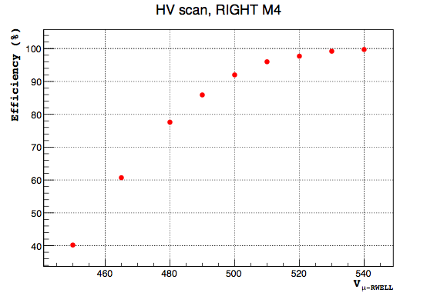
CMS GE2/1 sector μ-RWELL: HV scan
M4 right side:
  Drift Field = 3.0 kV/cm
  Vμ-RWELL = scan
Efficiency = # hits (Tracker 1 & Tracker 2 & M4 right)
                # hits (Tracker 1 & Tracker 2)
Muon
beam
Ar/CO2 70/30
Notes:
DAQ (actually debugging latency scan tool)

Slide 21
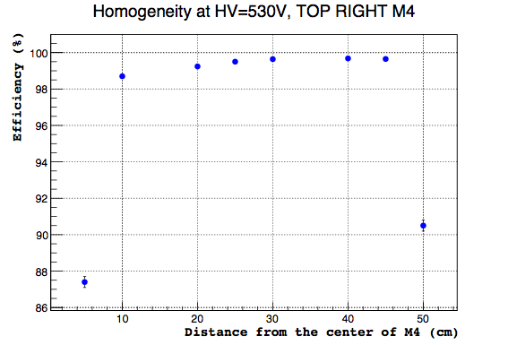
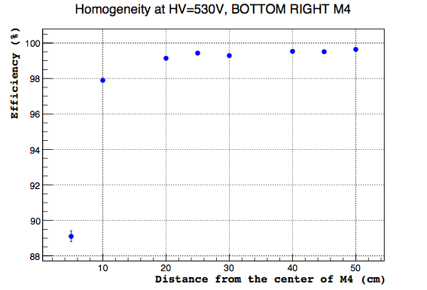
CMS M4 μ-RWELL: homogeneity
Efficiency = # hits (Tracker 1 & Tracker 2 & M4 right)
                # hits (Tracker 1 & Tracker 2)
Muon beam
M4 right side:
  Drift Field = 3.0 kV/cm
  Vμ-RWELL = 530 V
ε ~98=99%
TOP
BOTTOM
ε ~98=99%
M4 right scheme
Beam on the edge of the detector
NOT inefficiency!!

Slide 22
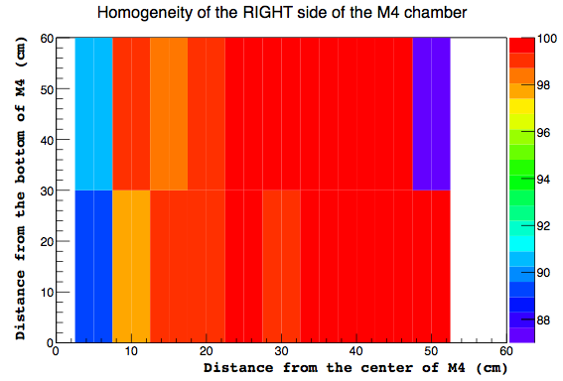
CMS GE2/1 sector μ-RWELL prototype
M4 right side:
  Drift Field = 3.0 kV/cm
  Vμ-RWELL = 530 V
Efficiency = # hits (Tracker 1 & Tracker 2 & M4 right)
                # hits (Tracker 1 & Tracker 2)
Muon beam
Notes:
DAQ (actually debugging latency scan tool)

Slide 23
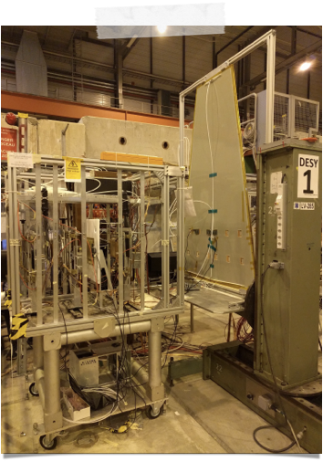
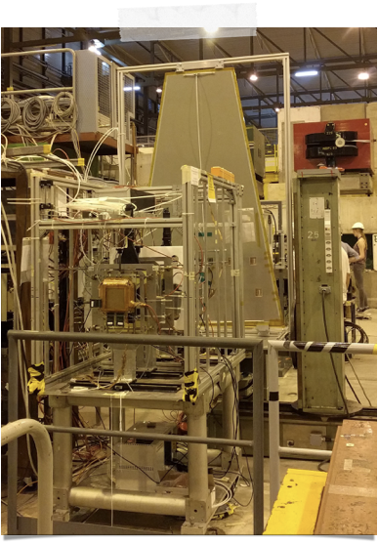
μ-RWELL High Rate version
When: 5 - 19 July 2017
2 GEM Trackers (10x10 cm²)
RD51 setup
2 μ-RWELLs
(10x10 cm²)
HR scheme
1 μ-RWELL
(CMS-GE2/1 M4 shape)
LR scheme

Slide 24
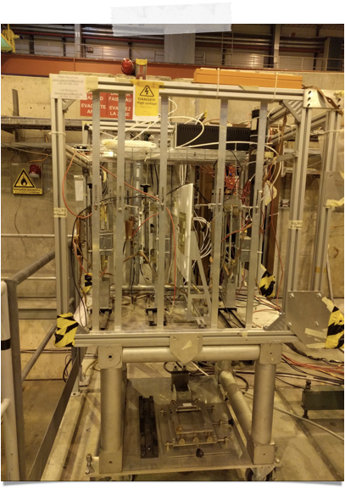
μ-RWELL High Rate version
Tracker GEMs
gas mixture:
  Ar/CO2 70/30
HR μ-RWELLs
gas mixture:
  Ar/CO2/CF4 45/15/40
HR μ-RWELL prototypes
10x10 cm²
6x8 mm² pad readout
BEAM
2 GEM Trackers
10x10 cm²
400 μm strip-pitch
X-Y strip readout
All detectors readout:
APV 25
(Charge Centroid analysis)

Slide 25
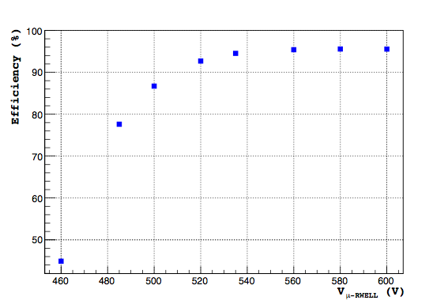
μ-RWELL High Rate version
  Drift Field = 2.5 kV/cm
  Vμ-RWELL = scan
Efficiency = # hits (Tracker 1 & Tracker 2 & HR proto)
                # hits (Tracker 1 & Tracker 2)
Ar/CO2/CF4 45/15/40
Courtesy of
LNF-DDG

Slide 26
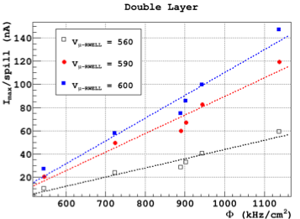
μ-RWELL High Rate: rate capability
Pion beam
Ar/CO2/CF4 45/15/40
Courtesy of
LNF-DDG
  Rate = beam scint. counts/4.2 s/(σxσy*2.53²)
  Beam profile: GEM trackers

Slide 27
Summary of results with μ-RWELLs
GE1/1 prototype at H8 test beam in 2016
  Very good time resolution, σt <6 ns (about 4.5 ns obtained)
  Fully efficient for a gain of >3000
  Tested with a rate up to ~35 kHz/cm² (only limited by beam rate)
GIF++ ageing (radiation tolerance) test
  Tested with global irradiation up to 100 kHz/cm² for CMS prototype
  Gain stability up to 20000
  No dark current, no discharges
  Qint > a century of GE2/1 at HL-LHC at the end of the test
    Up to 01/04/18 Qint ~ 32 mC/cm²
GE2/1 sector mechanical mock-up built
Technology Transfer with the Eltos company
Large 50-60x50 cm² μ-RWELL M4 modules built
  Exposed at the H4 test beam in July 2017
  Excellent uniformity! Efficiency between 98-99% over the whole surface.
HR μ-RWELL tested up to rates > 1 MHz/cm²

Slide 28
Conclusions
MPGDs, and in particular the μ-RWELL technology, are an excellent option for realising future large Muon detection systems
A large mosaic of ~50x50 cm² μ-RWELL detectors is probably the best solution from the industrial point of view
An upgrade of the muon system for the CLD detector of FCC-ee, substituting the RPCs with μ-RWELL detectors is an attractive opportunity
The IDEA detector concept for FCC-ee implements μ-RWELL
  This system can provide a time resolution of the order of 5 ns and a space resolution of <200 μm
  Stadalone muon reconstruction
  Trace back the muon stubs to the tracker tracks
  Provide excellent momentum resolution and a robust muon trigger
μ-RWELL technology is also suitable for the muon systems of detectors at future hadron colliders, like FCC-hh

Slide 29
Backup

Slide 30
Muon detectors for FCC-ee
There are two detector concepts for FCC-ee: the CLD (CLIC-inspired detector) model and the IDEA concept.
In the CLD (CLIC-inspired detector) the muon system is made of 6 muon stations interleaved in the iron return yoke, and every muon station is made of RPCs.
Also this muon detector could be improved by adopting finer space resolution MPGDs.
Muon stations
There is also the IDEA concept, discussed in the previous slide.

Slide 31
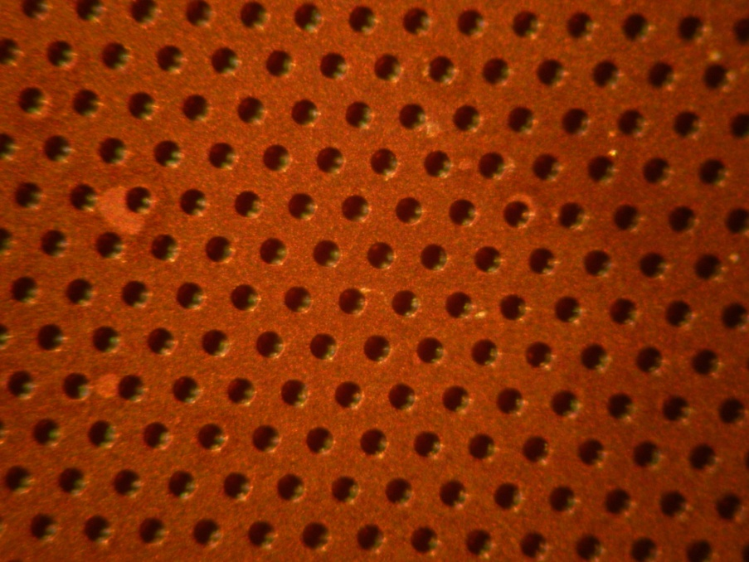
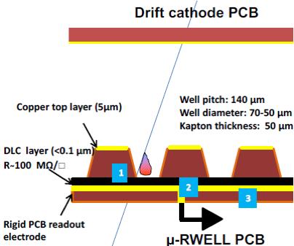
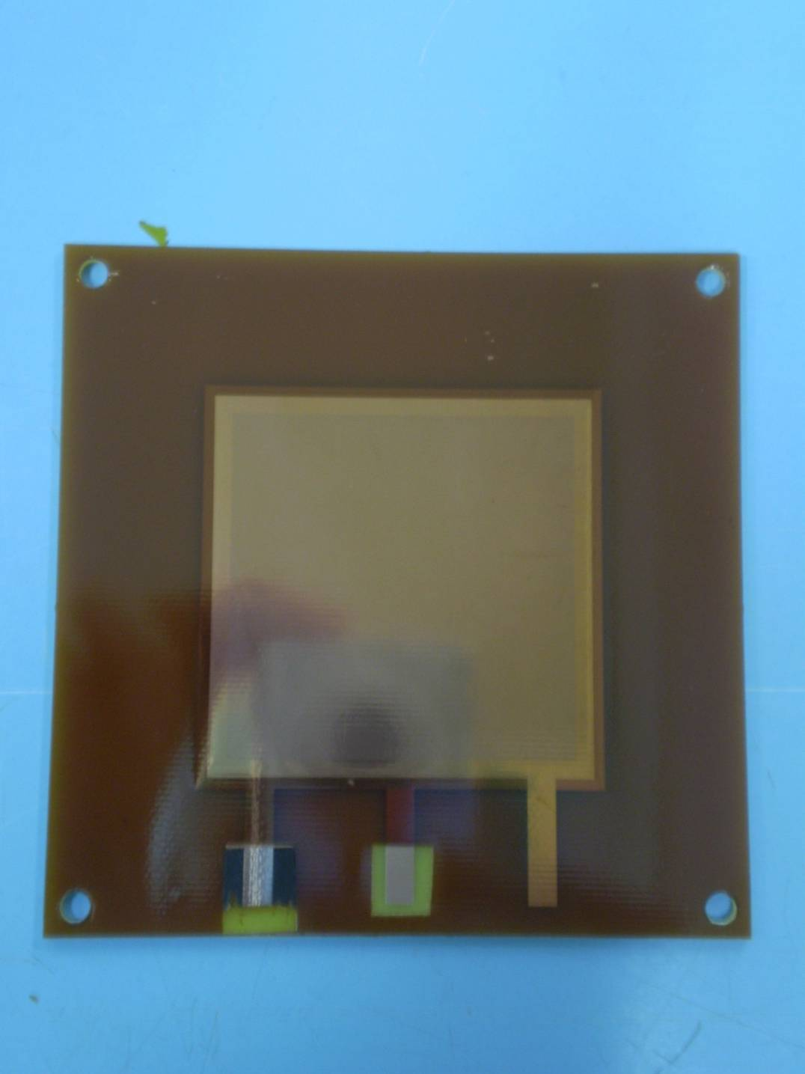
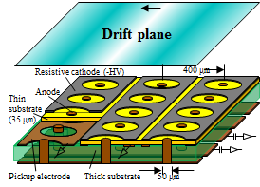
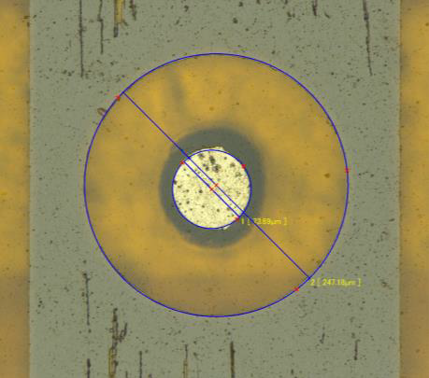
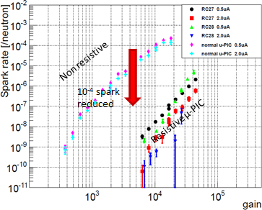
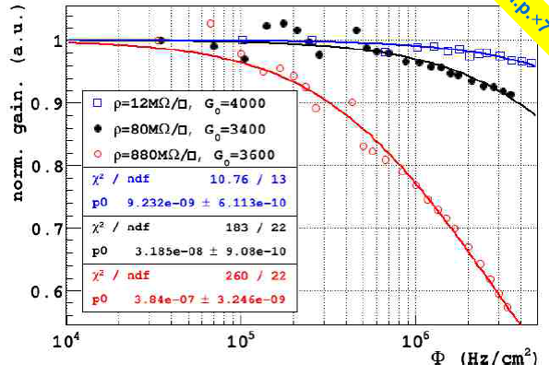
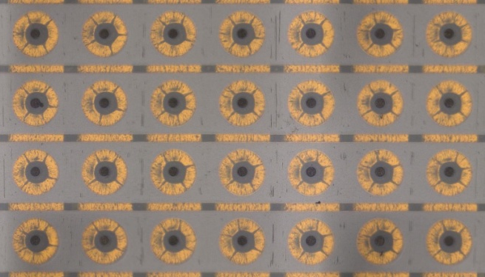
mPIC / m-RWELL for ATLAS Large-h Tagger Phase II Upgrade
Proposed for Phase II upgrade (~2023)
Need high granularity ~ 0.1mm
BG rate > 100kHz/cm² (HIP, gamma)
Rate tolerant, Pixel type detector needed
μ-RWELL Detector:
M. Poli Lener
μ-PIC with resistive Diamond-LC electrodes:
Very reliable
Almost completely discharge-free
adequate for high particle rates O(1MHz/cm²) thanks to the segmented-resistive-layer
suitable for large area applications (1.8 x 1.2 m² proto was tested in 2017)
F. Yamane
Spark rate reduction using
resistive μ-PIC for fast neutron
Resistive μ-PIC
using sputtered C:

Slide 32
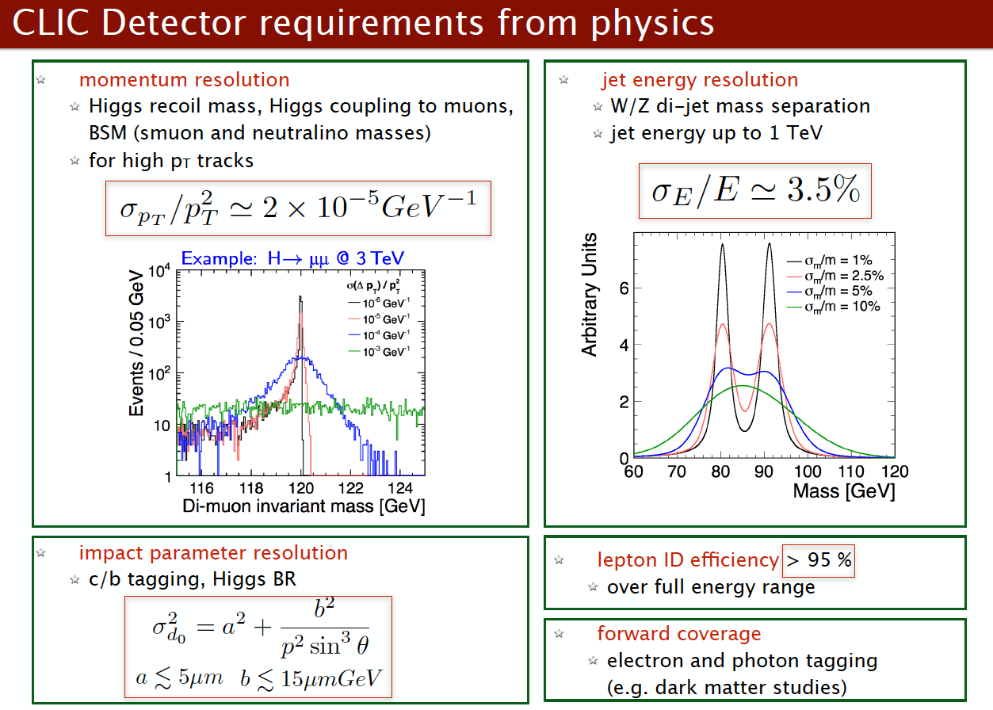
Muon detector for FCC-ee

Slide 33
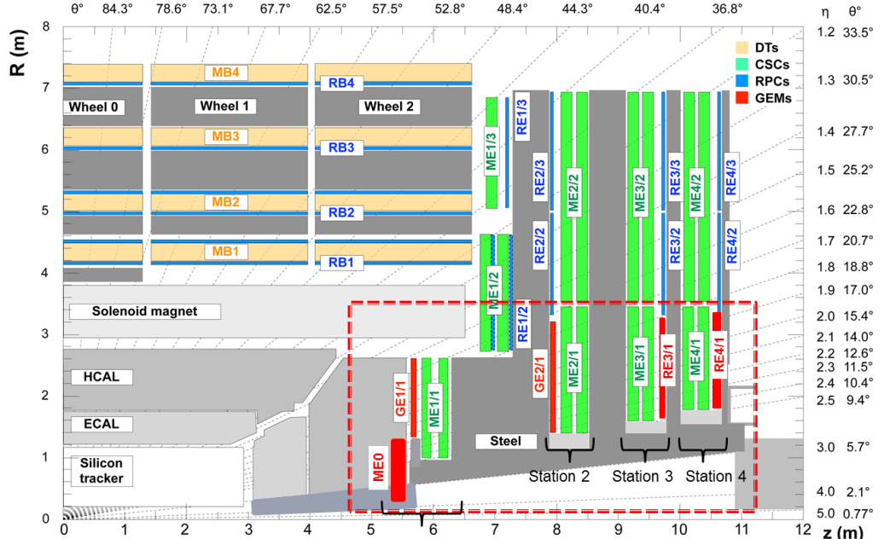
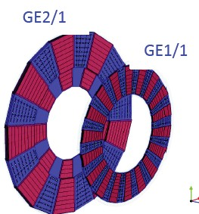
GEM Phase 2 Forward muon system
GE21 L1 trigger rate reduction, enhance via redundancy, reconstruction
  ME0 detector extends coverage and performance of muon Id and trigger beyond η=2.4 up to η<2.8
ME0:
GE2/1:
Muon tagger at highest η (η <2.8)
36 20°super-module wedge each consists 6 layers of chambers.
Numb. of chambers: 216
Installation: July 2024
1.6 < |η| < 2.4
36 20°super-chambers
Total number of chambers:72
Installation: YETS 2022
GEM Phase 2 : Trigger and reconstruction

Slide 34
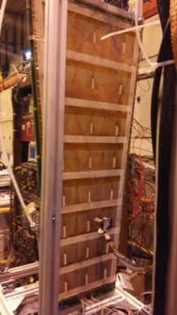
GE1/1 μ−RWELL: test at H8 (nov. 2016)
Construction & test of the first 1.2x0.5m² (GE1/1) µ-RWELL 2016
Mechanical study and mock-up of 1.8x1.2 m² (GE2/1) µ-RWELL 2016-2017
Construction of the first 1.8x1.2m² (GE2/1) µ-RWELL (only M4 active) 01-09/2017
GE1/1 μ−RWELL prototype
H8 Beam Area (18th Oct. 9th Nov 2016) Muon/Pion beam: 150 GeV/c
N° 2 LHCb µ-RWELL protos
10x10 cm²
40-35 MΩ/☐
400 µm pitch strips
Beam
S3
S2
S1
GEM Tracker 1
GEM Tracker 2
N° 1 CMS µ-RWELL proto
100x50 cm²
70 MΩ/☐
800 µm pitch strips

Slide 35
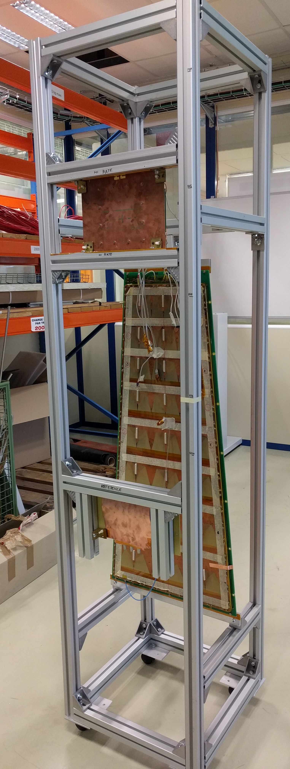
GE2/1 μ-RWELL: GIF++ ageing test
Context:
CMS Muon System, R&D Phase II Upgrade with MPGD: μ-RWELL
Motivations:
Need to qualify the behaviour and performance of
μ-RWELL detectors in a harsh radiation environment.
1) GE1/1 μ-RWELL (ArCO2)
2) “high rate” μ-RWELL (ArCO2CF4)
    10cmx10cm
3) reference μ-RWELL (ArCO2)
    5cmx5cm
Duration of the test:
will stay at least 6 months. GE2/1 HL-LHC dose achievable in a short time (few weeks)
2 m
50 cm
50 cm

Slide 36
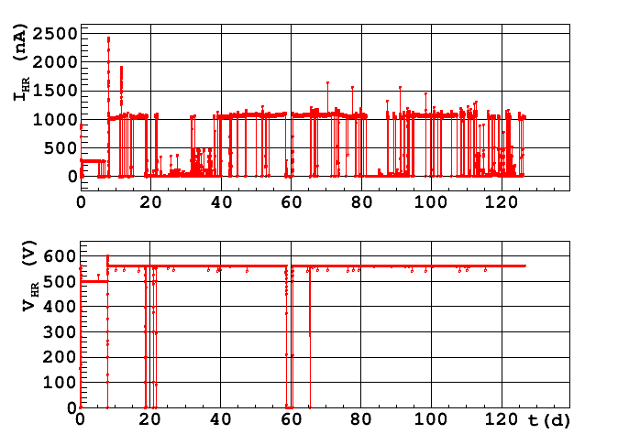
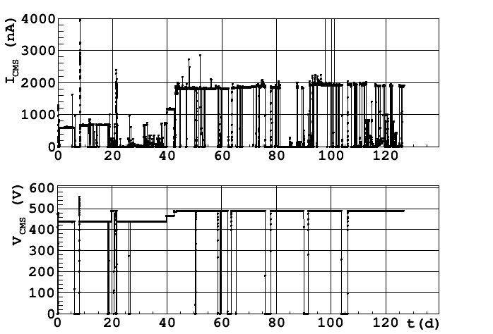
GE2/1 μ-RWELL: GIF++ ageing test
Highest spikes are of the order of 1-2 μA. This further demonstrates the intrinsic robustness of μ-RWELL.

Slide 37
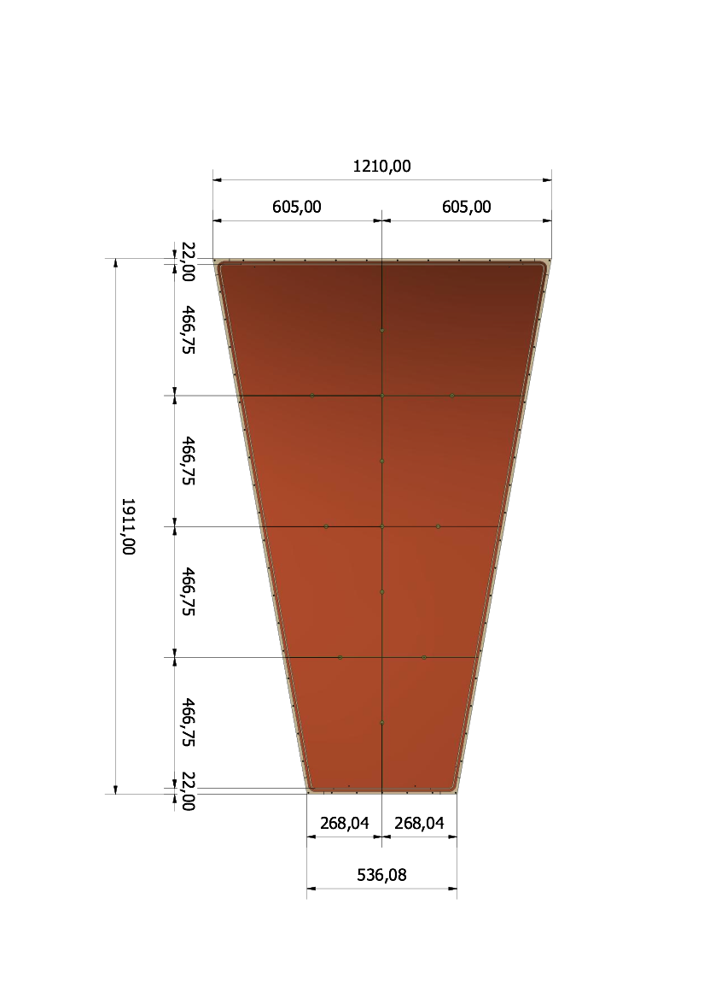
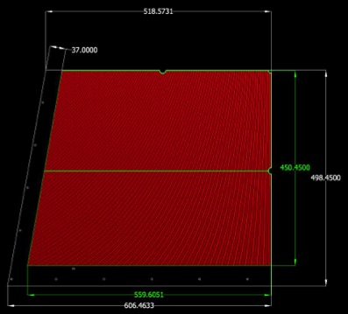
GE2/1 alternative option: μRWELL
We have built a full scale GE2/1 sector with 2 M4 μ-RWELL operating detectors.
M4 left and right are mirrored.
Size: 606.5 x 498.5 x 1 mm
Strip layout inspired to the GE2/1 GEM option
Final drawing finished (Gatta-LNF)
DLCed foils ready (Ochi-Kobe)
Preliminary tests at ELTOS done
PCB production at Eltos done, then glueing with kapton foil
M4
M3
M2
Modules fit within 74 mm
splicing → dead space less than 0.01%
M1

Slide 38
GE2/1 sector equipped with two active M4 μRWELL
M4 μRWell
M4 μRWELL detectors
Brought to H4 test beam on July 12th

