Slide 1





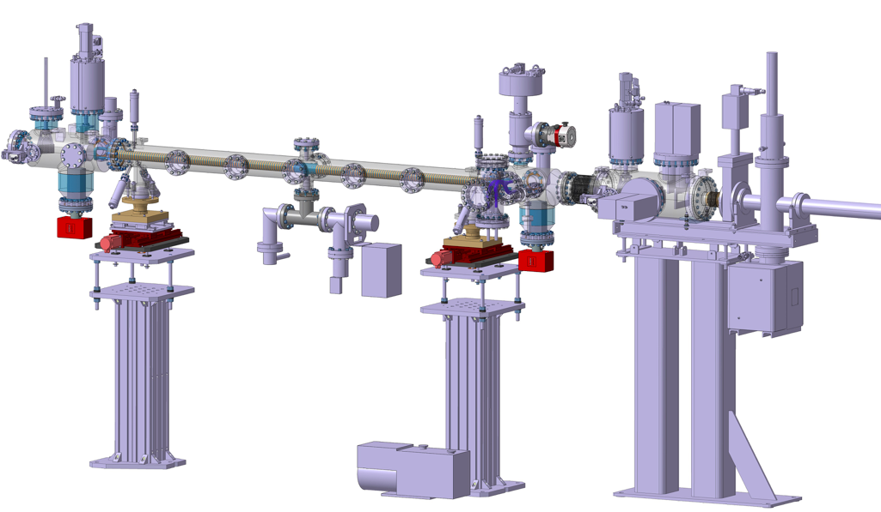
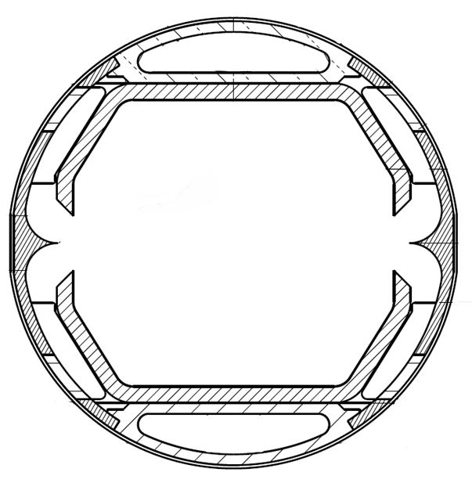


Results on the FCC-hh Beam Screen prototype at the KArlsruhe Research Accelerator (KARA)
L.A. Gonzalez,^{1, 2}
M. Gil Costa,^{3, 2} P. Chiggiato,² V. Baglin,² C. Garion,² R.Kersevan,² S. Casalbuoni,⁴ E. Huttel,⁴ I. Bellafont^{2,5} and F. Perez⁵
1
2
3
4
5
Task4.6: Measurements on cryogenic
beam vacuum system prototype
Results on the FCC-hh Beam Screen prototype at the KIT electron storage ring
Luis Gonzalez
LNF-INFN/CERN TE-VSC
FCC Week 2018 April 10th

Slide 2
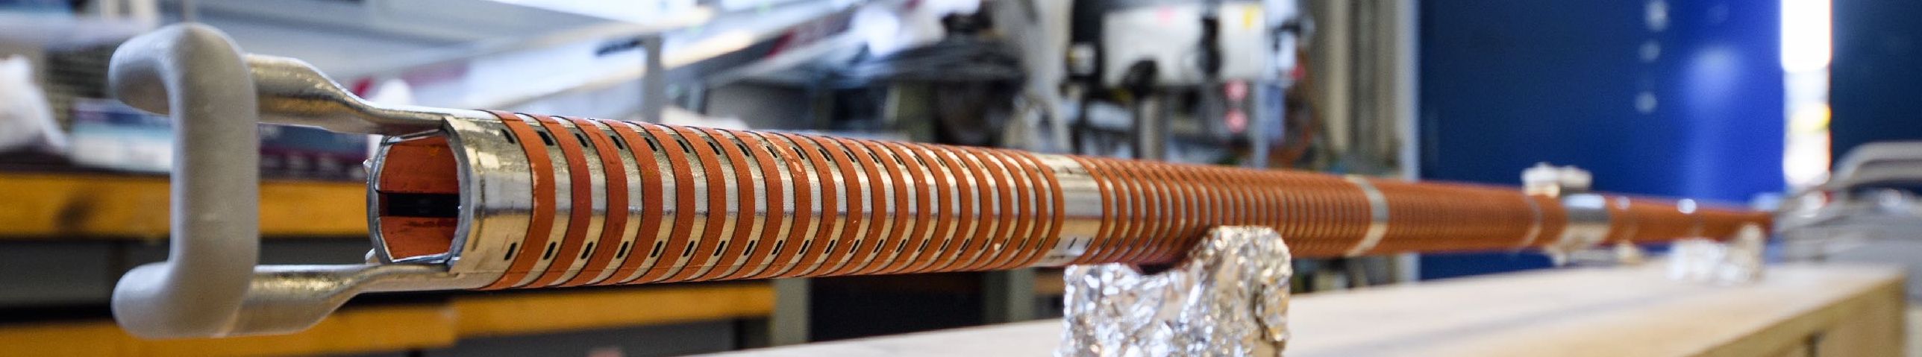
Motivation of Experiment
Validation of Simulation Techniques
used for the real machine
PSD
Reflectivity
Heat Load
Photoelectron Generation
 | LHC - 0.58A 7TeV | FCC-hh - 0.5A 50TeV
SR power [W/m] | 0,2 | 35,2
Flux* ph/m/s | 4,2·10¹⁶ | 1,5·10¹⁷
Critical Energy | 44,2eV | 4,3 KeV
*Photon energy above 4eV
R.Kersevan; Beam Dynamics meets Vacuum, Collimations, and Surfaces Workshop. KIT, Karlsruhe. March 2017
Test of FCC-hh Beam Screen at the ANKA Beamline.
Results on the FCC-hh Beam Screen prototype at the KIT electron storage ring
1
Luis Gonzalez
LNF-INFN/CERN TE-VSC
CERN February 20th 2018
FCC Week 2018 April 10th

Slide 3
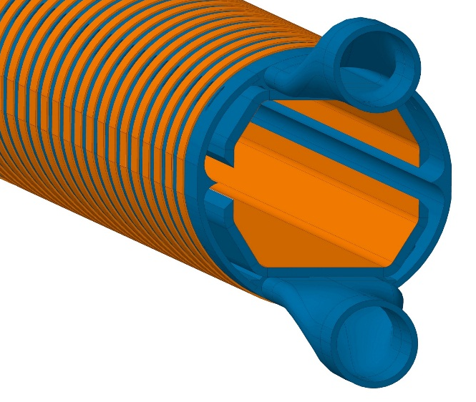
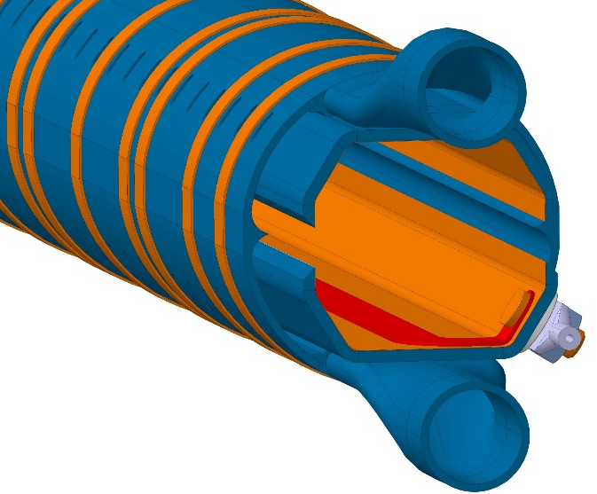
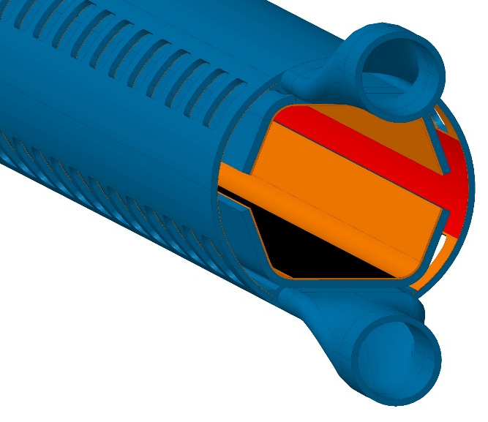
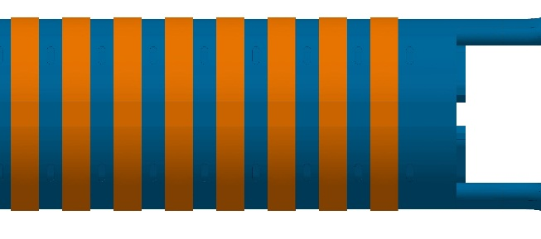
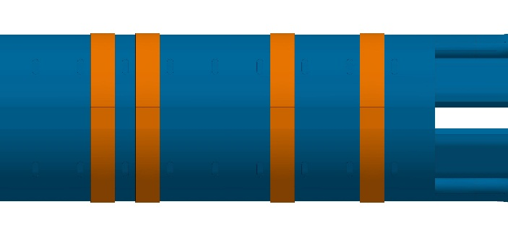
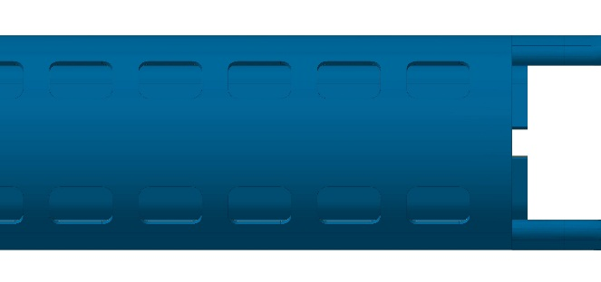
Samples: FCC-hh Beam Screen Prototypes
Prototype #1 July- Oct ‘17
Prototype #2 Jan- May ‘18
Prototype #3 June-Aug‘18
#1: Validation of temperature profile and validity of photon reflector
#2: #1 + Electrode for photoelectron current measurements
#3: Surface treatments as for baseline. Updated internal screen and pumping slots. Substitution Reflector for Sawtooth
Test of FCC-hh Beam Screen at the ANKA Beamline.
Results on the FCC-hh Beam Screen prototype at the KIT electron storage ring
2
Luis Gonzalez
LNF-INFN/CERN TE-VSC
CERN February 20th 2018
FCC Week 2018 April 10th

Slide 4
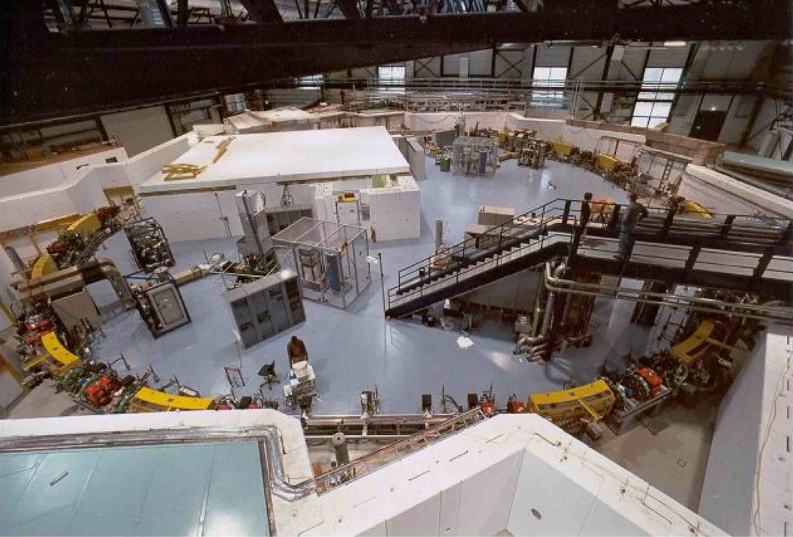
Experiment at KARA
KARA
(KArlsruhe Research Accelerator)
Ec FCC-hh = 4.2 KeV
Ec KARA = 6.2KeV
KARA reasonably resembles FCC-hh’s spectrum and linear power, and even at nominal beam energy (2.5 GeV) ANKA’s spectrum is a close match of that of FCC-hh.
Simulations performed with Synrad; M. Ady, R. Kersevan, M.Grabski, IPAC15. http://test-molflow.web.cern.ch/node/107
Test of FCC-hh Beam Screen at the ANKA Beamline.
Results on the FCC-hh Beam Screen prototype at the KIT electron storage ring
3
Luis Gonzalez
LNF-INFN/CERN TE-VSC
CERN February 20th 2018
FCC Week 2018 April 10th

Slide 5
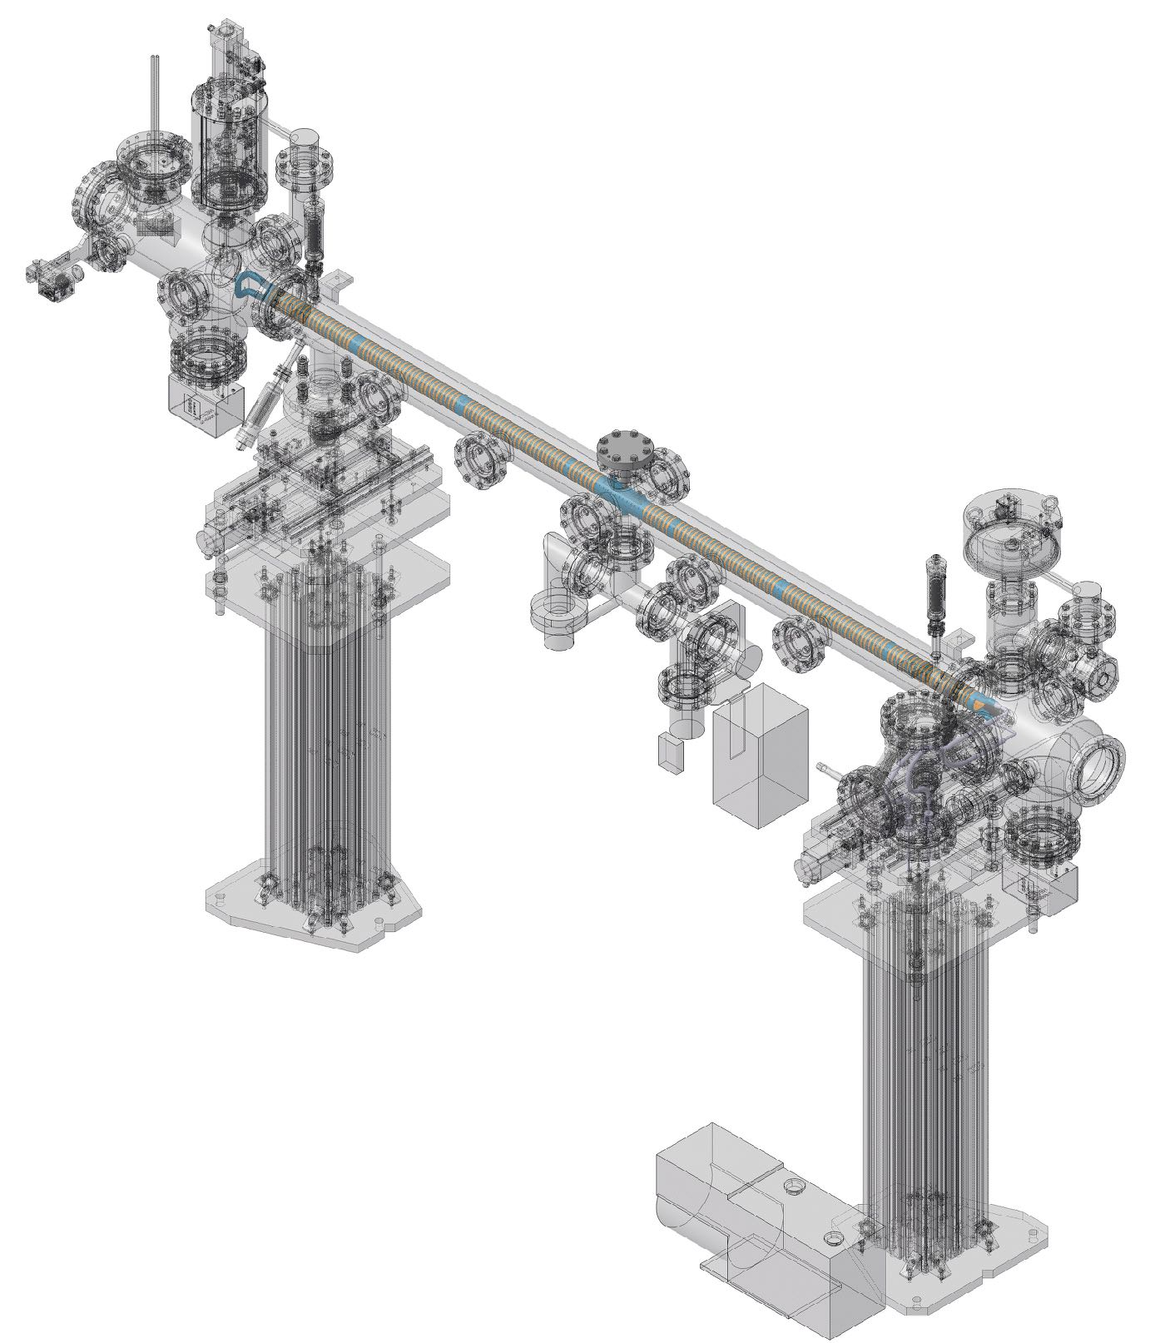
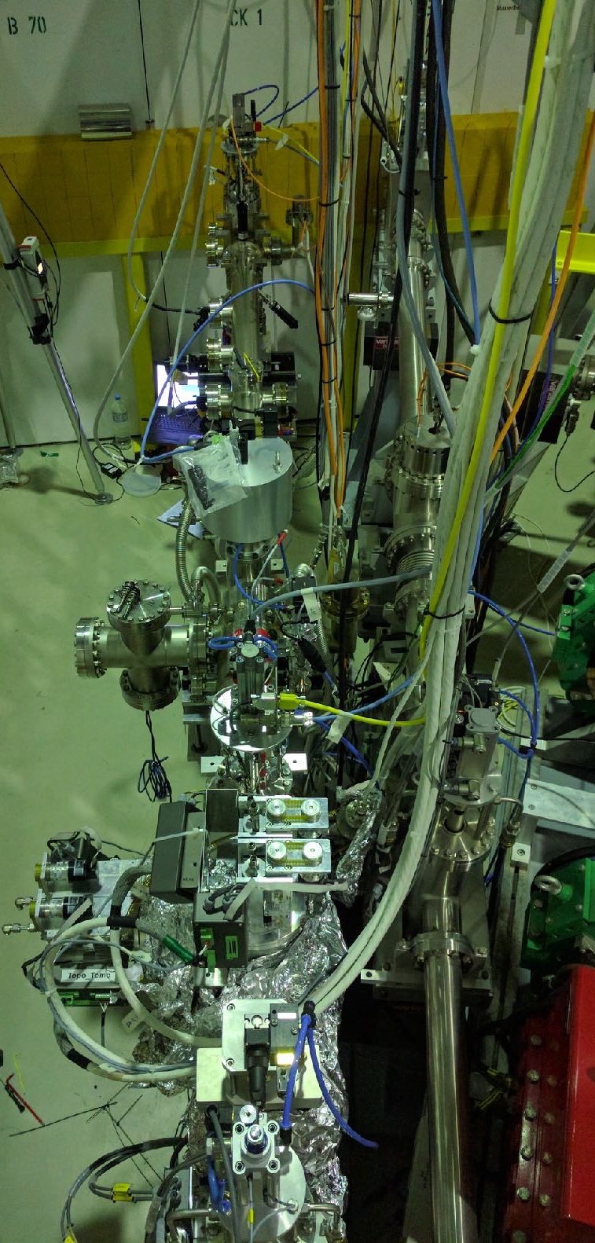
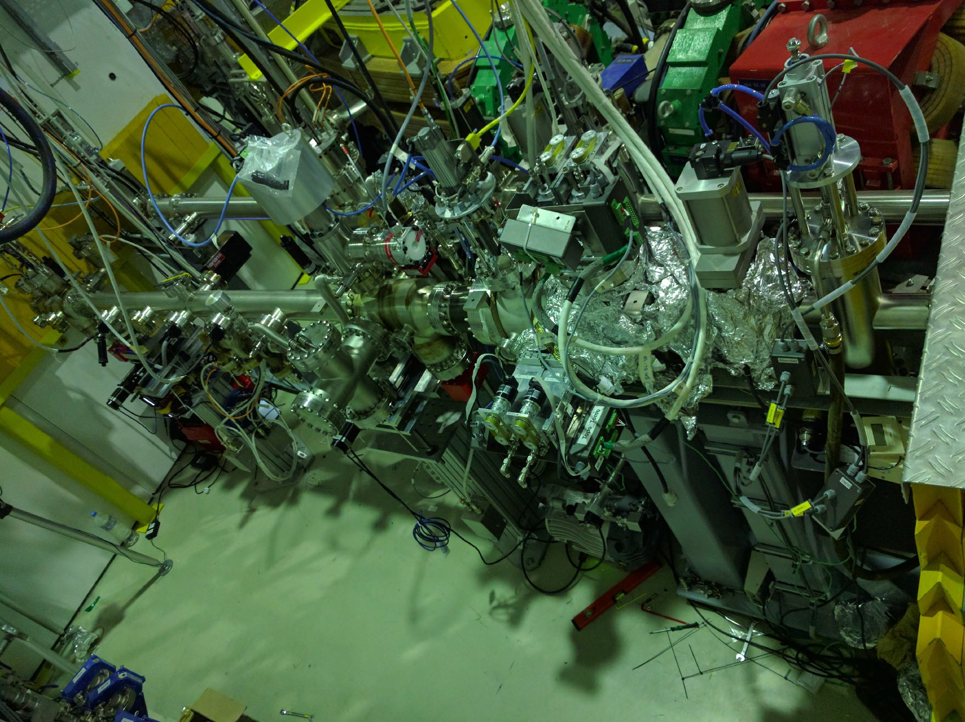
Experiment at KARA
The Setup
BEam Screen Testbench EXperiment
BESTEX (Installation May 2017)
Beam
Test of FCC-hh Beam Screen at the ANKA Beamline.
Results on the FCC-hh Beam Screen prototype at the KIT electron storage ring
6
Luis Gonzalez
LNF-INFN/CERN TE-VSC
CERN February 20th 2018
FCC Week 2018 April 10th

Slide 6
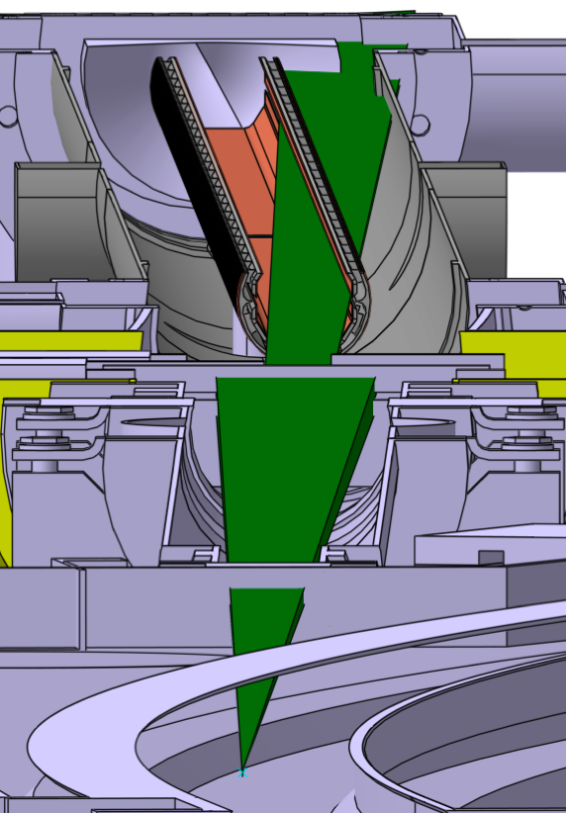
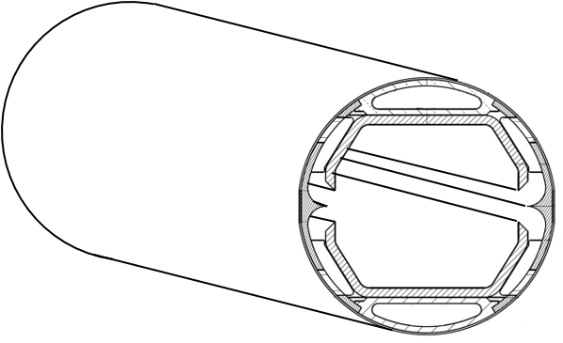
Experiment at KARA
Irradiated length 1.8m
KARA e-Beam
2m FCC-hh Protoype
D-horizontal
θ
D-vertical
2m
Test of FCC-hh Beam Screen at the ANKA Beamline.
Results on the FCC-hh Beam Screen prototype at the KIT electron storage ring
4
Luis Gonzalez
LNF-INFN/CERN TE-VSC
CERN February 20th 2018
FCC Week 2018 April 10th

Slide 7
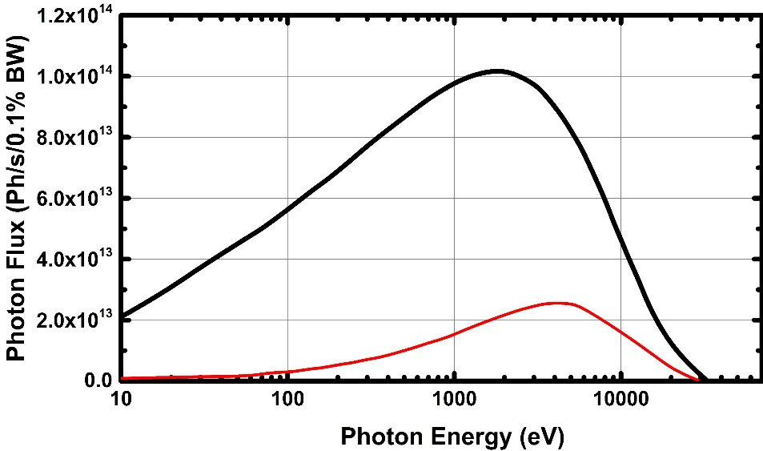
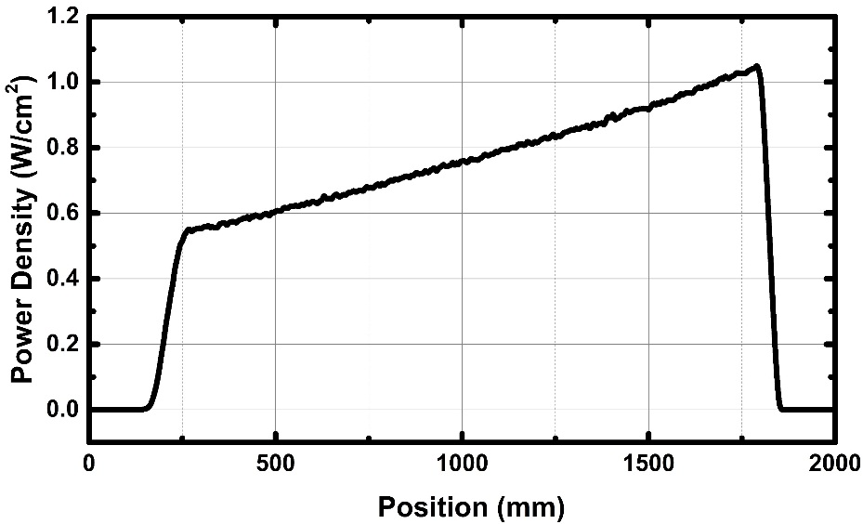
Experiment at KARA
Beam Direction
1.8m
 | KARA | FCC-hh
SR Flux | 8.7E+16ph/s | 1.5E+17ph/s
SR Power | 32W/m | 32W/m
Angle of Incidence | 18mrad | <2 mrad
Ec | 6.2KeV | 4.2KeV
After collimation :
83% of Photon Flux Cropped
69% of Photon Power Cropped
Test of FCC-hh Beam Screen at the ANKA Beamline.
Results on the FCC-hh Beam Screen prototype at the KIT electron storage ring
5
Luis Gonzalez
LNF-INFN/CERN TE-VSC
CERN February 20th 2018
FCC Week 2018 April 10th

Slide 8
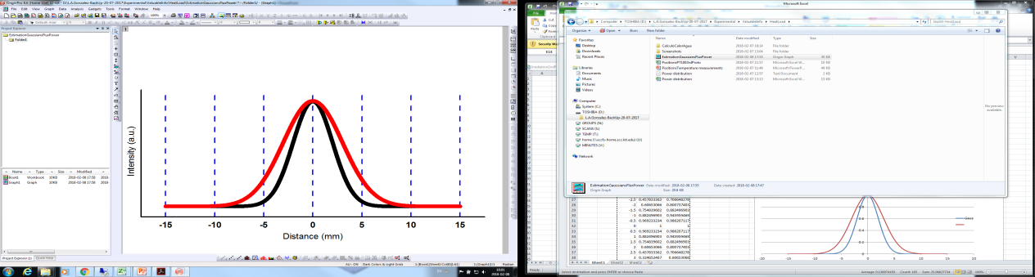
Experiment at KARA
Experimental Configurations
Ph Flux = 8.73E+16 Ph/s
Normal operation of FCC-hh
Misalignment @ FCC-hh
Ph Flux = 8.73E+16 Ph/s
Power
Flux
Geometry #1
Geometry #4
Power
Flux
Power
Flux
Geometry #2
Power
Flux
Geometry #3
Ph Flux = 1.44E+17 Ph/s
Injection @ FCC-hh
Injection @ FCC-hh
Ph Flux = 1.44E+17 Ph/s
Test of FCC-hh Beam Screen at the ANKA Beamline.
Results on the FCC-hh Beam Screen prototype at the KIT electron storage ring
7
Luis Gonzalez
LNF-INFN/CERN TE-VSC
CERN February 20th 2018
FCC Week 2018 April 10th

Slide 9
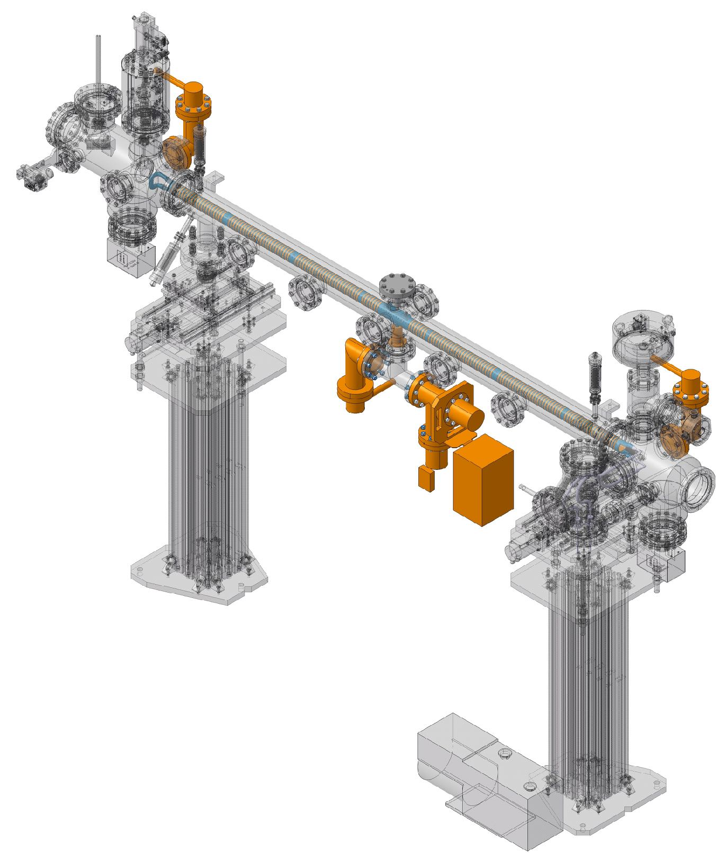
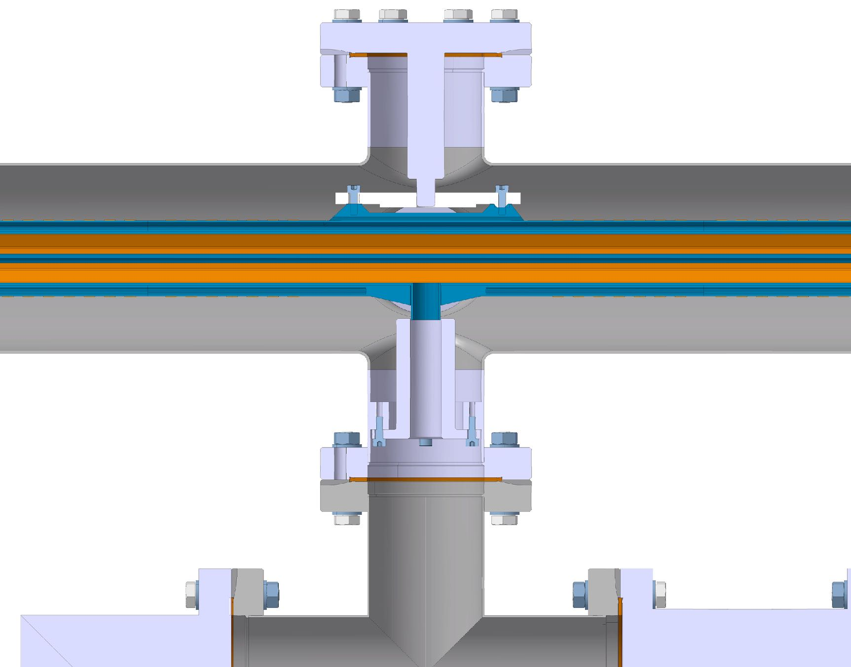
Experiment at KARA
PSD Studies
Back End BAG
Front End BAG
Beam
Middle
BAG + RGA
Chimney Connection
Test of FCC-hh Beam Screen at the ANKA Beamline.
Results on the FCC-hh Beam Screen prototype at the KIT electron storage ring
8
Luis Gonzalez
LNF-INFN/CERN TE-VSC
CERN February 20th 2018
FCC Week 2018 April 10th

Slide 10
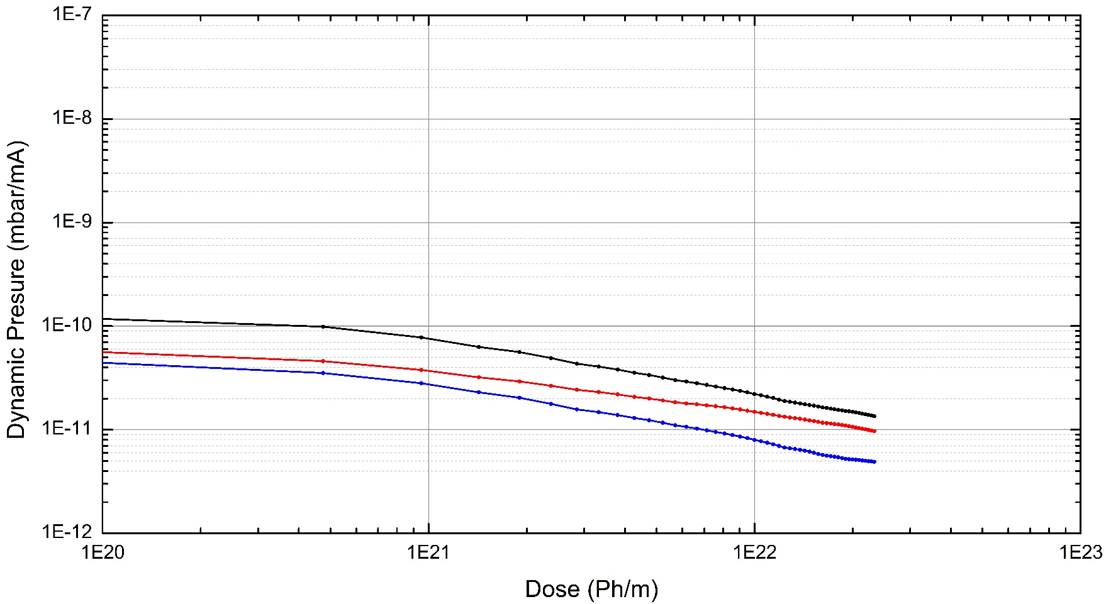
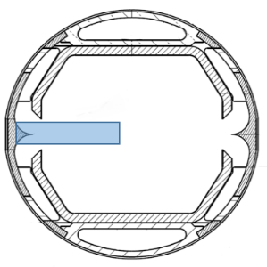
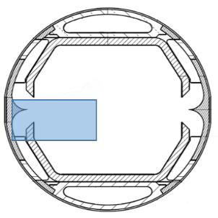
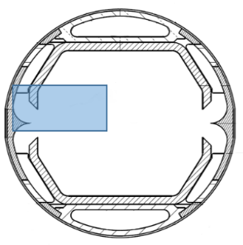
Experiment at KARA
PSD Studies
Experimental Results Prototype #1
Middle
Front
Back
Middle
Front
Back
During Irradiation of Geom #1 Dynamic pressure decreases due to conditioning as photon dose increases
#1
#2
#3
#4
Test of FCC-hh Beam Screen at the ANKA Beamline.
Results on the FCC-hh Beam Screen prototype at the KIT electron storage ring
9
Luis Gonzalez
LNF-INFN/CERN TE-VSC
CERN February 20th 2018
FCC Week 2018 April 10th

Slide 11
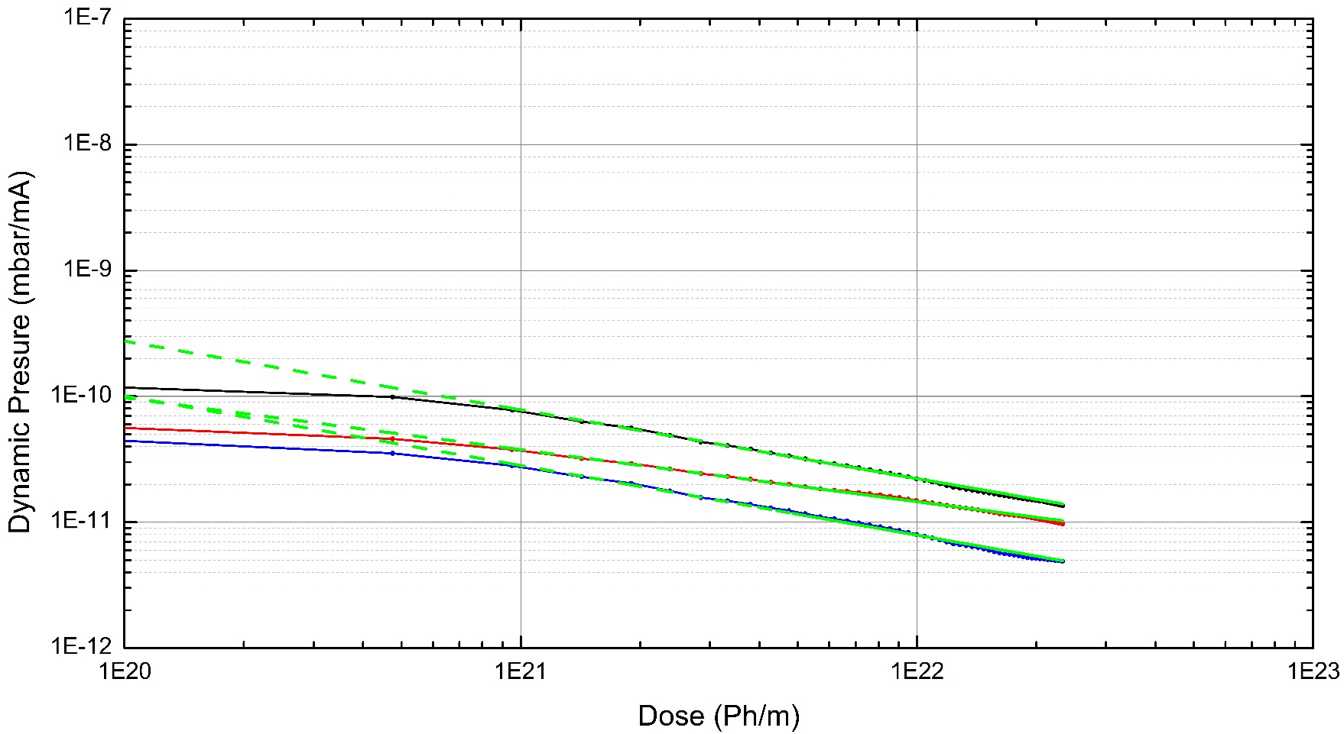

Experiment at KARA
PSD Studies
Experimental Results Prototype #1
Middle
Front
Back
Middle
Front
Back
Levenberg-Marquardt Algorithm
X=-0.54 ± 0.01
X=-0.41 ± 0.01
X=-0.55 ± 0.01
During Irradiation of Geom #1 Dynamic pressure decreases due to conditioning as photon dose increases
For doses higher than 1x10²² ph/m the normalized pressures decrease linearly
$$η∝Γ^{x}$$
#1
#2
#3
#4
Test of FCC-hh Beam Screen at the ANKA Beamline.
10
Luis Gonzalez
LNF-INFN/CERN TE-VSC
CERN February 20th 2018

Slide 12
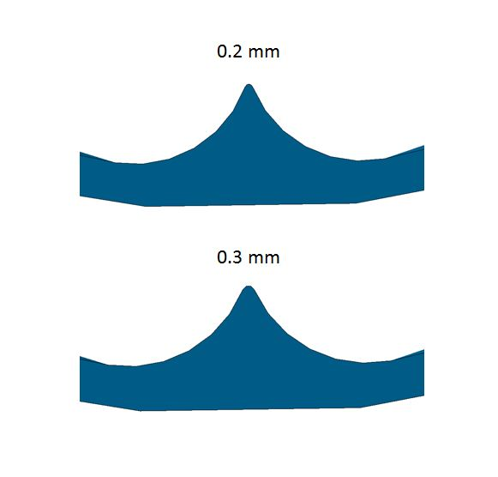
Experiment at KARA
PSD Studies
Experimental Results – Comparison with Calculations
 | 2.5GeV/130mA
 | 3Ah |  |  | 9.5Ah
 | Experiment | Calculations | Rel Discrepancy % | Experiment | Calculations | Rel Discrepancy %
Middle (mbar) | 5.7E-09 ± 15% | 6.3E-9 | 9% | 3.0E-09 ± 15% | 3.3E-9 | 13.2%
Front (mbar) | 2.9E-09 ± 15% | 2.9E-9 | 1% | 2.0E-09 ± 15% | 1.6E-9 | 15%
Back (mbar) | 2.0E-09 ± 15% | 2.8E-9 | 29% | 1.0E-09 ± 15% | 1.4E-9 | 25%
Important aspects to take
into account for a realistic model
Not leak tight Chimney
Rounded reflector
…
Results on the FCC-hh Beam Screen prototype at the KIT electron storage ring
Test of FCC-hh Beam Screen at the ANKA Beamline.
11
Luis Gonzalez
LNF-INFN/CERN TE-VSC
CERN February 20th 2018
FCC Week 2018 April 10th

Slide 13
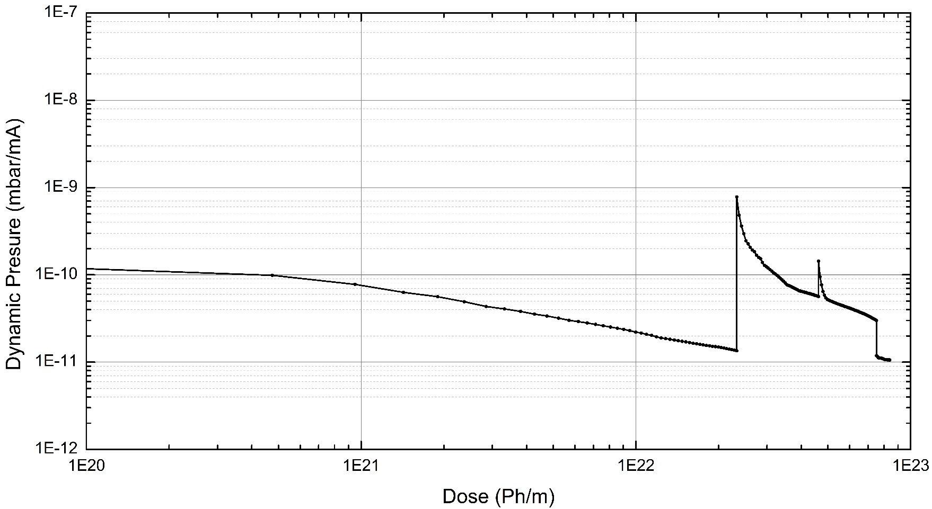
Experiment at KARA
PSD Studies
Experimental Results Prototype #1
At Geom #2 photon dose increases irradiating new areas away from the effect of the reflector - Normalized pressure increases
At Geom #3 normalized pressure continue the decreasing rate observed at #2 – Preconditioning of the inner chamber due to reflected photons
Back to Geom #1 the normalized pressure recovers the original decreasing trend
Middle
#1
#2
#3
#1
#1
#2
#3
#4
Test of FCC-hh Beam Screen at the ANKA Beamline.
Results on the FCC-hh Beam Screen prototype at the KIT electron storage ring
12
Luis Gonzalez
LNF-INFN/CERN TE-VSC
CERN February 20th 2018
FCC Week 2018 April 10th

Slide 14
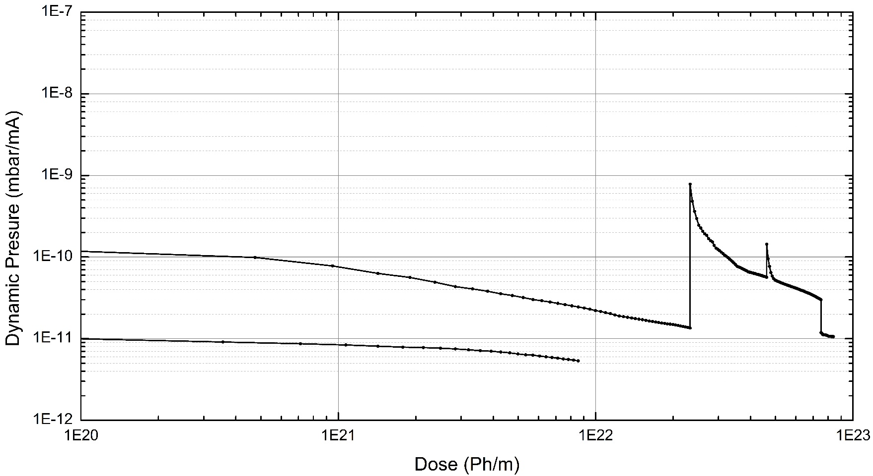
Experiment at KARA
PSD Studies
Experimental Results Prototype #1
At Geom #4, the pressure evolution indicates preconditioning of the inner chamber due to reflected photons during previous geometries
Middle
#4
#1
#2
#3
#4
Test of FCC-hh Beam Screen at the ANKA Beamline.
Results on the FCC-hh Beam Screen prototype at the KIT electron storage ring
14
Luis Gonzalez
LNF-INFN/CERN TE-VSC
CERN February 20th 2018
FCC Week 2018 April 10th

Slide 15
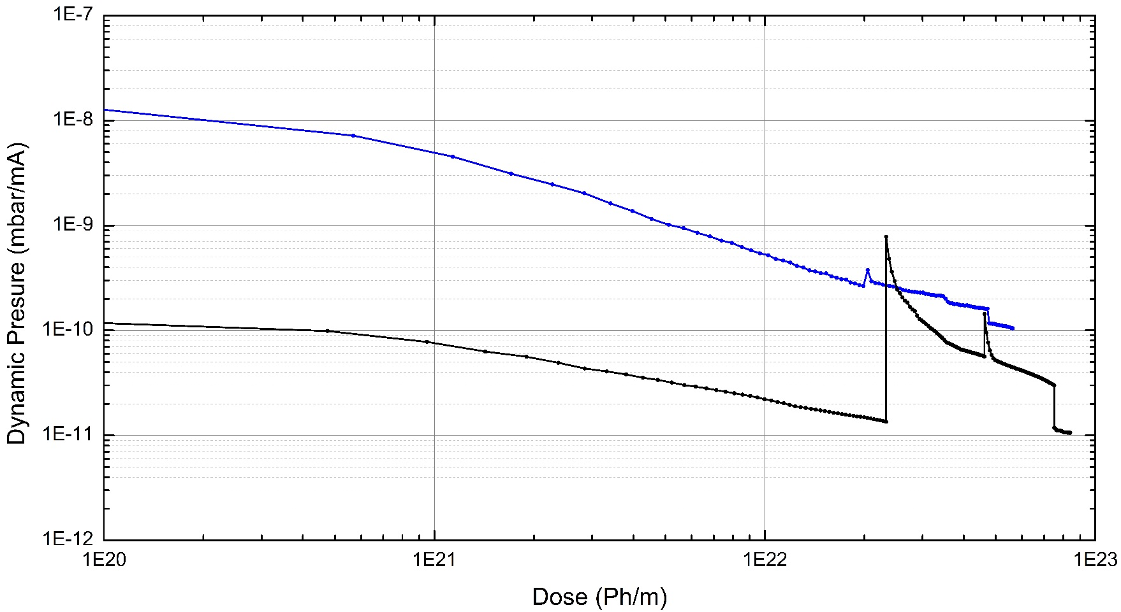
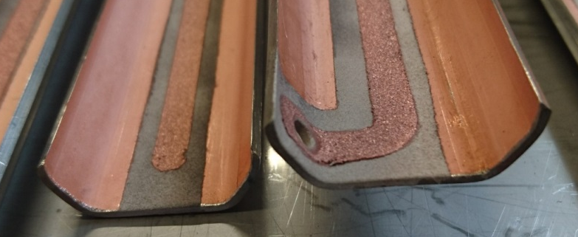
Experiment at KARA
PSD Studies
Experimental Results Prototype #2
At low doses, normalized pressure is about 100 times higher than for Proto#1 - Effect ascribed to the cold sprayed Cu and ceramics
The pressure increase at Geoms #2 and #3 is negligible
The effect of a large amount of photons reflected into the main chamber is now visible due to the presence of clearing electrode and ceramics
Back to Geom #1 the normalized pressure recovers the original decreasing trend
#1
#2
#3
#1
Middle Prototype #2
Middle Prototype #1
#1
#2
#3
#1
#1
#2
#3
#4
Test of FCC-hh Beam Screen at the ANKA Beamline.
Results on the FCC-hh Beam Screen prototype at the KIT electron storage ring
15
Luis Gonzalez
LNF-INFN/CERN TE-VSC
CERN February 20th 2018
FCC Week 2018 April 10th

Slide 16
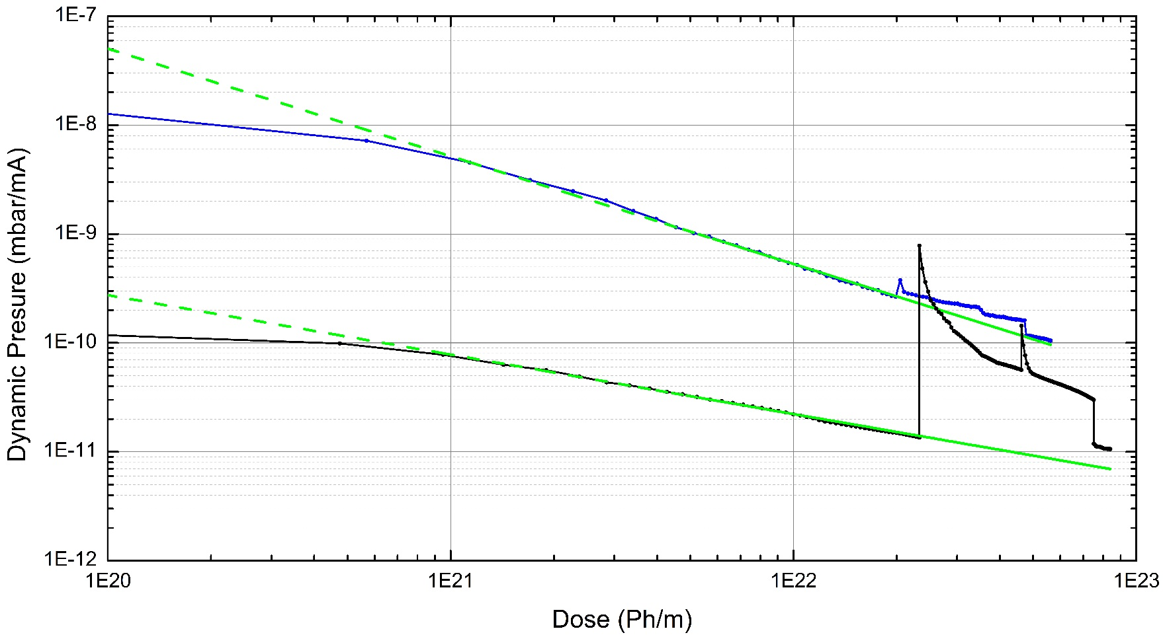
Experiment at KARA
PSD Studies
Experimental Results Prototype #2
At low doses, normalized pressure is about 100 times higher than for Proto#1 - Effect ascribed to the cold sprayed Cu and ceramics
The pressure increase at Geoms #2 and #3 is negligible
The effect of a large amount of photons reflected into the main chamber is now visible due to the presence of clearing electrode and ceramics
Back to Geom #1 the normalized pressure recovers the original decreasing trend
Sample#1
Sample#2
Levenberg-Marquardt Algorithm
X=-0.54 ± 0.01
X=-0.98 ± 0.01
Middle Prototype #2
Middle Prototype #1
$$η∝Γ^{x}$$
#1
#2
#3
#4
Test of FCC-hh Beam Screen at the ANKA Beamline.
Results on the FCC-hh Beam Screen prototype at the KIT electron storage ring
16
Luis Gonzalez
LNF-INFN/CERN TE-VSC
CERN February 20th 2018
FCC Week 2018 April 10th

Slide 17
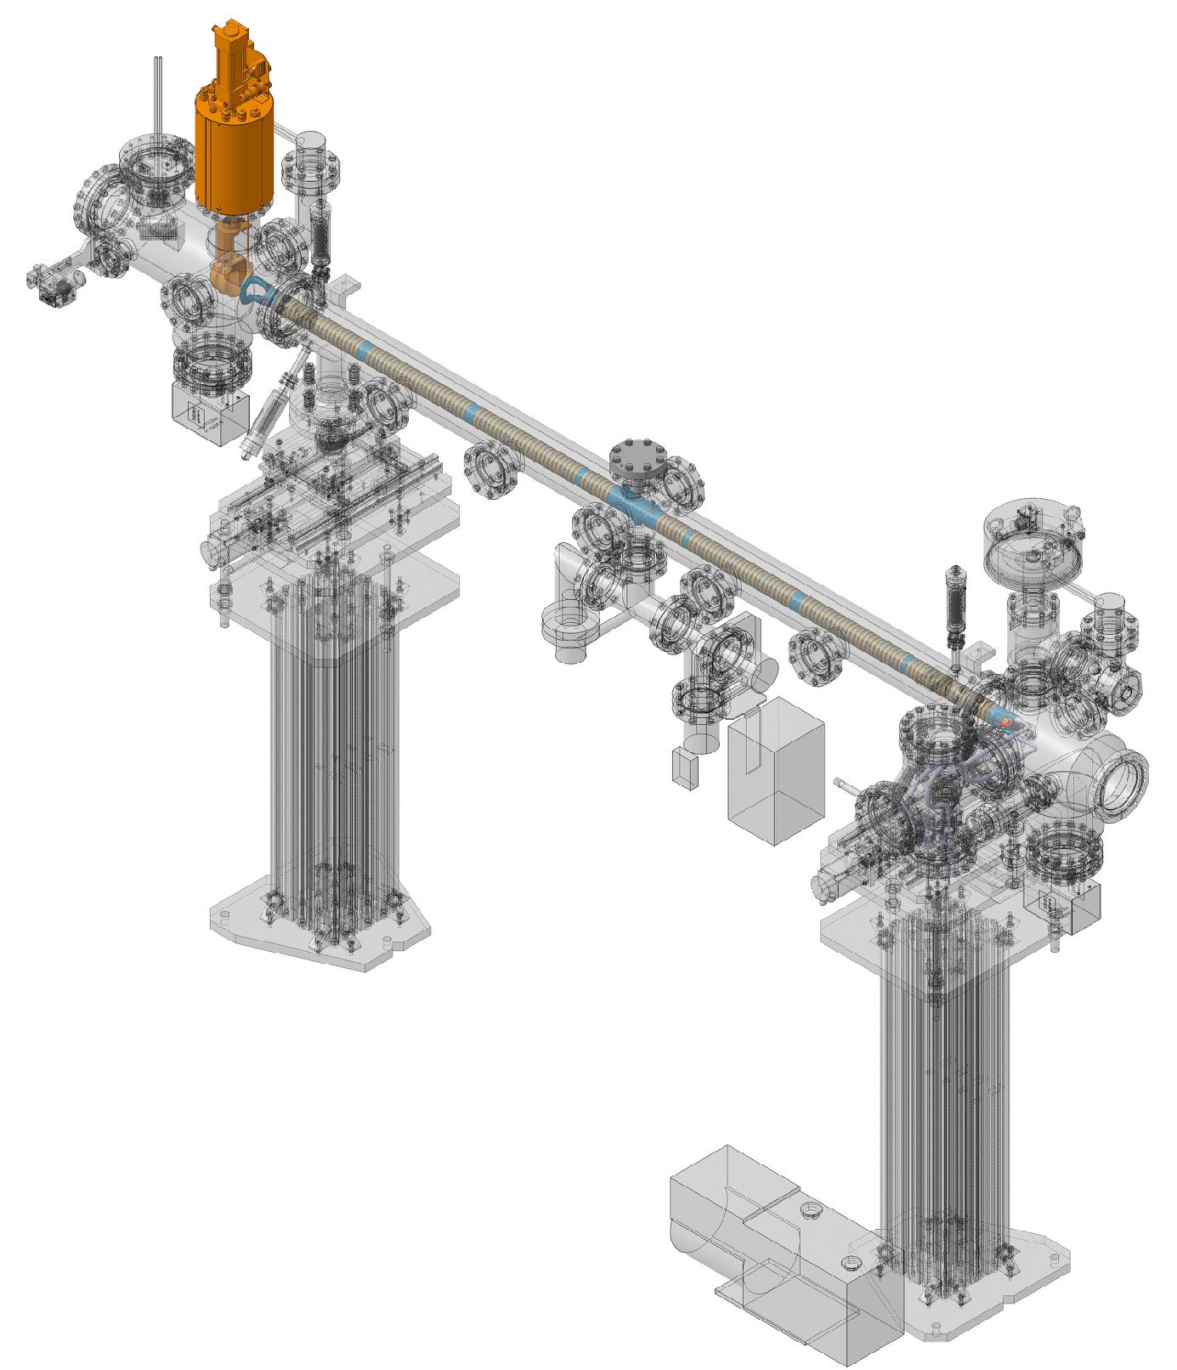
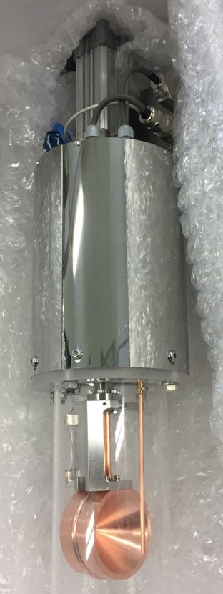
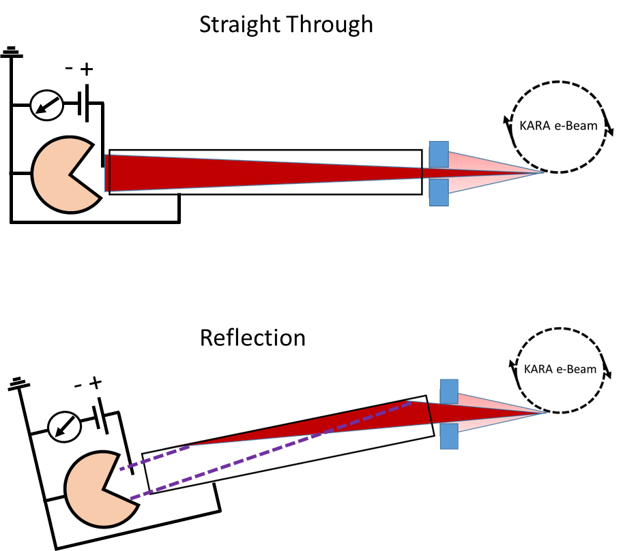

Experiment at KARA
Reflectivity Studies
Experimental Equipment
RI=$\frac{I_{Reflection}}{I_{Straight Through}}x100$
Beam
#1
#2
#3
#4
Test of FCC-hh Beam Screen at the ANKA Beamline.
Results on the FCC-hh Beam Screen prototype at the KIT electron storage ring
17
Luis Gonzalez
LNF-INFN/CERN TE-VSC
CERN February 20th 2018
FCC Week 2018 April 10th

Slide 18
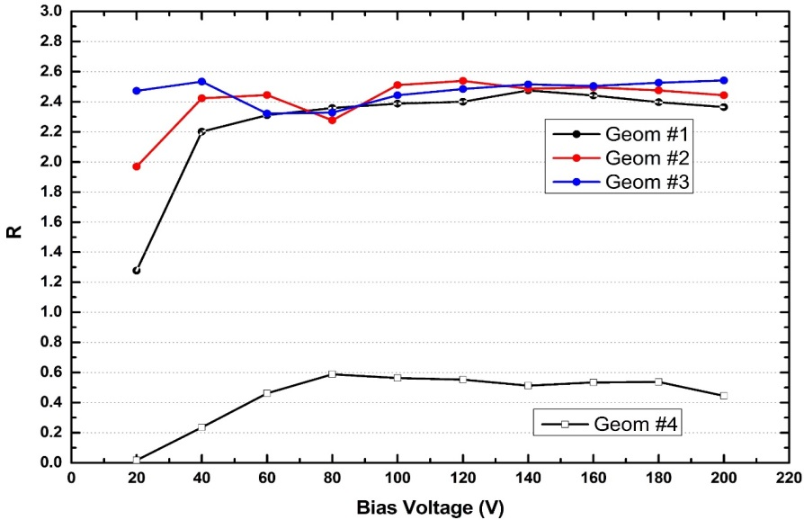

Experiment at KARA
Reflectivity Studies
Experimental Results Prototype #1
Photoelectron current measured at electrode
Comparison:
Straight vs Reflection
RI=$\frac{I_{Reflection}}{I_{Straight Through}}x100$
2.4%
0.5%
#1
#2
#3
#4
Test of FCC-hh Beam Screen at the ANKA Beamline.
Results on the FCC-hh Beam Screen prototype at the KIT electron storage ring
18
Luis Gonzalez
LNF-INFN/CERN TE-VSC
CERN February 20th 2018
FCC Week 2018 April 10th

Slide 19
Experiment at KARA
Reflectivity Studies
Experimental Results Prototype #1
Photoelectron current measured at electrode
Comparison:
Straight vs Reflection
The surface roughness and their aspect ratios were measured at different parts of the sample
RI=$\frac{I_{Reflection}}{I_{Straight Through}}x100$
2.4%
Stainless Steel
AR ~ 0.06
0.5%
Electrodeposited Cu
AR ~ 0.5
#1
#2
#3
#4
Test of FCC-hh Beam Screen at the ANKA Beamline.
Results on the FCC-hh Beam Screen prototype at the KIT electron storage ring
18
Luis Gonzalez
LNF-INFN/CERN TE-VSC
CERN February 20th 2018
FCC Week 2018 April 10th

Slide 20

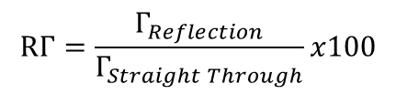


Experiment at KARA
Reflectivity Studies
Experimental Results Prototype #1
Photoelectron current measured at electrode
Comparison:
Straight vs Reflection
Calculation* of photons reaching photon cup
Comparison:
Straight vs Reflection
The surface roughness and their aspect ratios were measured at different parts of the sample
RI=$\frac{I_{Reflection}}{I_{Straight Through}}x100$
$$RΓ=\frac{Γ_{Reflection}}{Γ_{Straight Through}}x100$$
2.4%
Geom #1
Geom #2 and #3
Geom#4
$RΓ$=1.3%
$RΓ$=1.2%
Stainless Steel
AR ~ 0.06
0.5%
$RΓ$=0.3%
Electrodeposited Cu
AR ~ 0.5
#1
#2
#3
#4
Test of FCC-hh Beam Screen at the ANKA Beamline.
Results on the FCC-hh Beam Screen prototype at the KIT electron storage ring
18
Luis Gonzalez
LNF-INFN/CERN TE-VSC
CERN February 20th 2018
FCC Week 2018 April 10th

Slide 21
Experiment at KARA
Reflectivity Studies
Experimental Results Prototype #1
Photoelectron current measured at electrode
Comparison:
Straight vs Reflection
Calculation* of photons reaching photon cup
Comparison:
Straight vs Reflection
The surface roughness and their aspect ratios were measured at different parts of the sample
·
RI=$\frac{I_{Reflection}}{I_{Straight Through}}x100$
$$RΓ=\frac{Γ_{Reflection}}{Γ_{Straight Through}}x100$$
·
2.4%
Geom #1
Geom #2 and #3
Geom#4
$RΓ$=1.3%
$RΓ$=1.2%
Stainless Steel
AR ~ 0.06
0.5%
$RΓ$=0.3%
Electrodeposited Cu
AR ~ 0.5
Experimental results are in good correlation with Calculations
#1
#2
#3
#4
Test of FCC-hh Beam Screen at the ANKA Beamline.
Results on the FCC-hh Beam Screen prototype at the KIT electron storage ring
18
Luis Gonzalez
LNF-INFN/CERN TE-VSC
CERN February 20th 2018
FCC Week 2018 April 10th

Slide 22
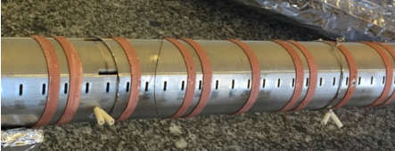
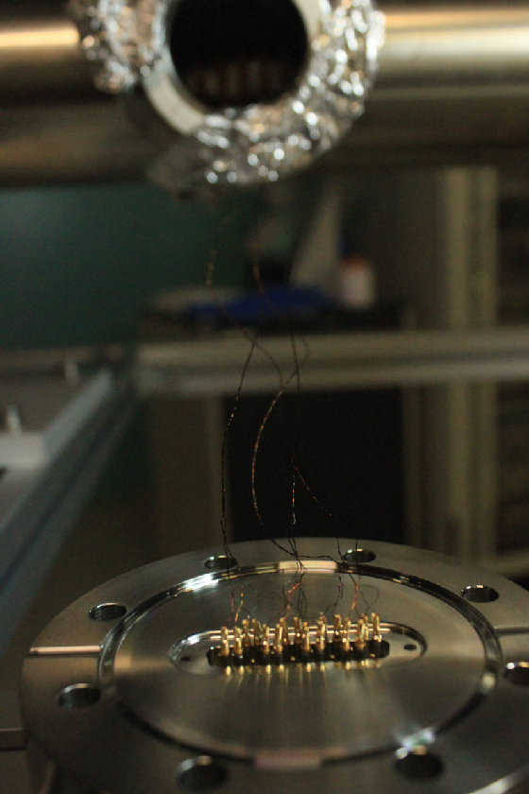
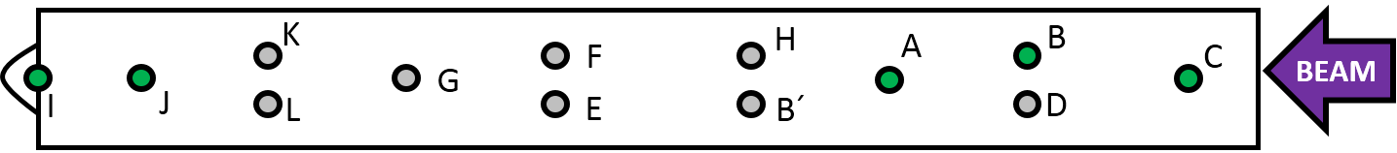
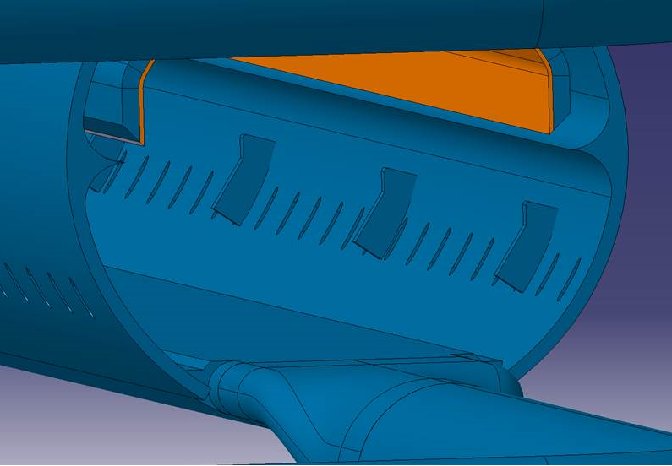
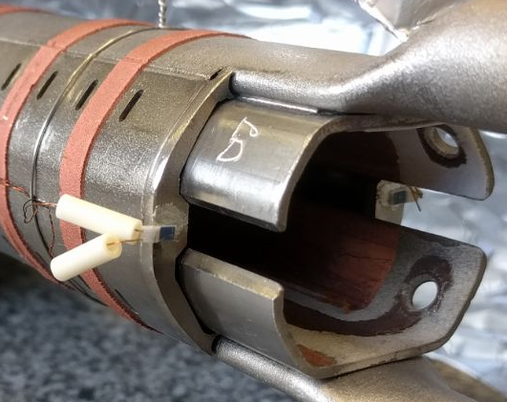
Experiment at KARA
Heat Load Studies
Experimental Equipment
PT100
PT100
Beam
Test of FCC-hh Beam Screen at the ANKA Beamline.
Results on the FCC-hh Beam Screen prototype at the KIT electron storage ring
19
Luis Gonzalez
LNF-INFN/CERN TE-VSC
CERN February 20th 2018
FCC Week 2018 April 10th

Slide 23
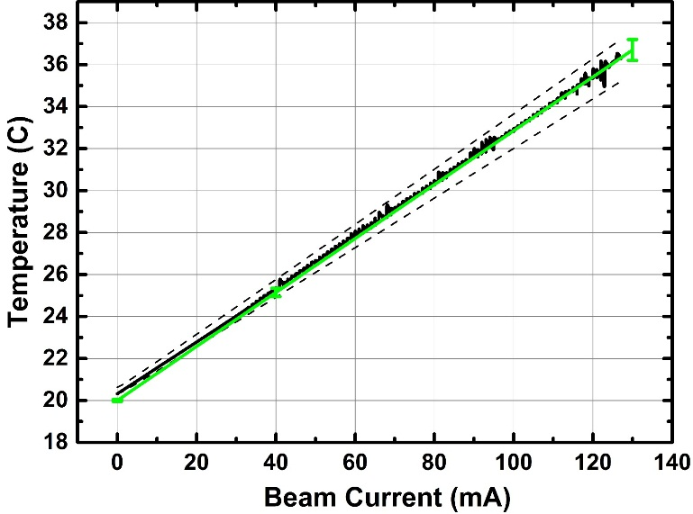
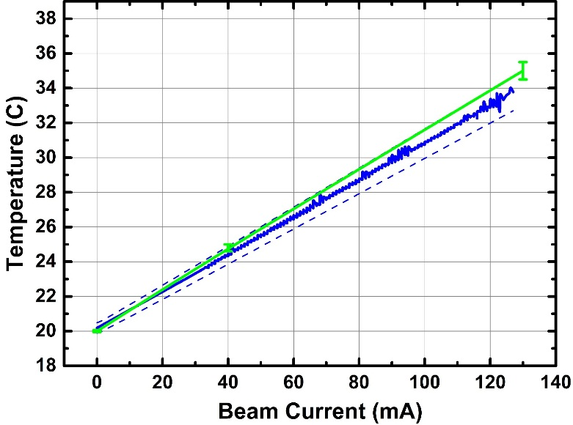
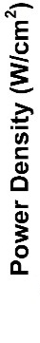
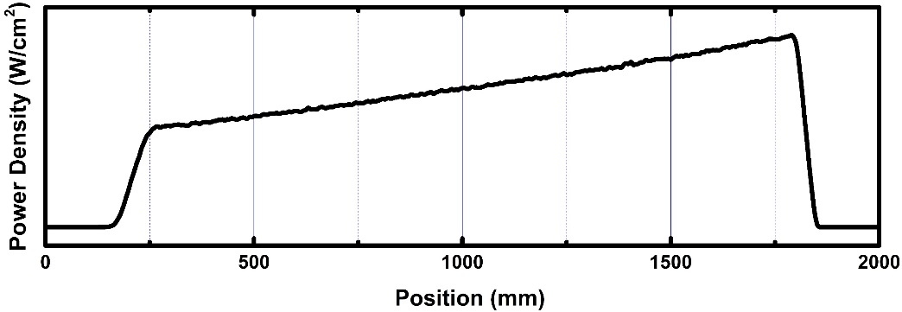

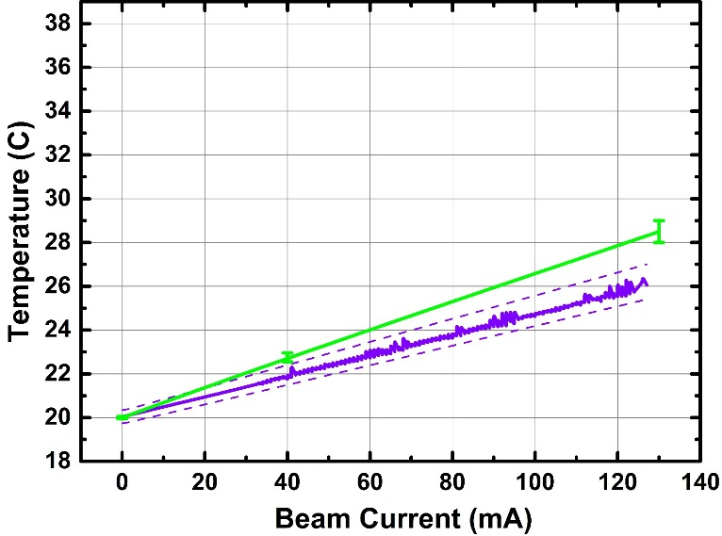
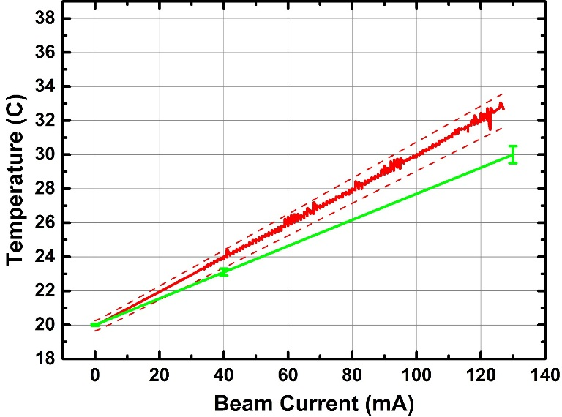
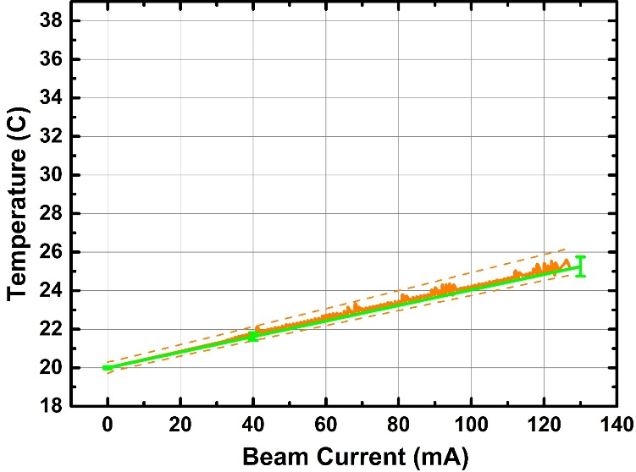

Experiment at KARA
Heat Load Studies
Experimental Results Prototype #2
Calculation
C
A
1.2
0
0
500
1000
1500
2000
J
B
I
Test of FCC-hh Beam Screen at the ANKA Beamline.
Results on the FCC-hh Beam Screen prototype at the KIT electron storage ring
20
Luis Gonzalez
LNF-INFN/CERN TE-VSC
CERN February 20th 2018
FCC Week 2018 April 10th

Slide 24
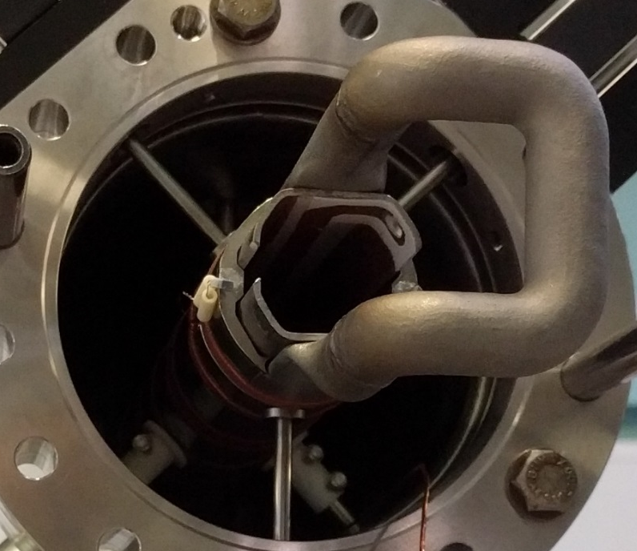

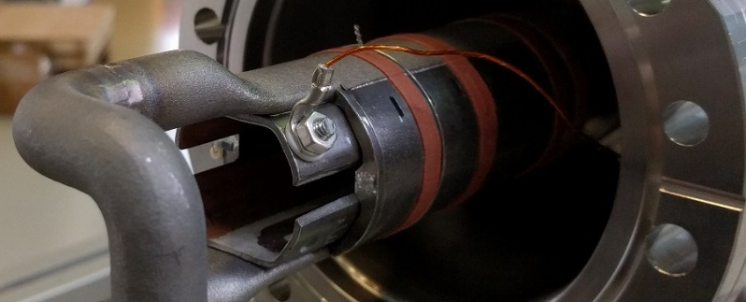
Experiment at KARA
Photoelectron Generation Studies
Experimental Equipment
Cold Sprayed Isolated Electrode
SR
e⁻
-
+
A
Test of FCC-hh Beam Screen at the ANKA Beamline.
Results on the FCC-hh Beam Screen prototype at the KIT electron storage ring
21
Luis Gonzalez
LNF-INFN/CERN TE-VSC
CERN February 20th 2018
FCC Week 2018 April 10th

Slide 25



Experiment at KARA
Photoelectron Generation Studies
Experimental Results – Prototype #2
SR
e⁻
-
+
A
#2
Photon Flux
75.4% Increase
Photoelectrons
23.7% Increase
#1
Test of FCC-hh Beam Screen at the ANKA Beamline.
Results on the FCC-hh Beam Screen prototype at the KIT electron storage ring
22
Luis Gonzalez
LNF-INFN/CERN TE-VSC
CERN February 20th 2018
FCC Week 2018 April 10th

Slide 26

Experiment at KARA
Photoelectron Generation Studies
Experimental Results – Prototype #2
#1
#2
SR
e⁻
40V
100V
-
+
A
#1
#2
Effect of the surface conditioning is visible
Test of FCC-hh Beam Screen at the ANKA Beamline.
Results on the FCC-hh Beam Screen prototype at the KIT electron storage ring
23
Luis Gonzalez
LNF-INFN/CERN TE-VSC
CERN February 20th 2018
FCC Week 2018 April 10th

Slide 27
Summary and Conclusions
After installation of BESTEX at KARA, experimental data has been obtained for the first two prototypes.
Experiments have been carried out in different irradiation configurations, in order to mimic the different scenarios at FCC-hh
Sample #1 shows a satisfactory behavior under SR in terms of vacuum
Sample #2 shows a large amount of photoelectrons reflected towards the BS’s main chamber
Reflectivity measurements show an unforeseen decrease of the amount of reflected photons for the misalignment case. Effect ascribed to the roughness of electrodeposited Cu at the BS´s main chamber.
Calculations were compared to experimental results :
  PSD calculations were compared to experimental results and tuned by using more realistic models. Discrepancies remain below 30% in all cases.
  Temperature distribution calculations are in good agreement with experiment.
  Experimental reflectivity results are in good correlation with calculations
Measurements on Photoelctron generation inside the BS have been peformed.
Instation of Sample #3 (Sawtooth profile) and test to be carried out from June 2018
Test of FCC-hh Beam Screen at the ANKA Beamline.
Results on the FCC-hh Beam Screen prototype at the KIT electron storage ring
24
Luis Gonzalez
LNF-INFN/CERN TE-VSC
CERN February 20th 2018
FCC Week 2018 April 10th

Slide 28
Thank You
Test of FCC-hh Beam Screen at the ANKA Beamline.
Results on the FCC-hh Beam Screen prototype at the KIT electron storage ring
Luis Gonzalez
LNF-INFN/CERN TE-VSC
CERN February 20th 2018
FCC Week 2018 April 10th

Slide 29




Fluorescent Screen Information
Test of FCC-hh Beam Screen at the ANKA Beamline.
Results on the FCC-hh Beam Screen prototype at the KIT electron storage ring
Luis Gonzalez
LNF-INFN/CERN TE-VSC
CERN February 20th 2018
FCC Week 2018 April 10th

Slide 30




Fluorescent Screen Information
Test of FCC-hh Beam Screen at the ANKA Beamline.
Results on the FCC-hh Beam Screen prototype at the KIT electron storage ring
Luis Gonzalez
LNF-INFN/CERN TE-VSC
CERN February 20th 2018
FCC Week 2018 April 10th

Slide 31




Fluorescent Screen Information
Test of FCC-hh Beam Screen at the ANKA Beamline.
Results on the FCC-hh Beam Screen prototype at the KIT electron storage ring
Luis Gonzalez
LNF-INFN/CERN TE-VSC
CERN February 20th 2018
FCC Week 2018 April 10th

Slide 32

Alignment
Test of FCC-hh Beam Screen at the ANKA Beamline.
Results on the FCC-hh Beam Screen prototype at the KIT electron storage ring
Luis Gonzalez
LNF-INFN/CERN TE-VSC
CERN February 20th 2018
FCC Week 2018 April 10th

Slide 33


Alignment
Test of FCC-hh Beam Screen at the ANKA Beamline.
Results on the FCC-hh Beam Screen prototype at the KIT electron storage ring
Luis Gonzalez
LNF-INFN/CERN TE-VSC
CERN February 20th 2018
FCC Week 2018 April 10th

Slide 34

Alignment
Test of FCC-hh Beam Screen at the ANKA Beamline.
Results on the FCC-hh Beam Screen prototype at the KIT electron storage ring
Luis Gonzalez
LNF-INFN/CERN TE-VSC
CERN February 20th 2018
FCC Week 2018 April 10th

Slide 35


Experiment at KARA
PSD Studies
Experimental Results
Middle
Front
Back
Levenberg-Marquardt Algorithm
X=-0.16 ± 0.01
X=-0.02 ± 0.01
X=-0.23 ± 0.01
Power
Flux
Test of FCC-hh Beam Screen at the ANKA Beamline.
Results on the FCC-hh Beam Screen prototype at the KIT electron storage ring
Luis Gonzalez
LNF-INFN/CERN TE-VSC
CERN February 20th 2018
FCC Week 2018 April 10th

Slide 36


Experiment at KARA
PSD Studies
Experimental Results
Middle
Front
Back
Levenberg-Marquardt Algorithm
X=-0.16 ± 0.01
X=-0.02 ± 0.01
X=-0.23 ± 0.01
Lower starting point lower conditioning rate.
Indicates pre-conditioning of the Geometry #4 region due to scattered photons
Test of FCC-hh Beam Screen at the ANKA Beamline.
Results on the FCC-hh Beam Screen prototype at the KIT electron storage ring
Luis Gonzalez
LNF-INFN/CERN TE-VSC
CERN February 20th 2018
FCC Week 2018 April 10th

Slide 37




Experiment at KARA
Photoelectron Currents Ratio
Reflectivity Studies
Experimental Results
.
Geometry #1
$$\frac{I_{Reflection}}{I_{Straight Through}}x100$$
$$\frac{Γ_{Reflection}}{Γ_{Straight Through}}x100$$
.
Straight Irradiation
Irradiation after Reflection
Geometry
#1
2.4%
1.3%
Geometry #2
Straight Irradiation
Irradiation after Reflection
Geometry #3
2.4%
1.2%
Geometry
#2 & #3
Geometry #4
Straight Irradiation
Irradiation after Reflection
0.5%
0.3%
Geometry
#4
Test of FCC-hh Beam Screen at the ANKA Beamline.
Results on the FCC-hh Beam Screen prototype at the KIT electron storage ring
Luis Gonzalez
LNF-INFN/CERN TE-VSC
CERN February 20th 2018
FCC Week 2018 April 10th

Slide 38
ANKA Parameters
Energy | 2.5 | GeV
Emittance | 50 | nm
Circumference | 110.4 | m
Current | 200 | mA
Optics | 4x2 | DBA
DP-Field | 1.5 | T
DP SR Power | 18 | W/mrad
DP SR Photon Flux | 6 10¹⁹ | Ph/(s mrad)
E_{critic} | 6.2 | KeV
FCC Parameters
DP SR Power | 32 | W/m*
DP SR Photon Flux | 1x10¹⁷ | Ph/(s m*)
BESTEX Parameters (at ANKA after collimation)
DP SR Power | 32 | W/m*
DP SR Photon Flux | 5 10¹⁶ | Ph/(s m*)
Incident angle | 18 | mrad
*m: irradiated length
Test of FCC-hh Beam Screen at the ANKA Beamline.
Results on the FCC-hh Beam Screen prototype at the KIT electron storage ring
Luis Gonzalez
LNF-INFN/CERN TE-VSC
CERN February 20th 2018
FCC Week 2018 April 10th

