Slide 1
Z pole scan strategy and √s spread measurement
 | Z | W | H (ZH) | ttbar
beam energy [GeV] | 45.6 | 80 | 120 | 175-182.5
arc cell optics | 60/60 | 60/60 | 90/90 | 90/90
emittance hor/vert [nm]/[pm] | 0.27/1.0 | 0.84/1.7 | 0.63/1.3 | 1.4/2.8
β* horiz/vertical [m]/[mm] | 0.15/.8 | 0.2/1 | 0.3/1 | 1/1.6
SR energy loss / turn (GeV) | 0.036 | 0.34 | 1.72 | 9.21
total RF voltage [GV] | 0.10 | 0.75 | 2.0 | 8.8-10.3
energy acceptance [%] | ±1.3 | ±1.3 | ±1.7 | ±2.4-2.8
energy spread (SR / BS) [%] | 0.038 / 0.132 | 0.066 / 0.165 | 0.099 / 0.165 | 0.15 / 0.20
bunch length (SR / BS) [mm] | 3.5 / 12.1 | 3.0 / 7.5 | 3.15 / 5.3 | 2.75 / 3.80
bunch intensity [10¹¹] | 1.7 | 2.3 | 1.8 | 3.2-3.35
no. of bunches / beam | 16640 | 1300 | 328 | 40-33
beam current [mA] | 1390 | 147 | 29 | 6.4-5.4
SR total power [MW] | 100 | 100 | 100 | 100
luminosity [10³⁴ cm⁻²s⁻¹] | 230 | 34 | 8.5 | 1.9-1.7
luminosity lifetime [min] | 70 | 24 | 18 | 25
allowable asymmetry [%] | ±5 | ±3 | ±3 | ±3

Slide 2
Z pole scan strategy: # points ? Energies ?
At the Z pole, δE_{beam}/E_{beam} ≃ 0.132% ⇒ δE_{beam} ≃ 60 MeV
σ (nb)
σ⁰
Z → hadrons
No ISR
Γ_{Z}
m_{Z}
Measure integrated luminosity
Measure E_{beam}
E_{beam} (GeV)

Slide 3
Z pole scan strategy without energy spread
Three parameters to fit : m_{Z}, Γ_{Z}, and σ⁰
  Need (at least) three centre-of-mass energies at and around the Z pole
    With a calibration of the beam energy to 50 keV (A. Blondel’s talk)
    With a relative precision on the absolute luminosity of 10⁻⁴ (M. Dam’s talk)
      And a point-to-point relative precision of 5×10⁻⁵
  Precision targets
    100 keV on m_{Z} ; 100 keV on Γ_{Z}; dominated by the above.
    Statistical precision is a few keV with the FCC-ee statistics
  Possible beam energies around half-integer spin tunes ν = E_{beam} / 0.4406486
ν | 99.5 | 100.5 | 101.5 | 102.5 | 103.5
E_{beam} | 43.85 | 44.29 | 44.72 | 45.16 | 45.61
√s | 87.69 | 88.57 | 89.43 | 90.31 | 91.21
ν | 103.5 | 104.5 | 105.5 | 106.5 | 107.5
E_{beam} | 45.61 | 46.04 | 46.49 | 46.92 | 47.36
√s | 91.21 | 92.07 | 92.97 | 93.83 | 94.71

Slide 4
Z pole scan strategy without energy spread
Result of the 3-parameter fit to a Breit-Wigner
  With 100 ab⁻¹ at the peak (√s = 91.21 GeV)
  With 30 ab⁻¹ + 30 ab⁻¹ at peak ± 1, peak ± 2, peak ± 3, peak ± 4 (in spin tune)
    Standard at LEP
      EWPO measurements would have been statistics limited with ±3 or ±4
    All these options meet the (100 kev, 100 keV) target at FCC-ee
      Need another criterion to decide
  Note: Results of the fit with Peak, Peak ± 2, Peak ± 4
    σ(m_{Z}) = 64 keV
    σ(Γ_{Z}) = 97 keV
Scan | ± 1 | ± 2 | ± 3 | ± 4 | (−4,+3) or (−3,+4)
σ(m_{Z}) [keV] | 84 | 85 | 91 | 99 | 95
σ(Γ_{Z}) [kev] | 313 | 153 | 116 | 100 | 107
At the expense of a loss of statistics for rare Z decays

Slide 5
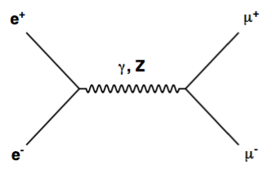
Z pole scan strategy without energy spread
Choice driven by sin² θ_{W}^{eff} and α_{QED} (m_{Z}) determination from A_{FB}(μμ)
sin²θ_{W}^{eff}
α_{QED}(m_{Z})
⨂
A_{FB}(e⁺e⁻ → μ⁺μ⁻)
87.9 GeV
94.3 GeV

Slide 6
Z pole scan strategy without energy spread
Best energies for A_{FB}
  91.2 GeV for the effective weak mixing angle
  87.9 GeV and 94.3 GeV for the electromagnetic coupling constant
Closest half-integer tunes
  ν = 103.5 for the peak
    √s = 91.2 GeV
  ν = 99.55 below the peak (Pk – 4)
    √s = 87.8 GeV
  ν = 106.55 OR ν = 107.5 above the peak (Pk + 3 or Pk + 4)
    √s = 93.9 GeV OR √s = 94.7 GeV (equidistant from 94.3 GeV)
      Favour Pk + 3 for the sake of statistics (rare decays)
Minimal scan strategy within four years and with two detectors
  100 ab⁻¹ at the peak (√s = 91.2 GeV)
  30 ab⁻¹ + 30 ab⁻¹ at peak – 4 (√s = 87.8 GeV) and peak + 3 (√s = 93.9 GeV)
Note: more statistics is always welcome
(3 IPs instead of 2; 6 years instead of 4; 5 points instead of 3; etc.)

Slide 7
Z lineshape with energy spread
The Z lineshape is slightly modified
  With δE ~ 60 MeV for each beam, δσ/σ ~ −0.45% at the peak and +0.15% off peak
  If the energy spread δE_{peak} at the peak is known with an uncertainty σ(δE_{peak})
    σ(Γ_{Z}) ~ 12 MeV × σ(δE_{peak})/δE_{peak}
      1% uncertainty of δE_{peak} leads to > 120 keV uncertainty on Γ_{Z} !
    Need to find a way to determine δE_{peak} to ~0.2%
      Relaxed to ~1% for σ(δE_{off-peak})/δE_{off-peak}
Δσ/σ (%)
⇒ Apparent increase of the Z width
Γ_{Z} → [Γ_{Z}² + 8 δE²_{peak} ]^{1/2}
⨂
E_{b} (GeV)

Slide 8
Z lineshape with energy spread
Can m_{Z}, Γ_{Z}, and σ₀ and δE be fit altogether with a five-point scan ?
  IFF δE is constant in time, identical at all points, independent of the bunch …
    σ(δE)/δE ~ 1%
    σ(m_{Z}) = 85 keV
    σ(Γ_{Z}) = 350 keV
  And we certainly do not want to assume that the energy spread
    Does not depend on time
    Does not depend on energy
    Does not depend on the bunch
    Does not depend on anything else
Better idea(s) required

Slide 9


Note: A_{FB}^{μμ} with energy spread
Convoluting A_{FB} with a Gaussian has almost no effect at the peak
  The sampling of √s around √s₋ = 87.8 and √s₊ = 93.9 GeV, however, is not uniform
    Has to weigh the asymmetry by the production cross section:
  Effect is to increase the effective √s₋ and decrease the effective √s₊
    And therefore decrease the absolute value of the asymmetry in both points
Need to know the energy spread to better than 1% at √s±
  To limit the effect on α_{QED} to < 10⁻⁵ (same as the effect from the √s knowledge)
    Similar constraint as for the Z lineshape
⇒ Δα_{QED}/α_{QED} ~ 10⁻³
Stat: 3×10⁻⁵

Slide 10
Make use of e⁺e⁻ → μ⁺μ⁻ events
How are the events modified with energy spread (in the c.o.m.) ?
  Generates a longitudinal boost in the centre-of-mass frame
μ⁺
In the e⁺e⁻ centre-of-mass frame
No energy spread
e⁺ (E_{b}, E_{b}−δE₊)
Δθ = π
e⁻ (E_{b}, E_{b}+δE₋)
Δθ < π
With energy spread
μ⁻

Slide 11
Make use of e⁺e⁻ → μ⁺μ⁻ events
Competes with initial state radiation (that you cannot get rid of)
  Need to have good ISR prediction
μ⁺
In the e⁺e⁻ centre-of-mass frame
No ISR
e⁺ (E_{b}, E_{b}−δE)
Δθ = π
e⁻ (E_{b}, E_{b})
γ (δE)
Δθ < π
With ISR
μ⁻

Slide 12
Make use of e⁺e⁻ → μ⁺μ⁻ events
Also competes with muon angular resolution …
  Need to have good ISR prediction
  Need to master muon angular resolution
    Over the whole tracker accpetance
μ⁺
In the e⁺e⁻ centre-of-mass frame
Perfect resolution
e⁺ (E_{b}, E_{b})
Δθ_{ideal} = π
e⁻ (E_{b}, E_{b})
Δθ_{meas} < π
Finite resolution
μ⁻

Slide 13
The FCC-ee frame is not the e⁺e⁻ c.o.m frame
An e⁺e⁻ → μ⁺μ⁻ event produced at θ=π/2, with φ=0 or φ=π/2
  NB: there might also be a (small) asymmetry between the two beam energies
    Causes additional boost along z
y
μ⁺
e⁺
μ⁻
μ⁺
x
e⁻
z
μ⁻

Slide 14
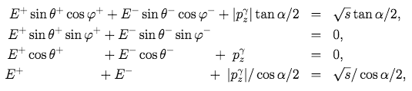
Total energy-momentum conservation
Assuming one photon emitted along one of the two beams
  Where E± are the measured energies of the μ±
  Where α is the beam crossing angle (nominal : 30 mrad),
  Where the z axis is the bisector of the two beam axes,
  Where the two beam axes form the (x,z) plane,
  Where θ± are measured with respect to the z axis in the FCC-ee frame,
  Where φ± are measured with to the x axis in the plane transverse to the z axis,
  Where √s is the centre-of-mass energy of the collision

Slide 15


Longitudinal boost x_{γ} = p_{z}(γ)/√s
Solve (E,p) conservation equations for x_{γ}
        With
  As a function of the muon angles only (usually better determined than momenta)
    Assume initially that α and the “natural” (x,y,z) axes are known perfectly
      z axis = bissector of the two beam axes
      (x,z) plane = plane that contains the two beam axes
      y = axis going upwards perpendicularly to that plane
    Assume that these axes match the local (detector) axes

Slide 16
Distribution of x_{γ}
With 10⁶ dimuon events (every 5 minutes at the Z pole)
  Returns the √s spectrum (with asymmetry) for perfect angular resolution and no ISR
    An angular resolution of 0.1 mrad seems adequately small (typical of CLD / IDEA)
    ISR slightly degrades the Gaussian core and add tails, needs to be unfolded
  Returns beam energy relative asymmetry with 10⁻⁶ precision
No BS: 0.038%
Nom. BS: 0.132%

Slide 17

Effect of σ_{θ,φ} and ISR
Fit the core of the x_{γ} distribution with a Gaussian and compare to E_{spread}
  With 10⁶ dimuons
  With σ_{θ,φ} = 0 and no ISR
    ~0.1% relative precision
      BINGO !
  Effect of ISR is to increase the x_{γ} width by 10%
    Need to be known with a precision better than 1% for a per-mil precision on E_{spread}
  Effect of σ_{θ,φ} = 0.1 mrad is to increase the x_{γ} width by 0.5% for nominal BS
    Need to be known with a precision of ~10% over the whole tracker acceptance
  Effect of σ_{θ,φ} = 1 mrad is devastating (similar to energy spread, difficult to control)
No BS Nom. BS
No BS
Nom. BS

Slide 18
Control the angular resolution to 0.01 mrad ?
Q: How to measure the angular resolution to 10% or better
  For any value of θ and φ ?
A: Take a muon track in dimuon events
  Refit it with the odd hits, on the one hand, and with the even hits, on the other
    And compare the angles
  Need only 100 tracks in each (θ , φ) bin for a 10% precision
    10⁶ dimuon events = 5 minutes at the Z pole = bins of 3×3 (mrad)²
  Expected to be stable in time
    Precision (or bin size) improves with dimuon statistics

Slide 19
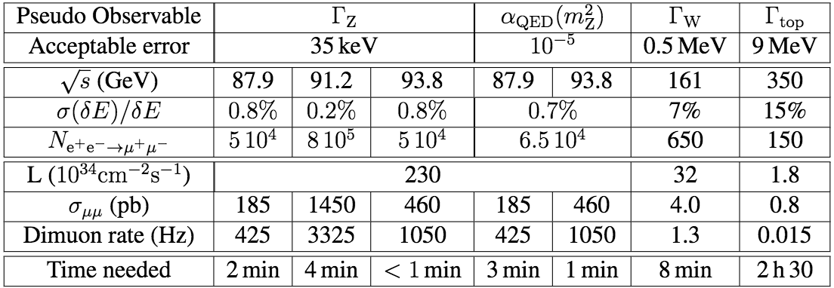
Summary (extract from the CDR)
A three-point scan of the Z resonance (87.8, 91.2, 93.9 GeV)
  Is adequate for the measurement of m_{Z}, Γ_{Z}, sin²θ_{W}^{eff} and α_{QED} with target precisions
    If the beam energy spread δE is known to a few per mil (for Γ_{Z} and α_{QED})
Dimuon events offer a permanent monitoring of δE
  With adequate precision, every few minutes
    And with the same as those used to measure the EW observables

Slide 20
Notes added
All these numbers are valid for nominal luminosities / energy spread
  For smaller energy spread, the precision requirement are quadratically less stringent
Example: 0.066% instead of 0.132% at the Z pole (still BS dominated)
  Precision required increases by a factor 4 to 0.8% instead of 0.2%
    Number of events needed decrease by a factor of 16 to 5×10⁴ instead of 8×10⁵.
  In the same time, the luminosity is reduced much less, by a factor 2^{2/3} ~ 1.58
    If the E spread decrease is achieved by increasing the vertical β*
      Keeping beam currents and vertical emittance unchanged
  Therefore the time needed decreases to 25 seconds instead of 4 minutes
All times displayed in the table are absolute maxima
All these numbers were derived from the muon angles only
  Angular resolution must be better than 0.1 mrad, + measured to better than 0.01 mrad
    Angular biasses must be kept below 0.01 mrad too (absolute alignment)
  To be studied: (probably marginal) influence of muon momenta

Slide 21
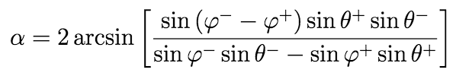
Beam crossing angle determination
With 10⁶ dimuon events (every 5 minutes at the Z pole)
  Spread sensitive to anything happening in the transverse plane
    φ resolution, p_{T} of emitted photons, and (x,y,z) axes knowledge
No BS: 0.038%
Nom. BS: 0.132%
See also poster
“1000 recipes to use up dimuons”

Slide 22
Detector alignment
Absolute angle determination is (usually) not an easy task
  Requires alignment of the local (detector) frame with the natural (FCC-ee) frame
    Z axis = solenoid axis vs bissector of the two beam axes
    (X,Z) plane = horizontal plane vs plane containing the two beam axes
Spread of α increases with anything happening in the transverse plane
  E.g., rotation around the Z axis changes both X and Y directions
    Similarly, rotation around the X (Y) axis changes Y (X) direction
Crossing angle (rad)

Slide 23
Detector alignment
Minimize the spread of the α distribution to find the three Euler angles
  Note: α spread dominated by the φ resolution (here 0.1 mrad)
    Precisions quadratically improves with the resolution in φ (here 0.1 mrad)

Slide 24
Detector alignment
Improve the angle corresponding to a rotation around the Y axis
  X and Z information get mixed by such a rotation
    Resuting in a strong (linear) correlation between x_{γ} and α:

Slide 25
Detector alignment
Minimize the correlation between x_{γ} and α:
  Improves the precision on that crossing angle by a factor of five.
    Reach a precision of 0.1 μrad on α and of 10⁻⁷ on x_{γ}
    Variation of the x_{γ} spread already insignificant with 100 times less events

Slide 26
Detector alignment
A finite crossing angle is the key
  A zero crossing angle cannot be determined with precision (sinφ⁺=sinφ⁻, sinθ⁺ = sinθ⁻)
    Spread is infinitely large even with a perfect detector alignment
    Leads to inaccurate absolute alignment
      With corresponding biases on the muon angles
  With a finite crossing angle, only events with sinφ⁺ ∼ sinφ⁻∼ 0 need to be rejected
    Cut |sinφ±| > 0.2 was applied in all previous plots
Possible bonus (to be studied)
  Built-in energy asymmetry between electrons and positrons

