Slide 1
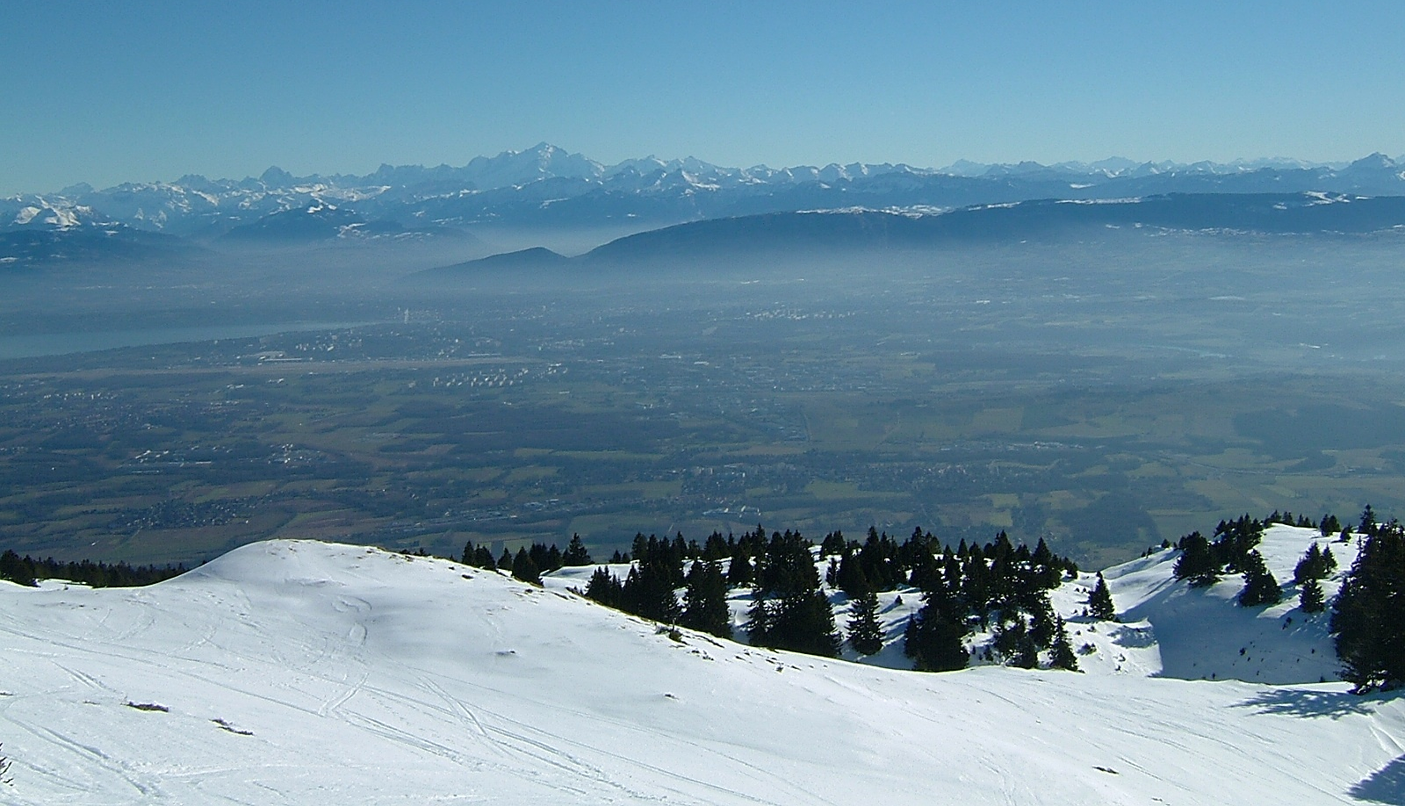

HE-LHC injection and extraction
Brennan Goddard
CERN TE/ABT
W.Bartmann, M.Hofer, A. Lechner, E.Renner

Slide 2
Overview
Introduction and requirements
Injection
  450 GeV
  1300 GeV
13.5 TeV dump system
  Extraction kickers and septa
  Dilution system
1300 GeV transfer lines
Conclusions

Slide 3
Introduction and requirements
450 or 1300 GeV injection energy (LHC-HE design choice)
HL-LHC 25 ns beam parameters
  2.2 x 10¹¹ pb in 2.5 μm
  Injection bunches at 1300 GeV limited by absorbers to 100 – 150
13.5 TeV extraction to beam dump
Aim for design with robust (i.e. non-sacrificial) absorbers
  Layouts, optics and designs constrained by need for absorber survival in the event of kicker failures
Transfer lines using existing TI 2 and TI 8 tunnels
  6 T SC dipoles for 1300 GeV injection

Slide 4
Injection: 450 GeV
450 GeV option is rather obvious
  LHC solution, if insertion optics, layout and spaces are similar
  Only changes could be due to new experimental insertion design….
Transfer lines also remain as today

Slide 5
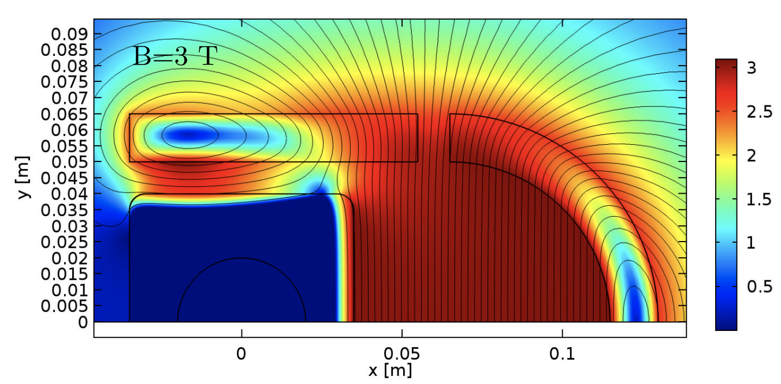
Injection: 1300 GeV
For 1300 GeV, rigidity increases by 2.9 for septa and kickers
  Profit from reduced gap for both options
Several solutions possible
  Increase proportionally insertion space for septa and kicker and limit beta* of experiment: this option will work and therefore no showstopper to inject higher energy beams
  Introduce new HW concepts: superconducting septum, short circuit mode for kickers, higher dI/dt
Even for short-circuit kicker need more space in lattice (+40 m) to keep same rise time (filling pattern)
  Impact on experiments and beta* reach
  Can devise intermediate solution to trade-off space for rise-time (1.5 μs = 20 m)

Slide 6
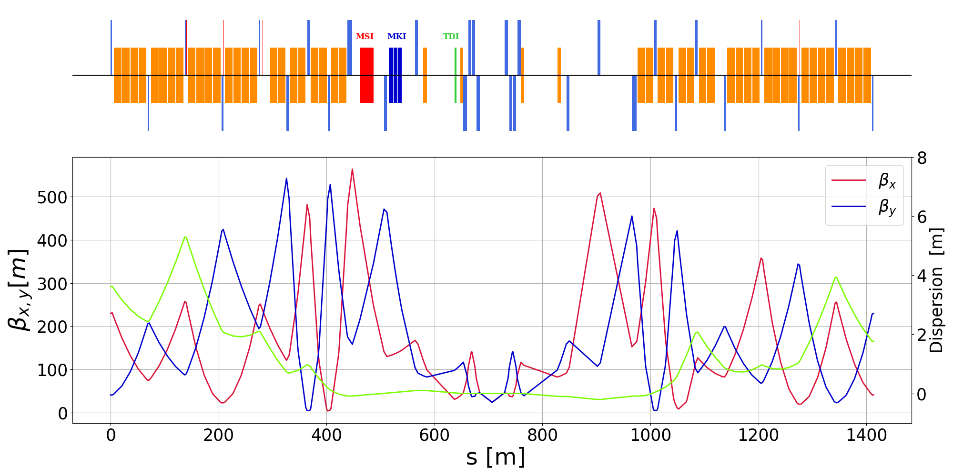
1300 GeV injection
Planes are exchanged (V septum, H kicker) wrt LHC to ease 90 deg matching from kicker to absorber
55 m instead of 22 m for the kicker, factor 2.5 more length vs 2.9 energy ratio, might be possible in terminated mode
Either superconducting septa or cryostat passage (or combination)
Betas at absorber may limit bunches per injection: another reason for terminated (faster) kicker
Collision optics matched to 10m β*

Slide 7
Dump system design assumptions
Reuse existing tunnel and caverns
  Similar extraction trajectories in H & V
  Can assume similar kicker and septum angles
Maximum ~300 mm dilution sweep radius
  Similar quadrupole layout and optics
2 matching quads in LSS per side of IP (Q4, Q5)
  Space available in LSS remains similar to LHC
Beam parameters
  450 / 1300 GeV at injection
  13.5 TeV at extraction
  2.5e11 p/b at 25 ns bunch spacing, 2800b
  Stored beam energy 1.4 GJ

Slide 8
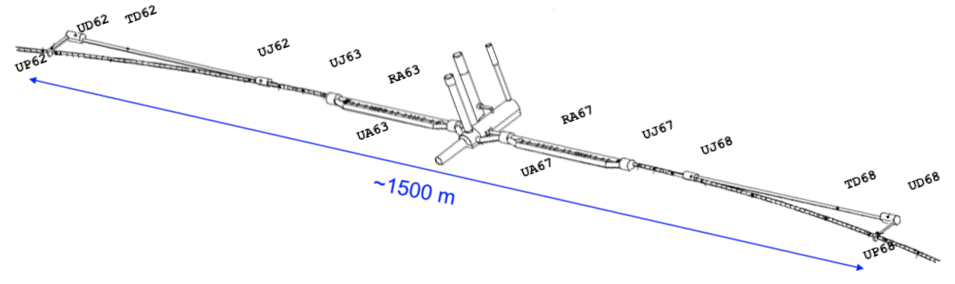
Extraction and beam dump
Available straight section LSS6 and dump channels TD62/68
  Geometry given – stick to kicker and septa locations similar to existing LHB ones
LHC Lambertson septa have challenging back-to-back design
  Can’t compensate with higher field/current for higher beam rigidity
Assume superconducting septa (as studied for FCC-hh)
  Gain space for additional absorber length
  Also consider cryostat passage through downstream quadrupole, ~1/3 deflection reduction

Slide 9
Extraction and beam dump
For extraction kickers assume same required deflection to clear the first thin normal conducting septum blade
  Compensate with more magnets, higher current and dI/dt
  Profit from the smaller gap for the higher injection energy cases (900 and 1300 GeV)
Absorbers
  Assume same protection functionality as for LHC: Septum protection (fixed) and downstream machine protection absorber (movable, transverse position follows the energy)
Optics
  Initial optics from HE-LHC repository had beta functions up to 1200 m in IR6 (c.f. 600 m present LHC): larger gaps detrimental for required kicker current

Slide 10
Extraction and beam dump
LSS6 optics
  Can be matched down to present LHC functions including matching quads in dispersion suppressor
  Beta functions at kicker and septum fit with deflection angle and quad kick/aperture
  Phase advance kicker-absorber 90º
  Dispersion to be matched globally
  Opened the space between Q4 and Q5 to generate more space for the kickers – limit given by trade-off with maximum beta functions
  Shifting Q5 has the drawback of also shifting the dilution kickers for the other beam further downstream

Slide 11
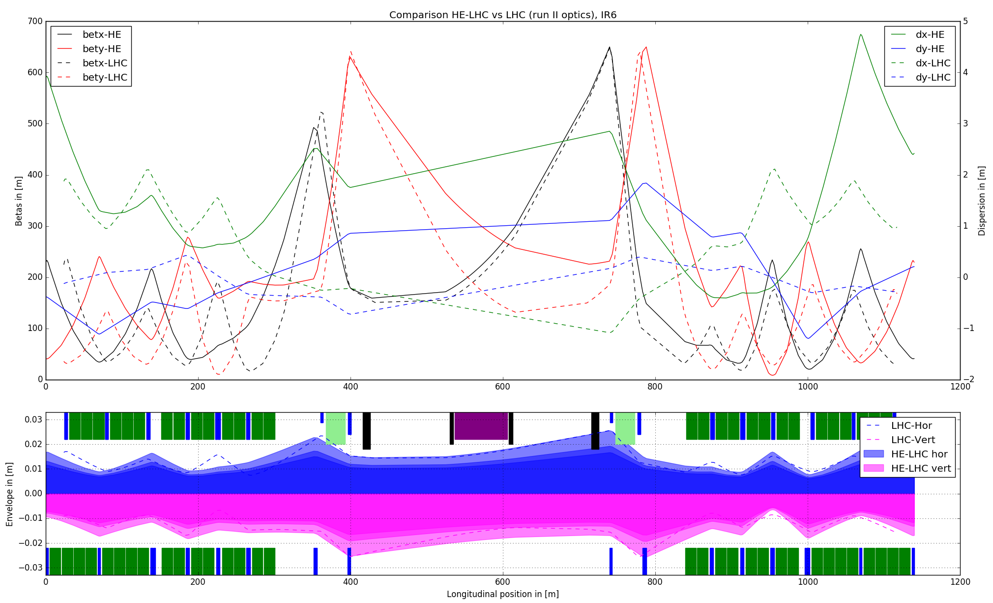
LSS6 optics for HE-LHC
LHC
HE-LHC
450, 900 and 1300 GeV envelopes; dashed line is present LHC

Slide 12
Extraction kicker parameters
 |  | LHC now | HE-LHC 1300 GeV inj | HE_LHC 450 GeV inj
Deflection angle | mrad | 0.27 | 0.27 | 0.27
Rigidity | T.m | 23337 | 45034 | 45034
Required Bdl | T.m | 6.30 | 12.16 | 12.16
Rise time | s | 3.00E-06 | 3.00E-06 | 3.00E-06
Aperture width | m | 0.072 | 0.072 | 0.072
Aperture height | m | 0.072 | 0.054 | 0.072
Magnet length | m | 1.42 | 0.75 | 0.75
Gap field | T | 0.323 | 0.49 | 0.49
Permeability | H/m | 1.26E-06 | 1.26E-06 | 1.26E-06
Inductance | mH | 1.78 | 1.26 | 0.94
Corr. factor stray inductance |  | 1.35 | 1.35 | 1.35
dI/dt | kA/us | 6.2 | 7.0 | 9.4
Current | kA | 18.5 | 21.1 | 28.1
Impedance | Ohm | 0.80 | 0.57 | 0.42
Voltage | kV | 29.7 | 23.8 | 23.8
# magnets |  | 13.7 | 33.1 | 33.1
Total magnetic length | m | 19.5 | 24.8 | 24.8
Filling factor |  | 0.76 | 0.76 | 0.76
Total installed length | m | 25.6 | 32.6 | 32.6

Slide 13
Optics vs extraction kicker parameters
Stay quite conservative with gap compared to Malta solutions – pure scaling with energy is too optimistic from engineering point of view
Creating more space in lattice for kickers brings current below 30 kA and dI/dt below 10 kA/us for 450 GeV (still challenging)
Higher injection energies clearly better (smaller gap for the fixed extraction energy) – 1.3 TeV case compares quite well to present system parameters
Optics functions at diluters similar to present LHC – calculations by A.Lechner show a factor 2-3 above damage limit
  Absorber limits constrain the design: need to get energy density down
  Increasing spot size of limited help, separation of bunches more effective
  Faster rise time helps: for 2 μs, need 14 kA/s and voltage of 36 kV
  But higher dI/dt means more difficult switch design, and higher voltage gives higher probability for erratics

Slide 14
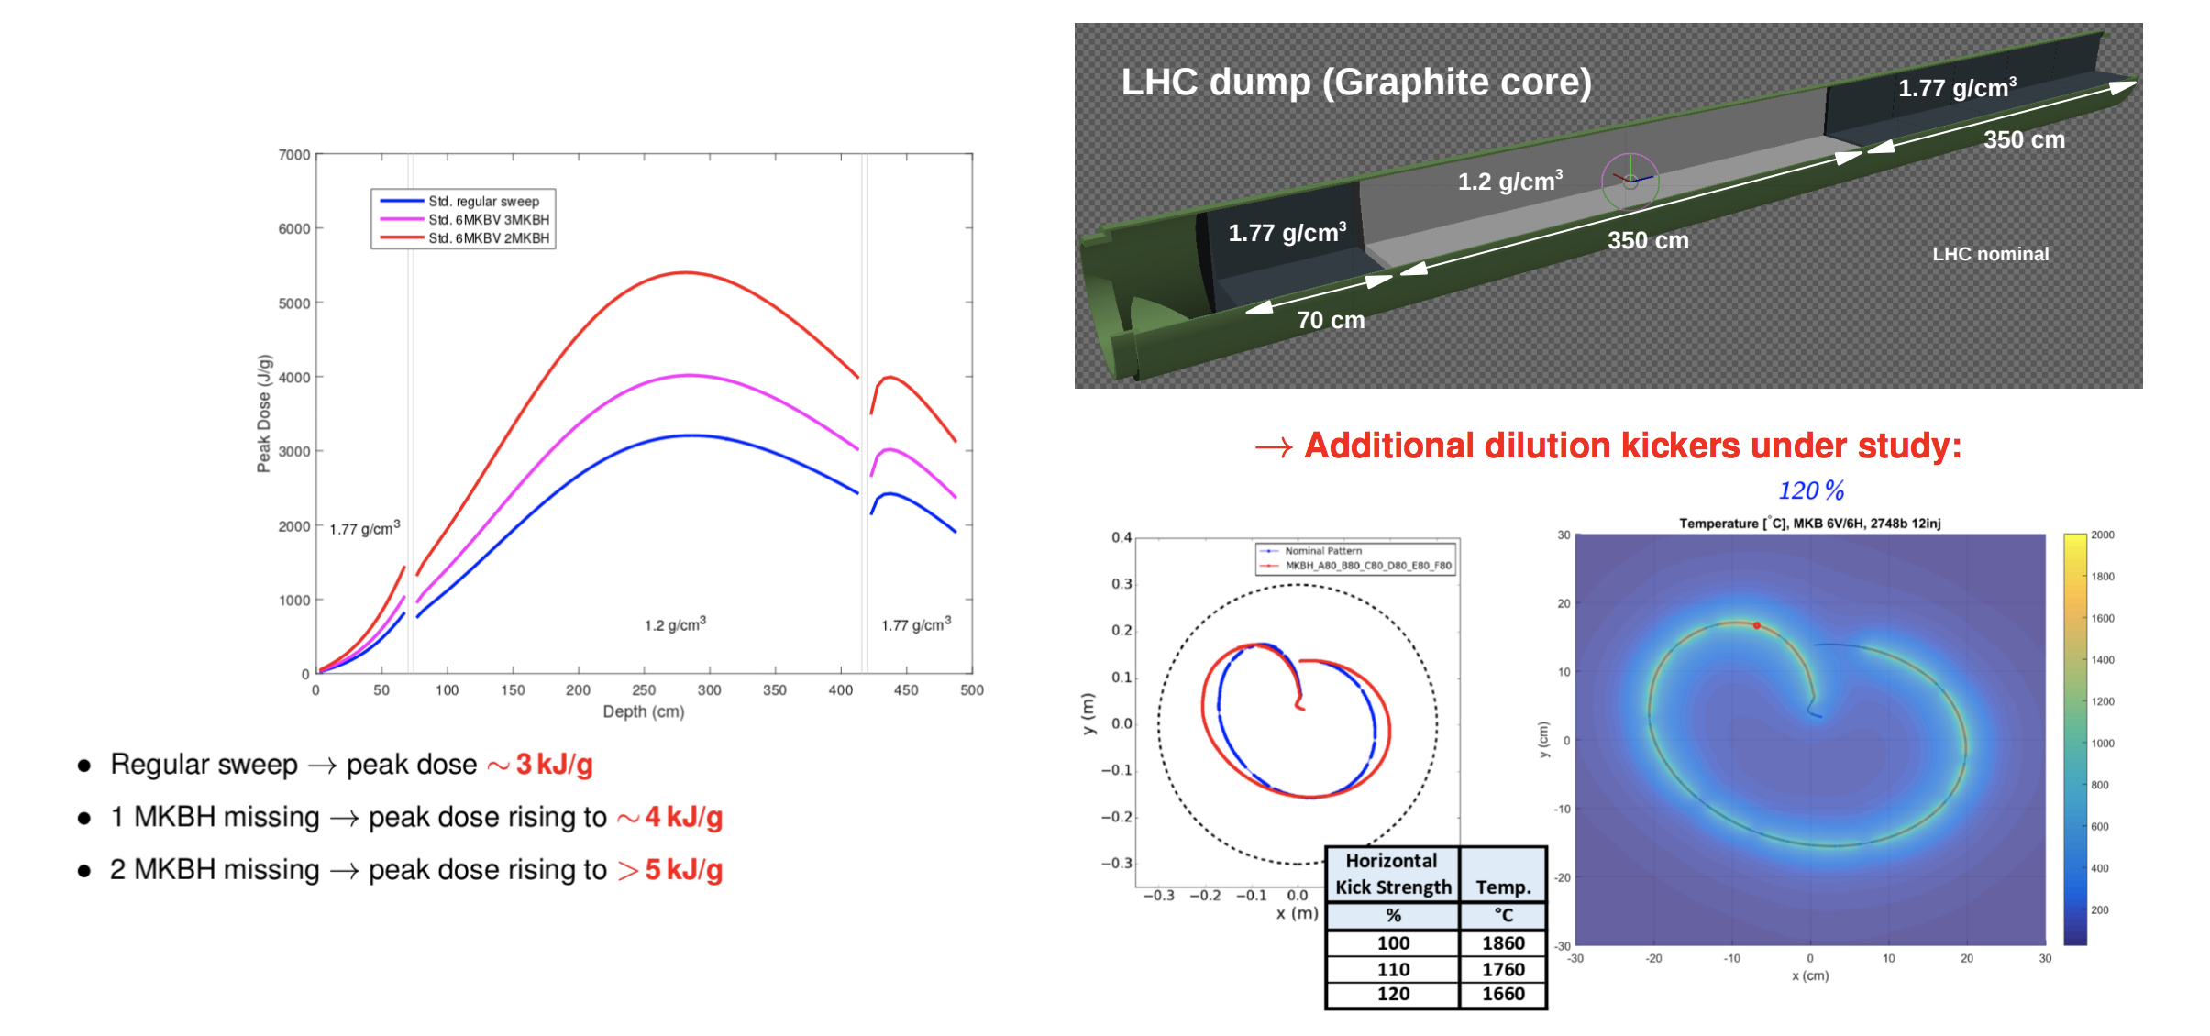
Dilution system
Already a challenge for HL-LHC at 7 TeV
A.Lechner, FCC Design Meeting Dec 7th, 2017

Slide 15
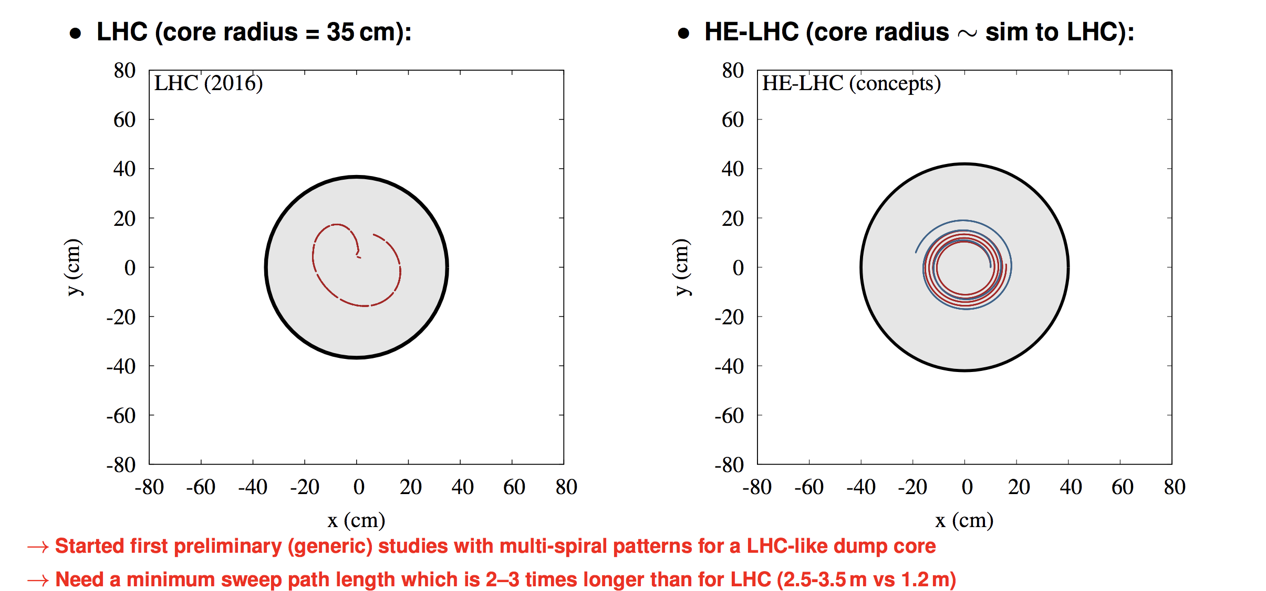
Optimising dilution sweep

Slide 16
Dilution kicker optimisation
Aim for 1 g cm⁻³ solid graphite core
  Fixes target of ~2.5 present sweep length
Optimised dilution sweep kicker characteristics
  Limited magnet current to 25 kA
  Limited switch voltage to 30 kV
  Assumed present kicker dimensions and inductance per unit length
  Varied module length and numbers to reach target kick, sweep length, voltage and current

Slide 17
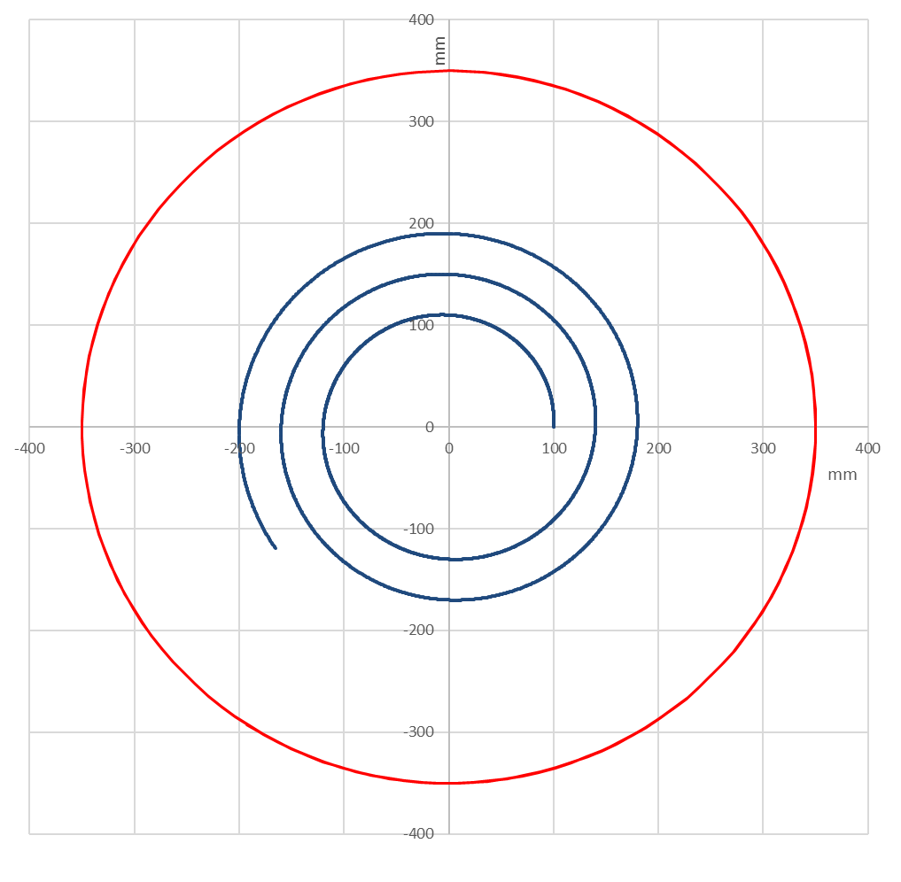
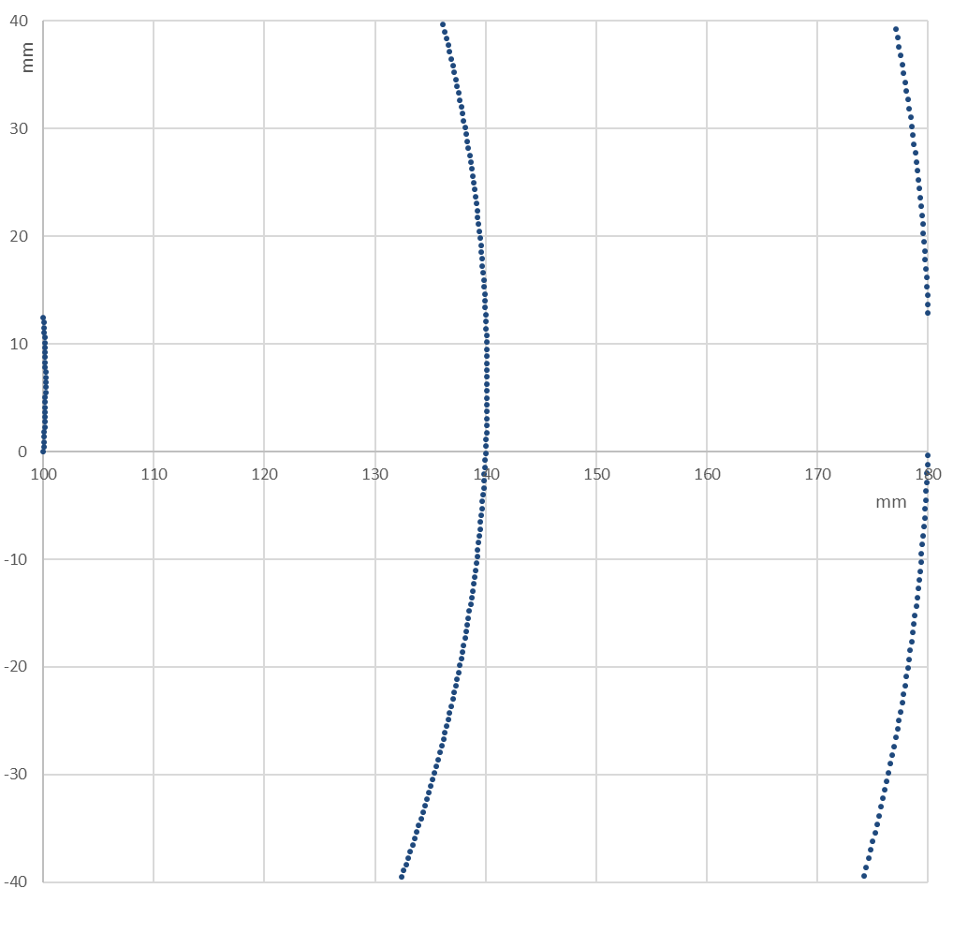
Possible dilution kicker parameters
2.6 turn spiral
Requires 42 m installed length (20 m for LHC)
38 modules (10 for LHC)
44 kHz frequency
Tight aperture at V dilution kicker exit

Slide 18
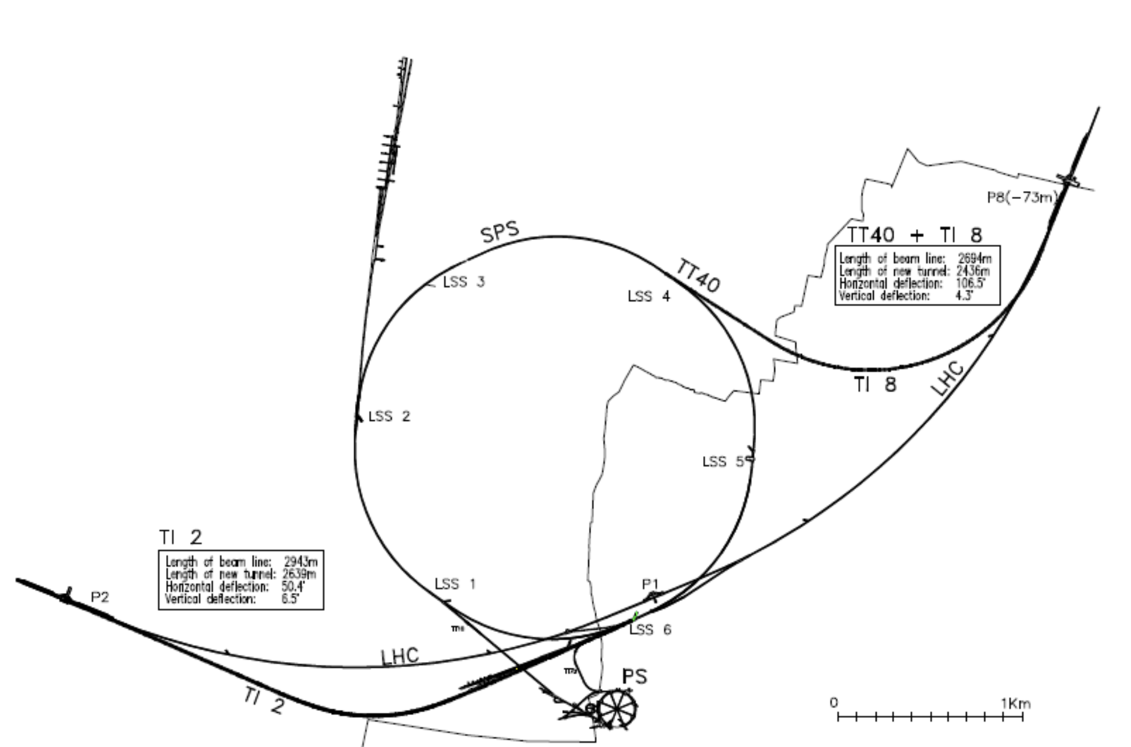
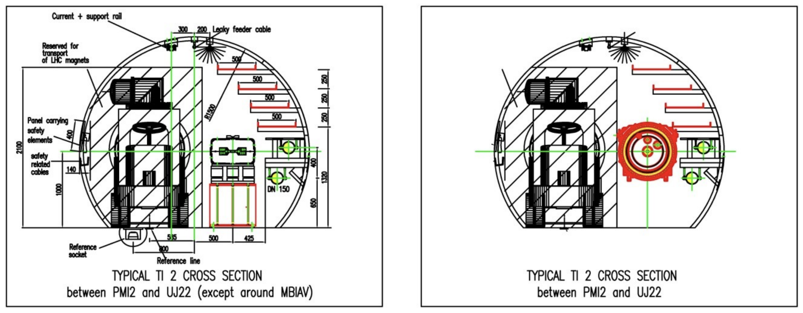
Transfer lines
1300 GeV transfer lines have several important aspects
  6 T SC dipoles (as scSPS ring)
  5.6 km total length (almost same again as SPS)
  2.15 km dipole length (~150º total bend angle)
  4.2% maximum slope
  3.0 m tunnel diameter

Slide 19
Summary
HE-LHC injection – strongly dependent on injection energy
  At 1300 GeV there is impact on experiments’ optics: β* has been matched down to 10 m
  Kicker and septum performance to push - SC septa to consider (depends on losses/quenches)
Dump extraction is feasible
  More space for extraction kickers, and advances in technology assumed
  Need to work out solution for (protection) absorber limits/rise time
  Trade-off between failure probability and consequences
  Septa require SC technology and/or cryostat passage
Dump dilution system most challenging
  Failure scenarios also to consider in design
Transfer lines to HE-LHC at 1300 GeV needs 6 T SC dipoles
  Almost 50% as many dipoles again as scSPS, and 80% of quadrupoles
  Integration, cryogenics, machine protection, collimation are all difficult

