Slide 1


Fast ion instability
Work supported by the Swiss State Secretariat for Education, Research and Innovation SERI
L. Mether (EPFL)
A. Oeftiger, G. Rumolo (CERN)
FCC Week 2018, Amsterdam
April 9th-13th 2018

Slide 2
Introduction
Gas molecules ionized by beam
Ions oscillate in beam field
Field from trapped ions impacts the beam
Positive ions attracted by beam field
Instability, tune shift,
ε growth
Ion instability mechanism in electron machines
For bunch train followed by gap, ions build up only during one train passage
Fast beam-ion instability
Due to their mass, ions hardly move during a bunch passage
Ions transfer information on bunch centroid position to trailing bunches → coupled bunch instability
Ion density increases with every bunch → effect stronger at tail of trains

Slide 3

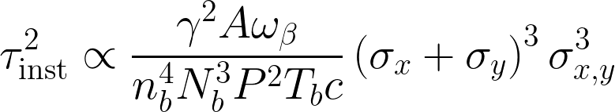
Ion trapping
The instability can be modelled using the linear approximation of the Bassetti-Erskine formula for a Gaussian beam field
  Trapping condition for ion mass number:
  Lower masses trapped for shorter bunch spacing T_{b}
  Estimated instability rise time:
    Faster rise time for larger number of bunches, larger pressure and smaller mass (if trapped)
  Due to the scaling with bunch spacing ions are a concern mainly at Z-pole operation
    N_{b} = bunch intensity, r_{p} = classical proton radius, σ_{x,y} = transverse beam size
    n_{b} = nr of bunches, P = pressure, ω_{β} = betatron frequency
Raubenheimer et al., Phys. Rev. E 52, 5, 5487,
Stupakov et al., Phys. Rev. E 52, 5, 5499

Slide 4
Simulation study
Goal to identify acceptable partial vacuum
pressures for H₂, N₂, CO and CO₂
N₂ and CO simulated together as one species
Simulations done for 2.5 ns bunch spacing
Typical simulation time 50 – 100 turns with trains of 50 – 150 bunches due to heavy computation time and real time restrictions
Radiation damping not included in simulations
  Vertical damping time (instability in vertical) is 830 ms, or 2533 turns
  → 4-8% damping over 50-100 turns
 | Mass number, A | Ionization cross-section, σ [Mbarn]
H₂ | 2 | 0.5
N₂ | 28 | 2.0
CO | 28 | 2.0
CO₂ | 44 | 2.0

Slide 5
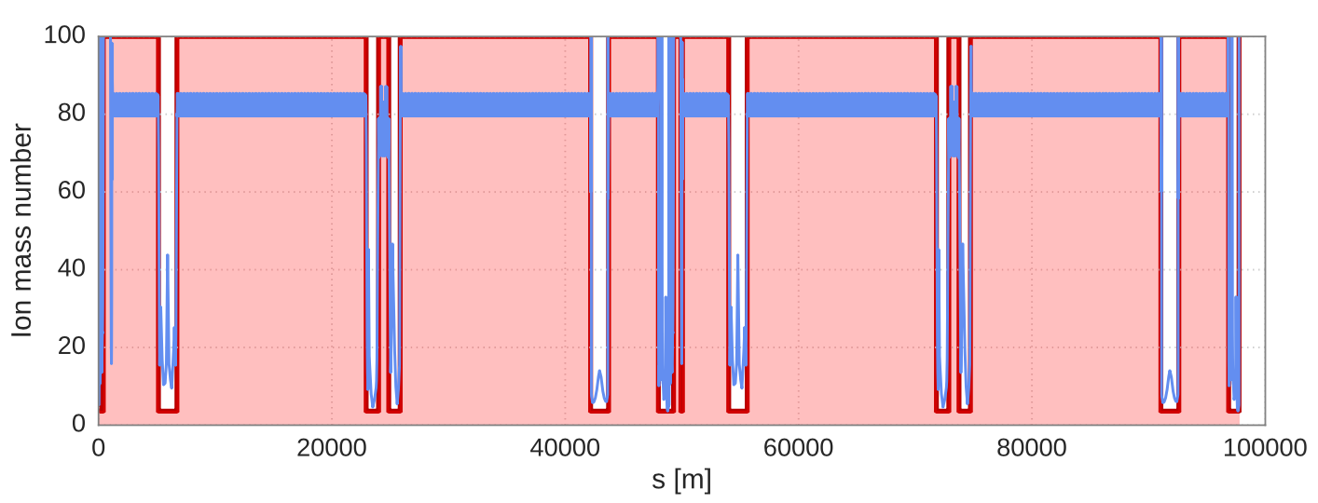
Machine lattice
Not possible to sample the lattice in detail within reasonable computation time
Arcs (87%) and straight sections (13%) simulated independently
  Fixed lattice functions for each case, chosen such that the threshold ion mass number for trapping is minimized
  Number of segments determined by convergence scans

Slide 6
Machine lattice
Not possible to sample the lattice in detail within reasonable computation time
Arcs (87%) and straight sections (13%) simulated independently
  Fixed lattice functions for each case, chosen such that the threshold ion mass number for trapping is minimized
  Number of segments determined by convergence scans
Mass numbers of considered species are below the trapping mass in the arcs, effect on beam observed nevertheless

Slide 7
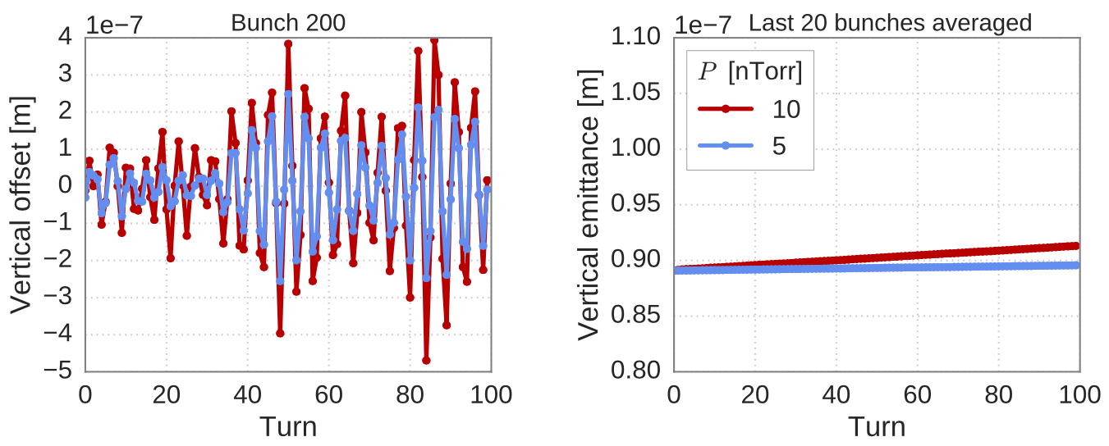
Arcs: H₂
Hydrogen simulated with 200 bunches over 100 turns, pressure up to 10 nTorr
Marginal effect on beam even for high pressures
Emittance growth rate for P = 10 nTorr is slower than the damping rate

Slide 8
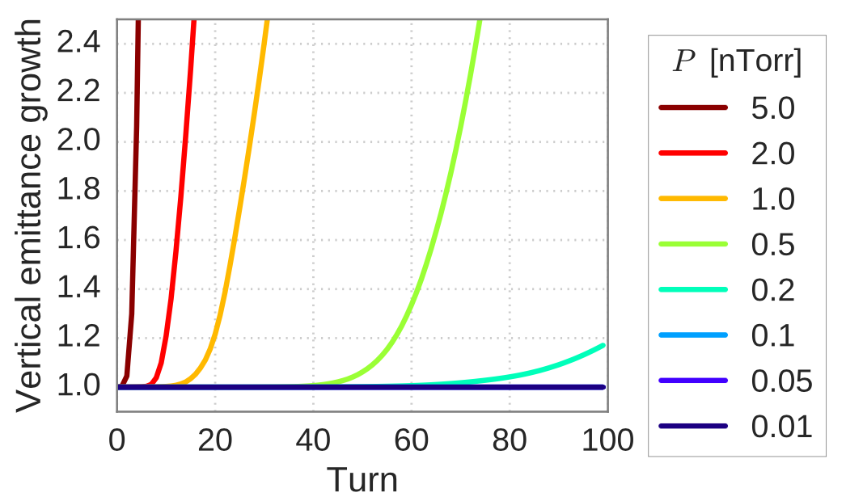
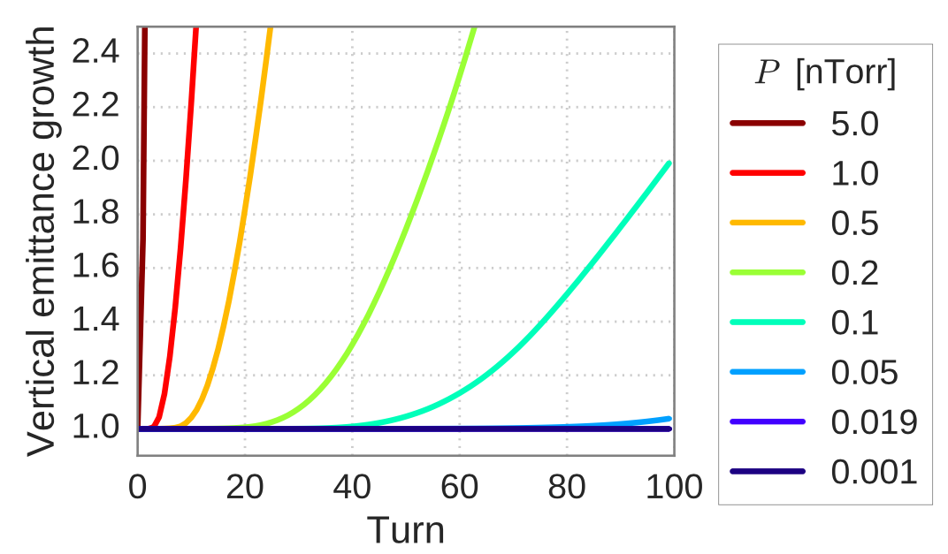
Arcs: heavier species
N₂, CO and CO₂ simulated with 150 bunches for 100 turns, pressure up to 5 nTorr
Instability sets in after fewer turns and grows faster for CO₂ than N₂ and CO
N₂, CO stable as of 0.1 nTorr
CO₂ still unstable at 0.1 nTorr, for lower pressures the growth rate is similar to the damping rate
Emittance growth of most unstable bunch
A = 28
A = 44

Slide 9
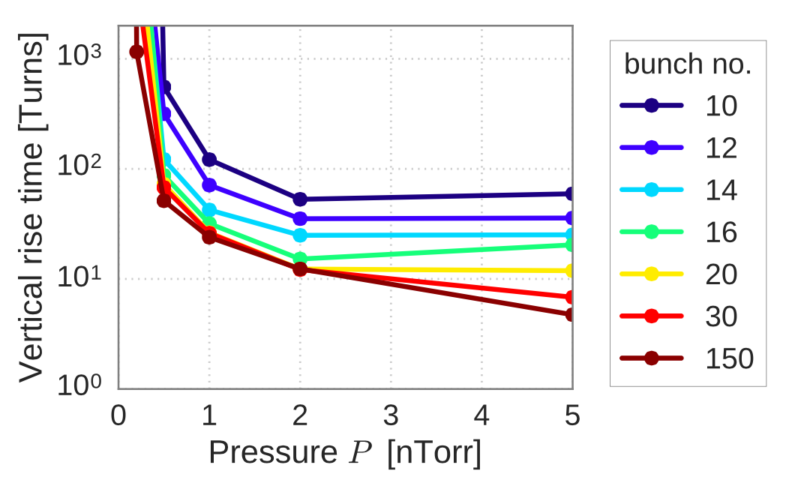
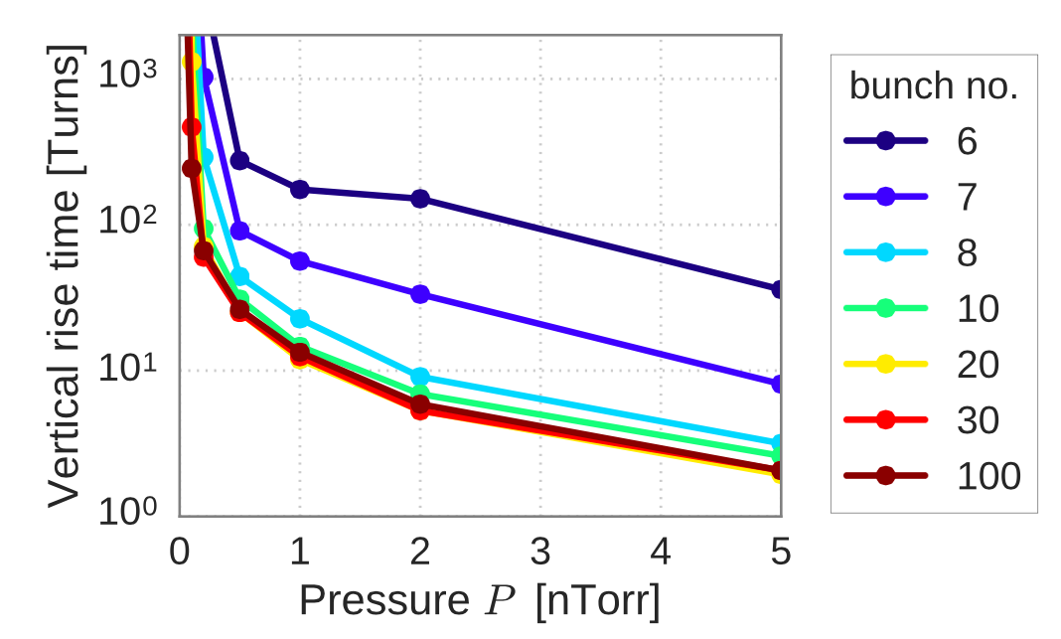
Arcs: instability rise times
Bunch-by-bunch rise times estimated from emittance growth
Saturate after a certain number of bunches
  Around bunch 20 for A = 28, around bunch 10 for A = 44
Effect probably due to the weak trapping: ions oscillate around beam only for a certain number of bunch passages before being lost
A = 28
Bunch-by-bunch rise time
A = 44

Slide 10
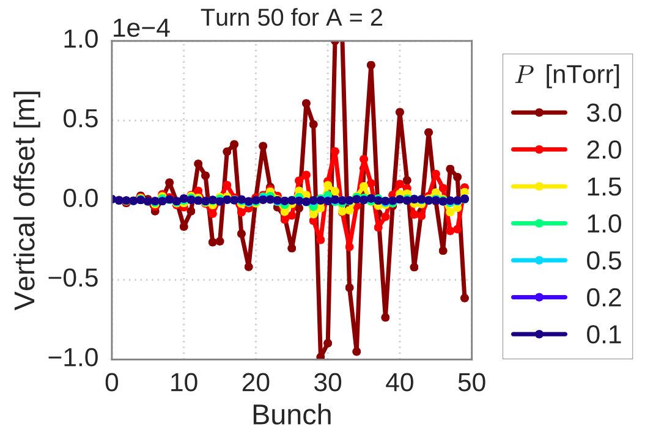
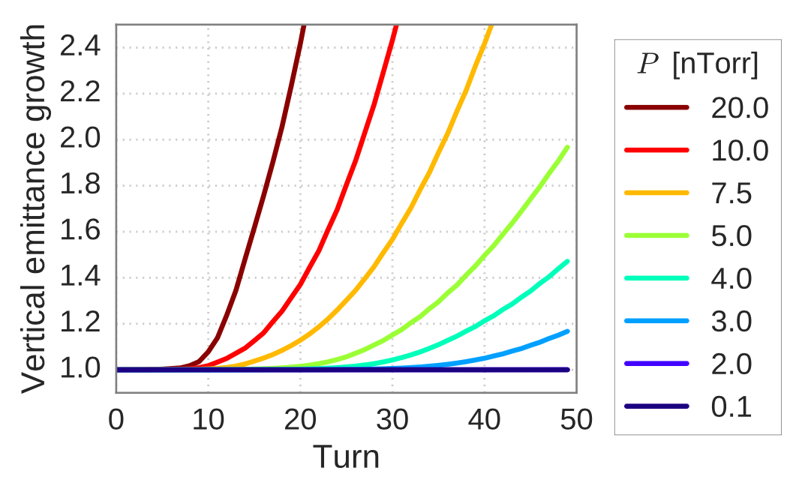
Straight sections: H₂
Hydrogen simulated with 50 bunches over 50 turns
Much stronger effect on beam than in the arcs, despite shorter length,
due to the lower trapping mass in the straight sections
Unstable down to around 1 nTorr
Emittance growth of most unstable bunch

Slide 11
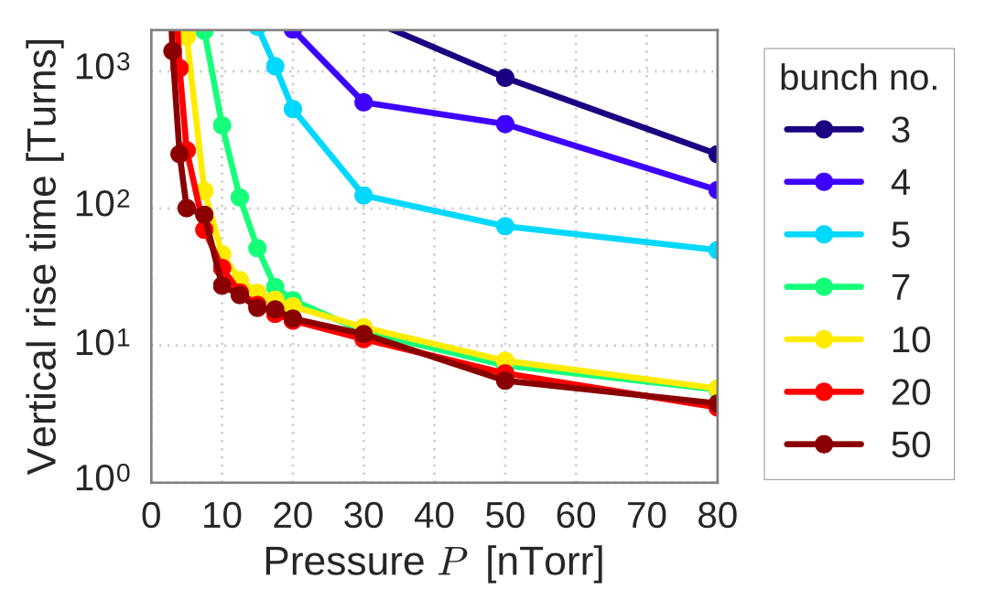
Straight sections: H₂
Hydrogen simulated with 50 bunches over 50 turns
Much stronger effect on beam than in the arcs, despite shorter length,
due to the lower trapping mass in the straight sections
Unstable down to around 1 nTorr
Rise times saturate after about 10 bunches, as for heavier species in the arcs
Bunch-by-bunch rise time

Slide 12
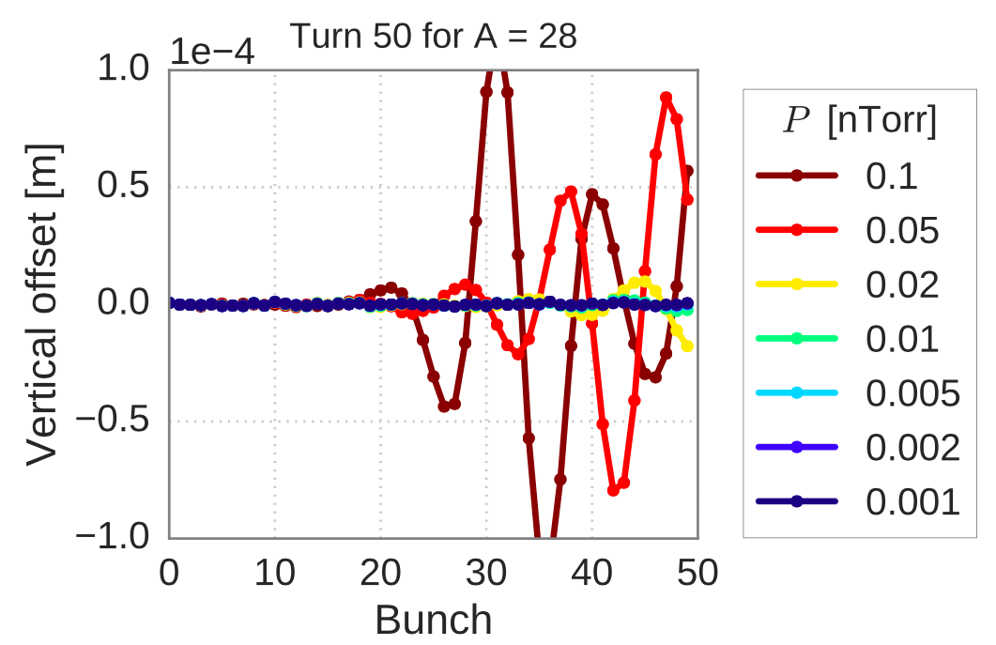
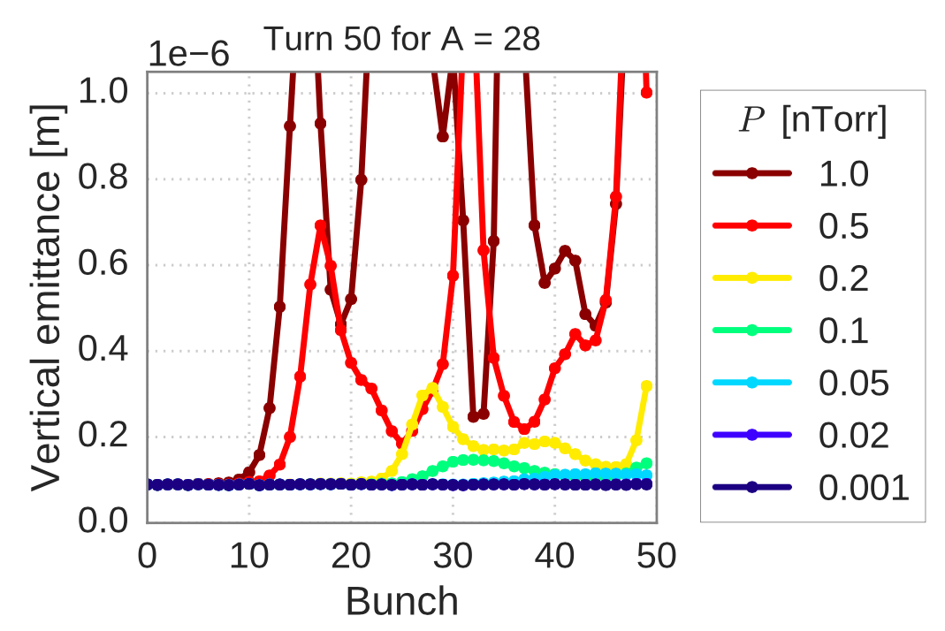
Straight sections: N₂ and CO
N₂ and CO simulated with 50 bunches for 50 turns
Growth of centroid motion visible from 10 – 20 pTorr
Emittance growth seen from 50 pTorr
Behaviour qualitatively different compared to arcs
  In agreement with expectations from linear theory

Slide 13
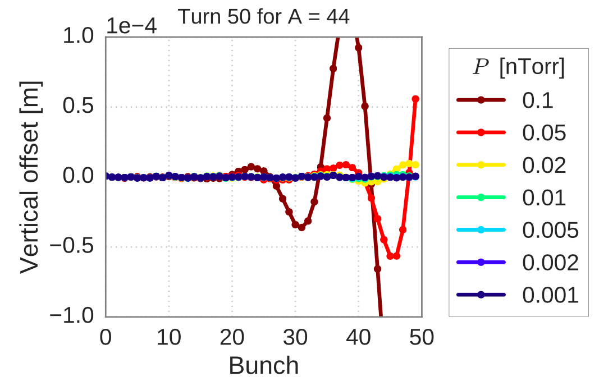
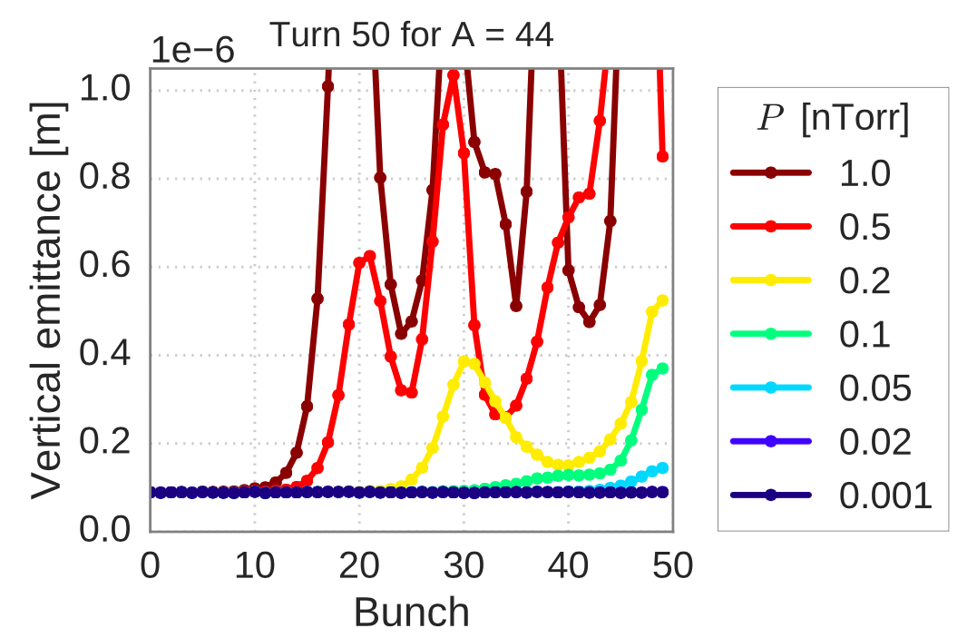
Straight sections: CO₂
CO₂ simulated with 50 bunches for 50 turns
Growth of centroid motion visible from 10 – 20 pTorr
Emittance growth seen from 50 pTorr
Behaviour qualitatively different compared to arcs
  In agreement with expectations from linear theory

Slide 14
Results summary
Partial pressure thresholds for residual gas species (without mitigation):
Constraint on total pressure depends on eventual vacuum composition:
e.g. 70% H_{2,} 10% each of other species (roughly an unbaked vacuum)
threshold of 0.5 nTorr in the arc, but
threshold of 0.025 nTorr in the straight sections
Constraints are probably tighter than vacuum specifications allow for
→ mitigation strategies are necessary
 | H₂ | N₂, CO | CO₂
Arcs | – | 0.1 nTorr | 50 pTorr
Straight sections | 0.5 nTorr | 5 pTorr | 5 pTorr

Slide 15
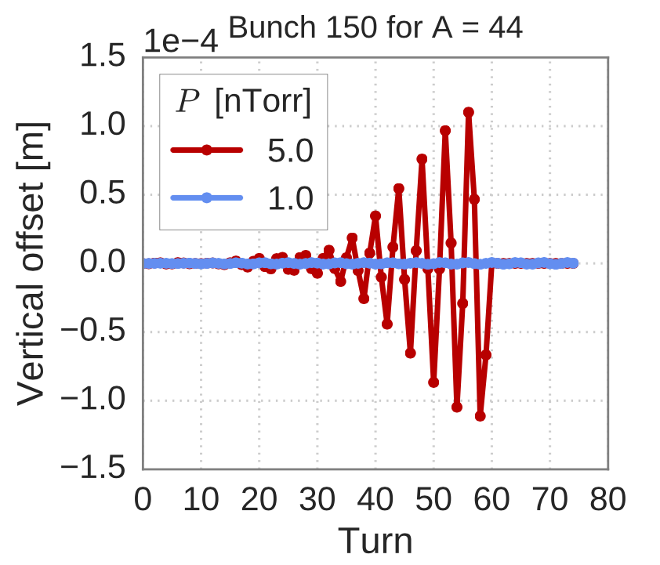
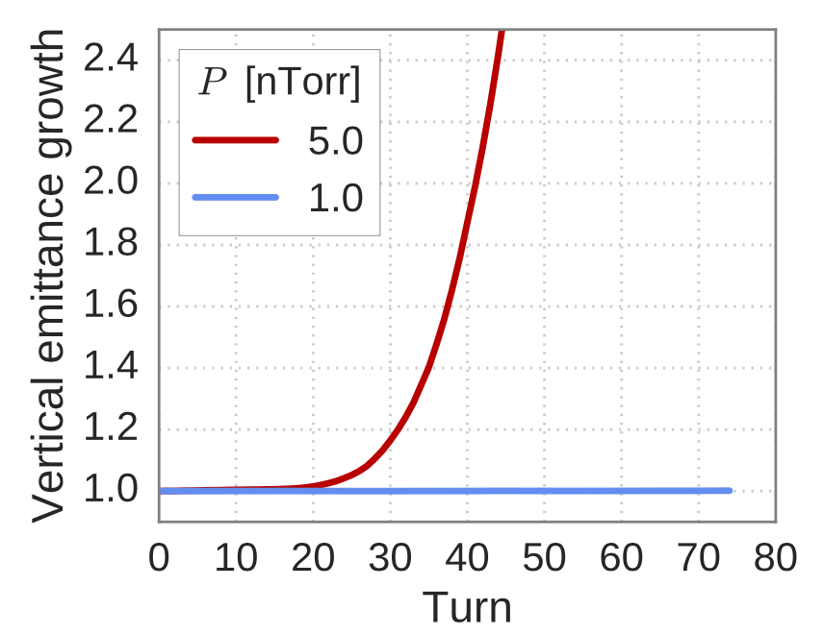
Mitigation options
Length of bunch train
Efficient only for heavier species in the straight sections, in the arcs would have to go to less than 10-20 bunches for an effect
Bunch spacing
A larger bunch spacing could increase thresholds in arcs and straight sections
  Test for CO₂ in the arcs with 7.5 ns bunch spacing shows significant improvement
  pressure threshold increased at least by a factor of 20
Feedback
Generally efficient at suppressing coupled bunch instabilities
A damping time of ~10 turns → realistically achievable pressure thresholds
However, emittance growth may still occur
Emittance growth of most unstable bunch

Slide 16
Conclusion and outlook
Partial pressure thresholds in FCC-ee have been determined for H₂, N₂, CO and CO₂
With 2.5 ns bunch spacing, instabilities develop faster than the damping time for partial pressures as low as 10 pTorr
Adjusting the bunch train length can only give partial mitigation, due to the limited trapping in the arcs
The constraints can be relaxed considerably by using a longer bunch spacing
A transverse feedback is expected to effectively mitigate the instability, but may not mitigate emittance growth (simulation studies are yet to be done)
A report of the results was delivered to the FCC study in December
(EDMS 1895017 v.1.0 | FCC-ACC-RPT-0025 v.1.0)

Slide 17
Thank you

Slide 18
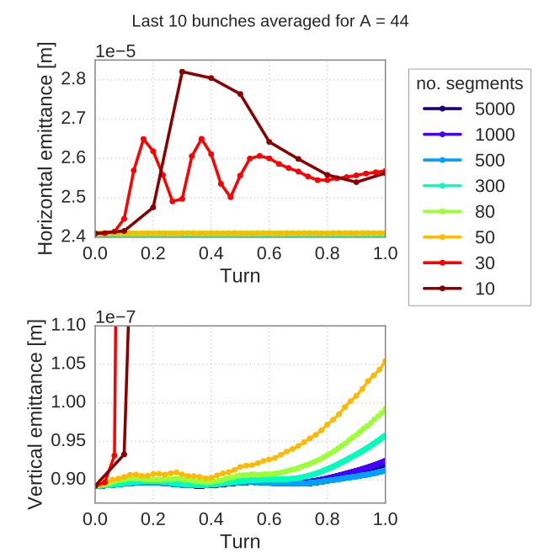
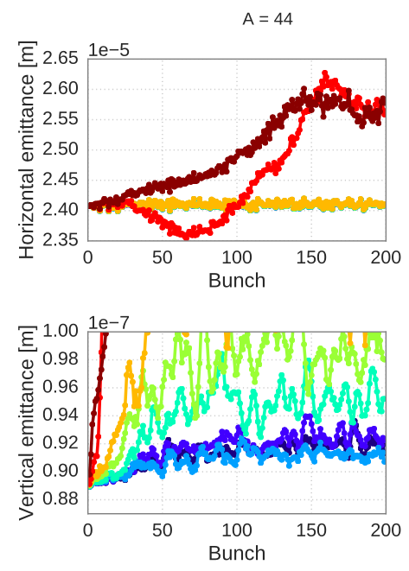
Convergence scans
Convergence scans performed for CO₂ in the arcs with a pressure of 5 nTorr
Fast instability develops within a turn
Convergence as of 500 segments
Results averaged over 10 random number seeds per case (no strong dependence on seeds)

Slide 19
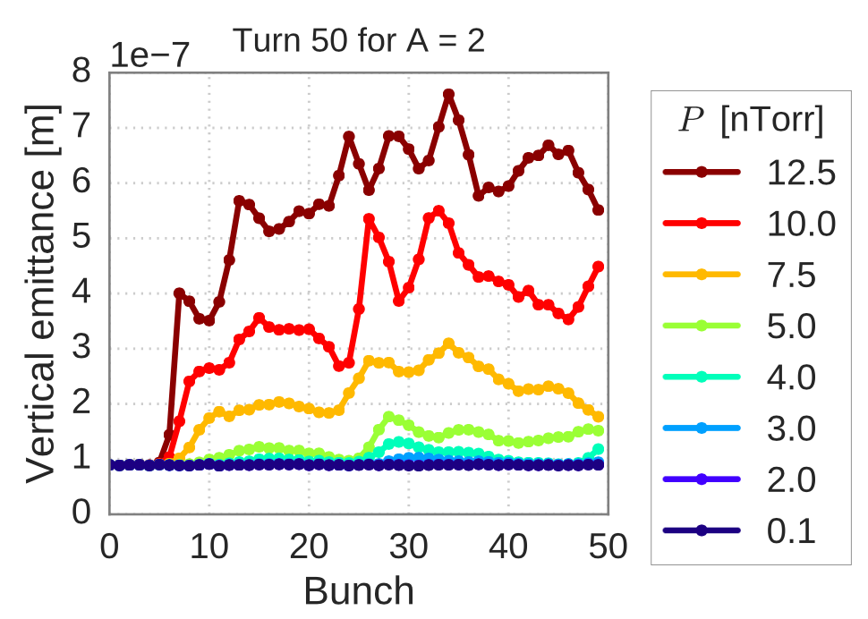
Straight section results: hydrogen
Hydrogen simulated with 50 bunches over 50 turns
Much stronger effect on beam than in the arcs, despite shorter length
Unstable down to around 1 nTorr

Slide 20
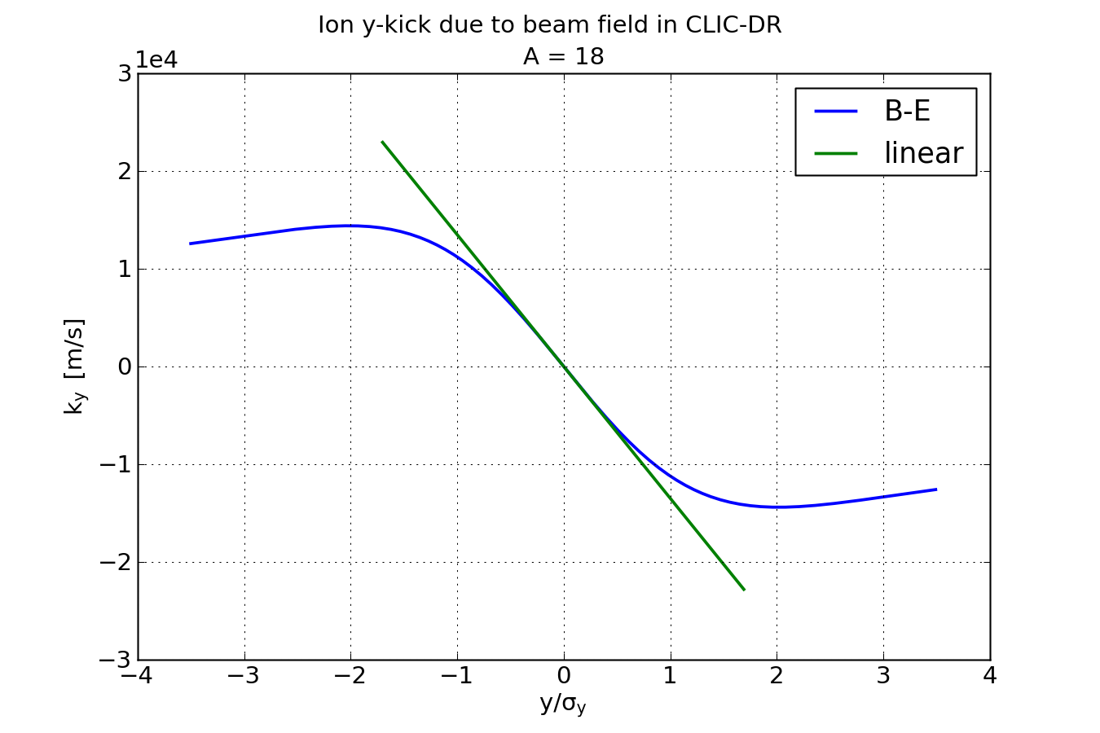
Beyond linear approximation
Linear approximation good only in small region around centre of beam
x,y ≈ 0.5 σ_{x,y}

Slide 21
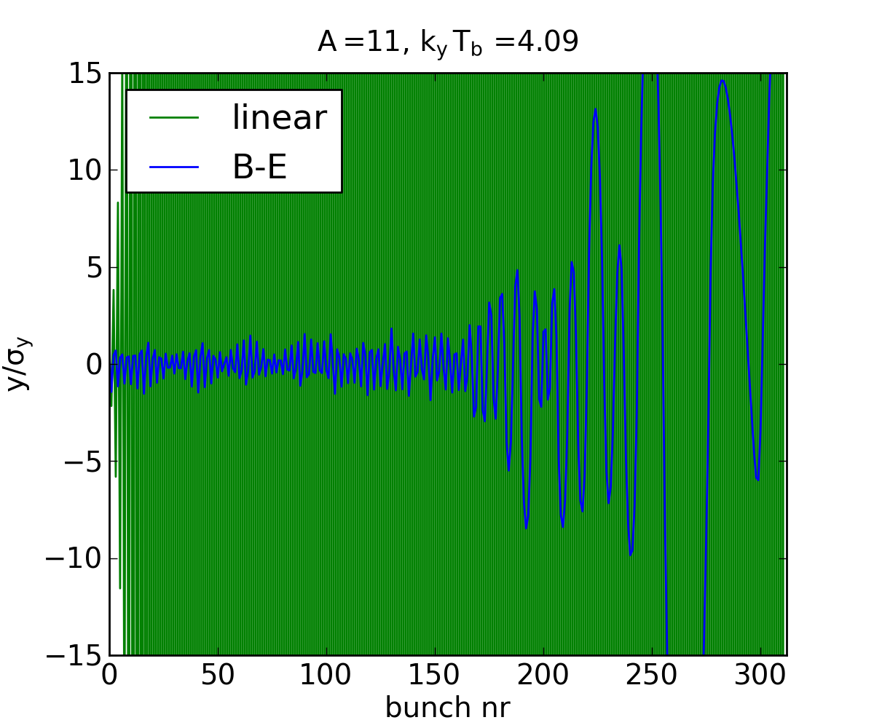
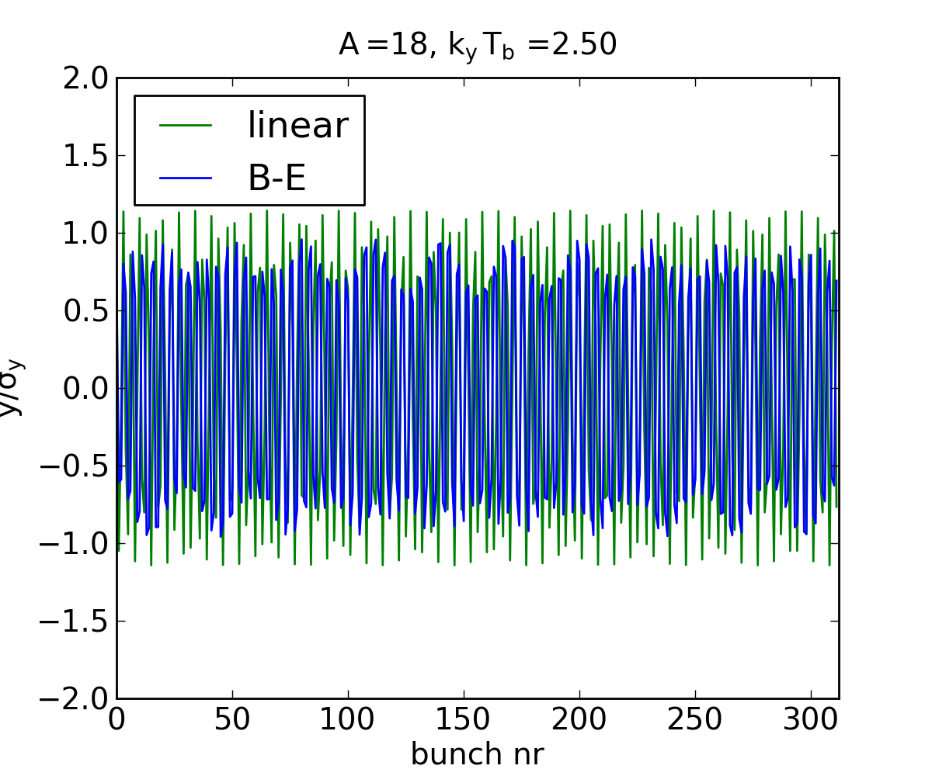
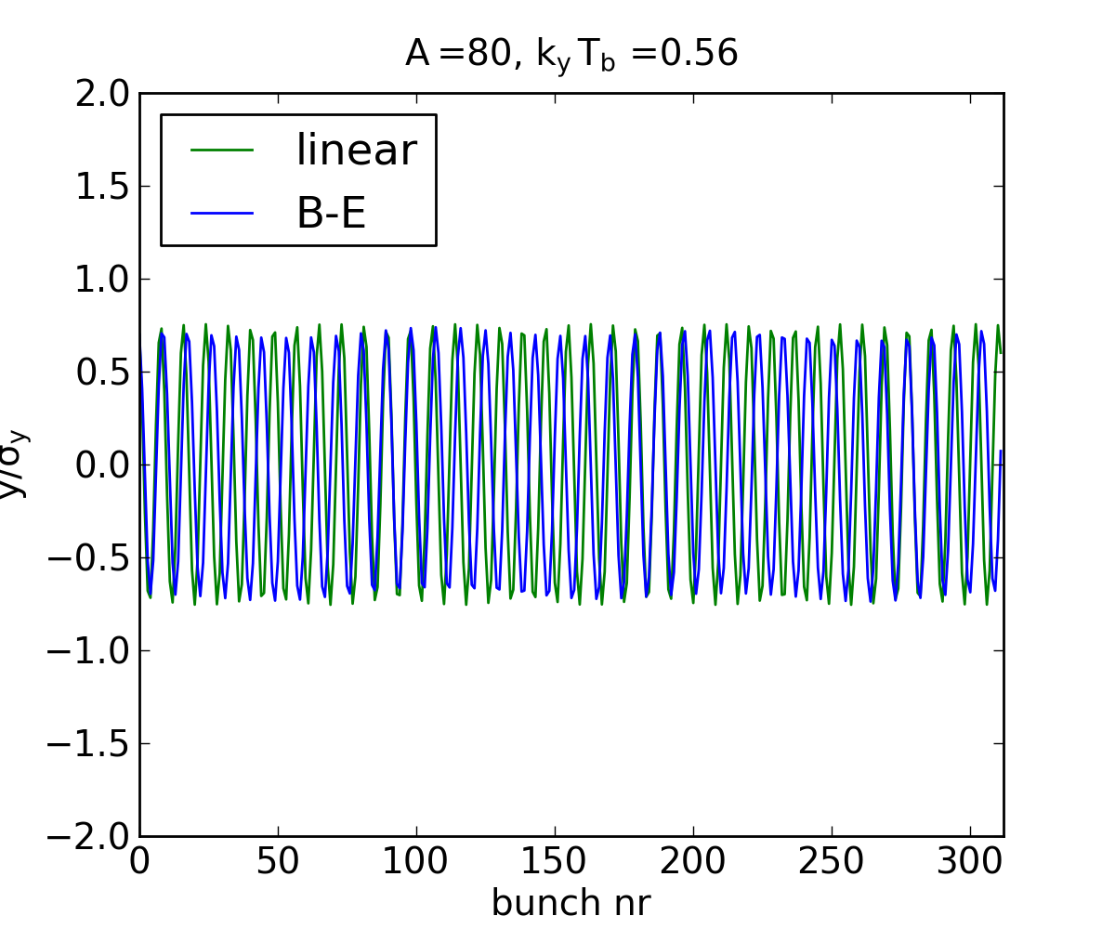
Beyond linear approximation
Effect on stability condition and ion trapping
Trajectories for ion of mass A during the passage of a CLIC bunch train
  x₀ = 0.7 σ_{x}, y₀ = 0.7 σ_{y}
Non-trapping, k_{y}T_{b} > 4
Weak trapping, k_{y}T_{b} = 2.5
Strong trapping, k_{y}T_{b} = 0.56

Slide 22
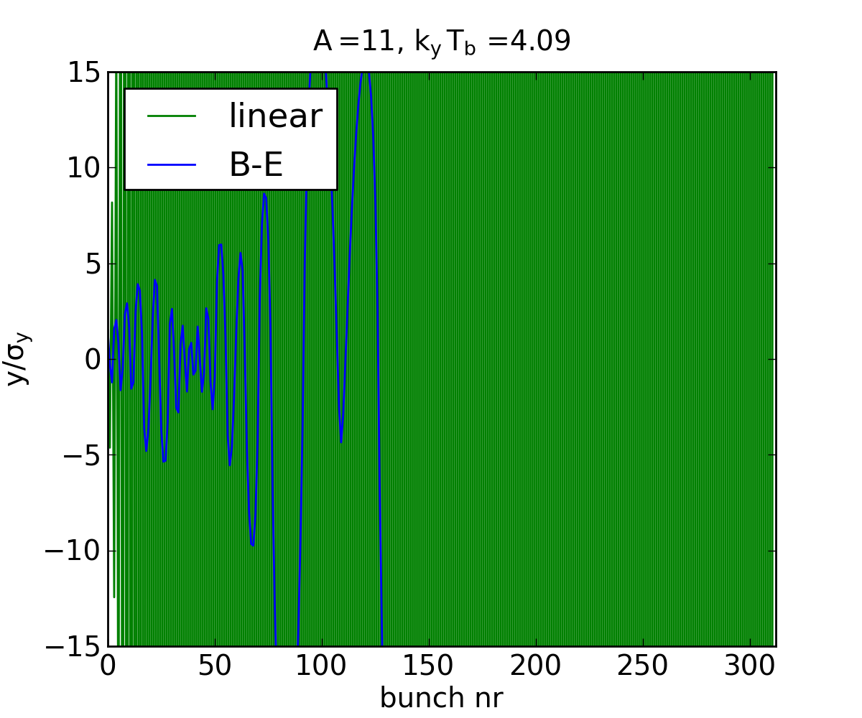
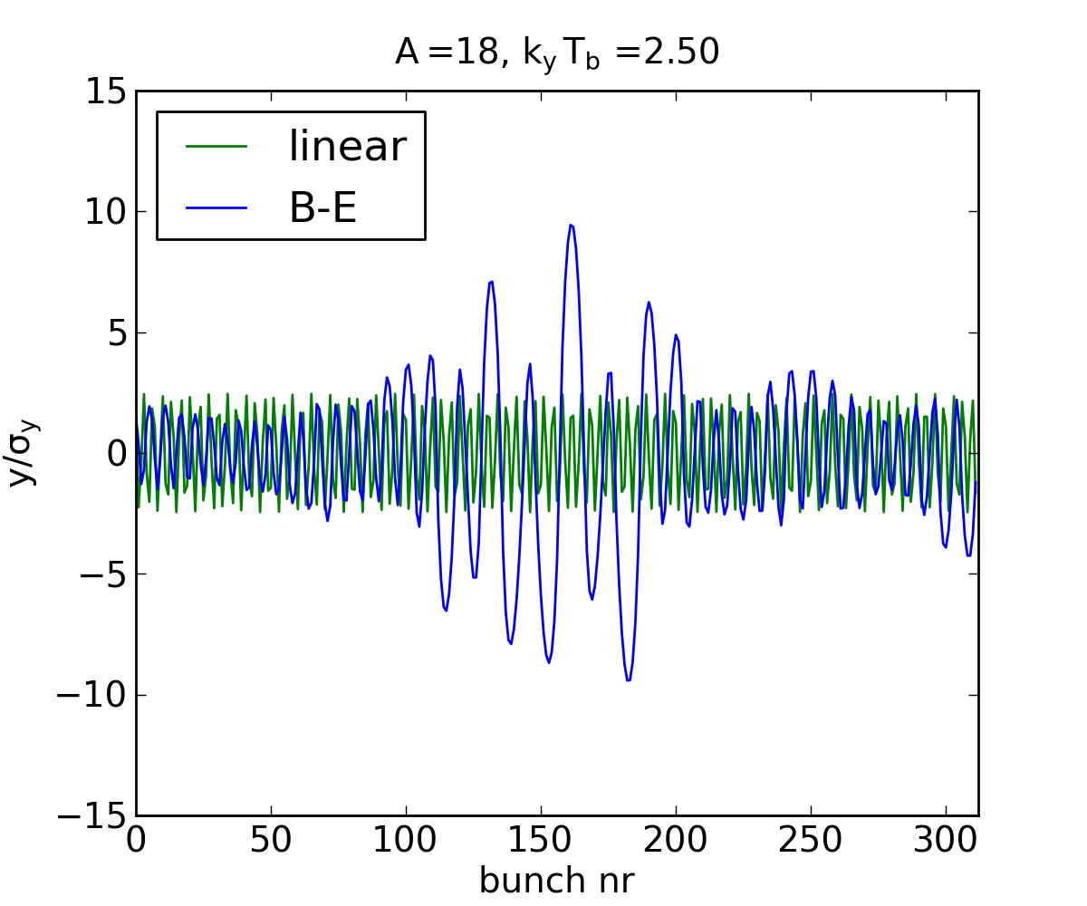
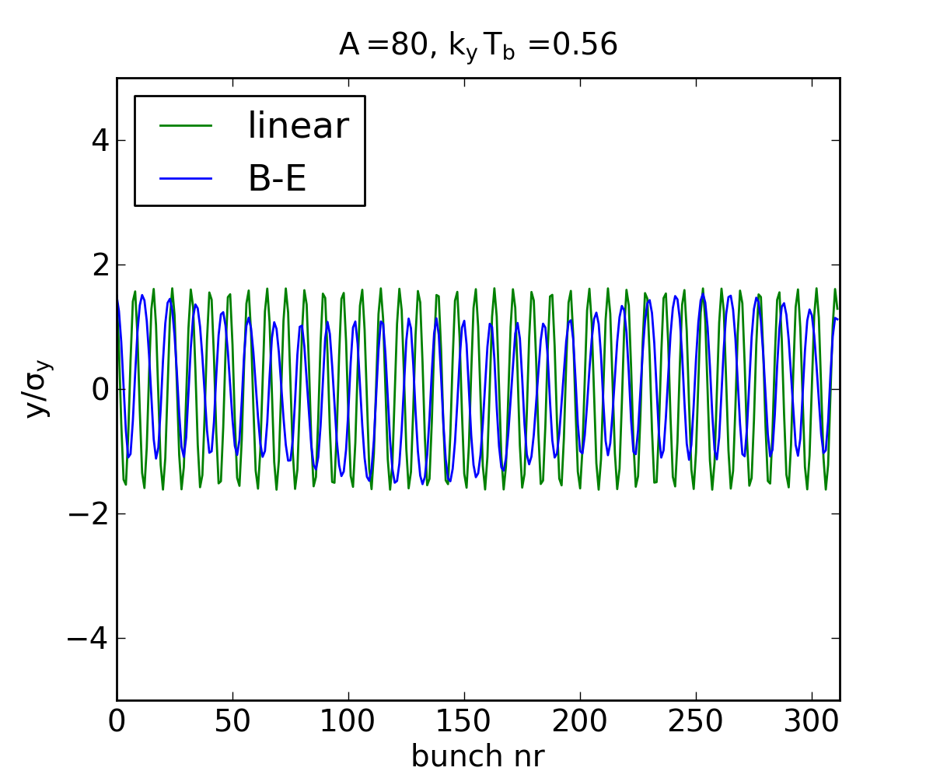
Beyond linear approximation
Effect on stability condition and ion trapping
Trajectories for ion of mass A during the passage of a CLIC bunch train
  x₀ = 1.5 σ_{x}, y₀ = 1.5 σ_{y}
Non-trapping, k_{y}T_{b} > 4
Weak trapping, k_{y}T_{b} = 2.5
Strong trapping, k_{y}T_{b} = 0.56

Slide 23
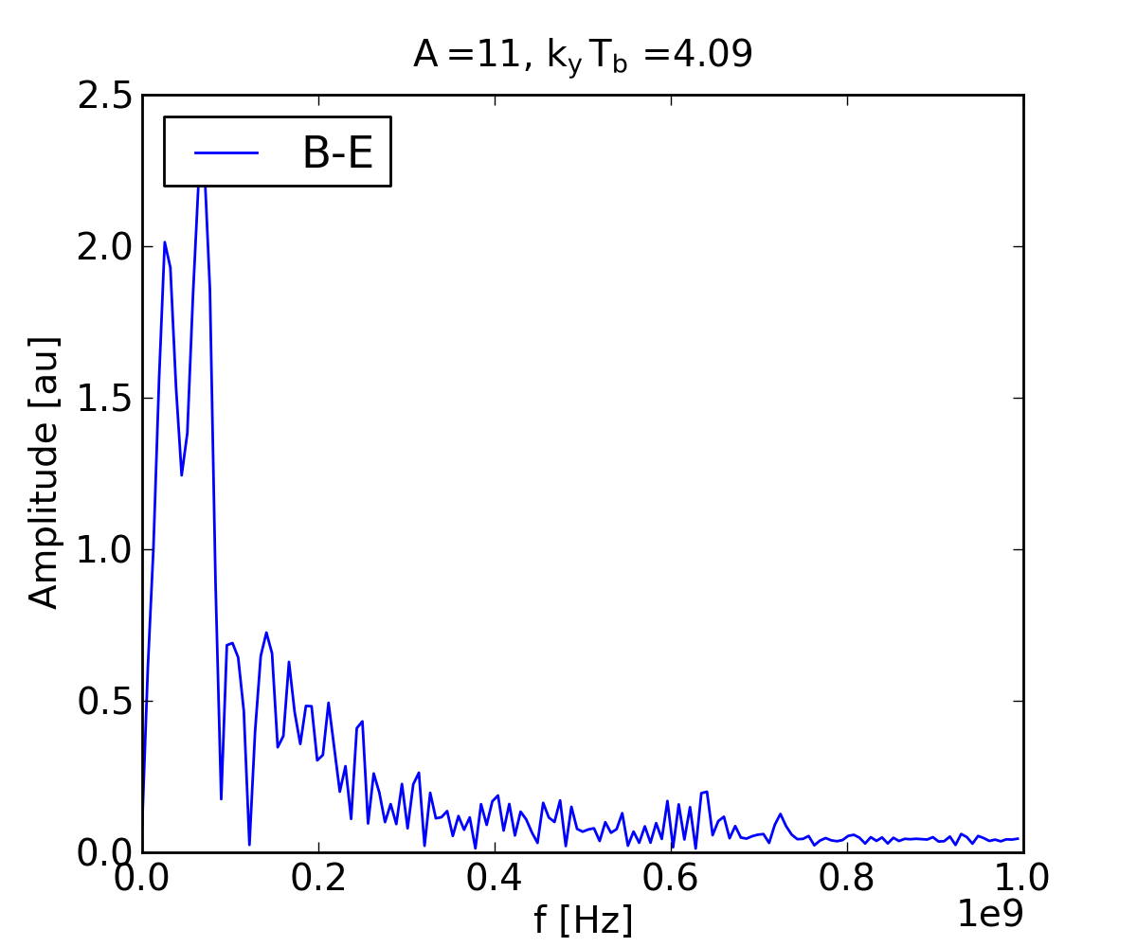
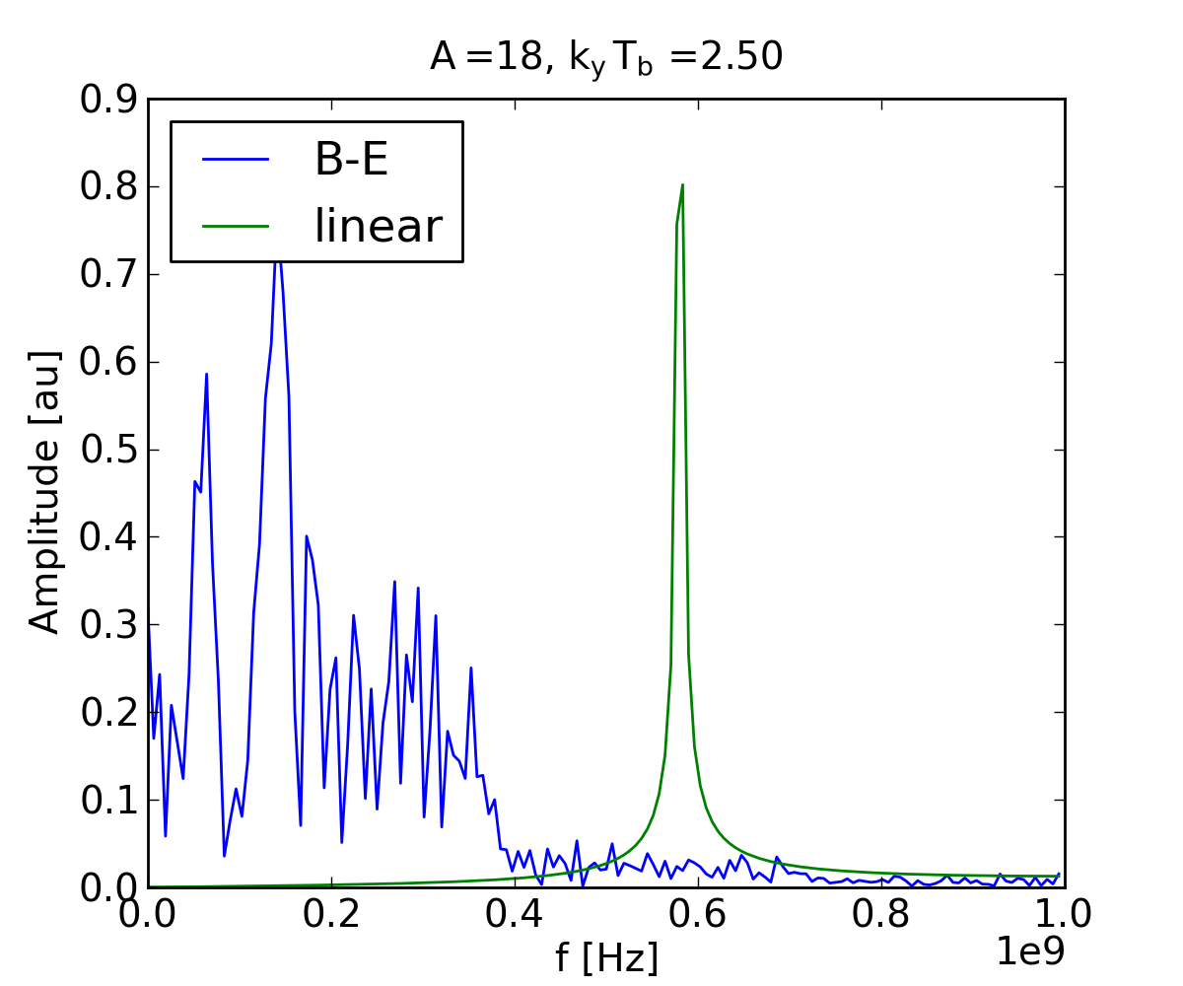
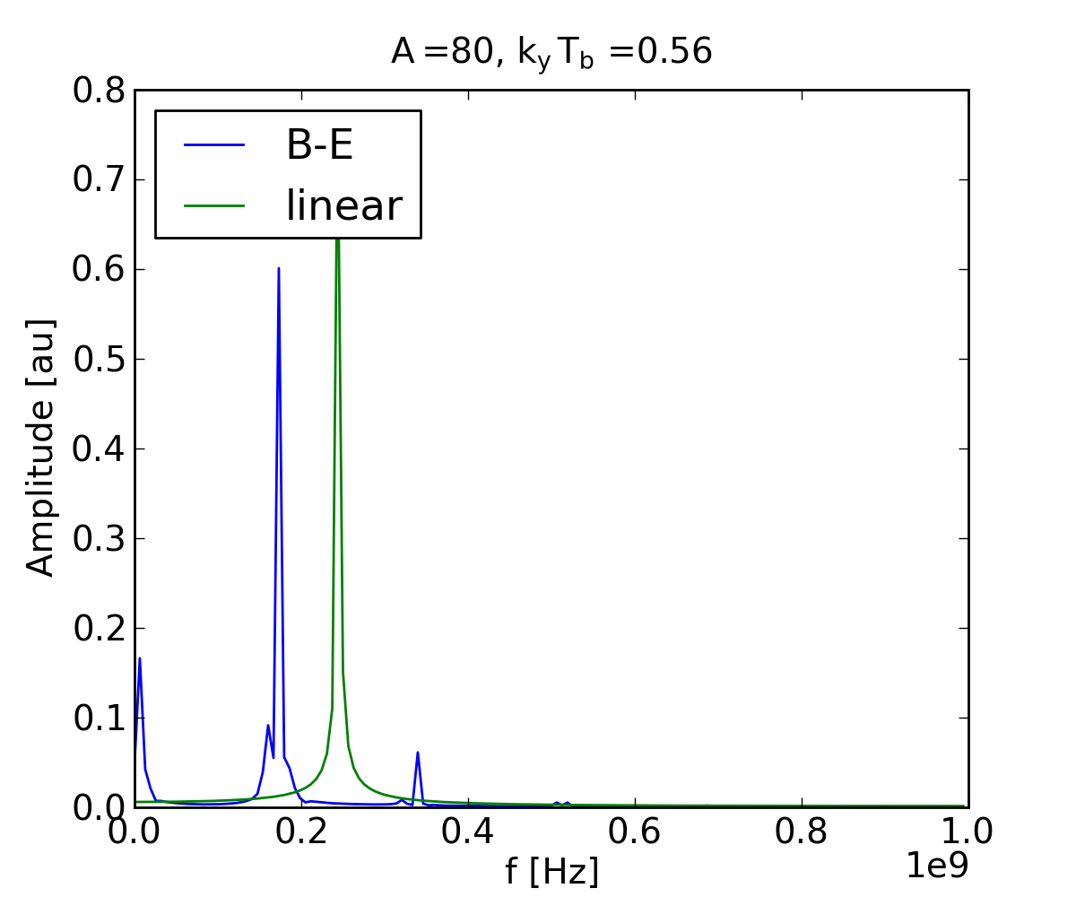
Beyond linear approximation
Effect on stability condition and ion trapping
Oscillation frequencies for ion of mass A during the passage of a CLIC bunch train
  x₀ = 1.5 σ_{x}, y₀ = 1.5 σ_{y}
Non-trapping, k_{y}T_{b} > 4
Weak trapping, k_{y}T_{b} = 2.5
Strong trapping, k_{y}T_{b} = 0.56

