Slide 1



FCC-eh Civil Engineering Developments
FCC week 2018 Amsterdam
J. Osborne, M.Stuart, J.Stanyard

Slide 2
Agenda
Civil Engineering study progress since Berlin 2017
Update on the principal structures
Tunnel cross-section and Junction cavern layout options
Alignment and Geology
Interaction region design
Construction cost and schedule
Ground Investigation Planning and Future Steps

Slide 3
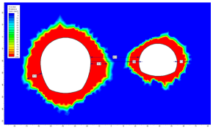
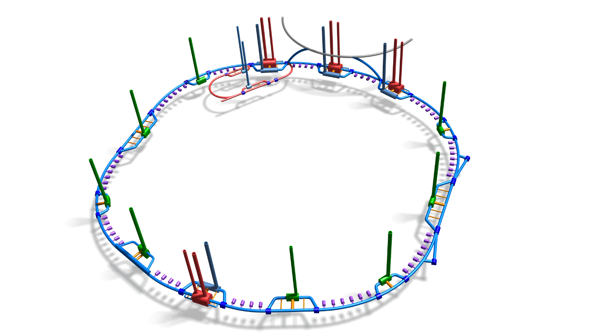
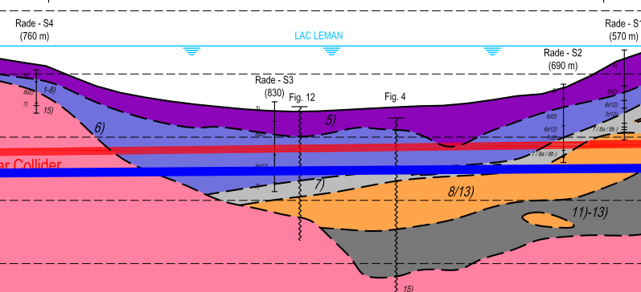


Study progress 2017/18
Alignment update following geological review of key areas:
Lake crossing
Arve and Rhone Valleys
Led to the lowering of the alignment by 30 m. Including the FCC-eh Machine
Phase 3 of cost and schedule study launched.
Produce a cost and schedule estimate that is compatible with the CDR baseline.
Design development with integration, including study to investigate feasibility of connections to FCC.
Cost and schedule round up for all 3 machines:
FCC-hh, FCC-ee and FCC-eh
CDR writing
Ongoing work:
Surface site investigation
Spoil management study
Site investigation planning
Cost and schedule updates
August 2017
September 2017
February 2018
March 2018
Ongoing

Slide 4
Schematic Layout of FCC-eh
FCC experimental point.
BDS
Linac.
Tunnel Dimensions:
400m Beam Delivery System (BDS)
1070m Linac
979m radius arcs (x2)
400m drift section.
Total Length of main tunnel = 9091m.
Total Length of RF Tunnel = 2140m

Slide 5
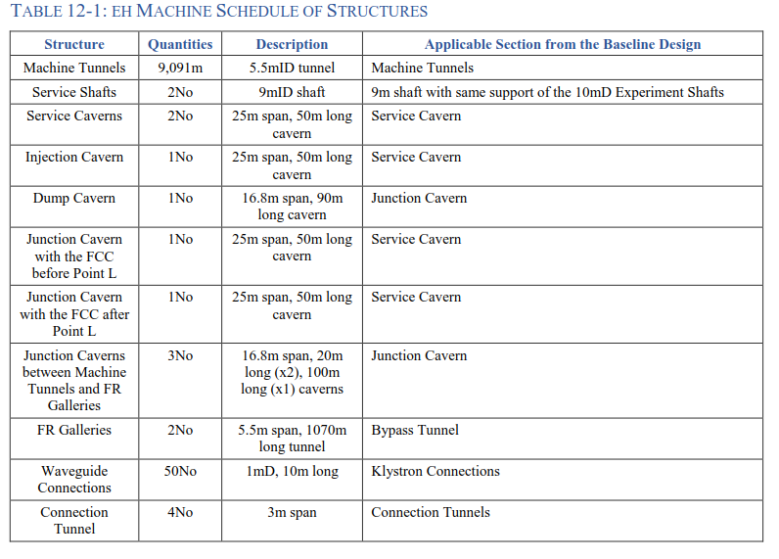
Structure schedule for FCC-eh
RF Galleries

Slide 6
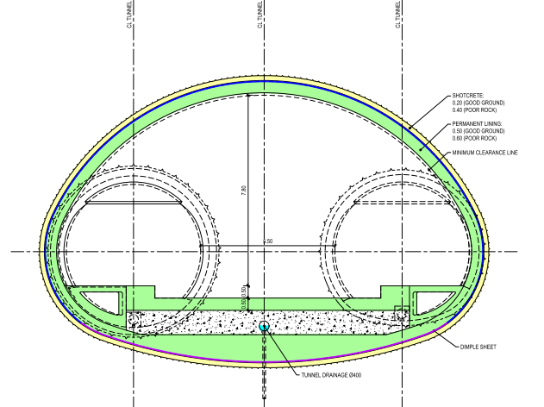

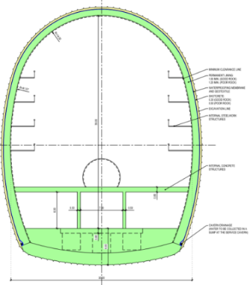
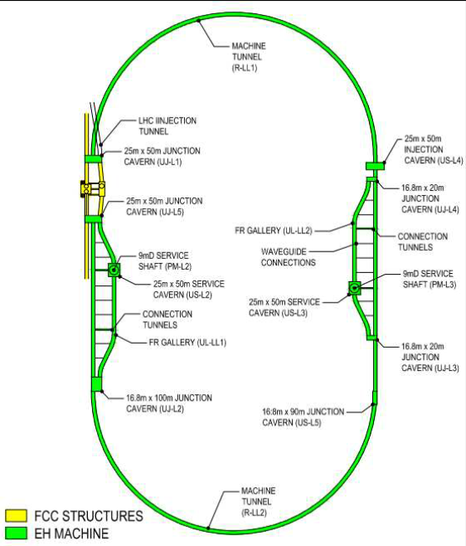
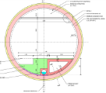
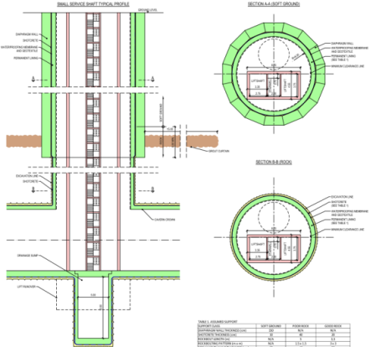
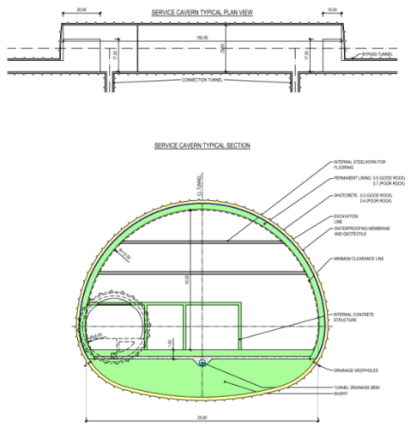
Scope of FCC-eh Structures
Junction Caverns
16.8 m x 15 m x 100 m
25 m x 15 m x 50 m
16.8 m x 15 m x 90 m
Small Experimental Caverns
30 m x 35 m x 66m
Tunnels:
9.091 km of 5.5m dia. machine tunnel.
2 x 1.04 km of 5.5m dia RF tunnel.
Shafts:
2 x Service shafts:
9 m dia. x 175 m depth
Service Caverns
25 m x 15 m x 50 m

Slide 7
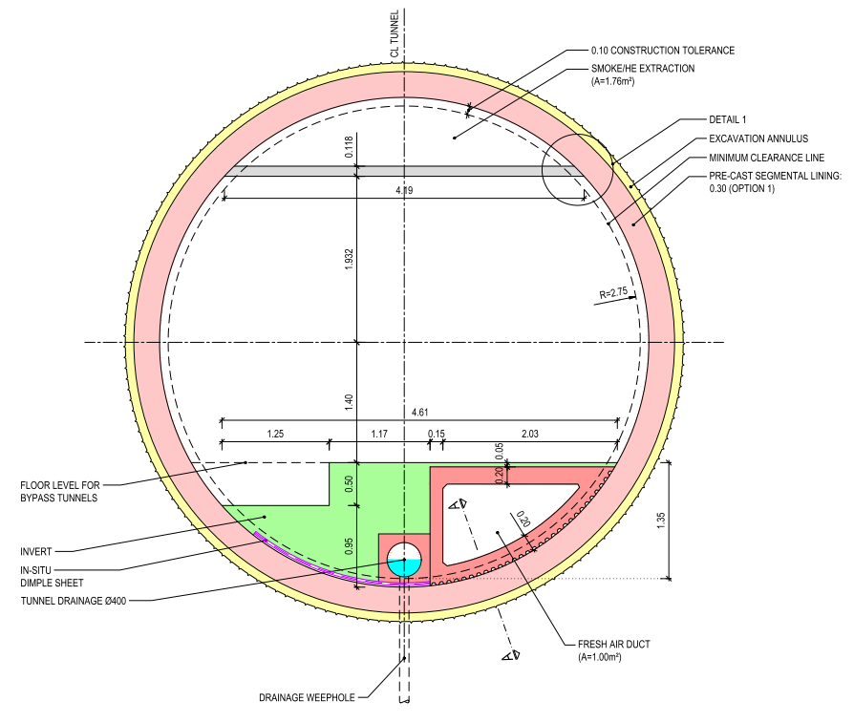
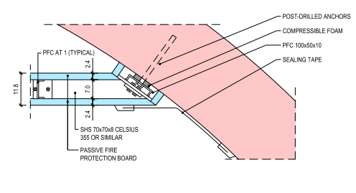
Typical tunnel cross-section
Steel structure with passive fire protection. Connection:
Pre-cast concrete segmental lining
Cast-in-situ concrete invert
Pre-cast concrete element

Slide 8
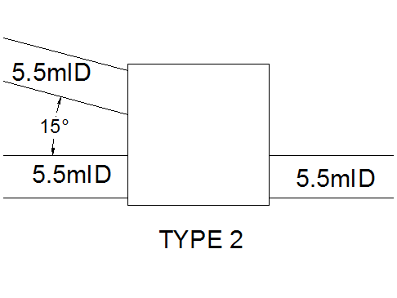
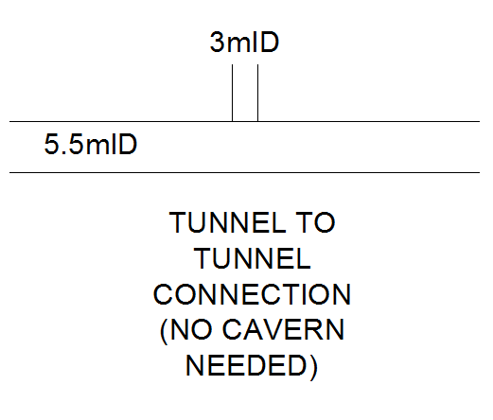
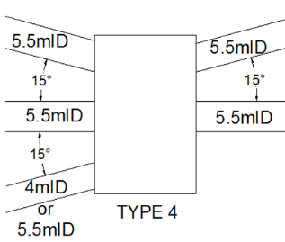
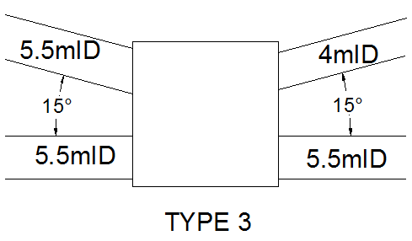
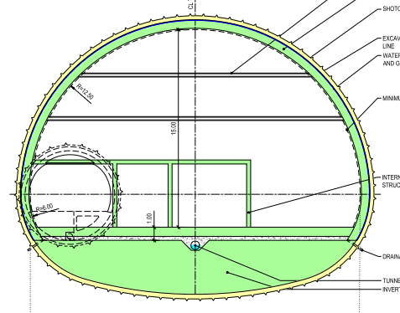
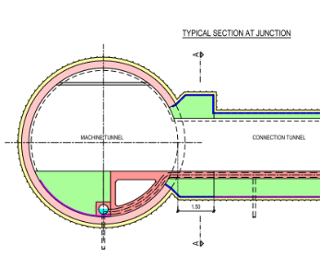
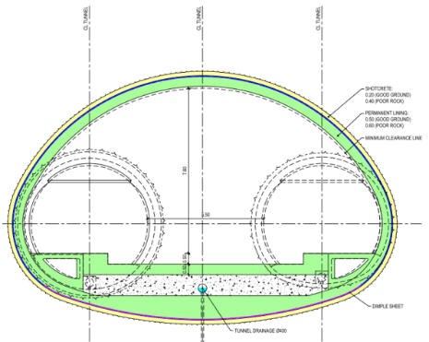
Junction cavern refinement
Junction caverns are required for structural stability when tunnels of similar size connect.
By evaluating each case individually, it was possible to omit some junction caverns
The remaining caverns have been grouped into 3 types. (Type 1 below indicates no cavern is needed)
Types 2, 3 and 4 are utilised for the FCC-eh machine.

Slide 9
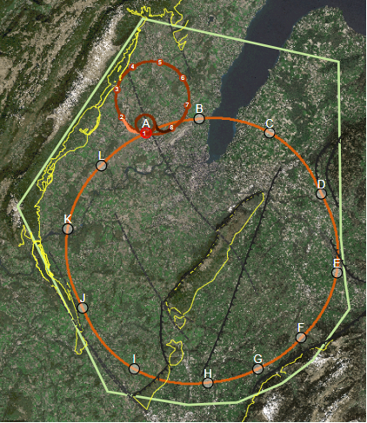
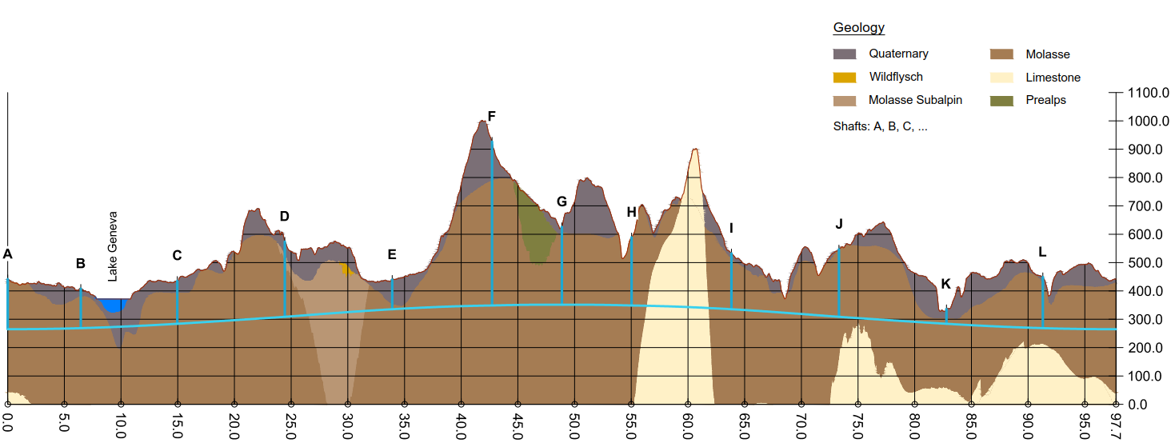
Alignment and Geology
After another round of alignment and geological optimisation the FCC-eh machine remains at FCC experimental point L provides the following benefits:
Lowest risk for construction, lowest geological risk.
Fastest and cheapest construction
Close to existing CERN land.

Slide 10
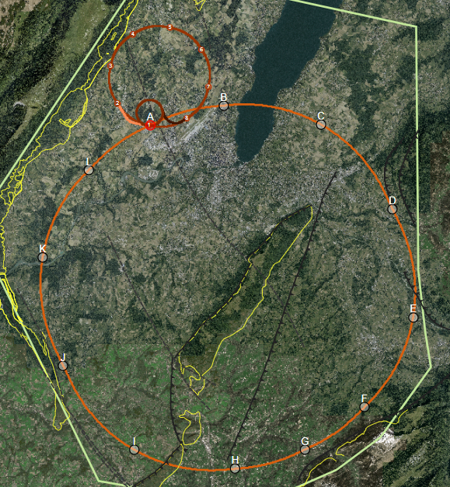
Geological Uncertainty along Alignment
Seismic and borehole information for lake crossing from proposed road tunnel, but layered nature of lake bed leads to uncertainty.
FCC-eh Located at Point L
Information near to CERN is strong due to previous experience on LEP/LHC.
Multiple deep boreholes in the area.
B
A
C
Location of the interface between molasse and molasse subalpine not certain, tunnel alignment in proximity.
L
D
K
Moraine/molasse interface not certain, cavern close to interface.
Lack of deep boreholes in area.
Alignment close to limestone rockhead
E
J
No deep borehole information available in the area.
Complex faulted region.
Molasse/limestone interface not certain.
F
Limestone formation known, but characteristics and locations of karsts unknown.
I
G
H

Slide 11

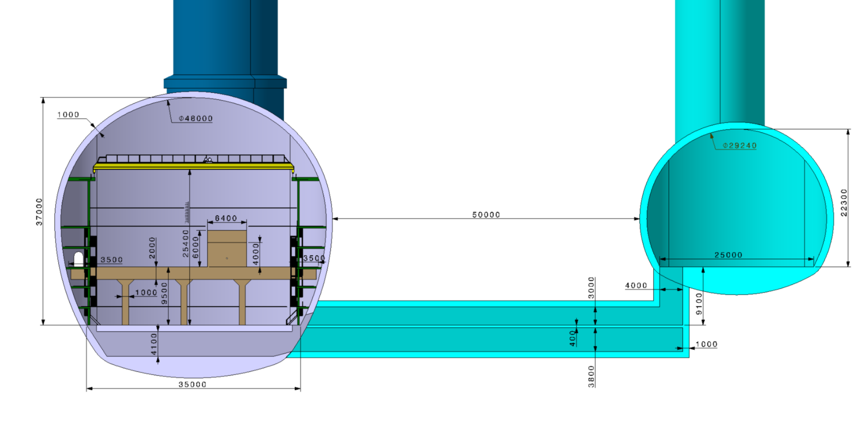
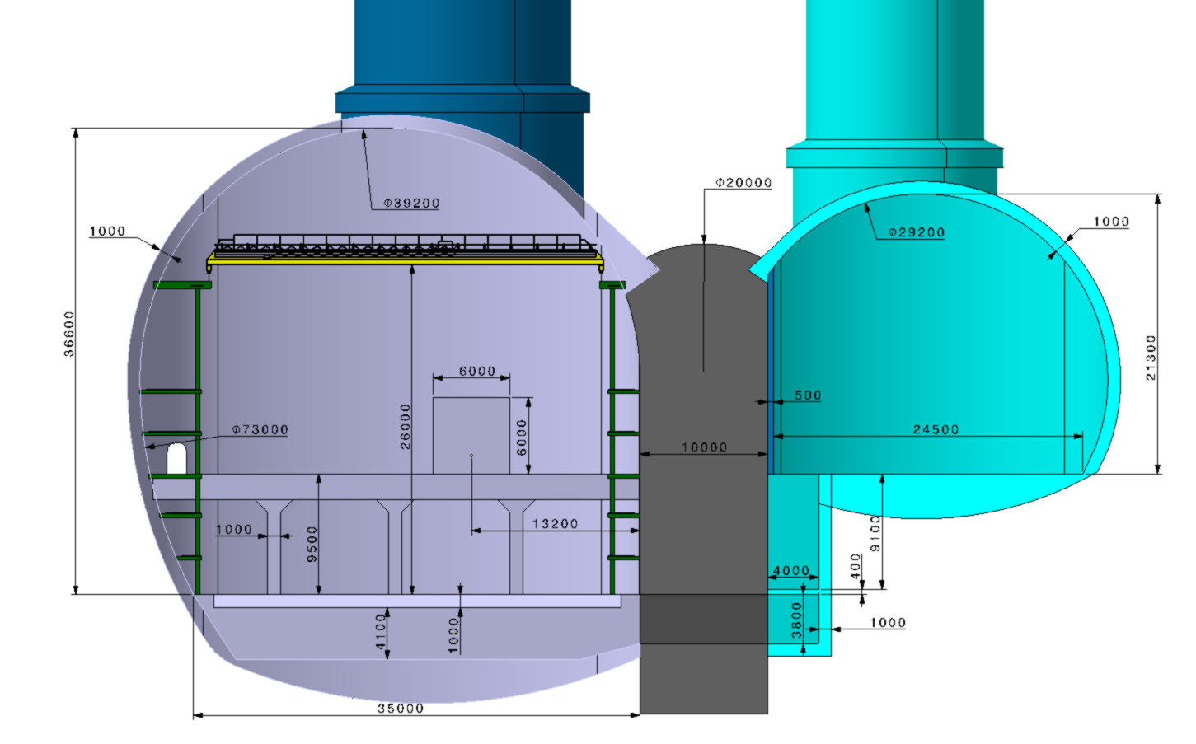
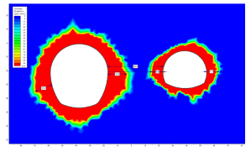
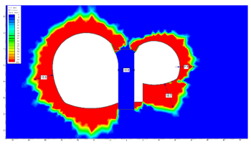
Experimental point layout options
With 45 m spacing in good molasse, the rock pillar alone is sufficient.
Cheapest and lowest risk option for CE
Separation to be maintained for the FCC & FCC-eh tunnels and caverns where possible.
With a 10 m spacing it is feasible but a high strength concrete pillar is required.

Slide 12



Cost and schedule study progress
Phase 1
Cost & Schedule estimate for “baseline” single tunnel design.
Phase 2
Cost & Schedule implications of variations considered:
  Double tunnel design
  Shallow option
  Alternative tunnel diameters
  Alternative shaft diameters
  Alternative cavern dimensions
  ee machine requirements
  Alternative schedule + Inclined access tunnels
Phase 3
Refinement of results from Phases 1 and 2:
  Review to include updates made to baselined design.
  Incorporate desirable variations from Phase 2.
  Incorporate FCC-eh Design

Slide 13
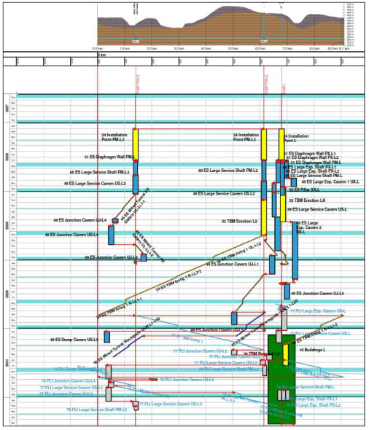
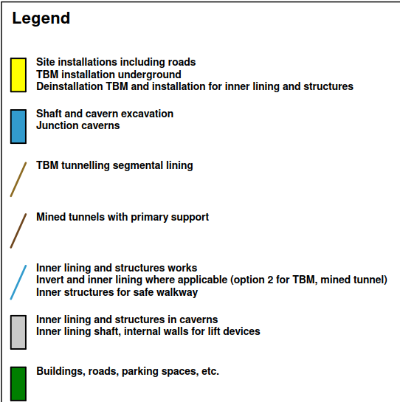
Construction Schedule
FCC-eh Schedule Considerations:
The eh Civil Engineering work is expected to be undertaken as part of the FCC construction
This schedule is therefore based on the schedule produced for the FCC main tunnel.
FCC overall CE schedule 6.5 years
FCC-eh: 4.5 years

Slide 14
Cost Update
 | 2011 Dimensions
 | Total length (m) | Diameter/width (m)
Tunnel | 7201 | 5
Total Shaft | 160 | 8
RF Gallery | 2842 | 6
Shaft Caverns | 60 | 20
Dump Tunnel | 180 | 5
Dump Caverns | 40 | 12
Junction Tunnel | 7 | 6
Waveguide Boreholes | 500 | 1
Junction Caverns 1 | 55 | 20
Junction Caverns 2 | 80 | 12
Contributors to cost changes
RF Galleries
Tunnel Length for FCC is 9091m
Ventilation ducts and fire compartments Included
Connection Tunnels between RF Gallery and Main Tunnel.
Increased Shaft depth to a total of 350m
Consultancy and contractors profit % increase
Injection Cavern added to structures schedule
Price escalation

Slide 15
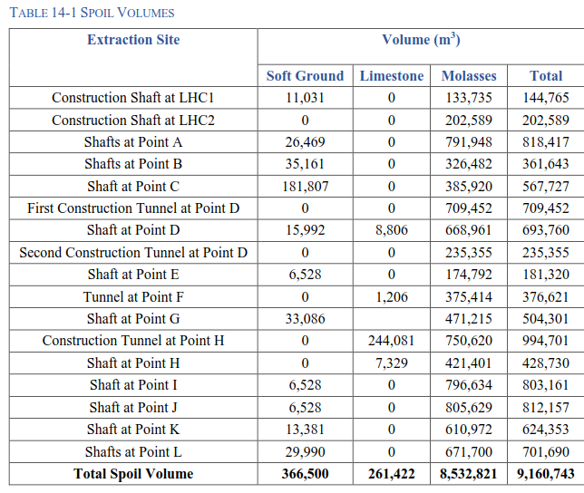
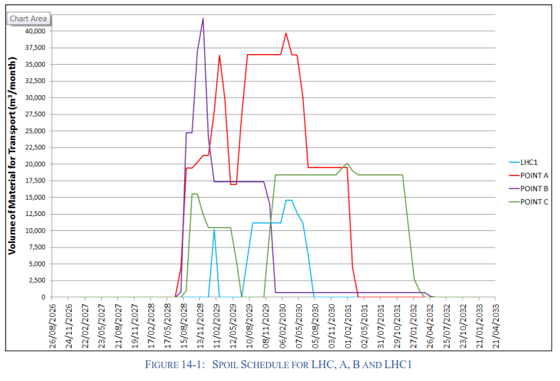
Spoil Management
Assumed bulking factor of 1.3
Production of up to 42,000m³ per month
9million cubic meters to dispose
Can the molasse be re-used?
Total Spoil volume of FCC-eh = 598,140m³

Slide 16
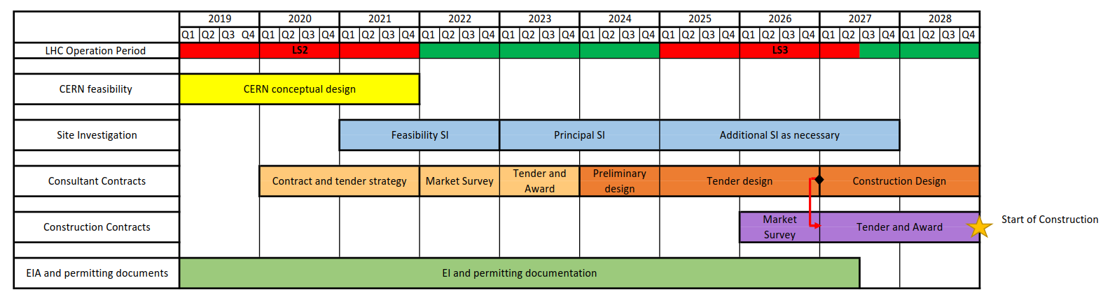
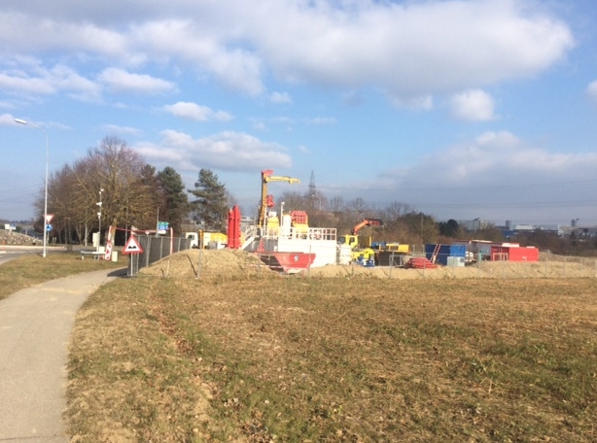
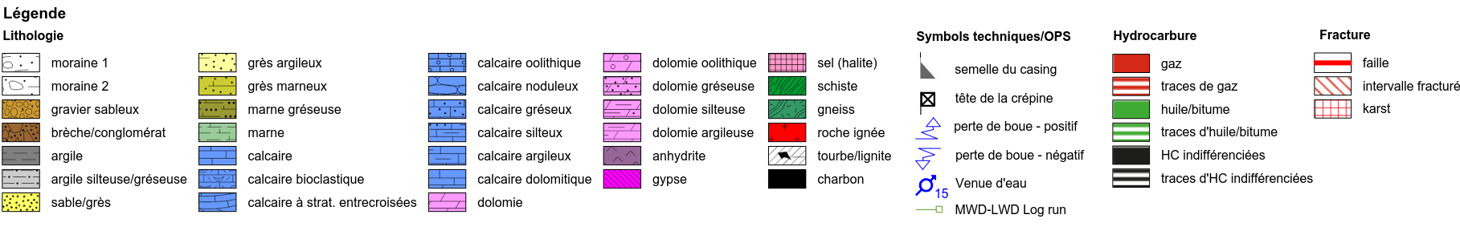
Ground Investigation Planning
Types of site investigation:
Collection of existing information
Walkover survey
Geophysical investigation
Boreholes
Site testing (eg Insitu stress test, point load testing, SPT)
Rock laboratory testing.
Geothermal site investigation in Satigny 2017/2018 (500m deep)

Slide 17
Other Future Steps
A further round of alignment optimisation for FCC following input from surface site investigations and potentially ground investigations.
  This will require an optimisation of the FCC-eh machine when/if the alignment is optimised.
Continuing to work with integration to refine designs for all structures and integrate the eh machine with the FCC machine.
Spoil disposal planning for FCC-eh as part of the overall spoil disposal plan.
A further cost update to be undertaken to refine the FCC-eh Costs.

