Slide 1

Marx prototype pulse generator design and initial results
M.J. Barnes (CERN)
L.M. Redondo (Instituto Superior de Engenharia de Lisboa, Portugal)
A. Kandratsyeu (Energy Pulse Systems, Portugal)
T. Fowler (CERN)

Slide 2
Outline
Parameters of injection system
Pulse power generators for kicker magnets
  Parameters
  Motivation & challenges
  Application: kicker system
  Marx generator concept & specifications
  Marx single switch unit measurements
  One & four Marx stage measurements
  Ongoing R&D
  Conclusions

Slide 3
Parameters of injection system
Hardware parameter | Unit | Kicker
Deflection | mrad | 0.18
Integrated field | T∙m | 2.0
Field rise time | µs | 0.43
Magnet single way delay | µs | 0.355
System impedance | Ω | 6.25
Magnet current | kA | 2.4
Generator pulse rise time | ns | 75
Generator output voltage | kV | 15
Flattop length | µs | 2.0
Flattop stability | % | ±0.5
‘boxcar’ stacking
circulating
beam
transferred
beam
transferred beam
intensity
septum magnet
kicker
field
time
quad
quad
FCC circulating beam
Injection kicker magnet
Injection kicker system must be highly reliable;
The baseline injection energy for the FCC-hh is 3.3 TeV;
For machine protection reasons, a maximum of 80-100 bunches can be accepted by the injection protection system and hence safely transferred into FCC at a time;
Each ring will be filled with 130 batches of 80 bunches (separated by 25 ns) ⇨ 2 µs pulse.
Oral presentation: FCC-hh transfer line and injection design, E. Renner, 11/04/2018, 15:30hrs.

Slide 4
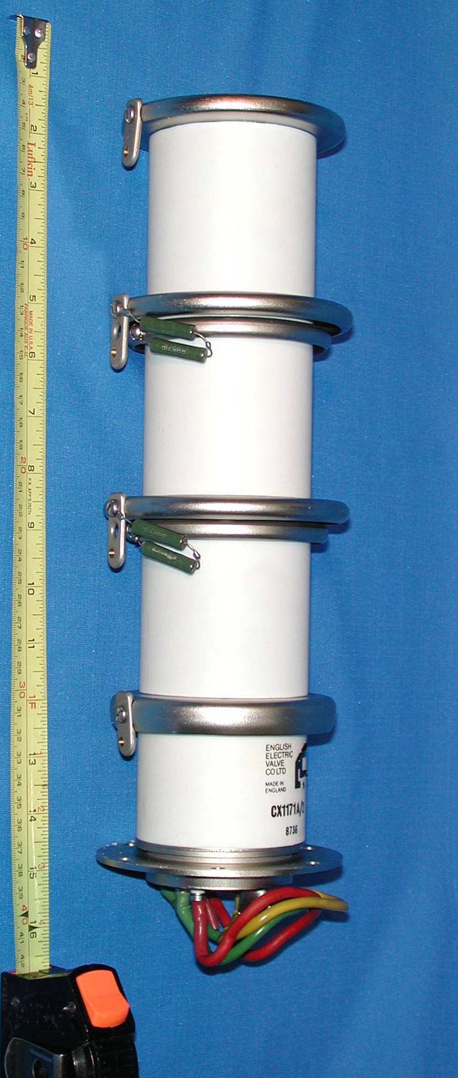
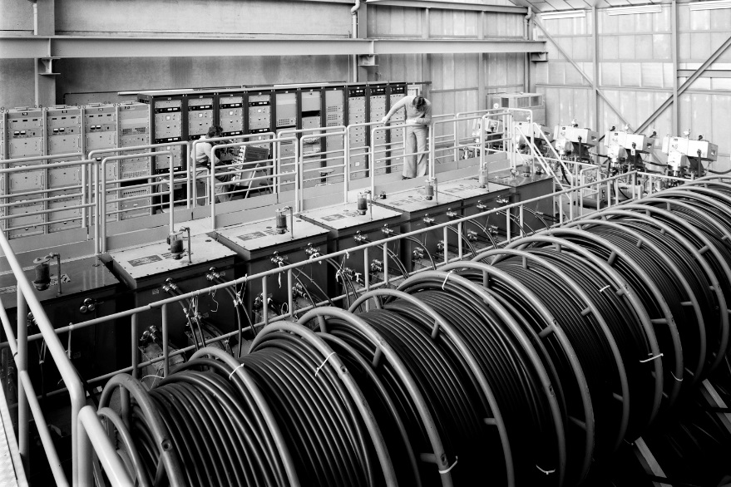
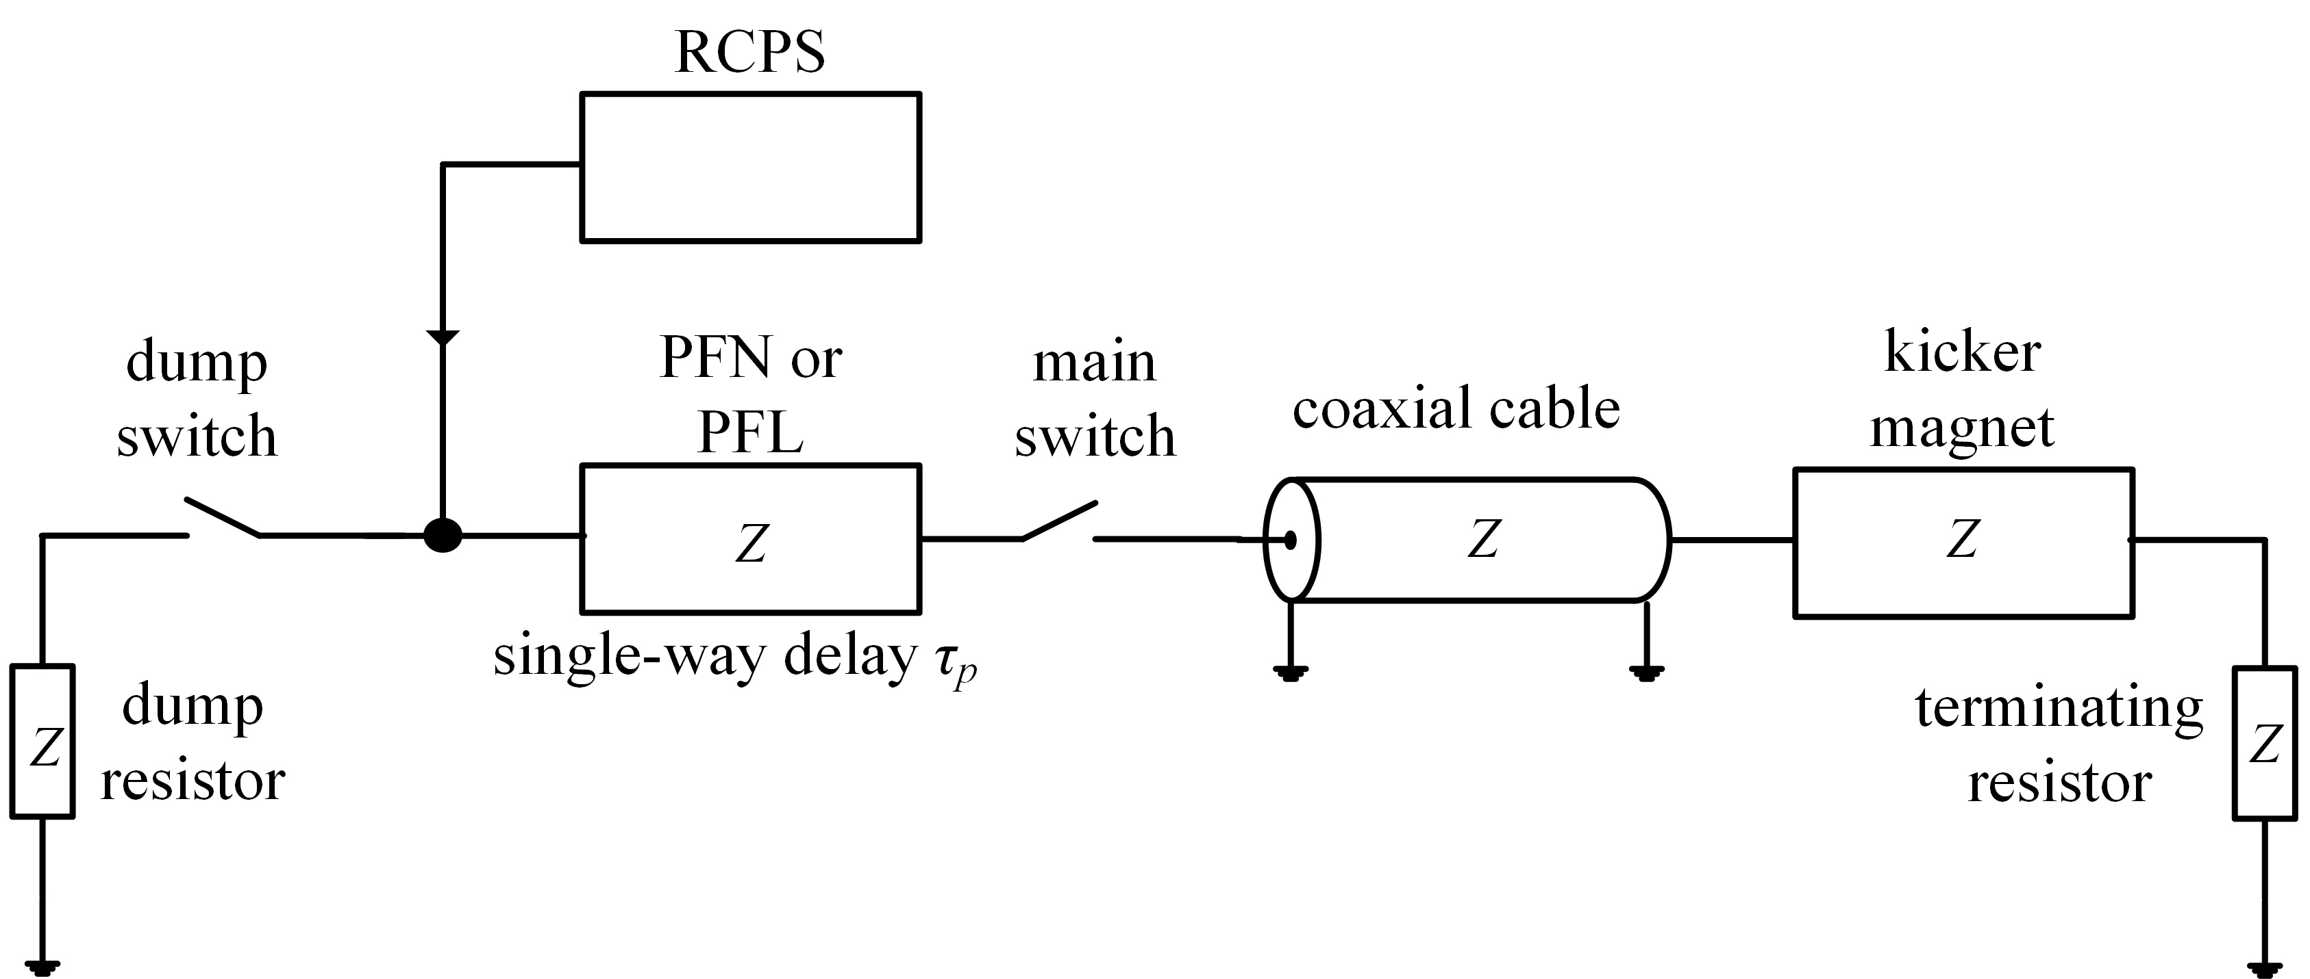
Pulse power generators for kicker magnets
~340mm
Reels of PFL
Max. pulse length = 2τ_{p}
Many kicker systems today use thyratron (gas tube) switches and pulse forming networks/lines (PFNs/PFLs);
  Long-term availability of thyratrons is a real concern;
  Thyratrons can exhibit unwanted, spontaneous, turn-on;
  Thyratrons require a PFN/PFL: the long-term availability of high-voltage PFL technology is a concern.
Solid-state technology and topologies show great promise for kicker application e.g.:
  Inductive Adder (Oral presentation: “Inductive adder prototype pulse generator for FCC-hh kickers”, D. Woog, 11/04/2018, 11:10hrs);
  Marx Generator.
Goal: to achieve reliable, fast-switch technologies based on semiconductor devices. Both the Inductive Adder (<3us pulse width) and Marx Generator technologies are being actively pursued.

Slide 5
Motivation & challenges
Semiconductor switches, such as SiC MOSFETs (metal-oxide-semiconductor field-effect transistors), can potentially be used in fast high current pulsed power accelerator applications to replace thyratrons and PFLs.
Thyratrons
Generally reliable
Robust (fault tolerant)
Relatively high voltage
Relatively high current
Long term availability
Spontaneous turn on
Can only be turned on
MOSFETs
Cost-effective
Easy to use
Off-the-shelf
Flexible
Modular
Maintainability
Can be turned on and off (thus PFL/PFN is not required)
Relatively low voltage
Relatively low current
Versus:
But…. Semiconductors have limited voltage and current rating. Hence, requires series and parallel connection of power semiconductors to achieve high pulsed power.

Slide 6
Solid-state Marx generator (1)
Electrical circuit first described by Erwin Otto Marx in 1924 – until recently the Marx did not use semiconductor switches.
Concept: generate a high-voltage pulse from a low-voltage DC supply and components.
The circuit operates by (1) charging capacitors in parallel, then subsequently connecting them in series to generate a high-voltage output pulse.
STEP 1
1a) All the odd numbered MOSFETs/IGBTs (i.e. M₁, M₃, M₅, …) are off.
1b) The capacitors (C₁, C₂ , … C₅) are charged in parallel, from Vdc, by turning-on all the even numbered MOSFETs/IGBTs (i.e. M₂, M₄, M₆, …) [V_{Marx} ≈ 0 V]:
X
X
X
X
X

Slide 7
Solid-state Marx generator (2)
The circuit operates by charging capacitors in parallel, then (2) subsequently connecting them in series to generate a high-voltage output pulse.
STEP 2
2a) Capacitors C₁, C₂ , … C₅ have been charged to V_{dc} in step (1b). All the even numbered MOSFETs/IGBTs (i.e. M₂, M₄, M₆, , …) are then turned off.
2b) All the odd numbered MOSFETs/IGBTs (i.e. M₁, M₃, M₅, …) are then turned on, to connect the capacitors in series. Here: V_{MARX} ≈ 5∙V_{dc}
X
X
X
X
X
For fast, rectangular, pulses MOSFET technology is required.

Slide 8
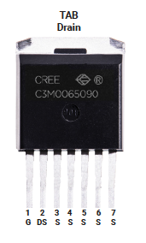
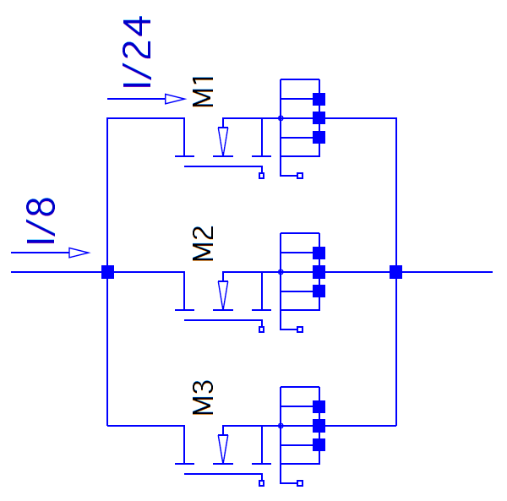
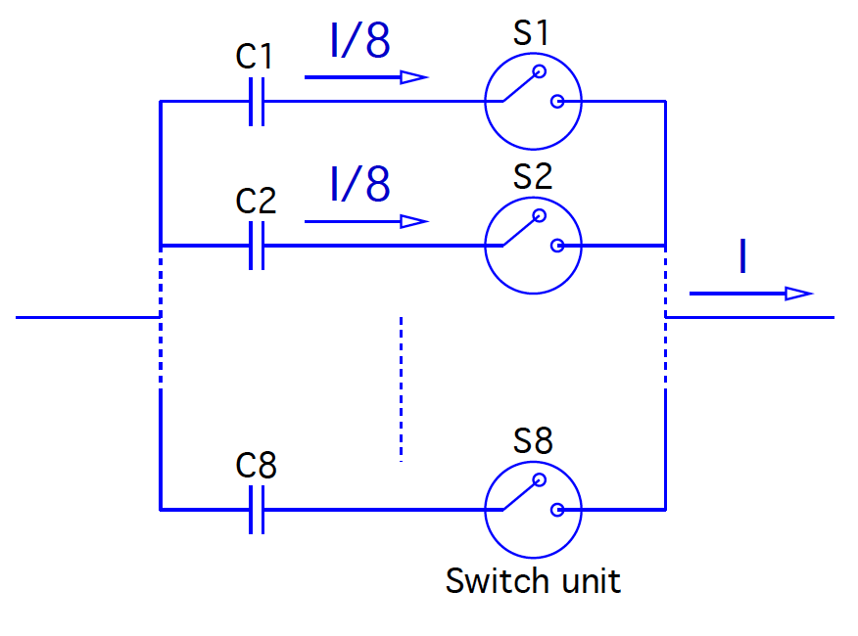
Marx generator solid-state modular concept
One MOSFET tested to date: CREE SiC MOSFET C3M0065090J, 900V, SiC MOSFET, in D2PAK-7L package, with separate emitter for gate voltage (C3M0065100J, 1000V, now available)
C3M0065090J data sheet parameter | Value
Min. Drain-Source Breakdown Voltage | 900 | V
Pulsed current | 90 | A
On-State Resistance | 65 | mΩ
Rise time (90 - 10 %) | 9 | ns
Fall time (10 - 90 %) | 7.5 | ns
Each switch unit consists of a pulse capacitor and 3 SiC MOSFETs in parallel
n staked (series) stages. Each stage consists of 8 switch units
Each switch unit (3 MOSFETs):
Each Marx stage (8 switch units ):
Capacitor

Slide 9
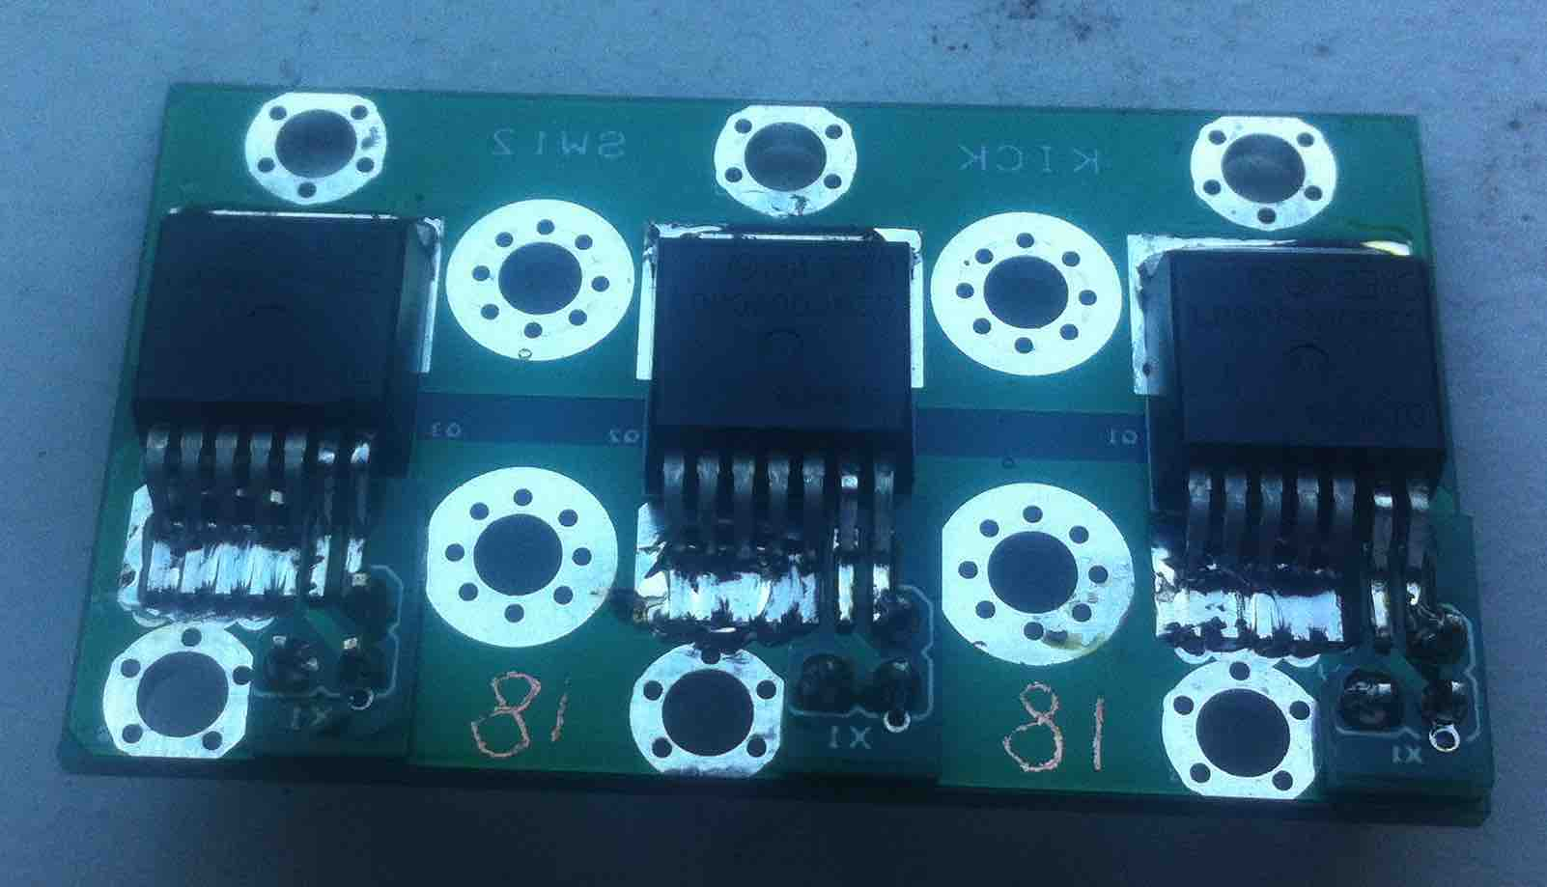
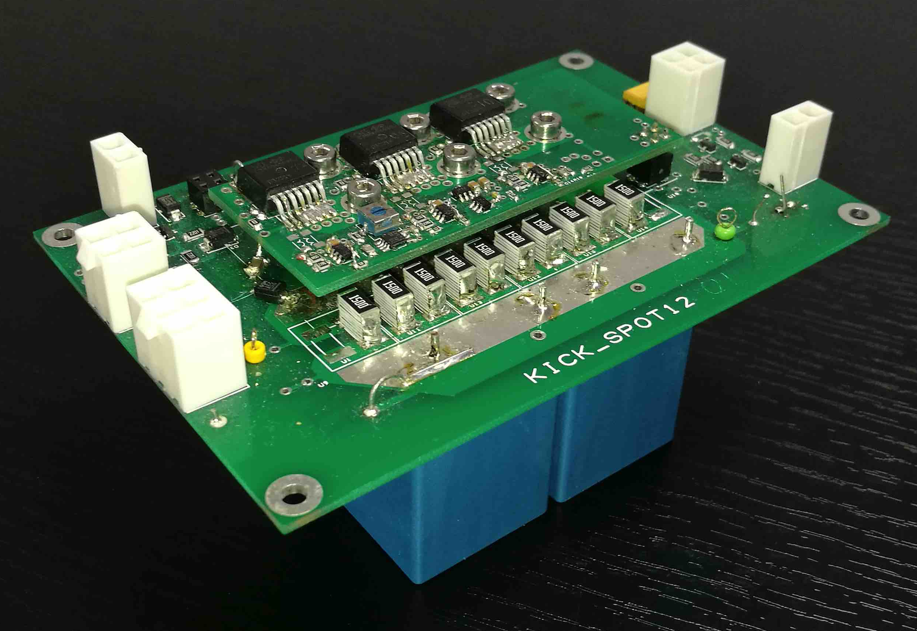
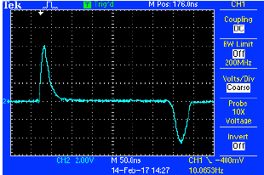
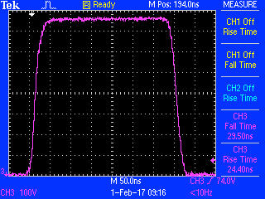
Marx MOSFET switch unit: measurements
Switch unit: 3 parallel MOSFETs with a 60μF capacitor:
Switch unit: current sharing of 3 parallel MOSFETs:
M1 | 166 A (33%)
M2 | 152 A (31%)
M3 | 182 A (36%)
Ldi/dt measured on drain pin
750 V pulse across 1.5Ω (500 A)
500A
~67A/div & 50ns/div

Slide 10
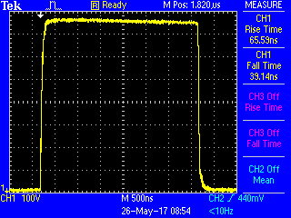
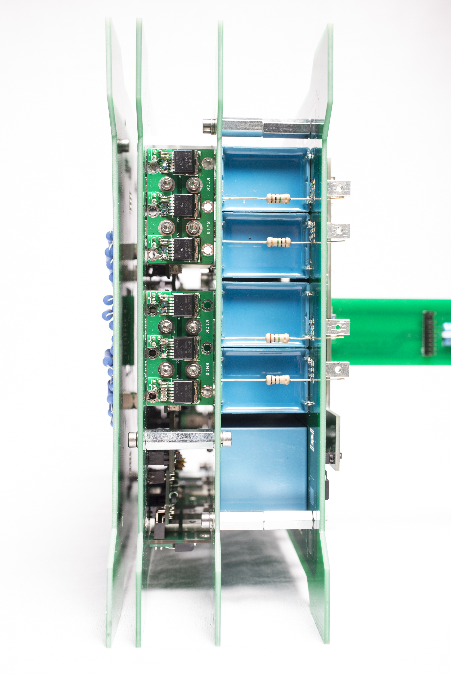
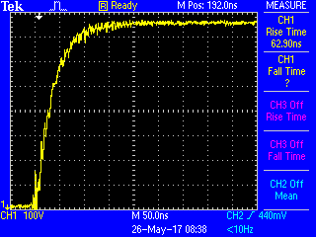
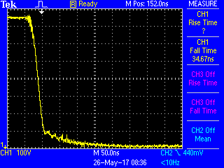
One MOSFET Marx stage: measurements
Operating conditions: Udc=800V, Rload=0.25Ω ⇨ ~3200 A expected:
77mm
Voltage “drop”: 40V
Voltage droop: 10V (~1.3%)
3200A
Rise time:
65ns (10-90%)
400A/div & 500ns/div
Fall time:
39ns (90-10%)
400A/div & 50ns/div
400A/div & 50ns/div

Slide 11
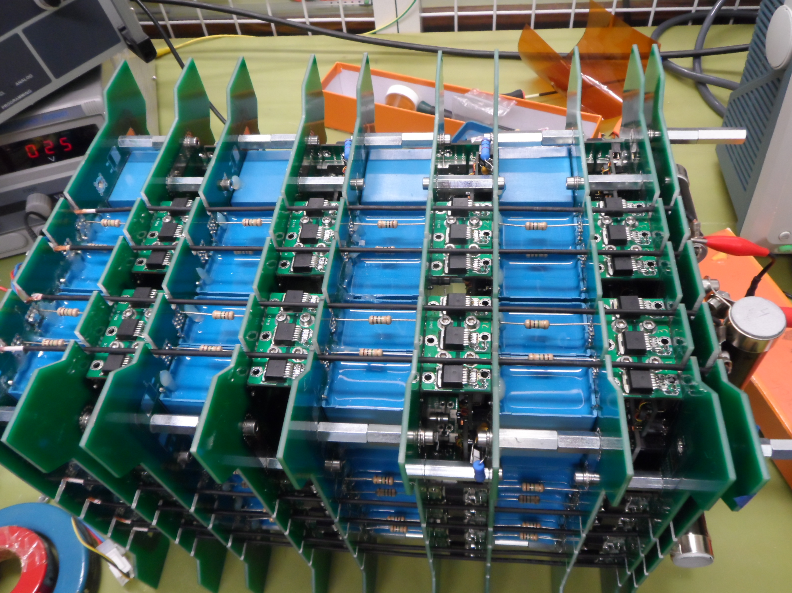
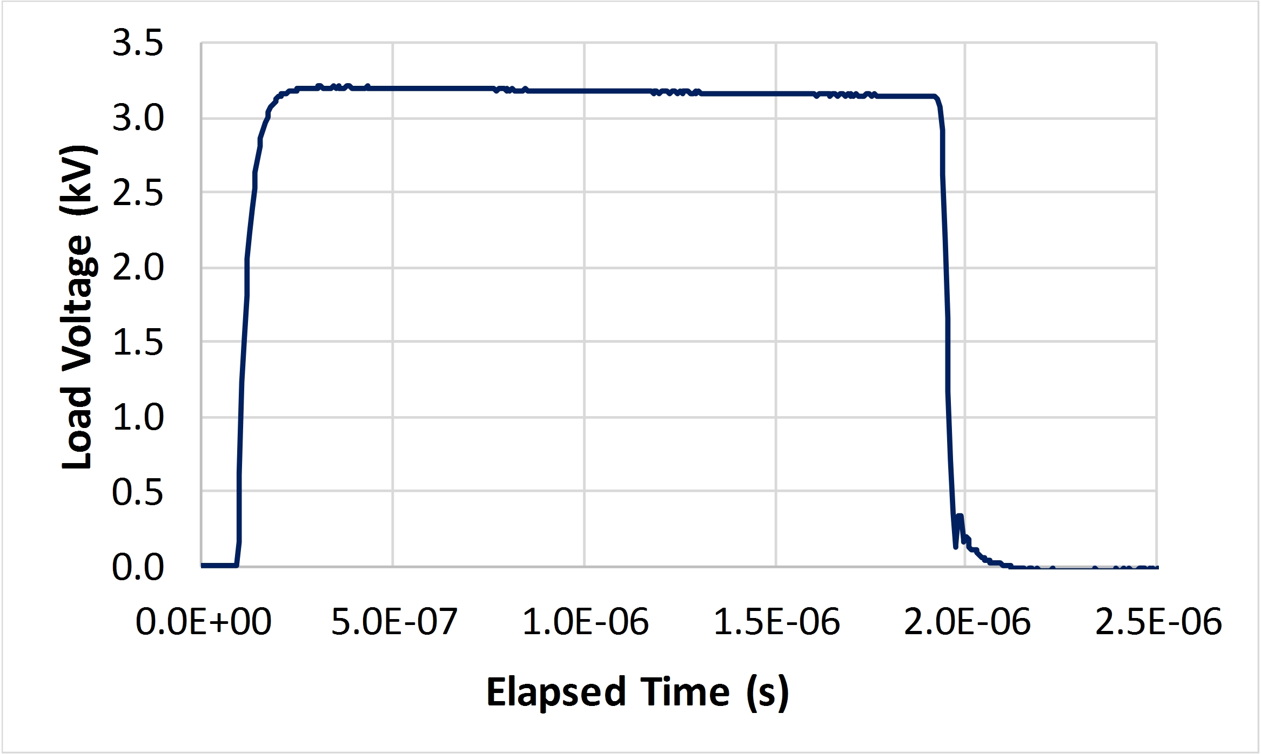
Four MOSFET Marx stages: measurements
Udc=800V, Rload≈1.175Ω ⇨ ~2700 A expected:
Measured load voltage:
Droop>>±0.5%
3200V
~1.8µs
Fall time:
28ns (90-10%)
Rise time:
53ns (10-90%)
Circuit time constant of 24 ns with a load of 1.175 Ω ⇨ four stage Marx circuit inductance of ~28 nH (~7nH/stage).
Current magnitude (2.7kA) meets specification (2.4kA),
Current rise time (53ns, 10-90%) is in the right “ball-park” (75ns);
Current flattop duration close to requirement (2µs).

Slide 12
Solid-state Marx: ongoing R&D/challenges
Studies to reduce flattop droop to within ±0.5%...
Low inductance is achieved with four return wires on each side of Marx, close to “go” current paths:
higher voltage ⇨ more clearance reqd. for insulation
⇨ higher circuit inductance
⇨ increased rise time
Study of fault conditions (e.g. short-circuit in magnet) and limitation of current
Study of possible failure modes of Marx generator
Long-term reliability
…..

Slide 13
Conclusions
ISEL & EPS have made very good progress carrying out R&D for a solid-state Marx generator for possible application to kicker systems:
SiC MOSFETs, connected in parallel, can be used in fast high current pulsed power applications: good current sharing.
Preliminary measurements with a solid-state Marx generator topology, with SiC MOSFETs, show that it is a promising candidate for generating fast, high current, pulses for kicker systems:
  One stage @ 800V ⇨ 3200A
  Four stages @ 3200V ⇨ 2700A: measurements show good performance (rise and fall).
The Marx generator topology is a promising candidate for replacing thyratrons and PFLs in kicker applications.
Future:
  Assemble and test more stages and investigate the overall performance and reliability.
  Long term operation with higher frequency;
  Behaviour under fault conditions (e.g. short circuit).

Slide 14
Questions?
Thank you for your attention !
Questions ?

Slide 15
Bibliography
J.A. Casey, F.O. Arntz, M.P.J. Gaudreau and M. Kempes, Solid-State Marx bank modulator for the Next Linear Collider, Pulsed Power Conference, 15−18 June 2003, pp. 641−644, https://doi.org/10.1109/PPC.2003.1277791.
A. Krasnykh, R. Akre, S. Gold and R. Koontz, A Solid-state Marx type modulator for driving a TWT, Power Modulator Symposium, 2000. Conference Record of the 2000 Twenty-Fourth International, Norfolk, VA, USA, 26−29 June 2000.
R. Phillips, M.P.J. Gaudreau, M. Kempkes, K. Ostlund and J. Casey, Affordable, short pulse Marx modulator, IEEE International Vacuum Electronics Conference, 22−24 April 2014, Monterey, CA, pp. 455−456.
S.C. Glidden and H.D. Sanders, Solid state Marx generator, Power Modulator Conference, Arlington, VA, USA, 14−18 May 2006, Arlington, https://doi.org/10.1109/MODSYM.2006.365246.
T. Beukers, C. Burkhart, M. Kemp, R. Larsen, M. Nguyen J. Olsen and T. Tang., P1-Marx modulator for the ILC, IEEE Power Modulator and High Voltage Conference, 23-27 May 2010, pp. 21−22.
M.A. Kemp, A. Benwell, C. Burkhart, D. MacNair and M. Nguyen, The SLAC P2 Marx, IEEE Power Modulator and High Voltage Conference, 2012, pp. 1721−1728.
L.M. Redondo and J. Fernando Silva, IEEE Trans. Plasma Sci., 37 (2009) 1632. https://doi.org/10.1109/TPS.2009.2023221.
L.M. Redondo, A. Kandratsyeu, M.J. Barnes, S. Calatroni and W. Wuensch, Solid-state Marx generator for CLIC breakdown studies, to be published in Proc. 2016 IEEE Power Modulator and High Voltage Conference, San Francisco, CA, USA, 5−9 July 2016, https://doi.org/10.1109/IPMHVC.2016.8012824.
L.M. Redondo, A. Kandratsyeu and M.J. Barnes, Marx generator prototype for kicker magnets based on SiC MOSFETs, IEEE Transactions on Plasma Science, 2018, DOI: 10.1109/TPS.2018.2808194.

