Slide 2
Cold Spray Additive Manufacturing
C. Garion
Outline
Cold spray technology:
Principle
Advantage
Possible applications in accelerators:
Local coating
Additive manufacturing
New materials
Applications of cold spray to UHV systems
Thermal outgassing
Leak tightness
Conclusion

Slide 3
Principle of Cold Spray
The gas dynamic cold spray coating is based on the projection of solid powder at high velocity.
Substrate
De Laval Nozzle
Compressed gas
Powder feeder
A compressed gas is heated before entering in a DeLaval Nozzle.
The gas is accelerated in the nozzle.
Powder is injected in the gas stream and accelerated as well.
The powder reaches velocity up to 1200 m/s.
The powder is plastically deformed and the coating is building up.

Slide 4
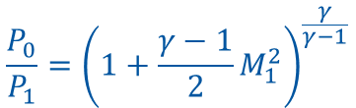
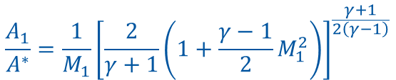



Principle of Cold Spray
1D isentropic flow equations:
De Laval Nozzle
P₁, v₁, T₁,
A₁
P₀, v₀, T₀
A*
$$\frac{P_{0}}{P_{1}}={\left(1+\frac{γ−1}{2}M_{1}^{2}\right)}^{\frac{γ}{γ−1}}$$
$$\frac{T_{0}}{T_{1}}=1+\frac{γ−1}{2}M_{1}^{2}$$
$$M_{1}=\frac{v_{1}}{c_{1}}=\frac{v_{1}}{\sqrt{γR_{s}T_{1}}}$$
$$\frac{A_{1}}{A^{∗}}=\frac{1}{M_{1}}{\left[\frac{2}{γ+1}\left(1+\frac{γ−1}{2}M_{1}^{2}\right)\right]}^{\frac{γ+1}{2\left(γ−1\right)}}$$
$$γ=\frac{c_{p}}{c_{v}}$$
γ=5/3 (1.67) for monoatomic perfect gas
γ=7/5 (1.4) for diatomic perfect gas and
γ=1,33 for polyatomic perfect gas
R_{s} is the specific gas constant given by R/M_{molar}
Nitrogen is commonly used. Helium is used to reach higher velocity.
Notes:
P0 ~30 – 50 bars
T0 : 300 C

Slide 5
Cold Spray Advantages and Limitations
Advantages:
No powder melting.
  No phase change.
  No grain growth.
  Low heating of the substrate.
No significant impact on the oxide content w.r.t. initial material.
Powder mixture possible.
Compressive residual stress (fatigue life increase).
Nozzle geometry can be tuned for a given jet size.
Thick coating.
High deposition rate.
Limitations:
One constituent has to be ductile.
Accessibility to the surface to be coated.

Slide 6
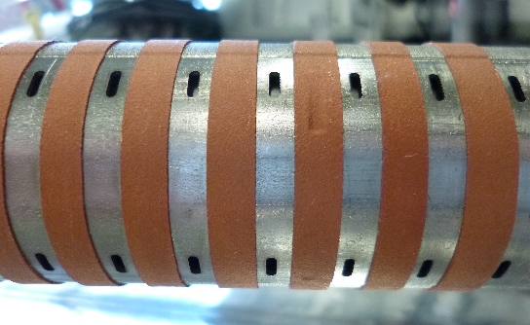
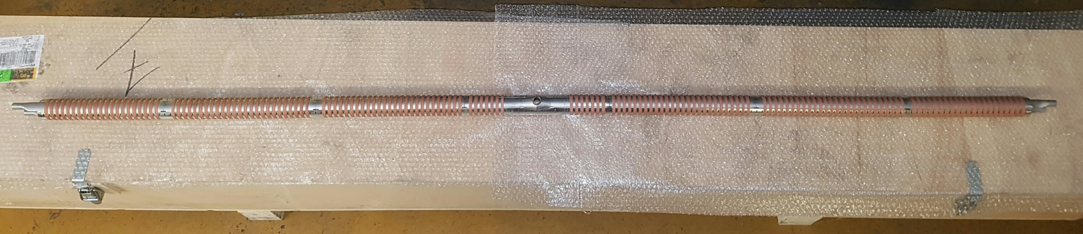
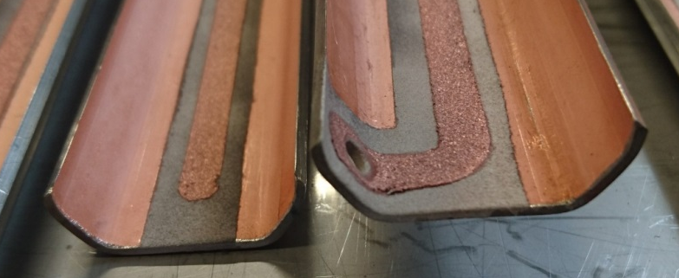
Possible Applications in Accelerators
Local coating:
Heat transfer:
Copper trips on FCC-hh beam screen prototype.
Electrode:
Measurement of electrons for the FCC-hh beam screen prototype experiment at ANKA.
Clearing electrode (optimisation of ceramic layer required for non-baked system).
Copper and aluminium cold spray coating on ceramic insulated copper coated stainless steel sheet

Slide 7
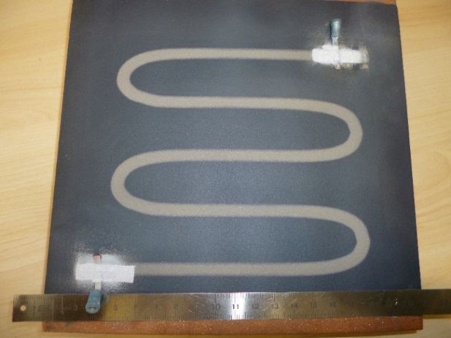
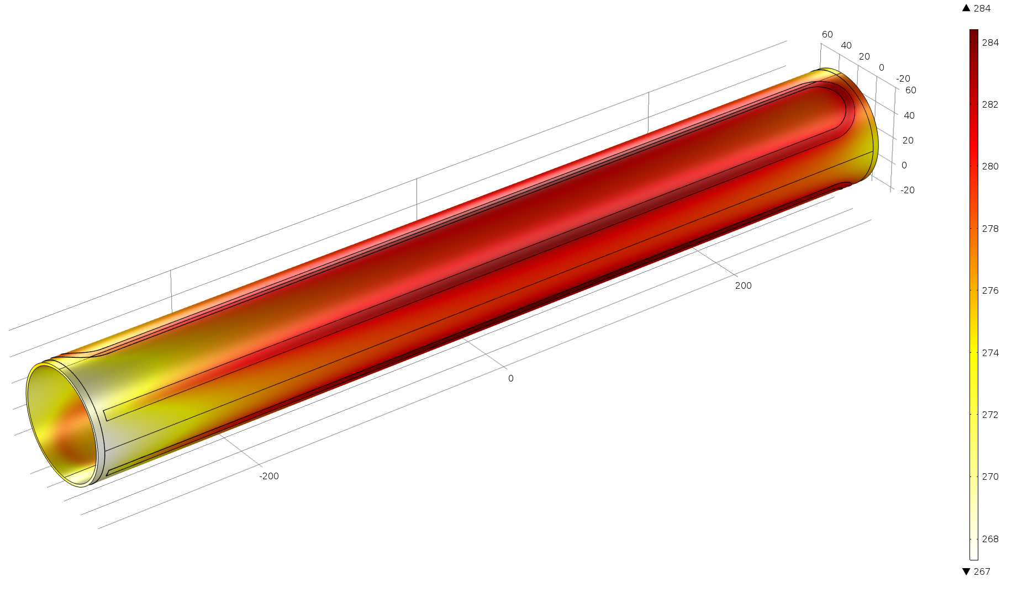
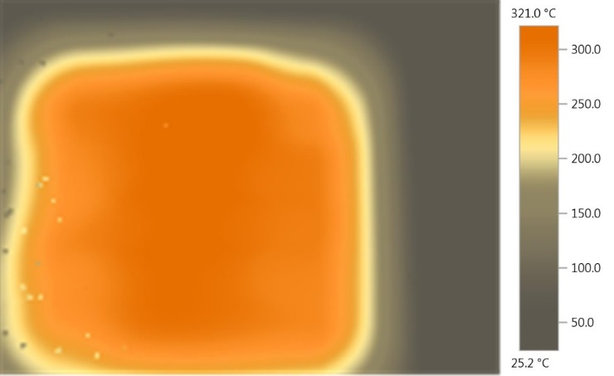
Possible Applications in Accelerators
Local coating:
Heating element for bake out in or outside vacuum
284
Ceramic insulation layer
Copper pipe
Copper plate with plasma sprayed ceramic and 0.2 mm thick cold sprayed titanium heating track
Titanium heating track
Connectors
267
Expected temperature profile on a copper tube, ID 80 mm
A prototype of a copper tube with permanent radiation tolerant bake out system is in fabrication.
A study will be carried out for heating system in a vacuum vessel (low outgassing of ceramic coating).
Measurement of the temperature field

Slide 8
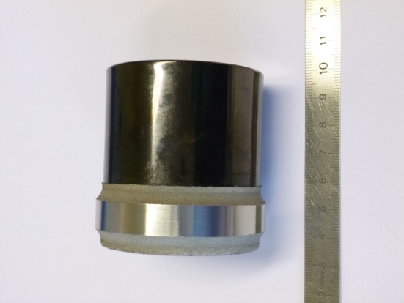
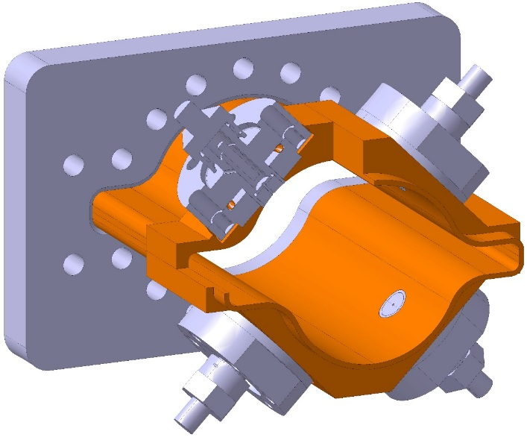
New Manufacturing Process
Additive manufacturing for:
Joining of dissimilar materials
New feature
Repair
Local reinforcement of thin walled structure
Titanium on glassy carbon
J. Villafuerte, ADVANCED MATERIALS & PROCESSES, 2014
FCC-ee quadrupole chamber with BPM

Slide 9
New Materials
Composite material:
Example of diamond copper composite
Metallization of polymer
Shuo Yin, Barry Aldwell and Rocco Lupoi, Advanced diamond-reinforced copper composite coatings via cold spray and material characterization, Trinity College Dublin
D. Giraud, Etude des composantes mécanique et métallurgique dans la liaison revêtement-substrat par projection dynamique pas gaz froid pour les systèmes aluminium/Polyamide6,6 et titane/TA6V, Mines ParisTech, 2014
Could it be a candidate for experimental vacuum chamber?
Could it be a candidate for collimator material?

Slide 10
Application of Cold Spray for UHV system
Requirements for UHV applications:
Outside vacuum chamber: not relevant.
In vacuum applications: low outgassing rate.
Vacuum barrier:
  Low outgassing rate.
  Leak tightness.
Ceramic plasma spray underlayer might be applied for some applications. Same requirements apply.

Slide 11
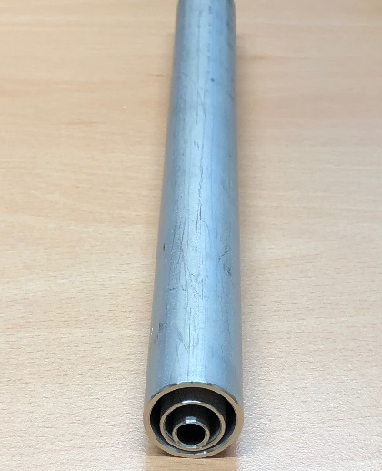
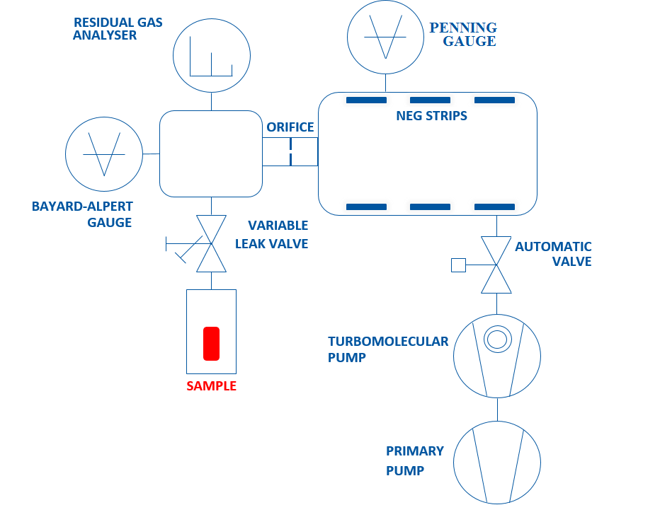
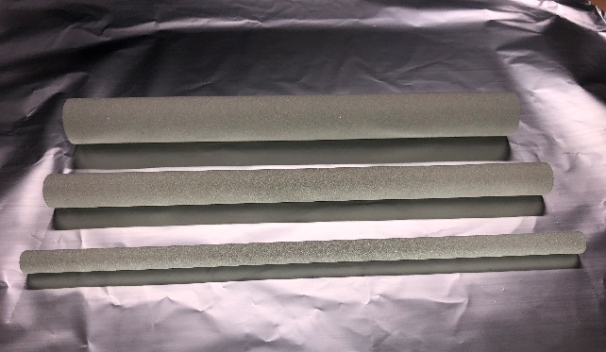
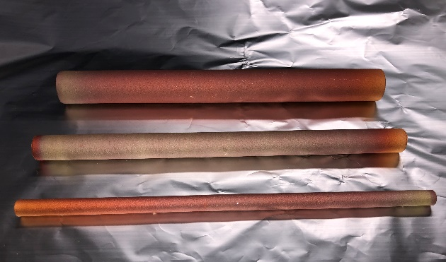
Vacuum Performance
Thermal outgassing
Samples:
Substrate: 3 stainless steel tubes, vacuum fired
Titanium coating, grade 2, 0.5 mm thick
Copper, 99.95%, 0.5 mm thick
Measurements by accumulation method:
Substrates
Set-up principle for thermal outgassing measurement by accumulation
Titanium coated samples
Copper coated samples

Slide 12
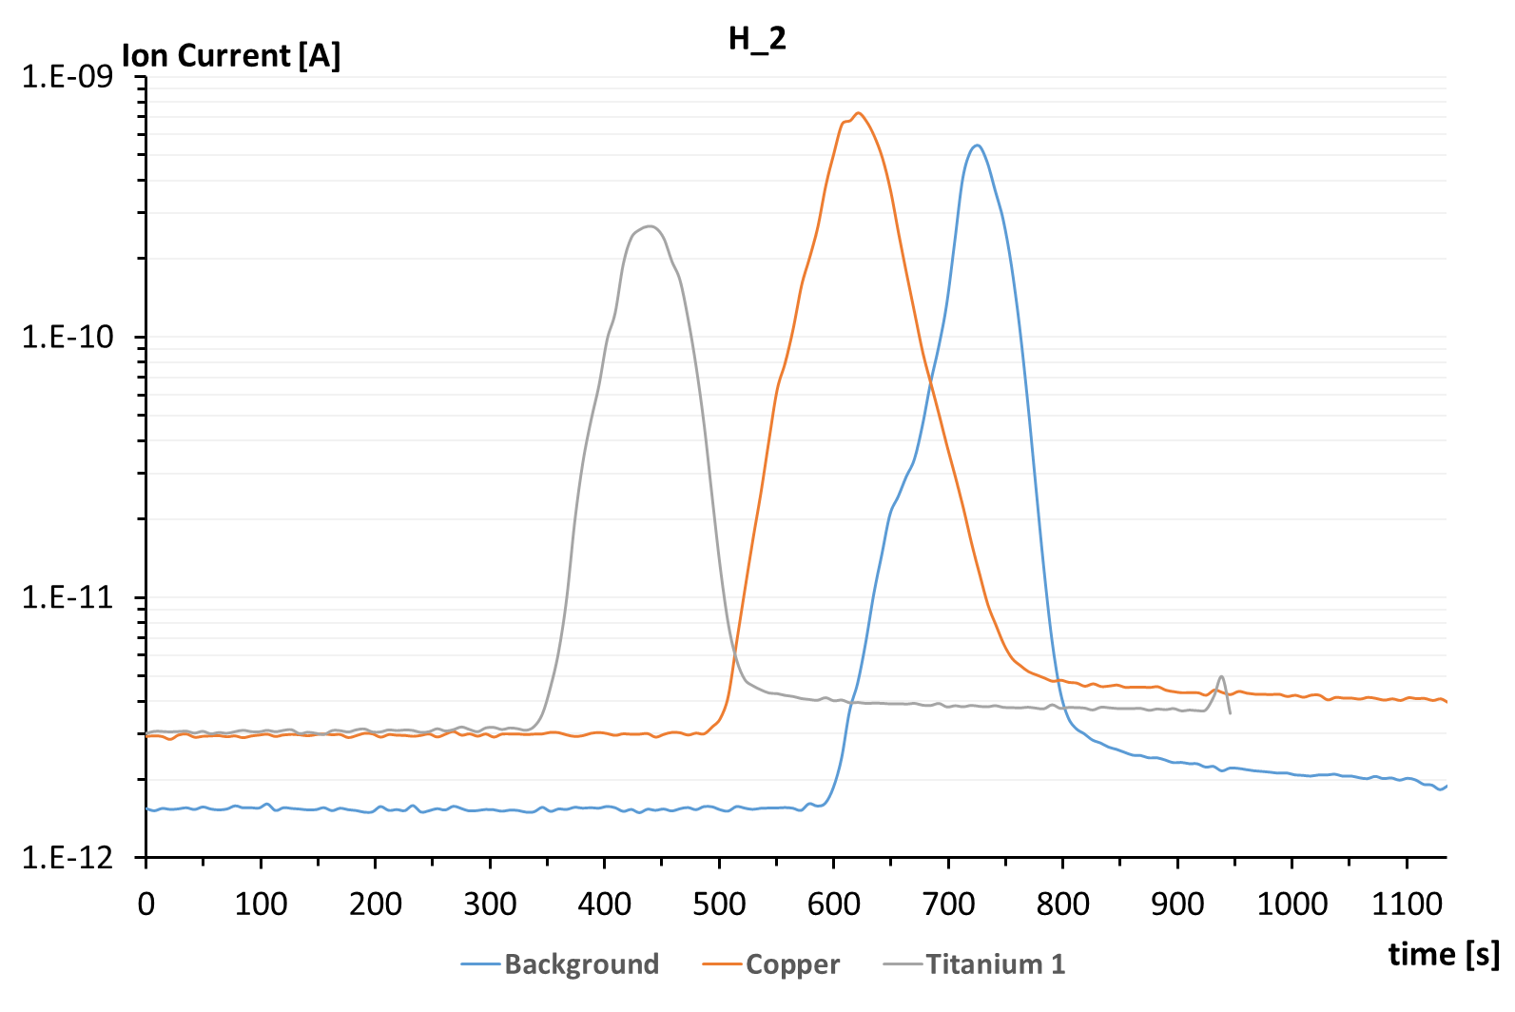
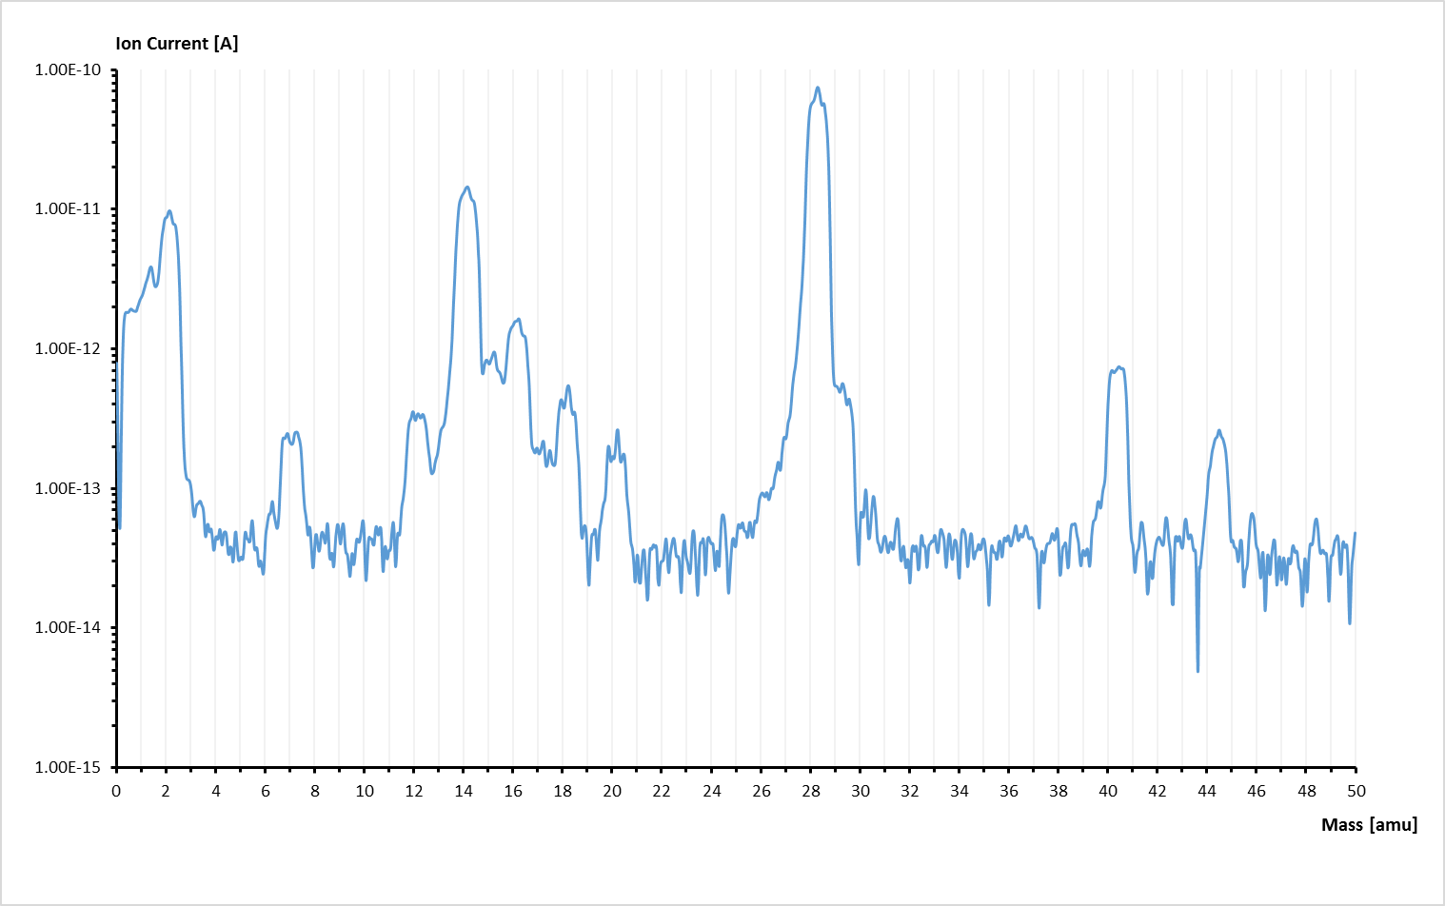
Vacuum Performance
Thermal outgassing
Typical current (pressure) curves accumulation time and valve opening
RGA scan for copper samples
 | Total Outgassing [mbar·l·s⁻¹] | Specific Outgassing (H2) [mbar·l·s⁻¹·cm⁻²]
Background | 3.9e-11
Stainless steel substrate | 6.37e-11 | 4.5e-14
Copper | 6.24e-11 | 3.9e-14
Titanium #1 | 1.73e-11
Outgassing of H2 for copper is similar to bulk material.
Titanium outgassing is surprisingly low. Measurement to be redone.
Inert gas used during the powder fabrication may have a significant impact (high outgassing of N2 and Ar observed, for copper).

Slide 13
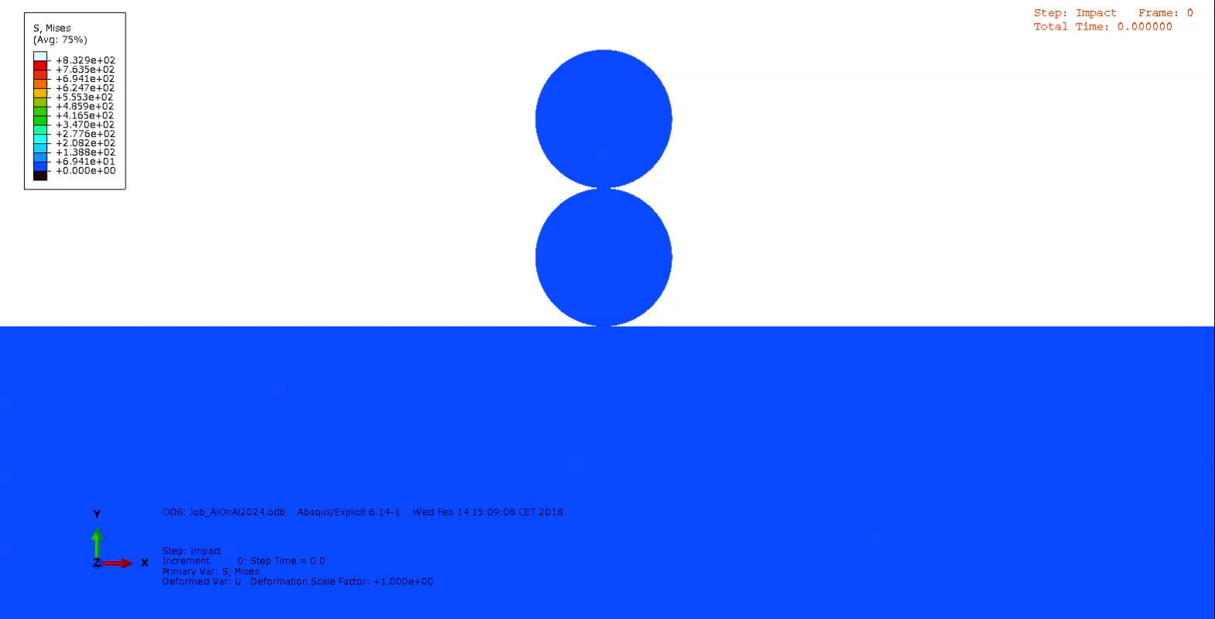
Vacuum Performance
Leak tightness
Present study program on aluminium coatings (in collaboration with Mines ParisTech):
Powder :
  Morphology, metallurgical characteristics, mechanical properties.
  Pre-treatment.
Processing parameters:
  Cold spray: gas pressure and temperature.
  Post-treatment.
Coating microstructure.
Vacuum performance.
Mechanical testing.
Modeling and numerical simulations.
Powder morphology
Aluminium Coating with “closed” porosities
Courtesy S. Weiller, F. Delloro (Mines ParisTech)

Slide 14
Conclusions
Gas dynamic cold spray is a coating method based on supersonic jet of powders, heavily plastically deformed during the impact.
Ductile materials are well suitable for this manufacturing process.
Cold sprayed copper coating has been successfully been applied on a first FCC-hh beam screen prototype.
Other applications have been identified in different field of high energy particle accelerators. First tests are ongoing.
A study is carried out at CERN to assess the vacuum performance of cold sprayed materials.

Slide 16
Bounding mechanism
Copper on copper
Rebound zone
T. Schmidt et al., From Particle Acceleration to Impact and Bonding in Cold Spraying, Journal of Thermal Spray Technology, 18, 5-6, 794-808, 2009
Typical surface around the critical velocity
A1050 powder on 2024-T3 substrate
Material jet
Q. Blochet, Influence of substrate surface roughness on cold-sprayed coating-substrate bond strength in aluminum-based systems, PhD Thesis, Mines ParisTech, 2015
Assadi et al., Bonding mechanism in cold gas spraying, Acta Materialia, 51, 4379-4394, 2003
Notes:
Adiabatic shear instability

Slide 17
Some properties: example of copper
Electrical conductivity
Bounding strength
With helium
With nitrogen
T. Stoltenhoff et al., Microstructures and key properties of cold-prayed and thermally sprayed copper coatings, Surface & coatings Technology, 200, 2006
Coating strength
After Jeandin et al., Coating properties in Modern cold spray, Ed. J. Villafuerte, Springer, 2015
N₂
He
C.H. Boyle, Mechanical performance of integrally bounded copper coatings for the long term disposal of used nuclear fuel, Nuclear Engineering and design, 293, 2015
F. Gärtner, Mechanical properties of cold-sprayed and thermally sprayed copper coatings, Surface & Coatings Technology 200, 2006
→ Material properties are affected by the cold spray process but they can significantly be recovered by dedicated post treatment.

Slide 18
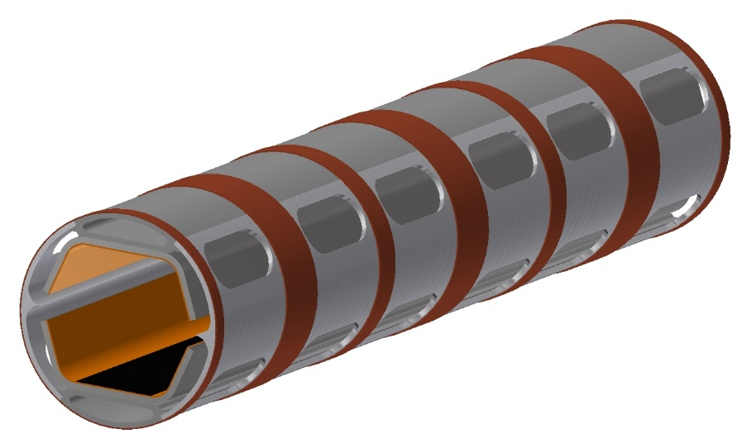
Application to FCC
FCC-hh beam screen
Cooling channel
Colaminated copper- stainless steel internal screen
Copper strip for heat transfer
Pumping holes
Requirements:
Copper material (thermal conductivity)
Stainless steel substrate
Discountinuous (longitudinally → reduced Lorentz forces during a magnet quench)
Continuous as close as possible to the cooling channel (better cooling and temperature control)
Done after beam screen assembly (welds)
No spray or coating contamination inside the beam screen
Industrial process

Slide 19
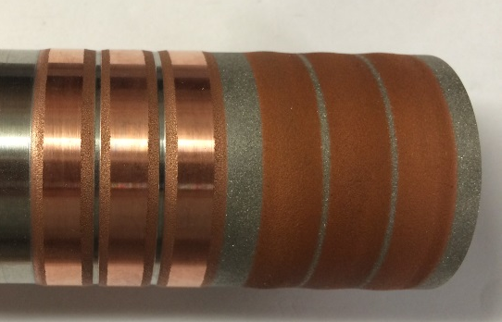
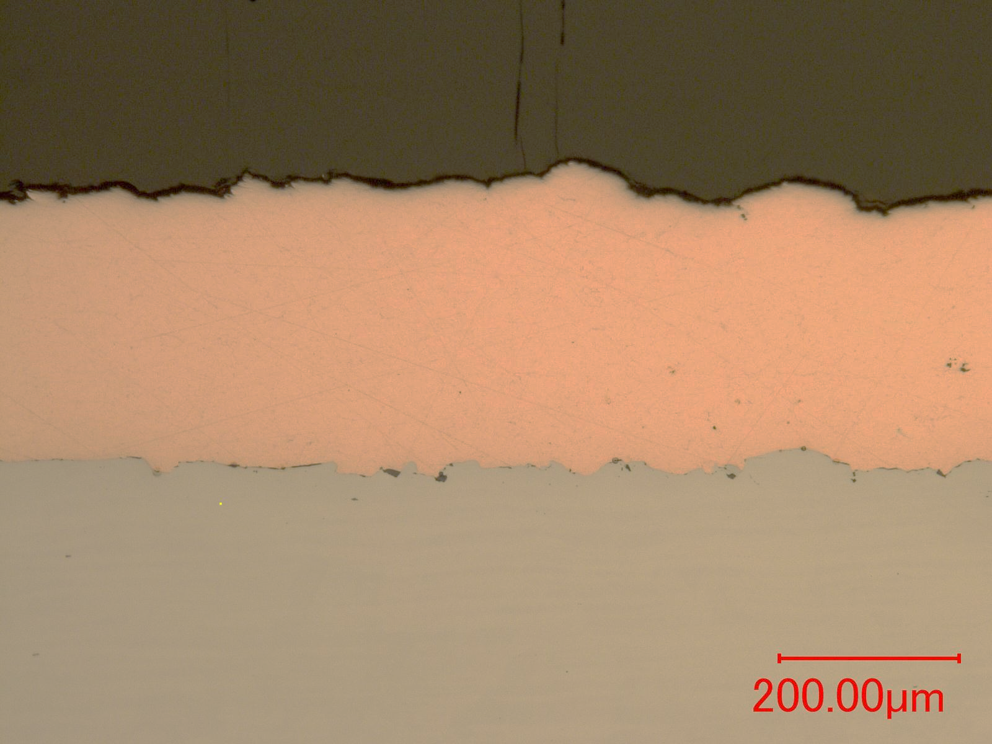
Application to FCC beam screen
Surface preparation by blasting (Al2O3)
Cold sprayed copper on austenitic stainless steel.
Possible improvements:
Surface preparation: laser treatment
Nozzle geometry: correct width
Process parameters

