Slide 1
AQA for Developers
M.F. GÓMEZ DE LA CRUZ

Slide 2
Installing Tortoise SVN

Slide 3
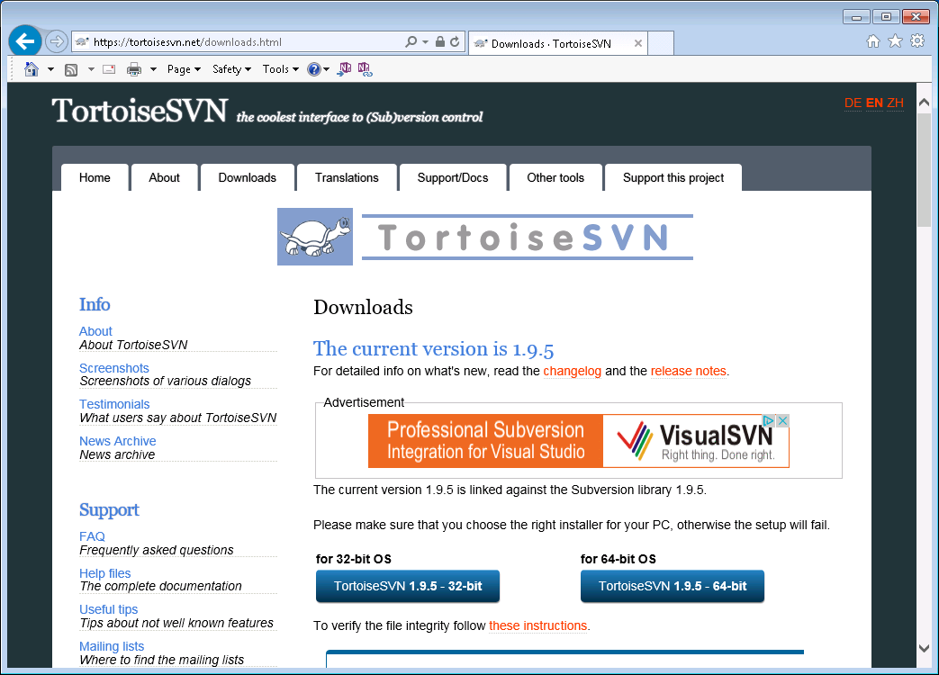
Downloading Tortoise SVN
OR

Slide 4
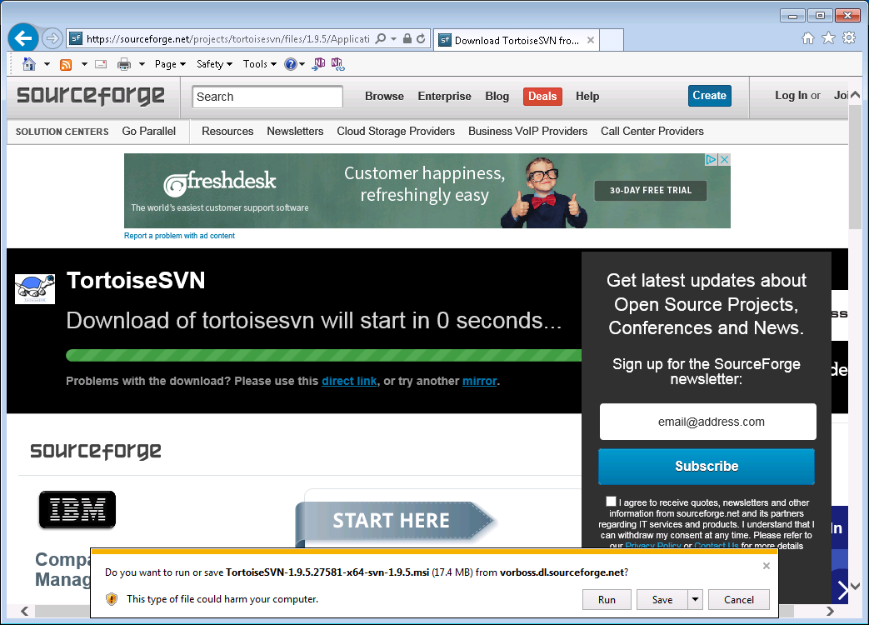
Downloading Tortoise SVN

Slide 5
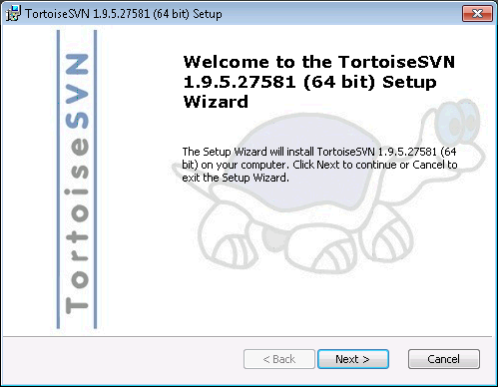
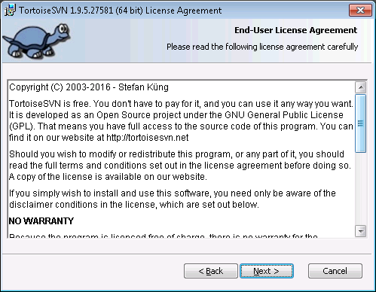
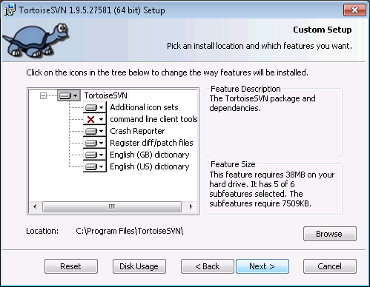
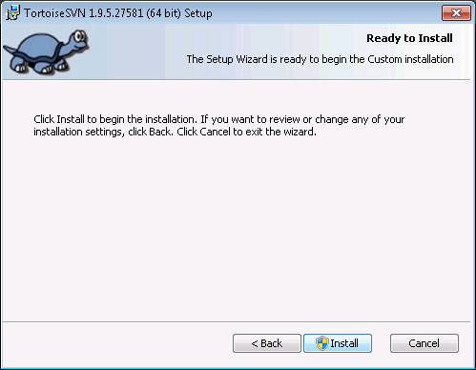
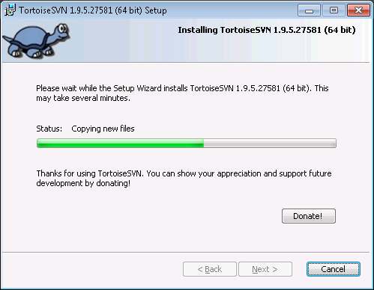
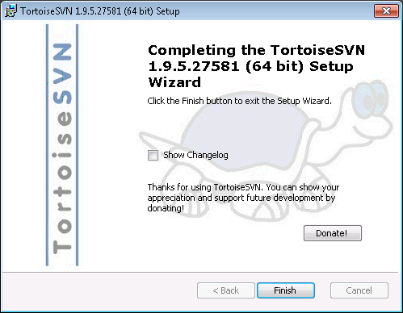
Installation Steps
1
2
3
4
5
6

Slide 6
Known issues

Slide 7
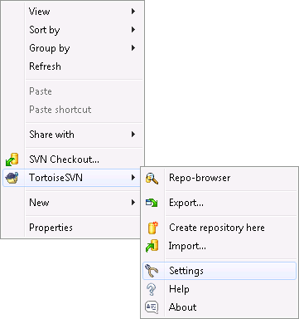
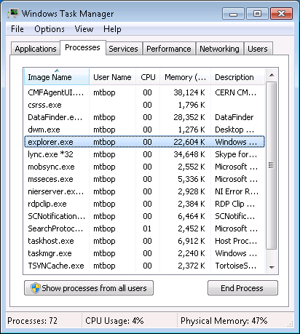
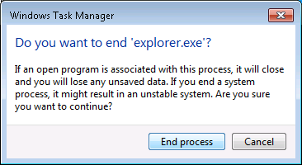
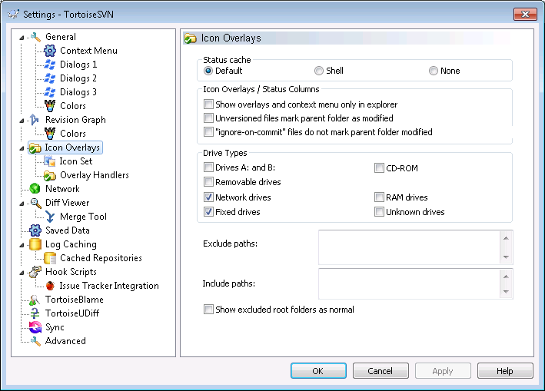
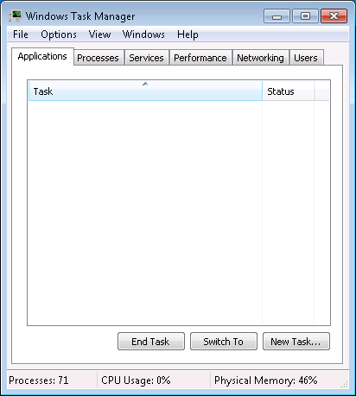
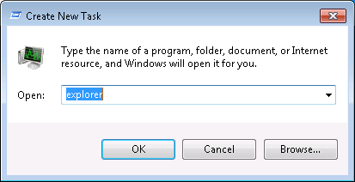
Missing Icon Overlays
1
3
Launch Task Manager
4
2
5
6
7

Slide 8
SVN Basis

Slide 9


Basic Subversion Concepts
Checkout/Update
Centralized repository
Commit/Add
Working
Copy
Working
Copy
Working
Copy
User1
User2
UserN

Slide 10
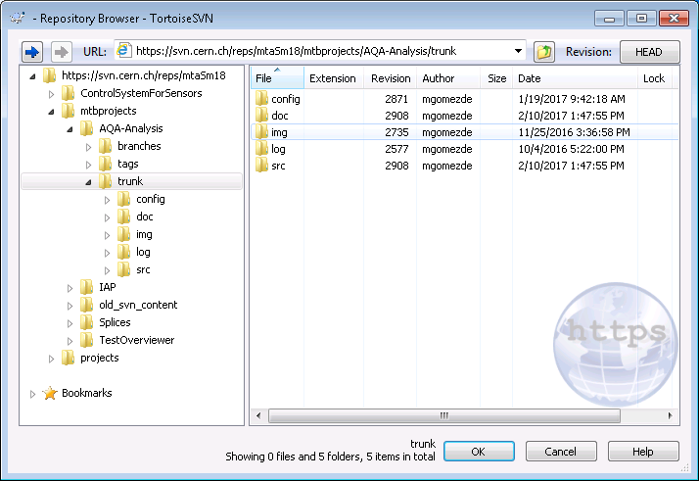
SVN Structure
trunk: The trunk contains the most current development code at all times. The trunk should only be used to develop code that will be your next major release. Don't brand the trunk with version numbers or release names. Just keep the trunk in "development mode" at all times.

Slide 11
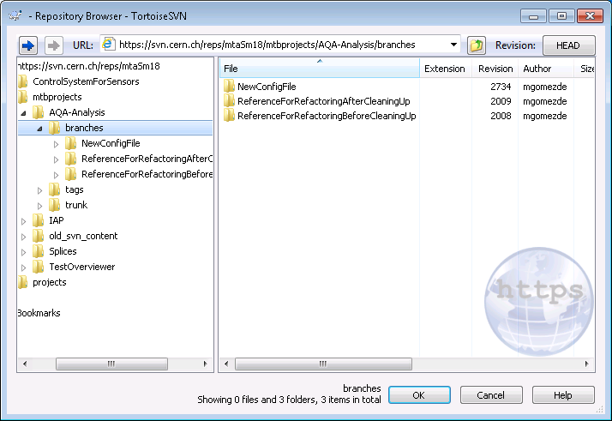
SVN Structure
branches: In the branches directory you can create paths for you code to travel to more specific goals like an upcoming release. The branches directory contains copies of your trunk at various stages of development.

Slide 12
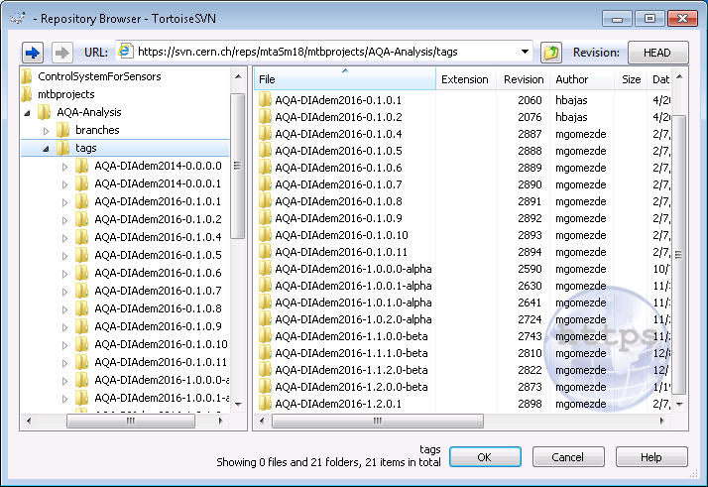
SVN Structure
tags: Tags are, like branches, copies of your code. Tags, however, are not to be used for active development. They mark (tag) a certain state your code is in.

Slide 13
AQA on SVN

Slide 14
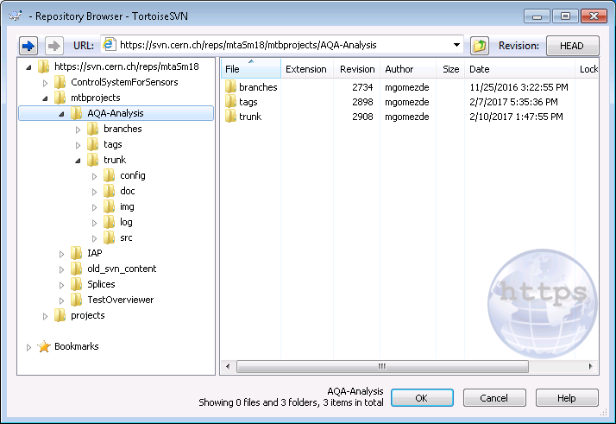
URL
AQA project directory into the SVN servers at CERN

Slide 15
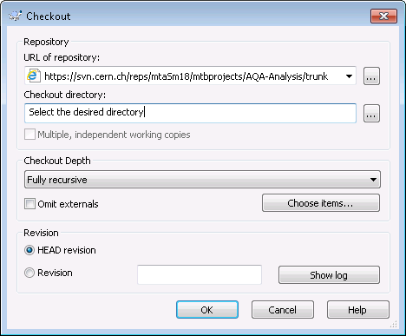


Checkout -> Create a WC
Centralized repository
Checkout
Working
Copy
Keep one working copy at a time

Slide 16
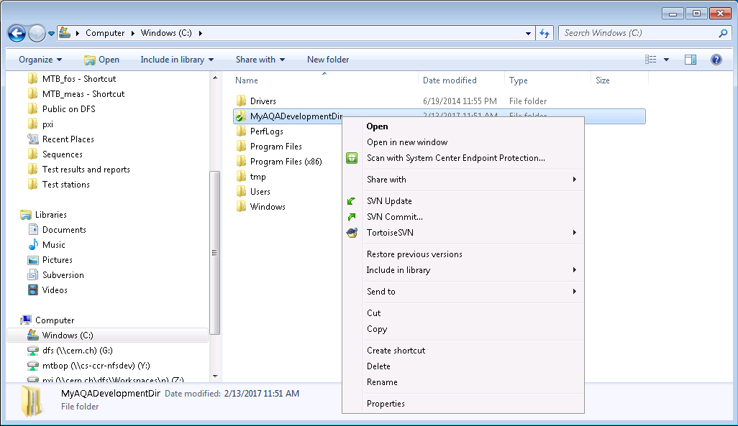
Update Your WC After Other Users’ Commit
Centralized repository
Update
Working
Copy
WC must exist

Slide 17
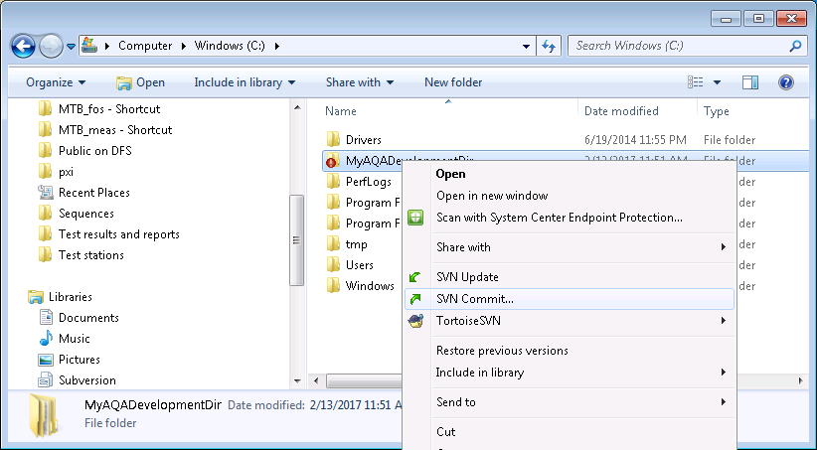
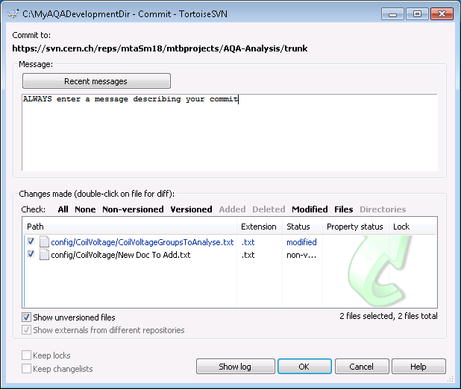
Commit Your Changes/Add New Files
Centralized repository
Commit/Add
Enter a descriptive message on every commit
Working
Copy
WC must exist
Do not forget to select new files

Slide 18
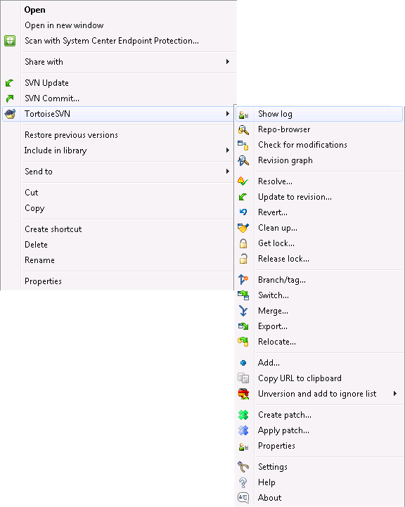
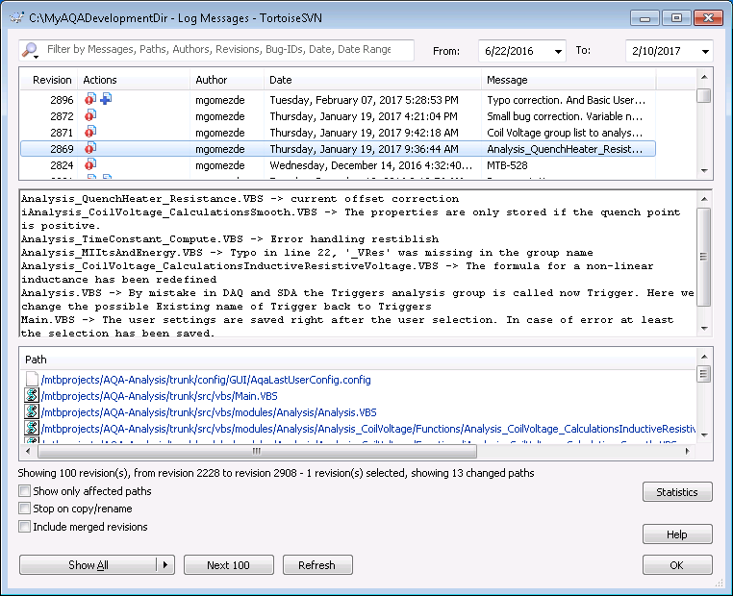
View Commit Log
Log History
Centralized repository
Log
Working
Copy
Affected Files
Commit Message

Slide 19
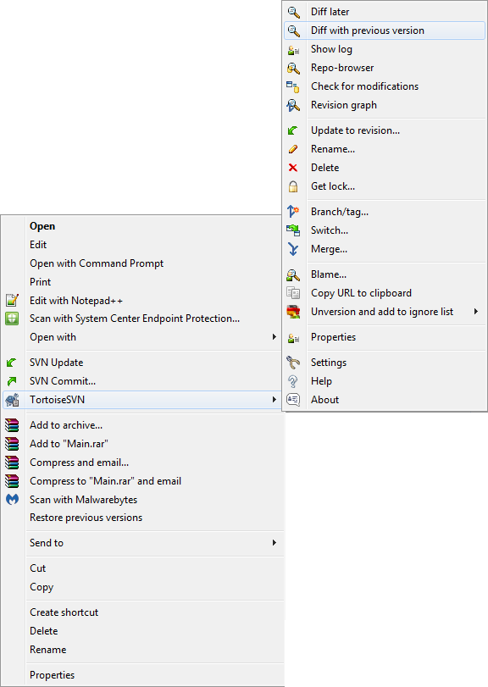

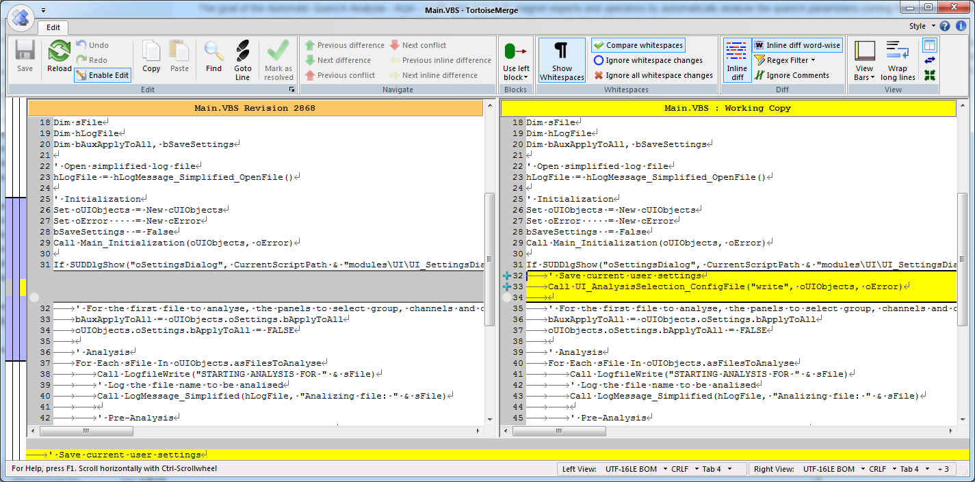
Differences
Current revision
Previous revision
Right click the file you
want to see differences
Centralized repository
Diff
Diff
Working
Copy

Slide 20
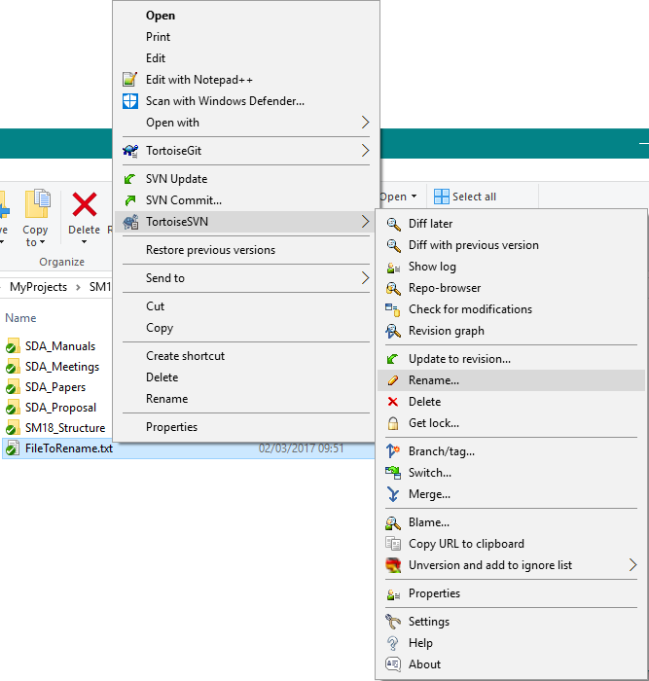
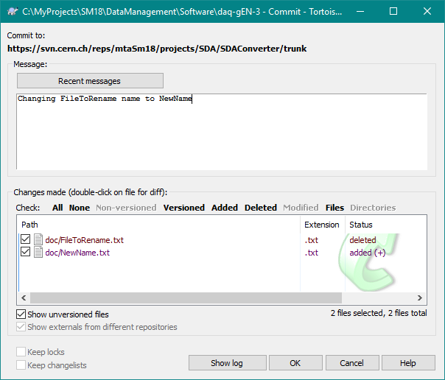
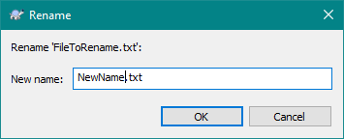
Rename File from Working Copy (method 1)
After renaming: commit
Right click the file you want to rename
Centralized repository
Rename
Working
Copy
New file to add
Old file to delete

Slide 21
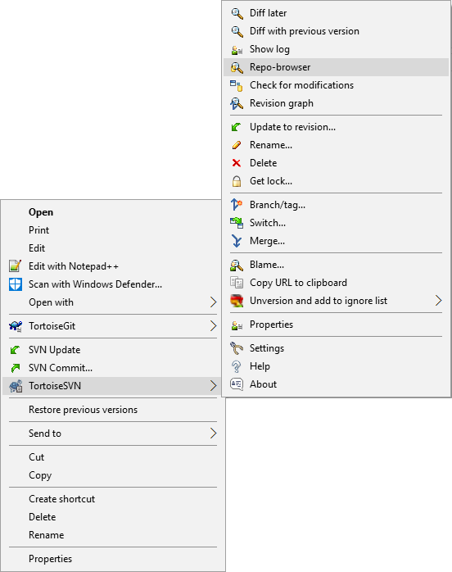
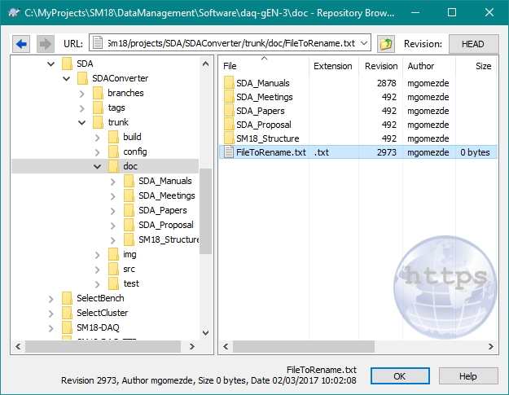
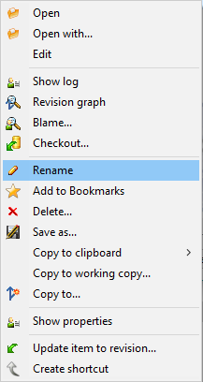
Rename File from Repository (method 2)
Navigate until the file/folder to delete
Centralized repository
Update (Rename)
Working
Copy
Update your WC after deleting

Slide 22

Delete File from Working Copy (method 1)
Right click the file you want to delete
After deleting: commit
Centralized repository
Delete
Working
Copy

Slide 23
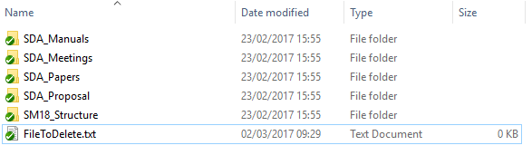
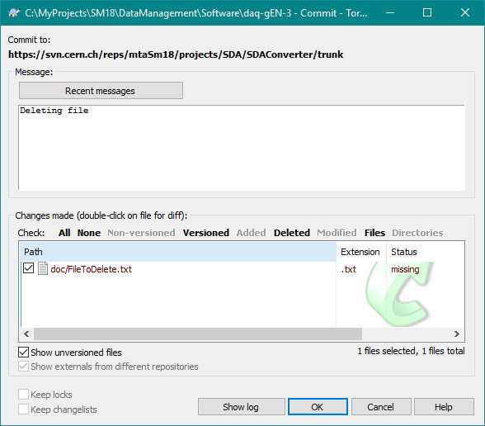
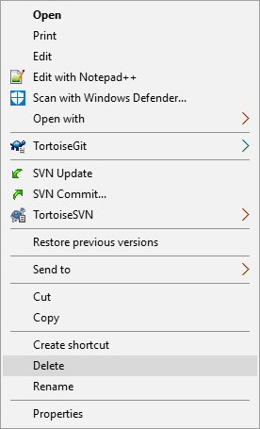
Delete File from Working Copy (method 2)
Centralized repository
Delete your file normally
Delete
After deleting: commit
Working
Copy
Select the file to delete it in the repository

Slide 24
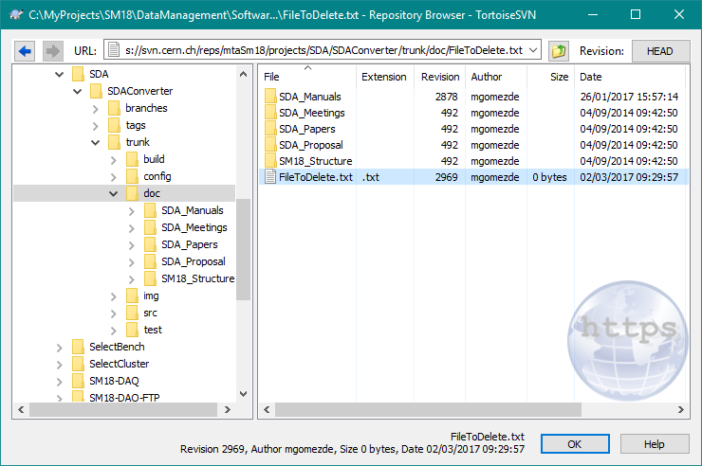
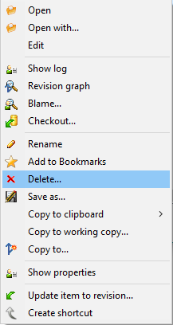
Delete File from Repository (method 3)
Navigate until the file/folder to delete
Centralized repository
Update (Delete)
Working
Copy
Update your WC after deleting

Slide 25
SVN File Conflict Sample

Slide 26
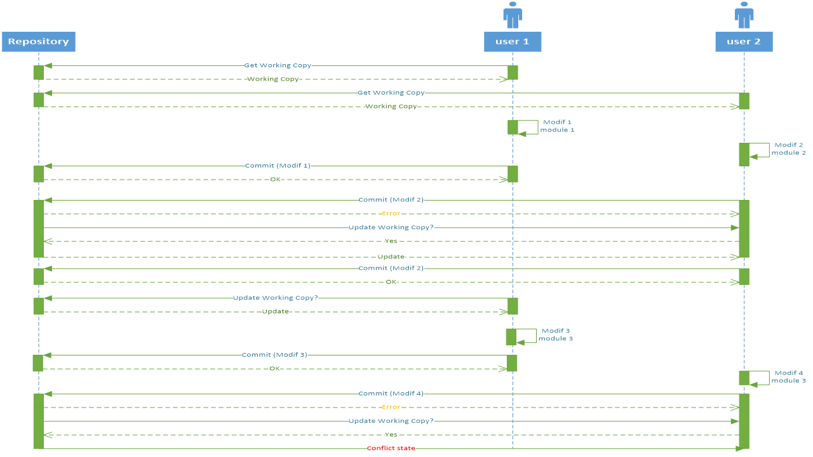
Sequence Provoking A Conflict

Slide 27
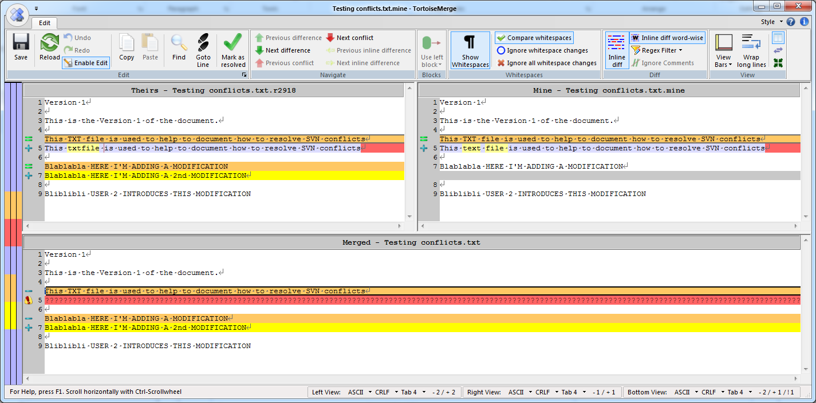
Editing Conflicts
Repository
Working Copy
Was equal in a previous revision
Actual content in conflict
Common content
Merge (In your Working Copy)

Slide 28
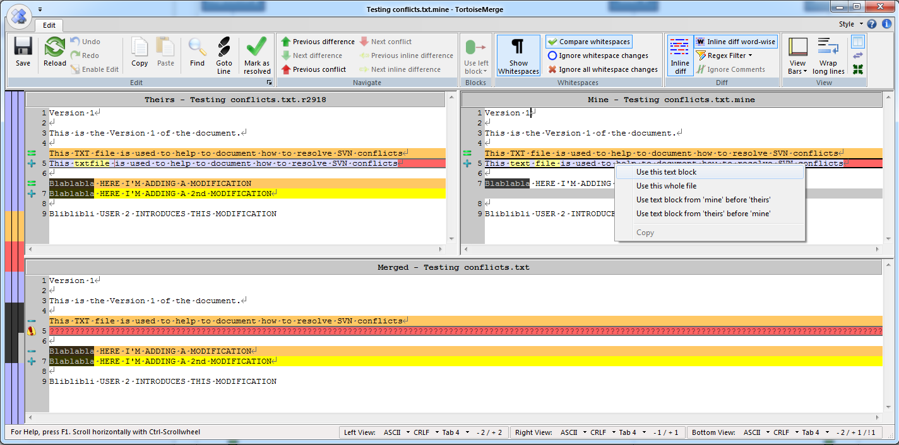
Editing Conflicts

Slide 29
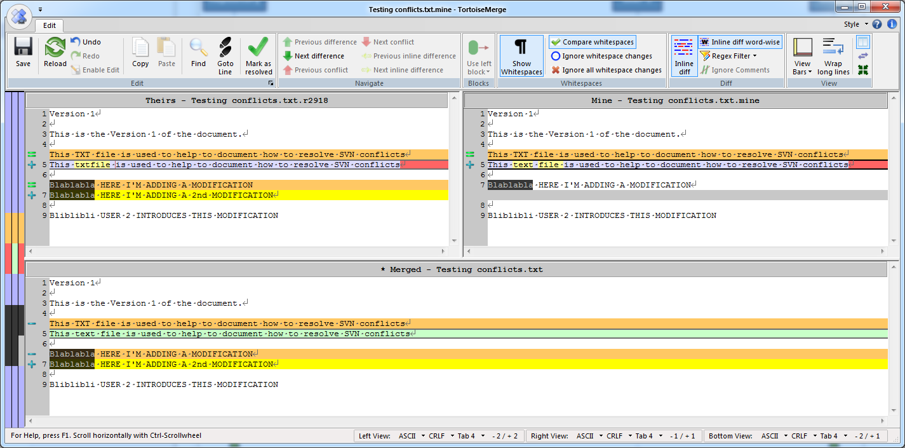
SVN Conflict Sample
This only affects the WC. Commit after conflict correction.

Slide 30
Working together

Slide 31



Inform Other Developers
I would like to implement ‘this’ in the module M1.
Please do not work on module M1
OK
I’m almost done with a small correction on M1. Wait until my commit
Fine
Ok

Slide 32
Inform Other Developers
I’m done
Ok, I’ll let you know when I’m done
Alright
Ok
Ok

Slide 33
Develop
Checkout or Update
Development
Testing
Validation
Commit

Slide 34
Inform Other Developers (Yes, again)
I’m done
Great
OK
Good

Slide 35
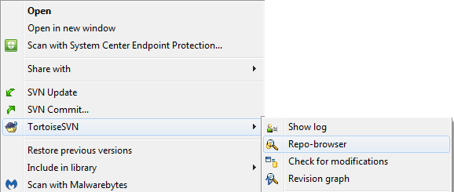
Important
Be careful when renaming or deleting files and directories.
You can delete and rename files and directories from the WC using the embedded commands of Tortoise SVN
Remember to update your WC or commit your changes afterwards.
You can delete and rename files and directories from the SVN repository

Slide 36
Tips
Make small modifications at a time
Do not work in the same issue/module/problem when you know other is already on it
In case of conflict you’ll need to go conflict by conflict. Check the SVN tutorials and be patient. SVN is still a better choice than not having a version control
Google “knows” almost everything. Most probably you are not the first one on having the issue

Slide 37
Conventions

Slide 38
File formatting
Indentation:
  Use tabs.
  Never use blank spaces.
Line length:
  Word-wrapping over scrolling.
  Use your best judgement to determine where to wrap the lines.
Spacing:
  Call˽Function˽(Arg1,Arg2) Call˽Function(Arg1,˽Arg2)
  aiMyArray(0)=1 aiMyArray(0)˽=˽1
  a=b+6*x a˽=˽b˽+˽6˽*˽x
  If(i=0)Then If˽(i˽=˽0)˽Then
  asShapes=Array(“circle”,“square”,“triangle”,“hexagon”) asShapes˽=˽Array(“circle”,˽“square”,˽“triangle”,˽“hexagon”)

Slide 39
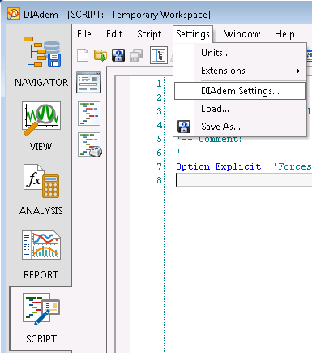
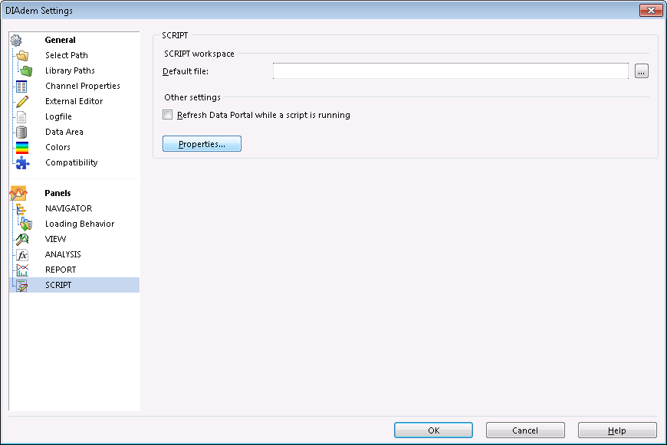
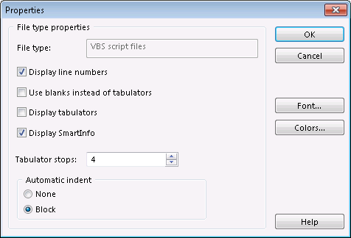
DIAdem Script Configuratin (Tabs)

Slide 40
Variables and Constants
Data Type | Prefix | Example
Array | a | aWeekDays
Boolean | b | bSend
Byte | byt | BytRasterData
Currency | c | cRevenue
Date (Time) | dt | dtStart
Double | d | dTolerance
Error | e | eOrderNumber
Handle | h | hSend
Integer | i | iSend
Long | l | lDistance
Object | o | oCurrent
Single | f | fAverage
String | s | sName
User-definet-type | udt | udtEmployee
Variant | vnt | vntCheckSum
Variables
Constants
Data type | First prefix | Second Prefix | Example
Integer |  | i | miUSER_LIST_MAX
String |  | s | gsNEW_LINE
Global | g |  | gsNEW_LINE
Local to module | m |  | miUSER_LIST_MAX

Slide 41
Local Variables
  Have a local scope
    A function, FunctionOne, that contains a local variable called TheLocalVar, can call a function SubFunctionOne that contains a local variables called as well TheLocalVar. These 2 variables are different, SubFunctionOne doesn’t override the content of TheLocalVar in function FunctionOne or viceversa.
    Can be only accessed from the function or block where it has been declared
  Variables can be declared everywhere with the condition of being declared before it is used. It is recommended to declare all variables at the beginning of the function.

Slide 42

Do Not Use Global Variables
My name is Variable, Global Variable, but you can call me GV.
By the way, what’s a local variable?
Use me, you don’t have to pass me around all the time.
I can be everywhere. I am everywhere for you.
Just follow this article about global variables.
The explanation is very good:
http://wiki.c2.com/?GlobalVariablesAreBad
Global variables are so easy to use
Don’t listen to him!
@#$%!?@#
Global variables are evil

Slide 43
Strings
sStringExample = “This is a string example”
sCharacterExample = “a”
sName = “Will Smith”
sStringConcatenation = “Hello ” & sName & “! How are you”
sStringConcatenation = “This is a string that needs to ” & _
“wrap onto another line”

Slide 44
Classes and Objects (I)
1 2 3 4 5 6 7 8 9 10 | Class cOneClass ‘ Cannot use Dim statement, must use Public, Private or Protected Public vntFoo Private sName Private aArray(), iArrayLength Private Sub Class_Initialized() ‘ Add class contructor statements End Sub ‘ Sub do not return values. CamelCase. First char is capitalised Public Sub AddElementToArray(iElement) iArrayLength = iArrayLength + 1 ReDim Preserve aArray(iArrayLength) aArray(iArrayLength) = iElement End Sub ‘ Function do return values Public Function iGetOneArrayElement(iPosition) iGetOneArrayElement = aArray(iPosition) End Sub End Class

Slide 45
Classes and Objects (II)
A class is a template of code for objects.
  Members: are variables within a class. Define a state.
  Methods: are functions in the class scope. Define a behavior.
An object is an instance of a class
1 2 3 4 5 6 7 8 9 10 | ‘ Local variable declaration Dim oOneClass ‘ Instantiate the object oOneClass. Object creation oOneClass = New cOneClass ‘ Provide a name to oOneClass oOneClass.sName = “MyFirstObject” … ‘ Destroy the object oOneClass = Nothing

Slide 46
Error Management on VBS (I)
Script execution stops when an error occurs.
Use On Error Resume Next, you take the control of the error management. The script is not interrupted.
Use On Error Goto 0 statement to give back the error handling to DIAdem.
You decide what to do with the error:
    Inform the user
    Log the error
    Try to solve the error
    Ignore it
    …

Slide 47
Error Management on VBS (II)
1 2 3 4 5 6 7 8 9 10 | ‘ Local variable declaration Dim fVar ‘ Get the error management control On Error Resume Next ‘ Division by 0 provokes an error fVar = 1/0 ‘ Display error to user MsgBox(Err.Description) ‘ Give back the error management to DIAdem On Error Goto 0

Slide 48
Comments
1 2 3 4 5 6 7 8 9 10 | ‘ This is a comment REM This is another comment. After REM there is a space … ‘ Calculate the circumference. Correct comment fCircumference = 2 * Pi * fRadius … fCircumference = 2 * Pi * fRadius ‘ Calculate the circumference. Correct but discourage … REM Calculate the circumference. Another correct example fCircumference = 2 * Pi * fRadius

Slide 49
Project Structure
 config  CoilVoltage  CoilVoltageGroupsToAnalyse.TXT  DIAdem  dataplugins  DataPlugin_magnet.URI  DataPlugin_magnet.VBS  DataPlugin_QH_parameter.URI  DataPlugin_ QH_ parameter.VBS  reports  views  GUI  AqaDefaultConfig.CONFIG  AqaLastUserConfig.CONFIG  MagnetParameters  MagnetTypeOrName.XLSX  Order  Order.TXT  RenameSmc.TXT  QuenchParameters  Limit_QH.XLSX  doc  img  DialogGraph.PNG  DialogGraph2.PNG  log  Extended  Simplified
 src  modules  ModuleName  Functions  [x]ModuleName_SubOrFunctionName1.VBS  [x]ModuleName_SubOrFunctionName2.VBS …  ModuleName_SubModuleName1  Functions [x]ModuleName_SubModuleName1_ SubOrFunctionName1.VBS …  [x]ModuleName_SubModuleName1.VBS  ModuleName_SubModuleName2  Functions [x]ModuleName_SubModuleName2_ SubOrFunctionName1.VBS …  [x]ModuleName_SubModuleName2.VBS  [x]ModuleName.VBS  Main.VBS

Slide 50
Validation And Production Process

Slide 51
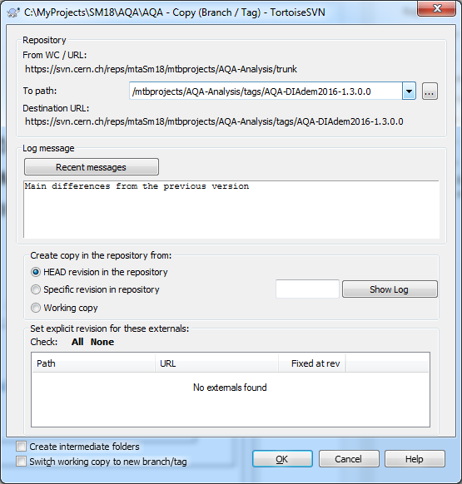
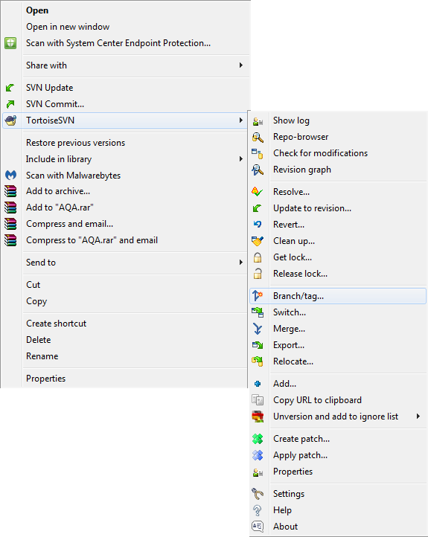
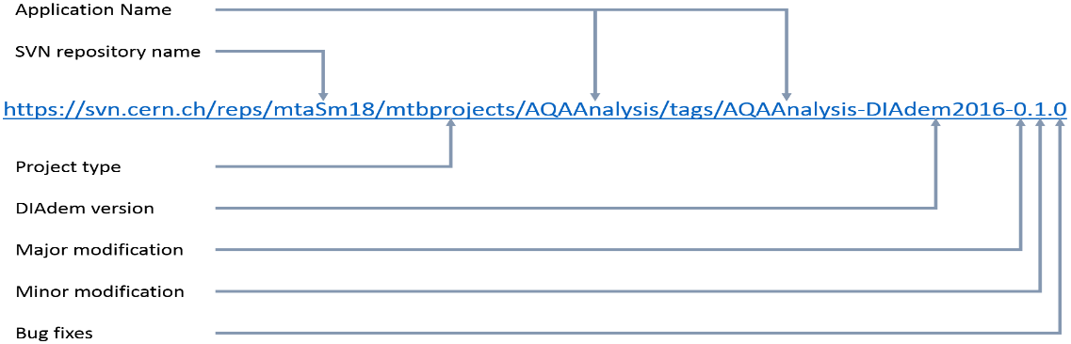
Create a Tag
Once you have a tested and validated version that you want to put in production you must create a tag on SVN

Slide 52

We Will Deploy The Latest Tag
When your tag is ready, inform us and we will deploy the latest lag
Never commit changes to a tag

