Slide 1

GANs for simulation: development for distributed computing systems
Elena Orlova, Higher School of Economics, Moscow, Russia
Advised by Sofia Vallecorsa, Andrei Gheata
14 August, 2017

Slide 2
Outline
Introduction
  Generative Adversarial Networks
Implementation
Summary

Slide 3
Introduction
Experiments need tools for fast simulation. Currently available solutions depend on the experiments.
We want to:
  have a generic interface in GeantV capable of using different fastsim options including ML based
  reproduce particle interactions with matter in a detector and provide related quantities such as energy or particle type
Generative Adversarial Networks!

Slide 4
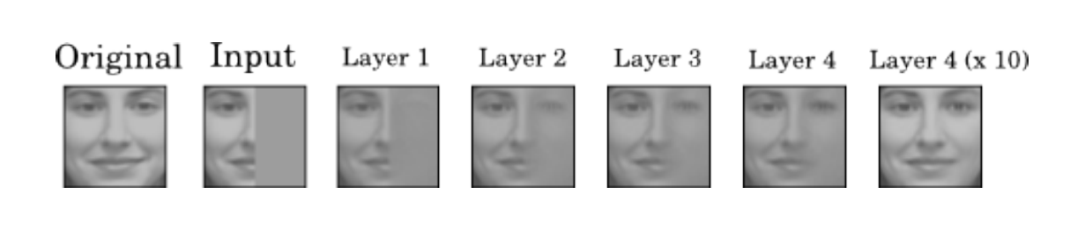
DL for simulation
Generative models (Generative Stochastic Networks, Variational Auto-Enconders, Generative Adversarial Networks, ..) can be used for simulation:
  Realistic generation of samples
  Use complicated probability distributions
  Optimize multiple output for a single input
  Work well with missing data
https://arxiv.org/pdf/1605.05396.pdf
Ranzato, Susskind, Mnih, Hinton, IEEE CVPR 2011

Slide 5
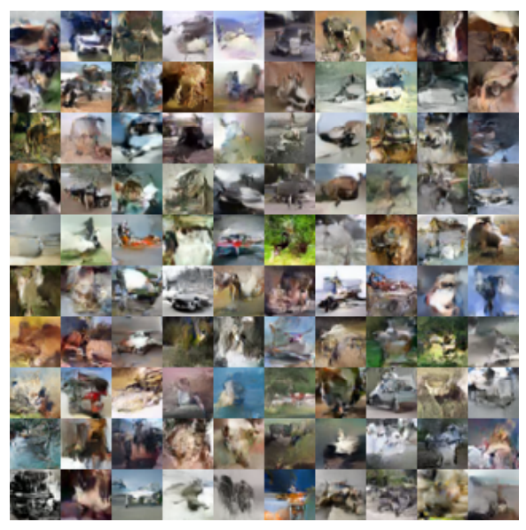
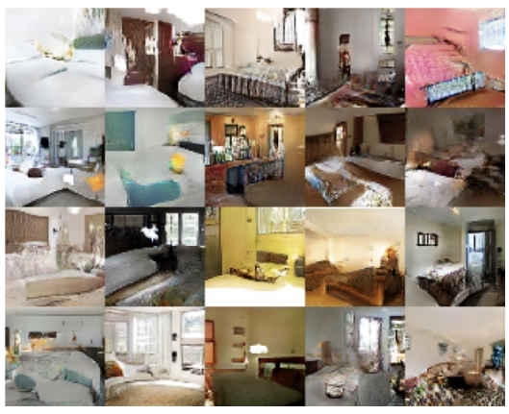
GAN results
Samples of images of bedrooms generated by
a DCGAN trained on the LSUN dataset.
Samples drawn trained on the CIFAR-10 dataset
https://arxiv.org/pdf/1701.00160v1.pdf

Slide 6
Generative Adversarial Networks
Generator
Discriminator
VS.

Slide 7
Generative Adversarial Networks
Two models:
  D(x) classifies images: fake or real
  G(x) produces images taking as input some random noise
Training procedure for G(z) is to maximize the probability of D(x) making a mistake
Noise
Real Data
Discriminator
Generator
Real/Fake

Slide 8
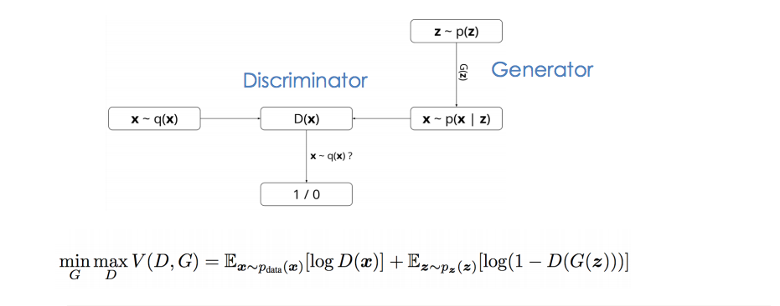
Generative Adversarial Networks

Slide 9
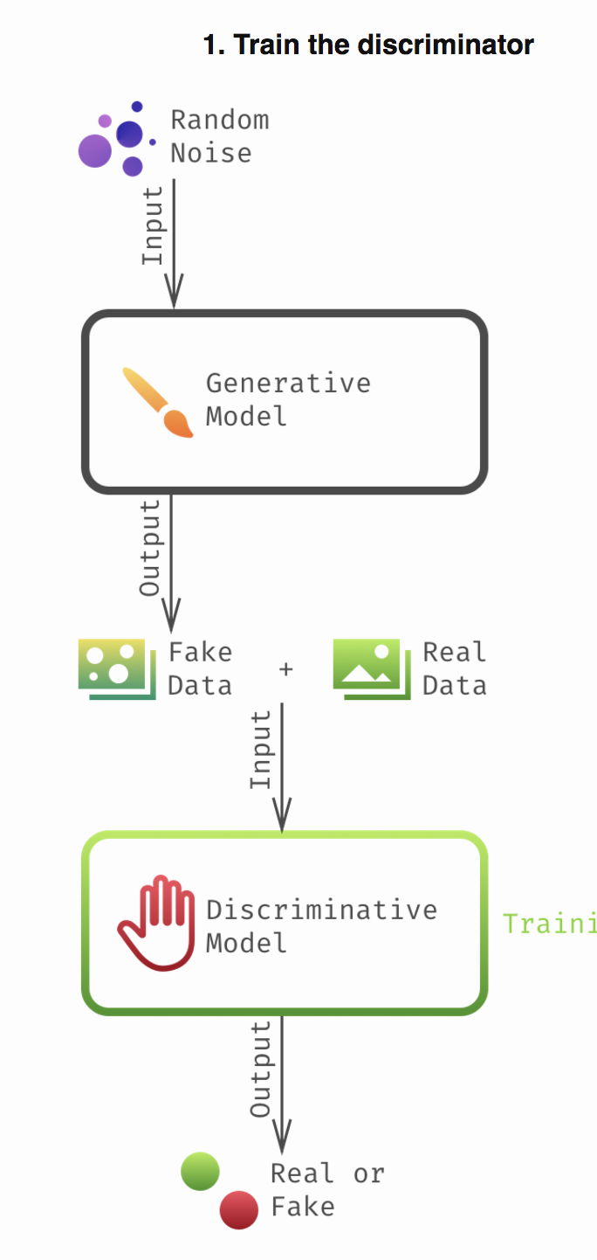
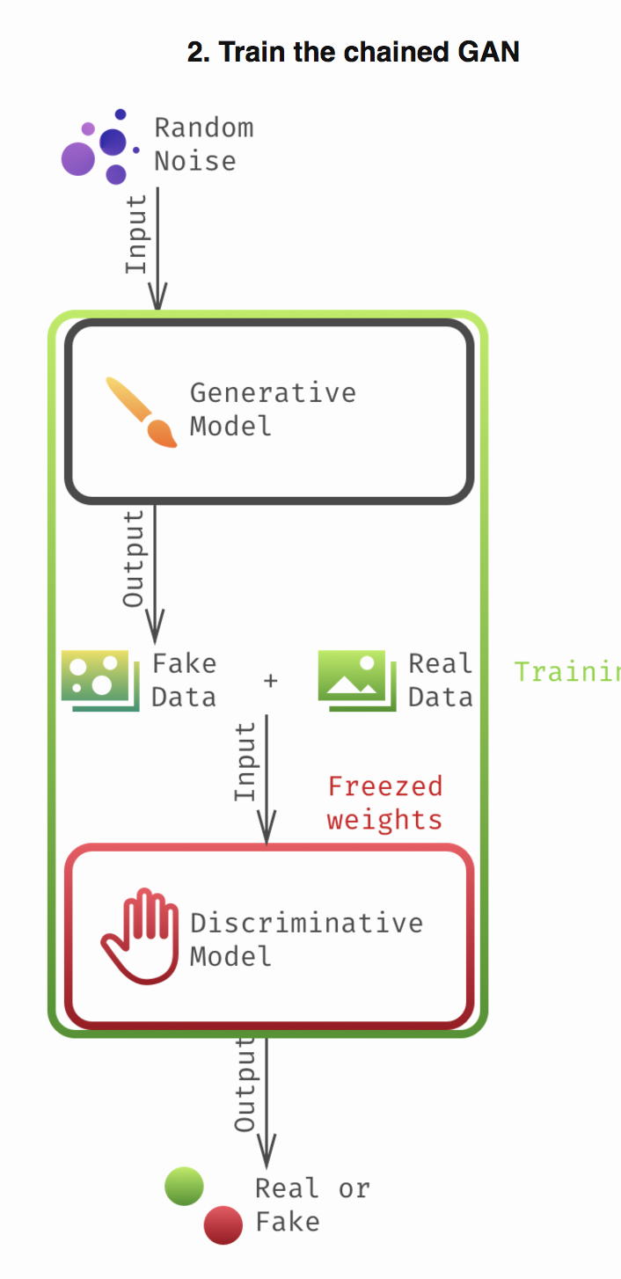
Train procedure
Sample noise and generate images with G
Sample images from training dataset and train the D to recognize G data from real data
Train combined G + D to tell you that G data it is real
At this stage D weights are frozen.
Back feed info to discriminator and repeat for as many epochs as needed

Slide 10
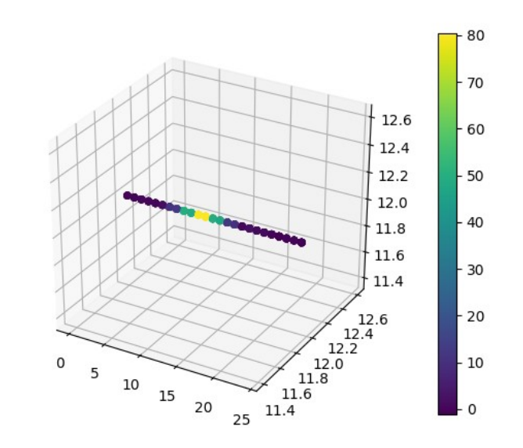
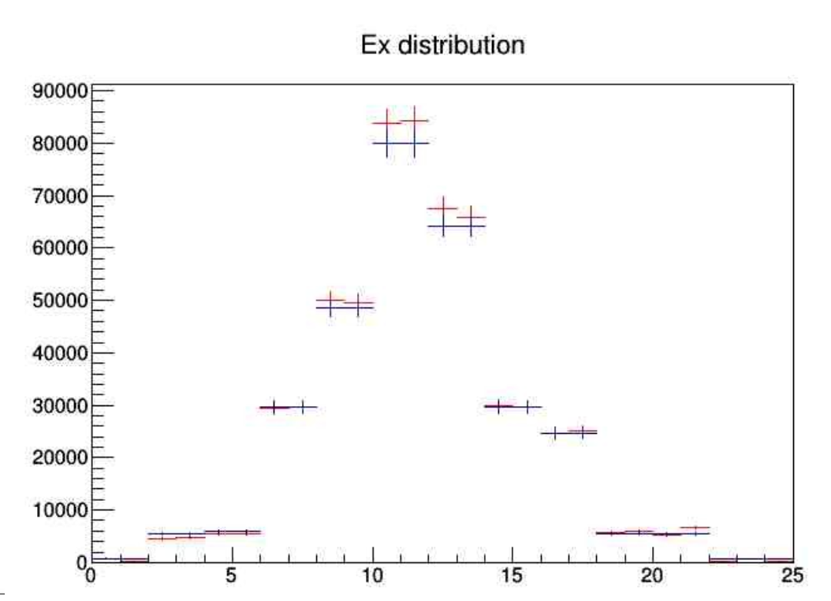
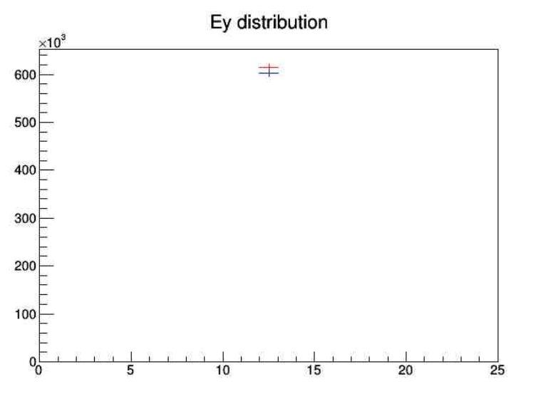
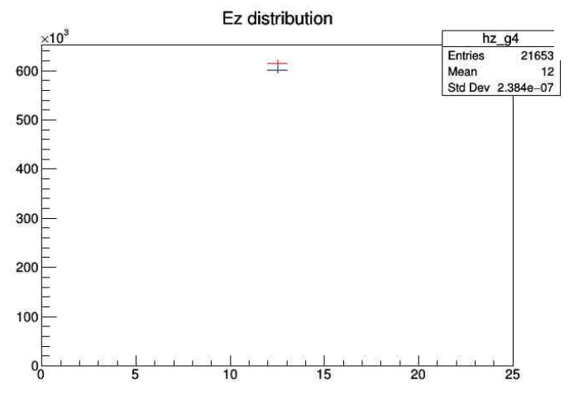
Toy gaussian test
Generate simplified 1D distribution to test GAN behavior
      Two gaussians centered at x=0.
      Fake a two classes (particles) signal
      Reproduce distribution with GAN

Slide 11
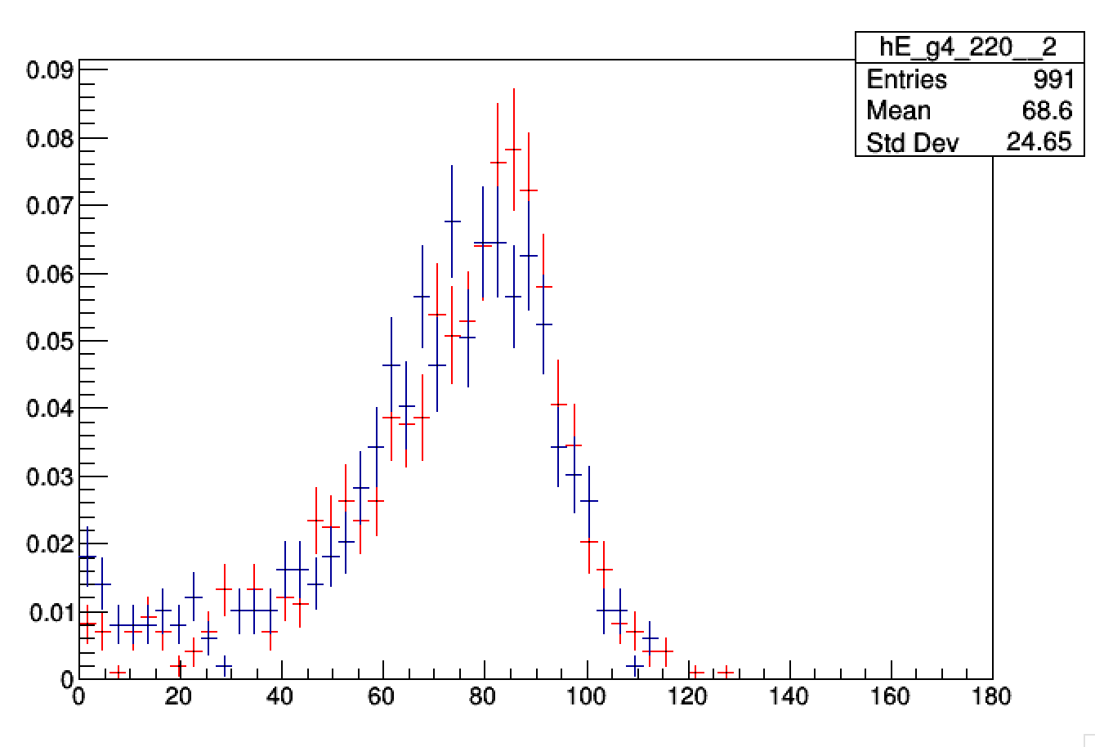
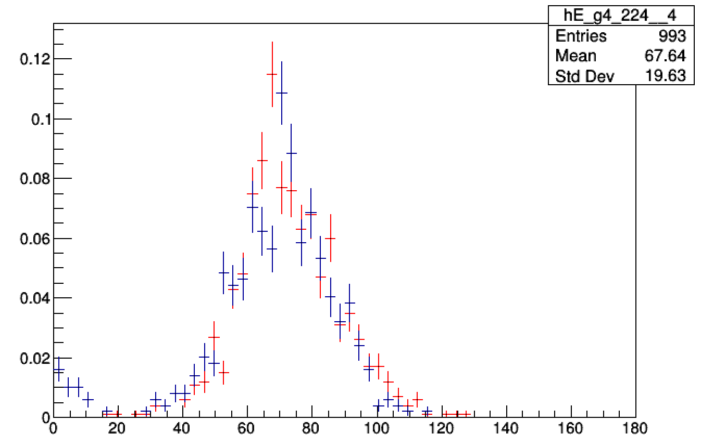
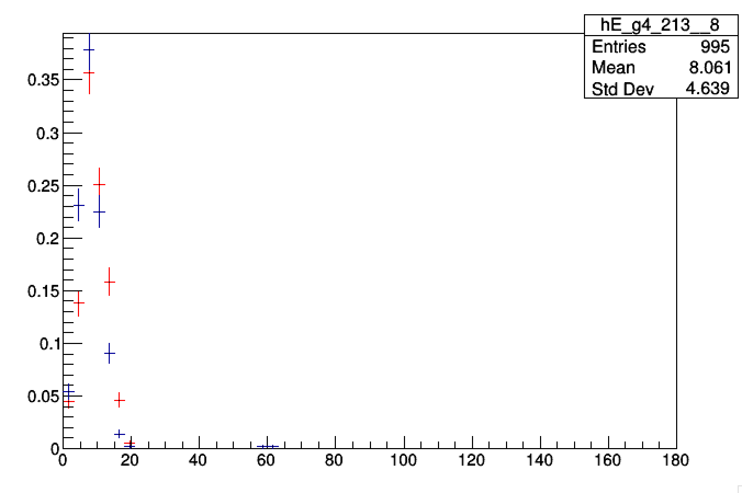
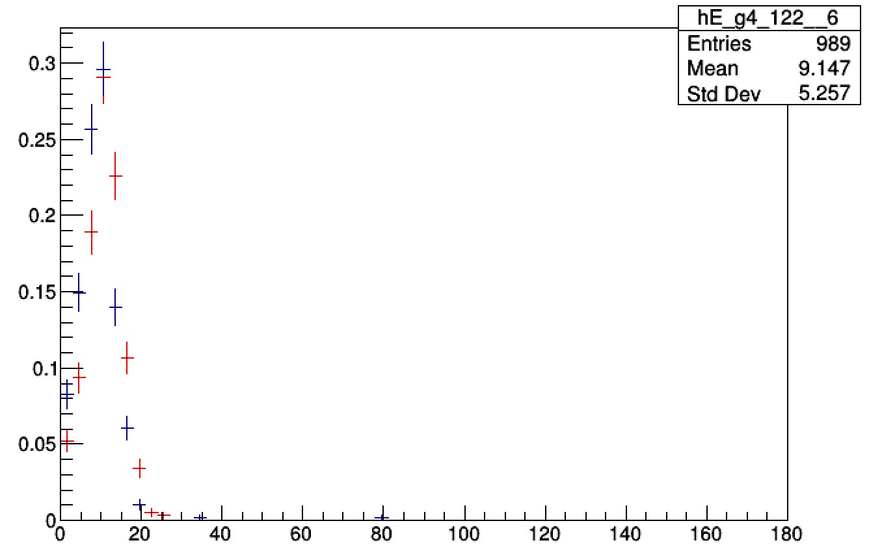
LCD calorimeter showers
Single electrons

Slide 12
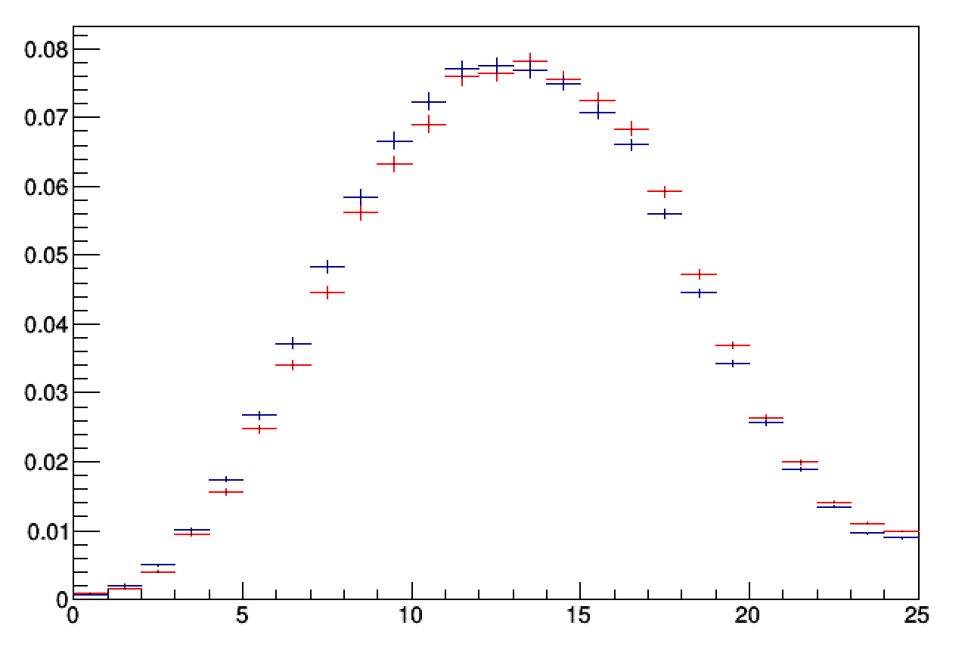
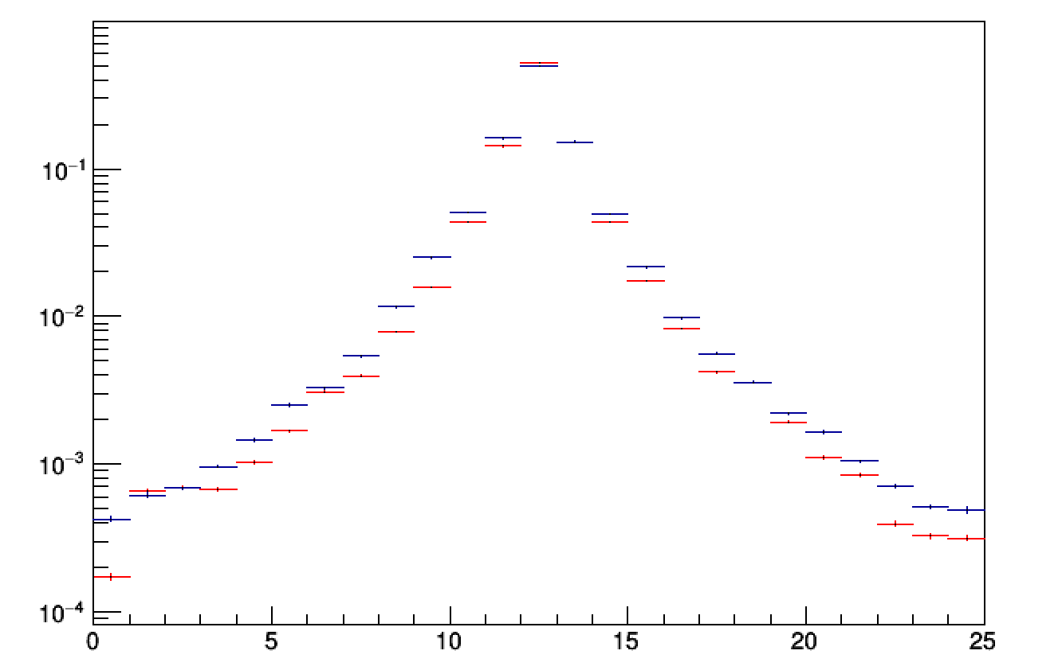
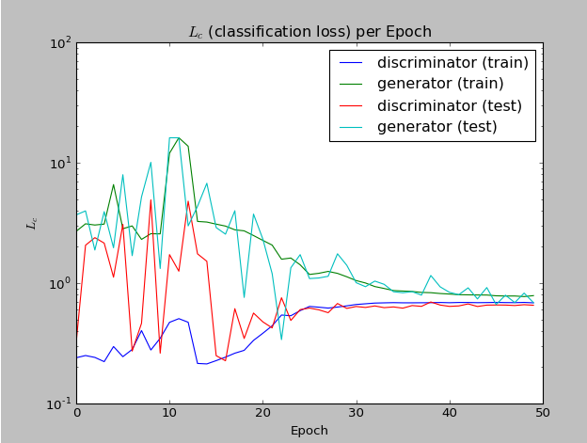
LCD calorimeter showers
Shower longitudinal section
Shower transverse section

Slide 13
Improving training
1 day on GTX1080
Improving performance:
  hyperparameters
  train on CPU clusters not only GPU clusters
neon

Slide 14
neon
new deep learning framework committed to best performance on all hardware
designed for ease-of-use, extensibility and « out-of-the-box » scaling through multiple nodes.
http://neon.nervanasys.com/index.html/

Slide 15
Keras/neon
Keras
No 3D transpose convolutional layer:
  Conv + Upsampling
Neon
Transpose convolutional layer in 3D
GAN model is implemented
Output: 1 + (W−F+2P)/S,
where W - input volume, F - filter size, P - padding, S - stride

Slide 16
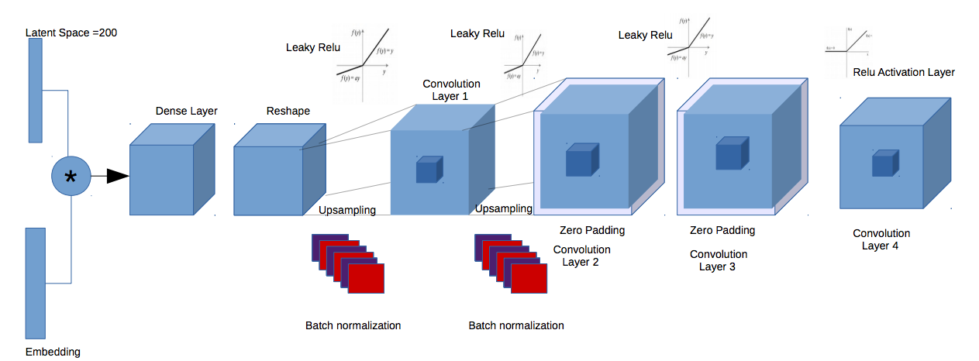
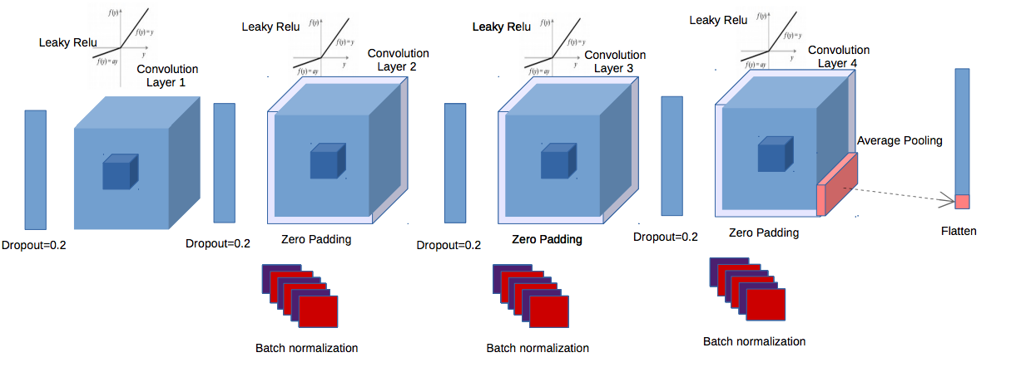
GAN in 3D
Generator and Discriminator are based on 3D convolutions
Generator
Discriminator

Slide 17
neon model
Generator
Discriminator

Slide 18
Current state
Our case is non standard and common framework might not be optimised for it: we have to work in collaboration with developers to fix issues:
  3D deconv
  “mkl” backend
  no embedding layer

Slide 19
Conclusion and plans
keep working on implementation
add parametrisation
testing with different parameters on different architectures

Slide 20
Motivation
  Historically simulation in particle physics has relied on Monte Carlo methods. Deep learning is a completely new approach.
  It will allow physicist to produce a huge amount of simulated data , needed by the next high luminosity LHC experiments, using limited computing resources .

Slide 21
Thank you!

Slide 22
Intel Competiton
The Modern Code Developer Challenge
The goal for Intel is to give budding developers the opportunity to use modern programming methods to improve code that helps move science forward.
https://software.intel.com/en-us/articles/the-modern-code-developer-challenge

