Slide 1
Updates on TDIS design
C. Bracco, A. Perillo Marcone, D. Carbajo Perez,
L. Gentini, A. Lechner, M.I. Frankl

Slide 2
Outline
Internal review motivation
Relevant recommendations
Modifications applied to TDIS design
Pending issue: risk of UFOs produced by friction of RF fingers against graphite ➔ impact on impedance according to what presented at the internal review
Questions for impedance team
Wish list (calculations and measurements) to be agreed with WP2
Conclusions

Slide 3
Internal review on December 1st 2017
Objectives:
Validate the technical choices made for the design of the new TDIS in terms of general mechanical/thermal concept, reliability of alignment and control for machine operation, exchange in case of failure.
Discuss the design by taking into account the past experience of operation with the previous generation of TDI and confirm that the new design addresses the limitations encountered in the past.
Identify possible limitations and critical items in the current design in terms of robustness with respect to thermo-mechanical efforts, compatibility with machine vacuum, compatibility with impedance requirements and beam quality, possible occurrence of high order RF modes (HOM), possible occurrence of electron cloud.
Propose the tests to be made on the prototype to validate the design before series production
Reviewers: M. Taborelli, A. Dallocchio, A. Grudiev, V. Kain and S. Sgobba

Slide 4
Recommendations
Full list of recommendations provided by the reviewers*, some brought to modify the mechanical design:
“ The panel recommends a simulation to verify the amount of energy deposited in the cooling water as well as in the pipes itself in case of a beam impact on the jaw. The resulting mechanical stress/strain (due to possible water pressure instantaneous increase) on the cooling pipes should be carefully evaluated.”
“The panel recommends also to carefully verify the energy deposition on the aluminum alloy back stiffeners of the TDIS in case of beam impact and to evaluate possible permanent plastic deformations with consequent permanent sag of the jaw”
“For the high Z part Ti-6Al-4V (Grade 5) blocks instead of aluminum alloy would be preferable for mechanical reasons and also for conditioning with respect to e-cloud.”
“The benefit of a copper coating has to be compared with the risks of damages in case of grazing beam impact (the impact is more likely than for collimators). The HRMT-35 test, which is already foreseen, will enable a better evaluation of the risk of UFOs and the type of damage on the coating.”
https://indico.cern.ch/event/579995/attachments/1403540/2143469/TDIS_review_form_final_APM.pdf

Slide 5
Updates on TDIS design overview
Thermo-mechanical simulations results
Jaws design update – Simulations summary
Fluka sim. | Simulation Input |  |  |  |  |  | Simulation output (Stiffener) |  |  |  | Remarks
 | Material | Tensile Yield strength [MPa]* | Geometry
 |  |  | a [mm] | b [mm] | c [mm] | d [mm] | Peak temperature [°C] | Peak stress [MPa] | Peak stresses zones | Safety factor
TDISv3 | Alu 5083 | 145 | 8 | 37.1 | 54 | 80 | 128 | > 145 | R1 | < 1 | Original design, high stresses at R1 zone. Plastic deformation expected.
TDISv11 | Mo alloy - TZM | 515 | 8 | 33.5 | 67 | 62 | 227 | 320 | [1] (no rib) | 1.61 | Current status. Peak stresses below yield strength.
 | Modification wrt previous case
* | Estimated value @peak temperature
a
R2
R1
b
[1]
c
Jaw cross-section sketch
Stiffener + Absorbing block
d

Slide 6
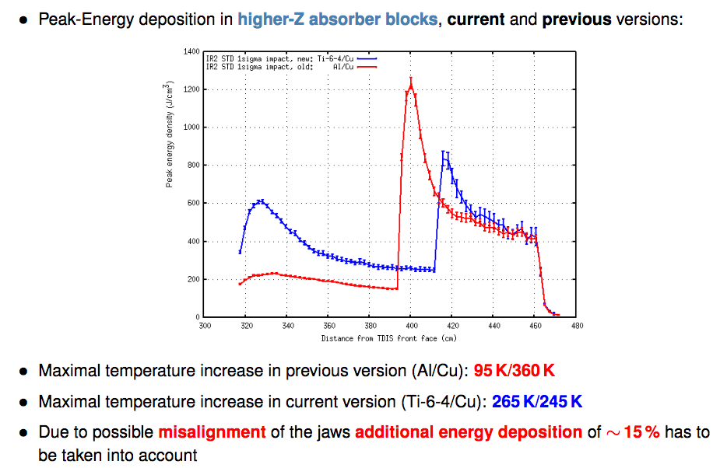
High-Z Absorbing Blocks
M.I. Frankl

Slide 7
Updates on TDIS design overview
Thermo-mechanical simulations results
Jaws design update – Simulations summary
Fluka sim. | Simulation Input |  |  |  |  | Simulation output (Stiffener) |  |  | Remarks
 | Material | Tensile Yield strength [MPa]* | Geometry
 |  |  | c [mm] | d [mm] | e [mm] | Peak temperature [°C] | Peak VM stress [MPa] | Safety factor
TDISv3 | Alloy 5083 | 145 | 54 | 80 | 965 | 143 | > 145 | < 1 | Original design, high stresses in case of grazing impact. Plastic deformation expected.
TDISv11 | Ti6Al4V | 500 | 67 | 62 | 965 | 365 (large impact parameter) | 273 | 1.83 | Material upgrade. Peak stresses below yield strength.
 | Modification wrt previous case
* | Estimated value @peak temperature
Graphite
Ti6Al4V
CuCr1Zr
c
Jaw cross-section sketch
Stiffener + Absorbing block
e
Jaw length
d

Slide 8
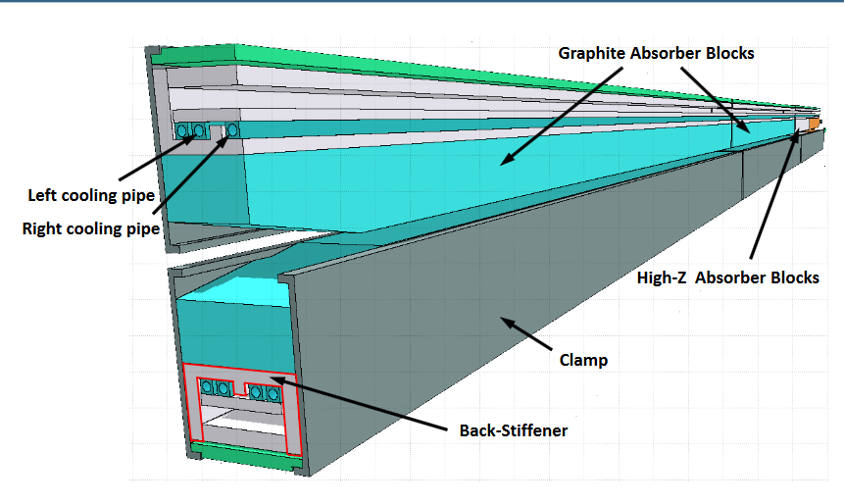
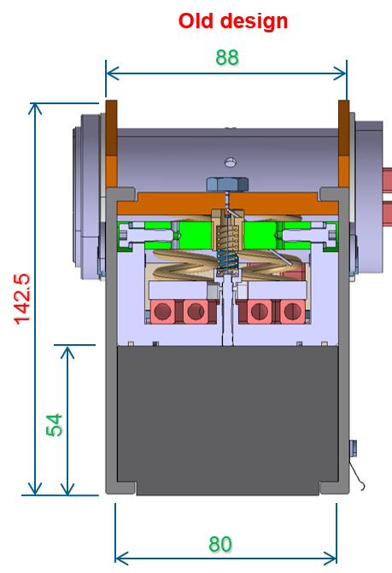
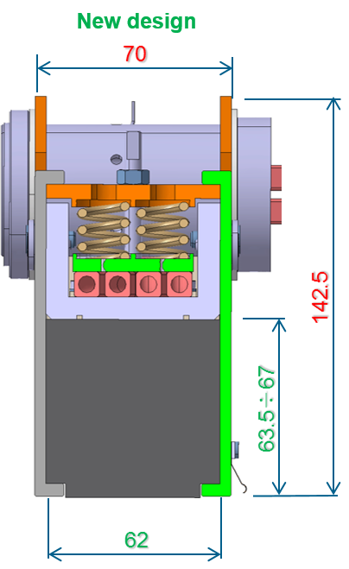
TDIS Modified Design
Design modifications according to recommendations ➔ improve robustness and easier integration
  Reduced jaw width to allow more space for jaw insertion inside the tank during assembly
  Increased height of absorber block
  Different back-stiffener material: TZM Mo-Alloy (high thermal shock resistance, stiffness and better shielding for the cooling pipes. Al 2219 as fall-back solution. Two prototypes, with Al and TZM, tested in parallel in HiRadMat in 2018)
  Cooling pipe inner diameter decreased from 6mm to 4 mm, pure Cu to improve cooling efficiency
  Clamps material upgrade (required due to higher energy deposition as result of jaw thinning): Stainless steel → Ti6Al4V
  Change 3rd jaw material: Al/Cu → Ti6Al4V/CuCrZr
HRMT-28 tests performed: graphite and 3D CC ➔ both survived (material analysis will follow after cool down)
HRMT-35 will be performed in week 33: Cu coating

Slide 9
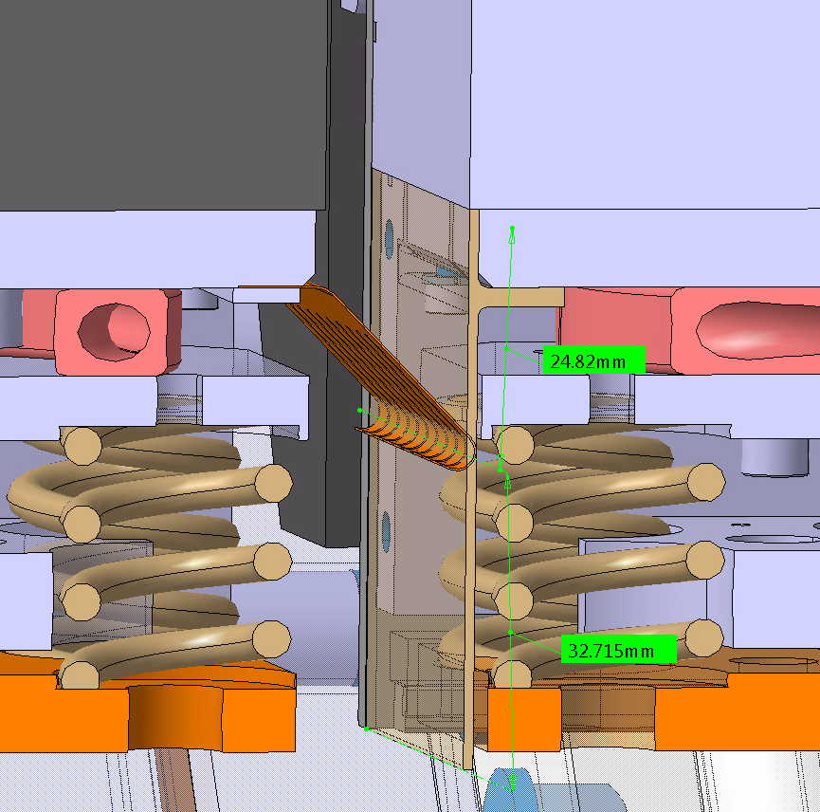
Pending issue…..
Absorber blocks
L. Gentini
Longitudinal jaw fingers
  The longitudinal jaw fingers are installed behind the absorber blocks. They admit a relative stroke between the jaws in operation of +24mm -32mm, over that:
  1- The fingers can slide on the absorber blocks (graphite or Aluminum).
  2- We lose contact between the jaws.
  In both cases no finger damage is expected but if fingers touch graphite ➔ dust ➔ UFOs (upper jaw)!
Additional switches ☒
HW interlock (need full redesign of control system) ✔
Add thin Ti sheet between fingers and graphite (being evaluated) ✔✔☒??
Removing RF fingers between modules (at least from upper jaws) ✔✔☒??

Slide 10
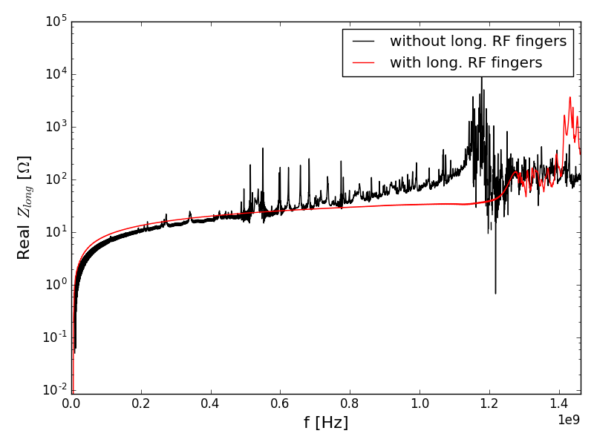
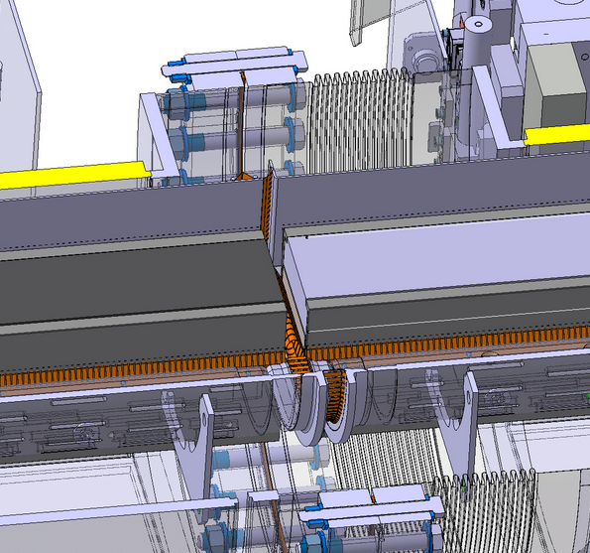
Longitudinal RF fingers
B. Salvant
RF fingers location optimized in order to minimize the field communication with the tank volume below the jaws (thanks Luca).
No visible HOMs in longitudinal impedance below 1.2 GHz thanks to granted continuity of image current flow.
Need to quantify the probability of contact failure of one/some RF fingers
Heat load left is mainly due to the resistive wall impedance of the jaw.

Slide 11
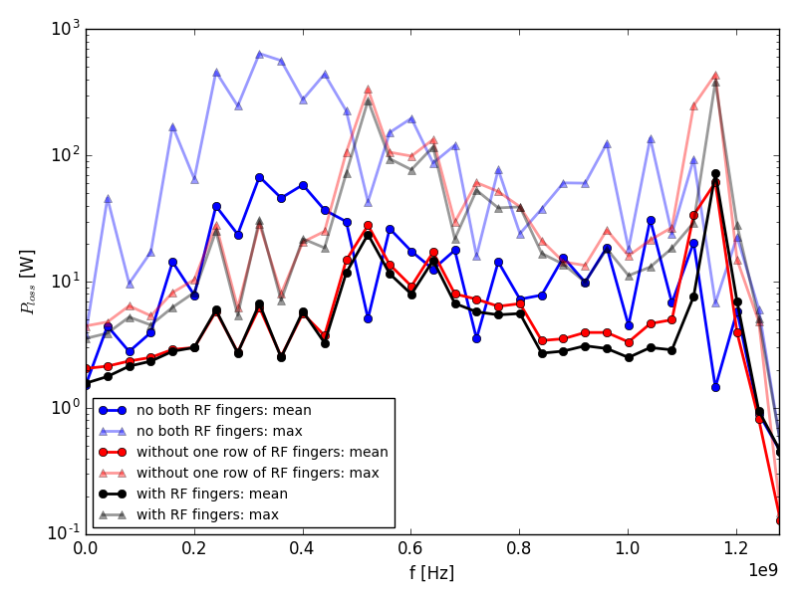
Evaluation of heating from HOMs
B. Salvant
Transverse RF fingers
On average expected < 100 W per spectral line.
Max values can reach 800 W
Heating is distributed on different elements depending on different field patterns.
Input needed on max allowed power deposited per sensitive elements in the structure.
We can then estimate the probability an HOM, if present, could be provoke deformation/damage on these part of the TDIS.

Slide 12
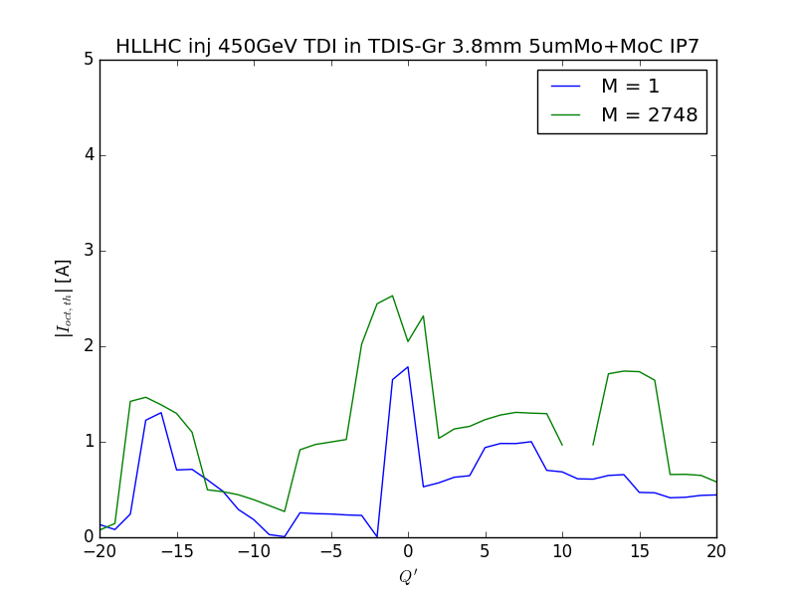
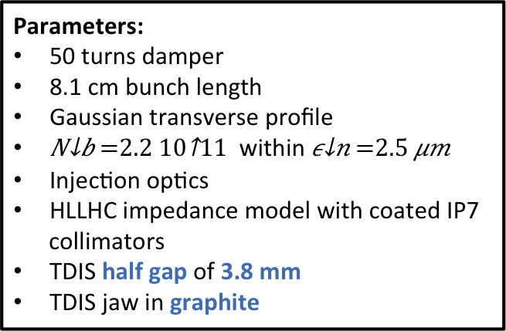
HL-LHC octupole stability threshold at 450 GeV
B. Salvant & N. Biancacci
Parameters:
50 turns damper
8.1 cm bunch length
Gaussian transverse profile
within
Injection optics
HLLHC impedance model with coated IP7 collimators
TDIS half gap of 3.8 mm
TDIS jaw in graphite
Coupled bunch
Single bunch
Assumed Graphite jaw and transverse HOMs as-they-are: statistical simulations to be done to exploit the full impact of HOMs!
10% increase in coupled bunch instability threshold at injection due to the HOMs.
Margins for impedance but without ecloud!
If Cu jaws, single bunch threshold 10% lower, CB may be unchanged as it is driven by HOMs.
No issues expected at flat top (<0.1% w.r.t. total impedance)

Slide 13
Our Questions
Calculations on TDIS design before internal review define in the worst case a maximum power loss of 800 W (HOM in case of no long. RF fingers) + 676 W (no Cu coating) + 250 W (e-cloud):
Which range of frequencies do we have to consider?
Uniform heating?
Local heating and/or outgassing?
Other effects like beam instabilities?
Possible to compensate (improved cooling, pumping, octupoles, transverse damper, etc)?
For HOM, systematic or sporadic effects?
Possible to define “absolute” thresholds and safety margins for different aspects?

Slide 14
Wish List for Impedance Calculations and Measurements
Identification of HOM and sites of power deposition for worst case scenario (reviewers’ recommendation) (end 2017)
Impedance related aspects for (end 2017):
  New design with RF fingers and Cu coating both jaws (ongoing studies, results will be presented at the next WP14 meeting on August 29th)
  New design without longitudinal RF fingers and without Cu coating upper jaw only
  New design without longitudinal RF fingers and without Cu coating both jaws
Transverse and longitudinal beam coupling impedance measurements with stretched wire test setup on prototype (reviewers’ recommendation) (end 2018)
Possible beam interference on temperature sensors in stretched wire test setup (reviewers’ recommendation) (end 2018)

Slide 15
Conclusion
The mechanical design of the TDIS was modified as a consequence of the identification of weak points after the internal review held in December 2016 ➔ impact on impedance calculations
Pending issue: eliminate any risk of UFOs production due to melted Cu coating and friction between RF fingers and graphite (other materials?) ➔ several options under investigation between those the removal of the fingers from (at least) the upper jaw
The design for prototype to be frozen by end 2017 (including impedance studies)
Tests on prototype (HiRadMat and impedance measurements with stretch wires) within end 2018 ➔ final design before LS2!

