Slide 1


Investigation of the Chiral Magnetic Effect using Event Shape Engineering at √sNN = 5.02 TeV Pb-Pb
Yiwen Huang (Eva)
CERN Summer Student Program
Supervisor: Alexandru Florin Dobrin
08/2017
Physics Background
Experimental Approach
Event Shape Engineering (ESE)
CGC-KLN Model
Connecting Data and Model
Summary & Outlook

Slide 2
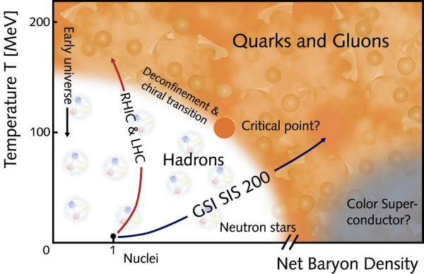
Physics Background
Quantum Chromodynamics (QCD) predicts at high temperature a new phase of matter, Quark Gluon Plasma (QGP), a deconfined system of quarks and gluons.
QGP is expected to be present in the early universe in the first milliseconds.

Slide 3
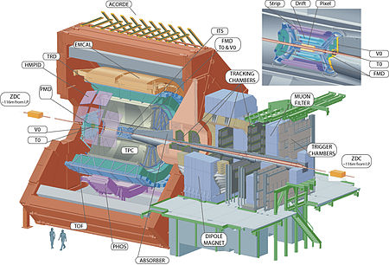
A Large Ion Collider Experiment

Slide 4
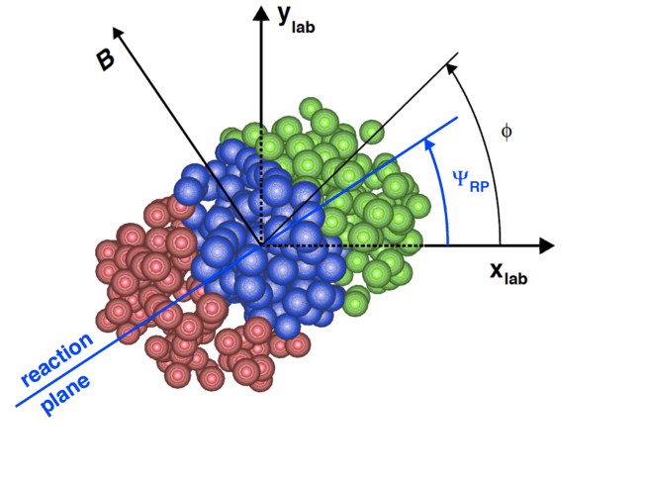
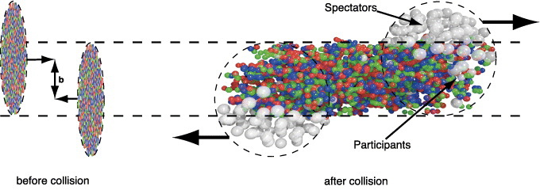
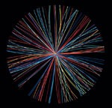
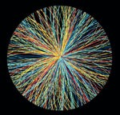
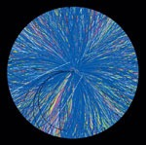
Experimental Approach
Impact Parameter b
Normal to the beam direction
Estimated from the multiplicity of the event → centrality
Reaction Plane ΨRP
Due to fluctuations of event shapes, use symmetry plane Ψn to investigate the collision
Low Multiplicity
Large b
Peripheral Collisions
High Multiplicity
Small b
Central Collisions

Slide 5
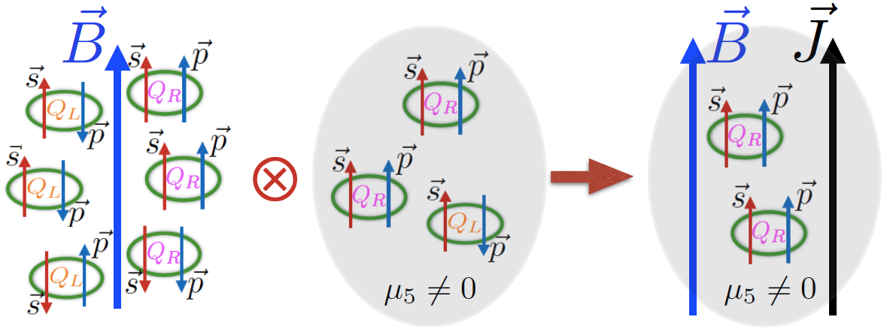
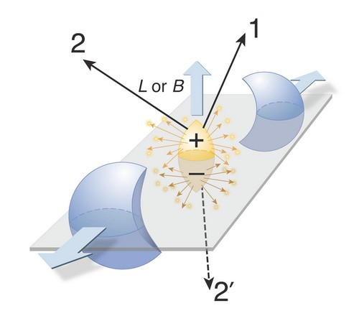
Chiral Magnetic Effect (CME)
An electric current will be induced in chiral domains along the B field in the heavy ion collisions (B ~ 10¹⁵ T).
Experimental evidence: Charge Separation along the magnetic field.
Kharzeev, D.E. et al. Prog.Part.Nucl.Phys. 88 (2016) 1-28 arXiv:1511.04050 [hep-ph]
3-particle correlator

Slide 6
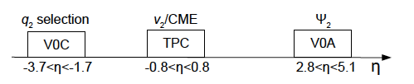
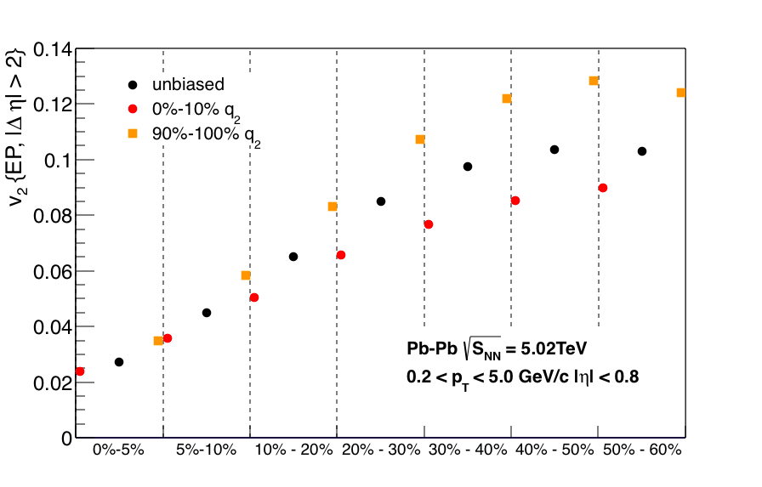
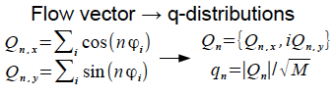
Event Shape Engineering (ESE)
Small q2
Large q2
Event Shape Selection
Using q2 to select different geometry
Using v2 to quantify event anisotropy

Slide 7
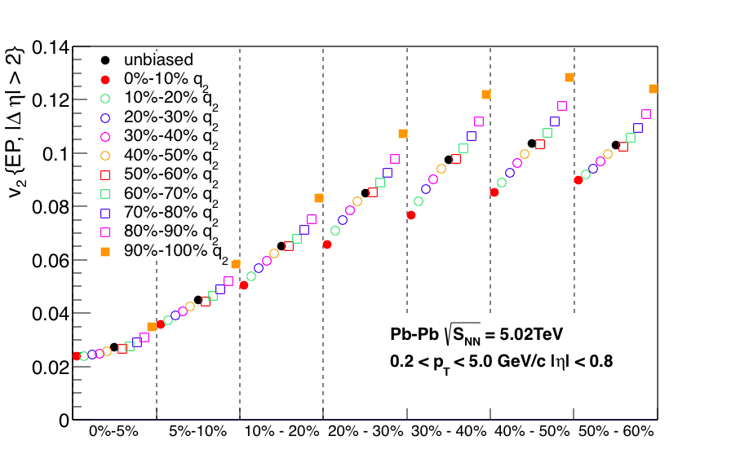
Event Shape Engineering (ESE)
Tracks: 0.2<pT<5 GeV/c, |η|<0.8
Large q2
Small q2
Large q2
Event Shape Selection
Using q2 to select different geometry
Using v2 to quantify event anisotropy

Slide 8
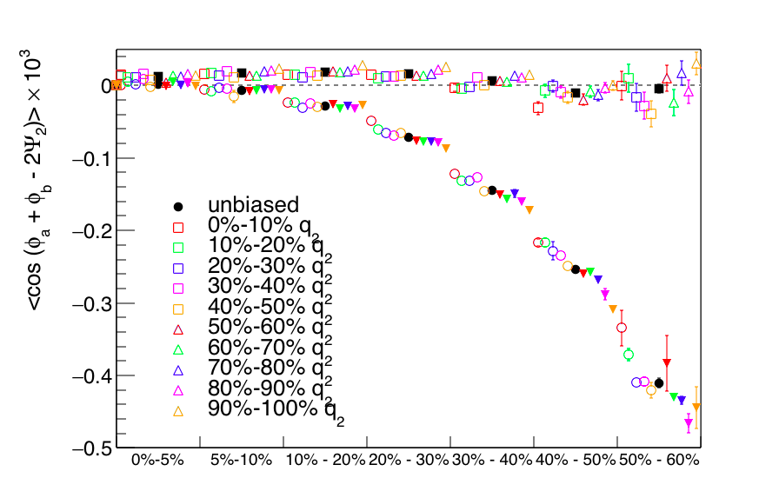
CME with ESE
3-particle correlator
Opposite sign signal
Potential CME signal + flow-related background contributions
γab scales with q2 in a given centrality bin: flow contributions
Same sign signal

Slide 9
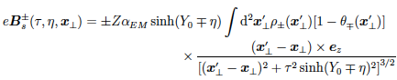
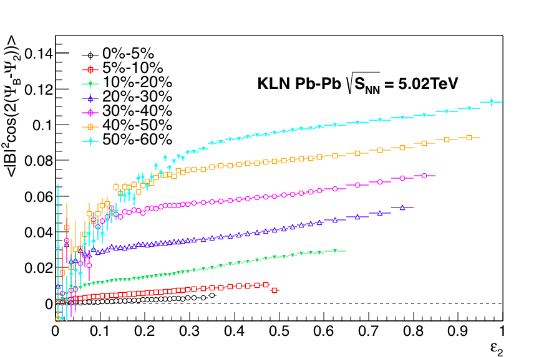
CGC-KLN Model
Monte-Carlo simulation using the KLN Model to calculate the magnetic field using spectators
To evaluate the dependence of the CME signal on different geometries
<|B|2cos(2(ΨB-Ψ2))>
Using 2 million events, the proper time τ=0.1 fm

Slide 10
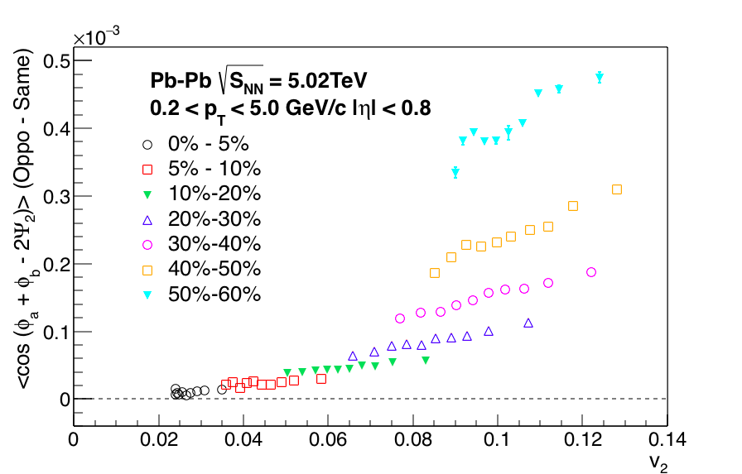
Connecting Data and Model
Linear fit γab (oppo - same) vs v2 and <|B|²cos(2(ΨB-Ψ2))> with ε2
Fit function: p1(v2)=p0(1+ p1(v2−⟨v2⟩)/⟨v2⟩)
Fit with fCME∗p1,MC+(1−fCME)∗1=p1,data to get the fraction of potential CME contributions

Slide 11
Summary & Outlook
Use Event Shape Engineering (ESE) to select the event shape to study the flow-related contributions of Chiral Magnetic Effect
γab (oppo-same) scales with v2
From the Monte Carlo results using the CGC-KLN Model (Pure CME): CME contributions scale with v2
To-do
Check the error on the γab (oppo-same) signal
Estimate the fraction of potential CME contributions by connecting the model and the data

