Slide 1


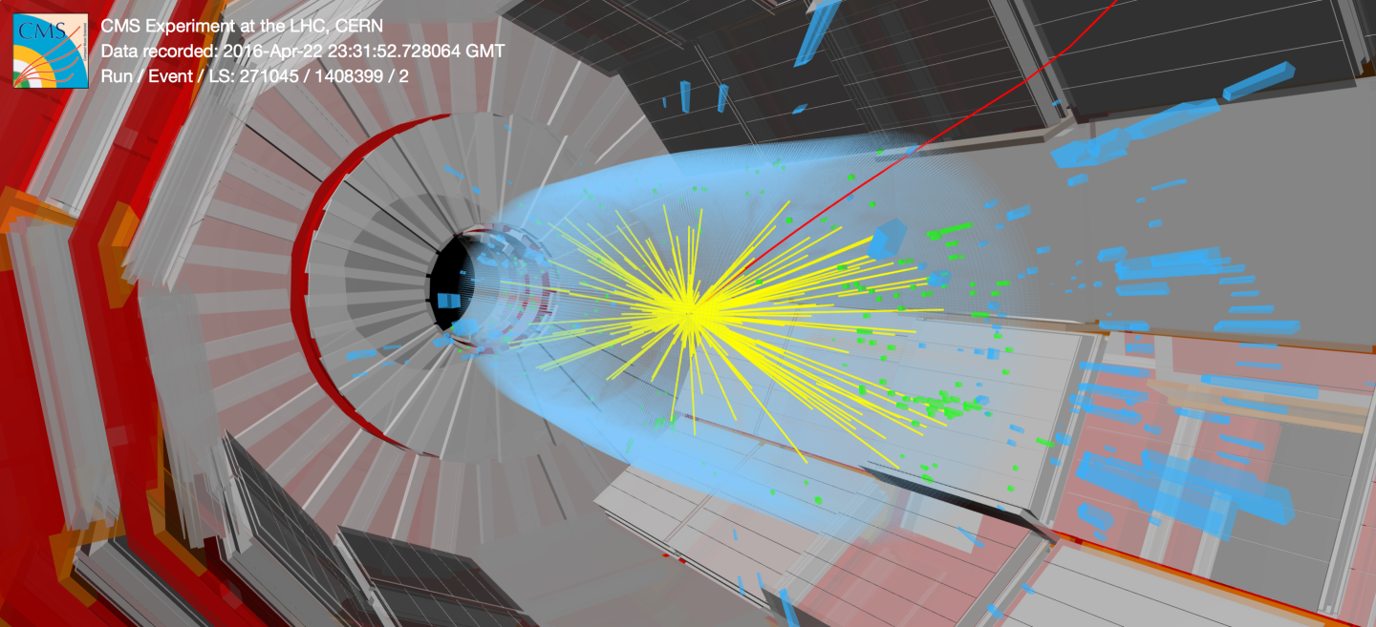
Deep Learning in the HGCal
Ofir Arzi
Supervisors:
Predrag Milenovic
Clemens Lange
Jan Kieseler
1

Slide 2
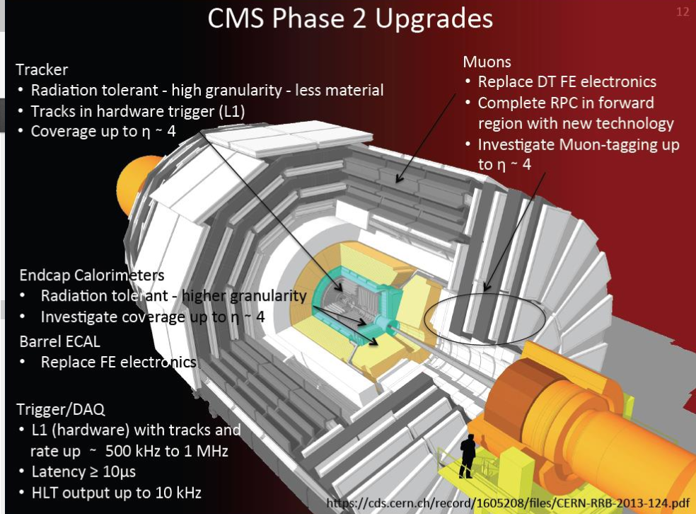

Slide 3
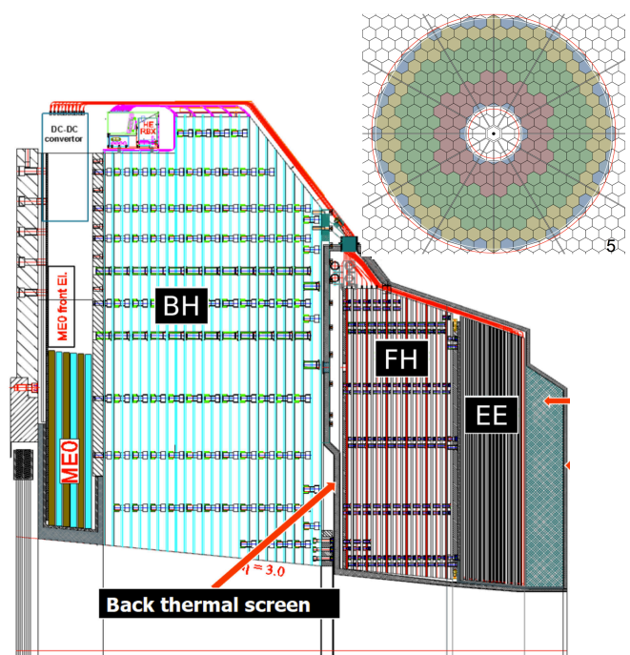
What is the High Granularity Endcap Calorimeter?
Future detector for the CMS experiment upgrade
Efficient reconstruction of e.m./hadron showers
High (5D) spatial, time and energy resolution.
mitigate pile-up (due to overlapping pp scatterings)
real-time shower development
2

Slide 4
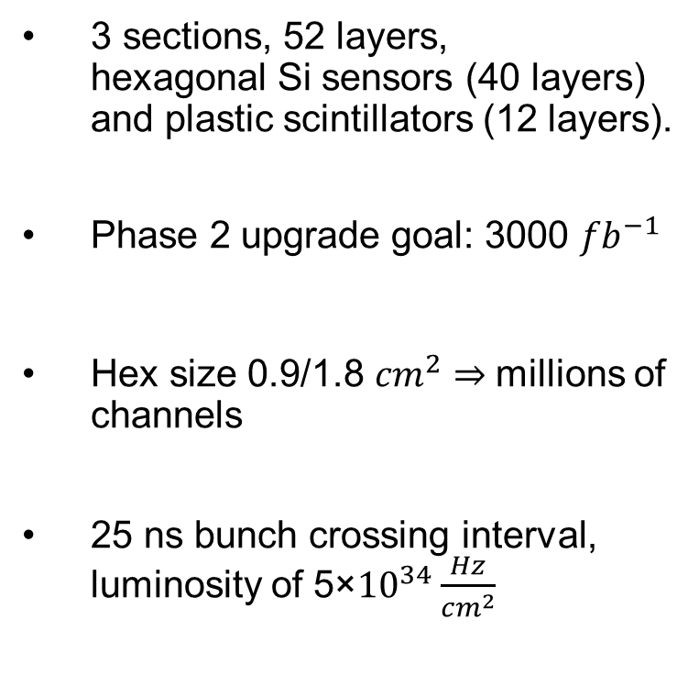
What is the High Granularity Endcap Calorimeter?
3 sections, 52 layers,
hexagonal Si sensors (40 layers) and plastic scintillators (12 layers).
Phase 2 upgrade goal: 3000 ${fb}^{−1}$
Hex size 0.9/1.8 ${cm}^{2}$ millions of channels
25 ns bunch crossing interval, luminosity of 5×${10}^{34}\frac{Hz}{{cm}^{2}}$
3

Slide 5
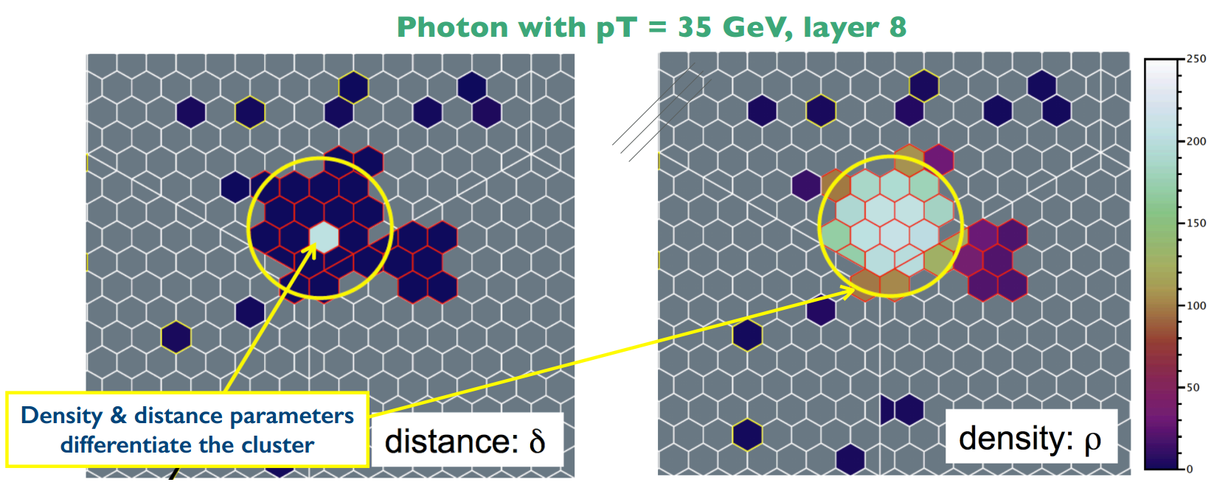
What is the HGCal?
Challenges:
  Reconstruct, identify particle showers
  Reconstruct particle energy
  Distinguish interesting physics from pile-up
Traditional approach:
    Cluster energy deposits
    Identify particles from clusters
    Infer particle energy (regressions)
4

Slide 6
Why Deep Learning?
Good for object/pattern recognition, identification
Proved usefull in computer vision, translation (facebook), autonomous vehicles, video games (reinforcement learning)
But requires large amounts of training data, training success not guaranteed, and applicability to problem is not easy to achieve – requires insights but does not provide them
6

Slide 7
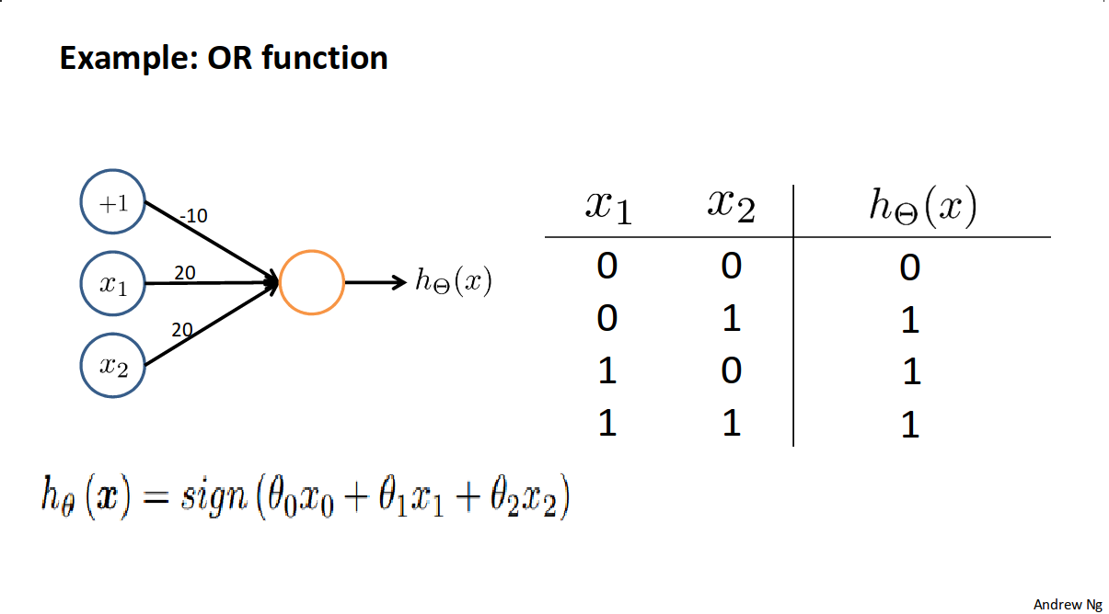
How Deep Learning Works?
Intuitively, NN as a digital circuit:
But can simulate any analog/digital function
Neural networks are fast – Matrix manipulations are efficient
7

Slide 8
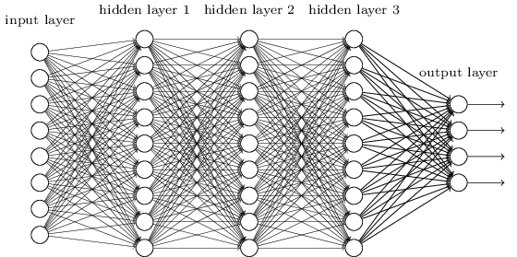
How Deep Learning Works?
Network is trained using the dedicated data sample
Follow the gradient – seek weights for minimum error (optimization problem)
Result is a function that can be applied to new data
8

Slide 9
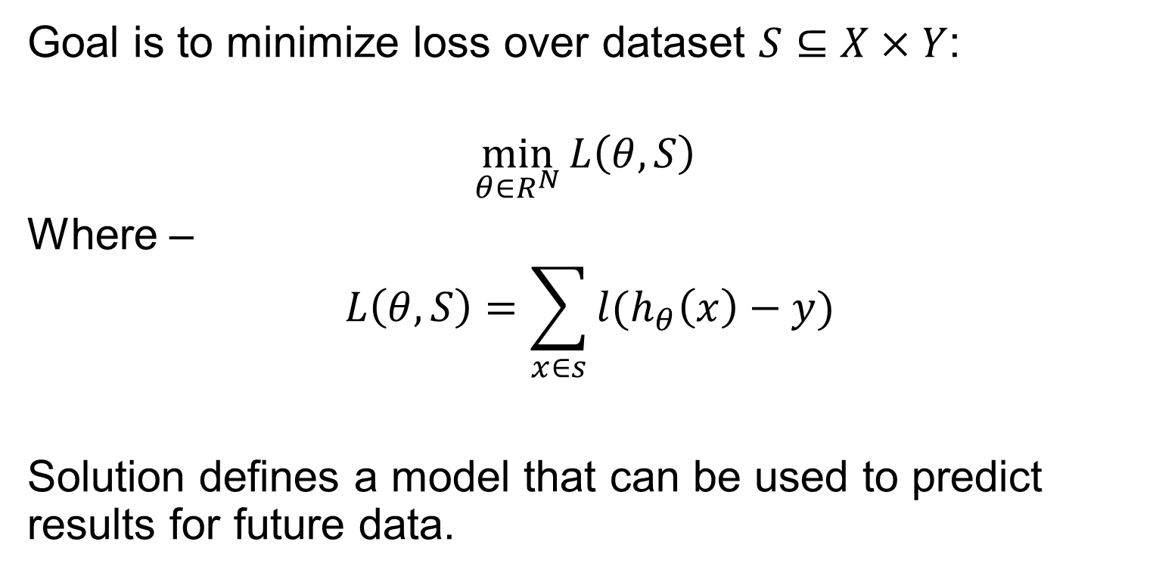
Why Deep Learning Works?
Goal is to minimize loss over dataset $S⊆X×Y$:
$$\min_{θ∈R^{N}}{L\left(θ,S\right) }$$
Where –
$$L\left(θ,S\right)=\sum_{x∈s}{{l(h}_{θ}\left(x\right)−y)}$$
Solution defines a model that can be used to predict results for future data.

Slide 10
Deep Learning and the HGCal
Prior methods performed tasks separately:
  Clustering
  Identification (decide type of shower)
  Regression (evaluate energy)
DNN – does all at once:
  Feed raw data around seed
  Construct shower around it.
  Determine the type of the shower and its energy
10

Slide 11
Deep Learning in HEP
Deep Neural Networks (DNN) were used in HEP for jet substructure and flavor classification, tracking and more
DeepJet – an effort within CMS to apply DNN to HEP for jet analysis
  Jet reconstruction and identification
  Flavor tagging outperforms standard CMS method.
9

Slide 12
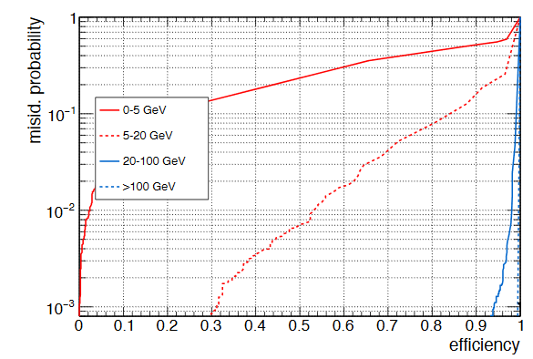
Convolutional DNN showed good results on high energy muon identification in a preliminary study
11

Slide 13
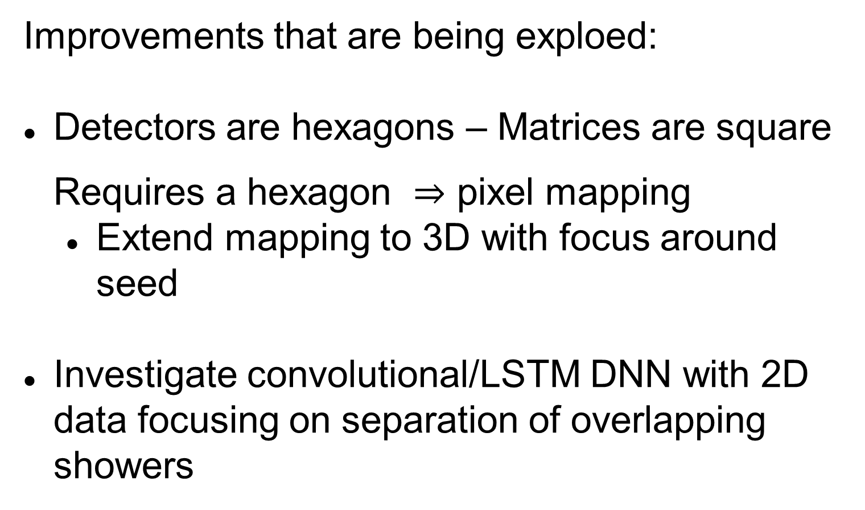
How I fit in
Improvements that are being exploed:
Detectors are hexagons – Matrices are square Requires a hexagon pixel mapping
  Extend mapping to 3D with focus around seed
Investigate convolutional/LSTM DNN with 2D data focusing on separation of overlapping showers
12

Slide 14
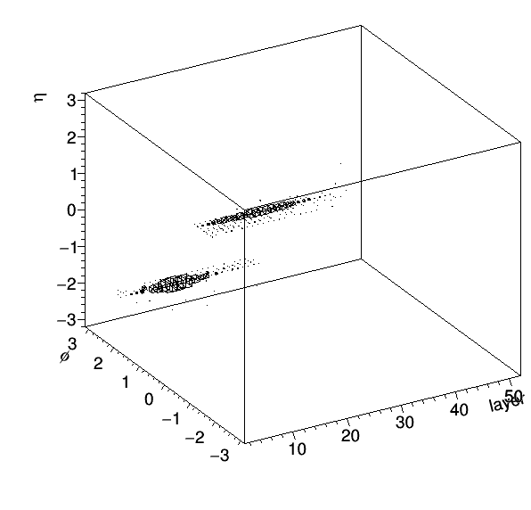
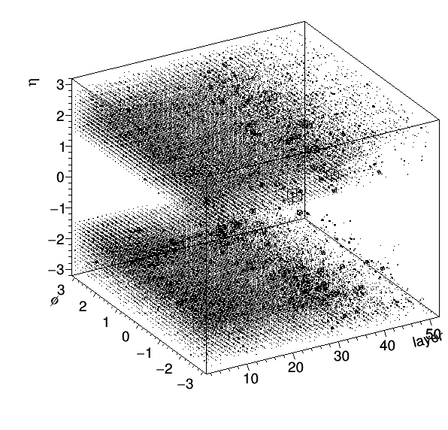

Slide 15
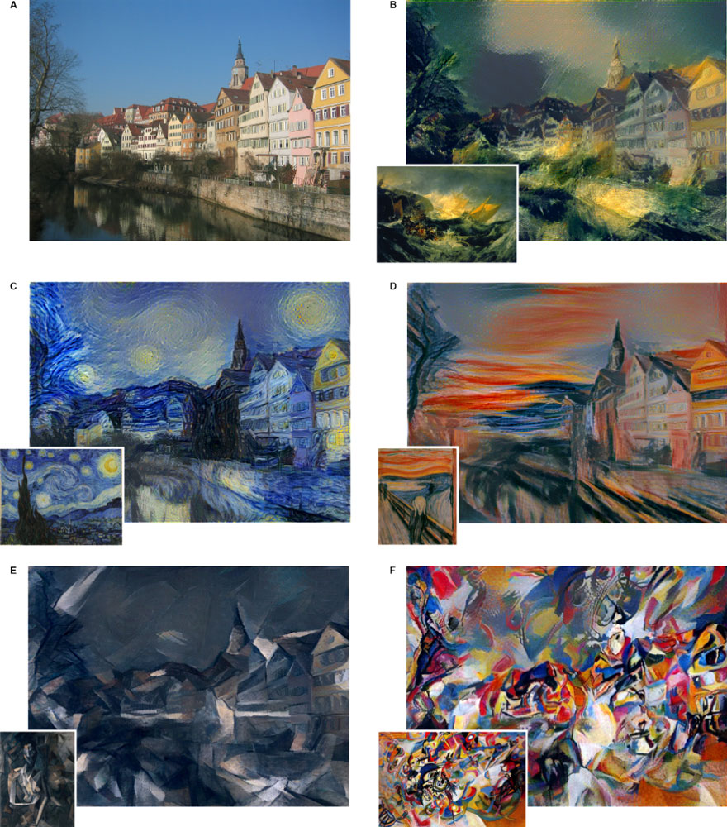
5

