Slide 1
CLARA
CLAs12 Reconstruction and Analysis Framework
Vardan Gyurjyan (Jefferson Lab)
gurjyan@jlab.org

Slide 2

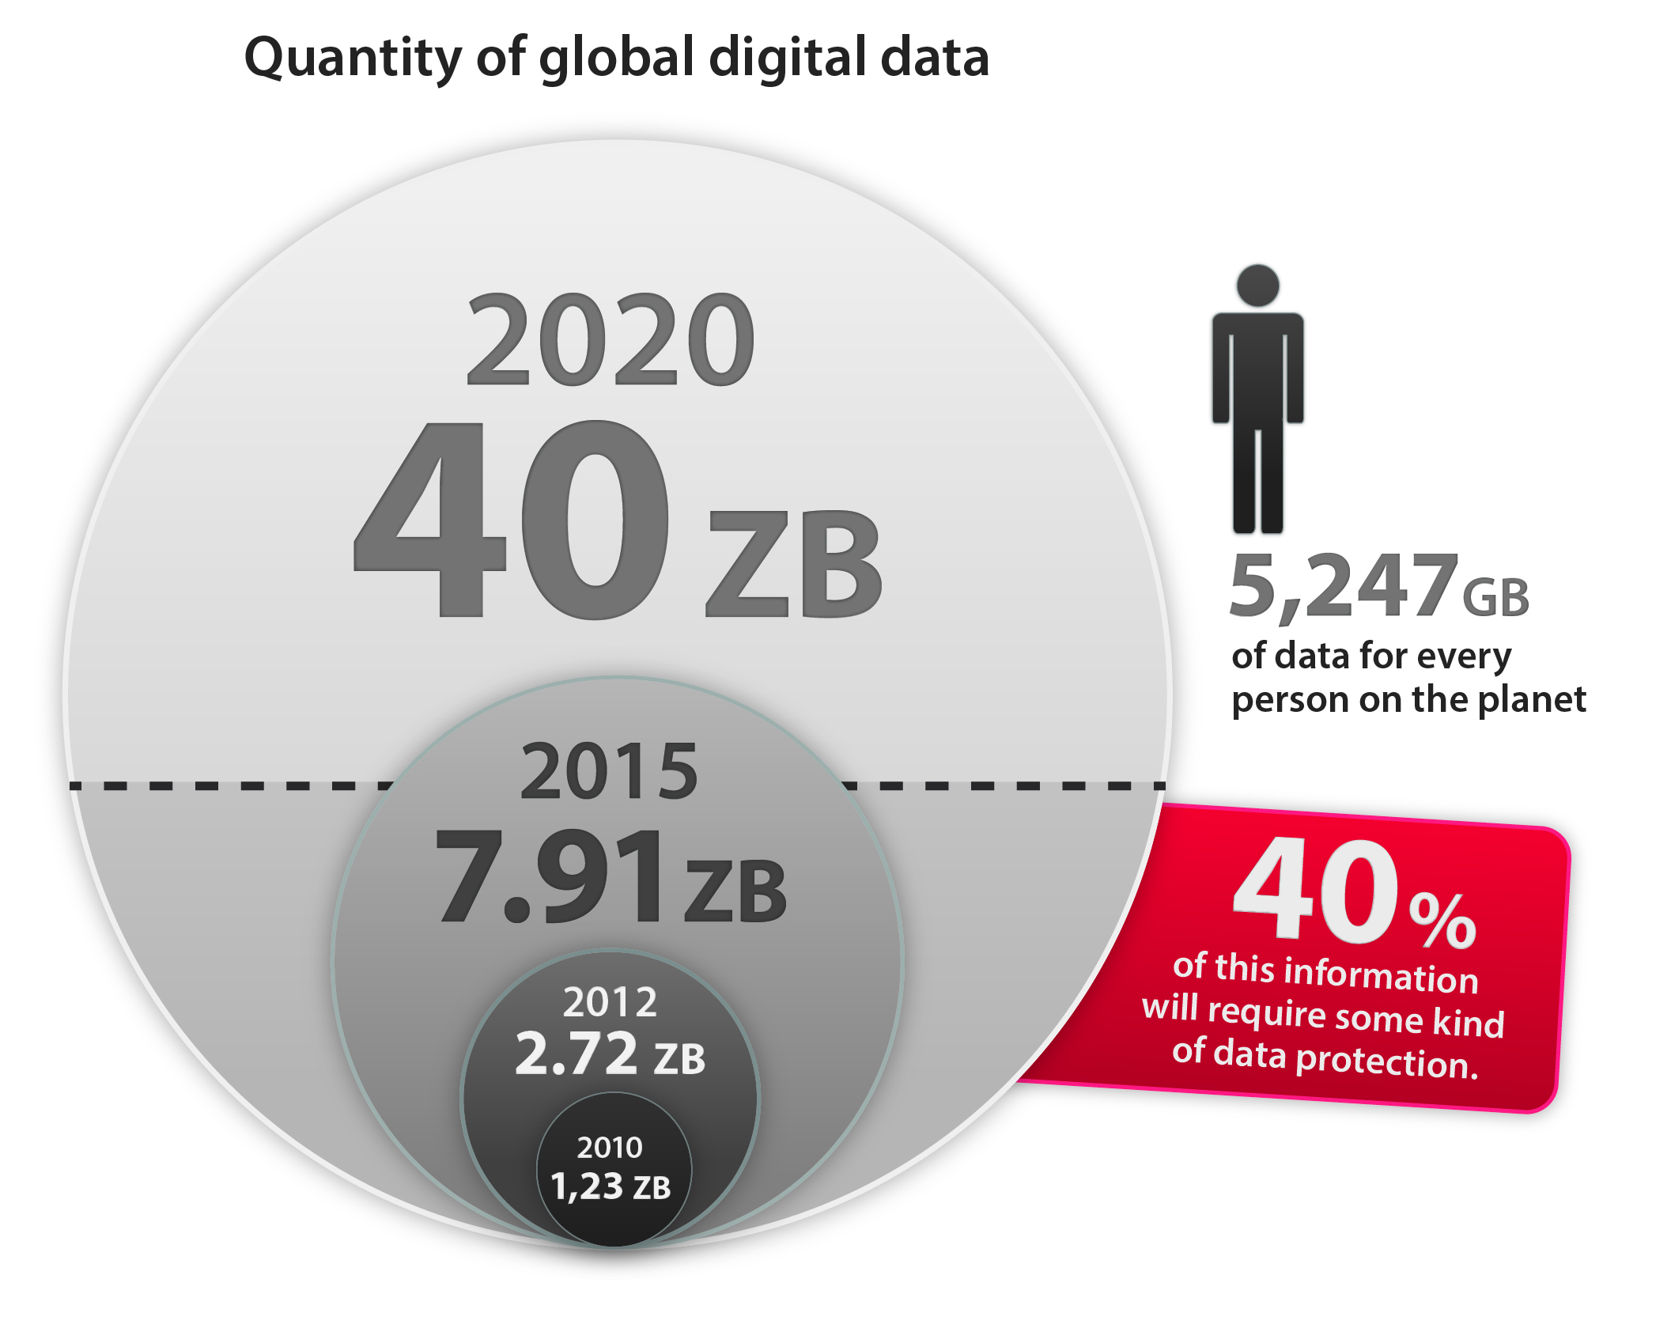
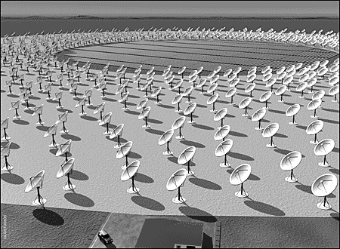
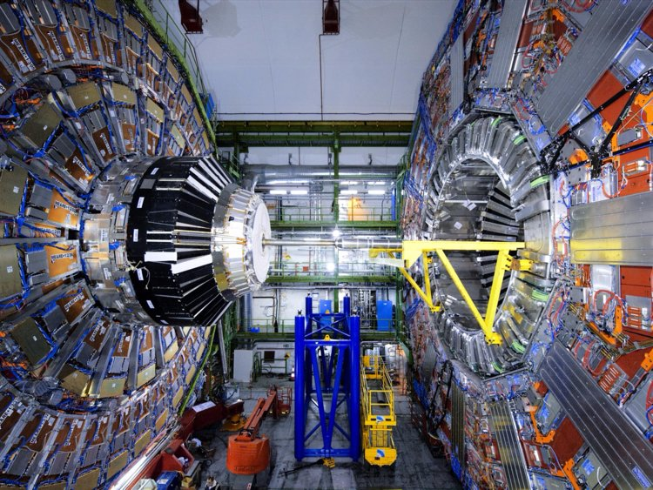
Global digital data demography
SKA Radio Telescope 700 TB/sec in 2020
Unprecedented 3V expansion of data
  Volumes
  Velocities
  Varieties
ATLAS 5 EB in 2026

Slide 3
HL-LHC software R&D requirements
Make use of advances in CPU, storage and network technologies
Enable new approaches to computing and software
Ensure the long-term sustainability of the software through the lifetime of the HL- LHC
Attract the required new expertise

Slide 4
LHC software
More than 20M lines of code (some of the components are 15 years old).
Single architecture (x86_64)
Self contained, monolithic
Serial processing model
Sustainability concerns
  Original authors no longer in the field
  Poor maintenance
  Not well documented
  Lacking unit tests

Slide 5
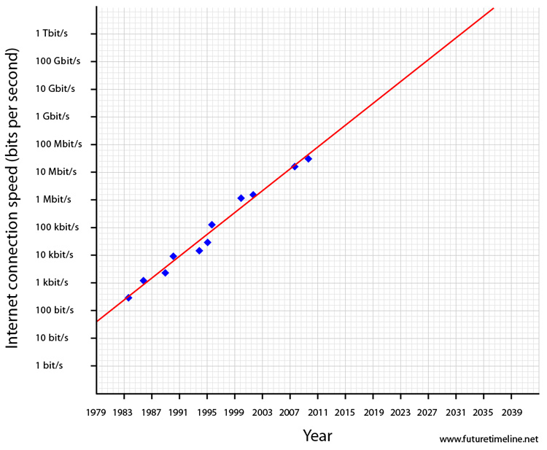
Future trends Moore’s law is dead, long live Nielsen’s law
Network bandwidth will continue to increase, but the ability to use it efficiently will need a closer integration with applications that supports:
  Software distribution and distributed data and workflow management
  Awareness of the extremely hierarchical view of data, from long latency tape access and medium-latency network access through to the CPU memory hierarchy.

Slide 6
Taking advantage of new architectures and programming paradigms will be critical for HEP to increase the ability of our code to deliver physics results efficiently, and to meet the processing challenges of the future.
(A Roadmap for HEP Software and Computing R&D for the 2020s. arXiv:1712.06982)

Slide 7
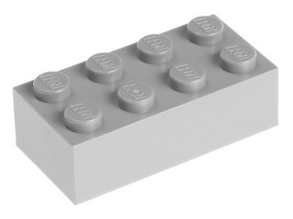
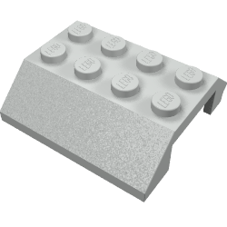

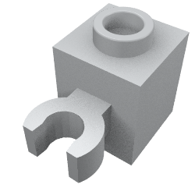
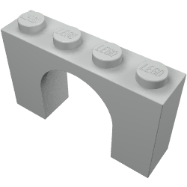
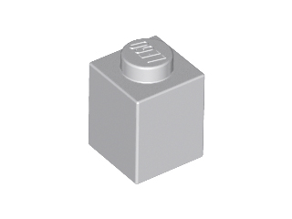
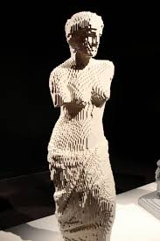

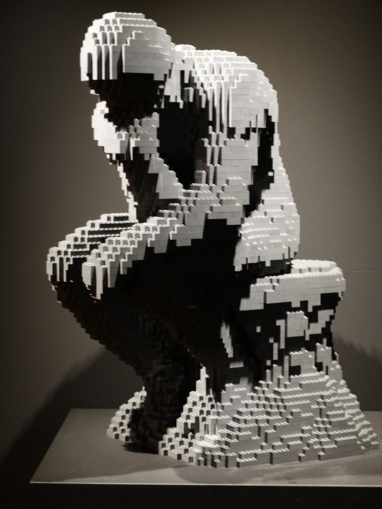
Perfect software

Slide 8
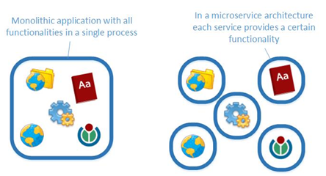

CS architectures to help
Micro-services architecture
Flow based reactive programming (FBP)

Slide 9
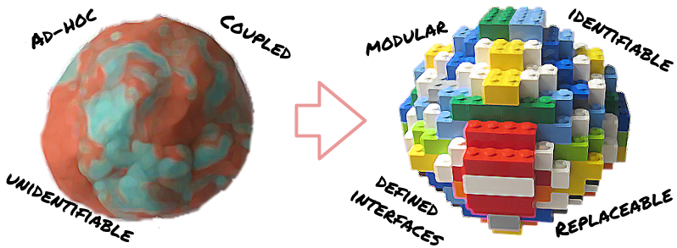
Micro-services: Advantages
Application is made of components that communicate data
  Small, simple and independent
  Easier to understand and develop
  Less dependencies
  Faster to build and deploy
  Reduced develop-deploy-debug cycle
  Easy to migrate to data
  Scales independently
  Independent optimizations
  Improves fault isolation
  Eliminates long term commitment to a single technology stack.
  Easy to embrace new technologies

Slide 10
Flow based programming (FBP)
Glue between micro-services
How they connect to achieve computational goals
Makes application truly distributed
A
B
B reacts on message
Named inputs
Sync/async message passing
{ A calls B } v.s. { A message B }

Slide 11
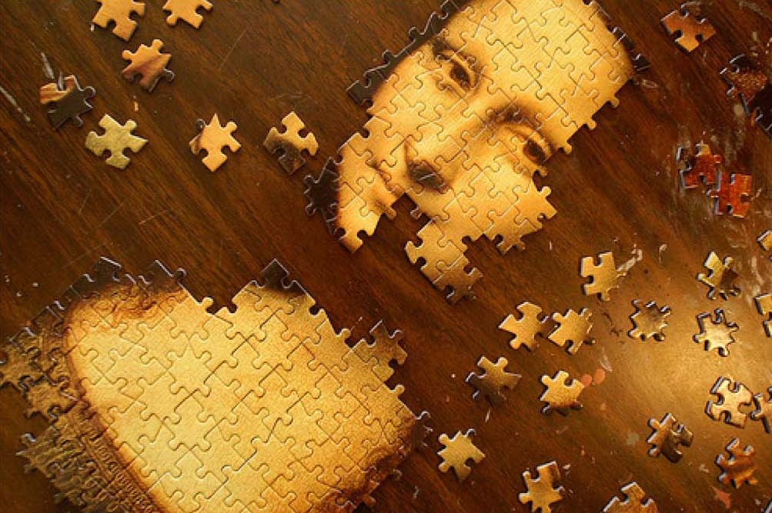
CLARA implements micro-services and FBP
Application is defined as a network of loosely coupled processes, called services.
  Services exchange data across predefined connections by message passing, where connections are specified externally to the services.
  Services can be requested from different data processing applications.
  Loose coupling of services makes polyglot data access and processing solutions possible (C++, Java, Python, Fortran)
  Services communicate with each other by exchanging the data quanta.
      Thus, services share the same understanding of the transient data, hence the only coupling between services.

Slide 12
CLARA architecture
Orchestration Layer
Local Registration
Local Registration
DPE
DPE
SC
SC
SC
SC
S
S
FE
S
S
S
S
Registration
gateway
security
Local Registration
Local Registration
DPE
DPE
SC
SC
SC
SC
S
S
Service Layer
S
S
S
S
Service Bus (xMsg)

Slide 13
CLARA service
Service Engine
Service
Service
SE
SE1
SE
SE
SE1
One request at a time
Multiple simultaneous requests

Slide 14
CLARA data processing environment
Service Container 1
Service Container 2
SE1
SE
SE
SE
SE1
SEn
SE1
Registration
Admin
Service Container n
SE1
SEn
Data processing Environment

Slide 15
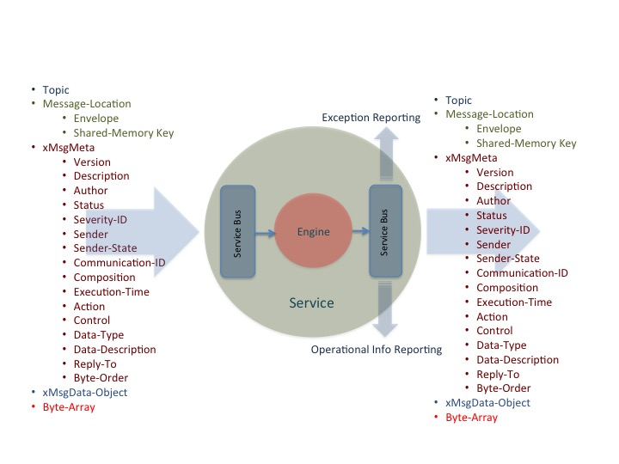
Data unit (event) stream processing
Data driven, data centric design.
  The focus is on transient data event modifications. Advantage over algorithm driven design is that a much greater ignorance of the data processing code is allowed (loose coupling).
Design = service composition + event-routing.
  Self routing (no routing scheduler)
Event routing graph defines application algorithm

Slide 16
Algorithm examples
S1
S2
S3
S4
S1 + S2 + S3 + S4;
S3 + S5 + S6;
S5
S6
F1
F2
S1 + S2 + S3;
while( S3 == ”needs calibration") {
F1 + F2 + S3;
}
S3 + S4 + S6;
S1
S2
S3
S4
S6

Slide 17
CLARA distributed file storage system
CDFS Master
DPE
File Metadata DB
Key = File Name
Value= DPE Info
Heartbeat/2sec.
Available local SSD/HHD
Available memory
Stored Files
  File name
  Status:
    Active
    Passive-hot
    Passive-cold
    Passive-ready-remove
Metadata of the
Dataset to be
processed
Control via SSH
Stage
Promote
Demote
Remove

Slide 18
CLAS12 reconstruction
CLARA micro-service
Can be deployed as a separate process or
a thread within a process. Multi-threaded
CLARA transient data-stream
Message passing through pub-sub middleware. No dependencies between micro-services.
FCAL
0.08ms
FTEB
0.05ms
FHODO
0.05ms
DCHB
34.05ms
DCTB
63.7ms
FTOF
1.16ms
RS
0.07ms
EBTB
0.38ms
EC
0.75ms
EBHB
0.37ms
LTCC
0.05ms
HTCC
0.14ms
CTOF
0.19ms
WS
0.25ms
Total data processing latency per event, per core = 101.29ms
(Note: dependents on magnetic field swimming step size, number of track and background)
For simulated data file = sidisSkim10K.hipo
Trigger efficiency = 100%
Track multiplicity >=2
No background
Node = Intel(R) Xeon(R) CPU E5-2697A v4 @ 2.60GHz 2x16
All tracks
Charge tracks
Black generated, Red: reconstructed hit-based, Green: reconstructed time-based

Slide 19
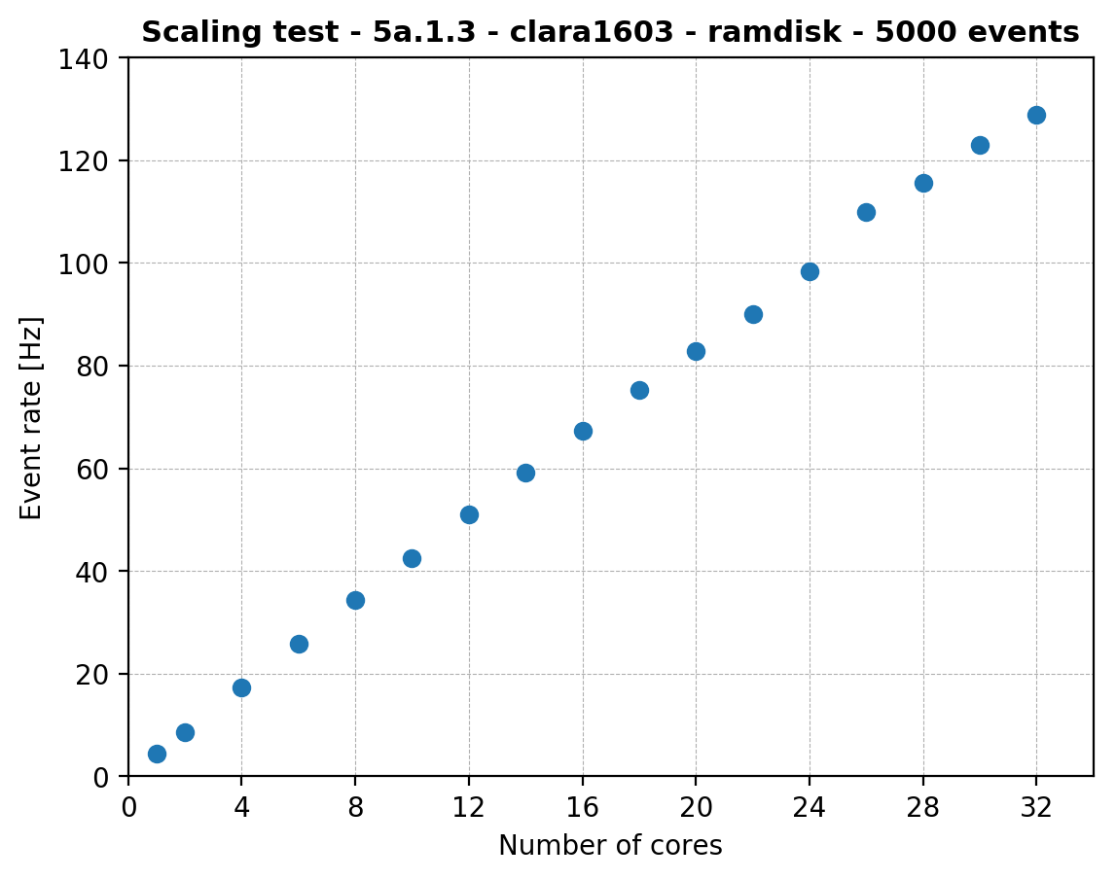
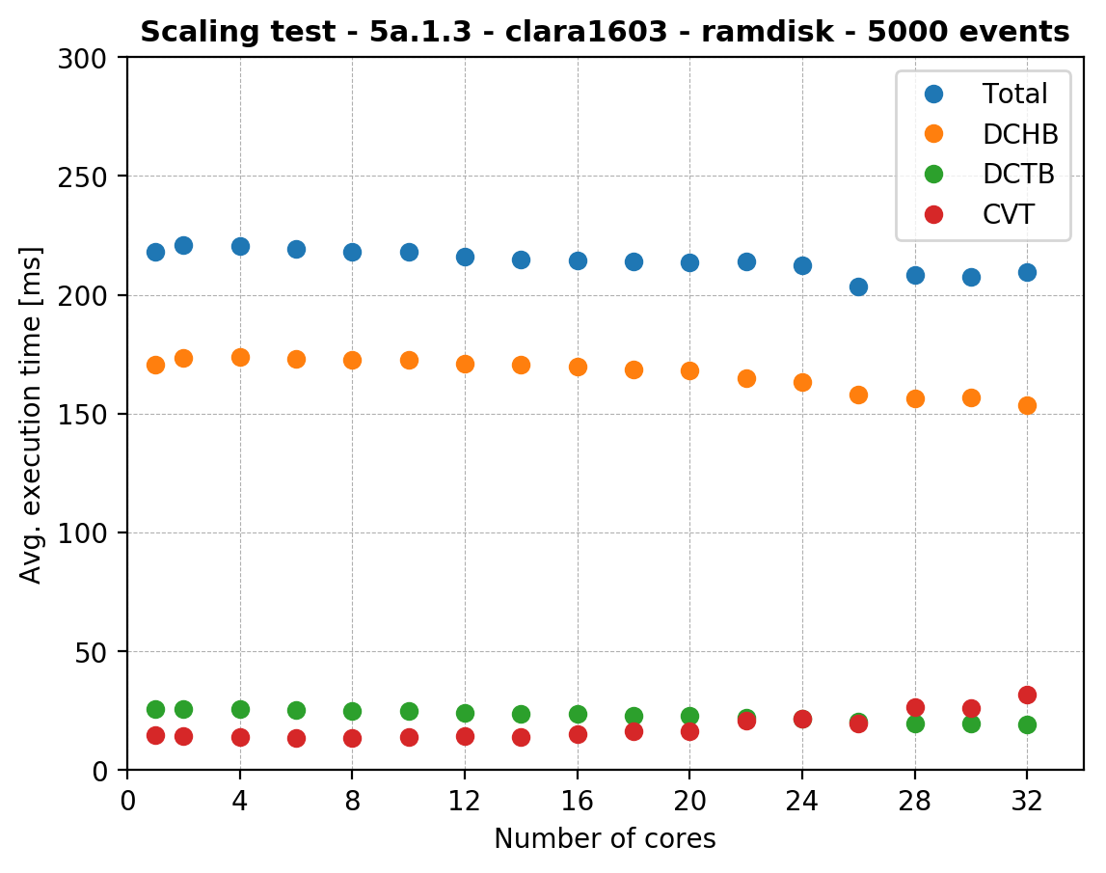
Vertical scaling

Slide 20
NUMA studies (Intel® Xeon® CPU E5-2697A V4 2.60GHz 2x16)
Measurement | 1 Process |  | 2 Processes |  | 4 processes
 | 8P-8H ms | 16P-16H ms | 8P-8H ms (N proc.) | 16P-16H ms (N proc.) | 8P-8H ms (N proc)
1 | 8.50 | 4.10 | 8.13(1) | 5.18(1) | 8.51(1) | 9.34(3)
 |  |  | 9.30(2) | 5.22(2) | 7.99(2) | 9.20(4)
2 | 8.32 | 4.13 | 8.19(1) | 5.16(1) | 8.48(1) | 8.90(3)
 |  |  | 9.31(2) | 5.22(2) | 8.05(2) | 9.19(4)
3 | 8.33 | 4.16 | 8.14(1) | 5.19(1) | 8.55(1) | 8.90(3)
 |  |  | 9.17(2) | 5.10(2) | 8.10(2) | 8.42(4)
Aver. proc. 1 | 8.38 | 4.13 | 8.15 | 5.18 | 8.51
Aver. proc. 2 |  |  | 9.26 | 5.18 | 8.06
Aver. proc. 3 |  |  |  |  | 9.05
Aver. proc. 4 |  |  |  |  | 8.88
Rate in KHz | 0.119 | 0.242 | 0.123+0.108=0.231 | 0.193+0.193=0.386 | 0.117+0.124+0.110+0.113=0.464

Slide 21
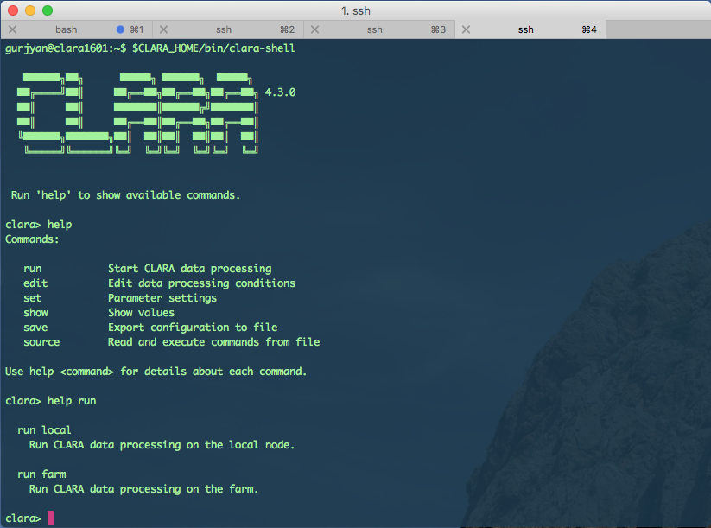
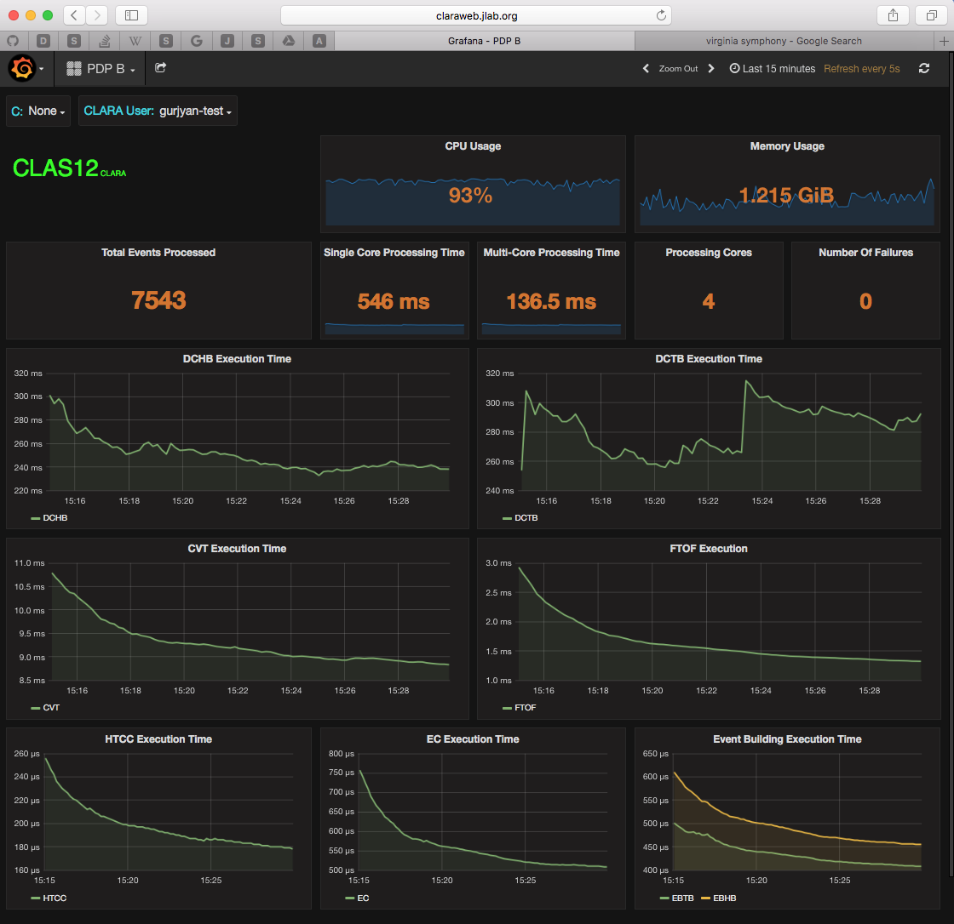
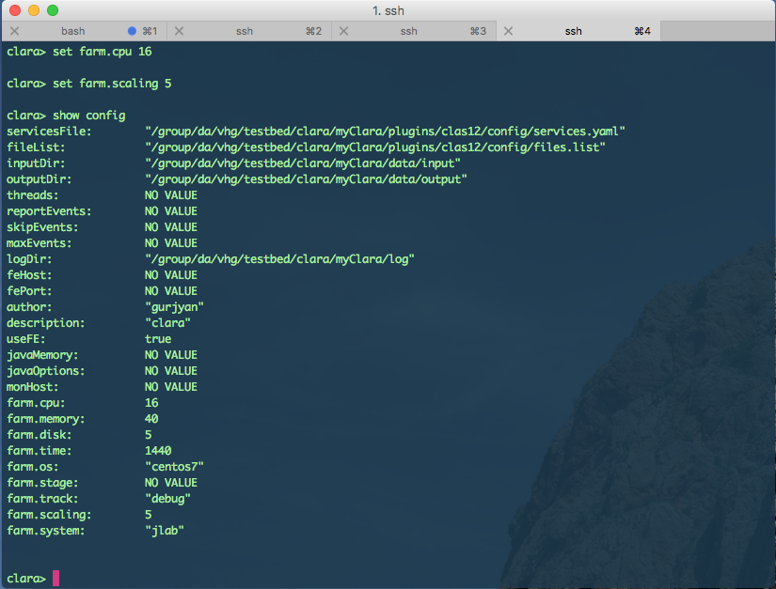
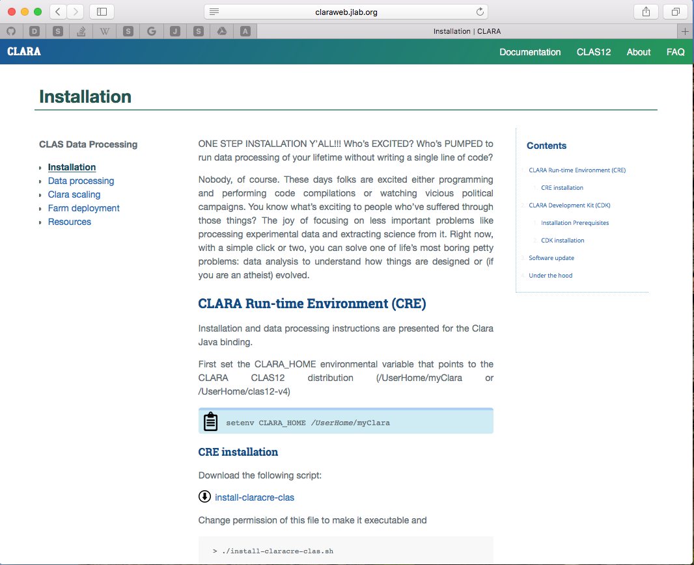
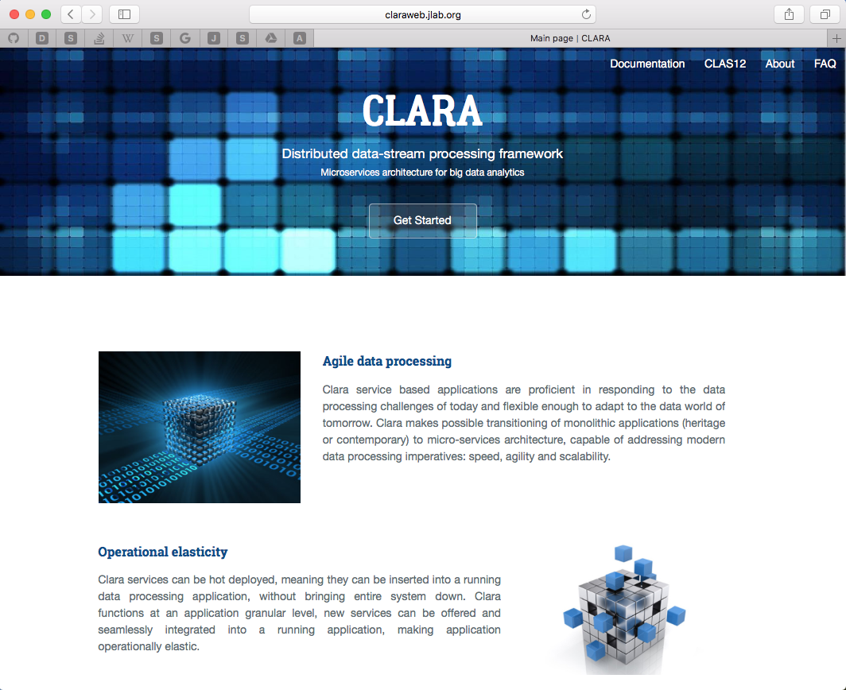
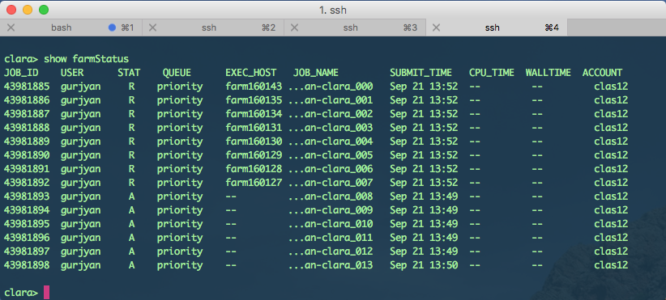
User experience

Slide 22



CLAS12
Experimental and Simulated Data
CLARA Data Bus
Glossary
Data processing services. Scaling up to Cn cores.
Data passage/link between services
Service control messages
Service configuration
Knowledge feedback
IO services
In memory data queue (ring-buffer)
Computing resource boundaries
Data-processing environment | CLARA DPE
CLARA DPE Farm Node_{N}
Cn
1
R
CLARA Data Bus
EBCMD
Table
1
Cn
CLAS12 Simulation and Reconstruction Multi-Node Application
CLARA DPE
MC
S₁
MC
S_{N}
EBCMD
Extraction
Service
1
Cn
EC
HT
TOF
TT
PID
DST
Cloud Computing Resources
EC
Event
Generator
HT
CLAS12 Reconstruction Multi-Node Application
Cloud Node_{N}
TOF
Assumptions
TT
STAT
EBCMD
Extraction
Service
CLARA Data Bus
JLAB Computing Resources
σ_{R}
_{Calculation}
_{Service}
σ_{B}
_{Calculation}
_{Service}
SF
_{Calculation}
_{Service}
GPD-TMD
_{Calculation}
_{Service}
Some other experiment
reconstruction program
Simulated data Reconstruction
PID
Model
Parameterization
W
Cn
1
CLARA DPE
CLARA DPE
Other Experiment and/or Research Facility Computing Resources
STAT
CLARA DPE
R
σ_{R}
_{Extraction}
_{Service}
σ_{B}
_{Extraction}
_{Service}
SF
_{Extraction}
_{Service}
GPD-TMD
_{Extraction}
_{Service}
W
W
EBCMD
W
W
EBCMD
Extraction
Service
CLARA DPE
Assumptions
CLARA DPE
Cooked,
DST
EBCMD
Table
EBCMD
Table
EBCMD
Table
EBCMD
Table
Reconstructed Data
CLARA Data Bus

Slide 23
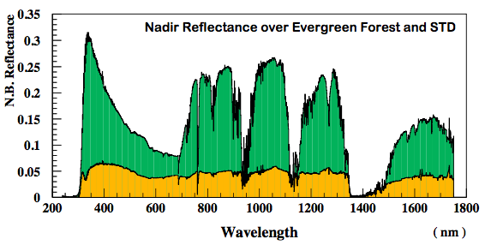
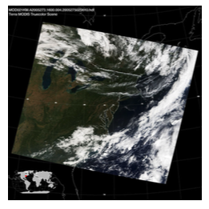
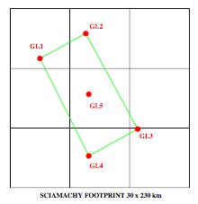
NASA EOS data fusion and processing
OBJECTIVES:
  To demonstrate NAIADS approach and full functionality using existing data;
  To benchmark NAIADS performance;
  Available data: 9 years of near-coincident measurements of from SCIAMACHY and MODIS; Create new fused SCIAMACHY/MODIS/ECMWF data product (requested by a number of projects).
SCIAMACHY Level-1 Data:
  Spectral measurement for every footprint: 30 km x 230 km; Swath 950 km (4 footprints) from 10 AM Sun-synch orbit.
ECMWF Data (re-analysis):
  Gridded (0.125o);6 weather parameters; Map every 6 hours;
MODIS/Terra Level-2 Data:
  Level-2 Cloud and Aerosol Data
  Spatial scale: 1 / 5 km and 10 km spatial; Swath 2300 km (global coverage daily); 10:30 AM Sun-synch orbit.

Slide 24
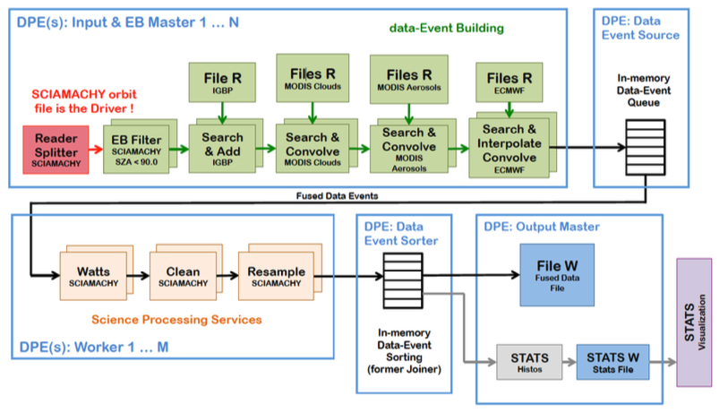
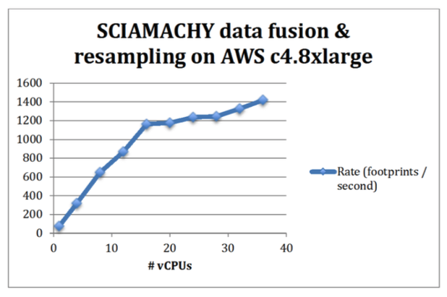
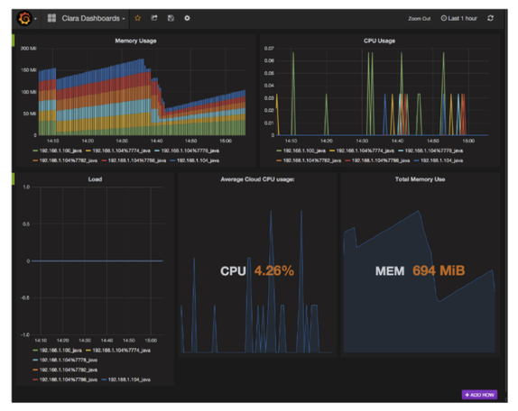
NAIADS deployment on AWS
AWS c4.8xlarge instances,
36 vCPUs ~= 18 physical cores
Staging data from AWS S3
Data processing rate based on average workflow execution over 10 SCIAMACHY files.
Vertical scaling up to 1.4KHz on single AWS node
Data processing continuous web monitoring
9 years of data has been processed. More data is currently being processed.

Slide 25
NASA SRB data flow diagram
Container is empty. Next month/day/hour
Event Builder CLARA Service
C++
Stage 2 CLARA Service
C++
File
Stage 1
Fortran
Grid-pixel
Container
C++
Grid-pixel
Dispatcher
C++
Stage 2
Fortran
Grid
Next Grid
Total Time/Storage for 34 years
(1983-2016)
Writer CLARA Service
C++
ISCCP HXS: 29TB
Stage 1 processing: 153 days (1°), 238 days (0.5°).
2200 lines of Fortran code.
Stage 1 files: 47TB each 1° and 0.5°
Stage 2 processing: 85 days (1°), 119 days (0.5°).
1700 lines of Fortran code.
Stage 2 files: 1.1 TB (1°), 4.1TB (0.5°)
File
21 hours to process 1 month data
45 minutes to process 1 month data

Slide 26


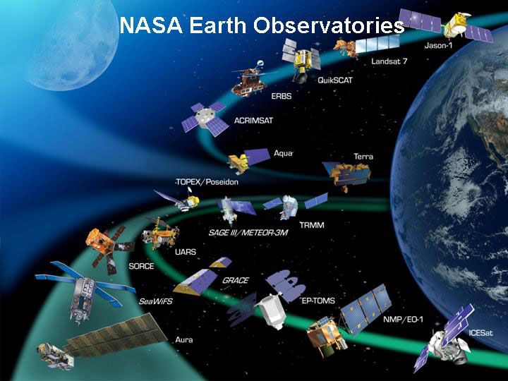
Conclusion
CLARA Reactive Data-stream Processing Framework
Micro-services architecture for data analytics
About:
We use CLARA to create software applications as a suite of independently deployable, small, modular services in which each service runs a unique algorithm, communicating with each other through a well-defined mechanism to serve data processing goals. Services of the same software application can be written in different programming languages, where each service is developed, optimized and maintained independently.
Resilient:
CLARA system stays responsive in the face of failure. Resilience is achieved by replication, containment, isolation and delegation. Failures are contained within each service, isolating services from each other and thereby ensuring that parts of the system can fail and recover without compromising the system as a whole.
Elastic:
CLARA system stays responsive under varying workload. It reacts to changes in the input data rate by increasing or decreasing the resources allocated to service these inputs (horizontal and vertical scaling). CLARA implements predictive, as well as reactive, scaling algorithms by providing relevant live performance measures. We achieve elasticity in a cost-effective way on commodity hardware and software platforms.
Robust:
CLARA uses asynchronous message-passing to establish boundaries between services that ensure loose coupling, isolation, location transparency, and provides means to delegate errors as messages. Employing explicit message-passing enables load balancing and overall data-flow, i.e. application algorithm control and orchestration.
http://claraweb.jlab.org
https://github.com/JeffersonLab/clara-java
https://github.com/JeffersonLab/clara-cpp
https://github.com/JeffersonLab/clara-python

