Slide 1
STATE-OF-THE-ART INFRACTRUCTURE FOR HPC

Slide 2
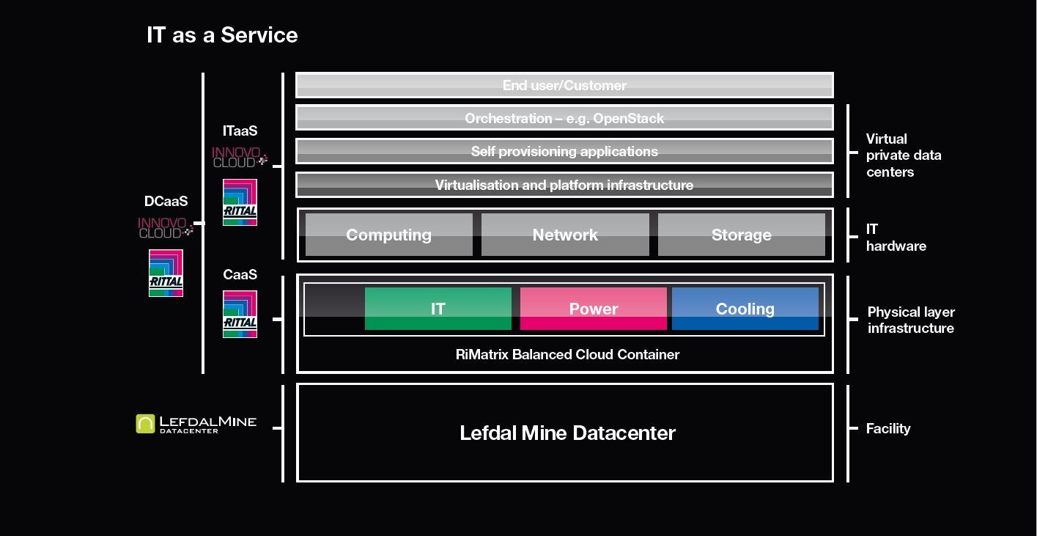
Rittal & iNNOVO Cloud

Slide 3
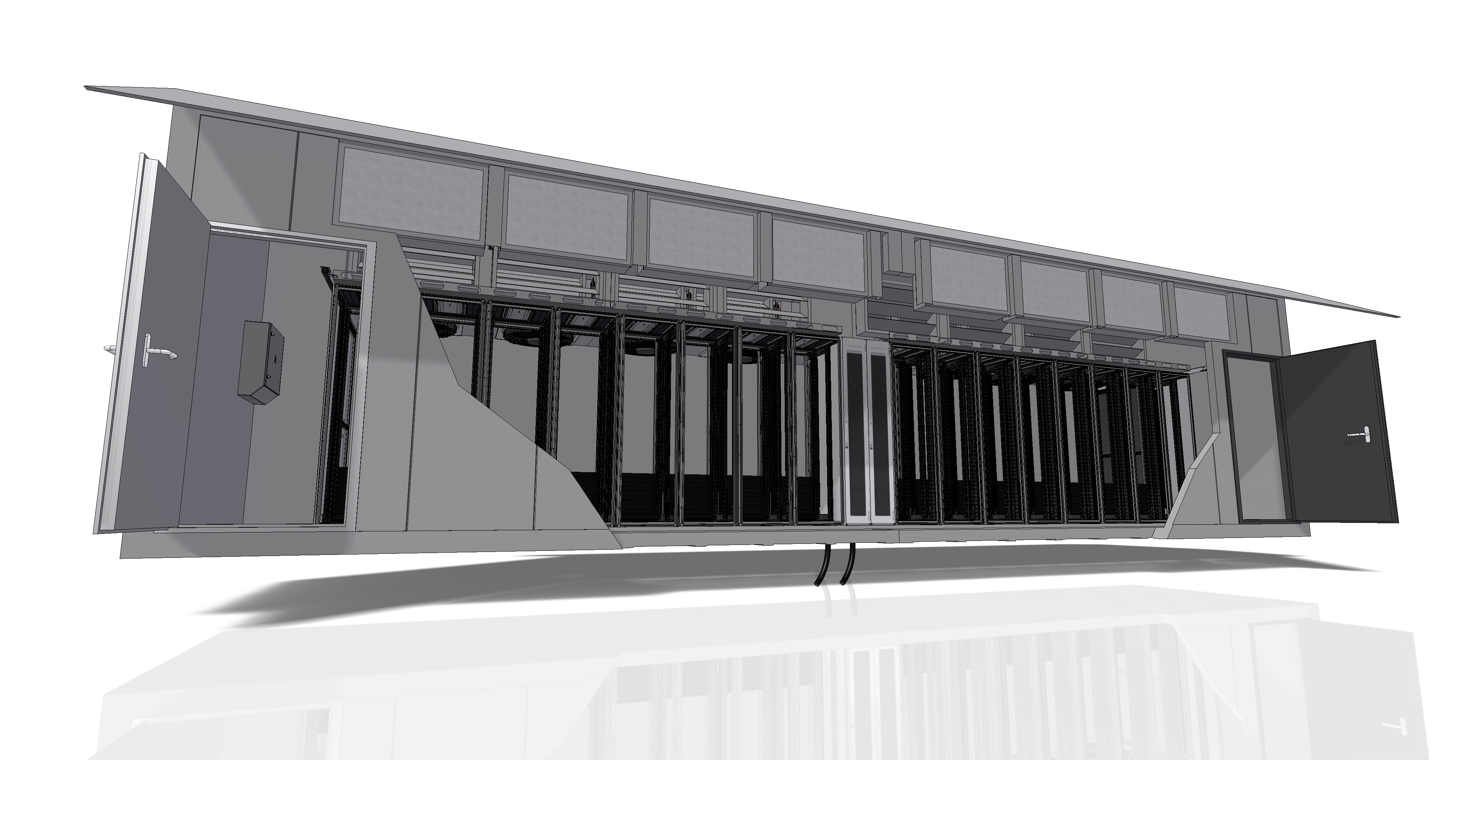
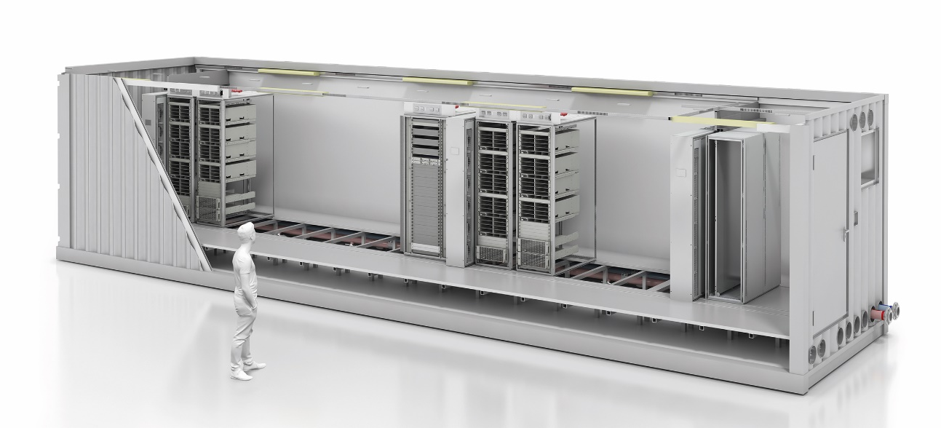
iNNOVO & Rittal
STATE-OF-THE-ART PHYSICAL INFRACTRUCTURE FOR HPC, Edge and Fog

Slide 4
Solution Stack
Solutions
Integration
Delivery
IT Components
RiMatrix
Data Center Container
OT Infrastructure
Security Rooms
Edge Data Center
Rack solution
IT Racks
IT Power
IT Cooling
IT Security & Monitoring
IT Service

Slide 5
The Edge Market
Why are we looking at EDGE Market?
EDGE Market is the next big wave of Cloud!
EDGE Market 2017 – 1.47billion USD
CAGR – 35.4% - Market worth 6.72 billion USD 2022
Asia market itself: $32 billion USD by 2022
By 2019, 43% of IoT data will be processed at the edge
By 2025, 80 billion connected IoT end-points
Source – IDC Q4 2017, Gartner Q4 2017

Slide 6
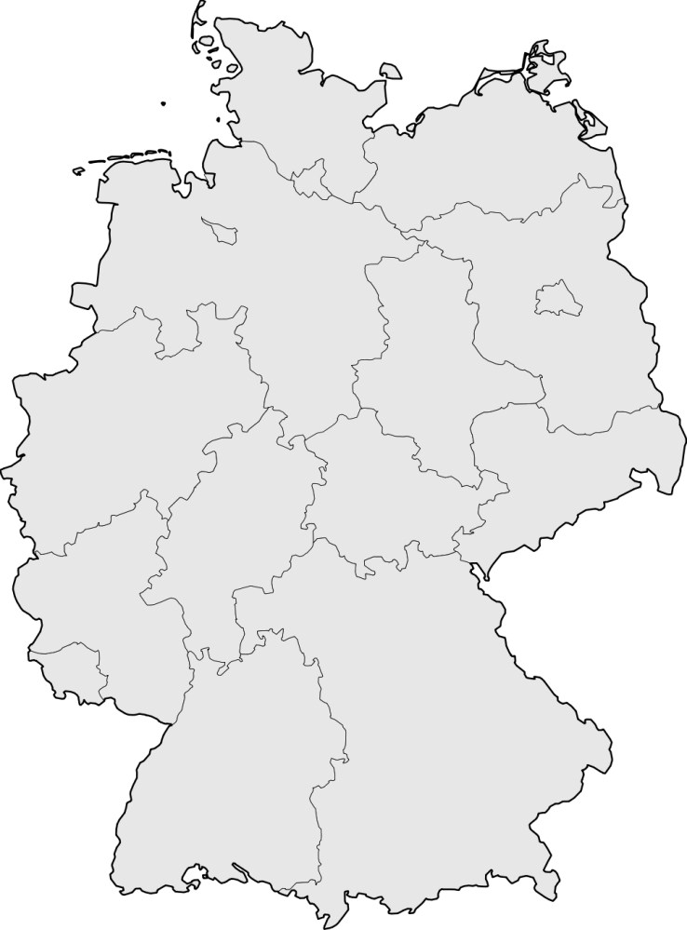


Use Cases for HPC (aaS)- Application in Manufacturing
Assumption: if in 2025, if each physical asset has a Digital Twin that produces data in real time, then
the data must be stored, processed and analyzed and the production processes must be controlled (in real time).

Slide 7
HPC applications at the Edge
Current data center infrastructure does not scale for industry 4.0 and (I)IoT
Estimate IDC: 30-40% of the IoT computing power is critical and/or latency (i. e. in the ms range) that cannot be controlled by a central data center.
Source: Data Age 2025: The Evolution of Data to Life-Critical, International Data Corporation (IDC), April 2017
IoT data avalanche intensifies low bandwidth expansion in Germany
Dependence on US cloudproviders and unresolved questions on the data sovereignty of European companies
The current centralized data center IT infrastructure cannot cope with the immense flood of data alone.
Extremely expensive network expansion, i. e. very high CAPEX upfront investment > 1 billion euros
Significant challenges for the current German digital backbone in Frankfurt: provision of electricity capacity and availability of the required space in Frankfurt are at the limit, e-mobility aggravates the shortage of electricity in Frankfurt.
Network coverage not guaranteed as many companies are located in remote areas
Frankfurt is most important Internet hub
The world's largest Internet peering node, i. e. connectivity to major carriers and cloud providers (DE-CIX)
Notes:
Bildlizenz: Für digitale Produkte, weltweit, ohne Zeitlimit; nicht für Print Produkte

Slide 8

HPC (ITaaS) Edge
Consumption of HPC (aaS)
1
Dynamic Colocation:
Decentralized structure in the sense of Hyperscale, Spine, Leaf and Edge
Mobile solutions, flexible and scalable
technical support hotline, operation, maintenance and replacement
24/7 monitoring, security and service
2
Two cloud service areas:
Infrastructure as a Service (IaaS):
Flexible rental and scaling of IT infrastructure on-demand, including financing services
Expansion capacity of Leaf/Edge as a virtual pool across all locationsEstablishment of value-added platforms, establishment of an eco-system
Software as a Service (SaaS), in Development:
Industrial Data Space
Industrial Analytics
5G Video Analytics
Medical data space
Partner Offering
Notes:
Bildlizenz: Für digitale Produkte, weltweit, ohne Zeitlimit; nicht für Print Produkte

Slide 9
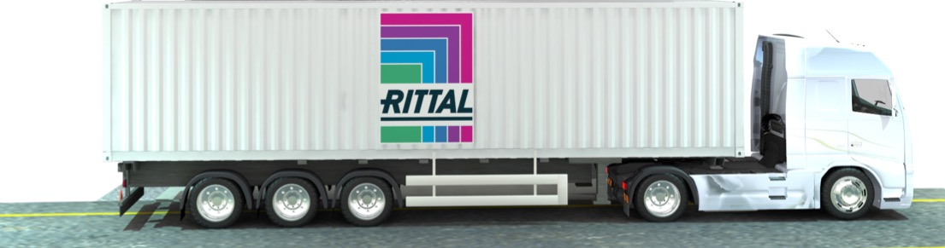
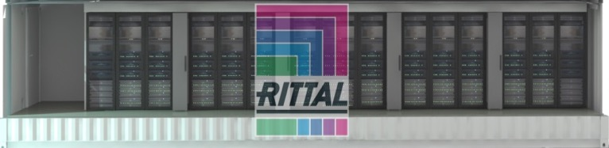
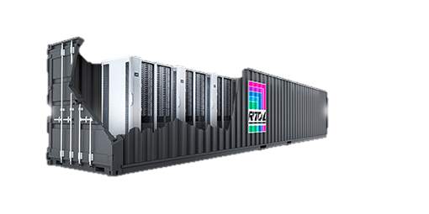
Modular and Containerised Solutions
The Container Datacenter
DC near premise for low latency workload and high data sovereignty requirements
Turn-Key delivery in 8-12 weeks instead of 100 weeks of planning and construction for a DC room or Brick & Mortar facility
Highly flexibel: DC can be transported to any requested site
On request: fully opexed on a pay as you go basis
Highly secure BCC IT Container
Early Fire Detection, Fire extinguishing in place, F90 container enclosure available on request
Alarm systems, video surveilleince within the container available on request
Access Control to container can be synced to existing access control system
Full scalable OT & IT
DC Containers available with Chiller Container, UPS Container and generator for maximum autonomy
Ready for 200-300 KW redundant IT capacity in 10 Rittal TS-IT Racks
IT Equipment can be scaled and shaped according to the individual Use Case and Cloud Purpose
Our Offering
Notes:
Bildlizenz: Für digitale Produkte, weltweit, ohne Zeitlimit; nicht für Print Produkte

Slide 10
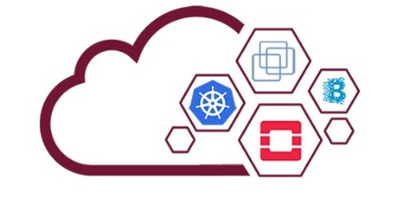
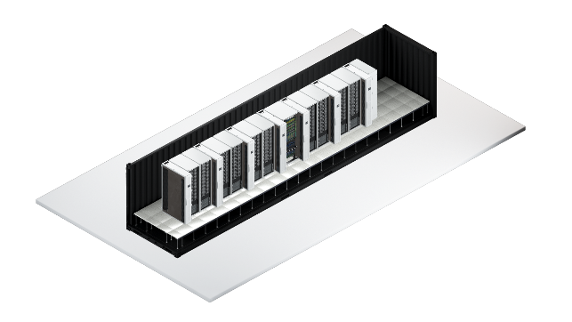
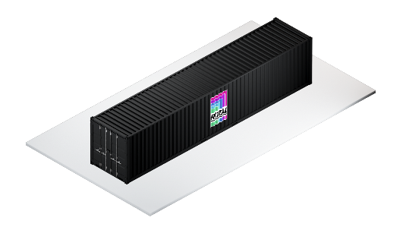
Modular and containerised
Edge DC Enclosure: BCC IT Container
Deployment Options
Commercial Offering
+ Cloud Orchestration
+ bare metal Deployment e.g. Ubuntu MaaS with CoreOS/Kubernetes
+ or Multi Region OpenStack/Azur Stack (automatisierter self-service)
+ or VMware (auf Wunsch: full managed)
Pay-as-you-Go
Pay-as-you-Reserve
+ HW Blobs as a Service
+ Container (incl. racks) with UPS and Chiller
+ Custom Hardware Stack (with n Blobs)
Mix: PayG + Mtl Rate mit Mindestlaufzeit
Mtl. Rate mit Mindestlaufzeit
Container as a Service
Container (with or without racks) incl. UPS and Chiller
Notes:
Bildlizenz: Für digitale Produkte, weltweit, ohne Zeitlimit; nicht für Print Produkte

Slide 11
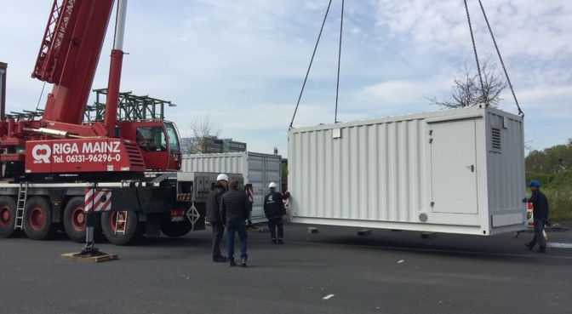
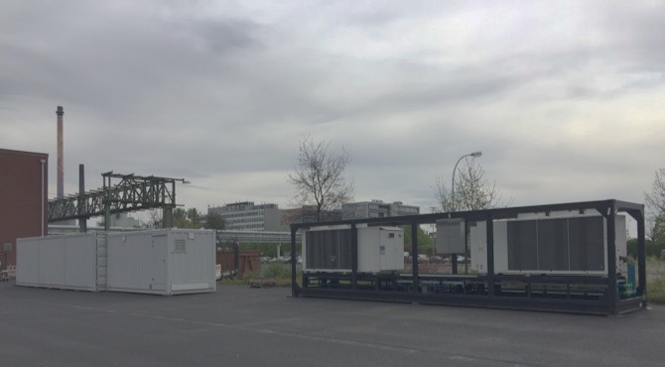
German Edge Cloud
Edge DC Example: Cloudpark Höchst (Infraserve)
Notes:
Bildlizenz: Für digitale Produkte, weltweit, ohne Zeitlimit; nicht für Print Produkte

Slide 12
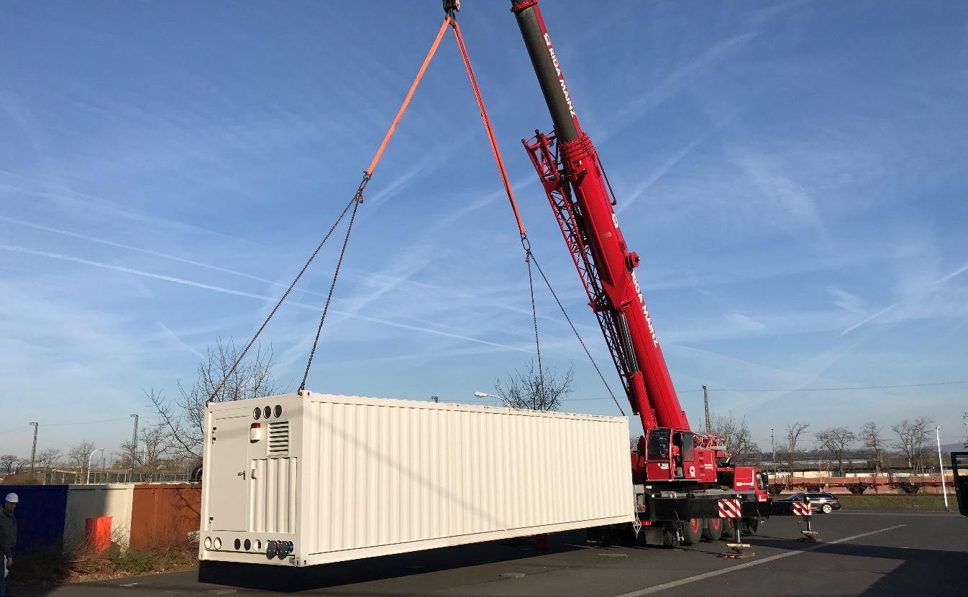
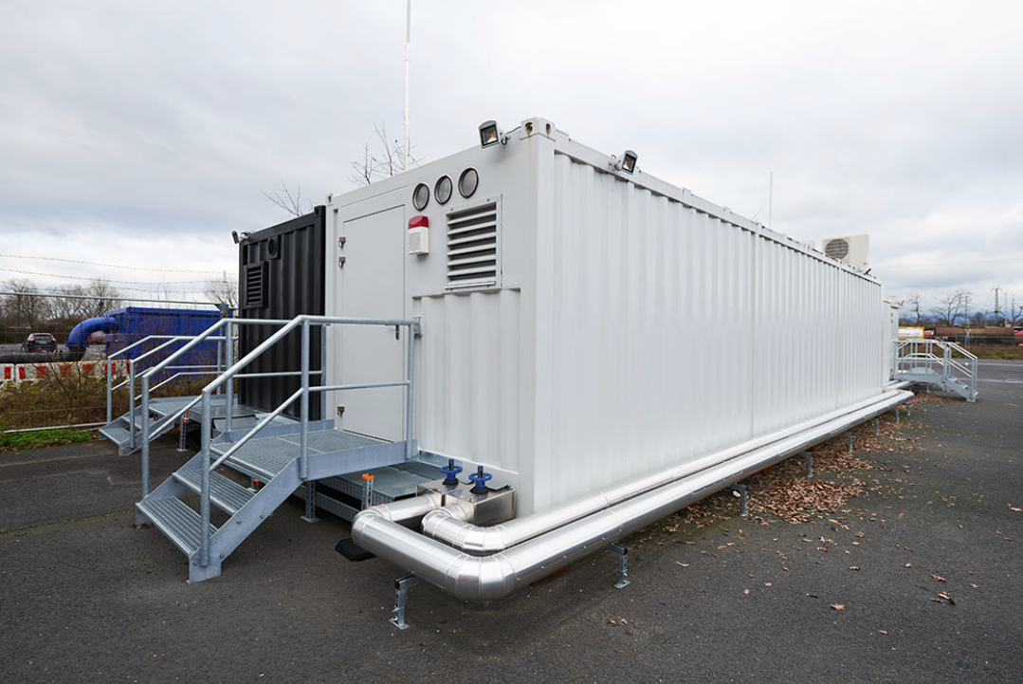
iNNOVO‘s Cloud Park in Höchst
Live Showcase for a containerized, scalable and modular Edge Datacenter

Slide 13
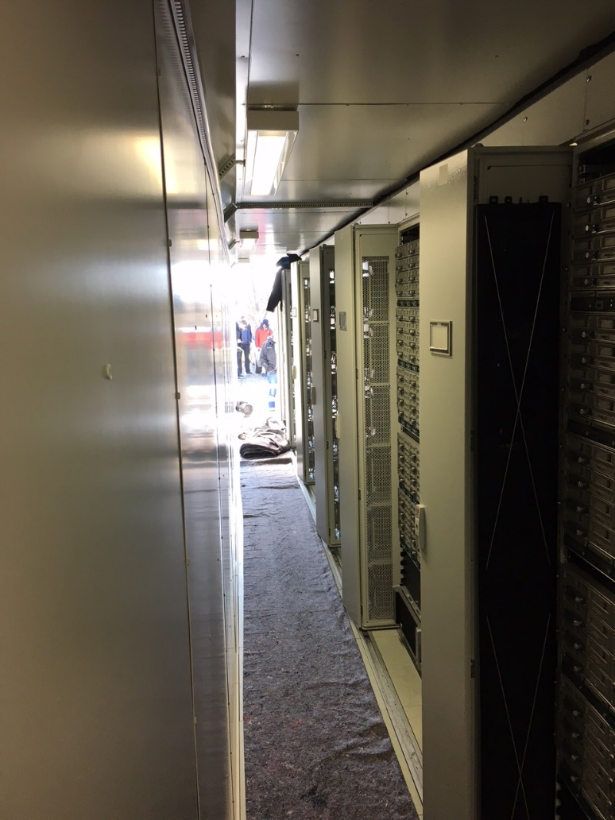
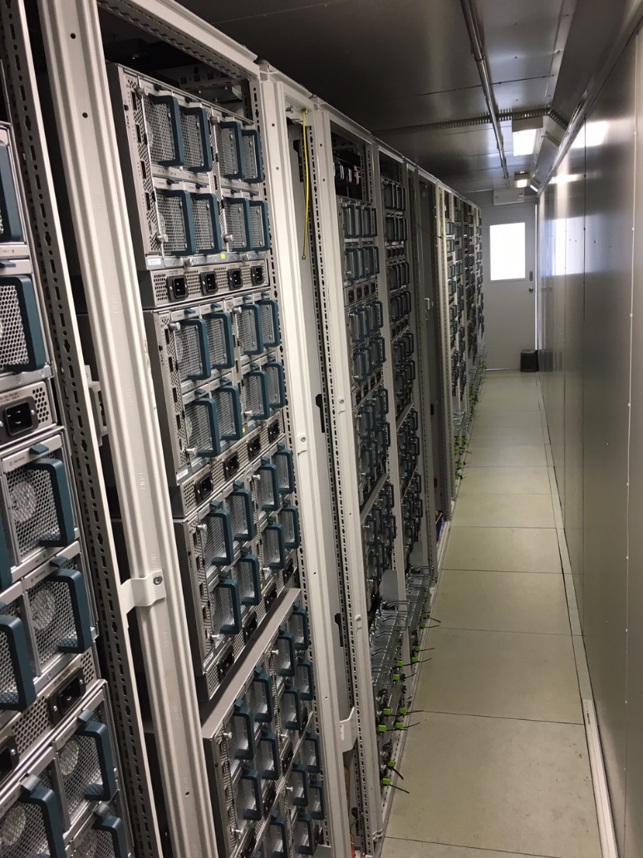
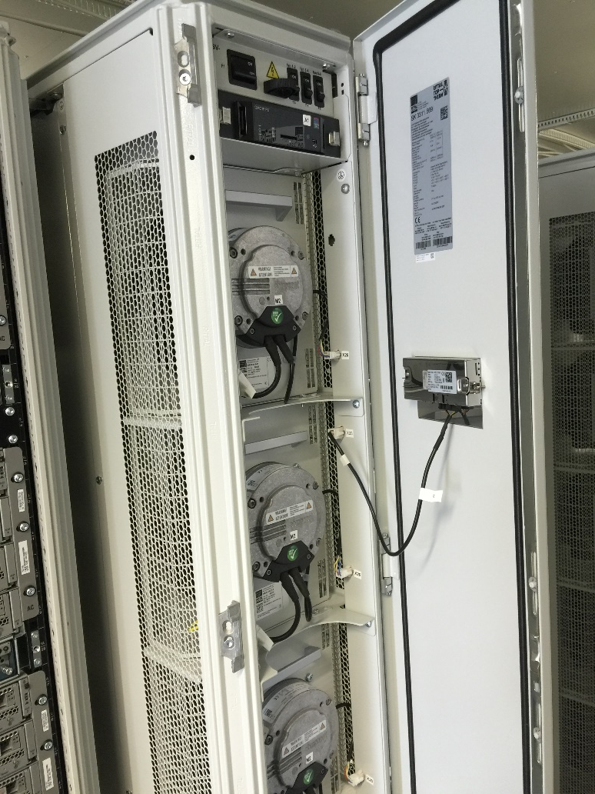
Edge Datacenter
Example: HPC/BD Container, 240 KW, 20 KW/rack, PUE 1,14

Slide 14
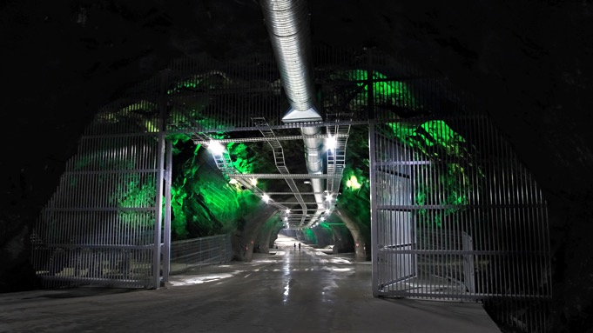
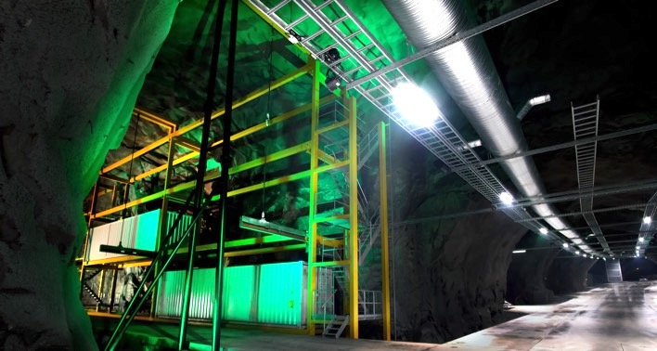
Lefdal Mine Datacenter
Level 3 LMD & iNNOVO Cloud Container

Slide 15
HPC IaaS Use Case – Architecture
GEC N/W Sicherheitsarchitektur Legende
LWL Encryption
various suppliers available on the market
Multi Layer Sicherheitsarchitektur from Edge to Cloud
Blockchain: Transactional security (as a cloud service)
Layer 2 encryption (opt.)
Point-2-Point or Point-2-multipoint
Central Spine
IM
ISMS
N/W Mon
L2 L3 Networking
-Tagged MPLS, German manufacterers available (e.g., Ciena), n*100Gbps Port Routing,
- Openstack Neutron SDN BCP on top
- customer-tenant separation VLAN/VPN
Blockchain
Carrier
International Cloud Provider
MPLS/
SDN
(EVPN/
VXLAN/ SDN)
NAC
F/W
MPLS + Neutron SDN (or EVPN/VXLAN/Neutron SDN)
Firewall (HW/SW)
- customer Zoning via vFW (SDN) oder pFW
- External access control
Regional Leafs
Network Access Control
At each location (Edge, Leaf, Spine) mit controlled access to GEC N/W
NAC
VEC 2
VEC 3
Network Access Control
Network Access Control
Identity Management / secure Auth.
E.g. CyberArk, protect4use
PKI Infr. For authentication
IM
Local Edges
ISMS
Information Security Management System
NAC
NAC
N/W Mon
Network Monitoring
z.B. snort, inkl. Intrusion Detection & Protection
NAC
NAC
Notes:
Bildlizenz: Für digitale Produkte, weltweit, ohne Zeitlimit; nicht für Print Produkte

