Slide 1
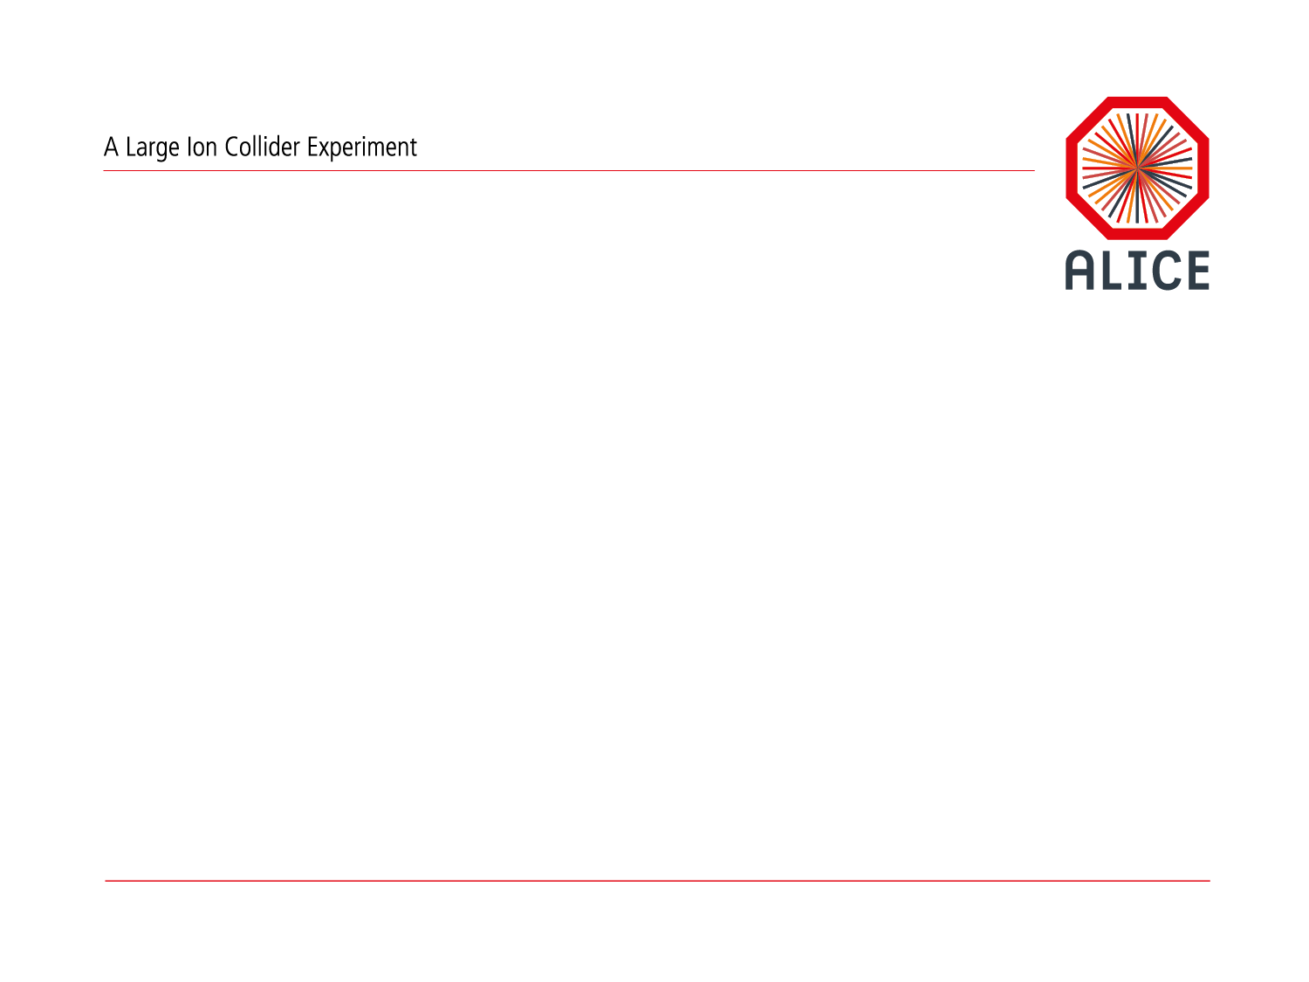
ALICE Simulation for Run3
“Towards Faster Simulation”: Ideas and Developments
Sandro Wenzel (CERN) for WP12

Slide 2
Run3 Simulation Software
1. Detector Setup (Geometry, Material, Magnetic Field )
2. Modeling Hits
(Model interaction of tracks inside actual sensitive detector regions)
3. Description of readout processes
(How energy deposit is translated into hardware signal)
O2 Common Simulation Layer
Data format, Magnetic Field, Management (Run, Detector, etc), Geometry tools, Passive structures, Configuration, ….
FairRoot
ALFA
Major rewrite of simulation within the new common online/offline project (O2)
Major Novelties:
Continuous readout of detector
Detector data is aggregated into ”timeframes” which are further processed in a novel data-flow computing framework based on collaborating devices.
Notes:
Cannot talk abo ut about every single detail
“Port + upgrade simulation from AliRoot to O2”
Implement or recast simulation infrastructure/services in O2
geometry, mag-field, sim data model (hits), generator interfacing, simulation configuration, …, stack handling, ...
All detectors implement simulation/digitization module in O2 for Run3
All detectors implement an up-to-date geometry/material description
All detectors implement efficient (CPU + memory) tracking action / hits creation / digitization
Detectors are prepared for continuous time readout if applicable
SEE HERE: USER STORIES OF HIDDEN SLIDE

Slide 3
Run3 Simulation Software
1. Detector Setup (Geometry, Material, Magnetic Field )
2. Modeling Hits
(Model interaction of tracks inside actual sensitive detector regions)
3. Description of readout processes
(How energy deposit is translated into hardware signal)
O2 Common Simulation Layer
Data format, Magnetic Field, Management (Run, Detector, etc), Geometry tools, Passive structures, Configuration, ….
FairRoot
ALFA
Major rewrite of simulation within the new common online/offline project (O2)
Based on common (simulation) software building blocks and a partnership with many other experiments
Major Novelties:
Continuous readout of detector
Detector data is aggregated into ”timeframes” which are further processed in a novel data-flow computing framework based on collaborating devices.
See talk by T. Kollegger
Actual simulation (“hits”) will stay Virtual Monte Carlo (VMC) based and be quite similar to Run2
Able to use different engines (G4, G3, Fluka) based on one geometry description (TGeo) and abstract scoring code
Notes:
Cannot talk abo ut about every single detail
“Port + upgrade simulation from AliRoot to O2”
Implement or recast simulation infrastructure/services in O2
geometry, mag-field, sim data model (hits), generator interfacing, simulation configuration, …, stack handling, ...
All detectors implement simulation/digitization module in O2 for Run3
All detectors implement an up-to-date geometry/material description
All detectors implement efficient (CPU + memory) tracking action / hits creation / digitization
Detectors are prepared for continuous time readout if applicable
SEE HERE: USER STORIES OF HIDDEN SLIDE

Slide 4
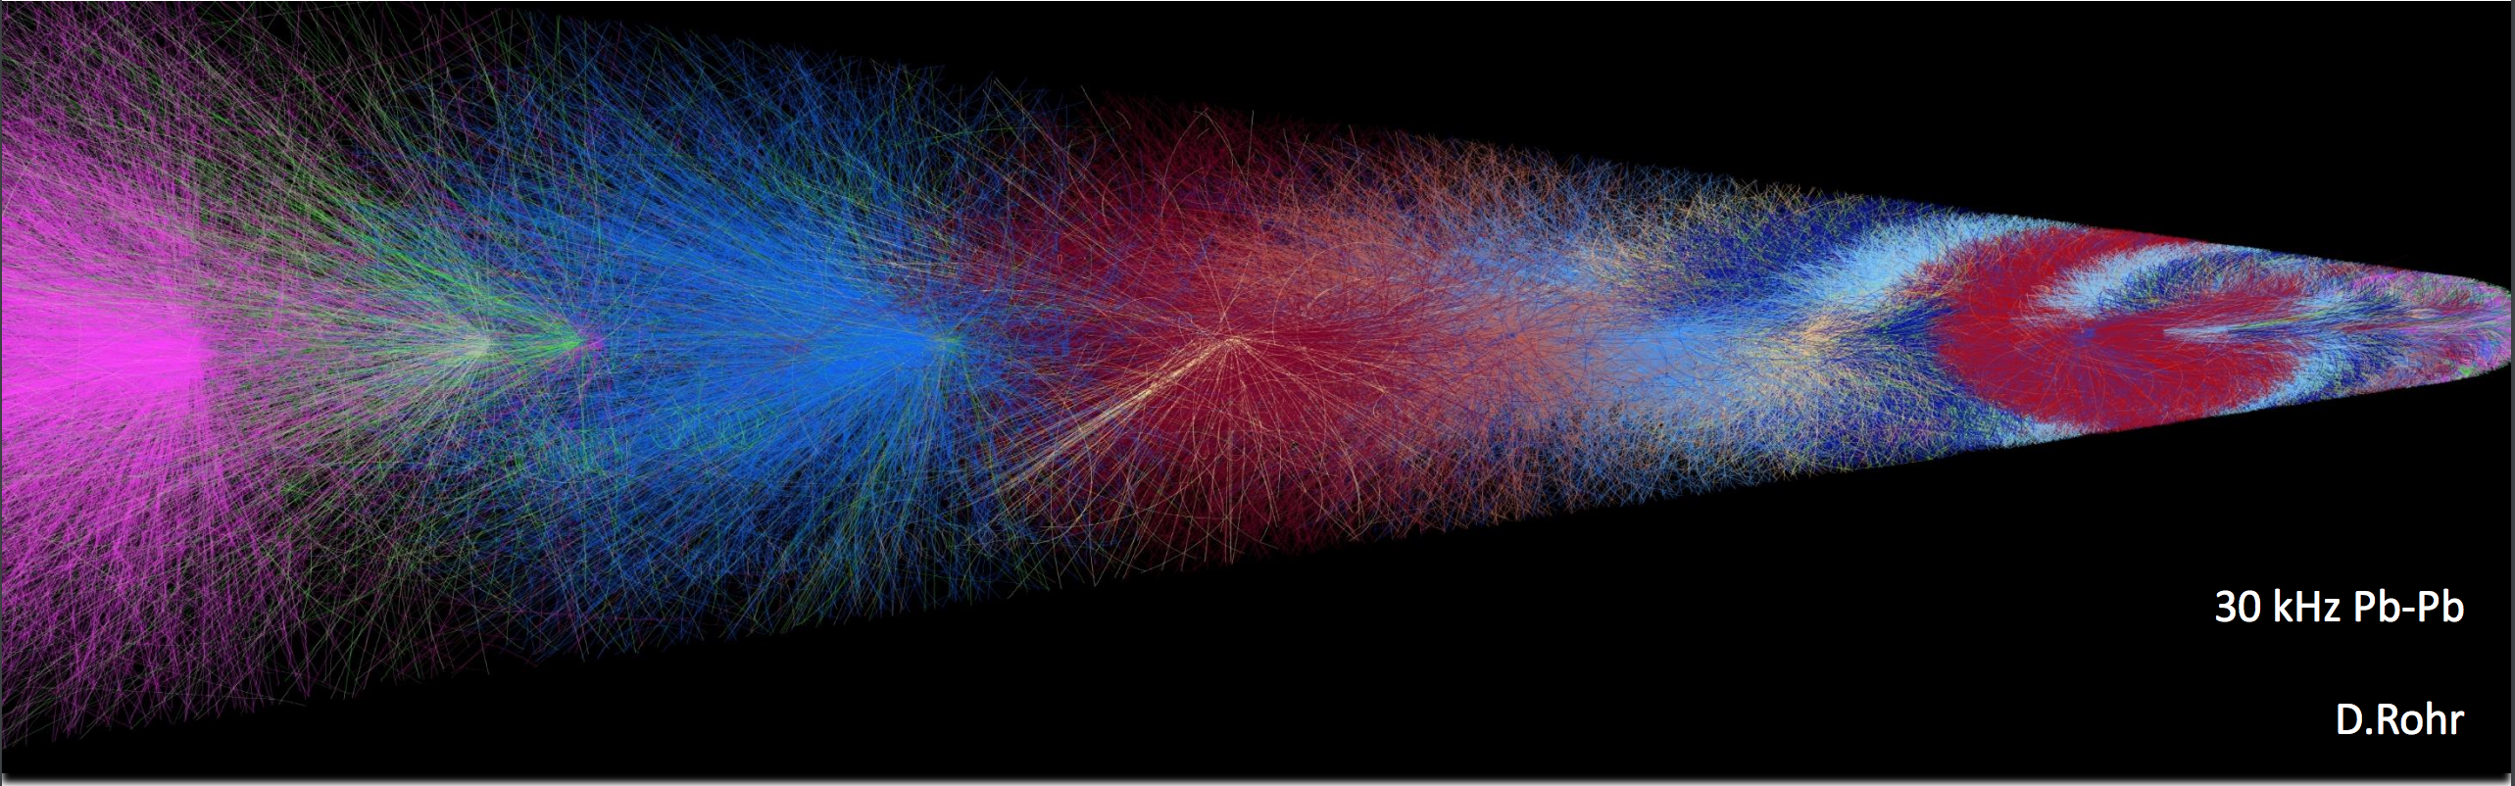
Main “Challenge” Run3/Run4: Continuous Readout
Overlapping events in the TPC
Biggest conceptual changes required in digitization and reconstruction

Slide 5
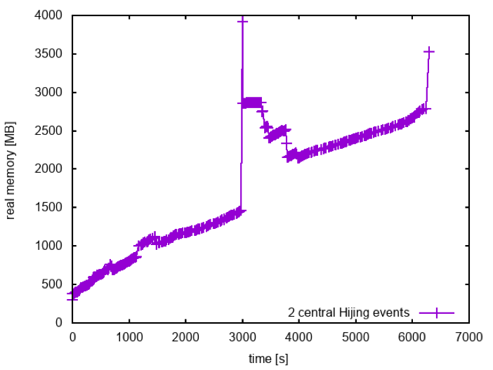
Starting point for activities mentioned in this talk
Scale of the simulation problem : Focus on hit creation
The occupancy of Pb-Pb events can be quite large (O(100k) primaries)
Substantial CPU times (+ pressure on memory) if full event is treated as the most basic unit
Worked hard to achieve Run3 simulation on any laptop … but
Setting the rough scale (taking similar cuts + settings used in Run2)
Data is preliminary and only indicative to visualize the rough scale
Processing time for one event can be O(h)
Memory may be on the order of GB(s) per event
Simulation of 2 large central Hijing events (70k primaries each)
Not ideal for scheduling jobs when given O(h) slots
  Difficult to access to opportunistic resources on HPC machines
  On grid usually not able to optimally fill 24h allocations

Slide 6
Faster Simulation Ideas: The big picture
Tuning by Leveraging Monitoring (”Big”) Data
(Track) Parallel + Heterogeneous Simulation Architecture
Benefit / Support Improved Libs + R&D (VecGeom, GeantV, …)
“Faster Simulation” (in terms of wall-time + CPU time per event)
Integrated Full and Fast Simulation Framework
Digitization R&D: Vectorization etc.
Improved Workflow/Scheduling
Higher CPU Efficiencies
Opportunistic access to HPC
Etc.
Researching FastSim Options (ML; …)

Slide 7
Faster Simulation Ideas: The big picture
Tuning by Leveraging Monitoring (”Big”) Data
(Track) Parallel + Heterogeneous Simulation Architecture
Benefit / Support Improved Libs + R&D (VecGeom, GeantV, …)
“Faster Simulation” (in terms of wall-time + CPU time per event)
Integrated Full and Fast Simulation Framework
Digitization R&D: Vectorization etc.
Improved Workflow/Scheduling
Higher CPU Efficiencies
Opportunistic access to HPC
Etc.
Researching FastSim Options (ML; …)

Slide 8
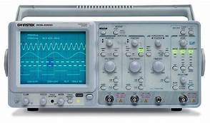
Leveraging Monitoring “Data”: Simulation tuning
Loosely coupled monitoring
AliRoot simulation
O2 Simulation
Any FairRoot simulation
Invested work and develop(ed) loosely coupled + “platform independent” monitoring mechanism to be able to inspect the simulation at step level
Key to
  Understand details of simulation
  Compare AliRoot (Run2) to O2 (Run3)
  Compare different simulation engines (Geant4, Geant3)
  Simulation tuning and optimization

Slide 9
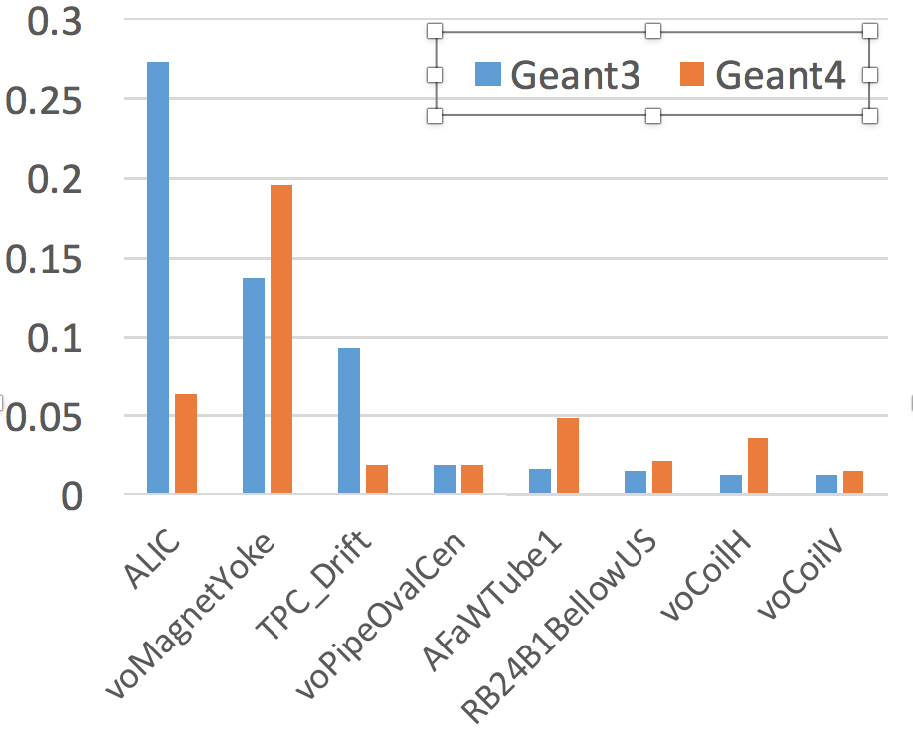
First insights from monitoring
LD_PRELOAD=libMCStepLogger.so o2sim
Allows us obtain detailed costs of various detector components on simulation CPU budget
See where to focus with tuning/optimization
O2 work in progress
Preliminary non-trivial observations (also Run2):
We will be able to improve simulation for Run3.
See strong opportunity for common tools here!
  Found frequent queries to the magnetic field in detector volumes which are fully outside of the field region

Slide 10

Easy Track Parallelism through FairMQ-based architecture
Remember: Basic simulation entities in terms of full events are (too) large and static
From full event to track-parallelism on the primary level to speed up simulation (time to return)
FairMQ message
Easy track-parallelism by loosely coupled architecture of entities communicating via messages.
Works trivially for any VMC worker
Easy to implement
Combinable with G4-MT
Scalable across node
Memory sharing by copy-on-write
Large events
Subevents
Similar to ideas implemented by ATLAS

Slide 11
Embrace ALFA: FairMQ-based parallel simulation
From full event to track-parallelism to speed up simulation
FairMQ message
Large events
Subevents
“Event - based serial FairRoot simulation”
“Collaborative ALFA simulation treating subevents in parallel”
~45min one event (1core)
~6min for one event (6cores + HT);
<< 2GB per process

Slide 12
Towards fast-sim with heterogeneous workers
Is this a potential architecture towards parallel full + fast sim?
Step 1:
Different worker queues based on primary properties (function on type, energy, Pt, …) and some heuristics
heterogeneous “specialized” workers
Sharing ideas with “Heterogeneous Computing” presented by Ch. Leggett yesterday

Slide 13
Ideas for a Parallel Full-Fast Sim Framework
Is this a potential architecture for parallel full + fast sim?
O2 “thought” in progress
Specialized workers with feedback to stack
Possible Step 2??:
Worker selection based on primary or secondary (function on type, energy, Pt, location)
Can be combined or alternatively done at VMC level inside each worker (see Andreas Morsch)
Need some prototyping
Finally, hope to raise incentive for physics community

Slide 14
Improvements through Accelerated Geometry
Transport engines (G4) spend a considerable CPU amount in geometry related queries
Particularity for ALICE and other VMC users is to use TGeo both as
Descriptive (modelling) language
Tracking geometry in VMC (Geant3, Geant4, Fluka)
sync geometry states
VMC user code
(modelling, scoring)
TGeo geom
Geant4
G4 geom
G4RootNavigator
dispatch to

Slide 15
Improvements through Accelerated Geometry
Transport engines (G4) spend a considerable CPU amount in geometry related queries
Particularity for ALICE and other VMC users is to use TGeo both as
Descriptive (modelling) language
Tracking geometry in VMC (Geant3, Geant4, Fluka)
We like to profit from VecGeom
Algorithms globally ~2-3x faster than TGeo
(How) can we profit from it?
CMS good reports based on a first integration into G4… but not directly applicable to us
We actually need integration of the VecGeom SIMD navigation engine
sync geometry states
VMC user code
(modelling, scoring)
TGeo geom
Geant4
G4 geom
G4RootNavigator
dispatch to

Slide 16
Improvements through Accelerated Geometry
ALICE is actively pushing VecGeom-G4 integration on the navigator level and contributing to the development
As of 3/18, prototype available
  First promising results
  No impact for user scoring code! Benefit will come automatically!
Target integration into Geant4 to share this with other experiments
VMC user code
(modelling, scoring)
TGeo
Geant4
G4RootNavigator
dispatch to
VMC user code
(modelling, scoring)
TGeo
Geant4
G4VecGeomNavigator
translate in memory
dispatch to
VecGeom geom

Slide 17
Executive summary
ALICE is currently undergoing major changes in the software stack developed for Run3/Run4
Changes/challenges for simulation include
  Continuous Readout Simulation
  New software framework and usage of common components based on FairRoot/ALFA
  We are limited by long wall-clock times per event as well as memory
ALICE is targeting/investigating “faster simulation”, e.g., through
  A dedicated optimization program leveraging monitoring data and tools
  A heterogeneous simulation architecture targeting track-level parallelism (in VMC)
  A dedicated push to connect VecGeom navigation to G4 replacing TGeo navigation
  Investigating fast simulation components (within an integrated full and fast simulation framework)
  Improved workflow on grid and enhanced scheduling capabilities due to more fine-grained workloads
  Support simulation R&D, e.g., the GeantV engine, and target future integration

Slide 18
BACKUP

Slide 19
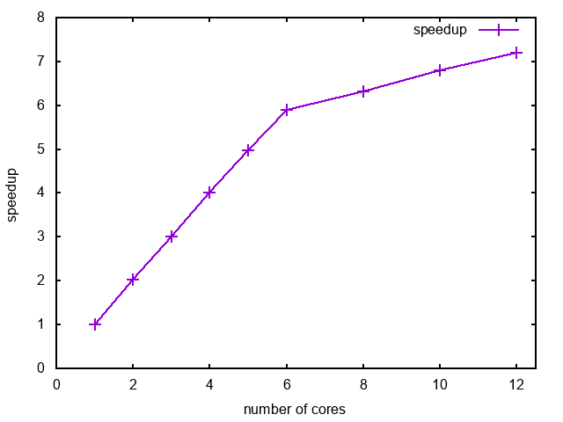
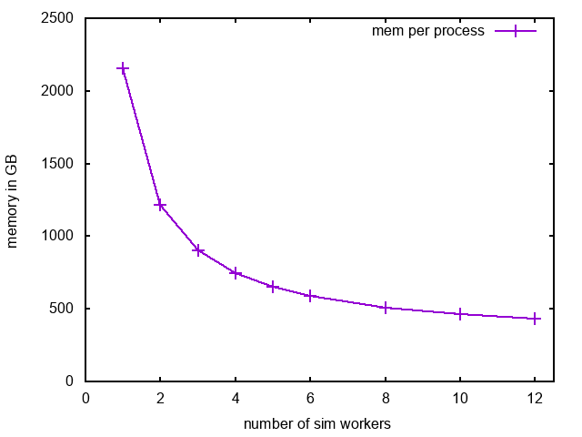
Preliminary performance study of device-based simulation
Memory per process in GB
Speedup
hyperthreading region
Number of simulation workers
Number of simulation workers
Perfect parallelization up to number of physical CPU cores;
Further gain in hyperthreading region
Better memory footprint per worker as number of workers increases
~45min -> ~6min
to finish one event
Well below 2GB limit per worker
(on my desktop PC)
Subevent size 500primaries

