Slide 1
Detector Validation for Dark Matter Searches at 380 GeV
OUTLINE
Software and detector parameter list
e⁺ e⁻→ x x γ cross sections at 380 GeV
Validation results focusing on:
Photon detection efficiency
Electron detection efficiency
Background veto efficiency
Summary and Outlook

Slide 2
Software
Event generation Whizard 2.3.1
380 GeV beam spectrum; Generator cut on γ only
Event simulation and reconstruction software:
ILCSoft-2017-08-23, CLIC_o3_v13
Processors:
TruthTrackFinder
Pandora, BeamcalReco, LumicalReco
Pandora provides particle id for leptons photons and hadrons. For Beamcal and Lumical there is no particle id; it is fixed to electron.
No pair background was overlaid.

Slide 3
DM Searches Processes at 380 GeV
Process | √s [GeV] | Cuts | σ [fb]
e⁺ e⁻→ χ˳ χ͂˳ γ (S) | 380 | 10° < θγ < 170° , Eγ>10 GeV | 1.0 10²
e⁺ e⁻→ ν ν̅ γ (IB) | 380 | 10° < θγ < 170° , Eγ>10 GeV | 2.7 10³
e⁺ e⁻→ e⁺ e⁻ γ (B1) | 380 | 10° < θγ < 170° , Eγ>10 GeV | 8.9 10⁴
e⁺ e⁻→ γ γ (B2) | 380 | 10° < θγ < 170° , Eγ>10 GeV | 3.9 10³
e⁺ e⁻→ μ⁺ μ⁻ γ (B3) | 380 | 10° < θγ < 170° , Eγ>10 GeV | 3.6 10²
e⁺ e⁻→ τ⁺ τ⁻ γ (B4) | 380 | 10° < θγ < 170° , Eγ>10 GeV | 2.8 10²
Processes used for the current validation studies:
Data samples generated with 10° < θγ < 170° , Eγ>10 GeV
Essential to reduces the rate of reducible background events which mimic mono or multiphoton events to have a good sensitivity to new physics when looking for excess in e⁺ e⁻→ ν ν̅ γ (IB)

Slide 4
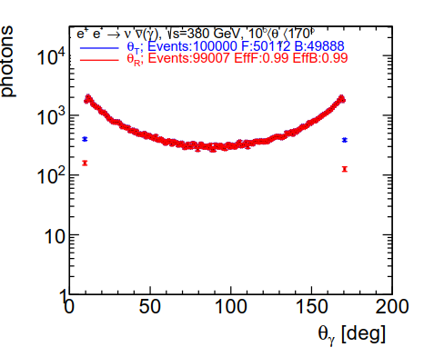
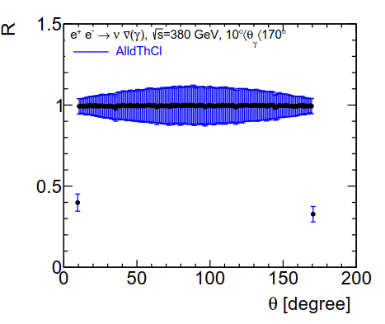
Photon Detection Efficiency
Left : dN/dθγ True(blue) and Reconstructed(red)
Right: dεγ/dθγ; the reconstruction efficiency is > 99% over a large θ range; it decreases to 40% ~ 9.5˚ and 170.5˚; Ecal crack. Events with θ<10 or θ>170 ?; beam crossing boost.
Analysis cut after reconstruction 10°<θγ<170° discards these events.

Slide 5
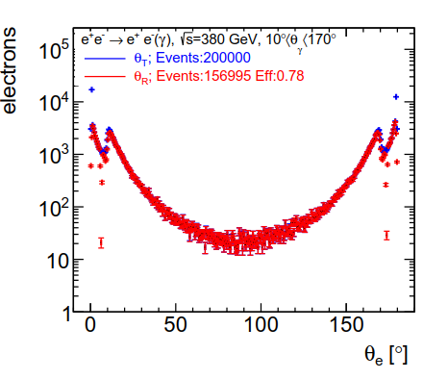
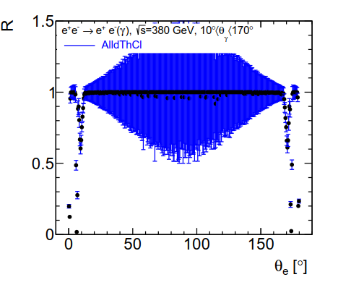
Electron Detection Efficiency
Left : dN/dθe; True(blue) and Reconstructed e (red)
Right: dε/dθe the reconstruction efficiency is ~ 0.99 except in the F/B regions <12 and > 168˚; => zoom in F region.

Slide 6
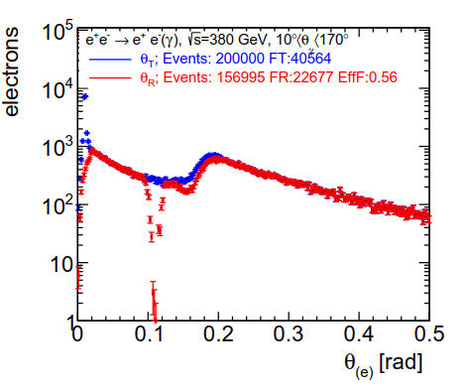
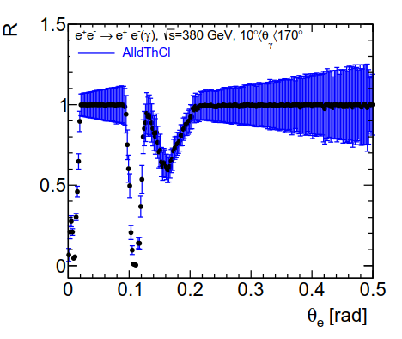
Electron Detection Efficiency
Left: dN/dθe ; Right: dε/dθe
The e reconstruction efficiency is poor in 3 regions
θe< 25 mrad: Beam pipe, Beamcal transition region
θe~100 mrad: StS beam pipe
170 mrad < θe <200 mrad: Ecal crack and end of tracker
=> Display of e⁺ e⁻→ e⁺ e⁻ γ events

Slide 7
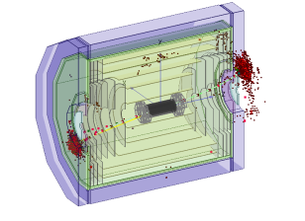
Event 1296 Ecal crack
e⁺ e⁻→ e⁺ e⁻ γ event:
e⁻ at 9.6˚: the track is well reconstructed but the e⁻ is identified as a π⁻ (no ecal cluster, Ecal crack )
e⁺ at 170.6˚ the track is not reconstructed, the e⁻ is reconstructed as N (Ecal crack)
e id unreliable, but the tracking and Hcal energy measurement allow event veto.

Slide 8
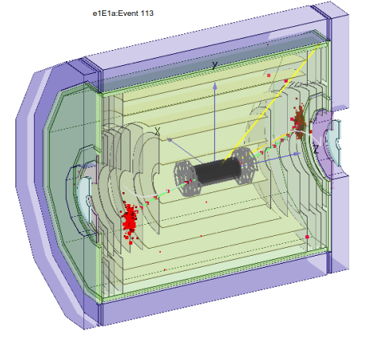
Event 113 Tracking
e⁺ e⁻→ e⁺ e⁻ γ event:
e⁻ at 12˚: the track is not reconstructed and the e⁻ is identified as a γ ; Ecal energy measurement.
e⁺ at 168˚: the track is not reconstructed, the e⁻ is reconstructed as a γ
e id unreliable but Ecal energy measurement allow event veto

Slide 9
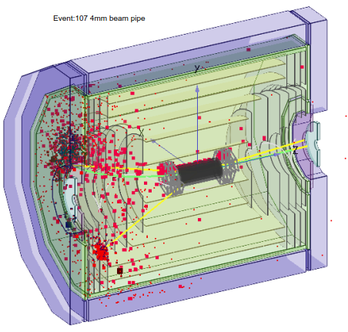
Event 107
e⁺ e⁻→ e⁺ e⁻ γ event:
The e⁻ at θ=10 mrad is in the beam pipe and the e⁺ at θ=173.9˚ showers in the StS beam pipe. It creates hits but no cluster is reconstructed in the Lumical.
=> Event not rejected

Slide 10
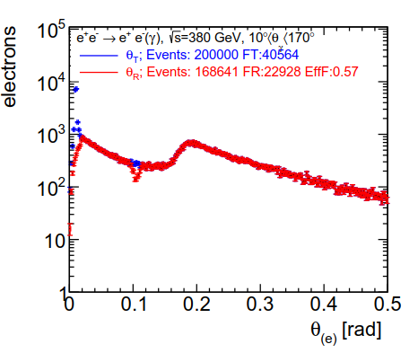
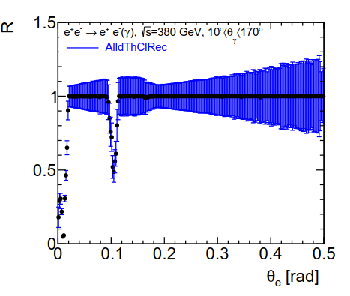
Electron Detection Efficiency
Left: dN/dθe (T and R) ; Right: dε/dθ
For reconstructed e or γ or N matched with a true e
the detection efficiency ~ 170-200 mrad is increased to ~99%
The efficiency ~ 100 mrad is increased to ~ 50%
For 12˚ <θ< 168˚ the particle ID is unreliable or impossible.
Improve efficiency ~ 100 mrad ?

Slide 11
Beam Pipe
The stainless steel conical beam pipe has a thickness of 4 mm at 310 mm of IP and 4.8 mm close to the Lumical.
It has a half cone angle of 6.6˚. It creates a dead region of ~ 15 mrad. Andre has designed a beam pipe with a thickness of 1 mm at 310 mm from the IP and 4.8 mm in front of the
Lumical

Slide 12
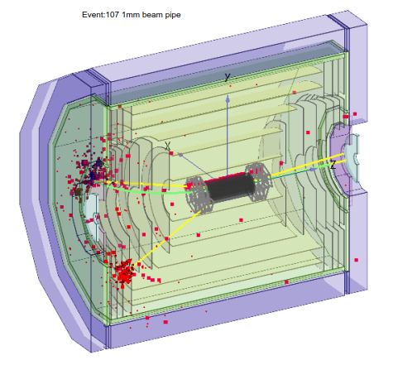
Event 107
e⁺ e⁻→ e⁺ e⁻ γ event:
4 mm beam pipe (left); 128 GeV e⁺ ; no energy cluster in Lumical => event not rejected.
1 mm thickness (right); 128 GeV e⁺ matched with 2 clusters
In Lumical having 41 and 25 GeV => event rejected.

Slide 13
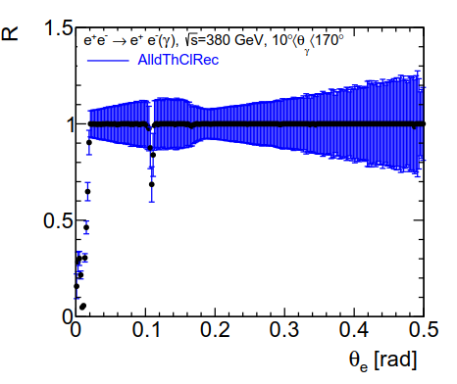
Electron Detection Efficiency
Left: dε/dθ; StS beam pipe of 4.8 mm; ε ~ 50%
Right: dε/dθ; StS beam pipe of 1 mm
The detection efficiency increases to > 70%,
Single particle detection efficiency -> Background event veto.

Slide 14
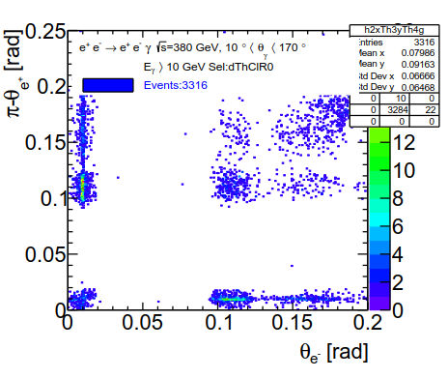
Event Veto Inefficiency; 4mm BP
dN/dθe⁻d(π-θ)e⁺ for events without reconstructed e⁻ and e⁺ and without Ecal, Hcal energy veto; inefficiency ~ 3.3% => 2937 fb. The e detection inefficiency in the region
90 mrad < θ < 200 mrad in combination with the inefficiency for θ < 25 mrad is the largest contribution

Slide 15
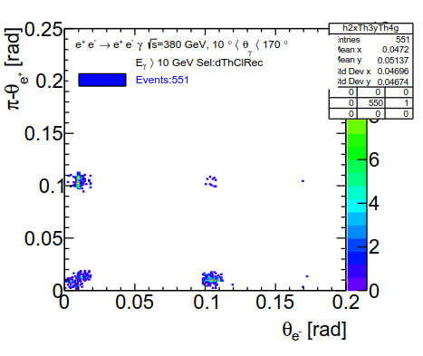
Event Veto Inefficiency; 4mm BP
dN/dθe⁻d(π-θ)e⁺; Events without reconstructed e⁻ requiring the energy deposit E in Ecal, Hcal or Lumical E<5 GeV =>
Veto inefficiency ~ 0.6% => 490 fb.
For θe⁻ and π-θe⁺< 25 mrad; Inef ~ 0.1% => 100 fb (20%)
Inefficiency dominated by events with one e < 25 mrad and the other in the crack due to StS beam pipe.

Slide 16
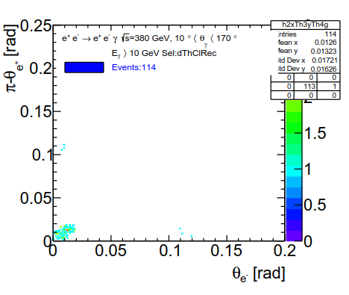
Event Veto Inefficiency; 1mm BP
dN/dθe⁻d(π-θ)e⁺; Events without reconstructed e⁻ requring the energy deposit in Ecal, Hcal, Beamcal or Lumical E<5 GeV
Veto inefficiency reduced by a factor 5 to ~ 0.1% => 101 fb.
Most events have θe⁻ and π-θe⁺< 25 mrad

Slide 17
B Cross Sections before and after Energy deposit veto
Process | √s [GeV] | Cuts | σ [fb] | σ[fb]
e⁺ e⁻→ ν ν γ (IB) | 380 | 10° < θγ < 170° , Eγ>10 GeV | 2.7 10³ | 2.7 10³
e⁺ e⁻→ e⁺ e⁻ γ (B1) | 380 | 10° < θγ < 170° , Eγ>10 GeV | 8.9 10⁴ | 4.9 10²
e⁺ e⁻→ γ γ (B2) | 380 | 10° < θγ < 170° , Eγ>10 GeV | 3.9 10³ | <0.01
e⁺ e⁻→ μ⁺ μ⁻ γ (B3) | 380 | 10° < θγ < 170° , Eγ>10 GeV | 3.6 10² | 0.02
e⁺ e⁻→ τ⁺ τ⁻ γ (B4) | 380 | 10° < θγ < 170° , Eγ>10 GeV | 2.8 10² | 0.01
B Cross sections for 4 mm B.P before and after veto
After veto B2, …B4 <=0.02 fb. B1 = 490 fb.
With a 1mm StS beam pipe B2 is reduced to 101 fb.
Is this level of background adequate for the DM searches?

Slide 18
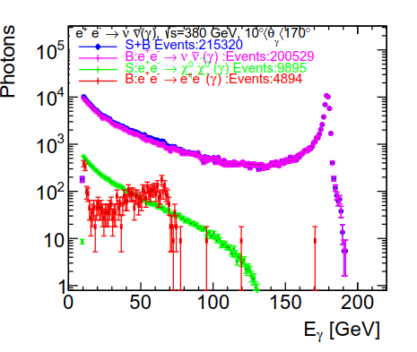
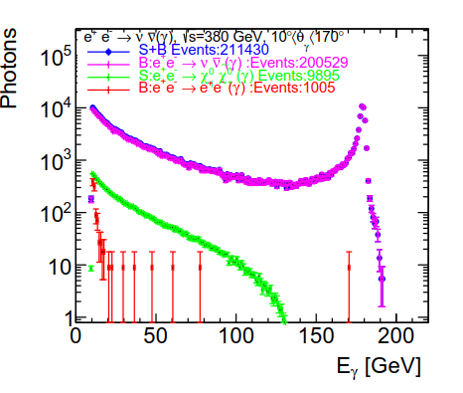
dN/dEγ; 4/1 mm beam pipe
Left : dN/dEγ for S+IB+B1, S, IB , B1 for 4mm beam pipe
Right: dN/dEγ for S+IB+B1, S, IB , B1 for 1mm beam pipe
With a 4 mm beam pipe B1, e⁺ e⁻→ e⁺ e⁻ γ is affecting significantly the energy distribution in the region Eγ<80 GeV

Slide 19
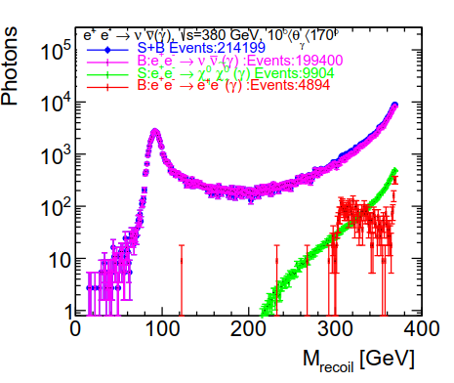
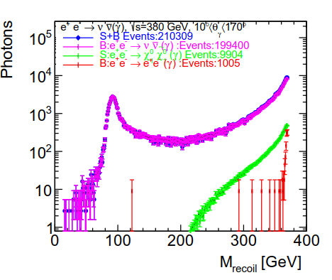
dN/dMRecγ; 4/1 mm beam pipe
Left : dN/dMRec for S+IB+B1, S, IB , B1 for 4mm beam pipe
Right: dN/dMrec for S+IB+B1, S, IB , B1 for 1mm beam pipe
With the 4 mm beam pipe the B1, e⁺ e⁻→ e⁺ e⁻ γ is affecting the recoil mass distribution for M>300 GeV. It makes the excess and mass measurement difficult.

Slide 20
Summary
e⁺ e⁻→ X X γ were used to study the γ and e detection efficiency at 380 GeV without pair background overlaid.
For events with 10° < Θγ < 170˚ the γ reconstruction efficiency is ~ 99%.
The e⁻ (γ, N) reconstruction efficiency is ~ 99% for 1° < Θγ < 179°except for Θ~ 6° and θ~174˚ ; StS conical beam pipe location. It affects the veto efficiency for searches with missing energy.
Reducing the beam pipe thickness improves the veto efficiency allowing to reduce the background cross section to a level adequate for DM searches.

Slide 21
Outlook
Perform the same study at 380 GeV with pair background and γγ-> hadrons overlaid.
Check γ energy resolution and its impact on the DM mass measurement.

Slide 22
Backup

