Slide 1
Detector Validation for Dark Matter Searches at 380 GeV
OUTLINE
Software and analysis condition
e⁺ e⁻→ x x γ cross sections at 380 GeV
Event selection observables
Signal and Background selection efficiencies
Summary and Outlook

Slide 2
Software and Analysis conditions
Event generation Whizard 2.3.1; 380 GeV Generator cut on γ only
Event simulation and reconstruction software:
ILCSoft-2017-10-20, CLIC_o3_v13
Processors: TruthTrackFinder, Pandora, BeamcalReco, LumicalReco with γγ->h overlaid
Pandora provides particle id and Pfo selections for leptons photons and hadrons.
For Beamcal and Lumical there is no particle id; it is fixed to electron; a Pt cut is added to reject hadrons from γ γ -> hadron.

Slide 3
DM Searches Processes at 380 GeV
Process | √s [GeV] | Cuts | σ [fb]
e⁺ e⁻→ χ˳ χ͂˳ γ (S) | 380 | 10° < θγ < 170° , Eγ>10 GeV | 1.0 10²
e⁺ e⁻→ ν ν̅ γ (IB) | 380 | 10° < θγ < 170° , Eγ>10 GeV | 2.7 10³
e⁺ e⁻→ e⁺ e⁻ γ (B1) | 380 | 10° < θγ < 170° , Eγ>10 GeV | 8.9 10⁴
e⁺ e⁻→ γ γ (B2) | 380 | 10° < θγ < 170° , Eγ>10 GeV | 3.9 10³
e⁺ e⁻→ μ⁺ μ⁻ γ (B3) | 380 | 10° < θγ < 170° , Eγ>10 GeV | 3.6 10²
e⁺ e⁻→ τ⁺ τ⁻ γ (B4) | 380 | 10° < θγ < 170° , Eγ>10 GeV | 2.8 10²
Processes used for the validation studies:
Data samples generated with 10° < θγ < 170° , Eγ>10 GeV
Essential to reduces the rate of reducible background events which mimic mono or multiphoton events to have a good sensitivity to new physics when looking for excess in e⁺ e⁻→ ν ν̅ γ (IB)

Slide 4
ν ν̅ γ Event Selection
The event selection requires at least one isolated γ with Eγ>10 GeV; 10°<θγ<170° and little additional energy.
if Nγ>1 sort γs by energy; select the most energetic γ
Apply γ isolation criteria Ei
Ei=|E (in cone ΔR=0.4 around the γ direction) – Eγ| / Eγ
Require little energy outside of the cone Eo
Eo=|Etot-Eγ|/ETot
Ei and Eo depend on γ reconstruction quality, on the beam induced background and on the Pt cut value applied on the Pfo’s.
Eo allows discriminating signal and background; it peaks at 0 for S and peaks ~ 1 for B.

Slide 5
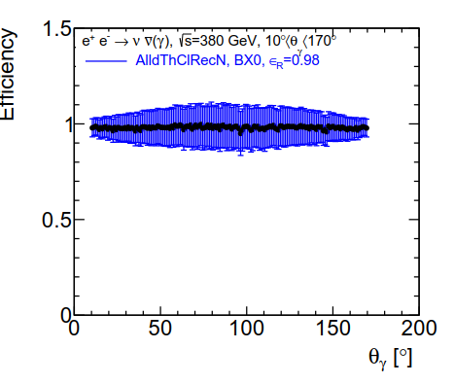
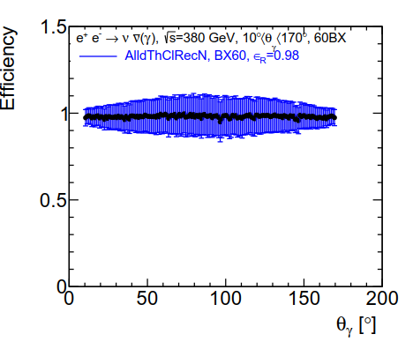
Photon Reconstruction Efficiency
No Ei, Eo selection
Select γs with Pfo Pt>0.75 GeV; 10°<θγ<170° and Eγ>10GeV
dεγ/dθγ; left no γγ-> hadron overlaid; right with γγ-> hadron
The reconstruction efficiency is >98% for 10°<θγ<170°.
The main origin of the inefficiency is:
γ conversion and γ misreconstruction as N
γγ-> hadron has no impact on the reconstruction efficiency

Slide 6
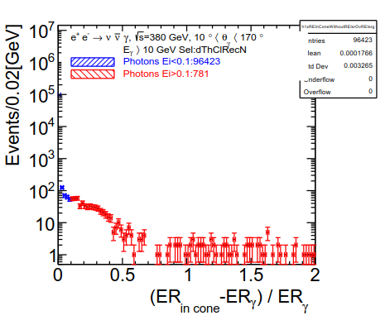
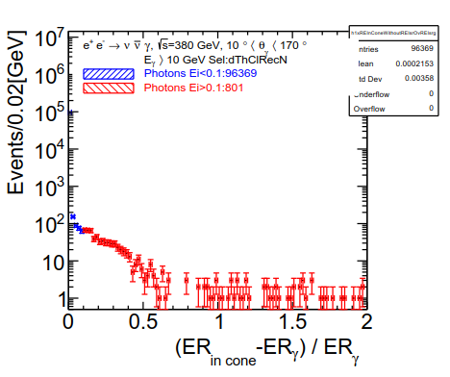
Ei Selection on ννγ events
dN/dEi; left no γγ->hadron; Pfo Pt>0.75 GeV; dN/dEi peaks~0
events with Ei>0.1 are due to:
γ conversion with bremstrahlung
γ misreconstruction as n γ or n γ + m N
Right with γγ-> hadrons; the number of events with Ei>0.1 is similar; ε(Ei)=99%. Ei not affected by γγ-hadron background.

Slide 7
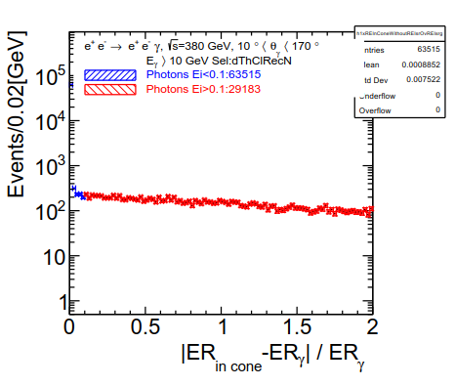
Ei Selection on eeγ events
dN/dEi; with γγ->hadron; Pfo Pt > 0.75 GeV;
dN/dEi peaks ~0 but with a tail; for Ei<0.1 ε(Ei)=64%
Events with Ei>0.1 are mainly due to energy from e ending in the γ cone.
Ei reduces eeγ background by 36%

Slide 8
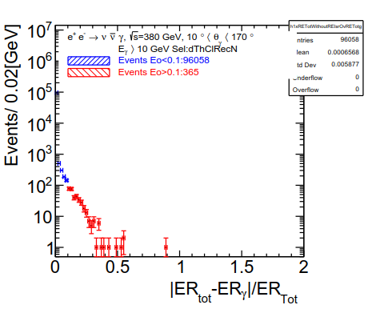
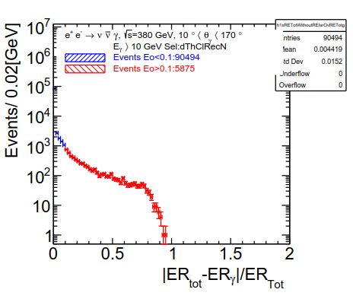
Eo Selection on ννγ events
dN/dEo; Pfo Pt>0.75 GeV; left no γγ->hadrons
Events with Eo>0.1 are due to
γ conversion; γ misreconstruction as n γ or n γ + m N
ε(Eo) > 99 %
Right, with γγ->hadrons, Eo tail increases and ε(ννγ)↘91%

Slide 9
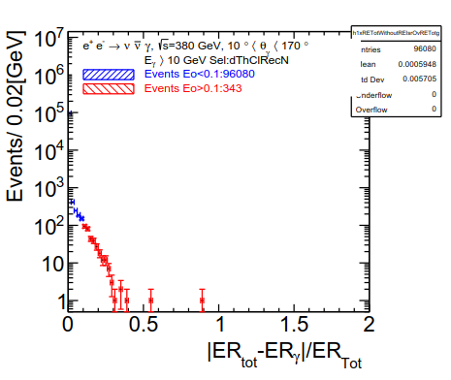
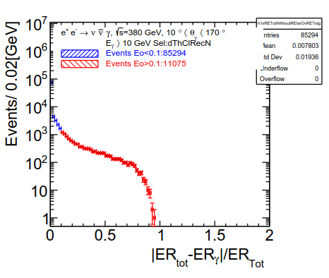
Eo Selection on ννγ events
dN/Eo; PfoPt>0.5 GeV; left no γγ->hadrons
The selection efficiency is similar; ε(Eo) > 99 %
Right with γγ->hadrons the Eo tail increases; reducing the Pt cut value from0.75 to 0.5 GeV increases the total energy deposit in the detector and ↘ ε(ννγ) from91% to 86%

Slide 10
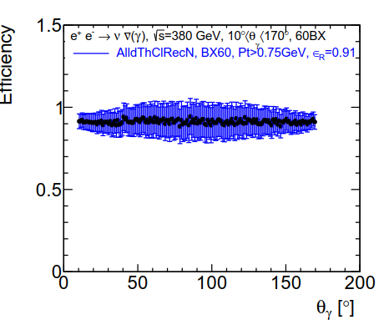
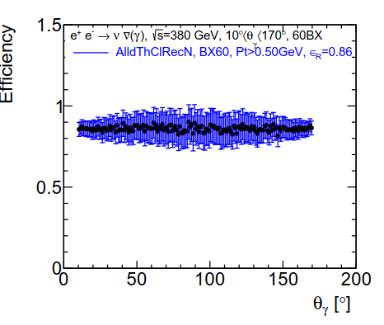
ε(γ) for ννγ Events
dε(γ)/dθγ; with γγ-> hadron overlaid Ei<0.1 and Eo<0.1
Left PfoPt>0.75 GeV; ε = 91%
Left PfoPt>0.50 GeV; ε = 86%
ε(γ) has no θ dependence

Slide 11
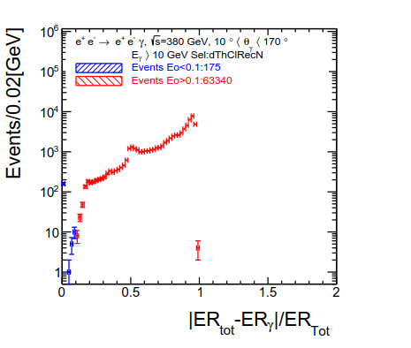
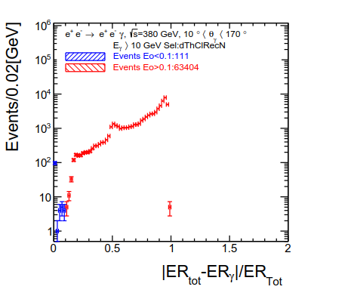
Eo Selection on eeγ events
dN/dEo; with γγ->hadrons for the 1mm StS beam pipe
Left PfoPt>0.75 GeV; ε(eeγ)=1.75 10⁻³ => σ=156 fb
Right PfoPt>0.50 GeV; ε(eeγ)=1.11 10⁻³ => σ=100 fb

Slide 12
Cross Sections before and after
Event Selection
Process | √s [GeV] | Cuts | σ [fb] | σ[fb]
e⁺ e⁻→ ν ν γ | 380 | 10°< θγ <170°, Eγ>10 GeV, PfoPt >0.75 GeV | 2.7 10³ | 2.5 10³
e⁺ e⁻→ e⁺ e⁻ γ | 380 | 10°< θγ <170°, Eγ>10 GeV Pfo Pt>0.75 GeV | 8.9 10⁴ | 1.5 10²
e⁺ e⁻→ ν ν γ | 380 | 10°< θγ <170°, Eγ>10 GeV, PfoPt >0.50 GeV | 2.7 10³ | 2.3 10³
e⁺ e⁻→ e⁺ e⁻ γ | 380 | 10°< θγ <170°, Eγ>10 GeV Pfo Pt>0.50 GeV | 8.9 10⁴ | 1.0 10²
Cross sections for 1 mm StS B.P before and after Ei and Eo selection for Pfo Pt> 0.75 Gev and > 0.5 GeV
σ(eeγ) is reduced to 100-150 fb depending on the Pfo Pt cut value and ε(ννγ) is only reduced by 9-14%

Slide 13
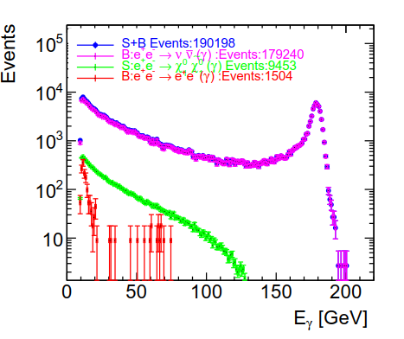
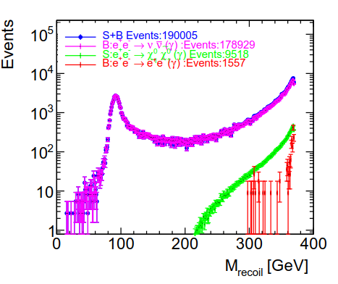
dN/dEγ; dN/dMRec; 1 mm B.P
Pfo Pt>0.75 GeV
Left : dN/dEγ for S+ννγ+eeγ, S, ννγ and eeγ; eeγ peaked at
a low Eγ with a tail 30-70 GeV
Right: dN/dMRecoil for S+ννγ+eeγ, S, ννγ and eeγ; eeγ peaked at high Mrecoil and a tail ~ 300-350 GeV

Slide 14
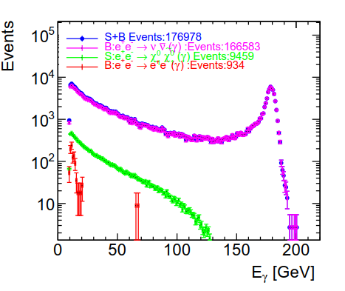
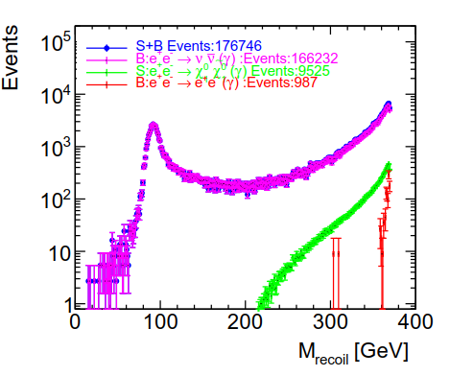
dN/dEγ; dN/dMRec; 1 mm B.P
Pfo Pt>0.5 GeV
Left : dN/dEγ; Right: dN/dMRecoil
The eeγ background is peaked at low Eγ and high Mrecoil
Not much background un the region Mrecoil 220-340 GeV

Slide 15
Summary
e⁺ e⁻→ X X γ were used to study the ννγ and eγγ selection efficiency at 380 GeV with pair background overlaid using
a StS beam pipe of 1mm thickness.
For events with 10° < Θγ < 170˚ and Eγ>10 GeV
For Pfo Pt>0.75 GeV; ε(ννγ)=91% and ε(eeγ)=1.75 10⁻³
For Pfo Pt>0.50 GeV ε(ννγ)=86% and ε(eeγ)=1.11 10⁻³
The Ei; Eo event selection allow reducing the eeγ background cross section to a very low level while keeping a high signal efficiency.

Slide 16
Outlook
Perform the same study at 380 GeV with pair background and γγ->h overlaid.
Check γ energy resolution and its impact on the mass measurement.
Finalyze the analysis

Slide 17
Backup

