Slide 1
STRUCTURE OF MATTER
Discoveries and Mysteries
Rolf Landua
CERN

Slide 2
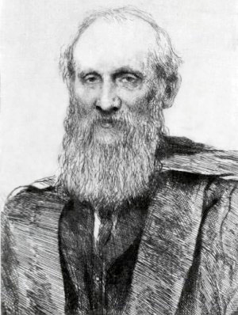
PREFACE
This is a lecture about 100 years of particle physics.
It covers about 100 years of ideas, theories and experiments.
More than 50 Nobel prize winners on particle physics
This is a broad overview about the main discoveries.
In the early 1900s, most physicists believed that physics was complete, described by classical mechanics, thermodynamics, and the Maxwell theory.
“There is nothing new to be discovered in physics now. All that remains is more and more precise measurement. “ (Lord Kelvin, 1900)
DARK CLOUDS:
1) Blackbody radiation - Quantum Physics
2) Michelson-Morley experiment - Special Relativity
Lord Kelvin

Slide 3

Particles/Fermions
Fields/Bosons
e⁻
Special
relativity
Photon
Radio-activity
1
1900
Atom
1910
Nucleus
Quantum
mechanics
1920
p⁺
Spin, Antimatter
Fermions / Bosons
Fermi Beta-Decay
1930
e⁺
n
Yukawa π exchange
μ ⁻
1940
π
Particle zoo
QED
1950
P, C, CP violation
p⁻
W,Z bosons
2
1960
νe
u
d
s
Higgs
νμ
EW unification
1970
STANDARD MODEL
GUT
QCD & Colour
τ⁻
c
b
SUSY
g
1980
Strings
W
Z
3 generations
1990
ν mass
t
2000
ντ
Higgs
2010

Slide 4
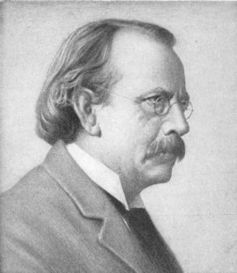
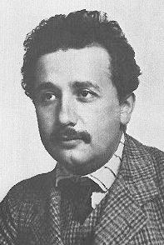
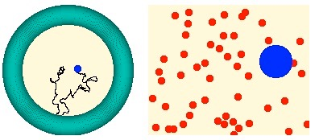

MATTER IS MADE OF PARTICLES
1897: ELECTRON - the first ‘discrete’ building block of matter
J.J. Thomson
1905: ATOMS ARE REAL - Explanation of Brownian Motion (Perrin)
A. Einstein

Slide 5
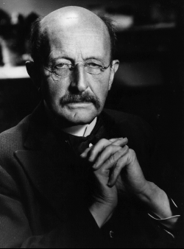
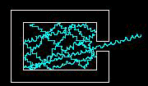


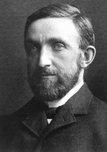
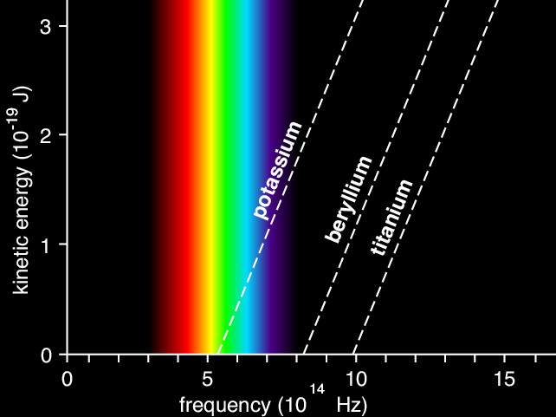
ENERGY COMES IN QUANTA
1900: ELECTROMAGNETIC RADIATION IS EMITTED IN QUANTA
ε = h ν
M. Planck
1902: PHOTOELECTRIC EFFECT
“The electron energy does not show the
slightest dependence on the light intensity”
P. von Lenard
1905: LIGHT IS EMITTED AND ABSORBED IN QUANTA
Emax = hν - W
“My only revolutionary contribution to physics”
A. Einstein

Slide 6
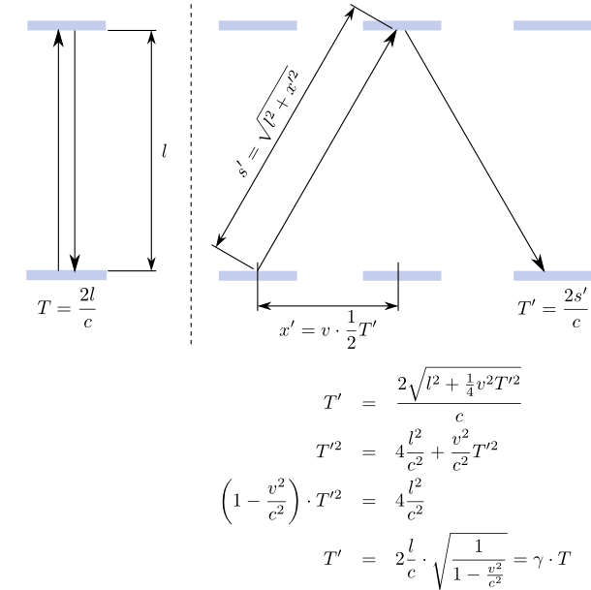
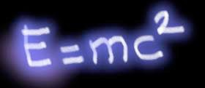
SPECIAL RELATIVITY
1905: SPEED OF LIGHT IS ALWAYS CONSTANT
A. Einstein
Time passes slower
in moving reference frame
1) Time dilation, space contraction
2) Modification of Newton’s laws, relativistic mass increase.

Slide 7
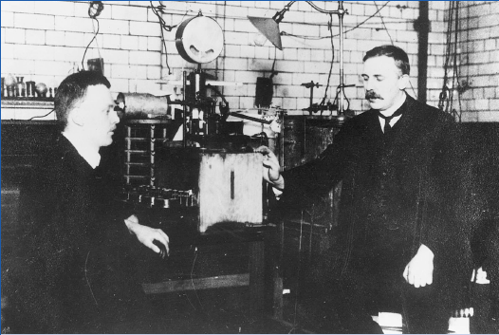
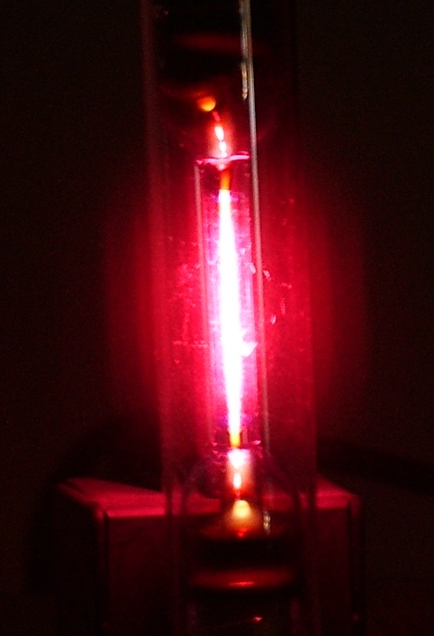
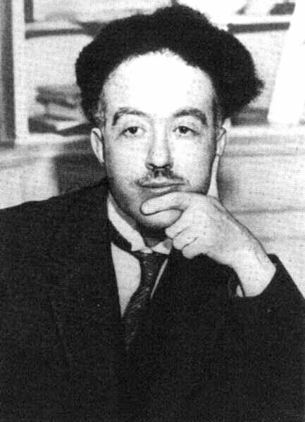
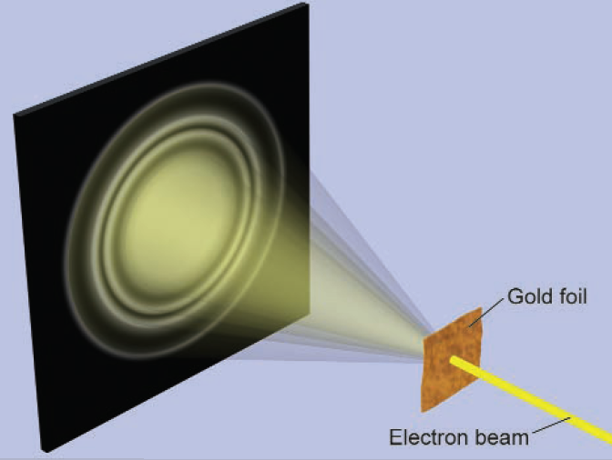

THE BEGINNING OF ATOMIC PHYSICS
1909: NUCLEI: very small + heavy within (almost) empty atom
Rutherford
1913: BOHR MODEL- (empirical) explanation of discrete spectral lines
(using Planck’s constant h) to quantize angular momentum
Hydrogen
1923: DE BROGLIE
Particles are waves
L. de Broglie

Slide 8
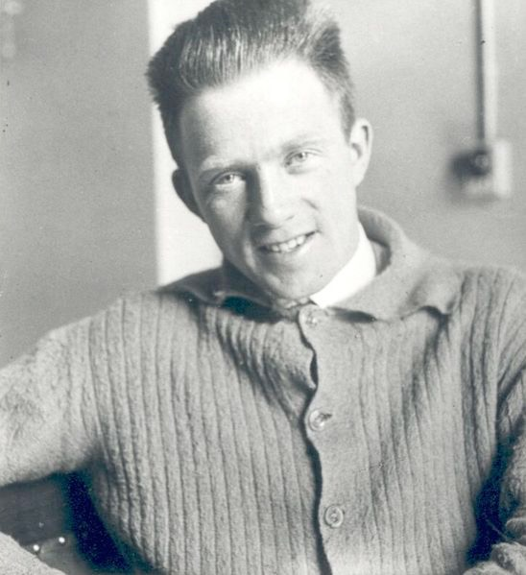
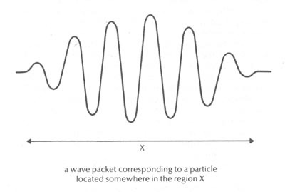


QUANTUM MECHANICS
1923: UNCERTAINTY RELATION
Heisenberg
Fourier analysis of a wave packet (e.g. acoustics)

Slide 9

INTERLUDE 1
From classical to quantum mechanics
Energy E of a particle with mass m,
momentum p, in a potential V(r)
Total energy = kinetic + potential energy
(‘Hamiltonian’)

Slide 10


How to translate
from particle to wave language?
A wave is described by a spatial function ψ(x) with circular frequency
and wave vector
PLAIN WAVE:

Slide 11





De Broglie momentum of a “particle wave”:
Energy of a “particle wave”:

Slide 12


Schrödinger equation:
END OF INTERLUDE 1

Slide 13
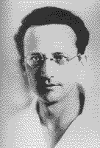
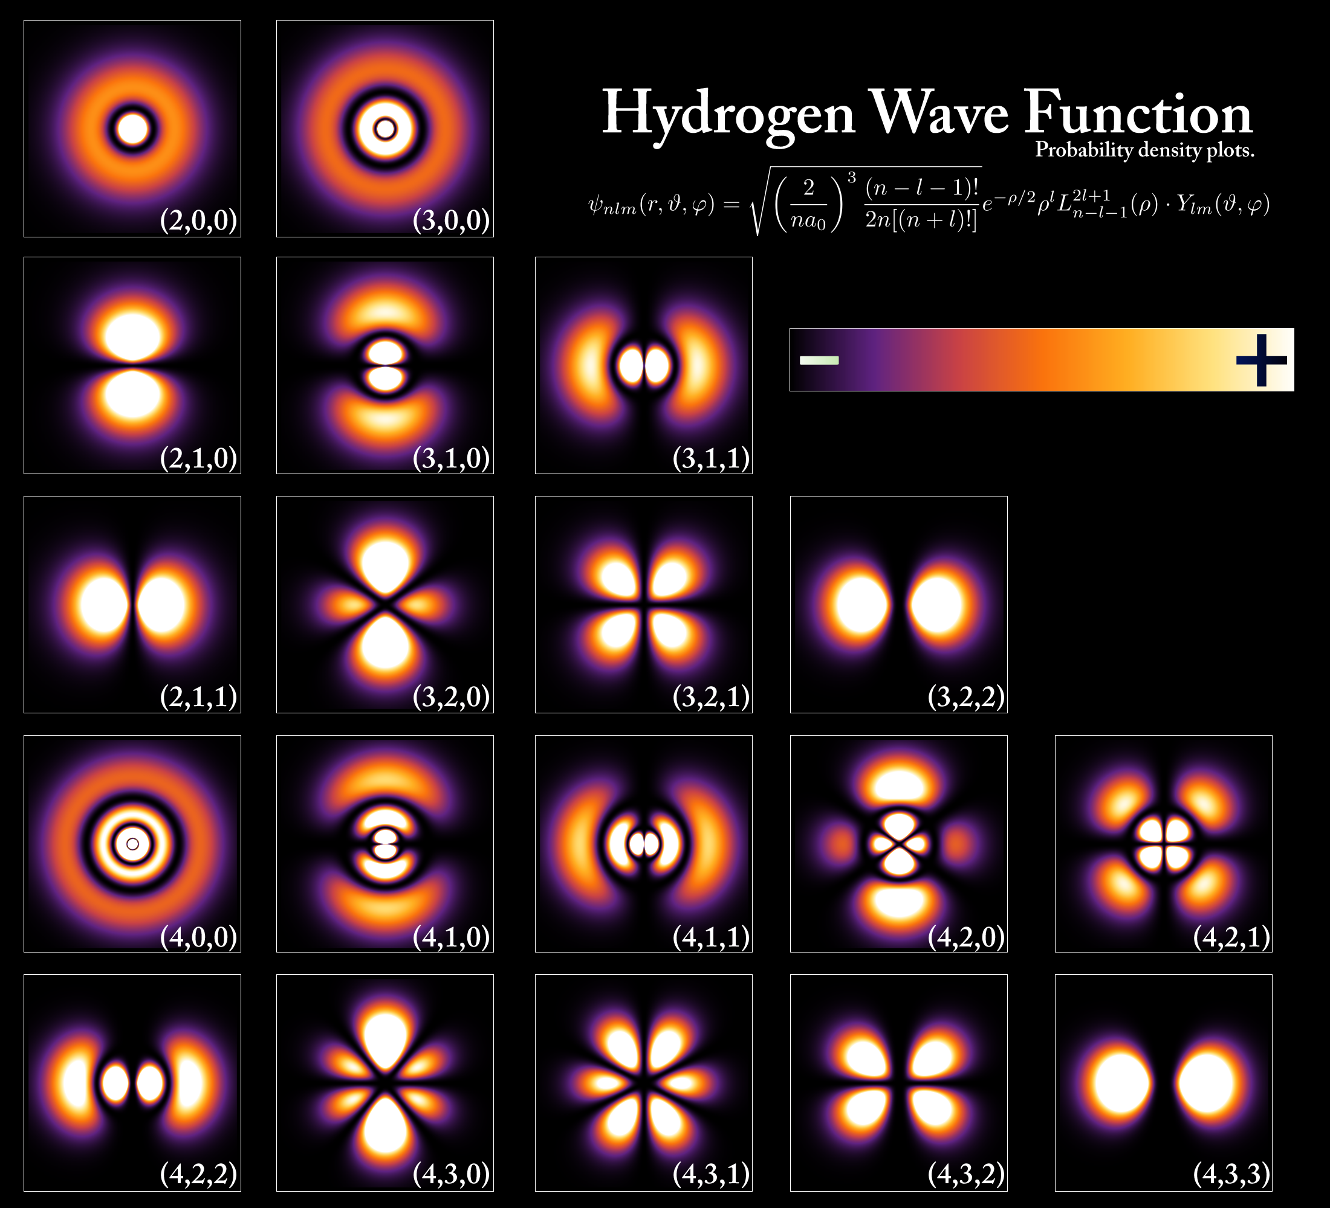
NON-RELATIVISTIC QUANTUM MECHANICS
  Atom = spherically symmetric Coulomb potential: V(r) ~ 1/r
  Wave function describes ‘standing waves’ (time independent)
Schrödinger
Interpretation (Born, 1927):
ψ = probability amplitude
|ψ|² = probability

Slide 14
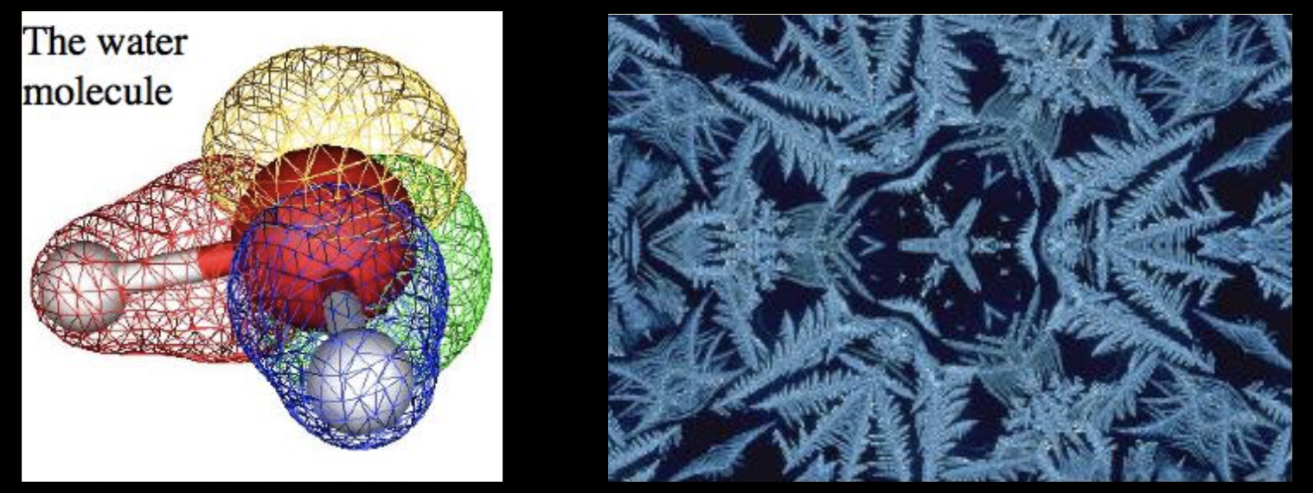
THE ORIGIN OF SHAPE !
Linus Pauling, 1928

Slide 15

INTERLUDE 2
But :
is only valid if v<<c
Quantum mechanics
Special Relativity
Relativistic quantum mechanics

Slide 16
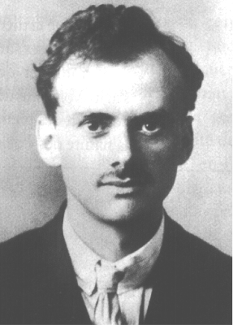




Let’s try (set = c = 1)
non-relativistic
relativistic
Paul A.M. Dirac
(1928)
became known (later) as the
“Klein-Gordon equation”
but … it describes particles that can ‘disappear’

Slide 17



One more try (still = c = 1, V = 0)
relativistic
square-root
*
Paul A.M. Dirac
(1928)
“Dirac equation”
time and space coordinates
treated equally!
time and space coordinates
treated equally!
have to be 4x4 matrices

Slide 18
RELATIVISTIC ELECTRON WAVE FUNCTION
e⁻
Electron, spin up
e⁻
Electron, spin down
Ψ =
e⁺
Positron, spin up
e⁺
Positron, spin down
ELECTRON SPIN 1/2 EXPLAINED
ANTIPARTICLES MUST EXIST !
SPIN 1/2 PARTICLES (FERMIONS): (PAULI) EXCLUSION PRINCIPLE
END OF INTERLUDE 2

Slide 19
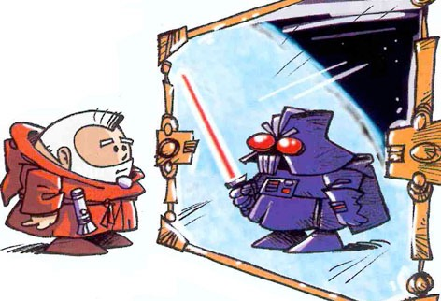
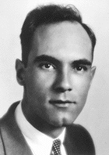
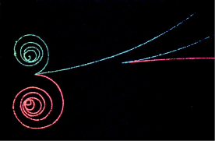
ANTIPARTICLES
1932: POSITRON DISCOVERY
EVERY PARTICLE HAS AN ANTIPARTICLE
Anderson
WHEN ENERGY CONVERTS TO MASS,
PARTICLES AND ANTIPARTICLES ARE PRODUCED

Slide 20
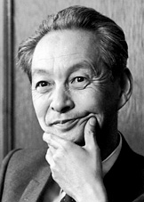
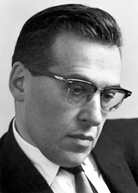
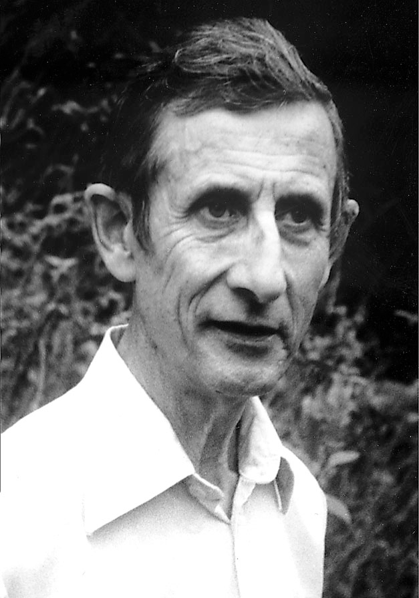
QUANTUM FIELD THEORY (1927 - 1948)
Since the classical electromagnetic field consists of photons -
how should the interaction between electrons and photons
be correctly described, based on the principles of special relativity and quantum physics?
S.I. Tomonaga
Second quantization:
Particles are treated as excitations of an underlying field
Creation and annihilation operators
J. Schwinger
F. Dyson

Slide 21
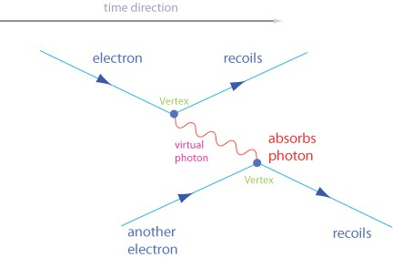
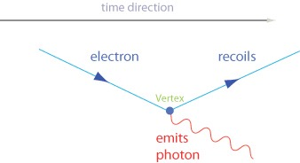
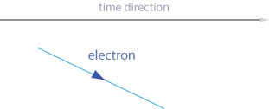
QUANTUM ELECTRODYNAMICS (1948)
Feynman graphs:
Graphical notation of particle reactions in space-time to derive
probability amplitudes
R.P. Feynman

Slide 22
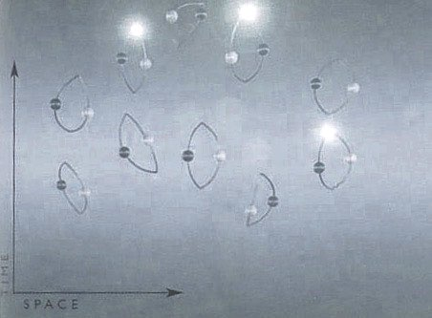
VACUUM FLUCTUATIONS
Quantized fields: Ground state energy is ≠ 0
QF fluctuations and particle-antiparticle-pairs populate empty space !
[ Remark: should give rise to (lots of) “vacuum energy” ]

Slide 23
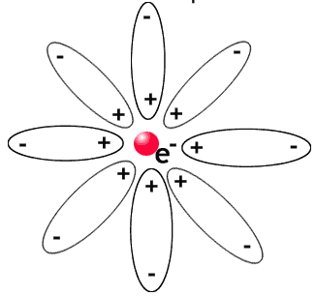
RENORMALISATION
The ‘naked’ electron + vacuum fluctuations = electron
Vacuum fluctuations: charge (hence coupling constant) are energy dependent

Slide 24
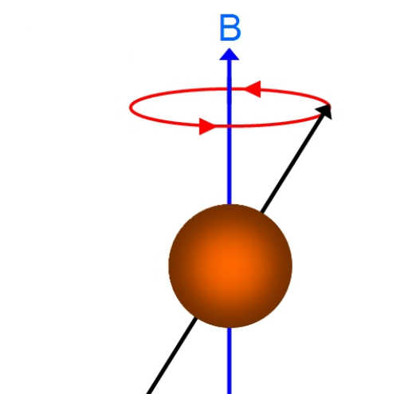

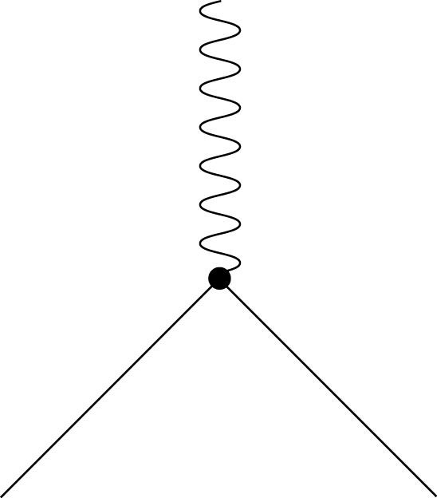
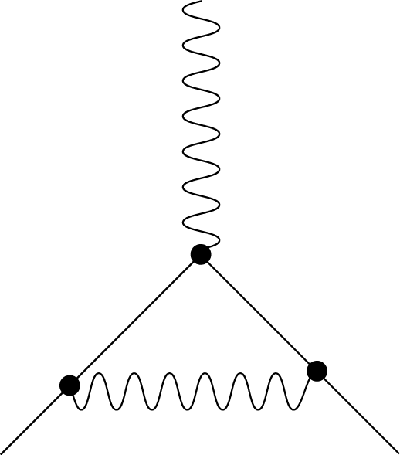
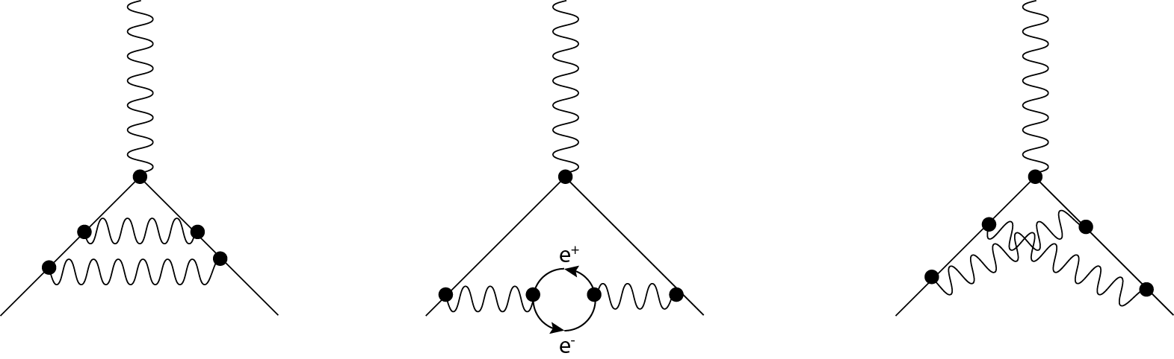
BEST THEORETICAL PREDICTION EVER
Vacuum fluctuations have observable effects
Electron anomalous magnetic moment “g”
+
+
“Leading order”
Second order
Fourth order corrections
g = 2
a = (g-2)/2 = 1/2π * 1/137
~ 0.0011614
Current precision (theory and experiment agree!) :
a = 0.00115965218073(28)

Slide 25
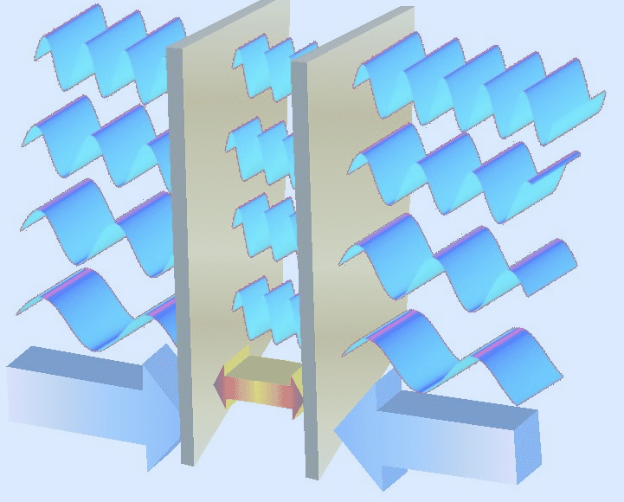

CASIMIR EFFECT
p = 100 kPa (d=11 nm)
SPOOKY: at 11 nm distance, the pressure is 1 atm.
(force on two uncharged metal plates)

Slide 26
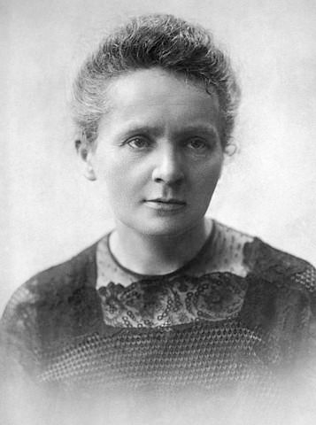
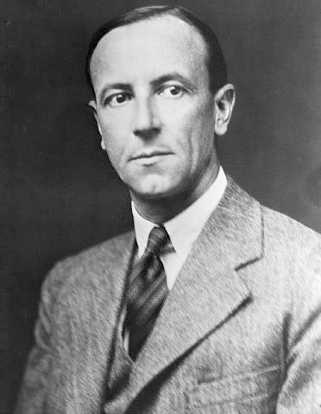
“NUCLEAR” PHYSICS
1895-1900: RADIOACTIVITY - strange radiation phenomena
M. Curie
1903: Alpha-, Beta-, Gamma-Radiation
1911: Nucleus - positive, very small - surrounded by electrons
E. Rutherford
1932: NEUTRON
n
p
p
n
Alpha particle = He nucleus
J. Chadwick

Slide 27
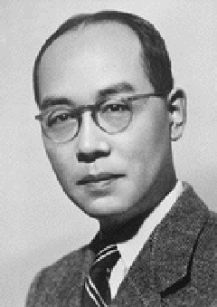
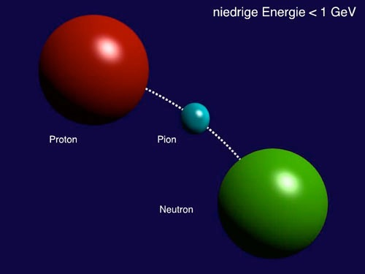
NUCLEAR PHYSICS - 1934
What keeps protons and neutrons together ?
Yukawa (1934)
Why is the range of nuclear forces finite?
(maximum size of nuclei ~ 5 fm)
Yukawa model:
New “strong” interaction
Exchange of “pion”
Pion has mass: finite range of 1-2 fm

Slide 28
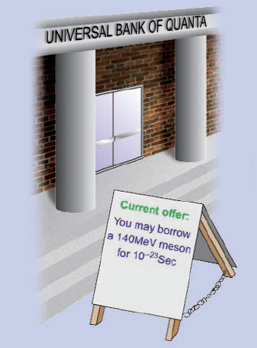
Toy model:
UBS offers you a loan of
1000 Euro x Seconds

Slide 29
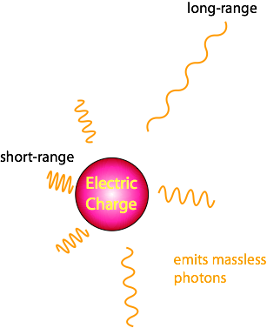
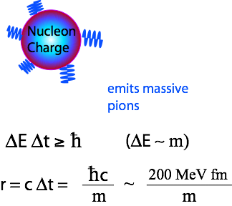

Electromagnetic
vs
Nuclear
Exchange Forces
Coulomb law
Yukawa potential ~ Modified “Coulomb” law

Slide 30



QUARKS AND QCD
An accelerator is a giant microscope ….
… and can also produce new particles:
E = mc²

Slide 31
1948 - 1960s: New accelerators and detectors
PARTICLE ZOO contained ~ 200 'elementary particles'
Mesons
BARYONS
π ⁺
π ⁻
π ⁰
Δ⁺⁺, Δ⁺, Δ⁰, Δ⁻
Pions
K⁺
K⁻
K⁰
η'
Delta
Λ⁰
Kaons
Eta-Prime
η
Σ⁺, Σ⁰, Σ⁻
Lambda (strange!)
φ
Eta
Sigma (strange!)
Phi
Ξ⁰, Ξ⁻
ρ ⁺
ρ ⁻
ρ º
Sigma(very strange!)
Rho
Underlying structure ?

Slide 32
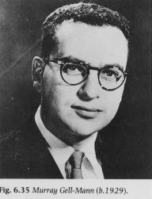

Classification scheme based on ‘quarks’
1963
3 types of “quarks” : up, down, strange (and their anti-particles)
u
d
s
+2/3 e
-1/3 e
-1/3 e
electric charge
+2/3
-1/3
-1/3
Gell-Mann, 1963
(G. Zweig, 1963)
u
u
u
d
d
π⁺
p
Meson
Baryon

Slide 33
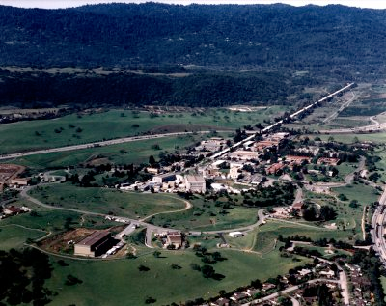
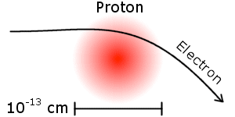
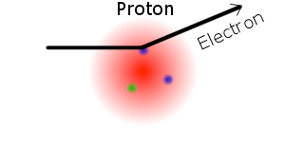
Discovery of quarks
Electron-Proton scattering at Stanford
1956 Hofstadter: proton radius ~ 1 fm
E = 0.2 GeV
Stanford Linear Accelerator Centre
1967 Friedmann, Kendall, Taylor: three ‘point-like particles’ inside a proton
E = 20 GeV
Measured cross-sections perfectly
compatible with presence of
2 up- and 1 down-quark in proton

Slide 34
The concept of “Colour” charge
How can you explain this particle ?
u
Δ⁺⁺
u
three fermions are not allowed to be in the same quantum state
(Pauli exclusion principle)
+2/3
u
+2/3
Spin = 3/2
+2/3
+2/3
A new concept: “colour charge”
Colour charge is the source of ‘strong force’
There are three types of colour (e.g. “red”, “green”, “blue”)
Only colour-neutral states can exist
(Bardeen, Fritzsch, Gell-Mann)

Slide 35




Quarks carry a “colour” charge - in addition to their electric charge
(that makes them different and hence exclusion principle does not apply)
red
u
Δ⁺⁺
u
u
green
blue
red
WHITE
(colour-
neutral
state)
green
blue

Slide 36
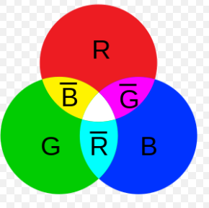
Quarks interact by exchanging ‘gluons’ that carry colour (and anti-colour)
red
blue
quark
Gluon
red-antiblue
blue
red
quark
Total number of gluons: 3 x 3 - 1 = 8
(1 combination is a ‘colour-singlet’, i.e. neutral)

Slide 37
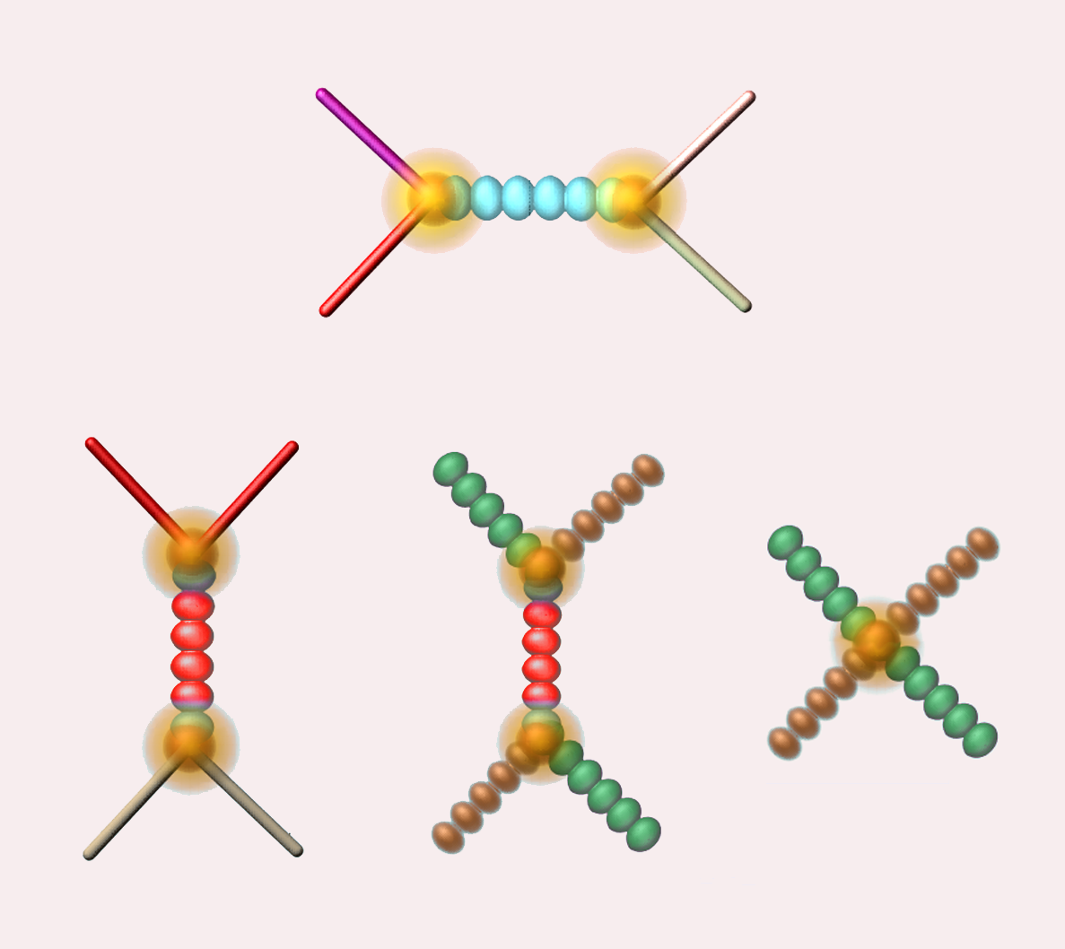
Since gluons carry a (colour) charge:
Gluons can interact with other gluons
Quark
Quark
Quark
Quark
Quark
Quark
GLUON
GLUON
GLUON
GLUON
GLUON
GLUON
Quark
Quark
GLUON
GLUON

Slide 38

The self-interaction of the gluons results in the energy of the gluon string
increasing with distance between quarks.
This produces a force that keeps the quarks as ‘prisoners’.
quark
quark

Slide 39
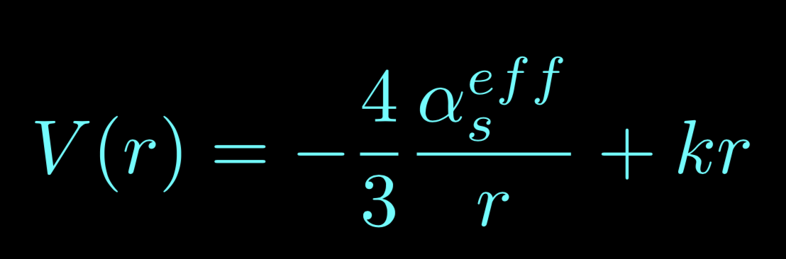
QCD ‘potential’ between two quarks
V[r]
Fragmentation
~ kr
k ~ 1 GeV/fm
r [fm]
1
2
3
bound states
(Distance between two quarks)
~ 1/r

Slide 40


Gluon ‘strings’ break : new quark-antiquark pairs
Analogy to breaking a
magnet into two halves: does not produce a magnetic monopole
Meson
excited
state of
meson
string breaking: two mesons

