Slide 1
Fast, just-in-time queries on heterogeneous raw data
Anastasia Ailamaki
EPFL and RAW Labs SA
With Manos Karpathiotakis, Stella Giannakopoulou, Matt Olma, and the DIAS lab

Slide 2
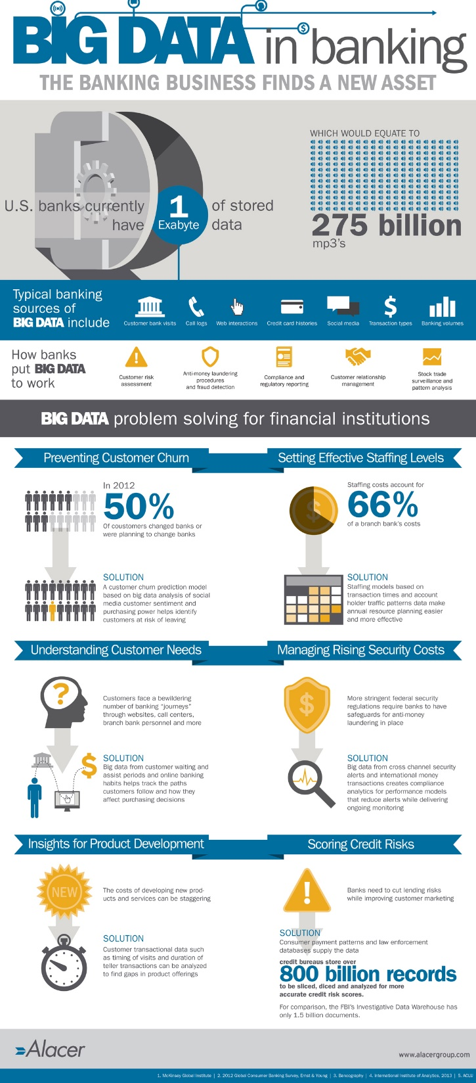
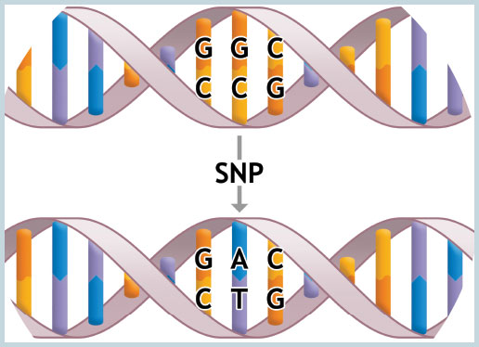

most firms estimate that they are only analyzing 12% of the data that they already have
Forrester, 2014
growing data
growing heterogeneity
data movement restrictions
available data impedes business & scientific analytics

Slide 3
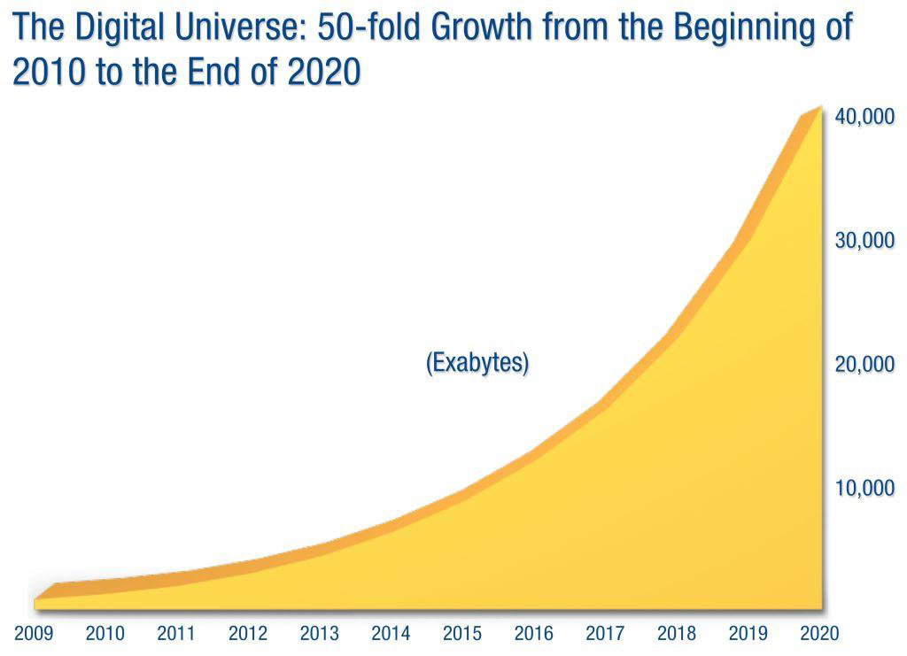
(The Digital Universe, EMC/IDC 2014)
store interesting data
explore data efficiently
Processing technology grows much slower than data
(WinterCorp Survey)

Slide 4
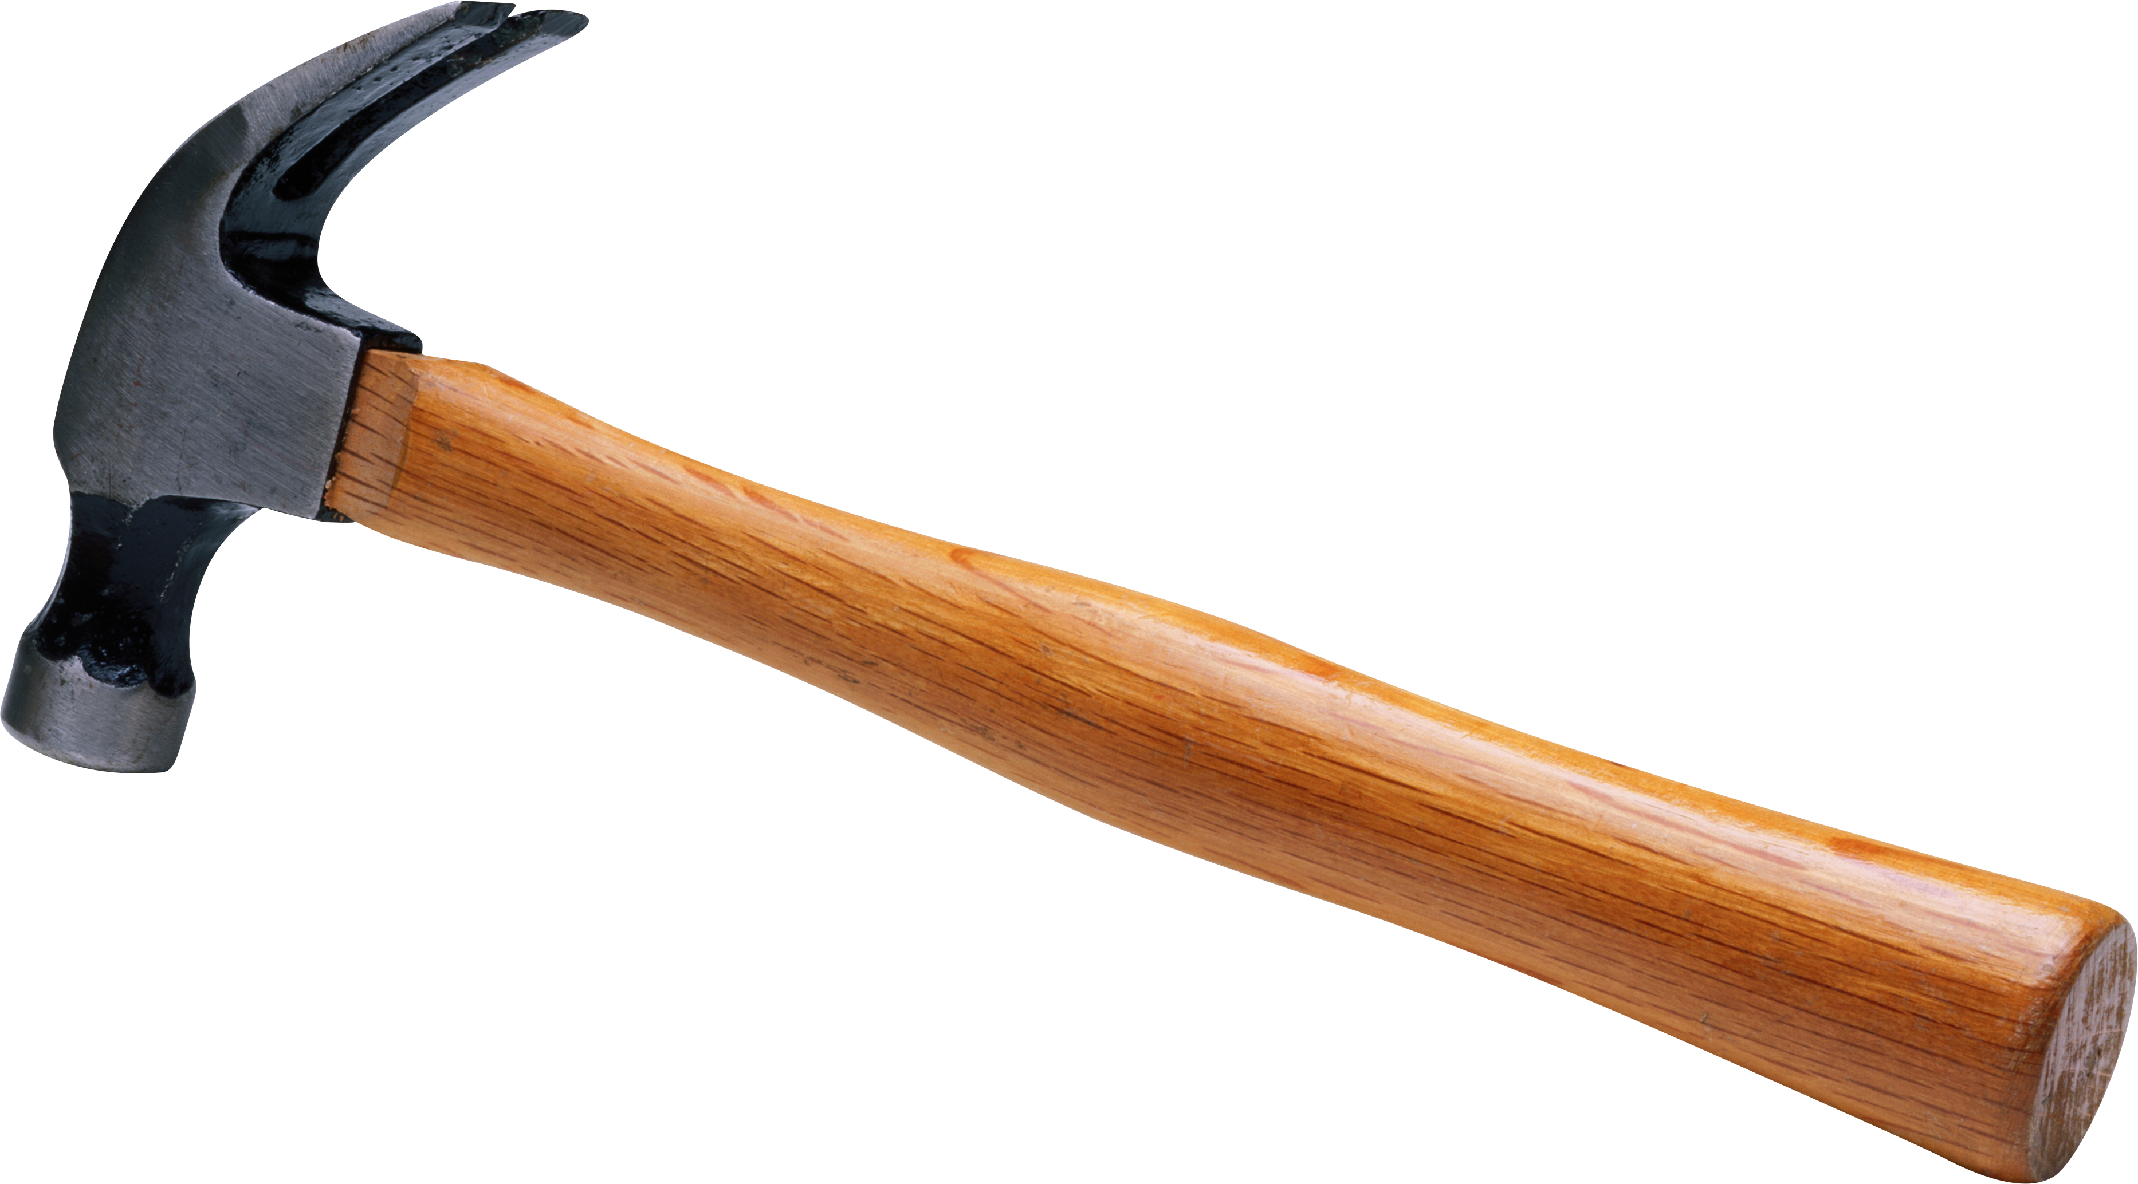
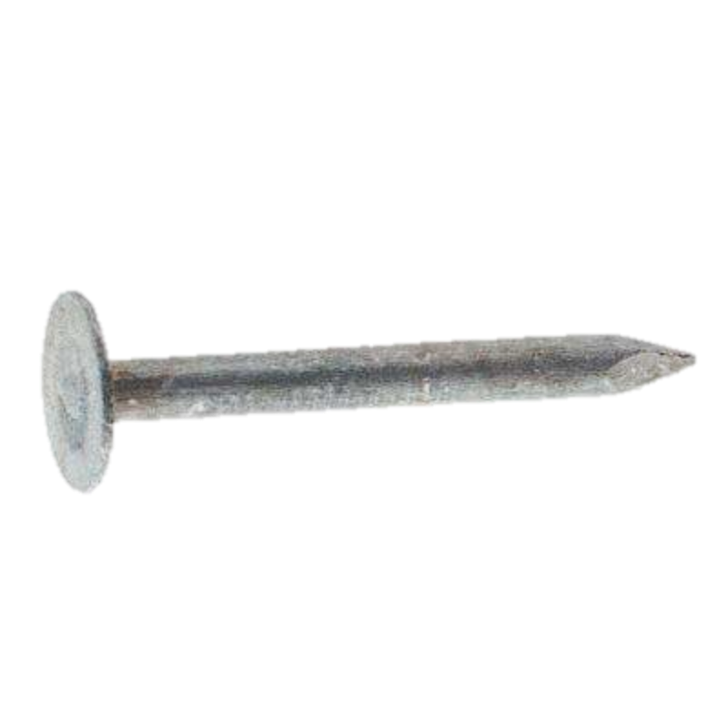
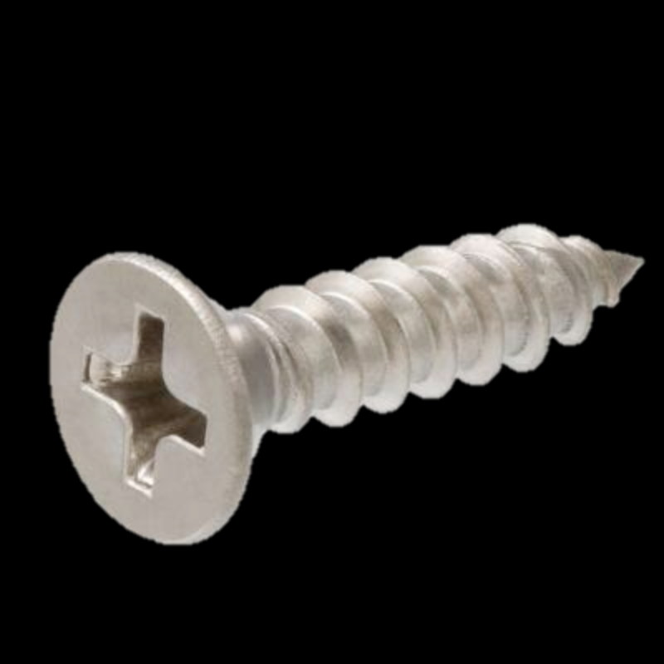
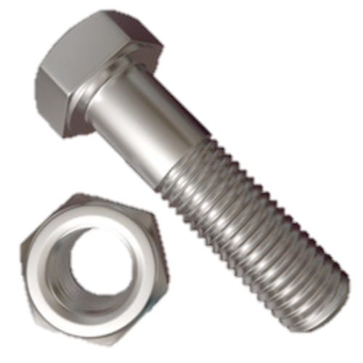
When you have a hammer…
QUERY
3. (finally!) Run analytics
Database
Operational
$$$$$
Database
Database
1. Write software tools
to analyze data
LOAD
LOAD
LOAD
EXCEL DATA
XML/JSON
MACHINE LOGS
90% of the data is never used.
2. Clean, extract, transform, load ALL data

Slide 5

build database to run queries
information
process
cache
access
time
store
collect
data
→ bloated database software

Slide 6
new: one DB per app/data pair
80% of analysts’ time goes to
data preparation and configuration
Main-memory
DBMS
Column
stores
NoSQL
systems
Stream
DBMS
OLAP
Large-scale
embarrassingly parallel
OLTP

Slide 7
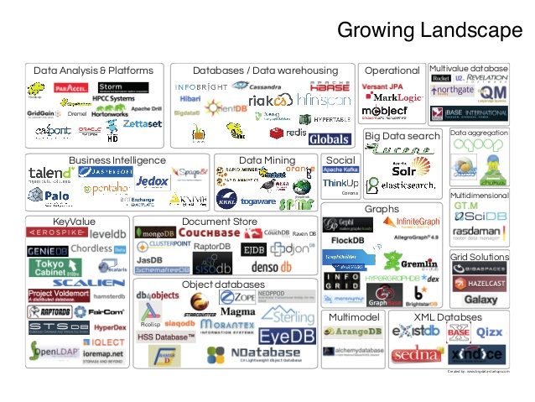

databases will be extinct

Slide 8
The way forward
Data model:
  Support variety (complex structured and unstructured data)
  Col-store/Row-store are only two of many possible layouts
Storage model:
  Don’t store!
  Run in situ and cache based on actual needs/usage
Execution model:
  Generate engine based on query, available caches, history
Fundamentally rethink DB stack

Slide 9
RAW — A lean and agile engine
Adaptive Query Processing
  A database per query and dataset
  SQL++ to query and clean all data
Adaptive data access
  Tune database dynamically
The Human Brain Project
  An inspiring use case
process
cache
access
store
collect

Slide 10
RAW — A lean and agile engine
Adaptive Query Processing
  A database per query and dataset
  SQL++ to query and clean all data
Adaptive data access
  Tune database dynamically
The Human Brain Project
  An inspiring use case
process
cache
access
store
collect

Slide 11
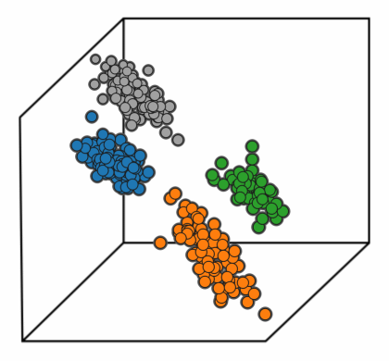





Detecting active spambots
Classify /
Cluster
Transform &
Load
[Symantec data]
Flexibility
Ad-hoc queries
over diverse data formats
Performance
Fast queries
regardless of data format

Slide 12





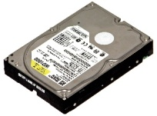
fast queries on heterogeneous data
cannot load into a Database System!
diverse formats
legacy software
privacy limitations
data “owned” by one database
RAW: interface to raw data
With extended SQL
code-generated engine
…
RAW
key: data virtualization

Slide 13
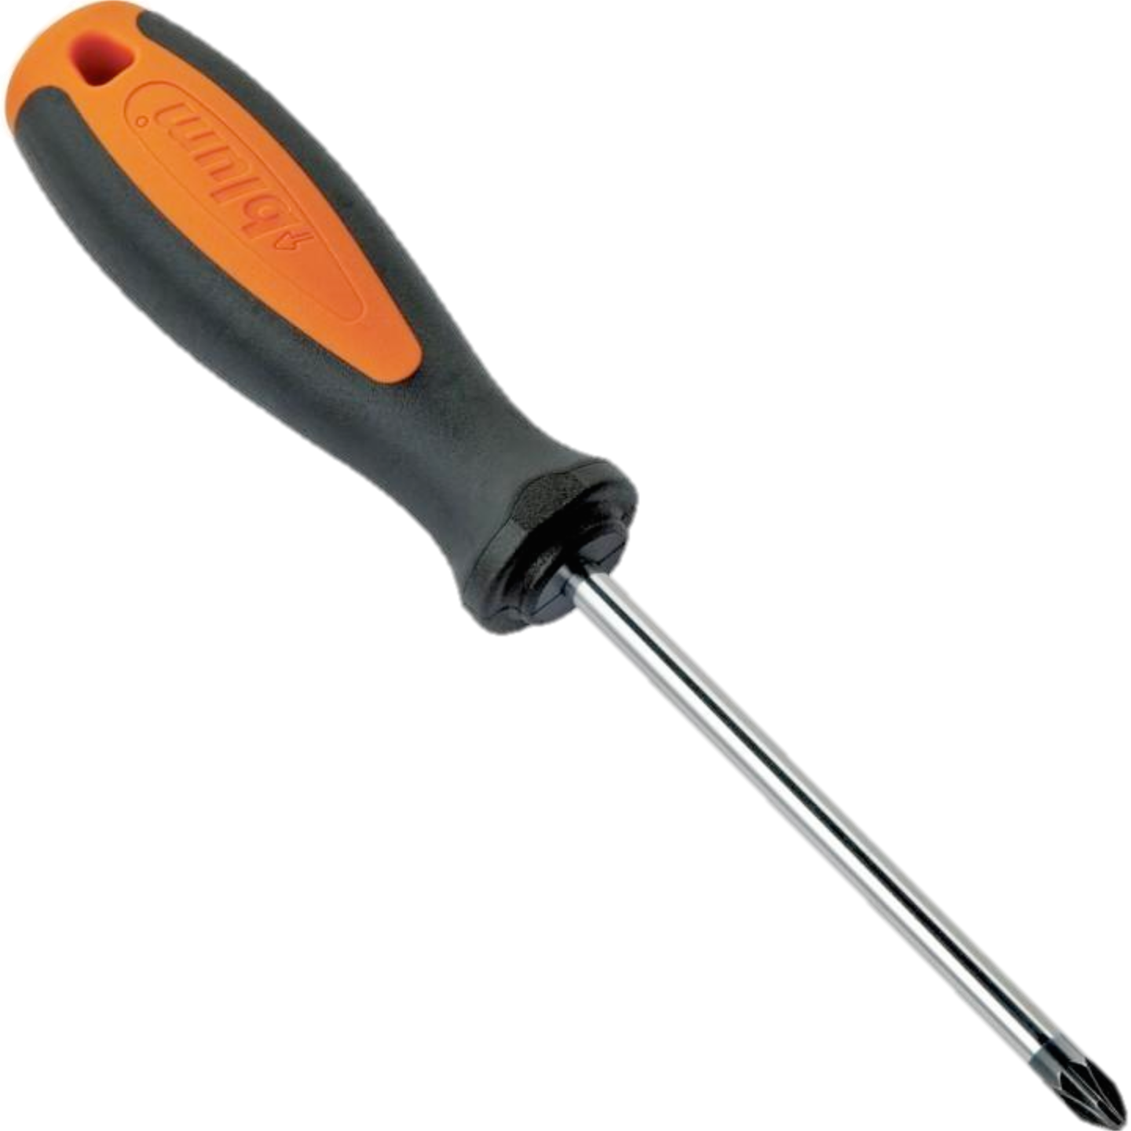
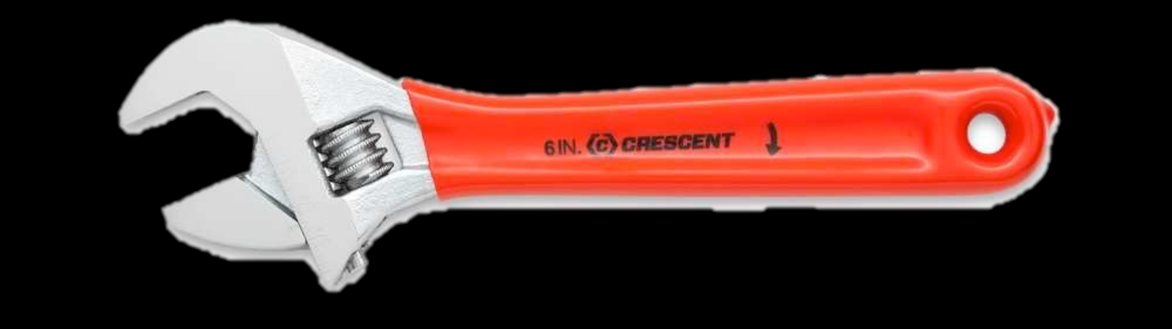
Adapting a query engine to data
Generate plug-in per data source
Treat each source as native storage format
Query original data formats, files, and scripts

Slide 14
How to build a just-in-time data base
[VLDB14,CIDR15,
VLDB16]
join
SELECT bot, country, …
FROM SpamEmail e, SpamCategories c
WHERE e.id == c.id AND
e.lang = ‘English’ AND …
scan
CSV
filter
scan
JSON
DBMS
JSON
CSV
SpamCategories
SpamEmail

Slide 15
How to build a just-in-time data base
join
SELECT bot, country, …
FROM SpamEmail e, SpamCategories c
WHERE e.id == c.id AND
e.lang = ‘English’ AND …
scan
CSV
filter
scan
JSON
Code Generate the Access Paths
Code Generate the Query
Build Position and Data Caches
JSON
CSV
SpamCategories
SpamEmail

Slide 16
Queries Monoid comprehensions
Monoids:
Abstraction for “aggregates” computation
Monoid Comprehensions*:
Operations between monoids
*Fegaras
[SIGMOD95,
TODS 2000,…]
for {
} yield
p <- Patients, r <- BrainRegions,
p.id = r.id, r.amygdala.Vol > 0.2
bag p.age
Sum/Bag/List/Set/Top-K/…
Support multiple data models as input & output

Slide 17




“SQL++” Comprehensions Algebra
SELECT r.age
FROM Patients p
JOIN BrainRegions r
ON (p.id = r.id)
WHERE r.amygdala.Vol > 0.2
for {
p <- Patients,
r <- BrainRegions,
p.id = r.id,
r.amygdala.Vol > 0.2
} yield bag r.age
Internal Calculus
if-else
record construction
function application
(nested) comprehension
…
$$Δ^{bag}$$
$$σ$$
$$Patient$$
$$Brain$$
Algebraic form amenable to relational optimizations

Slide 18
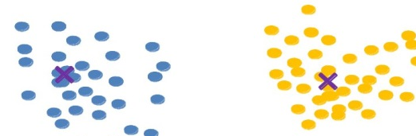
Data cleaning using monoid comprehensions
for(o←orders) yield list split(o.ship_date,”/”)
c₁
c_{n}
dataGroup := for (o←orders)
yield cluster(o.item,kmeans)
…
dictGroup := for (d←dict)
yield cluster(d.item,kmeans)
c₁
c_{n}
…
for(d₁←dataGroup,
d₂←dictGroup,
d₁.center = d₂.center,
similar(metric,d₁.item,d₂.item,θ))
yield group (d₁.item)
Optimize cleaning operations holistically

Slide 19
SQL-like extensions for data cleaning
Functional Dependencies:
orderno, item → quantity
SELECT o.orderno, o.item, *
FROM Orders o
FD((o.orderno, o.item), o.quantity)
Data Deduplication:
SELECT <projections>
FROM <dataset>
DEDUP([<metric>,] [<theta>,] <attributes>)
Mask complex comprehension syntax

Slide 20
Symantec Spam Email Analysis
95GB Binary - 22GB JSON – 22GB CSV
50 queries
suboptimal plan
build
caches
string data & zone maps
zone
maps
BIN
CSV
JSON
BINCSV
BINJS
CSVJS
BINCSVJS
Flexible and fast by specializing & adapting

Slide 21
RAW — A lean and agile engine
Adaptive Query Processing
  A database per query and dataset
  SQL++ to query and clean all data
Adaptive data access
  Tune database dynamically
The Human Brain Project
  An inspiring use case
process
cache
access
store
collect

Slide 22
Querying raw data w/o index:
Diminishing returns
60GB smart meter data,
selectivity 1%,
128GB RAM, 1 thread
Tuning pays off after 45 queries
Loading pays off after 220 queries
Scanning all data is slow
Indexing/tuning non-trivial for ad hoc data

Slide 23
Invest in popular data subsets
Raw
Data
File
Refine partitions over the data => Skip if useless for query
Tune indexes over popular partitions => Minimize data accesses

Slide 24
Adapt to data: Logical partitioning
attr1
attrN
Q₁
Q_{n}
 |  | ...
…
…
Enable data skipping
Fine-grained access path selection
Capture implicit clustering
Iteratively partition dataset
Homogeneous
Query-based
Increase disjointness: Reduce distinct values
Remove tails: Reduce excess kurtosis
Collect data statistics at runtime
Calculate number of sub-partitions
Set the “ground” for reducing data access

Slide 25
Adapt to queries: index tuning
attr1
attrN
Q_{m}
 |  | ...
…
Index tuning on partition level
Choose what & when to build
costs vs. gains
Should I build or not?
What
Value-Existence (i.e., Bloom filters)
Value-Position (i.e., B+ Trees)
B+
When
Based on randomized algorithm
Cost of scan vs. cost of build + gain
Bf
Build and drop based on budget
Maximize gain: build cost vs performance

Slide 26

Append & in-place updates
attr1
attrN
Q_{m}
 |  | ...
Store partition state
- Calculate hash value (MD5)
Monitor file for modifications
Recognize updated partitions
Fix modified partitions
Drop/Re-build cache/index
Bf
B+
Bf
Bf
B+
Bf
 |  | ...
Minimize update overhead

Slide 27
Slalom: Adaptive indexing over raw data
SQL query
Incremental logical partitioning
Based on data distribution
Raw Data Access
Adaptive partition indexing
Based on access patterns
Indexing
Structures
Online tuner
Raw Data Access
Monitors data for updates
Updates data structures
Raw data
Combining Online Tuning with Adaptive Indexing
Adapt data access to queries and data at runtime

Slide 28
From raw data to results
59GB uniform dataset, 128GB RAM, cold caches
1000 point & range queries interchange on 2 attributes, sel: 0.5%-5%
1439.71
757.96
~
~
In-situ adaptive indexing achieves interactive access
28

Slide 29
RAW — A lean and agile engine
Adaptive Query Processing
  A database per query and dataset
  SQL++ to query and clean all data
Adaptive data access
  Tune database dynamically
The Human Brain Project
  An inspiring use case
process
cache
access
store
collect

Slide 30

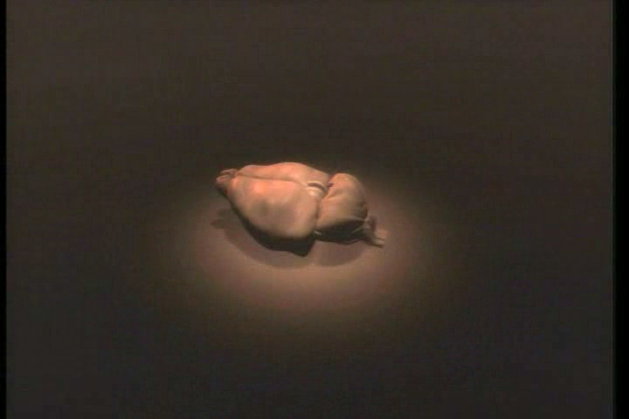
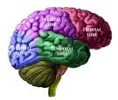



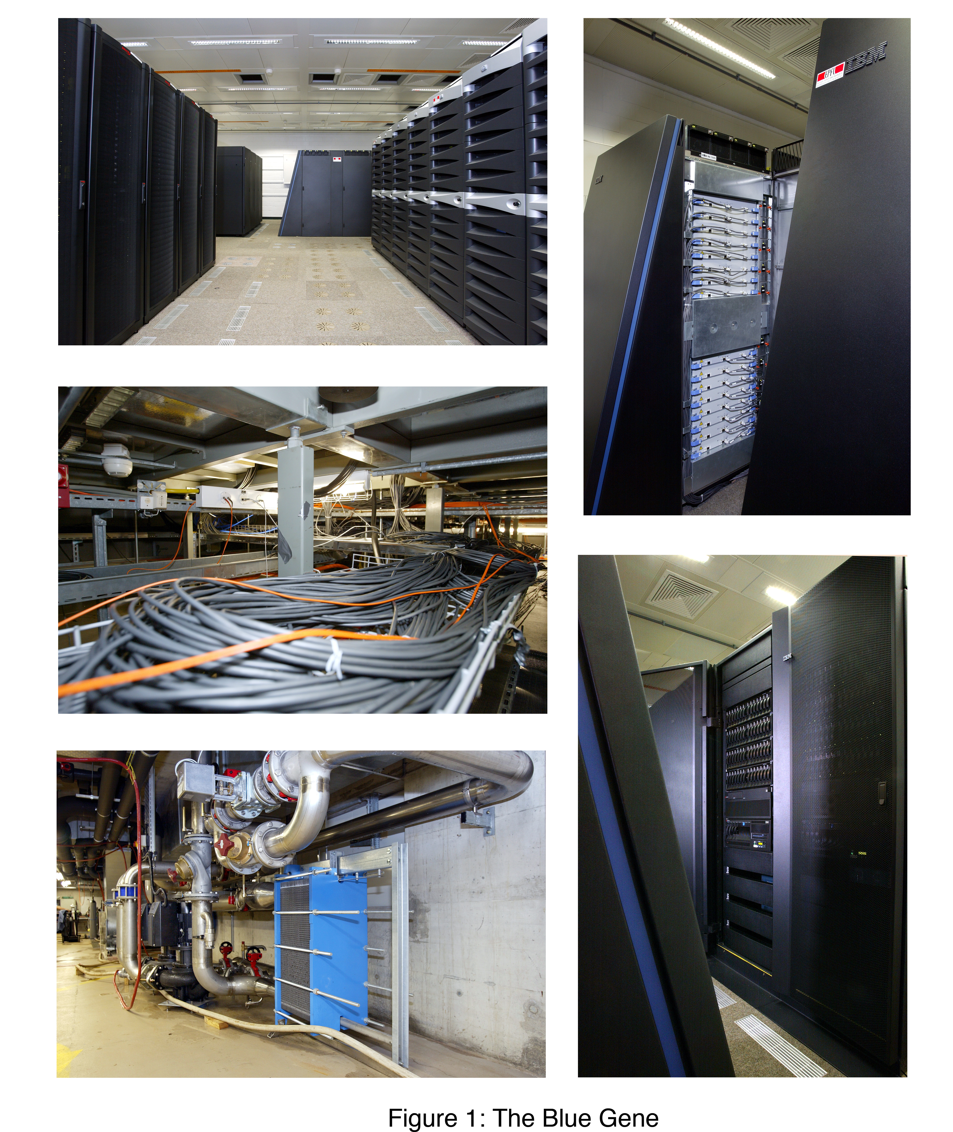
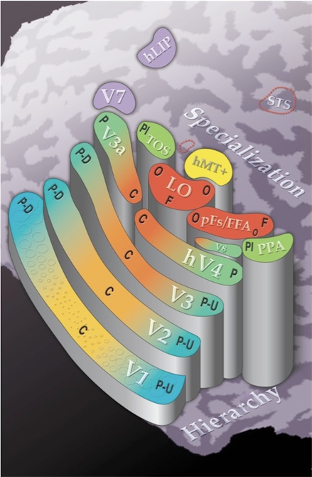

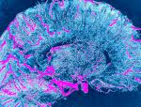
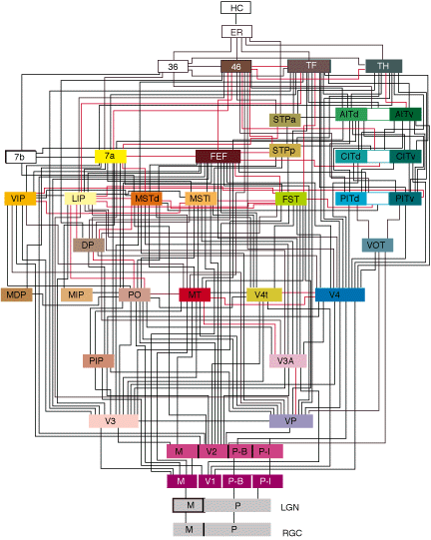
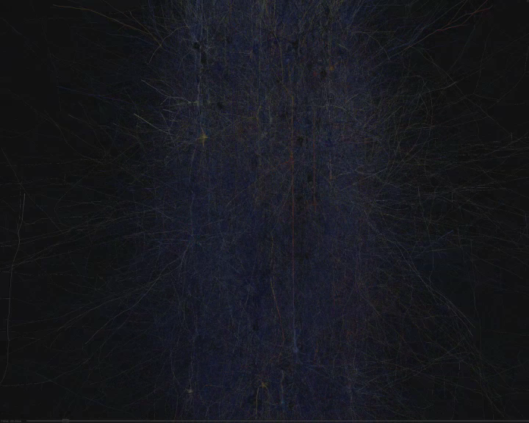
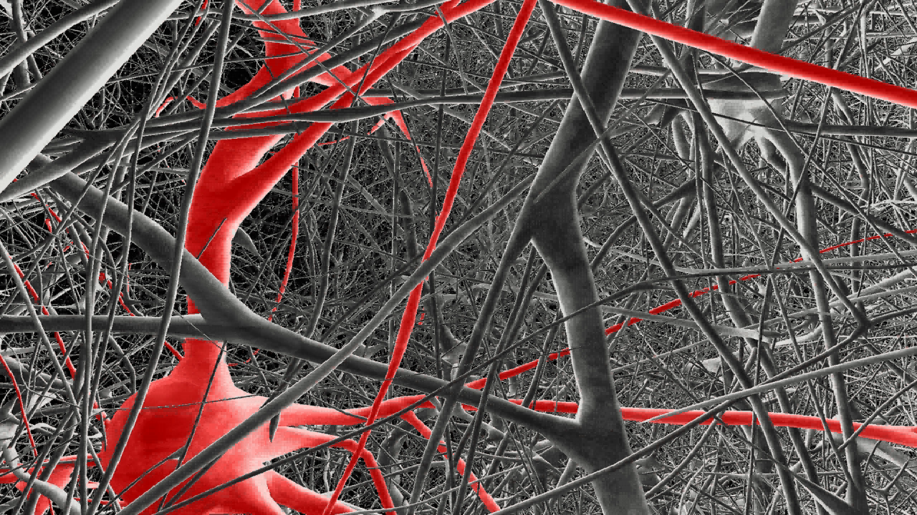
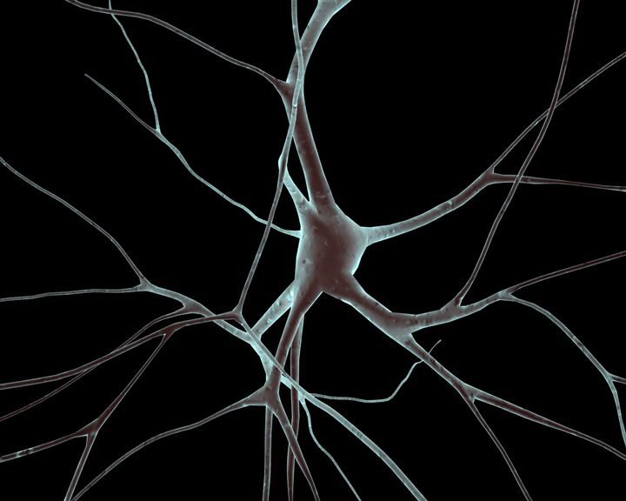
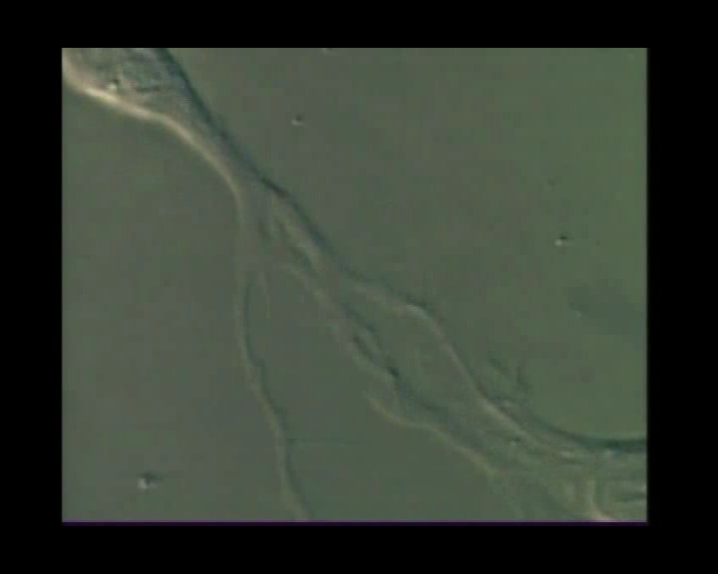
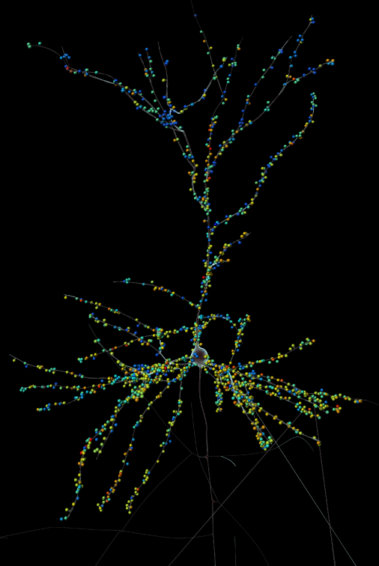


human brain project
cognition
data
knowledge
patterns
whole brain
rules
unifying models
circuits
synapses
neurons
integrate clinical and simulation data
molecules

Slide 31
patient data: medical informatics
health services
epidemiology data visualization
hypothesis testing
clinical trials

Slide 32
biological disease signatures
the coupling of
clinical measurements with
validated biomarkers
Example: Alzheimer’s disease
Clinical - Phenotype
Cognition: memory
Functional capacity
General physical health
Quality of life
Proteomic Biomarkers
CSF protein: beta amyloid level, tau protein
Genomic Biomarkers
Rare genetic mutation: APP, PSEN1, PSEN2
Common genetic variant: APOE e4e4 …
Structural Biomarkers
Volumetric change: hippocampus, inferior temporal cortex…
Beta amyloid imaging
memory loss/tau level/APOE e4e4/hippocampus atrophy/amyloid

Slide 33
medical informatics platform
visualization
analysis
diagnostics
unified portal
federation
PRIVACY
PRIVACY
create a local store
local data mirror
local data mirror
scans
clinic
labs
scans
clinic
labs
hospital 1
hospital N

Slide 34
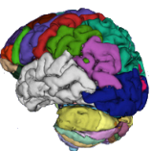
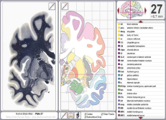
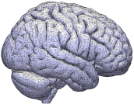
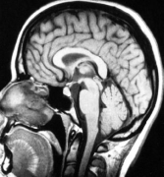
image preprocessing (Lausanne)
3d image of the brain
Identified tissue types
Normalized and mapped to brain regions
MRI scan
(DICOM)
Data store
Features
NIFTI conversion
Segmentation
Tissue types
Normalization
Feature
Extraction
script converts
DICOM to
NIFTI
format
(3d volume)
Image processing
to discover
the type of tissue each
voxel corresponds to
data normalized to same standards, format
intermediate data also available
extract interesting features from normalized data

Slide 35

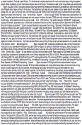
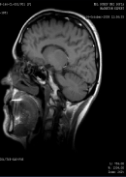
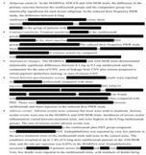
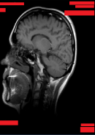
two-level anonymization
Federation and data map
exclude fields
aggregate values
remove keywords
query `filter
response cleaner
database
anon headers
match words
mask images
personal identifier eraser
each hospital’s responsibility

Slide 36
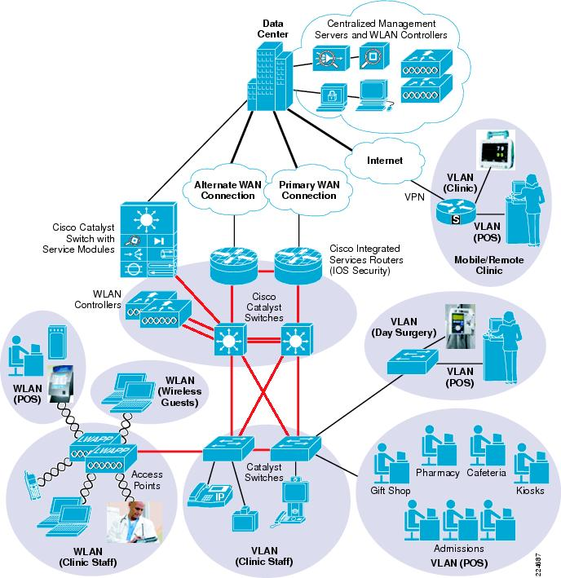

access to private hospital data
no move, no copy

Slide 37
clinical+genetic+imaging data → signature
Patients (CSV)
Brain_GrayMatter (Binary)
id | Protein: AACT | Age | Phenotype | …
1 | 1.4 | 45 | Trauma | …
2 | 2 | 55 | Chronic Symptoms | …
3 | 0.2 | 56 | … | …
 | 0 | 1 | … | n
0 | 0.45 | 0.75 | … | 0.1
1 | 0.33 | 0.3 | … | 0.38
… | … | … | … | …
m | 0.12 | 0 | … | 0.47
BrainRegions (JSON)
signature:
age > 50
AND
amygdala.Vol > 0.3
AND
AACT < 1
[{"id": 1,
"amygdala": {"X":15,"Y":20, “Vol”: 0.5},
"hippocampus": {"X":17, "Y":10, “Vol”:0.2}},
{"id": 2, ...},
{"id": 3, ...}]

Slide 38
How RAW works
1. Ask a question
2. Generate the needed software tools
3. Discover interesting data
EXCEL
Database
XML/JSON
Database
MACHINE LOGS
Data is accessed and integrated in real time

Slide 39
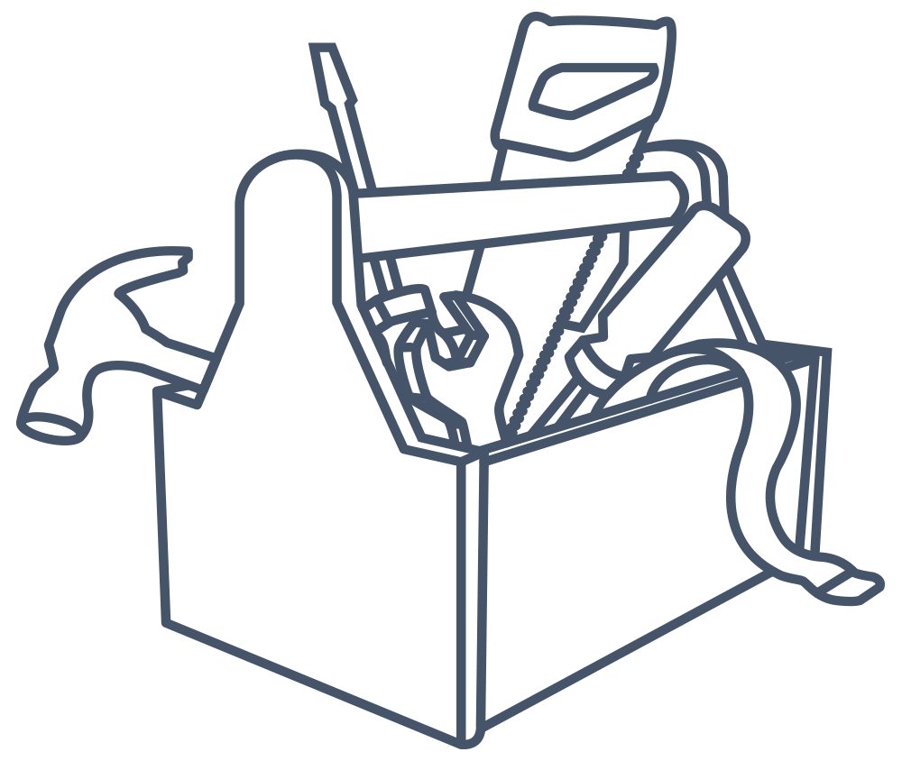
Why RAW is fast
RAW
memory
Just-built useful tools
Frequently used data
EXCEL
Database
XML/JSON
Database
MACHINE LOGS
As queries run, RAW remembers information on data accessed
and generated code. Its “database” is only the useful data.

Slide 40

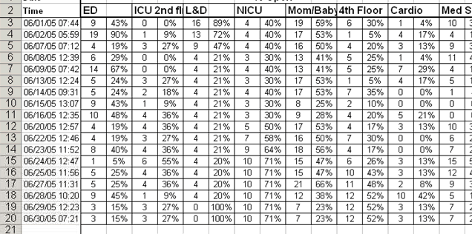
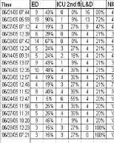
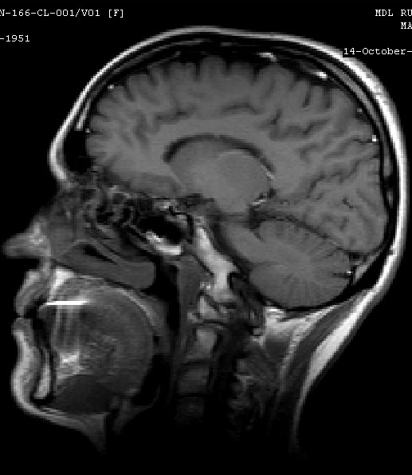
deployment: hospital data mirror
analysis
data federation
query Client
Lab
Results
Clinical
data
RAW query engine
CSV
Medical Data
Scans
(MRI, CT)
CSV
EXCEL
DICOM
Features
raw data
Nifti
extract
anonymize
convert
Other
Data

Slide 41
Medical Informatics Platform
visualization
analysis
diagnostics
Q
unified portal
Niguarda (IT)
UniClinic (DE)
CHUV (CH)
User Interface
User Interface
User Interface
A
Q
Federation and Data Map
Federation and Data Map
Federation and Data Map
Q
Q
A
A
A
RAW Query Engine
RAW Query Engine
RAW Query Engine
Hospital Data
Hospital Data
Hospital Data

Slide 42
What we learned
currently data management cost grows with data owned
impossible to pre-cook a database system suitable for all data
from manual ingestion to automatic adaptation: rethinking DB stack with just-in-time queries and storage

Slide 43
RAW
Just ask. dias.epfl.ch raw-labs.com
Notes:
Ask away.
Ask ahead.
Go ahead, ask.
Go ahead and ask.

