Slide 1
B->X_{s}γ at B-factories
Antonio Limosani
University of Melbourne

Slide 2
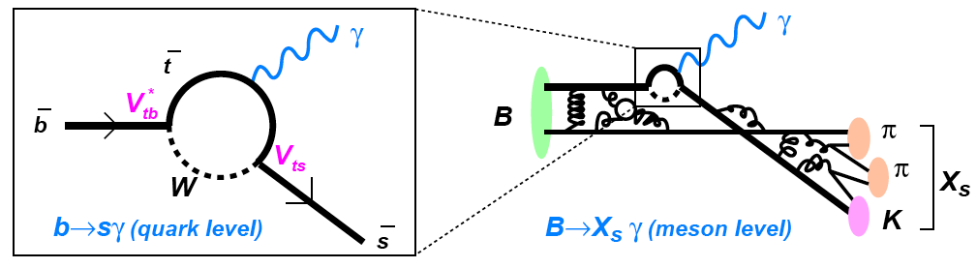
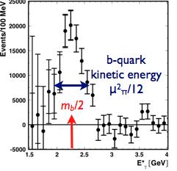
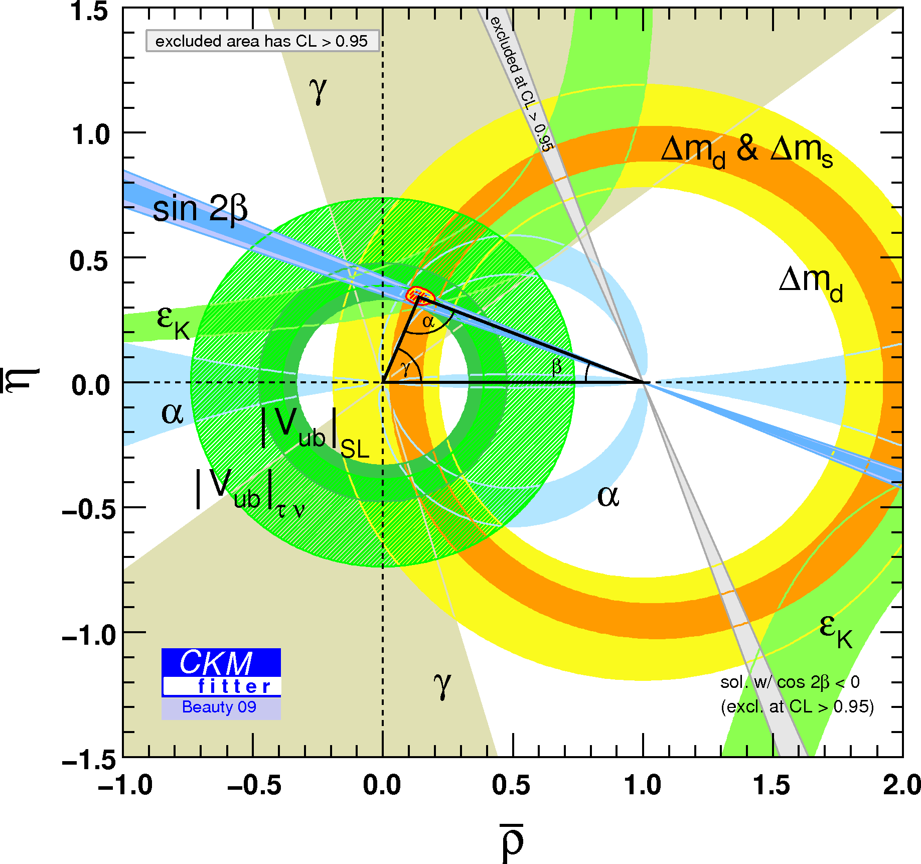
Dynamics of radiative B decays
Total decay rate and CP asymmetry: Probe for New Physics
Differential decay rate : Photon is a messenger of the dynamics of the b-quark
“b”-quark mass essential input to |V_{ub}|

Slide 3
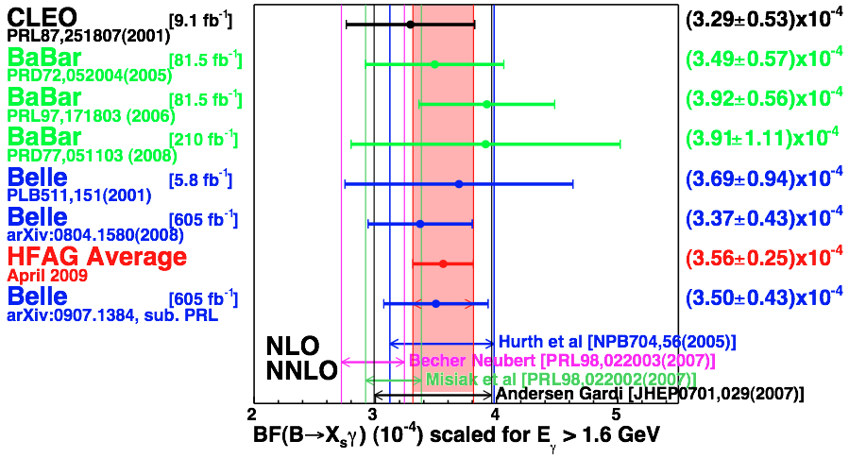
Branching fraction summary
Moments of the spectrum are crucial to the extraction of the average.

Slide 4
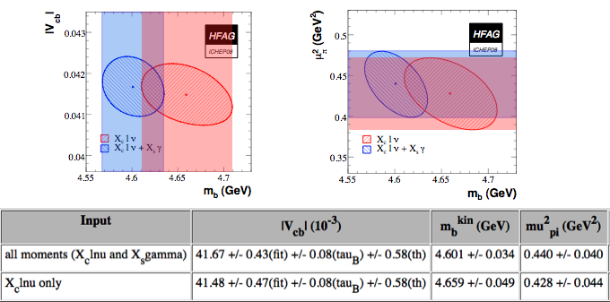
In the Global fit

Slide 5
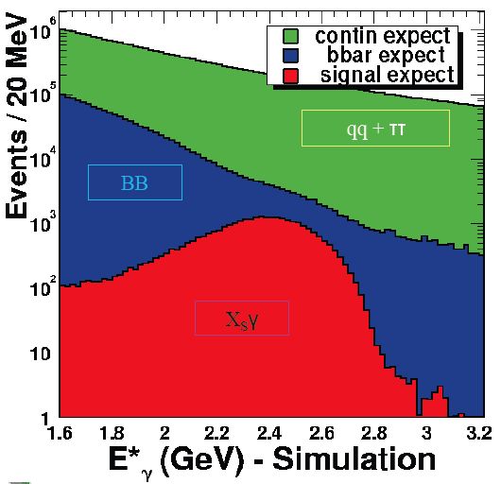
Challenging Measurement
Overwhelming background from
  Continuum under the Y(4S) peak from light quarks and tau pairs
  Light meson decays cascaded from Y(4S)
Exponential rise as photon energy is lowered. But theory uncertainty decreases
Cuts E(γ) > 1.7, 1.8, 1.9, 2.0 GeV
Techniques
  Sum of exclusive modes : Reco γ and X_{s} as K+nπ
  Fully Inclusive: Reco γ with/out lepton tag
  Full reconstruction B-meson tag: Υ(4S)->B1B2
  Reco B1->D(nπ) + γ from B2

Slide 6

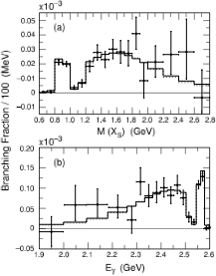
Sum of Exclusive modes
Reconstruct the hadronic Xs system as sum of K/Ks + nπ±/π⁰ and isolated γ
Excellent resolution on M(X_{s}) → E_{γ} relies on momentum measurement → tracking detectors
Spectrum in the B meson rest frame
Eliminates much of the photon background
“s”-quark fragmentation and un-measured Xs contribution is poorly known
Aubert et al. Phys.Rev.D72:052004,2005.
~81/fb

Slide 7
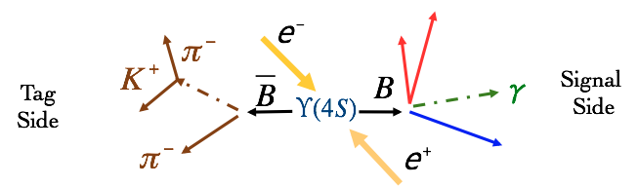
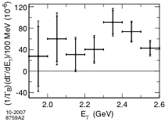
Full Reconstruction
Tag B is fully reconstructed in a hadronic decay mode and search for an isolated photon from the other B decay
Negligible continuum background
B rest frame, B flavour
Very low efficiency for full reconstruction ~0.3%
Aubert et al. Phys.Rev.D77:051103,2008
~210/fb

Slide 8
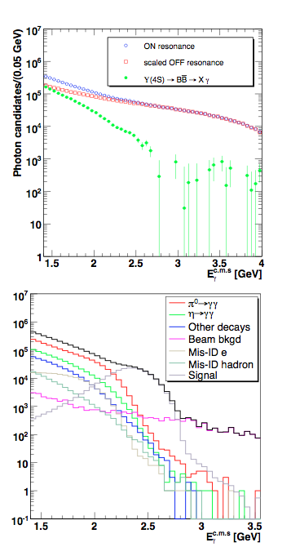
Fully Inclusive
Find isolated clusters in the calorimeter
High Energy E_{γ} > 1.4 GeV
Veto γ from π/η & Bhabha and use event topology and/or lepton tag to suppress continuum background
Estimate continuum bkgd using off resonance data
Estimate B-decays using “corrected” MC sample

Slide 9

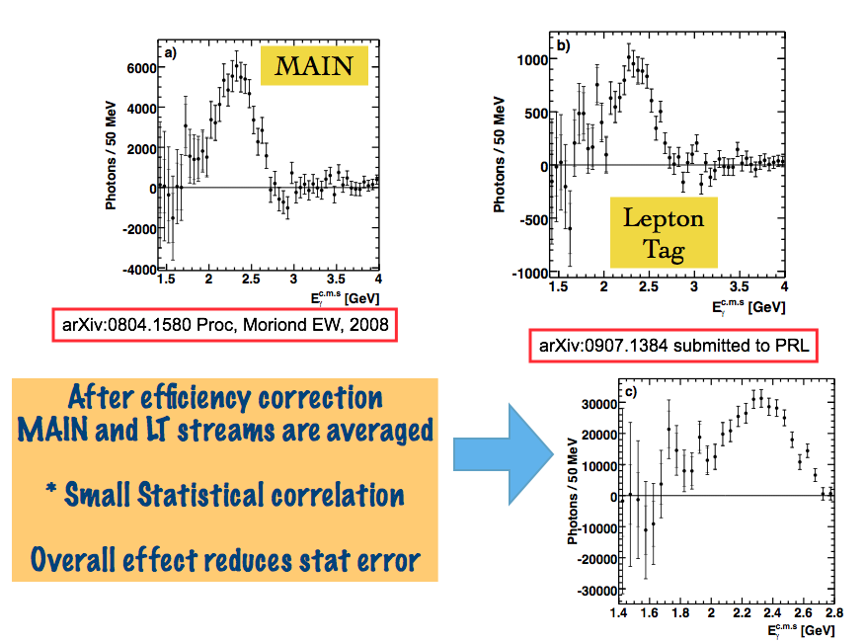
Fully Inclusive Spectrum
605/fb

Slide 10
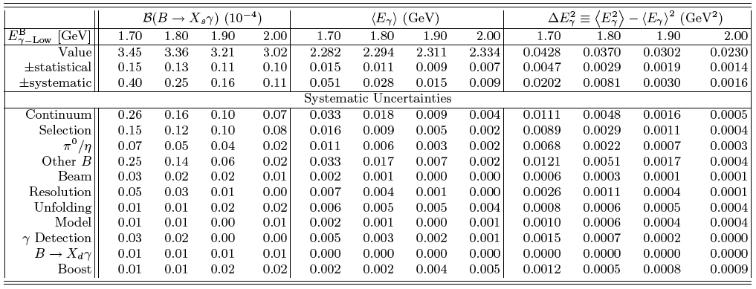
Summary of Results
A.L et al (Belle) Submitted to PRL arXiv:0907.1384
BF(B->Xs γ : E > 2.0 GeV )
(3.02 ± 0.10 ± 0.11 ) x 10⁻⁴ Belle 2009
(3.41± 0.27 ± 0.29 ) x 10⁻⁴ BABAR 2006
(2.94 ± 0.39 ± 0.25 ) x 10⁻⁴ CLEO 2001
μ(B->Xs γ : E > 2.0 GeV )
(2.334 ± 0.007 ± 0.009 ) x 10⁻⁴ Belle 2009
(2.316 ± 0.016 ± 0.010 ) x 10⁻⁴ BABAR 2006
(2.346 ± 0.032 ± 0.011) x 10⁻⁴ CLEO 2001

Slide 11
Overall summary
Analysis | Current
Inclusive full B Recoil Signal events Stat error Sys error M(ES) fit BB bkgd | 119 +/- 22 23% @ 210/fb ~12% ~9%
Inclusive Lepton tag Signal events Stat error Sys error Model dependence BB bkgd | 758 +/- 66 8% @ 81/fb ON 9.6/fb OFF ~8% ~6%
Inclusive : No tag Signal events Stat error Sys error BB bkgd Continuum | 68960 +/- 3770 5.6% @ 605/fb 5% 5% (dep. ON/OFF ratio)
Sum of Exclusive modes Signal events Stat error Sys error Missing Xs fraction Xs fragmentation | 1513 +/- 85 6% @ 81/fb ~10% ~6%
Full recon B tag analysis is certainly the future w.r.t a Super B-factory
Background from B in the lower energy region will be the biggest problem. Some nice techniques in untagged analyses to measure bkgd from pi0 and eta, and correct for effects of hadronic clusters in the EM calorimeter. The latter is somewhat limited. Should investigate control sample of K_L.
Can we learn about Xs fragmentation by studying Xs in the recoil measurement?
Henning Flächer Talk@Vxb2007 Heidelberg

Slide 12
Model errors
In 2004 Belle inclusive analysis, model error was assigned based on the comparison of two models for B->Xs γ. 2.5% on the partial branching fraction at 1.8 GeV.
In 2007 BABAR inclusive analysis, sophisticated iterative procedure on measured moments data to decide the model parameter. Correction factors to correct for smearing and B rest frame 7.9% on the branching fraction at 1.9 GeV.
In 2008/9 Belle inclusive analysis, theory spectra are matched to the measured spectrum, thus model parameters are chosen based on full spectrum. Done for 5 signal models. Entire correction procedure is dependent on the given model and parameters. Correction includes unfolding for distortion in the Calorimeter. Uncertainty assigned based on the difference between models. 0.5% on the partial branching fraction at 1.7 GeV.
Why are they so different?
These numbers propagate to the global fit, we need to be aware and estimate if they are having an impact

Slide 13
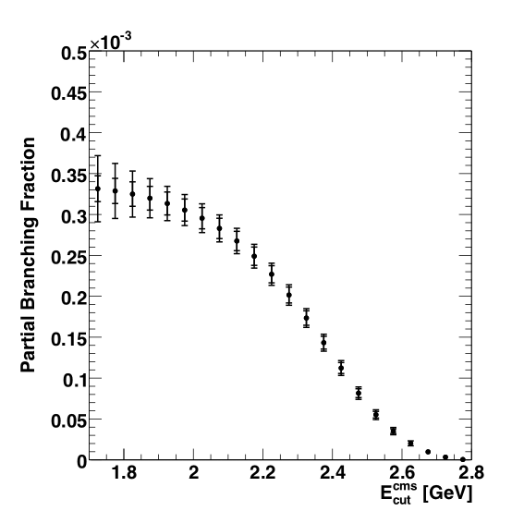
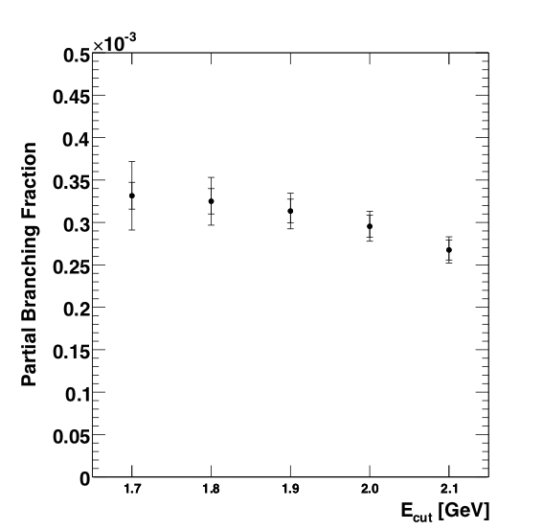
Υ(4S) to B frame
Fully inclusive measurements are our most precise to date, but all in Υ(4S)
Correction to B-frame is model dependent, and, moreover increases as the lower threshold energy cut is raised
This model error can’t be avoided, can we use Y(4S) data instead of B frame data
Y(4S) frame
Y(4S) frame
B frame
E(cut) PBF
GeV [10⁻⁴]
2.0 2.95±0.14±0.12
2.0 2.94±0.14±0.12±0.02
2.1 2.68±0.12±0.10
2.1 2.62±0.12±0.10±0.05
B frame

Slide 14
Global fit of all data
As is done with Vcb, mb, and other HQET parameters, it is time we performed a fit to all B->X_{s}γ data?
The expression for B->X_{s}γ BF is normalised by the B->X_{C}lν branching fraction and moreover the extrapolation to low threshold depends on HQET parameters. Can we add the BF for B->X_{s}γ to the global fit?
Otherwise all B->X_{s}γ partial branching fractions and moments alone can be fit in a given scheme/model to yield
  BF(B->X_{s}γ : E>1.6 GeV)
  b-quark mass
  μ²_{π}

Slide 15
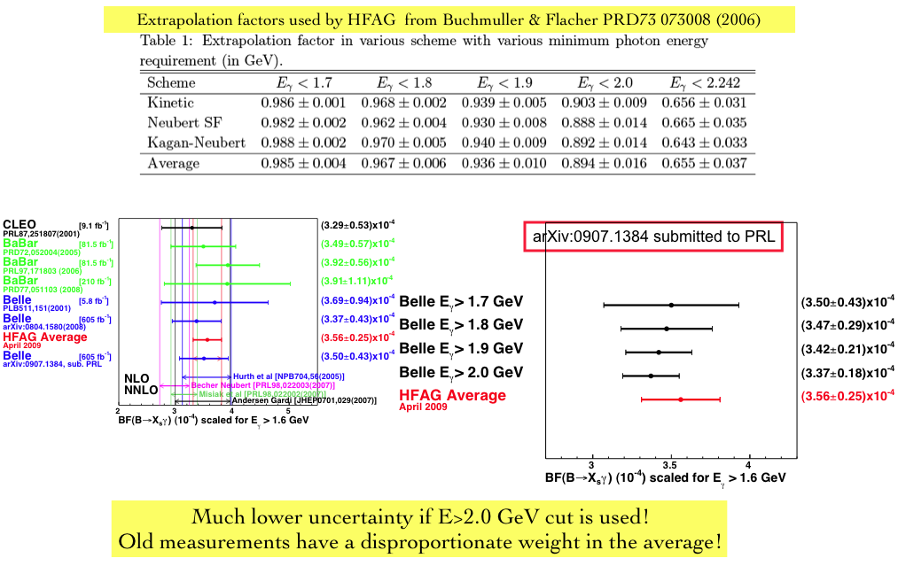
Problem with the W.A ?

Slide 16
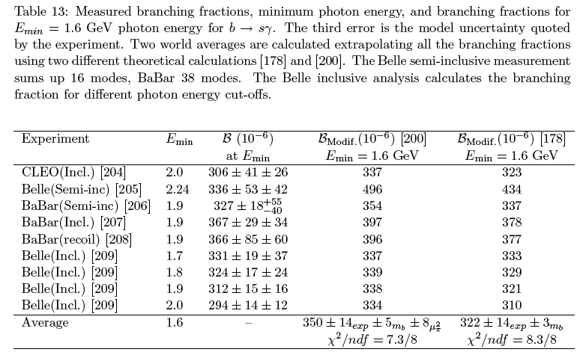
Proposed solution
One way to alleviate this problem is to include all measured data in the fit, e.g all PBF measurements at the different cuts. To do this correctly one needs to use the correlations between correlated measurements.
A.L. did this in Artuso, Barberio & Stone “B Meson Decays” PMC Phys.A3:3,2009.
The uncertainty on the average of experimental measurements
is reduced from 7% to 5%. In terms of constraining new physics
this would have have a big impact! Including unused data from
BABAR would improve the average even further.

