Slide 1

ENLIGHT 2019
Annoucement of a proposal for next year

Slide 2
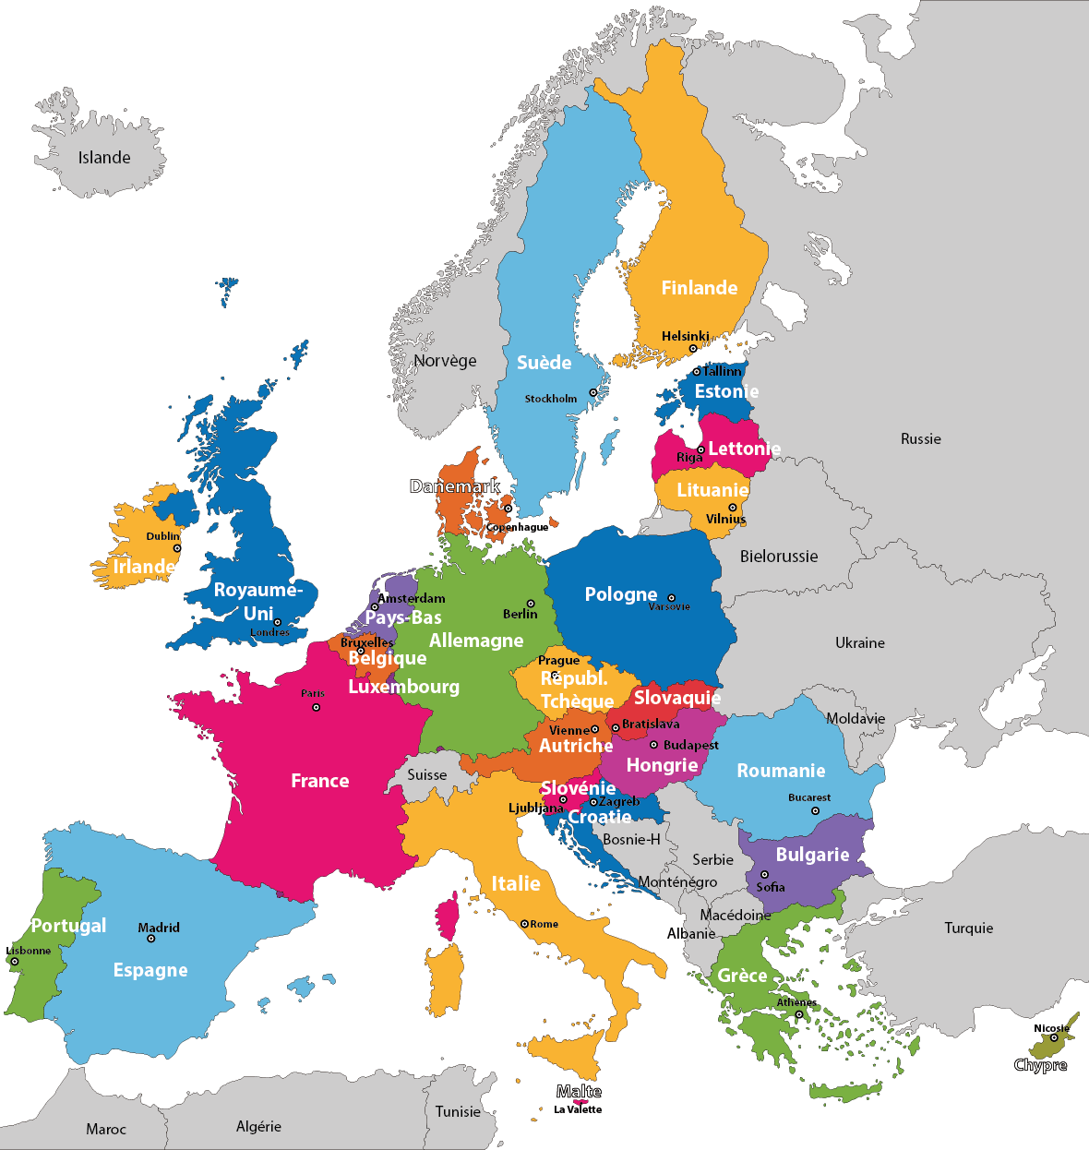
Where?

Slide 3
Where?

Slide 4
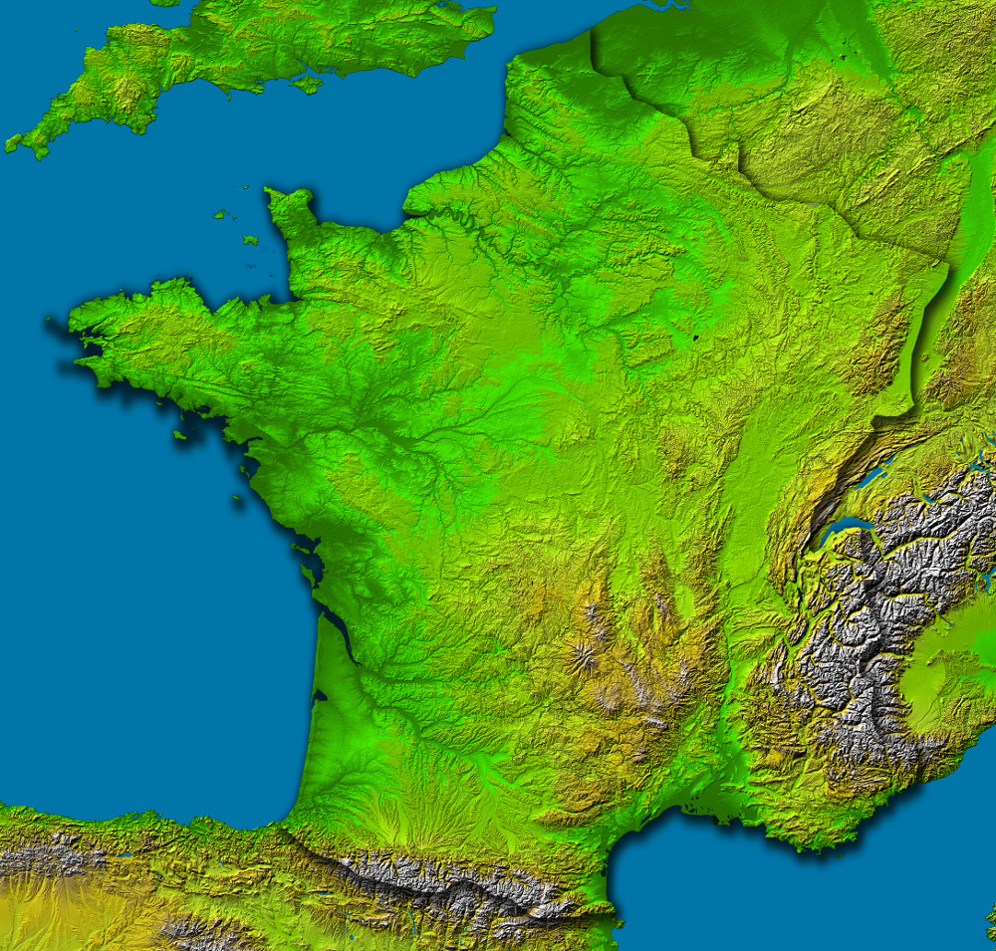
Where?

Slide 5

Where?

Slide 6
Where?
Paris
Rouen
LeHavre
Cherbourg
and
CAEN

Slide 7


Slide 8
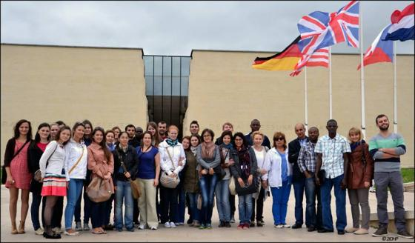

Slide 9
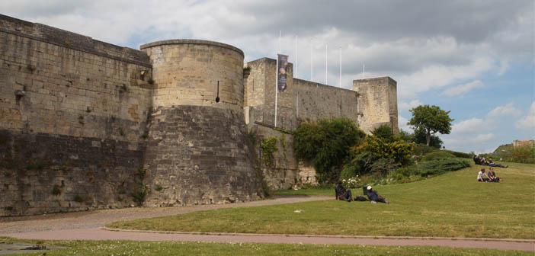

Slide 10
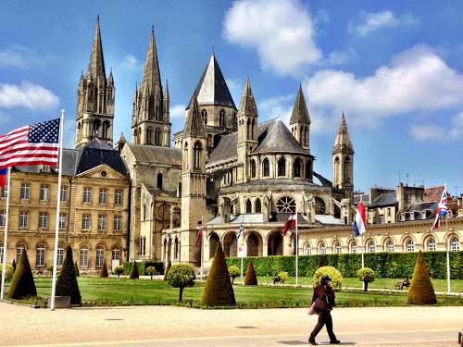

Slide 11
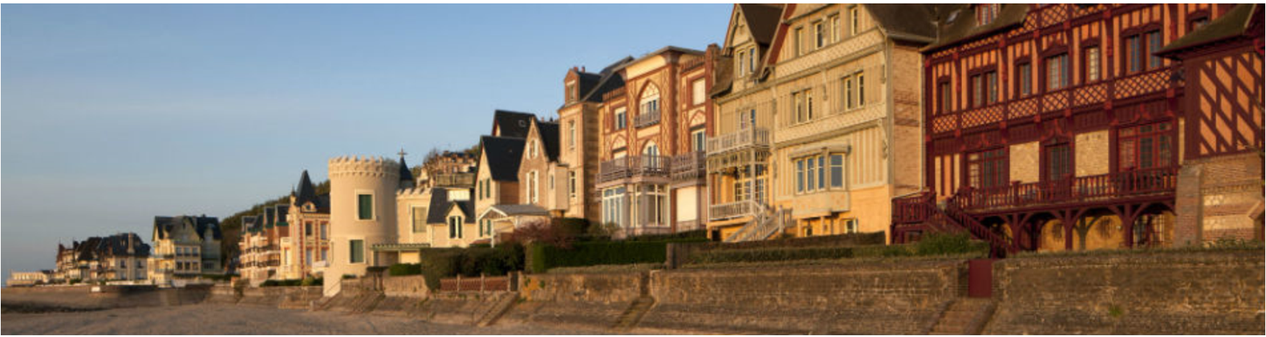

Slide 12


Slide 13
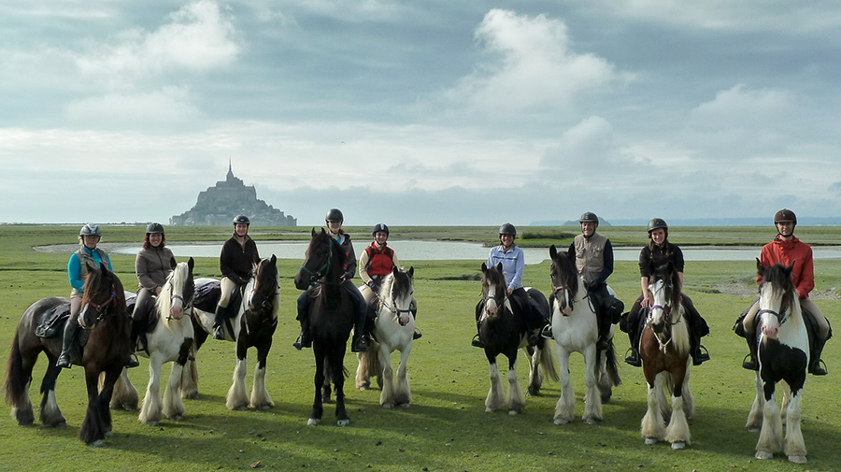

Slide 14
When?
The very first week of July 2019:
Monday 1st to Wednesday 3rd

Slide 15
When? Tentative schedule
Monday 1st July
Training day (on the campus):
  morning and afternoon
EPTN meeting (at CFB):
  Afternoon
  and evening
Tuesday 2nd July
ENLIGHT annual meeting day 1 (at CFB):
  Morning and afternoon
Social event somewhere in Normandy
Wednesday 3rd July
ENLIGHT annual meeting day 2 (at CFB):
  Morning and afternoon
Visit of CYCLHAD building possibly after patient duty.

Slide 16

Why?
A hadrontherapy center has been built in Caen and will begin proton treatments this July 2018: the CYCLHAD center
But as important: around this protontherapy modality is existing a scientific ressource center for hadrontherapy research, the main part of the
project

Slide 17
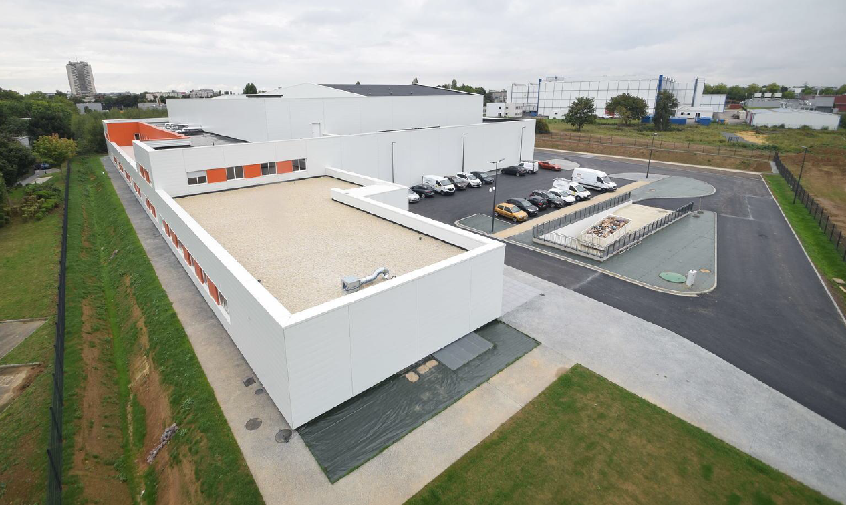
The CYCLHAD SAS building completed in 2017

Slide 18
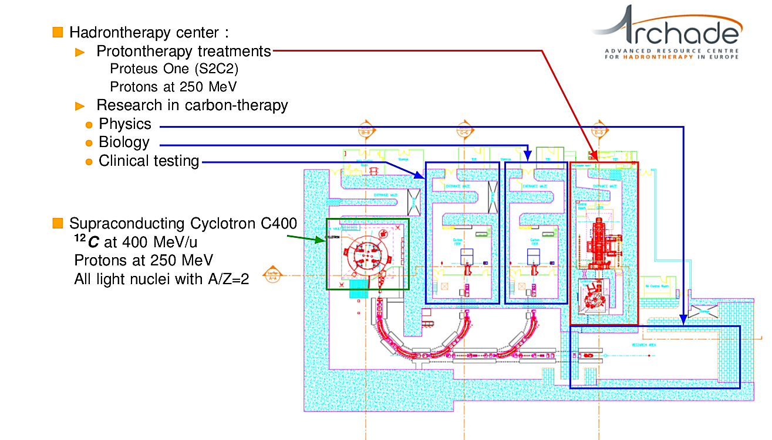
The CYCLHAD SAS premise is hosting treatment and experimental rooms…
1
2

Slide 19
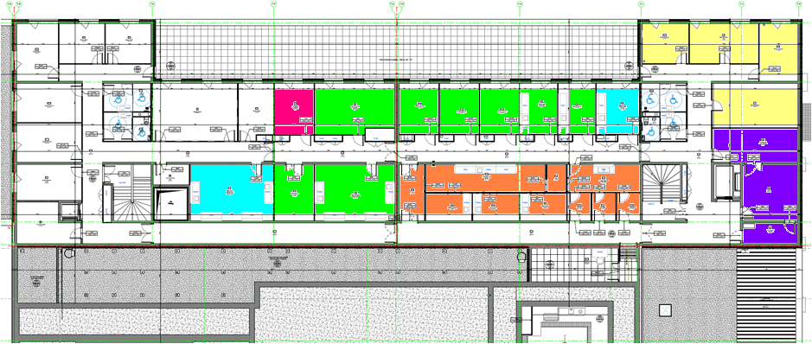
… and surfaces for laboratories
At the 2nd floor, 28 rooms devoted to science (researcher offices, laboratories, animal house, and logistic spaces) totalizing about 500 m ²

Slide 20


The CYCLHAD SAS received the installation of the Proteus®One in September 2017

Slide 21
The CYCLHAD SAS 4 pillars to receive the C400 for its assembly starting in 2020

Slide 22
The CYCLHAD SAS the beam lines hall seen from the physics exp. room

Slide 23
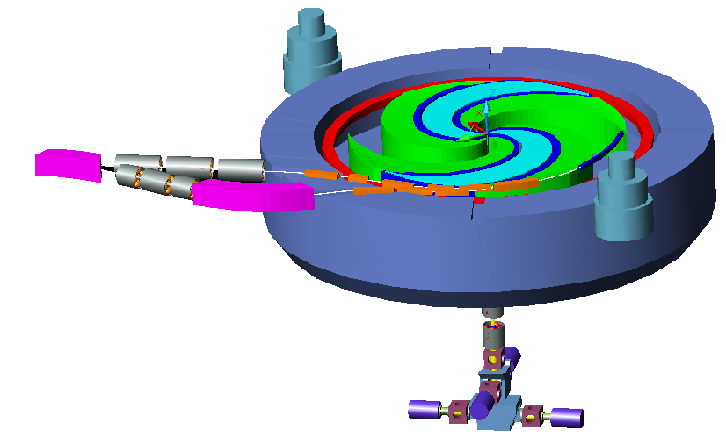
The production of C400 by NHa SAS
The C400 has been designed by Russian teams of Doubna between 2006-2009 for IBA under the direction of Yves Jongen
The PI is presently owned by the ARCHADE organization in Caen
It will by an isochrone super conducting cyclotron able to accelerate Protons, He, Li, B, C, N, O, Ne

Slide 24
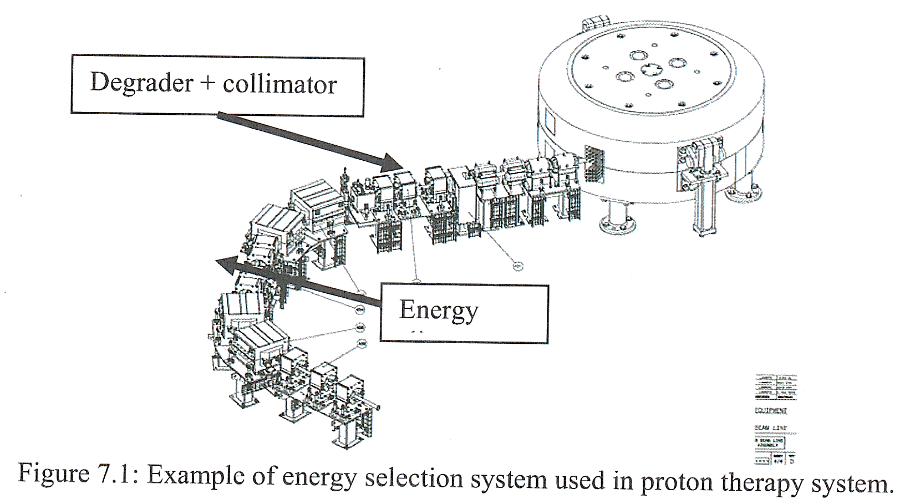

Slide 25










Several research institutions are supporting the scientific programme under the coordination of the ARCHADE association

Slide 26
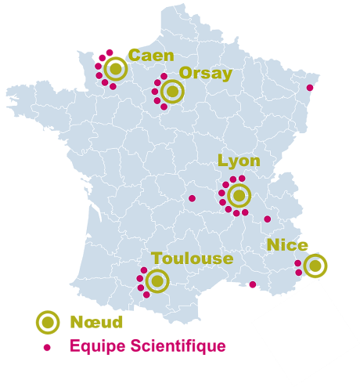
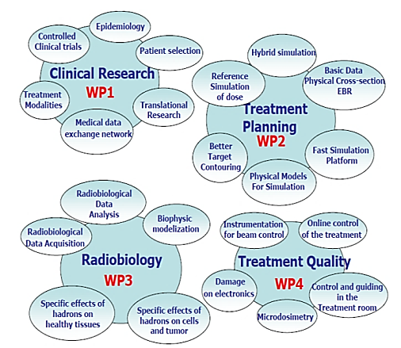

The ARCHADE project in Caen : position in France …
… coming soon: RADIOTRANSNET

Slide 27
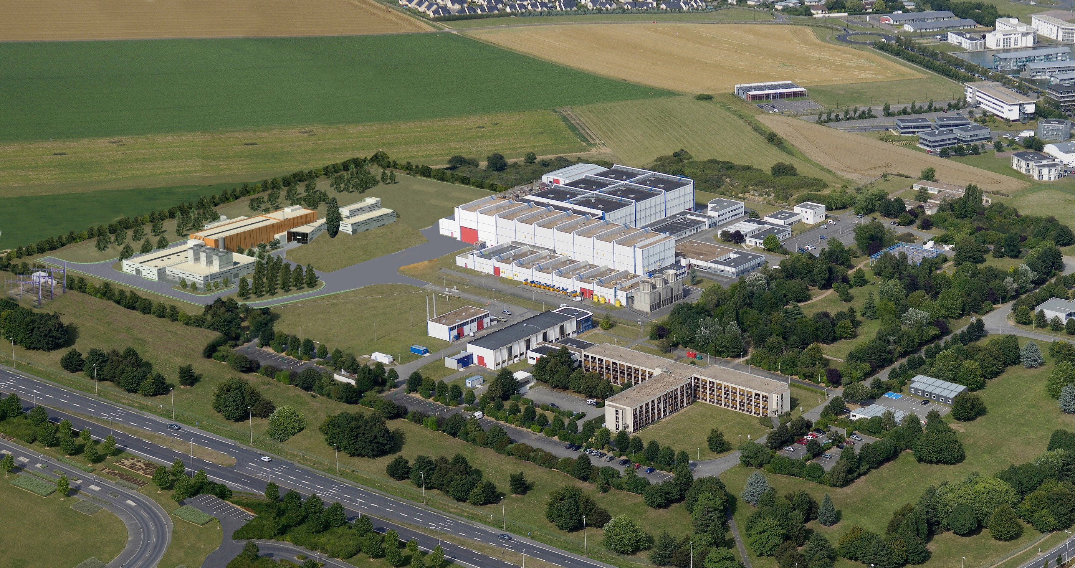

Slide 28
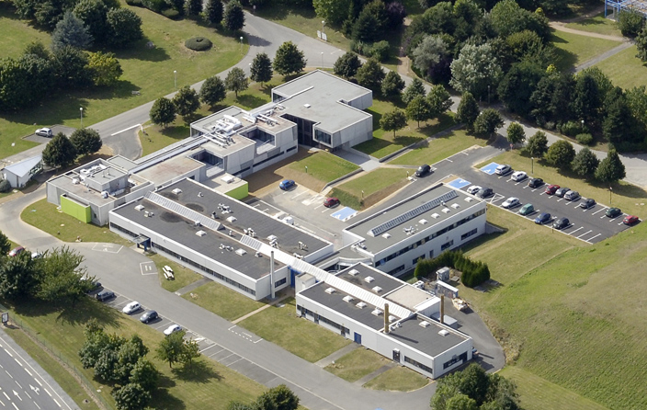

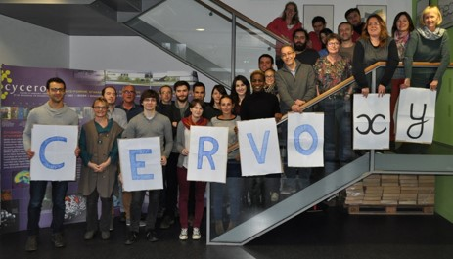

Slide 29
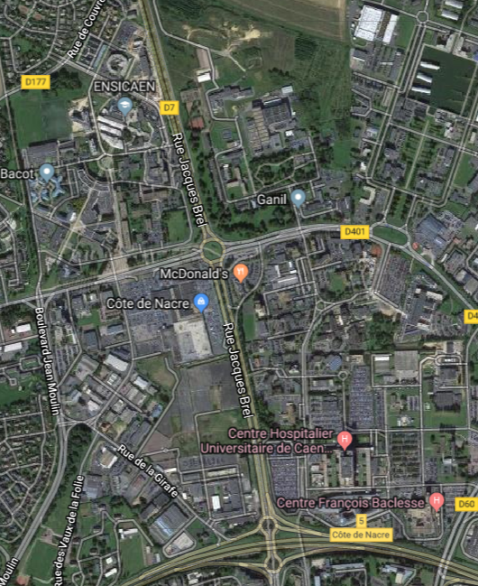


The ARCHADE project in Caen
ARCHADE partners are all located in the « North end » of Caen
CYCLHAD
GANIL
Guesthouse for external users
CIMAP-LARIA
CYCERON-ISTCT-CERVOxy
Medical School
ENSICAEN-LPCCaen-GREYC
Scientific Univ.
Univ. Hospital
ABTE-TOXEmac
Centre Fr Baclesse
1300m

Slide 30
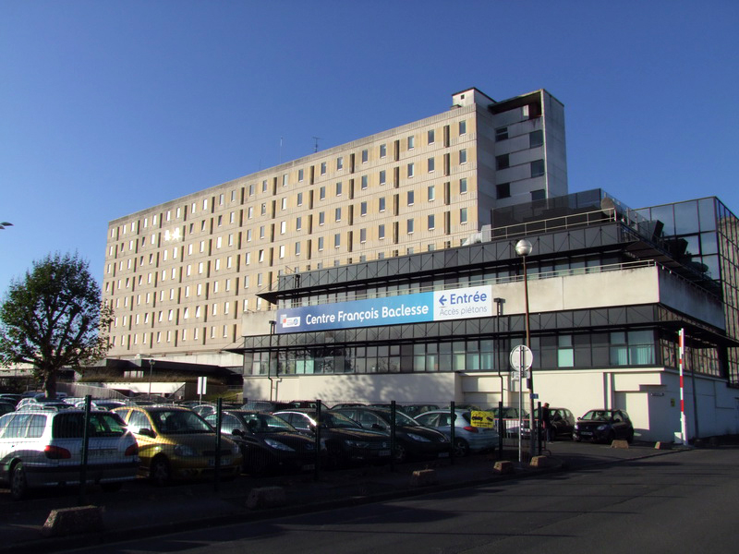

How?

Slide 31
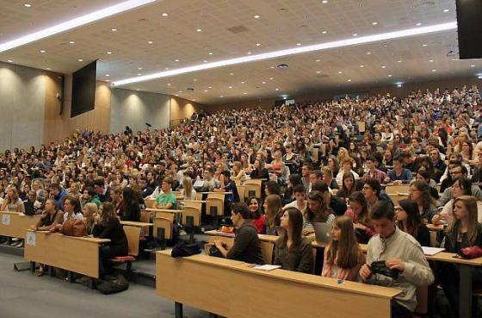
How?

Slide 32
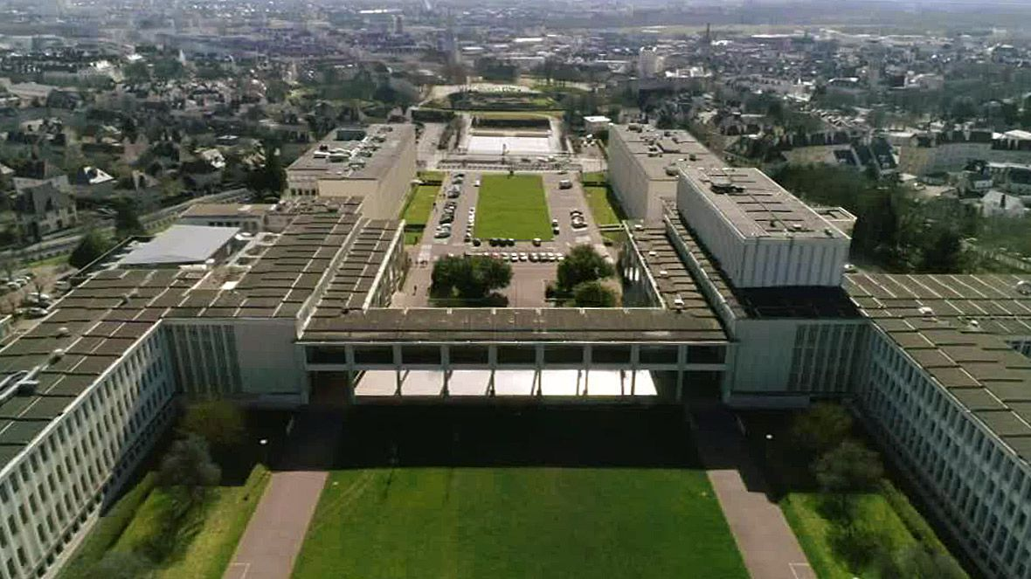
How?

Slide 33
What?
All the usual topics of ENLIGHT meetings…. plus
  Basic fragmentation models
  Big data in hadrontherapy
  Translational science, e.g. about hypoxy and cancer stem cells resistance
  Clinical research
  Beam acces and « external users » situation in Europe
  Etc.

Slide 34
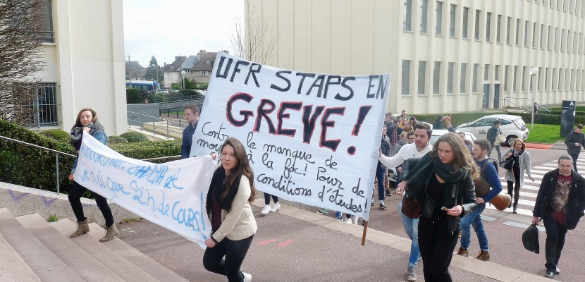
So welcome in Caen next year… hopefully whithout this funny French speciality

Slide 35

Welcome to
Thank-you, questions ?

