Slide 1


ARIES WP3 kick-off
- the Industrial and Societal Applications of Particle Accelerators
New applications of low energy electron beams
ANDRZEJ G. CHMIELEWSKI
INSTITUTE OF NUCLEAR CHEMISTRY AND TECHNOLOGY
Cracow, Poland, September 13th,2017

Slide 2

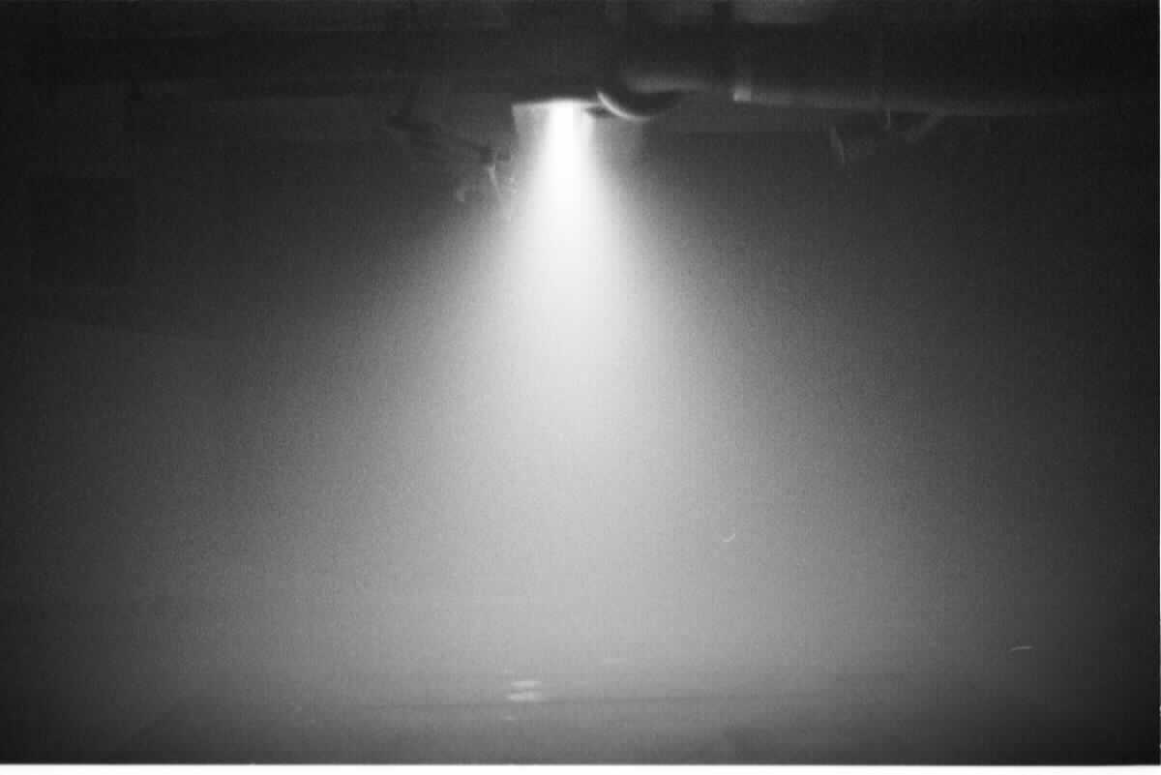
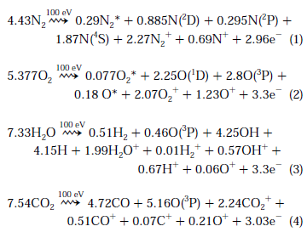
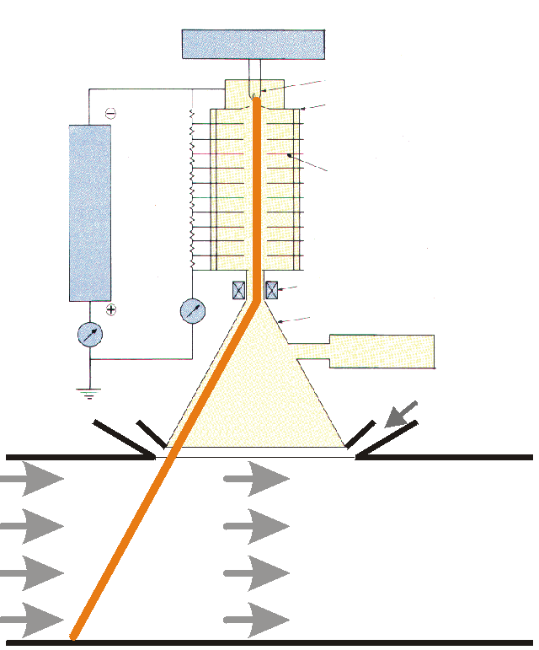
Electron beam

Slide 3

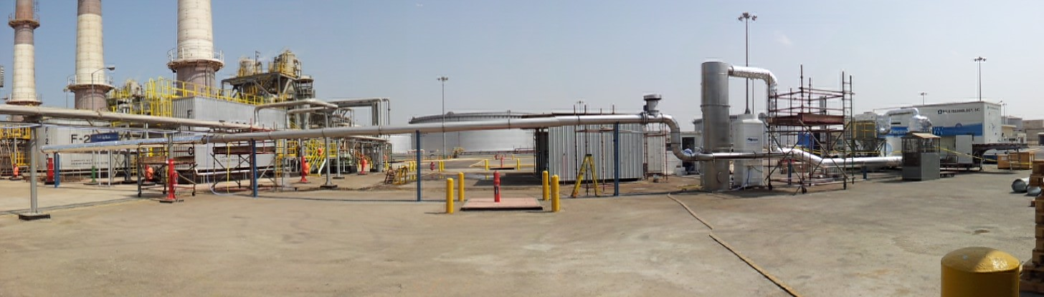
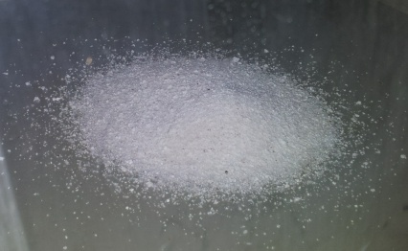
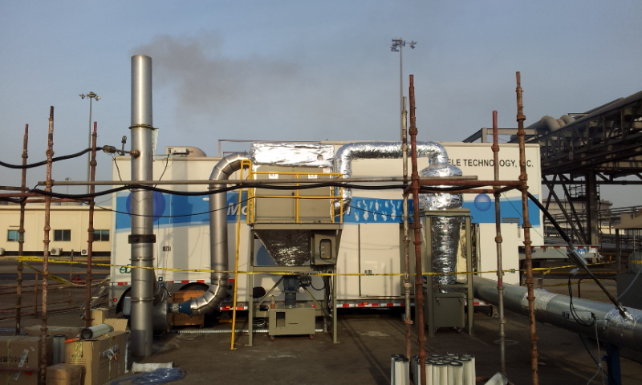
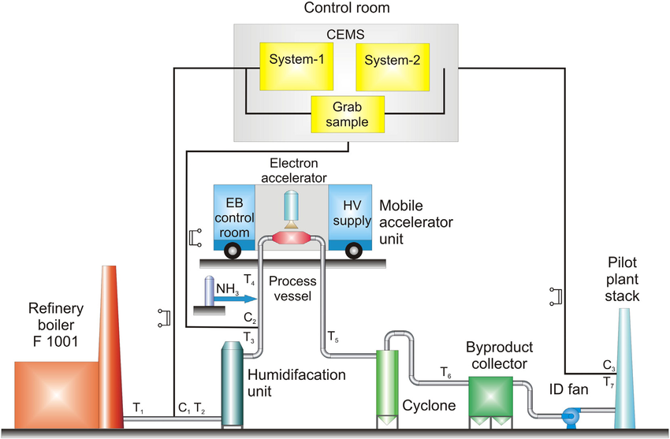
EBFGT at ARAMCO, Jeddah, AS - gudron
A.G.Chmielewski, J.Licki, A.Pawelec,S.Witman

Slide 4
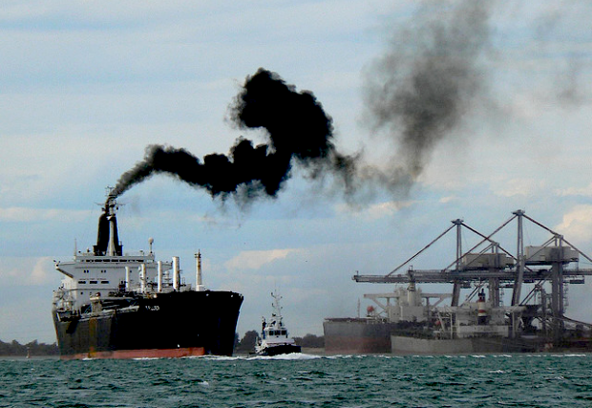
Marine transportation
EMISSION
Two stroke Diesel up to 81 MW
6 to 14 pistons ( each 1820 dm³ )
Heavy oil
Consumption 250 ton per day
Typical off-gases – 13 % O2, 5,2% CO2, 5,35% H2O,
1500ppmv NOx, 600ppmv SOx, 60 ppmv CO, 180 ppm VOC

Slide 5

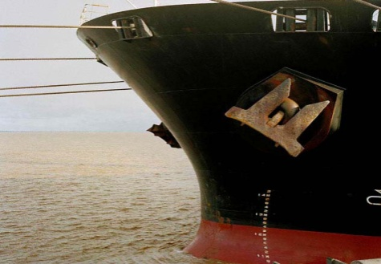
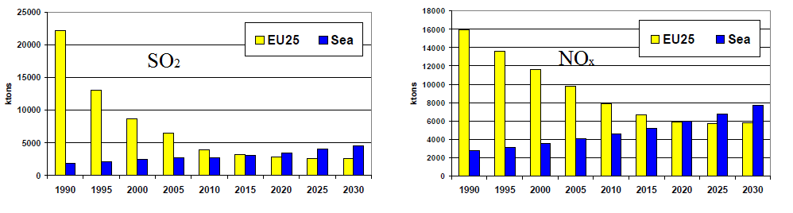
Ships – big emitters

Slide 6
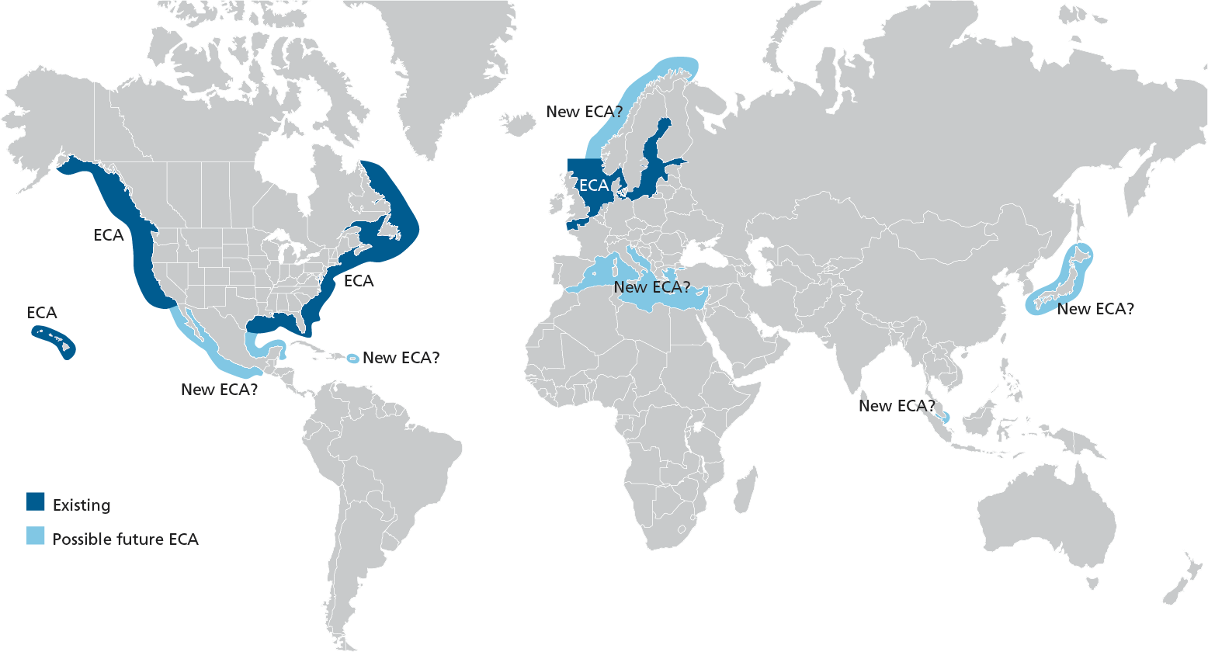

Emission Control Areas
IMO MARPOL Convention

Slide 7

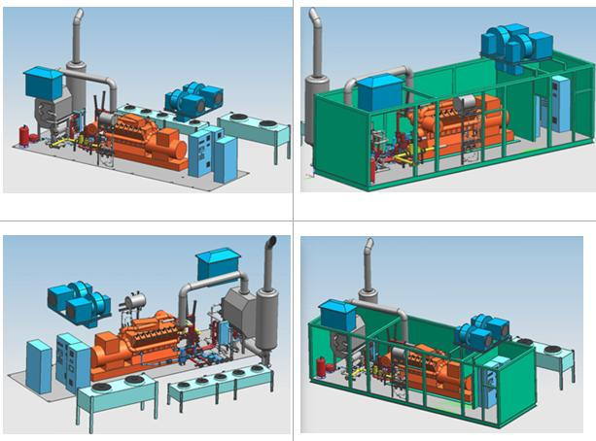
Stationary power Diesel units
Poland, Szpital Miejski Sochaczew – 412 kWe
Poland, Huta Miedzi Głogów – 936 kWe
Poland, Elektrownia Opole – 1058 kWe
Poland, Elektrownia Bełchatów – 2106 kWe
Greece, Andros – 3104 kWe
Greece, Ikaria – 3104 kWe

Slide 8
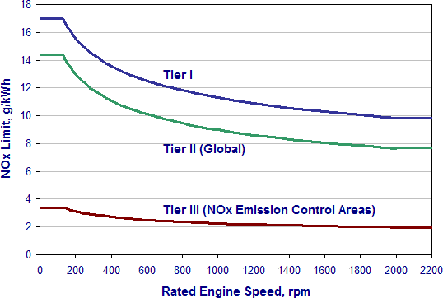
Emission standards
IMO MARPOL Convention
9,5 g/kWh = ca.1500 ppm V,

Slide 9
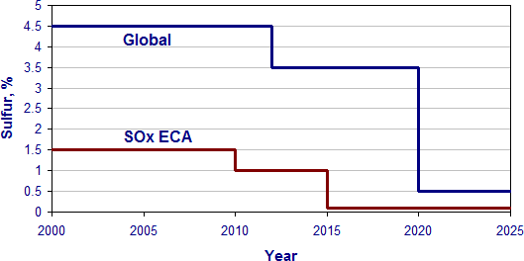
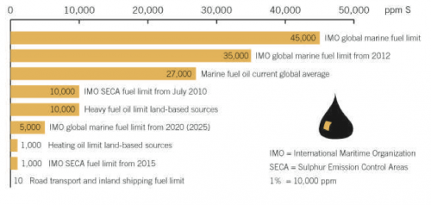
MARPOL Annex VI Sulfur limits in fuel
Approved alternative is off-gases purification (open sea and ECA). For 1,5% S in fuel for SOx ECAs, ship has to be equipped in FGT SOx ≤ 6 g/kWh (recalculated as SO2).

Slide 10
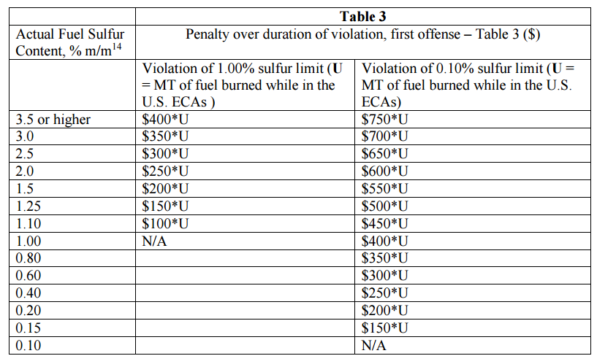
Fines at North America’s SECAs - using high sulfur fuel( or lack of de-SOx unit)
For $ 400 over due and consumption of 50 ton daily:
$ 400 * 50 ton = $ 20,000 /day; in the close future $ 750 * 50 ton = $ 37,500 / day

Slide 11
Emission and standards
Diesel:
6 MW,
6 pistons,
4 strokes,
85% load
Off-gases:
4.727 Nm³/kWh
1500 ppmv,
9.5g/kWh
Limits for NOx
315 ppmv,
2g/kWh
Requested.
efficency 79%

Slide 12
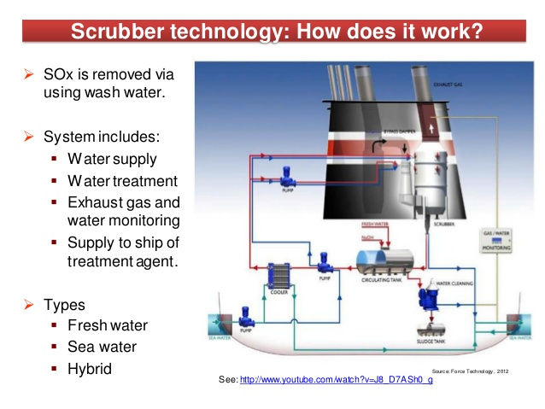
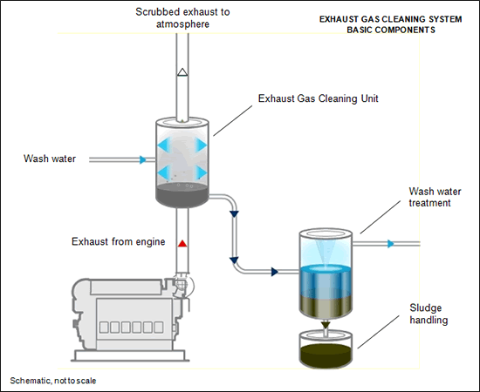
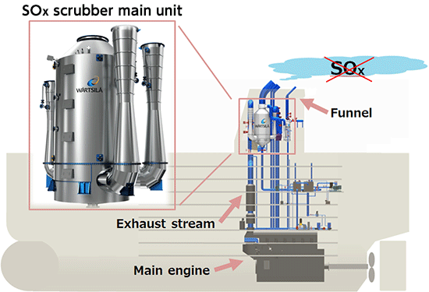
Sea Water Scrubbing based on SO₂ in sea water
Waswater is dumped into sea
Removal of NOx is low due to low NO solubility in water.
SCR has to be approved

Slide 13
Is sence to use fuel like in cars ?
Ship with engine 25 MW fire ca. 20 000 ton per year.
Fuel with 0,1 % S increase cost by 3 - 5 millions $US annually .
And what about NOx ?
And what in the future with VOC (PAH) ?

Slide 14
Electron beam FGT
SOx and NOx removed in one step

Slide 15

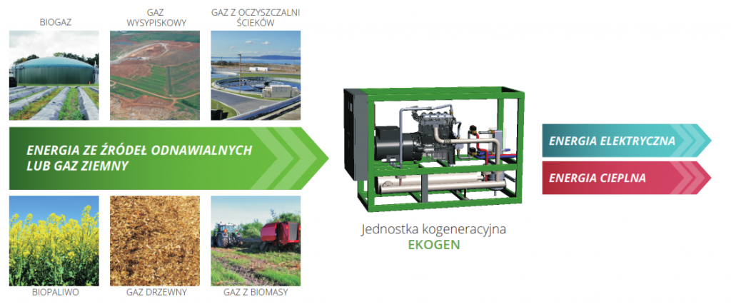
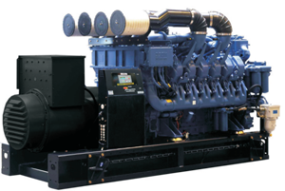
Industrial partners
From the very beginning, the company is focused on developing diesel technology. This experiences led the MTU company to leading position among the manufacturers of the land and sea applications.
“Dostarczamy niezawodne urządzenia, które wytwarzają energię.” “We are providing only reliable power-generating devices ““Поставляем надёжные устройства, которые вырабатывают энергию.” “Поставляємо надійні пристрої, які виробляють електроенергію.”

Slide 16



Hybrid new solution !
Futher developments underway.
TANGO 2
A.G.Chmielewski, J.Licki,Y.Sun,A.Pawelec, E.Zwolińska, S.Witman,Z.Zimek

Slide 17
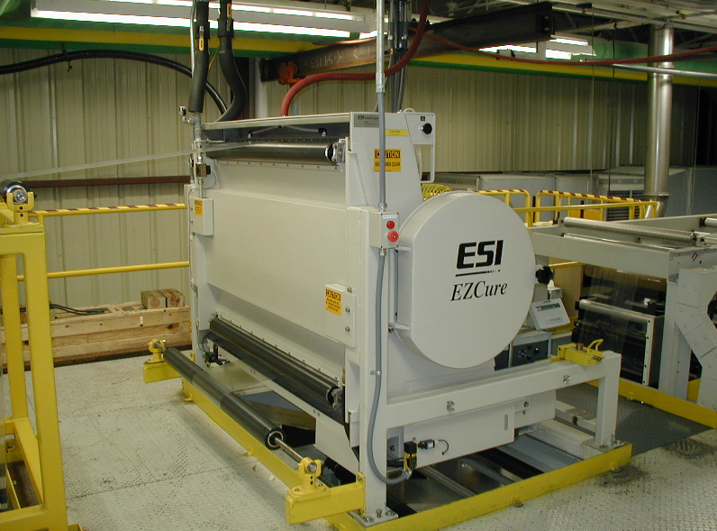
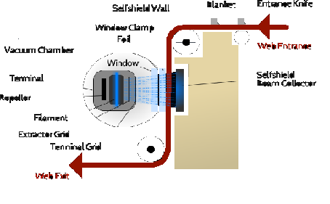
Low energy ebeams
ESI – “EZCure®“
Energy Science Inc.
100 – 300 keV
ESI CB-300

Slide 18
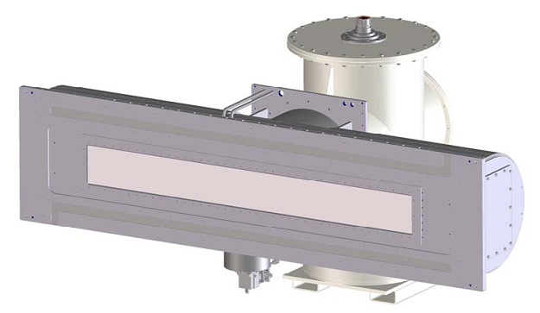

Linear cathode eb machine
- Energy: 75 - 250 kV
- Current: 0 - 2000 mA
- EB width: 400 - 3000 mm
- Dose uniformity: < 10 %
-No window cooling needed.

Slide 19

RENEWABLE ENERGY SOURCES
Hydro
Geo-thermal
Biomass
Solar
Wind
Notes:
Biomass catalytic partial oxidation, using solar energy.
wind energy
solar energy
geothermal energy
wave energy
tidal energy
hydroelectric power below 10 MW
energy derived from biomass

Slide 20


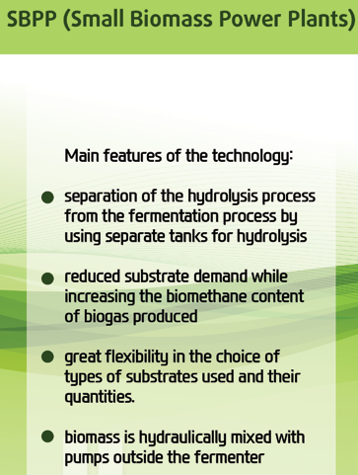
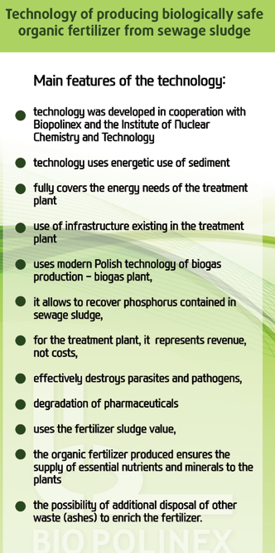

Industrial partners
Biopolinex Sp. z o. o. is building on the basis of owned patent rights, the so-called “MEB system” (small bio-methane heat and power stations) which are the perfect solution for agricultural farms, processing plants, dairies, manufacturers of pig and cattle meat as well as others with resources of biomass.
BIOGAS POWER PLANTS; БИОГАЗОВЫЕ ЭЛЕКТРОСТАНЦИИ; BIOGAZOWNIE

Slide 21
BIOGAS
Biogas is produced by the biological breakdown of organic matter in the absence of oxygen.
Biogas consist mainly of methane and carbon dioxide and a very small amounts of other substances, but its composition varies depending upon the origin of used feedstock.
It can be used as a low - cost fuel for heating purpose also in modern waste management facilities where it can be used to generate and electrical power.
The combustion of biogas reduces the emission of sulfur dioxide and nitrogen oxides in comparison to the combustion of fossil fuels.
Biogas production is a versatile biotechnology capable of converting almost all types of biomass to methane and carbon dioxide under anaerobic (absence of oxygen) conditions.

Slide 22
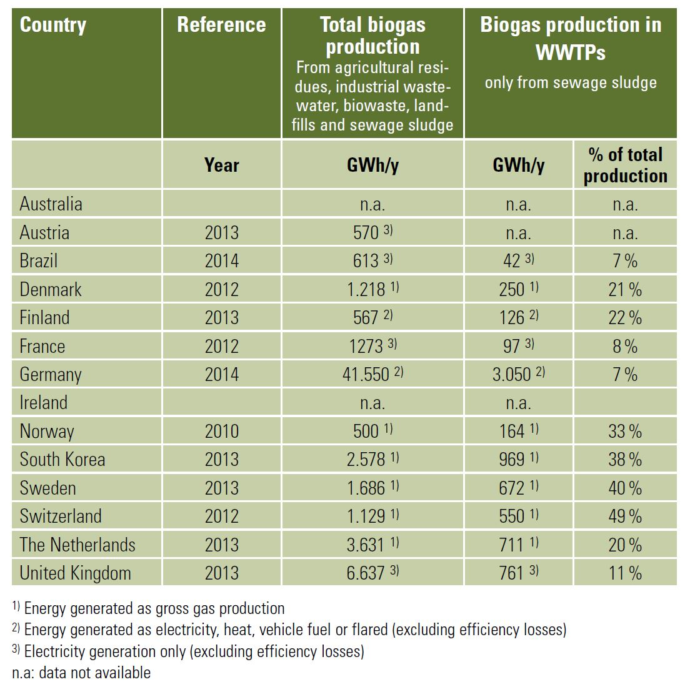
Biomass for biogas production
http://www.iea-biogas.net/files/daten-redaktion/download/Technical%20Brochures/Wastewater_biogas_grey_web-1.pdf
Notes:
http://www.iea-biogas.net/files/daten-redaktion/download/Technical%20Brochures/Wastewater_biogas_grey_web-1.pdf

Slide 23
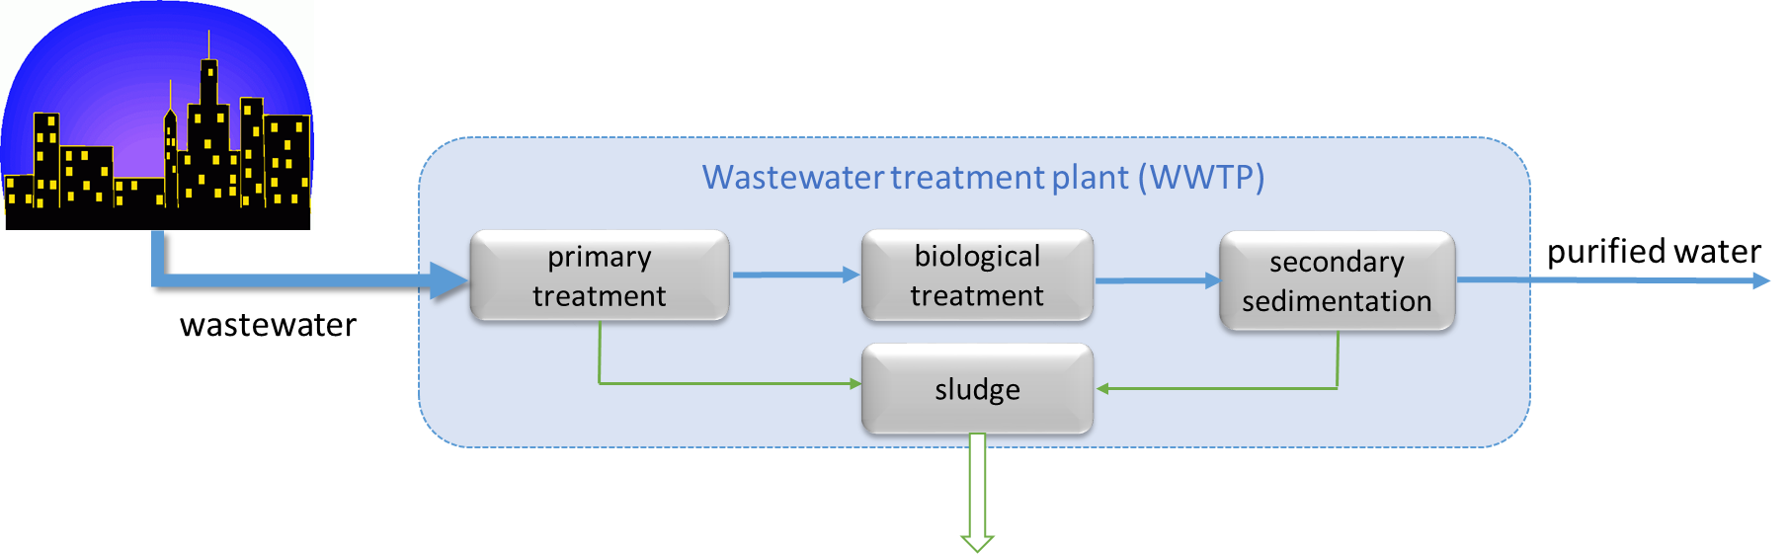
Waste Water Treatment Plants
In wastewater treatment plants (WWTPs) sewage sludge is produced as part of the water cleaning process.
The sludge contains the particles removed from the wastewater, which are rich in nutrients and organic matter, leaving the water clean for its release into nature. Growing population centers and expanding industry, which are increasingly well served by wastewater treatment facilities, result in rapid growth of sewage sludge production

Slide 24
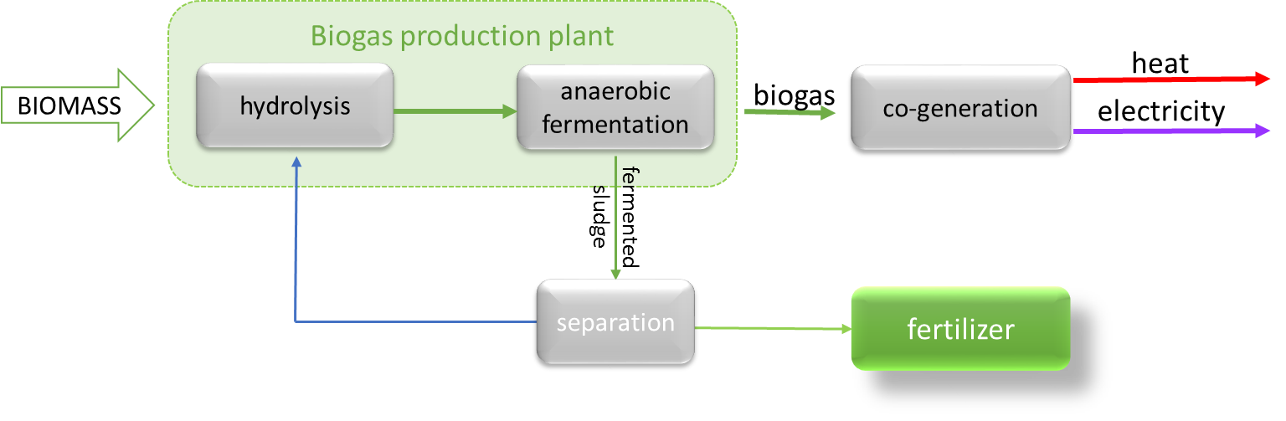
Biogas production using sewage sludge
The sludge is pumped into the anaerobic reactors where digestion takes place, usually at mesophilic temperature (35 – 39 °C). During a retention time of around 20 days, microorganisms break down part of the organic matter that is contained in the sludge and they produce biogas, which is composed of methane, carbon dioxide and trace gases. Biogas is used to feed cogeneration systems in order to simultaneously produce heat and electricity.

Slide 25
Advanatges of anearobic sludge fermentation process
Post-fermentation slurry contains 3 – 5% of dry matter,
Dry matter content can be increased up to about 35% applying dewatering process,
The volume of organic matter is reduced by about 50% in comperison to unfermented substrate,
Improvement of fertiliser value eg. a part of the organic nitrogen is converted to ammonium, which is more easily accessible for plants,
Reduction of methane emission to the atmosphere in comparison to untreated sludge,
Odour reduction.
Notes:
Apart from heat and electricity in biogas plants post-fermentation slurry is produced.

Slide 26
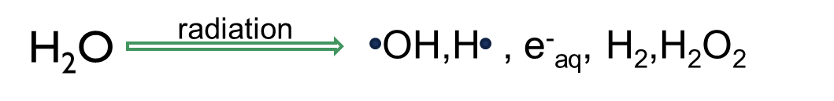
Sludge Disinfection
The sludge of municipal wastewater origin is biologically contaminated by viruses, bacteria and eggs of parasites.
Anaerobic fermentation can reduce number of pathogenic microorganisms but can’t eliminate them completely.
Dissinfection process must be applied.
Under irradiation the decomposition of pollutants and elimination of microorganisms in water undergo due to reaction of water radiolysis products.
Notes:
Number of pathognic microorganisms reduced

Slide 27
Pilot experiments

Slide 28

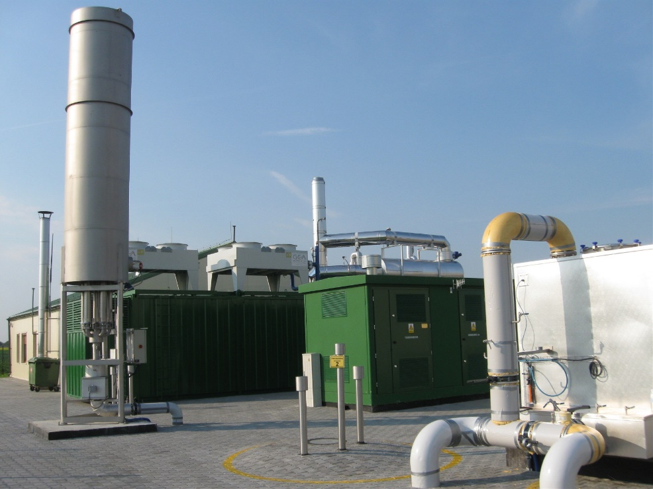
Biogas plants – INCT experience
Participation in the design and start-up of biogas plants with capacity of 1.2 MW in Koczergi and Międzyrzec etc.

Slide 29
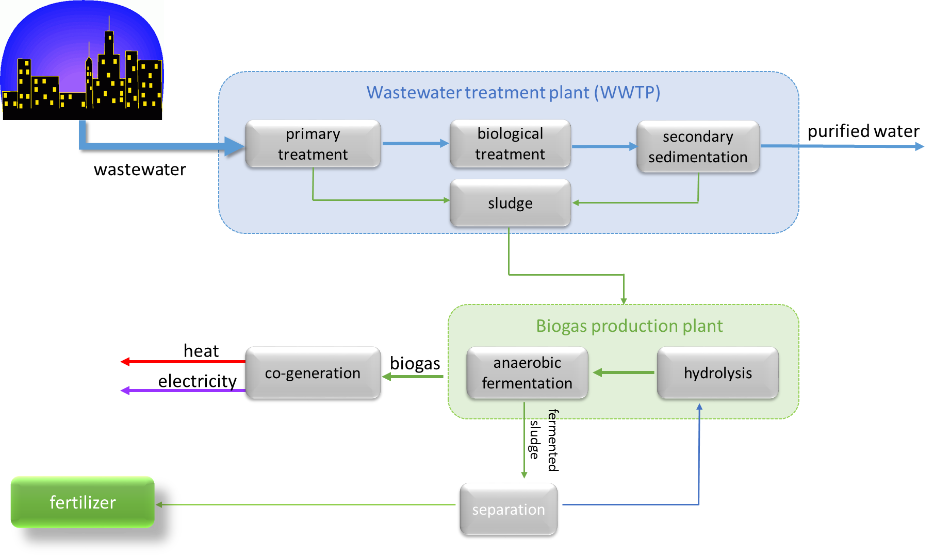
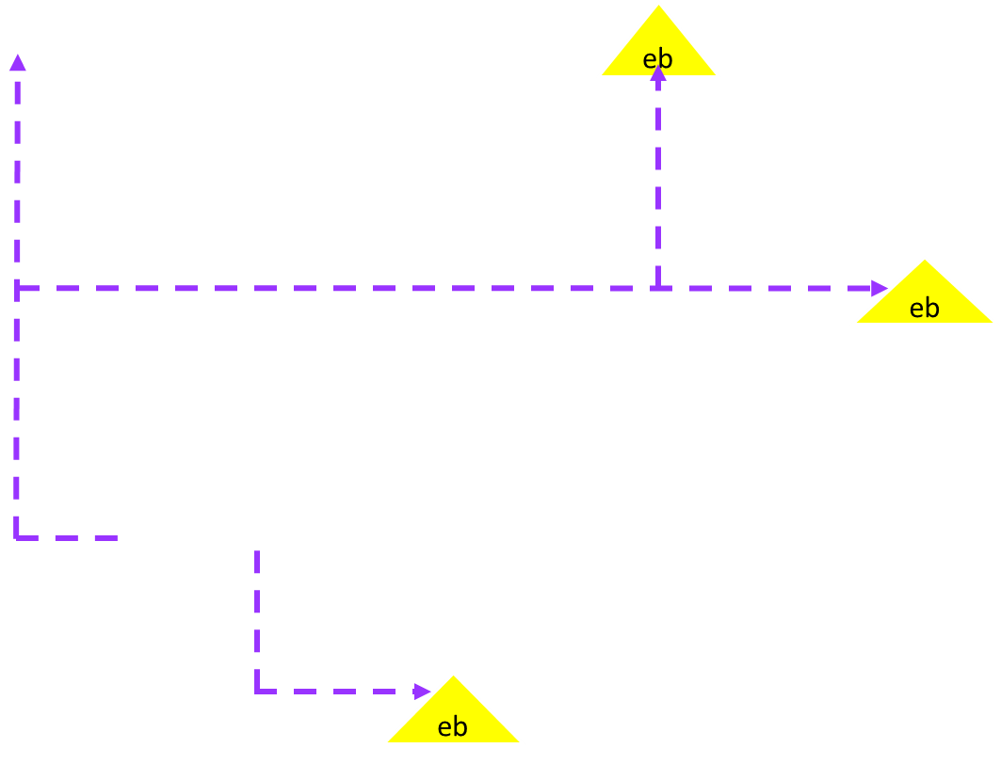
Hybrid biogas - eb system
A.G.Chmielewski,Z.Zimek, U.Gryczka, R.Edgecock,K.Pietrzak

Slide 30

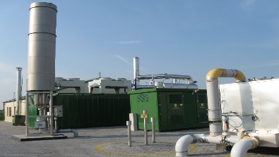
We need new solutions to preserve the environment – zero energy sludge hygenization plant!
A.G.Chmielewski,Z.Zimek, U.Gryczka, R.Edgecock,K.Pietrzak

Slide 31
Advantages of proposed solution:
Environmental friendly technology
Biogas production is disposal of problematic wastes
Production of renewable power through combined heat and power cogeneration
Production of microbiologically safe organic fertiliser
Technology can be applied in any place with sufficient biomass resources while there is no need to ensure external electric energy supply

Slide 32

Thank you !

