Slide 1
ARIES WP3 kick-off
The new Compact 10 MeV TT50 Rhodotron
Philippe Dethier
Marketing and Business Development Director
IBA
September 13th 2017 – NUTECH, Kraków, Poland
Notes:
Title slide should include: Presenter Name, Job Title, Company Name / Organization, Date / Time

Slide 2
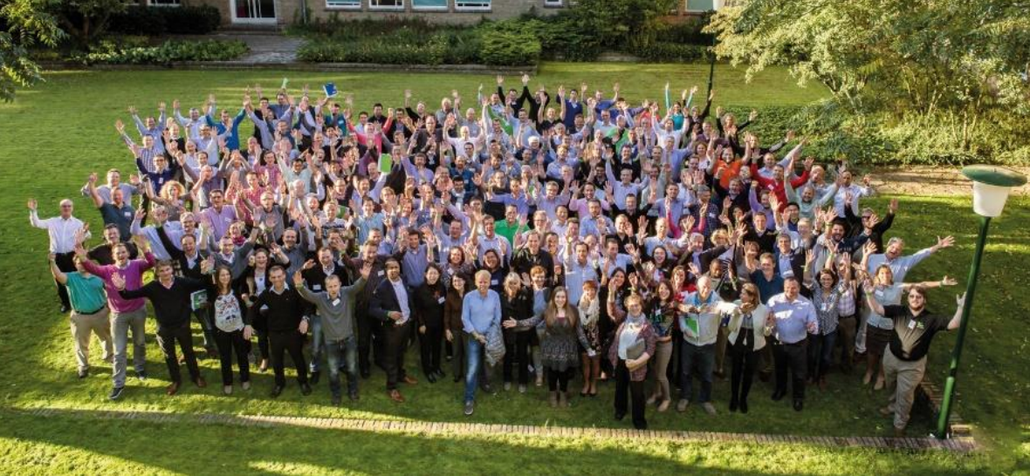
IBA in a nutshell
Based in Belgium, listed on Euronext Brussels
Focused on particle accelerators
>400 accelerators worldwide
2016 sales of ~€330 million
1,500 people worldwide, 40 nationalities
15 offices on 3 continents

Slide 3
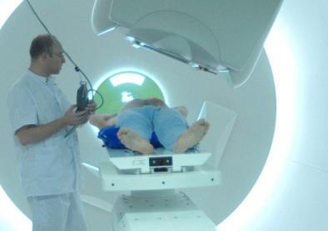
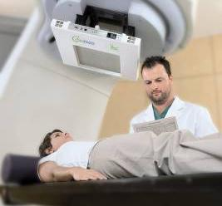




IBA Main Activities
Proton Therapy
Dosimetry
Cancer treatment
Patient and machine QA
Industrial
Cancer diagnostic
Industrial applications
RadioPharma

Slide 4
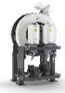
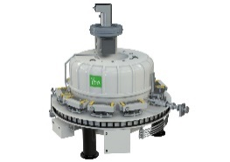
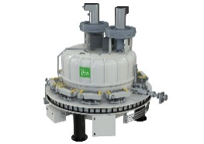
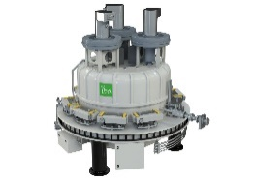
10 MeV Rhodotron product range
TT50 specifications
  Up to 10 MeV, 20 kW
  Low manufacturing and installation costs
  Compact footprint
  Efficient use of energy
  High duty cycle
TT50
20 kW
TT100
40 kW
TT200
100 kW
TT300
245 kW
TT1000
560 kW

Slide 5
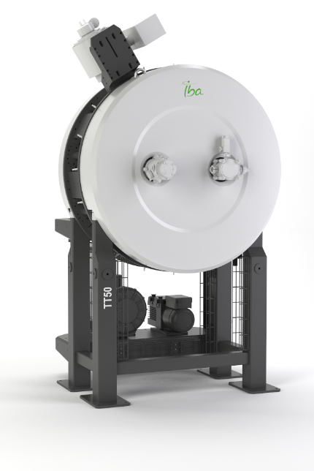
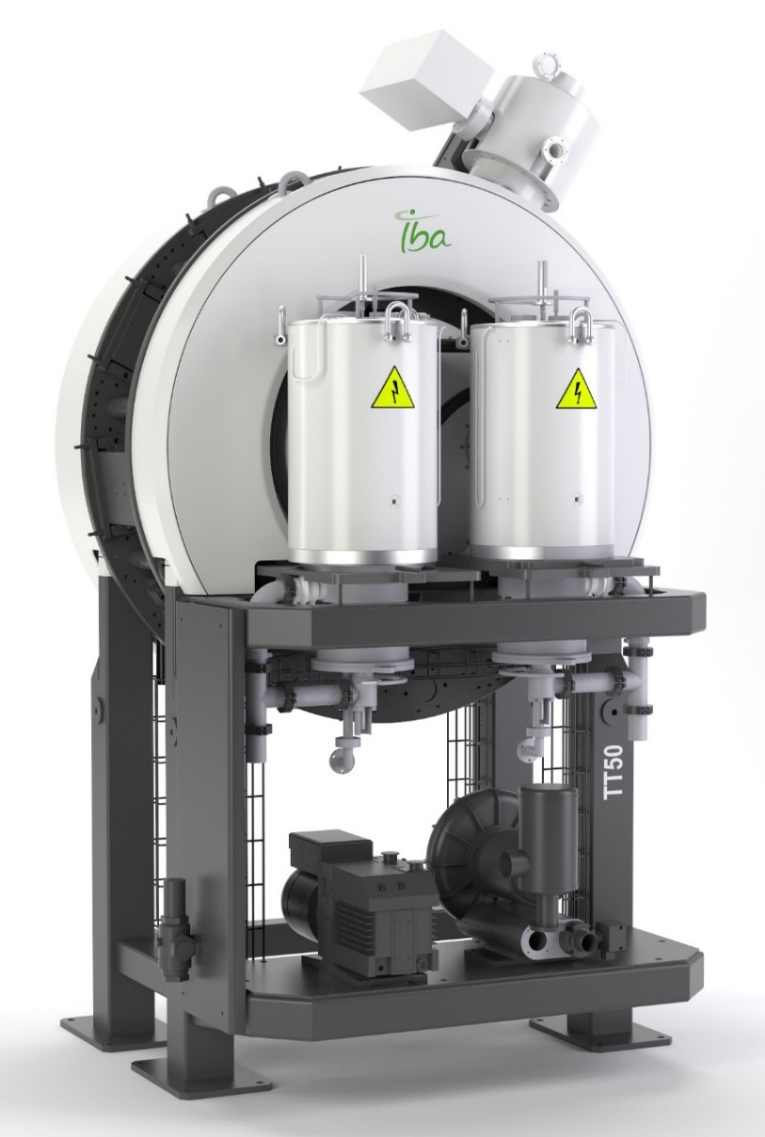
TT50 Technical Overview
Pulsed RF System
Vertical cavity
BnR Control System
Permanent Magnets
Transport and install frame
Compact Design

Slide 6
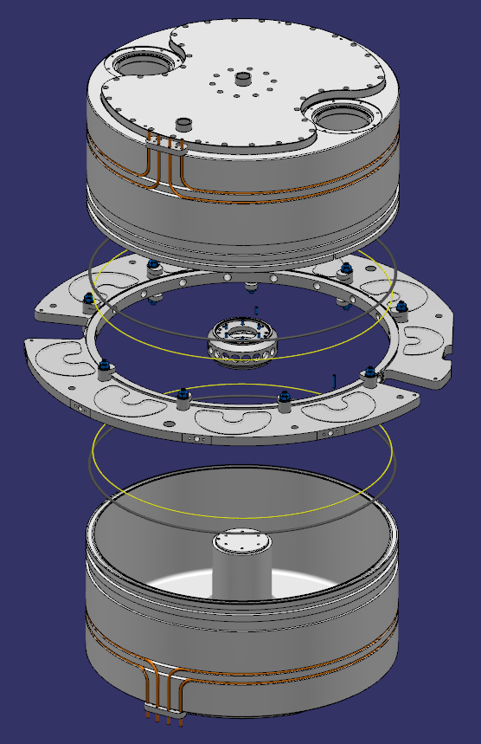
TT50 : Cavity and Radio Frequency
Smaller cavity ~ Ø 60 cm → increased frequency
352MHz aligned with commercial RF components
Single vacuum chamber for magnet systems

Slide 7
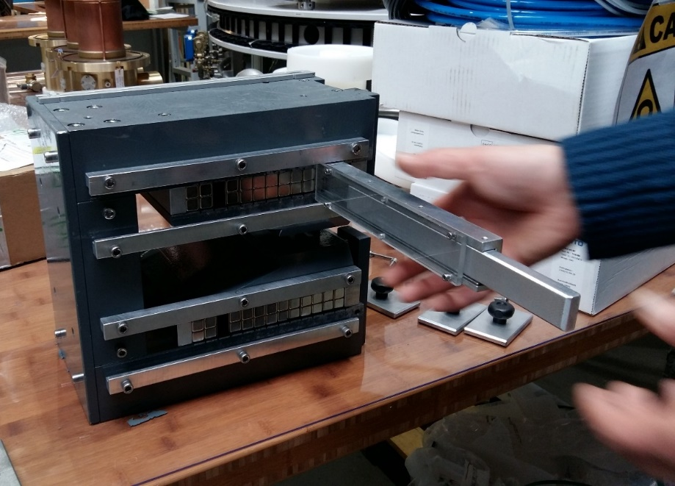
TT50 : Deflection Magnets
Permanent magnets to reduce cost & tuning
Linear magnetic field with number of magnets
Notes:
Neodymium boron magnets

Slide 8
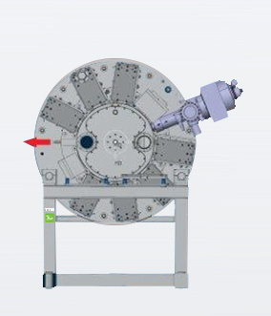
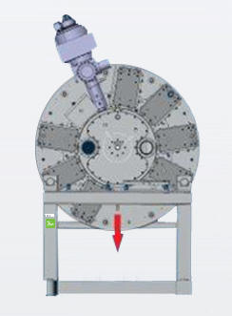
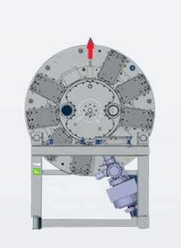
TT50 : Clocking
Energy: 5, 6, 7, 9 or 10 MeV
Beam exit: Top, side or bottom

Slide 9
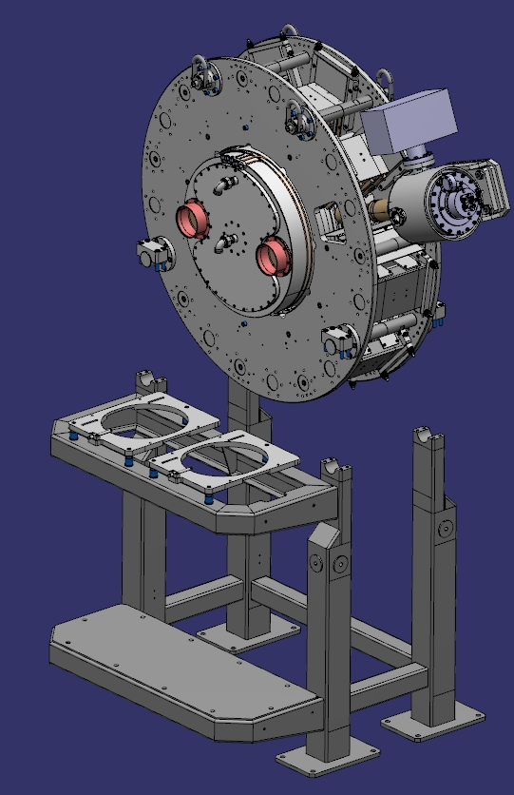
TT50 : Installation
Vertical installation → no beamline bending
Frame with pre-installed equipment
Plug-2-plug for fast installation
Size and weight:
  130 cm diameter
  55/120 cm deep (without/with amplifiers)
  1,8 T

Slide 10
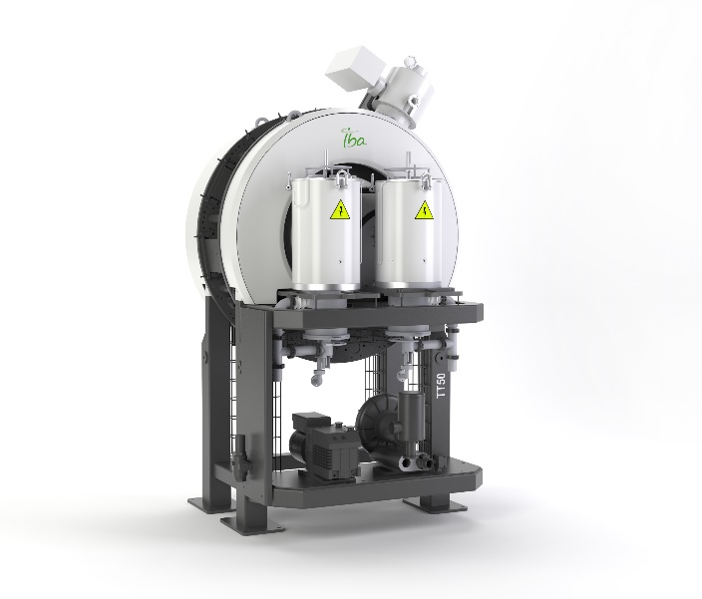
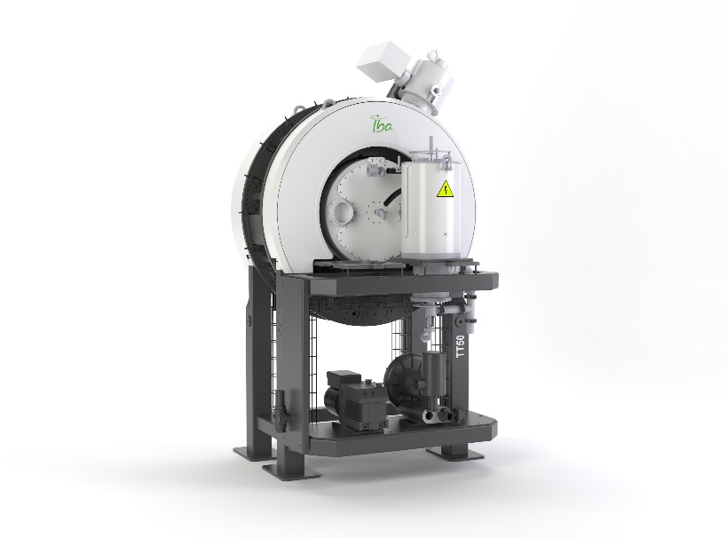
TT50 : Target Commercial Proposals
  Sterilization and Food
  Security, R&D and others
2 Final Power Amplifiers
5, 6, 7, 9 and 10 MeV
Exit options : ← ↑ ↓
Up to 20 kW
1 Final Power Amplifier
5, 6, 7, 9 MeV
Exit options : ← ↑ ↓
Up to 2 kW

Slide 11
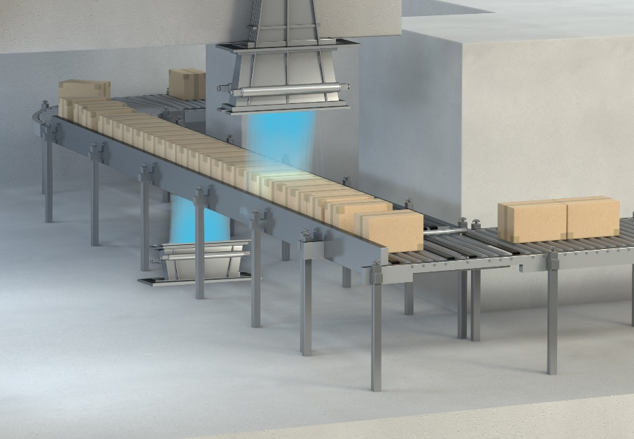


TT50 : Target Applications
Mobile systems
E-beam sterilization
Optional 2-side beam
R&D systems
Food systems

Slide 12
TT50 test planning
Permanent Magnets Validation
RF ON
Final Validation & Acceptance
Installation done
juil.
août
sept.
oct.
nov.
déc.
2017
Today
TT50 Ready for Customers
Rigging in test vault
First Beam

Slide 13
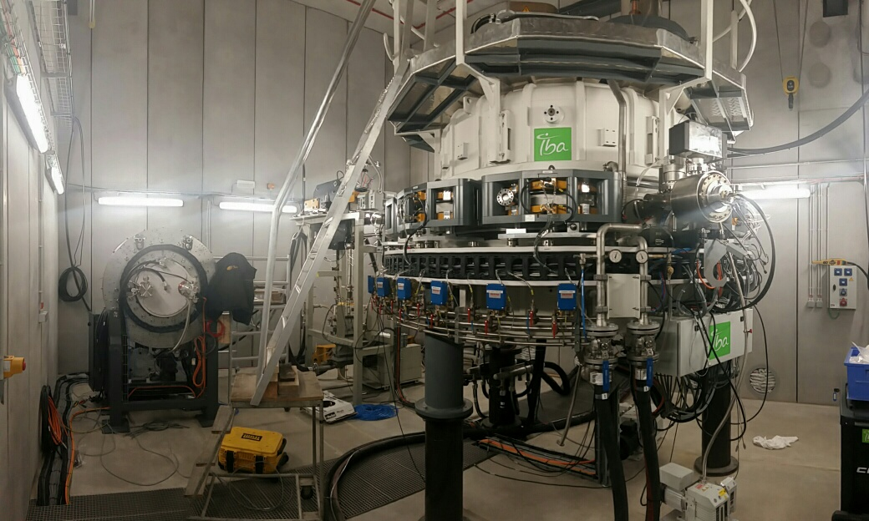
Testing in IBA vault
The new compact TT50
The new high efficient TT300

Slide 14

Thank you!

