Slide 1
ARIES Industrial and Societal Applications Network
Rob Edgecock / University of Huddersfield & STFC

Slide 2
Outline
Introduction to ARIES
WP3
Partners
Objectives
Reporting
Deliverables
Milestones
Papers
Meetings
Proof of Concept fund

Slide 3
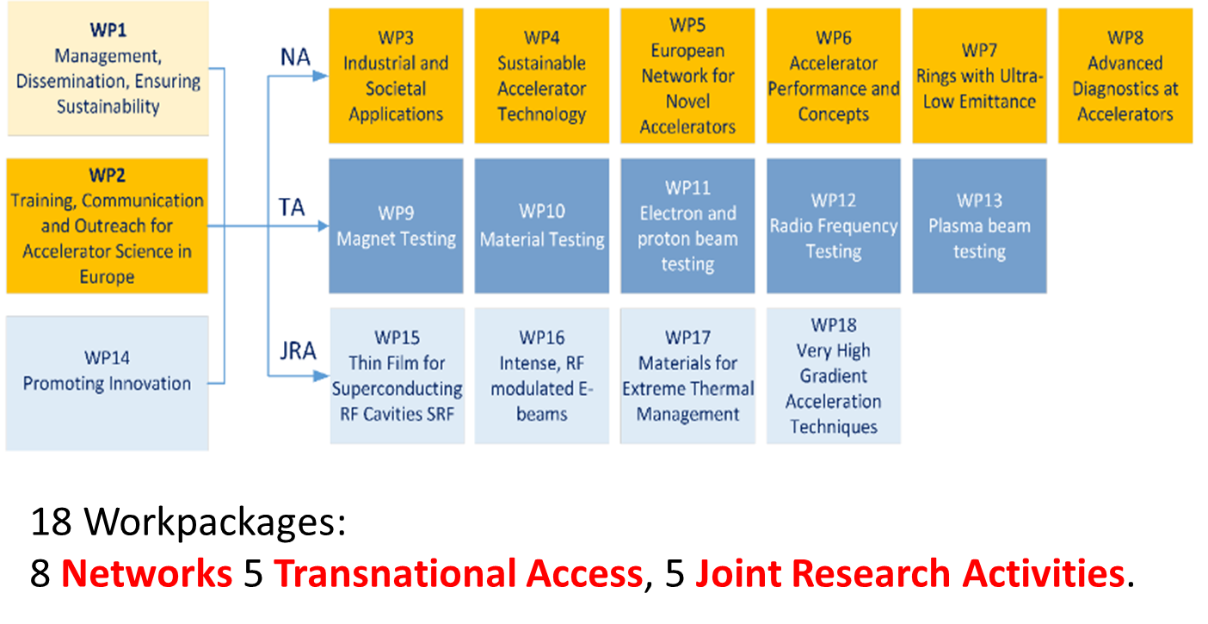
Introduction to ARIES
ARIES: see http://aries.web.cern.ch/

Slide 4
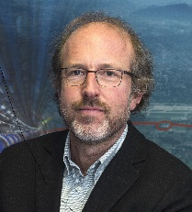
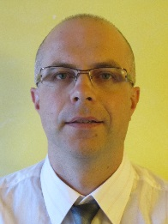
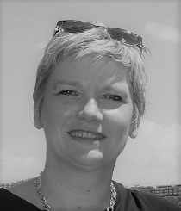
ARIES
Scientific
Advisory Committee
Governing Board
One representative from each beneficiary and partner organisation
Project Coordinator (ex-officio)
Deputy Project Coordinator (ex-officio)
Industry
Advisory Board
Project coordinator
Maurizio Vretenar
Steering Committee
Administrative Manager
Management Team
Project Coordinator
Deputy Project Coordinator
Administrative Manager
Project Coordinator
Svetlomir Stavrev
18 Workpackage Coordinators
Project assistant
Valérie Brunner
Communications
Jennifer Toes

Slide 5
WP3
ISA: Industrial and Societal Applications of accelerators
Three science areas:
  Industrial and environmental applications of electrons up to 10MeV
  Accelerator radioisotope production
  Applications of electron beams up to ~200 MeV
Will do real work (i.e. not organise workshops)
Focus is on improving or developing new applications

Slide 6
WP3
Task 3.1. Coordination and Communication (Rob Edgecock)
- Coordinate the WP activities
- Monitor the progress of WP tasks and ensure the obligations are met
- Manage the WP budget and use of resources and prepare internal and deliverable reports
Task 3.2. Low energy electron beam applications: new technology development (Frank-Holm Roegner)
- Study and document the requirements for current e-beam applications
- Study the introduction of new technology from the research area to bring improvements to these applications
- Develop a standard electron beam unit to make the transition to electron beam applications easier for newcomers
Task 3.3. Low energy electron beam applications: new applications (Andrzej Chmielewski)
- Study the use of electron beams in the environmental area
- Study the expansion of the use of electron beams in the industrial area
- Document the new applications and the requirements on the accelerator technology
Task 3.4. Medium energy electron beams (Angeles Faus-Golfe)
- Study of the applications of electron beams up to 140 MeV in the medical and other areas
- Study of the construction of high performance electron linear accelerator up to 140 MeV
Task 3.5. Radioisotope production (Conchi Oliver)
- Document the requirements for compact accelerators for radioisotope production
- Optimise the design of a new compact cyclotron for PET isotope production, with the aim of maximising the production
- Analyse different solutions for a compact source for PET, with the aim of improving the performance and cost
- Study which existing and possibly new therapeutic isotopes are of interest clinically and how they can be produced
using particle beams
- Study and compare novel acceleration techniques for ^(99m)Tc and therapeutic isotope production

Slide 7
WP3 - Partners
Full partners:
  CERN (Switzerland)
  Ciemat (Spain)
  CNRS (France)
  Fraunhofer FEP (Germany)
  University of Huddersfield (UK)
  IBA (Belgium)
  INCT (Poland)
Associates:
  EBtech
  IAEA
  iiA
  Slovak Medical University

Slide 8
Reporting
WPs must report scientific results after
  12 months – to CERN
  18 months – PR to the EU
  36 months – PR to the EU
  48 months – PR and Final Report to the EU
Template comes to me from Maurizio/Valerie/Jennifer
I’ll then send it to Task leaders
With 18 WPs, usually needs to be concise!
(Financial reports will also be required from all partners)

Slide 9
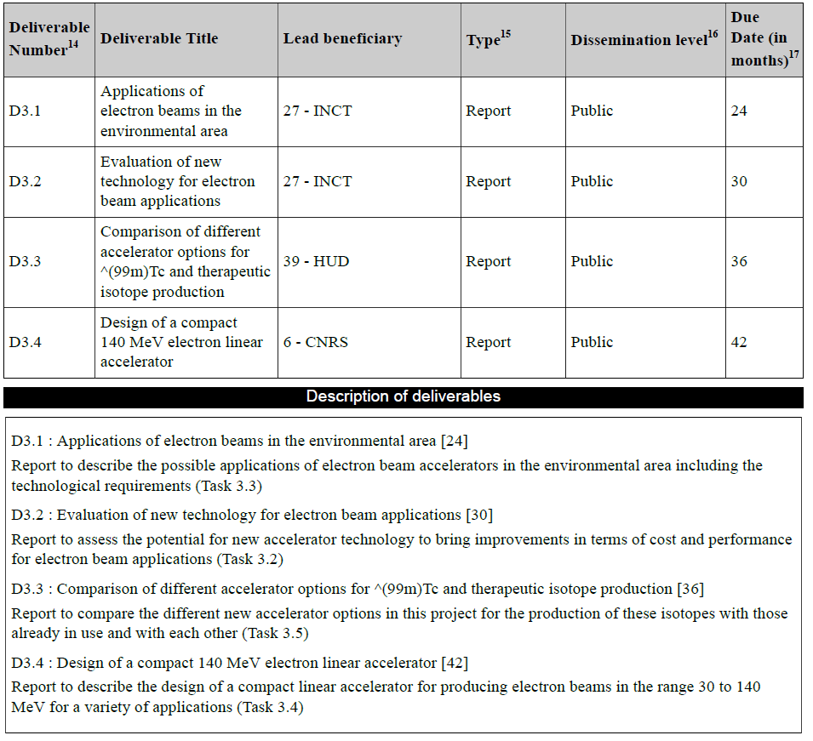
Deliverables

Slide 10
Deliverables
Go to the EU, so important
Must be on time
Approval procedure:
  well in advance, start writing using template on website
  >1 month in advance, send to me for comments, etc
  1 month in advance, send to Maurizio
  Will allow the deliverable to be uploaded by the deadline
“Reasonable” length: 12-20 pages?
Scientific documents

Slide 11
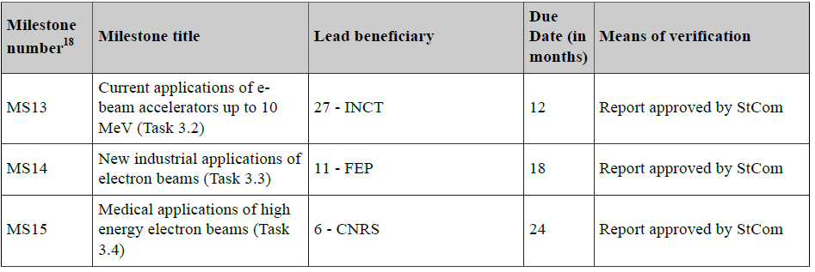
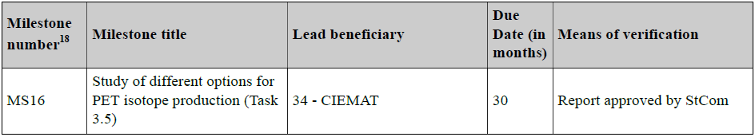
Milestones

Slide 12
Milestones
Don’t go to the EU, so not quite as important
Should still be on time
Approval procedure:
  well in advance, start writing using template on website
  >1 month in advance, send to me for comments, etc
  1 month in advance, send to Maurizio
  Will allow the deliverable to be uploaded by the deadline
Can be short length: >4 pages?
Scientific documents

Slide 13
Papers
Worth considering whether deliverables & milestones could be converted to refereed papers
Papers are encouraged
Three rules:
  Must ensure open access (free of charge, online access for any user) to all peer-reviewed scientific publications relating to its results. In particular, it must as soon as possible and at the latest on publication, deposit a machine-readable electronic copy of the published version or final peer-reviewed manuscript accepted for publication in a repository for scientific publications.
  Must have an acknowledge to EU funding
  Must be uploaded onto the ARIES website

Slide 14

Papers
Acknowledgement
All ARIES publications (including Transnational Access) must include the following acknowledgement:

Slide 15
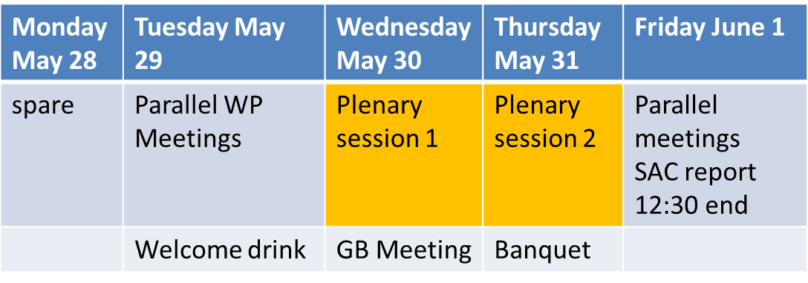
Meetings
ARIES Annual meetings
  Next one: Riga, Latvia, 29th May to 1st June 2018
WP3 Annual Meetings
Task leaders meetings: every ~month by video
Task meetings: every n months (n=1 to 4)
Agenda, etc, on indico at CERN under ARIES → WPs → WP3

Slide 16
Proof of Concept Fund
Organised by WP4
~50 kEUR per project
First call ~November
We should be ready
Call documents still to be approved
But will look something like……..

Slide 17
Main aspect of the procedure
The proposal shall present (in max # pages?):
Background and aim of the project
Technical summary
Business Plan
Work plan and Risk analysis
Resources
Project Deliverables
Collaboration agreements

Slide 18
Main aspect of the procedure
1 single set of documents will drive the procedure.
The documents will be widely distributed and published on a dedicated page of ARIES website.
The project proposals shall be submitted according to a fixed template, and specified timeline.
The proposals shall have a max num of pages and include a business plan (fixed num page for this?)
The evaluation/ selection of proposal is carried out by a panel (EvPa) appointed by IAB, chaired by WP14 leader.
The EvPa is choosed among WP leaders and can include external advisors.
The EvPa will propose projects for award to GB decision

Slide 19
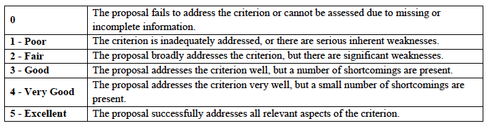
The evaluation / selection
Evaluation is carried out according criteria of excellence (i.e. innovation potential), impact (i.e. create potential new market opportunities), implementation (i.e. credibility of the methodology).
Scores are 3/5 minimum per criteria with a minimum cumulative threshold of 9.
Interpretation of scores are provided in a table as guideline

