Slide 1

Plans and Activities at CERN
Maurizio Vretenar, CERN (and incidentally, ARIES Coordinator
WP3 Kick-off, Krakow, 14.09.2017

Slide 2
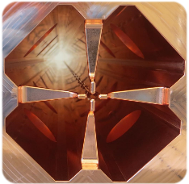
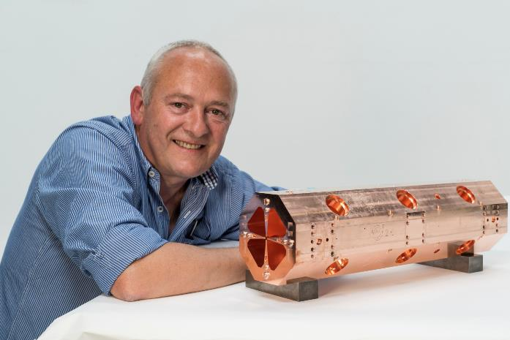
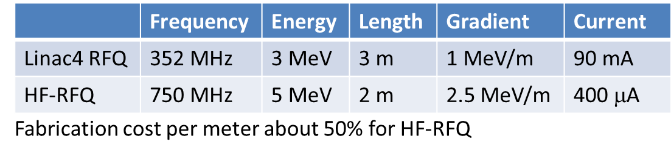
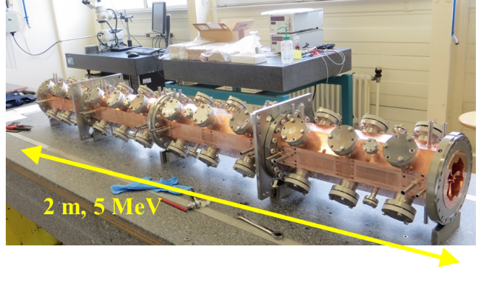
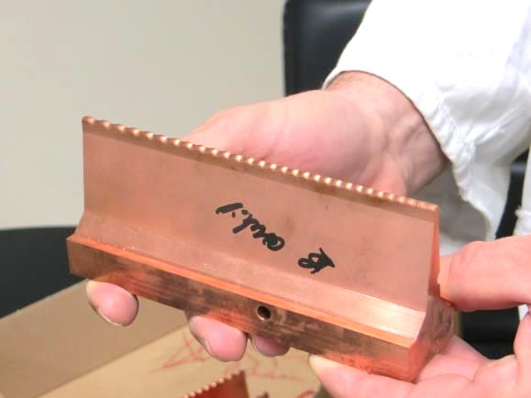
The CERN mini-RFQ design
The CERN «mini-RFQ» development (High-Frequency RFQ)
Radio Frequency Quadrupole (the first element of any ion acceleration chain) at high frequency – targeted at low current applications requiring small dimensions, low cost, low radiation emissions, up to portability
The first unit (5 MeV protons) built at CERN for the ADAM company
Notes:
Century started with great success of lhc, accelerators known by everyone – lhc is the top of an iceberg

Slide 3
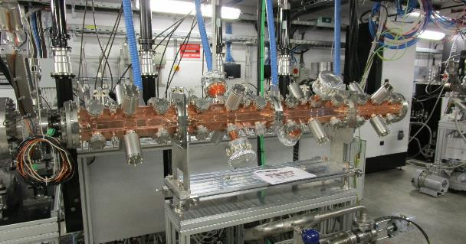
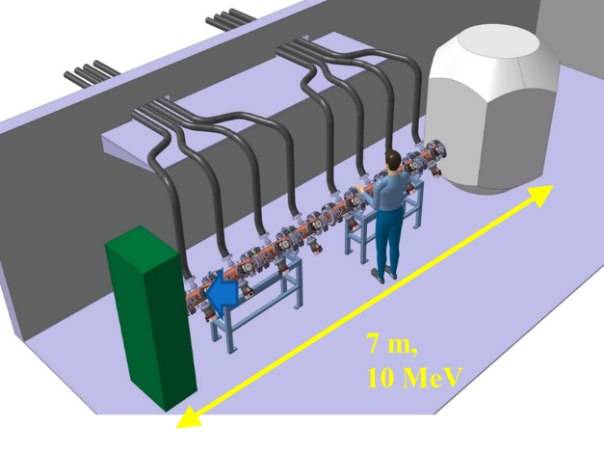
Applications of the «mini-RFQ»
The modular design allows using the same structure for different energies and particles
Injector for a proton therapy linac (5 MeV)
Production of PET isotopes in hospitals (10 MeV)
PIXE analysis of artwork (2 MeV)
Testing cellular response to proton beams (2 MeV)
Acceleration of q/m=1/2 particles (deuterons for neutron production, carbon 6+ for beam therapy, alpha particles for targeted therapy.
Built
Designed
In
construction
Proposal
Preparation
Under
study

Slide 4
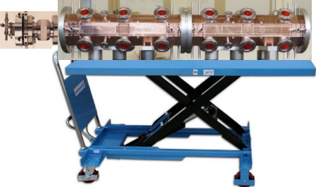
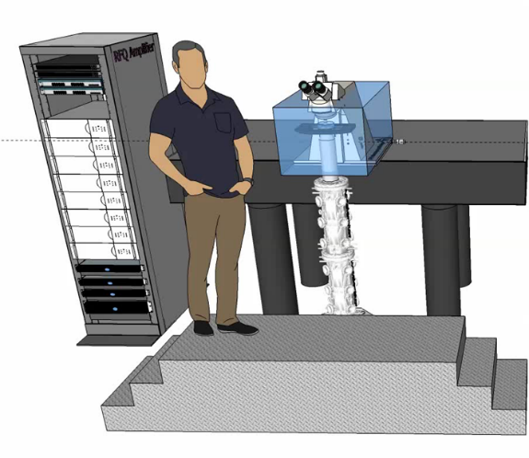
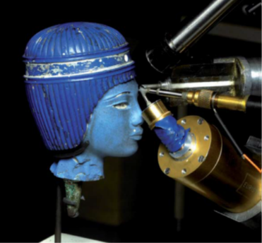
Analysing art and molecules…
The PIXE RFQ (Proton Induced X-ray Emission)
A transportable system of only 1m and 100 kg to test artwork in situ (chemical composition of outer layer). Can allow dating (from composition of paint) or finding the origin of jewelry.
In construction at CERN (collaboration with INFN Florence)
The COMPASS RFQ for proton radiobiology
Collaboration Amsterdam Medical Centre – Eindhoven University – CERN (request for funding in preparation)
The PIXE RFQ installed in vertical position in a system to measure cell response (DNA damage and repair) to a proton beam, to collect data for proton therapy.

Slide 5
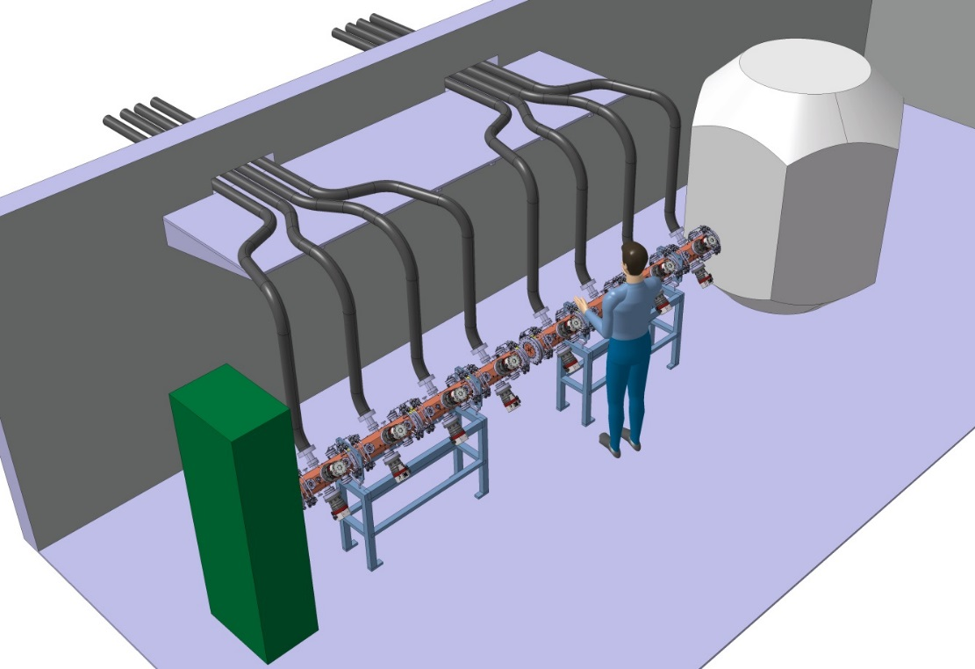
PET isotope production in hospitals with RFQs
The RFQ design can be used for higher energy and maximum duty cycle for a compact PET isotope production system. Two consecutive RFQs for 10 MeV in a length of 4 m.
Controlled beam loss and low weight makes it possible having the PET production unit next to the scanner inside the hospital, without concrete bunkers and heavy shielding.
Simplifies logistics for isotope distribution; paves the way to a wider use of short-living isotopes (e.g. C11).
Solid-state RF amplifiers, low cost and high reliability
Target shielded by layers of iron and borated (6%) polyethylene, overall radius <1m (2 μSv/h at contact).
RF amplifier room
7 m,
10 MeV
No radiation around accelerator and target.
Easy operation (one button machine).
High reliability.
Minimum footprint (15 m2).

Slide 6
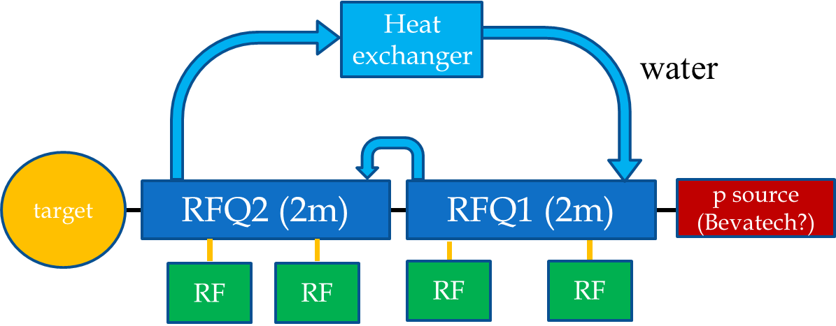
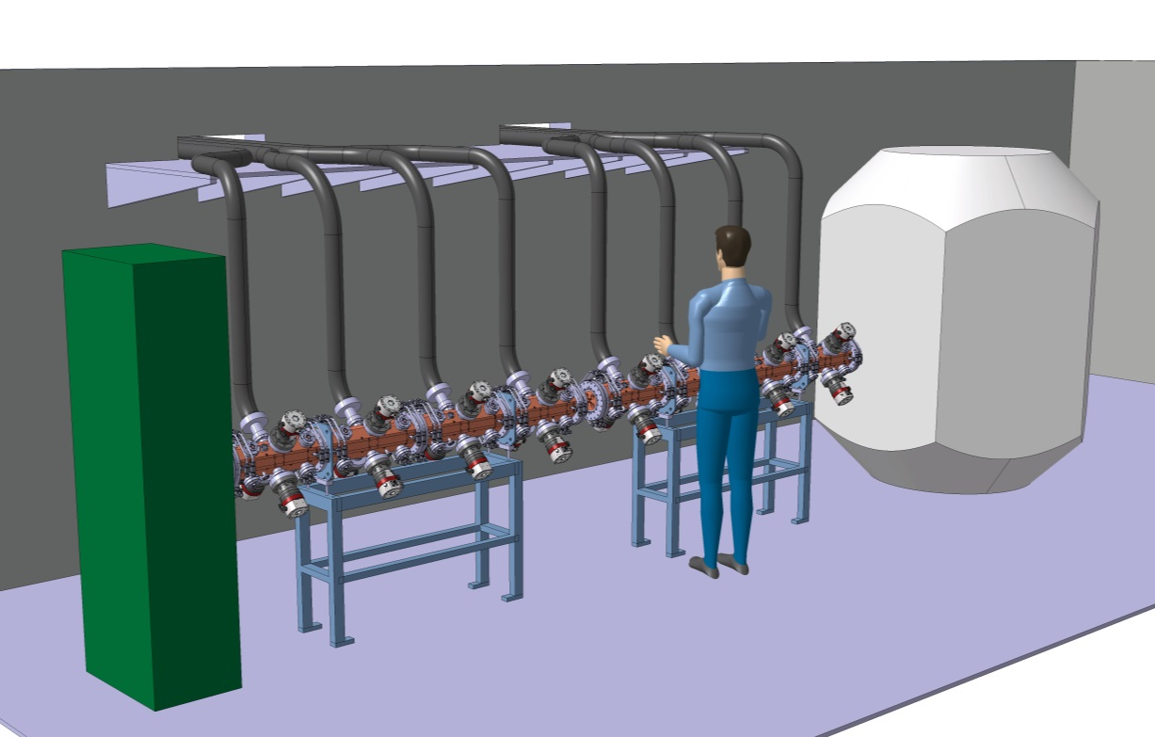
RFQ-based PET production system parameters
Energy | 10 MeV
Length | 4 m
Peak current | 500 μA
Duty cycle | 4 %
Average current | 20 μA
RF power, peak | 700 kW
RF power, average | 28 kW
Indicative cost accelerator:
RFQs 500 kEUR
RF amplifier 800 kEUR
Ion source 150 kEUR
Controls, accessories 50 kEUR
TOTAL 1.5 MEUR
Cost of target and shielding to be evaluated

Slide 7
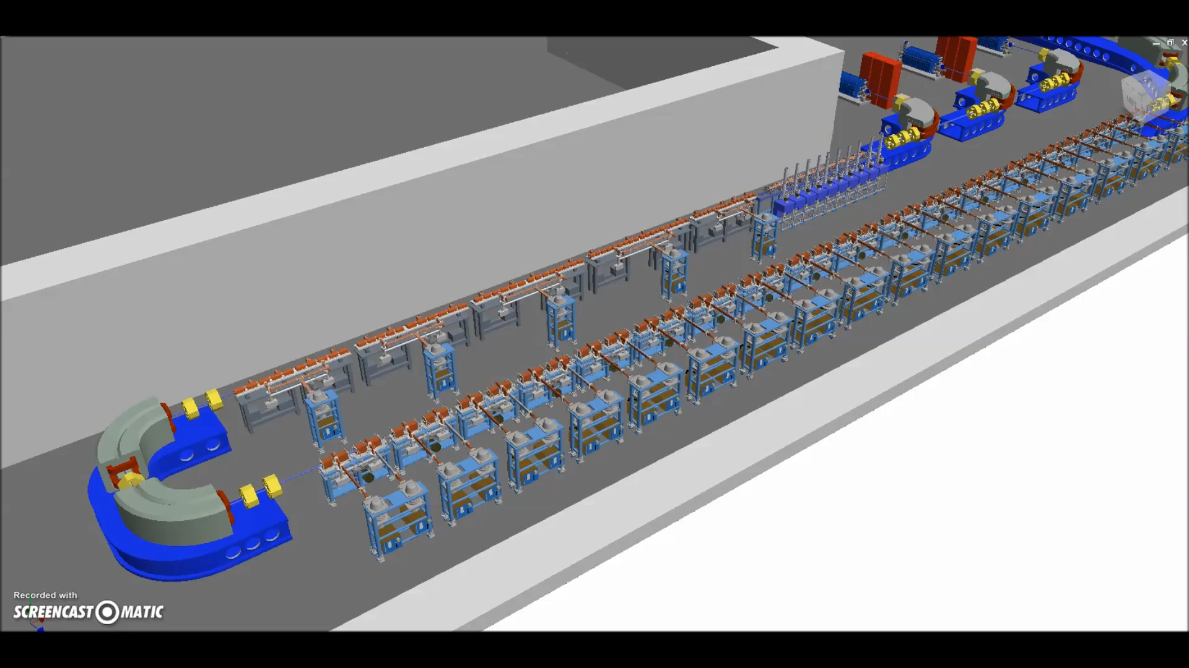
PIMMS2 and carbon ion acceleration
The PIMMS (Proton-Ion Medical Machine Study) design at CERN in 1996-2000 has made a fundamental contribution to the development of synchrotron-based accelerator systems for multi-ion cancer therapy.
CERN is now preparing a PIMMS2 project for the design and prototyping of a compact linac-based carbon therapy accelerator (400 MeV/u).
The CABOTO concept, developed in collaboration with TERA
40 m

Slide 8
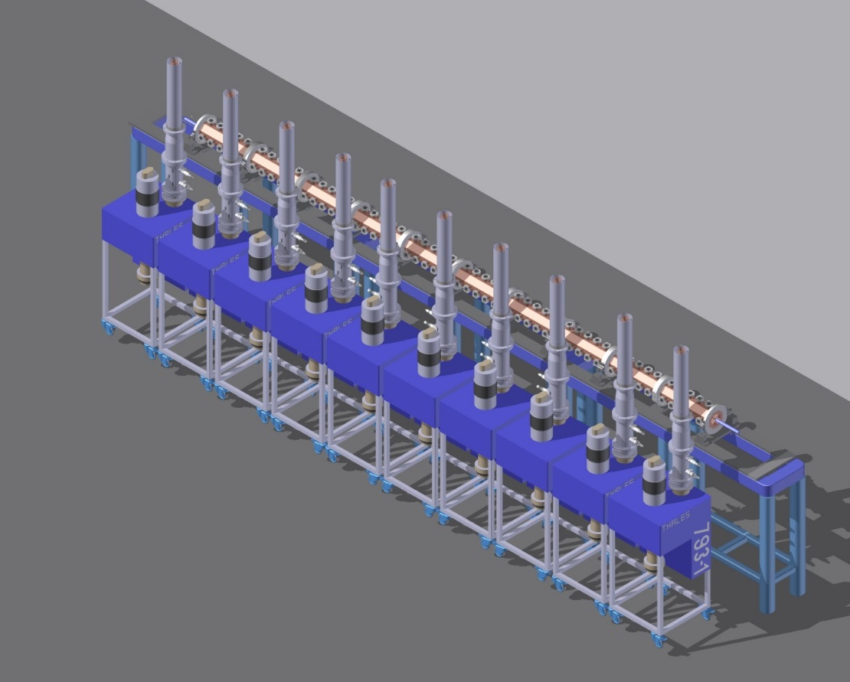
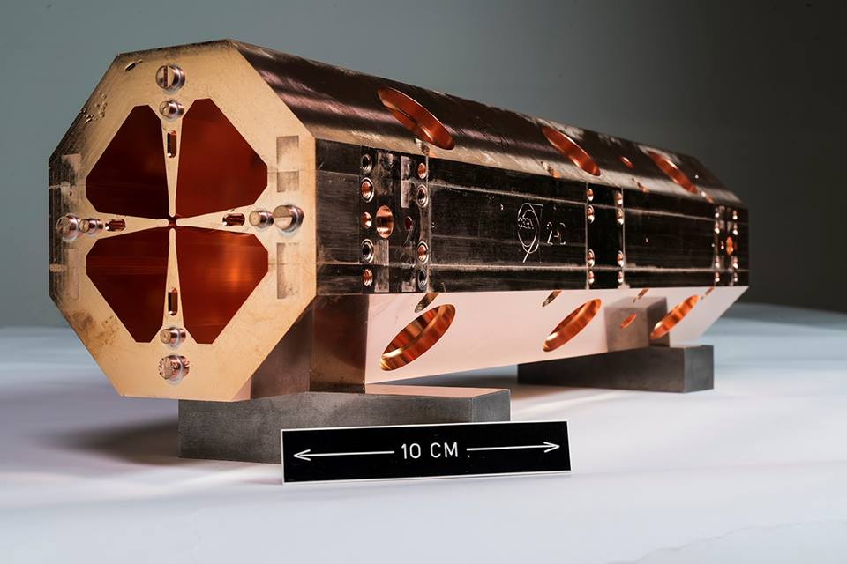
The RFQ for q/m=1/2 ions
Parameter | Value
Length [m] | 2.58
Transmission [%] | 51.2
Average aperture r [cm] | 0.13
Energy range [MeV/u] | 0.04-5
Output transverse emittance 99.5% [π∙mm∙mrad] | 0.12
Output longitudinal emittance 99.5% [π∙deg∙MeV] | 0.16

Slide 9
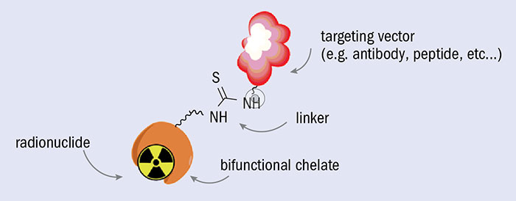
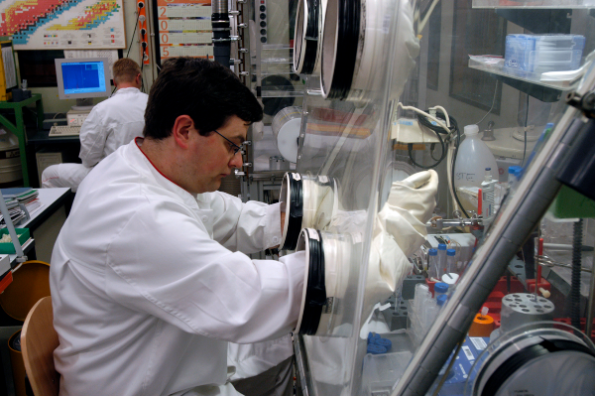
Therapeutic isotopes: Targeted Alpha Therapy
Production of alpha-emitting therapeutic isotopes
Injected radiolabeled antibodies accumulate in cancer tissues and selectively deliver their dose. Particularly effective with alpha-emitting radionuclides (minimum dose on surrounding tissues).
Advanced experimentation going on in several medical centres, very promising for solid or diffused cancers (leukaemia).
Potential to become a powerful and selective tool for personalised cancer treatment.
If the radioisotope is also a gamma or beta emitter, can be coupled to diagnostics tools to optimise the dose (theragnostics)

Slide 10
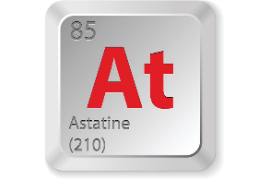
Accelerators for Alpha Emitters - Astatine
In the trial phase, only small quantities of a-emitting radionuclides are needed, provided by research cyclotrons.
If this technique is successful, there will be a strong demand of α-emitters that the accelerator community has to satisfy.
One of the most promising α-emitters is Astatine-211, obtained by α bombarding a natural Bismuth target (209Bi(α,2n) 211At nuclear reaction).
At production needs α (q/m=1/2) accelerator; optimum energy 28 MeV (sufficient yield but below threshold for 210Po), current >10 mA.
The use of α’s in cyclotrons is limited by extraction losses; linacs have a strong potential.
Synergy with low-energy section of carbon therapy linacs (q/m=1/2).
Astatine, the dream of the medieval alchemist.
The rarest element on earth (only 25 g at any given time)
The less stable element in the periodic table (<100)
Half life (210At): 7.2 hours

