Slide 1
ELENA electron cooler and SEM grids status
L. Jorgensen / BE-BI

Slide 2
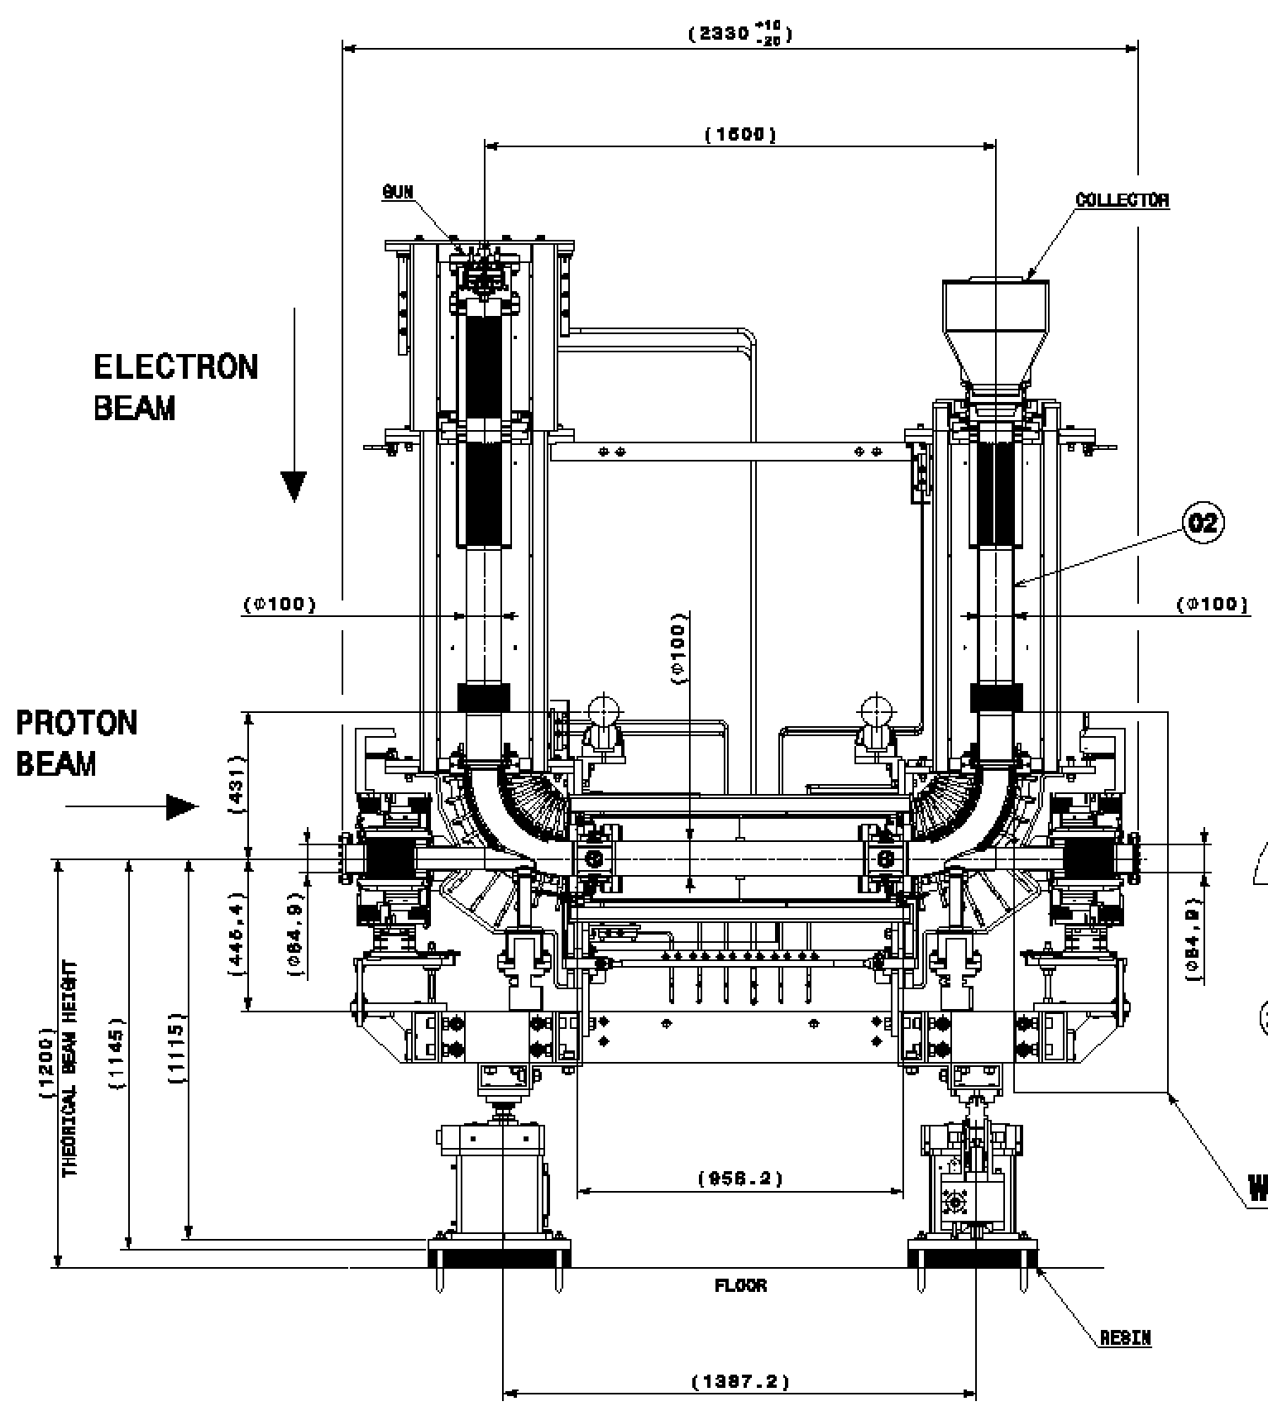
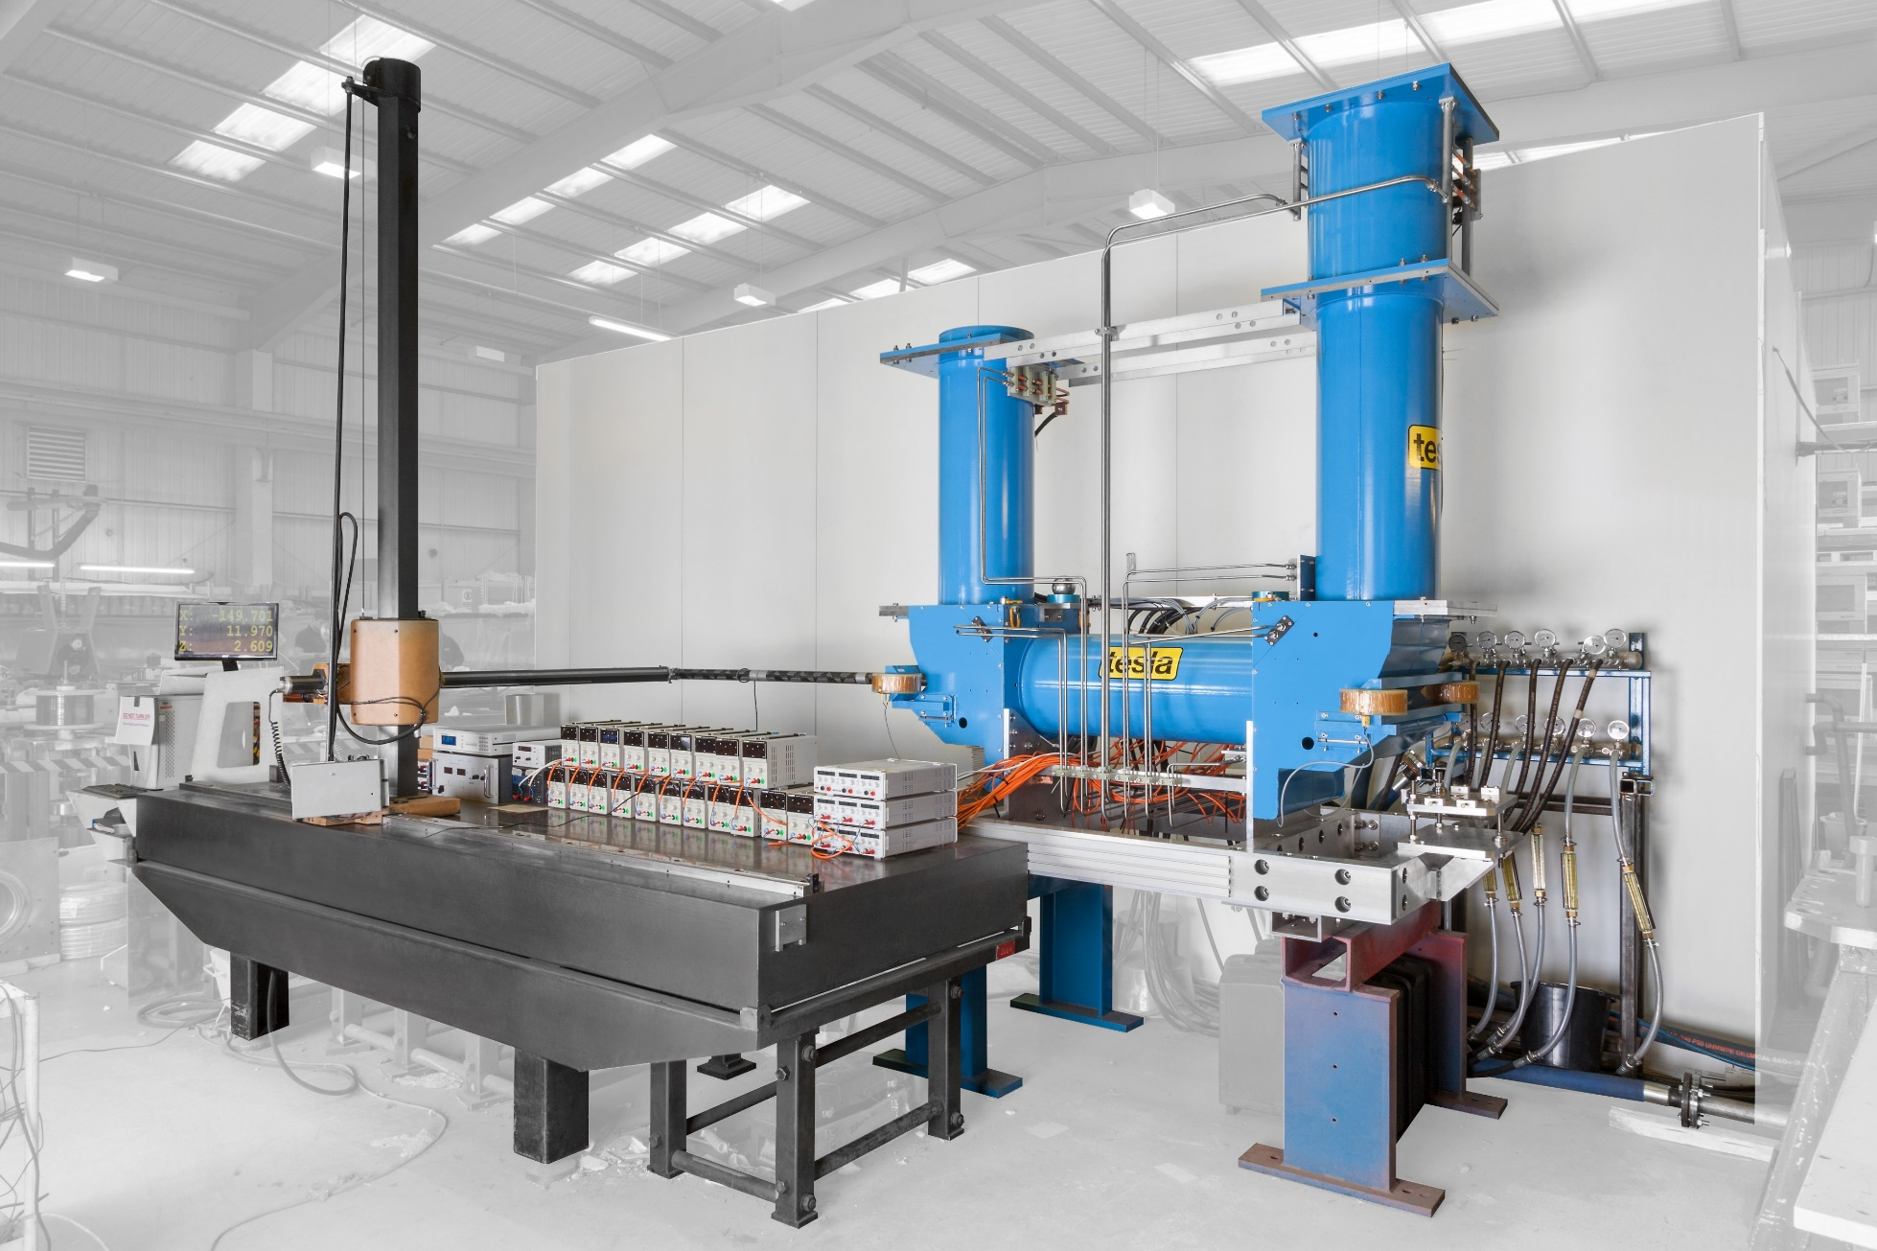
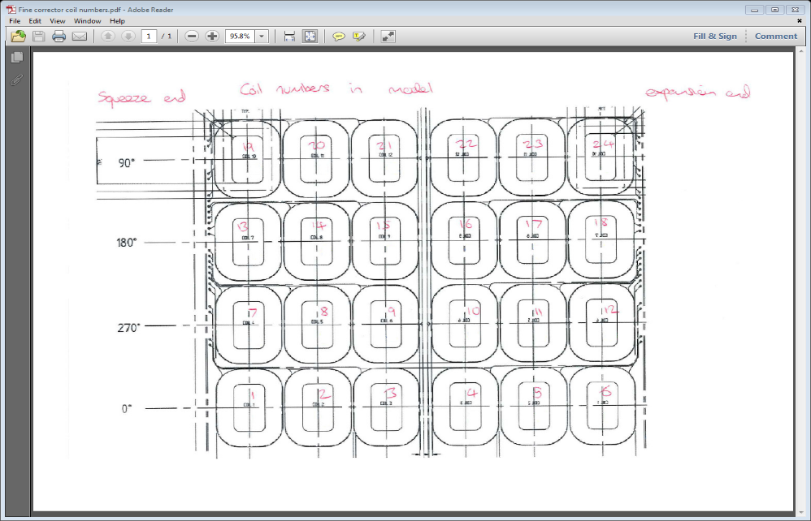

Slide 3
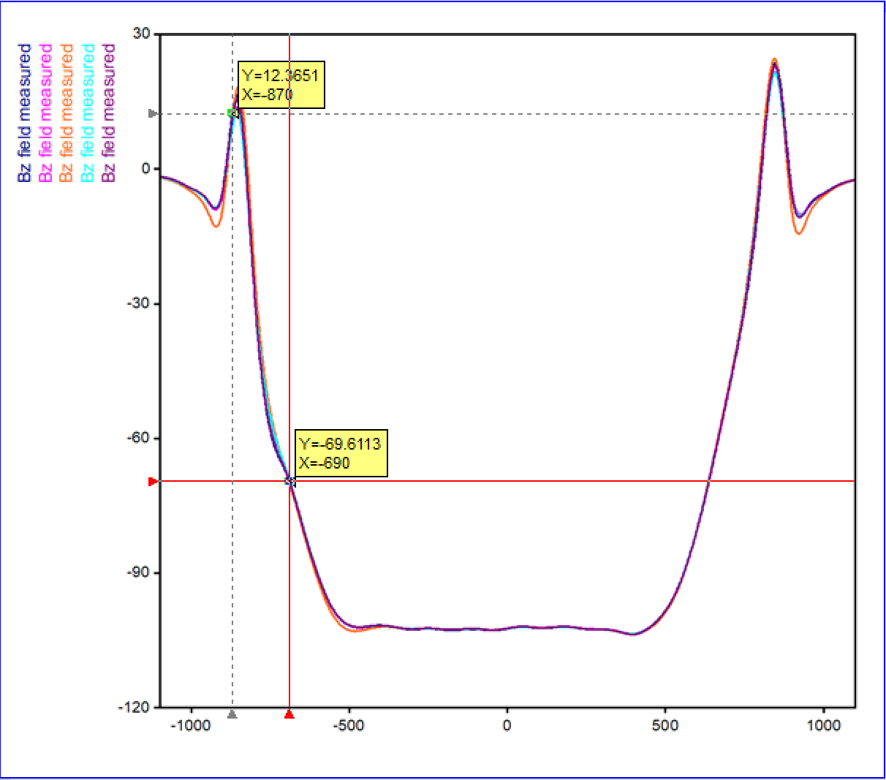
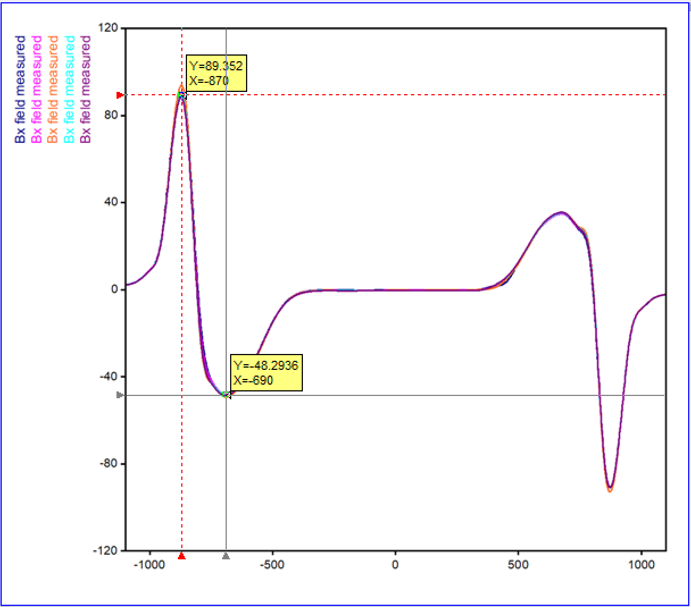
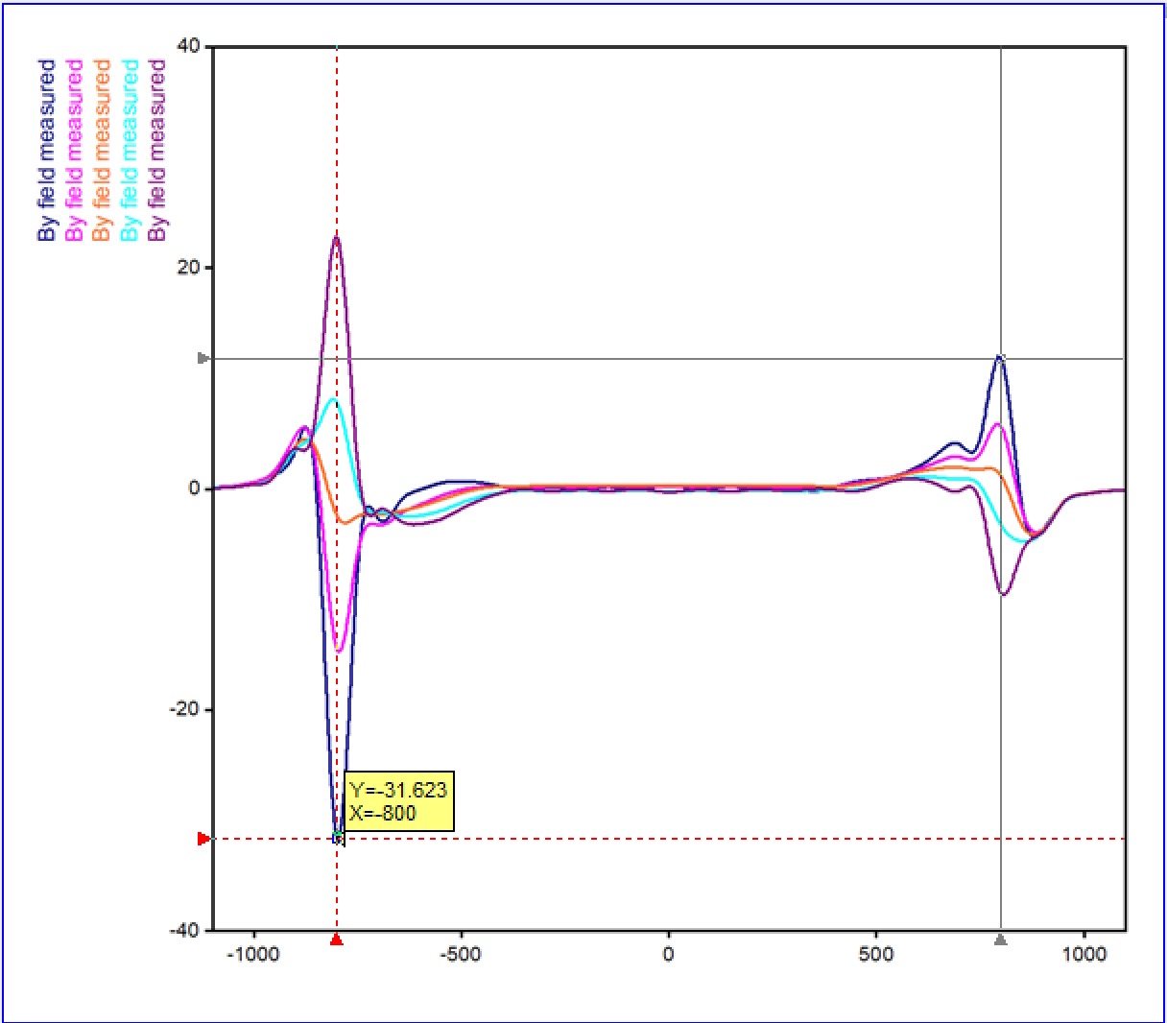
Electron cooler
Magnetic measurements at Tesla Engineering has been finished and the magnetic system has been packaged and shipped to CERN.

Slide 4
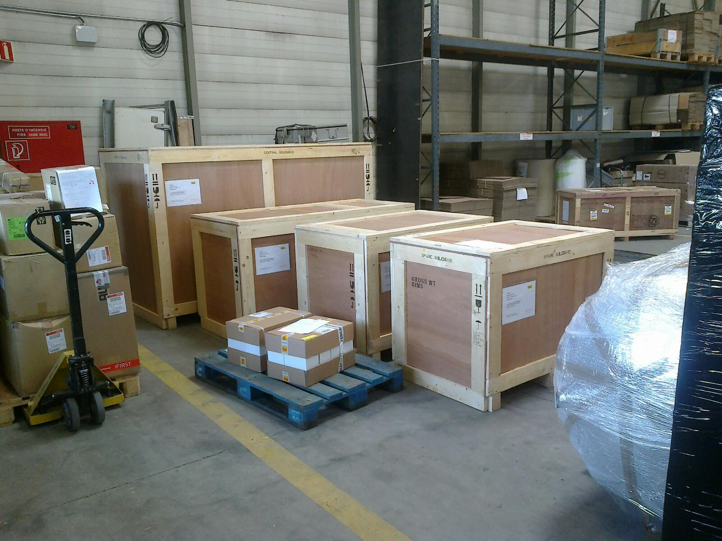
Magnets at CERN reception this Monday

Slide 5
Next step:
Magnets to be transported to Bat. 180 for certification.
Certification will take 2-3 weeks ????
Then assembly in AD Hall and a few tests.

Slide 6
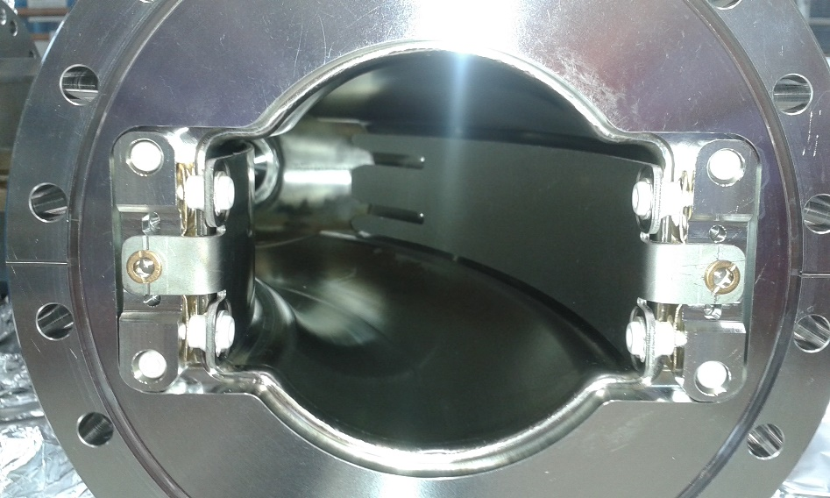
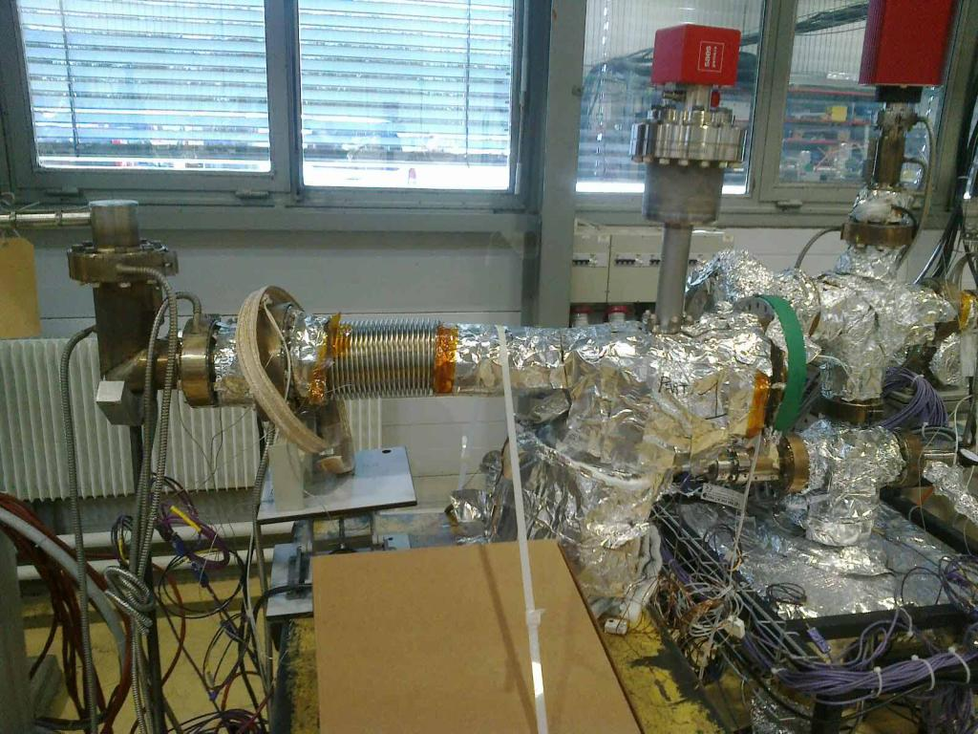
Electron cooler vacuum
Toroid chamber 1 has had the old NEG coating removed and is now back at the NEG coating lab to be re-coated.
Toroid chamber 2 has been leak-tested on its own and will now be fitted with electrodes and re-tested.

Slide 7
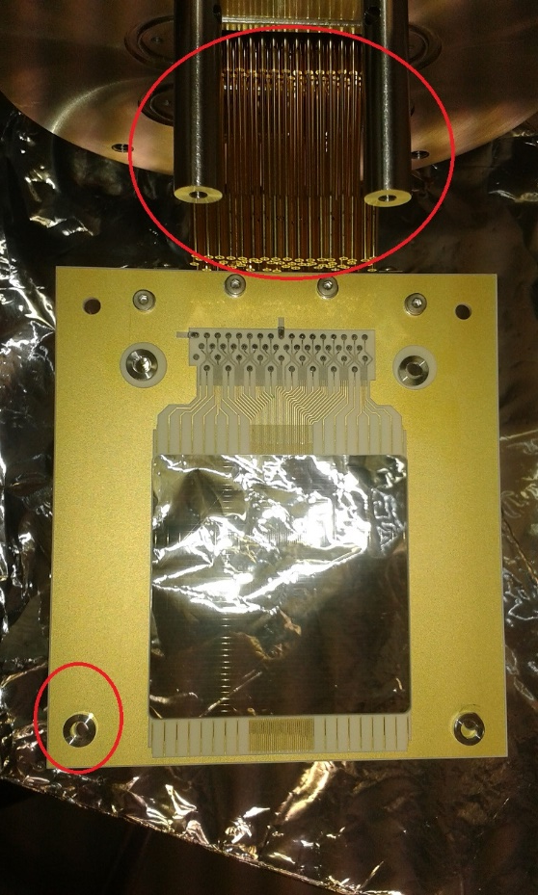
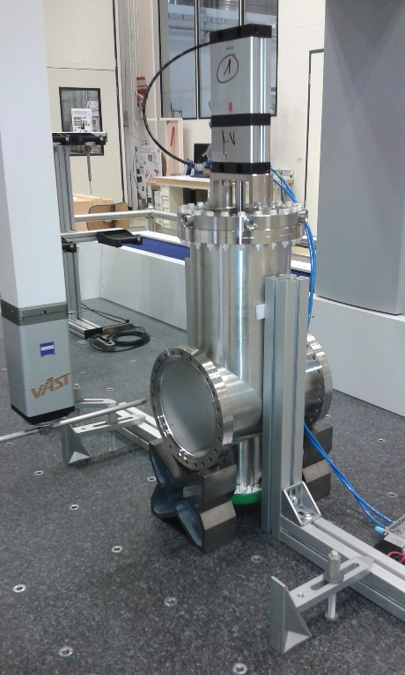
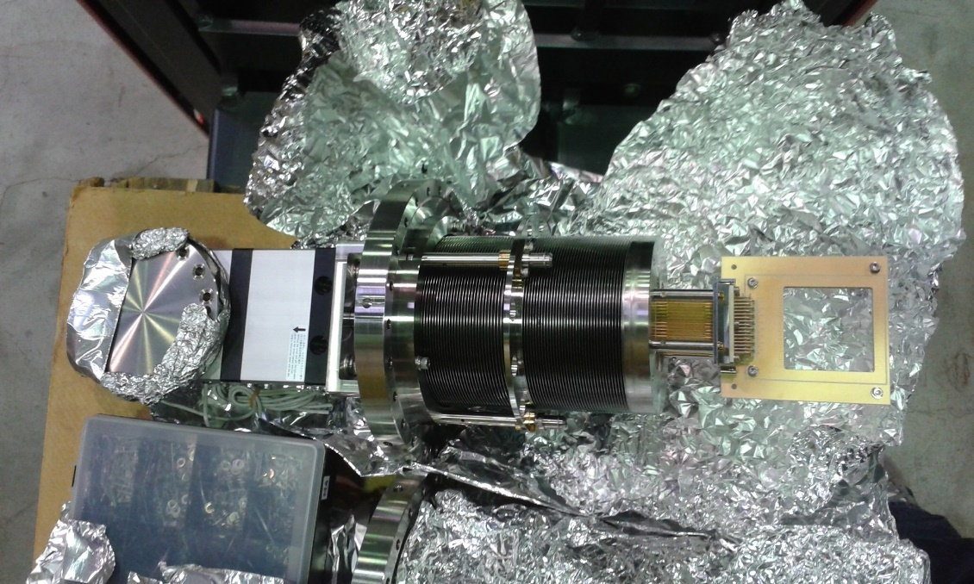
SEM grids
11 tanks ready – not yet all leak tested.
5 mechanisms ready – at cleaning service.
5 partial grid assemblies ready.
2 – maybe 3 – systems ready for installation within a few weeks.

