Slide 1

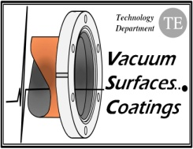

TE-VSC seminars
Vacuum Characterisation of Magnetron-Sputtered Amorphous Carbon Films for the Eradication of Electron Cloud Effects in Particle Accelerators
A. Ashraf, P. Chiggiato, P. Costa Pinto, M. Taborelli, Ch. Yin Vallgren, I. Wevers
CERN, 1211 Geneva 23, Switzerland
G. Debut, R. Kersevan
ESRF, Grenoble, France
Outlook:
The LHC and its future upgrade.
Electron Clouds
Magnetron Sputtered Carbon Films
Vacuum Characterization
Influence of Coating Parameters (Discharge Gas Pressure)
Conclusions

Slide 2
Introduction: LHC is back
The Large Hadron Collider restarted one week ago: a short period of collisions at the injection energy of 450 GeV per beam will be followed by a ramp in energy to 3.5 TeV per beam.
LHC physics will begin with collisions at this energy.
After the 2010-2011 shut-down, the LHC performance will be approaching its nominal values:
Nominal beam energy : 7 TeV (protons)
Luminosity: 10³⁴ cm⁻²s⁻¹
2808 bunches along the ring, 1.15x10¹¹ protons per bunch, 25 ns spacing
LHC is an evolutive accelerator: its performance will be gradually increased.

Slide 3
Introduction: LHC upgrade
A higher LHC luminosity (10³⁵ cm⁻²s⁻¹) is required in about 8 to 10 years, when the halving time of the statistical experimental errors will exceed 5 years.
proton per bunch
Bunch cross section
revolution frequency
bunches per beam in the ring
The luminosity can be increased:
    by increasing beam focusing at the interaction zones
    by increasing the bunch intensity
    The main limitation to the LHC bunch intensity lies in its injection chain, in particular the SPS. Amongst the limiting factors, electron cloud is one of the most severe.

Slide 4
Electron Clouds in High-Intensity Particle Accelerators
Electron clouds in beam pipes are generated by electron multipacting on the wall of the vacuum chamber. (copyright Mauro)
+
+
+
+
The beams are perturbed by electron cloud effects:
  Transverse emittance blow-up (bunch expansion).
  Dynamic pressure rise (electron stimulated desorption).
  Septum magnet sparking.
  Beam losses.
The electron cloud mechanism is eradicated whenever the maximum secondary electron yield (δ_{max}) of the beam pipe wall is lower than a well defined threshold.
For the LHC beam in the main ring and its injector chain:
δ_{max} < 1.3

Slide 5
Thin Films for the Eradication of Electron Clouds
For as cleaned st. steel, copper and aluminum δ_{max}>2.
Lower values can be obtained by high temperature bakeout and high electron bombardment doses (>10⁻³ C mm⁻²).
Ti-Zr-V film coating have δ_{max}≈1.1 after activation at temperature higher than 180°C (24h). But they cannot be applied to the SPS because the SPS magnet vacuum chambers are not bakeable.
Low SEY are obtained
for Ti-Zr-V coatings after heating in vacuum.
About 15 Kg of Ti-V-Zr are spread over 6 Km of LHC beam pipe

Slide 6
Thin Films for the Eradication of Electron Clouds
Many clean elements and their compounds fulfill the δ_{max}<1.3 threshold.
Ding, Tang, and Shimizu, J. Appl. Phys. 89 (2001) 718
But when exposed to the air, their SEY increases steeply, resulting in δ_{max} higher than about 1.5 due
to oxides formation and water adsorption.
An additional and progressive rise is recorded during months of stay in the air, eventually leading to δ_{max} higher than 2: airborne hydrocarbon adsorption.
  [N. Hilleret, EPAC 2000 proceedings]
Either in situ heating or particle bombardment (conditioning) is necessary to recuperate lower SEY values: surface degassing + possibly formation of a carbon layer

Slide 7
Carbon Films for the Eradication of Electron Clouds
Graphite is a very interesting candidate…but it needs to be deposited onto the vacuum chamber walls.
SEY of graphite
δ_{max}
δ_{max}
N. Rey Whetten, J. Appl. Phy. 34(1963)771

Slide 8
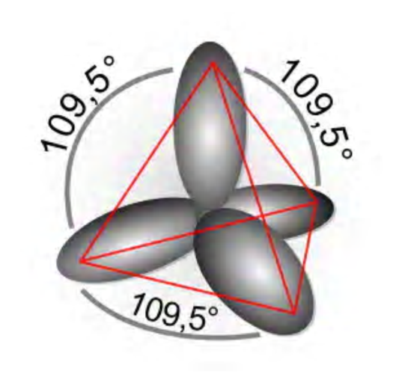
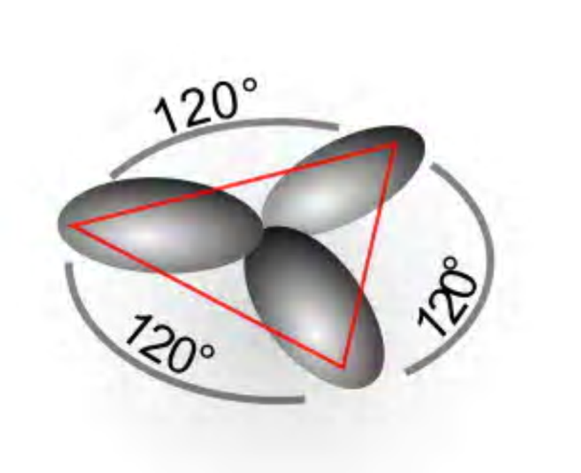
Carbon Films for the Eradication of Electron Clouds
However, carbon films are neither pure graphite nor pure diamond. In general they are amorphous (lack of long-range order). Locally, the carbon orbital hybridization can be diamond-like (sp³) or graphite-like (sp²).
sp³
sp²
Source: Wikipedia ‘hybridization’
Production of amorphous carbon (a-C) films with the highest fraction of sp² hybridization
+
without excessive heating of the vacuum chamber during coating (SPS constraint)

Slide 9
Carbon Films for the Eradication of Electron Clouds
Magnetron sputtered carbon films in cylindrical configuration.
-U
Graphite rod
Standard coating parameters (magnetic field 150 G)
Sample ID | Discharge gas | Voltage [V] | Current [A] | Power [W] | Max. sub. T [°C] | Pressure [Torr] | Dep. Time [h] | Thickness [nm]
100 mm | Ne | 822 | 0.57 | 466.3 | 160 | 1.8E-02 | 22 | 580
Discharge
gas
Sputtered
C atoms
The low δ_{max} of graphite is preserved
+
B
δ_{max}= 0.95
Vacuum chamber
9

Slide 10
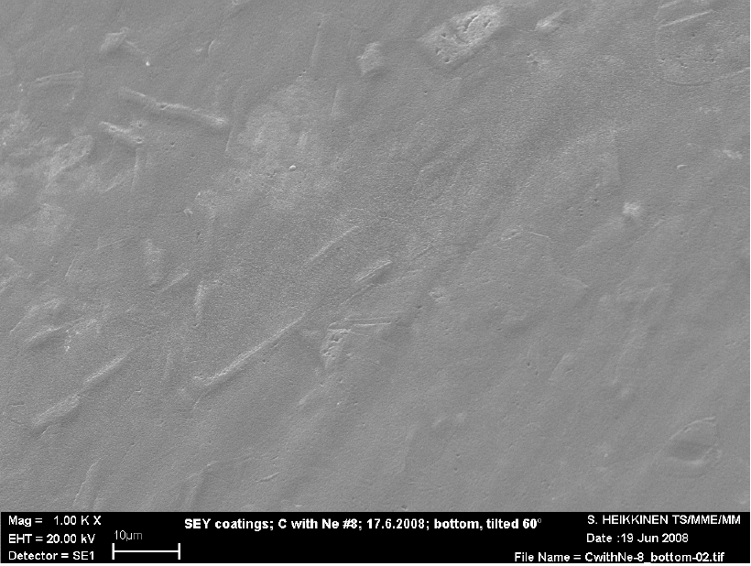
Carbon Films for the Eradication of Electron Clouds
Advantages of magnetron-sputtered C films:
They do not need any in situ bakeout to attain the low δ_{max} .
Their δ_{max} is lower than that of activated TiZrV and scrubbed surfaces.
Multiple exposures to air do not increase the δ_{max} if the samples are correctly stored.
Good adhesion, no loose dust C particles.
Resistive behavior: major impact on the impedance can be excluded.
0.2 μm
10 μm

Slide 11
Vacuum characterisation of magnetron sputtered C films
To be implemented in the vacuum system of particle accelerators, magnetron sputtered C films need to be thoroughly characterized. The following characteristics are to be measured:
Water vapor outgassing rate for unbaked samples (important for the SPS on which the pumping speed cannot be increased)
Outgassing rates of the main gases released after bakeout (necessary for baked accelerators, for example the damping rings of CLIC)
Electron stimulated desorption yields.
Photon stimulated desorption yields.
A 50 cm long, 10 cm diameter, stainless steel vacuum chamber was used for the first tests.
A 2-m long, 6 cm diameter, double-wall for water cooling, stainless steel vacuum chamber was used for the PSD measurement.

Slide 12
Water Vapor Outgassing
Conductance C= 2.88 l s⁻¹ for H₂O
Sample
TMP S_{N2}= 250 ls⁻¹
Penning gauge
The water vapor outgassing rate is higher than that of uncoated stainless steel by a factor of 20 after 100 h of pumping.

Slide 13
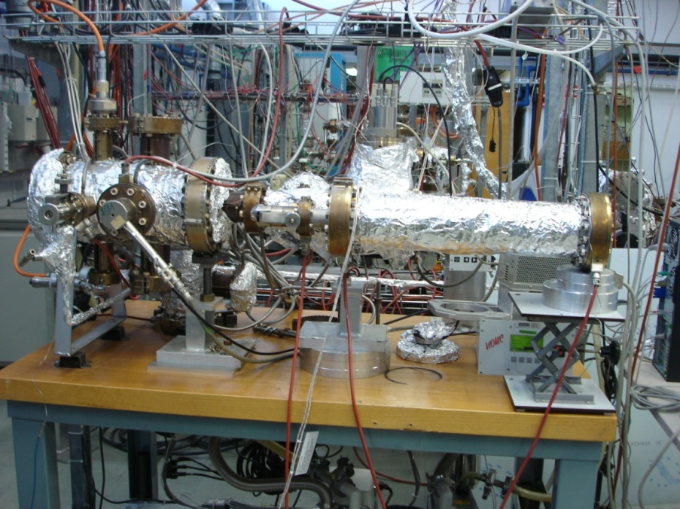
Thermal Outgassing of Baked C Films
The sample is baked at 150°C (24h)
B
A
g
a
u
g
e
R
G
A
Sample
Sample
M
a
i
n
c
h
a
m
b
e
N
E
G
s
r
t
r
i
p
p
u
m
p
e
d
C
P
e
n
n
S_{c} is the conductance of the orifice
I_{RGA} the RGA signal
α_{RGA} the calibration factor
Δt_{acc} the accumulation time
i
g
a
u
g
n
g
e
L
N
2
t
r
T
M
P
s
H
2
a
p
t
a
t
i
2
6
0
l
o
n
/
s
E
x
h
a
u
s
t

Slide 14
Thermal Outgassing of Baked C Films
H₂
Compared to uncoated stainless steel:
H₂: about 5 times lower
CO₂: at least a factor of 5 higher
The outgassing of the discharge gas (Ne) is not an issue
Gas | Outgassing Rate [Torr l s⁻¹ cm⁻²]
H₂ | 3 x 10⁻¹³
CH₄ | 2 x 10⁻¹⁶
CO | 2 x 10⁻¹⁵
CO₂ | 7 x 10⁻¹⁵
Ne | 1 x 10⁻¹⁶

Slide 15
Electron Stimulated Desorption
The system is baked at 300°C (24h); the sample is measured unbaked and after 2 h heating at some selected temperatures
Electron energy: 500 eV --Bombarding current: 1 mA--Estimated bombarded area: 200 cm²
Measurement taken after 100 s of bombardment

Slide 16
Electron Stimulated Desorption
CO has the highest ESD yield, followed by H₂ and CO₂.
For heating temperature higher than 120°C, the ESD yields of the C coated sample are lower than that of bare stainless steel.
H₂ and CH₄: when heated, the carbon coated sample is at least 10 times better than the uncoated.
CO and CO₂: C coated and uncoated samples have a similar behavior.

Slide 17
ESD yields for 24 h heating at 250°C

Slide 18
ESD yields for 24 h heating at 250°C

Slide 19
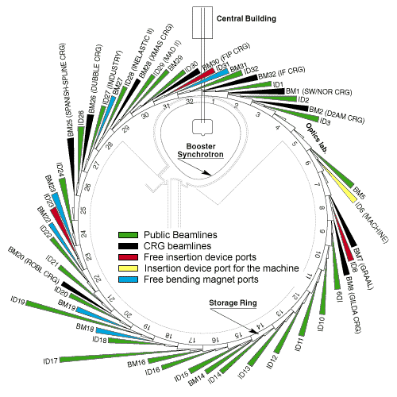
Photon Stimulated Desorption
Angle of incidence = 25 mrad
Critical Energy
20.5 KeV
Angular acceptance
4.234 mrad
Photon Flux (E>10eV)
2.94x10¹⁵ photons (s mA)⁻¹
Beam Energy
6 GeV
Typical Beam Current
185 mA
Angle of incidence = 25 mrad
C coated chamber
The system is bakes at 300°C (24h). The sample is not baked.
The sample is separated from the rest of the system by a gate valve (at the diaphragm position, not pictured in the drawing); it is pumped by an auxiliary TMP during the bakeout of the system.
At the end of the bakeout, the gate valve is opened.
31

Slide 20
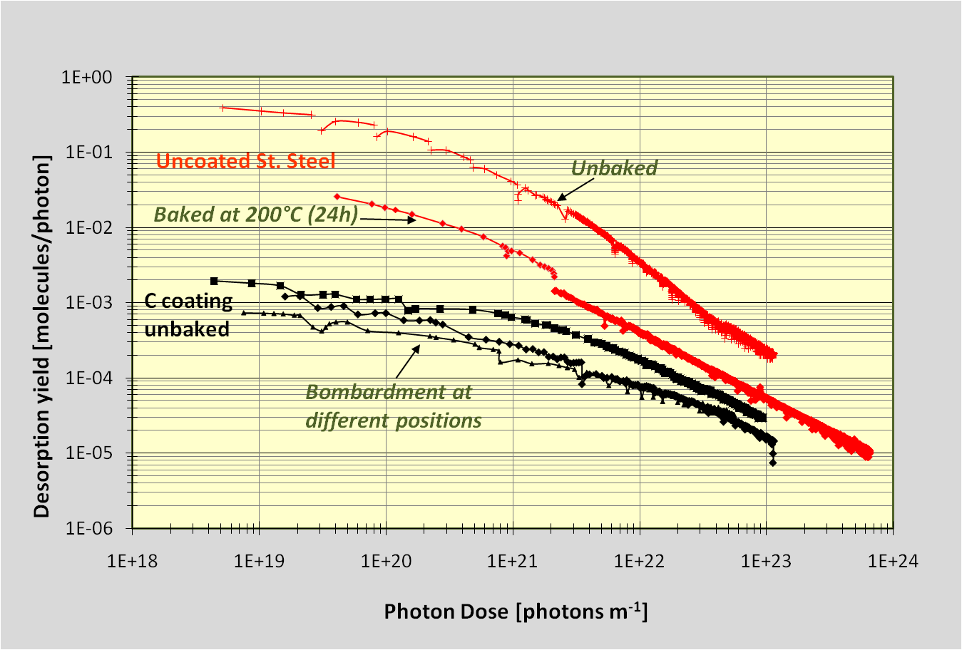
Photon Stimulated Desorption
The photon desorption yield of the unbaked C coated sample is lower
than that of uncoated stainless steel.

Slide 21
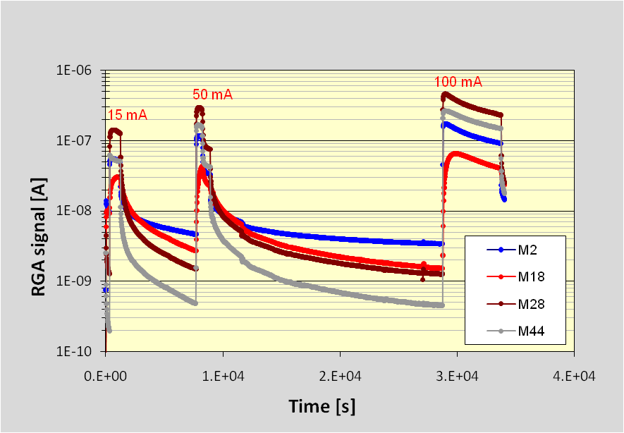
Photon Stimulated Desorption
CO and CO₂ are the two leading gases; on the contrary, for stainless steel, H₂ is the main desorbed gas.
In progress: measurement of baked carbon coated samples.

Slide 22
Role of the Discharge Gas Pressure
The data presented until now were obtained for samples coated with a selected set of coating parameters.
Is there any chance to reduce even further the outgassing rates, in particular water vapor outgassing of unbaked samples, by changing those parameters?
Sample ID | Discharge gas | Voltage [V] | Current [A] | Power [W] | Max. sub. T [°C] | Pressure [Torr] | Dep. Time [h] | Thickness [nm]
100 mm | Ne | 830 | 0.31 | 257.3 | 140 | 3.9E-03 | 23 | 715
Decreasing the discharge
gas pressure by a factor of 4.6
Modification of the outgassing rates.
Unbaked samples: Water vapor outgassing is reduced by a factor of 10
Baked samples (150°C, 24h):
H₂, CO and CO₂ : no significant variation (less that a factor of 3 change).
Ne: 2 order of magnitude higher (from 10⁻¹⁶ to 10⁻¹⁴ Torr l s⁻¹ cm⁻²)

Slide 23
Why a lower discharge gas pressure reduces
water outgassing?
L. G. Jacobsohn and F. L. Freire, Jr. J. Vac. Sci. Technol. A 17.5., Sep/Oct 1999, p. 2841
‘…a decrease of the network interconnectivity occurs for increasing plasma pressure depositions.’
Lower pressure means:
Higher mean free path for C and energetic Ne atoms
higher energy of impingement onto the growing film
higher density
lower porosity
lower water intake.

Slide 24
Discharge gas trapping
The discharge gas can be implanted in the growing film.
Energetic ions are neutralized when impinging on the target.
As neutrals they can rebound toward the substrate with a significant energy.
They can lose energy in collisions with the discharge gas
Lower the pressure, higher the probability to reach the film and be implanted
In addition, the discharge gas content depends on gas mass, cathode voltage,
target-sample distance, and substrate temperature.
TiZrV thin films

Slide 25
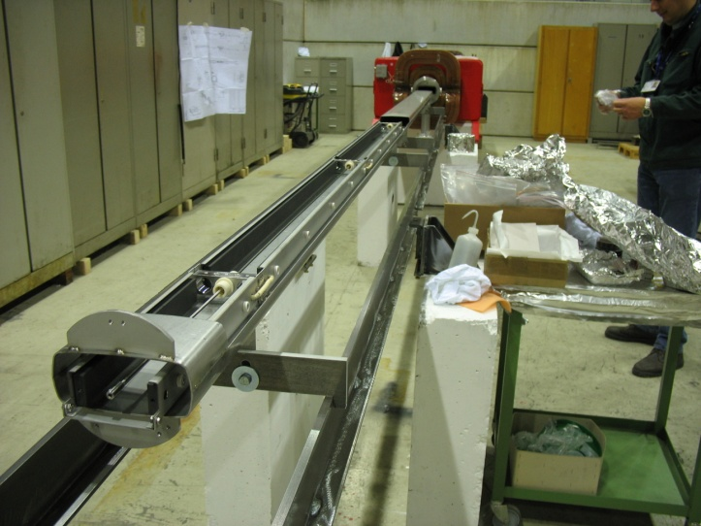
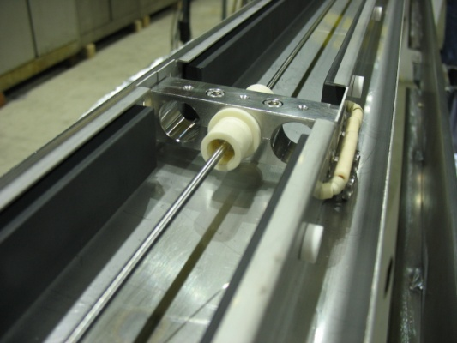
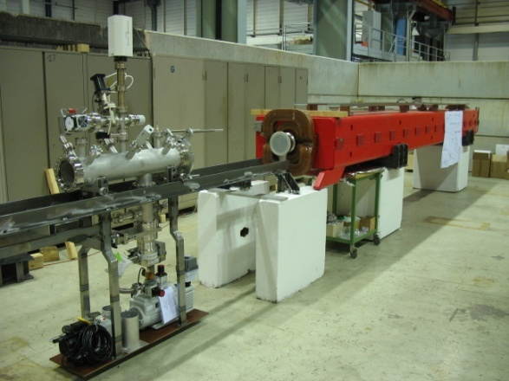
Conclusions
Magnetron sputtered carbon films are an effective solution to eradicate electron clouds in high intensity particle accelerators. They can be implemented both in bakeable and unbakeable beam pipes of existing and future accelerators.
They have a negligible impact on vacuum chamber aperture.
The thermal and stimulated outgassing features are in general better than those of uncoated stainless steel, except for the water vapor outgassing of unbaked samples.
The latter records a reduction of one order of magnitude by decreasing the discharge gas pressure by a factor of about 5…at the detriment of the Ne outgassing rate.
Ongoing activities
Optimization of the coating parameters.
Study of the implementation of such coatings in real accelerators, with the final objective of coating the whole SPS ring (8 Km, more than 1000 vacuum chambers).

Slide 26
Future activities for cylindrical samples:
Production of other samples coated with the same sputtering parameters (3 batches of two):
Characterizations chain:
Sample 1:
  water outgassing;
  outgassing measurements at RT and after baking at 150°C and 250°C (24h).
Sample 2:
  water outgassing, then ESD : RT, 120°C (24 h), 200°C and 250°C;
  repeat for the 3 batches.
Change coating parameters
Three values of Ne pressure for at least 2 batches of two samples.
Voltage
Sputtering rate
Substrate temperature

Slide 27
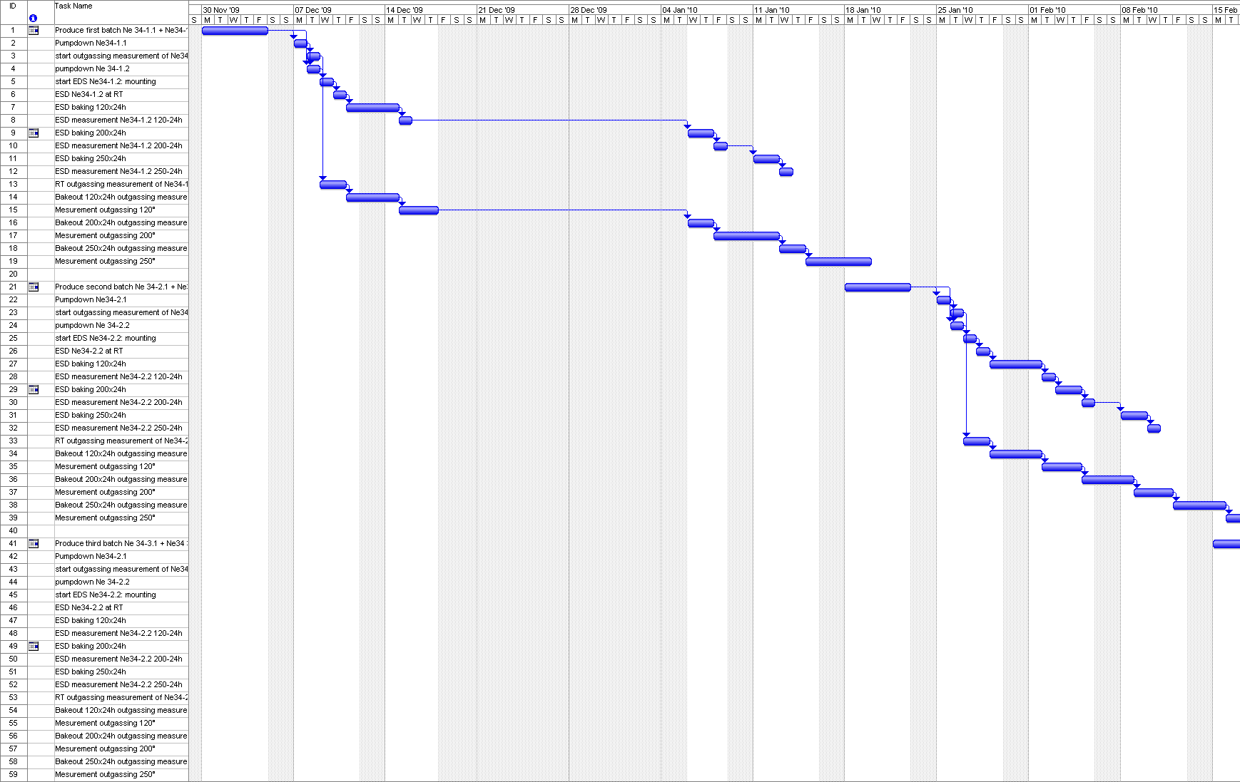

Slide 28
Backup slides

Slide 29
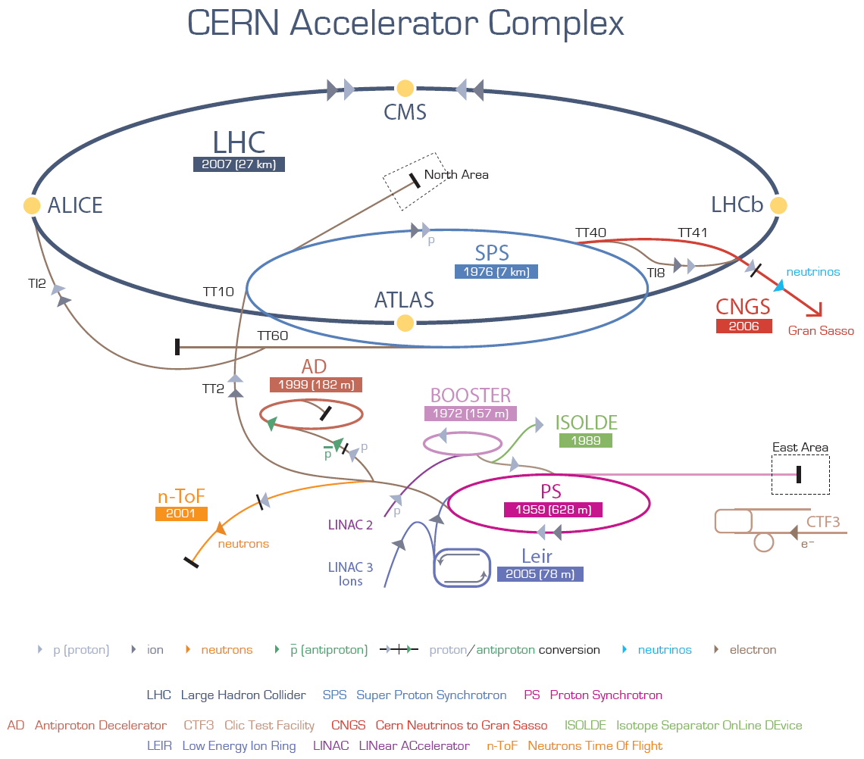
Backup slides: LHC injector chain

