Slide 1

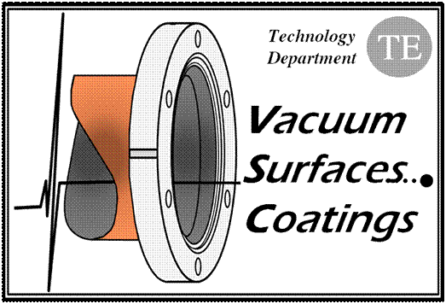
Dynamic behaviour
of the LHC beam vacuum
V. Baglin
CERN TE-VSC, Geneva
1. LHC
2. Beam vacuum dynamics
3. LHC beam vacuum system
4. 2009 operation

Slide 2
1. LHC

Slide 3
CERN accelerator complex

Slide 4
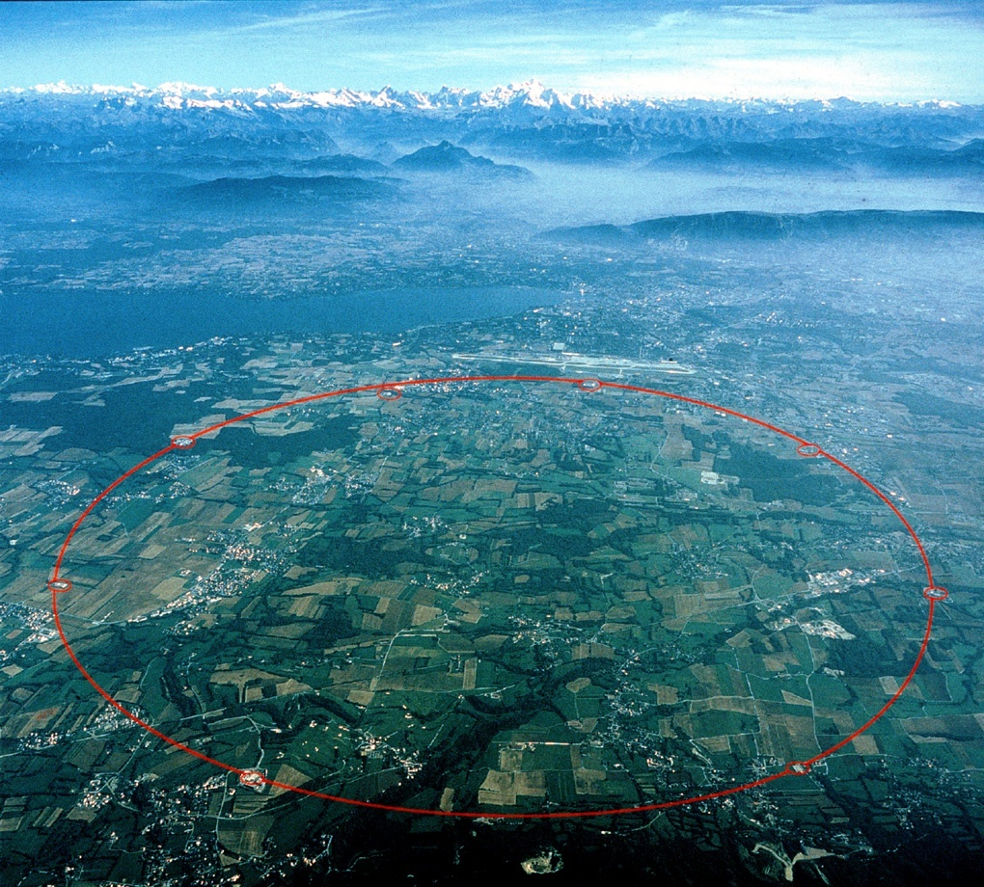
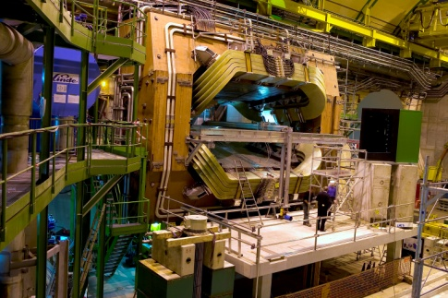

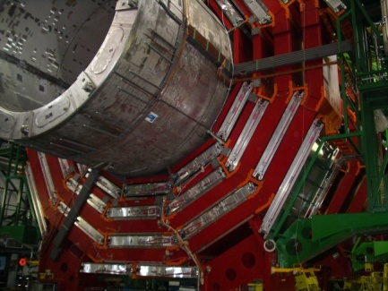
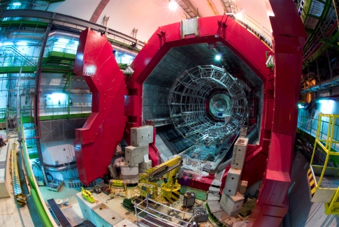
The CERN Large Hadron Collider (LHC)
LHCb
ATLAS
26.7 km circumference
8 arcs of 2.8 km
8 long straight sections of 575 m
4 experiments
7 TeV
CMS
ALICE

Slide 5
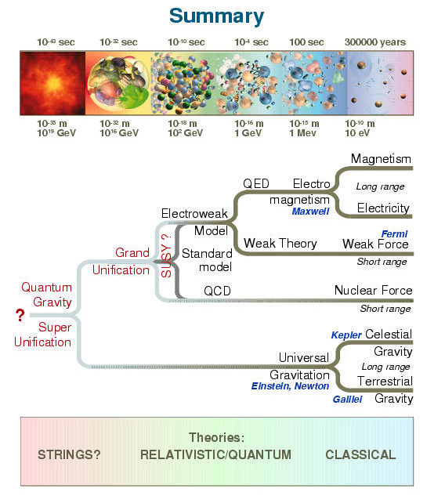
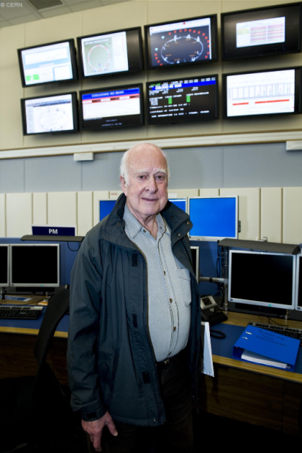
The LHC Experiments
Probe matter till 10⁻¹⁸ m
Higgs boson(s) should explain the mass of particles
Origin of matter-antimatter asymetry
Study the origin of the universe (quark gluons plasma)
Discovery of new particles : symetry ?
String theory ?
… P. Higgs in the CERN Control Room

Slide 6
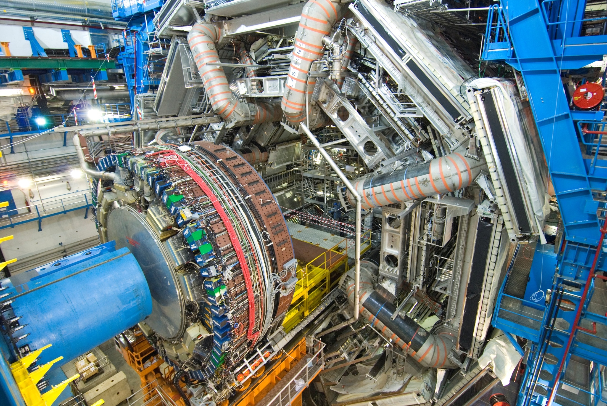

ATLAS : Toroids and End-Cap Calorimeter

Slide 7
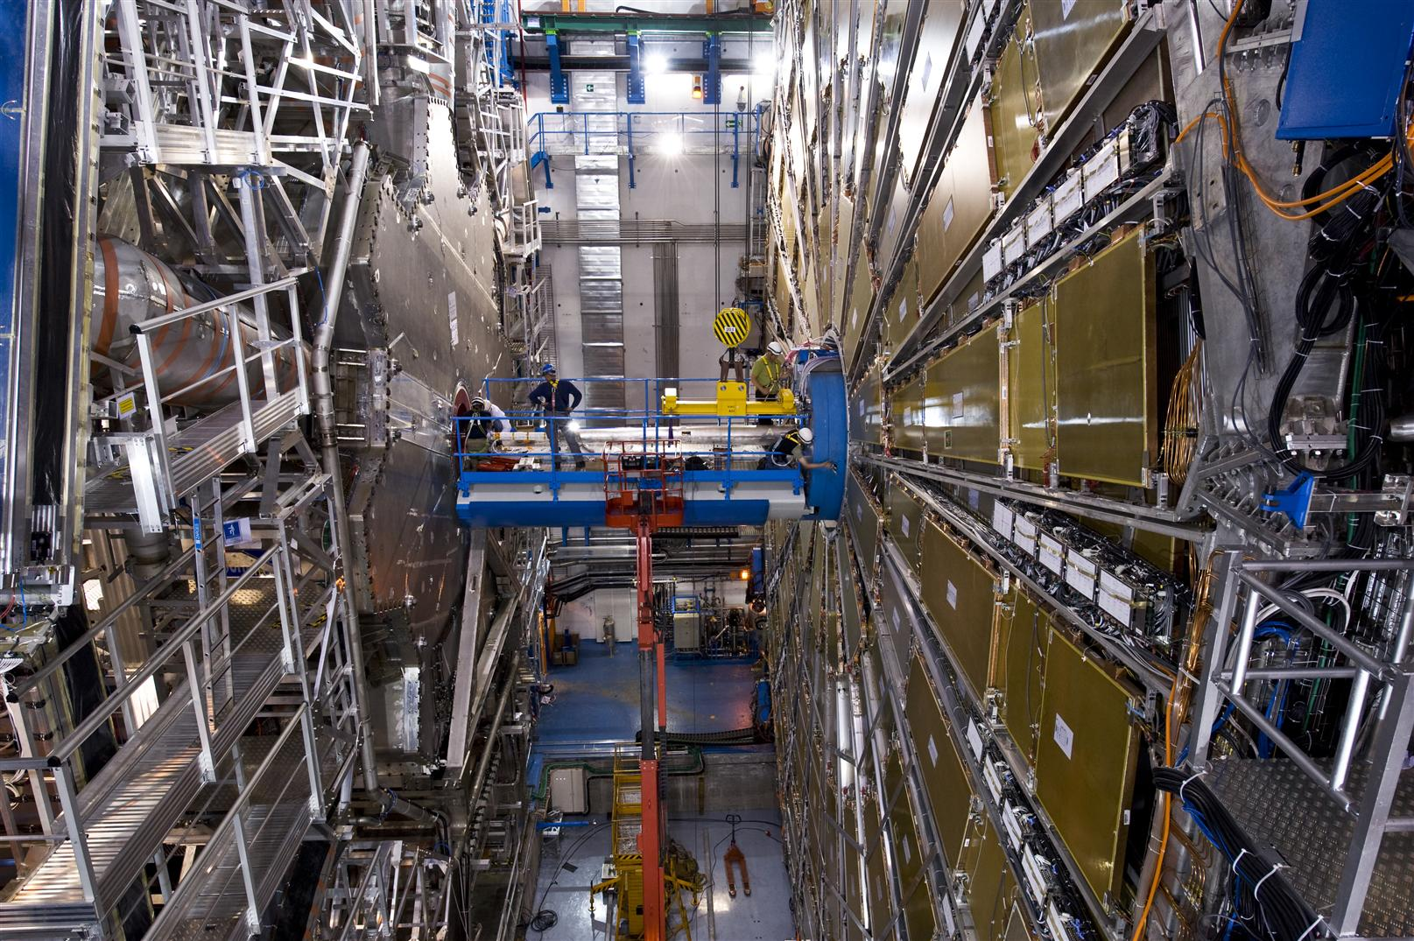
Beam Pipe Installation in ATLAS Before Closure

Slide 8
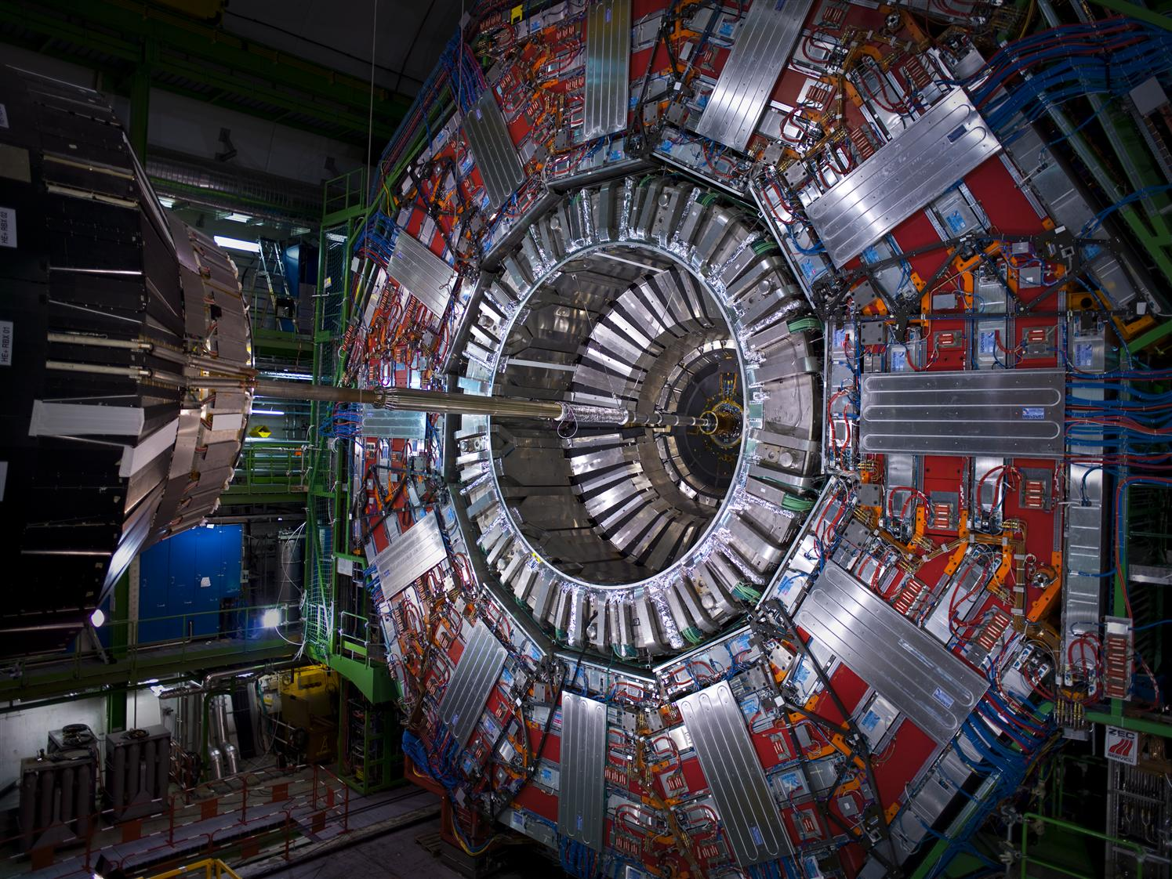

CMS Beam Pipe
CMS Ready to Close: Aug 2008

Slide 9
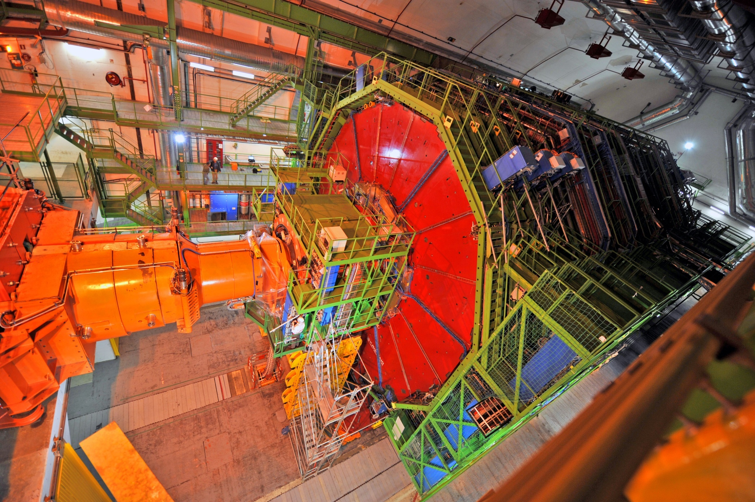
CMS Closed and Ready for Beam

Slide 10
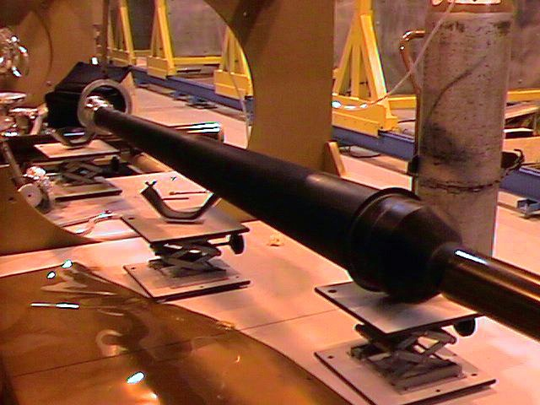
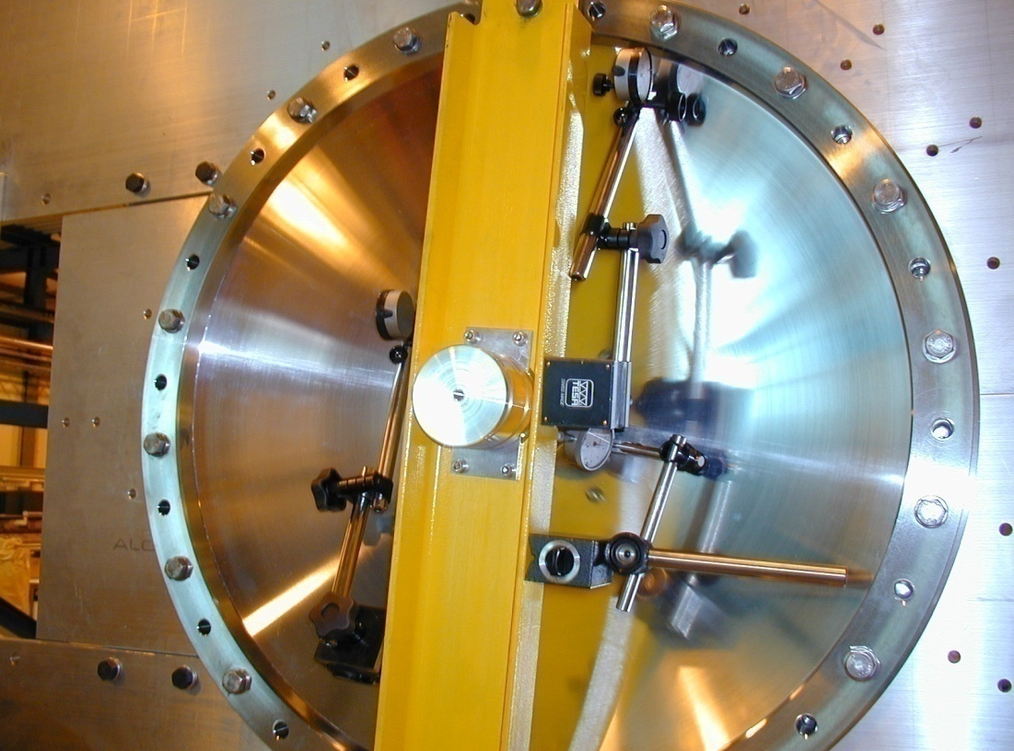
Vacuum Chambers for LHC Experiments
High Transparency
Courtesy R. Veness AT/VAC
Courtesy R. Veness AT/VAC
LHCb beryllium vacuum chamber, 0.8 mm
Getter coated, bakeable to 250 degres
LHCb aluminium vertex window

Slide 11
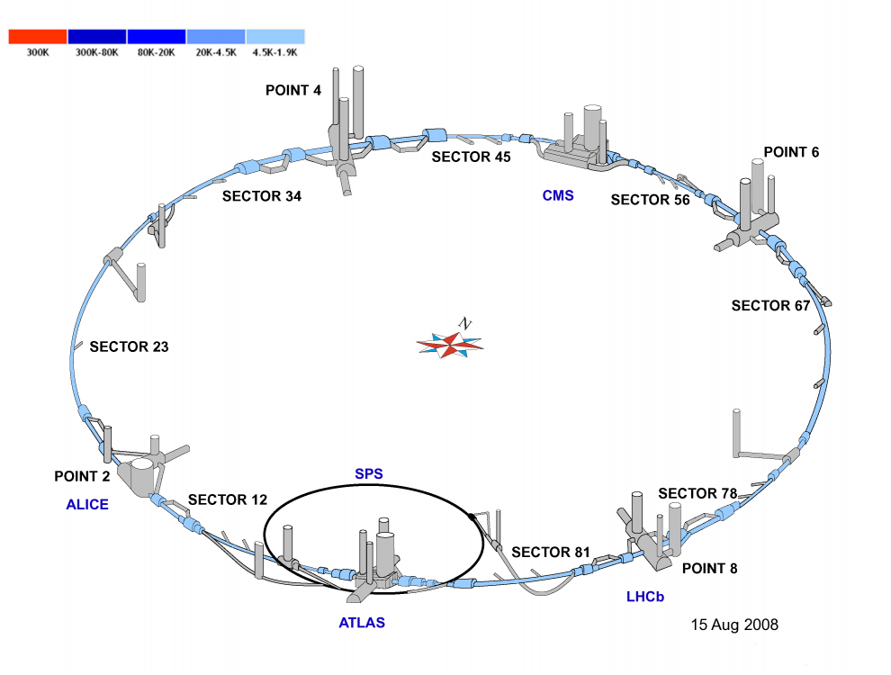
23 km d’aimants supraconducteur refroidis à 1,9 K

Slide 12
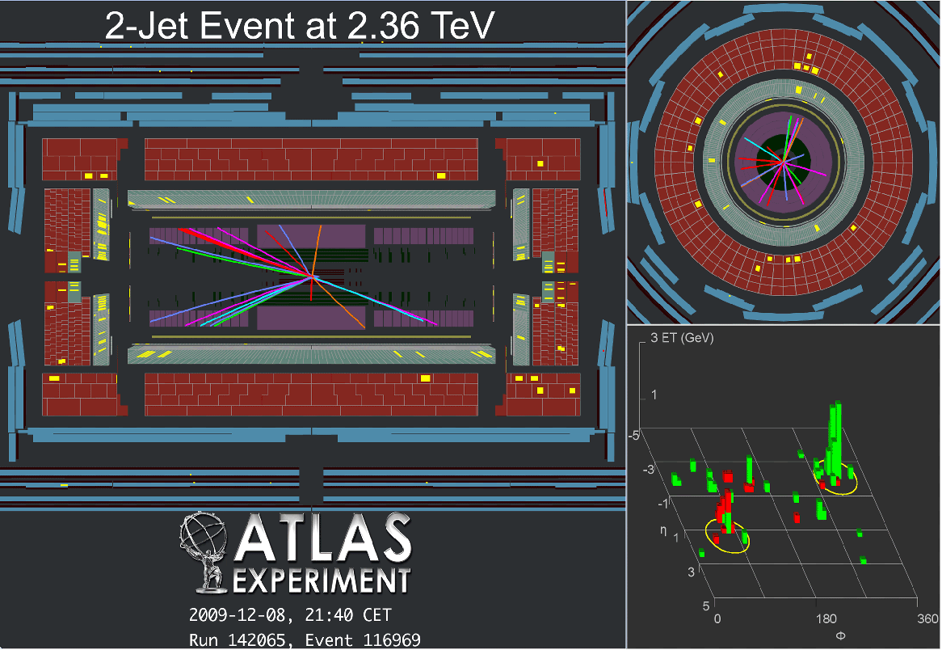
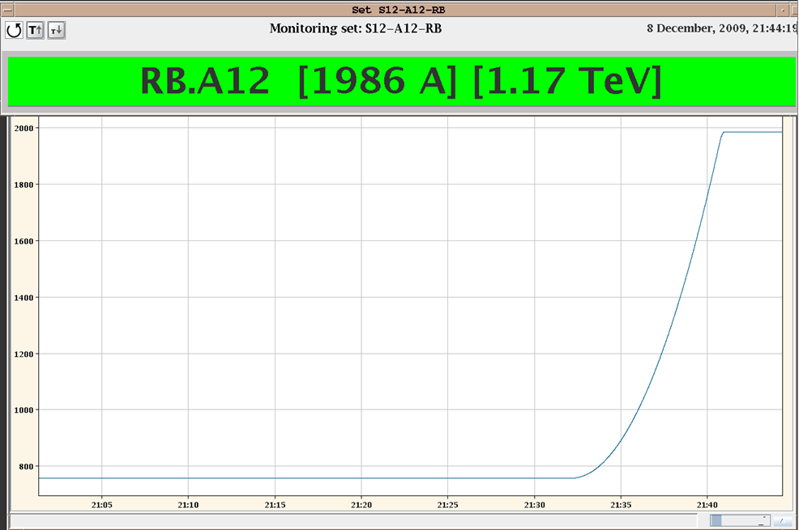
For the first time, 2 beams at 1.18 TeV – 8th December 2009 at 21:34
1st collisions in ATLAS at 2.36 TeV

Slide 13
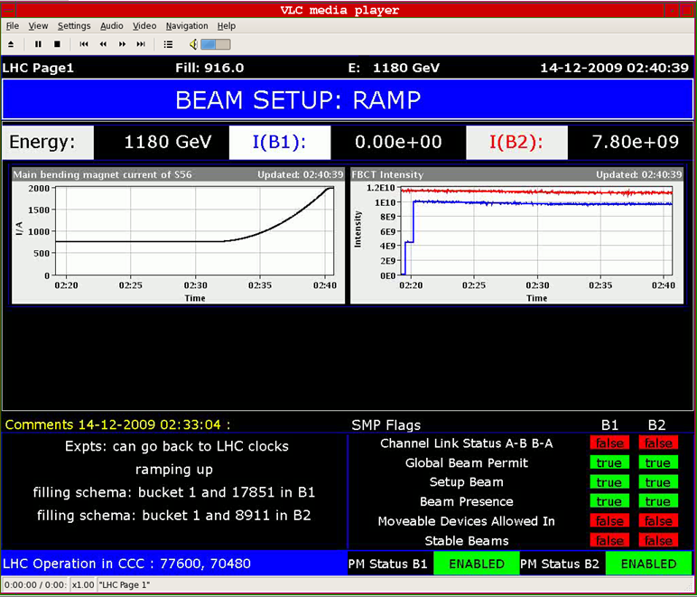
Page 1: Collisions in ATLAS and CMS at 2.36 TeV – 14th December 2009

Slide 14
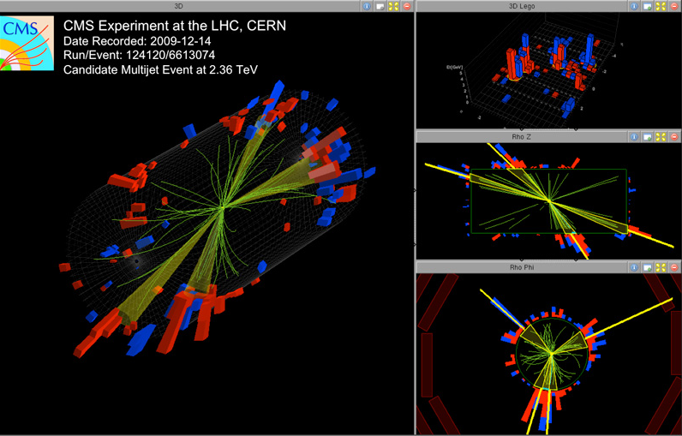
1st collisions in CMS at 2.36 TeV – 14th December 2009 at 4:00

Slide 15
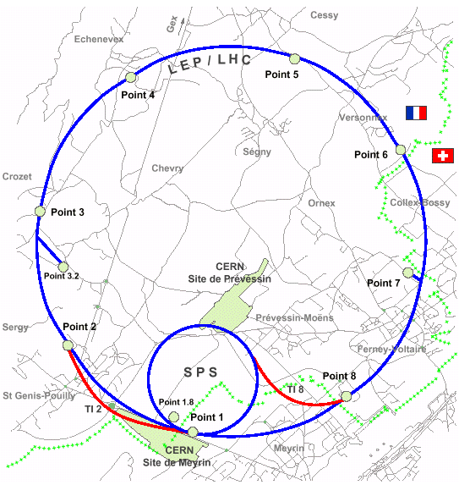
LHC Layout

Slide 16
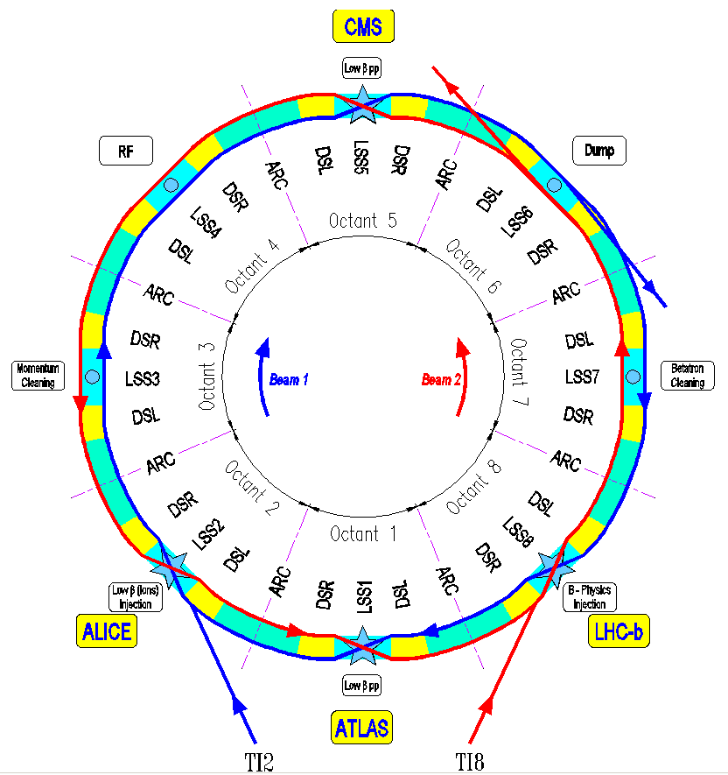
LHC Layout

Slide 17
LHC Parameters
Circumference 26.7 km
Beam energy at collision 7 TeV
Beam energy at injection 0.45 TeV
Dipole field at 7 TeV 8.33 T
Luminosity 1 x 10³⁴ cm⁻².s⁻¹
Beam current 0.584 A
Protons per bunch 1.15 x 10¹¹
Number of bunches 2808
Nominal bunch spacing 24.95 ns
Normalized emittance 3.75 μm. rad
Total crossing angle 285 μrad
Energy loss per turn 6.7 keV
Critical synchrotron energy 44.1 eV
Radiated power per beam 3.6 kW
Stored energy per beam 362 MJ
Stored energy in magnets 11 GJ
Operating temperature 1.9 K

Slide 18
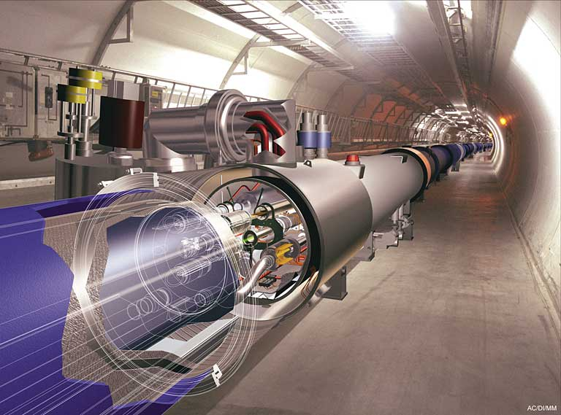
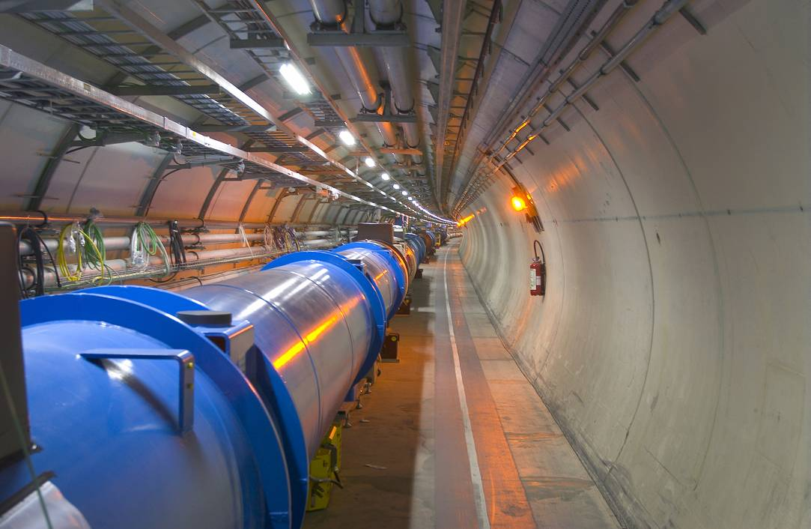
LHC : Superconducting Technology

Slide 19
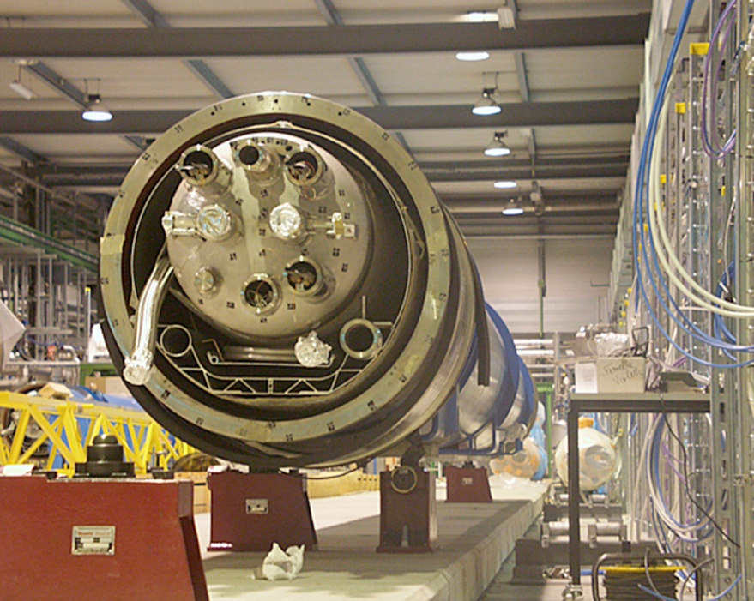
InsulationVacuum System
Characteristic | Quantity for LHC machine & QRL
Insulation vacuum system length | 22,4 km & 25 km
Welds | ~ 250 000 (90 000 in-situ)
Weld length | ~ 100 000 m
Elastomer joints | ~ 18000
Elastomer joint length | ~ 22 000 m
Multi-layer insulation | ~ 9 000 000 m² or 200 m²/m of cryostat
Vacuum subsectors | 234
Vacuum subsector length | 214 m (machine) & 428 m (QRL)
Vacuum subsector volume | ~ 80 m³
Fixed turbo pumps | 178
Nominal turbo pumping speed | 0,25 l/s/m of cryostat
Fixed vacuum gauges | 974
Mobile turbo pumping groups | 36
Mobile primary pumping groups | 36
a dipole cold mass inside its cryostat

Slide 20
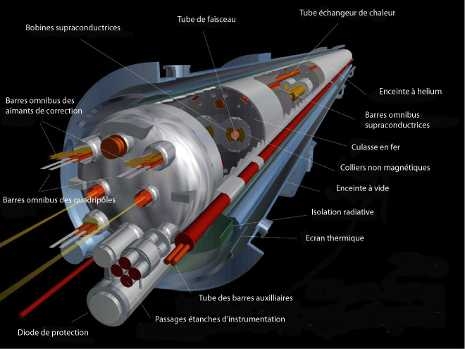
Superconducting Dipole

Slide 21
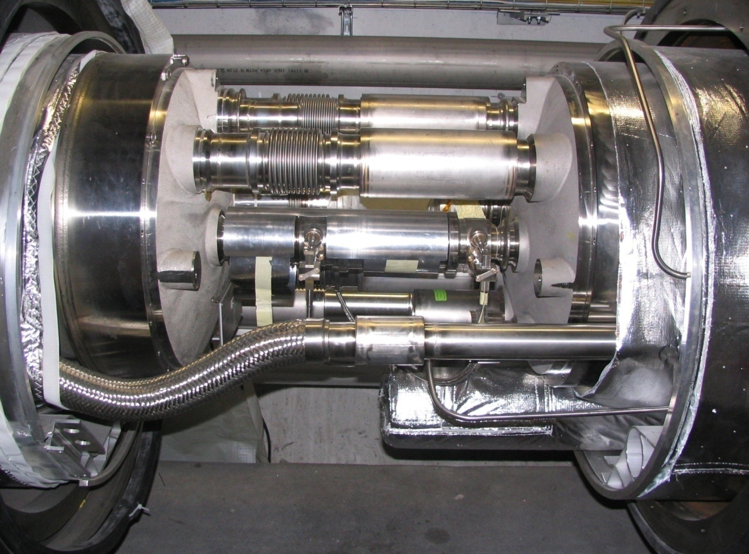
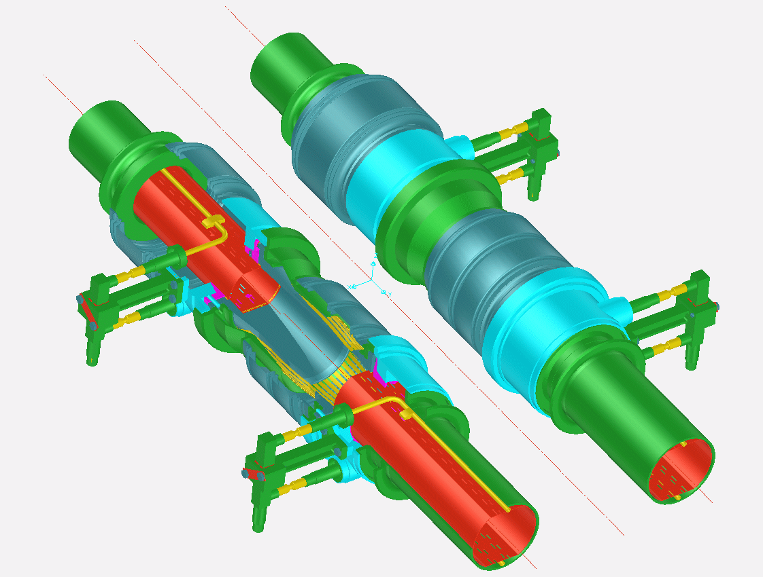
Dipole-Dipole Interconnection
Bellows
Cold bore
Plug-in module
Beam screen
Cooling tube
exit pieces

Slide 22
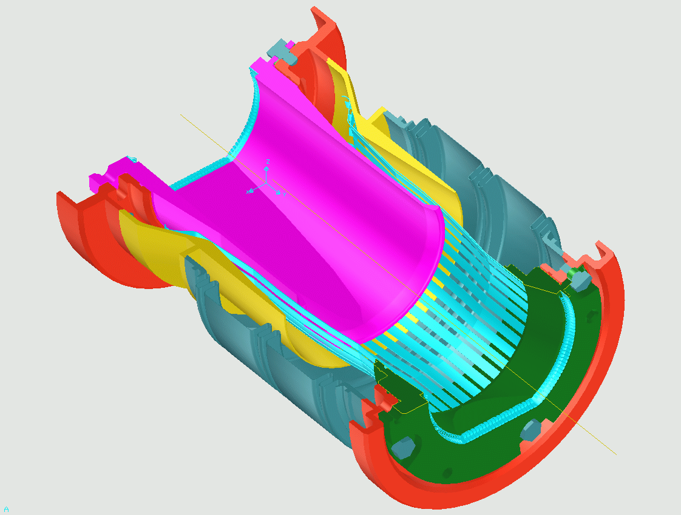
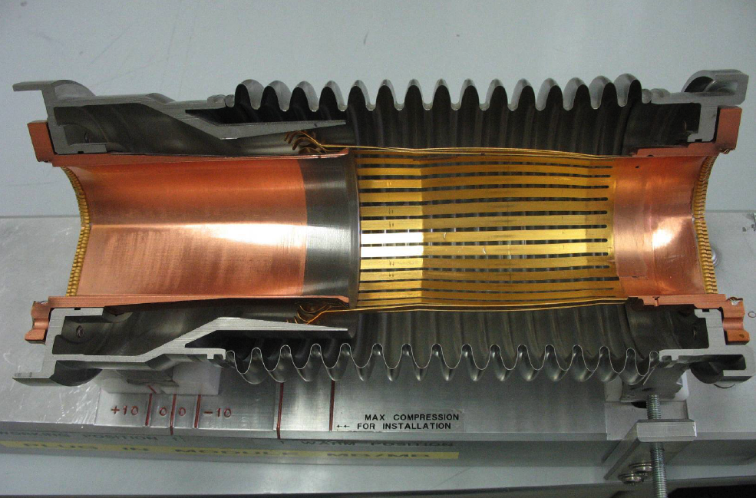
Plug-in Modules with RF Fingers
Screw & Spring washer
Upstream flange
Copper transition tube
RF bellows
RF-contact strips
coating 5 μm
Indium brazed
Rhodium coating 3 μm
RF-contact Gold coating 5 μm
Screw & Spring washer
Plug-in module transition tube
RF-contact transition flange
Downstream flange
RF-contact strips
coating 5 μm
Indium brazed
Courtesy R. Veness AT/VAC
Working position
Room temperature position

Slide 23
2. Beam vacuum dynamics

Slide 24
Un vide pas si vide …..
La combinaison de la circulation des faisceaux avec son environnement conduit à la :
Désorption stimulée de neutres et de particules chargées qui conduisent à la :
Diminution des performances de la machine
Et par consequent à un utilisateur mécontent ….
Quelles sont ces interactions ?
La comprehension des interactions du faisceau avec le systeme à vide est donc essentielle !

Slide 25
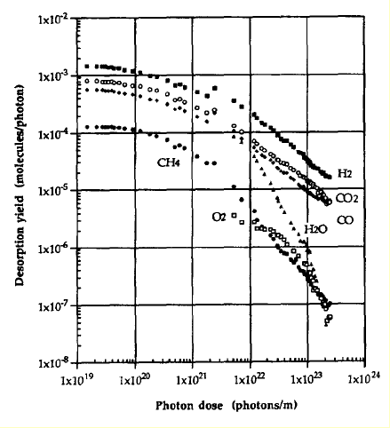
Photon Stimulated Desorption
Synchrotron radiation induces gas desorption : SR machine, LEP, LHC
Heat load and gas load
η_{photon} is the photon desorption yield
Beam cleaning during the first period of LEP
Cu baked at 150°C
O. Gröbner. Vacuum 43 (1992) 27-30
O. Gröbner et al.
J.Vac.Sci. 12(3), May/Jun 1994, 846-853

Slide 26
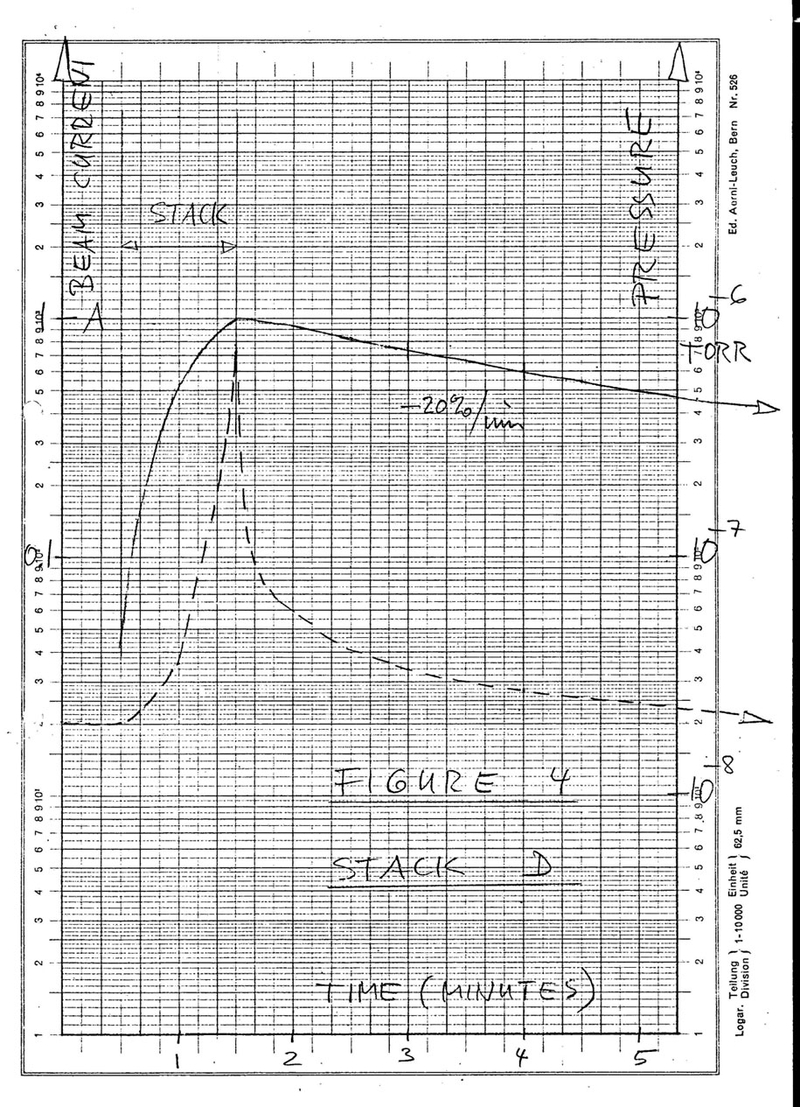
Vacuum Instability : the Effect
In circular machine with large proton current : ISR, LHC
current
Beam current stacking to 1 A
Pressure increases to 10⁻⁶ Torr (x 50 in a minute)
Beam losses
pressure
First documented pressure bump in the ISR
E. Fischer/O. Gröbner/E. Jones 18/11/1970

Slide 27
Vacuum Instability : Mecanism and Recipy
Reduction of the effective pumping speed, S_{eff}
Baked
stainless steel
Solution :
  Reduce η_{ion}
A.G. Mathewson, CERN ISR-VA/76-5

Slide 28
Electron Cloud : the Mecanism
In modern machine with dense bunches and large positive current : KEK-B, PEP-II, SPS, RICH, LHC …
Emittance growth, gas desorption and heat load in cryogenic machine
Key parameters :
  bunch structure
  vacuum chamber dimmension
  secondary electron yield
  photon electron yield
  electron and photon reflectivities
  …
F. Ruggiero et al., LHC Project Report 188 1998, EPAC 98

Slide 29
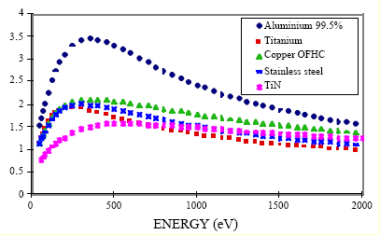
Electron Cloud : the Recipies
Play with the key parameters
Reduce photoelectron yield (perpendicular vs grazing incidence)
Reduce secondary electron yields (scrubbing, TiZrV coatings, carbon coatings, geometry ..)
Reduce the amount of electrons in the system (solenoid magnetic field, clearing electrodes, material reflectivities …)
Adapt the bunch structure or the chamber geometry to reduce multiplication
…
Secondary Electron Yield
N. Hilleret et al., LHC Project Report 433 2000, EPAC 00

Slide 30
3. LHC beam vacuum system

Slide 31
Beam screen

Slide 32
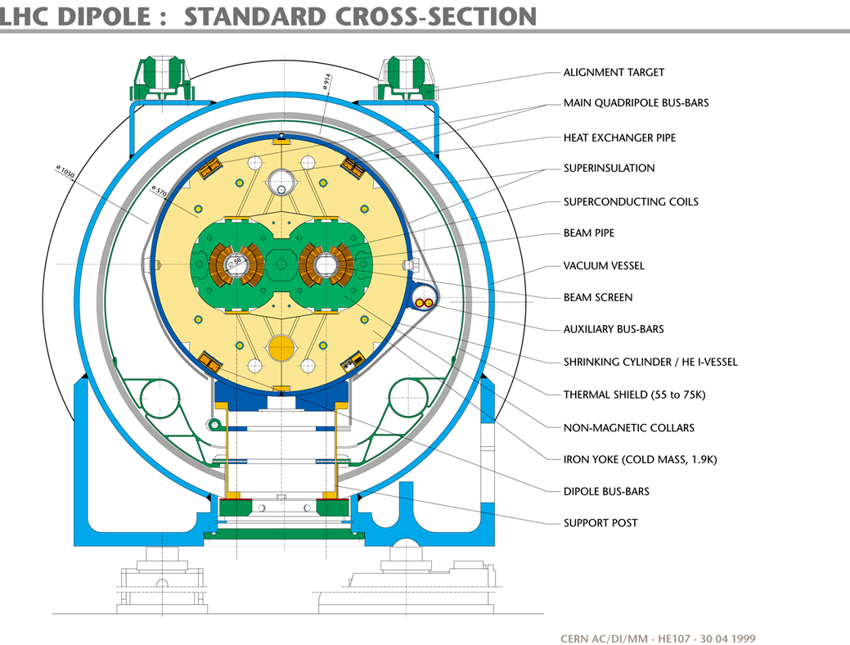
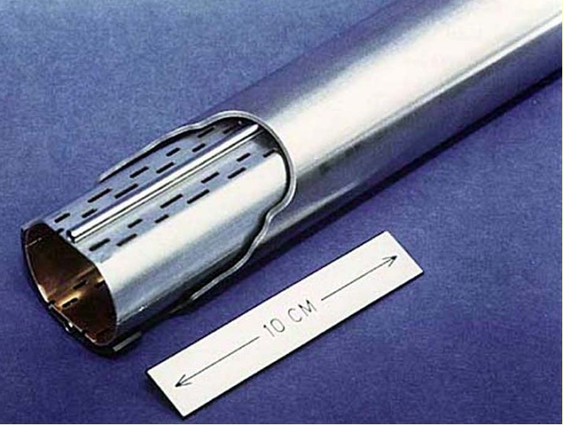
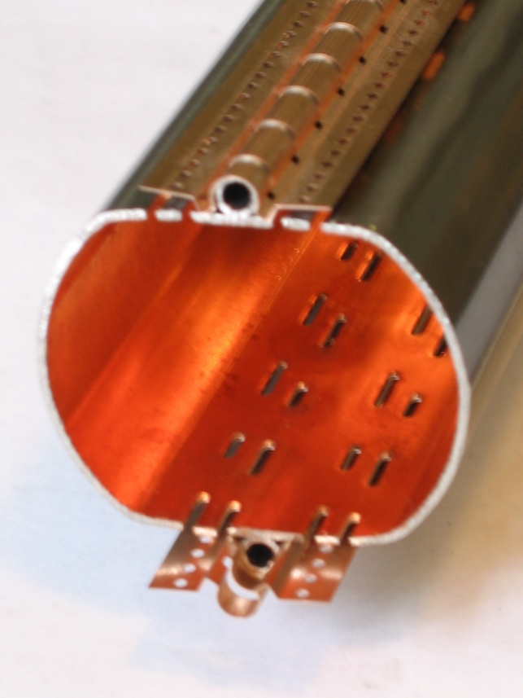
LHC Dipole Vacuum System
Cold bore (CB) at 1.9 K which ensures leak tightness
Beam screen (BS) at 5-20 K which intercepts thermal loads and acts as a screen
Courtesy N. Kos CERN AT/VAC

Slide 33
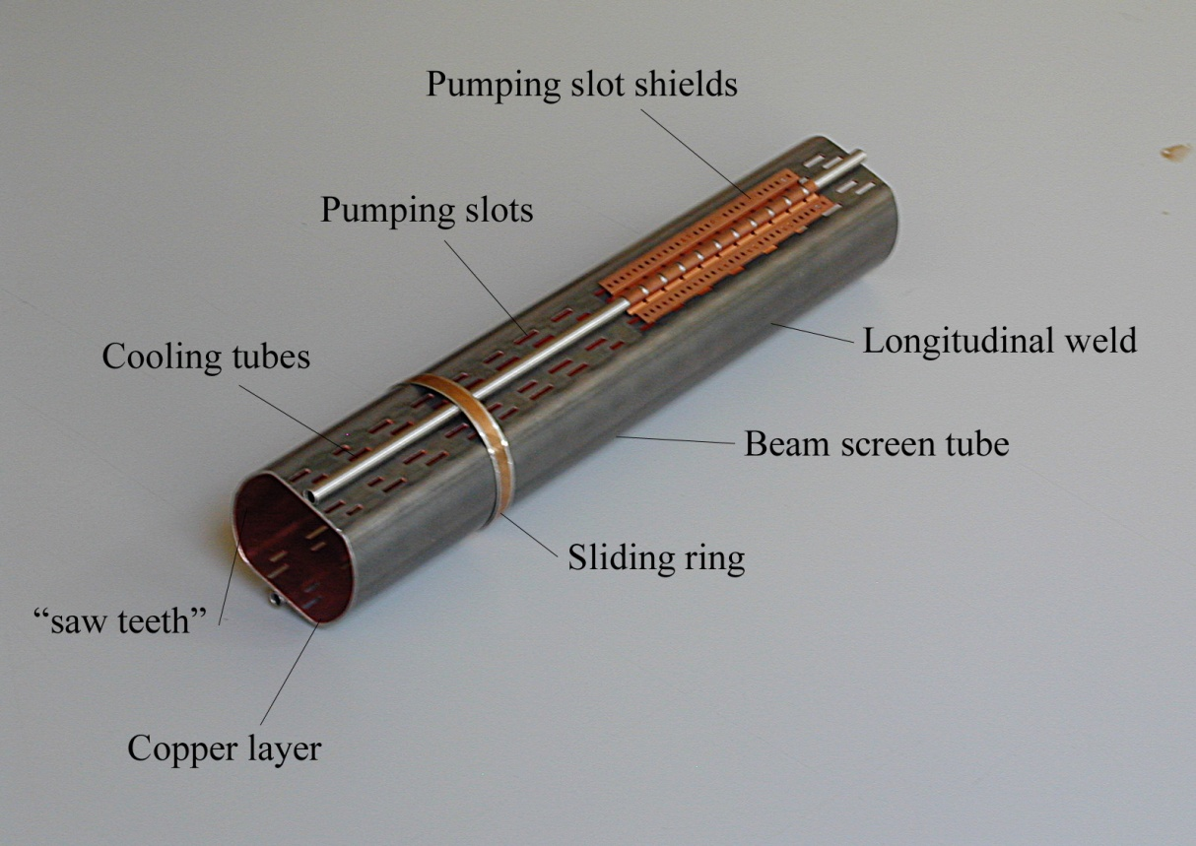
Beam Screens Functionalities
Intercept the heat load induced by the circulating beam (impedance, synchrotron radiation, electron cloud)
Operate between 5 and 20 K
Non-magnetic stainless steel substrate to withstand quench forces (few tons) and to ensure a good field quality
Copper colamination onto non-magnetic stainless steel to reduce impedance
Pumping holes to control the gas density
Rounded pumping slots to reduce electromagnetic leakage towards the cold bore held at 1.9 K or 4.5 K
Electron shield to protect the cold bore from the heat loads induced by the electron cloud
Saw teeth to reduce photoelectron yield and forward reflectivity of photons to reduce the seed of electrons
Courtesy N. Kos CERN AT/VAC

Slide 34
LHC Vacuum System Principle
Molecular desorption stimulated by photon, electron and ion bombardment
Desorbed molecules are pumped on the beam vacuum chamber
100 h beam life time (nuclear scattering) equivalent to ~ 10¹⁵ H₂/m³ (10⁻⁸ Torr H₂ at 300 K)
In cryogenic elements
Molecular physisorption onto cryogenic surfaces
(weak binding energy)
Molecules with a low recycling yield
are first physisorbed onto the beam screen
(CH₄, H₂O, CO, CO₂) and then onto the
cold bore
H₂ is physisorbed onto the cold bore

Slide 35
LHC Vacuum System Principle : Demonstration
Equilibrium pressure
Equilibrium coverage
A perforated beam screen allows to control the gas density
No holes
Short tube
(pumping at the extremity)
BS ~ 5 K
BS ~ 19 K
CB ~ 4 K
~ 2% holes
V. Baglin et al. EPAC’00, Vienna 2000.

Slide 36
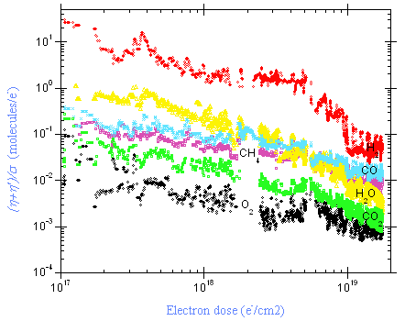
Performances of Copper Beam Screens
PEY, Reflectivity
SEY vs photon dose
V. Baglin et al., CERN Chamonix XI, 2001
V. Baglin et al., CERN Chamonix XI, 2001
SEY vs electron dose
ESD yields at 15 K
V. Baglin et al., CERN Chamonix XI, 2001
V. Baglin et al., CERN LHC PR 721, 2004

Slide 37
Cryosorbeur

Slide 38
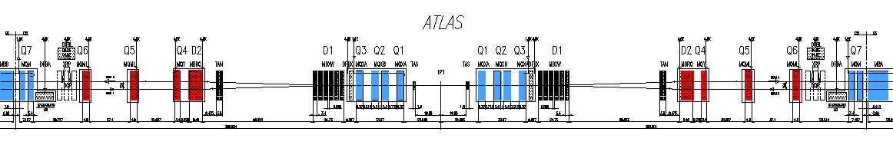
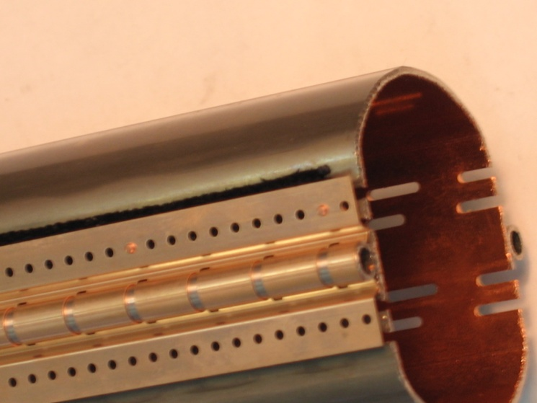
LHC Long Straight Section Vacuum System
Dynamic vacuum ⇒ perforated beam screens
1.9 K cold bore (~660 m, arc beam screen technology)
~ 4.5 K cold bore ( ~ 740 m) ⇒ cryosorbers
Required performances (for installation of 200 cm²/m):
  Operates from 5 to 20 K
  Capacity larger than 10¹⁸ H₂/cm²
  Capture coefficient larger than 15 %
Courtesy N. Kos CERN AT/VAC

Slide 39
Why Cryosorbers ?
Design requires > 100 h life time with 4.5 K cold bore and thick surface coverage
⇒ porous surface
4.5 K
1.9 K

Slide 40
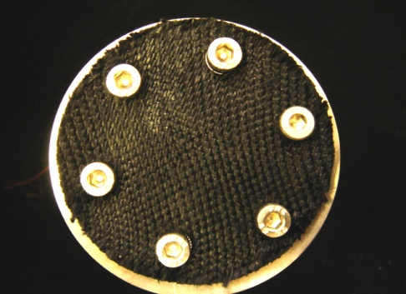
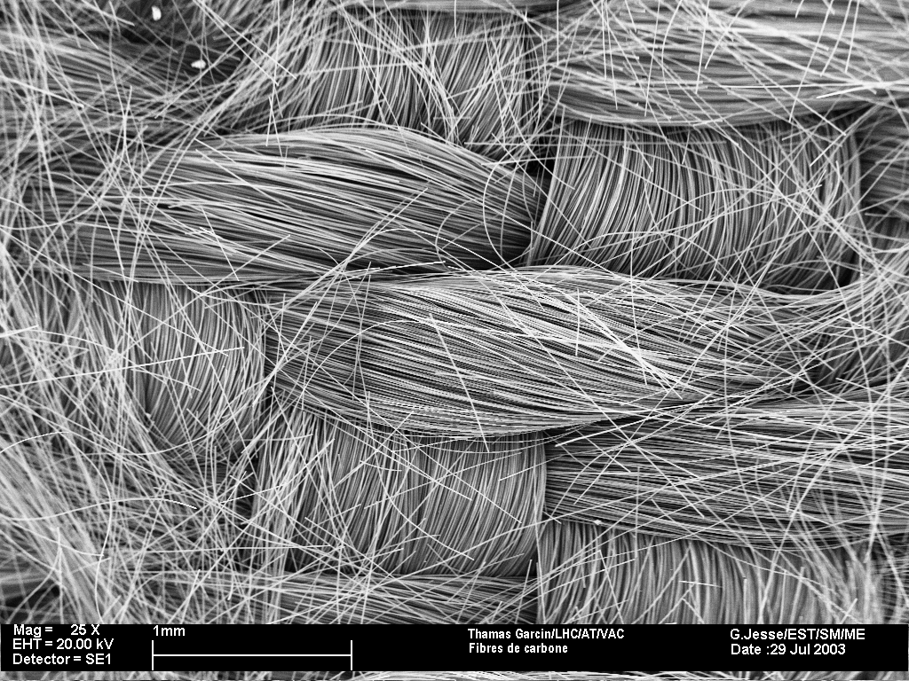
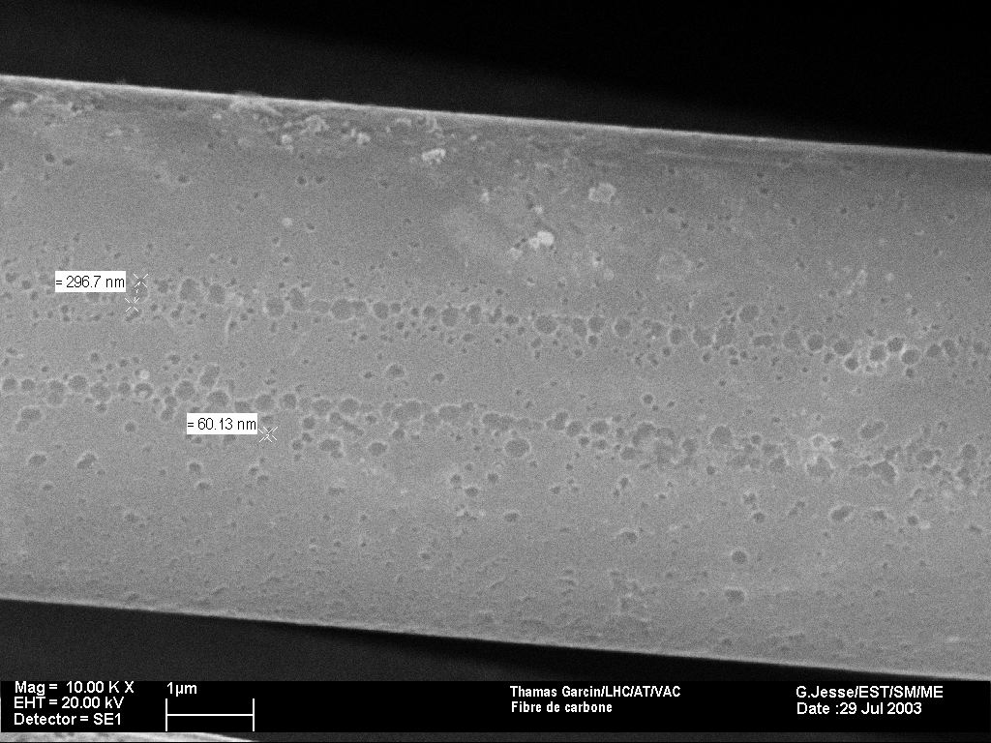
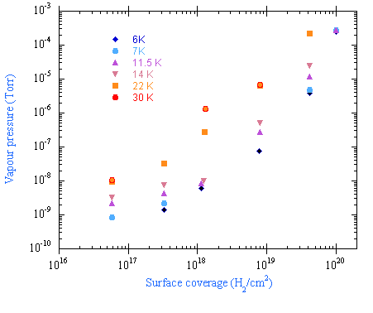
H₂ Adsorption Isotherm on Cryosorbers
Woven carbon fiber developed by BINP
Capacity :
  10¹⁸ H₂/cm² at 6 K
  10¹⁷ H₂/cm² at 30 K
X 25
X 10 000
V. Anashin et al. Vacuum 75 (2004) 293-299
Capacity
R ~ 10³ R_{Cu}
V. Baglin et al. EPAC’04, Luzern 2004.

Slide 41
Non Evaporable Getter Coating

Slide 42
LHC Vacuum System Principle
Molecular desorption stimulated by photon, electron and ion bombardment
Desorbed molecules are pumped on the beam vacuum chamber
100 h beam life time (nuclear scattering) equivalent to ~ 10⁻⁸ Torr H₂ at 300 K
In room temperature elements
Molecular chemisorption on NEG coating and in sputter ion pump
Large pumping speed
Very low stimulated desorption yields
NEG has δ_{max} ~ 1.1 when activated, thus no (or little) electron cloud

Slide 43
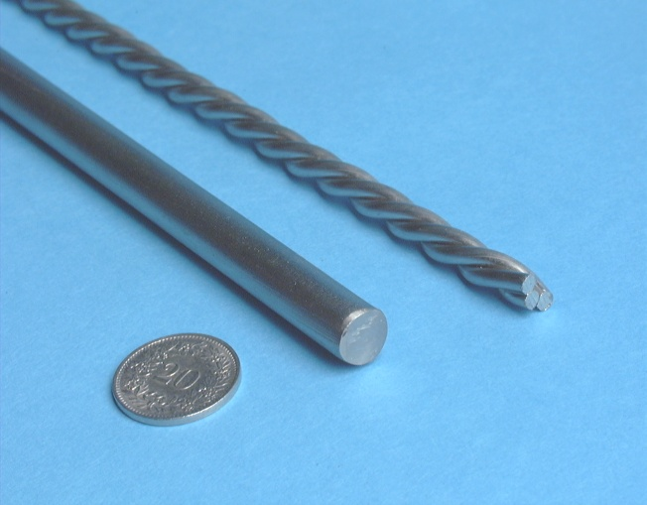
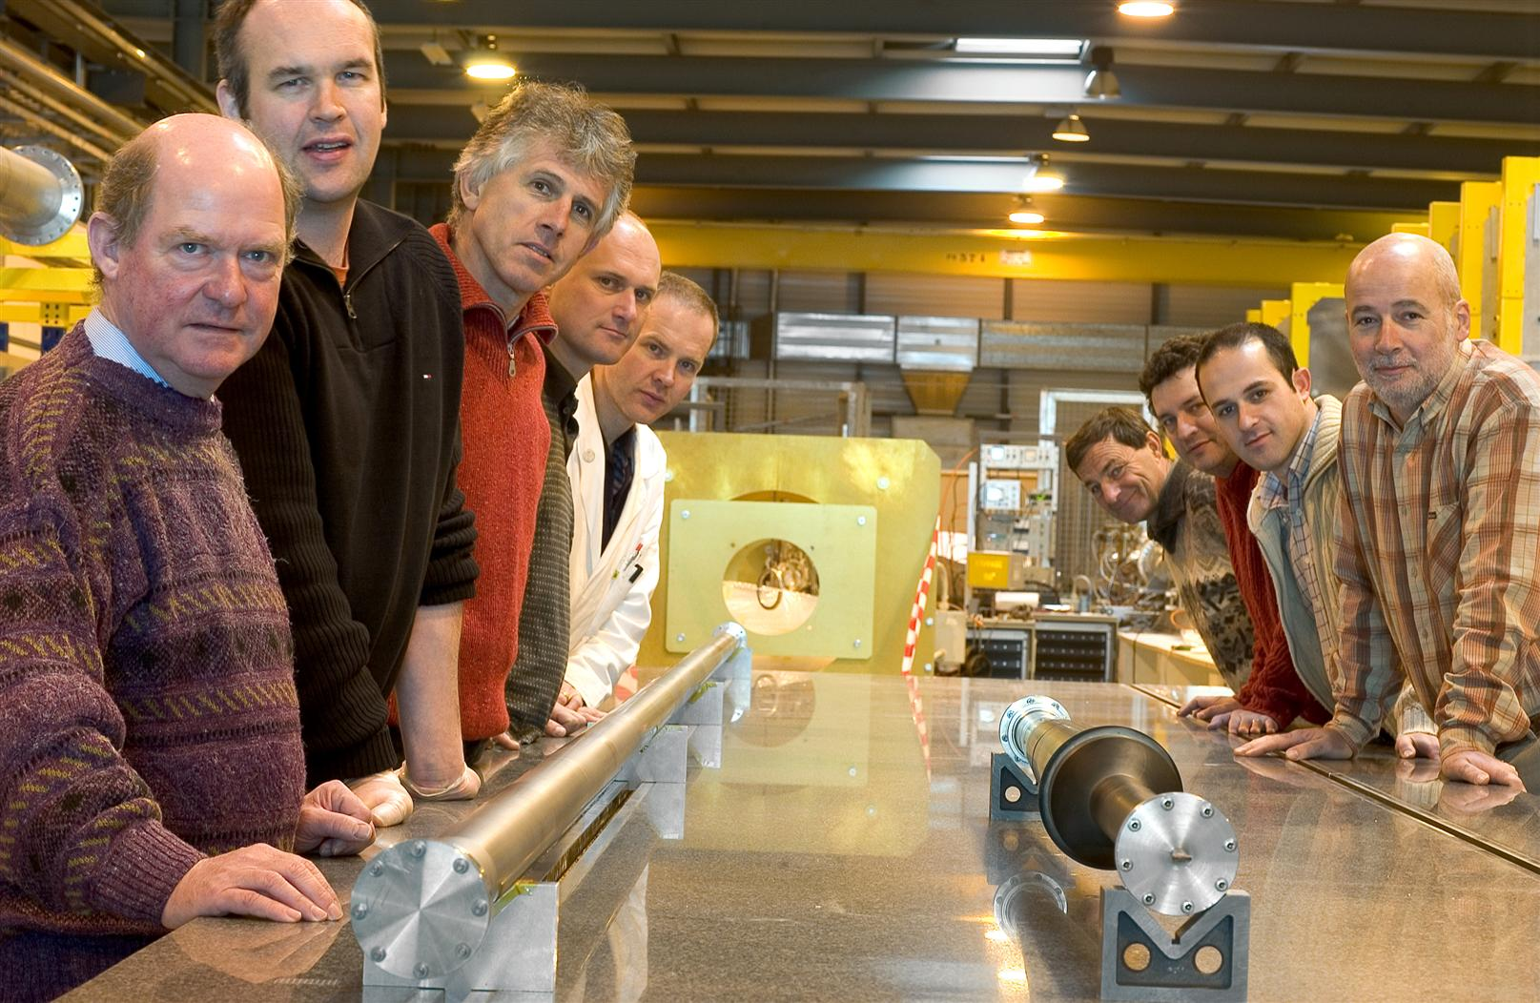
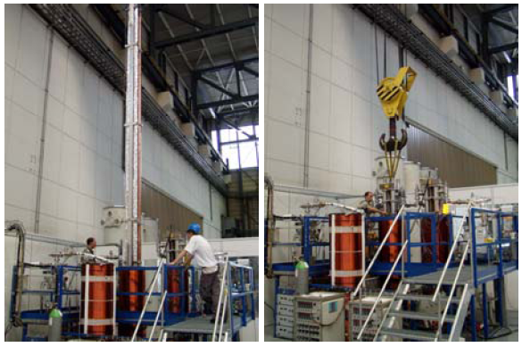
TiZrV is deposited by magnetron sputtering
All room temperature vacuum chamber including the experimental beam pipe are coated with TiZrV
Courtesy P. Chiggiato
Courtesy P. Chiggiato
Courtesy R.Veness

Slide 44
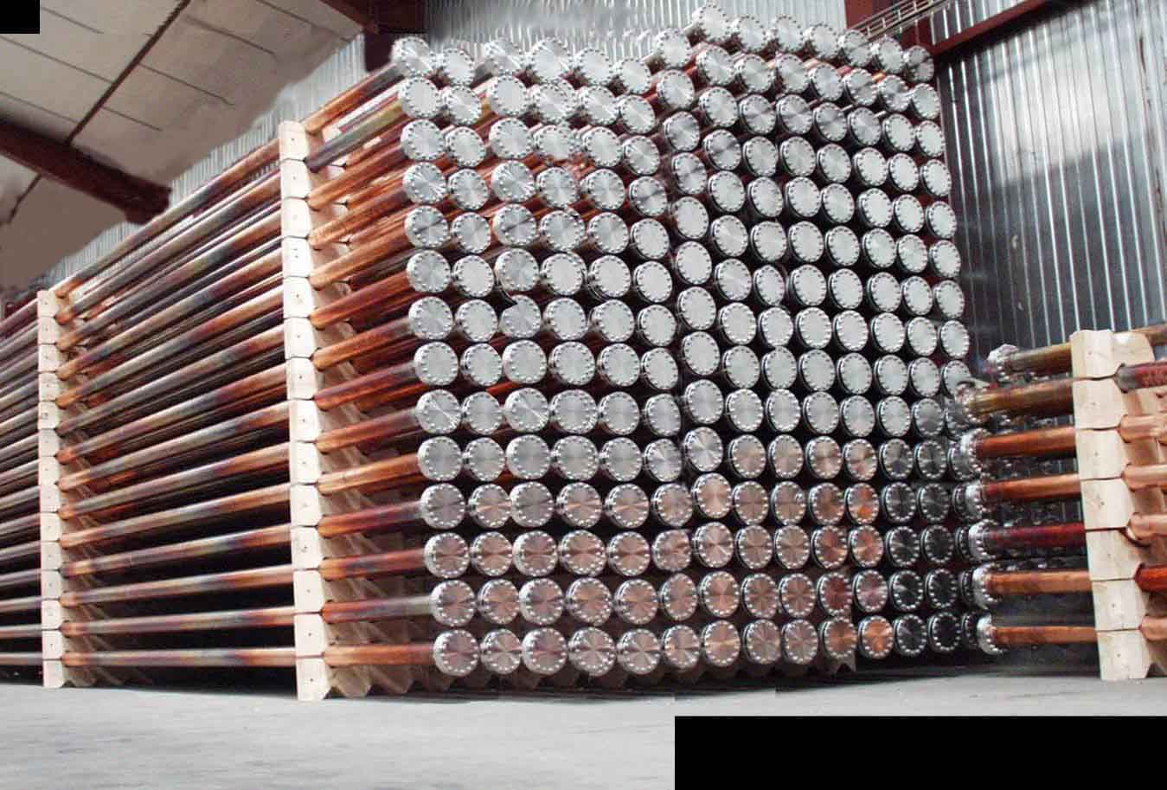
Room Temperature Vacuum System
~ 1 μm thick, Non Evaporable Getter TiZrV coated vacuum chambers ensure the required vacuum performances for LHC
Some vacuum chambers were constructed and getter coated …
Courtesy R.Veness and P. Chiggiato

Slide 45
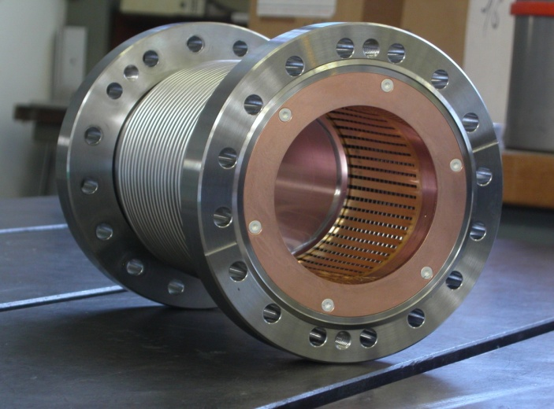
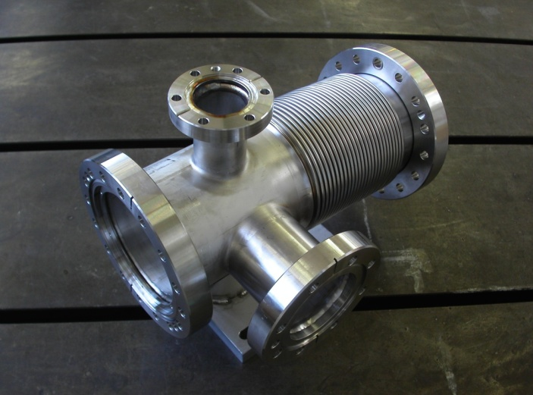
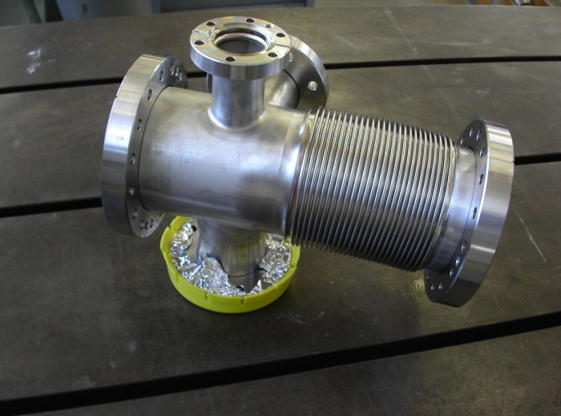
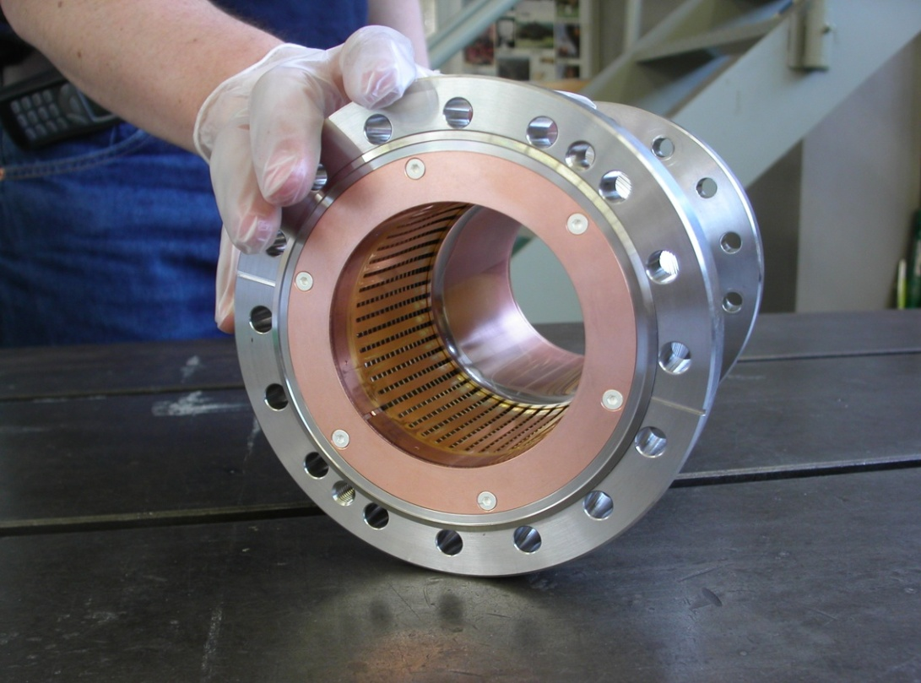
Warm Modules for Interconnection
Short module 200 mm
Long modules 300 mm
Short: no pumping
Long: pumping & support option
Cross-sectional transitions with inserts
Courtesy R. Veness

Slide 46



Room Temperature Vacuum System
….. and installed inside the LHC tunnel
Collimators
Warm magnets
Vacuum chambers

Slide 47
Room Temperature Vacuum Sectors
LHC ~ 220 vacuum sectors : 108 at RT and 112 at cryogenic temperature
~10 m till 150 m long
contains : kickers, septum, collimators, masks, beam instrumentation
~1200 vacuum chambers, ~700 warm modules, 180 B.A gauges, 520 Penning gauges
From 28 m up to 115 m NEG beam pipes
From 28 m up to 115 m NEG beam pipes
sector
valve
sector
valve
sector
valve
Penning Gauge
sector
valve
Penning Gauge
Bayard-Alpert Gauge
Bayard-Alpert Gauge
Penning Gauge
Penning Gauge
cryomodule
cryomodule
cryomodule
cryomodule
All metal valve
All metal valve
ion pump
S_{N2}=30 l/s
ion pump
S_{N2}=30 l/s
ion pump
S_{N2} =30 l/s
Bayard-Alpert Gauge
ion pump
S_{N2} =30 l/s
RGA
QMG 125
Pinch-Off
Mobile turbo molecular pumping group
S_{N2}=60 l/s
Conductance (N₂) for a 7 meters NEG beam pipe ≈ 9 l/s
Conductance (N₂) for a 7 meters NEG chamber ≈ 9 l/s

Slide 48
Commissioning of the NEG
Bake out of stainless steel part first
Followed by NEG activation
Gauges
outgassing
Bakeout of the uncoated parts
300
activation
200
Heating Temperature [°C]
Coated chamber
100
Heating Time [h]
Courtesy G. Bregliozzi, P. Chiggiato

Slide 49
Room Temperature Vacuum System : Final Performances
Ultimate Vacuum Pressure Distribution after NEG Activation of the
LHC Room Temparture Vacuum Sectors
G. Bregliozzi et al. EPAC’08, Genoa 2008

Slide 50




TiZrV Vacuum Performances
Pumping Speed
ESD Yields
Courtesy P. Chiggiato
C. Benvenuti et al. J.Vac.Sci.Technol A 16(1) 1998
PSD Yields
Secondary Electron Yield
V. Anashin et al. EPAC 2002
C. Scheuerlein et al. Appl.Surf.Sci 172(2001)

Slide 51





Residual Gas Densities in the LHC Long Straight Section and Experiments
Intrinsicaly, the TiZrV NEG coating has good vacuum performances (high pumping speed, low desorption yields and low SEY)
A. Rossi, CERN LHC PR 783, 2004.
A. Rossi, CERN LHC PR 783, 2004.
~ 10⁻¹⁰ mbar with circulating beam

Slide 52
4. 2009 operation

Slide 53


Slide 54
Today’s LHC beam intensity and energy
2009
2 x 2 bunches at 5 10⁹ protons/bunch : 2x20 µA
Beam energy 1.18 TeV
2010
Nominal intensity : 0.2 mA/bunch at 1.1 10¹¹ protons/bunch
156 x 156 nominal bunches : 2x32 mA
Beam energy less than 5 TeV

Slide 55


Photon stimulated desorption
2009
SR power ~ 0 W
Critical energy ~ 0.2 eV
Photon flux 6 10¹¹ ph/m/s
“Il ne se passe jamais rien ici”
2010
SR power ~ 3 mW/m
Critical energy ~ 16 eV
Photon flux 4 10¹⁵ ph/m/s (4% nominal)

Slide 56

Electron cloud and ion instabilities
2009 & 2010
Bien evidement, rien en 2009
Paolo, pas la peine de prévoir un séminaire l’ année prochaine pour ca !
Youpi les vacances !
Fin du séminaire d’aujourd’hui ?

Slide 57
Some observed dynamics events

Slide 58

A noisy vacuum gauge

Slide 59



A noisy vacuum gauge

Slide 60

Where one can find more informations
https://espace.cern.ch/te-vsc-lhc/Piquet_Service/default.aspx

Slide 61


Another noisy vacuum gauge ?

Slide 62



No : beam screen’s temperature oscillations
The pressure follows the temperature
The surface coverage is defined by the adsorption isosteres
The gas is “trapped by the porous” site of adsorption of the metallic surface

Slide 63

Other forms of beam screen oscillations

Slide 64


Cryosorber-BS gas transfert
Courtesy N. Kos CERN AT/VAC
In the 10-8 range, a few monolayers of hydrogen strike the cryosorber per day

Slide 65




TCTVB and TCDD.4L2 on 29-10-2009
Movement of objects in vacuum produce outgassing
Even movements of TV screens are observed !

Slide 66

Ion and proton beam on TDI (BN)
ion
P
Same outgassing rate for ion and proton beam at 450 GeV (we, VSC, have our prime discovery as well !)
Under analysis

Slide 67
Joyeuses fêtes de Noel
Meilleurs vœux de sante et de bonheur pour 2010
Thank you for your attention !!!

