Slide 1

50 ns test and e-cloud considerations
G. Iadarola
with input from LHC and Injectors operation crews,
D. Amorim, G. Arduini, B. Bradu, X. Buffat, L. Carver, P. Chiggiato, C. Schwick, S Hancock, W. Hofle, V. Kain, E. Metral, A. Romano, L. Mether, D. Mirarchi,
G. Rumolo, B. Salvant , M. Solfaroli Camillocci, C. Yin Vallgren
LMC meeting, 26 Jul 2017

Slide 2
Outline
Test with 50 ns beams:
  e-cloud observations
Electron cloud effects in dipole correctors
  Simulations
  Cell-by-cell observations
Update on coherent motion observations
  Considerations on Fast Beam-Ion Instability

Slide 3
Outline
Test with 50 ns beams:
  e-cloud observations
Electron cloud effects in dipole correctors
  Simulations
  Cell-by-cell observations
Update on coherent motion observations
  Considerations on Fast Beam-Ion Instability

Slide 4
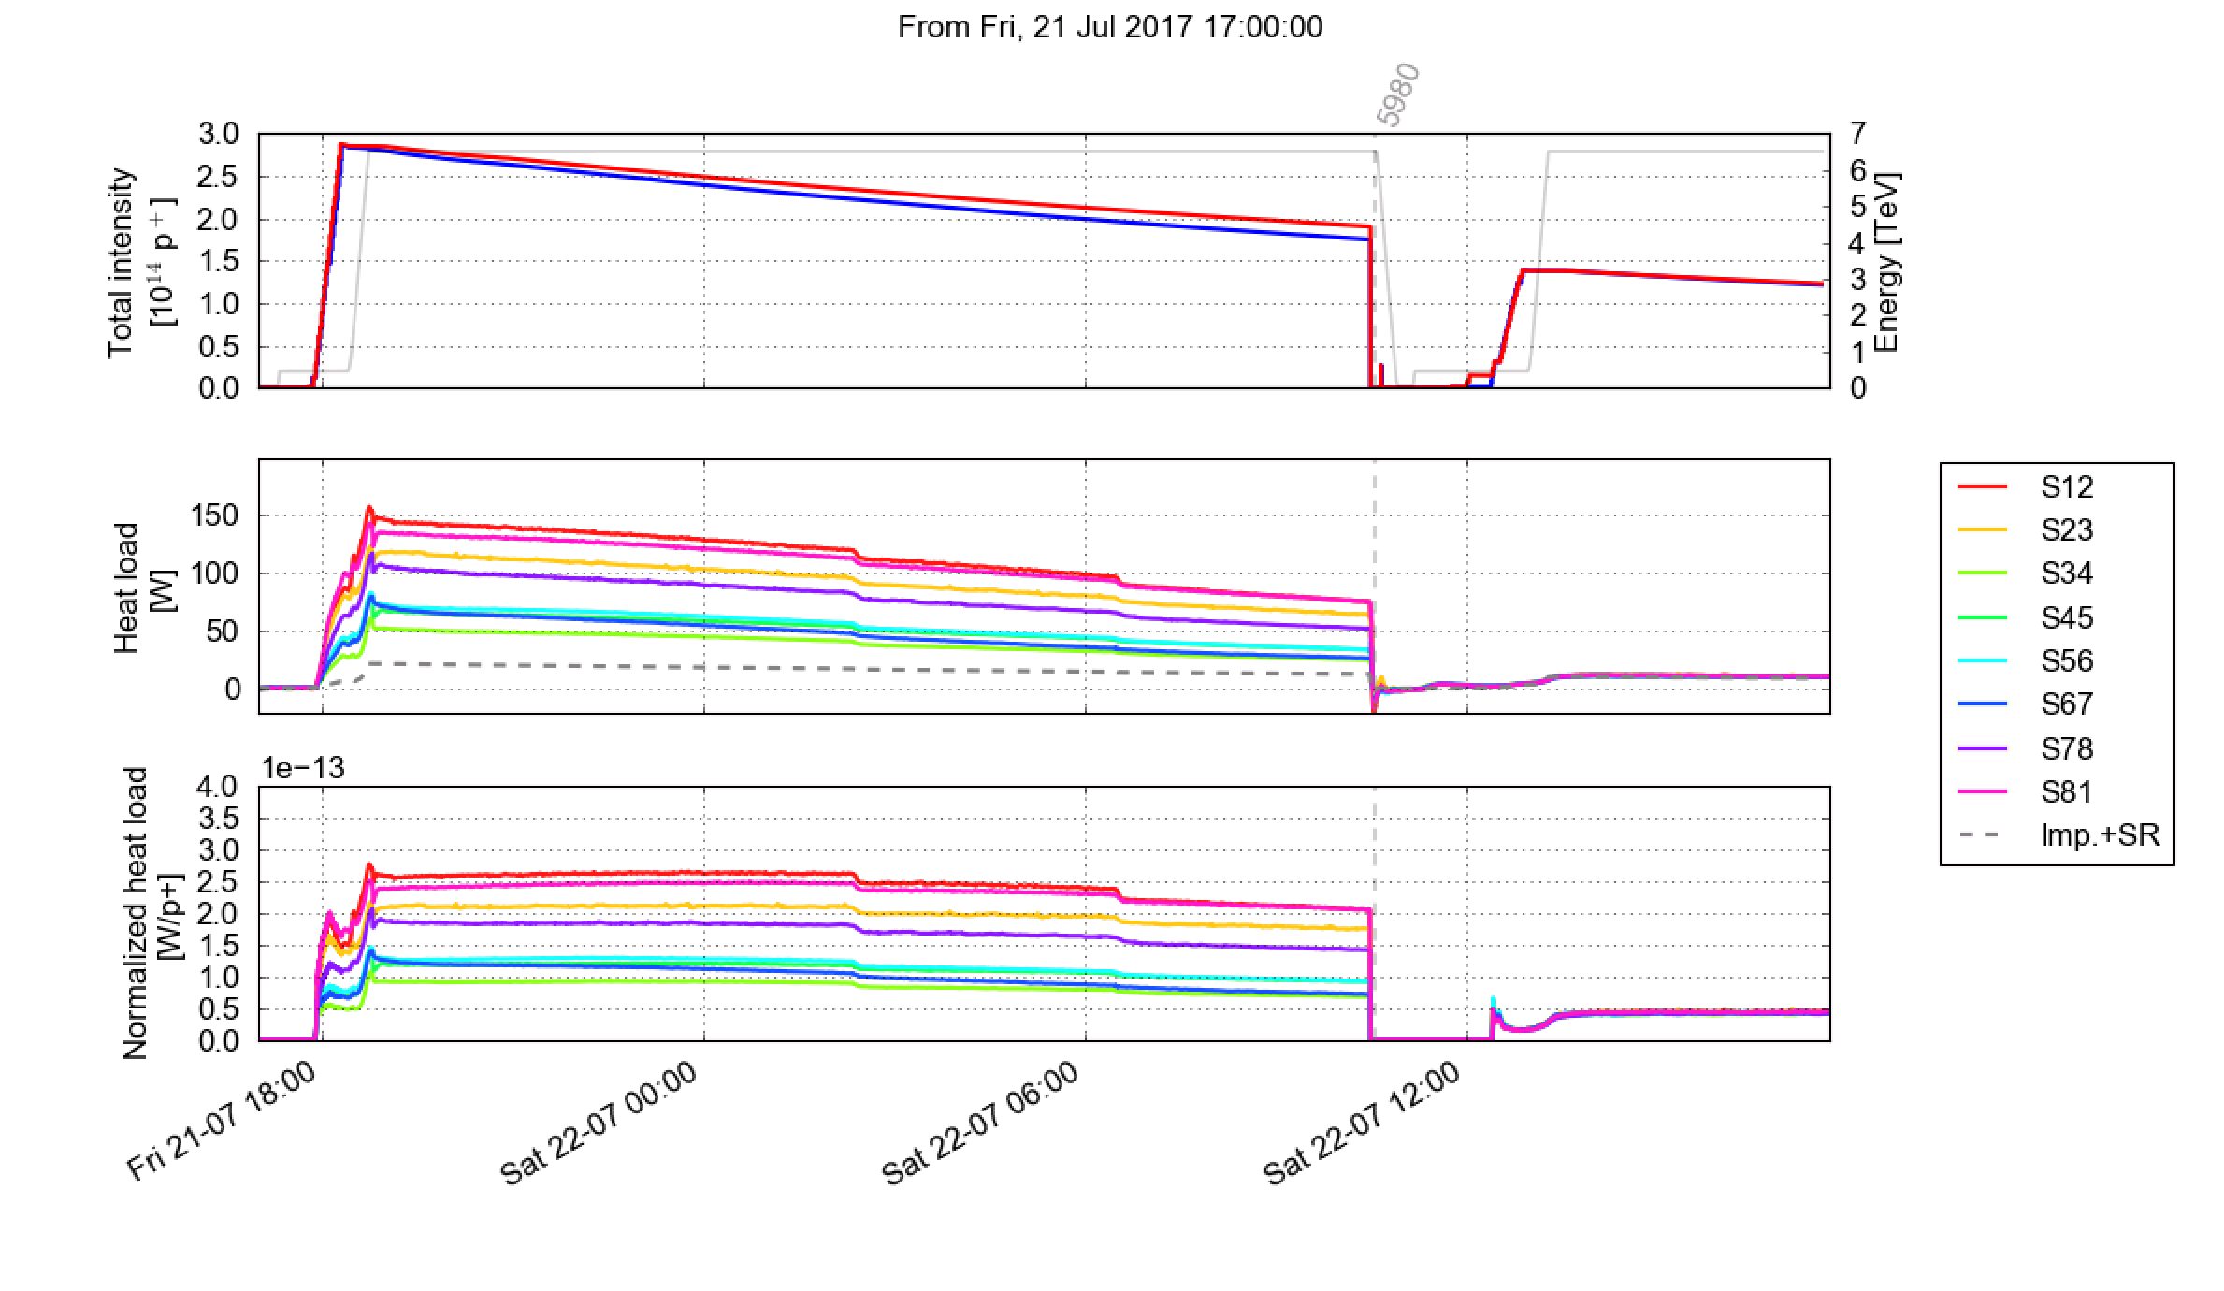
Test fill with 50 ns
25 ns
50 ns
A fill with 50 ns bunch spacing was performed on Saturday afternoon in order to probe the impact of the bunch spacing on losses and other observations in 16L2
We aimed at changing only the bunch spacing:
Used same filling pattern as for production physics fills, replacing each 25-ns train of 48 bunches with a 50-ns train of 24 bunches
1284 b/beam. Avg. bunch intensity at 6.5 TeV: 1.07e11 p/bunch
Used non-BCMS scheme in the PS → gave transverse emittances similar to BCMS 25 ns
No change in machine settings
The planned set of measurements was performed rather quickly, still the fill was kept 6.7 h in Stable Beams as beam from the injectors was not available for refill with 25 ns

Slide 5
Test fill with 50 ns
Electron cloud suppression with 50 ns confirmed by heat load measurements on the beams-screens
Consistent with expectations from impedance and synchrotron radiation
Large differences between sectors observed with 25 ns are not visible with 50 ns
25 ns
50 ns

Slide 6
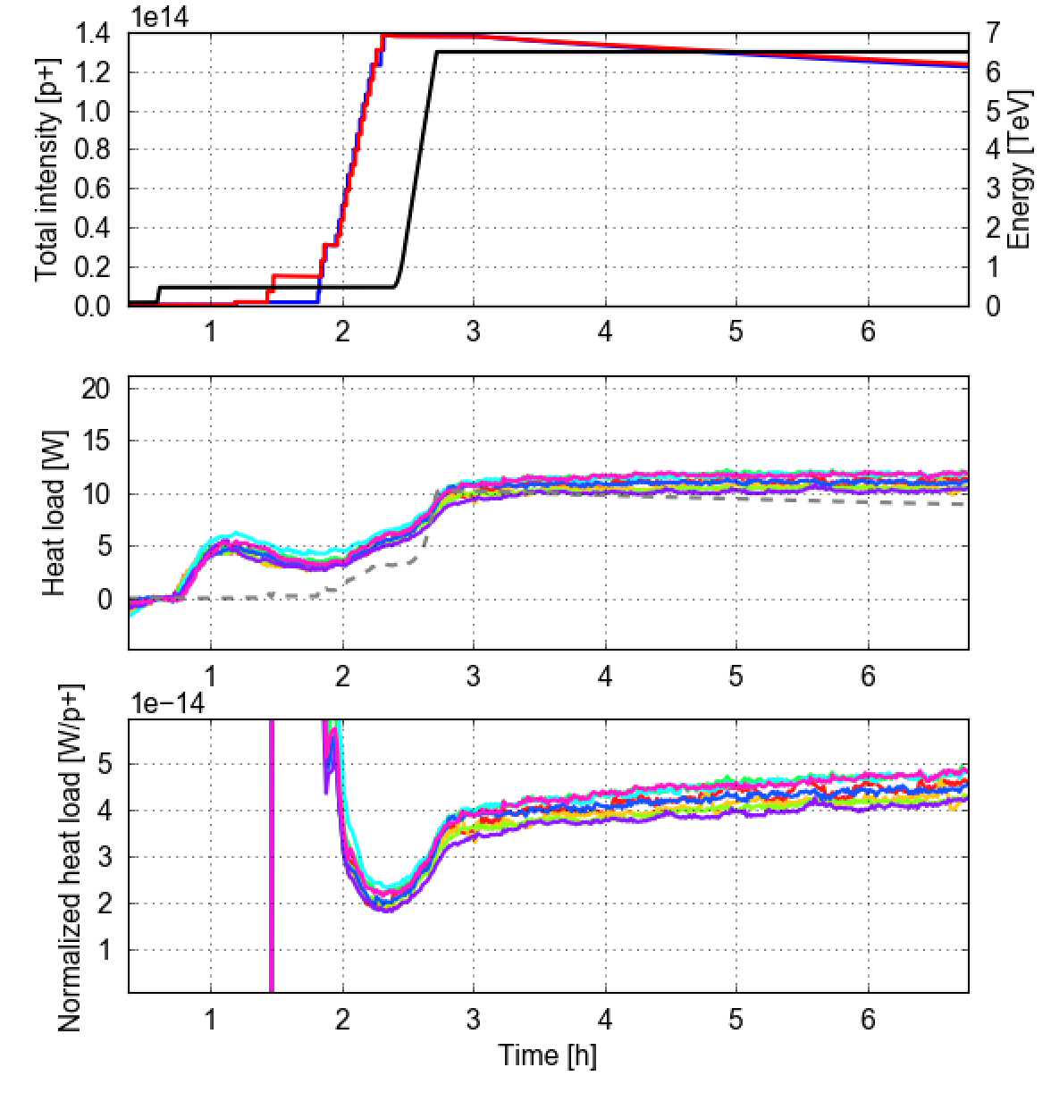
Test fill with 50 ns
Electron cloud suppression with 50 ns confirmed by heat load measurements on the beams-screens
Consistent with expectations from impedance and synchrotron radiation
Large differences between sectors observed with 25 ns are not visible with 50 ns
25 ns
50 ns

Slide 7
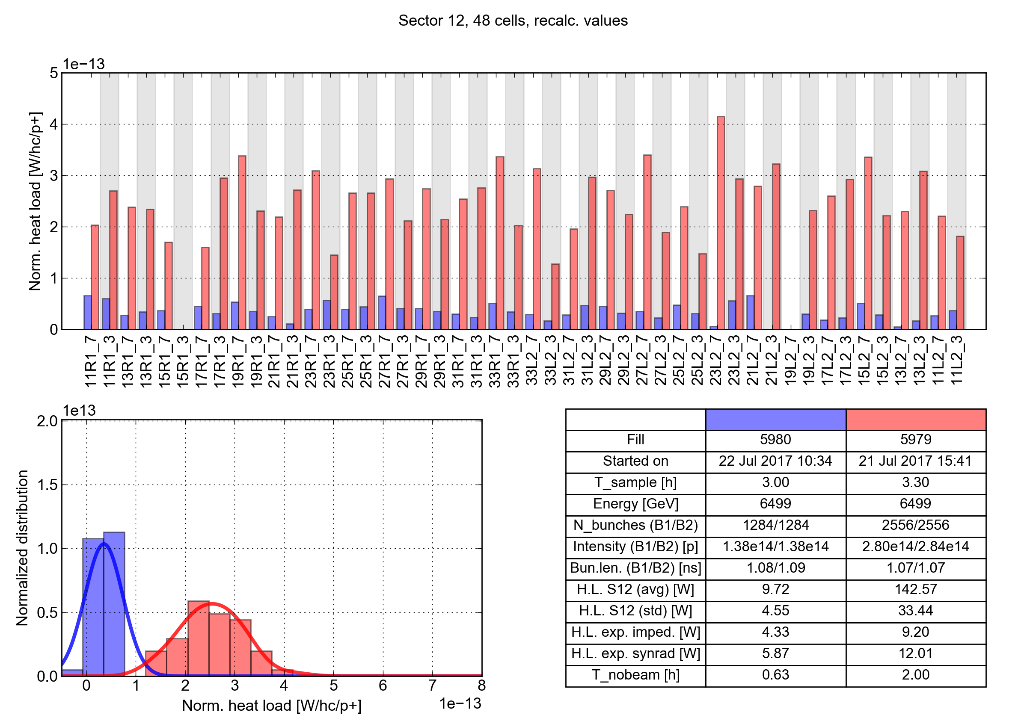
Cell-by-cell comparison
Reduction of normalized heat load is observed in all cells
16L2
50 ns
25 ns
Sector 12
For high load sectors distributions of normalized heat loads do not overlap
50 ns
25 ns

Slide 8
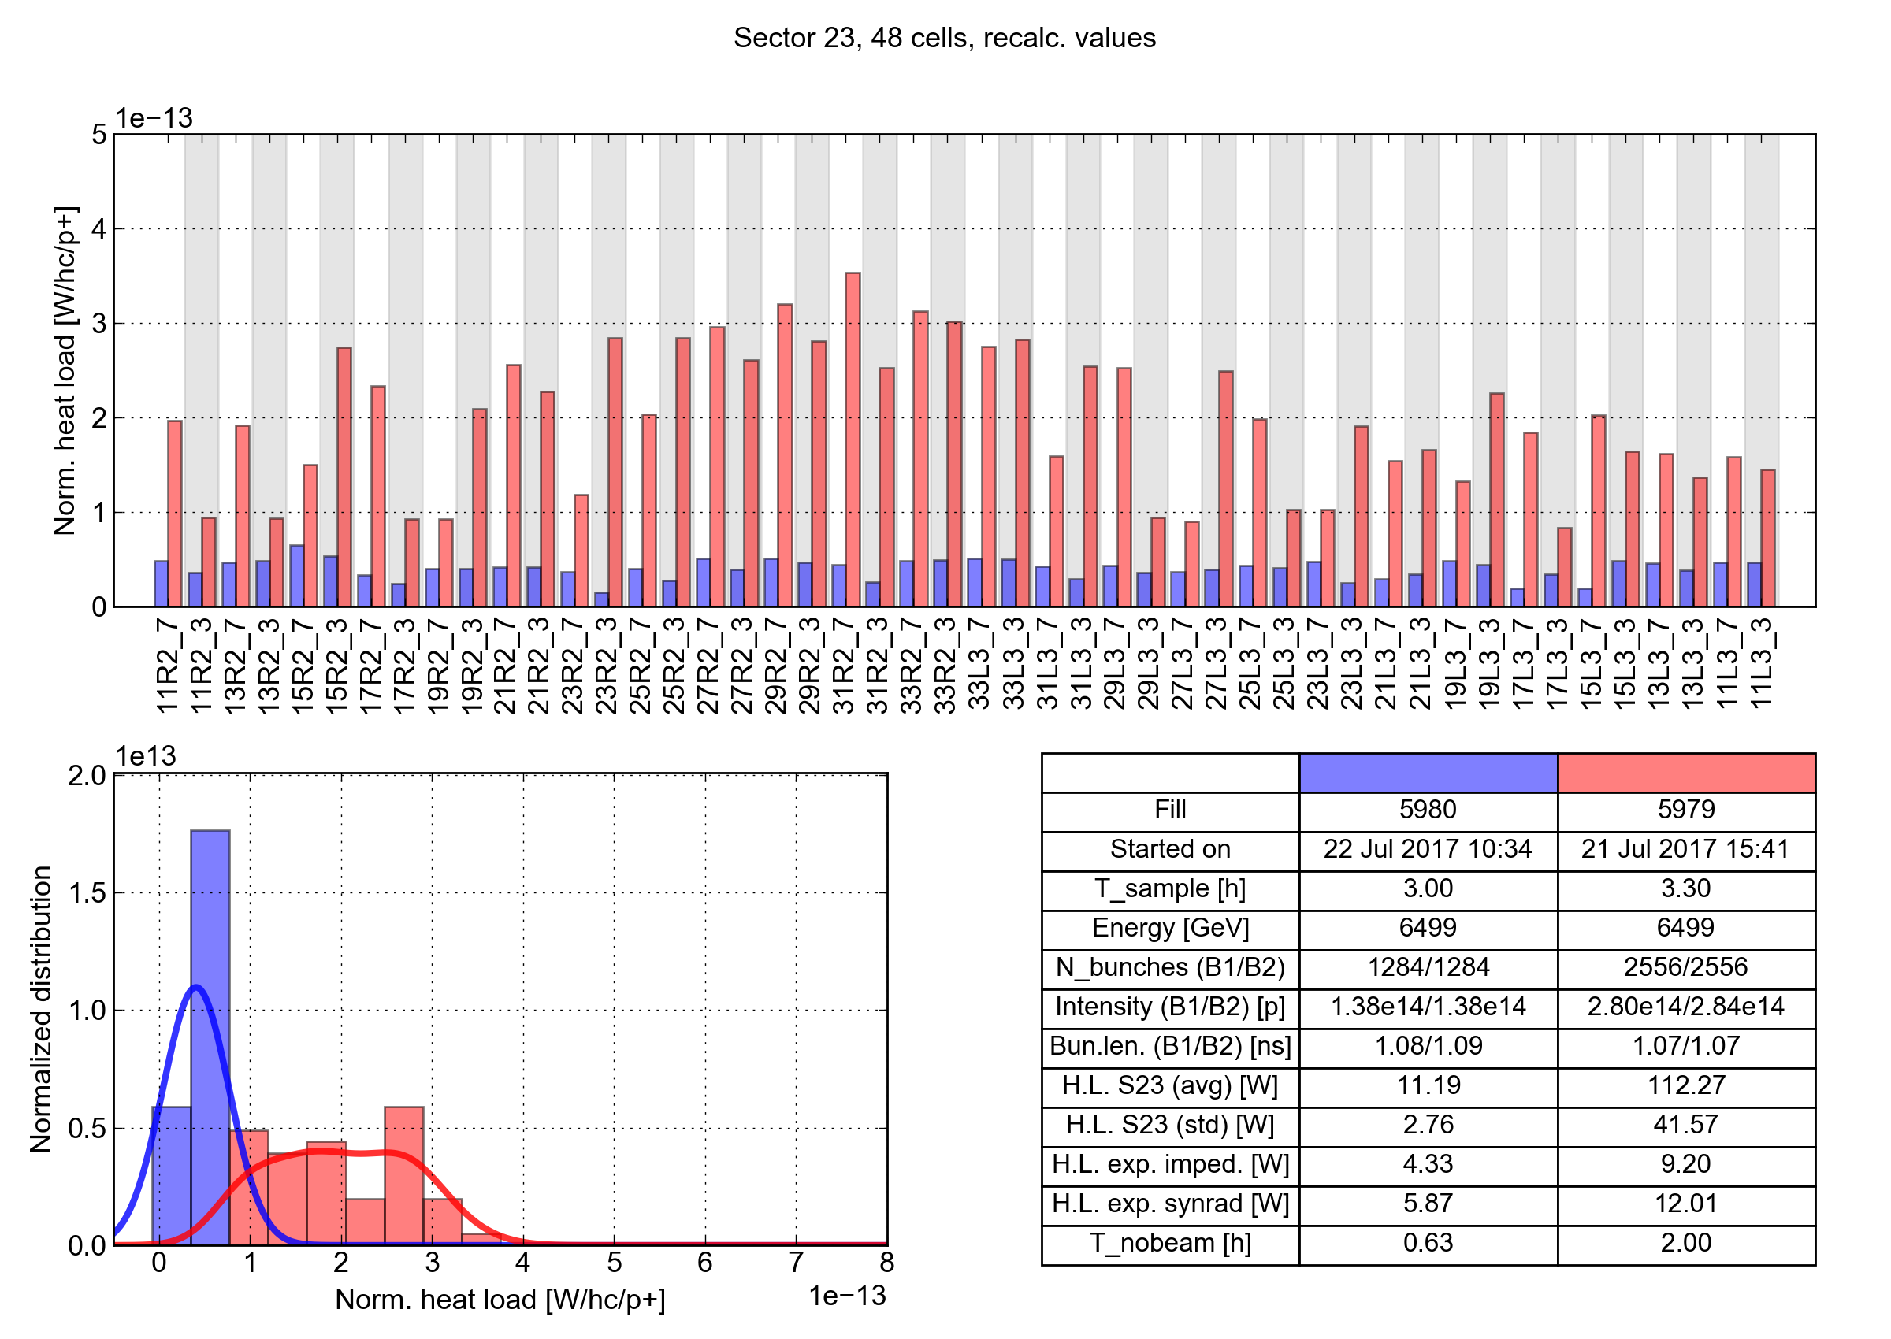
Cell-by-cell comparison
Reduction of normalized heat load is observed in all cells
50 ns
25 ns
Sector 23
For high load sectors distributions of normalized heat loads do not overlap
50 ns
25 ns

Slide 9
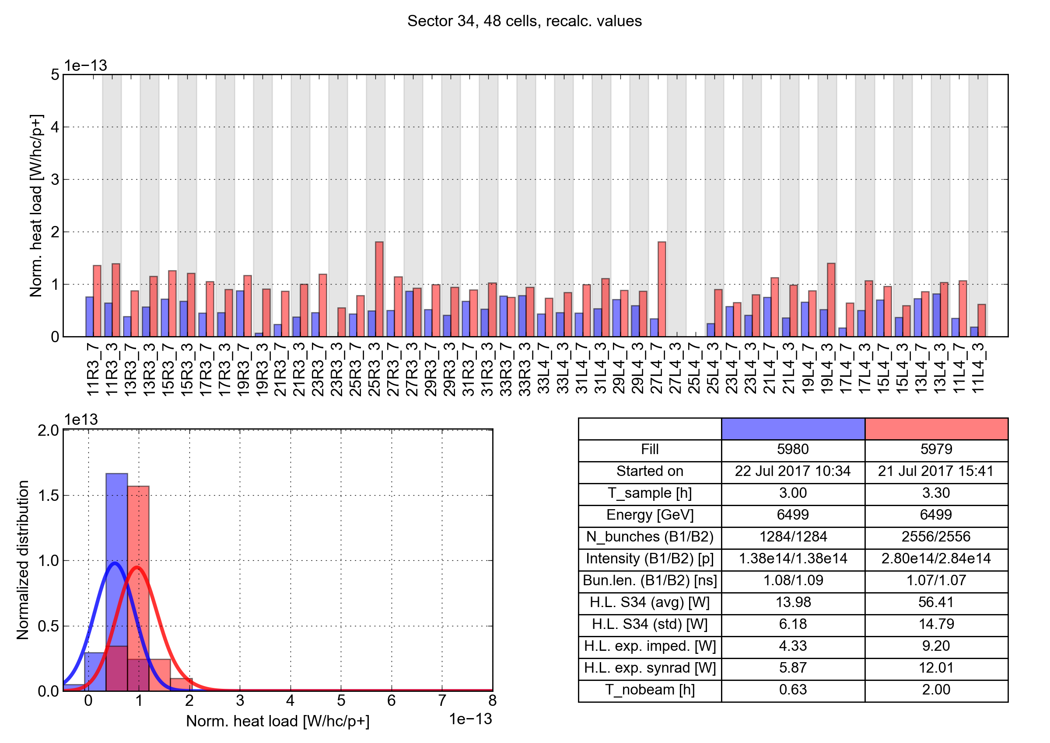
Cell-by-cell comparison
Reduction of normalized heat load is observed in all cells
50 ns
25 ns
Sector 34
For low load sectors normalized heat loads are more similar
e-cloud contribution not dominant anymore
50 ns
25 ns

Slide 10
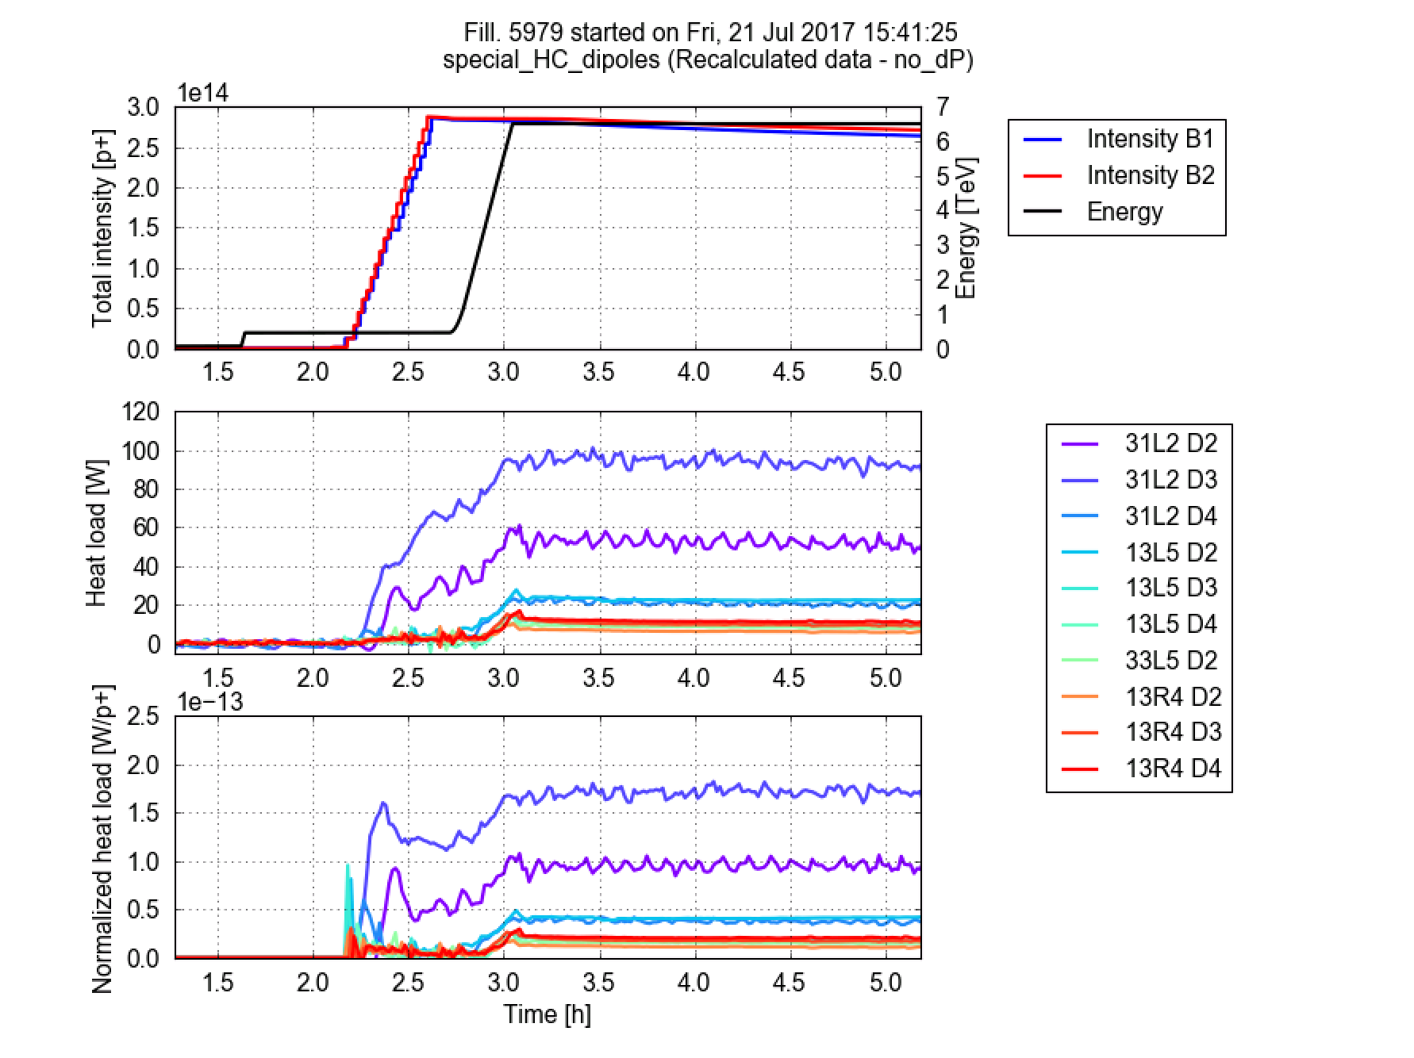
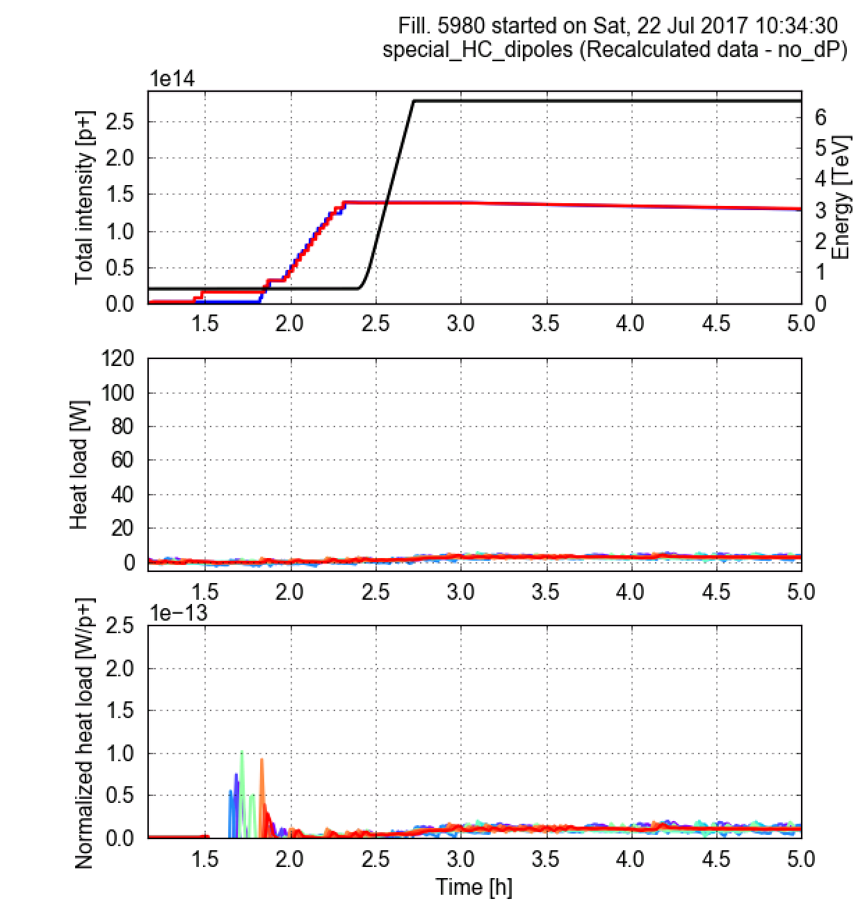
Instrumented magnets
Observation on instrumented magnets and LSS matching quadrupoles are consistent with observations on the arc averages:
Heat loads are reduced and large differences are suppressed

Slide 11
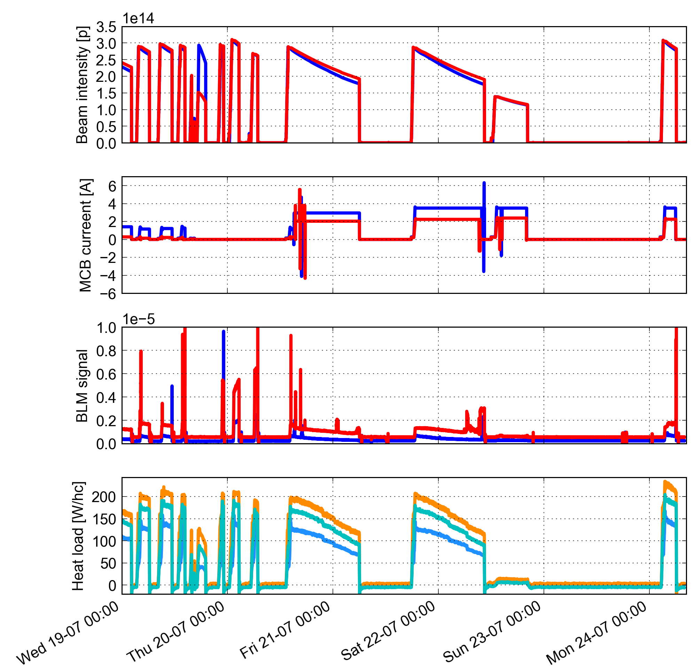
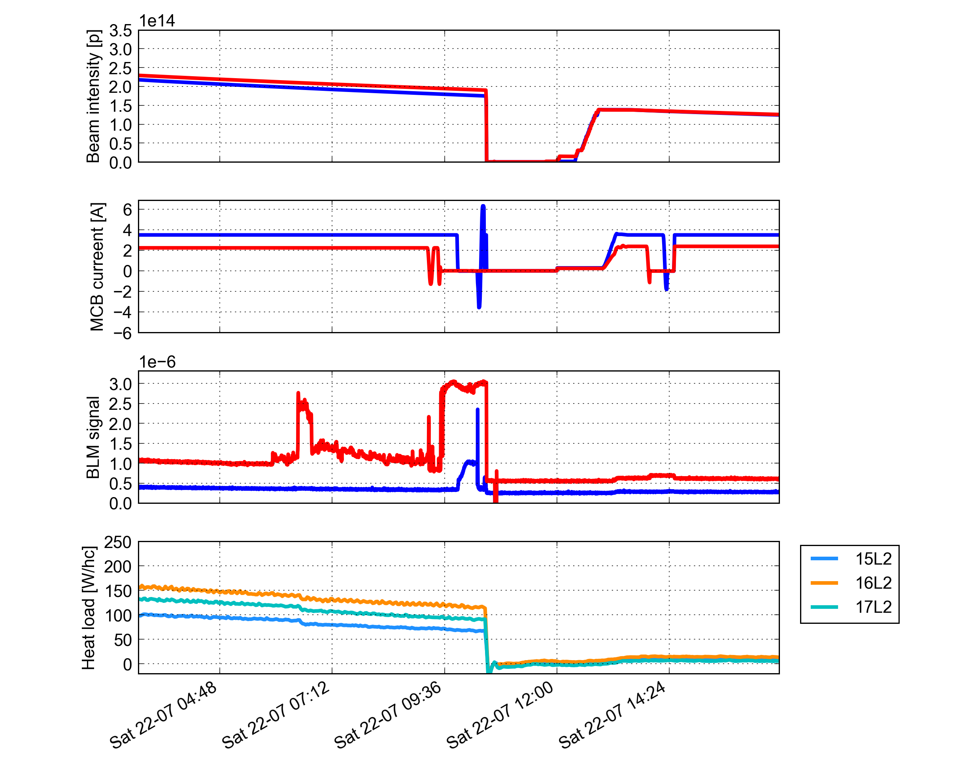
Heat loads on the beam-screens at 16L2 and close-by
50 ns
No anomalous behavior compared to the other arc half-cells
No changes in heat loads observed when changing the current in dipole correctors

Slide 12
Heat loads on the beam-screens at 16L2 and close-by
50 ns
Zoom
No anomalous behavior compared to the other arc half-cells
No changes in heat loads observed when changing the current in dipole correctors
No correlation with measured steady state losses
Heat load reduction with 50 ns similar to other half-cells

Slide 13
Outline
Test with 50 ns beams:
  e-cloud observations
Electron cloud effects in dipole correctors
  Simulations
  Cell-by-cell observations
Update on coherent motion observations
  Considerations on Fast Beam-Ion Instability

Slide 14
Effect of the dipole correctors on the cell heat load
Do we expect an effect on the heat load when changing the corrector setting?
Not really: there is a dependence on the magnetic field, but heat load values quite low (L_{corr} = 68 cm over 50 meter cell length)
SEY_{max}
PyECLOUD simulations
25 ns, 1 beam
2800 bunches
A. Romano

Slide 15
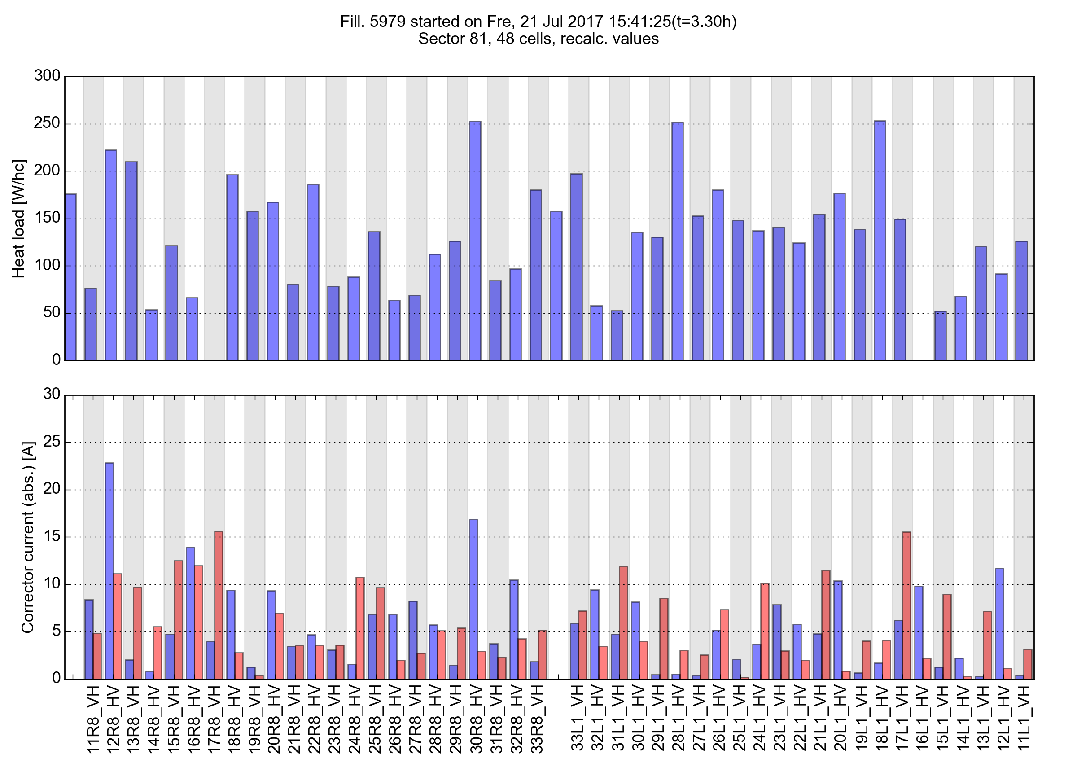
Impact of correctors on cell-by-cell heat loads
Any correlation between corrector settings and cell heat load?
Nothing evident when looking at the cell-by-cell patterns…
B1 B2

Slide 16
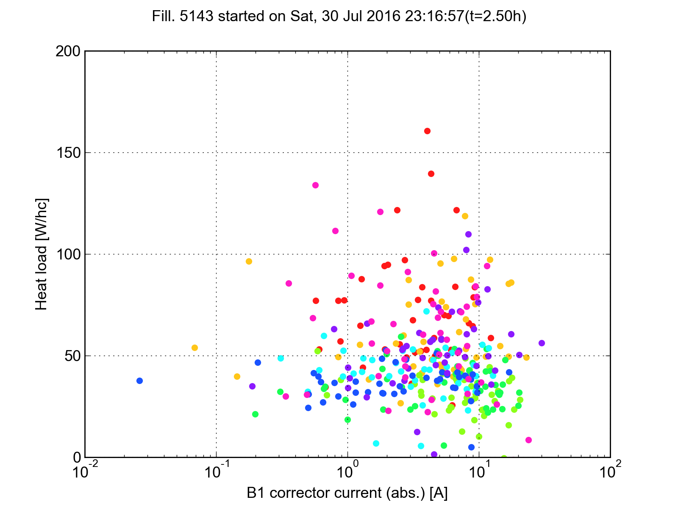
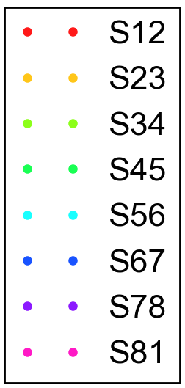
Impact of correctors on cell-by-cell heat loads
Correlation plot produced for a fill with only B1 in the machine (~2000b), to avoid arbitrary assumptions in combining the effect of the two correctors in the same half cells → no dependence could be identified
Correctors settings at high energy did not change much during Run 2 (see next slide)
this plot practically also shows the dependence on the integrated current in the MCBs

Slide 17
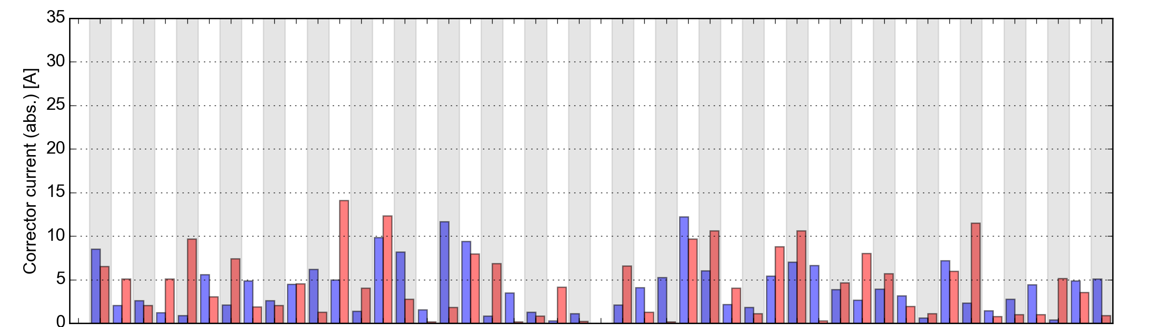
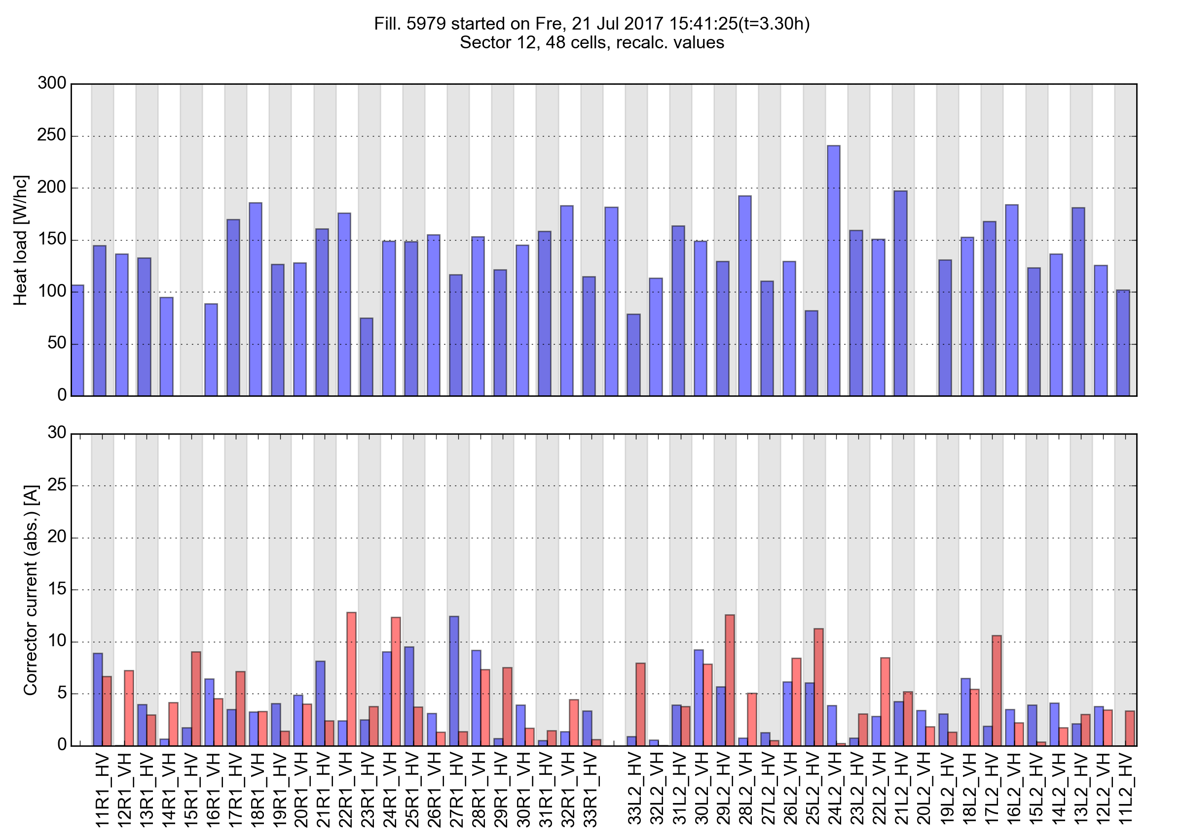
Corrector settings 2016 vs 2017
Correctors settings at high energy did not change much during Run 2
Jul 2015
Jul 2017

Slide 18
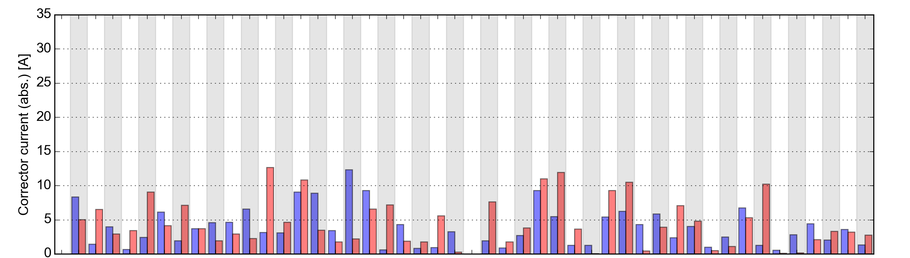
Corrector settings 2016 vs 2017
Correctors settings at high energy did not change much during Run 2
Jul 2016
Jul 2017

Slide 19
Outline
Test with 50 ns beams:
  e-cloud observations
Electron cloud effects in dipole correctors
  Simulations
  Cell-by-cell observations
Update on coherent motion observations
  Considerations on Fast Beam-Ion Instability

Slide 20
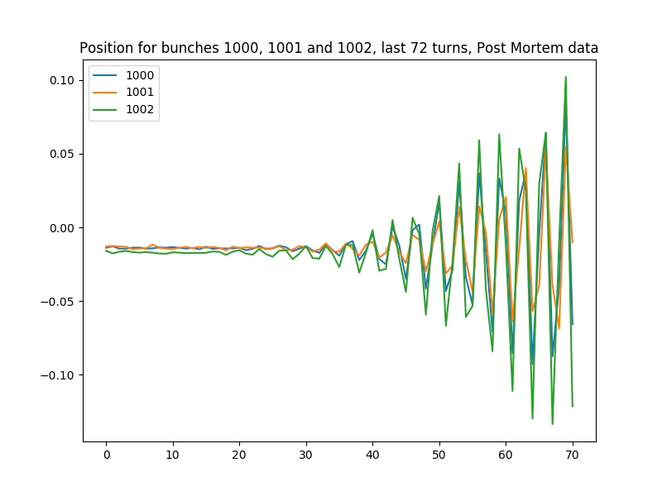
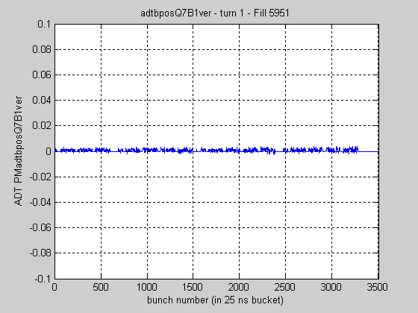
Coherent motion observations: update
All dumps in the last week has features similar to those described by Elias and Xavier in the last two LMC meetings:
  Coherent motion is observed after the sharp increase of beam losses in 16L2 right before the dump
  At high energy the dynamics is too fast (10-20 turns) to perform spectral analysis on the beam motion
We had one dump at injection on Sat 15 July. In that case the beam stayed longer, allowing to get a better insight on the instability:
  Clear indication of coupled bunch motion
  Large positive tune shift of the unstable mode
D. Amorim
X. Buffat
L. Carver
B. Salvant

Slide 21
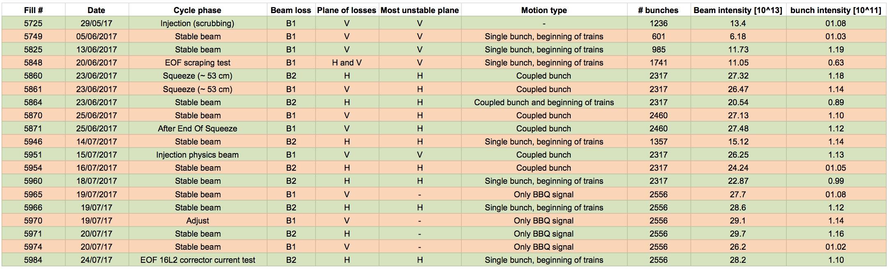
Coherent motion observations: update
Summary table with main observations:

Slide 22
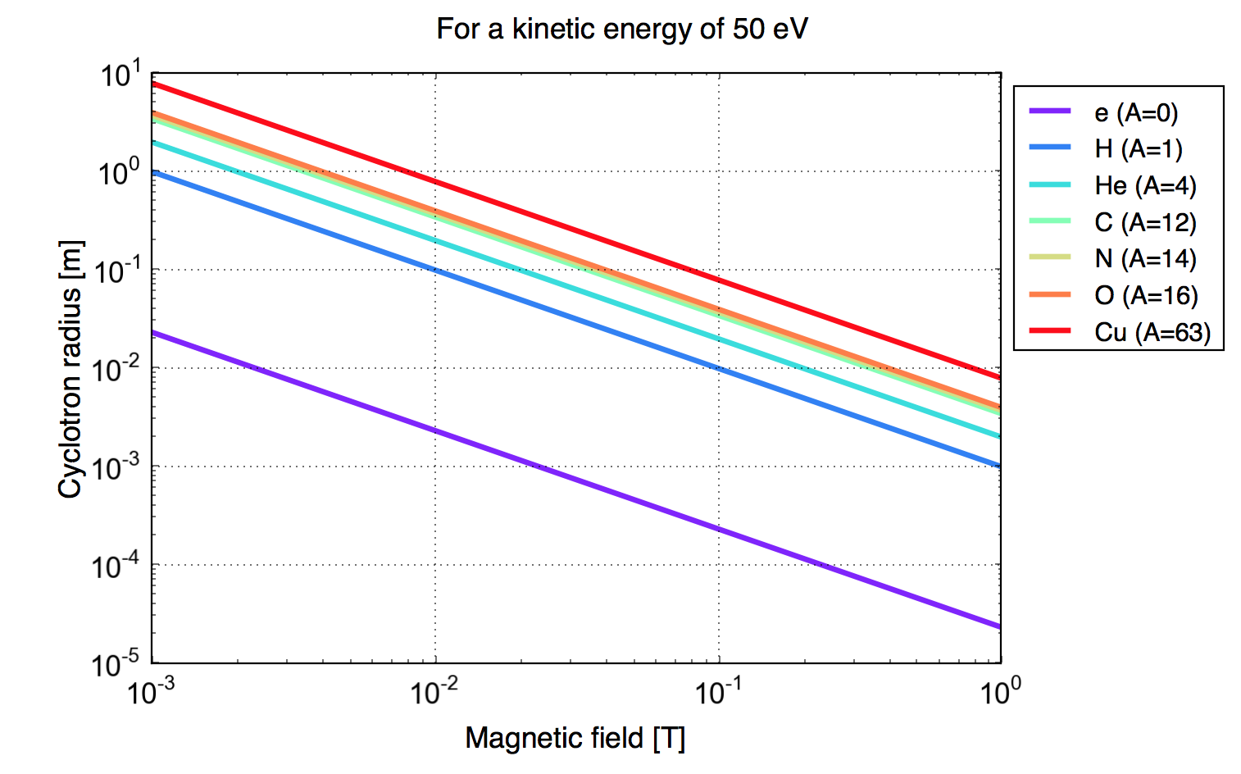
Fast beam-ion instability?
The presence of localized losses and coherent beam motion suggests that the underlying mechanism for the beam oscillation could be a Fast Beam-Ion Instability (FBII)
Coupled-bunch (FBII), typically encountered in electron machines due to ion trapping
→ Not expected with positively charged beams due to the repulsion of the ions
However (first calculations by L. Mether and G. Rumolo presented at LBOC 82):
Simulations show that for high enough density (1e13 ion/m³) ions can drive an instability even with protons
The presence of electron cloud in the chamber could enhance the ionization mechanism and change the dynamics (trapping?)
  This can be quantitatively assessed only with simulations of the full three-stream system (beam-electrons-ions) → requires some development work…
Involved ions and electrons have energies in the order of 10¹-10² eV
  their motion can be strongly influenced by “weak” magnetic fields (as those introduced by the MCBs)
I_{MCB}= 1 A
B = 50mT

Slide 23
Summary and conclusions
In the 50 ns fill performed on Sat 22 Jul, the expected e-cloud suppression was clearly visible on the heat loads in all twin-bore magnets in the machine
  No particular behavior is observed at 16L2 and neighboring cells
  In particular there is no correlation of heat load with beam losses when changing the current in the MCBs
  It would be desirable to perform a scan during a 25 ns fill with same number of bunches and bunch intensity to have a clear comparison (e.g. if at some we need an intermediate intensity fill for MP reasons)
The contribution of the corrector magnets to the heat load per half cell is expected to be small
  No evident correlation is found between cell-by-cell heat loads and corrector settings
As observed before, coherent beam motion was present right before all dumps
  Too fast at high energy to allow for a meaningful spectral analysis
  In the case of the dump at 450 GeV the beam stayed for a longer time after becoming unstable → observed clear coupled bunch motion, large positive tune shift
  First simulations show that a Fast Beam Ion Instability (FBII) could be a possible driving mechanism for the coherent motion (for large enough ion density) → some development work needed to make quantitative estimates

Slide 24
Thanks for your attention!

Slide 25
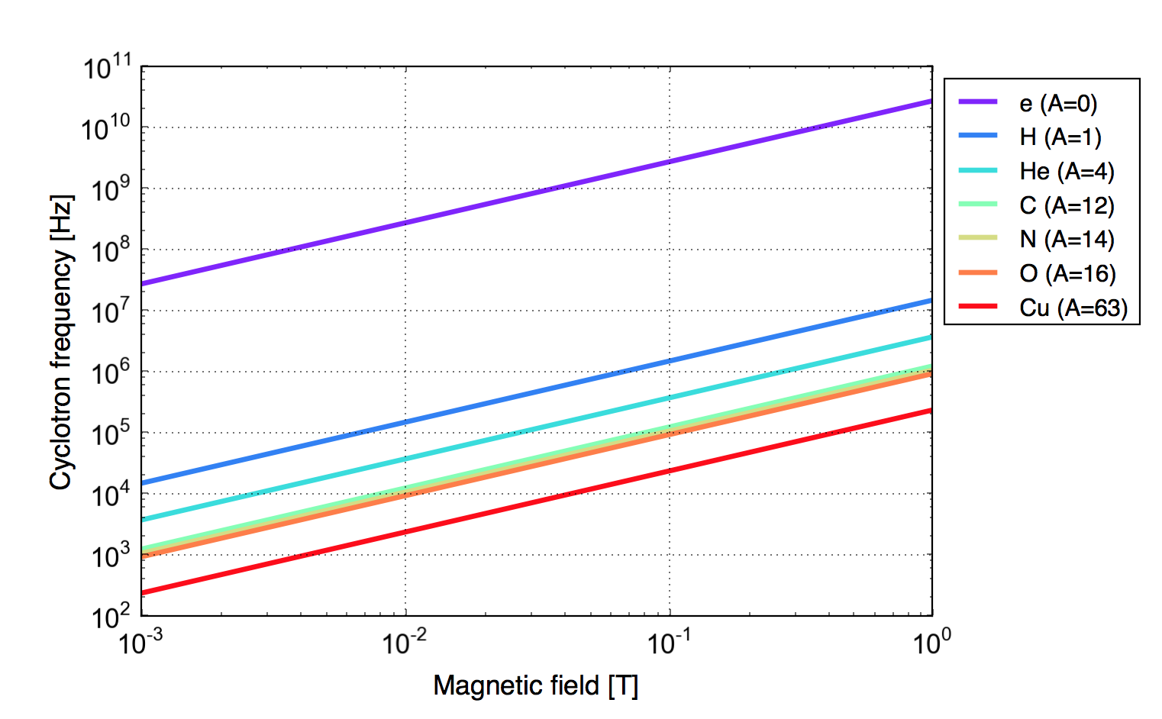
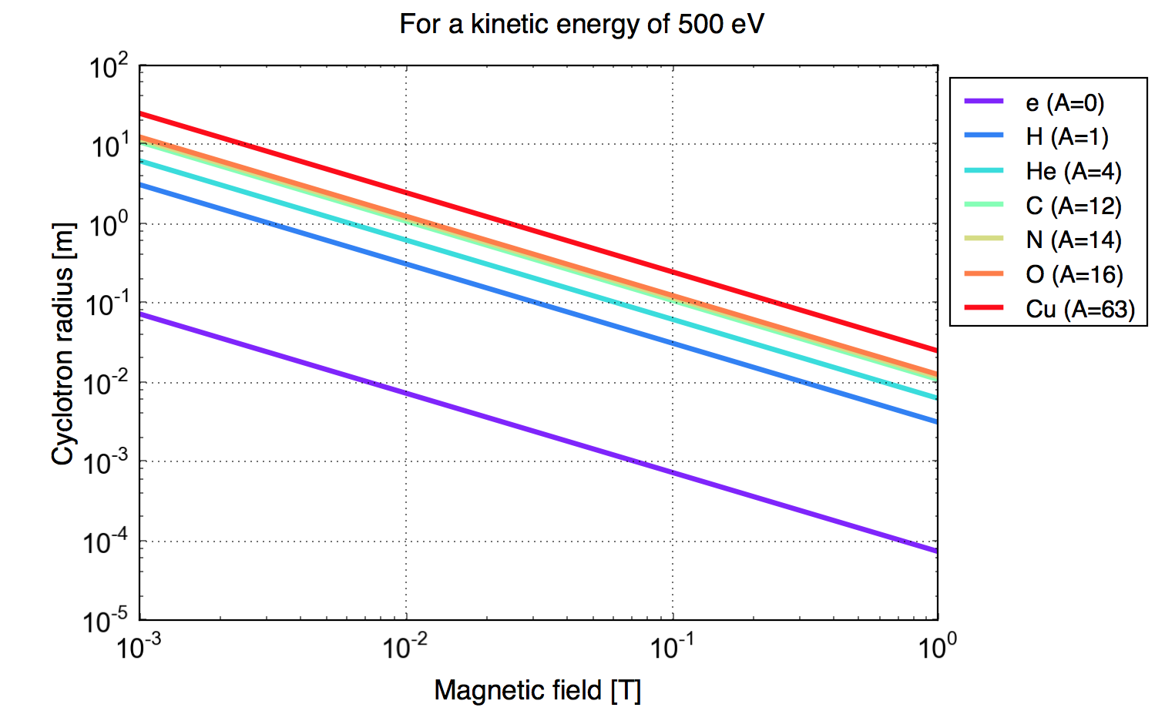
100 mA
1 A
100 mA
1 A
100 mA
1 A

Slide 27
Fill 5979
(21 Jul 2017)
25 ns, 2556b/beam, 6.5 TeV

Slide 28
B1 B2

Slide 29
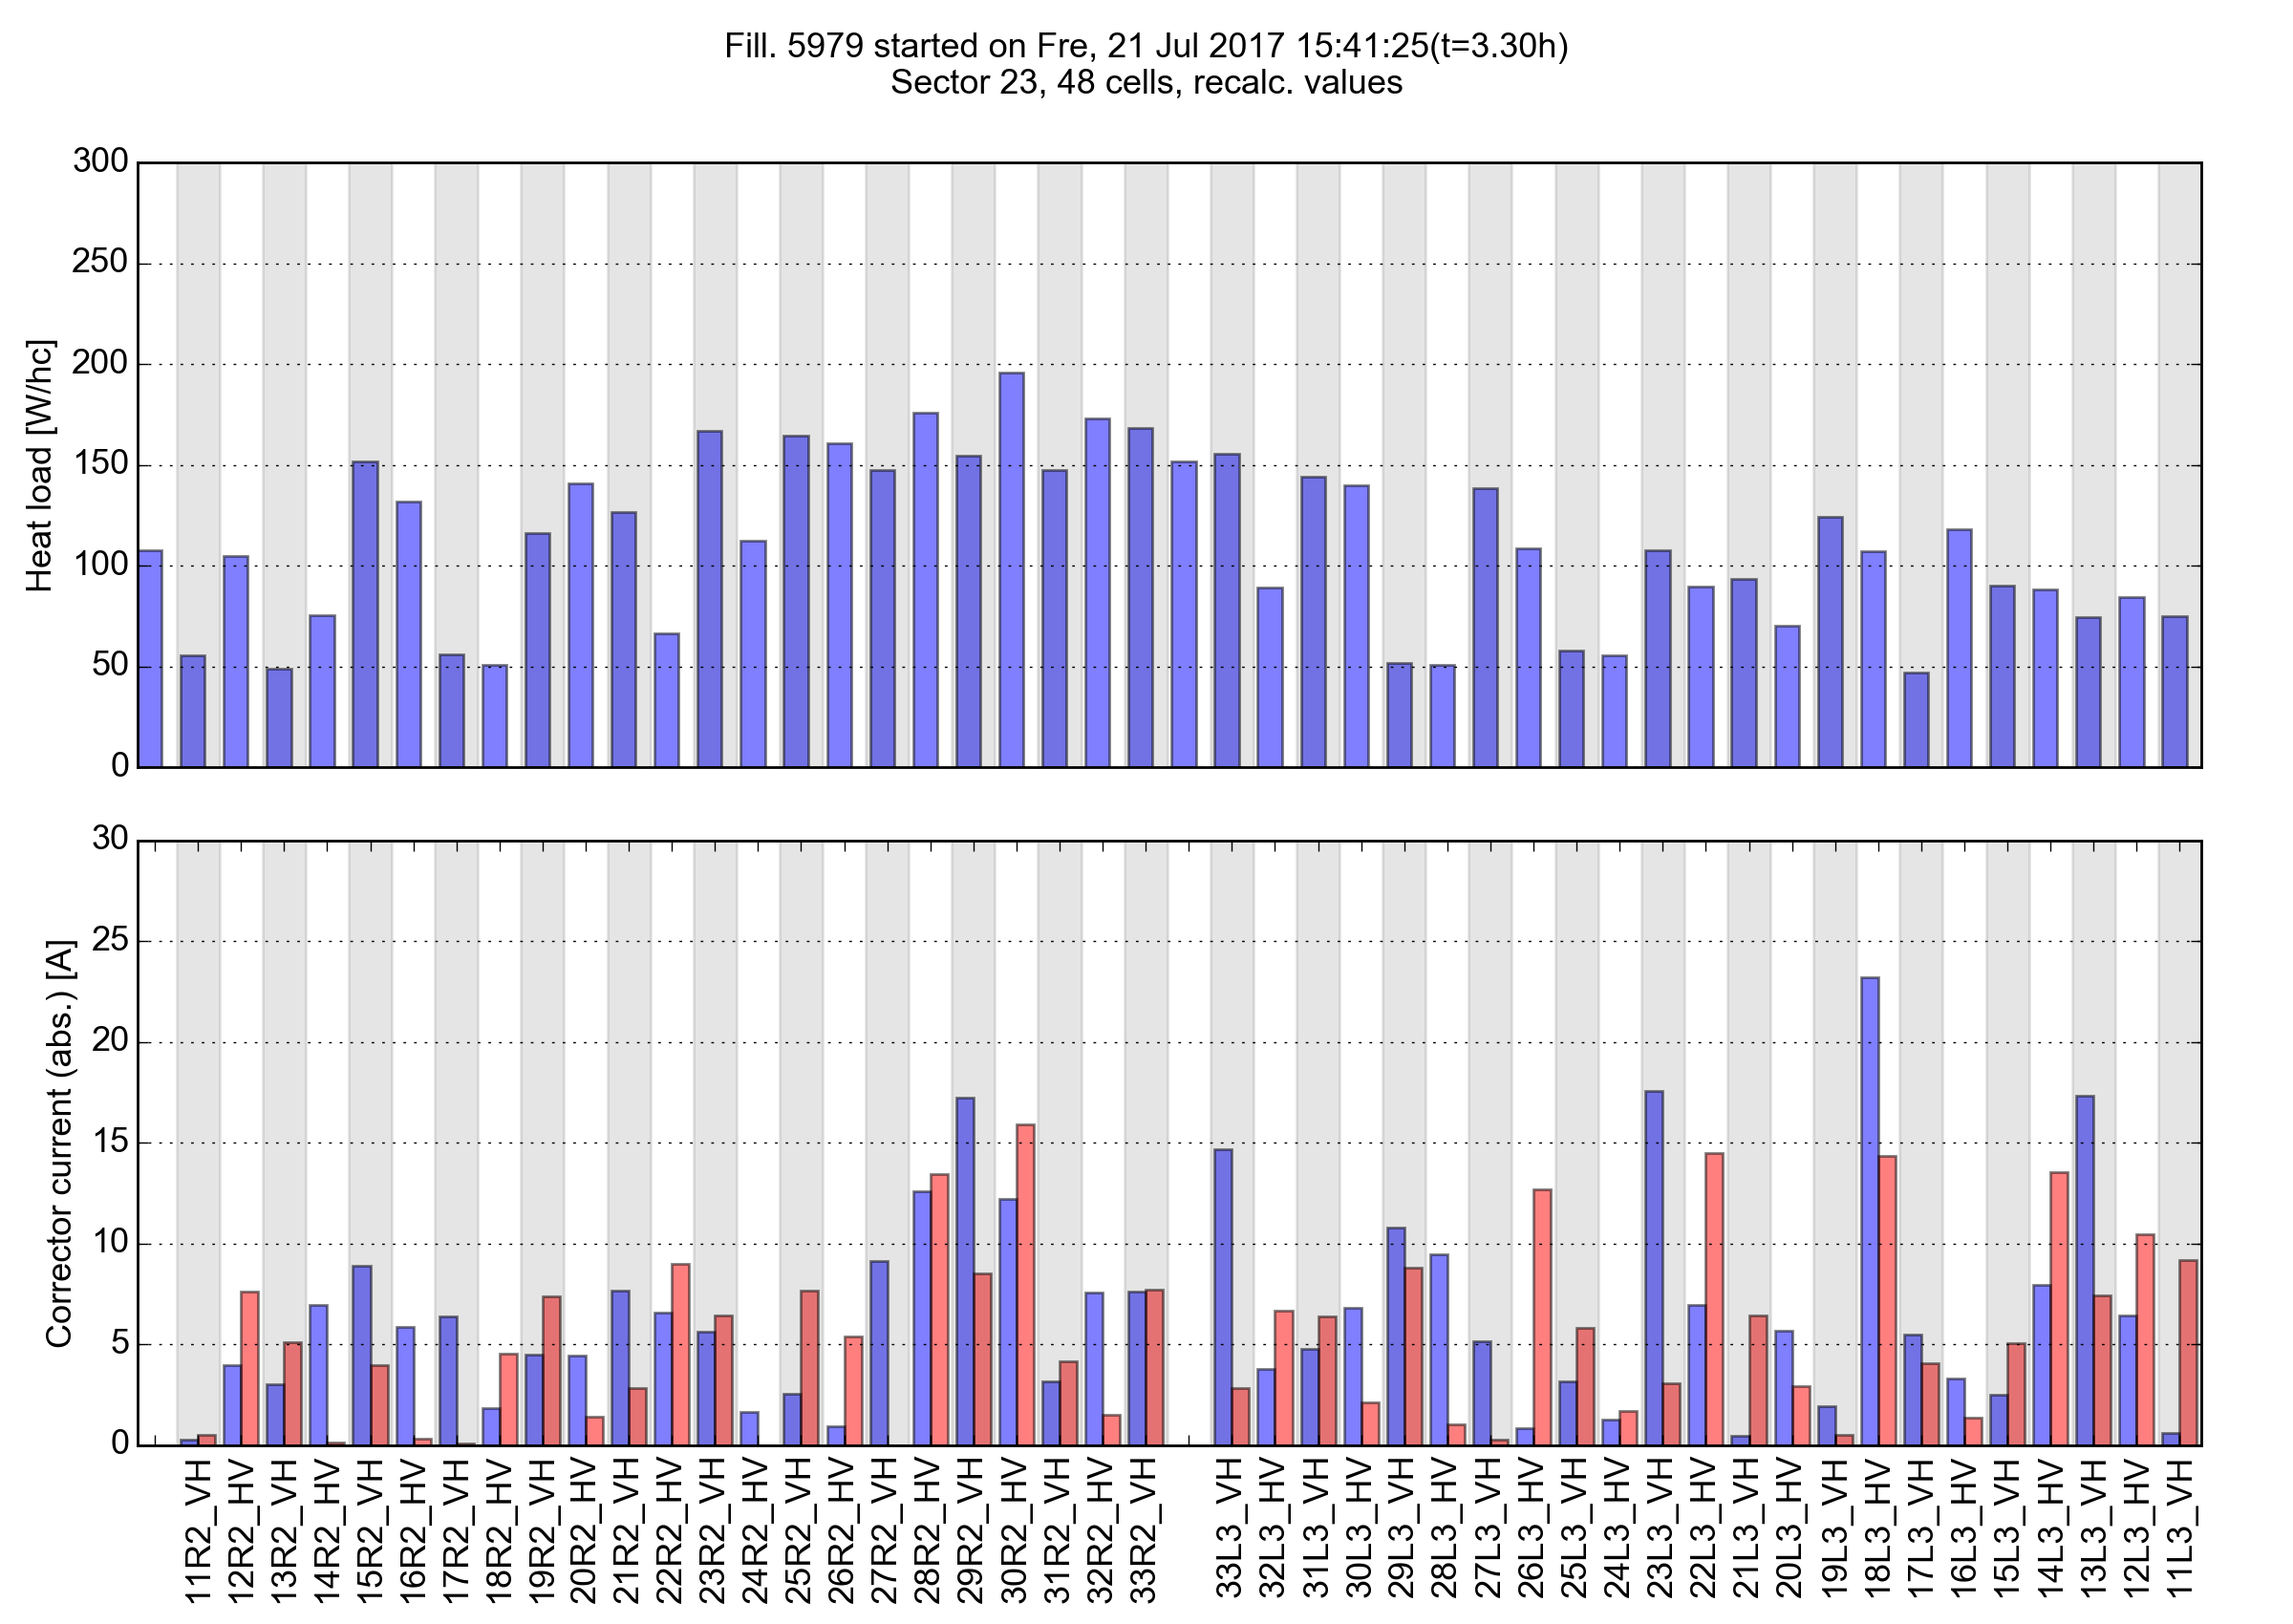
B1 B2

Slide 30
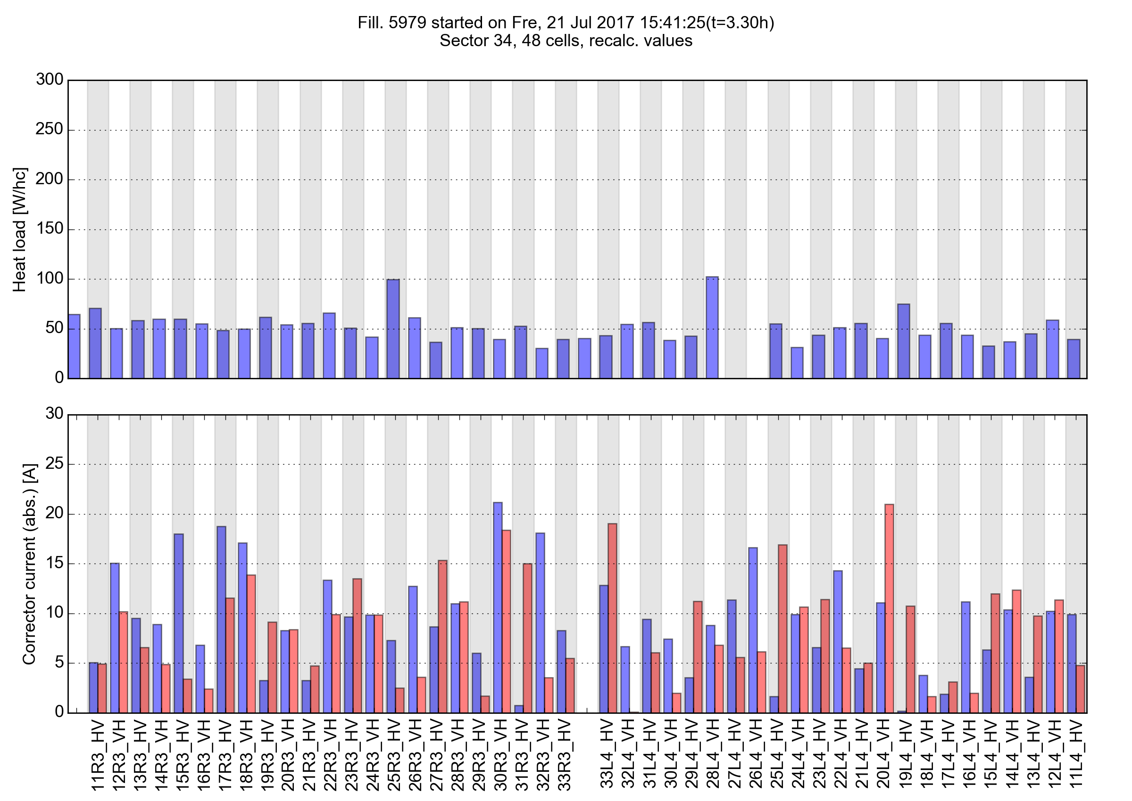
B1 B2

Slide 31
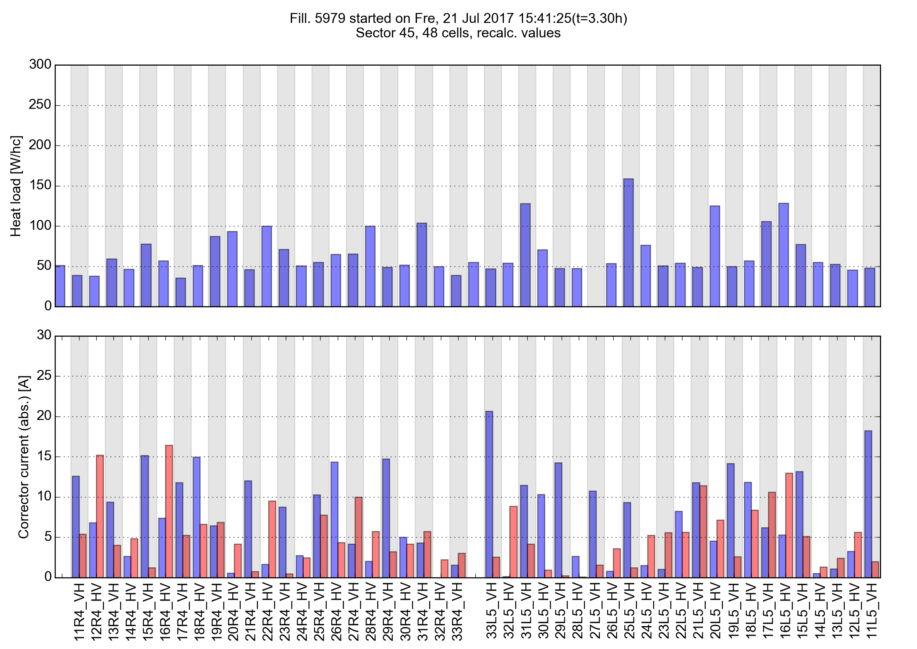
B1 B2

Slide 32
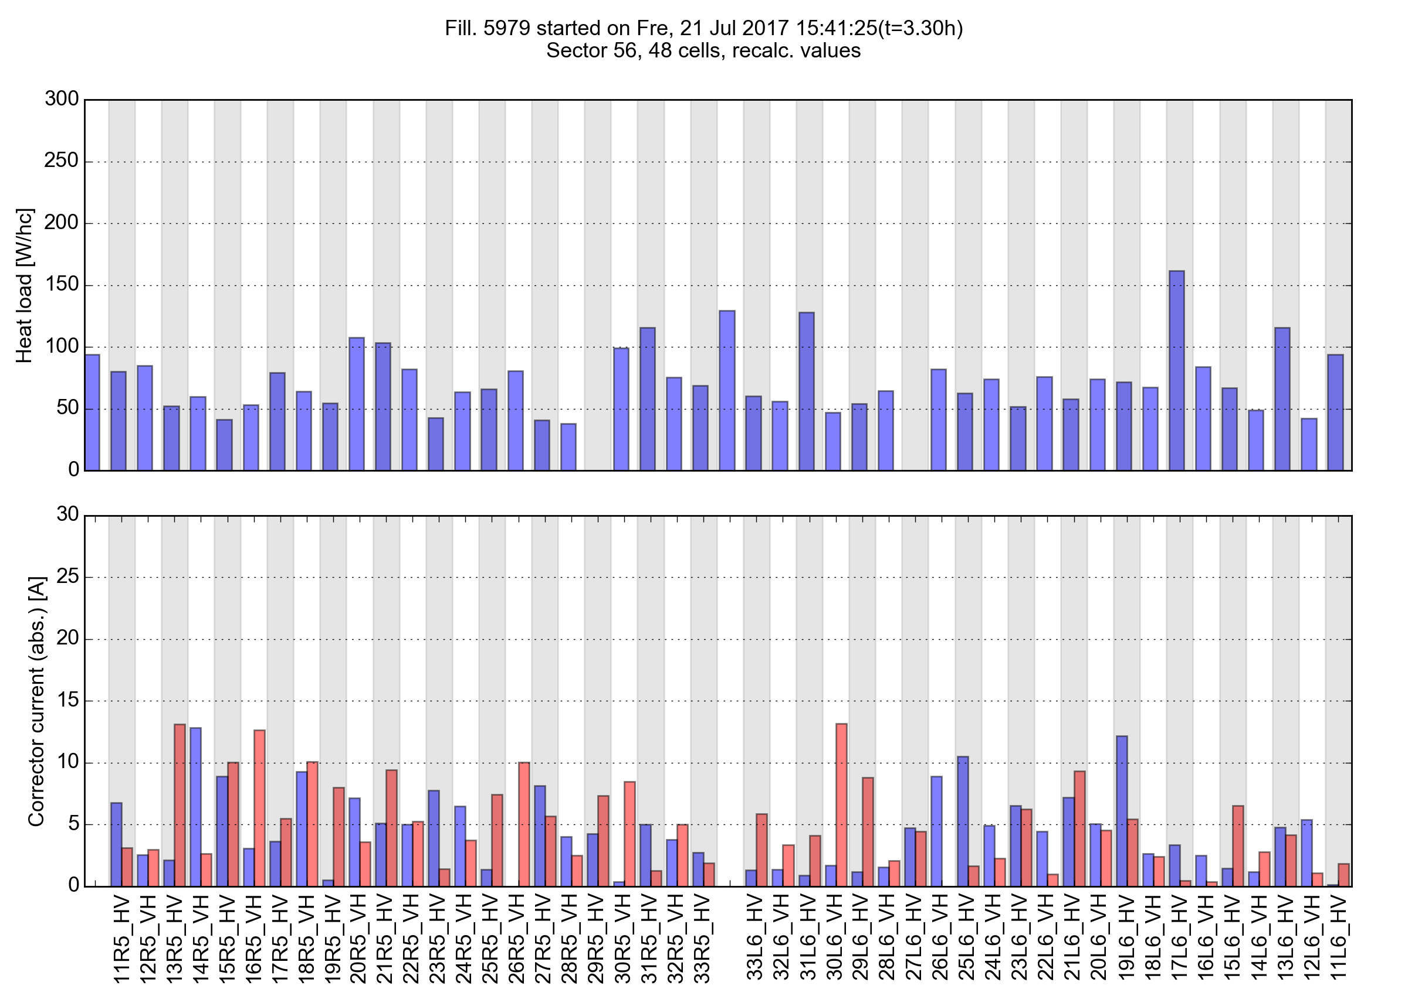
B1 B2

Slide 33
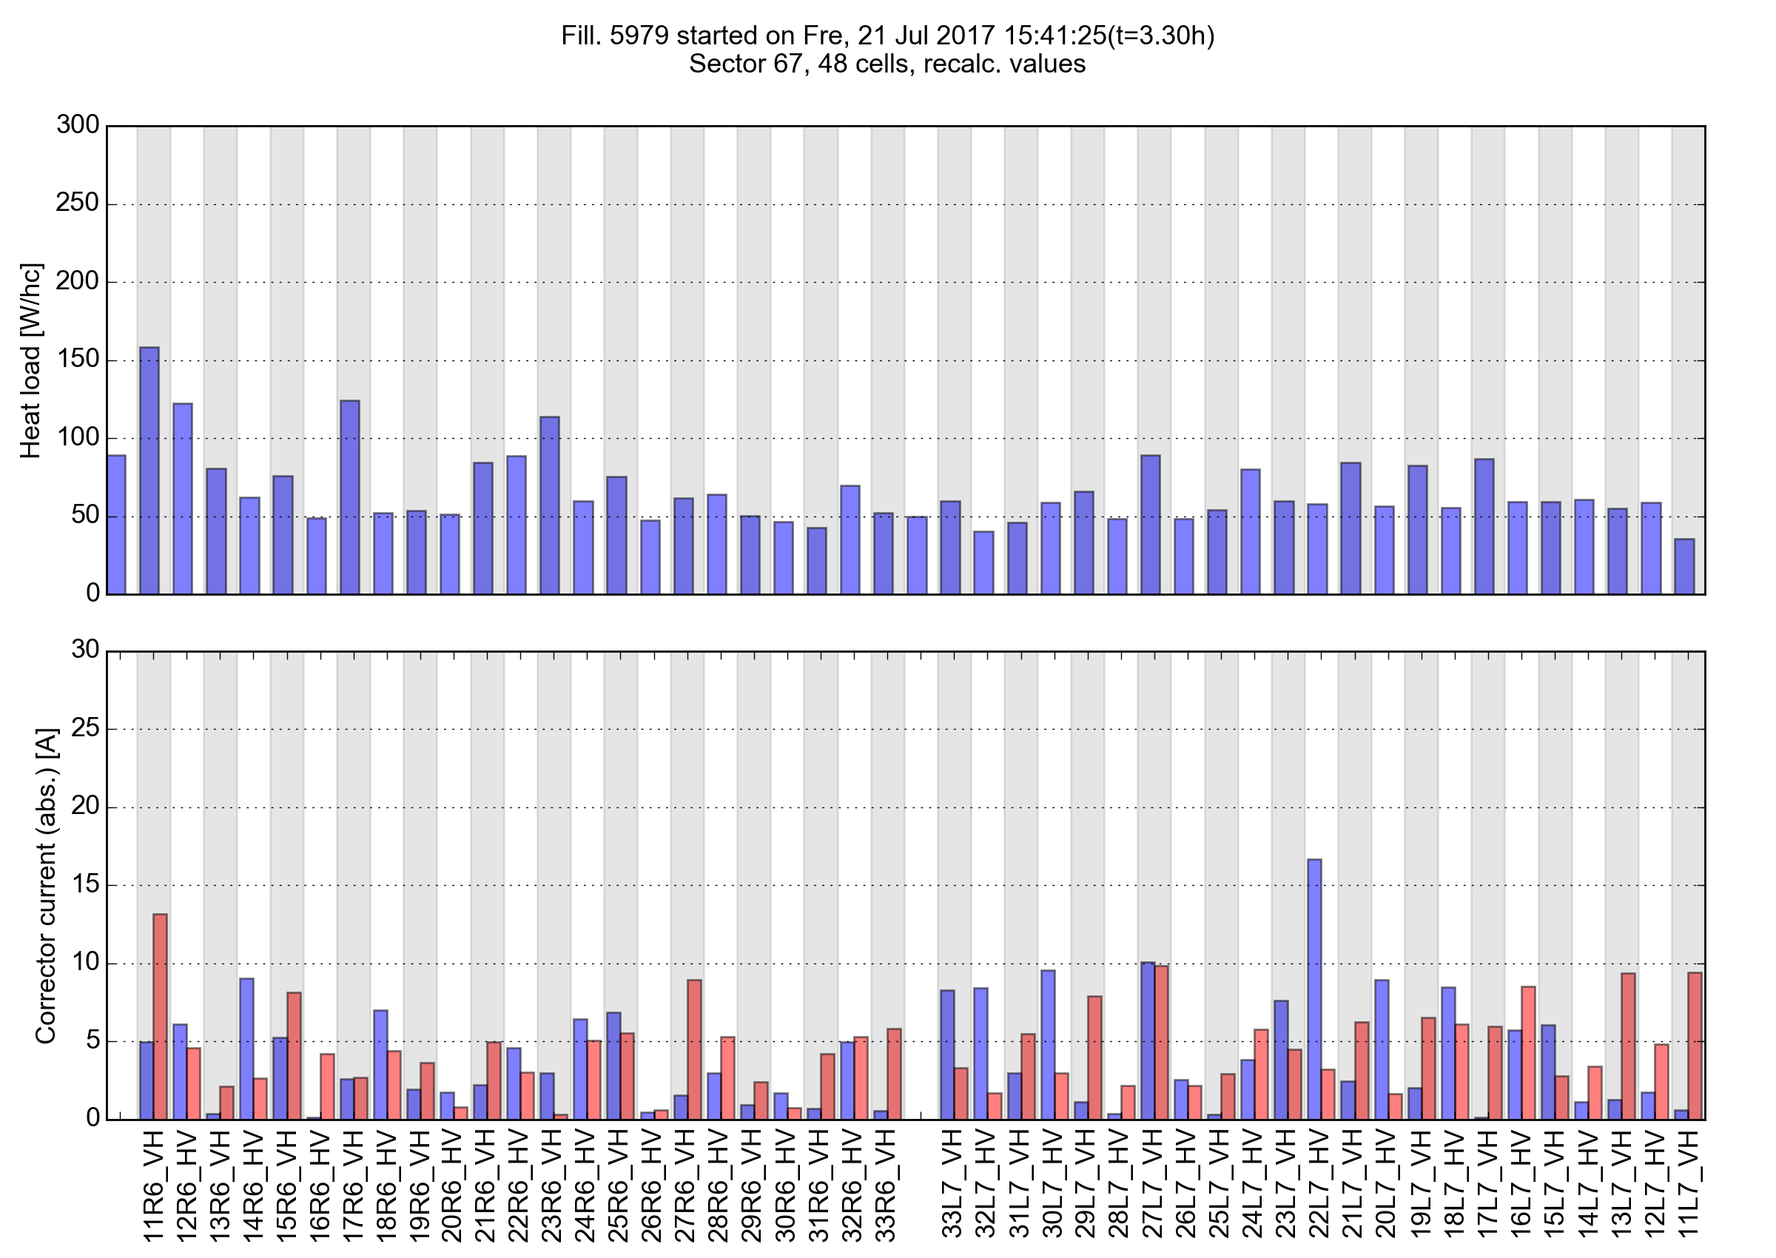
B1 B2

Slide 34
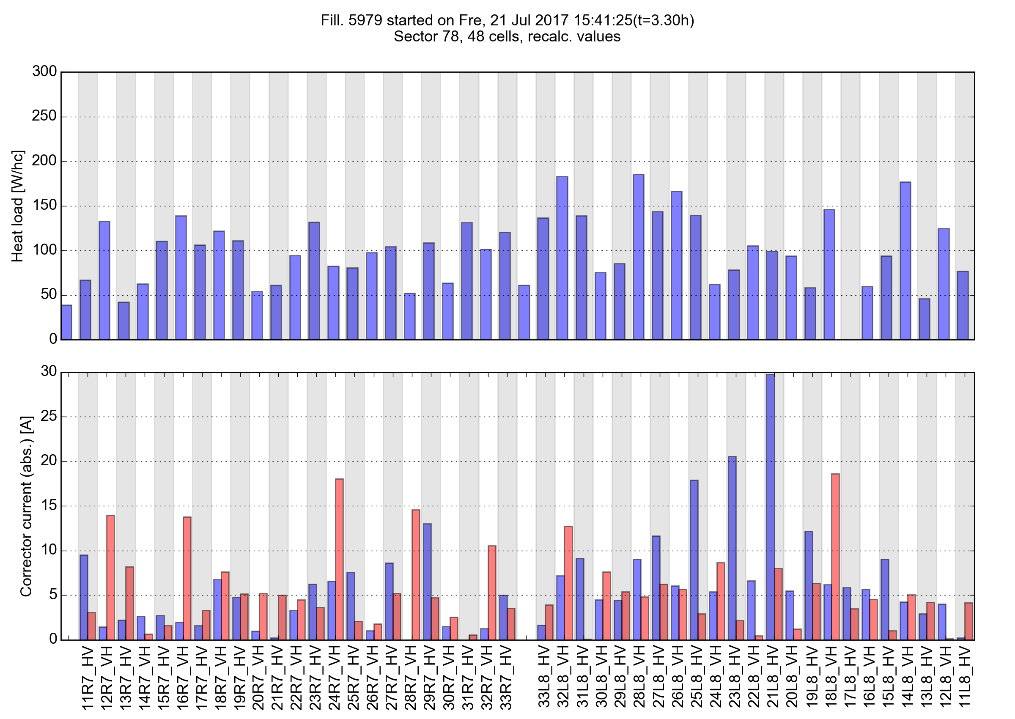
B1 B2

Slide 35
B1 B2

Slide 36
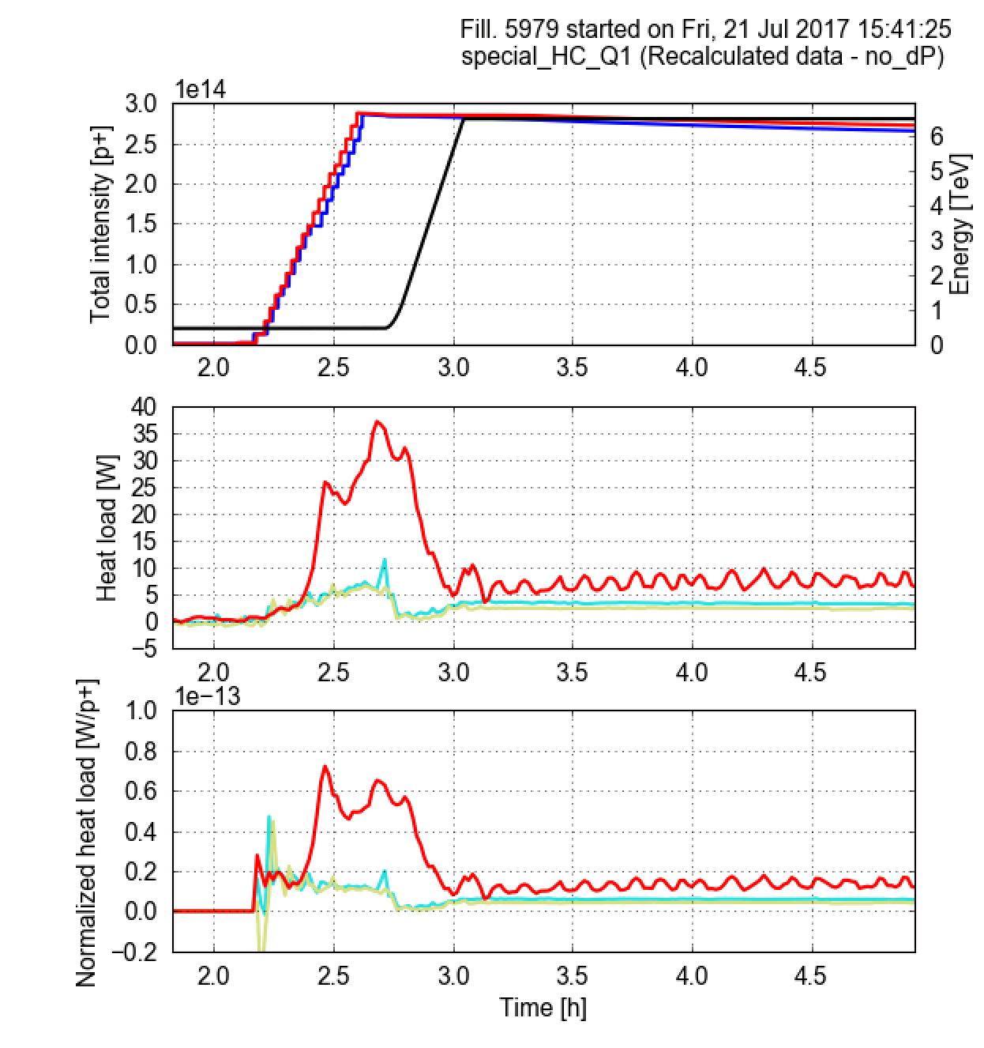
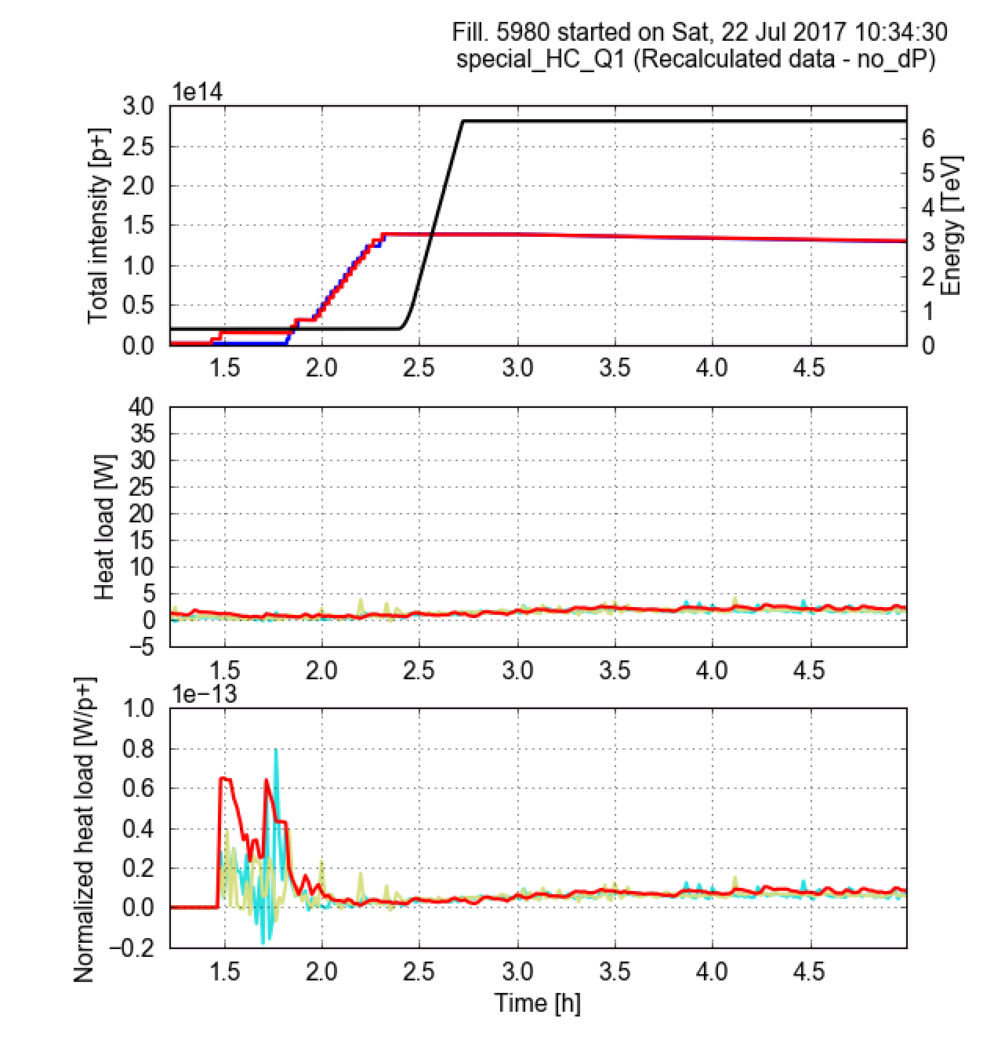
Instrumented quadrupoles
Consistent with observations on the arc averages:
Heat loads are reduced and large differences are suppressed

Slide 37
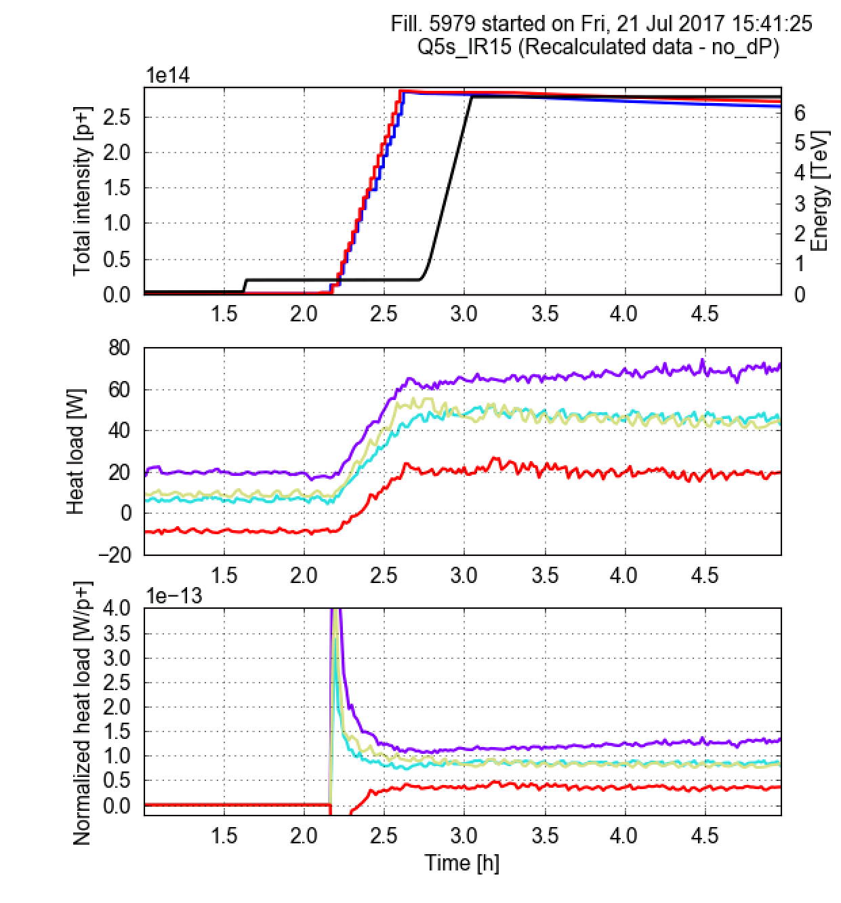
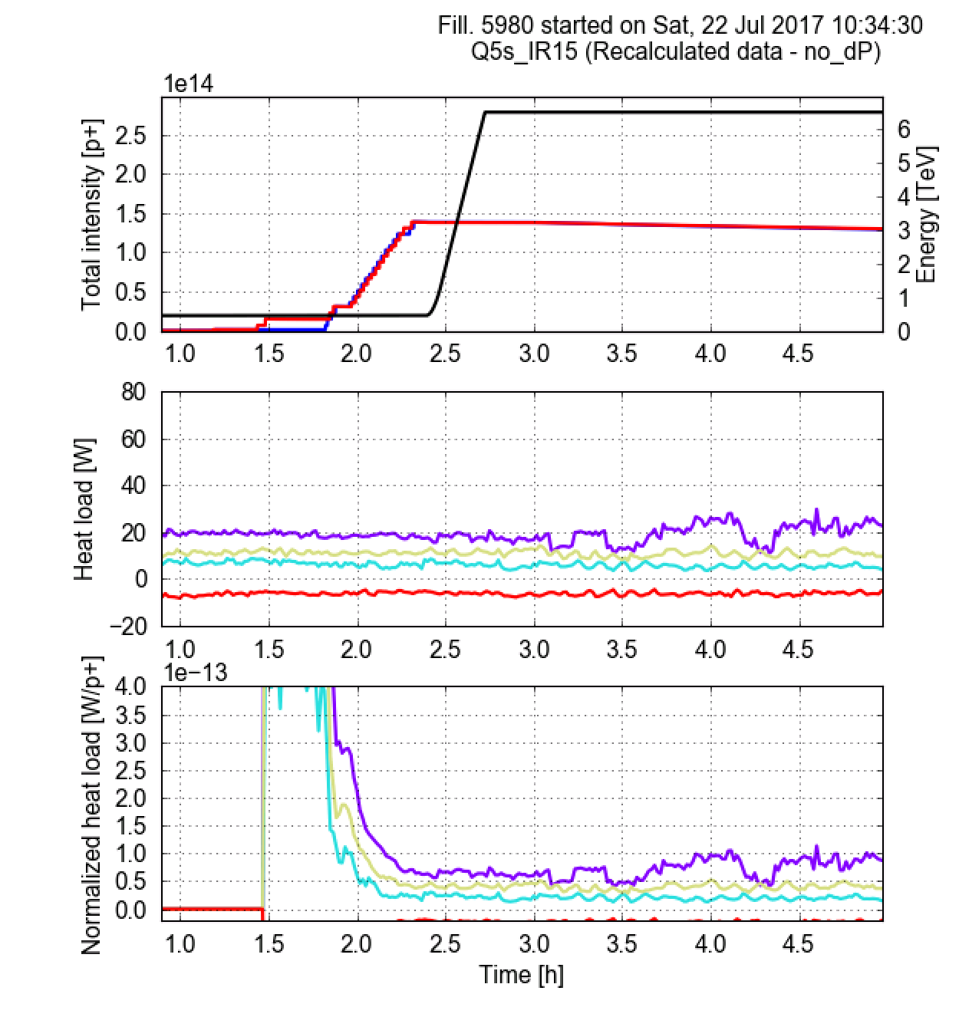
Stand alone quadrupoles: Q5s
Consistent with observations on the arc averages:
Heat loads are reduced and large differences are suppressed

Slide 38
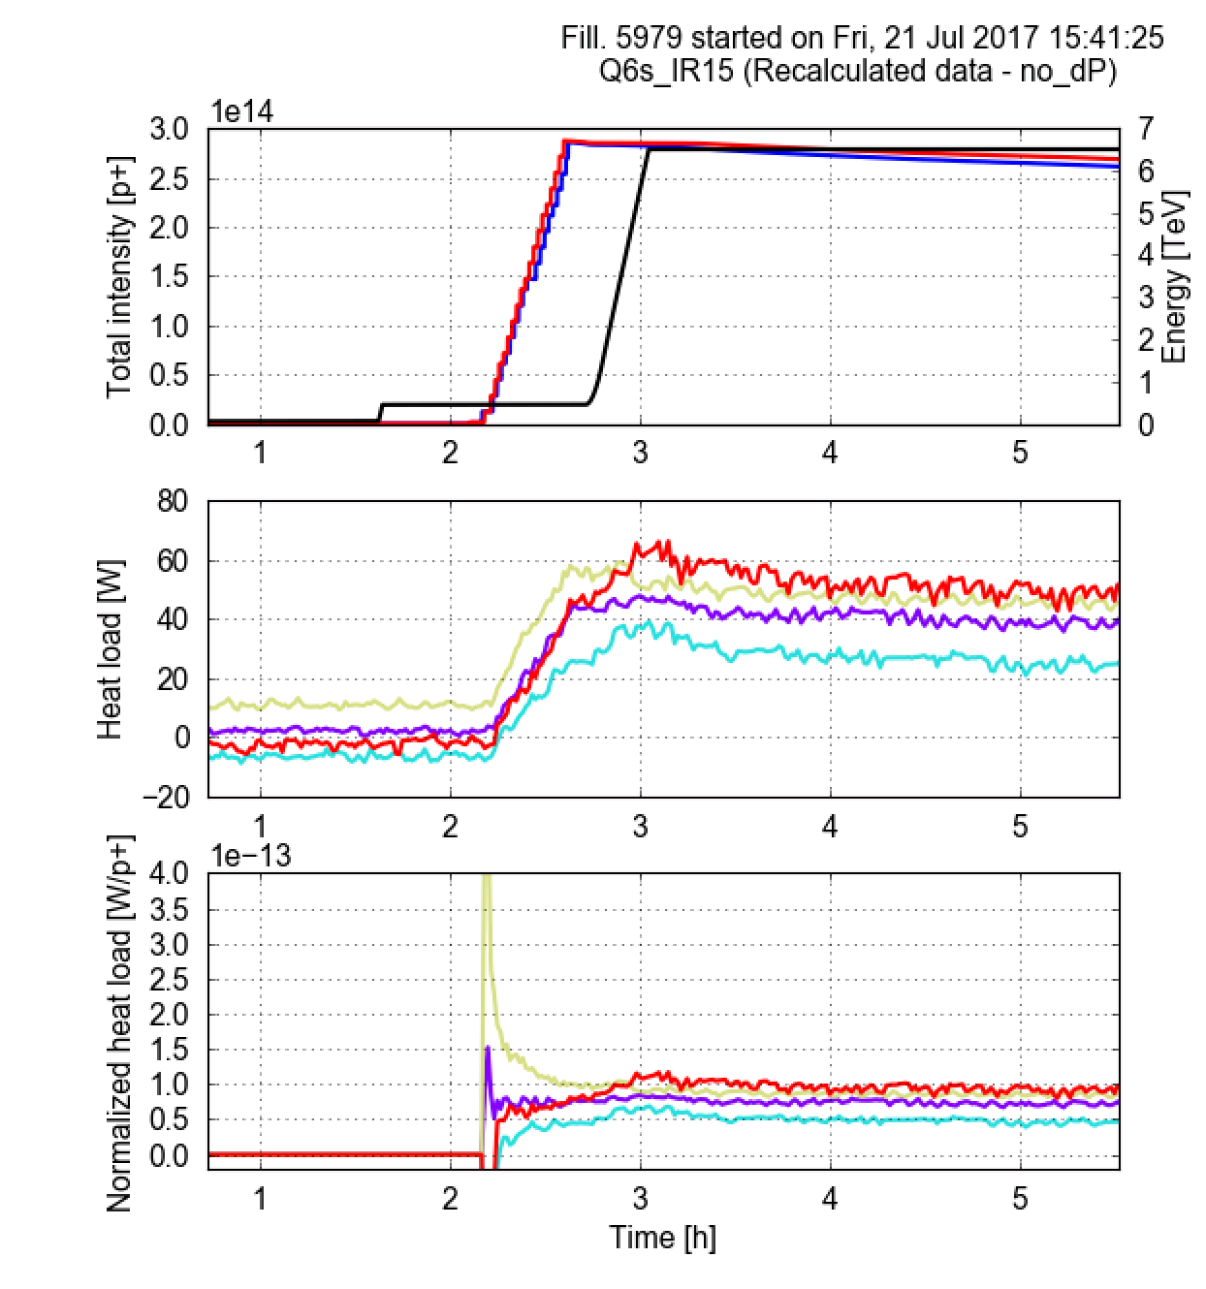
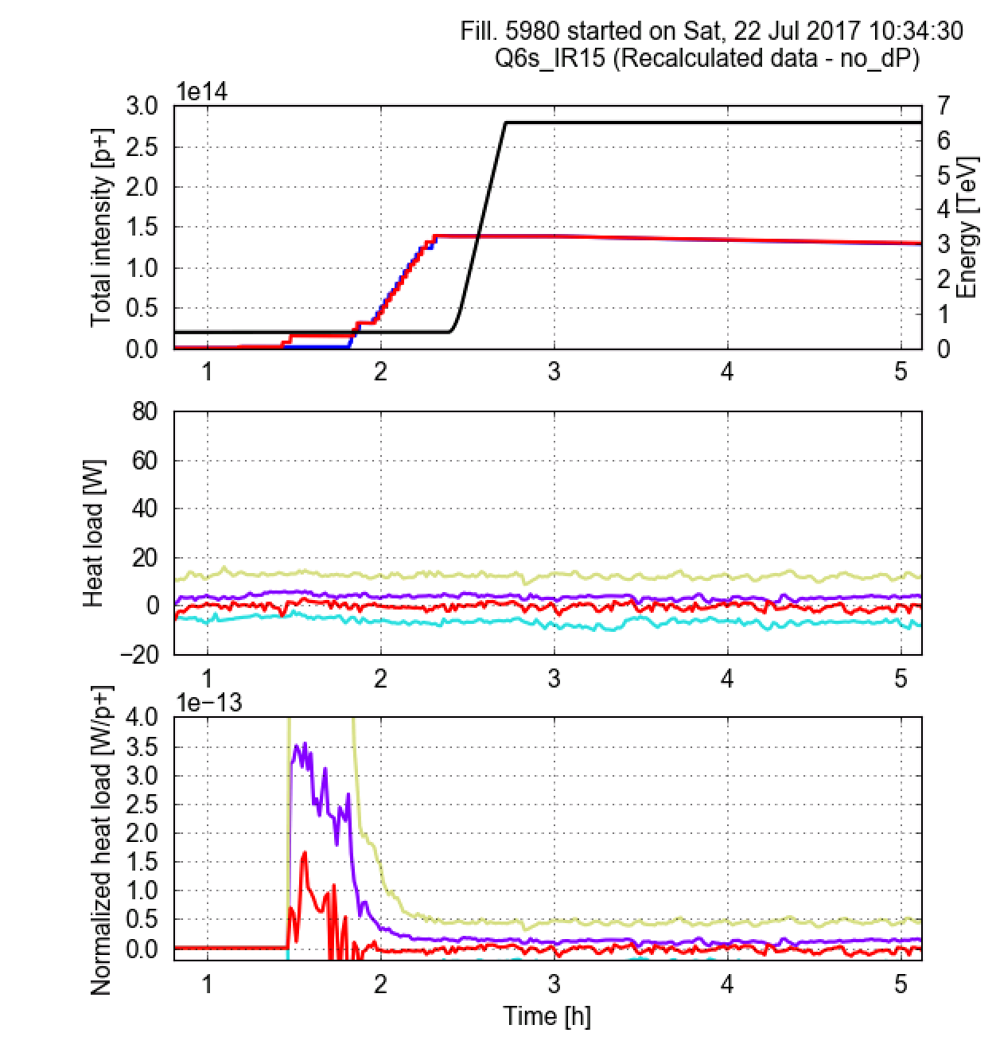
Stand alone quadrupoles: Q6s
Consistent with observations on the arc averages:
Heat loads are reduced and large differences are suppressed

Slide 39
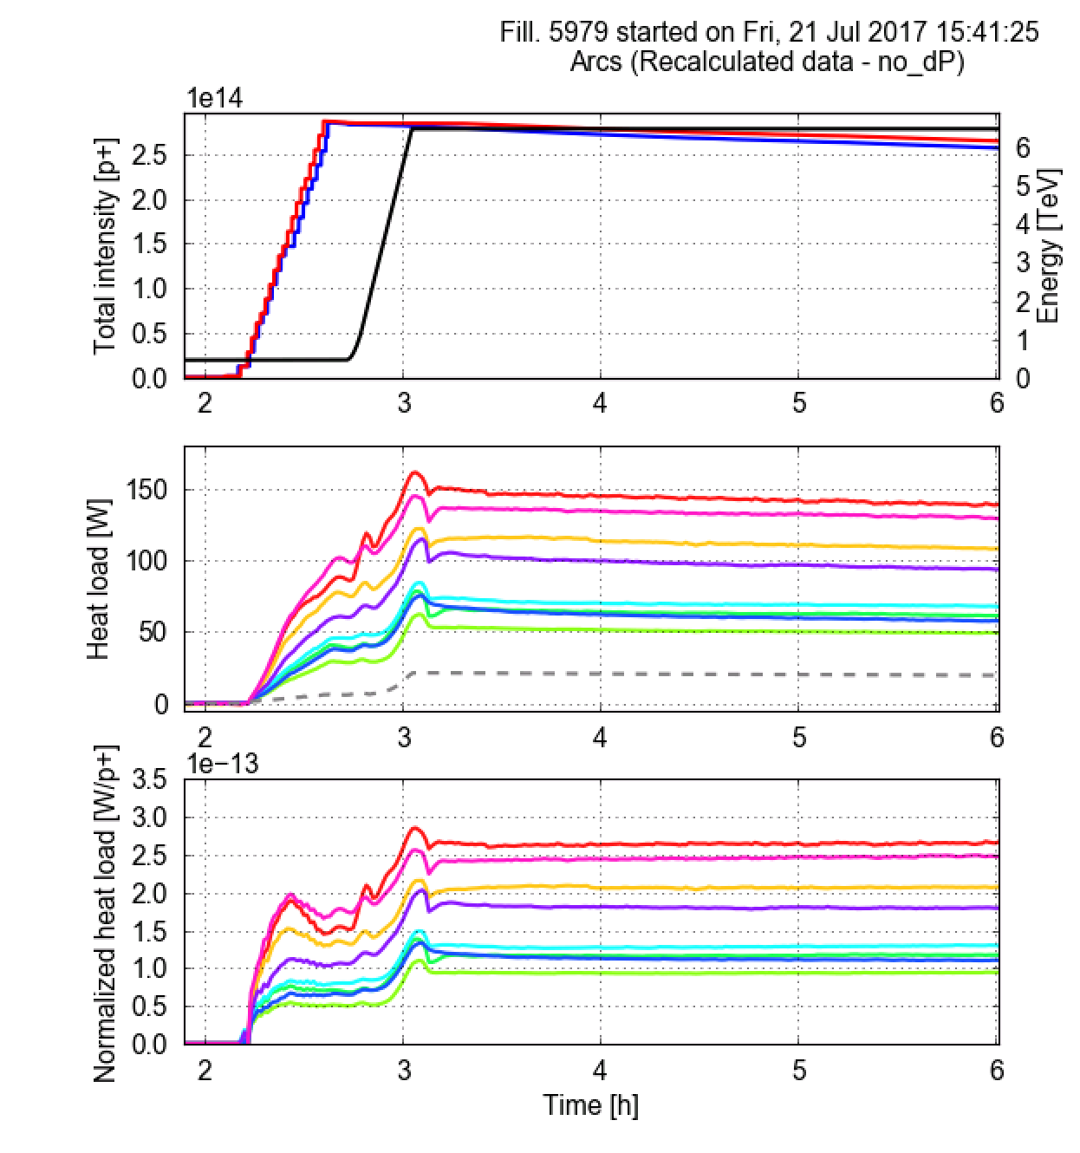
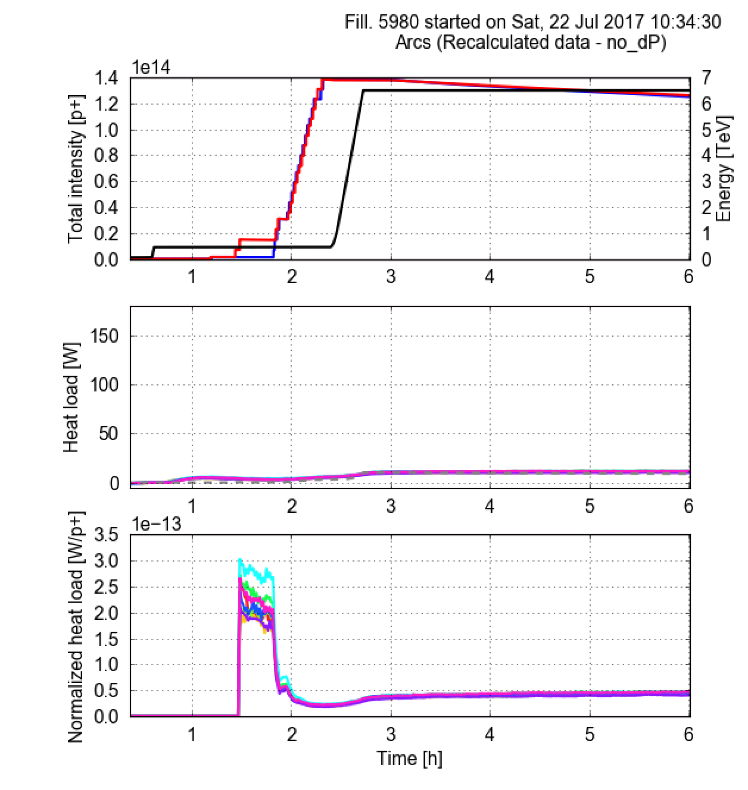

Slide 40
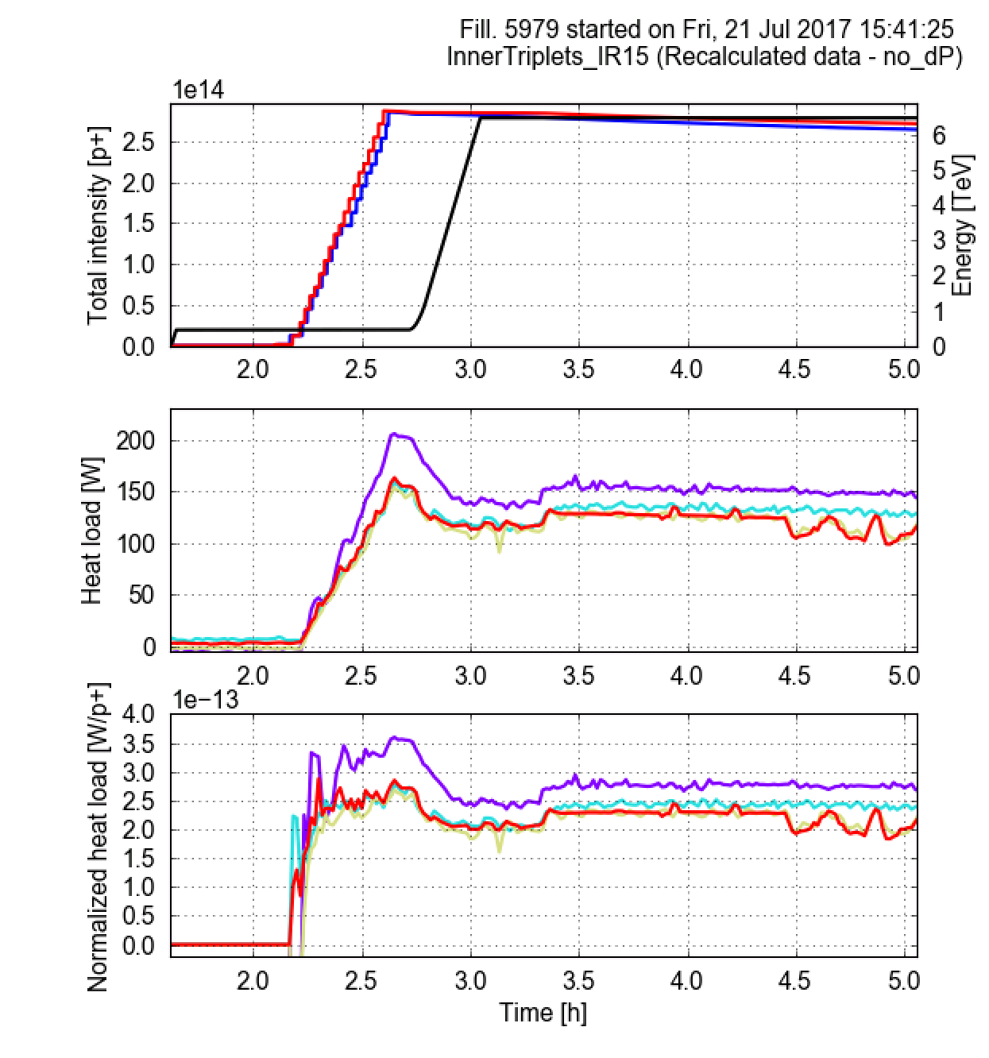
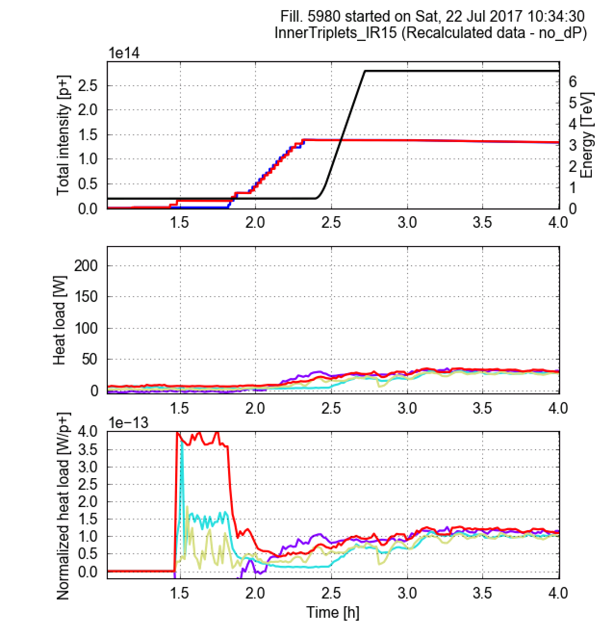

Slide 41
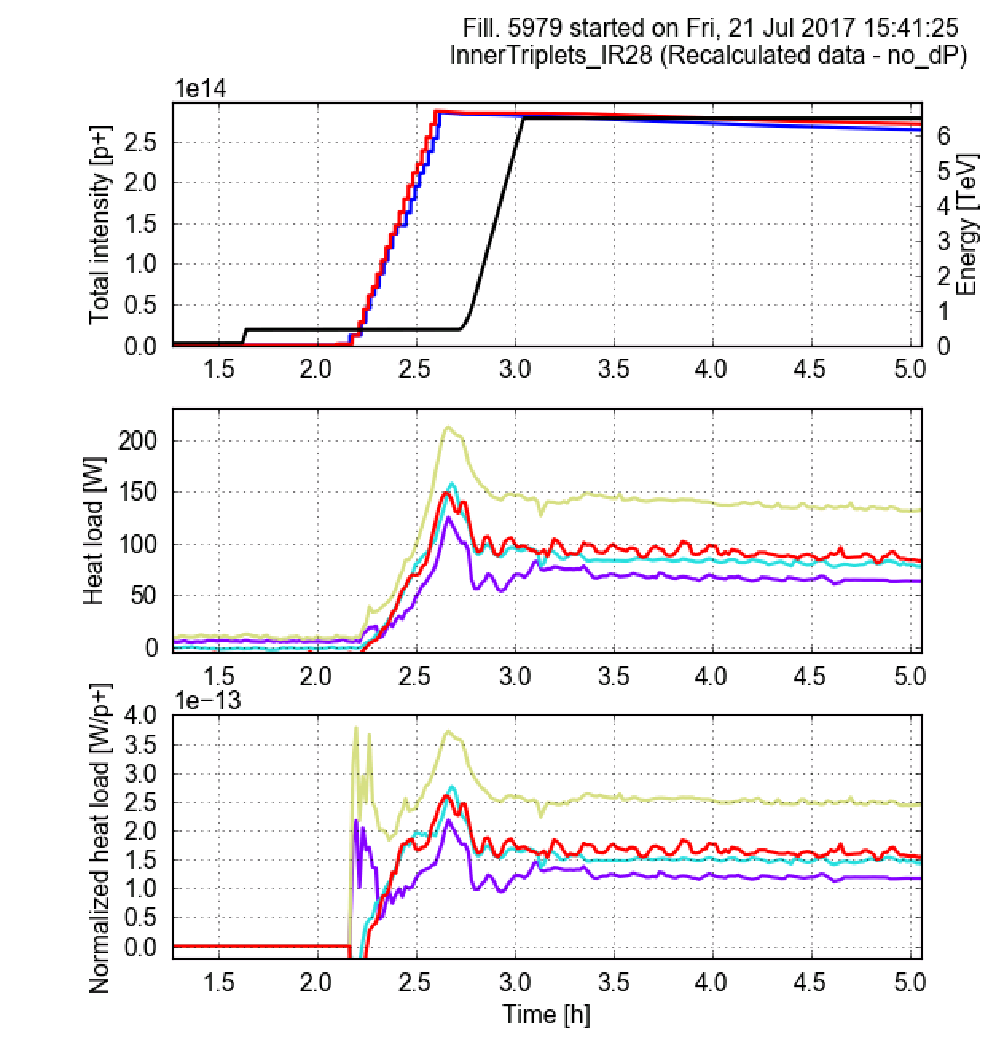
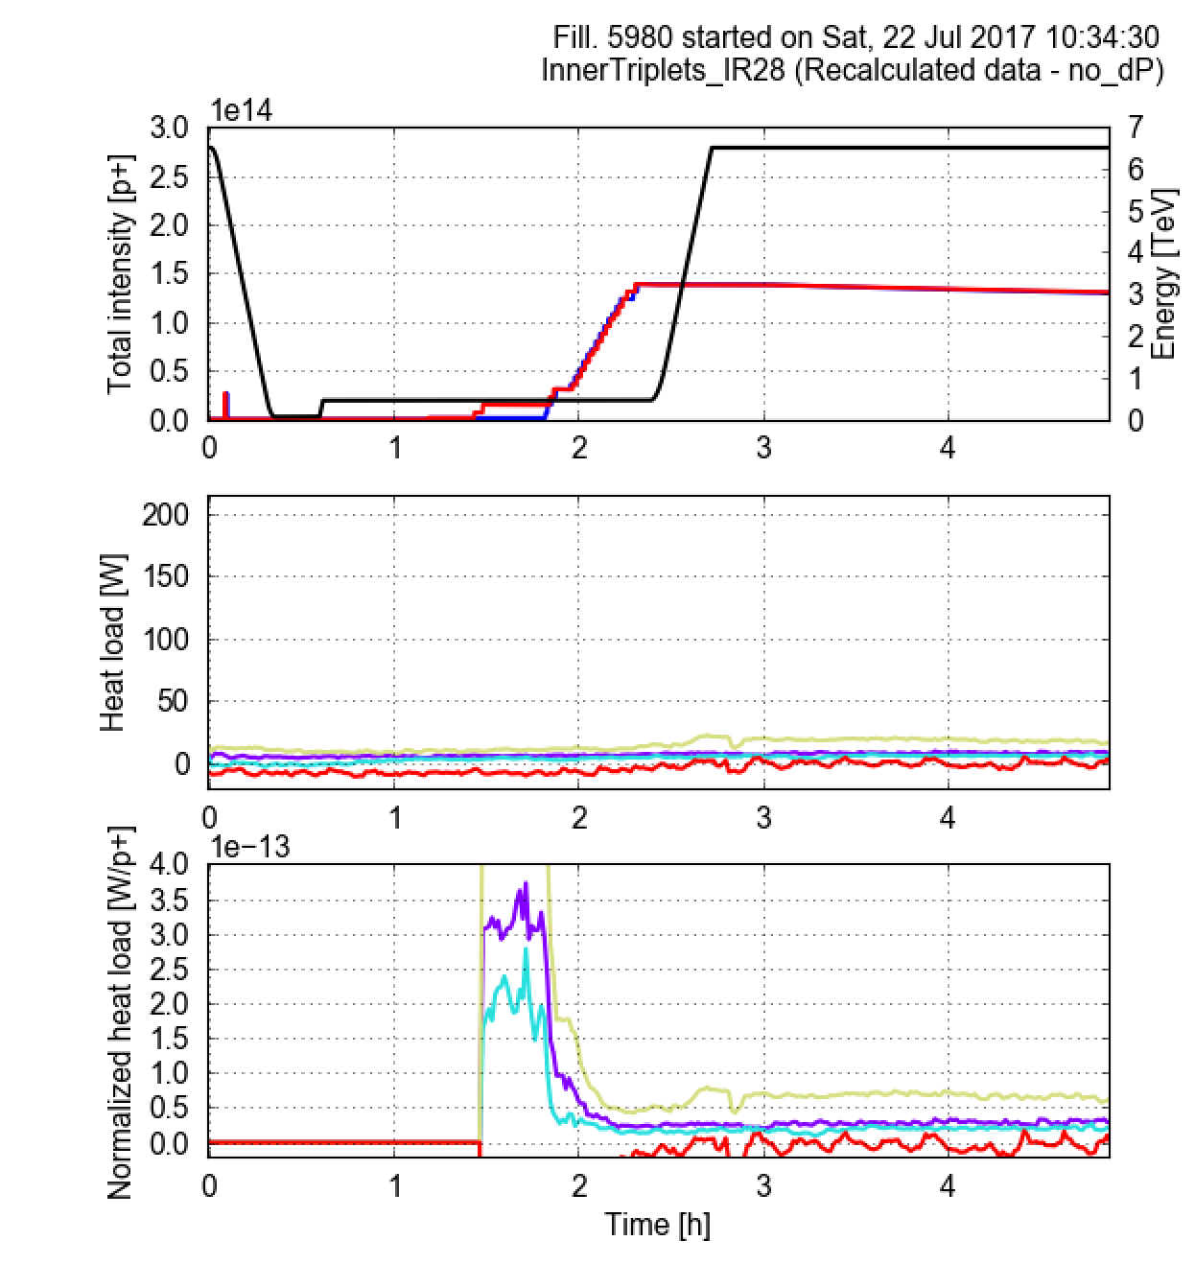

Slide 42
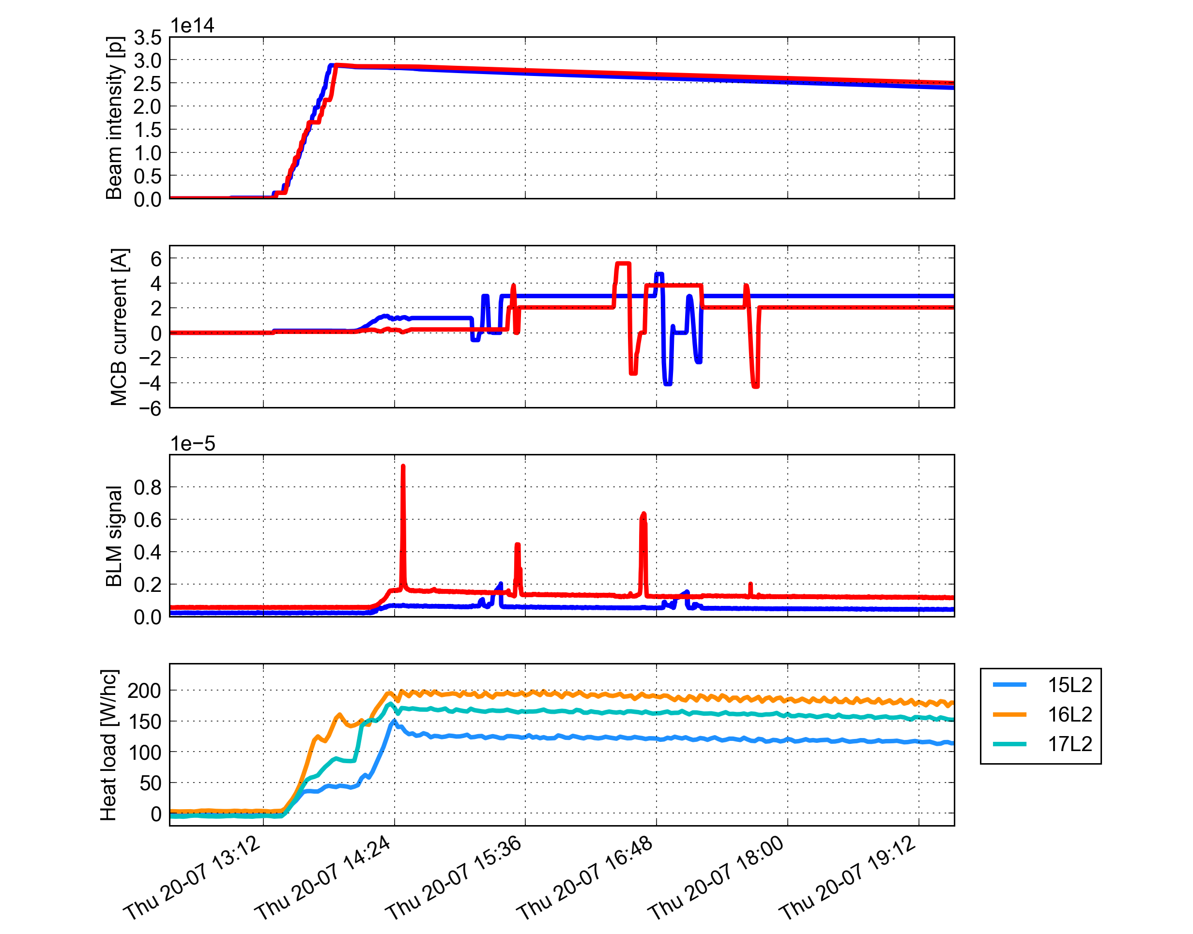

Slide 43
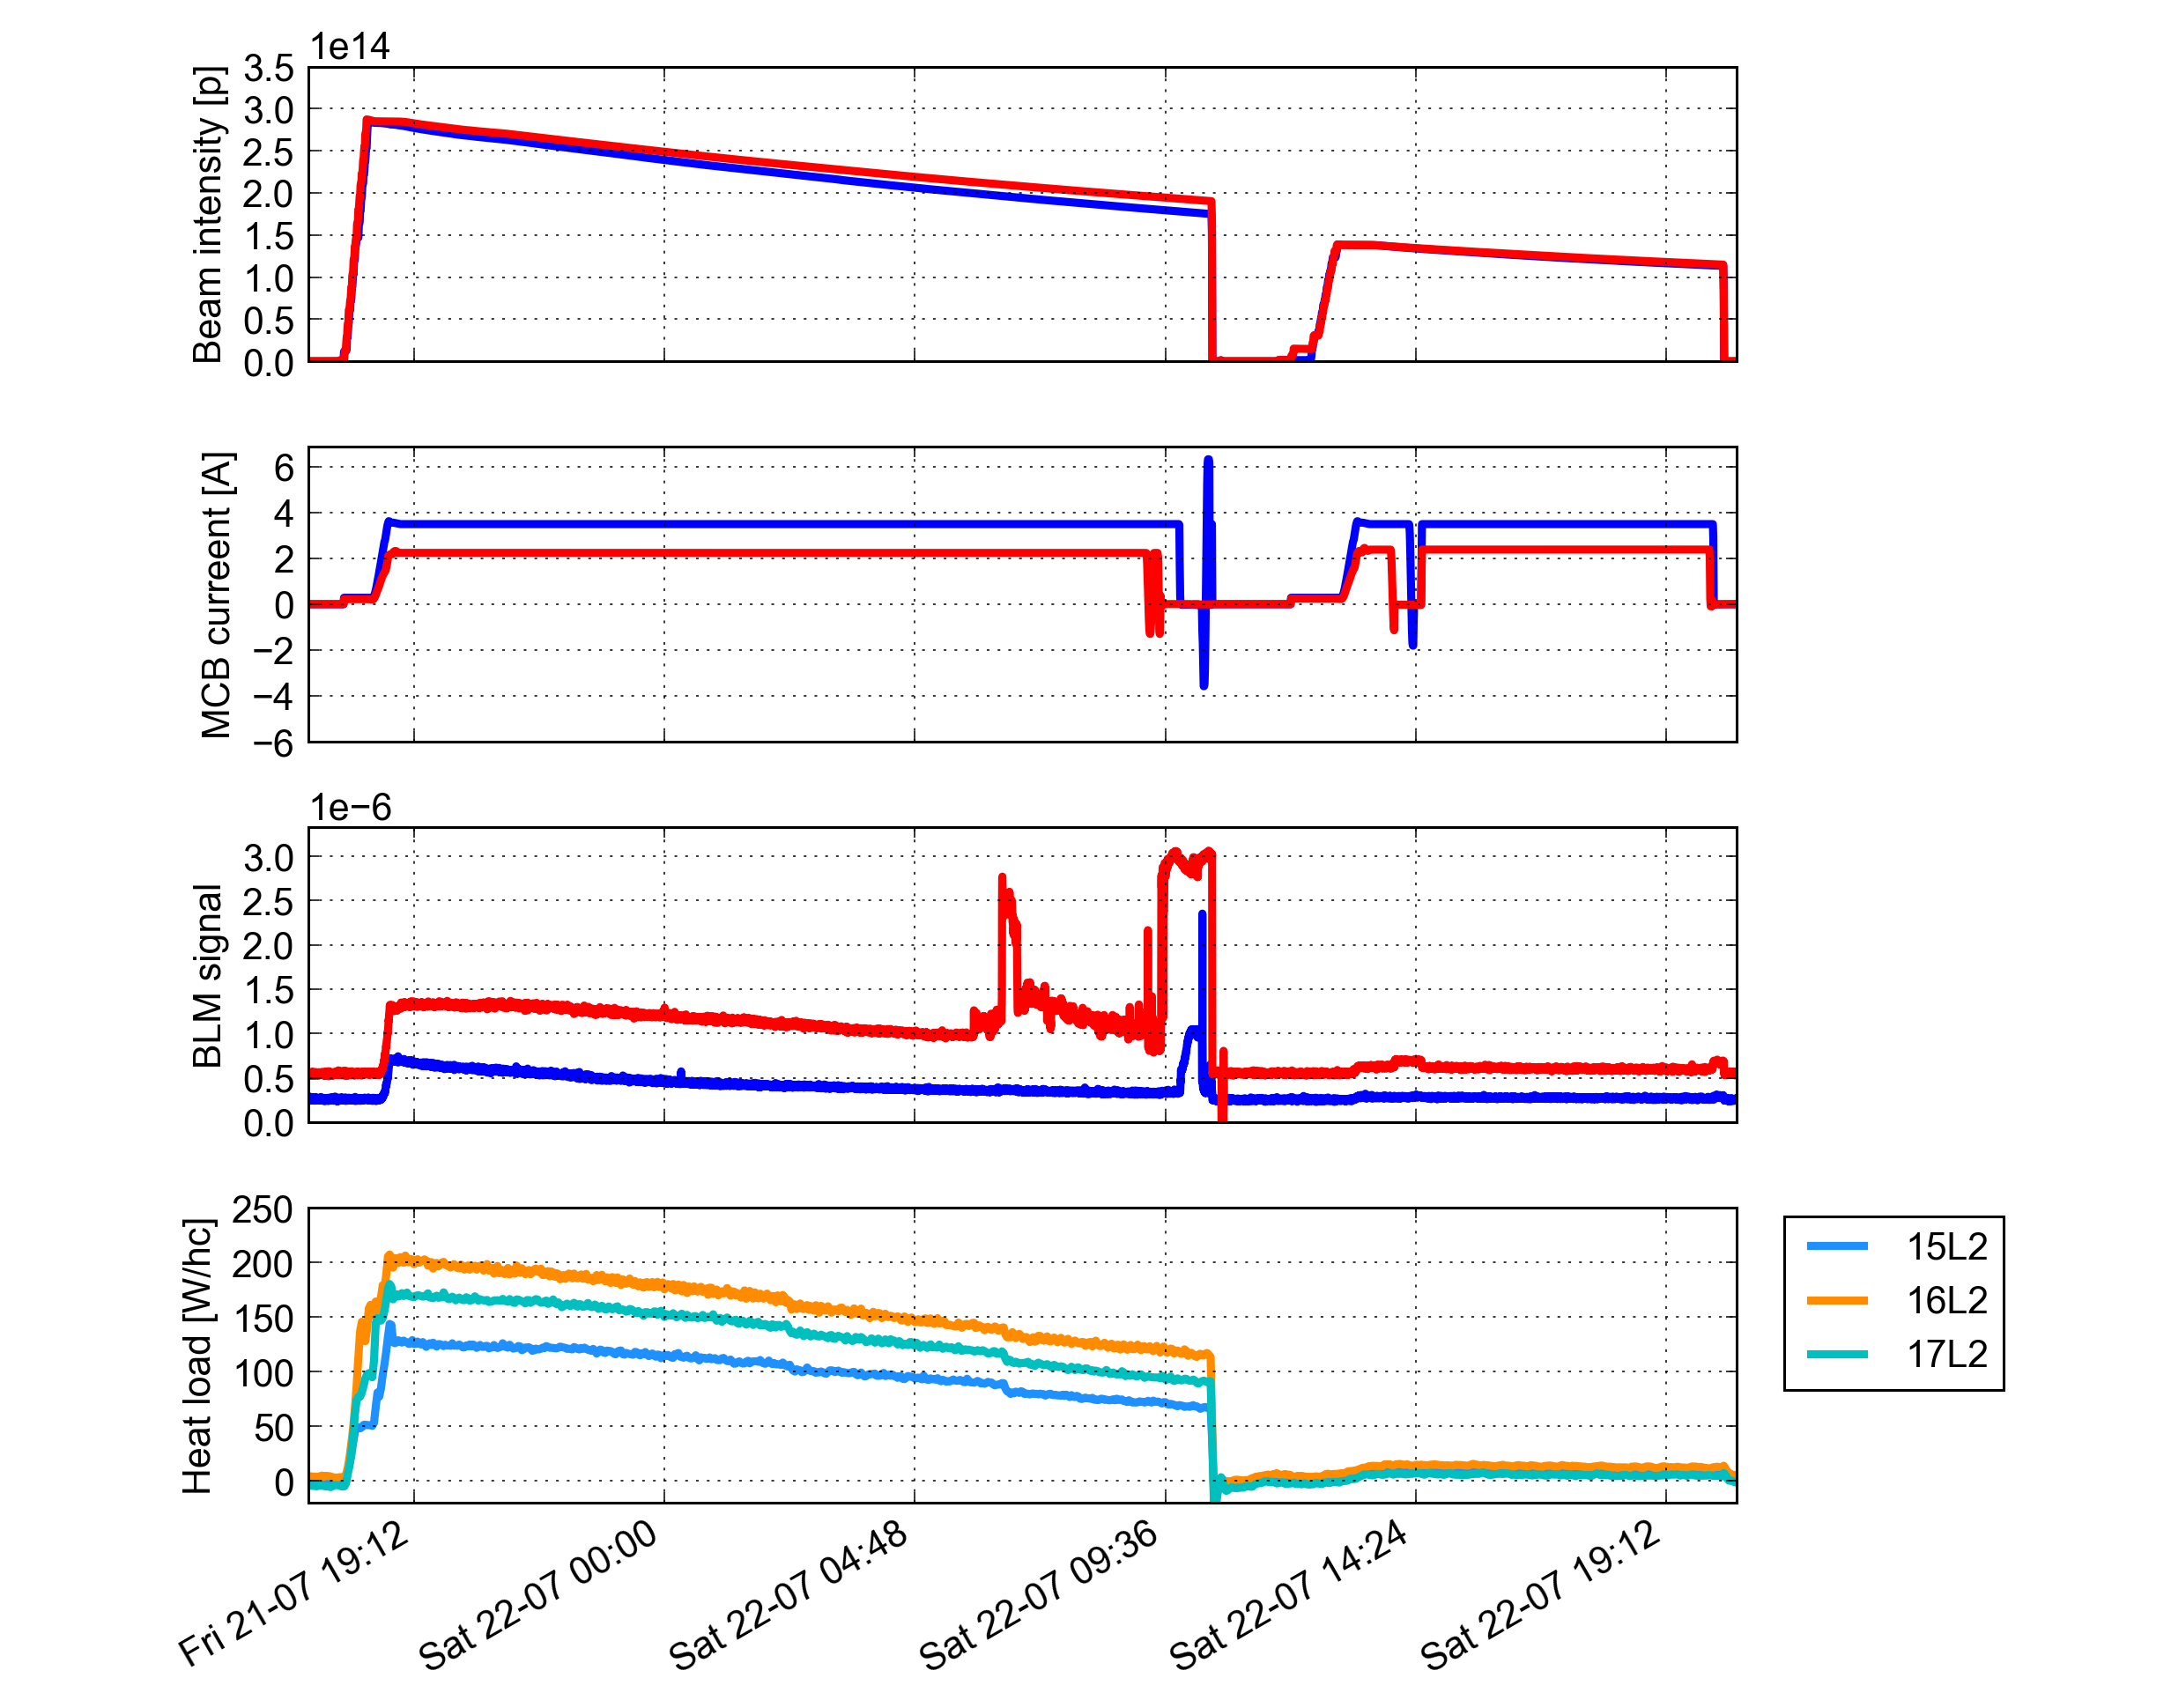

Slide 44
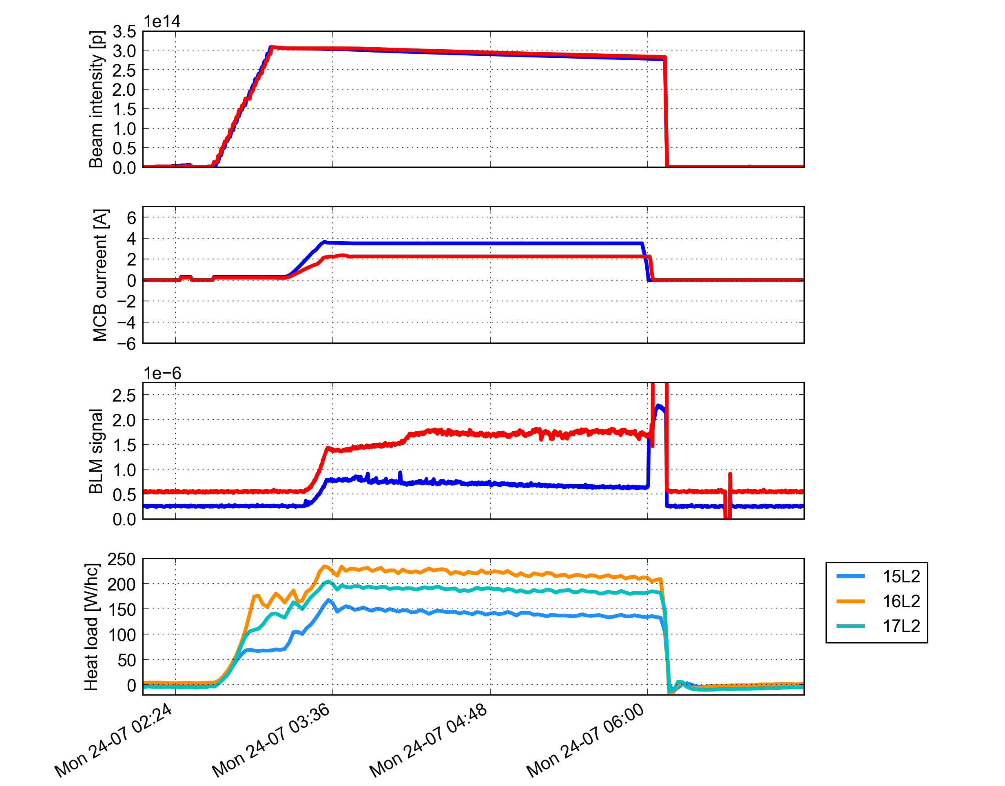

Slide 45
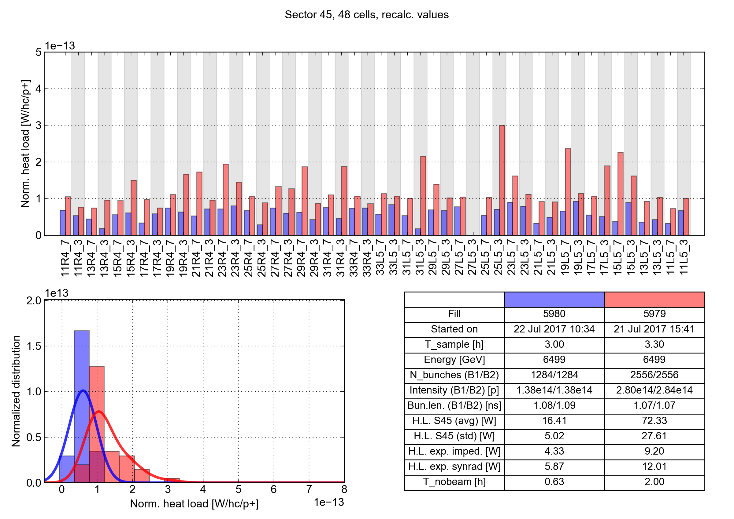
Cell-by-cell comparison
Reduction of normalized heat load is observed in all cells
50 ns
25 ns
Sector 45
50 ns
25 ns

Slide 46
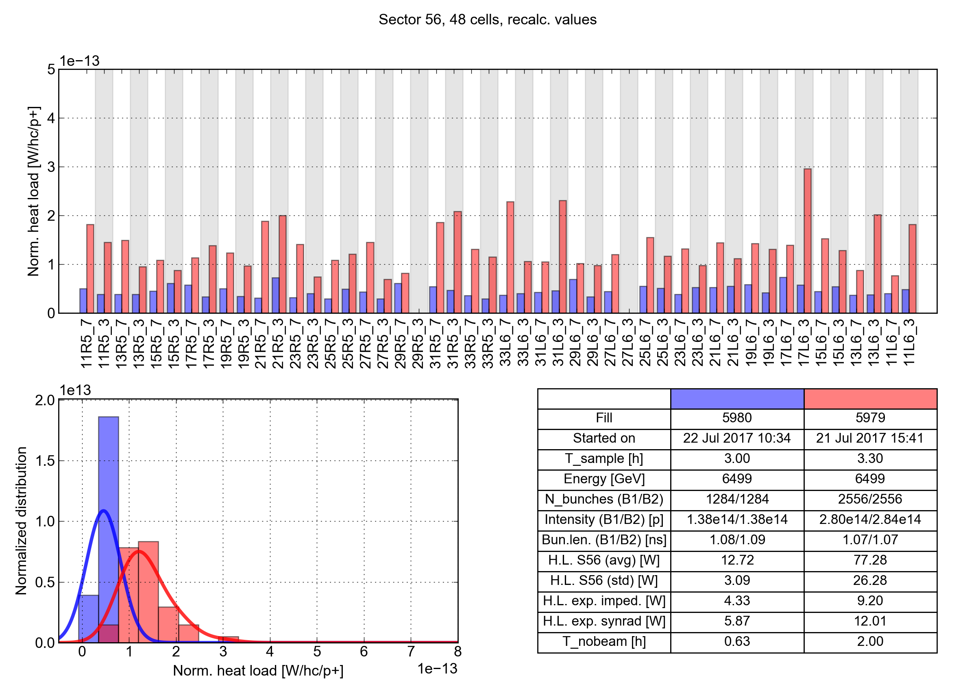
Cell-by-cell comparison
Reduction of normalized heat load is observed in all cells
50 ns
25 ns
Sector 56
50 ns
25 ns

Slide 47
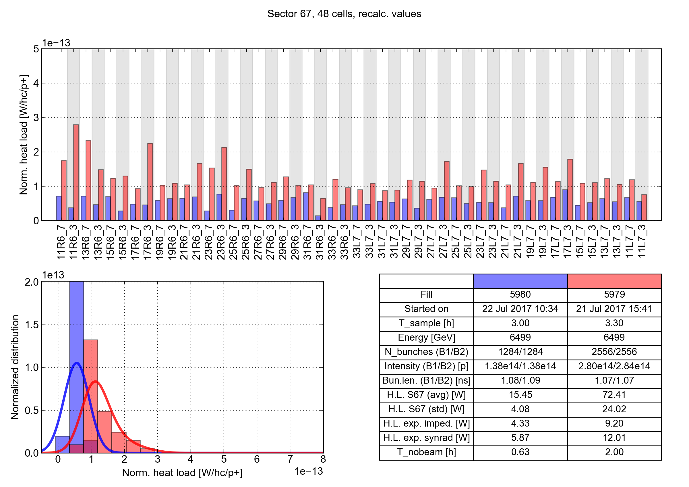
Cell-by-cell comparison
Reduction of normalized heat load is observed in all cells
50 ns
25 ns
Sector 67
50 ns
25 ns

Slide 48
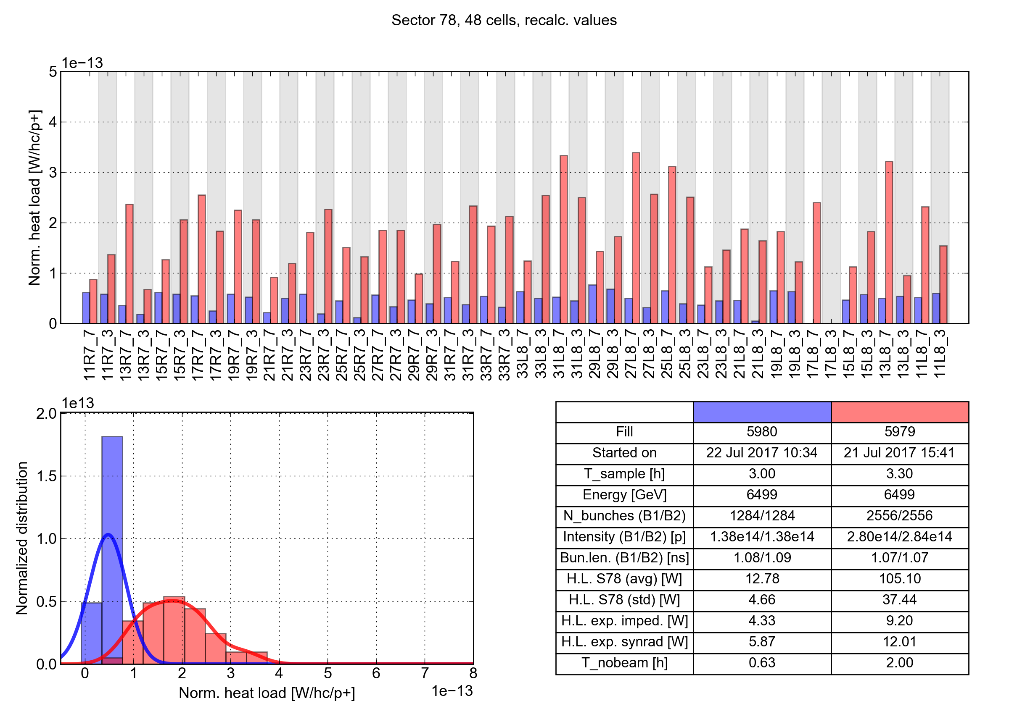
Cell-by-cell comparison
Reduction of normalized heat load is observed in all cells
50 ns
25 ns
Sector 78
50 ns
25 ns

Slide 49
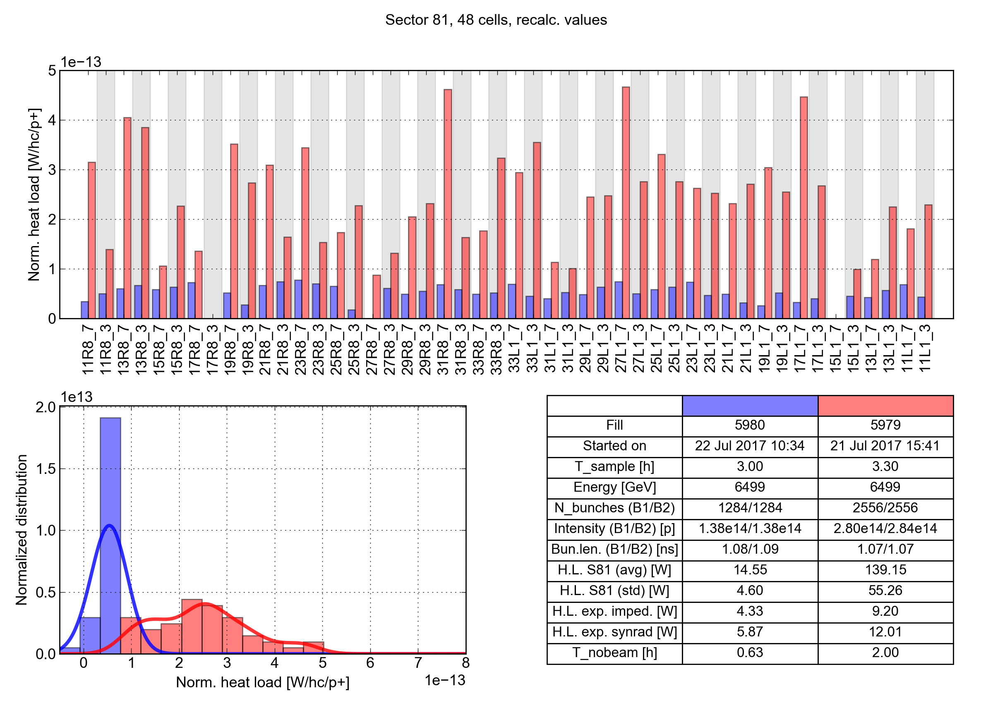
Cell-by-cell comparison
Reduction of normalized heat load is observed in all cells
50 ns
25 ns
Sector 81
50 ns
25 ns

Slide 50
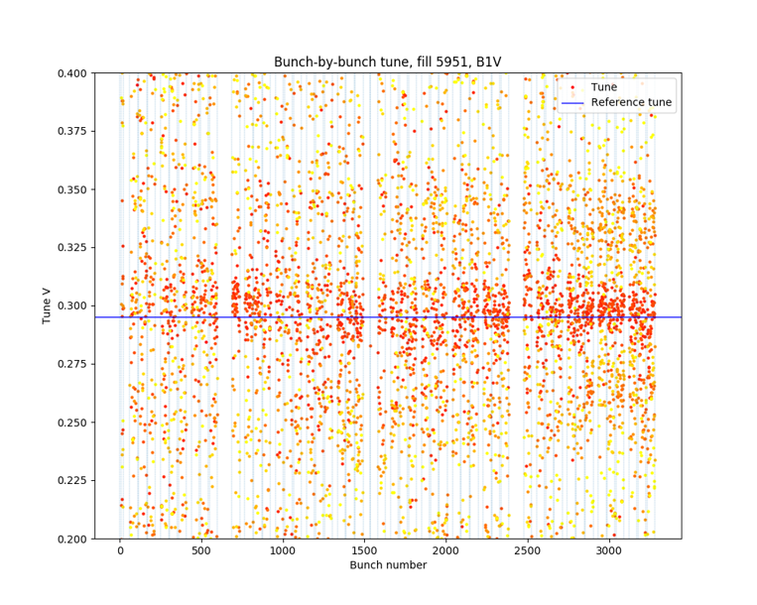
Observations of Coherent Motion
Clear coupled bunch coherent motion in B1V was observed for fill 5951 at injection energy on Saturday July 15th from ADT Post Mortem.
30-40 turns of large signal amplitude allows basic tune analysis to be performed.
Tune shift is seen when comparing bunch by bunch tunes before and after the instability.

Slide 51
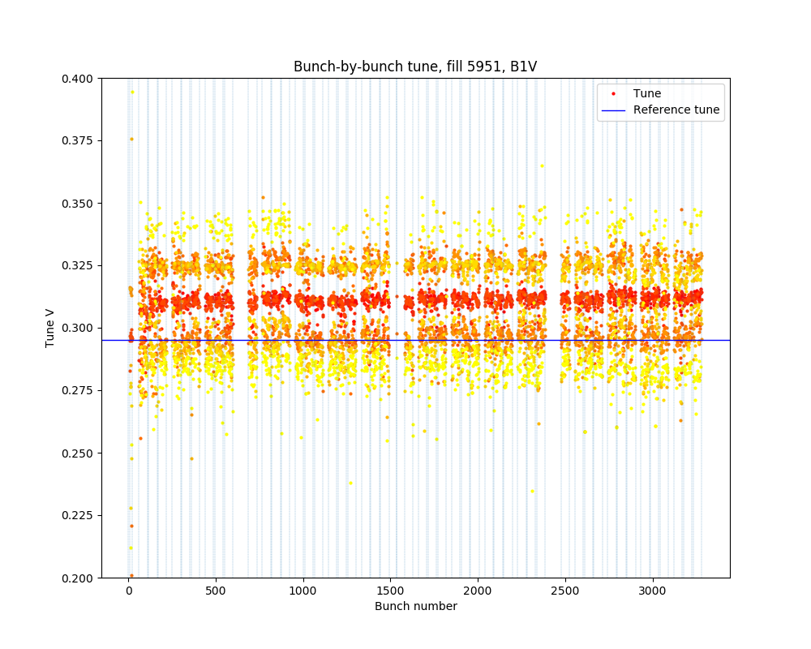
Observations of Coherent Motion
Clear coupled bunch coherent motion in B1V was observed for fill 5951 at injection energy on Saturday July 15th from ADT Post Mortem.
30-40 turns of large signal amplitude allows basic tune analysis to be performed.
Tune shift is seen when comparing bunch by bunch tunes before and after the instability.
Clear tune shift is seen which is on the order of 3Qs. To be understood.

Slide 52
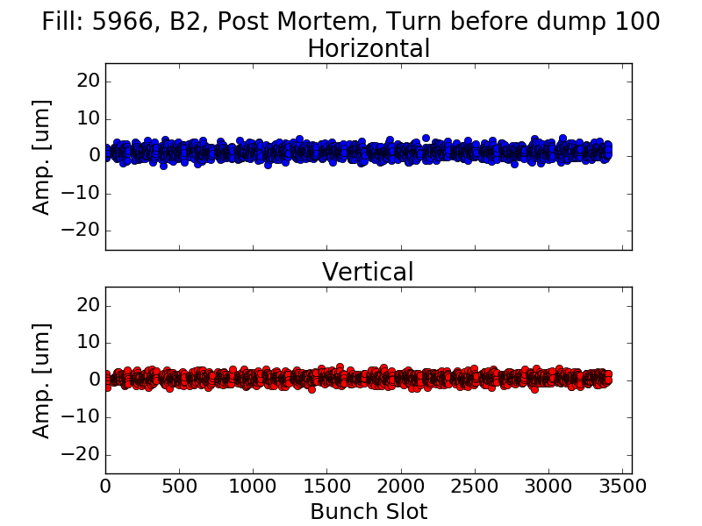
Observations of Coherent Motion
Weak coherent motion observed in dumps at flat top for both beams, with usually a single bunch pattern (head of trains). Coupled bunch motion observed in some cases.
Data from the ADTObsBox show few turns (~20) with increasing oscillation amplitude → Spectral analysis is more difficult
This behaviour is typical among most high energy dumps.
→ We could try to probe the instability mechanism with dedicated studies at injection energy (assuming that an instability can be triggered within a reasonable time).

