Slide 1
Can an impedance be the source of the observed differences?
P. Arpaia
F. Giordano
G. Iadarola
B. Salvant

Slide 2
Agenda
Context
Rough scalings
Broadband impedance
Narrow band impedance
  Comparison for 25 ns and 50 ns fill (5979 and 5980)
  Including more fills
Conclusion

Slide 3
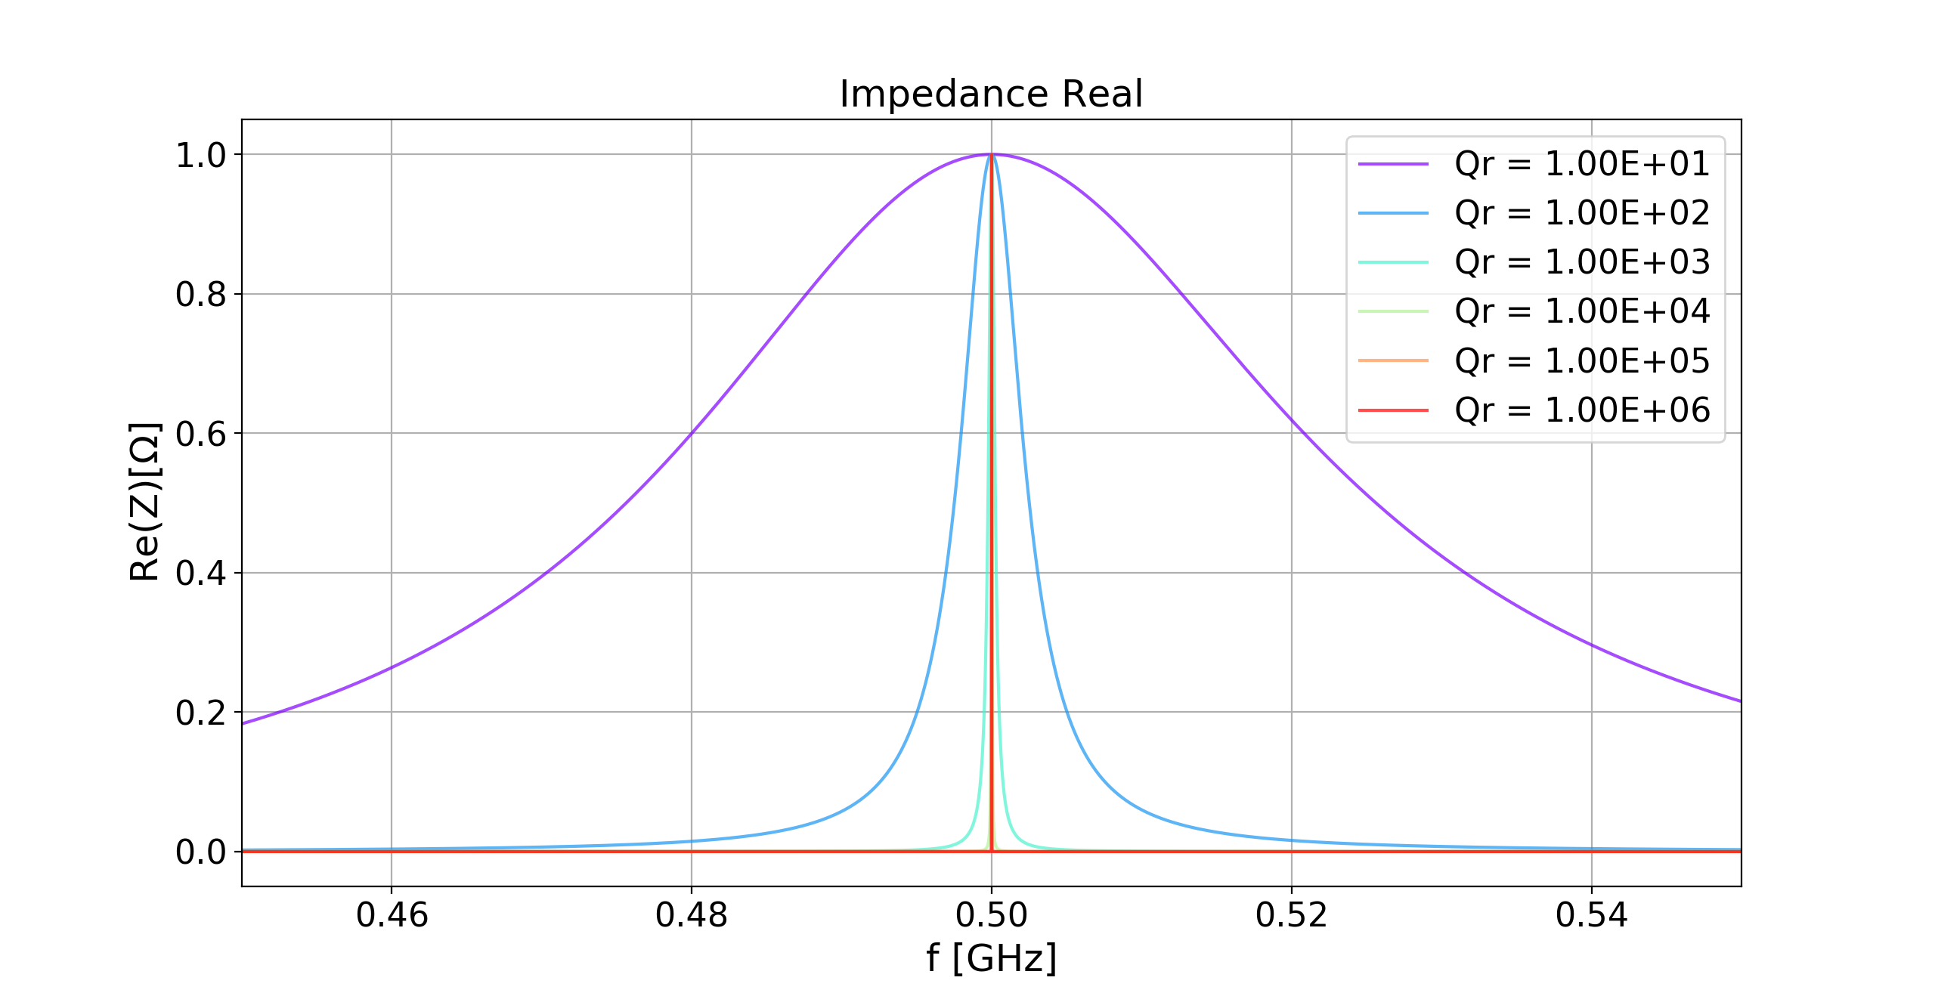
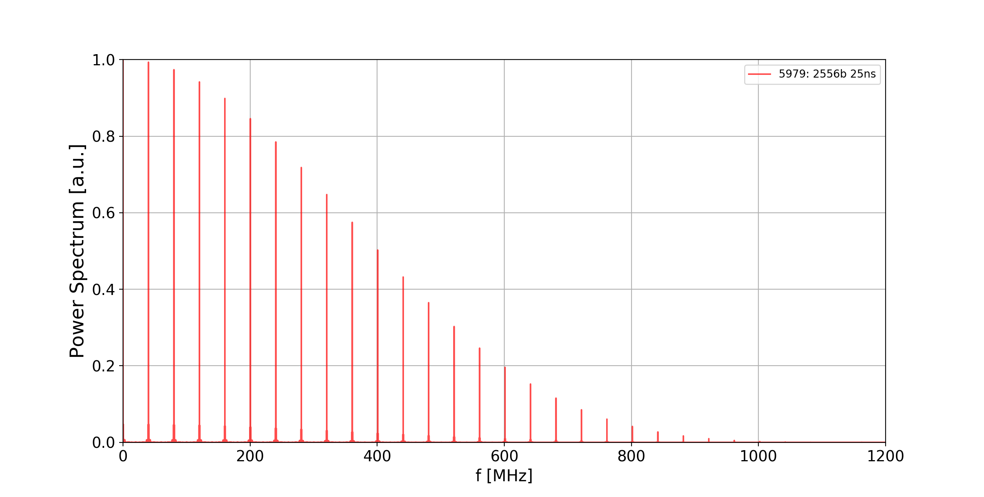
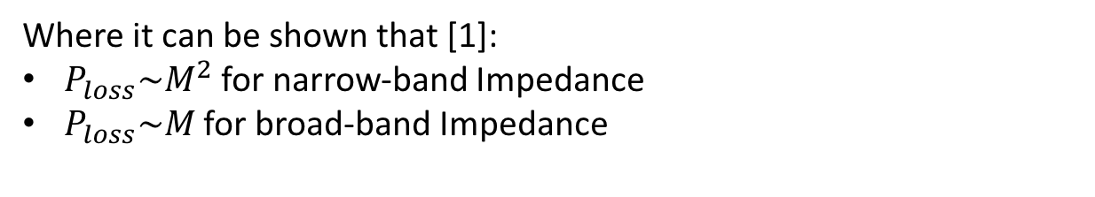
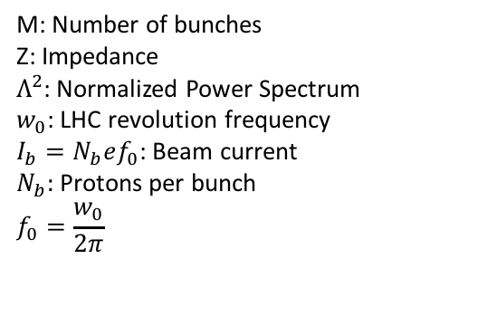
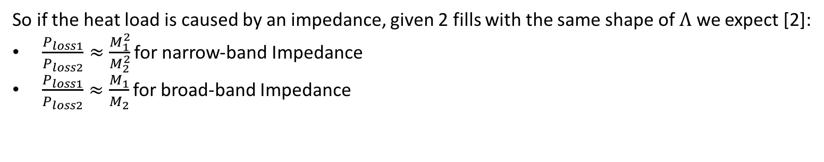
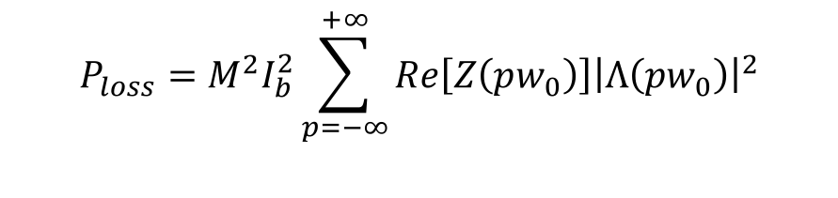
Power Loss dependencies
For a given Impedance the Power loss is computed as:
$$P_{loss}=M^{2}I_{b}^{2}\sum_{p=−∞}^{+∞}{Re\left[Z\left(pw_{0}\right)\right]{\left|Λ\left(pw_{0}\right)\right|}^{2}}$$
M: Number of bunches
Z: Impedance
$Λ^{2}$: Normalized Power Spectrum
$w_{0}$: LHC revolution frequency
$I_{b}=N_{b}ef_{0}$: Beam current
$N_{b}:$ Protons per bunch
$$f_{0}=\frac{w_{0}}{2π}$$
Where it can be shown that [1]:
$P_{loss}\sim M^{2}$ for narrow-band Impedance
$P_{loss}\sim M$ for broad-band Impedance
So if the heat load is caused by an impedance, given 2 fills with the same shape of $Λ$ we expect [2]:
$\frac{P_{loss1}}{P_{loss2}}≈\frac{M_{1}^{2}}{M_{2}^{2}}$ for narrow-band Impedance
$\frac{P_{loss1}}{P_{loss2}}≈\frac{M_{1}}{M_{2}}$ for broad-band Impedance
[1]:H. Lee M. Furman and B. Zotter. “Energy Loss of Bunched Beams in RF Cavities”. In: (1986)
[2]:F. Giordano. “Impact of filling scheme on beam induced RF heating in CERN LHC and HL-LHC”, Appendix A

Slide 4
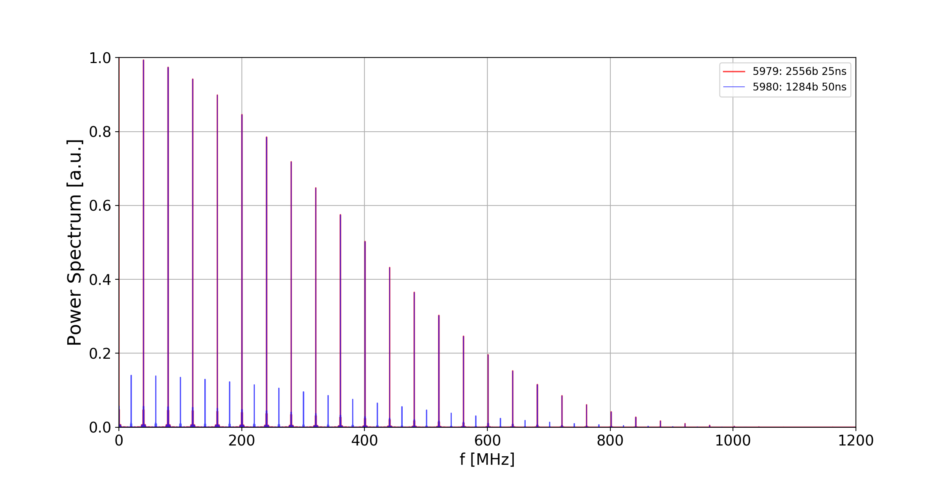
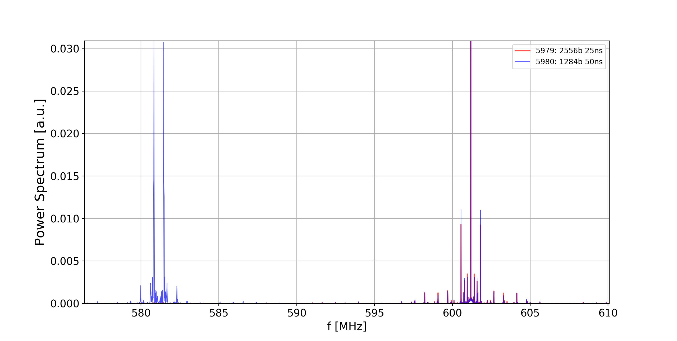

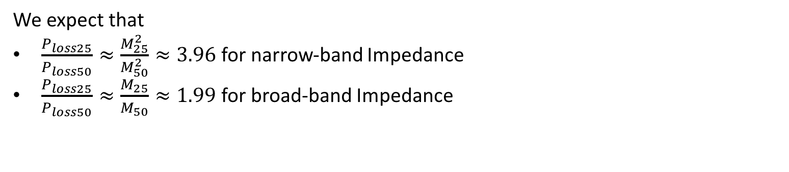

New 25ns and 50ns fills
$$M_{25}=2556$$
$$M_{50}=1284$$
Both Spectra are normalized to better observe that around the pair main lines the shapes are the same
We can say that for all the pair main lines we have:
$${shape(Λ}_{25})≈{shape(Λ}_{50})$$
We expect that
$\frac{P_{loss25}}{P_{loss50}}≈\frac{M_{25}^{2}}{M_{50}^{2}}≈3.96$ for narrow-band Impedance
$\frac{P_{loss25}}{P_{loss50}}≈\frac{M_{25}}{M_{50}}≈1.99$ for broad-band Impedance

Slide 5
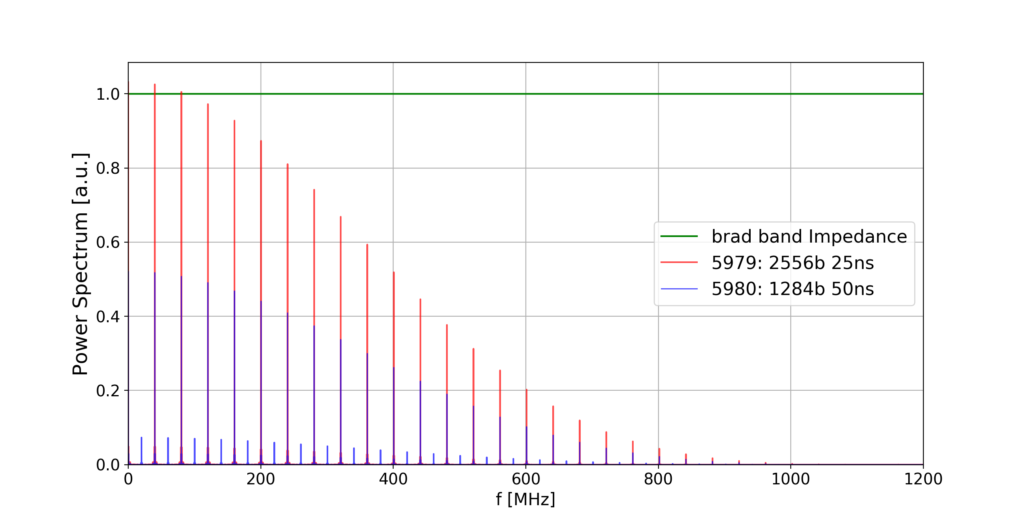
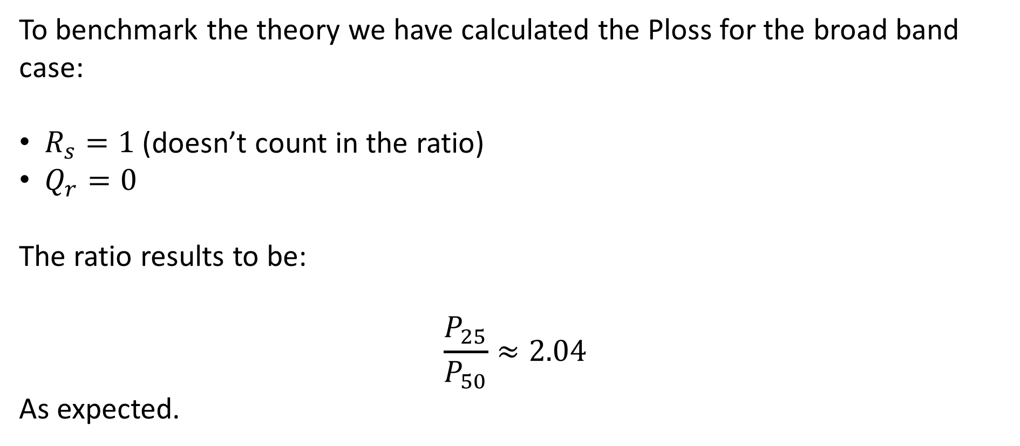

Broad band Impedance
To benchmark the theory we have calculated the Ploss for the broad band case:
$R_{s}=1$ (doesn’t count in the ratio)
$Q_{r}=0$
The ratio results to be:
$$\frac{P_{25}}{P_{50}}≈2.04$$
As expected.
$$R_{s}[Ω]$$

Slide 6
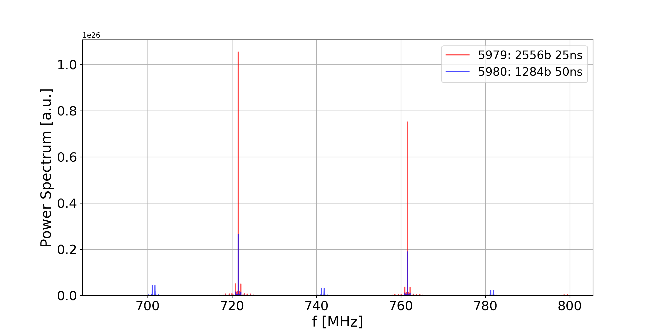
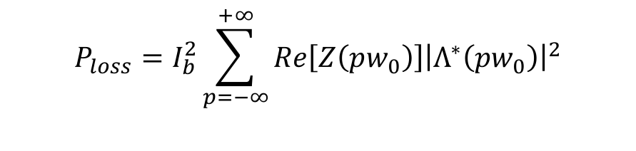
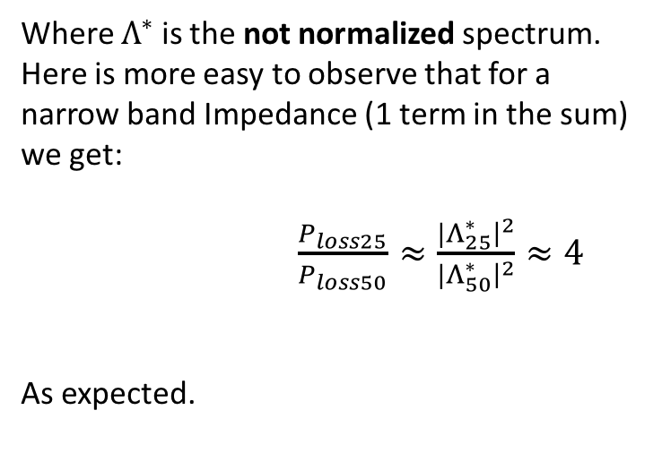
Narrow Band case
The Power Loss formula can also be written as:
$$P_{loss}=I_{b}^{2}\sum_{p=−∞}^{+∞}{Re\left[Z\left(pw_{0}\right)\right]{\left|Λ^{∗}\left(pw_{0}\right)\right|}^{2}}$$
Where $Λ^{∗}$ is the not normalized spectrum.
Here is more easy to observe that for a narrow band Impedance (1 term in the sum) we get:
$\frac{P_{loss25}}{P_{loss50}}≈\frac{{|Λ}_{25}^{∗}{\left.​\right|}^{2}}{{|Λ}_{50}^{∗}{\left.​\right|}^{2}}≈4$
As expected.

Slide 7
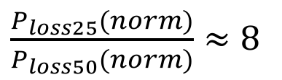
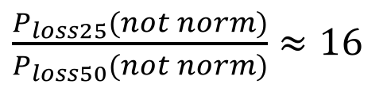
Cryogenic measurements on sector 23 (TE-CRG and G. Iadarola)
norm: normalized to the number of bunches
25ns: fill 5979
50ns: fill 5980
The ratio between the heat loads of the 50ns and 25ns not normalized on M should be between 2 and 4 if it’s caused by an Impedance.
$\frac{P_{loss25}(norm)}{P_{loss50}(norm)}≈8$
$\frac{P_{loss25}(not norm)}{P_{loss50}(not norm)}≈16$
Neither a narrow nor a broad-band Impedance can explain this ratio
Factor 2 between the number of bunches

Slide 8
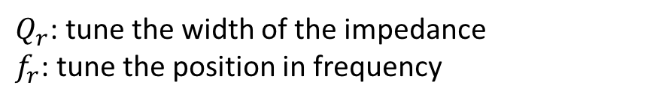

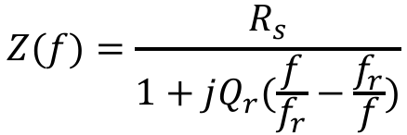
Resonator model Impedance: more general case of 1 mode
$$Z(f)=\frac{R_{s}}{1+jQ_{r}(\frac{f}{f_{r}}−\frac{f_{r}}{f})}$$
$f_{r}$: 0.50 GHz
$Q_{r}$: tune the width of the impedance
$f_{r}$: tune the position in frequency

Slide 9
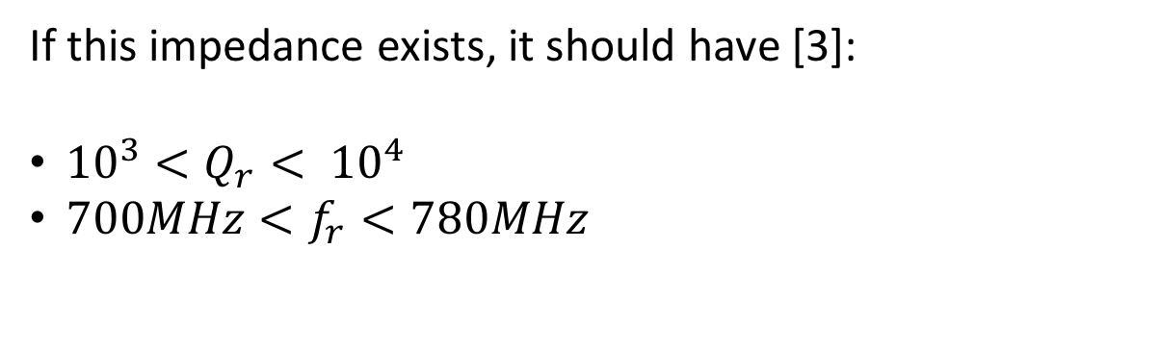
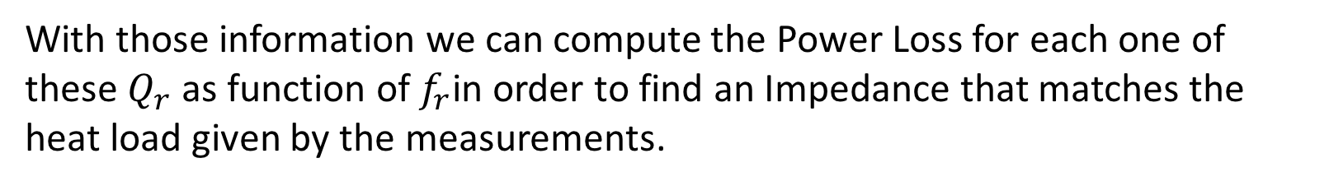
What we already know about this Impedance
If this impedance exists, it should have [3]:
${10}^{3}<Q_{r}< {10}^{4}$
$700MHz<f_{r}<780MHz$
With those information we can compute the Power Loss for each one of these $Q_{r}$ as function of $f_{r}$in order to find an Impedance that matches the heat load given by the measurements.
[3] B.Salvant: Expected impedance of a PIM non-conformity

Slide 10
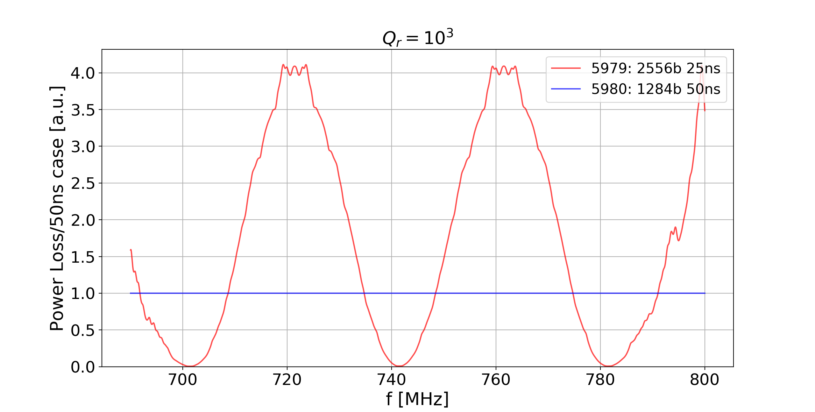
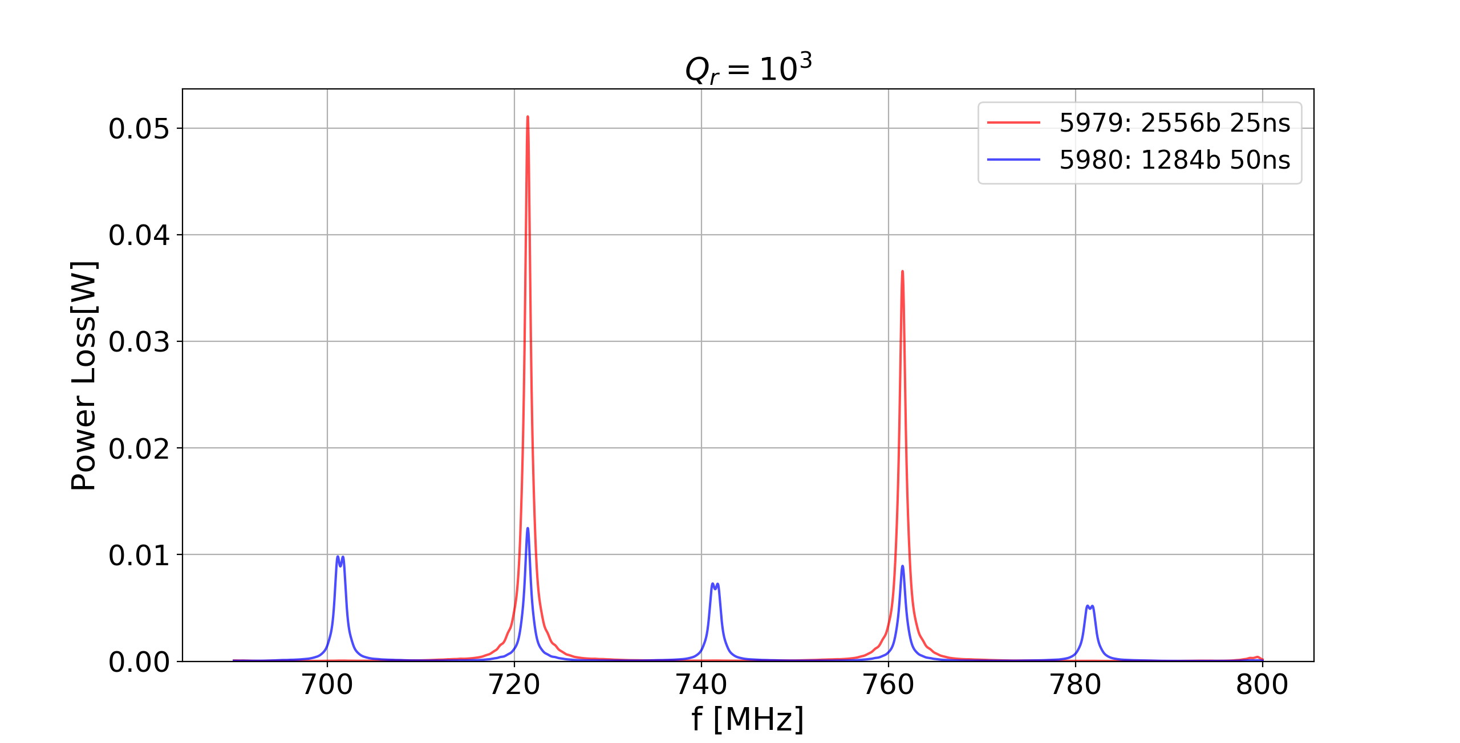
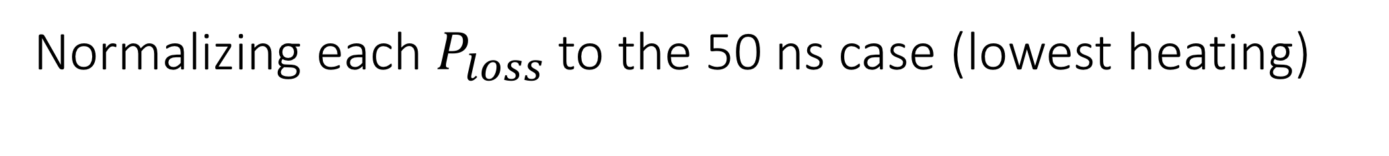
Normalizing each $P_{loss}$ to the 50 ns case (lowest heating)
Before Normalization
After Normalization
Far from factor 16.

Slide 11
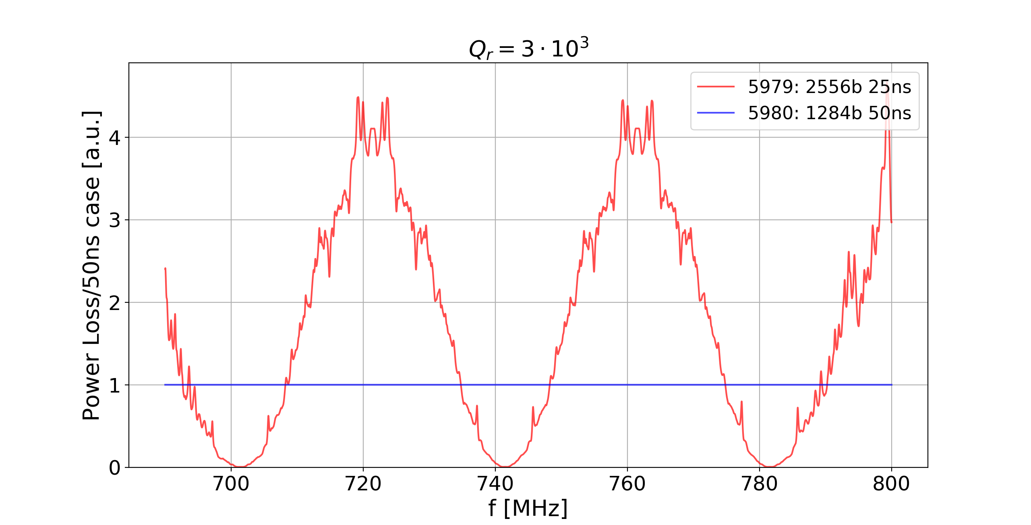

Increasing $Q_{r}$ [1/4]
Far from factor 16.

Slide 12
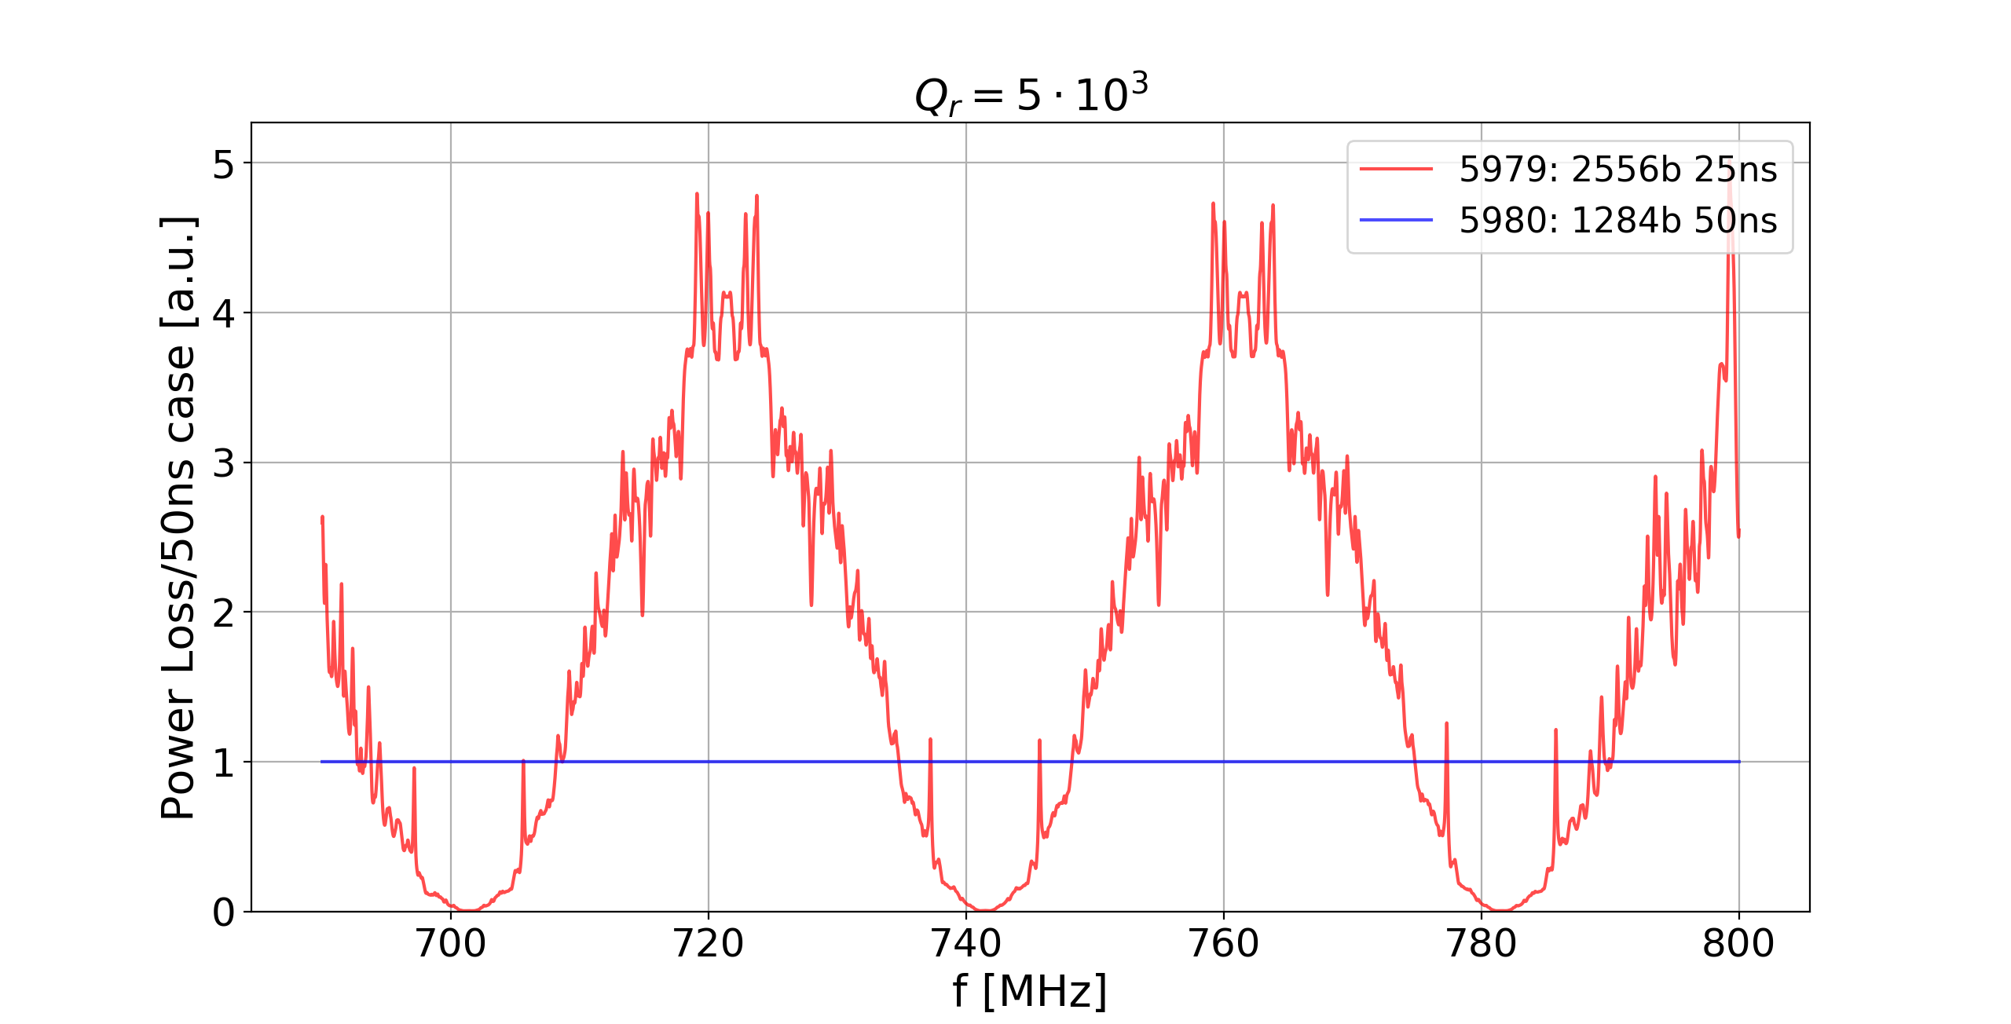

Increasing $Q_{r}$[2/4]
Far from factor 16.

Slide 13
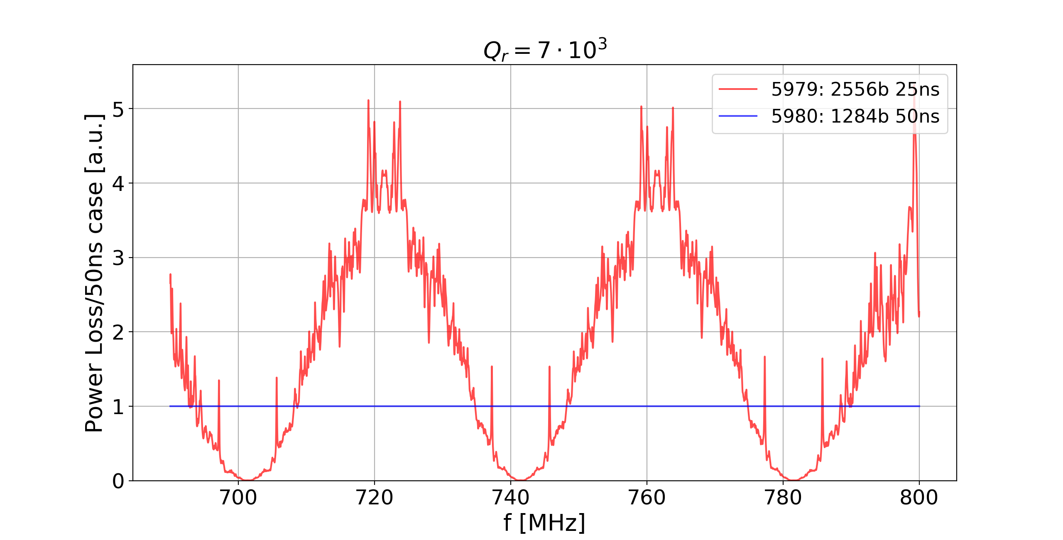

Increasing $Q_{r}$[3/4]
Far from factor 16.

Slide 14
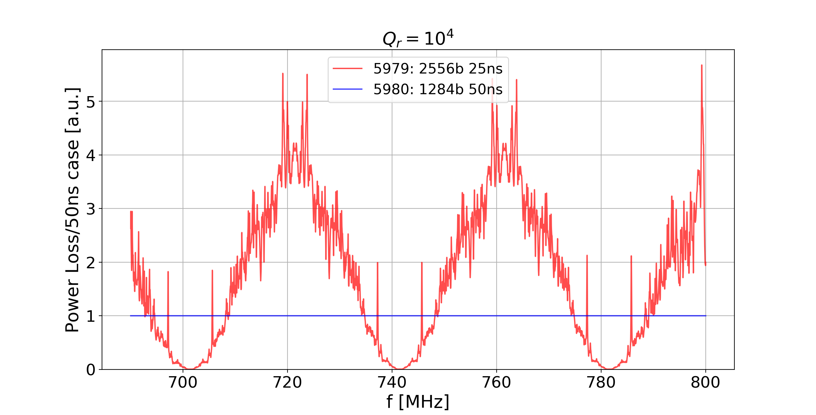

Increasing $Q_{r}$[4/4]
We are always far from factor 16.
It’s very improbable that is an Impedance the source of the heat load.

Slide 15
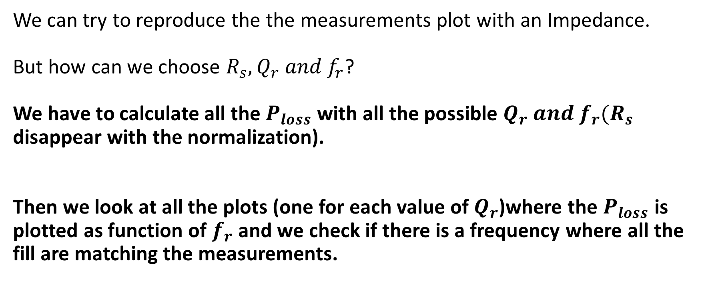
To be more convinced …
We can try to reproduce the the measurements plot with an Impedance.
But how can we choose $R_{s},Q_{r} and f_{r}$?
We have to calculate all the $P_{loss}$ with all the possible $Q_{r} and f_{r}(R_{s}$ disappear with the normalization).
Then we look at all the plots (one for each value of $Q_{r}$)where the $P_{loss}$ is plotted as function of $f_{r}$ and we check if there is a frequency where all the fill are matching the measurements.

Slide 16
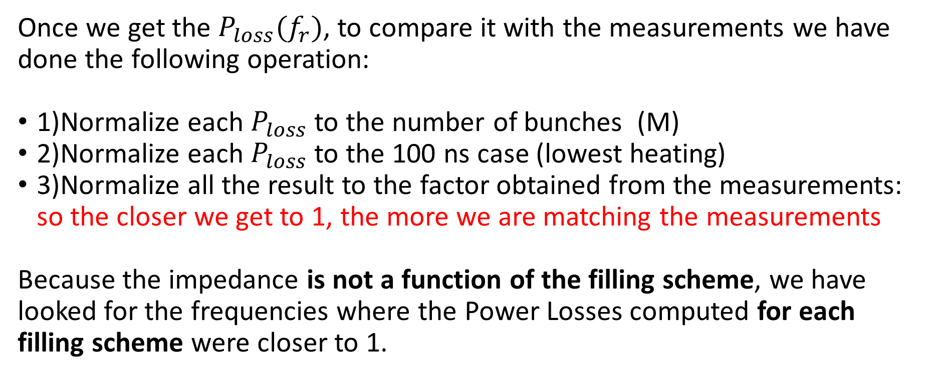
How is the $P_{loss}$ normalized ?In the same way of the measurements!
Comparing with the cryogenic measurements
Once we get the $P_{loss}(f_{r})$, to compare it with the measurements we have done the following operation:
1)Normalize each $P_{loss}$ to the number of bunches (M)
2)Normalize each $P_{loss}$ to the 100 ns case (lowest heating)
3)Normalize all the result to the factor obtained from the measurements: so the closer we get to 1, the more we are matching the measurements
Because the impedance is not a function of the filling scheme, we have looked for the frequencies where the Power Losses computed for each filling scheme were closer to 1.

Slide 17
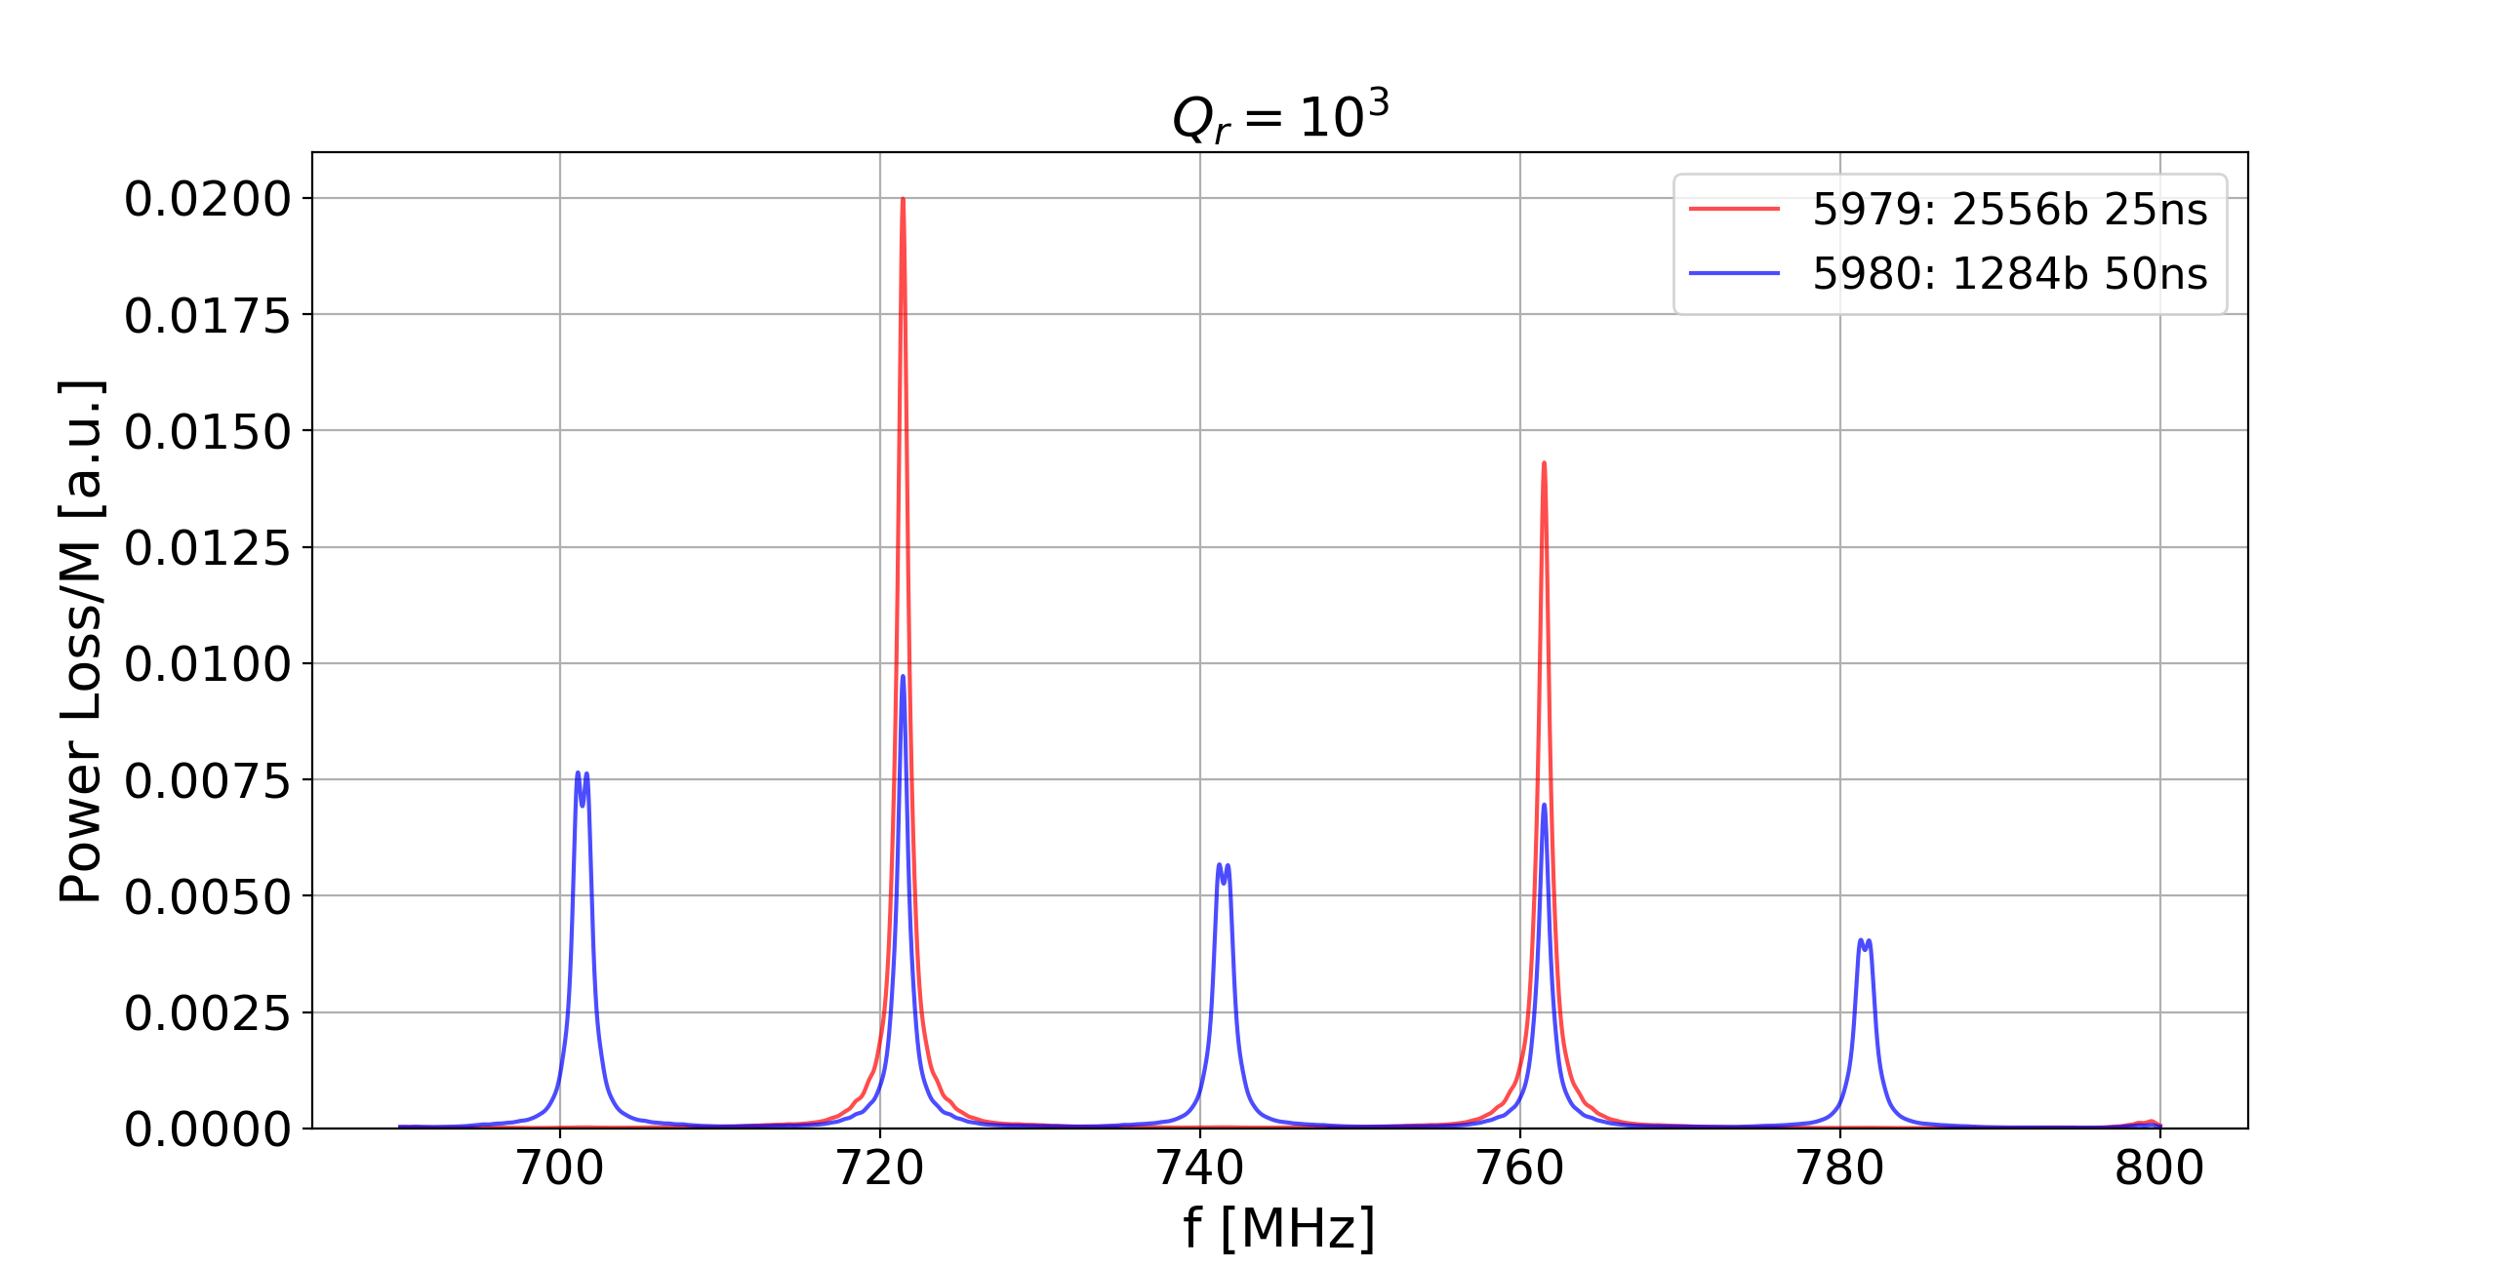

1)Normalize each $P_{loss}$ to the number of bunches(M)
Before
$$\frac{1}{M}$$
After

Slide 18
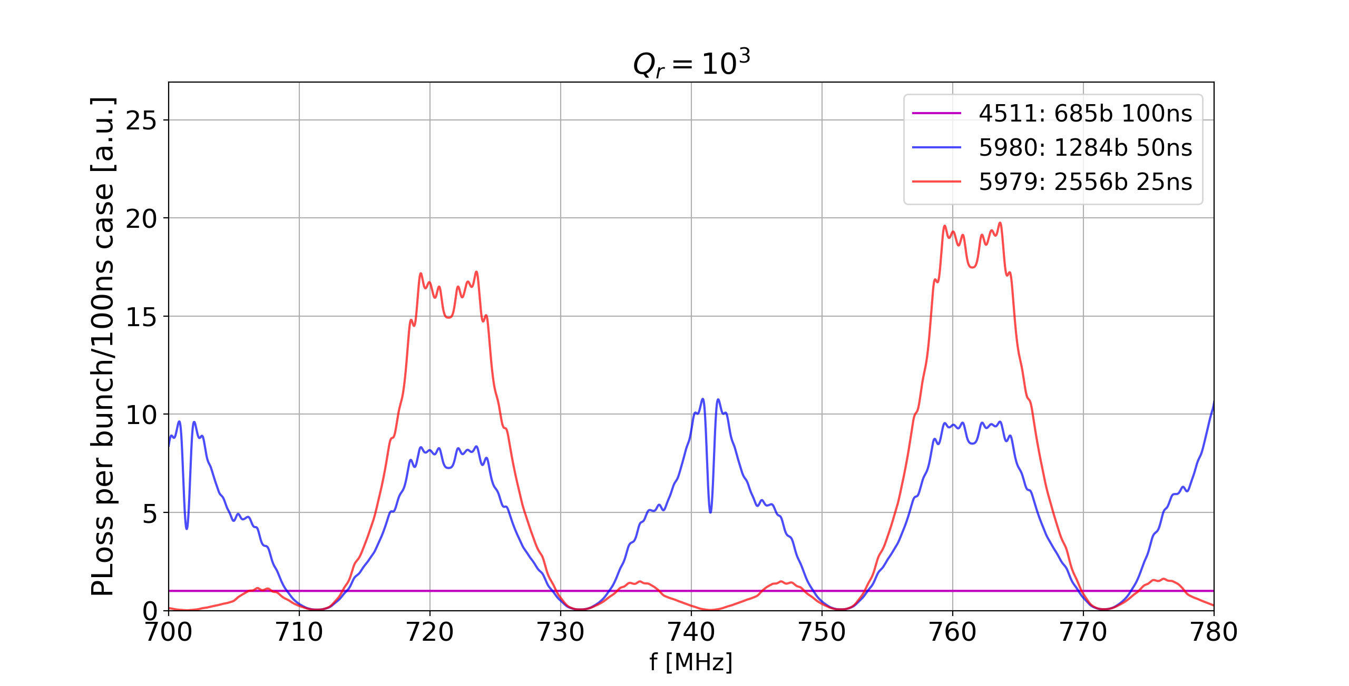
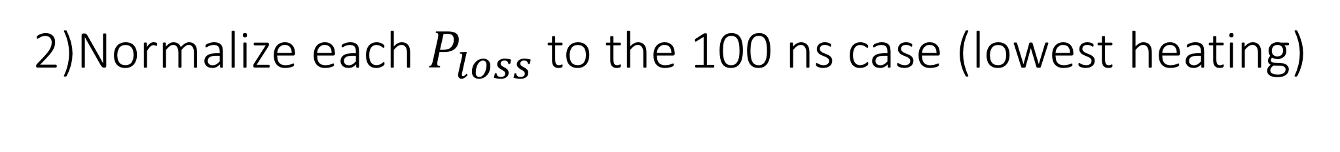
2)Normalize each $P_{loss}$ to the 100 ns case (lowest heating)
Before
After

Slide 19
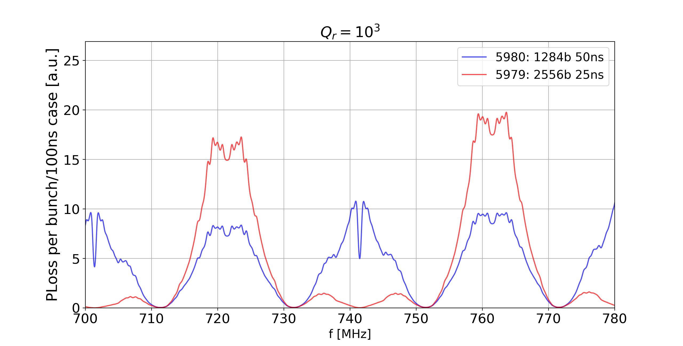
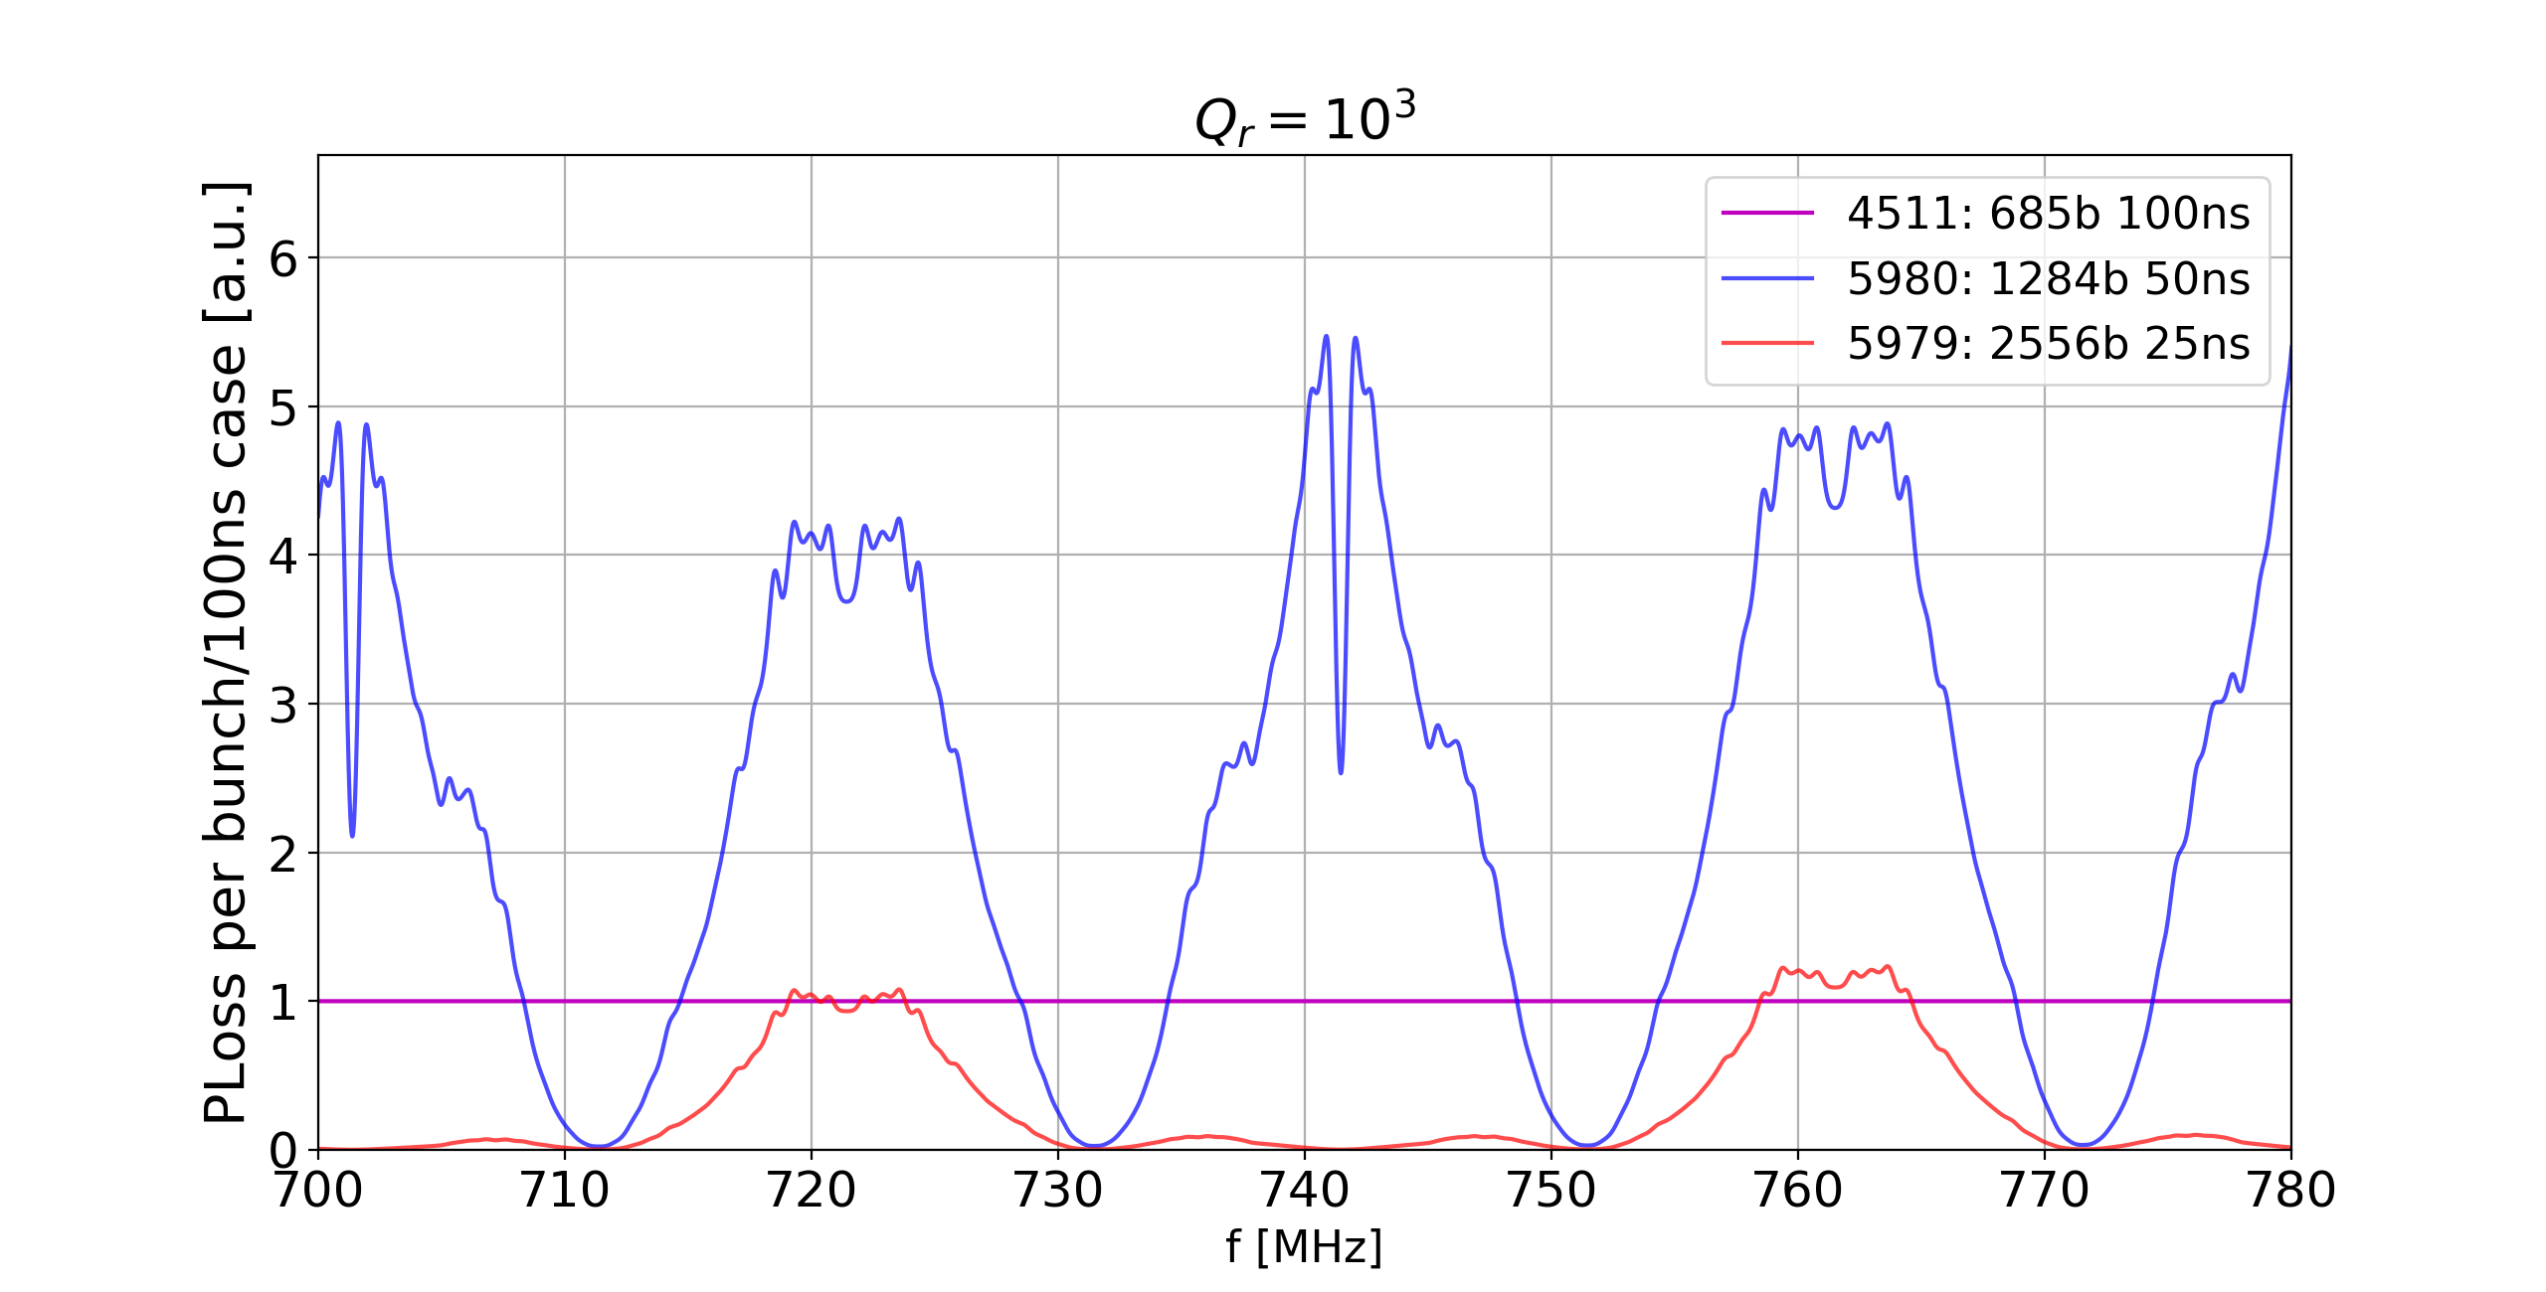
3)Normalize all the result to the factor obtained from the measurements
Before
After
We look for a frequency where all the curves are closer to 1

Slide 20
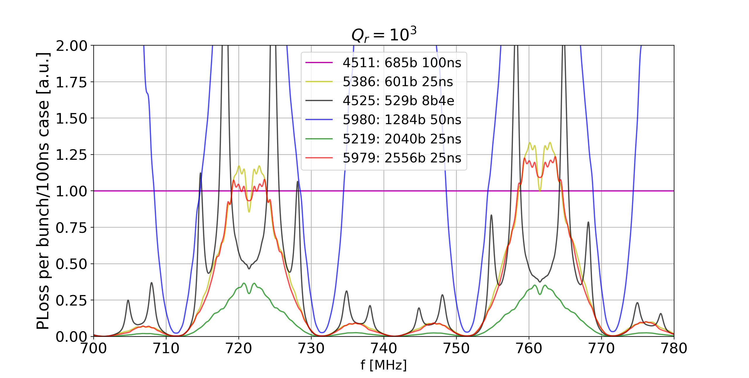
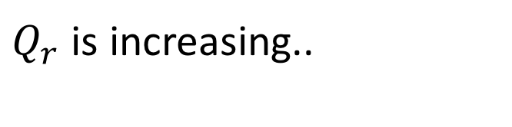
Taking in account all the fills studied we get: [1/5]
$Q_{r}$ is increasing..

Slide 21
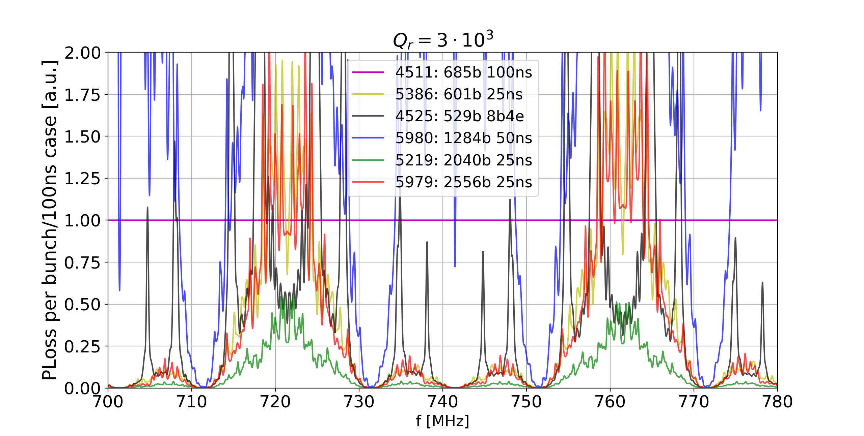
Taking in account all the fills studied we get: [2/5]
$Q_{r}$ is increasing..

Slide 22
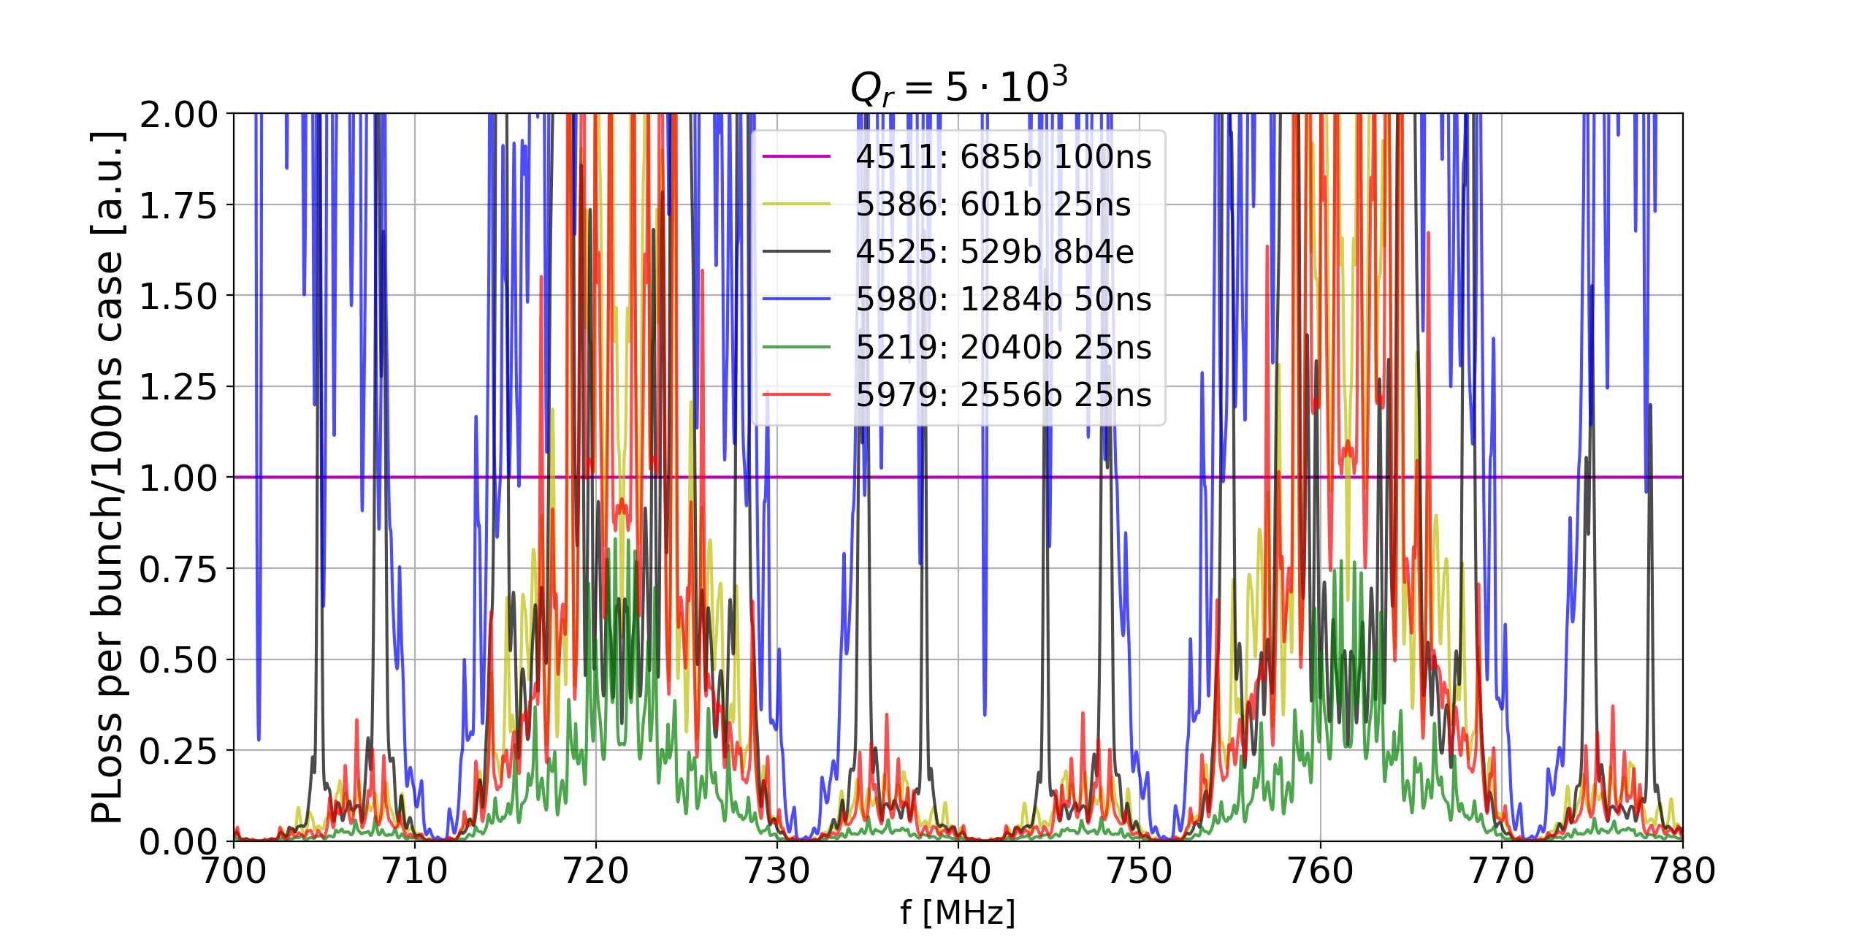
Taking in account all the fills studied we get: [3/5]
$Q_{r}$ is increasing..

Slide 23
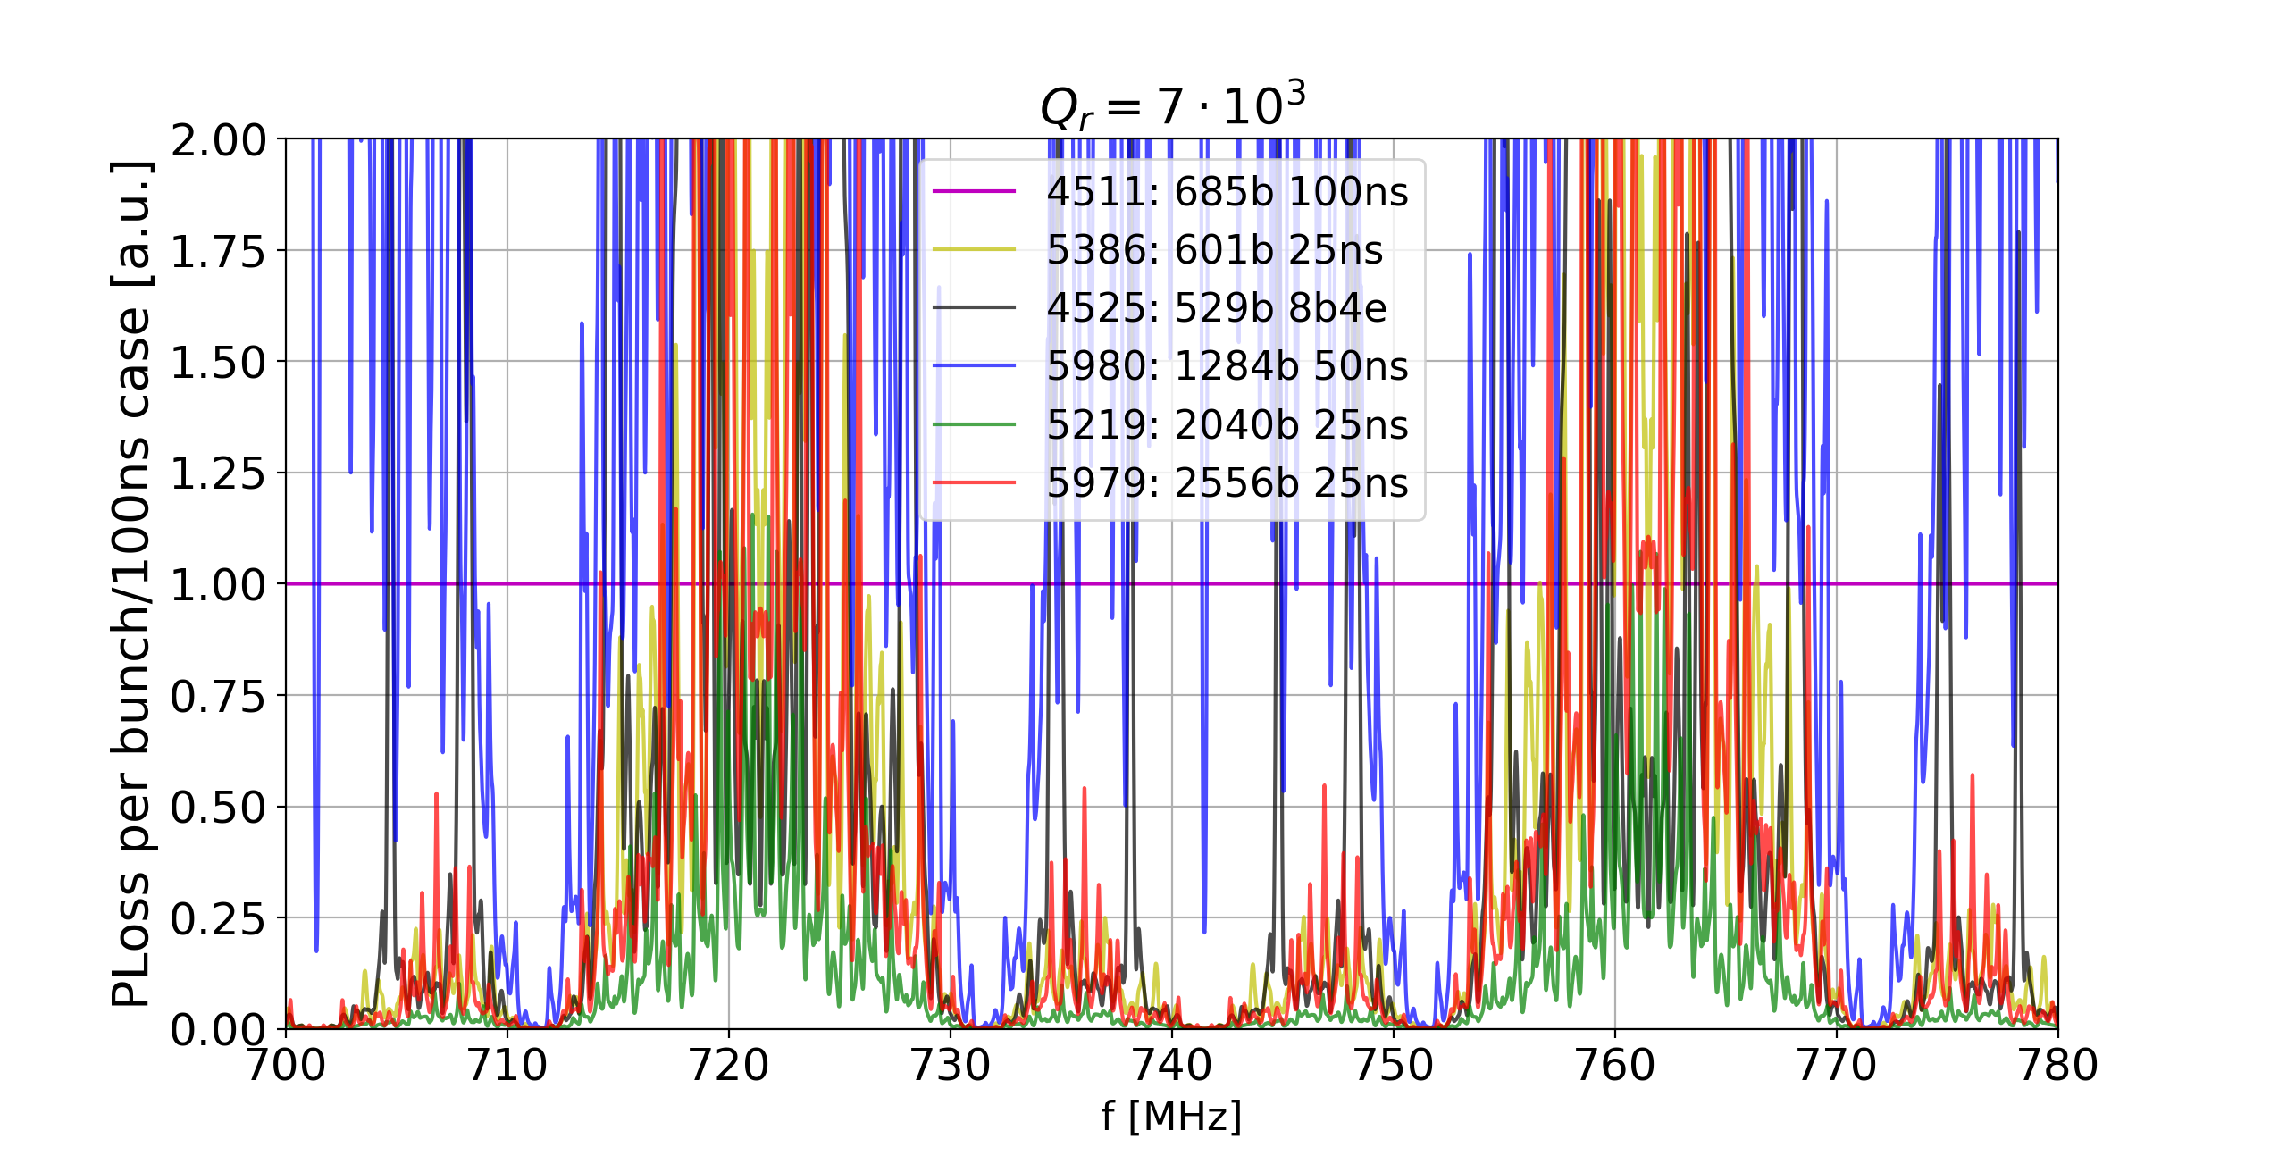
Taking in account all the fills studied we get: [4/5]
$Q_{r}$ is increasing..

Slide 24
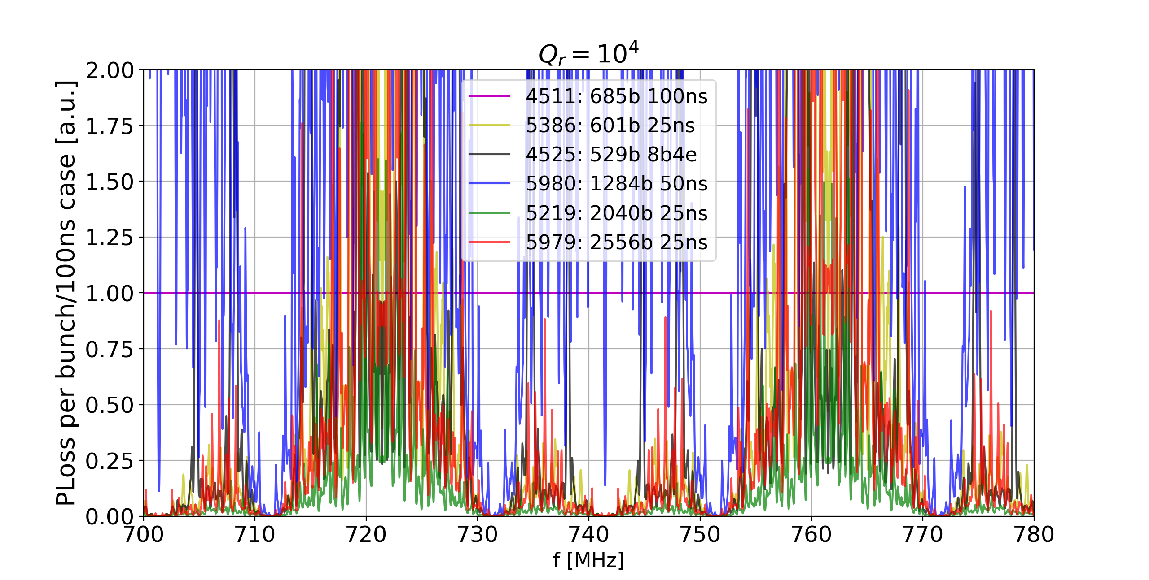
Taking in account all the fills studied we get: [5/5]
$Q_{r}$ is increasing..

Slide 25
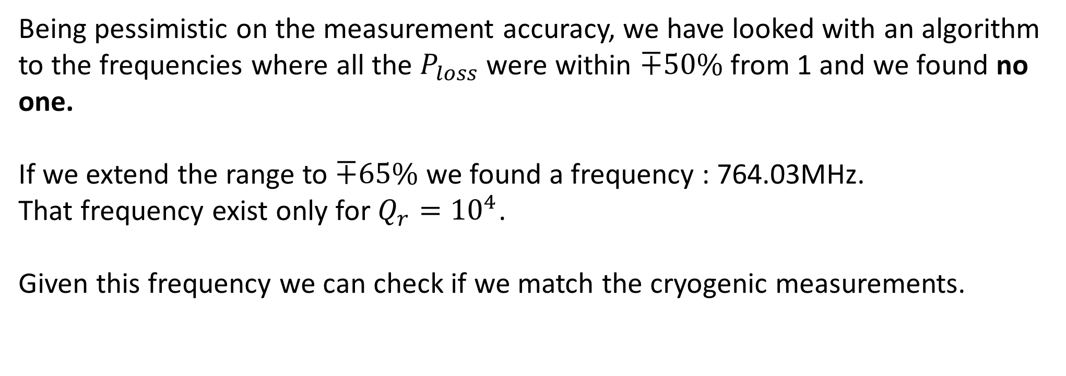
Is there any frequency that explain that heating?
Being pessimistic on the measurement accuracy, we have looked with an algorithm to the frequencies where all the $P_{loss}$ were within $∓50\%$from 1 and we found no one.
If we extend the range to $∓65\%$ we found a frequency : 764.03MHz.
That frequency exist only for $Q_{r}={10}^{4}$.
Given this frequency we can check if we match the cryogenic measurements.

Slide 26
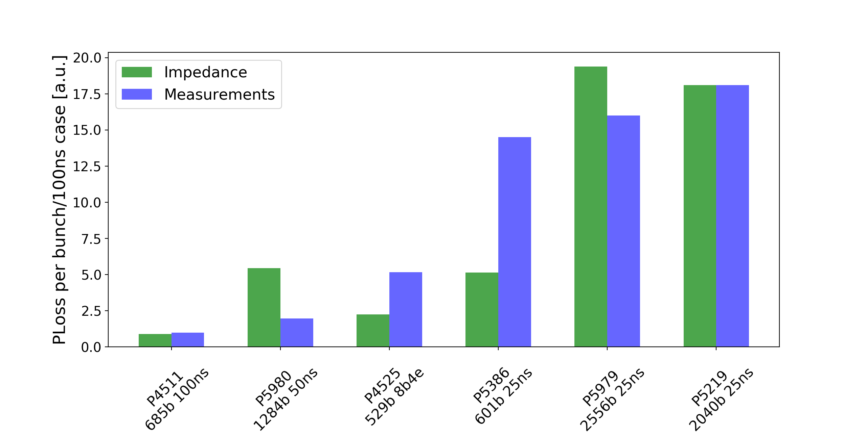
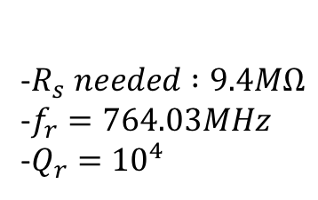
Measurements Comparison
-$R_{s} needed :9.4MΩ$
-$f_{r}=764.03MHz$
-$Q_{r}={10}^{4}$
Bad agreement with the Measurements

Slide 27
Conclusions
The ratio between the 25ns and the 50ns Ploss is too huge to be explained with an impedance.
The only frequency that seems give us an impedance that get close to the measurements does not match all the measurements for all the fills.
The Shunt Impedance needed for the only frequency found in order to match the heating is too huge to be reasonable.
This Impedance should be the same for all the sectors → It is even more improbable that this impedance exist

Slide 28
Binomial Distribution formula
https://cernbox.cern.ch/index.php/s/6aGnq8rDMooBTDD

