Slide 2
Longitudinal limitations and study priorities for LHC-type beams in the PS
23/08/2017
H. Damerau, A. Huschauer, A. Lasheen

Slide 3
Introduction
LIU/HL-LHC projects set demanding beam parameters for the PS after LS2: N_{b} = 2.6 · 10¹¹ ppb with ε_{l} = 0.35 eVs (longitudinally)
Reliably double intensity of 25 ns spacing beam for LHC
Small but longitudinally quite ‘challenging’ accelerator
  Longitudinal beam structure changes
  Bunch length ~200 ns at injection, ~4 ns at ejection
  Acceleration at various harmonic numbers, h = 7…21
  RF manipulations
  25 RF cavities:
  Tuneable, fixed frequency, wide-band impedances
  Gap relays, mechanical and electrical short-circuits
  Direct and 1-turn delay feedback systems
  Impedance even changes during the cycle

Slide 4
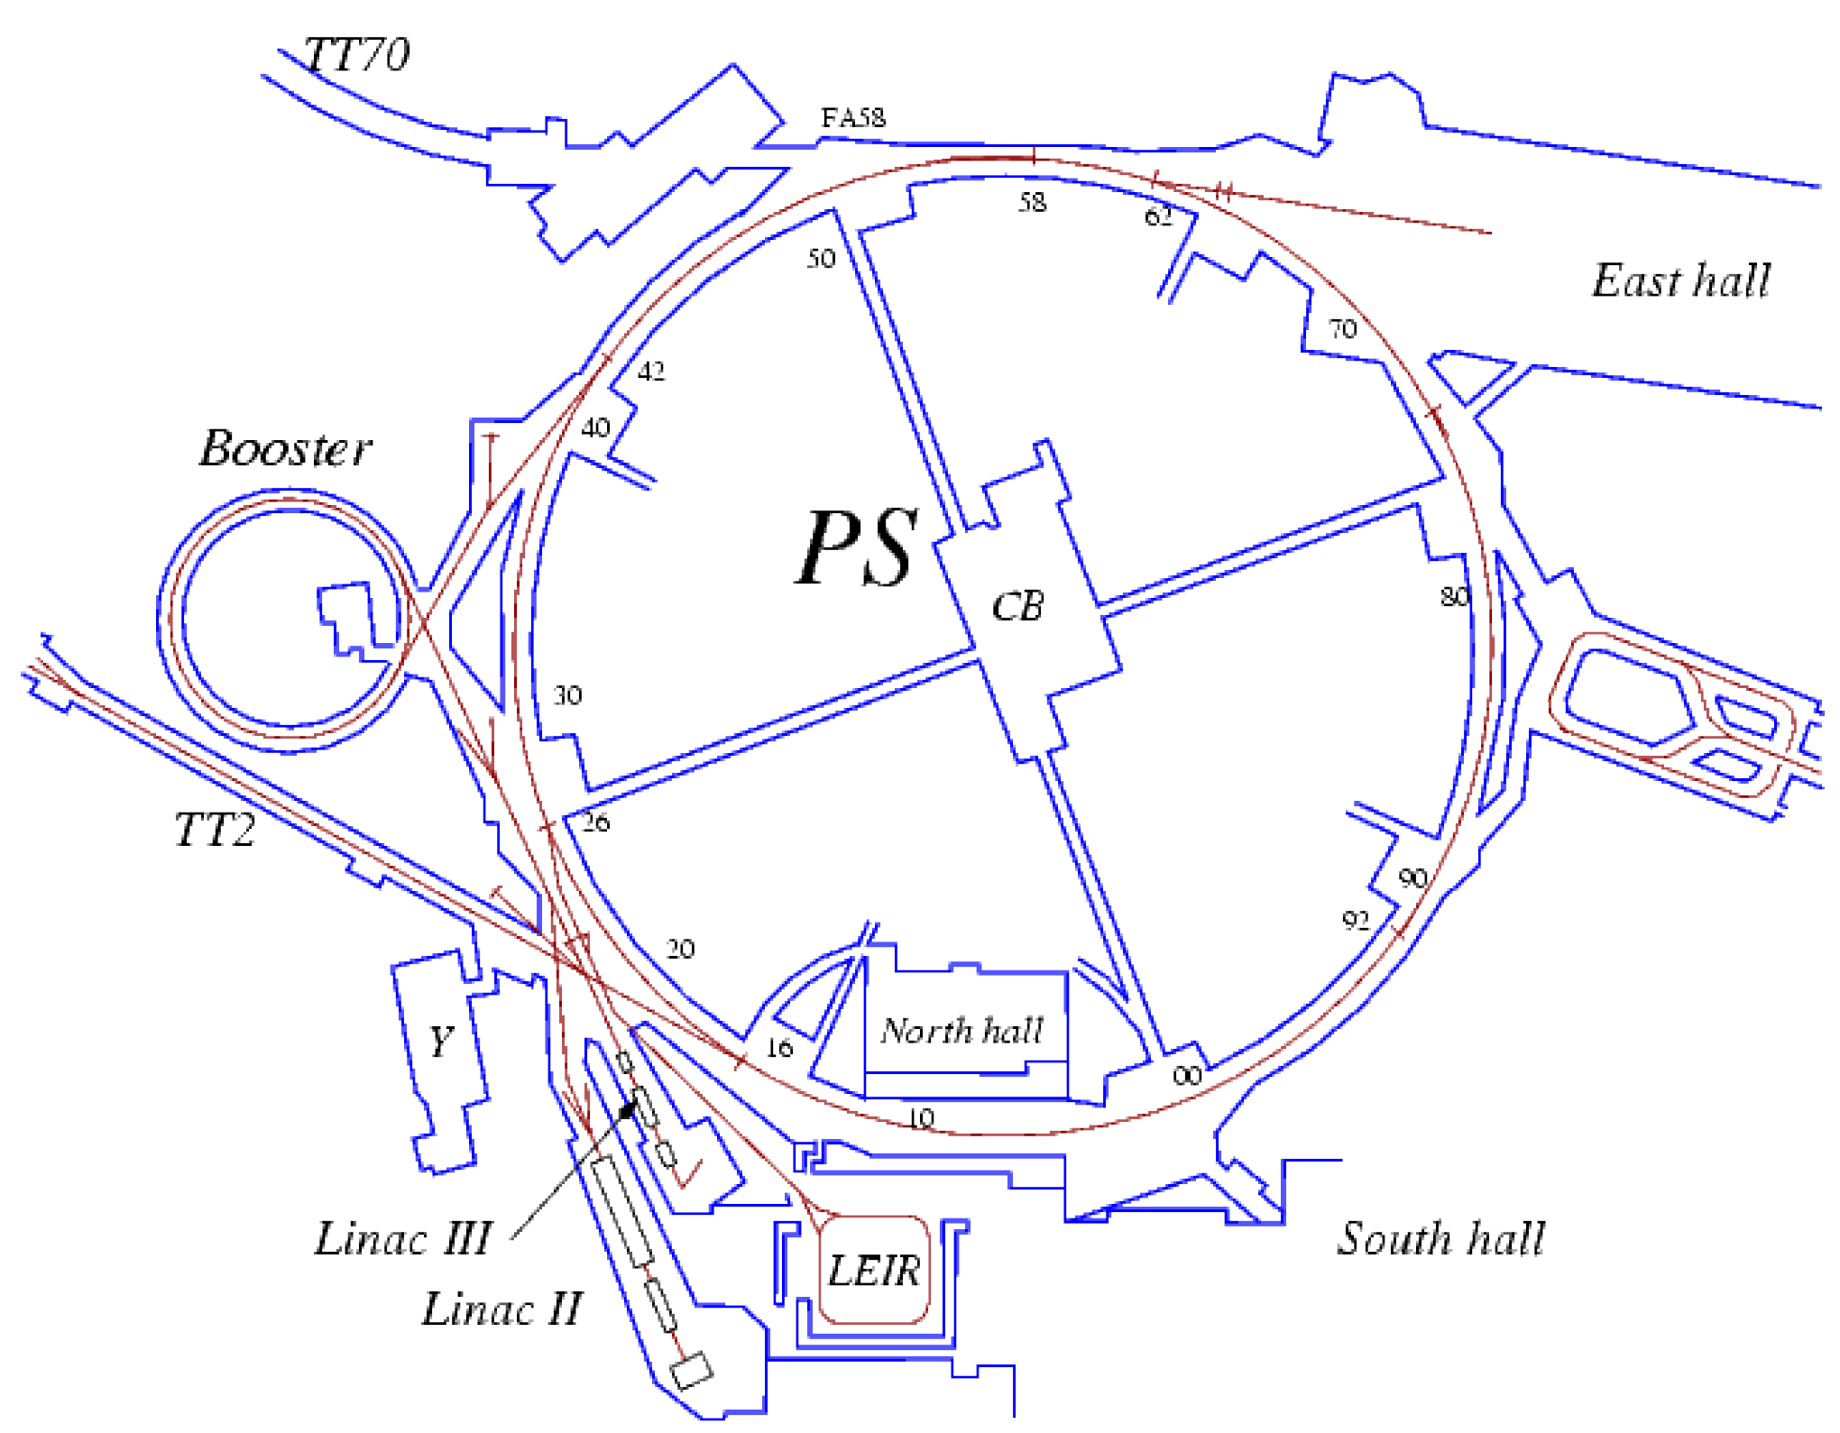
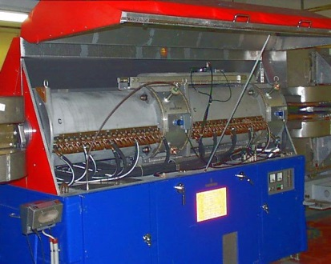
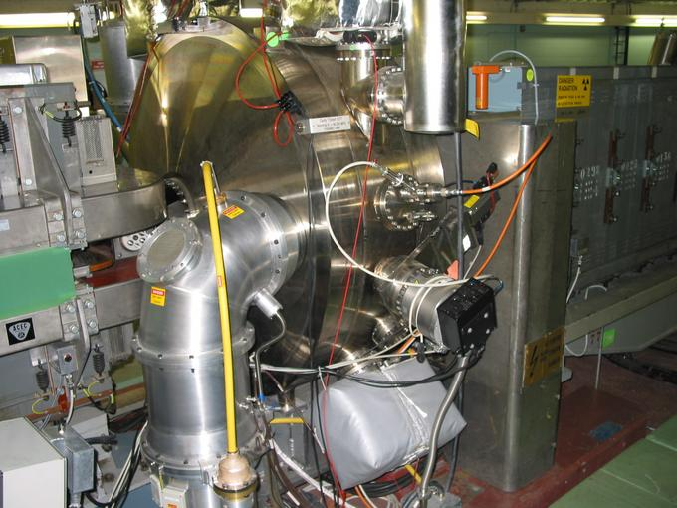
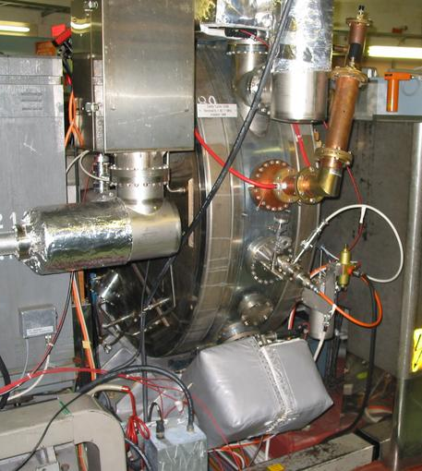
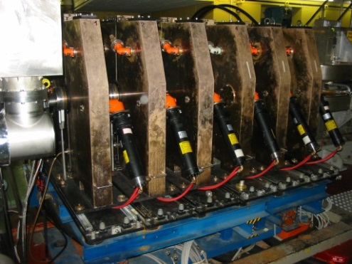
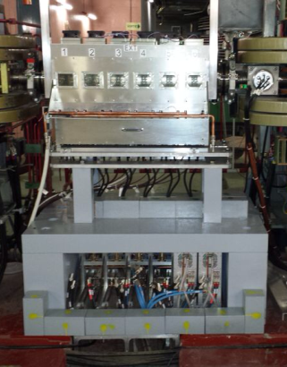
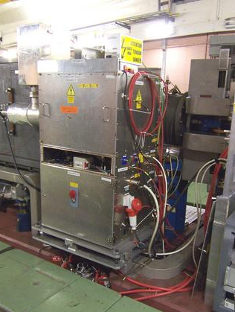
RF systems in the PS
RF Manipulations
2.8 – 10 MHz
51
56
46
66
40 MHz
Acceleration
76
77
36
78
80
to SPS
81
86
88
89
91
96
92
80 MHz
11
8
6
2
200 MHz
Longitudinal blow-up
0.4 – 5 MHz
20 MHz

Slide 5
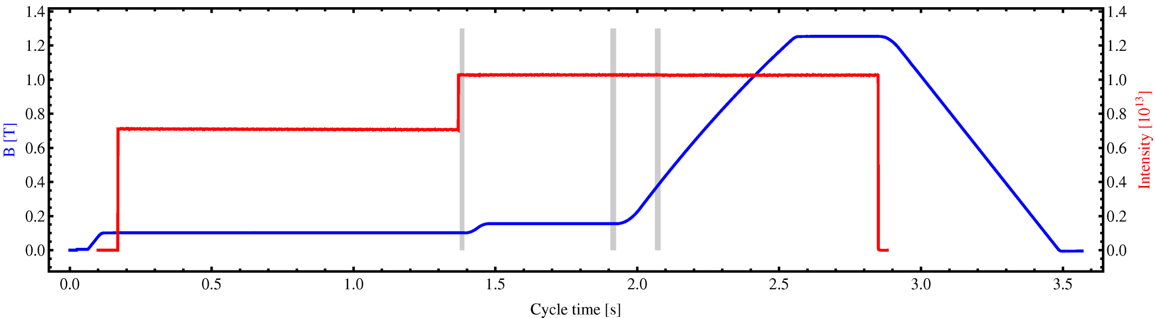
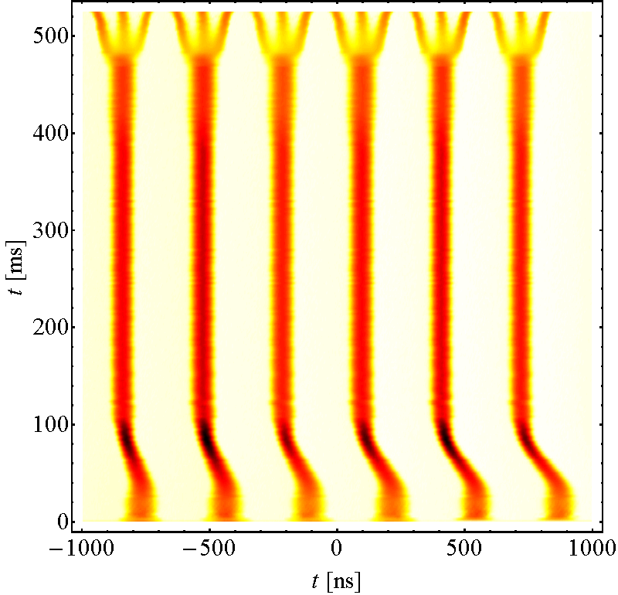
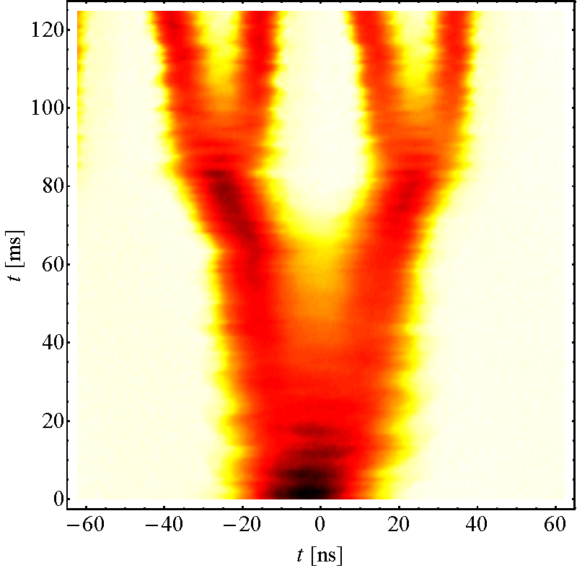
The LHC25ns cycle in the PS
Inject 4+2 bunches
Eject 72 bunches
Controlled blow-ups
h = 21
γ_{tr}
h = 7
h = 84
Instability
Triple splitting at E_{kin} = 2.5 GeV
Split in four at flat top energy
2nd injection
E_{kin} = 2.5 GeV
Transient beam-loading
26 GeV/c
→ Each bunch from the Booster split in 12 → 6 × 3 × 2 × 2 = 72

Slide 6
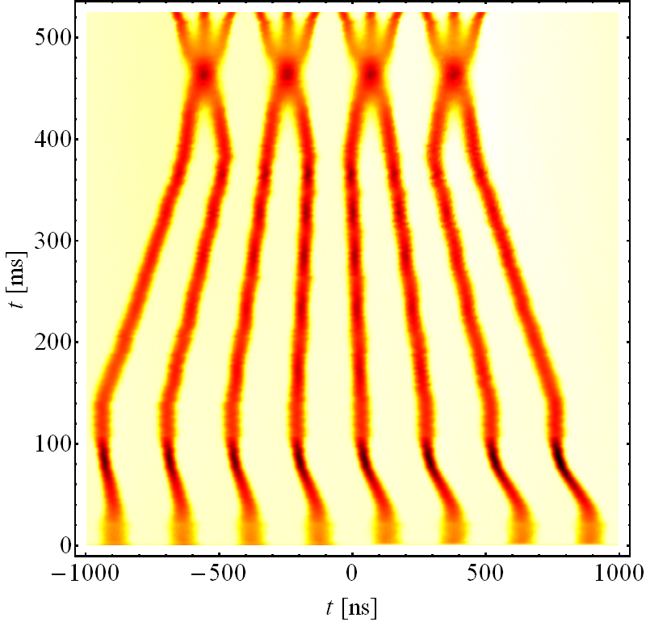
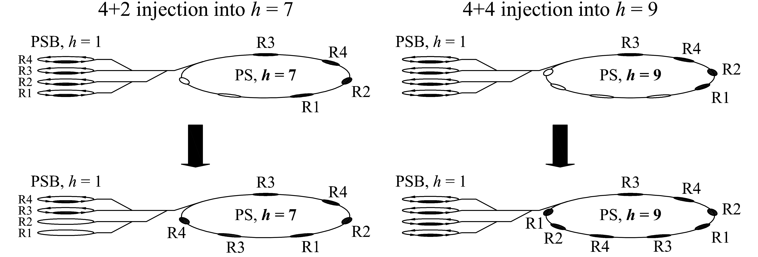
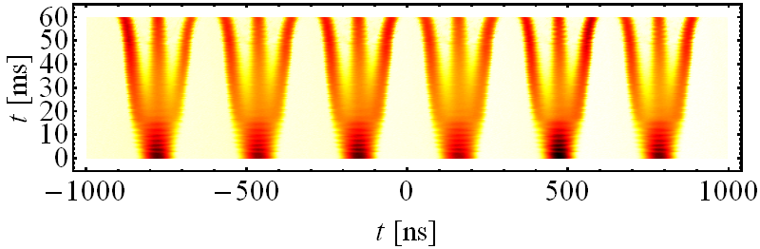
RF Manipulations and beam control
Advanced RF manipulations for large variety of LHC type beams
Different injection harmonics, many harmonics during cycle
4+2 injection into h = 7
4+4 injection into h = 9
E_{kin} = 2.5 GeV
Nominal scheme
High brightness (BCMS)
Less intensity per bunch from the PSB and smaller transverse ε_{x,y}
Beam for collisions in LHC since autumn 2016
Batch compressions, merging, splitting (BCMS): 2nd LIU scenario

Slide 7
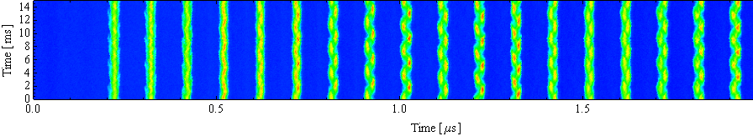
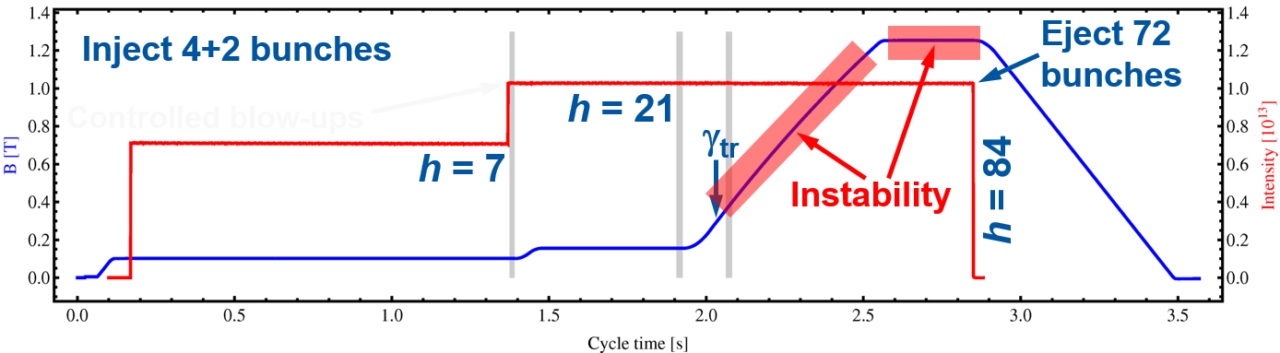
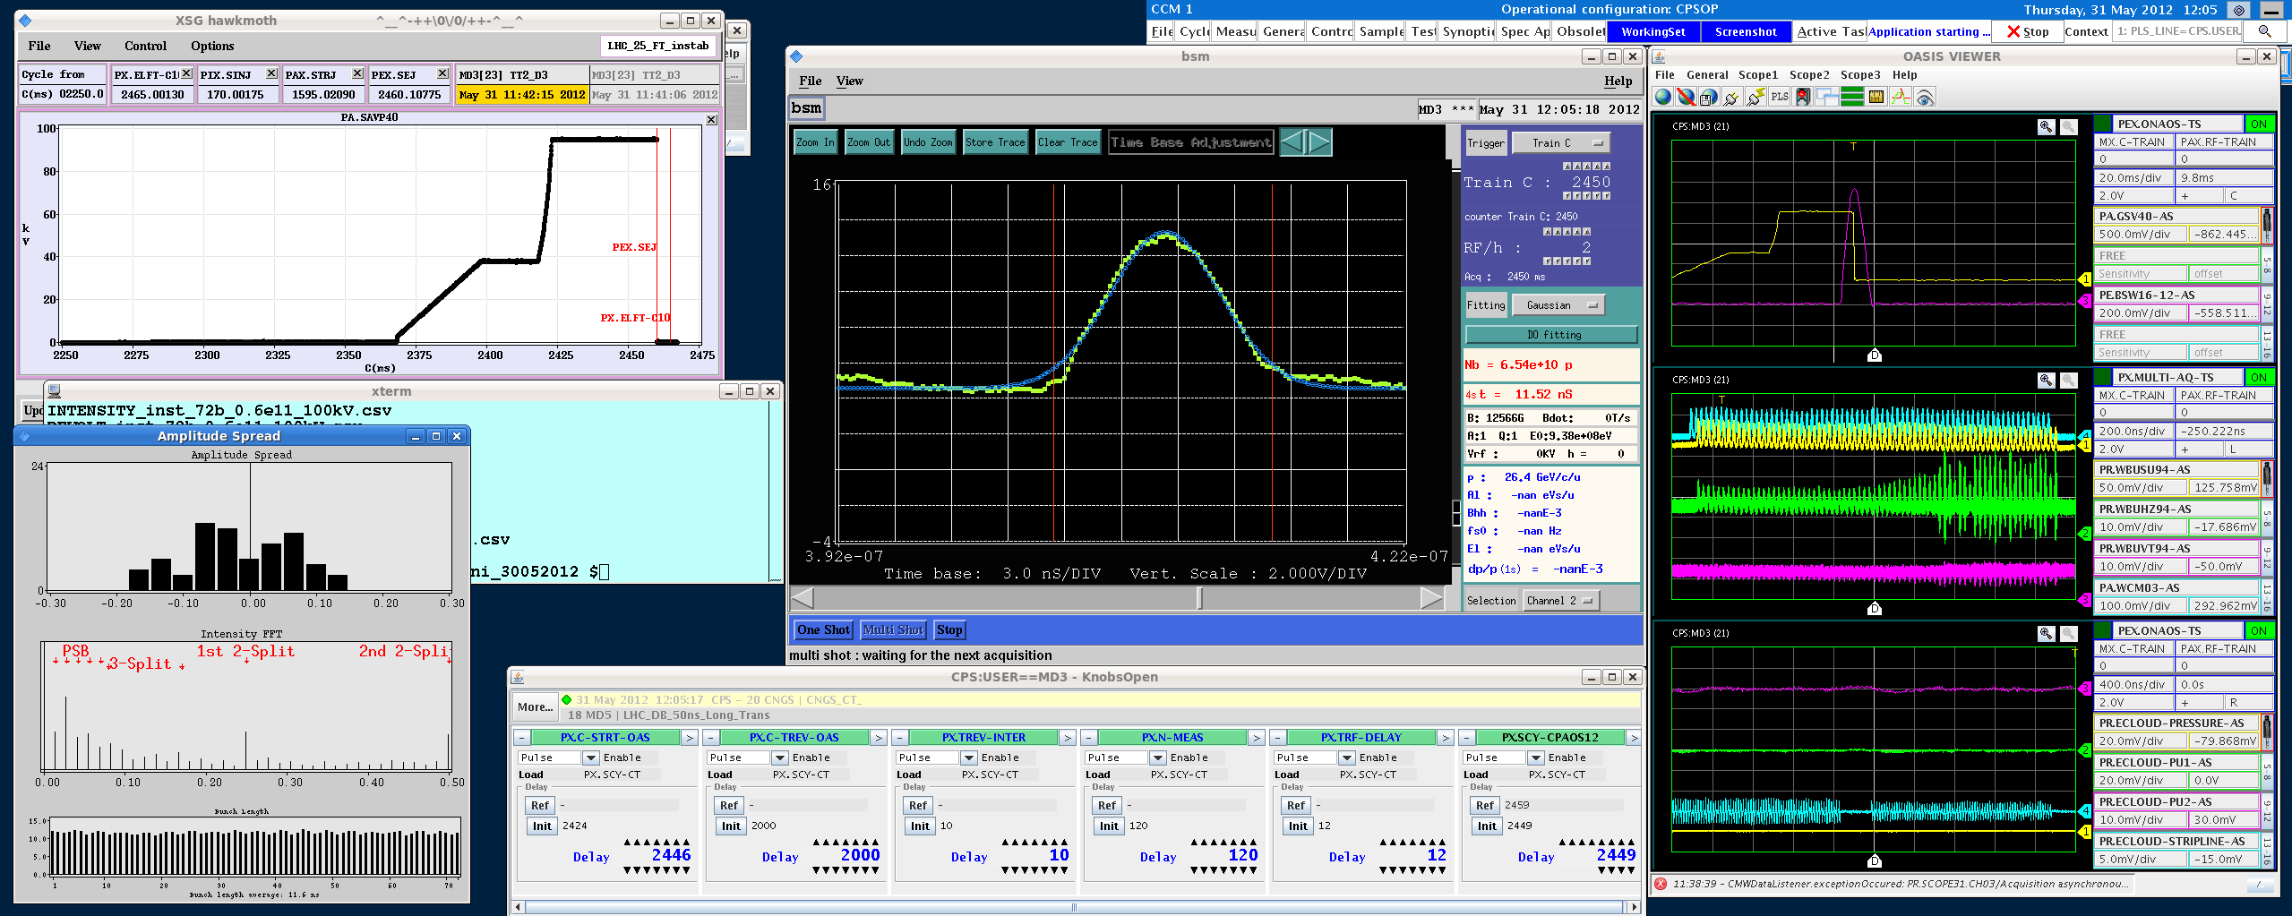
Intensity limiting effects in the PS
Acceleration/Bunch splittings
Longitudinal CBI
Transient beam loading
Transition crossing
Flat top
Longitudinal CBI
Transv. instabilities
Electron cloud
Injection flat bottom
Space charge
Headtail instability
Hor.
Vert.

Slide 8
Longitudinal instabilities (LHC-type beams)
Longitudinal instability at flat-bottom
  Caused by 10 MHz RF system → Detuning unused cavities
Uncontrolled longitudinal blow-up after transition
  Observed above ~1.5 · 10¹¹ ppb → controlled blow-up
Coupled-bunch instabilities after transition
  During acceleration and flat-top, mode pattern changes
  Partly cured by wide-band multi-harmonic feedback
Microwave instability during bunch rotation
  High-frequency structure observed on bunches arriving in SPS

Slide 9
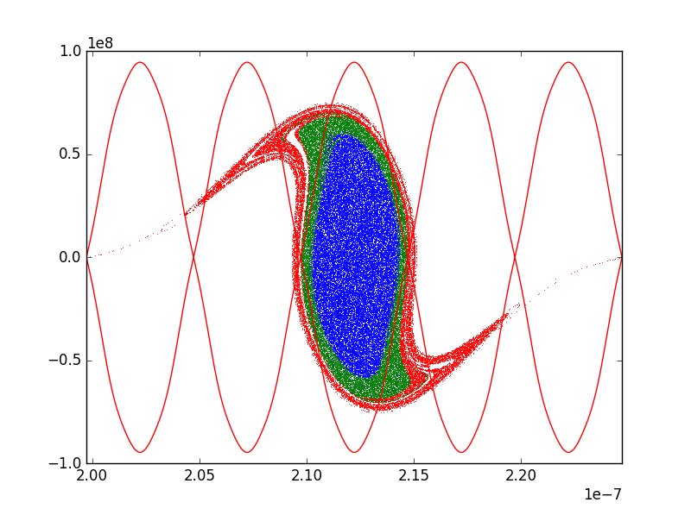
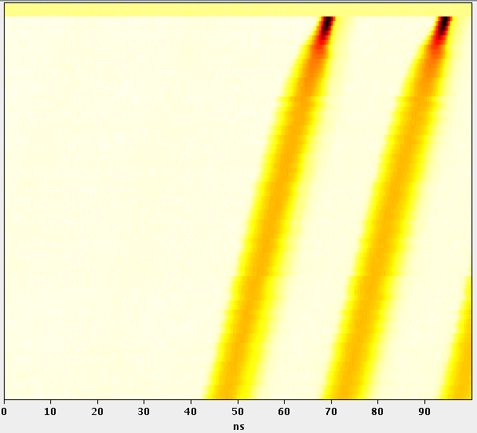
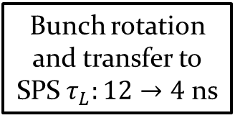
PS-SPS transfer
Bunch rotation and transfer to SPS $τ_{L}:12→4$ ns
PS bunch in SPS bucket
The bunch is shortened before extraction to fit in the SPS bucket (fast voltage increase of the 40 MHz and 80 MHz cavities)
If the longitudinal emittance is larger due to instability, the bunch does not fit in the SPS bucket and lead to important losses in the SPS
  Blue: bunch
  Green: Surface occupied by the bunch if emittance blow-up after splittings
  Red: Surface occupied by the bunch if particle loss before/during splittings

Slide 10
Longitudinal upgrade baseline
Limitation | Mitigation
Longitudinal beam stability Coupled-bunch oscillations | Reduced impedances of all RF cavities Improved wide-band feedback 10 MHz Replaced 1-turn delay feedbacks 10 MHz New 1-turn delay feedbacks for 20, 40 and 80 MHz cavities Dedicated coupled-bunch feedback Wide-band Finemet longitudinal kicker Optimised handshake with SPS PS-SPS transfer with both 40 MHz cav.
Bunch-to-bunch equalization | 1-turn delay feedbacks
Reliability and long-term maintainability | Replace anode power supplies for 40 MHz and 80 MHz RF systems Upgrade to a digital beam control
Availability of 80 MHz cavities for protons and ions | New fast ferrite tuners
Most PS RF systems affected by upgrades
Reduce impedance sources and mitigate consequences

Slide 11
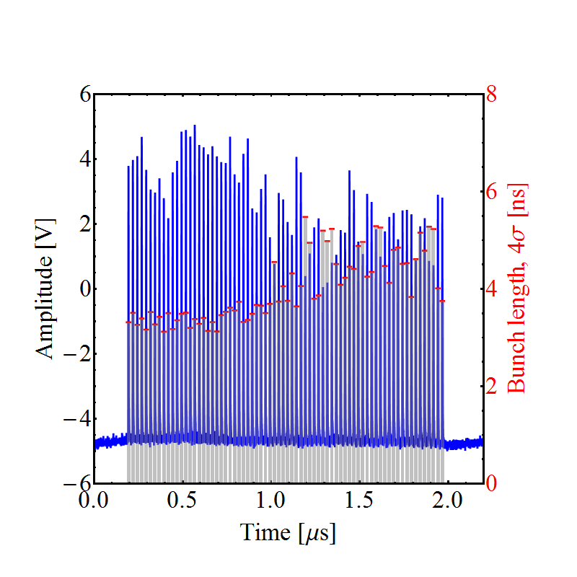
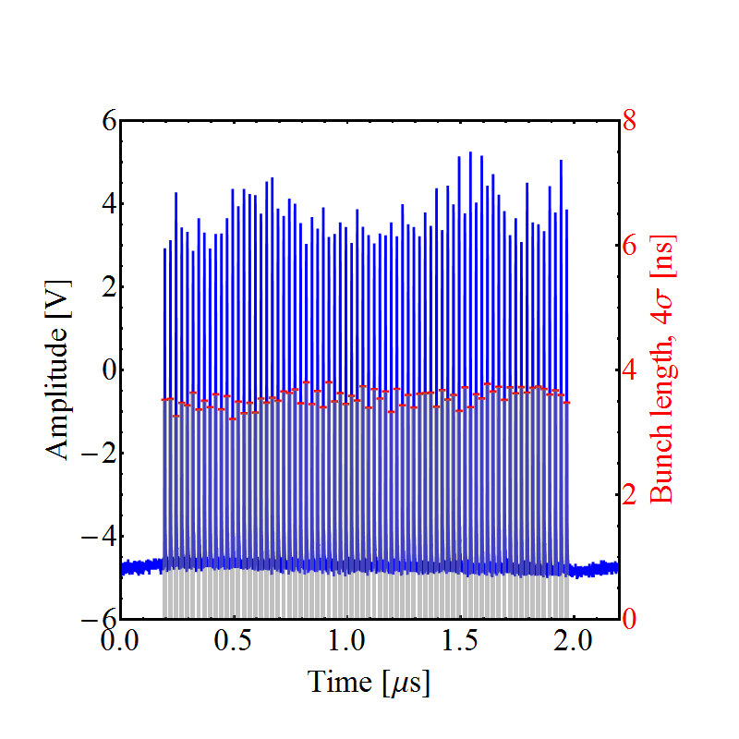
Where do we stand?
  10 MHz 1-turn delay feedbacks operational
  Prototype coupled-bunch feedback covering all possible modes
    Regularly delivered ~2 · 10¹¹ ppb with nominal longitudinal emittance of ε_{l} = 0.35 eVs with gaps of unused 40/80 MHz cavities closed
    Beam quality as at ~1.3 · 10¹¹ ppb without feedback
Feedback off
Feedback on

Slide 12
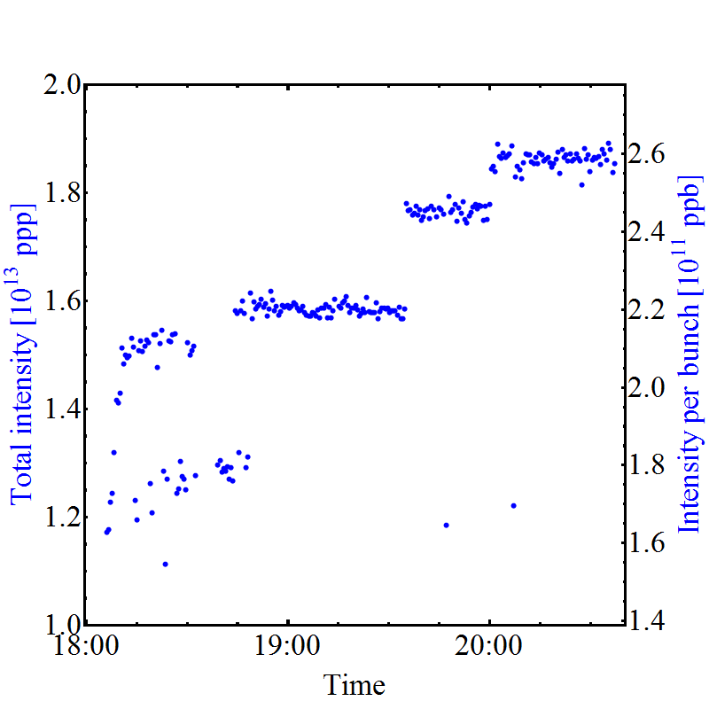
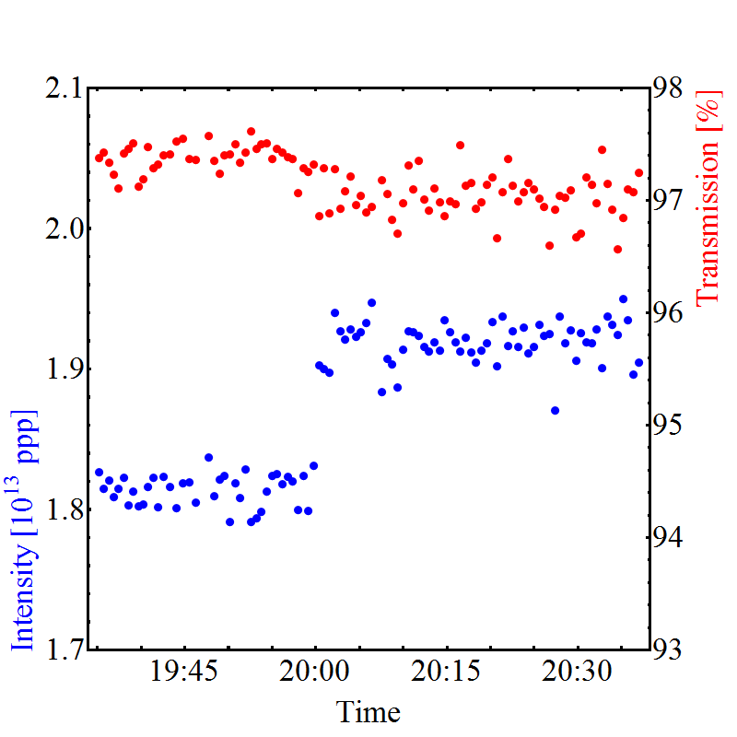
Higher intensity?
  Pushing intensity at expense of larger longitudinal emittance
    Bare minimum of 40/80 MHz cavities with gap open (C40-78, C80-88, C80-89)
    Trips of remaining cavities C40-78 and C80-08 due to beam loading
Intensity ramp up
Overall transmission N_{ej}/(N_{inj1}+N_{inj2})
  Excellent transmission up to 2.6 · 10¹¹ ppb, even with ε_{l} > 0.35 eVs
  No further RF issues related to high intensity

Slide 13
Higher intensity?
  Present longitudinal upgrades probably not sufficient
    Quadrupolar coupled-bunch oscillations after transition and at start of the flat-top
    Emittance blow-up due to impedance of 40 MHz and/or 80 MHz cavities
    What more can and needs to be done?
    Add higher-harmonic cavity for passive damping?
    Improve understanding of longitudinal issues
      Impedance model
      Tracking simulations including impedance and feedback models
    Experimental studies
      MDs ‘abusing’ available hardware

Slide 14
Longitudinal studies - stability
Study quadrupole coupled-bunch instability and effects of high-frequency cavity impedance on longitudinal stability
  Quadrupolar coupled-oscillation measurement during the cycle and determination of growth rates
  20 MHz, 40 MHz or 80 MHz as Landau cavities at flat-top
Intensity limit with coupled-bunch feedback
  Six gaps of Finemet cavity available (since ITS2)
  Measure damping time versus feedback gain
  Evaluate behaviour for BCMS (12 bunches accelerated in h = 21)
First results from 10 MHz/40 MHz promising
Up to 2 · 10¹¹ ppb reached again in 2017

Slide 15
Longitudinal studies - impedances
Impedance measurements of 10 MHz cavities
  Impedance of ferrite cavities at h = 21 and under operational conditions
  Check latest upgraded 10 MHz amplifier prototype
Impedances of 20 MHz, 40 MHz and 80 MHz RF cavities
  Tomographic calibration of cavity return signals
  Measure beam induced voltage and beam spectrum
  High-frequency structure of beam during, e.g., de-bunching
Multi-harmonic feedbacks for high-frequency cavities
  Commission feedbacks for cavities at 20 MHz, 40 MHz and 80 MHz
  MDs may require special conditions (e.g., sequence of cycles)
Started, profits from work for 10 MHz cavities in 2016
Strong 80 MHz structure
C40-78 tests in May, development ongoing → September

Slide 16
Longitudinal studies – PS-SPS transfer
Optimized bunch rotation?
  Flip 80 MHz phase to linearize first part of rotation?
  Use 2 × 40 MHz and 3 × 80 MHz for bunch rotation
Study uncaptured particles at PS-SPS transfer
  Fixed frequency acceleration removing uncaptured beam before PS extraction
Adiabatic bunch shortening using 40 MHz and 80 MHz RF
  Minimum bunch length without rotation
Re-check with new prototype anode power supply

Slide 17
Longitudinal studies – Space charge
PSB-PS transfer with large longitudinal emittance
  Demonstrate transfer with up to 2.8 eVs (standard beam)
  Demonstrate transfer with up to 1.5 eVs (BCMS)
Double-harmonic operation at flat-bottom and constant bucket area at beginning of acceleration
  Study phase loop behaviour with h = 7 + 14 at flat-bottom
  RF voltage program to avoid bunch shortening at start of acceleration
Constant bucket area operational on BCMS

Slide 18
Summary
  Main longitudinal issue to reach LIU/HL-LHC beams: stability
    Achieved 2.0 · 10¹¹ ppb, mainly due to wideband coupled-bunch feedback
    No further major show-stopper to reach 2.6 · 10¹¹ ppb identified
    Longitudinal emittance for stable bunches by far too large
  PS-SPS transfer
    Conclude on options using existing hardware
  Do we need more RF systems?
  Profit from the time with beam before LS2 to define upgrades
  Theoretical studies
    Longitudinal impedance model as input for particle tracking: Simulated, measured in the lab and with beam
    Simulations to guide decisions on new hardware, e.g. Landau cavity

Slide 19
Spare slides

Slide 20
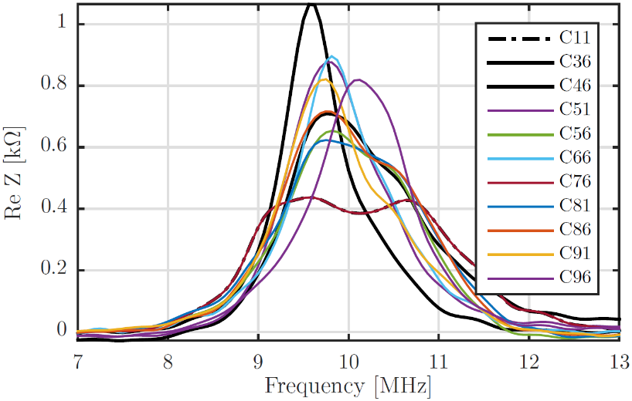
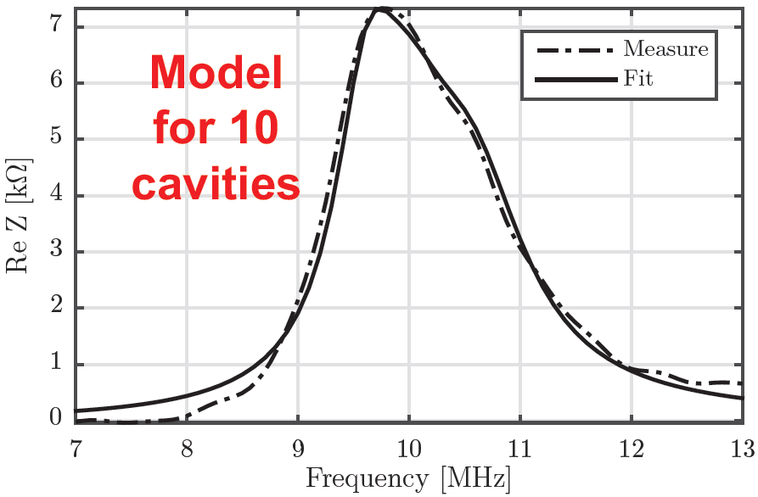
New 10 MHz cavity impedance model
  Studies revealed that 10 MHz cavity four times larger than previously assumed (G. Favia)
Σ of all 10 cavities (real part)
    Total impedance modelled as three resonators (fit of real part of impedance)
    Input for MuSiC code (M. Migliorati)

Slide 21
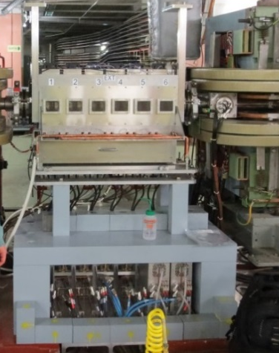
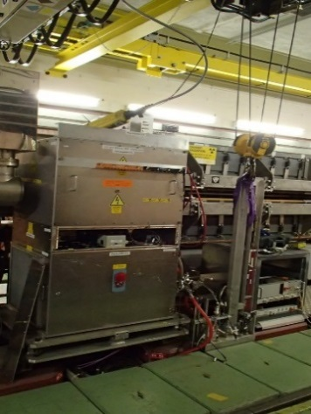
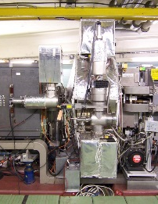
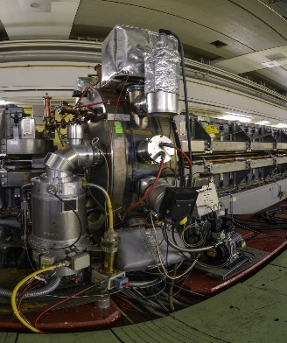
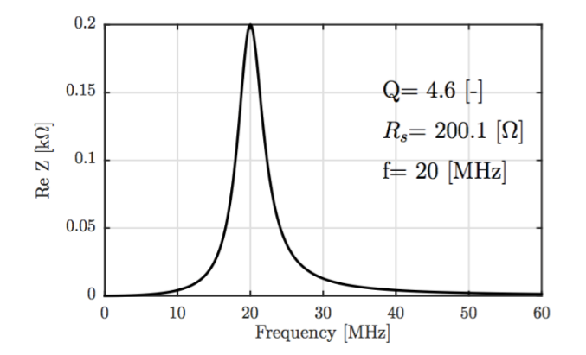
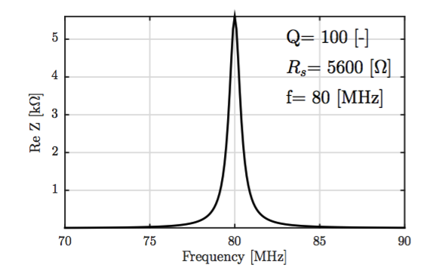
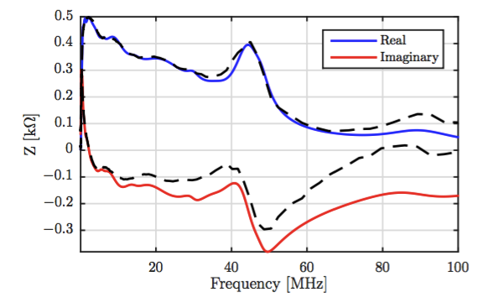
Further impedances from RF systems
Finemet
20 MHz
40 MHz
80 MHz
    Little effect in simulations

