Slide 1
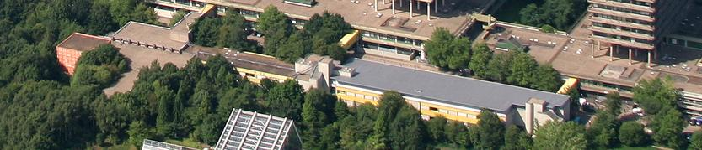

Ion beam analysis of materials with MeV beams at the Ruhr University Bochum
Ruhr-Uni-Bochum
Contribution to the ISOLDE workshop, Dec, 4th 2017, Hans-Werner Becker

Slide 2
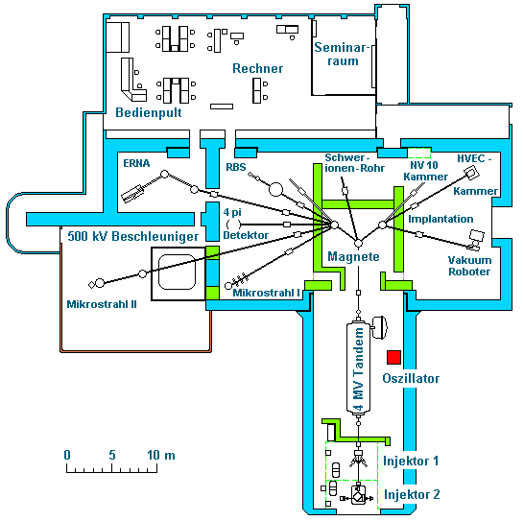
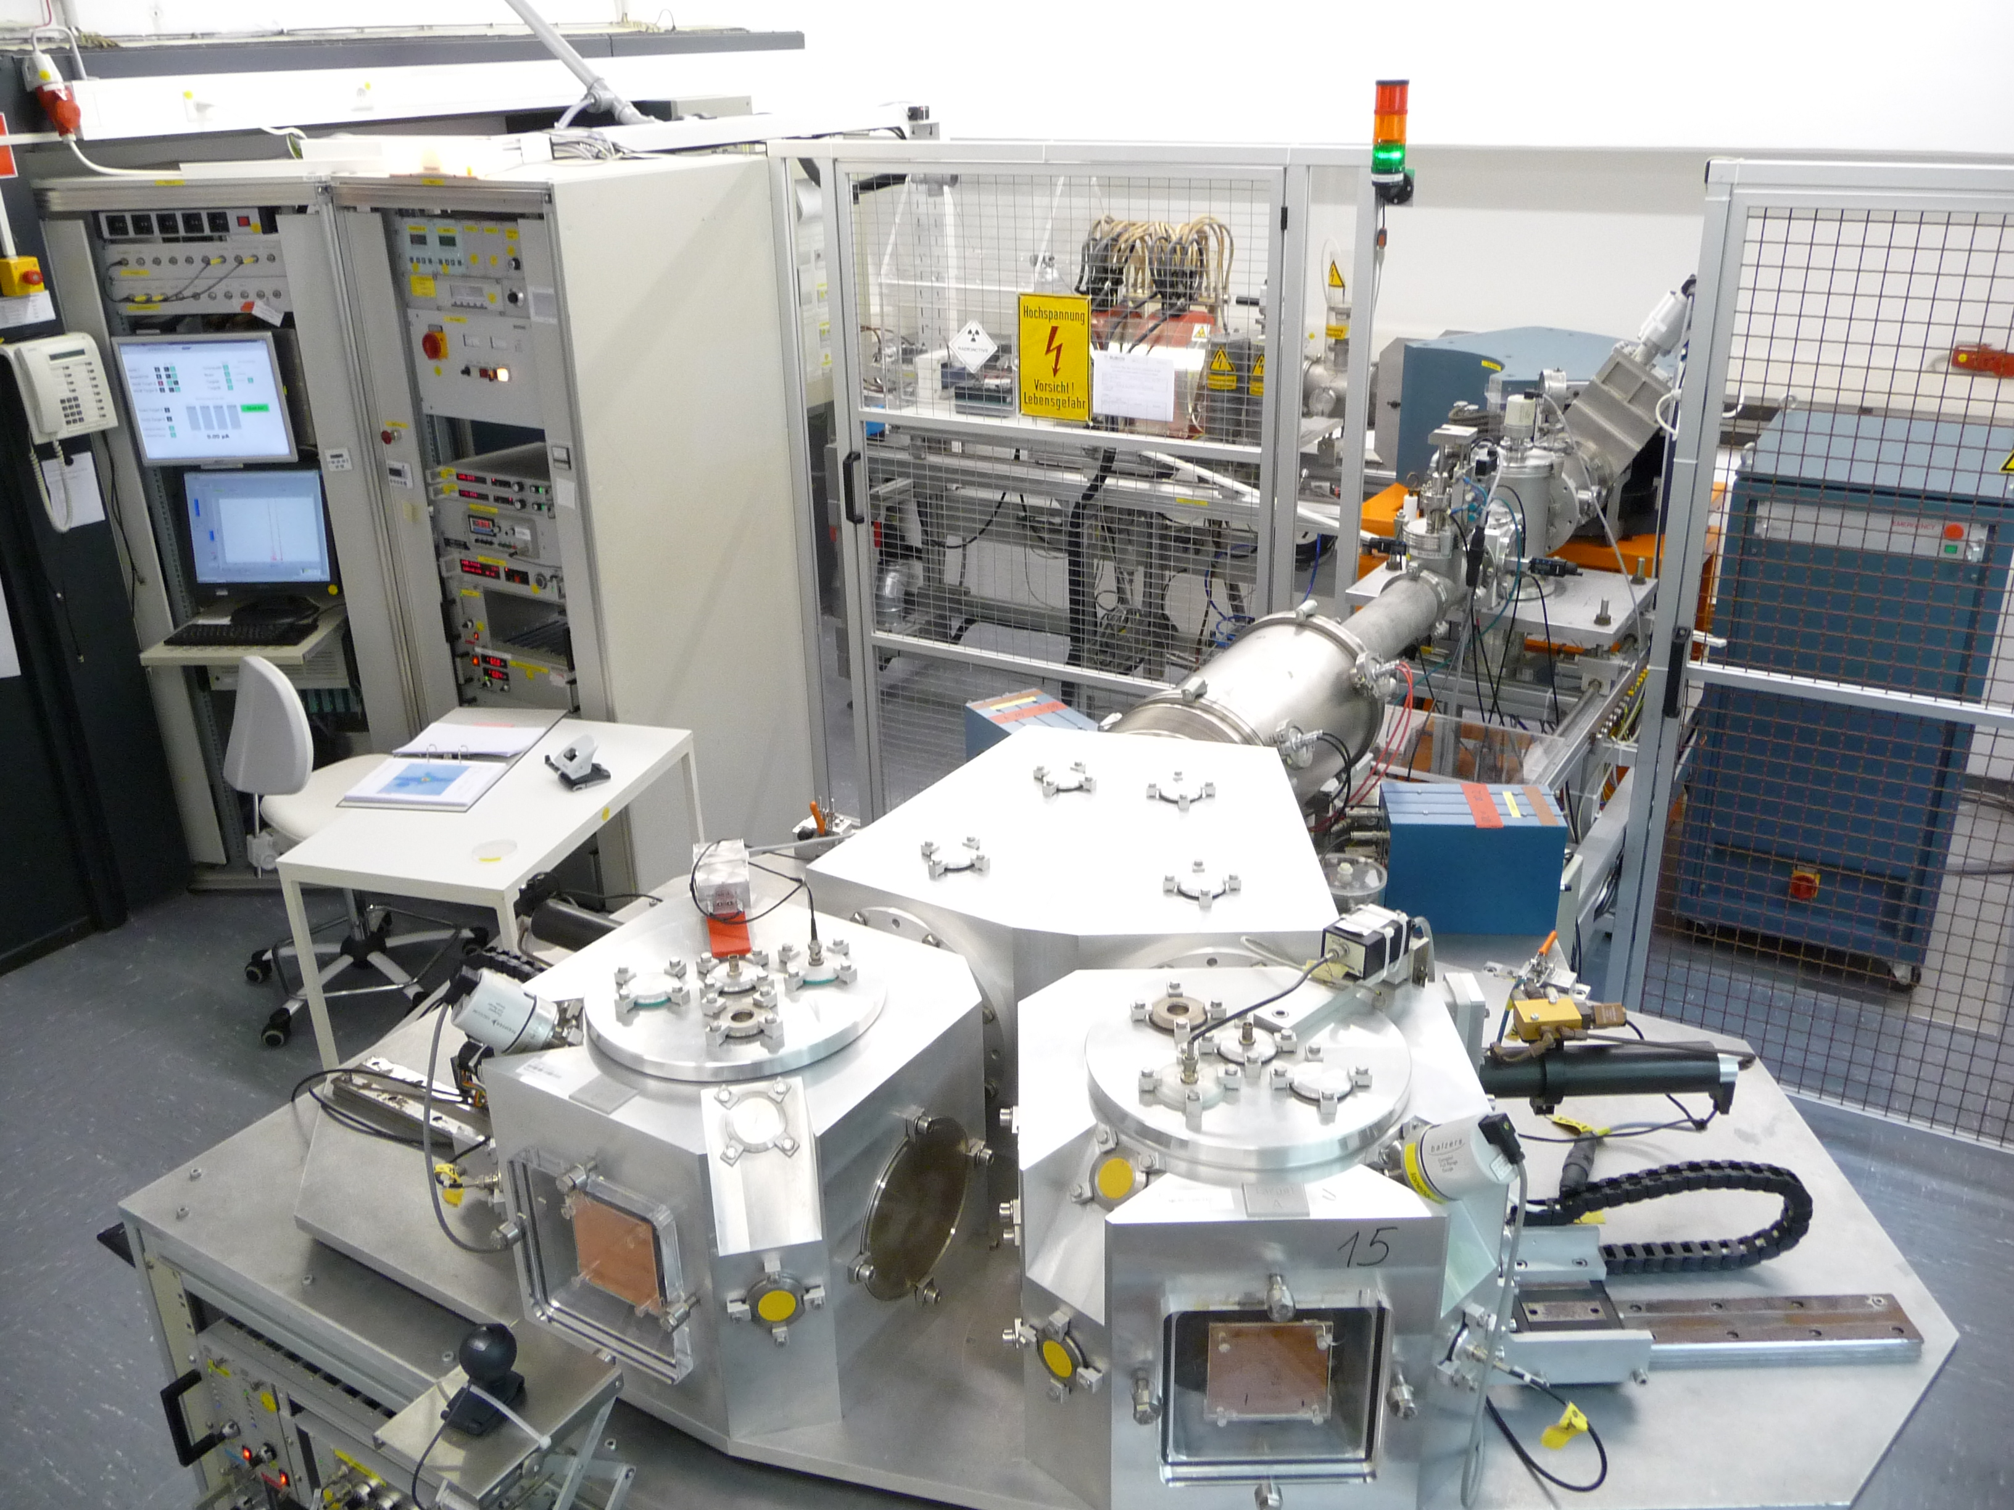
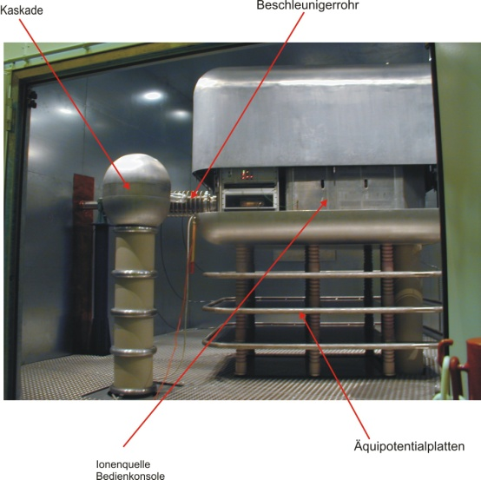
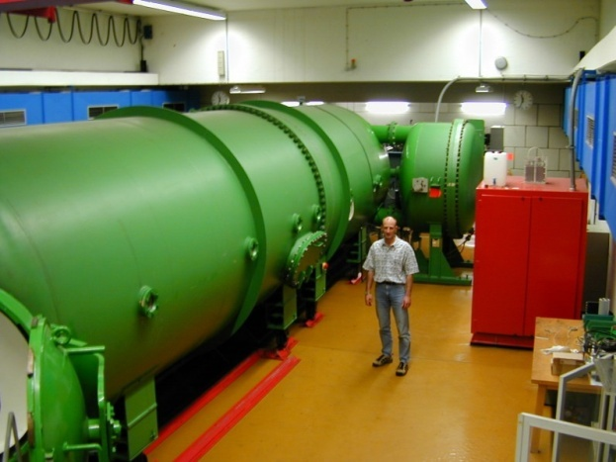
Accelerators in Bochum
Ion Beams from a few keV up to some 20 MeV

Slide 3
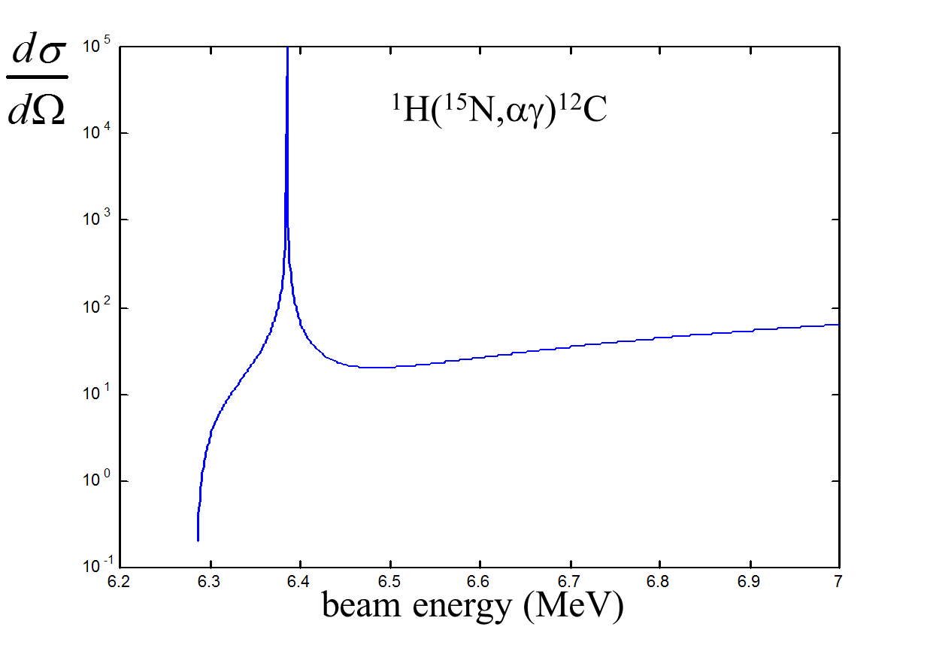
Depth profiling with
Nuclear Resonance Reaction Analysis
Motivation:
Detection of light elements (in particular Hydrogen)
isotopic tracing
Example:
Hydrogen depth profiling
with an ¹⁵N beam

Slide 4
Nukleare Reaktions Analyse (NRA) am Beispiel ¹⁵Ν(p,α γ)¹²C
Probe
E = E_{R}
E > E_{R}
Wirkungsquerschnitt [rel.]
Detektor
Strahlenergie [MeV]
E = E_{R}
E > E_{R}
Wasserstoff in Silizium
Ringversuch Bundesanstalt für Materialforschung

Slide 5
beam
sample
Depth resolution: a few nm

Slide 6
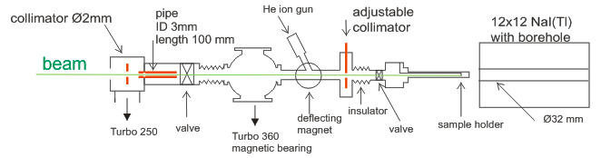
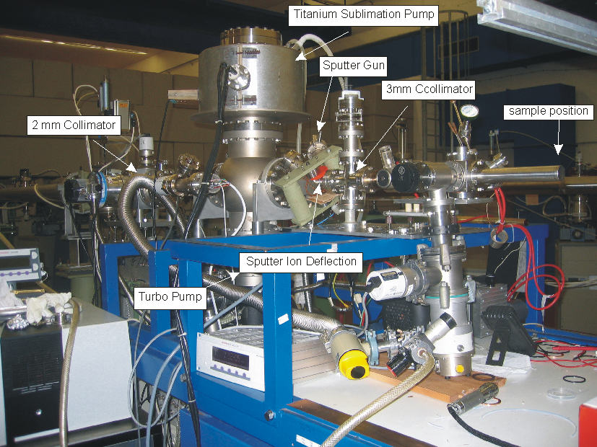
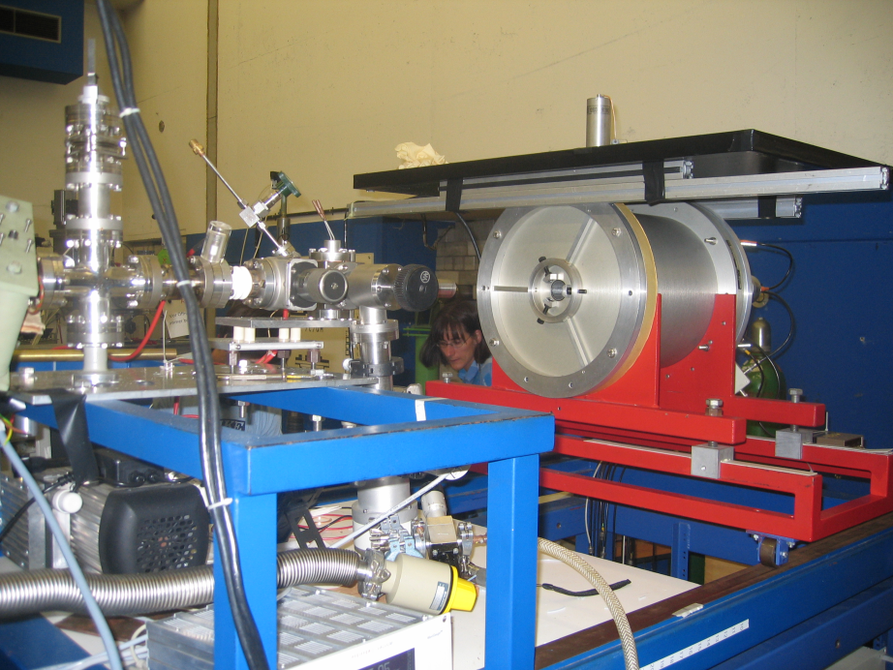
The set-up in Bochum
p = 2x10⁻⁹ mbar

Slide 7
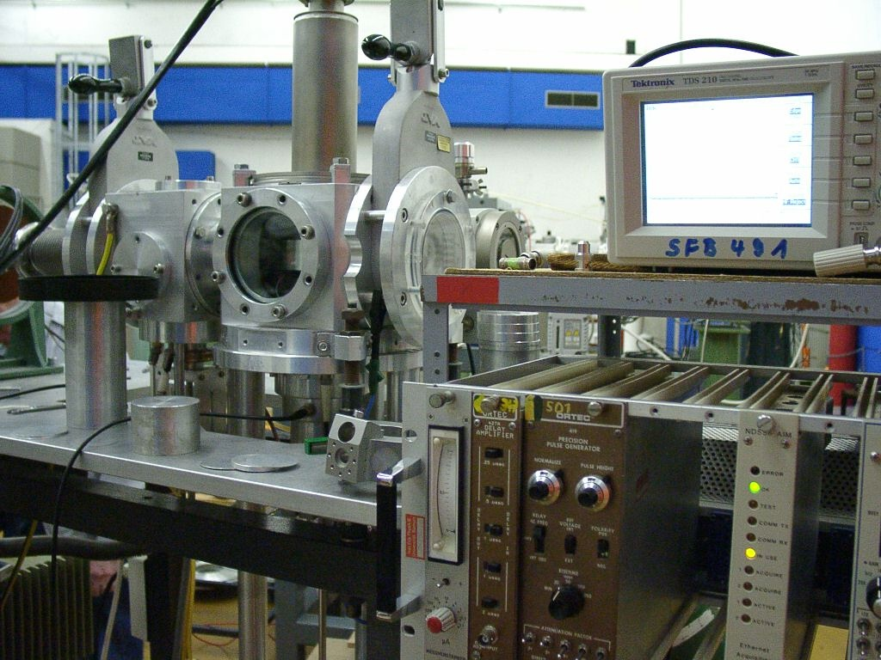
Rutherford Backscattering Spectroscopy
sample
Probability
for scattering:
E_{i}
Detector
E_{f} = k E_{i}
Scattering angle (u)
Energy of scattered particle:
ZrO₂ auf Si, E_{a} = 2,0 MeV,
AG Fischer / Devi, RUB
O
Zr
Si
energy scale →
mass scale →
depth scale ←

Slide 8
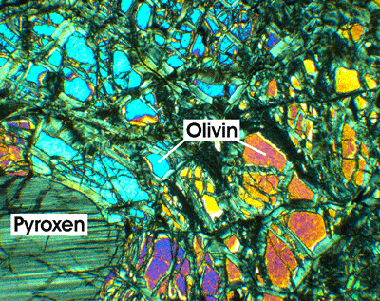
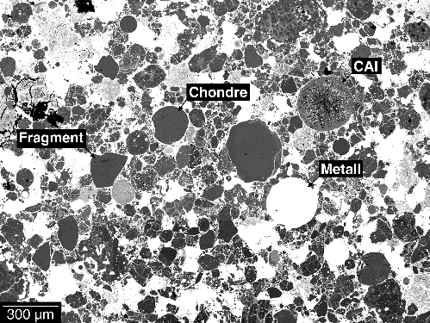
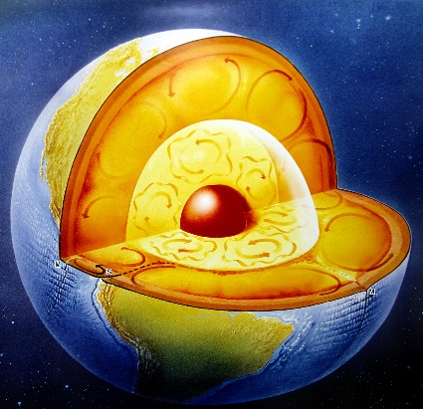
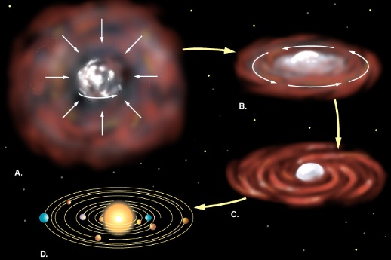
Study of Diffusion in Minerals – why?
1.
Diffusion is observed in samples
e.g. from subduction zones or meteorites…
…and one can learn something about
processes in the interior of the Earth or during the origin of the solar system
(time- temperature- and pressure scales)
when diffusion parameters are known!

Slide 9
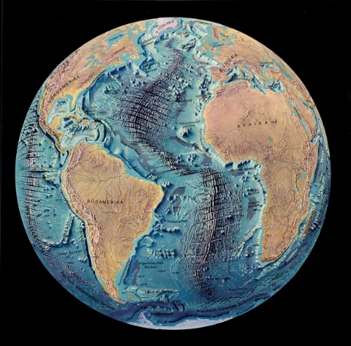
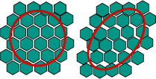
Study of Diffusion in Minerals – why?
2.
There is a close connection between diffusion and creep
mechanical properties
microscopic properties
and it all depends on defects in crystals !

Slide 10
Measurement of diffusion processes in the laboratory
Nature
Experiment
A
AB
Timescale
B
AB
B
100 μm
A
10 nm
100000 years
~ 8 days
Temperature scale
Q = activation energy

Slide 11
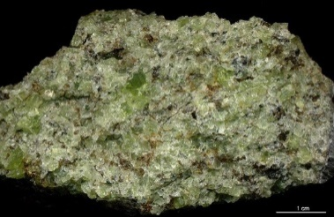
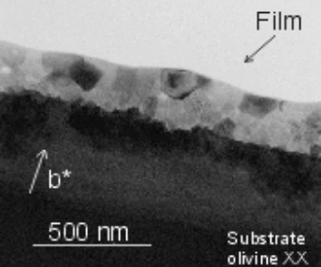
RBS-profile of a diffusion anneal
900 °C 67 hours fO2 = 1.e-15 bar
Example: Fe-Mg diffusion in olivine:
Fayalite
Fe₂SiO₄
Olivine:
(Fe_{x},Mg_{1-x})₂SiO₄
Forsterite
Mg₂SiO₄
Yield [counts]
Olivin
Olivin
O
before annealing
after annealing
- simulation
Mg
Si
Fe
Energy [keV]

Slide 12
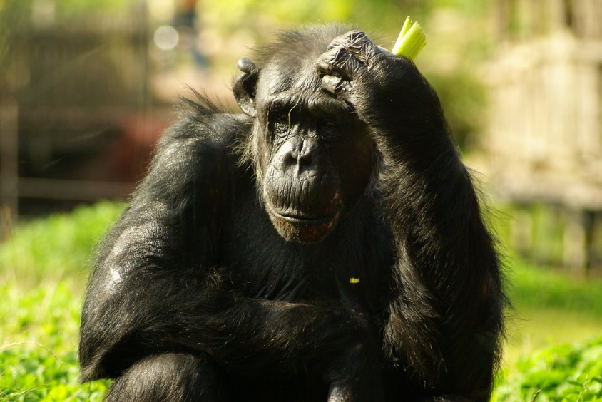
It would be very interesting for the understanding of diffusion studies to know more about amount and type of defects
PAC ?
There is only very little literature about PAC studies in minerals
e.g. Miami University Oxford, Ohio 2005
H. Jaeger, M. P. Rambo, R. E. Klueg, S. McBride…
Our first challenge is now
to understand what we can learn from PAC results
„finding a common language between geoscientists and PAC people“

Slide 13
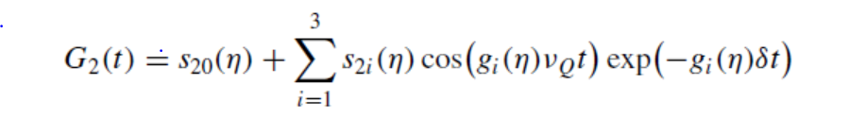
e.g. the investigations of zircon (ZrSiO₄)
Thesis McBride 2005
Measurement fitted with the perturbation function…
…to deduce
the EFG parameters:
(asymmetry parameter)
ν_{Q} (quadrupole frequency)
δ (damping parameter)

Slide 14
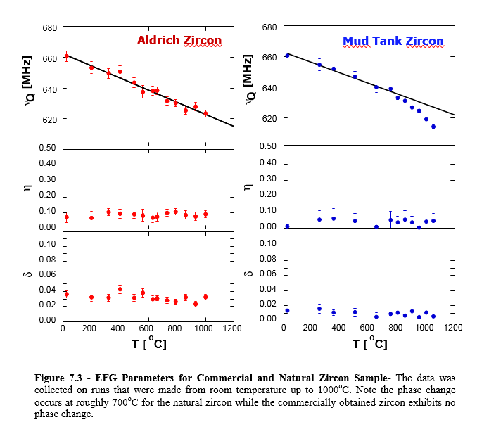
The EFG parameters
Change in slope of temperature dependence
> displacive phase transition ?
= 0 no radiation damage
> 0 radiation damage
and impurities ?
what to learn from
the damping parameter
Thesis S. P. McBride 2005

Slide 15

from the geoscientist
Main question: What is the physical picture, in terms of structure and defects, that we can learn from these and other PAC results?
For example, can we answer questions such as:
What is the concentration of a certain kind of defect at a given condition e.g. T, P,…
What is the geometry of the atoms around the defect site?
How much energy is required to form a certain kind of defect?
What are the different kinds of defects that are present in a crystal, and in what concentrations?
etc. etc.

Slide 16
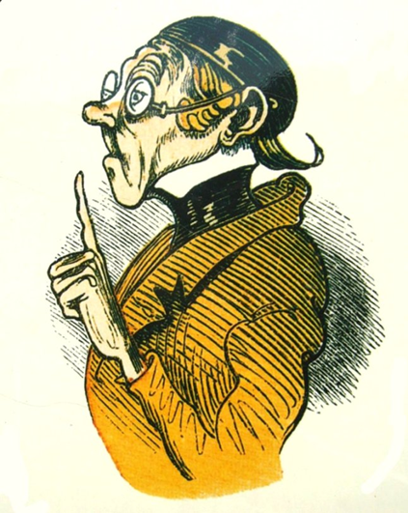
… is needed

