Slide 2
The HIE—ISOLDE Cryogenic System, its Infrastructure and
Considerations for Phase 3
O. Pirotte (TE/CRG)

Slide 3
Outline
Introduction : HIE-Isolde cryogenic system
Commissioning and operation in 2015
Commissioning and operation in 2016
Consolidations during EYETS 2016-2017
Commissioning and operation in 2017
Cryogenic system & Phase 3
Summary

Slide 4
HIE-Isolde cryogenic system: Process Flow Diagram
(Bypass)
Cryo-plant
6 x Jumper box + flexible TLs to allow easy disconnection/reconnections and to cope with a complex cool down procedure in five phases
2’000 liter Dewar to cope with cryo plant stops and keep shield T < 100 K

Slide 5
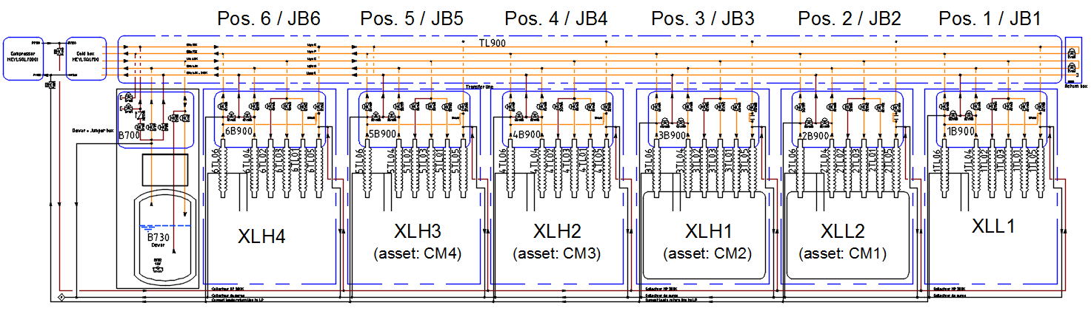
HIE-Isolde cryogenic system
Cryo-plant:
Compressor Station
+ Refrigerator (CB)
Cryogenic Distribution System (CDS):
Dewar +
valve box (DB) + Transfer Line + Jumper Box (6x) + Return Box
RB
Phase 3
Phase 2b
2018
Phase 2a
2017
Phase 1b
2016
Phase 1a
2015
Phase 3
Cryo-modules (6x)

Slide 6
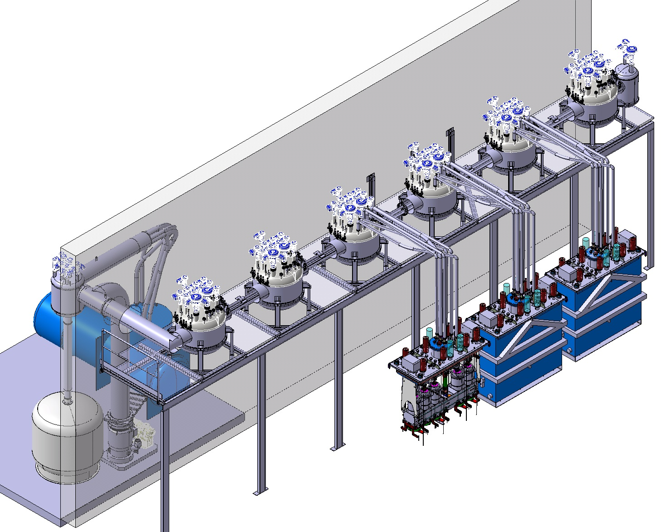
HIE-Isolde cryogenic distribution system (CDS)
JB1
RB
JB2
Transfer line
JB3
Refrigerator
(Cold box)
630 W @ 4.5 K
Flexible
transfer
lines
JB4
JB5
JB6
Dewar VB
Dewar
CM1 (2015)
CM2 (2016)
CM3 (2017)
CM4 (2018)

Slide 7
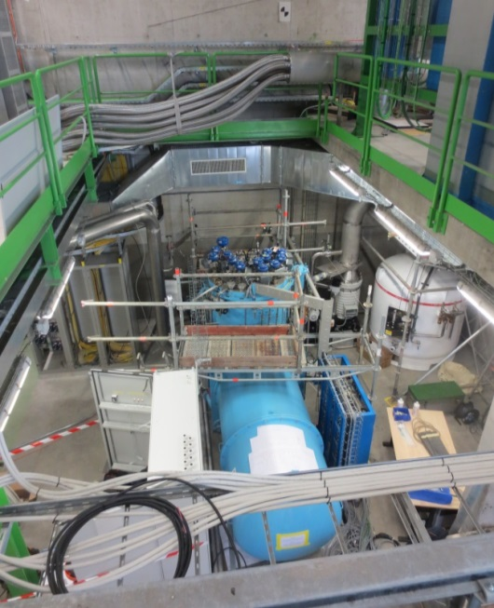
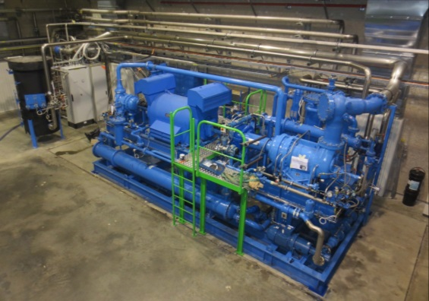
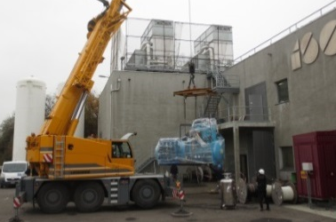
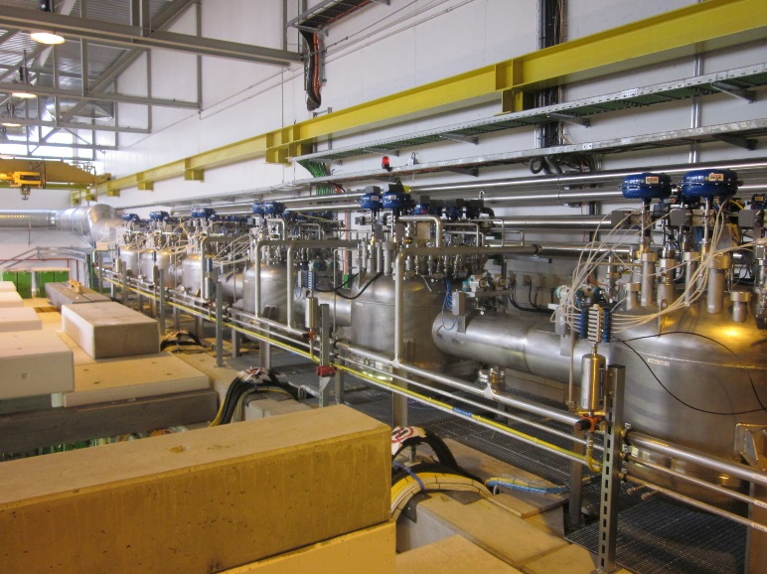
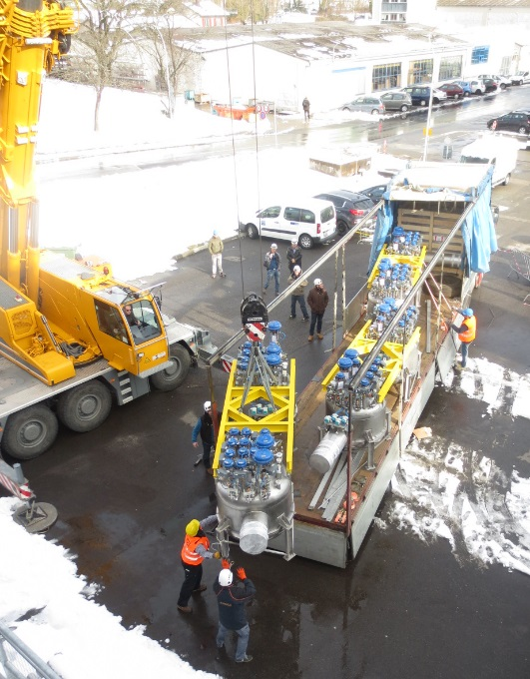
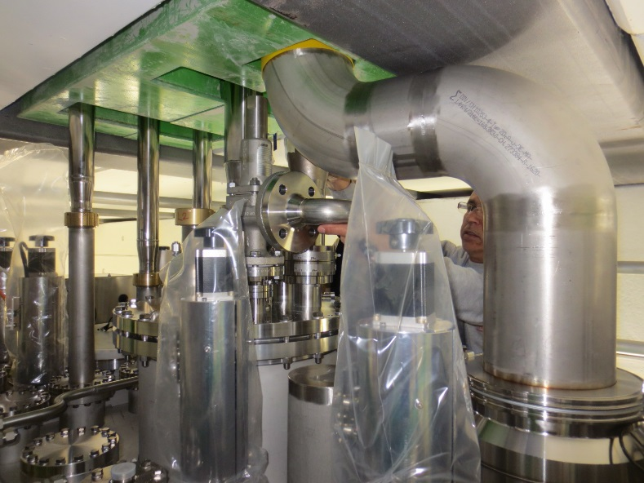
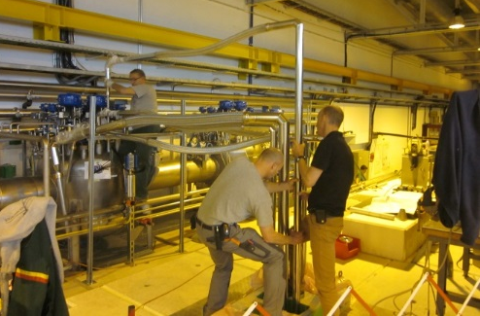
2015: cryogenic system installation
Cryoplant recovered from former LEP ALEPH experiment’s cryogenic installation (1989) on stand-by after the LEP de-commissioning
Refrigerator
Compressor station
Connection of cryo-module CM1
Cryogenic Distribution System

Slide 8
2015 : First commissioning and operation with CM1
Very short time to perform commissioning of cryoplant
First cool down and commissioning of CM1 performed manually
Operation performed with basic automatisms and interlocks
One incident : over-pressurization of CM1 -> burst of rupture disc
100 % availability during run of physics
Cavities cool-down to 4.5 K
Thermal shield cool-down from ambient temperature down to 90 K

Slide 9
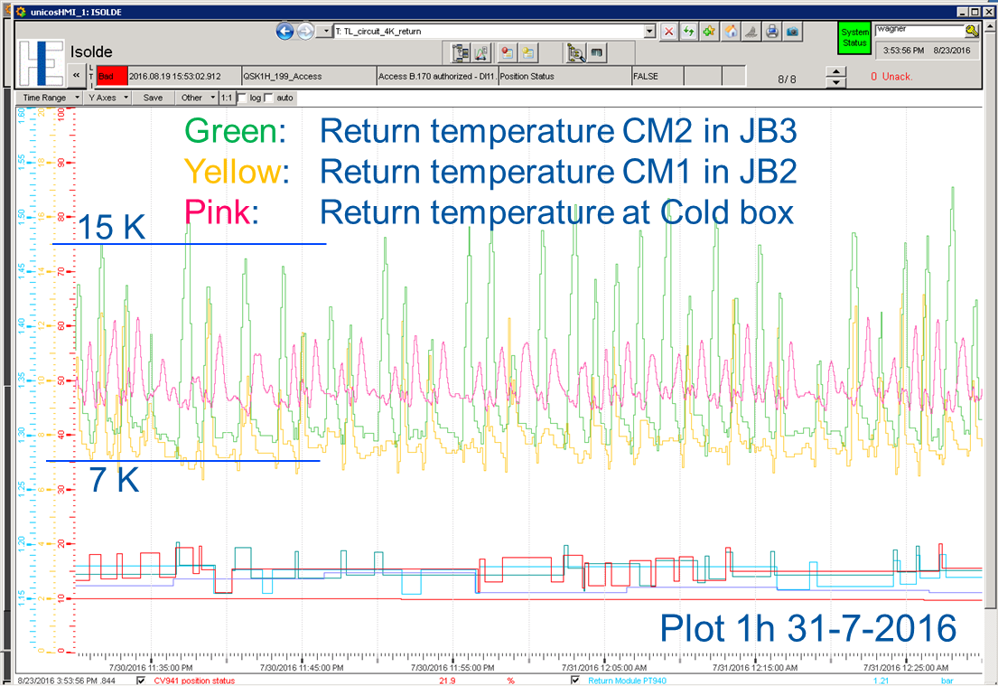
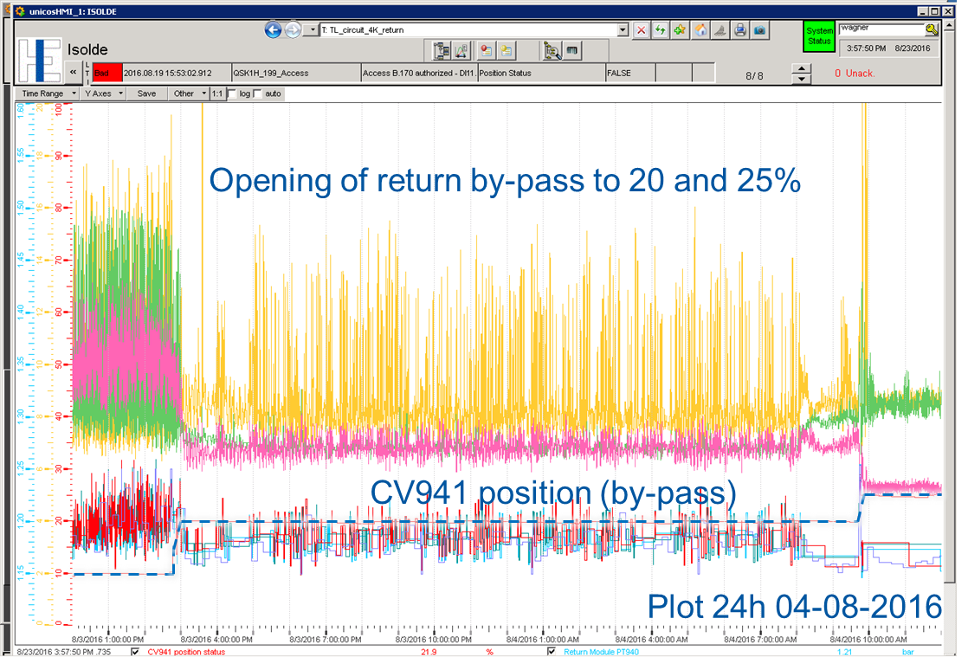
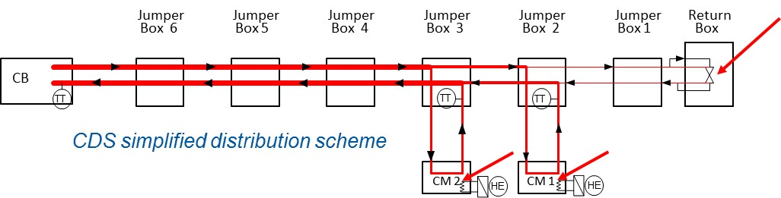
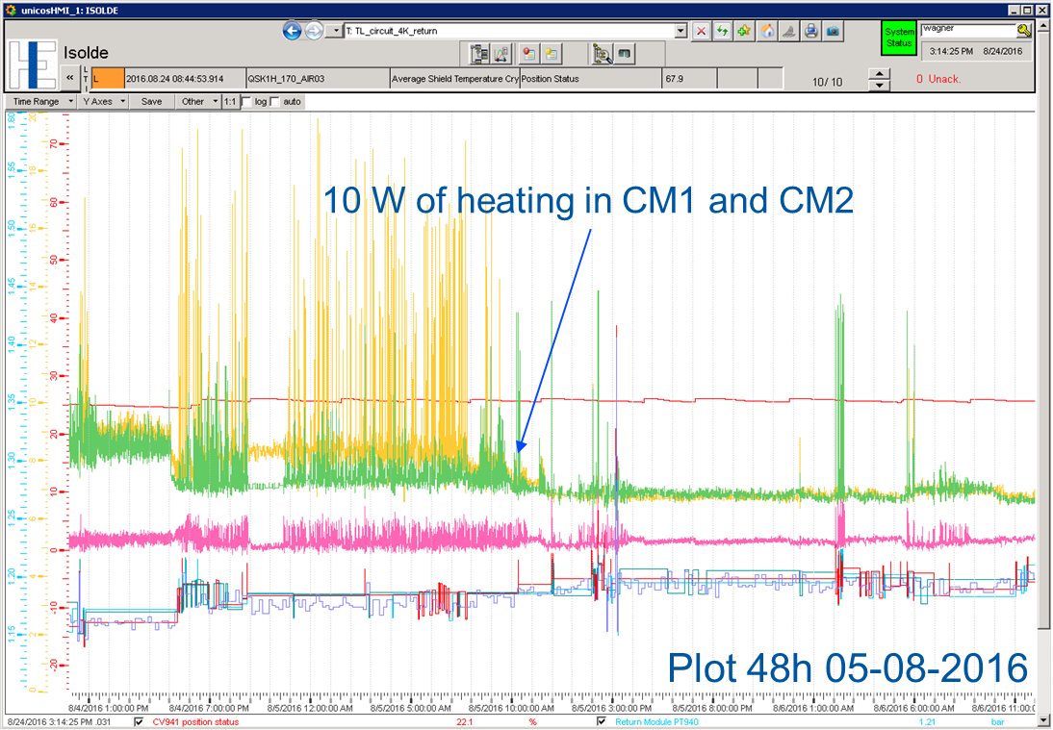
2016 : Commissioning and operation with 2 x CM
Cool down and commissioning of CM1 + CM2 hardly performed during summer 2016
Major issues identified :
  CP flow limitation,
  bad LHe “quality” supply,
  strong oscillations in the 4.5K return line and cavities tripping
  (-> indications of high heat load estimated to 3 x the expected figure)
Operational conditions found by increasing by-pass valve opening in the Return Box and by powering heaters in each CM
100 % availability during run of physics
Investigations of Cryogenic Distribution System (CDS) in situ did not show evidence of problem
(cold spots, vacuum issue)

Slide 10
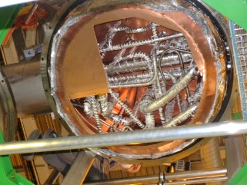
EYETS 2016-2017 : consolidation action plan
Compressor station and Refrigerator :
  Revision of the safety system with respect to overpressure events ;
  Review and simplification of safety chains;
  Update of CP logic -> allow full CP performance and ease restarts ;
  Update of refrigerator process control -> more robust process with automatisms allowing reconnection of cryo-modules in cool down situations
CDS :
Full commissioning of all jumper box;
Upgrade of PLC and logic including automatisms easing restarts and reconnection in cool down situations
Installation of CM3 and CDS endoscopic investigations

Slide 11
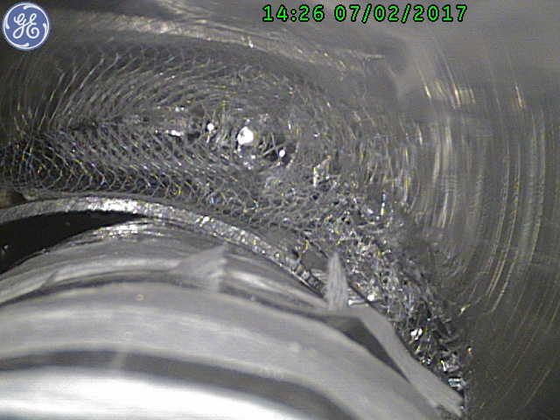
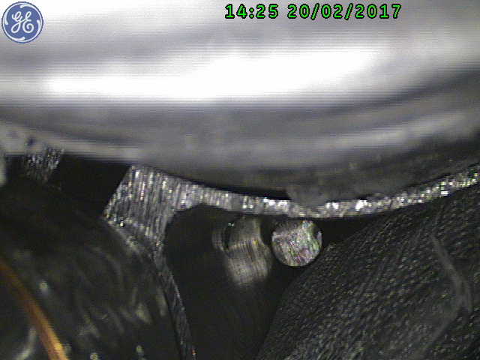
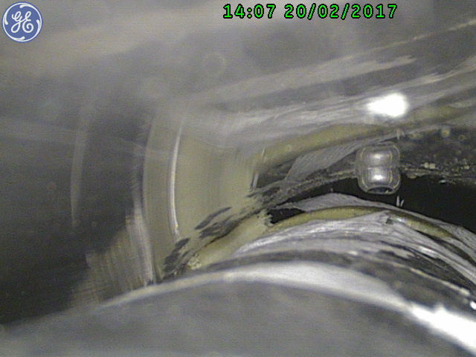
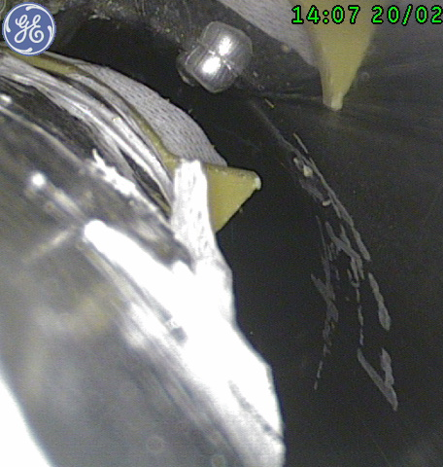
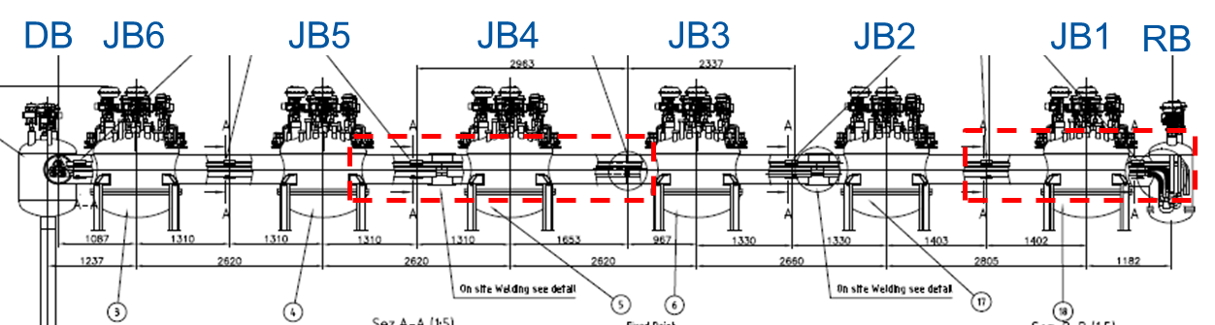
Main finding of endoscopic investigations :
contact of 4.5K process pipes with shield
View from JB4 to JB5
View from JB4 to JB3
Line C DN40
LHe 4.5 K
Line D
GHe 4.5 K
Shield
Vacuum
Jacket
Shield
Line G DN50
Gas Return
4.5 - 300 K
Line C DN40
LHe 4.5 K
View from JB4 to JB5
Spacers too fragile ? Incorrect design wrt thermal contraction force ?
Too narrow gap between 4.5 K process pipes and shield
Crushed spacer
Line C
LHe 4.5 K
Line C
LHe 4.5 K

Slide 12
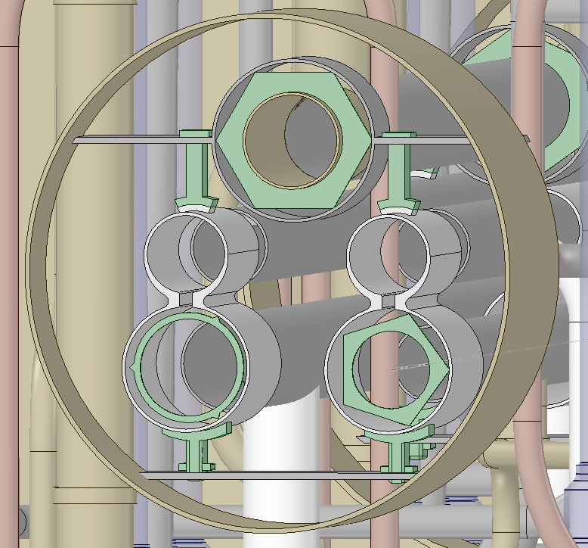
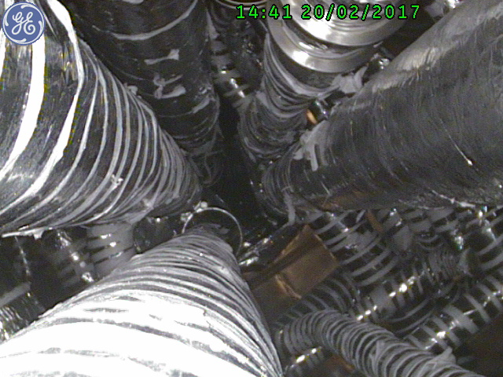
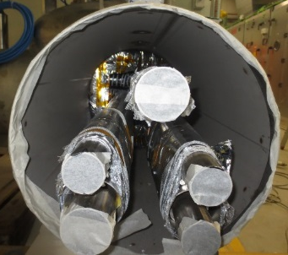
Main finding of endoscopic investigations :
contact of 4.5K process pipes with shield
Obvious contact of LHe and GHe 4.5 K lines (headers C & D) with the shield in the TL interconnecting the Jumper Box (JBs)
=> Implies significant contact all the way along transfer line
TL design
Meeting in situ with the manufacturer
Full repair : new design required -> postponed to next YETS
Setting up by TE-CRG of a crash program to repair "at best" and with no impact on the HIE-Isolde program
Line G
Gas Return
4.5 - 300 K
Line G
Line F DN32
Shield out 75 K
Line F
Shield out 75 K
Line E
Shield in 50 K
Line E DN32
Shield in 50 K
Line D DN50
GHe 4.5 K
Spacer
Line D
GHe 4.5 K
Line C
LHe 4.5 K
Line C DN40
LHe 4.5 K
Shield
View from return box of Jumper Box 1 to 2

Slide 13
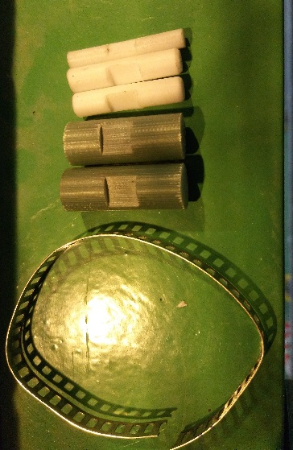
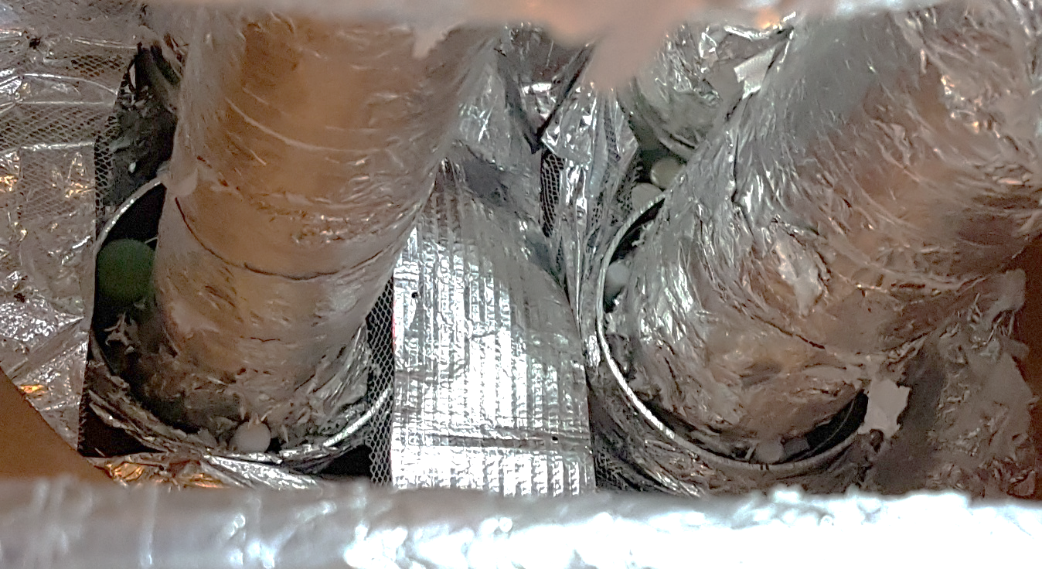
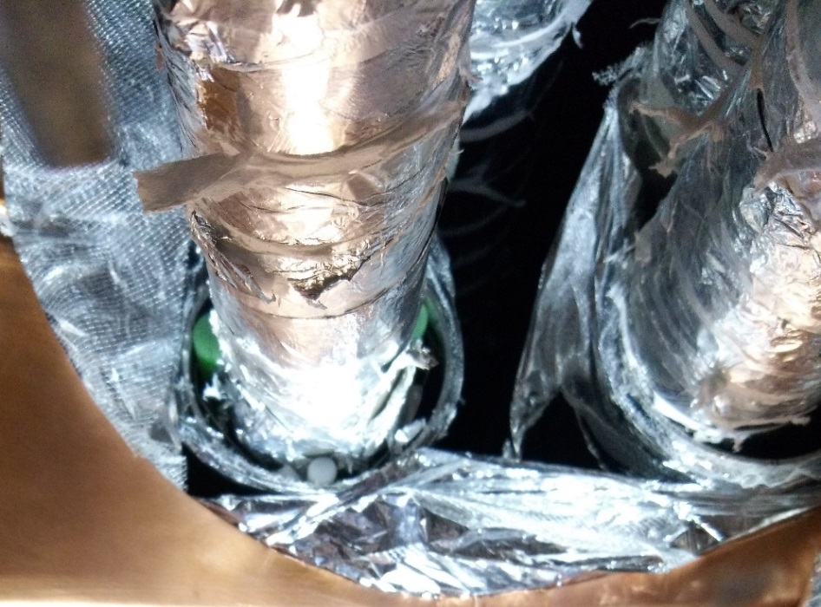
EYETS crash program: removal of contacts
Opening of all JBs
Insertion of spacer material to remove direct contacts
Operation successful for LHe 4.5 K process pipe
Not fully for GHe 4.5 K process pipe (requires too much force -> risk of breaking)

Slide 14

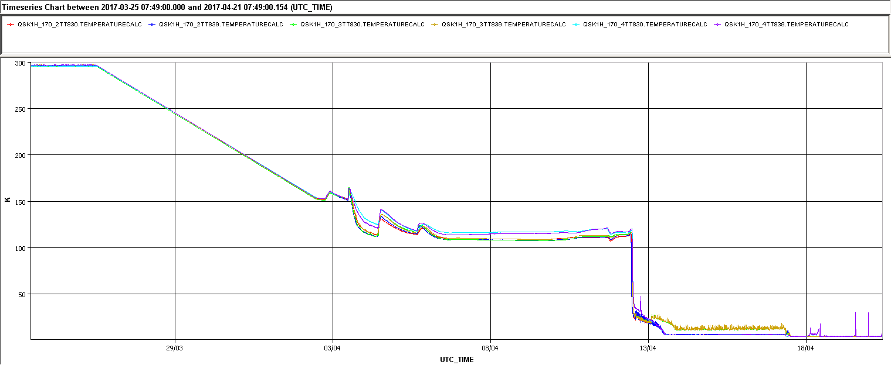
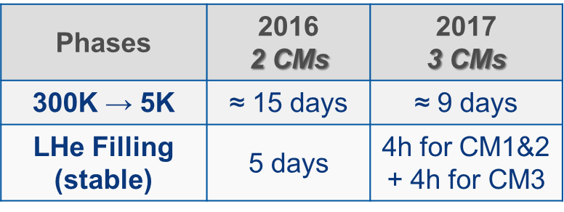
2017 : Commissioning and operation
Recommissioning of the cryo-plant (compressor station and refrigerator)
Full nominal power available from cryoplant
Successfull cooling and filling of the 3 CMs and dewar
  LHe filling of cryomodules achieved much quicker wrt 2016 and via the frame circuit only → proof of better LHe «quality»
Cool down with GHe derived from shield circuit
Cool down with shield and LHe circuits
Cool down phases :
Shield only
Shield + frame+vessel
Shield + frame + vessel + cavities
4.5K
Filling
Nominal
Cavitiy temperature [K]
Issues with LTs in CM3
Stop of cool down : RF multipacting conditioning

Slide 15
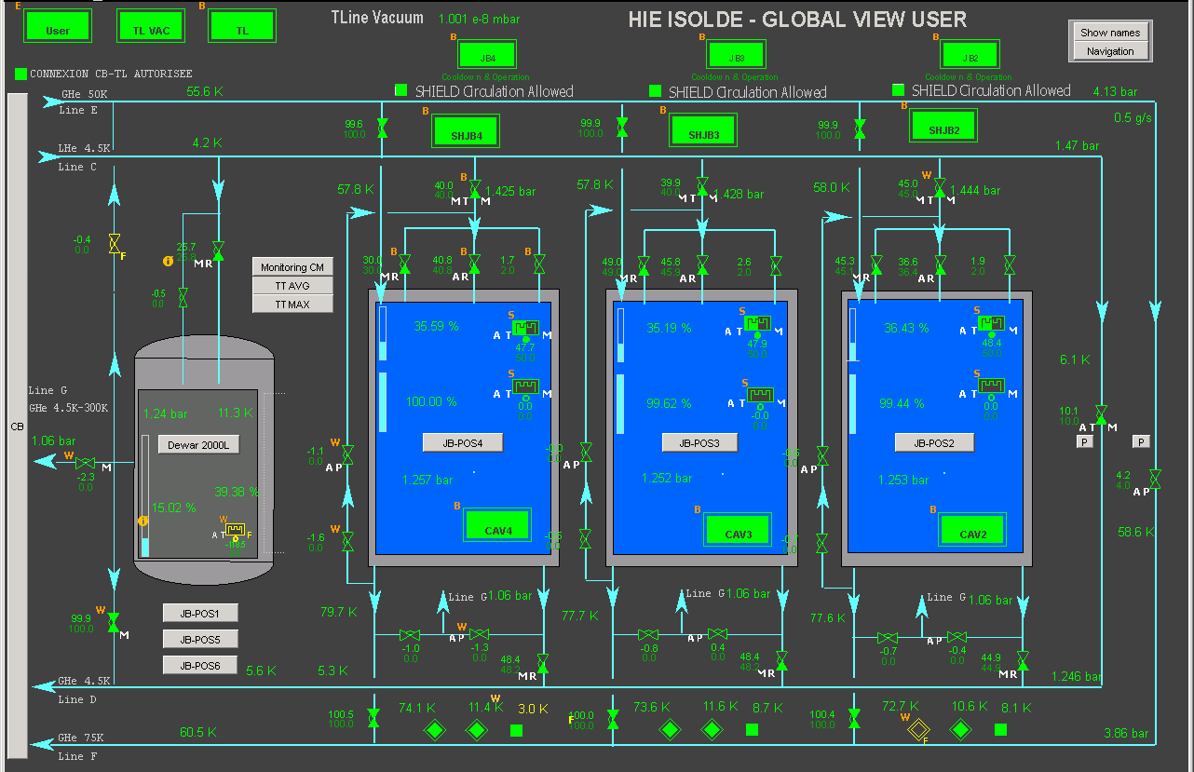
2017 : Commissioning and operation
Static heat load tests : LHe level drop
2016 : ~11W, shield actively cooled
2017 : ~13W, shield stopped
Issue with CM2 : 3 times higher => under investigation
Commissionning of new control system and processes
  Restart tests : done for most credible and expected cases (power cut, …)
  Automatisms : tested sucessfully
  Only the refilling with LHe is semi-automatic (waiting for CM4 and final version)
100 % availability during run of physics

Slide 16
Cryogenic system & Phase 3
In 2012 a dedicated MS and IT-3777/TE was launched for the cryogenic system including the a cryo-plant and a cryo-distribution system (main transfer line and 6 jumper boxes), with the following technical specification and overall capacity (extract from IT-3777/TE):
Reduced mode Maximum mode Design mode
(2 cryo-modules) (6 cryo-modules) (Max. cryogenic power)
Cooling power @ 4.5 K 250 W 700 W 1’400 W
Cooling power @ 50 K – 75 K 700 W 2’000 W 4’000 W
Helium liquefaction rate 0.5 g/s 1.5 g/s 3.0 g/s
The Invitation to Tender was cancelled early in 2013 due to the very high price of the proposed offers (9.8 MCHF) well above the HIE-Isolde available estimated budget for cryogenics (4.9 MCHF)
In common agreement with the HIE-Isolde collaboration, the decision was taken to use the former LEP ALEPH experiment’s cryogenic installation (1989) on stand-by after the LEP de-commissioning.
The total budget for cryogenics was reduced to 3 MCHF. However it clearly appeared that the maximum mode with 6 cryo-modules (phase 3 not approved) is not any more achievable with the as below LEP ALEPH cryo-plant available cryogenic power at 4.5 K (presented to the HIE-Isolde collaboration in the Cost & Schedule review of the 27th October 2014)
LEP ALEPH cryogenic plant specification
Cooling power @ 4.5 K 630 W
Cooling power @ 50 K – 75 K 2700 W
Helium liquefaction rate 1.5 g/s

Slide 17
Summary
Long series of issues due to lack of time to commission the cryo-plant and the CDS with the associated control logic
A major issue consisting in excessive heat load in the distribution system has been found and will be repaired during YETS 2017-2018
The former LEP ALEPH cryoplant has been now commissioned and is operational for HIE-Isolde phase 2.
The dewar commissioning is on-going
The final control system for the CDS will be completed with the CM4 installation
100% availability of the cryogenic system during all run of physics
The present cryo-plant will not be able to deal with Phase 3

Slide 18
Additional slide(s)

Slide 19
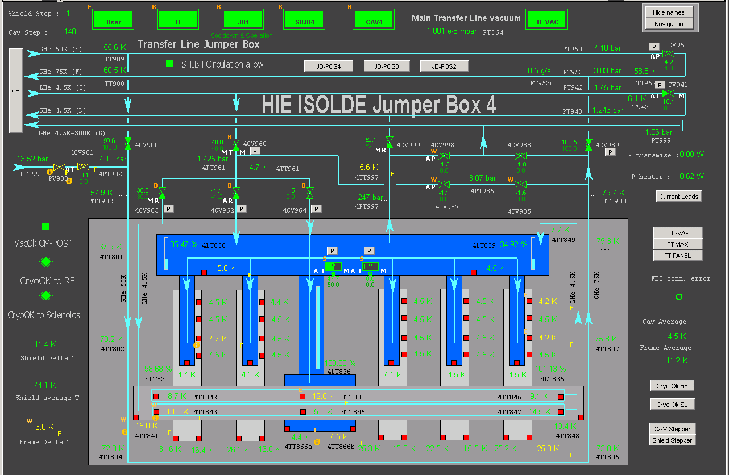
Nominal operation of new CM3 with 50W additional power
GHe 50K
Shield circuit
GHe 75K
LHe 4.5K
4.5K circuit
GHe 4.5K
Jumper Box
LHe vessel
Frame
Shield

Slide 20
Nominal operation with 3x50W additional power

Slide 21
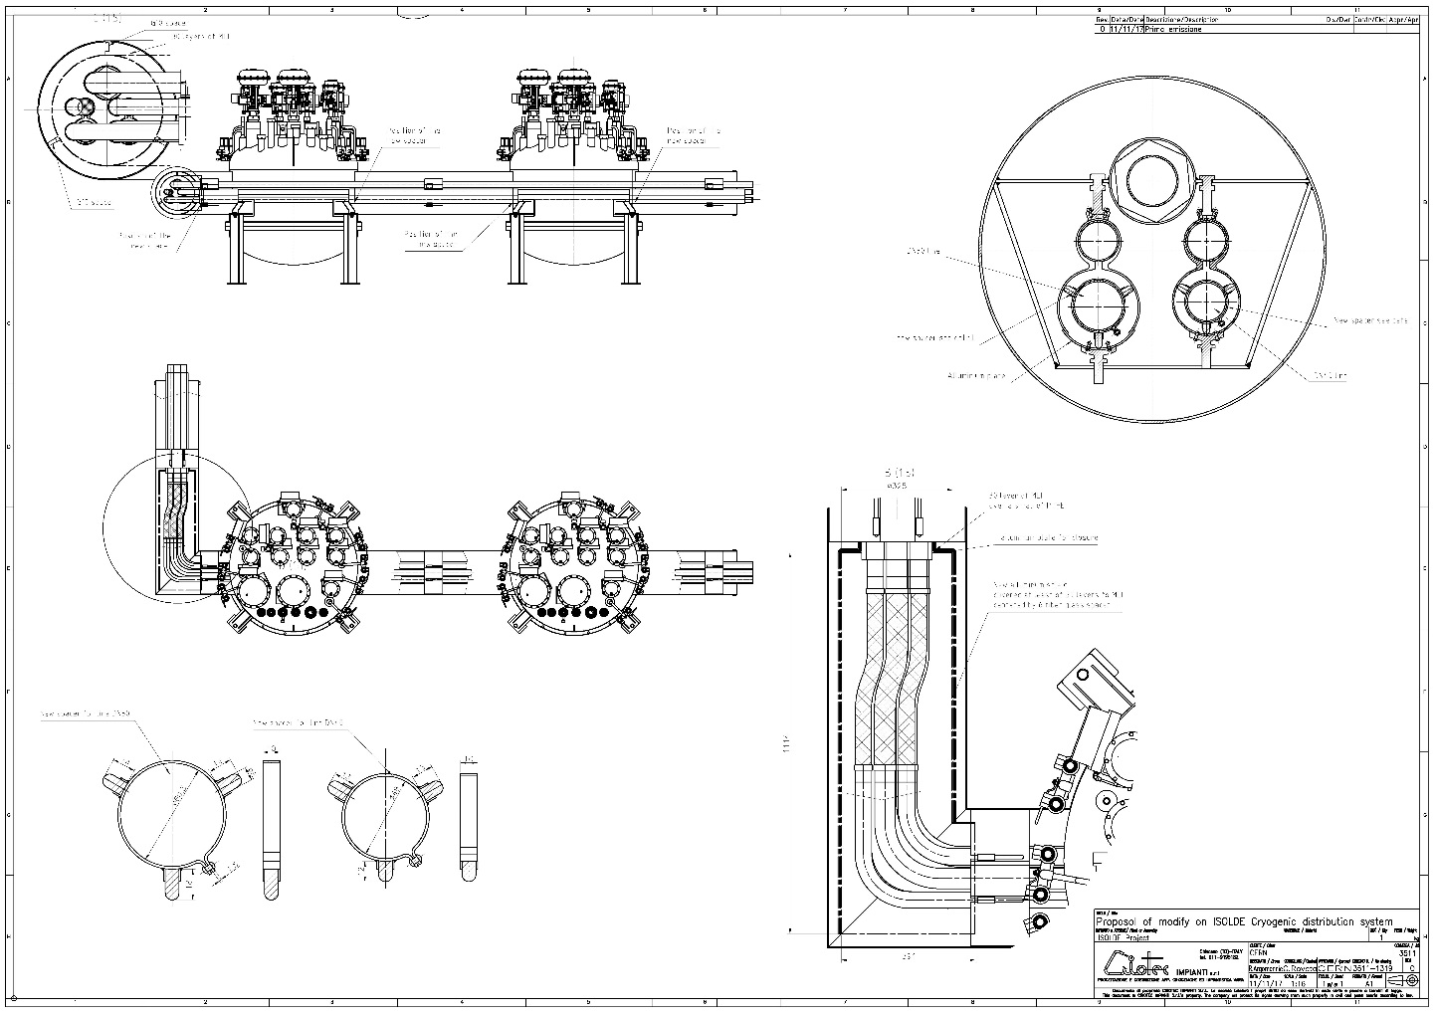
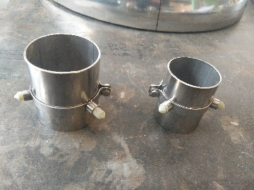
CDS repair : new design
Requirements:
  Control of gap between 4.5 K process pipes and shield;
  Correct alignment and freedom for pipe movements during thermal shrinkage
  Continuous shielding of 4.5 K process pipes (MLI issues)
New design
New internal spacers
Shield extension

Slide 22
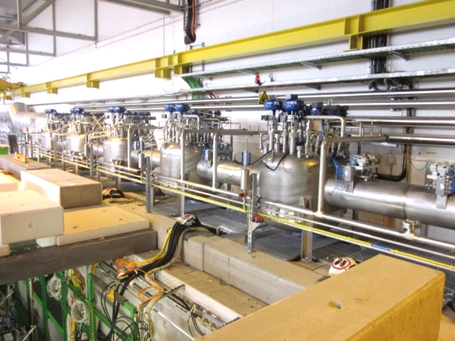
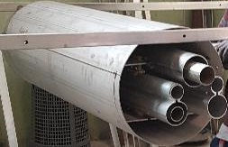
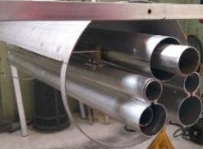
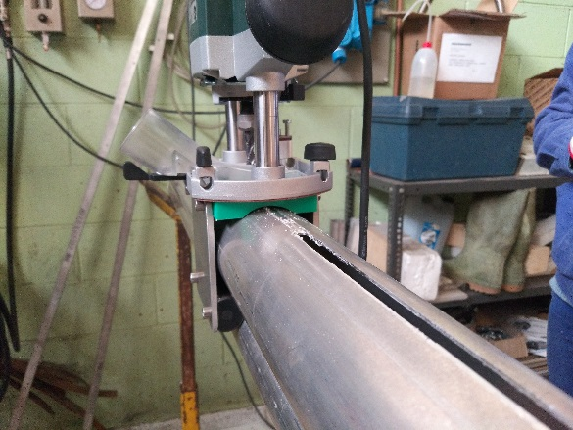
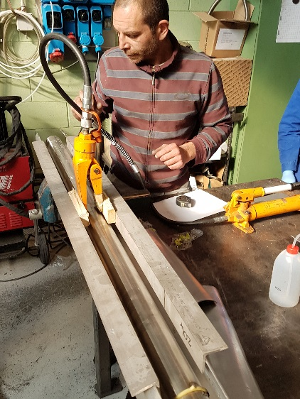
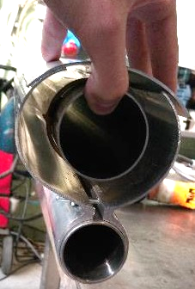
CDS repair : execution
Criotec workshop:
  Development of special toolings
  Test and validation on mockups
Repair procedure :
  Opening of JB and removal of temporary spacers
  Removal of vacuum jacket of TL
  Removal of MLI around the shields
  Cutting shields with portable milling machine
  Opening, widening and shaping of the shield
  Cleaning
  Removing of spacers and evaluation of “freedom” of the pipes
  Lowering and re-centring of 4.5K pipes (lowering by ~ 20 mm)
  Assembly of new internal spacers (one at each extremities)
  Completion of shield with pre-folded Al pieces (tag welded)
  MLI
  Re-assembly of the vacuum jacket
  Leak test
Repair time estimated to 4 weeks

