Slide 1
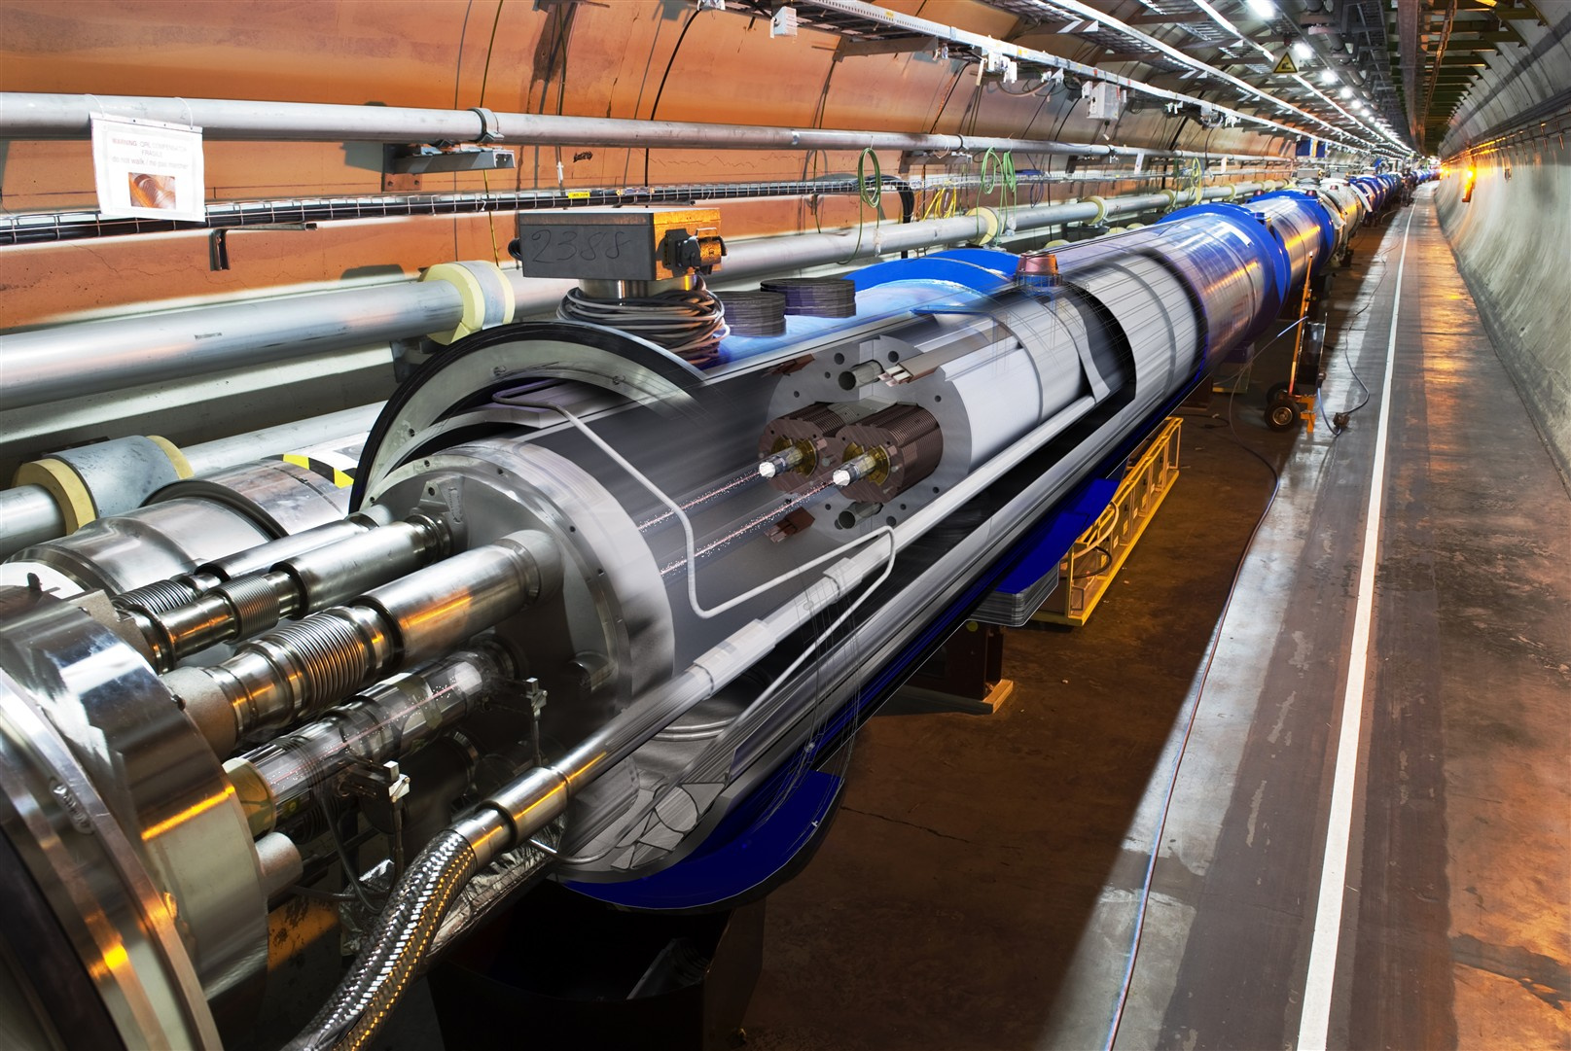
The LHC Control System
CERN Accelerators Control System
Eugenia Hatziangeli
Beams Department Controls Group
(input from J. Wozniak, R. Steerenberg, M. Lamont,
W. Sliwinski, R. Gorbonosov, T. Wlostowski)
CERN – Geneva - Switzerland
Accelerators and Technology Sector

Slide 2
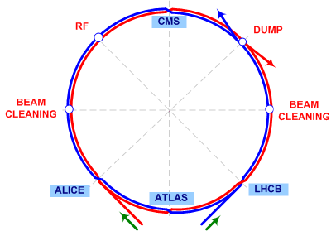
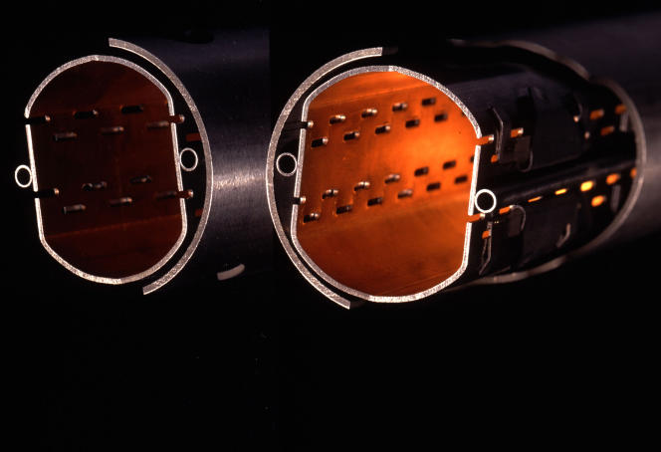
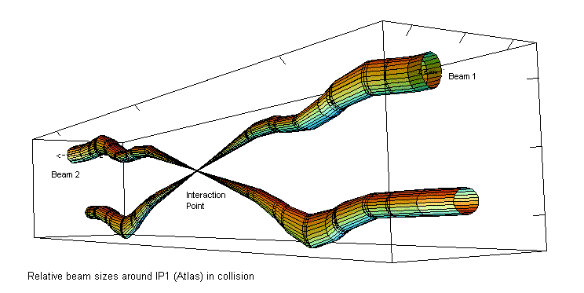
The Challenge
Accelerate 2 beams of 2.2x10e14 high energy protons in opposite directions around a 27km ring moving at 99.9999% of the speed of light
Through two very narrow, very cold tubes
Squeeze them down to 16 microns
Get them to and keep them colliding for 10-15 hours
Keeping beam-losses down to a very low level
THIS HAS TO BE DONE WITH THE CONTROL SYSTEM

Slide 3
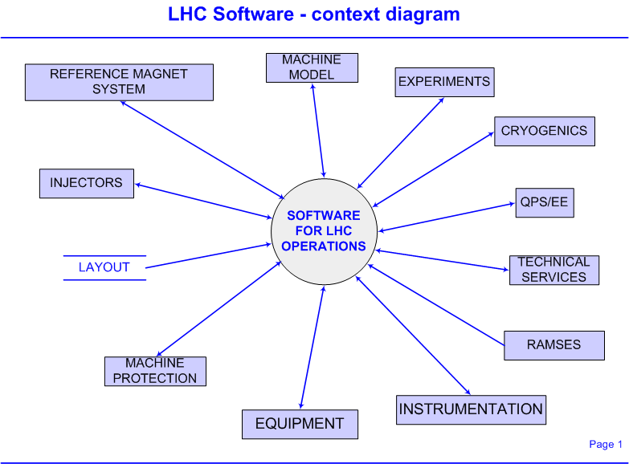
The Controls’ Challenge
EQUIPMENT
  Collimators/TDI/TCDQ etc.
  Beam Dump
  Power converters,
  Kickers
  RF, TFB, LFB
  Spectrometers & compensation
INSTRUMENTATION
  Distributed systems:
    BLMs, BPMs,
  Standalone:
    BCT, BTV, AGM, BIPM, BWS, Schottky..
  Tune, Chromaticity, Coupling
  Luminosity monitors
  Radiation Monitors
MAGNETS – RMS, errors
MACHINE PROTECTION
VACUUM, CRYOGENICS, QPS, EE
EXPERIMENTS
Settings, functions, monitoring, display, post mortem, control, acquisition, concentration, archiving, alarms, interlocks
⊗
⊗
Driving the machine through the cycle
Magnet errors, crossing angles, snapback, ramping, squeezing, colliding, orbit, parameter control, optimisation etc. etc.

Slide 4
High Level Control System Requirements
Provide controls to operators to act and affect changes to the accelerator (settings management, measurements, acquisitions, ..)
Automatic process control, feedback and sequence control
Display of operator information regarding the accelerator status and beam parameters
Monitoring, recording and logging of accelerator status and process parameters
Prevention of automatic or manual control actions which might initiate a hazard
Fault diagnostics and recovery
Machine protection - Detection of onset of hazard and automatic hazard termination (i.e. dump the beam ), or mitigation (i.e. control within safe operating limits)
Must cover all operational scenarios
  Commissioning (preparation, testing)
  Physics (proton-proton, proton-ion, ion-ion)
  Machine Development (experimenting, tuning)

Slide 5
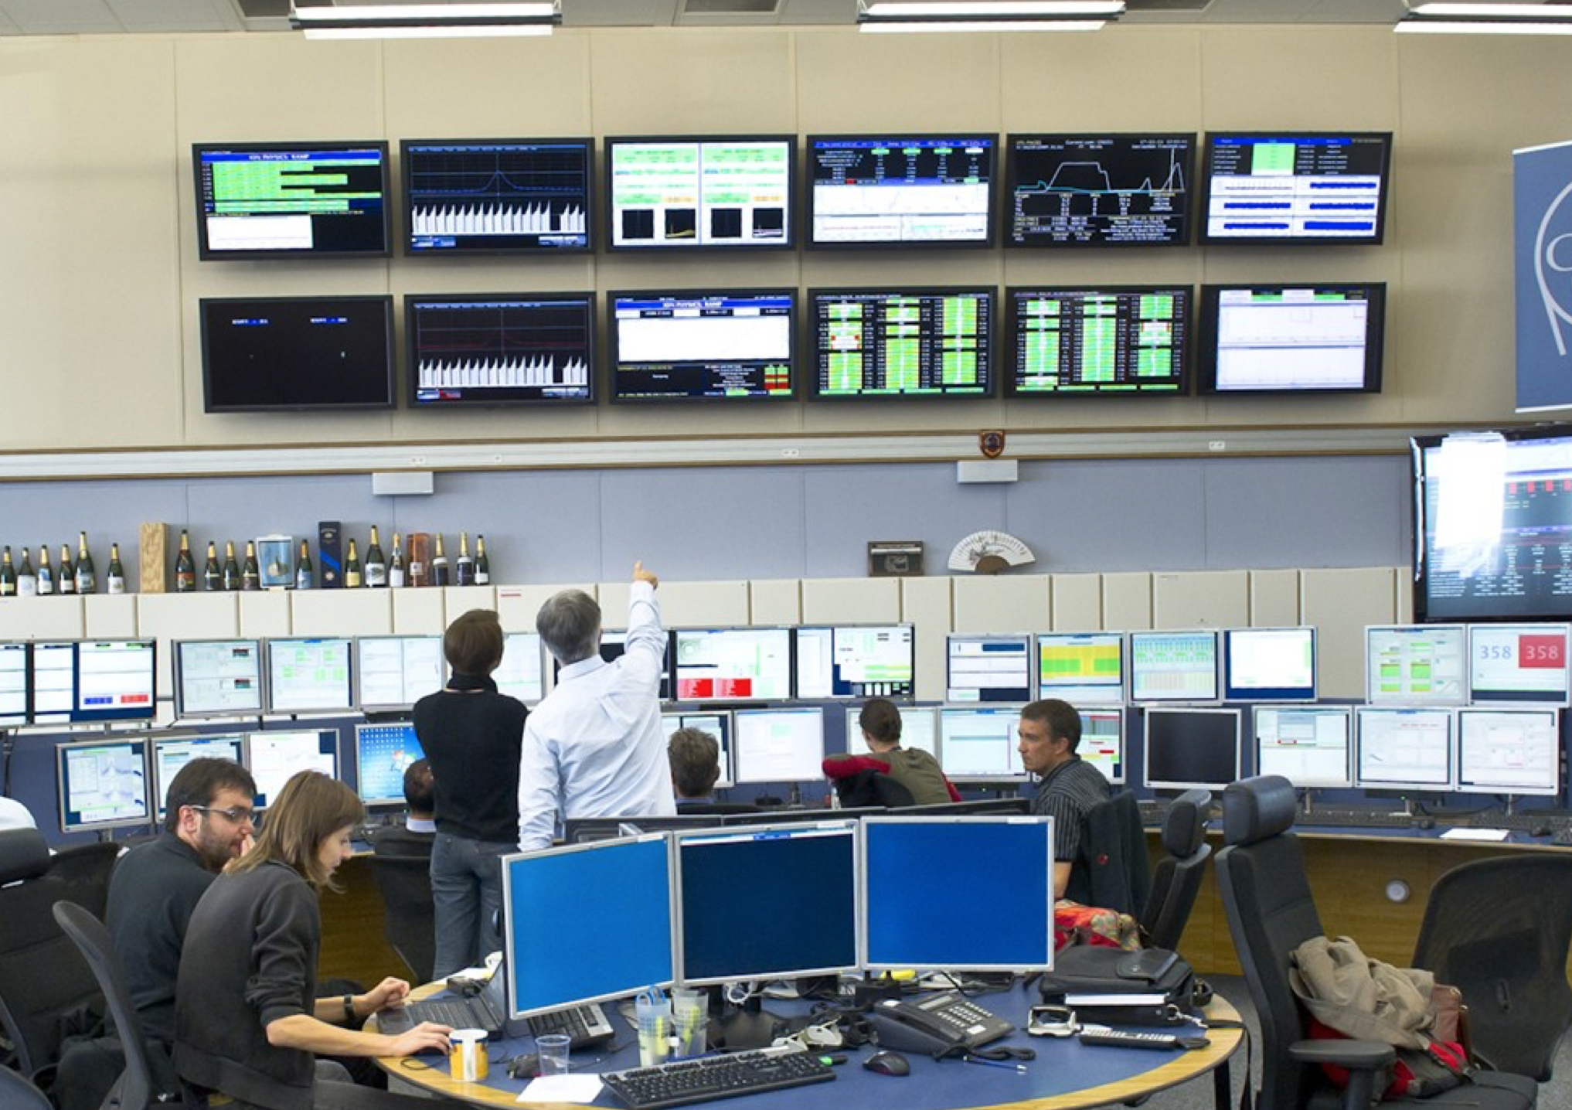
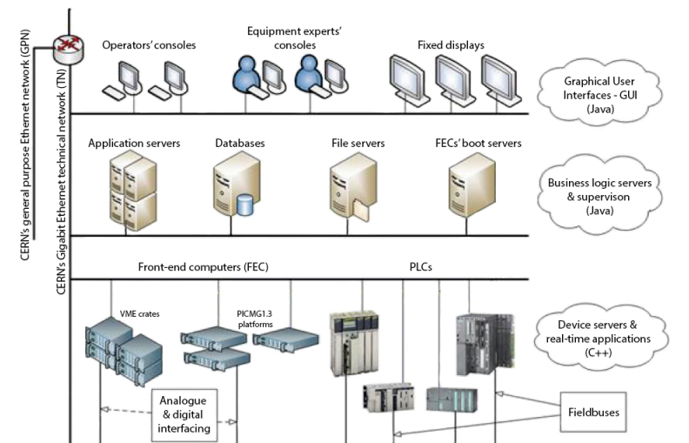
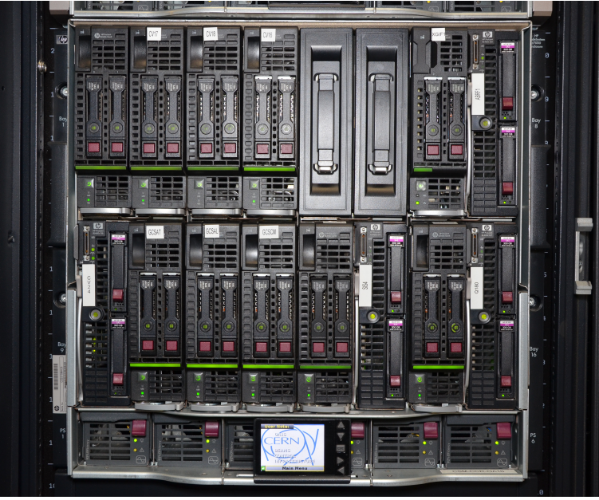
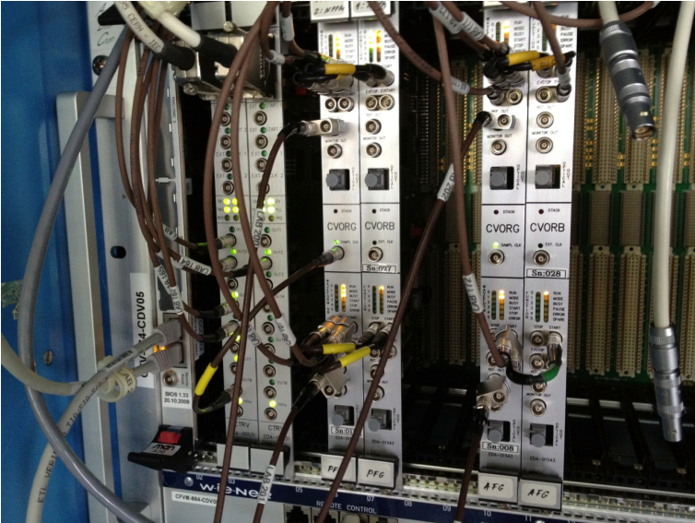

Control System Architecture
Fixed
Displays
Applications Tier
Server Tier
Equipment Tier
Operational Consoles
QUENCH PROTECTION AGENTS,
POWER CONVERTERS FUNCTIONS
GENERATORS, …
ACTUATORS AND SENSORS
CRYOGENICS, VACUUM, ETC…
BEAM POSITION MONITORS,
BEAM LOSS MONITORS,
BEAM INTERLOCKS, RF SYSTEMS, ETC…
LHC MACHINE

Slide 6
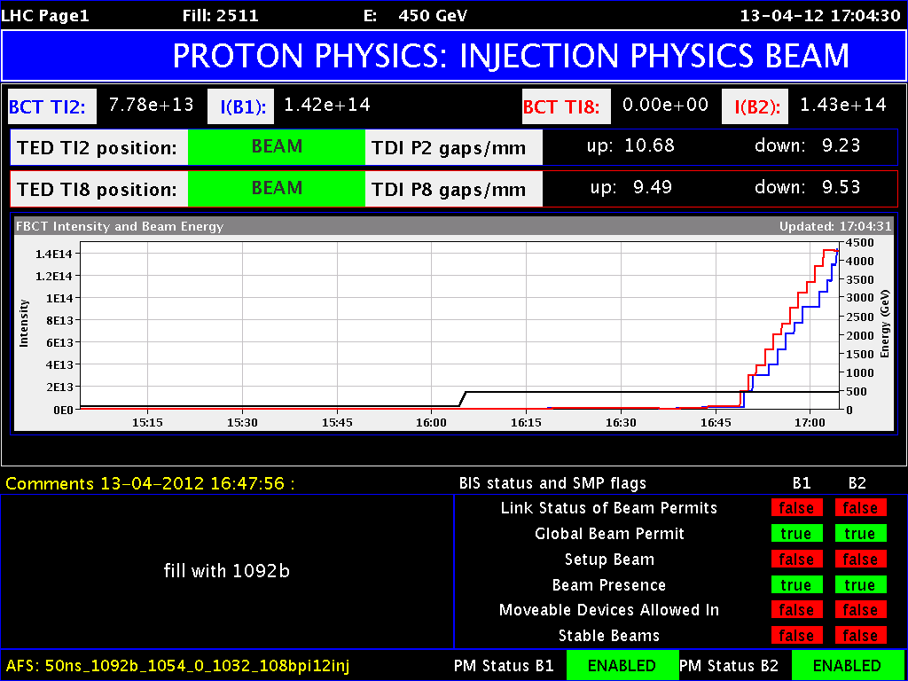
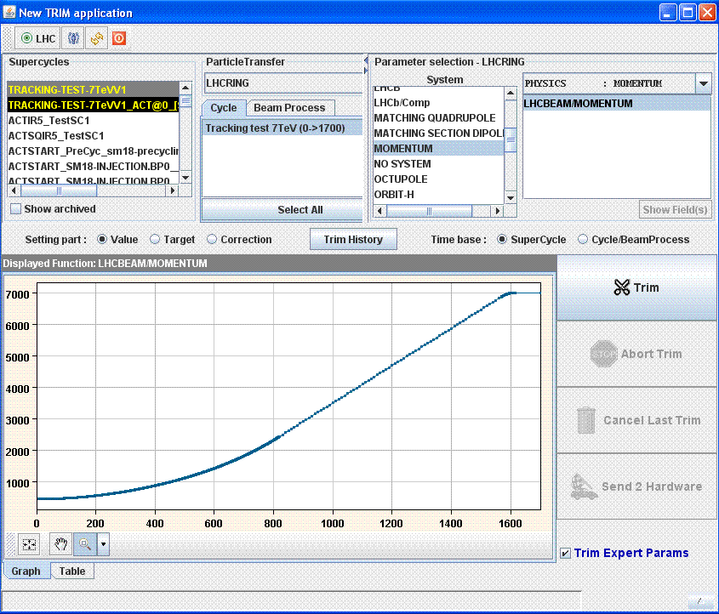
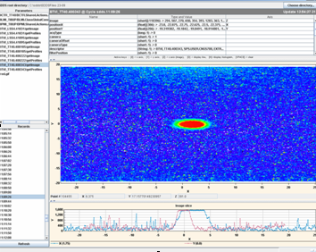
Control Software Architecture
Accelerator
control
Monitoring &
Diagnostics
Role Based Access
Machine
Protection
Logging
Measurements
LHC
Software
Architecture
Sequencer
Diagnostics
Monitoring
&
Alarms
Software
Interlock
System
Data
Management
Configs
Settings
Logging
Analogue
Signals
Observation
Post
Mortem
Role Based Access– Critical Settings Management
Equipment integration
Timing
System
FESA servers
FESA servers
Equipment Servers

Slide 7
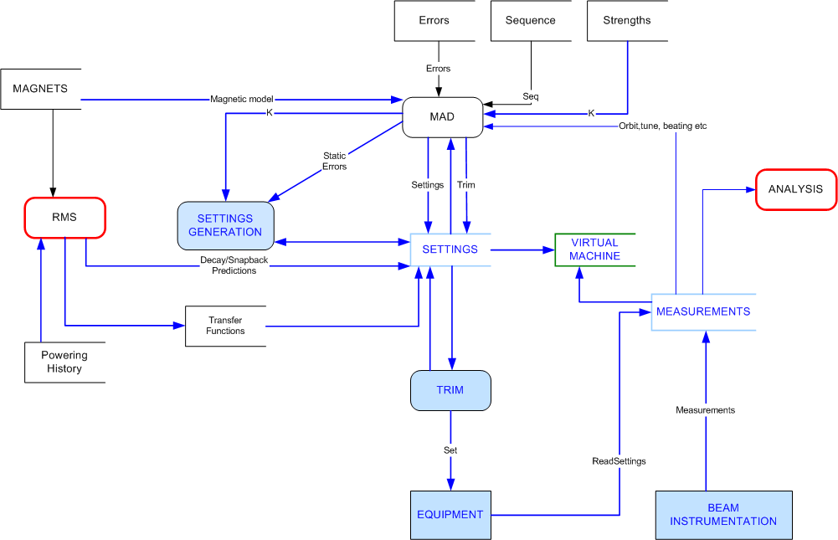
LHC Settings and Cycles
The LHC is Event Driven and not Timing Driven
  The Injector Complex is timing driven (repetition of cycle with pre-defined length)
  The LHC cycle contains Beam Processes (pre-cycle, injection, ramp, squeeze, etc.) that are in principle not time limited
  Each Beam Process contains settings for all devices and all beam processes are linked
  The Sequencer walks efficiently and securely through all steps in the beam processes and execute the pre-defined commands and checks
The LHC is Model Using High Level (physics) Parameters
  Settings Generation from theoretical model (MAD)
  Setting Management is done:
    Through dedicated application software (single or multiple parameters/hierarchies)
    Semi-automatic through feed-forward (FIDEL)
    and feedback (e.g. orbit, tune)
    Protected through Role Based Access Control and Critical Setting management to minimize
    undesired/mistakenly parameter changes

Slide 8
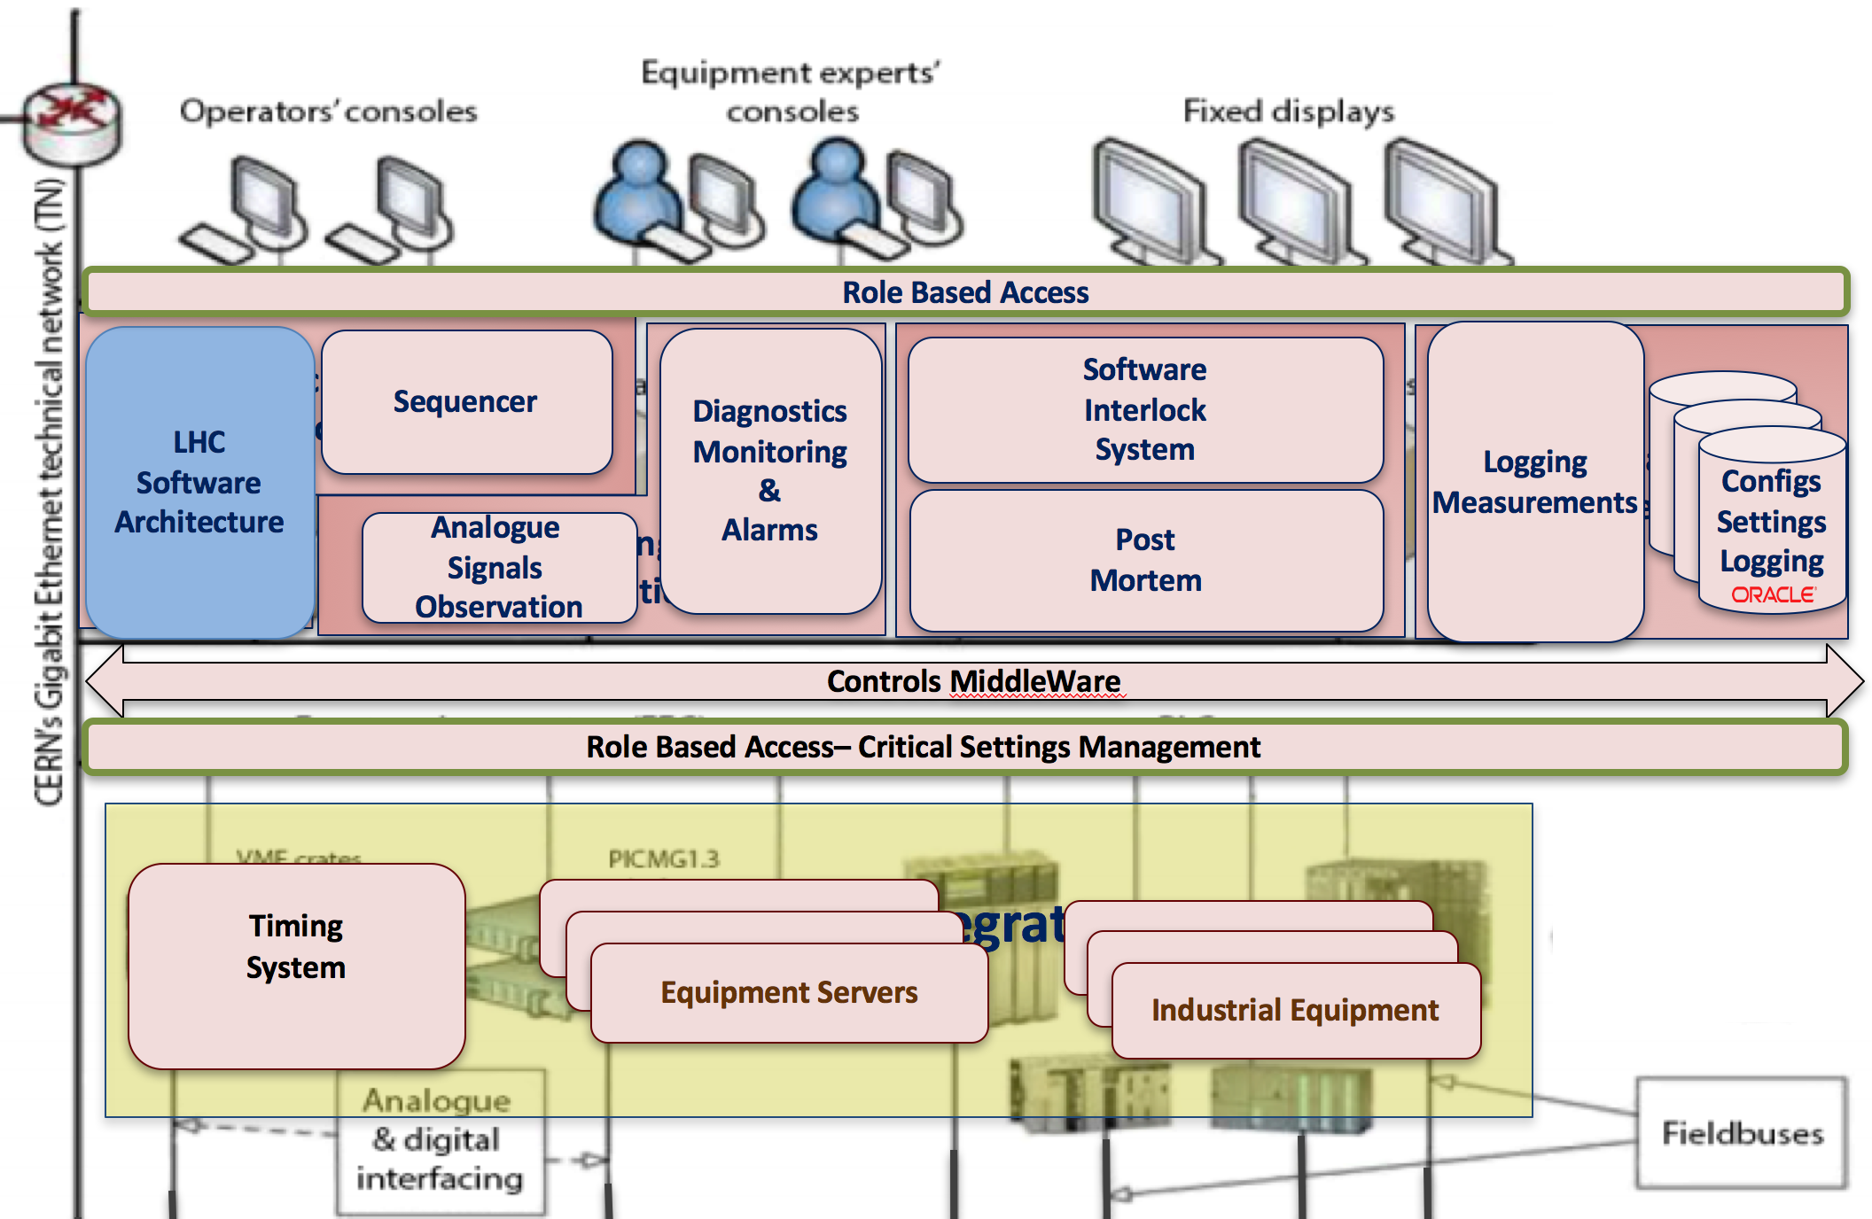
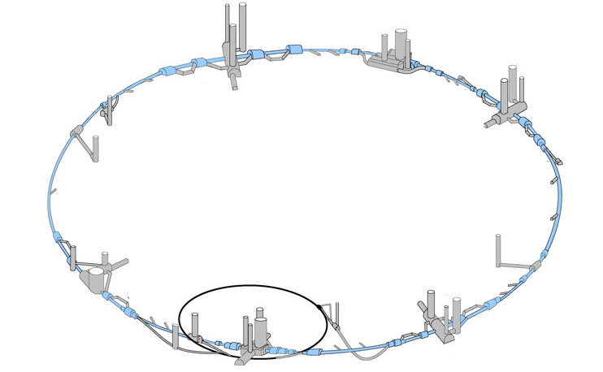
LHC Software Architecture
(LSA)
Settings Management System
270’000 device properties to control
Translation of high-level accelerator parameters to low-level device properties
Different settings within LHC cycle
Different operational scenarios
Horizontal
Tune
Used in 6 accelerators:
LHC, SPS, LEIR, PS, PSB, ISOLDE
  Exportable: used in GSI
> ~150 M of settings
~ 1M lines of code
Quadrupole 1
FIELD
Quadrupole 2
FIELD
…….
Quadrupole N
FIELD
Quadrupole 1
CURRENT
Quadrupole 2
CURRENT
…….
Quadrupole N
CURRENT

Slide 9
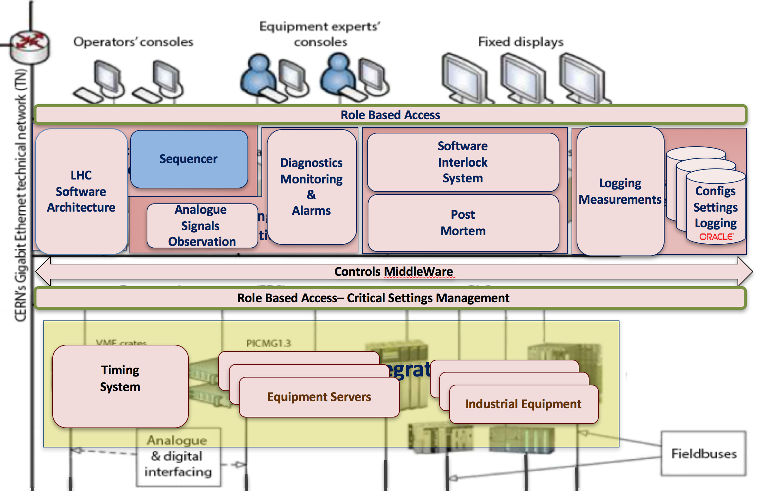

Sequencer
Automates execution of sequences of tasks
  Check the values of devices
  Ask the control system to load the settings
  Wait for the equipment to be ready
Operators memory
Reliable execution and error reporting
Safe mode
  run-through automatically
  run until task
  step task-by-task
Expert mode
  skip task
  jump to task
~ 1250 sequences for LHC Beam Operation
~ 350 tasks types
LHC main sequence: ~1100 tasks in total
Tasks
Run LHC
Prepare
LSA
reset magnet faults
Timing
send event
set state
start ramp
switch magnets to STANDBY
check beam dump ready
Magnets
reset faults
check state
set state
………….
Inject
Beam dump
check ready
Accelerate
Collimators
RF
………….
…~350…..

Slide 10
LHC Machine Protection
LHC relies on an Important and Complex Machine Protection System (MPS)
  Protect machine against damage from power of the beams
  In case MPS is triggered, efficient diagnostics through post-mortem data analysis is of prime importance

Slide 11
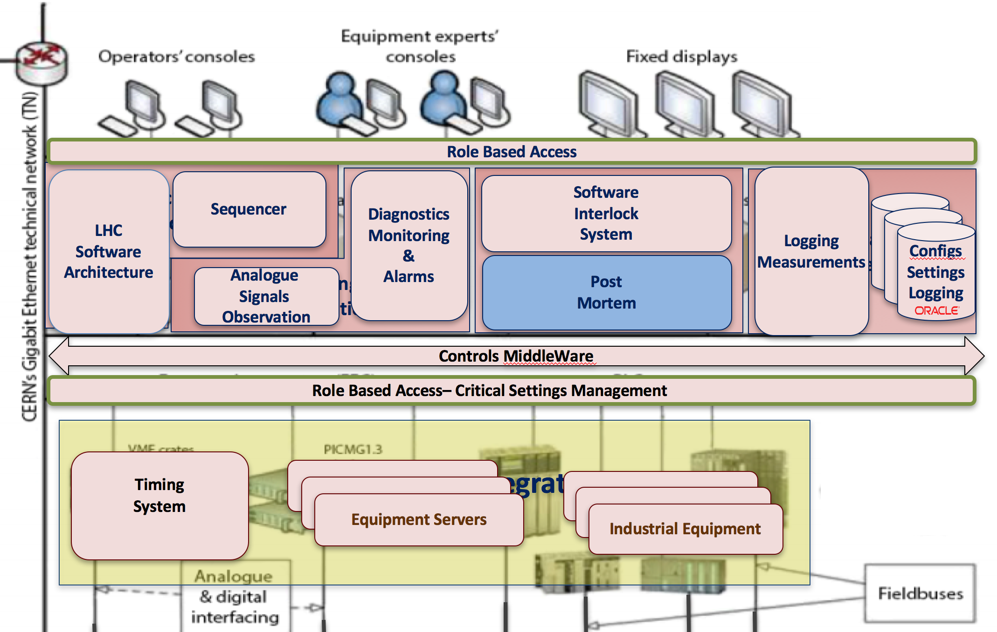
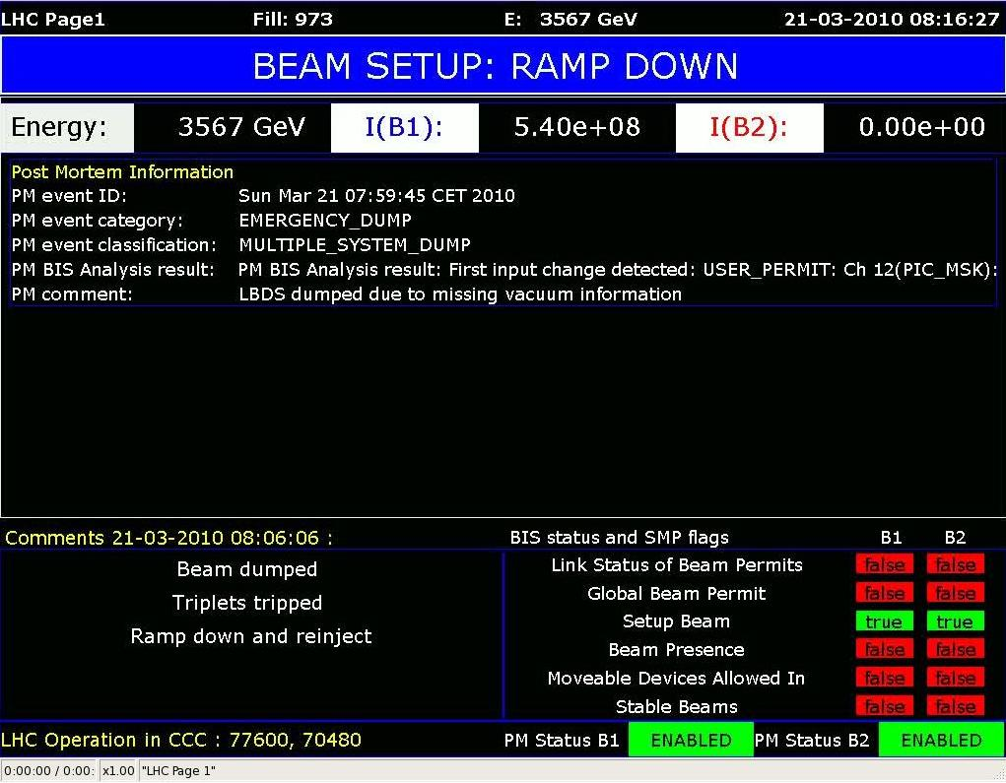


Post-Mortem Analysis
Part of overall Machine Protection
Detects the cause of the beam dump
Checks if all the protection equipment behaved as expected
Decides if it safe to continue the operations
Blocks the next injection otherwise
4 mission critical LHC applications
  LHC Beam Dump Analysis
  External Post-Operational Check
  Injection Quality Check
  Powering Event Analysis
2 GB per LHC Beam Dump
Publish
Sequencer
Injection Permit
Check results
Unlock/Lock
PM Analysis System
Push Data
Beam dump
Notes:
Today the LHC Control System contains 4 mission-critical applications based on PMA framework.
The LHC beam dump analysis which we were talking about so far.
The eXternal Post-Operational Check which is also triggered by beam dumps but is focused on the beam dump system of LHC only.
The Injection Quality Check which is triggered every time the beam is injected into LHC.
And powering event analysis which looks at problems related to power converters and magnets.

Slide 12
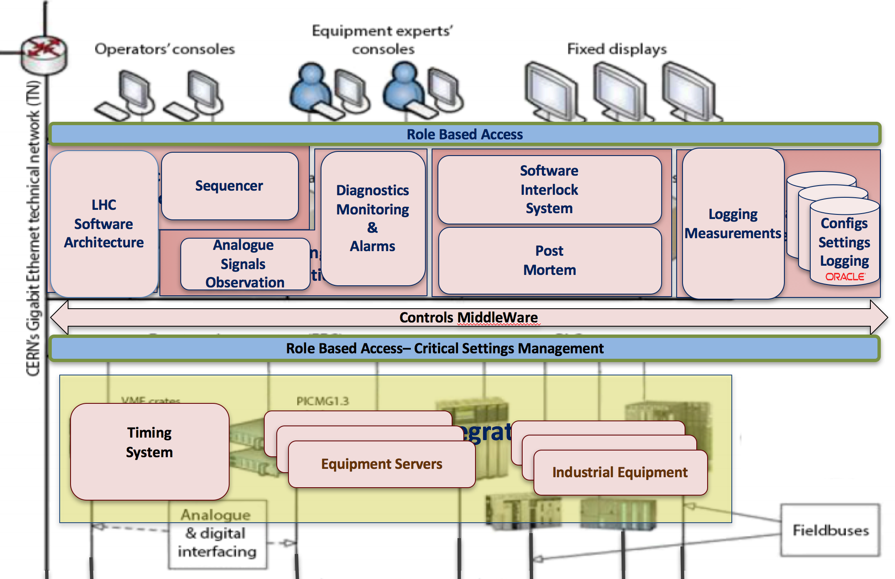

Role Based Access & Critical Settings
Role Based Access
  Protects the action (unauthorized access), not the value
  Authentication & Authorization
  Permission definitions
    Who, what, when, from where
  RBAC protects all the LHC equipment
  ~500’000 permission definitions
  ~500 users
Critical Setting Management
  Protects the value, not the action, ex. BLM, BPM, collimator thresholds
  Only experts can modify the value
  Digitally signed values
  100 critical value types => 1500 properties
3. token
2. token with roles
1. credentials: name, password, location
Protected
application
RBAC
System

Slide 13
Understanding the LHC
LHC operation relies heavily on Logging and Post-Mortem data
  For trouble shooting
  For machine performance analysis
  To enhance machine performance and to understand beam dynamics issues, high volume data observation systems (ADT/ObsBox data) provide valuable input
  For data analysis, long-term storage and efficient retrieval of data are key

Slide 14
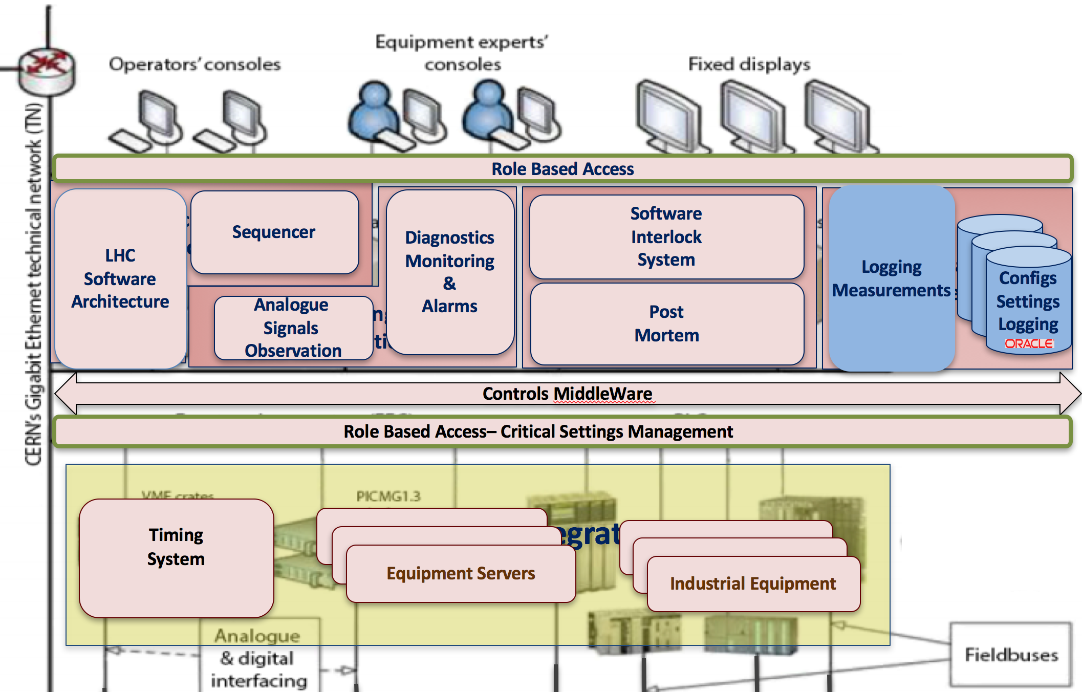
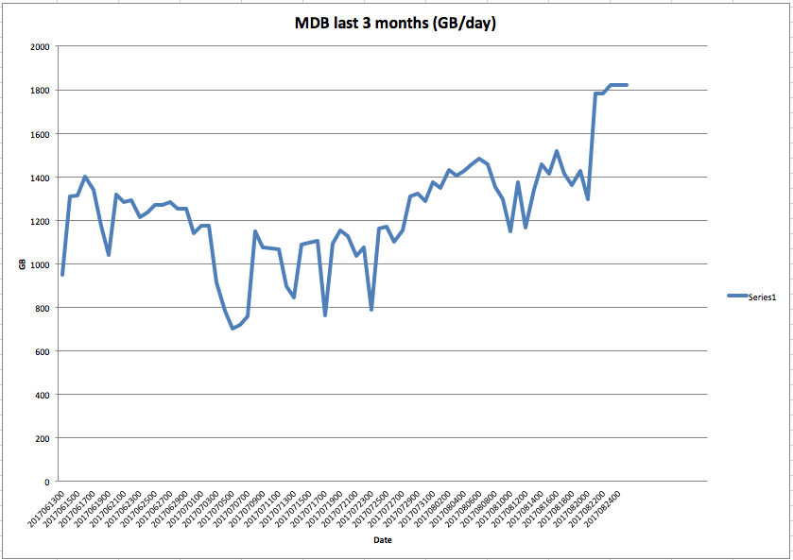
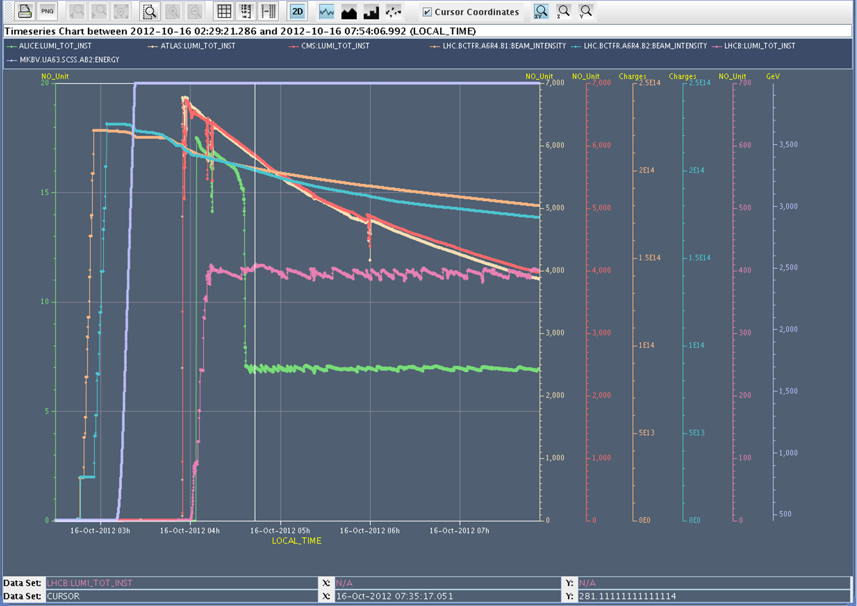
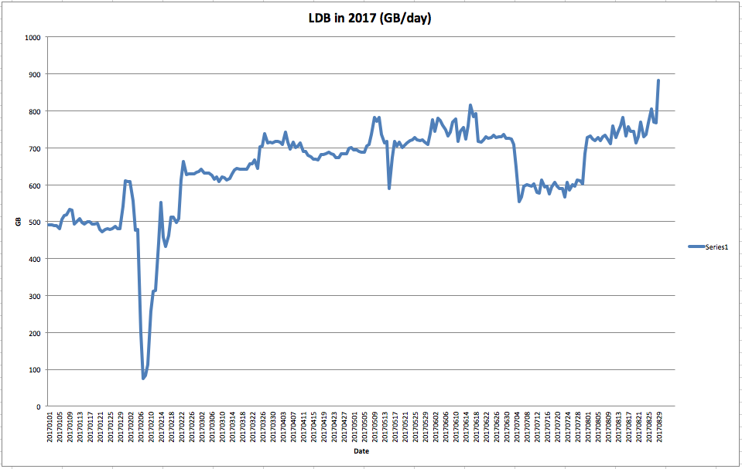
Measurement & Logging System
Storage for beam & equipment data beyond LHC lifetime
  No experiments’ data
~ 1000 clients
~ 5 million extraction requests/day
Measurement DB
7 days of raw data
Logging DB
>20 years of filtered data
Filter ~ 95 % reduction
~ 11TB / week (1.5TB/day)
~ 71e9 data points/day (4e9 in 2014)
~ 1.5M signals archived
~ 20k device properties
~ 1 TB/day
~ 1 PB of archived data
Allows analysis of accelerator behaviour over long periods of time

Slide 15

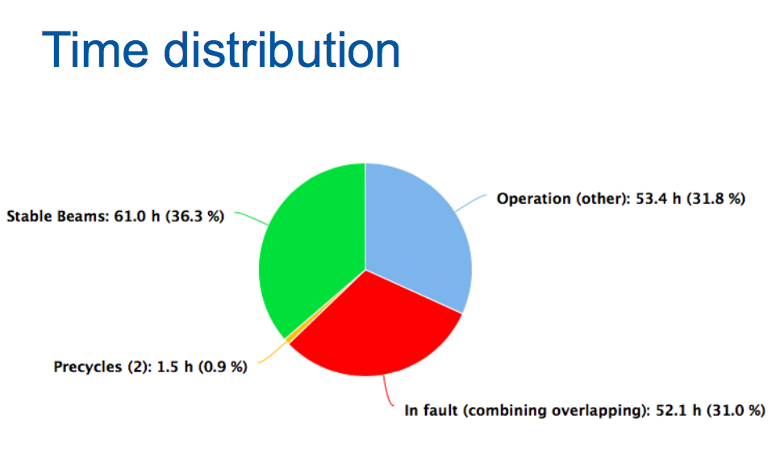
Towards LHC Performance Improvement
“Integrated Luminosity is important, hence machine/beam availability is key”
Physics time maximization
LHC procedures optimization through better tools
    Recent automation of Hardware Commissioning steps and validation have made this process much more efficient (~ 1 months → 2 weeks)
Control System fault minimization
Access
Interventions
Physics
Preparation
Squeeze
Beam Injection
Ramp
Accelerators Control System - E. Hatziangeli, CERN Beam Controls

Slide 16
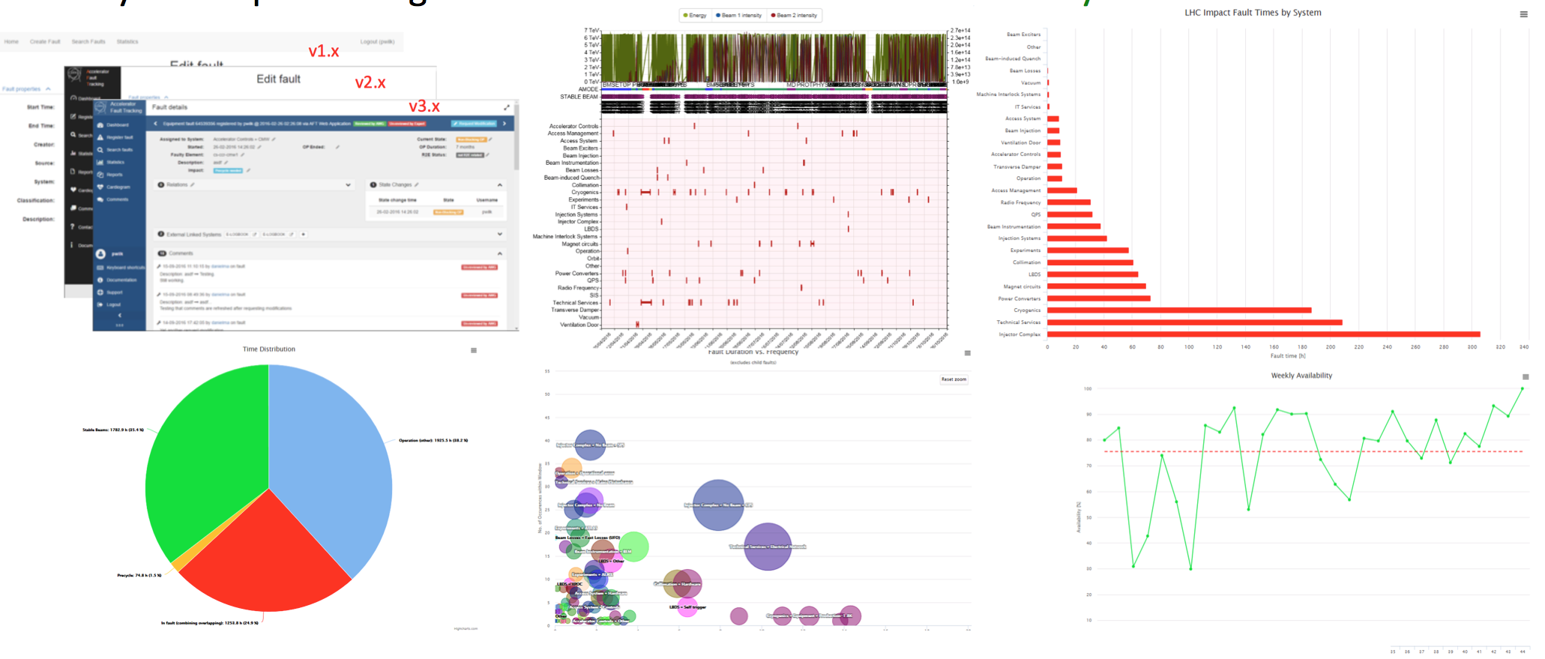
Accelerator Fault Tracking
“Why are we not doing Physics when we should be?”
“What can we do to increase machine availability?”
Coherent data capture: 830 faults recorded for LHC helping areas for improvements
Detailed fault classification and analysis for equipment groups
Covers CERN’s entire injector complex

Slide 17
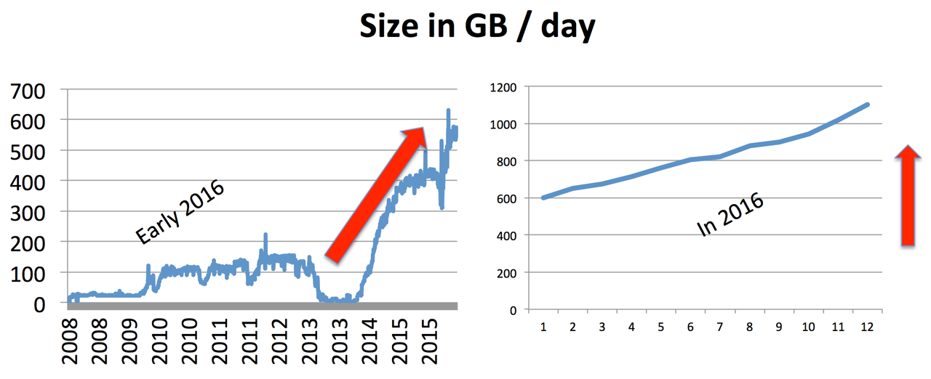
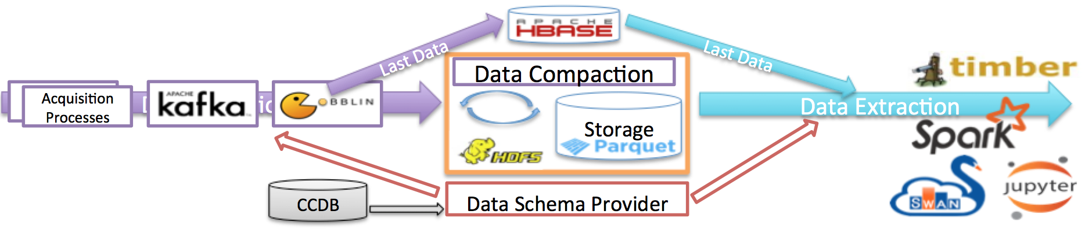
Towards BIG Data
Current data throughput rates in the existing Logging system approach 1 TB / day and are expected to continue to increase in the coming years
The next generation Logging System is being developed
Based on modern "Big Data" technologies (Hadoop, Kafka, Spark)
Built on open source components and libraries
Aims to answer the needs to store more data, & to be able to efficiently analyse it using the languages of choice by data experts

Slide 18

The LHC has a very Modular Distributed Control System
Performs mission-critical tasks
  70’000 equipment processes on ~2000 front ends machines
  ~2000 programs running on 550 servers
  500 different GUIs and ~300 server programs
  Developed by ~100 people from 16 different groups
  1100 Java executable
  ~10M lines of code
  1PB of archived data
Big (>1000) user community
It evolves constantly

Slide 19
BACK UP SLIDES

Slide 20
Upcoming Topics
Levelling / Anti-levelling
  With the performance increase and also in view of the HL-LHC luminosity levelling becomes important
  Depending on the type of levelling the control process can be complex
    Beam separation → “easy”, routinely used
    Crossing angle → “demanding”, being exploited today
    𝛽* → “challenging”, under development to be used in the coming years
New developments of more complex controls system components required/ongoing to link seamlessly existing systems in the machine together (e.g. orbit, collimators, optics, machine protection, ….)
All these upcoming work can be achieved with efficient collaborations of experts, operators and developers across the accelerator sector

Slide 21
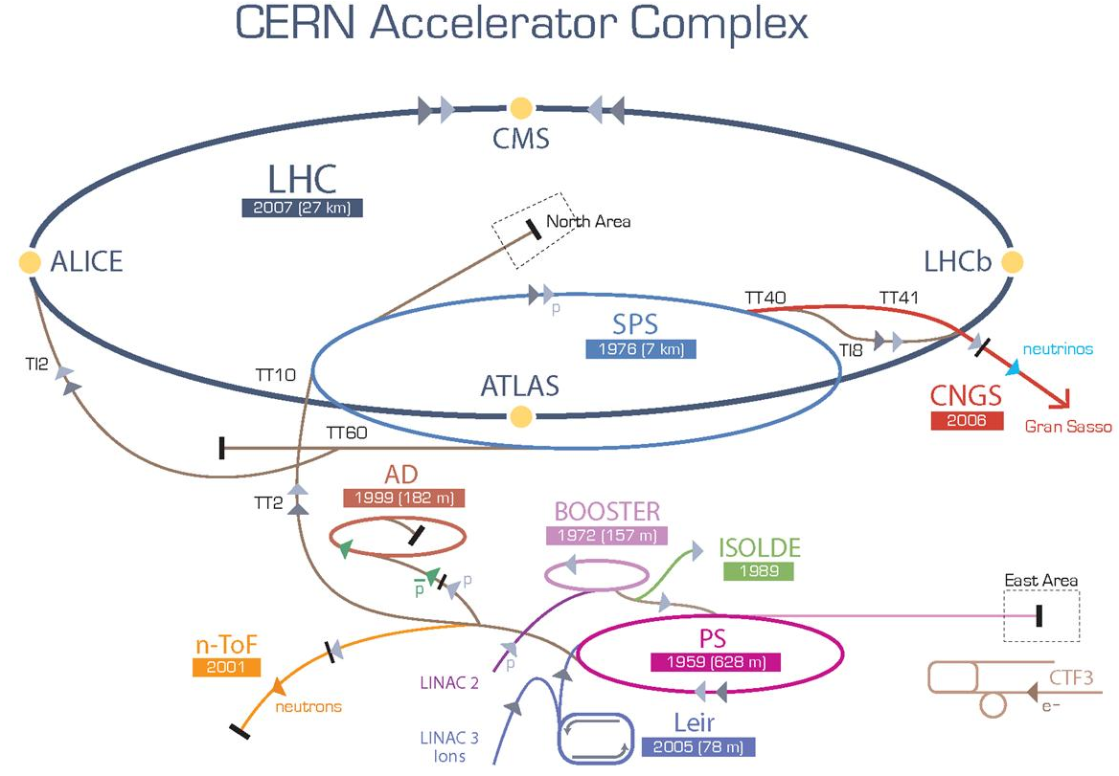
Additional challenge
The same controls infrastructure
is deployed on all CERN accelerators
Important Technical Challenges
  Highly exposed, critical operational services
  Serves dissimilar set of users, commonality vs. customisation
  Complex dependencies
  Challenging integration, difficult maintenance
  Technical errors ⬄ high impact
  Stability vs. fast turn around
  High reliability and availability

Slide 22
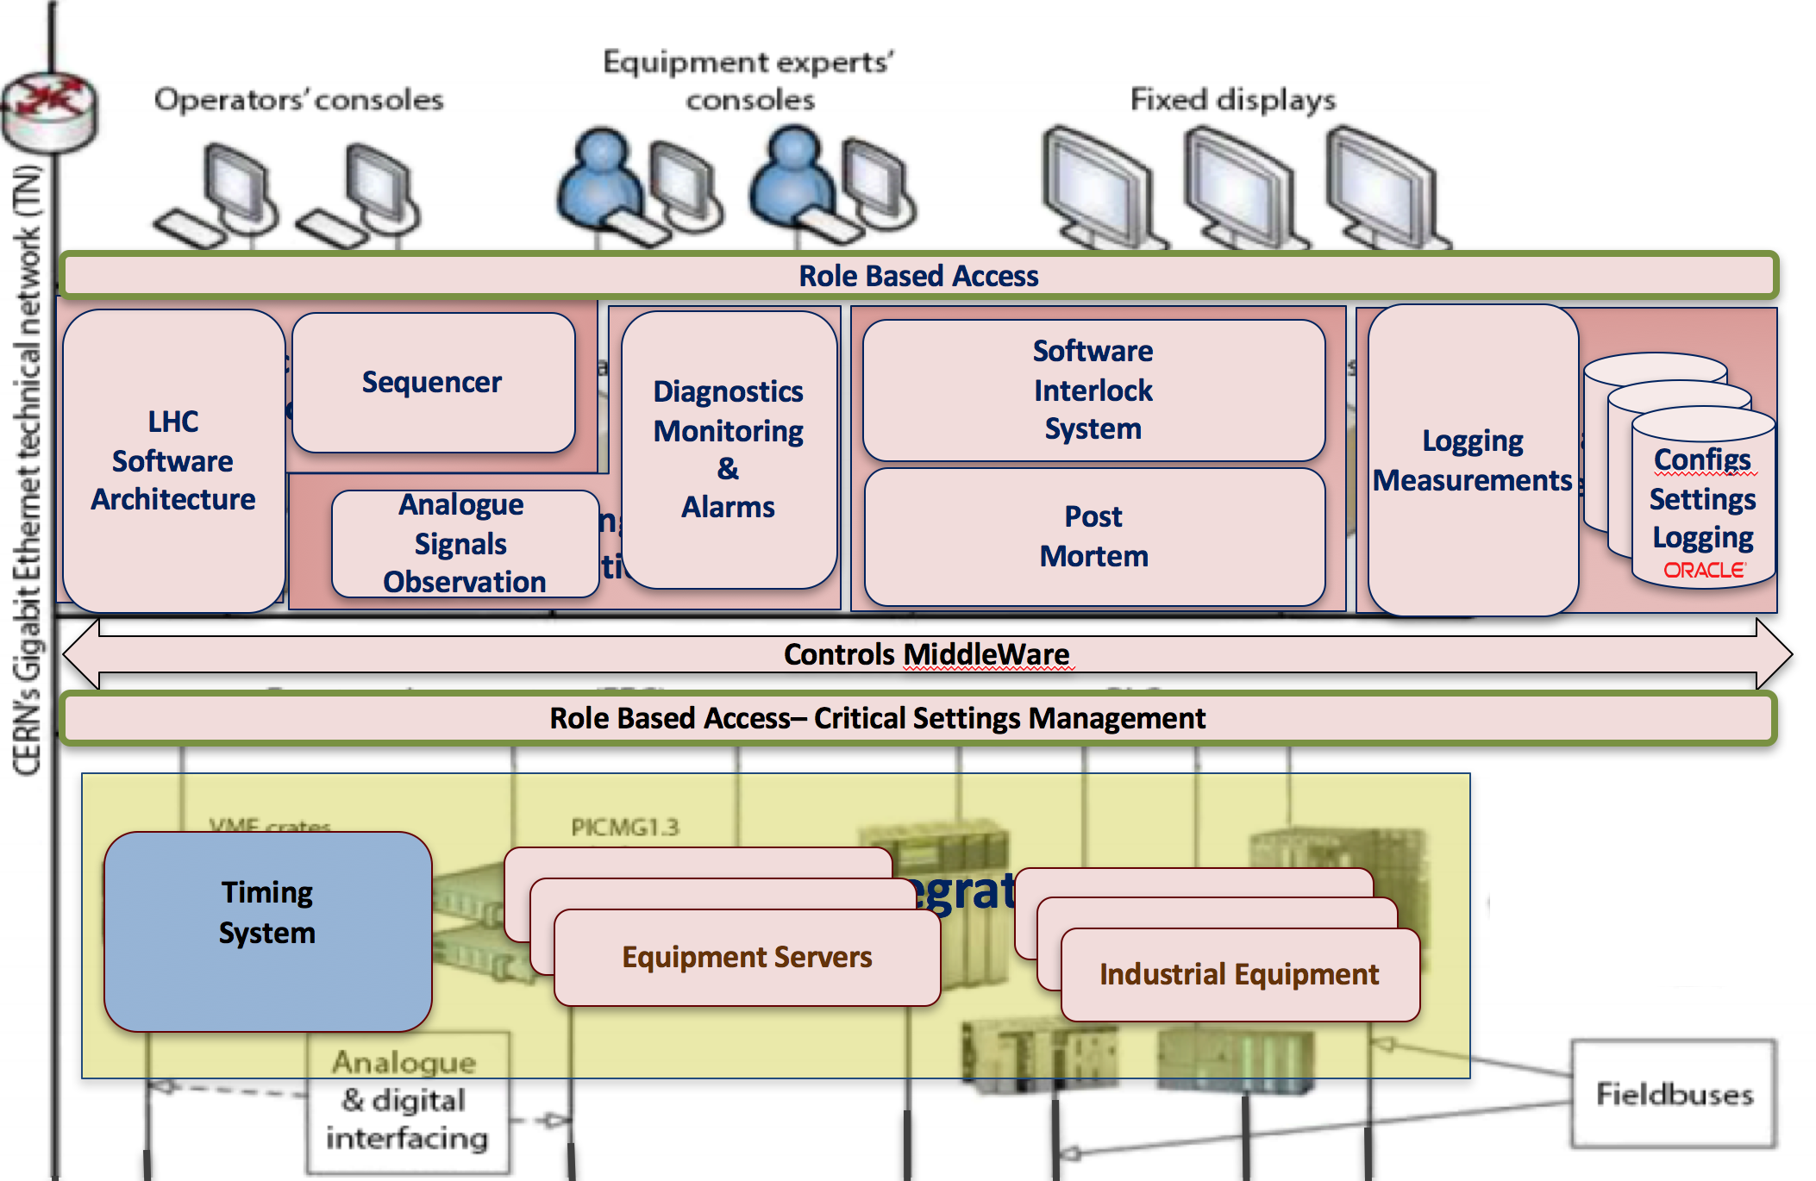
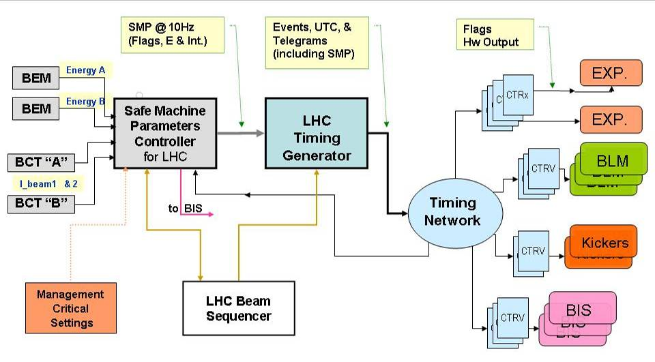
LHC Timing System
Event-based timing system
Dedicated network
Active and hot spare nodes
Manually calibrated
Have many systems acting in sync
  synchronously ramp up LHC magnets
  ~1000 receivers serving ~8000 clients
Provides common notion of time in distributed systems - to make sense of acquired data
  LHC: data timestamps have 1 μs precision
Distribution of critical parameters over the Timing network
Beam Energy,
Safe Beam Flags,
…
Interfaces with
- Kicker systems (BEM)
BCT system
BLM system
Experiments
Beam Interlock Syst.

Slide 23
Philosophy of development
Provide extensible Frameworks and Tools
Domain experts fill in the domain-specific knowledge
Develop and deploy Generic services
Applicability to all accelerators
Thorough Quality Assurance
Successful and efficient collaboration
  with equipment groups and operators
  with other laboratories (FermiLab, GSI, ESRF, ITER, MedAustron, Dubna)

Slide 24
Control Software Architecture
Accelerator
control
Monitoring &
Diagnostics
Remote Communication (JMS, RMI)
Machine
Protection
Data
Management
Controls MiddleWare
Equipment integration
BEAM POSITION MONITORS,
BEAM LOSS MONITORS,
BEAM INTERLOCKS, RF SYSTEMS, ETC…
QUENCH PROTECTION AGENTS,
POWER CONVERTERS FUNCTIONS
GENERATORS, …
ACTUATORS AND SENSORS
CRYOGENICS, VACUUM, ETC…
LHC MACHINE

Slide 25







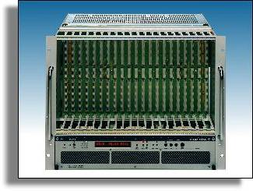
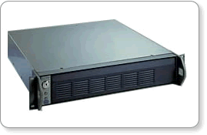
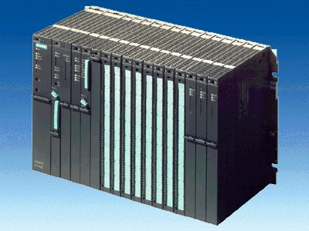
Controls SW Infrastructure
PUBLIC ETHERNET NETWORK
Fixed Displays
Core Control GUIs
Core Control GUIs
Fixed Displays
Core Control GUIs
Core Control GUIs
OPERATOR
CONSOLES
FIXED
DISPLAYS
Core Control GUIs
Expert GUIs
Fixed Displays
OPERATOR
CONSOLES
TCP/IP communication services
Remote communication (Java RMI, JMS)
Role Based Access
LHC
Software
Architecture
Sequencer
Diagnostics
Monitoring
&
Alarms
Software
Interlock
System
Logging
Measurements
FILE SERVERS
APPLICATION SERVERS
SCADA SERVERS
CERN GIGABIT ETHERNET TECHNICAL NETWORK
CTRL
CTRL
Configs
Settings
Logging
Analogue
Signals
Observation
Post
Mortem
TCP/IP communication services
TIMING GENERATION
T
T
T
T
Timing
System
C++
Controls MiddleWare
RT Lynx/OS
VME Front Ends
WORLDFIP
Front Ends
PLC
C++
C++
Role Based Access– Critical Settings Management
TCP/IP communication services
FESA servers
PVSS
FESA servers
PVSS
T
SCADA
Equipment Servers
T
T
T
T
C++

Slide 26
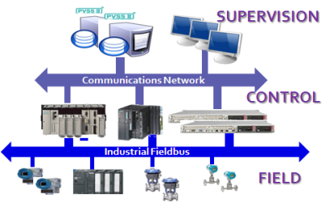
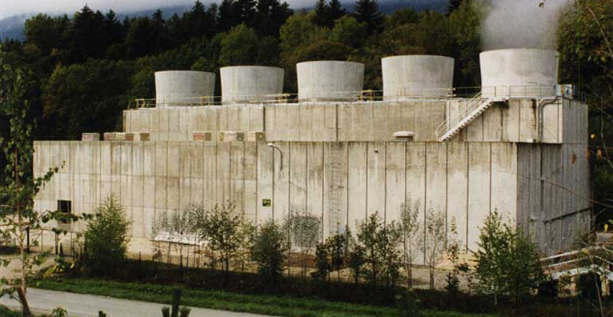
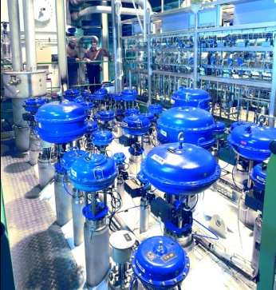
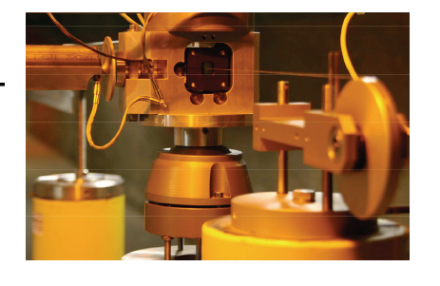
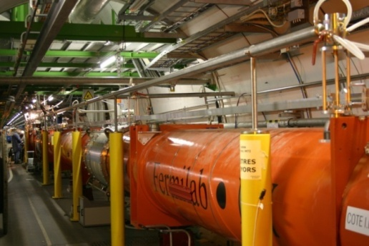
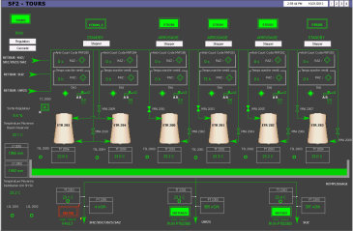
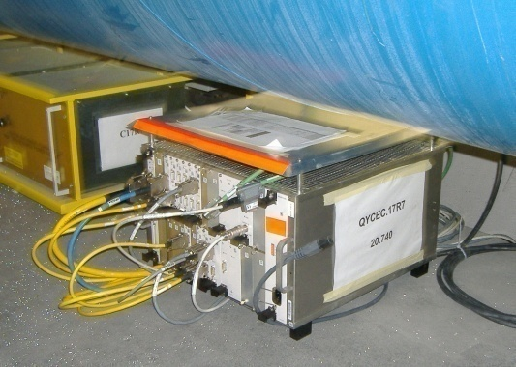
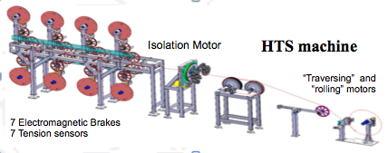
Industrial Process Control System
Process Control application framework UNICOS
  PLC or PAC-based applications
  UNICOS proposes a method to design and develop the control application which will run in commercial off-the-shelf products
JCOP FRAMEWORK
  Common Framework of tools and core components
  Device modelling, configuration, monitoring, alarms, etc
  Main users are software developers and LHC experiments
  Large software system
  Users >750 History: 14 years
  Many external contributions: e.g. experiments
LHC Magnet alignment
Cooling & Ventilation
LHC Cryogenics
HTS Winding machine

Slide 27
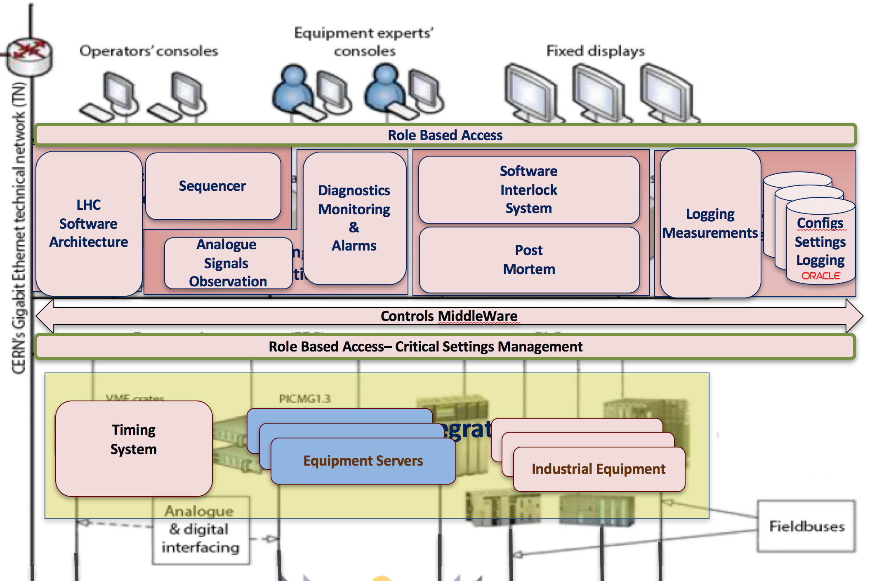
Front End Software Framework
Standard software framework to develop real-time Front-End Software to control all accelerators equipment
Hides the complexity of the controls infrastructure, simplifies the development, allows equipment experts to focus on their HW-specific logic
~100 developers from 16 equipment groups
~700 hardware device types (~200 in LHC)
~70000 devices (~25000 in LHC)
~1000 Front-Ends machines (~500 in LHC)
Exportable: used in GSI (Darmstadt)

Slide 28
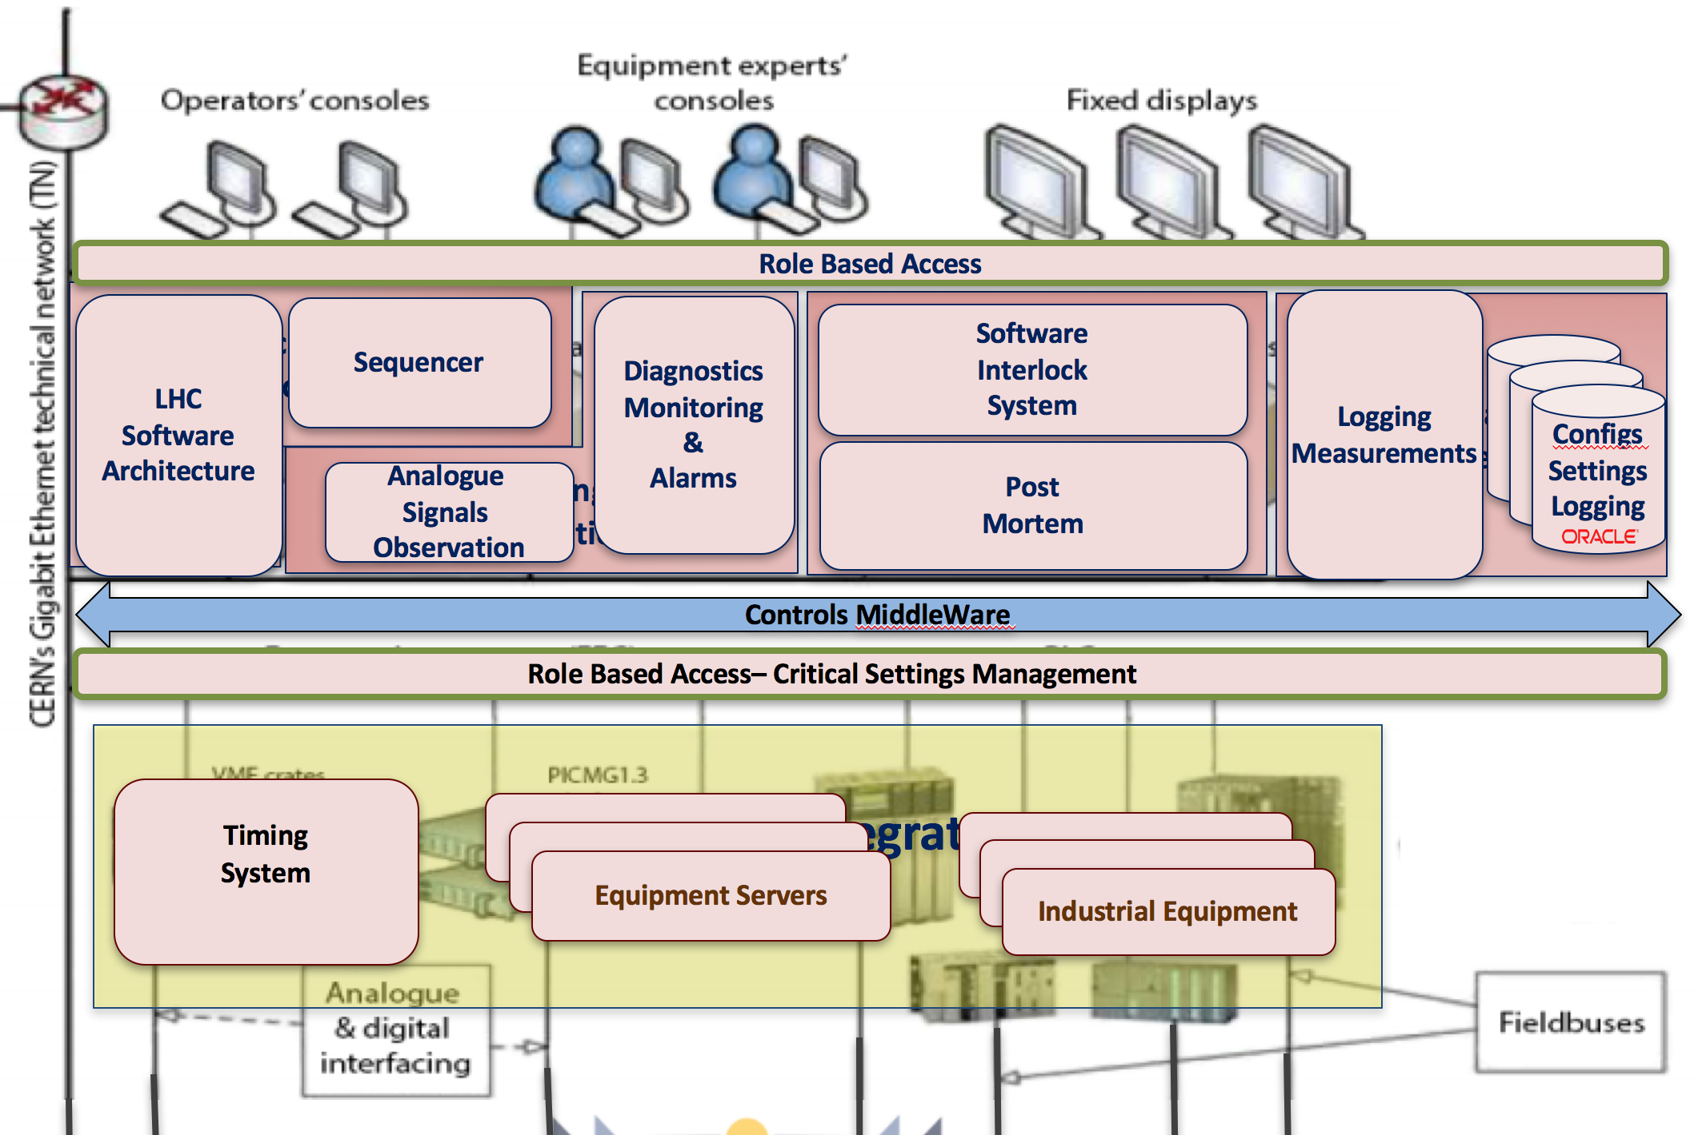
Controls MiddleWare
Reliable decentralised core communication layer based on ZeroMQ
Collection of software components & services
Operations: GET, SET, SUBSCRIPTION
Widely deployed for all CERN accelerators
Provides comprehensive diagnostics
4’200 Front-End servers processes
85’000 (incl. SCADA) devices
  85’000 devices
  2’000’000 equipment controllable properties
2 Directory Servers for device information how to connect
Exportable: used in GSI (Darmstadt)

Slide 29
LHC Setting Management
Generation of initial settings based on optics
Storage/modification of settings for all devices
Coherent modifications of settings
Settings versioning
History of changes and rollback
Communication with the hardware
Translation of high-level accelerator parameters to low-level device properties
Horizontal
Tune
6 accelerators:
  LHC, SPS, LEIR, PS, PSB, ISOLDE
  Exportable: used in GSI
> 200 HW types
> 150 M of settings
~ 200 client applications
~ 1M lines of code
Quadrupole 1
FIELD
Quadrupole 2
FIELD
…….
Quadrupole N
FIELD
Quadrupole 1
CURRENT
Quadrupole 2
CURRENT
…….
Quadrupole N
CURRENT

Slide 30
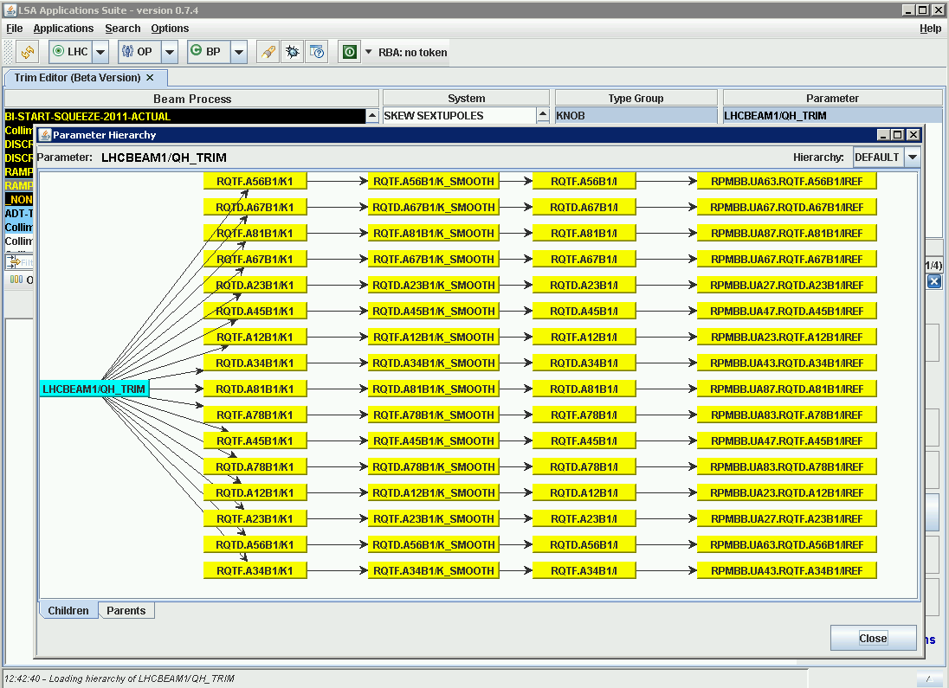
LSA Parameter Hierarchy

Slide 31
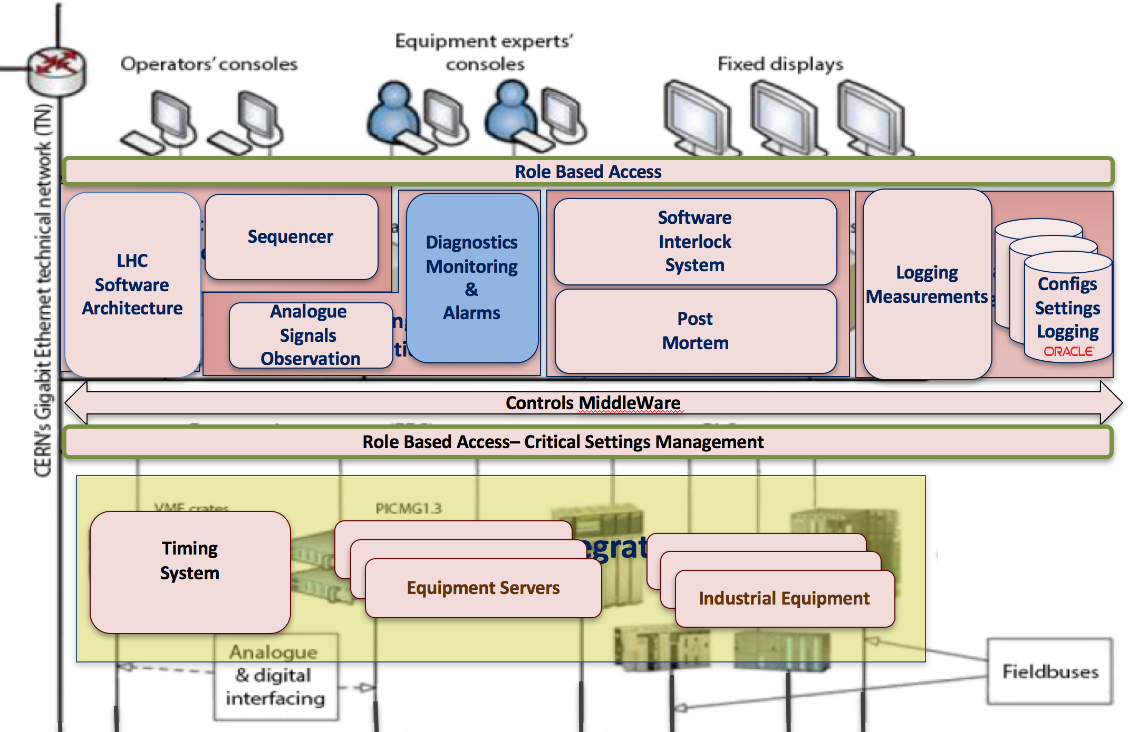
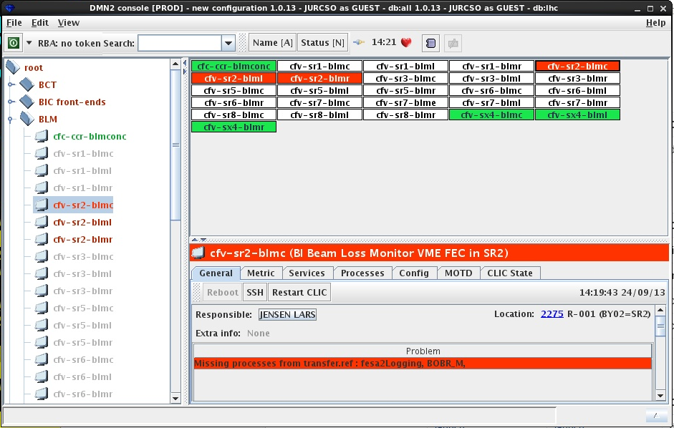
Diagnostic Monitoring
Monitors controls infrastructure
  Computers (front-ends, servers, consoles)
  Network
  Software applications
Provides overview of infrastructure state
Helps finding the root cause of the problem
Provides evolution history
Allows certain actions
  restart system
  restart process
Metrics from >2000 computers
~10 M updates / day

Slide 32
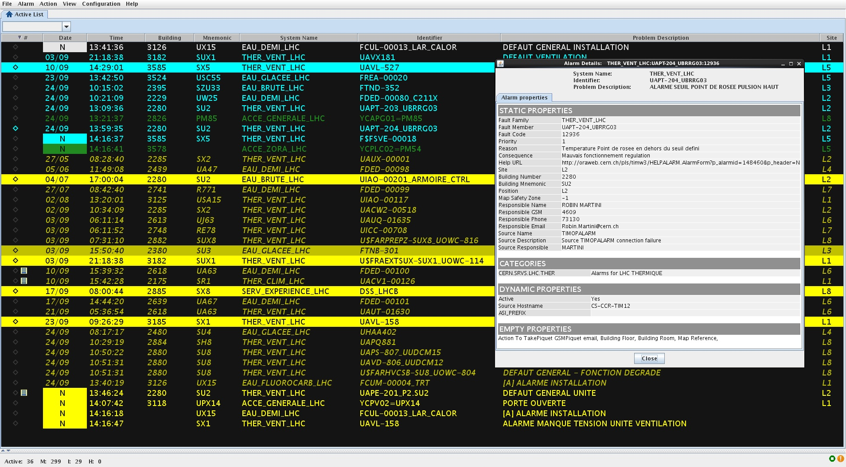
Alarms
Software alarms system
  Problem => notification
Does not deal with human/equipment safety
Notifies about problems requiring human intervention
Maps alarms to people and possible actions
Relevant alarms only
  Depends on accelerators
Alarms history
Alarms priority
~200 K alarm definitions
  80’000 for LHC
~150 alarm events/min

Slide 33
Sequencer
Automates execution of sequences of tasks
  Check the values of devices
  Ask the control system to load the settings
  Wait for the equipment to be ready
Operators memory
Reliable execution and error reporting
Safe mode
  run-through automatically
  run until task
  step task-by-task
Expert mode
  skip task
  jump to task
Parallel task execution
Sequence editing
~ 1250 sequences for LHC Beam Operation
~ 350 tasks types
LHC main sequence: ~1100 tasks in total
Tasks
Run LHC
Prepare
LSA
Timing
send event
set state
start ramp
reset magnet faults
switch magnets to STANDBY
Magnets
reset faults
check state
set state
check beam dump ready
………….
Beam dump
check ready
Inject
Collimators
Accelerate
RF
…~350…..
………….

Slide 34
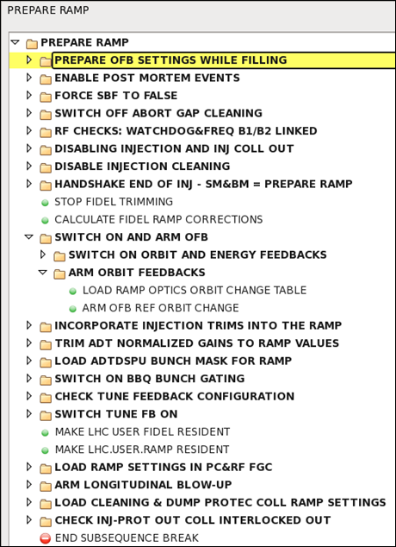
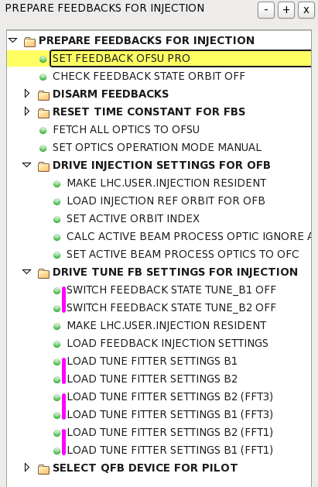
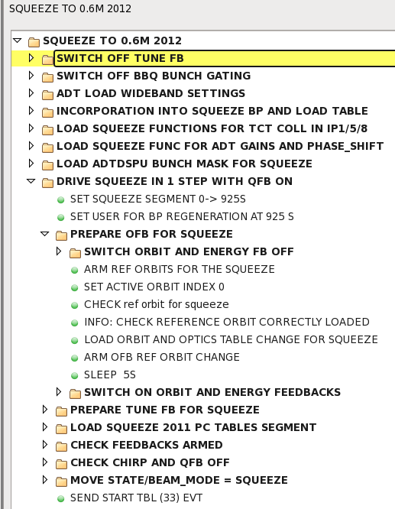
Sequencer Implementation

Slide 35

Software Interlock System
Part of overall Machine Protection
Surveys the state of key LHC components using complex condition logic
Provides the operations with condition calculation diagnostics
Extendable - add/modify/remove conditions/reactions
Deterministic and highly reliable system
Acts if necessary
  abnormal situation ⇒ beam dump
Deployed practically for all accelerators
LHC has
  ~2700 subscriptions
  ~5200 elementary values
  ~800 logical channels
  8 permits
Trigger 1Hz
External
Systems
Beam Interlock
Timing
Alarms
etc.
Data Processing
G
AND
E
F
OR
AND
A
B
C
D
Data Acquisition
Controls MiddleWare
Equipment

Slide 36
Management of Critical Settings
Protects the value, not the action, ex.
  BLM, BPM thresholds
  Collimator thresholds
  …
Only experts can modify the value
All the operators can use this value
Digitally signed values
100 critical value types => 1500 properties

Slide 37

Logging: daily extraction requests
LHC Workshop
TS
Christmas

Slide 38

LHC’s Figure of MERIT
Peak luminosity is important
Integrated Luminosity, hence machine/beam availability is key

Slide 39

LHC Future Timing System
Move to WhiteRabbit technology
  Time-based timing system
  Automatically synchronized “common time”
  Ethernet-based deterministic solution for ~0.5 ns accuracy and < 10 ps precision reliable data delivery among a few thousand nodes over large distances (tens of kilometers)
  Reliable: redundant both for topology and data
  Initiated and developed in the Controls group
  Open Source Hardware and Software

Slide 40
White Rabbit CERN Users
ATLAS
  Synchronisation of seismic measurements (M.Guinchard, Nov­Dec.2015)
General Machine Timing system upgrade in the Antiproton Decelerator and the ELENA ring
Beam Instrumentation
  Time­stamp events based on a reference clock that will be received by WR
Btrain over White Rabbit on CERN CO wikis (CERN access only)
  Magnetic field measurement and distribution of the data in real­time
LHC Instabilities Trigger Distribution
  Instability diagnostics
ProtoDUNE ­ CERN Prototype of DUNE
  SM­18: Magnetic field measurement and distribution of the data in real­time
SPS RF distribution over White Rabbit
CNGS Timing for neutrino measurements (2012­2014)

Slide 41
White Rabbit Non CERN Committed Users
Arkus, Japan
Cherenkov Telescope Array
China Spallation Neutron Source Institute of High Energy Physics Chinese Academy of Sciences ­ CSNS, Beijing, China
CHIRON­IT, The Netherlands
Culham Centre for Fusion Energy
DESY, Germany
DLR (German Aerospace Center, Institute for Technical Physics)
EISCAT, Sweden
EPFL, ESPLAB Switzerland
GSI, FAIR facility
ESS Bilbao, Spain
JINR (Russia)
Fermilab, USA
Paris Observatory
MIKES (Centre for metrology and accreditation, Finland)
LHAASO ( Tsinghua University, China)
….

