Slide 1
Proposal for an Additional BPMs
in the PSB Transfer Lines
M. Bozzolan, C. Bracco, Gian Piero Di Giovanni, B. Mikulec, L. Soby, J. Tan
LIU-PSB WG Meeting
29th August 2017

Slide 2
Additional BPMs
Additional BPM in the BI line.
2. Additional BPM in the BTP line.

Slide 3
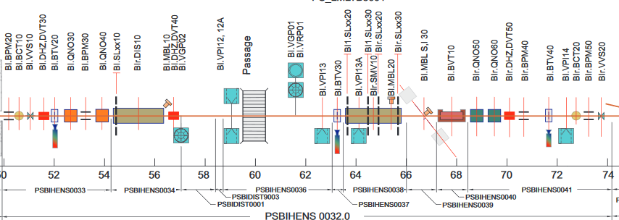
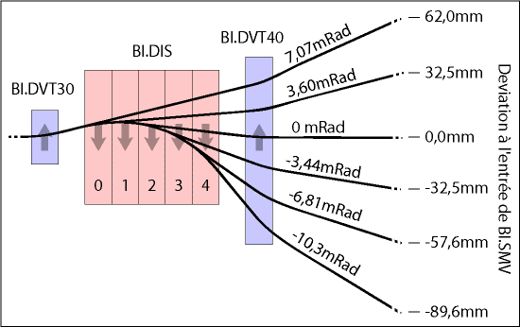
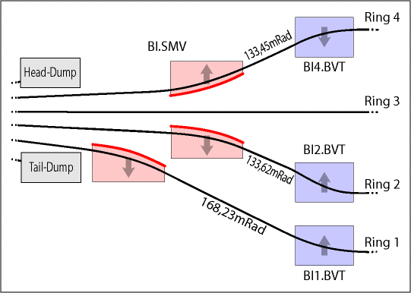
Additional BPM in BI: Motivation (I)
Injection in the PSB is a delicate process which includes steering, minimizing losses and slicing the beam.
With the available instrumentation a full diagnostic of the beam slicing process is challenging:
  Only 1 BPM, BI.BPM30 between quadrupoles before the DIS and slits at the entrance/exit of DIS/SMV.
  The commissioning mostly relies on minimizing the losses by checking the BLMs level and the OASIS
  signals from the slits which is very time consuming.
Difficult to validate simulations, understand the reason why a setting may or does not work:
  Most of the commissioning relies on the PSB operators experience and trial-and-error method.

Slide 4
Additional BPM in BI: Motivation (II)
We would like to put forward the proposal for an additional BPM to be installed in the BI line to
increase the available diagnostic tools.
There is available space between the distributor, DIS10, and the septum, BI.SVM10.
The optimal position would be as close as possible to SMV10:
  Where the beam vertical displacement is maximum, +25 mm/-60 mm at the entrance of SMV10.
The beam size (ellipse half axis) at the entrance of SMV10 for LIU beams is estimated to ~6/5 mm in H/V.
The value might change by < 3% if moving the BPM 3 m upstream wrt the SMV10 position.
The envelope (without mechanical tolerances) is calculated to be ~22/15 mm in H/V.
Beam size and envelope calculated using the fully matched optics:
  β_{X} at the entrance of BI.SMV10 can vary by a factor 2 (larger than nominal).
  β_{Y} at the entrance of BI.SMV10 can vary by a factor 4 (smaller than nominal).
Expected resolution to be 0.1 mm.
Desired accuracy to be 0.5 mm.
Calculations from C. Bracco (TE-ABT-BTP)

Slide 5

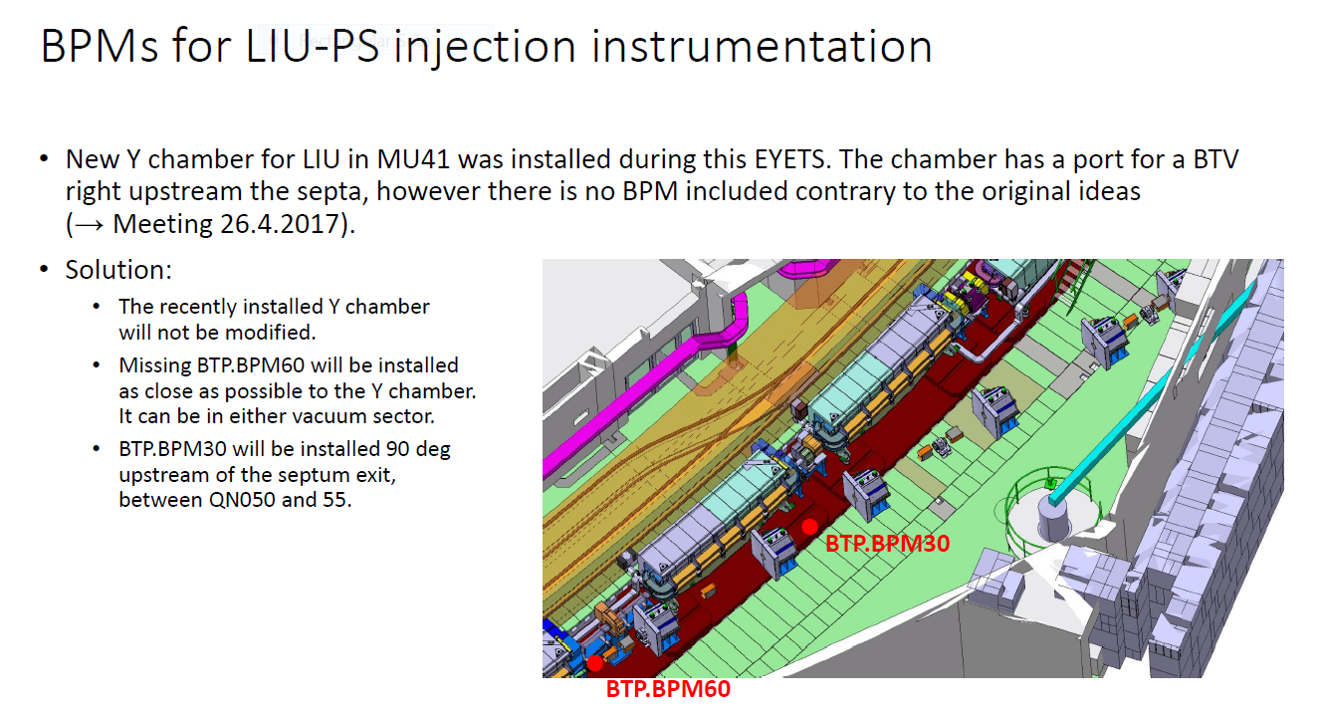
Additional BPM in BTP: Motivation
C. Hessler’s presentation at the LIU-PSB WG #197 (https://indico.cern.ch/event/652026/)

Slide 6
Cost estimates (from BE-BI)
Courtesy of J. Tan
Additional BPM in BI line:
Drawing office 20 kCHF
Production (1+1spare) 15 kCHF
Cables+ADCs 15 kCHF
TOTAL 50 kCHF
Additional BPM in BTP line (see LIU-PSB meeting 197):
Ceramic chambers x2 10 kCHF
Ferrite cores x2 5 kCHF
Cables 5 kCHF
TOTAL 20 kCHF
Manpower: 1 man-month (BE-BI-PI section)
Notes:
Timeline to Jocelyn
Work involved for TE-VSC, MME, Integration and Survey

Slide 7
Supporting Slides

Slide 8
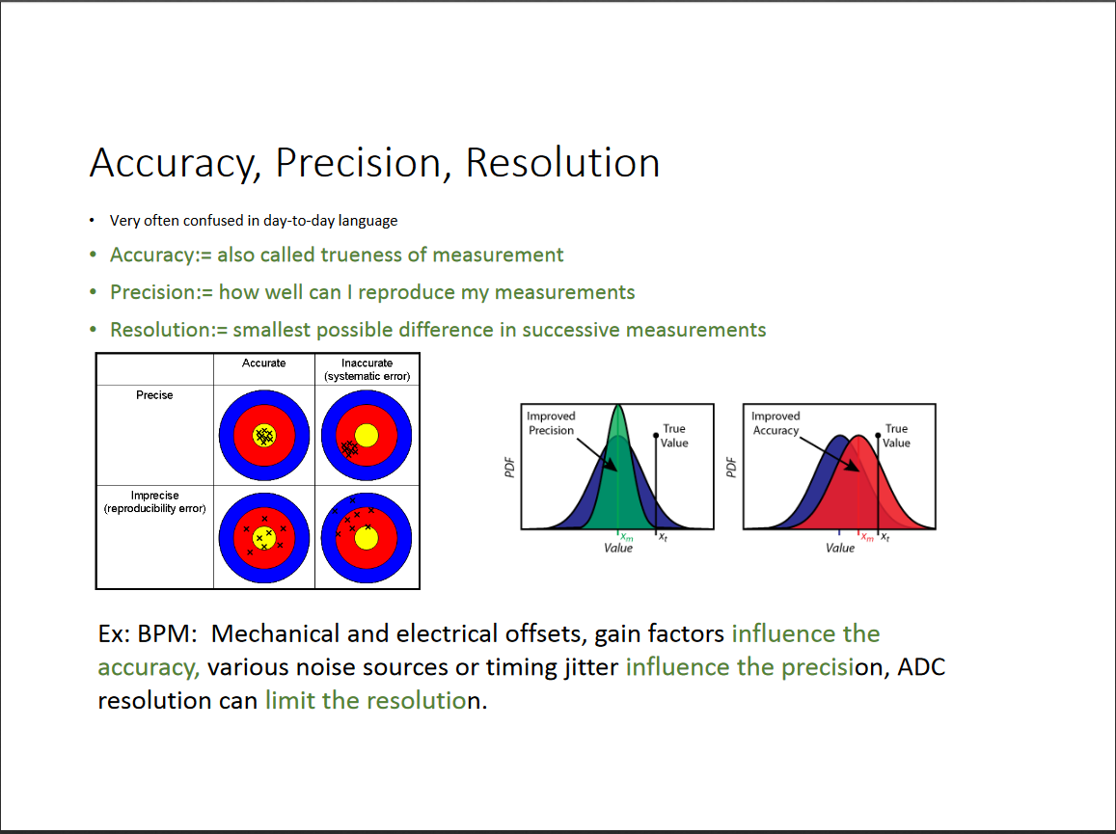
Accuracy/Precision/Resolution in BI
H. Schmickler, http://tinyurl.com/ycluhfgx

Slide 9
Beam-size/Beam-envelope in BI line
Formulas used in C. Bracco’s calculations:
1-sigma beam size is sqrt(emittance*beta*1.2 + dispersion^2*rms_momentum_spread^2)
The factor 1.2 is used to take into account a 20% difference in beta function wrt nominal.
The 4-sigma beam envelope (important for aperture studies) is calculated as:
4*sqrt(emittance*beta*1.2)+dispersion*max_momentum_spread+rms_orbit_displacement

