Slide 1
LIU WS Intervention in TS3
Ray Veness

Slide 2
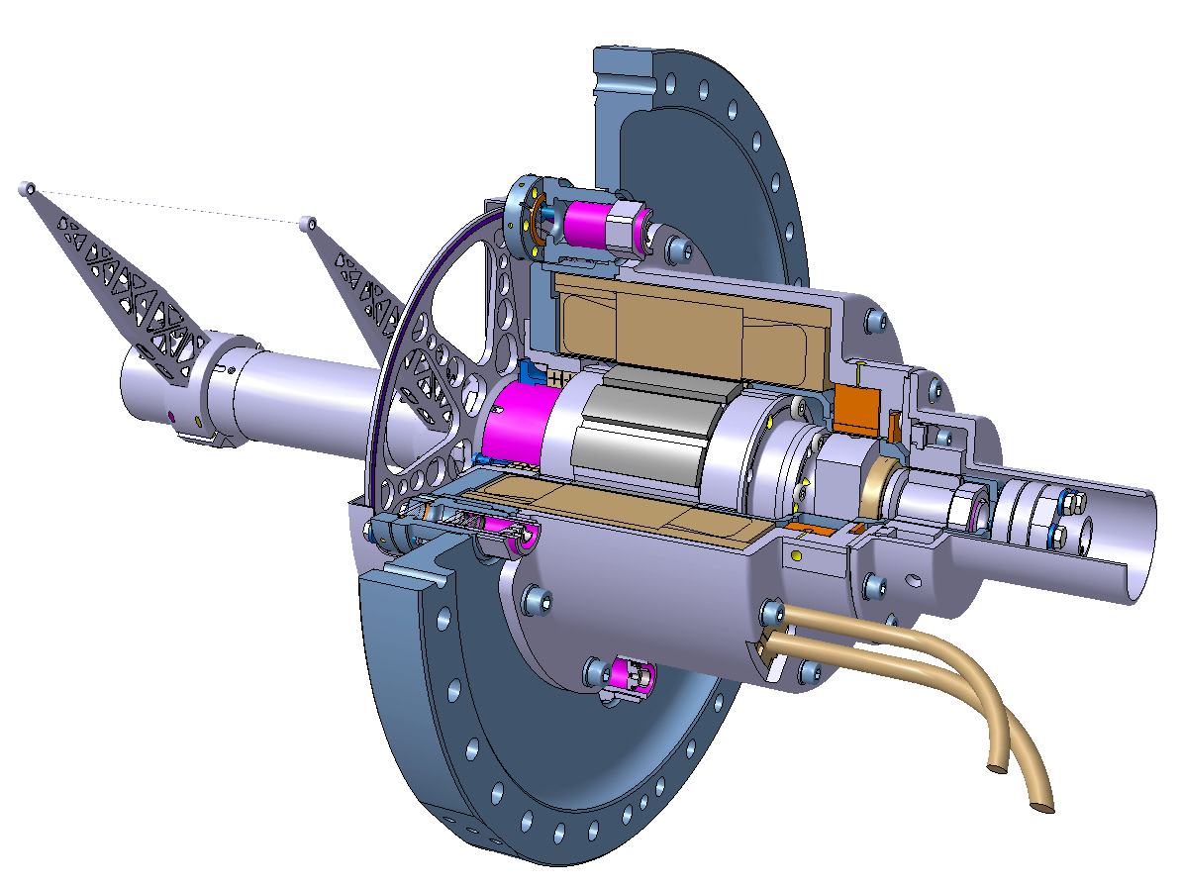
New fast wire scanner. Kinematic Unit
Interchangeability
  One design of kinematic unit for all machines
  Interchangeability of components
Design and Production Features
  Both shaft supports located in the stepped chamber
  No drum
  Direct drive
  Cantilevered shaft
  Magnetic auto-return device (magnetic brake)
  Standard CF flange DN273
  Optimised design of forks (reduced deformation)
  Optimized design of optical encoder disc
Vacuum
  Optical encoder focusers are outside vacuum
  Hybrid bearings (SS races, ceramic balls)
  Vacuum compatible motor supplied directly from subcontractor (CERN qualified)
  Increased stepped chamber wall thickness (0.4 mm vs. 0.3 mm)
Designed in collaboration with EN-MME
(N. Chritin, A. Demougeot)

Slide 3
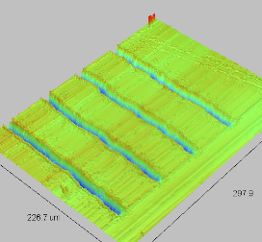
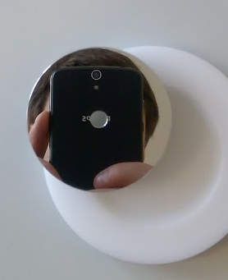
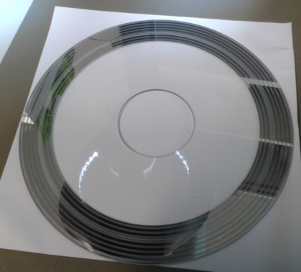
Shaft Angular Position Measurements. Optical Position Sensor
Optical encoder disk located inside vacuum
Follows the shaft movement
Lens system and optical fiber are located outside the vacuum volume
  Trapped volumes avoided
  Reduced outgassing load
Focal distance adjustment possibility by means of fine pitch thread
  Access from outside without venting
Glass disk with chrome encoder pattern deposition (baseline)
  So far better optical properties
  Disk holder required (2 additional parts)
  Higher inertia
Metal disk with laser engraved encoder pattern (preferred upgrade)
  Optical properties are comparable with glass disk (by recent tests)
  Laser engraving in collaboration with Dundee University
  Lower inertia due to optimised design
  Installation directly on the shaft
Bakable up to 200 ⁰C (metal disk)
roughness of optical track: Rt0.04
Optical slits pitch 0.02 mm.
Al microstructure
RSP6061 6062
…Acquisition will be discussed by Federico…

Slide 4
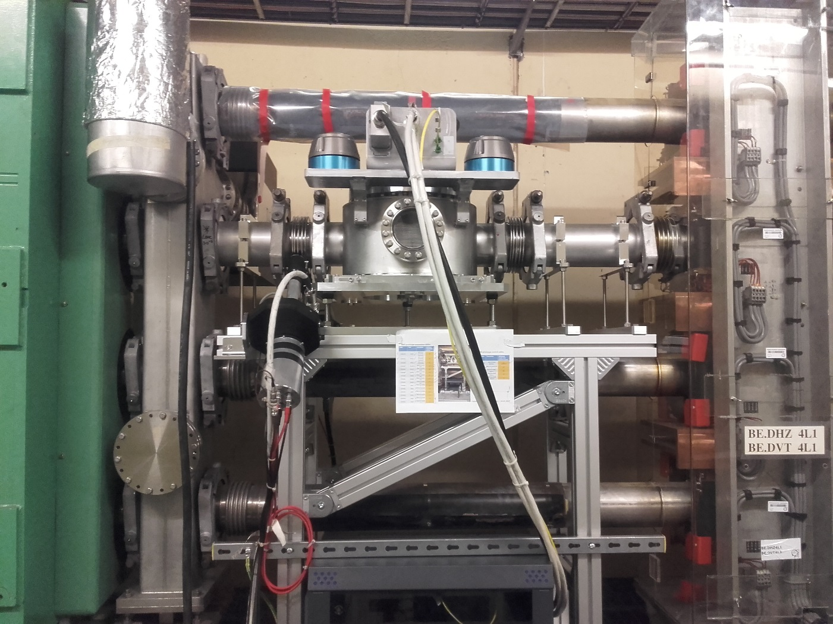
New fast wire scanner prototype in PS Booster (4L1)
Prototype installed in PS Booster on 15.03.2017
Ready for operation

Slide 5
https://www.youtube.com/watch?v=xO6YuPbzHp0&feature=youtu.be

