Slide 1
Measurement of Emittance
1/19
V. Blackmore
CM49
Oct 3rd 2017

Slide 2
The Analysis loop
2/19
Someone proposes something interesting
Make new “final” plots
... different cuts?
... better tracker reconstruction?
... better MC agreement?
... convenient global tracking?
... go through processing loops
... remember all the steps
... do mystic rain dance
... new plots appear
Should it have changed?
Distribution/selection changes
... sometimes “yes”
... sometimes “no”

Slide 3
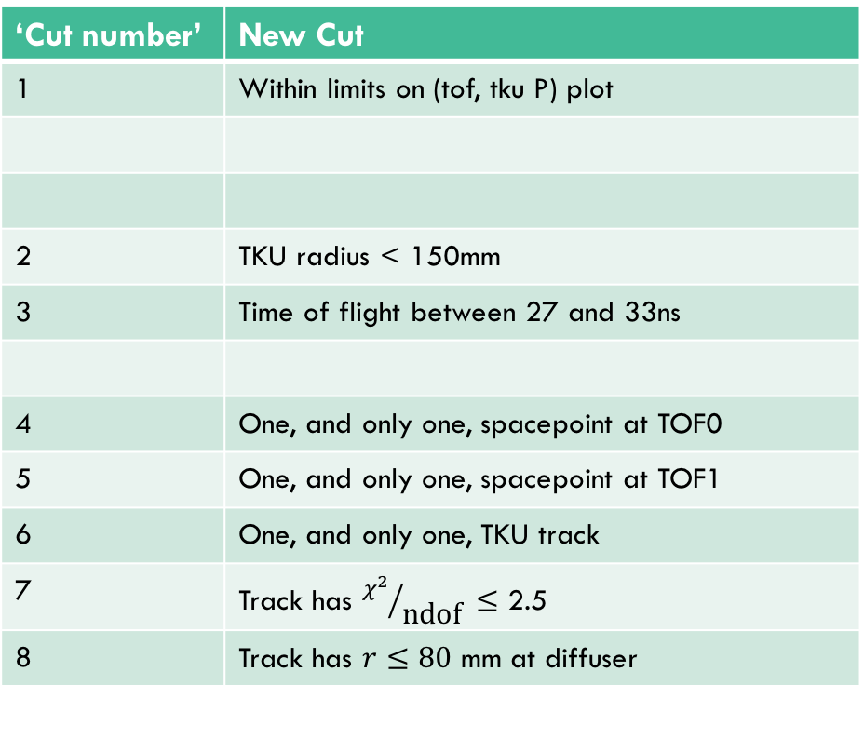
Old cuts, meet new cuts
3/19
‘Cut number’ | Old Cut
1 | Good M. Rayner TOF0 slab calibration
2 | Good M. Rayner TOF1 slab calibration
3 | Good M. Rayner TOF reconstruction
4 | Hit 5 stations of TKU
5 | Time of flight between 27 and 40ns
6 | Hit TOF0, TOF1 and 5 stations of TKU
7 | One, and only one, hit at TOF0
8 | One, and only one, hit at TOF1
9 | One, and only one, track in TKU
10 | TKU P-value > 0.01
11 | C. Rogers tracked radius at diffuser < 80mm
‘Cut number’ | New Cut
1 | Within limits on (tof, tku P) plot
2 | TKU radius < 150mm
3 | Time of flight between 27 and 33ns
4 | One, and only one, spacepoint at TOF0
5 | One, and only one, spacepoint at TOF1
6 | One, and only one, TKU track
7 | Track has ${χ^{2}}/{\text{ndof} }≤$ 2.5
8 | Track has $r≤80$ mm at diffuser

Slide 4
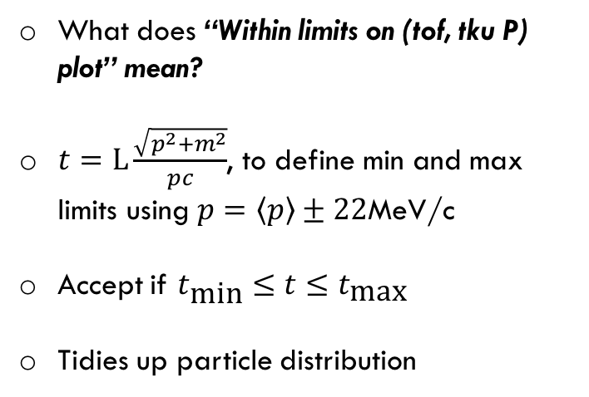
MAUS 2.8
All new cuts
No (tof, tku P cut)
4/19
Data
Data
What does “Within limits on (tof, tku P) plot” mean?
$t=L\frac{\sqrt{p^{2}+m^{2}}}{pc}$, to define min and max limits using $p=\left\langle p\right\rangle ±22$MeV/c
Accept if $t_{\text{min}}≤t≤t_{\text{max}}$
Tidies up particle distribution
All new cuts
No (tof, tku P cut)
Recon MC
Recon MC

Slide 5
MC, Data comparisons (MAUS 2.8)
5/19
New distribution to look at
Replaces P-value in analysis
Cut on values greater than 2.5
MAUS 2.8, all cuts

Slide 6
MC, Data comparisons (MAUS 2.8)
6/19
MAUS 2.8, all cuts
MAUS 2.8, all cuts
Still not quite getting |P| in agreement at TKU

Slide 7
MC, Data comparisons (MAUS 2.8)
7/19
Still not quite getting time-of-flight in agreement between data and recon MC
Interesting note: M. Rayner’s method to reconstruct |P| at TOF1 shows agreement → scales by electron peak
MAUS 2.8, all cuts

Slide 8
MC, Data comparisons (MAUS 2.8)
8/19
MAUS 2.8, all cuts
Similar...
MAUS 2.8, all cuts
MAUS 2.8, all cuts

Slide 9
MC, Data comparisons (MAUS 2.8)
9/19
MAUS 2.8, all cuts
Similar...
MAUS 2.8, all cuts
MAUS 2.8, all cuts

Slide 10
Can we improve MC agreement?
10/19
Durga made 4 different MC’s to go with Run 7469
  Uses MAUS 2.9
  Data reconstructed with MAUS 2.9
  Don’t have “diffuser tracking”, so comparing distributions without the diffuser aperture cut (all other cuts remain the same)
    ... advised to use a MAUS 3.0 reconstruction of data and MC for global tracking
    ... see “slide 2”
MC nickname | What is it?
“Magic” | The default beamline for Run 7469
“Magic p2” | Default beamline with D2 current + 2%
“Fit” | Beamline using Paolo’s D2 current-field fit
“Fit p1” | Using Paolo’s D2 current-fit + 1%

Slide 11
Chi-square/dof
11/19
Track fitting changed
... and is different again in MAUS 3.0
MAUS 2.8, all cuts except at diffuser
MAUS 2.9, all cuts except at diffuser

Slide 12
TKU total momentum
12/19
Total momentum at TKU appears similar
... so without fiddling with cuts, what happens to other MC’s?
MAUS 2.8, all cuts except at diffuser
MAUS 2.9, all cuts except at diffuser

Slide 13
TKU total momentum
13/19
Total momentum at TKU appears similar
... so without fiddling with cuts, what happens to other MC’s?
MAUS 2.9, all cuts except at diffuser
Magic
Magic p2

Slide 14
TKU total momentum
14/19
Total momentum at TKU appears similar
... so without fiddling with cuts, what happens to other MC’s?
MAUS 2.9, all cuts except at diffuser
Magic
Fit

Slide 15
TKU total momentum
15/19
Total momentum at TKU appears similar
... so without fiddling with cuts, what happens to other MC’s?
MAUS 2.9, all cuts except at diffuser
Magic
Fit p1

Slide 16
(Best) Time of flight
16/19
“Magic p2” captures TKU P best
.. better time-of-flight, but not perfect
MAUS 2.9, all cuts except at diffuser
Magic
Magic p2

Slide 17
(Best) TOF1 |P|
17/19
“Magic p2” captures TKU P best
.. better time-of-flight, but not perfect
MAUS 2.9, all cuts except at diffuser
Magic
Magic p2

Slide 18
(TOF, TKU |P|)
18/19
Need diffuser aperture cut to improve Recon MC agreement with data
Magic
Magic
Magic p2
Magic p2

Slide 19
Summary
* not legally binding, because sometimes I make mistakes...
19/19
Going ahead with “Magic p2” for absolutely, definitely, under-no-circumstances-not final* processing of data and MC
  Gains diffuser tracking, better tracker reconstruction
Concerns:
  From MAUS 2.8 to 2.9 there’s an overall reduction in particles passing defined cuts
  Change in chi-square/dof distribution
  Re-evaluate cut threshold once MAUS 3.0 distribution’s been seen
With best-available MC, can bin emittance and (fingers crossed) see better agreement between data and MC.
Data/Recon comparison | # surviving particles after all but “diffuser cut” |  | # surviving particles after all cuts
 | Data | Recon MC | Data | Recon MC
MAUS 2.8 | 23,276 | 26,944 | 18,711 | 20,552
MAUS 2.9: Magic | 22,387 | 24,844 | ... | ...
MAUS 2.9: Magic p2 |  | 26,210 | ... | ...
MAUS 2.9: Fit |  | 24.795 | ... | ...
MAUS 2.9: Fit p1 |  | 25,373 | ... | ...

