Slide 1

CERN – 9th October 2017
Conductor Studies
B. Bordini, J.E. Duvauchelle – CERN
M. Dhallé, P. Gao – Uni. Twente
C. Senatore, L. Gamperle, C. Barth – UniGe
2nd Review of the EuroCirCol WP 5

Slide 2
Outline
Introduction
  EuroCirCol Baseline Conductor
  Characteristics of the HL-LHC wires
Main Conductor Study - Critical Current vs. Transversal Load
  Introduction
  The Exponential Strain Function:
    Characteristics, Potential
    Computing the effect of Reversible I_{c} degradation in Wires and Cables
  Experimental Studies
    Plans and Goals
    Cable Measurements at CERN and at Twente University
    Wire measurements at the University of Geneva
Conclusions

Slide 3
EuroCirCol Baseline Conductor
J_{c} (T, B) scaling
Scaling Law
Parameters
J_{c} (16 T, 4.22 K) = 1.03 ∙ 1500 A/mm²
B_{c2} (4.22 K) = 25.5 T
T_{c0} = 16 K
α = 0.96
Assumed cable degradation 3 %
Main parameters
J_{c} (16 T, 4.22 K) = 1545 A/mm² B_{c2} (4.22 K) = 25.5 T

Slide 4
Characteristics of the HL-LHC wires
Average values measured at CERN
In the table the magnetic field is the background during I_{c} measurement; in terms of peak field the J_{c} is slightly higher
  Peak field 16 T → J_{c} of the 3 wires is respectively 1134, 1339 and 1129 A/mm²
For the RRP conductor with a sub-element size of 55 μm not so far in J_{c} from what used to design FCC magnets and larger B_{c2} (→ better performance at larger fields)
J_{c} (16 T, 4.22 K) = 1339 A/mm² B_{c2} (4.22 K) = 25.9 T

Slide 5
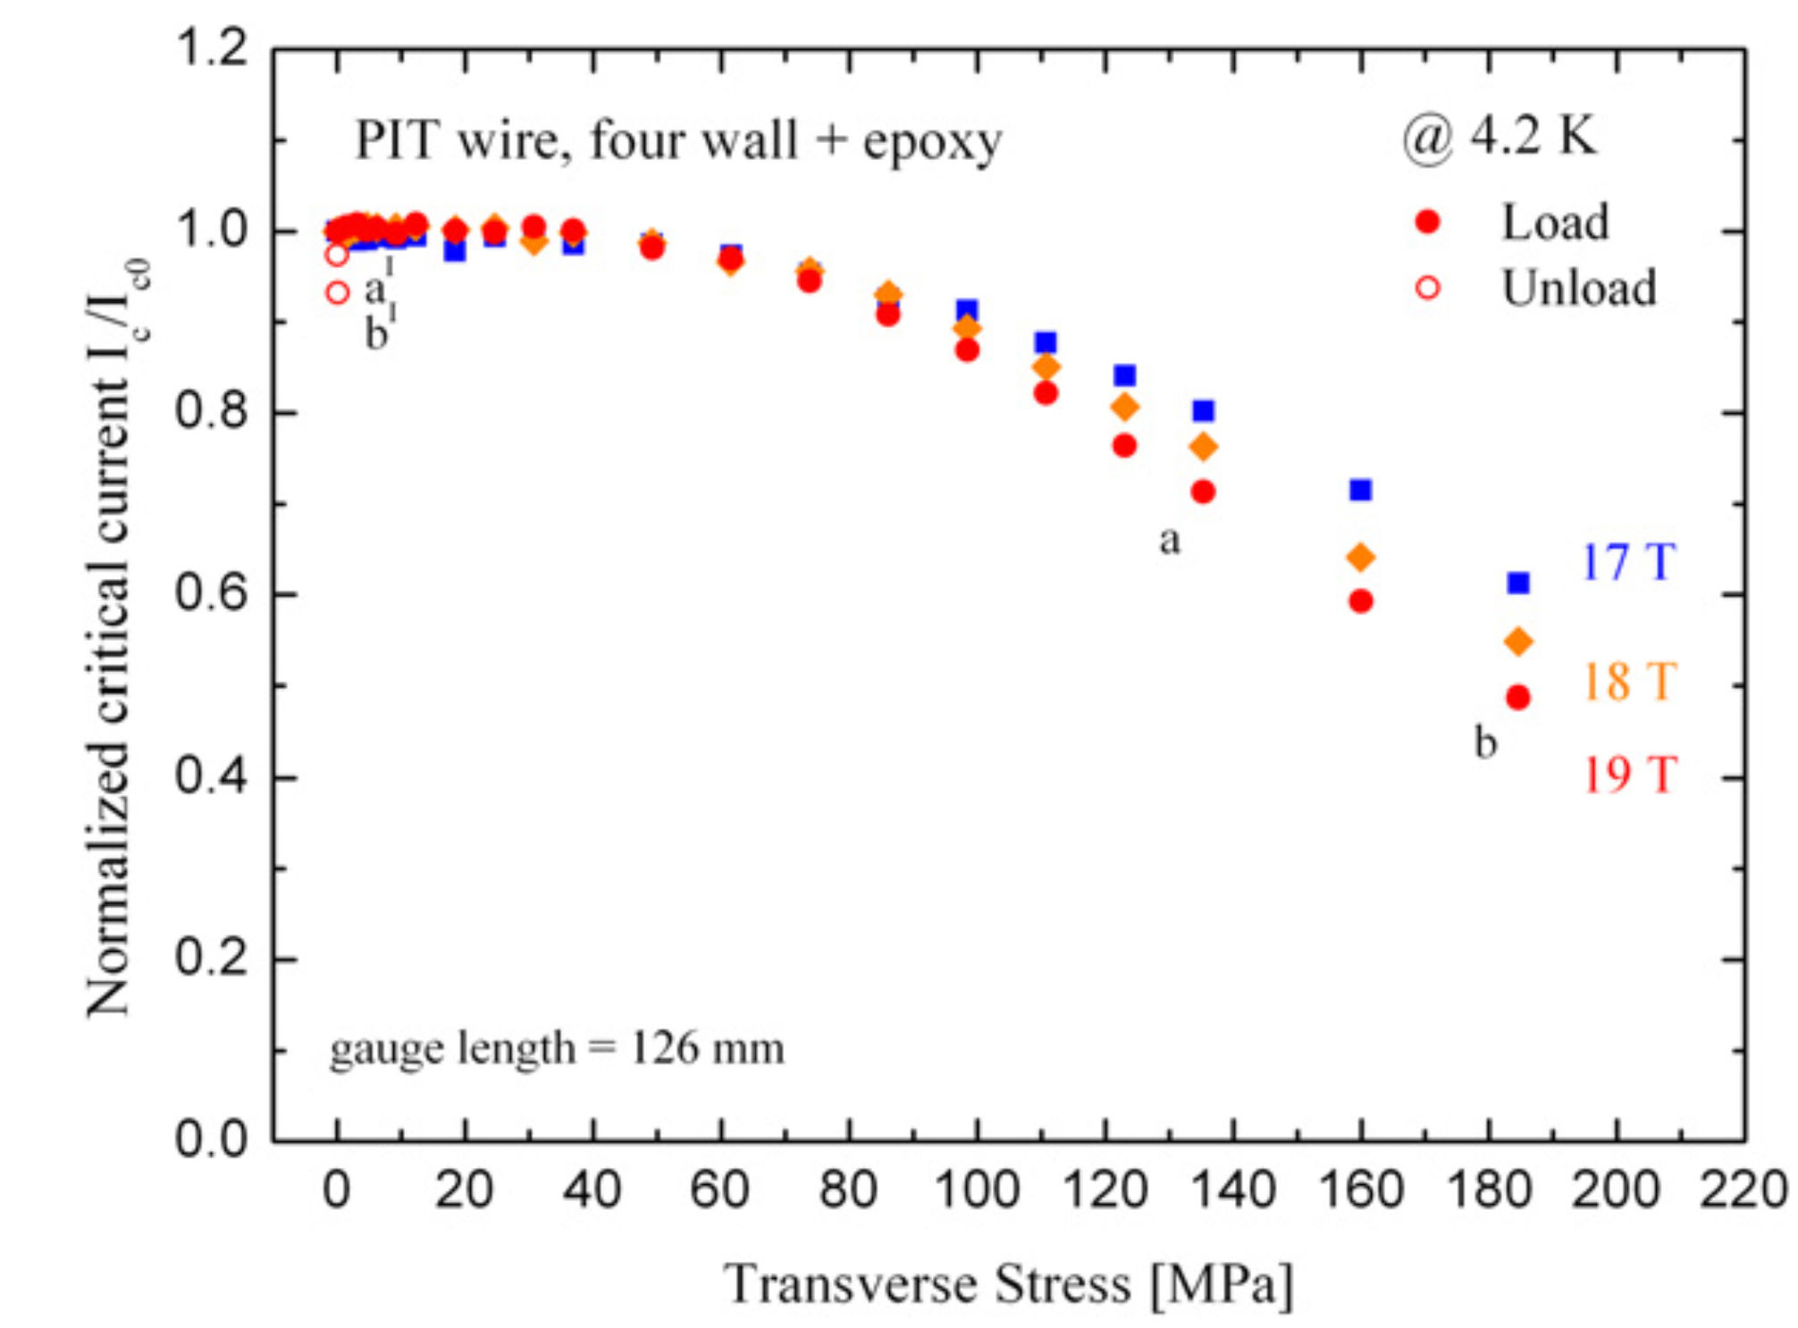
Main Conductor Study
Critical Current vs. Transversal Load - Introduction
In the development of a 16 T Nb₃Sn magnet one of the main issue is the large transversal stress applied on the conductor
While a significant amount of experimental data exists about the performance of Nb₃Sn wires under axial strain, not much is available for the case of transversal load
Around 2008 CERN started to develop a cable sample holder to measure samples in FRESCA test station under transversal load*
In 2009 a collaboration was established between CERN and the University of Geneva to develop a set up for measuring wires under transversal load **
In 2012 measurements of CERN cables under transversal pressure were performed at TWENTE University
Normalized I_{c} @ 4.2 K versus transversal load measured at UniGe in a 1.25 mm 288 PIT wire **
** G Mondonico, B Seeber, A Ferreira, B Bordini, L Oberli, L Bottura, A Ballarino, R Flukiger and C Senatore SuST 25 (2012) 115002 (9pp)
*B. Bordini, F. Regis, O. Crettiez, P. Fessia, M. Guinchard, J. C. Perez, and I. Sexton IEEE Trans. Appl. Supercond., VOL. 20, NO. 3, JUNE 2010

Slide 6
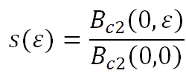
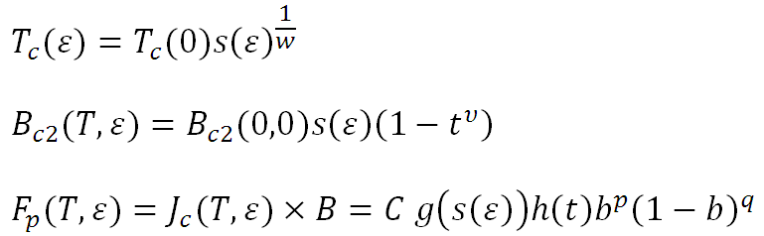
Main Conductor Study
Strain (Reversible Region) & I_{c} Scaling
The main parameter describing the strain dependence of the Nb₃Sn superconducting properties, it is the ‘strain’ function s(ε)
The strain dependence of the superconducting properties (in the case of axial applied strain) can be written as a function of s(ε)
Before the ‘exponential’ strain function (next slide), all the proposed functions were able (some better then others) to fit the experimental data (axial applied strain) but they did not have any extrapolation capabilities

Slide 7
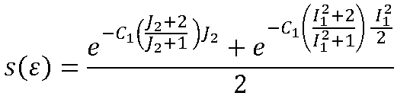
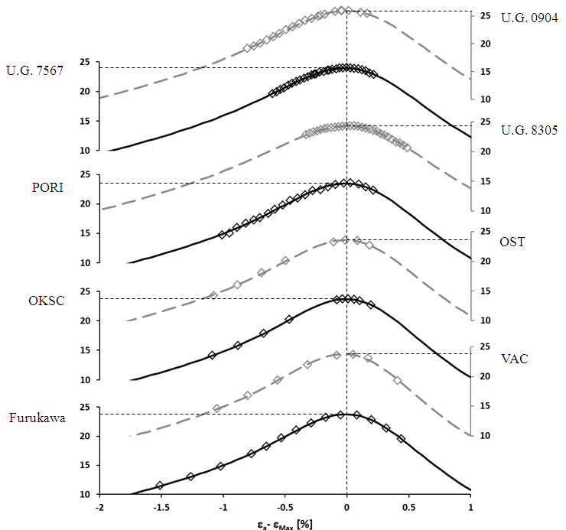
The Exponential Strain Function*
Characteristics
Where: I₁ is the first invariant of the strain tensor, J₂ second invariant of the deviator strain tensor
Only two fitting parameters:
  C₁ that defines the sensitivity (curvature) of the material to the strain and
  ε_{l0} the longitudinal pre-compression of the Nb₃Sn (ε_{l0} ~ ε_{max} in I_{c} vs. Axial Strain measurements)
More stable and has extrapolating capabilities
Written such that it can be directly generalized to any 3-D load
* Bordini B, Alknes P, Bottura L, Rossi L and Valentinis D 2013 SuST 26 075014

Slide 8
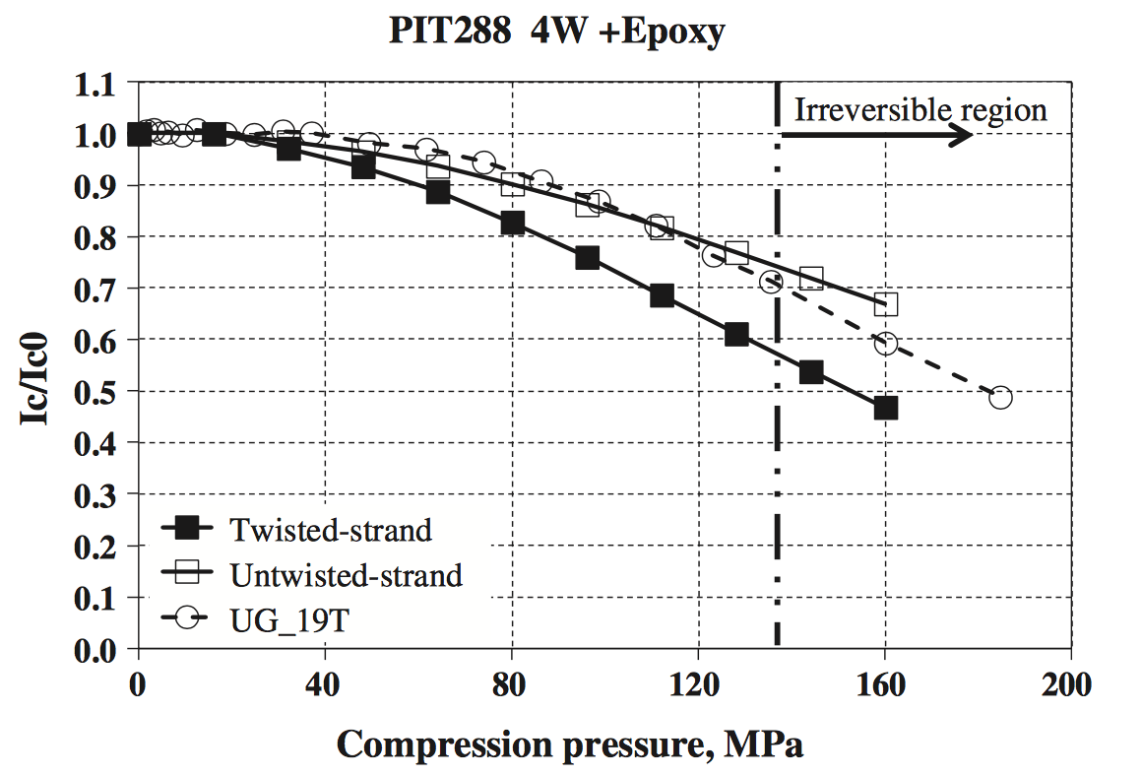
The Exponential Strain Function
Potential
It has the potential to be a real 3-D strain function
The exponential strain function was used to calculate the reversible degradation of a PIT wire under transversal pressure*
  2-D FE model* of a 1.25 mm 288 PIT wire measured under transversal pressure at UniGe**
  The model is in good agreement with experimental data
The exponential strain function was chosen as the most stable and extrapolative strain function in the recently released ESE scaling law ***
*T Wang, L Chiesa, M Takayasu, B Bordini Cryogenics 63 (2014) 275–281
** G Mondonico, B Seeber, A Ferreira, B Bordini, L Oberli, L Bottura, A Ballarino, R Flükiger and C Senatore SuST, 25 (2012), p. 115002 [9pp]
*** Jack W Ekin, Najib Cheggour, Loren Goodrich and Jolene Splett SuST 30 (2017) 033005 (38pp)

Slide 9
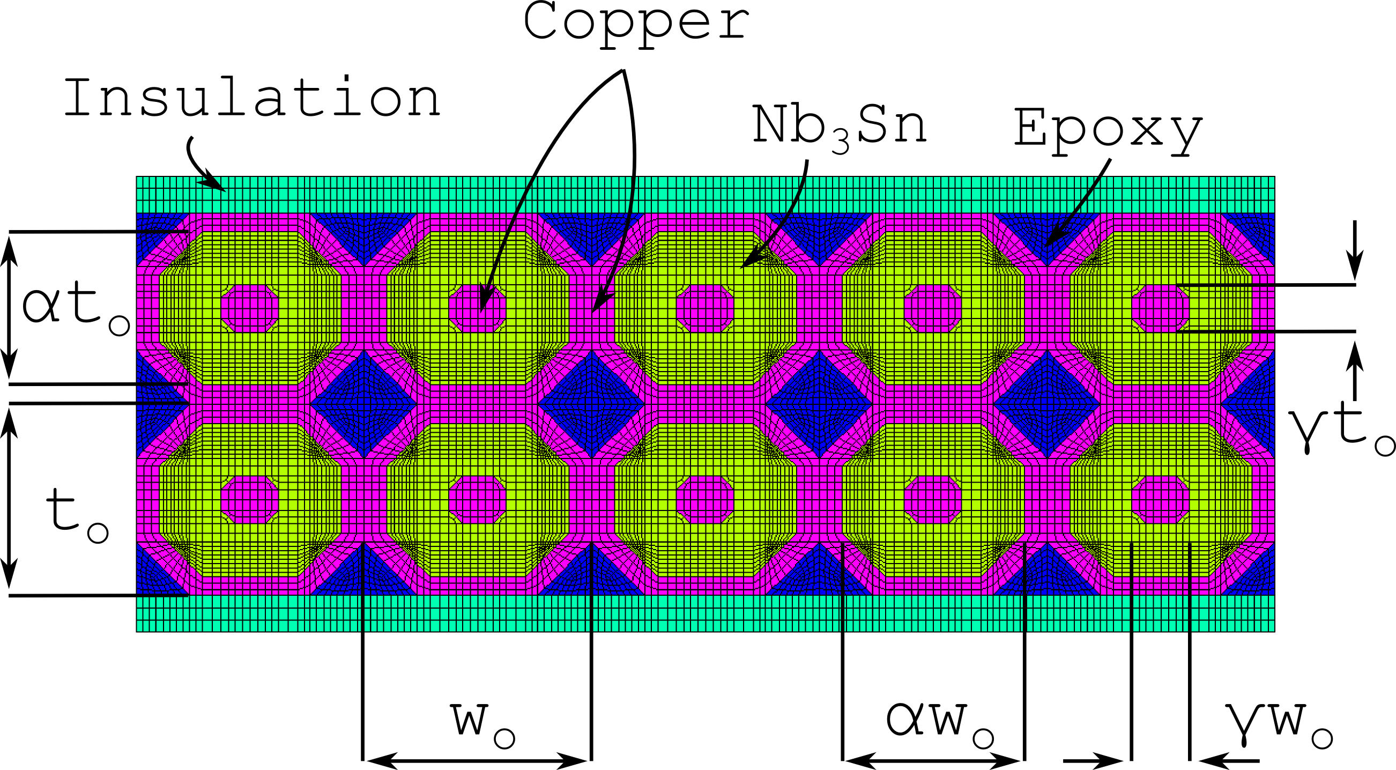
The Exponential Strain Function
Computing I_{c} degradation of Rutherford cables under transverse load* - Mech. Model
Developed a FEM mechanical model of the cable stack able to estimate the young modulus of the stack during loading (14 GPa) and unloading (37 GPa)
  Good agreement with data measured on impregnated cable stacks;
  The geometry of the cable is simplified, in particular the region where the sub-elements are embedded in a copper matrix is treated as a unique annulus of Nb₃Sn;
  The simplified geometry respects the main parameters of the conductor (cable filling factor, Cu to non-copper ratio, height and width of the cable and of the stack etc..);
  The material properties of the different components are taken from literature.
The significant difference of the young modulus during loading and unloading is explained by the plastic deformation of the Cu (during loading)
Courtesy of Giorgio Vallone
*G. Vallone, B. Bordini, P. Ferracin, presented at EUCAS 2017 and submitted for publication, IEEE Trans. Appl. Supercond.

Slide 10

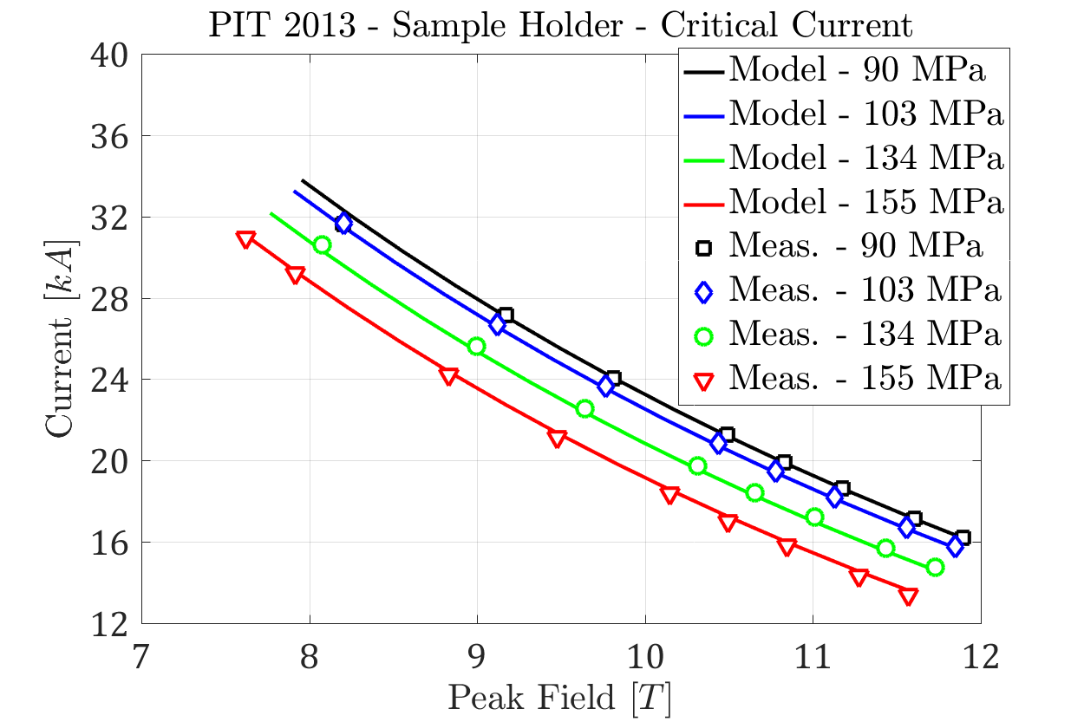
The Exponential Strain Function
Computing I_{c} degradation of Rutherford cables under transverse load* - Results
Calculated via a FEM model (2D and 3D) the strain in the cable stack during the test under transverse load in Fresca
The computed 3D strain multiplied by a constant factor, which accounts for the concentration of the stresses in the superconducting sub-elements, is used to compute the strain function and the critical current
The model is in good agreement with the experimental data measured** on PIT cable in FRESCA
Courtesy of Giorgio Vallone
*G. Vallone, B. Bordini, P. Ferracin, presented at EUCAS 2017 and submitted for publication, IEEE Trans. Appl. Supercond.
** B. Bordini, P. Alknes, A. Ballarino, L. Bottura, L. Oberli IEEE Trans. Appl. Supercond., VOL. 24, NO. 3, JUNE 2014

Slide 11
Main Conductor Study
Experimental Studies – Plans and Goals
Compare CERN and Twente set-ups for measuring cables under transversal pressure
  CERN and Twente University both prepare and measure the same two cables, one based on the PIT wire and the other on the RRP
    18 strands cables based on 1 mm strand
    The strands are FRESCA 2 wires: 132/169 RRP and 192 PIT
Correlate the wire measurements under transversal pressure carried out at UniGe with cable measurements
  UniGe measures the same wires used in the cable tests at CERN and Twente
Verify the compatibility of high J_{e} with large transverse pressure on the conductor

Slide 12
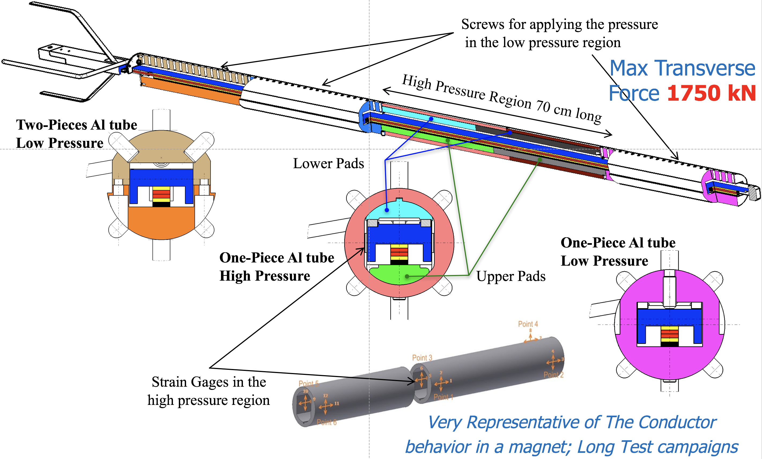
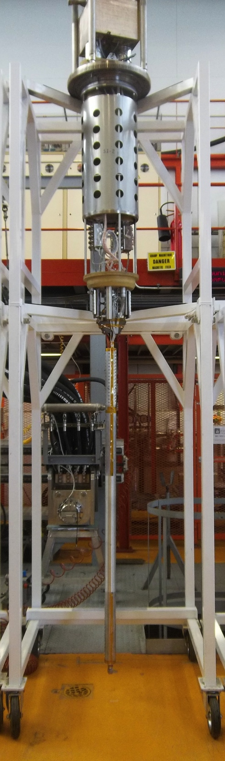
Experimental Studies
CERN Cable Samples Holder

Slide 13
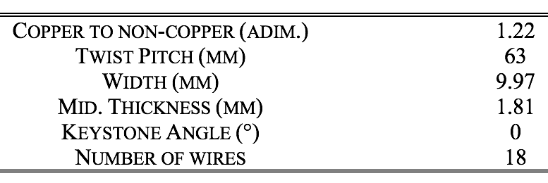
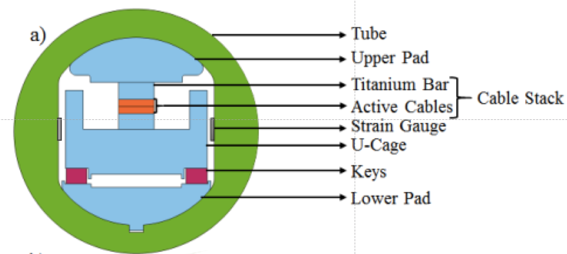
Experimental Studies
Test at CERN on a RRP cable* - Sample
The cable sample tested was a rectangular 18 -strand Rutherford cable based on the 1 mm RRP 132/169
The sample is constituted by:
Two 1.8 m long active cables that carry the current;
two Ti6Al4V bar, 3 and 4 mm thick, that sandwich the active cables;
The different components of the sample stack are separated by fiberglass braid and the sample is vacuum impregnated with epoxy (CTD-101)
The two active cables are spliced together in the bottom (along 15 cm) while on the top they are each spliced with a NbTi cable (along 20 cm)
*J. E. Duvauchelle , B. Bordini, J. Fleiter, A. Ballarino presented at EUCAS 2017 and submitted for publication, IEEE Trans. Appl. Supercond.

Slide 14
Experimental Studies
Test at CERN on a RRP cable* – Measurements
The critical current of the cable was defined at an electric field equal to 0.03 µV/cm
The first test was done at a relatively low transverse pressure (85 MPa)
  at this pressure, as verified in the experiment, the I_{c} is not significantly affected by the transverse load
The following tests consisted in measuring the I_{c} at higher and higher transverse loads;
  in between these tests, I_{c} measurements at 80-85 MPa were carried out to verify whether or not the previous test produced a permanent degradation in the sample.
*J. E. Duvauchelle , B. Bordini, J. Fleiter, A. Ballarino presented at EUCAS 2017 and submitted for publication, IEEE Trans. Appl. Supercond.

Slide 15
Experimental Studies
Test at CERN on a RRP cable* – Results 1/2
At 120 MPa observed a significant I_{c} decrease
  at 11.6 T the I_{c} is 95.2% of the current at 85 MPa
  associated with a reduction of the B_{c2}
The following test (3) at 80 MPa showed a significant recovery of the critical current
  permanent degradation only 1.8% at 11.6 T and part of it due to a small damage of the sample which occurred during the last part of the second test (120 MPa) when a couple of quenches were done inverting the current in the sample
This behavior suggests that the degradation at 120 MPa is dominated by the reversible component and it is due to the strain on the superconductor that decrease the strain function
*J. E. Duvauchelle , B. Bordini, J. Fleiter, A. Ballarino presented at EUCAS 2017 and submitted for publication, IEEE Trans. Appl. Supercond.

Slide 16
Experimental Studies
Test at CERN on a RRP cable* – Results 2/2
The test at 140 MPa (test 4) showed a further decrease of I_{c} and B_{c2}
When retested (test 5) at 80 MPa, the permanent degradation was similar (2.4% at 11.6 T) to that one of the previous test at 80 MPa.
At 160 MPa (Test 6 ) not only a further degradation of the B_{c2} (and I_{c} ) but also a significant reduction of the n-value that suggested a relevant permanent degradation in the cable.
  The last test at 80 MPa (test 7) confirmed this reduction of the n-value and showed a significant increase of the permanent degradation
These results are consistent with what was found in a previous test on a similar cable based on the PIT conductor
*J. E. Duvauchelle , B. Bordini, J. Fleiter, A. Ballarino presented at EUCAS 2017 and submitted for publication, IEEE Trans. Appl. Supercond.

Slide 17
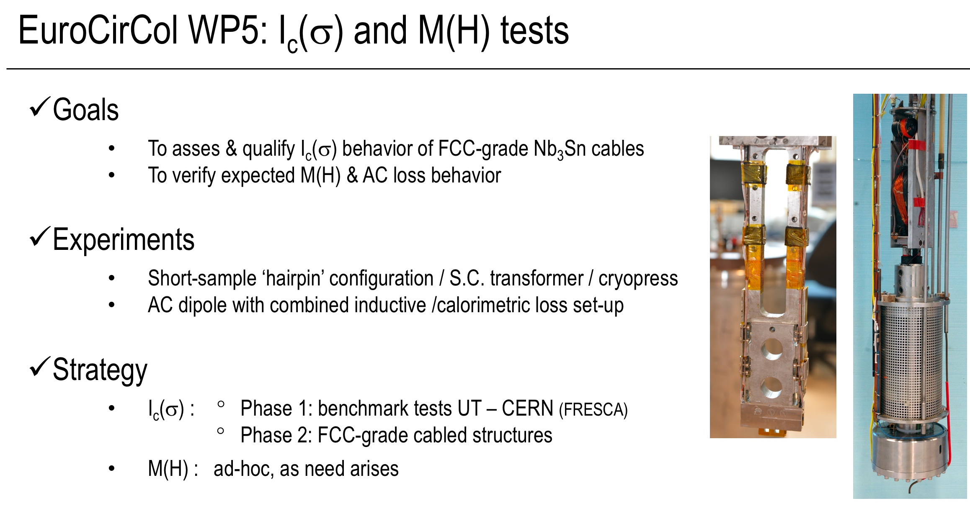
Experimental Studies
Tests at Twente – Plans and Goals

Slide 18
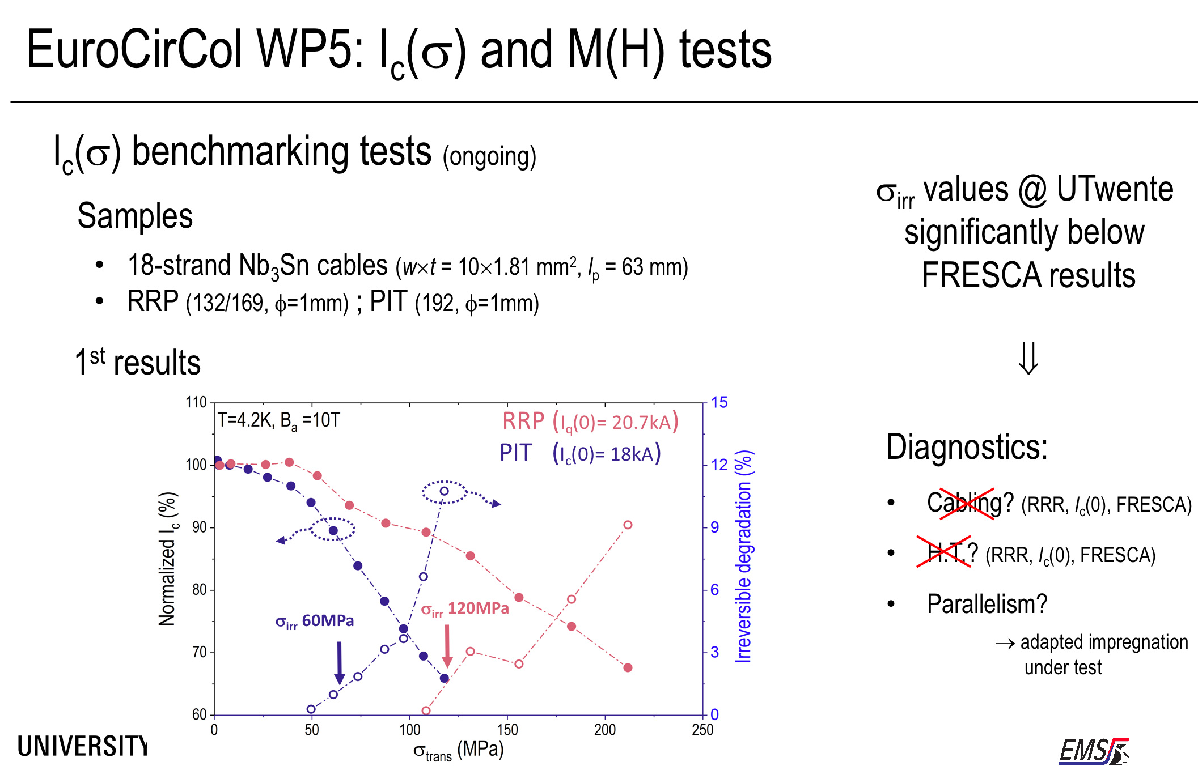
Experimental Studies
Test at Twente – Too Large Degradation

Slide 19
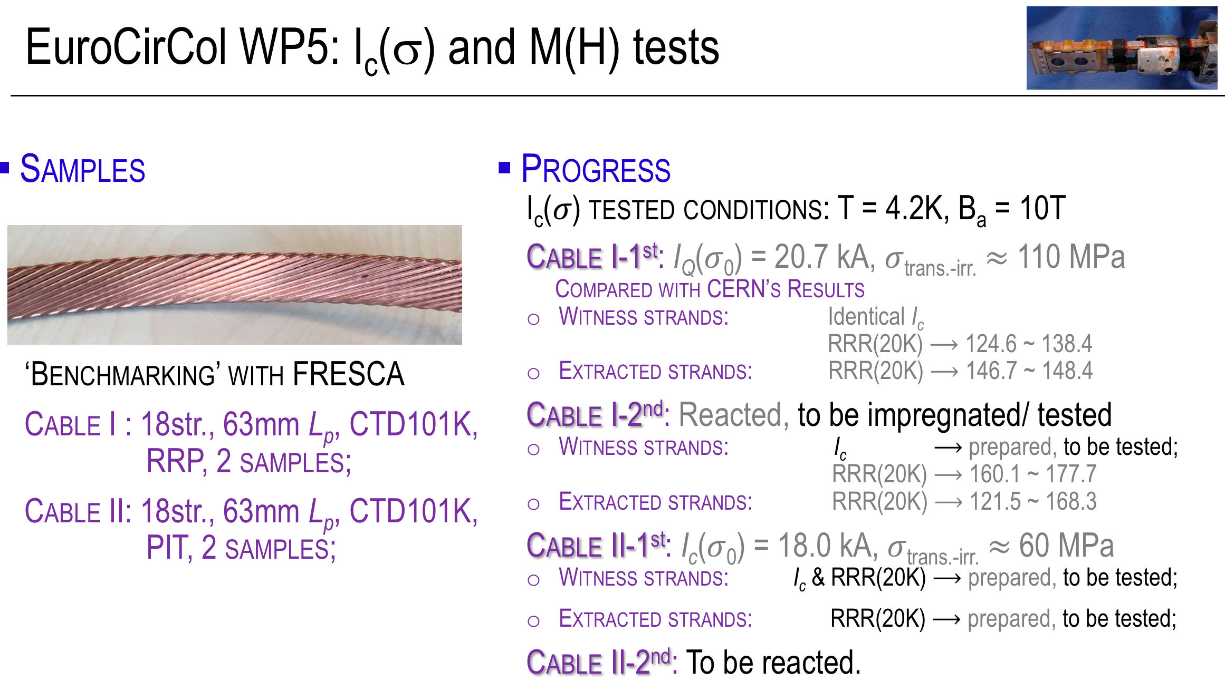
Experimental Studies
Test at Twente – Status

Slide 20
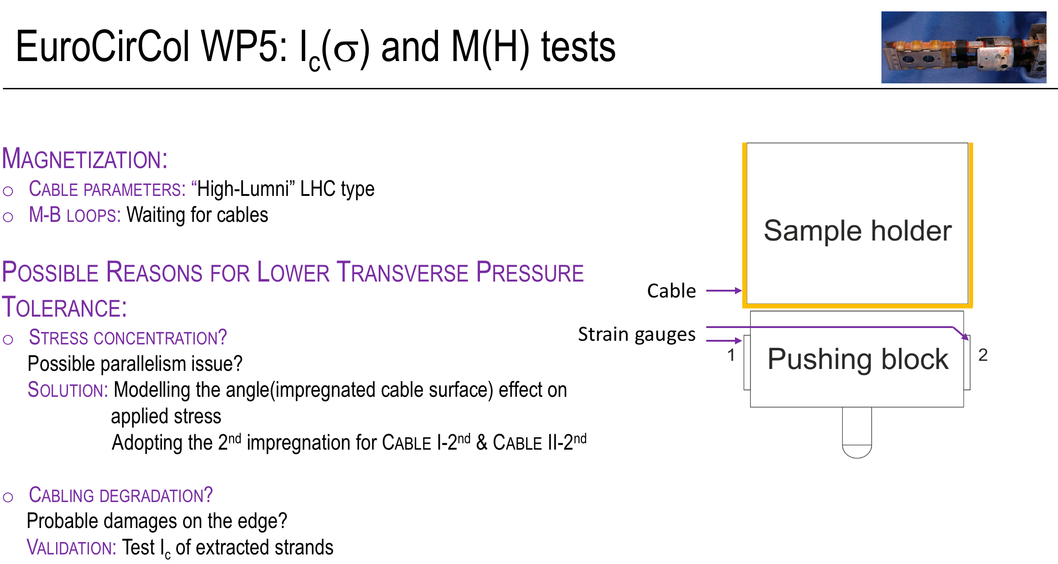
Experimental Studies
Test at Twente – Plans

Slide 21
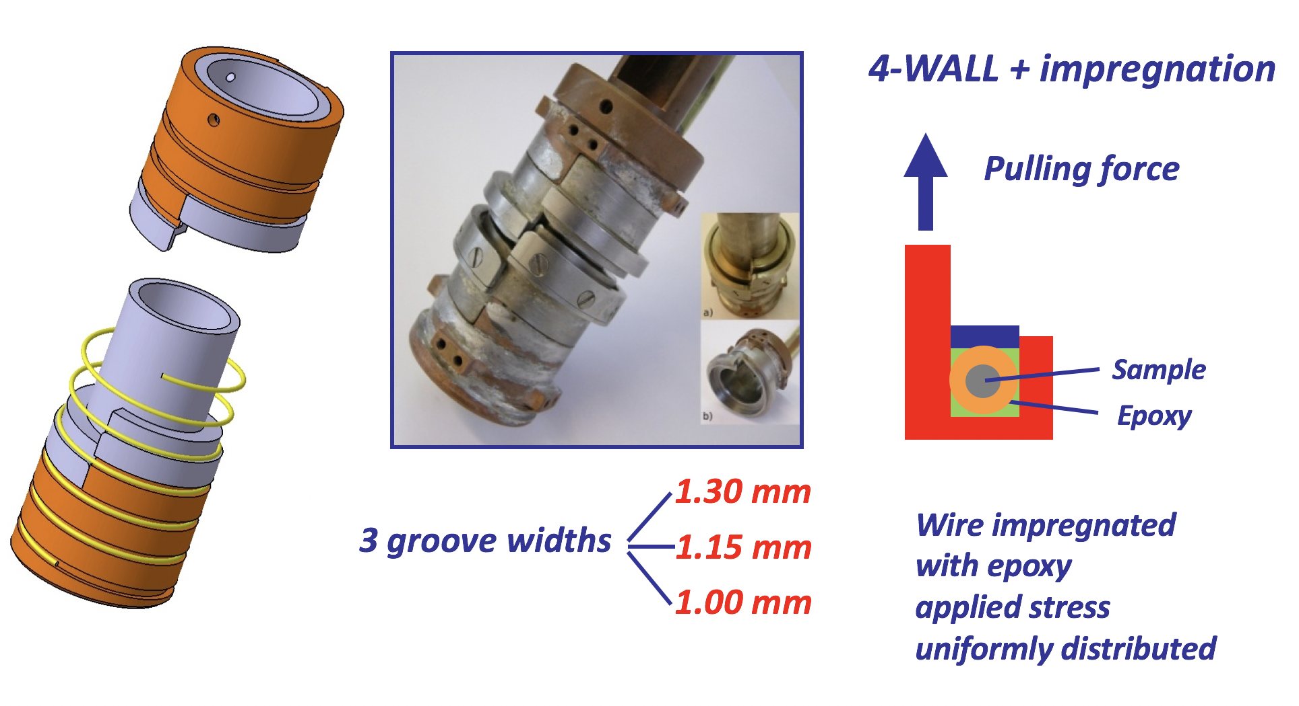

Experimental Studies
UniGe Wire Sample Holder for Transverse Load
Extremely Rapid and Versatile Test Set-Up for Superconducting Wires

Slide 22
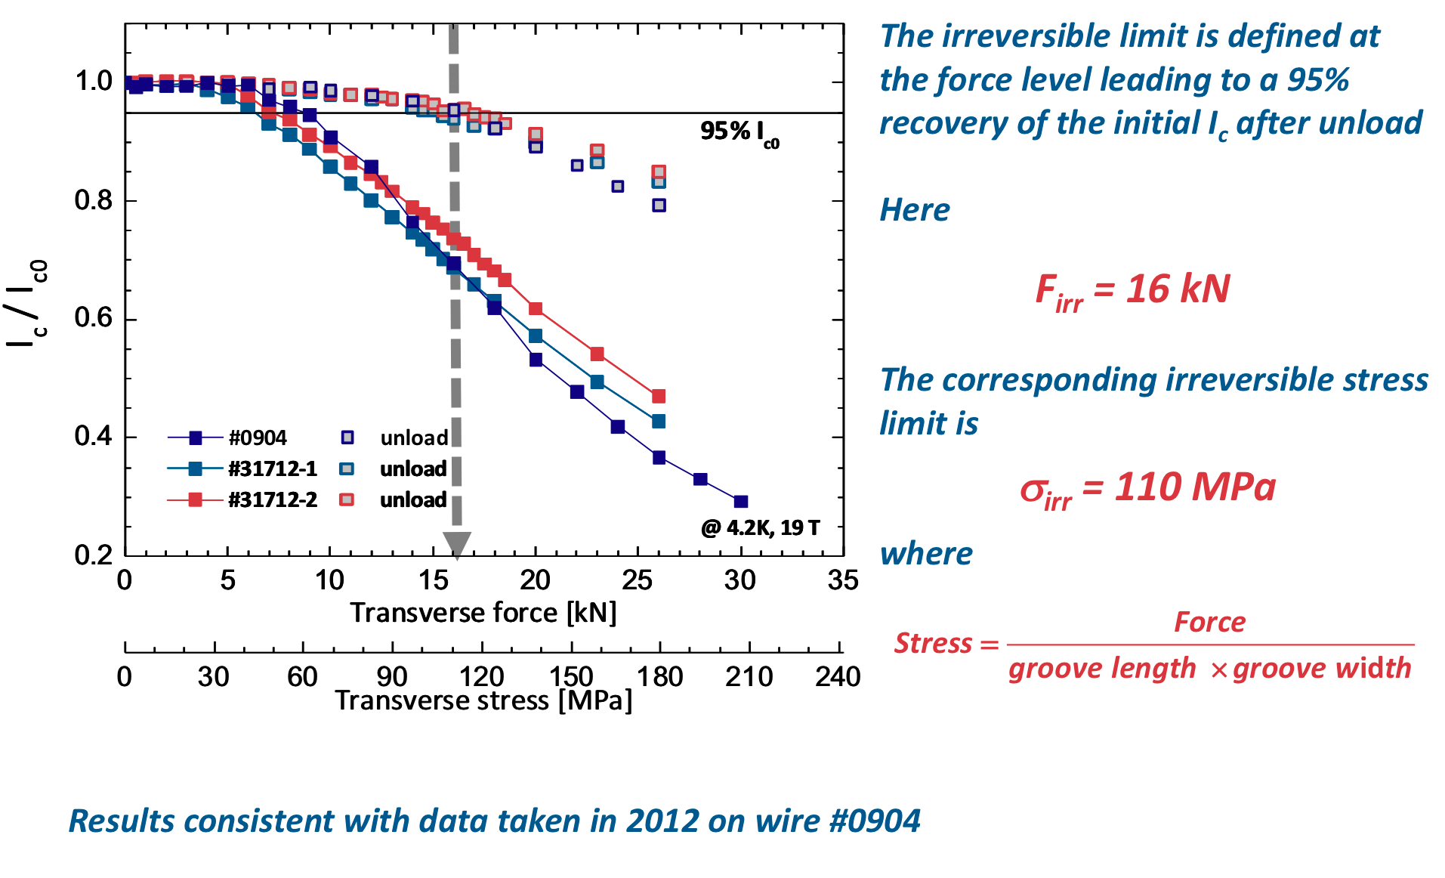
Experimental Studies
1 mm round PIT wire @ UniGe – reproducibility

Slide 23
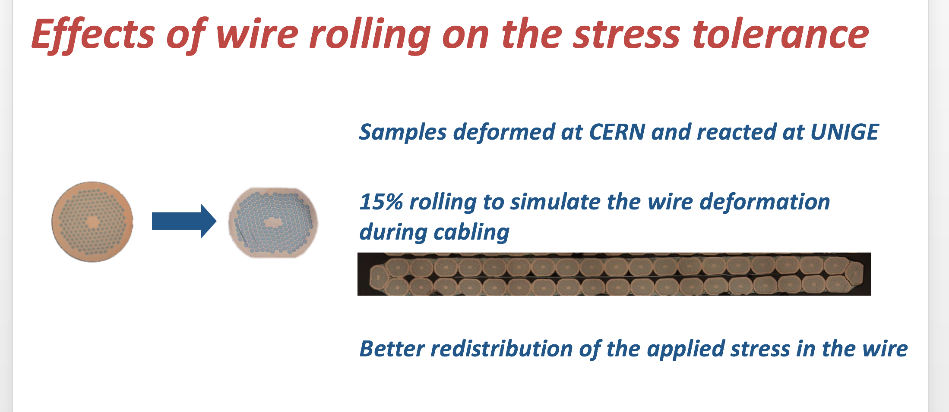
Experimental Studies
1 mm PIT wire @ UniGe – Rolling

Slide 24
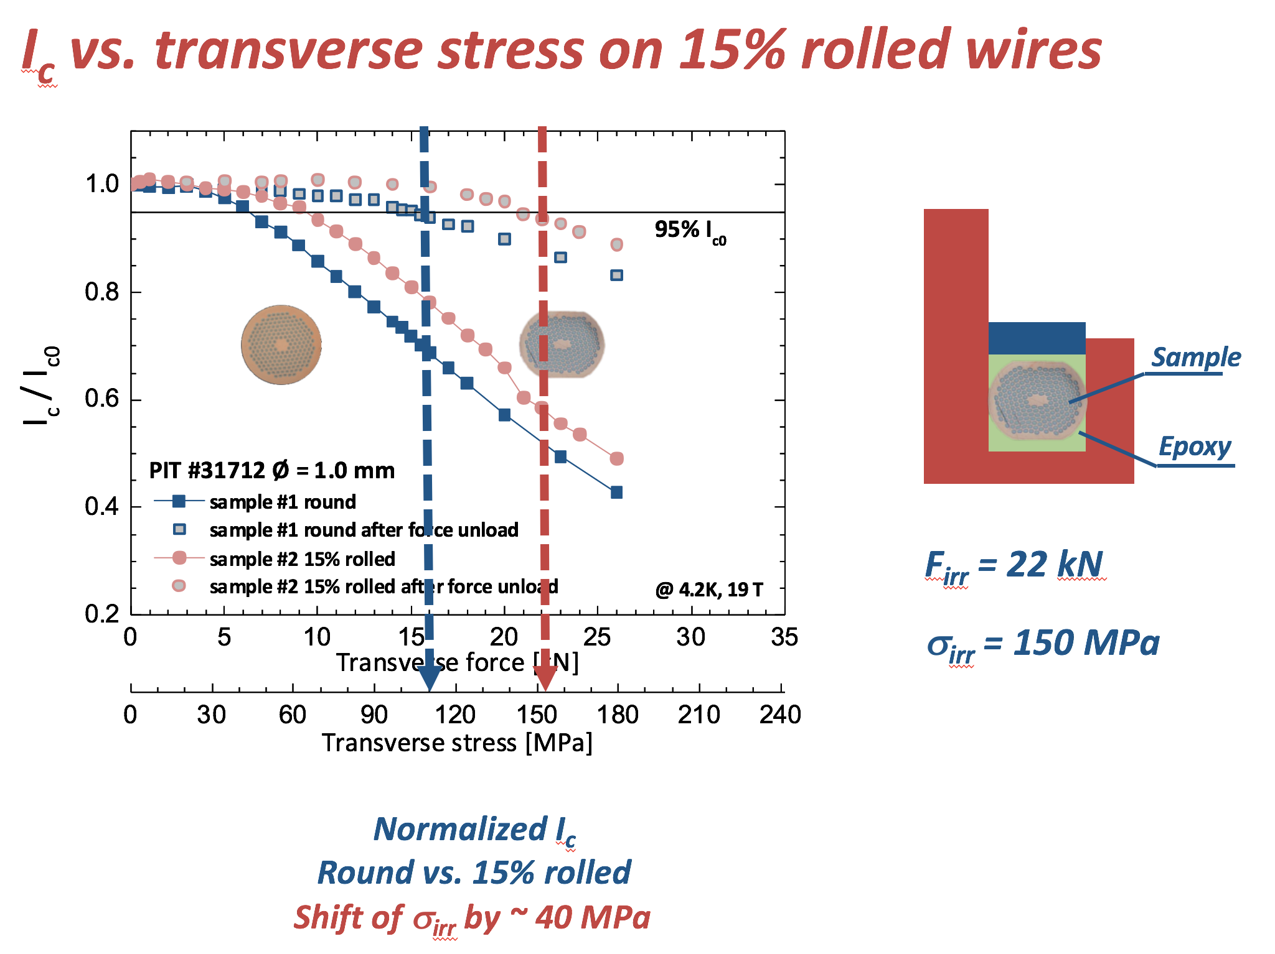
Experimental Studies
1 mm PIT wire @ UniGe – Effect of Rolling 1/2

Slide 25
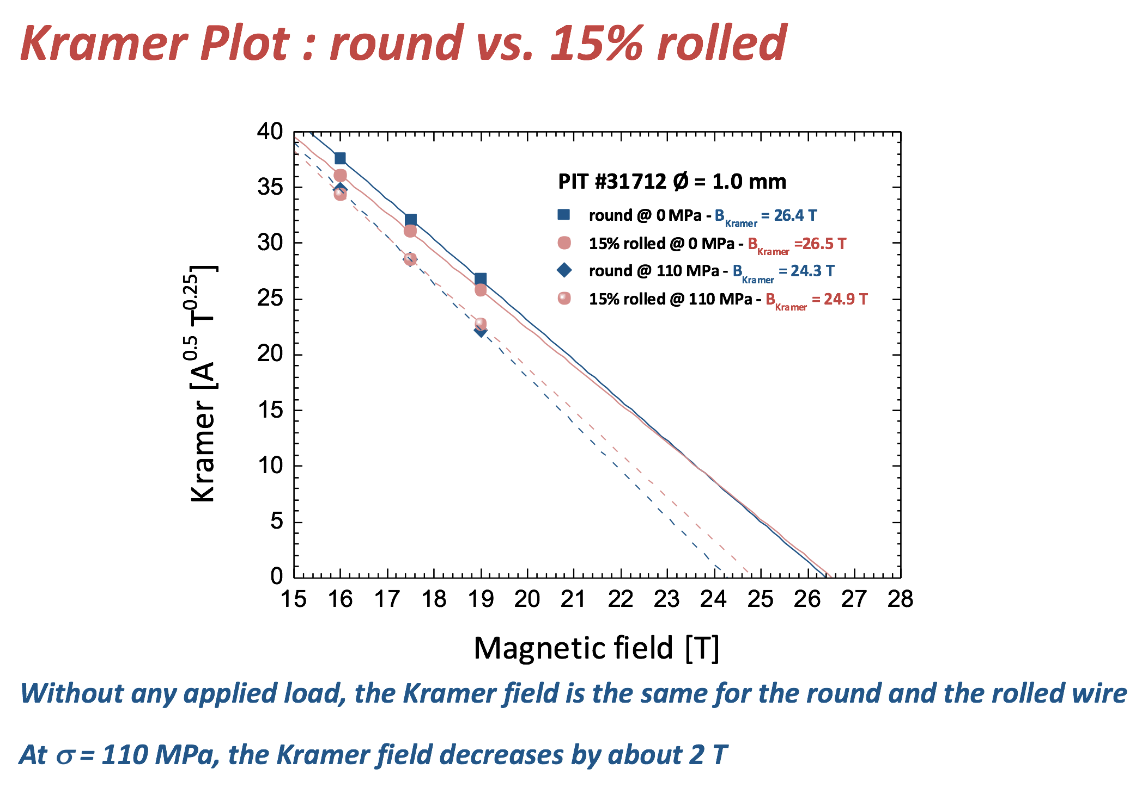
Experimental Studies
1 mm PIT wire @ UniGe – Effect of Rolling 2/2

Slide 26
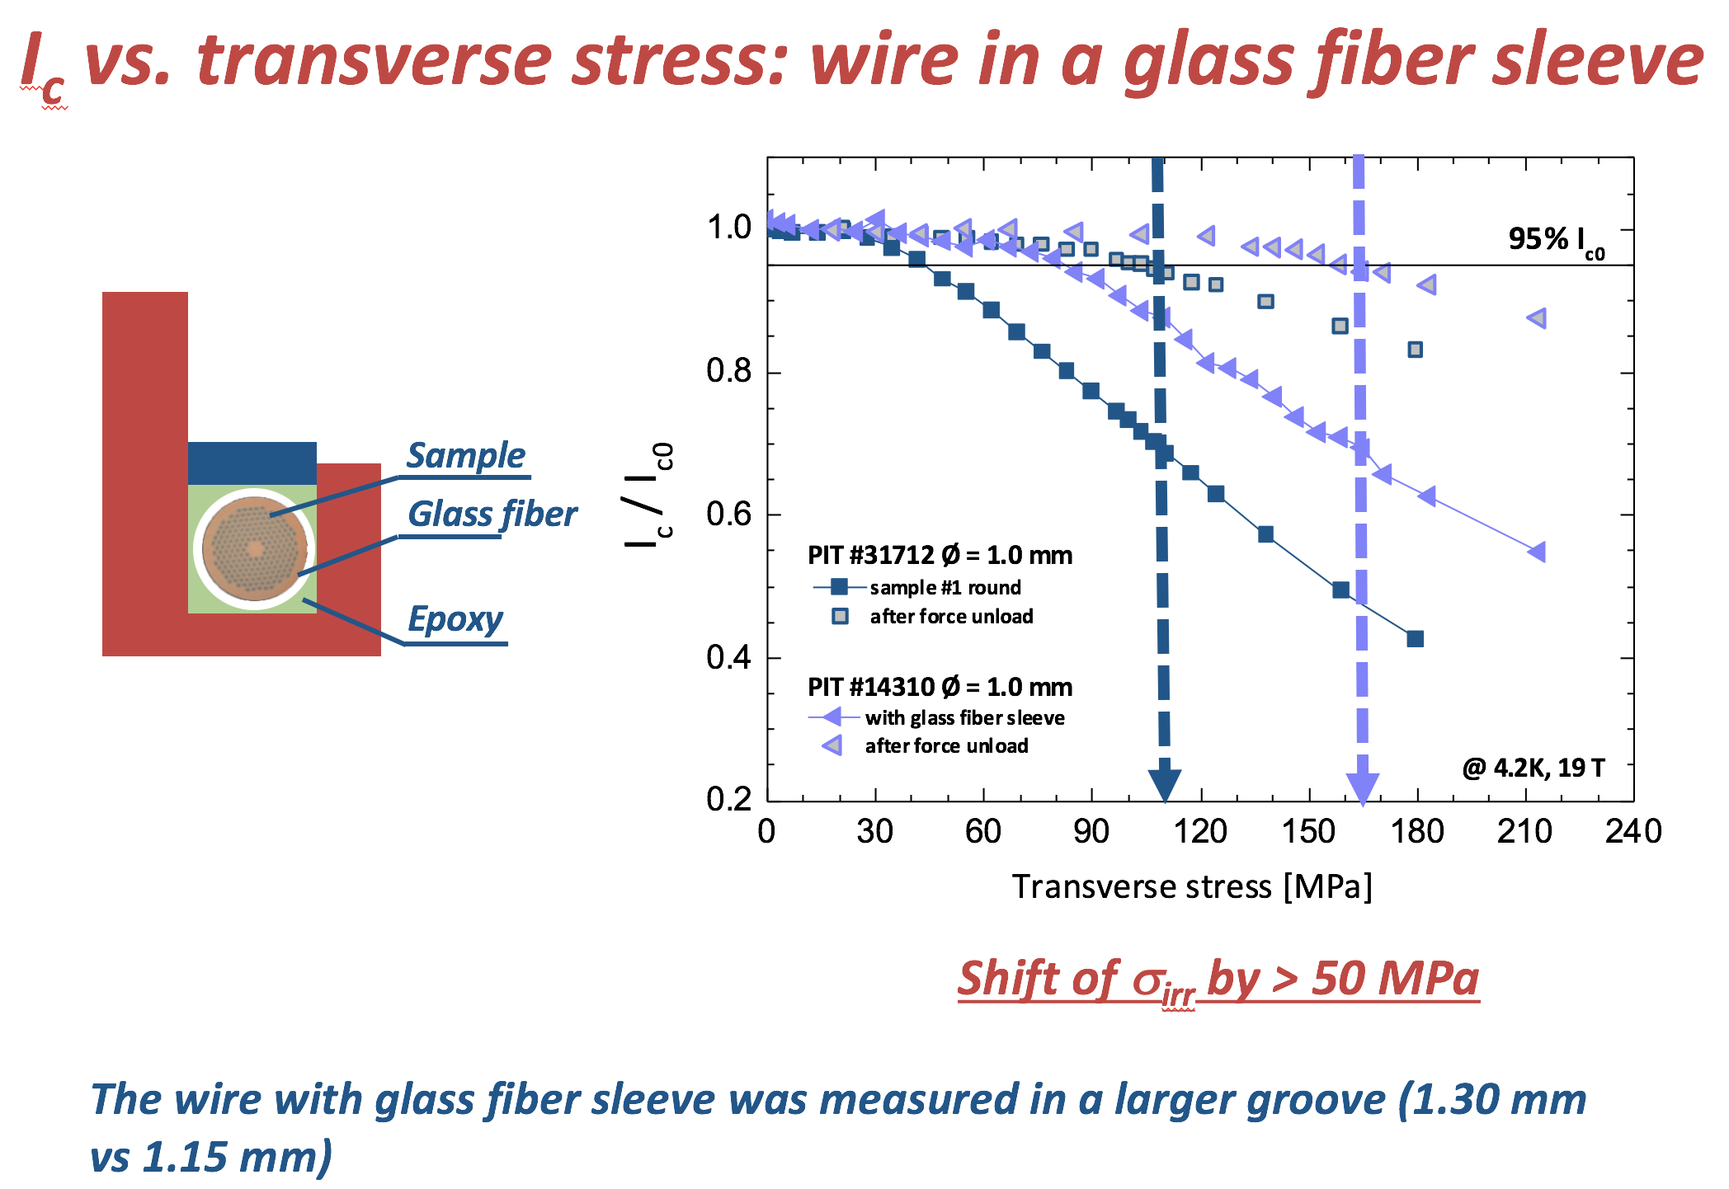
Experimental Studies
1 mm PIT wire @ UniGe – Effect of Glass Fiber

Slide 27
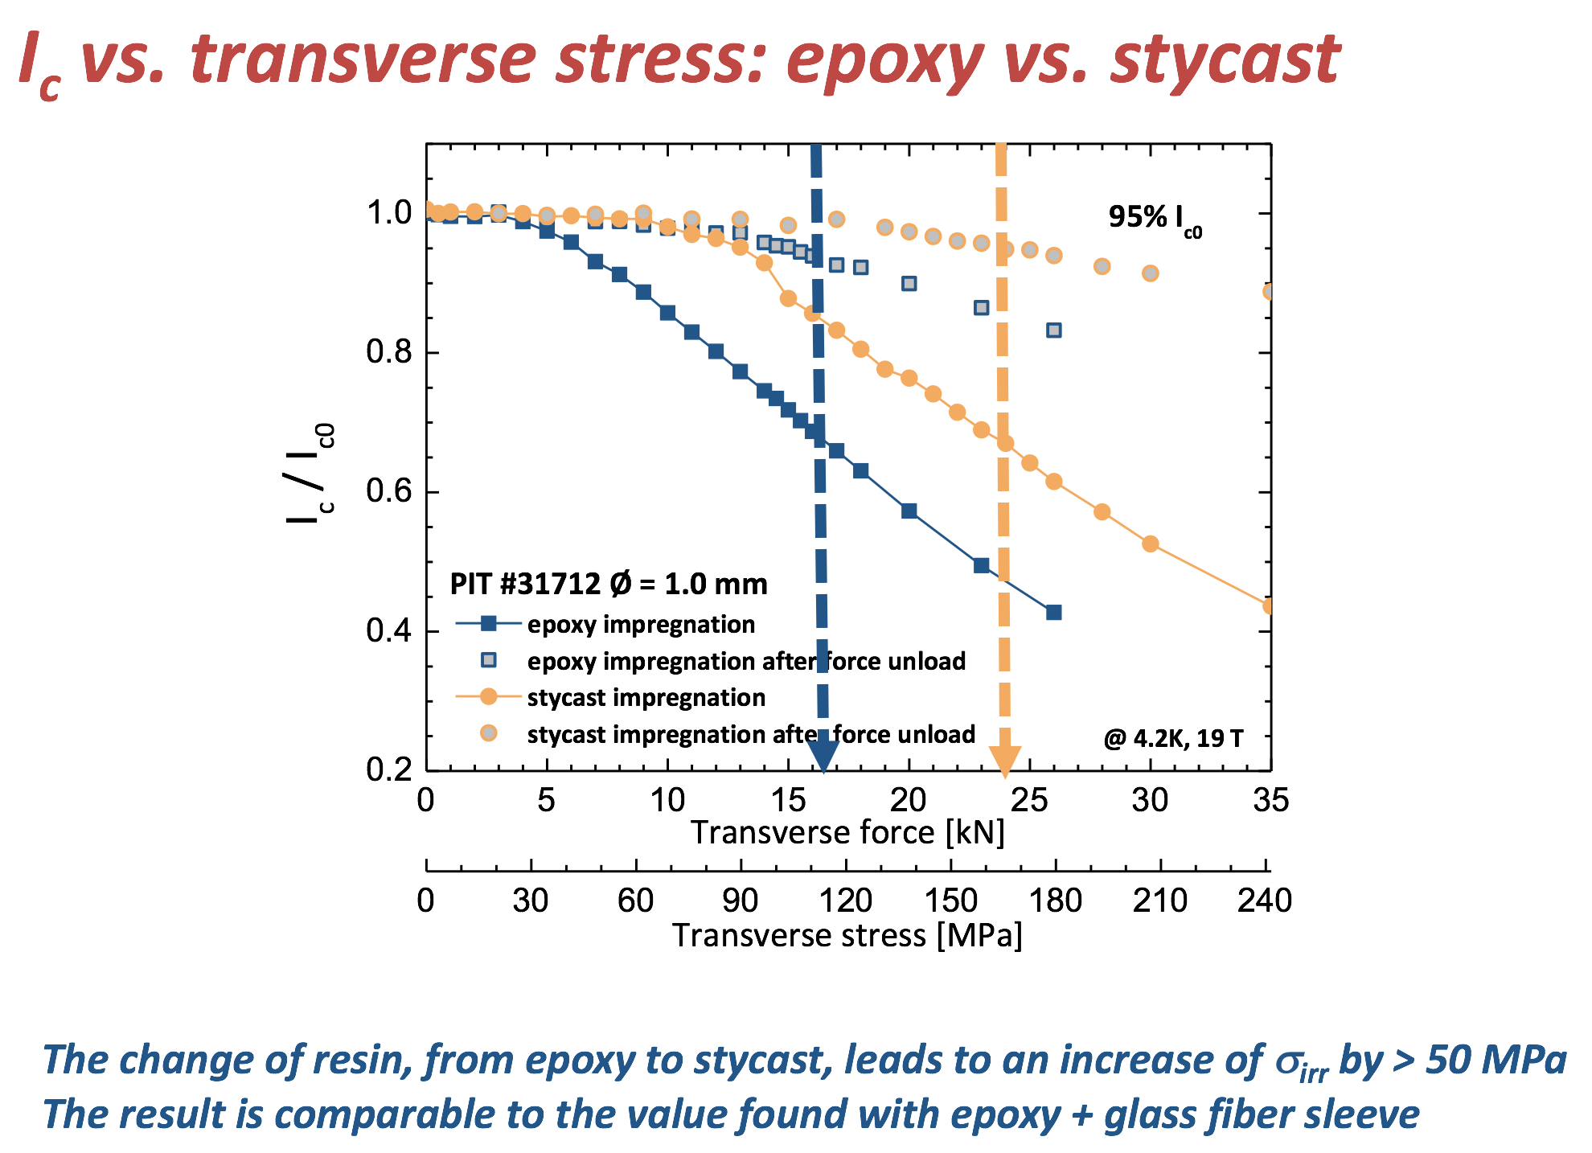
Experimental Studies
1 mm PIT wire @ UniGe – Epoxy vs. Stycast 1

Slide 28
Experimental Studies
1 mm RRP wire @ UniGe
Heat Treatment on going
First Results by the end of the year

Slide 29
Conclusions
The average Critical Current of the HL-LHC RRP wire with a sub-element size of 55 μm is not so far from (14 %) the value used for the design of the FCC magnets; furthermore the B_{c2} is even slightly larger than what assumed
Wire and Cable measurements under transverse load suggest that the effect of reversible degradation can not be neglected in the design of FCC magnets
  The Exponential Strain Function associated to a FEM model can be a tool to assess the reversible degradation in cables and magnets
  CERN and Twente will continue the benchmarking exercise to make sure of having reliable set ups that apply a uniform and controlled transverse pressure
  Wire measurements are becoming more and more representative of the cable behavior – very powerful and versatile tool
  We intend to investigate the effect of different wire/cable layouts and of different impregnation (materials)

Slide 30
Thank You For Your Attention !
The average Critical Current of the HL-LHC RRP wire with a sub-element size of 55 μm is not so far from (14 %) the value used for the design of the FCC magnets; furthermore the B_{c2} is even slightly larger than what assumed
Wire and Cable measurements under transverse load suggest that the effect of reversible degradation can not be neglected in the design of FCC magnets
  The Exponential Strain Function associated to a FEM model can be a tool to assess the reversible degradation in cables and magnets
  CERN and Twente will continue the benchmarking exercise to make sure of having reliable set ups that apply a uniform and controlled transverse pressure
  Wire measurements are becoming more and more representative of the cable behavior – very powerful and versatile tool
  We intend to investigate the effect of different wire/cable layouts and of different impregnation (materials)

