Slide 1
Status of
ERMC and RMM
Susana Izquierdo Bermudez and Juan Carlos Perez
CERN-TE/MSC/MDT: N. Bourcey, P. Ferracin, J. Ferradas Troitino, L. Lambert, J. Massard, G. Maury, J. Mazet, R. Ortwein, J. Osieleniec, E. Rochepault, D. Tommasini
CERN-TE/MSC/SCD: A. Bonasia, J. Fleiter, B. Bordini
CERN-TE/MSC/MM: C. Petrone
CERN-TE/MSC/TF: H. Bajas
CERN-TE/MME: P. Moyret
EuroCirCol Review

Slide 2
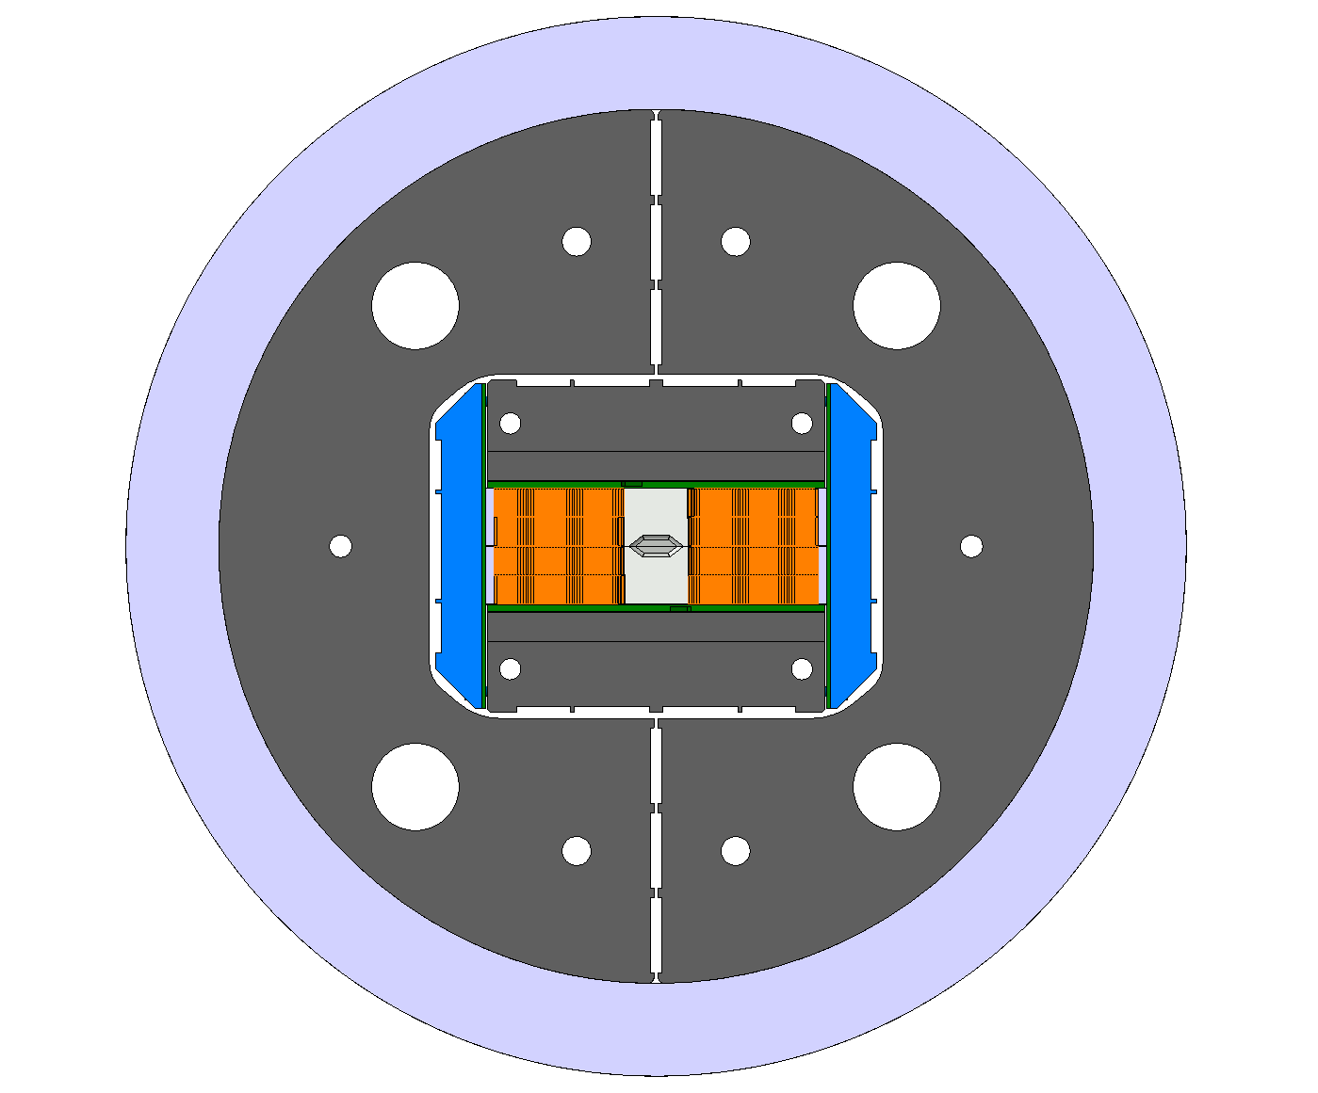
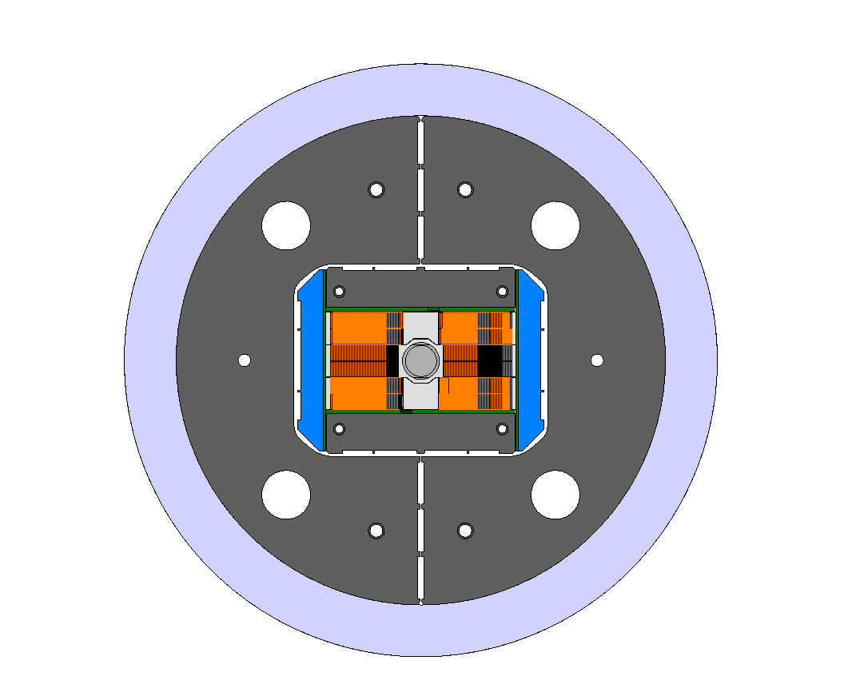
The ERMC and RMM program
ERMC
Enhanced Racetrack Model Coil
16 T midplane field
Demonstrate field on the conductor
Coil technology development
Base for the development of the technology needed for the 16 T dipole program
RMM
Racetrack Model Magnet
16 T in a 50 mm cavity
Demonstrate field on the aperture
Mechanics (including inner coil support)

Slide 3
ERMC & RMM design strategy
Stage 1 priorities:
Demonstrate the field
      Design based on the “available” critical current density (~20% lower than FCC target at 18 T, 4.2 K)
      As field quality is not an objective, profit from the use of an iron pole to decrease the ratio between the field in the aperture and in the coil to ~ 1
Study the mechanics
Stage 2 priorities:
Coil size → Grading
  Design based on the target FCC critical current density
  High Field Nb₃Sn splice development needed
Field quality (b_{n}<10 units, including iron saturation)
  Still, it will need to be accommodated within the same structure, changing only the collar pack assembly
Non graded design
Design finished
Components for the magnet structure under procurement
Graded design
2D magnetic and mechanical design done
Activity launched on splice development, but further feedback needed before starting the engineering design.

Slide 4
Non-Graded Design

Slide 5
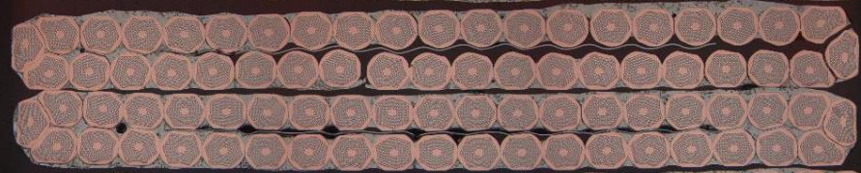
Strand and Cable
B. Bordini & J. Fleiter & A. Bonasia
1 mm diameter wire, cu/sc =1
RRP 120/127 (62-64 µm) & RRP 150/169 (54-55 µm)
40-strand cable
  Bare width x thickness:
  20.9 x 1.82 mm
  SS core 14 mm wide and 25 μm thick
3 cable unit lengths (220 m x 3) available
Assumed growth during HT : 3% (thickness), 1% (width)

Slide 6
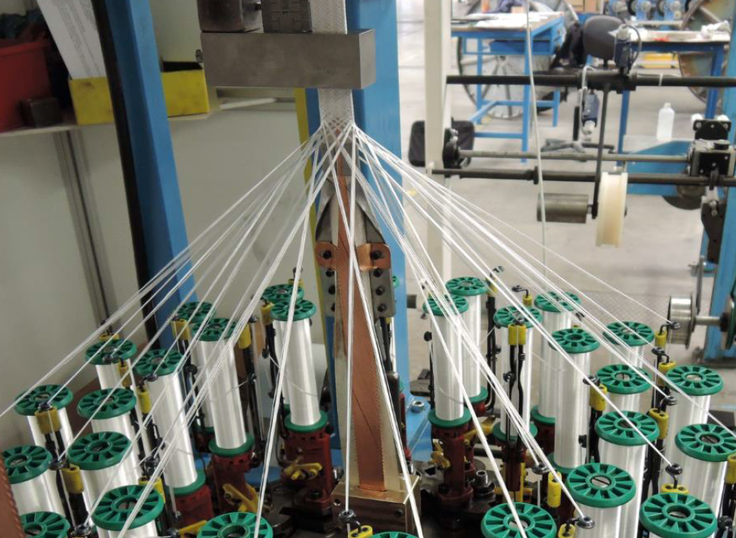
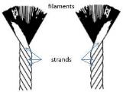
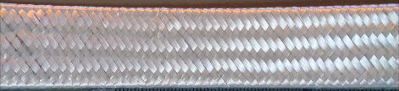
Cable insulation
Baseline: 0.150 ^{+0.00/-0.02 mm} Mica-Glass Insulation
Insulation tests preformed to define the best parameters:
  S2 glass 636 11 TEX yarn
  14 yarns (ply) per bobbin
  32 bobbins
  Speed (angle) set to guarantee full coverage and appropriate thickness
yarns
https://indico.cern.ch/event/641886/

Slide 7
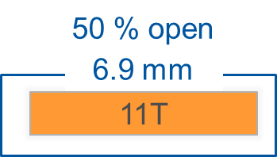
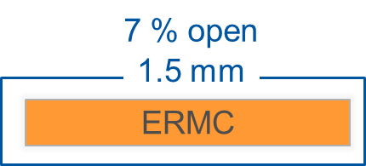
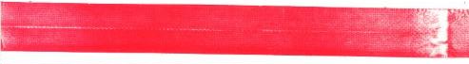
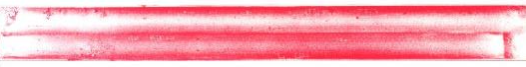
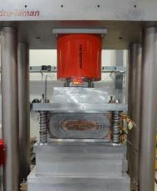
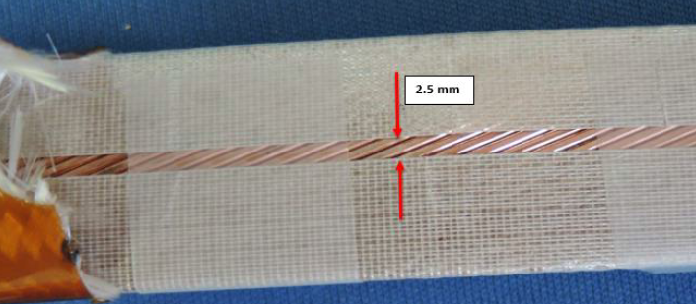
Cable insulation
Remark: plots not on scale
Some evidences on 11 T and SMC 11 T that the C-Shape mica can have a negative impact on the uniformity of the pressure distribution.
Contact pressure on outer coil turns, SMC11T under 50 MPa compression
SMC11T-1
(no mica)
Upper layer
Lower layer
SMC11T-3
(mica)
Upper layer
Lower layer
After some iterations, braiding with wider mica tapes (44 mm) feasible.
One cable unit length insulated, ready to be wound.
The other two cable unit lengths will be insulated end of October.
https://indico.cern.ch/event/641884/
https://indico.cern.ch/event/659541/contributions/2689641/attachments/1507432/2349396/Visite_CGP_ERMC.pdf

Slide 8
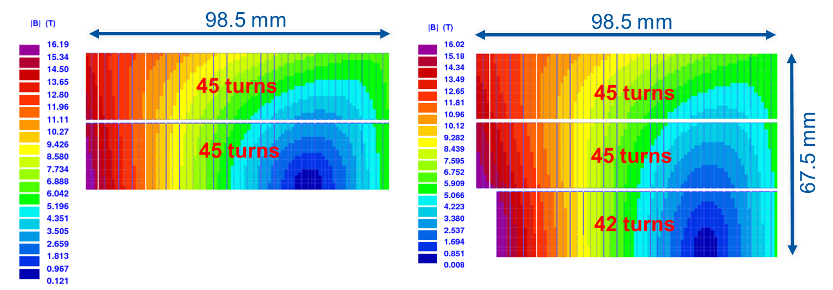
Magnetic design
ERMC
Two double-layers with 45 turns each wounded around a magnetic pole
B_{p}/B_{o} = 1.097
RMM (ERMC double layers +)
Middle double layer with 42 turns each wound around a titanium closed cavity
Coil aperture radius = 31 mm
Closed aperture radius = 25 mm
B_{p}/B_{o} = 1.097

Slide 9
Magnet parameters
 | Units | ERMC | RMM
Nominal current (I_{nom}) | kA | 13.1 | 11.4
Overall current density | A/mm² | 282 | 245
Bore field | T | 15.7 | 16.0
Peak field at I_{nom} | T | 16.0 | 16.2
Stored energy at I_{nom} | MJ/m | 1.5 | 2.1
Differential inductance at I_{nom} | mH/m | 16.6 | 31.1
Assuming Hi-Lumi Jc
Short sample field at 4.2 K | T | 16.7 | 17.2
Short sample field at 1.9 K | T | 18.3 | 18.8
(1-B/B_{ss}) at 1.9 K | % | 13 | 14

Slide 10
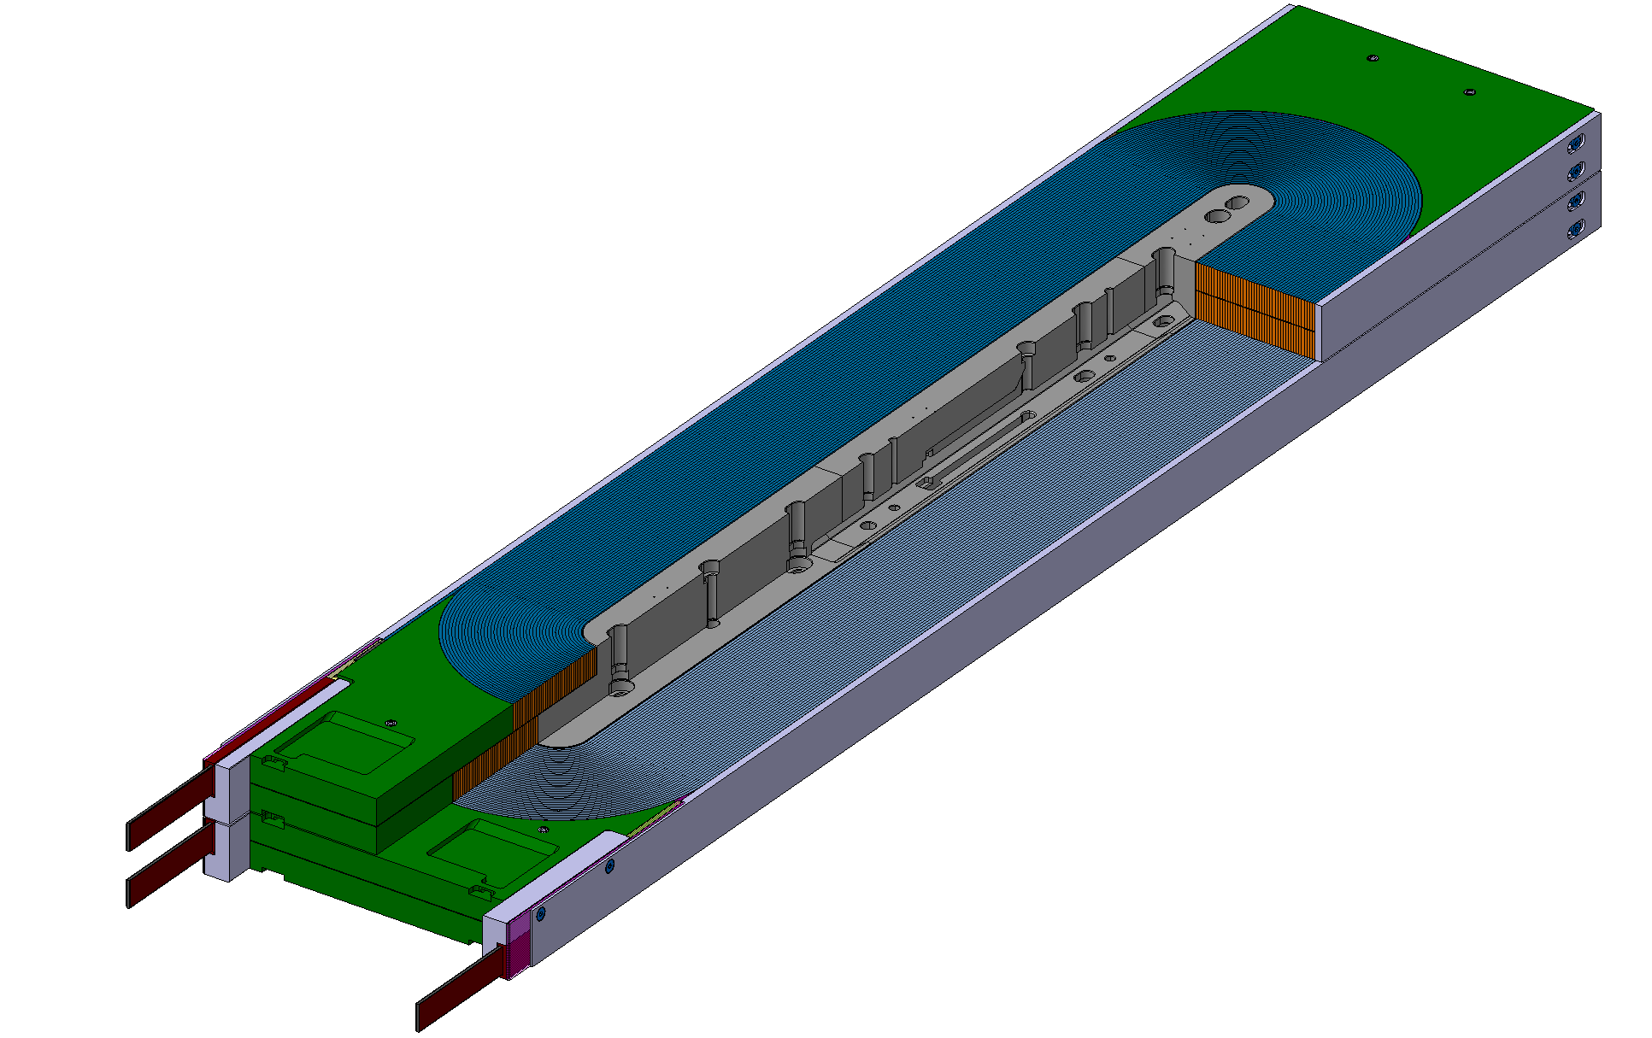
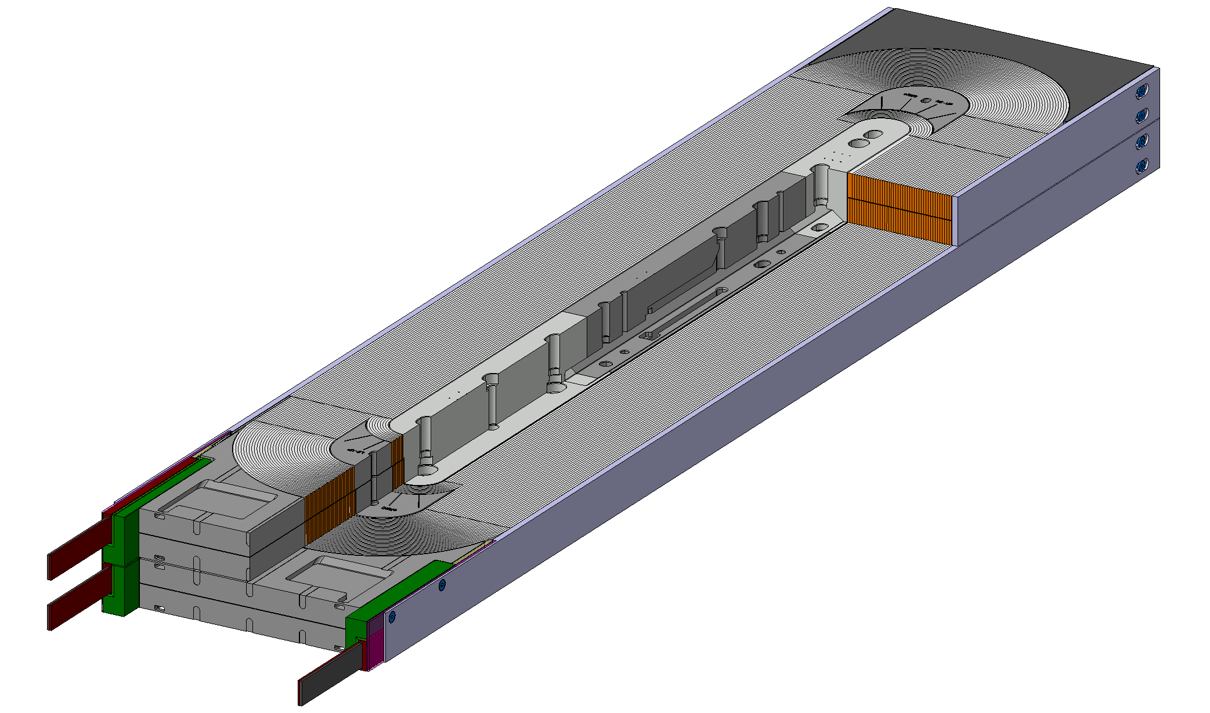
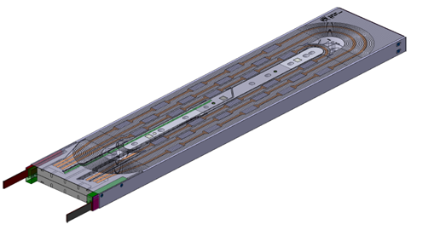
Evolution of the coil design
End spacers introduced on the coil ends
  Larger peak field for the same amount of conductor, but more favourable from the mechanical point of view.
End-saddles on stainless steel instead of G11.
  Limit the displacement on the coil ends.
Design of the instrumentation and quench heaters finalized.
October 2016
April 2017
October 2017
End spacers
G11 end saddles
Stainless steel end saddles

Slide 11
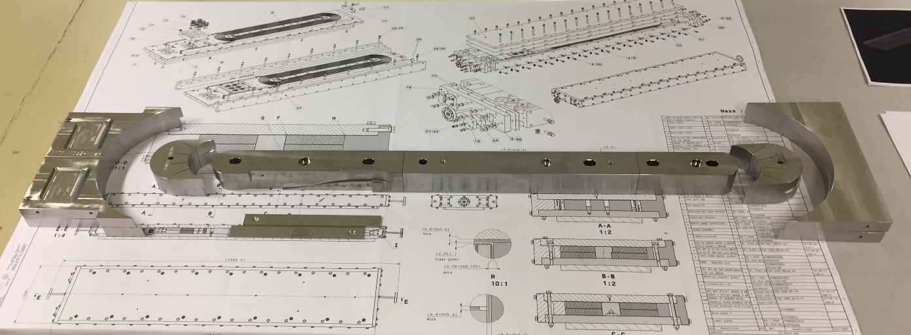
Coil components
Coil parts for 3 ERMC coils in house.
Traces under procurement, expected to be delivered mid-November.

Slide 12
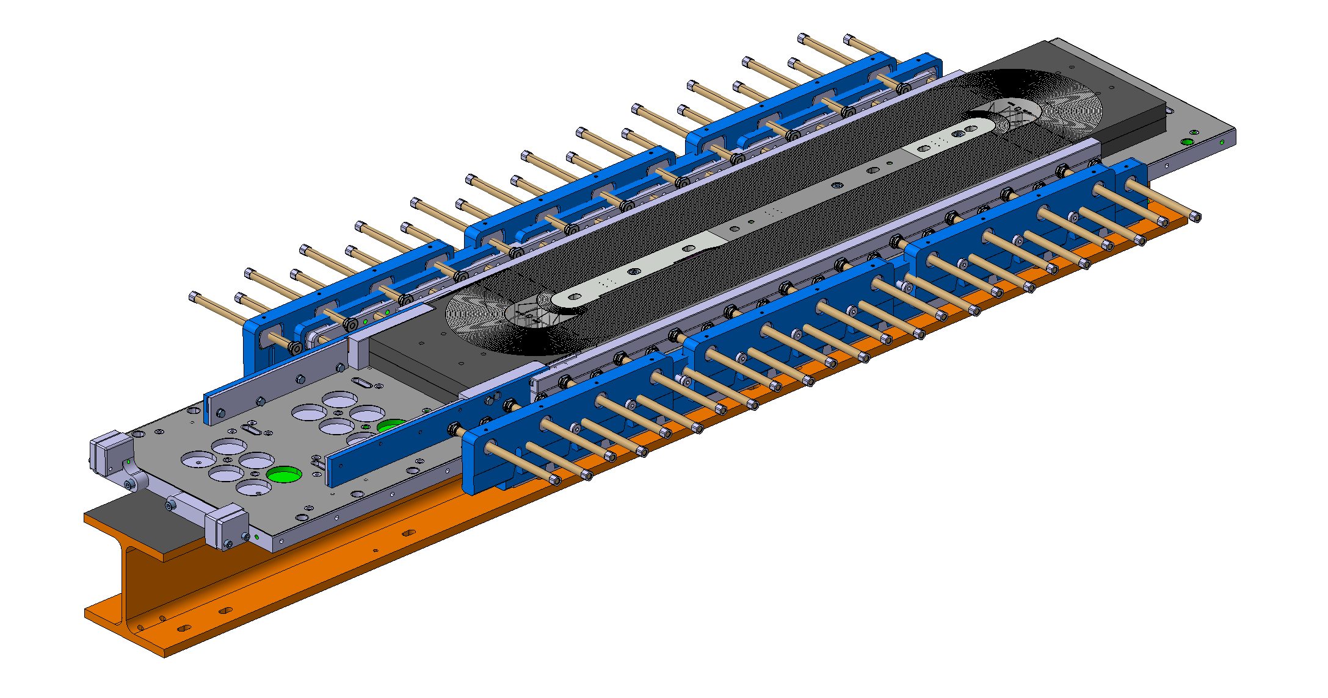
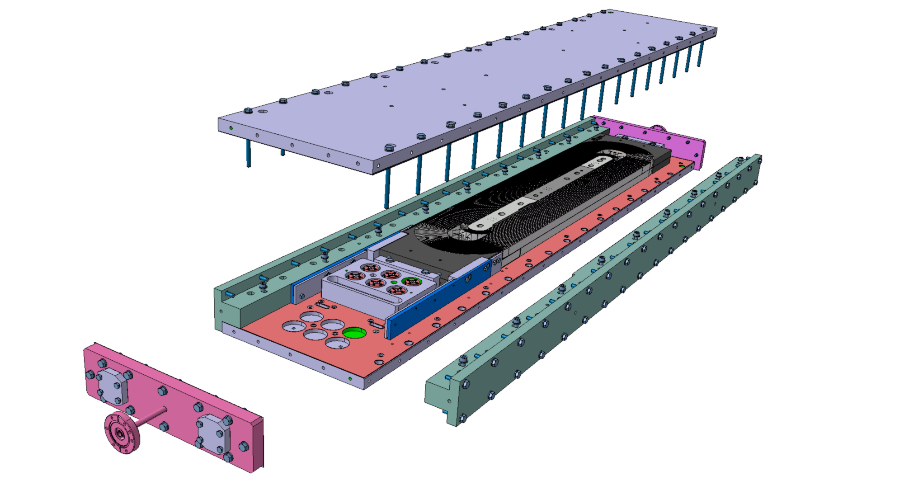
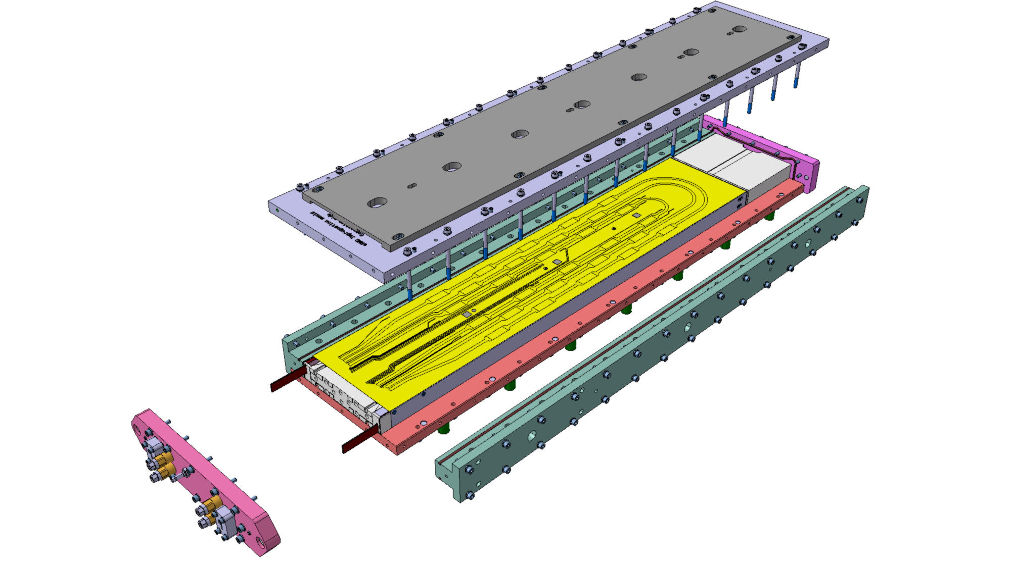
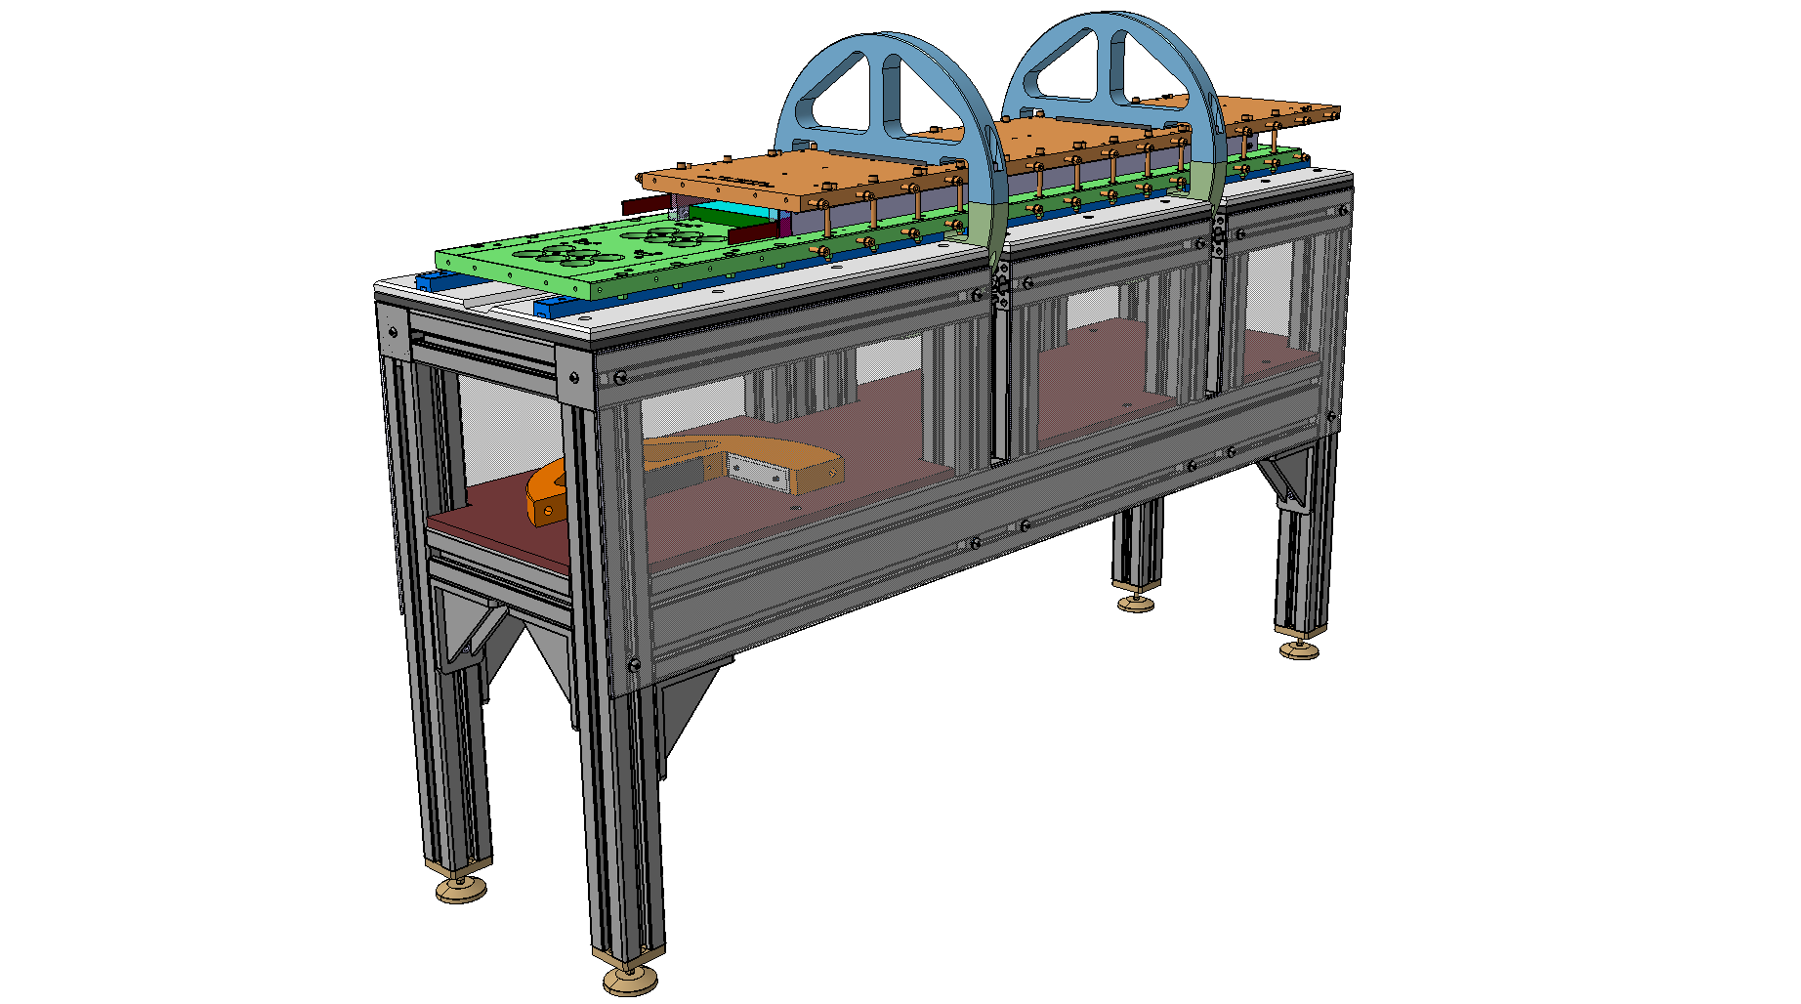
Coil fabrication
Expected to be delivered Oct-2017
ERMC10 – Winding
ERMC20 – Reaction
ERMC30 – Splicing
ERMC40 – Impregnation

Slide 13
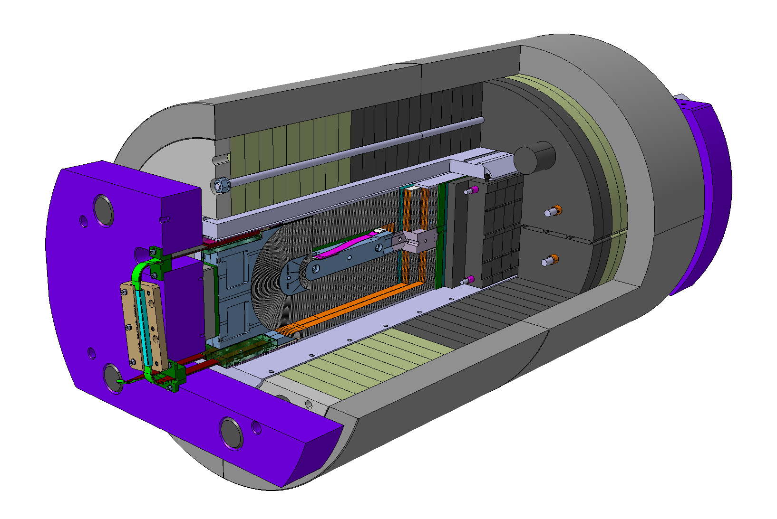
Mechanical design
Mechanical structure capable to load the magnet up to 18 T, with enough margin to perform an experimental exploration of the different parameters relevant to magnet performance.
To allow a further exploration of the assembly parameters:
  Two different sets of shells have been procured:
    One shell, full length
    Two shells, central split
  Aluminum rods and stainless steel rods are under procurement.

Slide 14
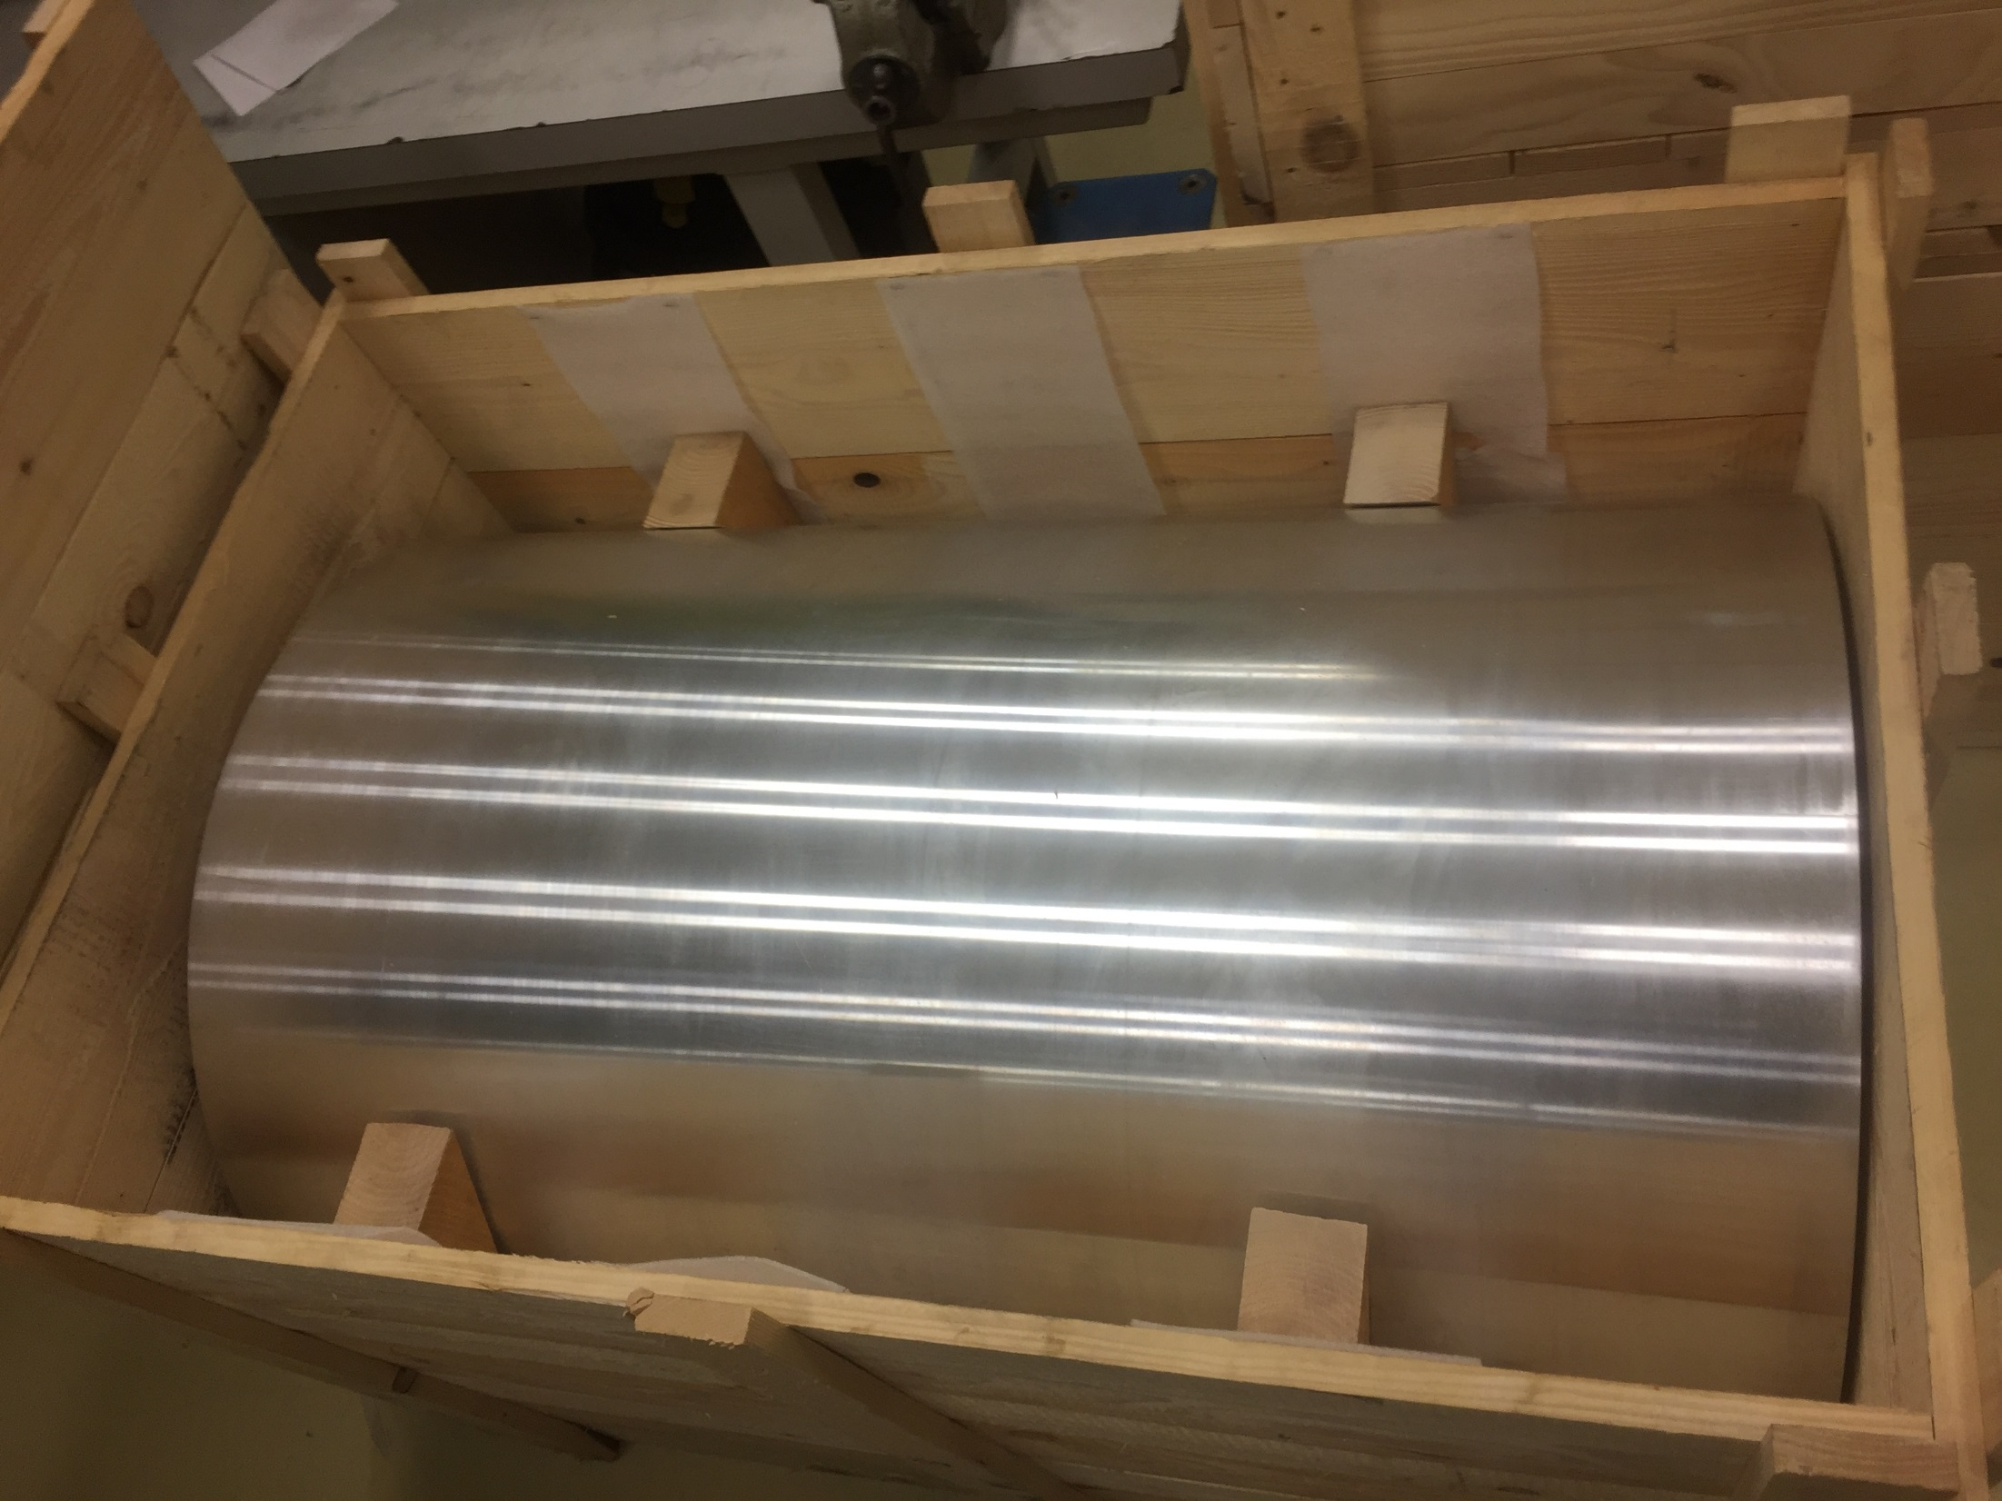
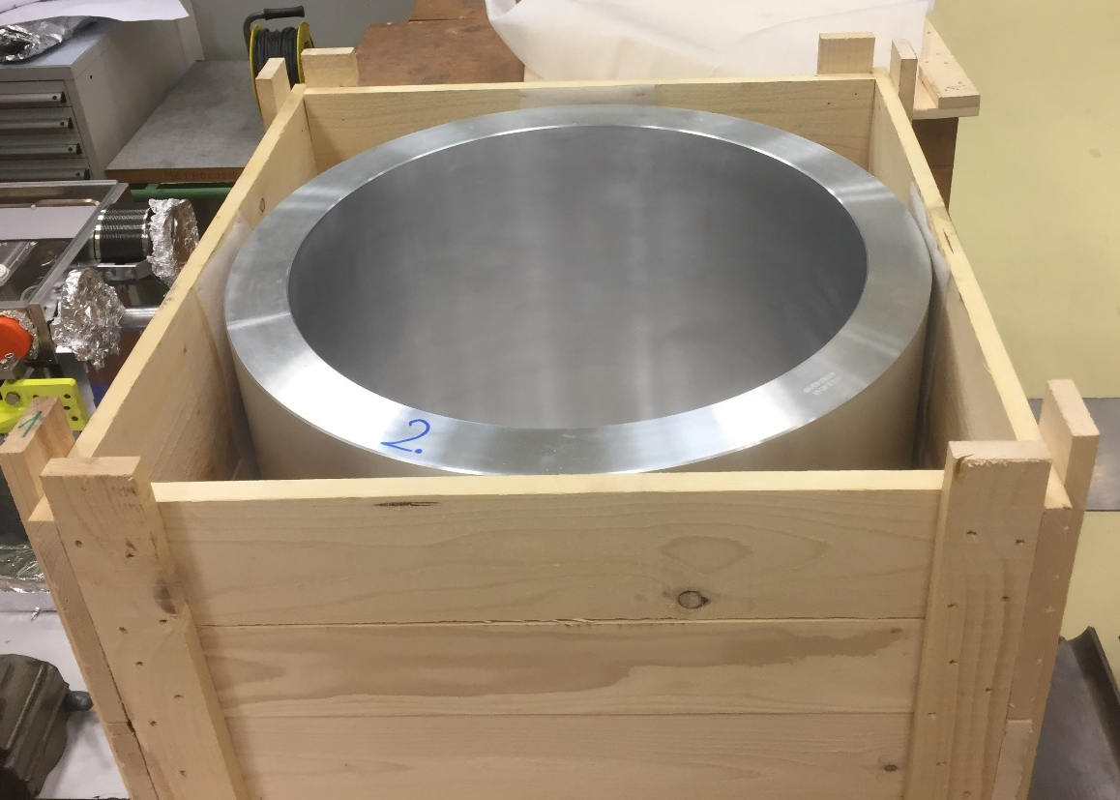
Magnet components
Shells delivered to CERN, under metrology control.
Rest of the magnet components under procurement
  Yoke and pads expected to be delivered January 2018
  End plate in the critical path (procurement launched Sep - 2017)

Slide 15
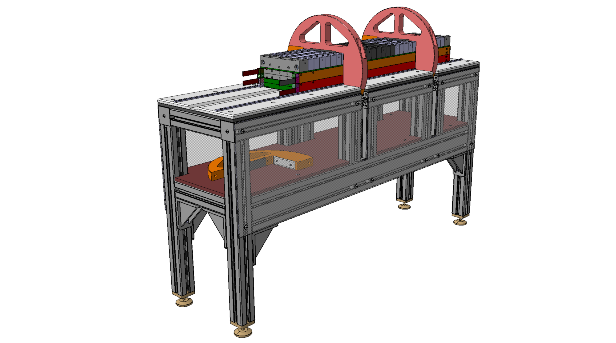
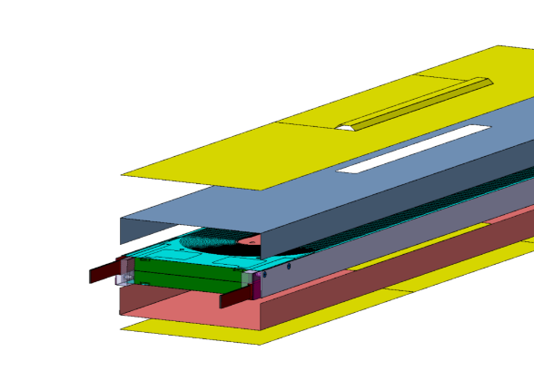
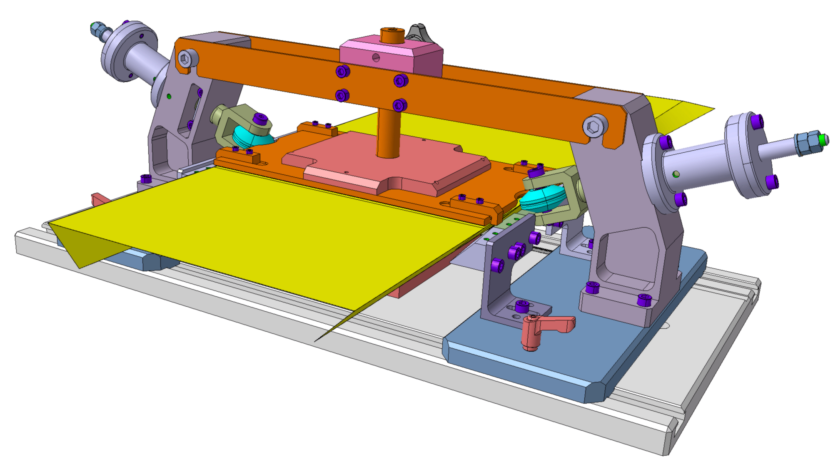
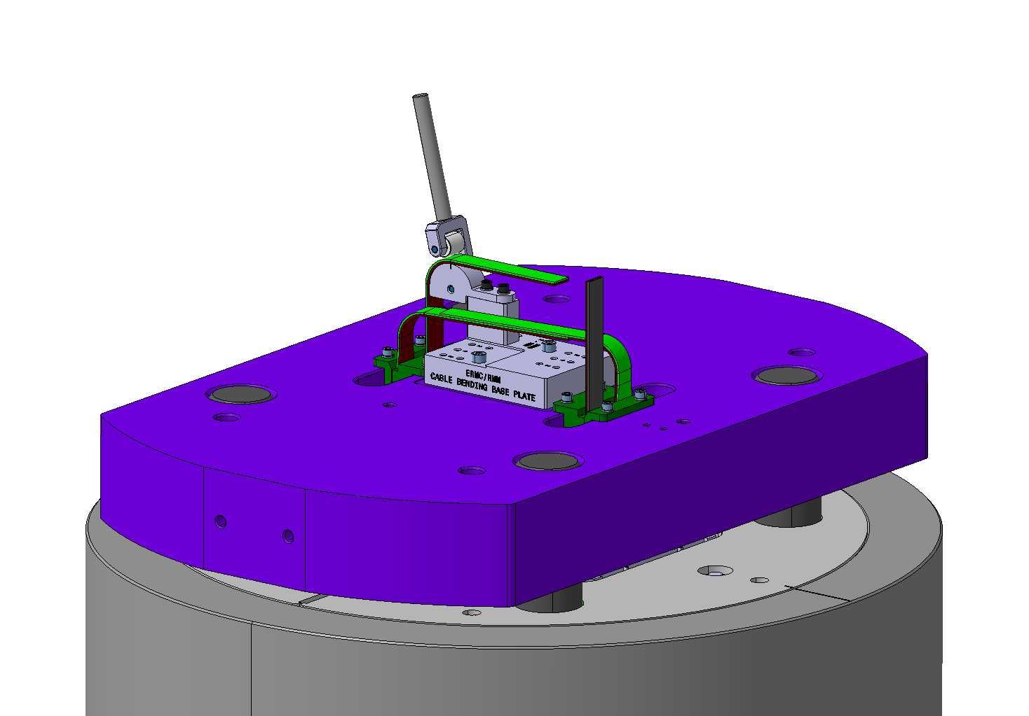
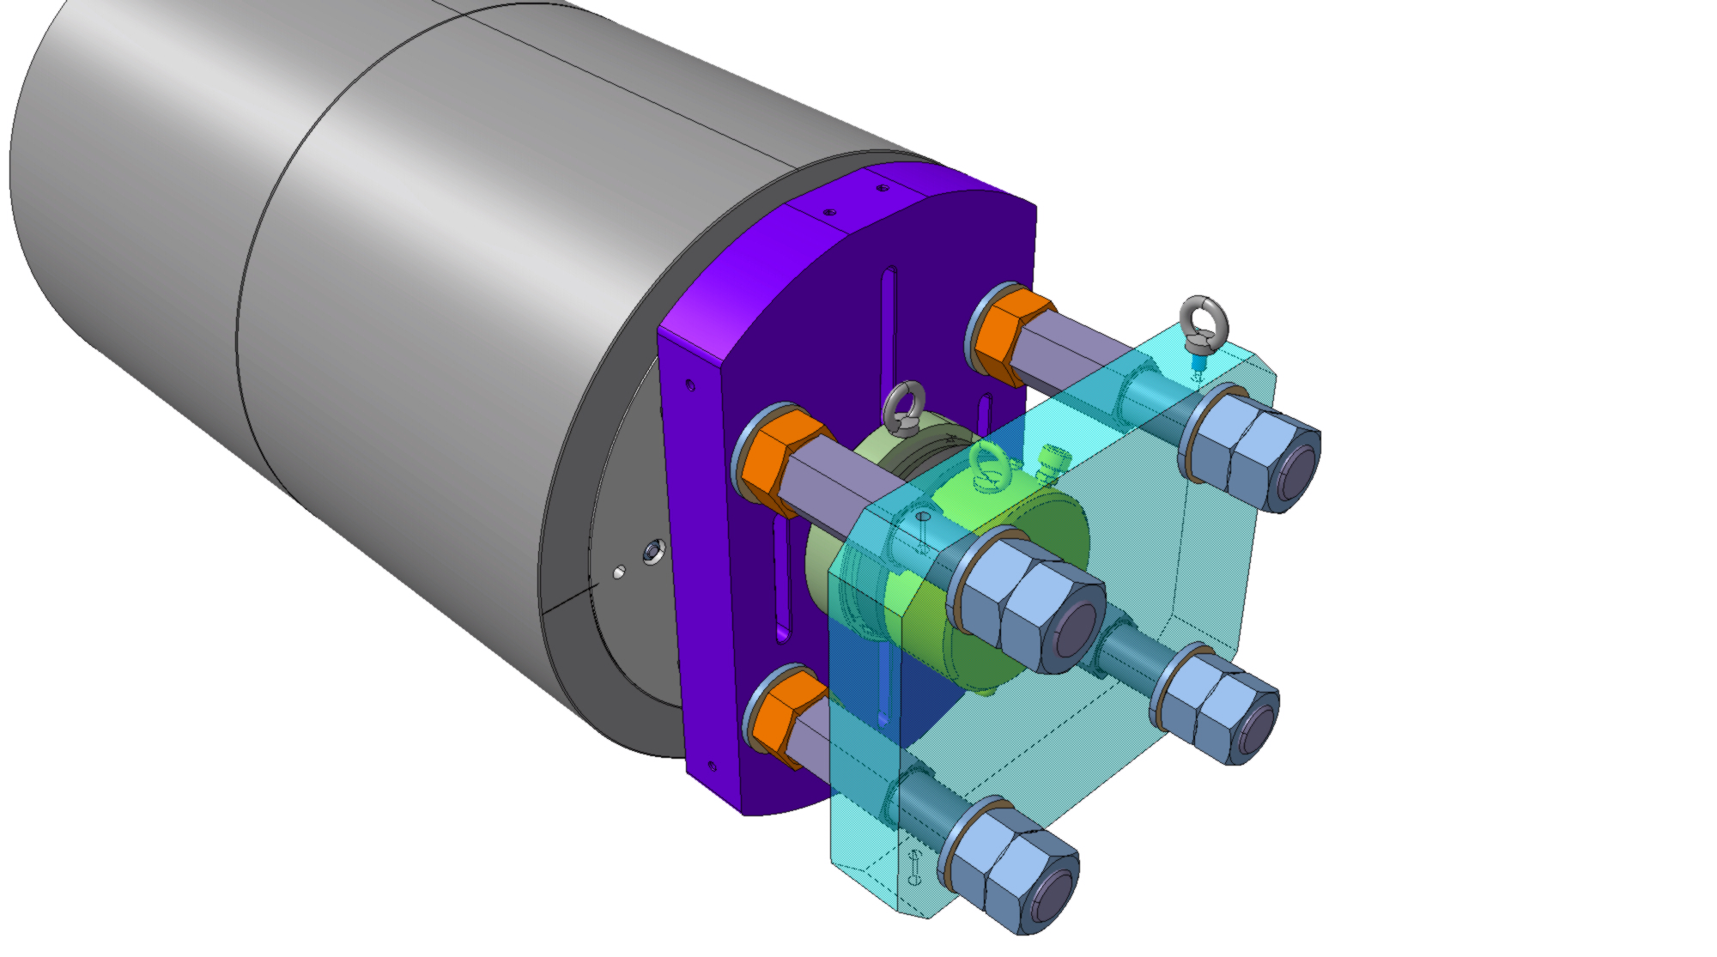
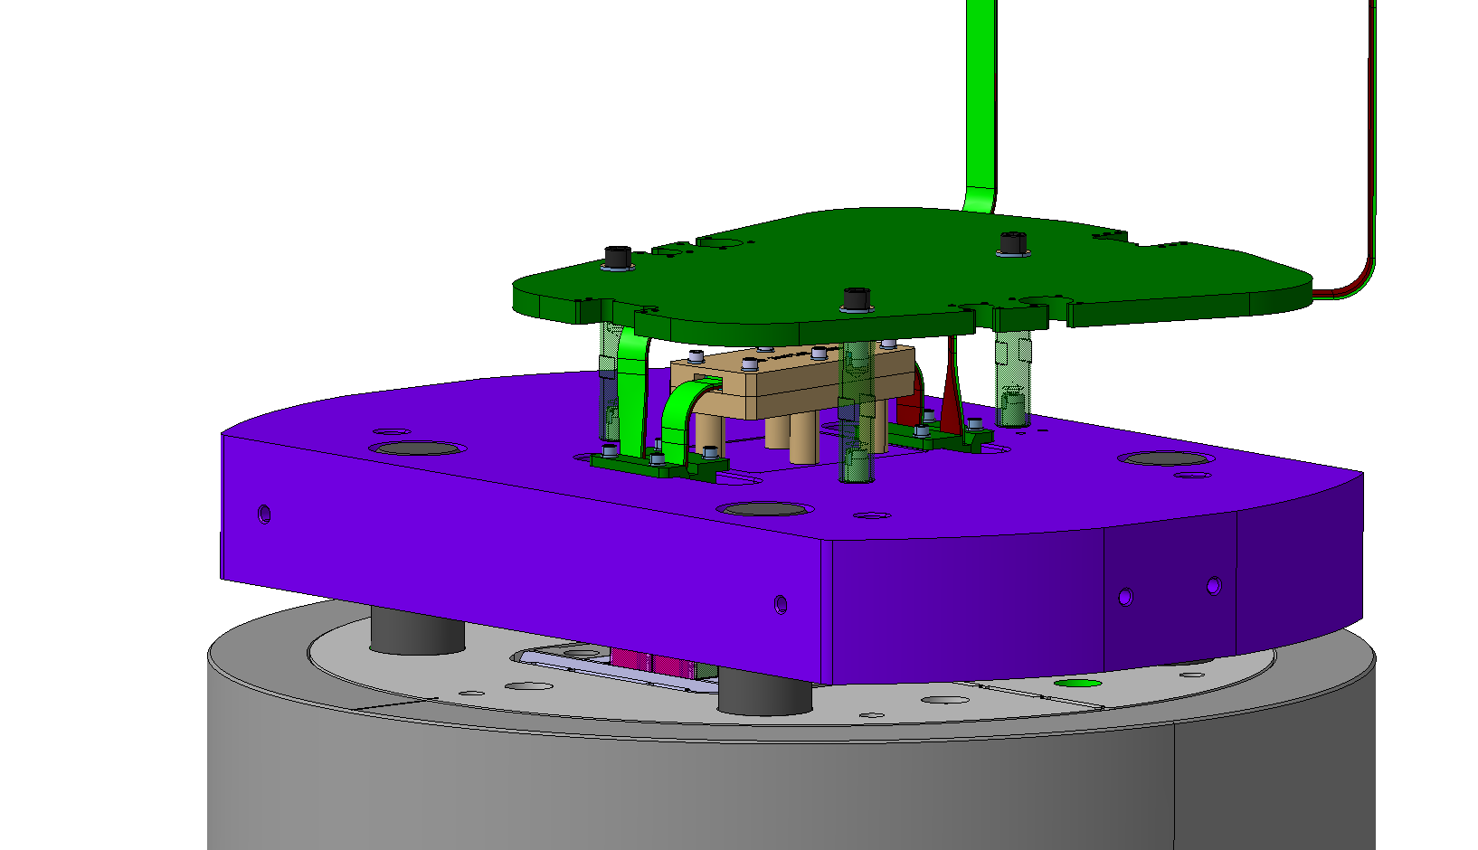
Magnet assembly
Under procurement. Expected delivery January 2017
ERMC50
Coil Pack Assembly
ERMC60
Ground Insulation
ERMC70
Insertion
ERMC80
Axial loading
ERMC90
Splicing and Connection box

Slide 16
Graded Design

Slide 17
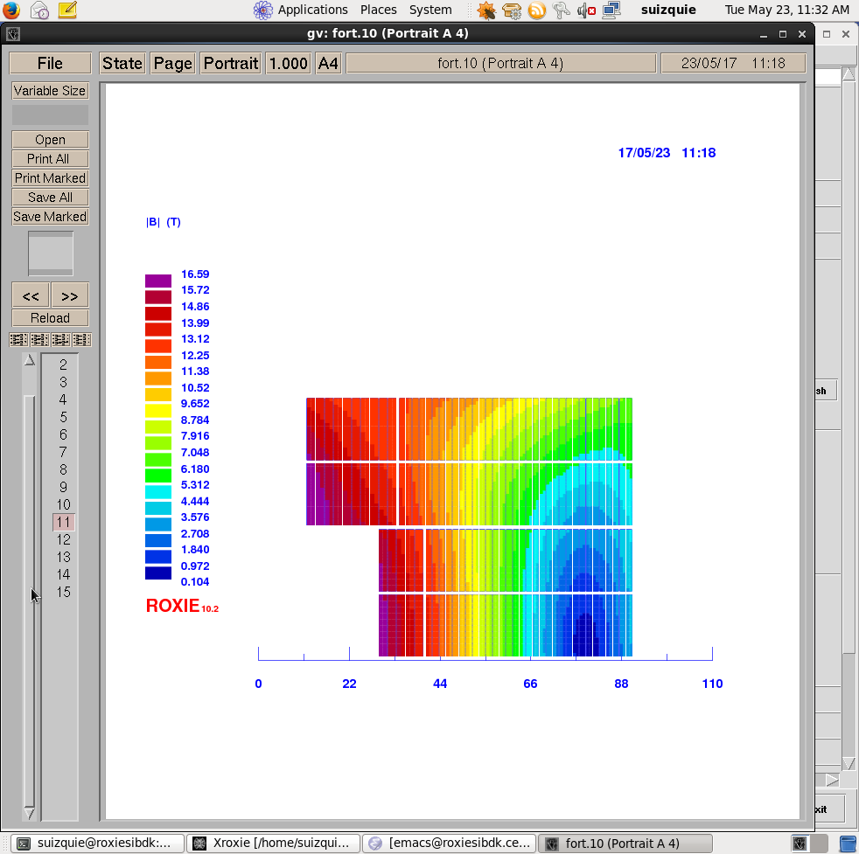
Magnetic Design
Strong synergy with the EuroCirCol Block design option, slightly more conservative in some aspects:
  16 T bore field, with 14 % margin, using “available” critical current density (RMM critical current density, assuming 5 % cabling degradation)
  20 % margin in the low field region, as the impact on coil size is relatively small.
  Inner support thickness of 4 mm. In a later stage, coil with 2 mm inner support can be produced to study the impact of the inner support on the performance.
  Minimum available copper to superconductor ration 1 instead of 0.8
Parameter | Unit | Non Graded | Graded
 |  |  | HF | LF
strand diameter | mm | 1 | 1 | 0.7
Cu/SC | -- | 1 | 1 | 1.15
# of strands/cable | -- | 40 | 28 | 40
# turns/quadrant | -- | 132 | 30 | 132
coil width | mm | 86 | 69
I_{nom} | A | 11546 | 8695
J_{overall} | A/mm² | 248 | 264 | 357
Ratio LF/JF | -- | n.a. | 1.35
B₀ at I_{nom} | T | 16.0 | 16.0
B_{p} at I_{nom} | T | 16.1 | 16.6 | 13.6
1-B_{p}(I_{nom})/B_{ss}(1.9 K) | % | 18.5 | 14 | 23
F_{x}/h at I_{nom} | MPa | 141 | 145
F_{y}/w at I_{nom} | MPa | -49 | -55

Slide 18
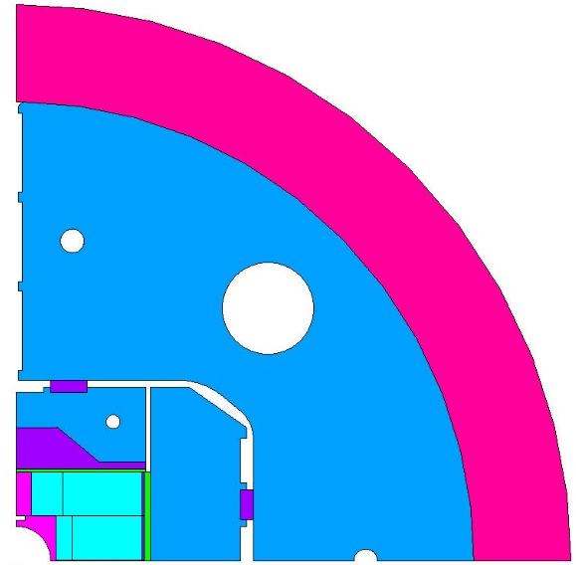
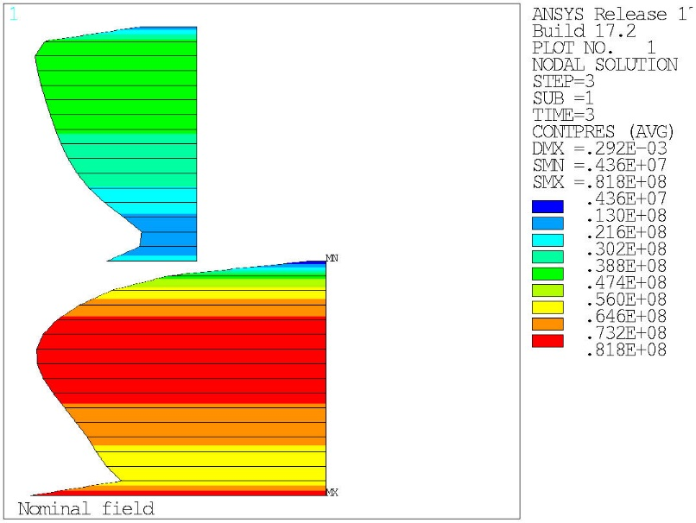
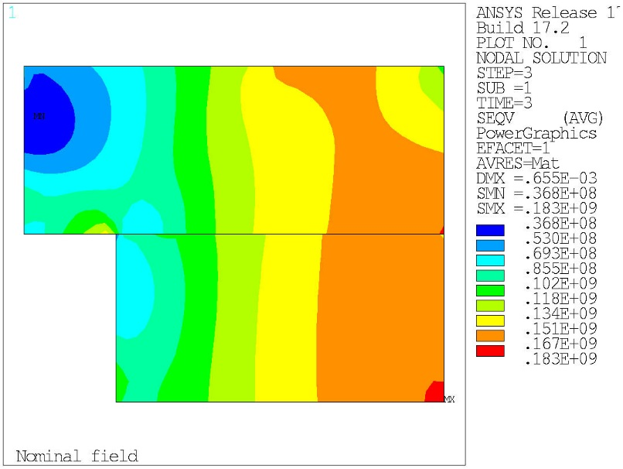
Mechanical design
Fulfills EuroCirCol Criteria.
  Max. Coil stress = 150 MPa at RT
  Max. Coil stress = 200 MPa at 1.9 K

Slide 19
Summary
Conductor and cable
  Non-graded: Strand, cable and insulation parameters defined. Three cable unit lengths have been produced.
  Graded: Strand parameters defined; cable and insulation parameters to be defined.
Non-graded coils
  Cross section and end design defined for ERMC and RMM.
  Coil parts for three coils received.
  ERMC coil fabrication starts in October 2017.
Graded coils
  2D Mechanical and Magnetic design done for the graded design.
  Activity on High Field Nb₃Sn splice development launched, but further progress is required before launching the detailed graded coil design.
    Relaying on EPFL program for the high field splice development.
Structure
  Baseline design completed.
  Aluminium shells received, yokes and pads expected to be delivered in January 2018
  End plate is in the critical path, but hopefully available February 2018.

