Slide 1
Updates on TCLIA
C. Bracco, V. Baglin, O. Aberle, J. Jowett, W. Reiegler

Slide 2
Outline
Motivation
Proposed changes
Next steps

Slide 3
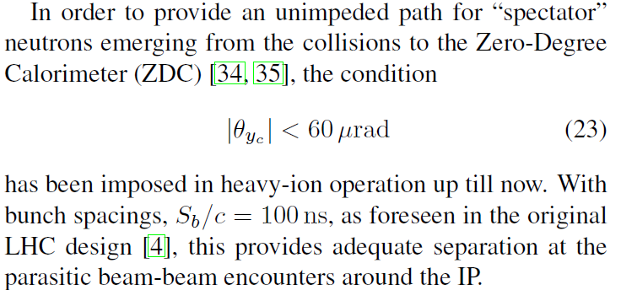
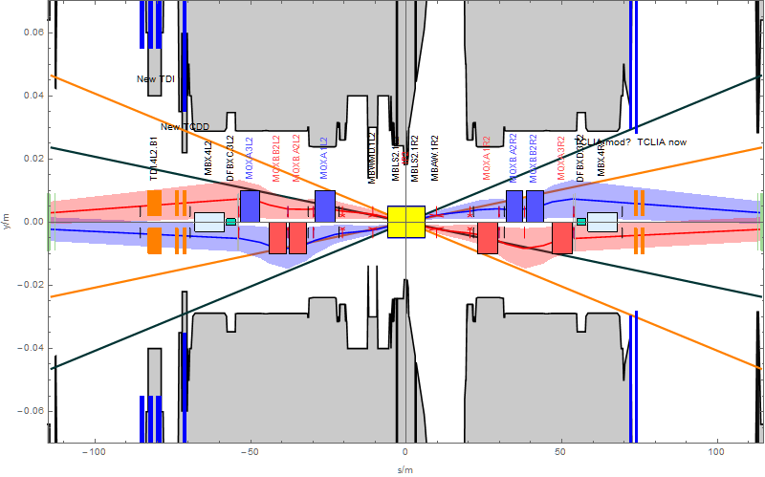
Motivation
LHC Design:
Since RLIUP workshop 2013 the 50 ns basic bunch spacing has become the baseline for HL-LHC Pb-Pb collisions.
N.B. HL-LHC Pb-Pb starts after LS2.
For safety, we should have several sigma separation at the closest encounters which means larger crossing angles ➔ aiming for ≥100 μrad. At present the TCLIA defines the main aperture limitation
Extreme positions of ZDC, ±100 µrad
Showing 100 µrad neutron cones
J. Jowett and W. Riegler

Slide 4
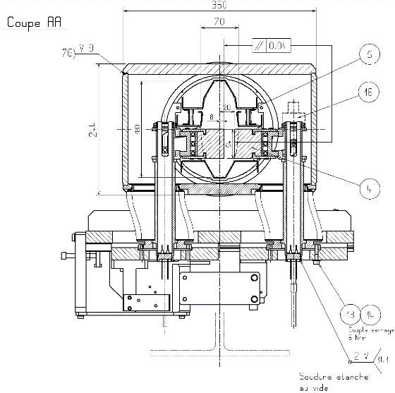
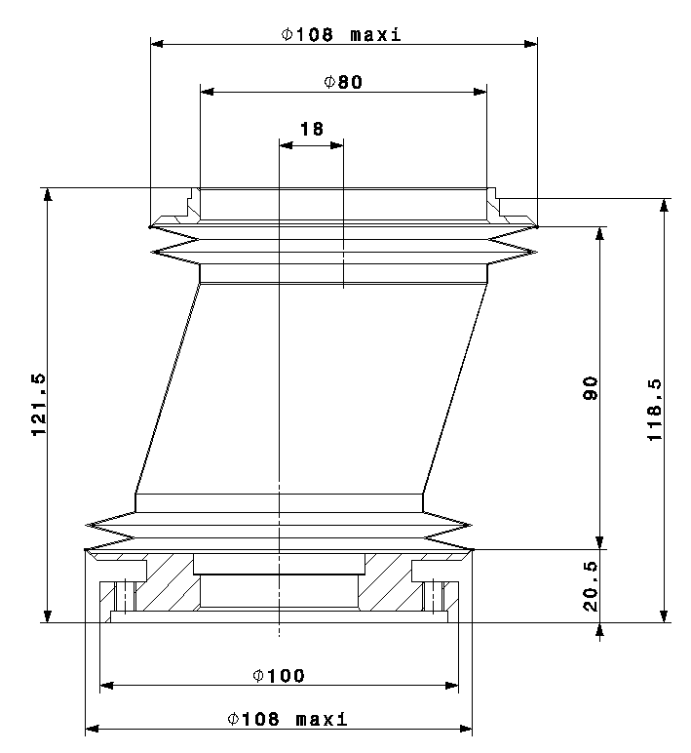
TCLIA, present situation and possible gain
Use maximum opening in the bellow
Maximum opening distance by design:
120 mm (Beam axis to axle centre line)
+ 40 mm (Bellow passage)
- 19 mm (Axle radius) - 1 mm (welding seam)
- 108 mm jaw thickness (at axle centre) - 1 mm end stop setting - 1 mm switch setting
= 30 mm (half gap) (theoretical maximum achievable half gap)
TCLIA jaw opening adjusted to 56 mm full opening.
Metrology measurements on spare TCLIA:
Operational half-opening can be increased by ~1.8 mm ➔ parking gap from 56 mm to ≥ 59 mm
Opening limitation is the opening in the vacuum tank at the level of the edge welded bellow
O. Aberle

Slide 5
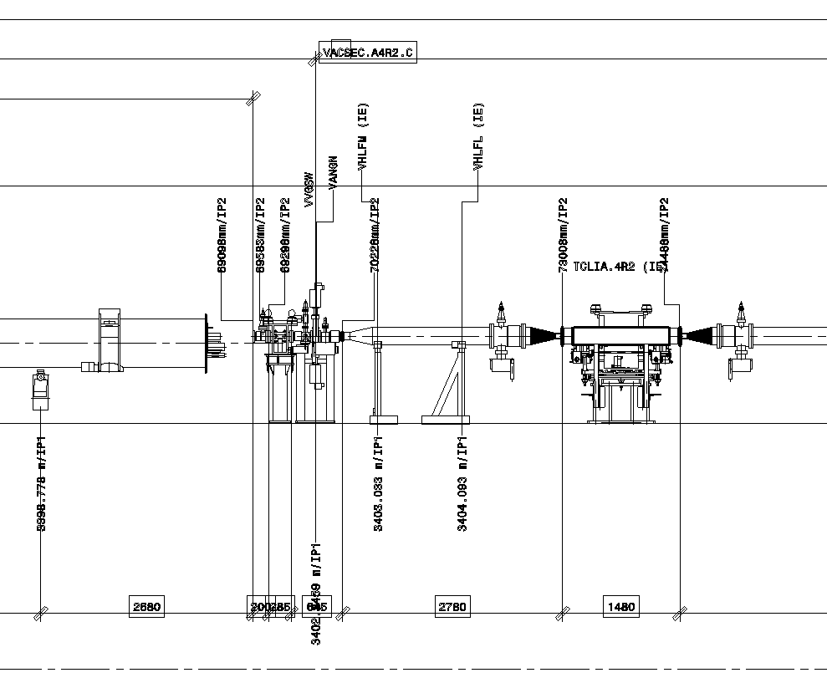
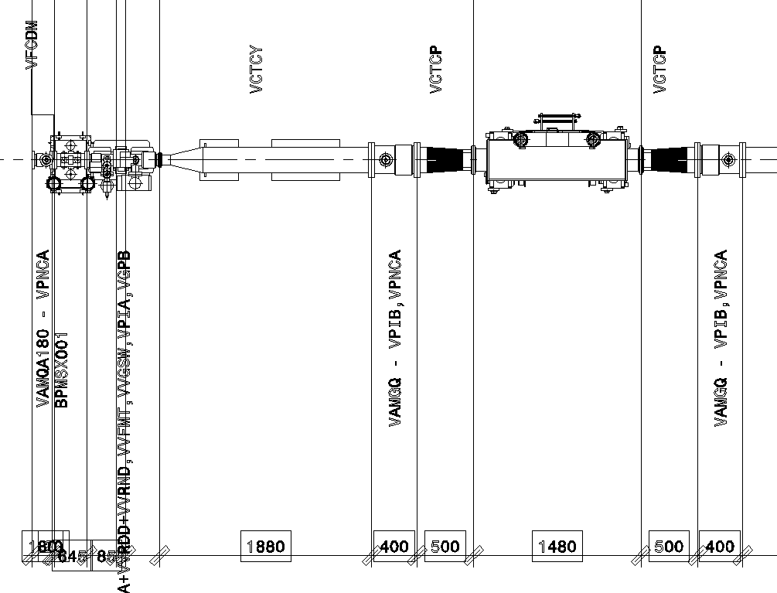
Proposed modifications
Top view
Q1 beam screen / cold bore assembly
TCLIA
VCTCY
BPM
VAB
VCTCY
VCTCP
VAMGQ
TCLIA
BPM
VCTCP
VAB
Side view
V. Baglin

Slide 6
Proposed modifications
Move TCLIA by ~2.2 m towards IP2
Top view
Q1 beam screen / cold bore assembly
TCLIA
VCTCY
BPM
VAB
VCTCY
VCTCP
VAMGQ
TCLIA
BPM
VCTCP
VAB
Side view
Move TCLIA by ~2.2 m towards IP2
V. Baglin

Slide 7
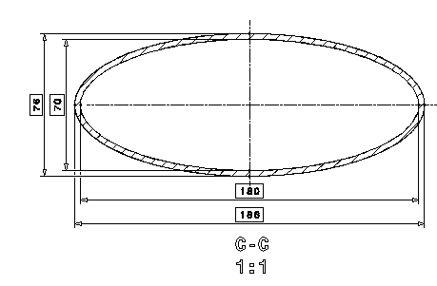
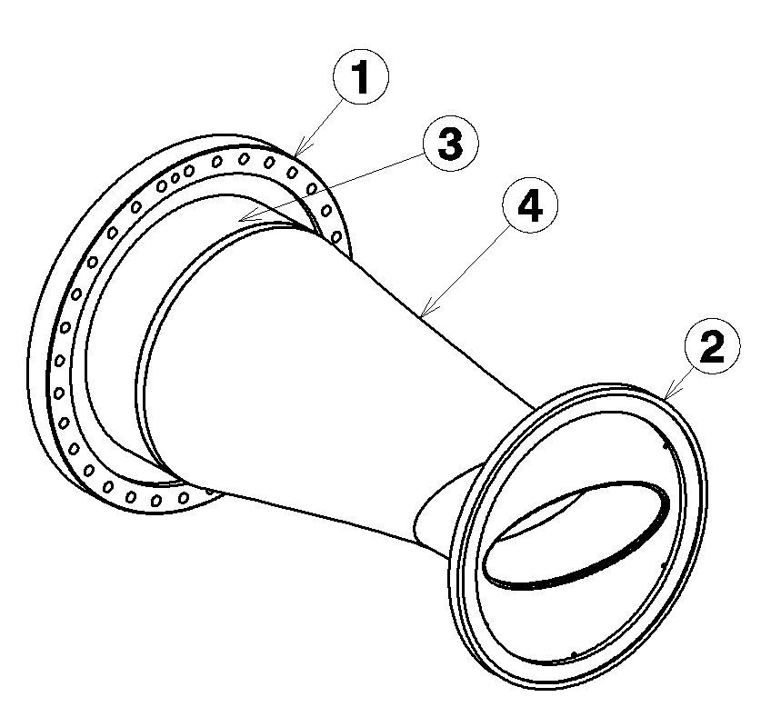
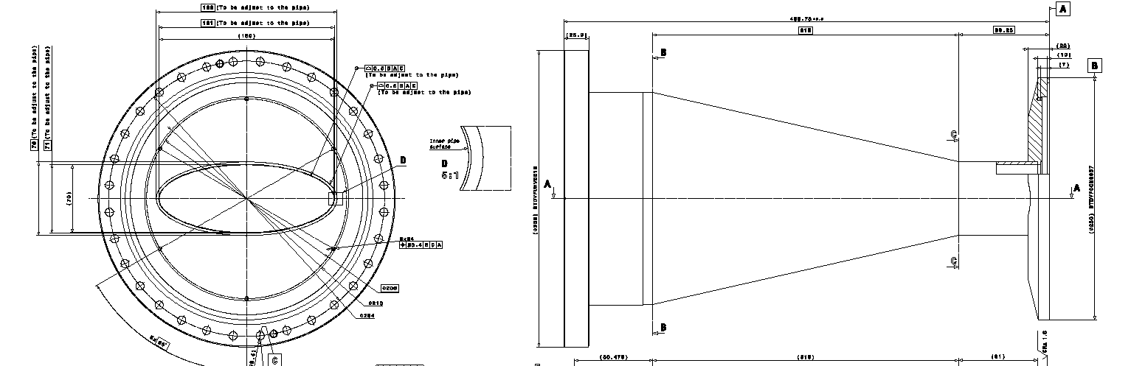
New VCTCP
BPM
VAB
VCTCY
VCTCP
LHCVCTCP0001
Transition circular ID212 to elliptical 180/70
Length 500
If VCTCY+VAMGQ+VTCTP replaced by new VCT : ID90 to elliptical 180/70
Gain in length of ~ 2.2 m
In this case, the TCLIA is very close to the VAB, be careful with induced interlock in case of pressure rise due to malfunctioning
VAMGQ
TCLIA
V. Baglin

Slide 8
Possible gain
Increase the maximum gap of the TCLIA for parking position to 59 mm, displace the TCLIA 2.2 m closer to IP2
 | Max full gap [mm] | Distance from IP2 [m] | Half-crossing [urad] | Separation [sigma]
Present | 56 | 74.248 | 70.1 | 4.0
New | 59 | 72.048 | 102.4 | 6.1
Assuming:
50 ns bunch spacing
Nominal Pb emittance (1.5 µm same beam size as 3.75 µm p emittance)
Beam energy E=7. Z TeV, β*=0.5 m at IP2

Slide 9
Next steps
Official approval:
Report on cost + manpower at the HL-LHC project steering meeting on October 26th 2017 ➔ Budget and BC (before next HL-LHC C&S review)
Prepare ECR and layout/integration studies (end 2017)
Present at LMC for final approval (end 2017, March 2018 latest deadline also for ECR)
Activity in PLAN
Once (if) approved:
Production of new vacuum components and validation (<2019)
Uninstall TCLIA.4R2.B1 ➔ transport to surface ➔ HW modification ➔ new vacuum components installed in tunnel ➔ transport and installation of modified TCLIA.4R2.B1 at new location (LS2)

