Slide 1

Aras Papadelis
LHCb 2004-2009
ATLAS 2009-2011
How to succeed with your
HARD HEPEXIT

Slide 2
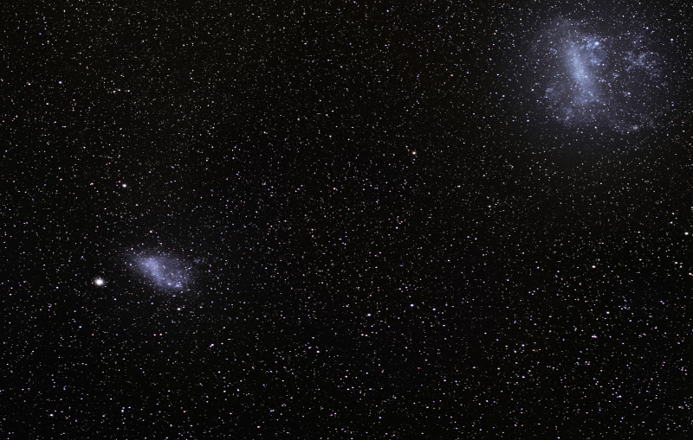
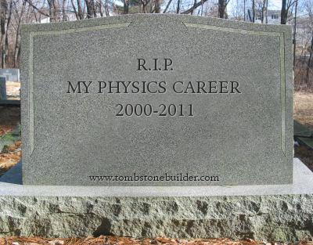

Slide 3

Insight 1
Factorize your physics interests - and reboot

Slide 4

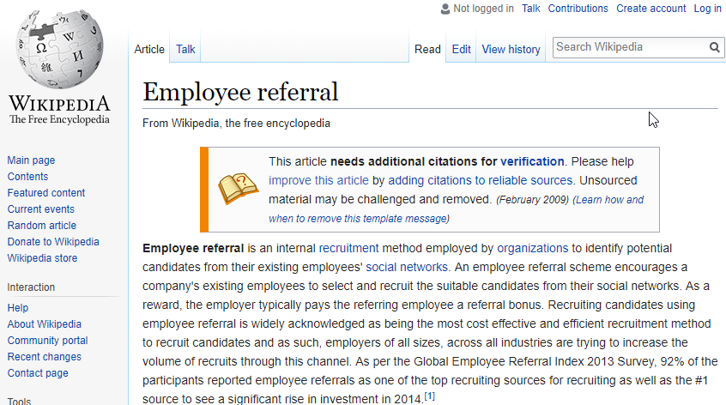
Insight 2
Using your network is win/win

Slide 5

Insight 3
I thought I knew how to code...

Slide 6
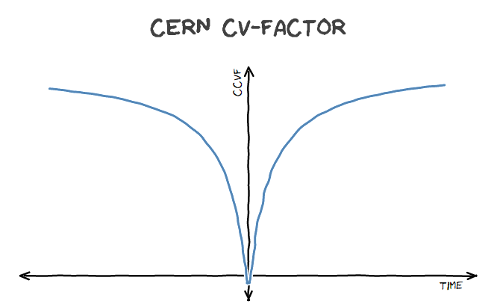
Insight 4
Your CERN backgound makes you stand out, but it takes time...

Slide 7





Slide 8
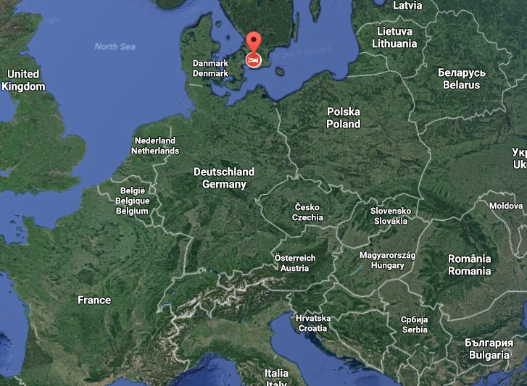

Slide 9
Thank you and good luck!
aras.papadelis@gmail.com

