Slide 1
CANCER BURDEN AND RESOURCES IN GHANA
EMMANUEL AMANKWAA-FREMPONG Ph.D
Clinical Oncologist

Slide 2
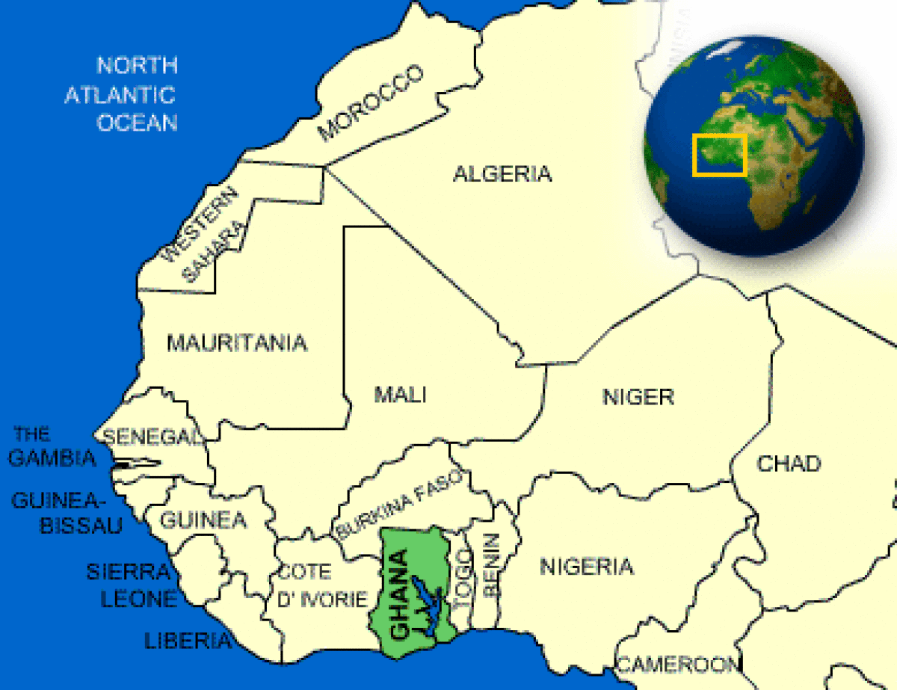
A POPULATION OF 27 MILLION PEOPLE

Slide 3
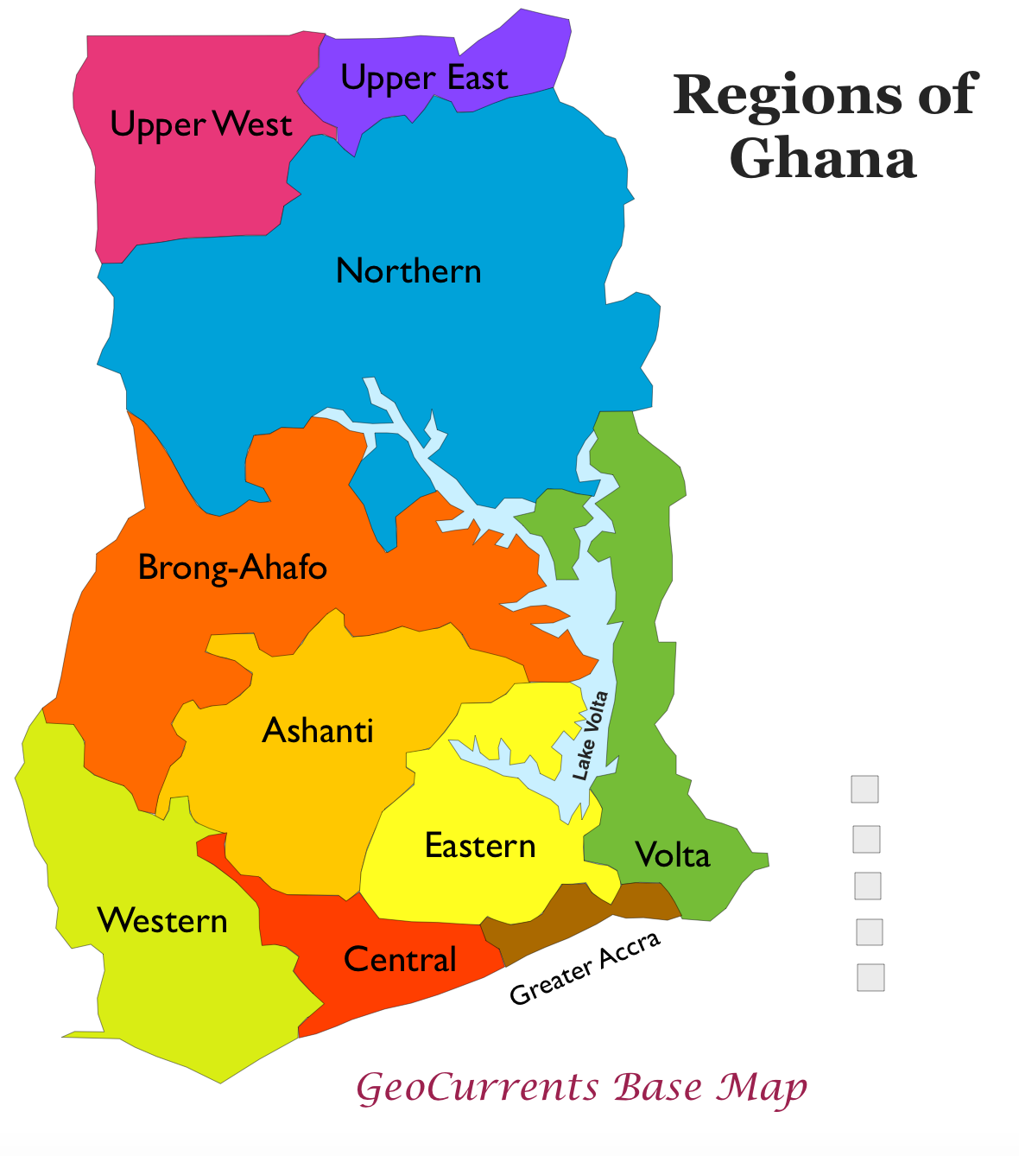
The capital Accra in Greater Accra Region(brown) has Two cancer centers. Another center in Ashanti .
SO THERE ARE THREE CENTERS IN GHANA
ALL MAINLY SITUATED SOUTHERN PART OF GHANA.

Slide 4
Human Resource
10 working radiation/medical oncologists
Three in Ashanti Region
7 in Greater Accra Region
20 Therapy radiographers
4 in Ashanti Region
16 in Greater Accra

Slide 5
Human resource
10 Medical physicist
3 in Ashanti region
14 nurses---chemotherapy
4 oncology nurses

Slide 6
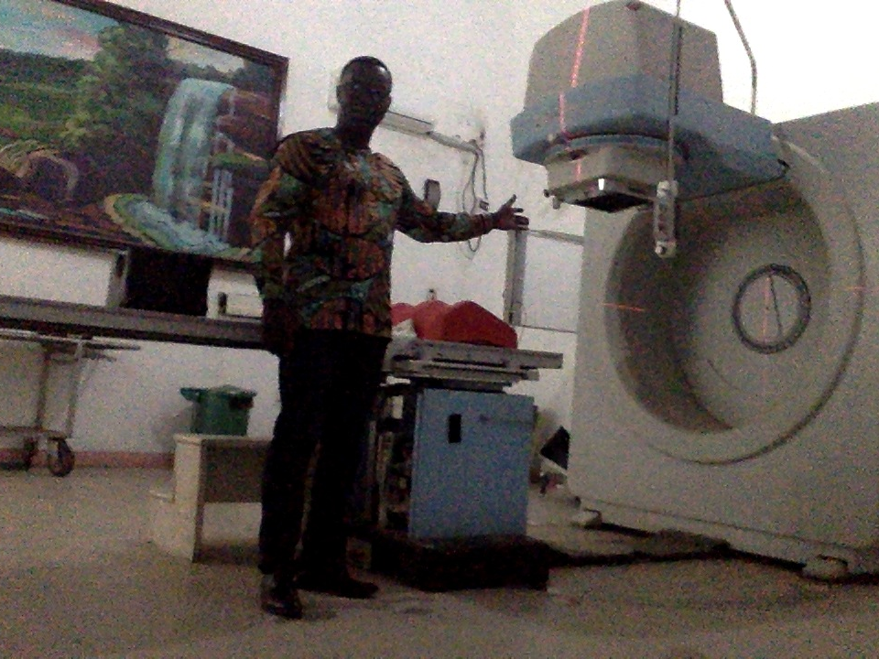
1 cobalt machine in my center
1 cobalt in Accra
1 Linear accelerator also in Accra private facility

Slide 7
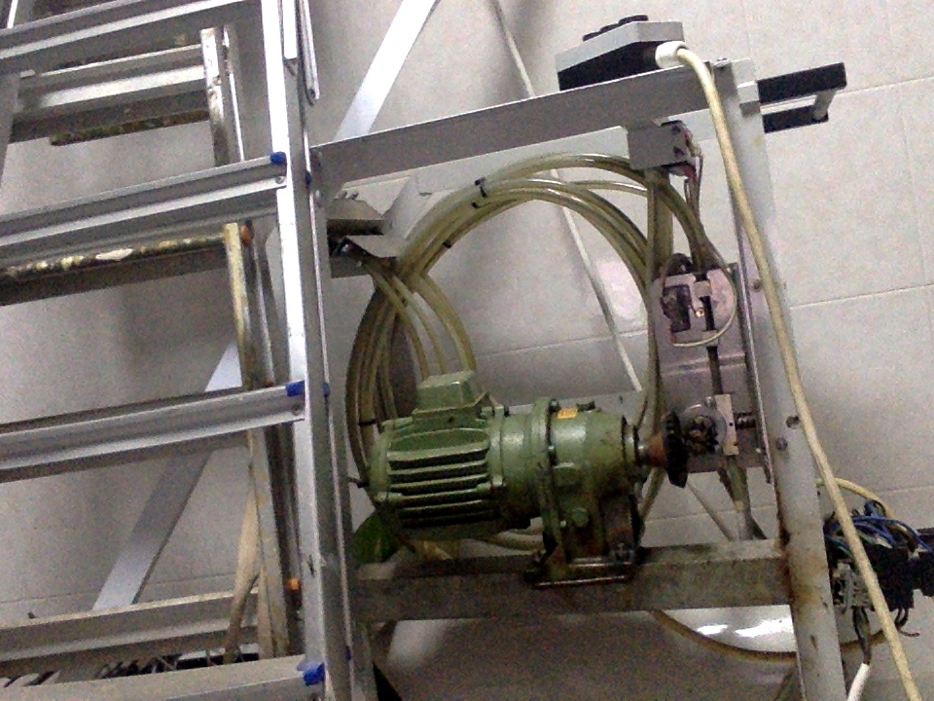
1 LDR brachytherapy in my center
1 HDR brachytherapy in Accra

Slide 8
Treatment planning/Treatment
3-D conformal radiotherapy in the country
Three 2-D Simulator machines
1 CT Simulator in private hospital
No software for verification in the public center in public center

Slide 9
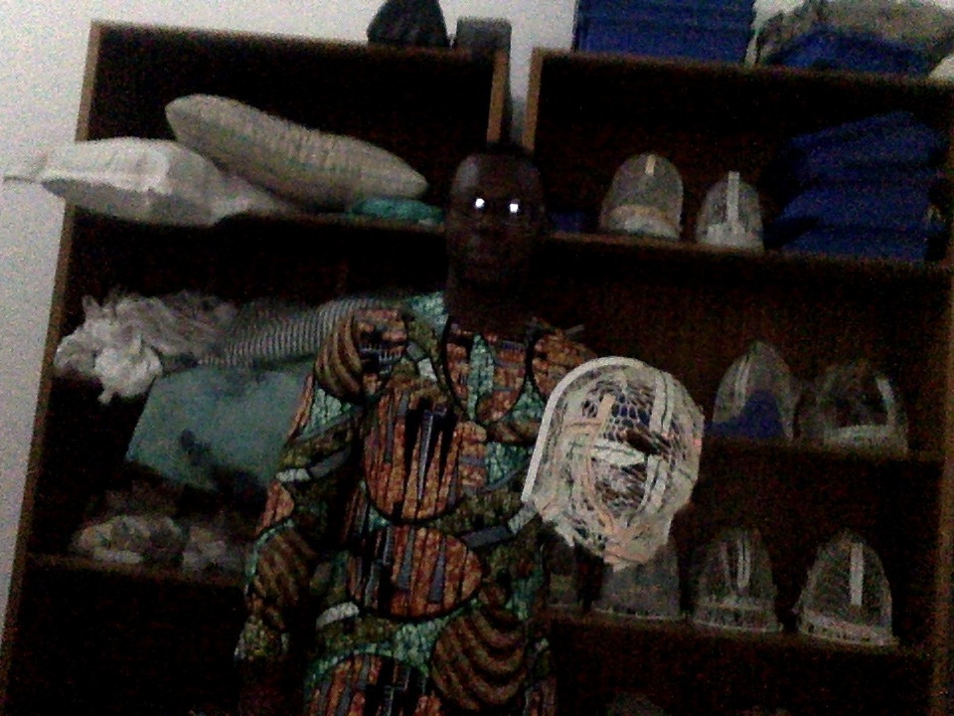
Mask :REUSABLE

Slide 10
CASE MIX
BREAST CANCER –40%
CERVICAL CANCER-35%
HEAD AND NECK
PROSTATE CANCER
COLORECTAL CANCER
OVARIAN CANCER
BLADDER CANCER
GASTRIC= SARCOMA

Slide 11
FUTURE
LINEAR ACCERATORS
CT SIMULATORS
HDR

Slide 12
PROBLEMS
POLITICAL WILL
MANAGEMENT ISSUES
MAINTENANCE CULTURE

Slide 13
THANK YOU

